Slide 1
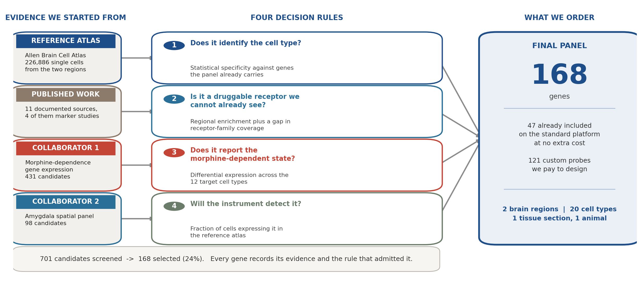
How the gene panel was selected
The instrument reads a fixed number of genes per tissue section, so every slot has to be earned. Four rules decided which genes earned one.
Spatial gene panel for orbitofrontal cortex and basomedial amygdala | 1/3

Slide 2
The same four rules, applied to real candidates
Each rule is a measurement with a threshold, so any gene's inclusion can be re-checked by someone else.
Rule | The measurement | Example ACCEPTED | Example REJECTED
1. Identifies the cell type | How much more specific it is than genes the panel already carries | Col23a1 - 3.7x more specific | Sfrp1 - 0.9x, no better than what we already have
2. Druggable receptor we cannot already see | Regional enrichment plus receptor- family coverage | Chrm1 - M1 receptor; we could only see M2 before | Gpr26 - no known drug binds it
3. Reports the morphine- dependent state | How many of the 12 target cell types change their expression | Per2 - changes in 11 of 12 | Nr4a3 - only 5 of 12 once restricted to our regions
4. The instrument will detect it | Fraction of cells expressing it in the reference atlas | Vps13a - present in 95% of cells | Mchr1 - only 32%, too faint to map reliably
Two consequences worth noting. A gene can pass one rule and still be turned down: the three most regionally enriched receptors were all dropped for being too faint to image.
And the rules are independent. A receptor earns its slot by showing where a drug target sits, whether or not morphine changes it - so one panel serves the pharmacology aim and the addiction aim at the same time.
Spatial gene panel for orbitofrontal cortex and basomedial amygdala | 2/3

Slide 3
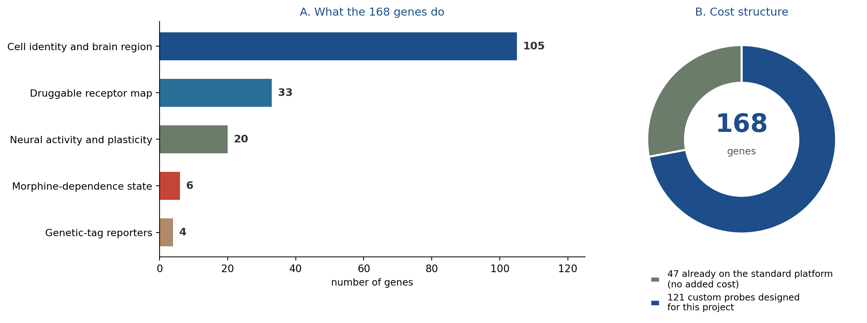
The final panel, and what it will measure
168 genes read simultaneously in two brain regions of the same animal, on one tissue section.
Question the panel answers | How
Which cell is this? | All 20 cell types across the two regions remain individually identifiable.
Where are the drug targets? | 33 receptors mapped in place, including four newly added: M1 muscarinic, group-III glutamate, relaxin, one orphan.
Was this cell recently active? | Activity and plasticity genes report which cells fired during the behaviour.
Is this cell in a dependent state? | New capability: separates dependence-positive from dependence-negative cells of the SAME type.
Spatial gene panel for orbitofrontal cortex and basomedial amygdala | 3/3

