Slide 1
TRAP whole-brain analysis — Hansol Lim
Figure + meaning + code for every step used in the final story
Findings: A = ORBm / BMAp (Active ≫ Passive) · B = COAa (Passive-biased)
Code: https://github.com/limserenahansol/TRAP_analysis
Built for AI-benchmark navigation (final-PDF figures only)

Slide 2
1 · Biological aim
• Primary: find regions with the largest, most consistent Active ≫ Passive TRAP density across morphine phases.
• Secondary: find Passive-biased regions (Passive > Active at Post + Withdrawal) that may track generalized motivation.
• Design: Active (contingent morphine SA) vs Passive (yoked) · During → Post → Withdrawal → Reinstatement.
• Readout: TRAP+ cell density (cells / sample volume mm³), L/R pooled · Allen atlas · calculated_mm3.
• Why it matters: Active-selective + Passive-flat → opioid-related seeking; Passive-biased → patient-relevant / general seeking candidate.
Data / cohort: TRAP_sample_manifest.csv · density workbook Hansol Lim 561 cell counts + density.xlsx
Repo: https://github.com/limserenahansol/TRAP_analysis

Slide 3
2 · Two findings (final story)
• FINDING A — ORBm & BMAp: Active ≫ Passive; Passive flat → dual-role craving (opioid seeking + WD negative affect).
• FINDING B — COAa: Passive > Active at Post + Withdrawal → cue/context + WD state → generalized-motivation candidate.
• Why keep both: A isolates opioid-related Active seeking; B is the Passive / patient-relevant contrast.
• Why not only behavior-matched regions for A: those track both opioid craving and Passive generalized motivation.

Slide 4
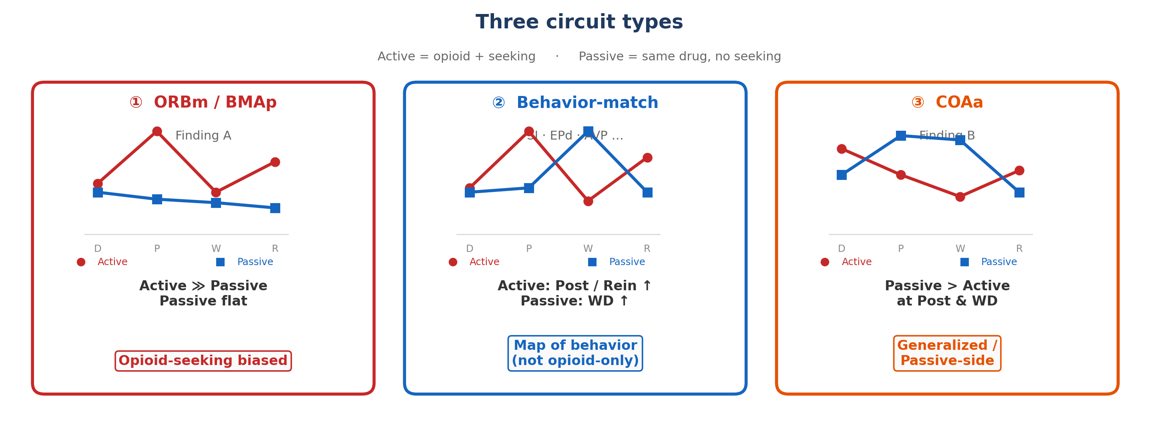
3 · Framing — opioid seeking vs general seeking
• WHAT: schematic separating Active-selective craving from Passive / general seeking.
• WHY: Passive-flat at ORBm/BMAp argues against pure general-seeking accounts.
• COAa is the Passive-side / generalized candidate to manipulate separately.
• AI check: agent should state both stories, not only Active≫Passive.
Figure source: forMark/schematic_three_circuits_clean.png
Related scripts: trap_forMark_figs.py · circuit justification PPT builders

Slide 5
4 · Workflow funnel (why cluster first, then zoom in)
~800+ atlas → hierarchy567 → forebrain_no_bs → K=4 → clusters 1&4 → 7 → ORBm/BMAp + COAa
• Problem: hundreds of atlas regions → testing one-by-one is under-powered and unstructured.
• Step 1 FILTER: forebrain_no_bs (~138) · universal PCA display + k-means K=4 on Active−Passive fingerprint across 4 phases.
• Step 2 KEEP: only clusters 1 & 4 match motivation timeline (A>P at Post & Reinstatement).
• Step 3 SHORTLIST: cluster4 BMAp/LM/RE/CP + cluster1 ORBm/CA/AId (= 7 regions).
• Step 4 ZOOM IN: density + cell count + mouse-level → only ORBm & BMAp survive as Finding A; Finding B from cluster 3 → COAa.
MATLAB: RUN_PIPELINE_ALL.m · Step_03_region_clustering… · Step_13_universal_cluster_viz/…
Python story figures: trap_region_selection_ppt.py · trap_region_zoomin.py · trap_build_pptx.py

Slide 6
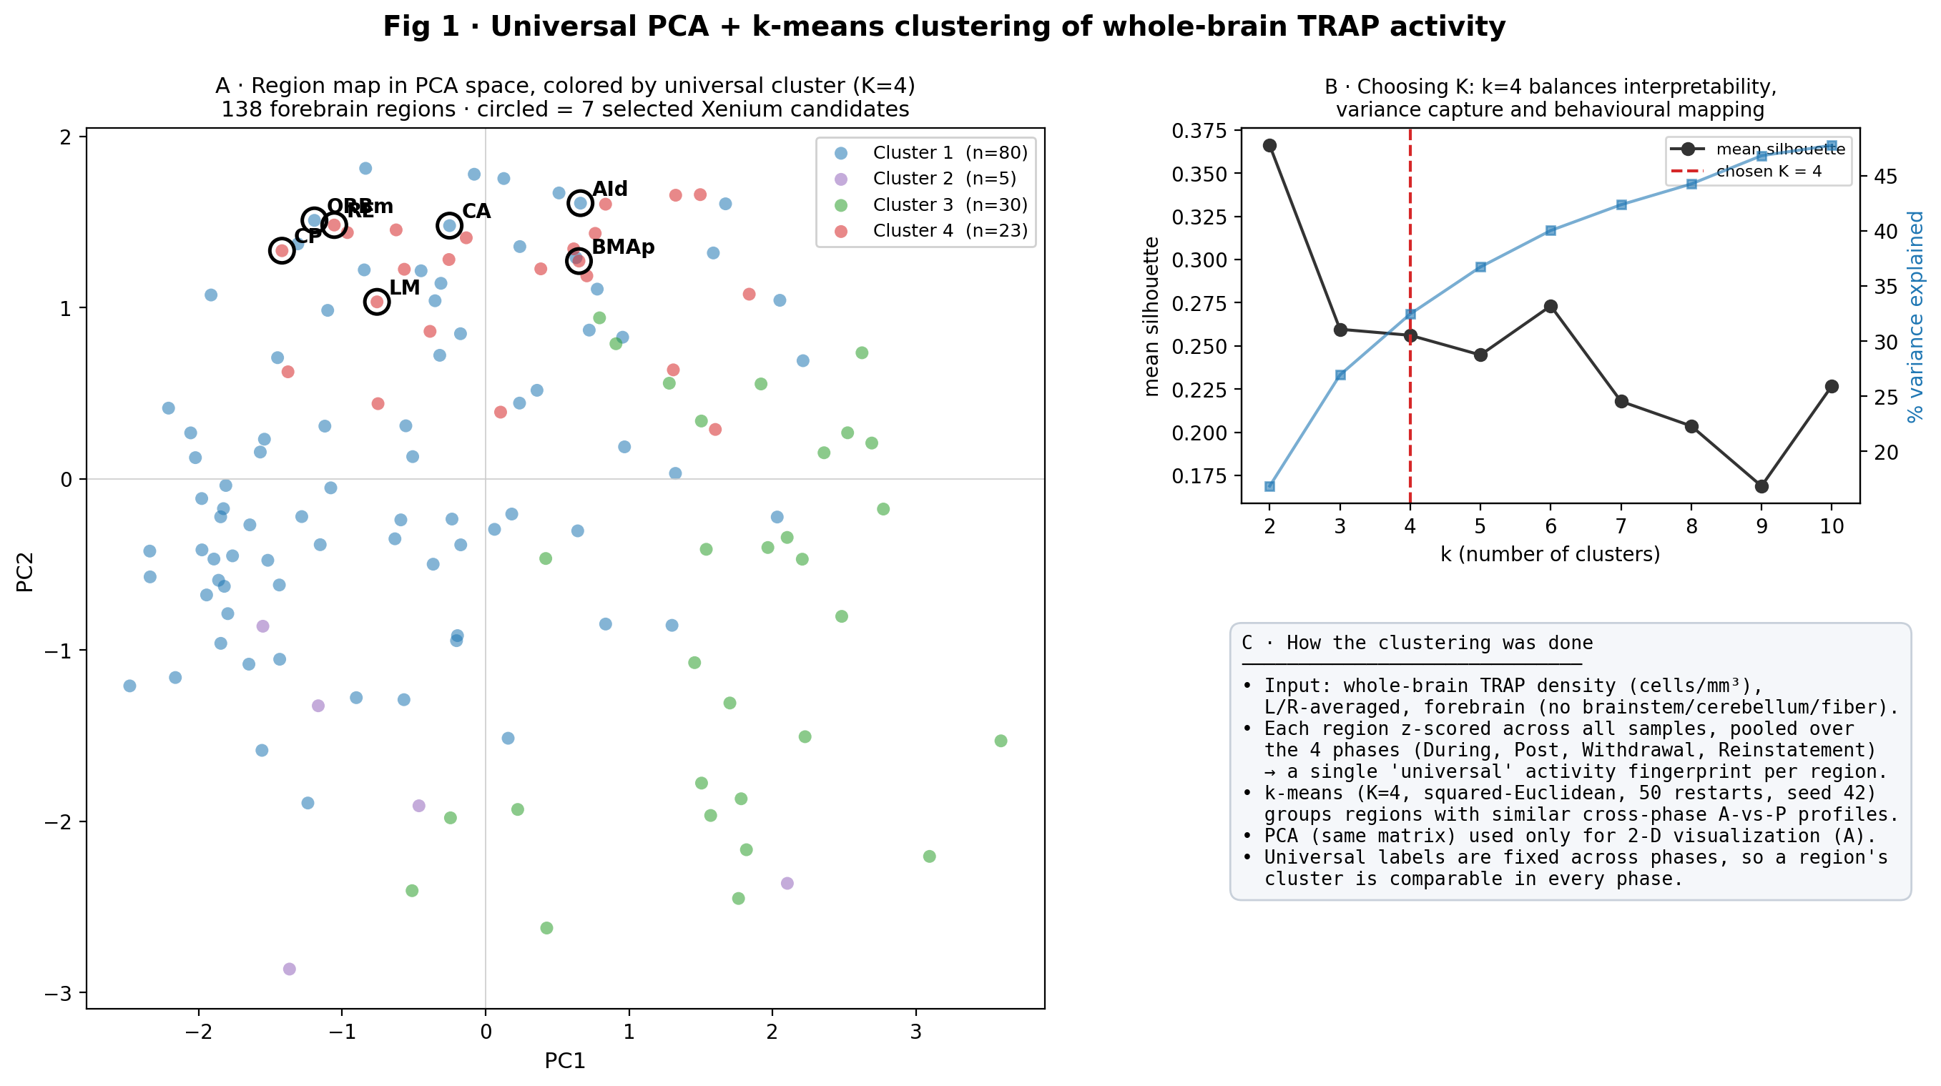
5 · Fig 1 — Clustering method + PCA map
• WHAT: 138 forebrain regions in PC1–PC2, colored by K=4; selected 7 circled.
• Method: z-score region profile across samples → k-means (sq-Euclidean, 50 restarts).
• PCA is 2-D display only; clusters use the full profile.
• AI check: keep fixed Step-3 K=4 labels; silhouette/elbow are supporting only.
CODE: trap_region_selection_ppt.py → region_selection_PPT/Fig01_…
Upstream MATLAB: Step_03 + Step_13 (roster 02_cluster_region_roster.csv)

Slide 7
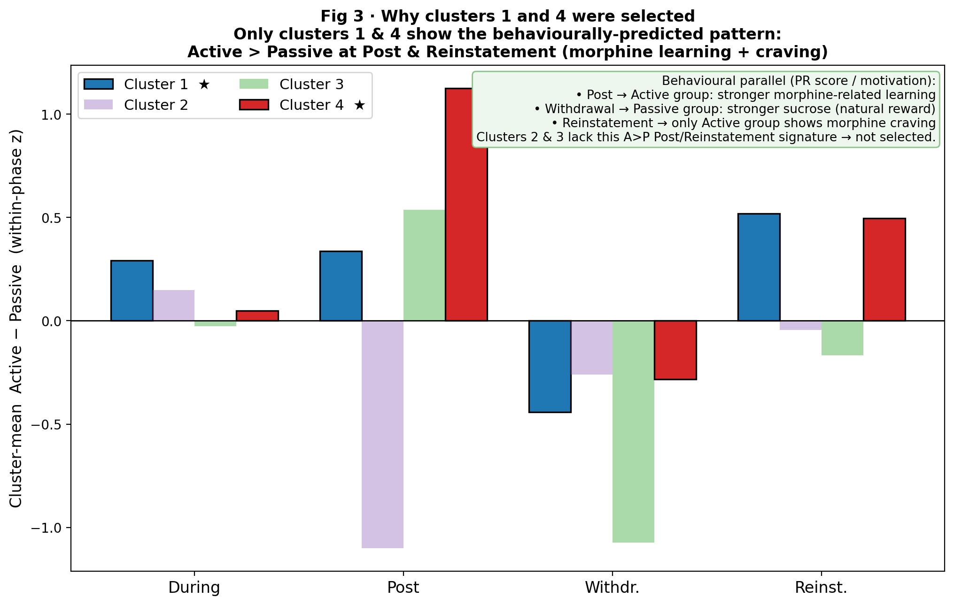
6 · Fig 3 — Why clusters 1 and 4
• WHAT: per-phase bars of cluster-mean Active − Passive.
• Only clusters 1 & 4 show A>P at Post & Reinstatement (motivation timeline).
• Post ≈ Active morphine learning; WD ≈ Passive sucrose shift; Rein ≈ Active craving.
• AI check: select clusters by phase pattern, not silhouette alone.
CODE: trap_region_selection_ppt.py → Fig03_why_clusters_1_and_4.png
Inputs: cluster_AP_split/Cluster{N}_region_AP_direction.csv

Slide 8
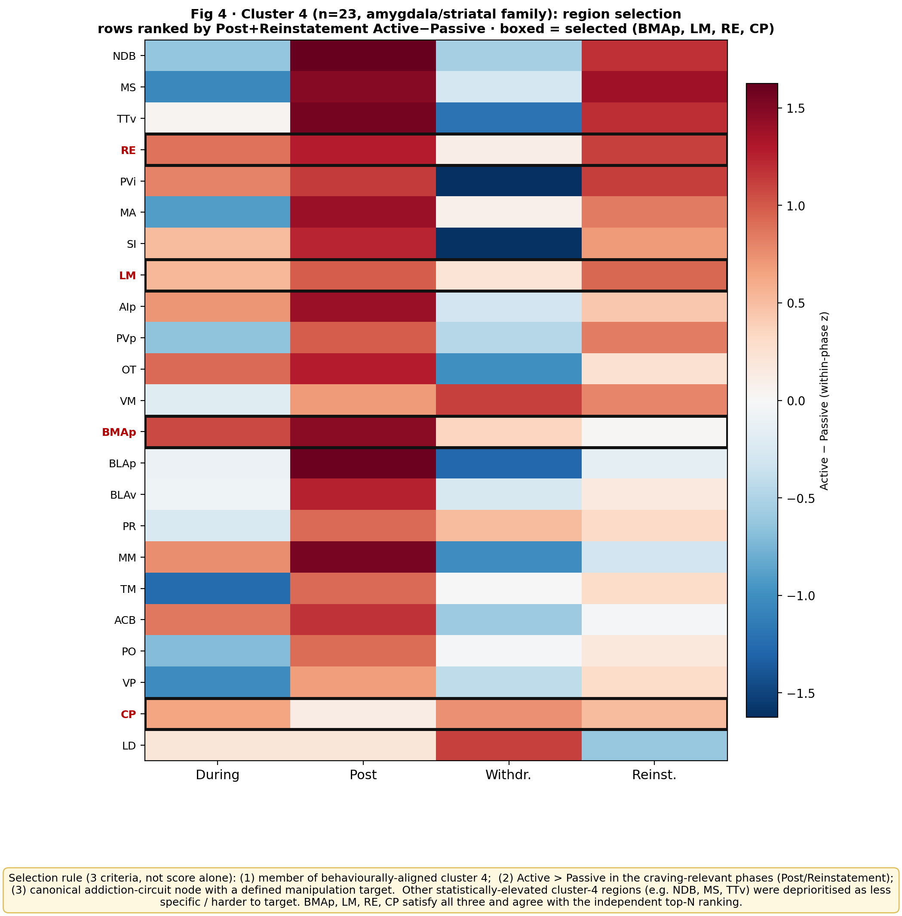
7 · Fig 4 — Cluster 4 shortlist (BMAp, LM, RE, CP)
• WHAT: cluster-4 regions × phase heatmap of Active − Passive.
• Boxed / selected: BMAp, LM, RE, CP (A>P in craving-relevant phases).
• BMAp later survives zoom-in as Finding A (with ORBm).
• AI check: recover BMAp from cluster-4 AP shortlist.
CODE: trap_region_selection_ppt.py → Fig04_cluster4_region_selection*.png
MATLAB support: shared/trap_cluster_split_by_AP_direction.m (Step 13)

Slide 9
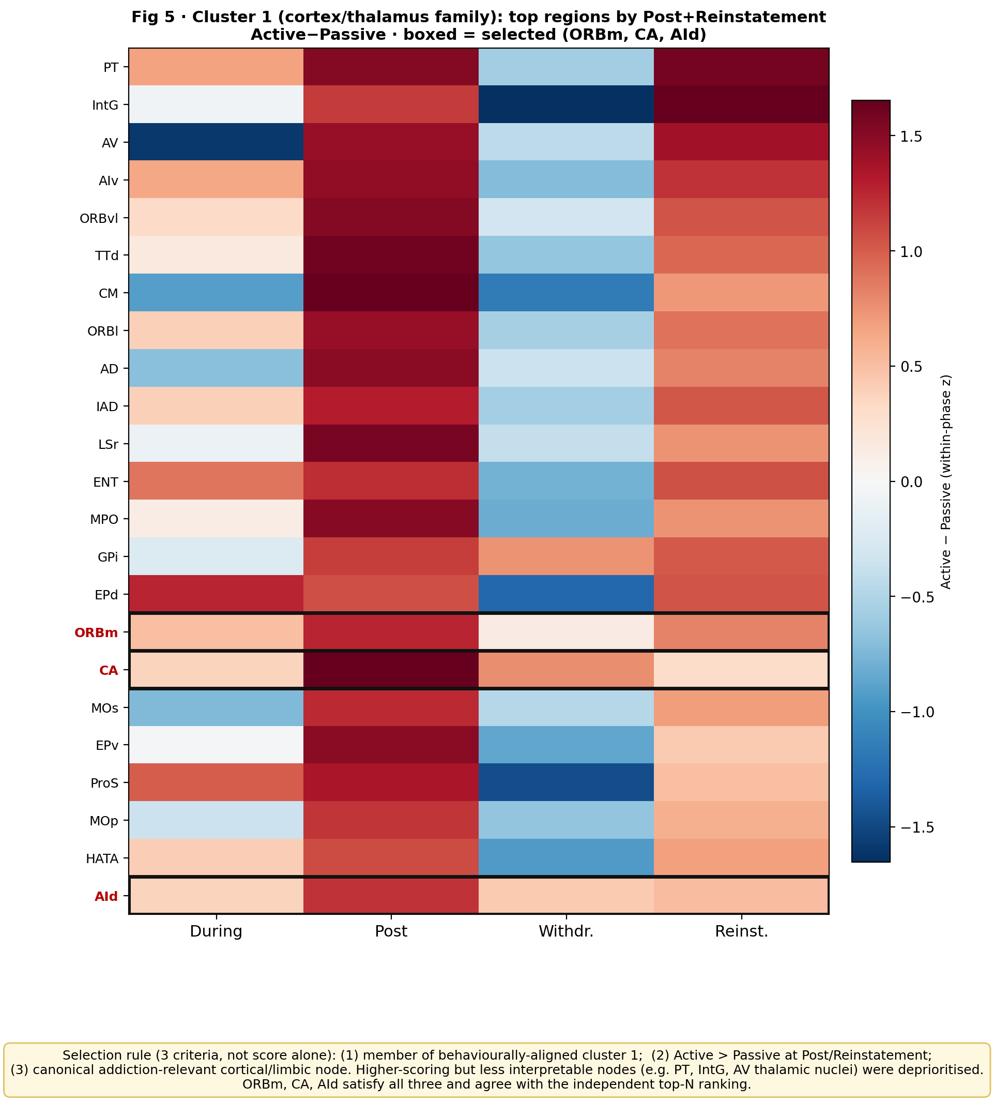
8 · Fig 5 — Cluster 1 shortlist (ORBm, CA, AId)
• WHAT: cluster-1 regions ranked / heatmapped by Active − Passive.
• Selected shortlist: ORBm, CA, AId.
• ORBm later survives zoom-in as Finding A (with BMAp).
• AI check: recover ORBm from cluster-1 shortlist.
CODE: trap_region_selection_ppt.py → Fig05_cluster1_region_selection*.png
MATLAB support: shared/trap_cluster_split_by_AP_direction.m (Step 13)

Slide 10
9 · Part 2 — Zoom-in logic (Finding A filter)
• After the 7-region shortlist, inspect density AND cell count across phases, Active vs Passive, every mouse.
• Keep regions where Active rises at Post, dips at WD but stays ≫ Passive, and Passive stays flat.
• Drop regions where Passive moves with Active (shared context) or one mouse drives the mean.
• Survivors for Finding A: ORBm + BMAp only.
CODE: trap_region_zoomin.py → region_zoomin/<REG>_density_count_by_phase.png
→ region_zoomin/<REG>_withinphase_ActiveVsPassive.png

Slide 11
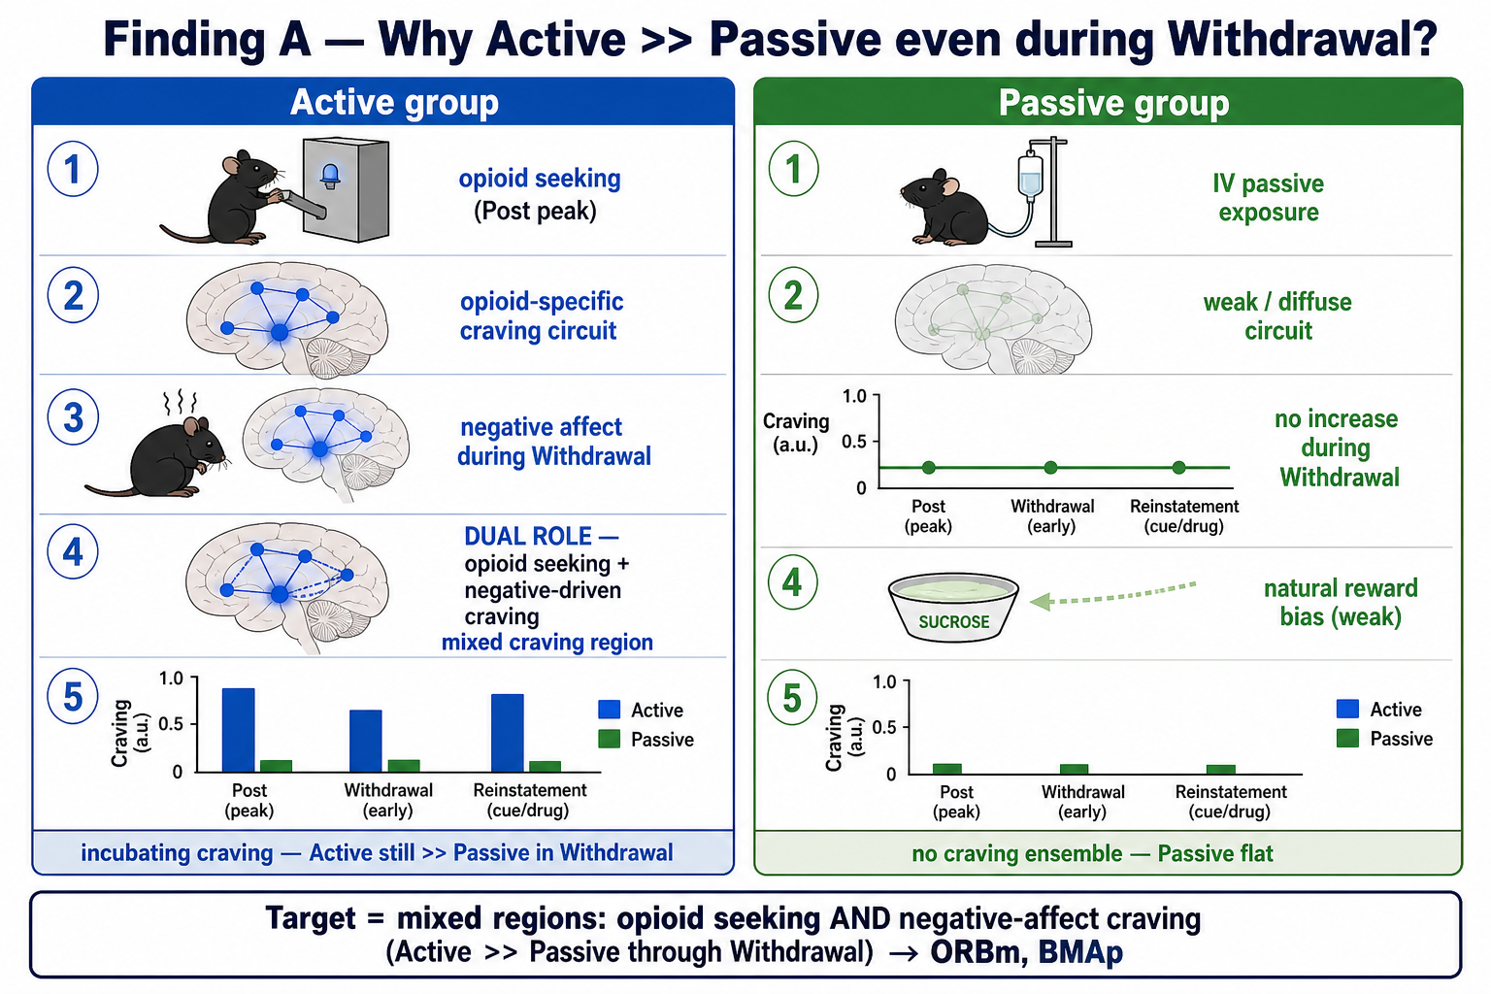
10 · Finding A schematic — dual-role craving
• WHAT: conceptual dual-mode craving at ORBm/BMAp.
• Post: opioid seeking (Active high). WD: negative-affect craving persists while Passive flat.
• WHY shown: frames why Active≫Passive through WD is incubation-compatible.
Figure: forMark/schematic_findingA_dual_role_incubation.png
Related: trap_findingA_bridge_fig.py · trap_forMark_figs.py

Slide 12
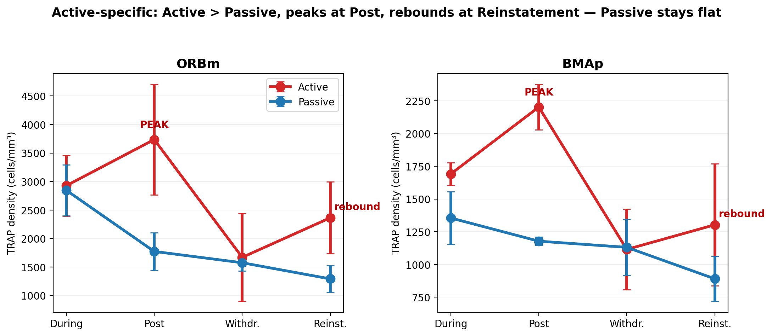
11 · Finding A evidence — ORBm & BMAp raw density
• WHAT: Active vs Passive density trajectories for ORBm & BMAp.
• Pattern: Active peaks Post, dips WD, rebounds Rein; Passive essentially flat.
• This is the Active-selective signature used to argue opioid-related seeking.
CODE: trap_forMark_figs.py / trap_hilo_ORBm_BMAp_COAa.py
Out: forMark/evidence_active_ORBm_BMAp.png

Slide 13
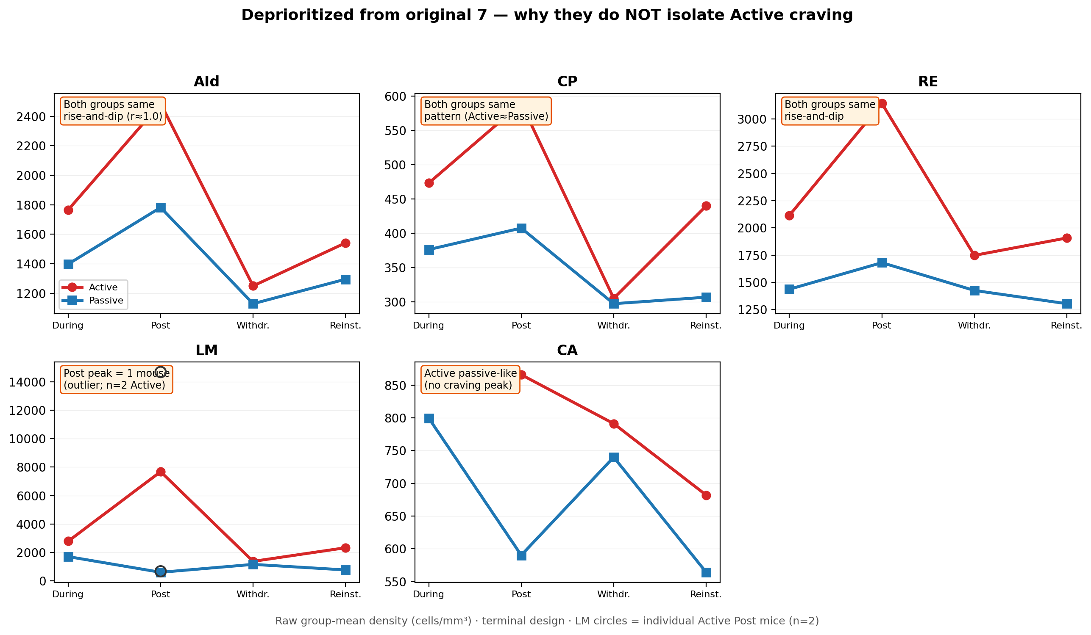
12 · Why not the other original-7 regions?
• WHAT: summary of why CA, AId, LM, RE, CP were deprioritized for Finding A.
• Typical failure modes: Passive not flat, both groups move together, or unstable mouse leverage.
• AI check: agent should not treat all 7 as equal final targets.
CODE / out: forMark/deprioritized_5regions_summary.png (forMark helpers)

Slide 14
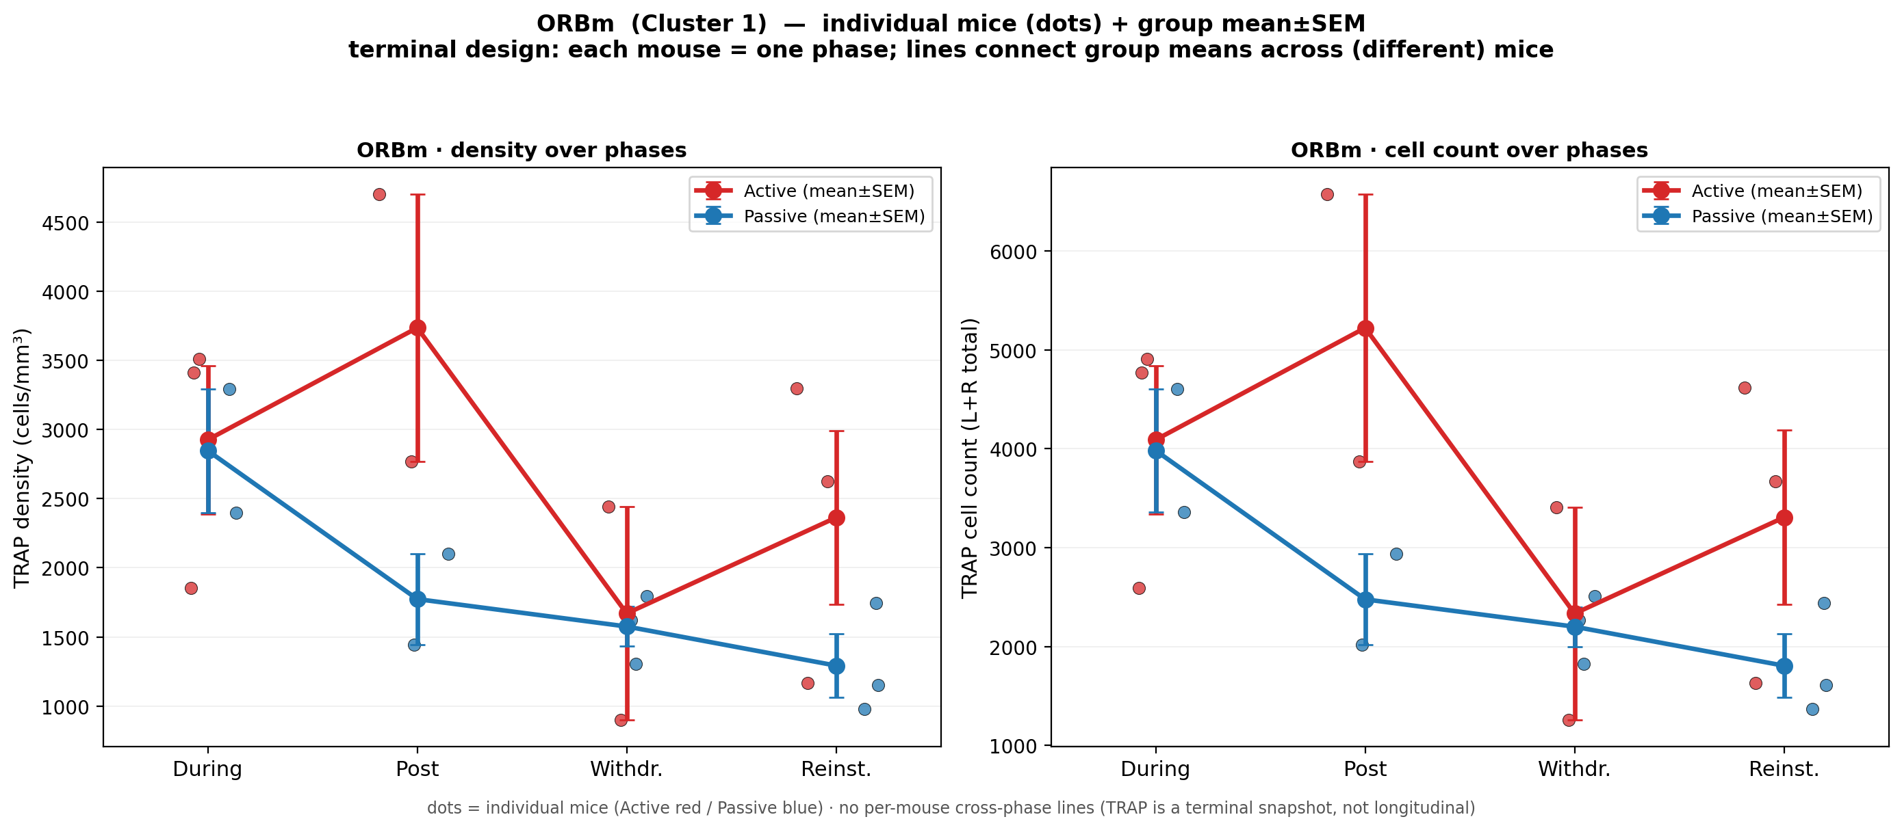
13 · ORBm zoom-in — density & cell count
• WHAT: ORBm group-level density and cell count by phase (Active vs Passive).
• Confirms the Active-selective rise / WD dip / Rein rebound pattern.
• Density metric = calculated_mm3 (cells / sample volume).
CODE: trap_region_zoomin.py
Out: region_zoomin/ORBm_density_count_by_phase.png

Slide 15
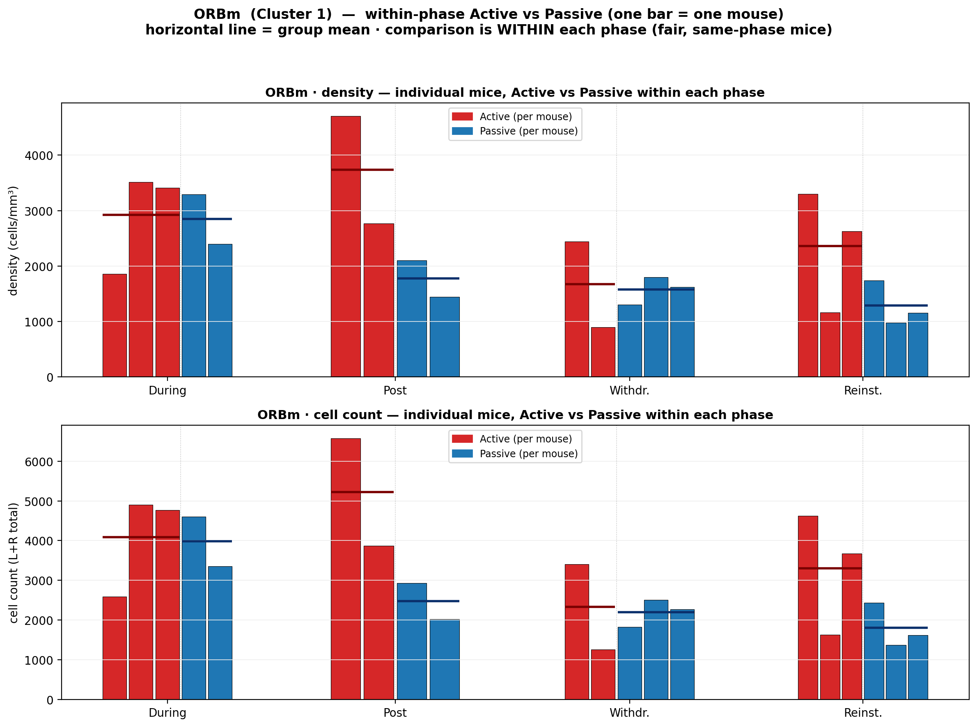
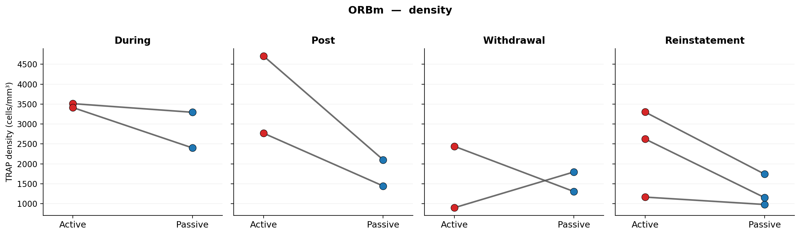
14 · ORBm mouse-level + paired slope
• Left: one bar = one mouse within-phase Active vs Passive. Right: paired-slope consistency across mice.
• Shows the effect is not a single-mouse artifact.
CODE: trap_region_zoomin.py · forMark/paired_slope/ORBm_density_paired_slope.png

Slide 16
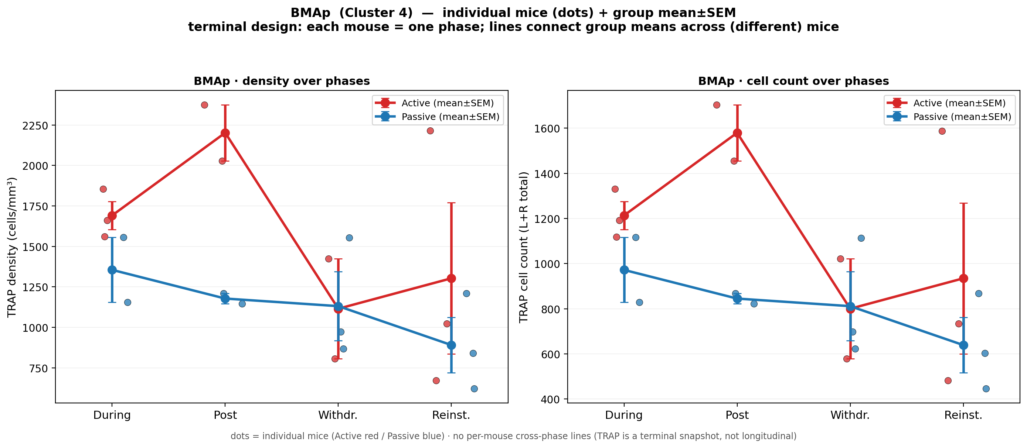
15 · BMAp zoom-in — density & cell count
• WHAT: BMAp group-level density and cell count by phase.
• Same Active-selective / Passive-flat motif as ORBm → second Finding A region.
• Anatomically: basomedial amygdala posterior (emotional valence / addiction motivation).
CODE: trap_region_zoomin.py
Out: region_zoomin/BMAp_density_count_by_phase.png

Slide 17
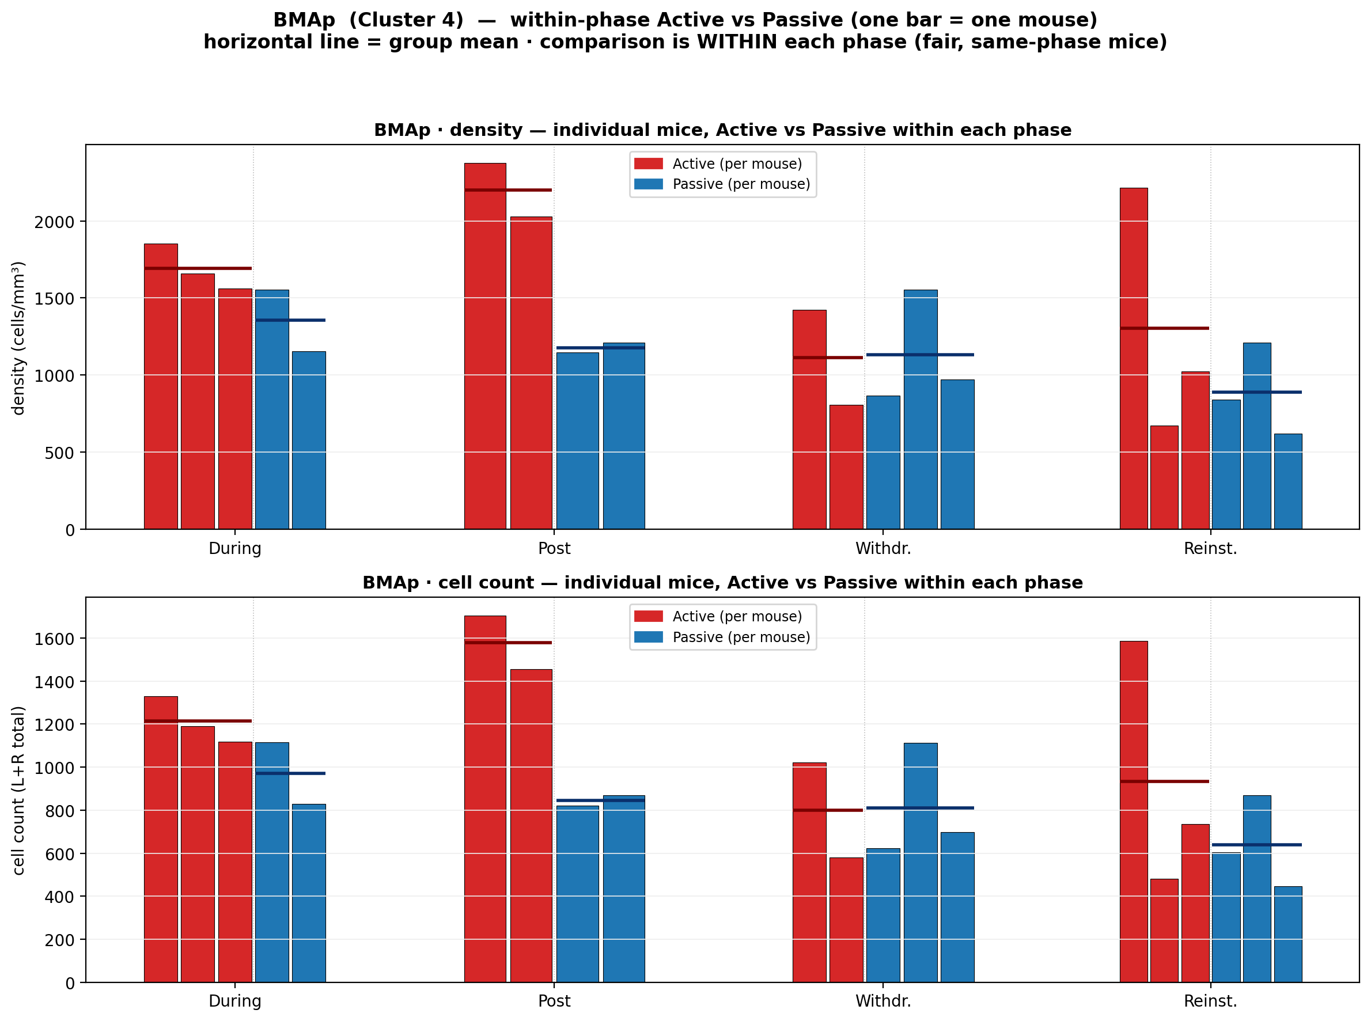
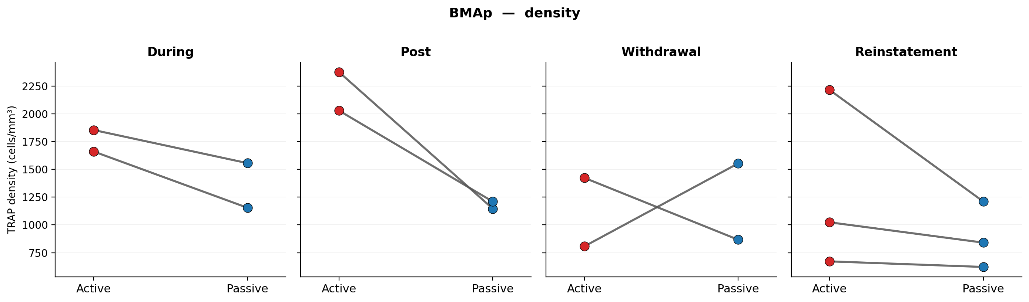
16 · BMAp mouse-level + paired slope
• Mouse-level Active vs Passive bars + paired slopes confirm BMAp consistency across animals.
CODE: trap_region_zoomin.py · forMark/paired_slope/BMAp_density_paired_slope.png

Slide 18
17 · Finding B start — why Passive matters
• Passive is not only a control: noncontingent exposure still engages cue/context and WD state.
• Regions with Passive > Active at Post + Withdrawal are candidates for generalized (non-opioid-selective) motivation.
• Manipulation prediction: COAa OFF may affect broad seeking (e.g. sucrose); ORBm/BMAp OFF should spare that more.
• This is a testable dissociation, not a proven causal result from TRAP alone.

Slide 19
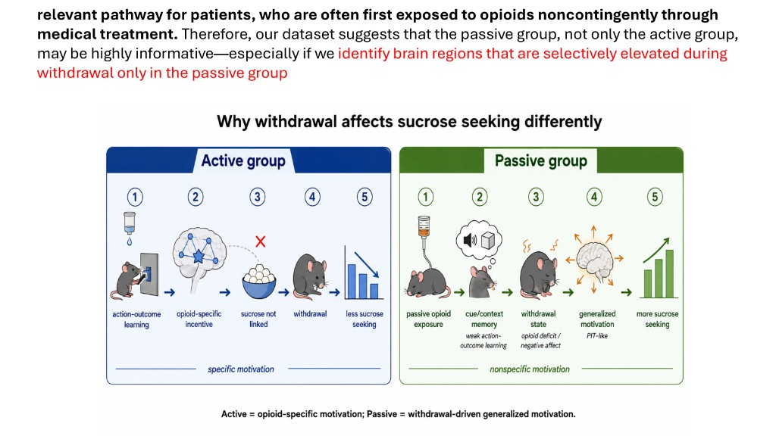
18 · Finding B schematic — Passive withdrawal / patient-relevant
• WHAT: schematic for Passive-biased / patient-relevant motif.
• Links Post+WD Passive elevation to cue/context + withdrawal state.
• Sets up cluster-3 screen for Finding B candidates.
Figure: forMark/schematic_findingB_passive_withdrawal.png
Related: trap_findingB_cluster_map.py

Slide 20
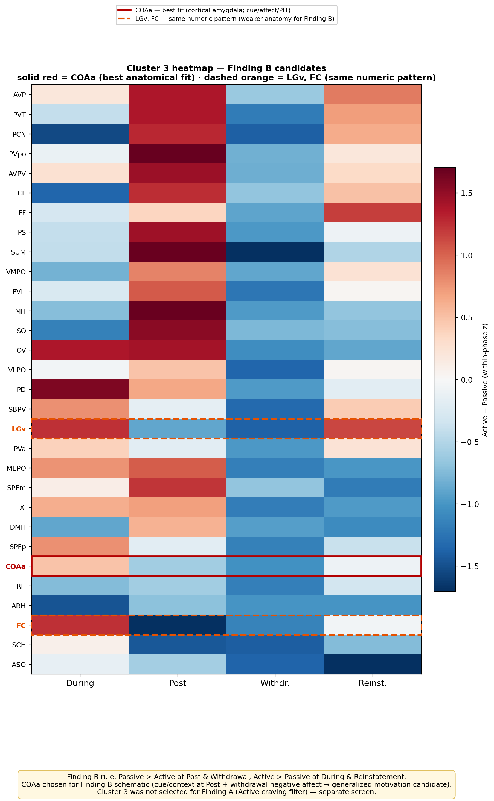
19 · Cluster 3 heatmap — Finding B candidates
• WHAT: cluster-3 region heatmap / ranking for Passive-biased pattern.
• COAa chosen as best anatomical fit (LGv/FC can match numerically).
• AI check: agent must produce a second Passive-biased story, not only Finding A.
CODE: trap_fig_cluster3_heatmap.py · findingB_COAa_revision/
Out: Fig_cluster3_FindingB_heatmap.png

Slide 21
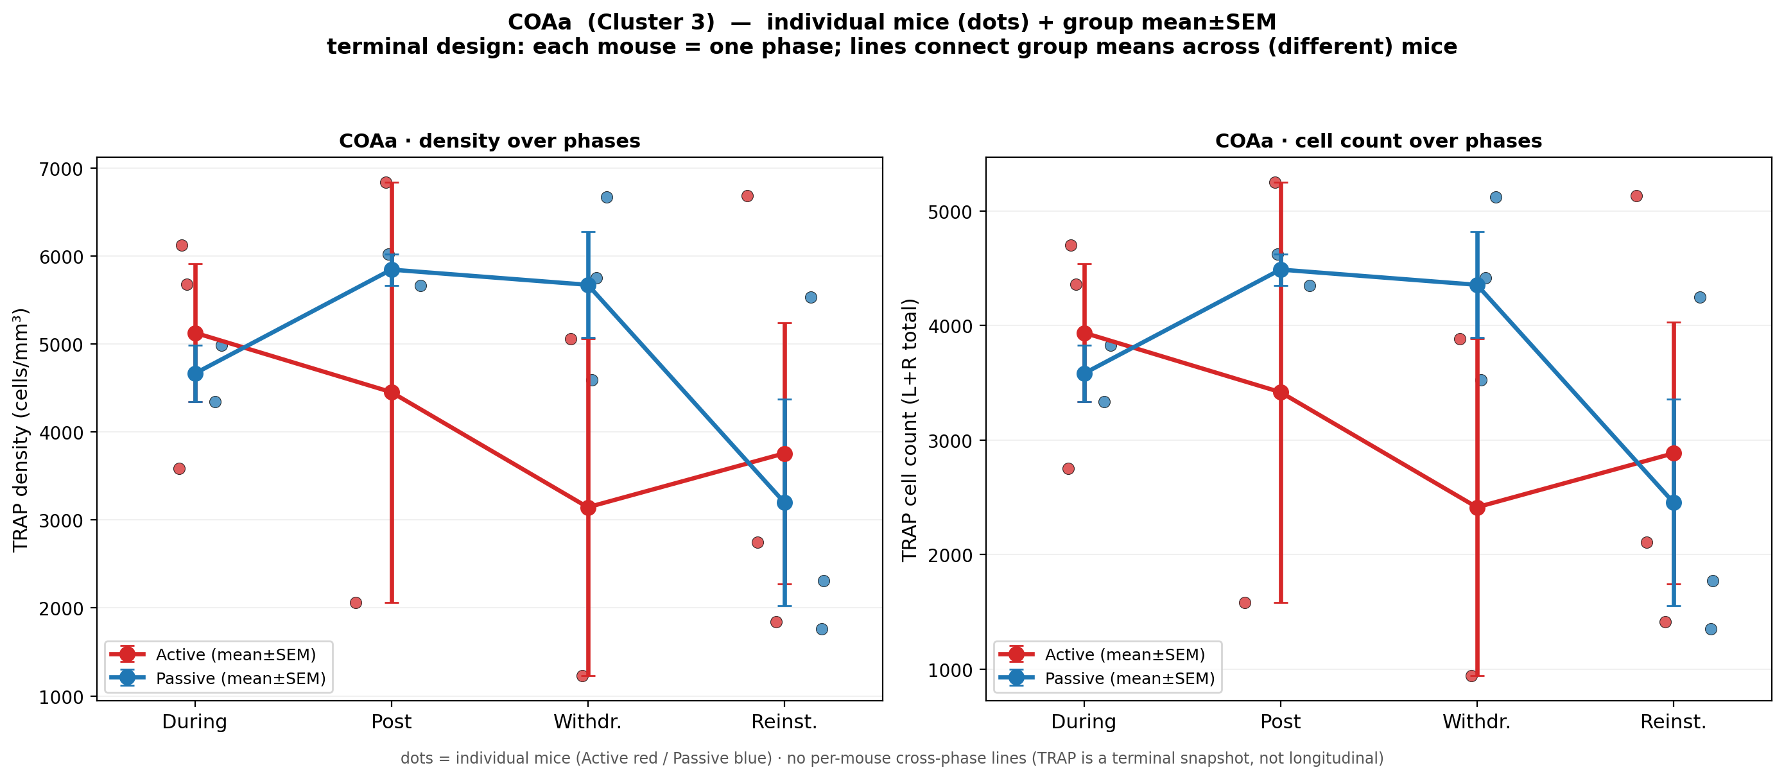
20 · COAa zoom-in — density & cell count
• WHAT: COAa density and cell count by phase, Active vs Passive.
• Pattern: Passive > Active especially at Post and Withdrawal.
• This is Finding B’s primary quantitative panel.
CODE: COAa family / P>A helpers (see trap_build_pptx_COAa_family.py)
Out: forMark/COAa_family/COAa_density_count_by_phase.png

Slide 22
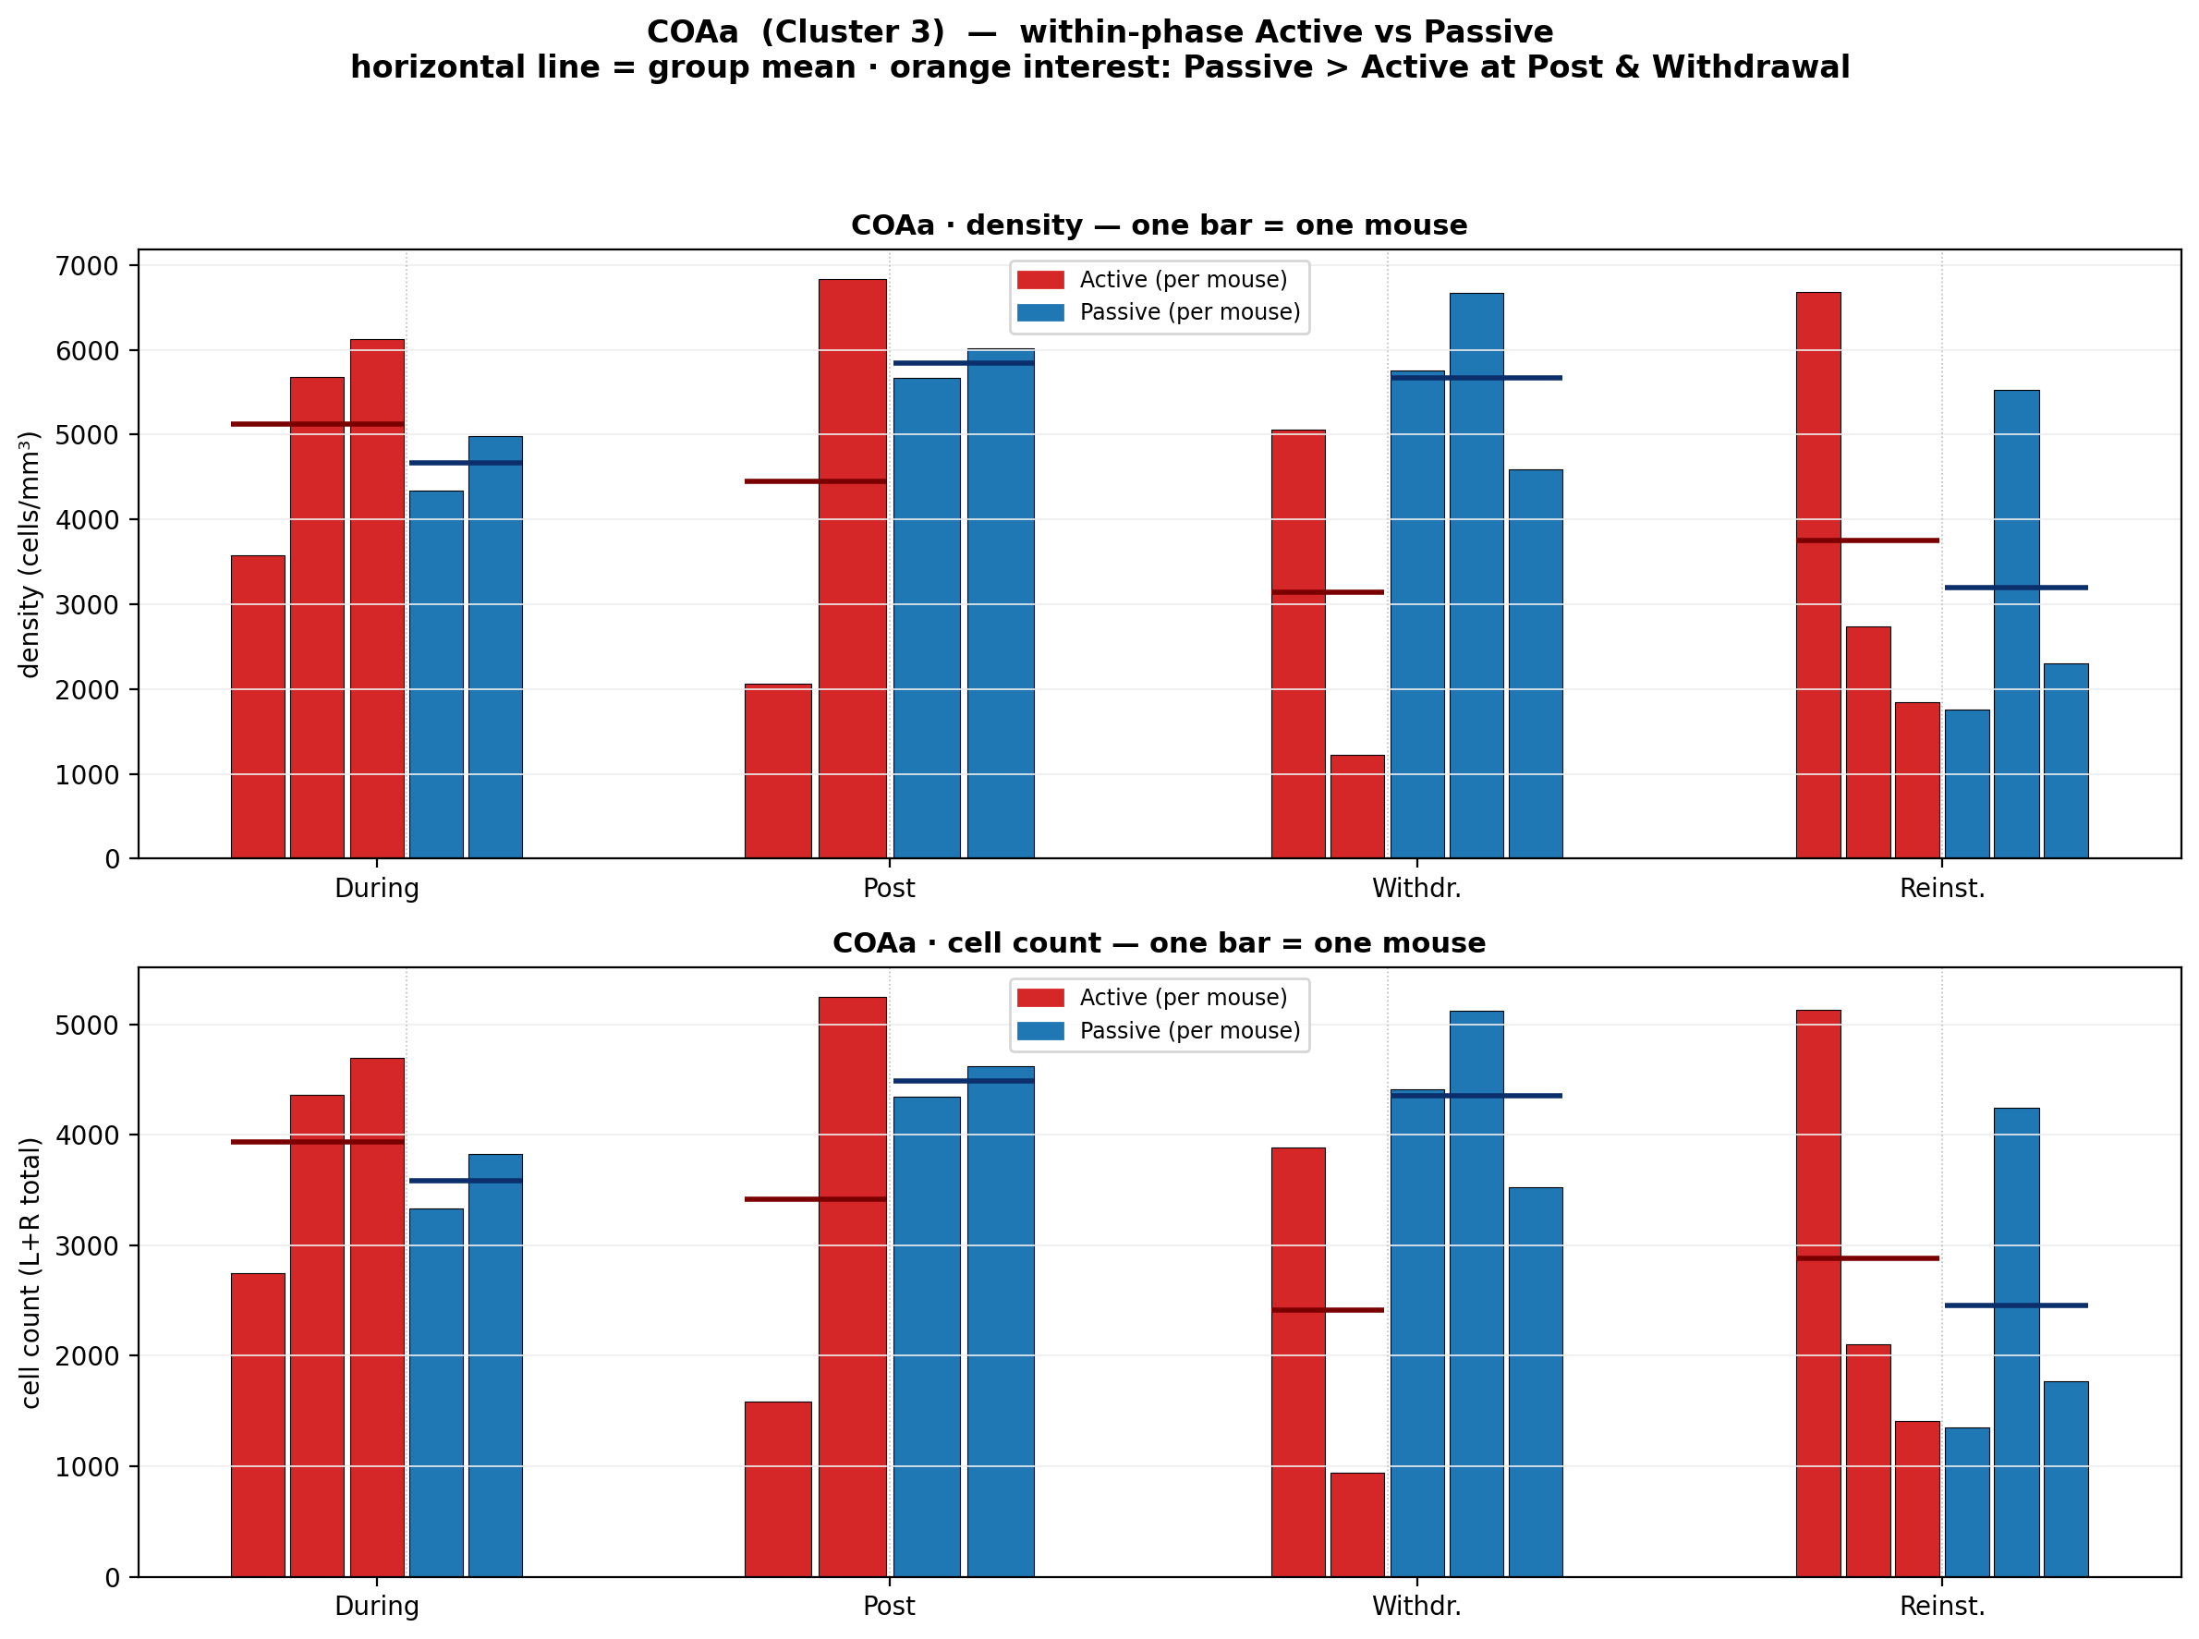
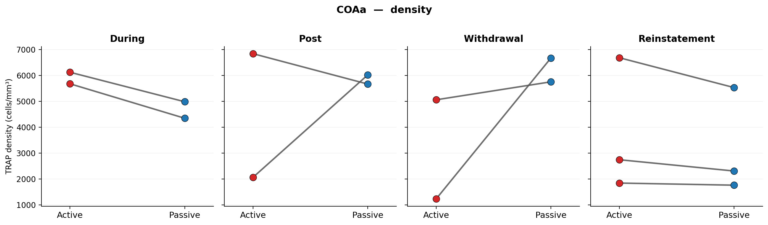
21 · COAa mouse-level + paired slope
• Mouse-level and paired-slope panels for COAa Passive > Active consistency.
CODE: P_gt_A_PostWD helpers · forMark/paired_slope/COAa_density_paired_slope.png

Slide 23
22 · Code map (where to click on GitHub)
• Pipeline drivers: init_TRAP_pipeline.m · trap_config.m · RUN_PIPELINE_ALL.m
• Clustering: Step_03_region_clustering_PCA_kmeans/ · Step_13_universal_cluster_viz/
• Final-story Python (repo root): trap_region_selection_ppt.py · trap_region_zoomin.py · trap_build_pptx.py
• Finding helpers: trap_fig_cluster3_heatmap.py · trap_hilo_ORBm_BMAp_COAa.py · trap_forMark_figs.py
• Pack offline copies: colleague_AI_benchmark_pack/code/
• Canonical outputs: TRAP_OUTPUT_calculated_mm3/region_selection_PPT/ · region_zoomin/ · forMark/
https://github.com/limserenahansol/TRAP_analysis

Slide 24
23 · AI-benchmark rubric (what success looks like)
• Recover biological aim: Active≫Passive primary + Passive-biased secondary.
• Reproduce funnel: forebrain → K=4 → keep clusters 1&4 → shortlist 7 → zoom survivors ORBm/BMAp.
• Name Finding A = ORBm + BMAp with Passive-flat Active-selective rationale.
• Name Finding B = COAa (Passive > Active at Post+WD); mention LGv/FC as numeric peers.
• Point to the correct scripts above for each figure — not the entire Step-13 PNG dump.
• Do not treat histology slides as pipeline-generated plots (they were inserted into the PPT).

Slide 25
24 · Summary
• Aim: map opioid-selective craving circuits vs generalized / Passive-side motivation.
• Method: cluster first (structure) → shortlist → zoom-in (individual regions + mice).
• Finding A: ORBm & BMAp — Active ≫ Passive, Passive flat.
• Finding B: COAa — Passive > Active at Post + Withdrawal.
• This deck = figure + meaning + code for the final story only.
• Companion docs in pack: 00_START_HERE.md · HOW_FINAL_PDF_WAS_MADE.md · FINAL_PDF_FIGURE_MAP.md
GitHub: https://github.com/limserenahansol/TRAP_analysis
Local pack: Research_Projects/02_TRAP_wholebrain/colleague_AI_benchmark_pack/

