Slide 1
Xenium custom add-on for ORBm and BMAp
Jesse Niehaus (PL-ILA-ORB morphine DEGs + enriched GPCRs)
Daniel Berg / Scherrer (GSE283418 amygdala spatial 98-gene panel)
What is already on the panel, what we added from Dan, what we propose from Jesse
Hansol Lim | Schnitzer + Scherrer | HEAL / TRAP2 x Ai14 | 9 September 2026
ORBm + BMAp Xenium add-on | Jesse Niehaus + Daniel Berg / Scherrer | 1/20

Slide 2
Take-home
One shared Xenium add-on. Two collaborator datasets. Three decisions.
1. Core panel stays
2. Dan 14 ADDED
3. Jesse PROPOSED
The 144-gene shared list
already covers TRAP / IEG
and opioid receptors.
Fos Arc Egr1 Junb
Nr4a1 Oprm1 Ntsr1
Grm5 Cartpt Foxp2
All 20 cell types remain
separable.
GSE283418 Resolve
98-gene smFISH.
38 already on panel.
14 informative extras
are now on MSGS111
(ranks 145-158).
Lamb3 is the closest
true BMAp gene.
Others are MEA/CEA
borders.
Morphine-dependence
signature, not cell-type ID.
Add only if that state
is a Xenium readout.
First: Rxfp1 (FREE)
Then: Per2 Pcsk1 Per1
Then: Nr4a3 Dusp1 Egr3
Do not swap Fos/Arc.
ORBm + BMAp Xenium add-on | Jesse Niehaus + Daniel Berg / Scherrer | 2/20

Slide 3
The two collaborator datasets
Different questions. Both re-checked in Allen WMB-10X for our ORBm / BMAp ROIs.
Jesse Niehaus | ORBm / mPFC
Daniel Berg / Scherrer | BMAp
5 days escalating morphine.
DESeq2 pseudobulk, padj 0.1.
PL-ILA-ORB subclasses.
IEG 77 TF 179
Plasticity 45 GPCR DEG 34
+ GPCRs enriched in PL-ILA-ORB
vs the rest of the 4M-cell atlas.
Ask: which genes change in
opioid dependence in ORB?
Not a cell-type marker list.
GEO GSE283418.
Resolve Molecular Cartography.
98-gene smFISH, amygdala sections
bregma -1.155 to -1.955.
Pain unpleasantness study.
NOT Hochgerner Visium.
RAW 8.3 GB images not downloaded.
Gene list from GPL35157 is enough.
Ask: which of Dan's spatial genes
are informative in our BMAp ROI?
ORBm + BMAp Xenium add-on | Jesse Niehaus + Daniel Berg / Scherrer | 3/20

Slide 4
Current shared panel on MSGS111
Xenium Mouse Brain v1 base (~248 genes) is free. Custom add-on cap is 100.
Original curated shared list: 144 genes | 44 free on base | 100 custom | 20/20 cell types separable
After Dan append: 158 genes | 44 free | 114 custom if all 14 are kept
ORBm_ORDER 140 (unchanged by Dan). BMAp_ORDER 140 (126 + 14).
Blocks: cell-type separators, reporter/transgene, class backbone, IEG, GPCRs, TFs, plasticity, published regional, then 12_GSE283418_added.
TRAP2 x Ai14, Active vs yoked Passive, tag at Post. PIs: Mark Schnitzer and Gregory Scherrer.
ORBm + BMAp Xenium add-on | Jesse Niehaus + Daniel Berg / Scherrer | 4/20

Slide 5
Dan | GSE283418 spatial transcriptomics
Berg + Scherrer | Resolve Molecular Cartography | 98-gene panel GPL35157
Paper: Spatial molecular profiling of amygdalar neurons enables precision pharmacology against pain unpleasantness.
Method: smFISH (Resolve), not Visium, not Xenium. Amygdala coronal sections.
We used the 98-gene platform table, then re-scored every gene in Allen BMAp-mapped subclasses.
38 / 98 already on our shared panel (Foxp2, Cartpt, Ebf1, Pdyn, Oprm1, Slc17a7, Drd1/2 ...).
14 were BMAp-informative and missing — these are now appended to MSGS111.
The rest are weak in BMAp anchors or mark CEA / glia / immune — do not add.
ORBm + BMAp Xenium add-on | Jesse Niehaus + Daniel Berg / Scherrer | 5/20

Slide 6
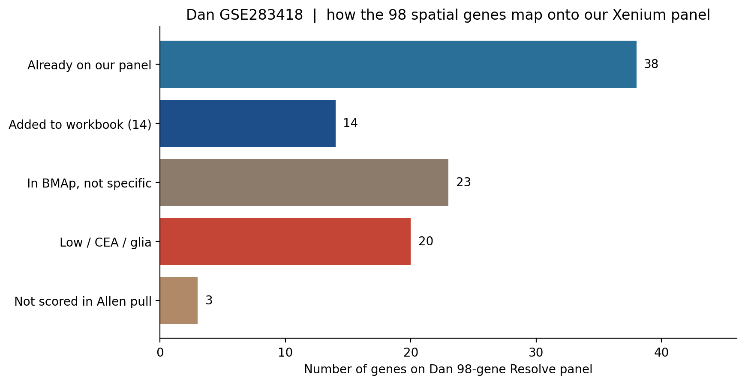
Dan | fate of the 98 spatial genes
Source: GSE283418 GPL35157 vs our shared panel, re-scored in Allen BMAp-mapped ROI.
ORBm + BMAp Xenium add-on | Jesse Niehaus + Daniel Berg / Scherrer | 6/20

Slide 7
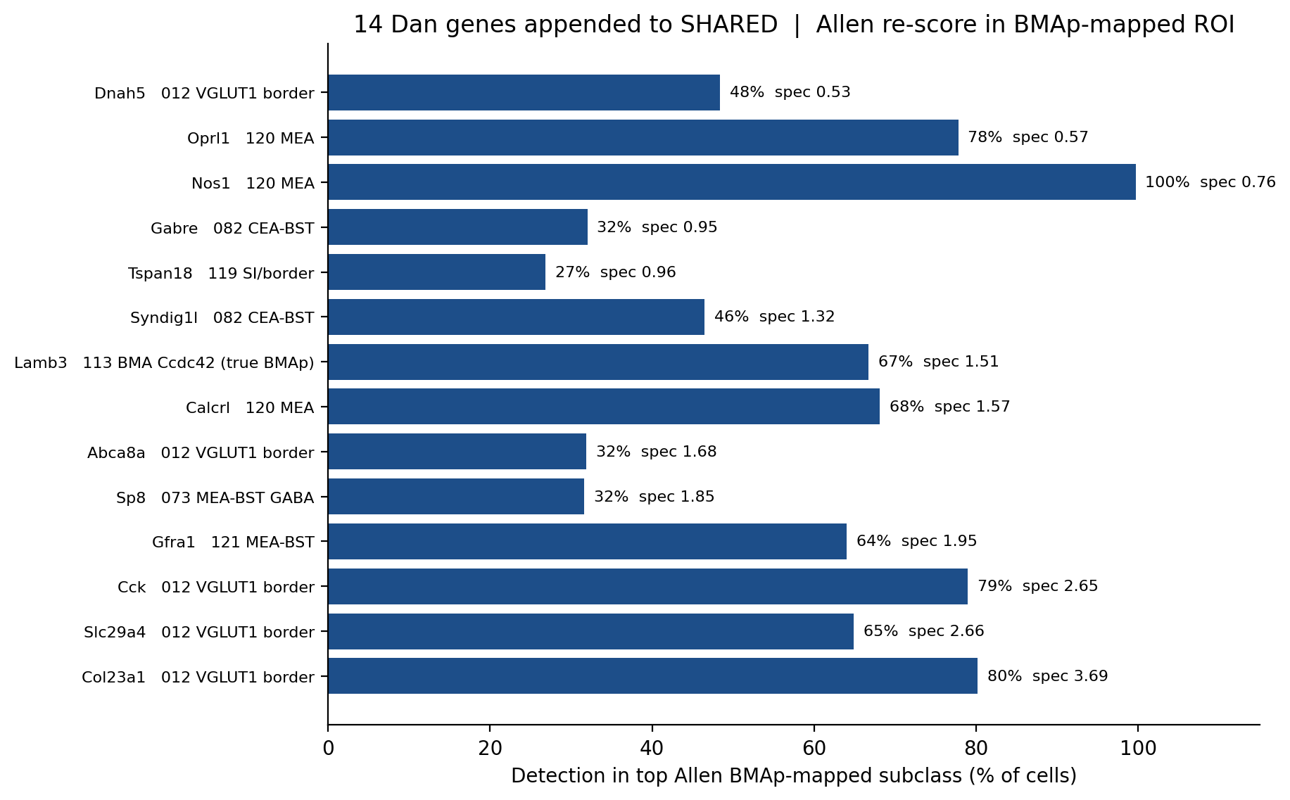
Dan | the 14 genes we added
Already on MSGS111 SHARED ranks 145-158, block 12_GSE283418_added. All 14 cost a custom slot.
ORBm + BMAp Xenium add-on | Jesse Niehaus + Daniel Berg / Scherrer | 7/20

Slide 8
Dan 14 | not all are BMAp nucleus
Allen re-score is in our BMAp-mapped ROI, which includes MEA / CEA neighbors.
Closest to true BMAp
MEA / BST neighbors
CEA / other | keep only if wanted
Lamb3
113 MEA-COA-BMA Ccdc42
Cck, Col23a1, Slc29a4
Abca8a, Dnah5
012 MEA Slc17a7
VGLUT1 border
(BMA / MEA overlap)
Calcrl, Nos1, Oprl1
120 MEA Otp Foxp2
Gfra1
121 MEA-BST Otp Zic2
Sp8
073 MEA-BST Sox6 GABA
Syndig1l, Gabre
082 CEA-BST Ebf1 Pdyn
Tspan18
119 SI-MA-LPO-LHA Skor1
Useful if the slide
includes CEA/MEA.
Not required for
BMAp cell-type ID.
ORBm + BMAp Xenium add-on | Jesse Niehaus + Daniel Berg / Scherrer | 8/20

Slide 9
Jesse | PL-ILA-ORB morphine dependence
OpioidDependenceDEG genesets | 5-day escalating morphine | DESeq2 padj 0.1
Four DEG lists: IEG (77), transcription factors (179), synaptic plasticity (45), GPCRs (34).
Plus GPCRs enriched in PL-ILA-ORB vs the rest of the Allen 4M-cell atlas (Fisher, FDR 0.05).
Most IEG / plasticity genes are Up. The hottest cells are 004 L6 IT, 030 L6 CT, 006 L4/5 IT, 022 L5 ET.
Classic activity IEGs (Fos, Arc, Egr1, Junb, Nr4a1) are already on our panel.
What is new: delayed / circadian IEGs (Per2, Pcsk1, Per1) and ORB-enriched GPCRs (Rxfp1, Mas1, Gpr68).
Jesse: check abundance on their MERFISH before adding many TFs.
ORBm + BMAp Xenium add-on | Jesse Niehaus + Daniel Berg / Scherrer | 9/20

Slide 10
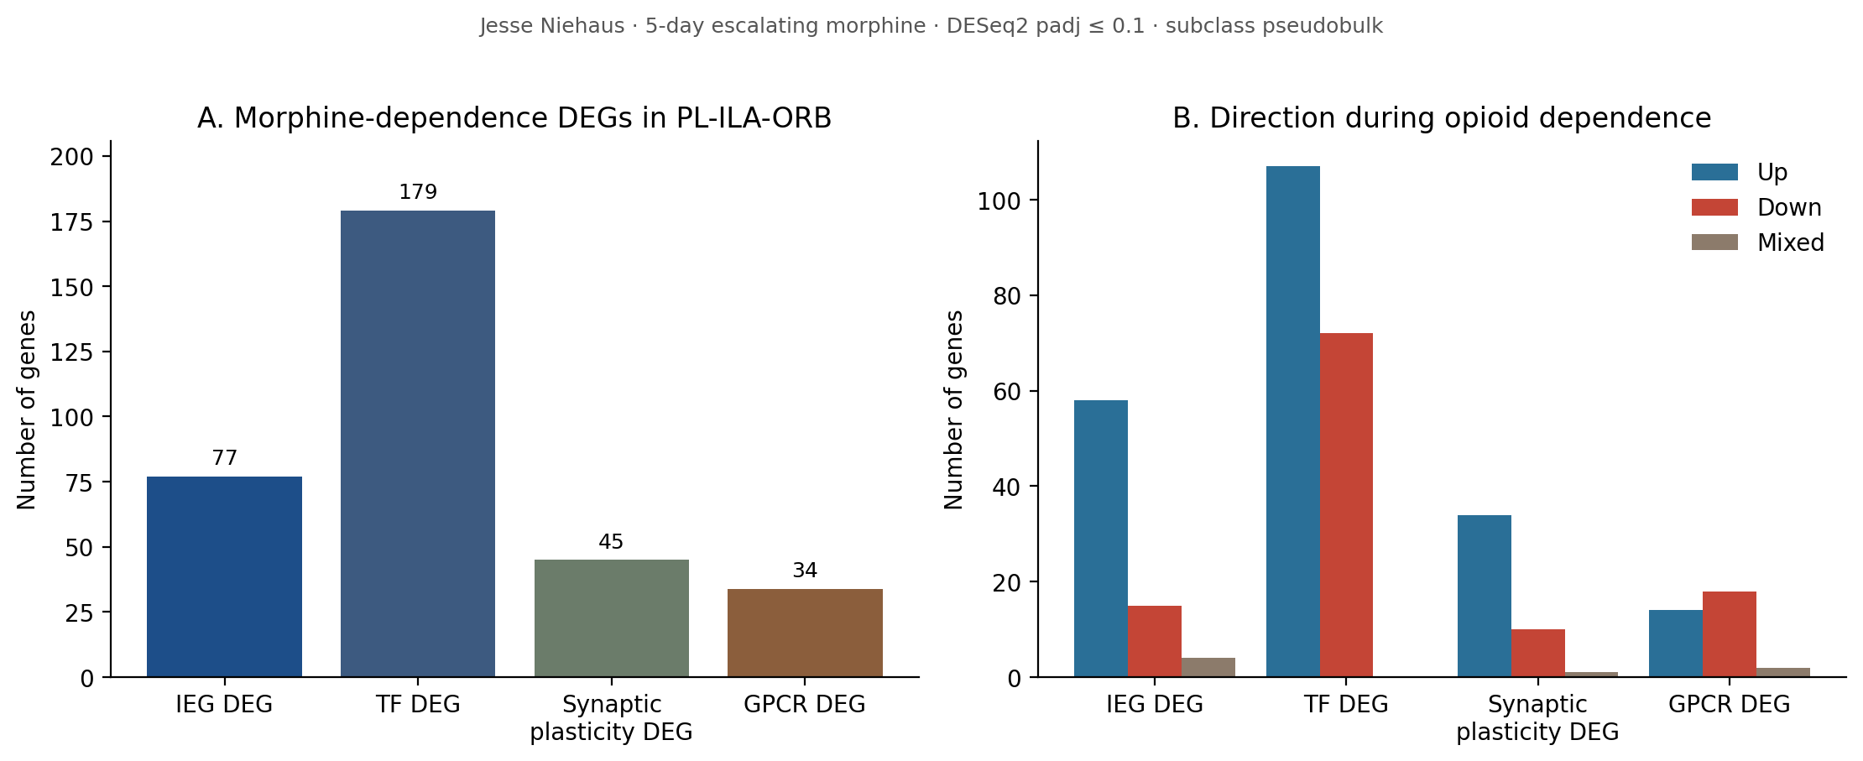
Jesse | DEG list size and direction
TF list is largest. IEG and plasticity are mostly Up. GPCR DEGs split Up/Down.
ORBm + BMAp Xenium add-on | Jesse Niehaus + Daniel Berg / Scherrer | 10/20

Slide 11
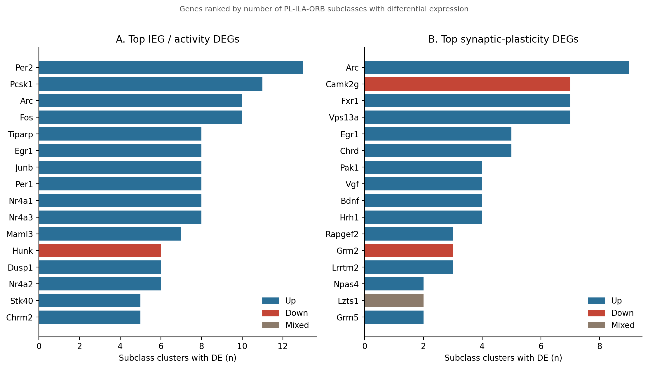
Jesse | widest IEG and plasticity DEGs
Per2 and Pcsk1 hit more ORBm subclasses than Fos/Arc. Camk2g is the widest Down plasticity gene.
ORBm + BMAp Xenium add-on | Jesse Niehaus + Daniel Berg / Scherrer | 11/20

Slide 12
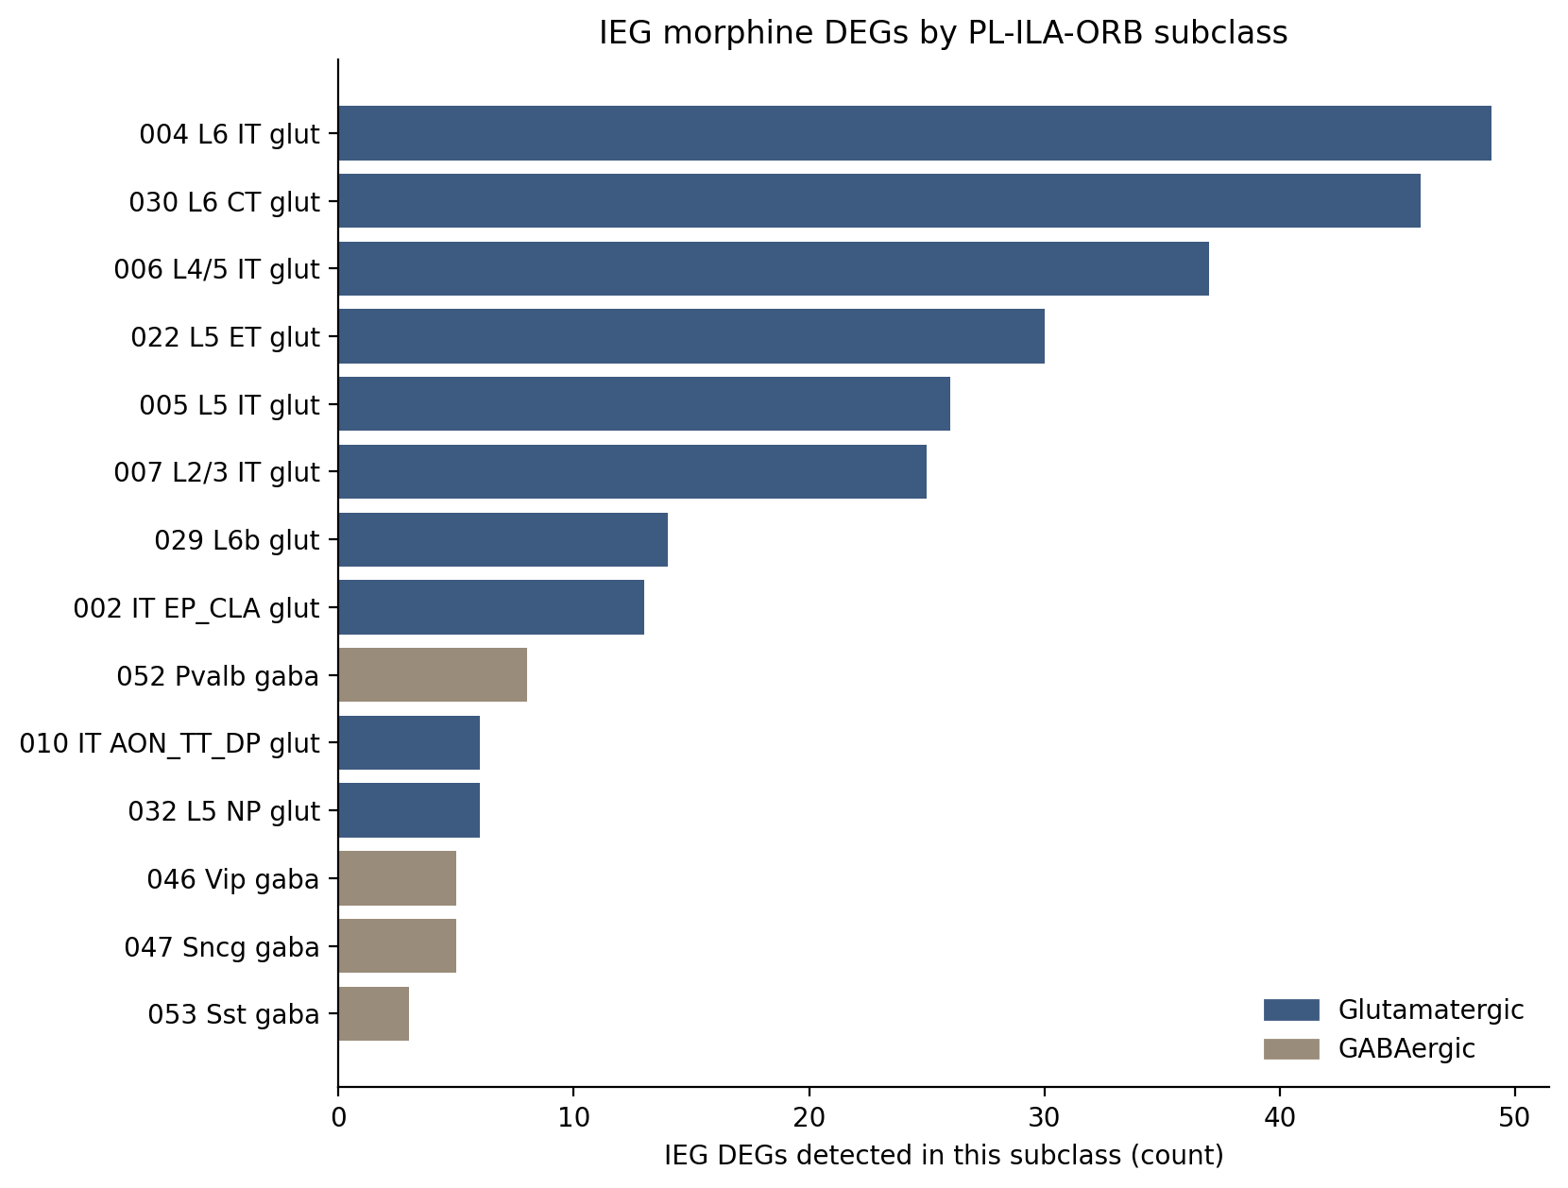
Jesse | which cell types change IEG
Morphine IEG response is glutamatergic-cortical. GABA (Pvalb / Vip / Sst) is weaker.
ORBm + BMAp Xenium add-on | Jesse Niehaus + Daniel Berg / Scherrer | 12/20

Slide 13
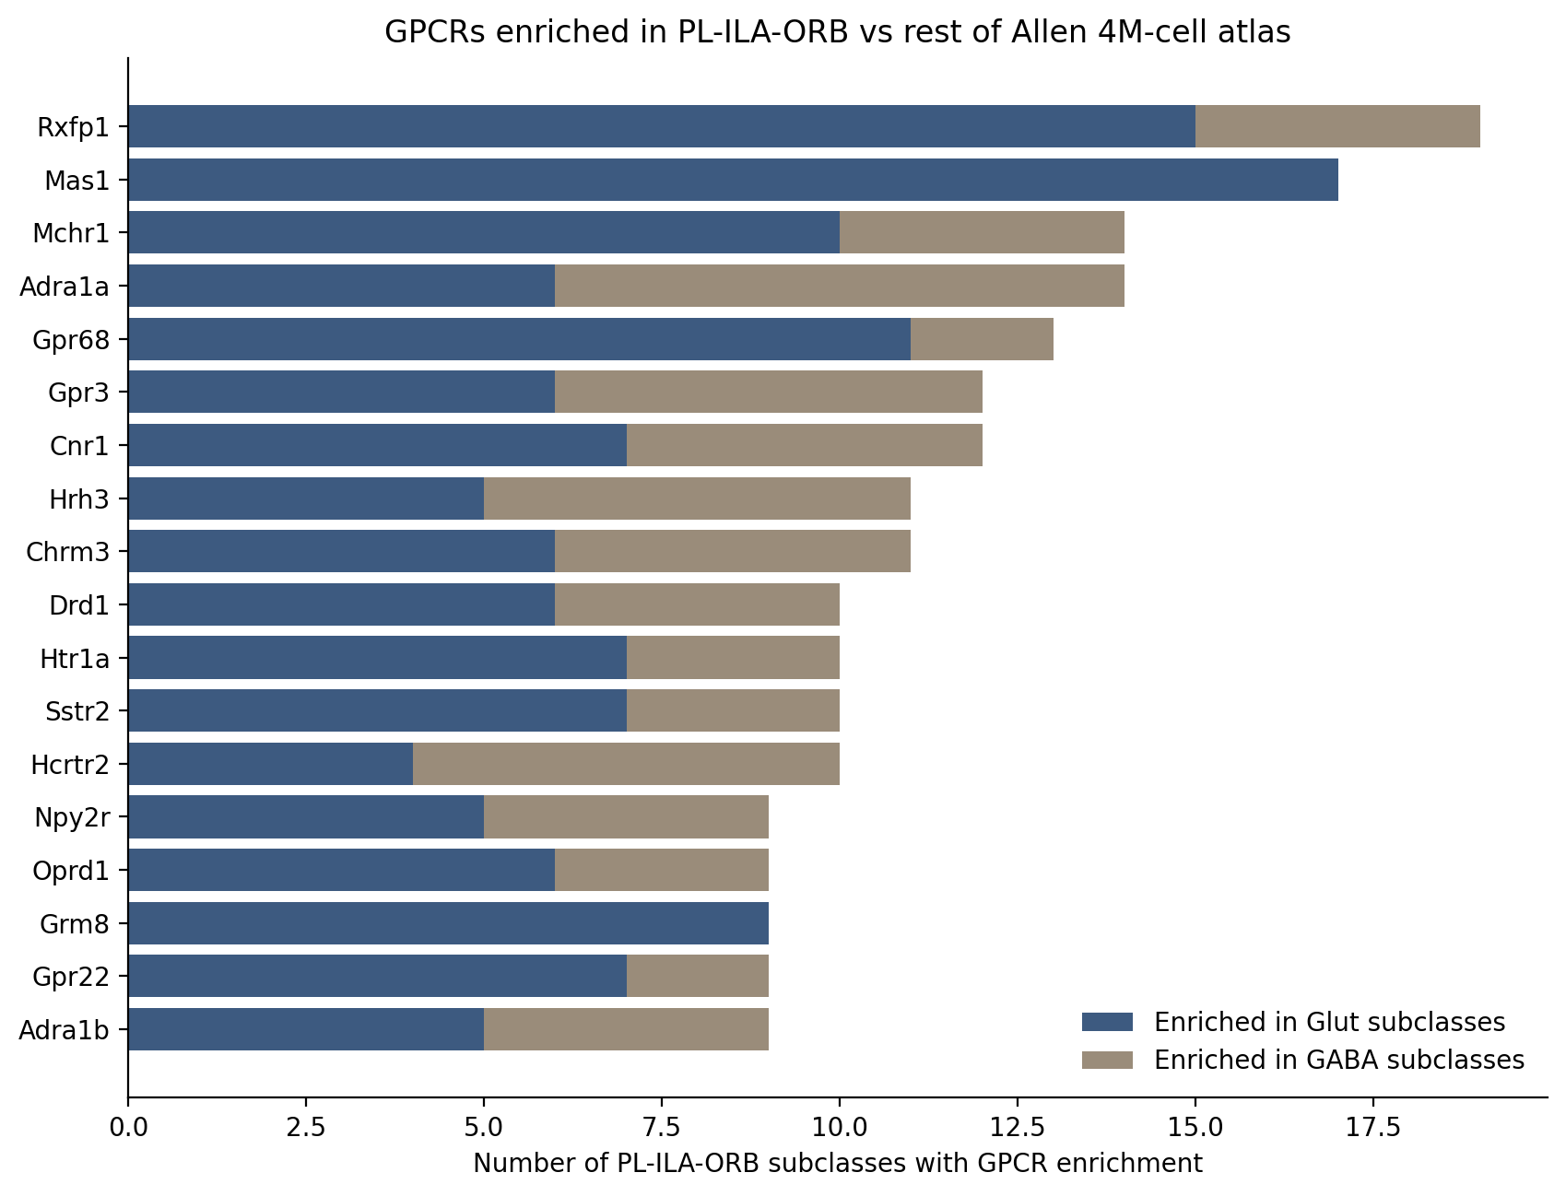
Jesse | GPCRs enriched in PL-ILA-ORB vs atlas
This is who lives in ORB, not necessarily what morphine changes. Rxfp1 is free on the Xenium base panel.
ORBm + BMAp Xenium add-on | Jesse Niehaus + Daniel Berg / Scherrer | 13/20

Slide 14
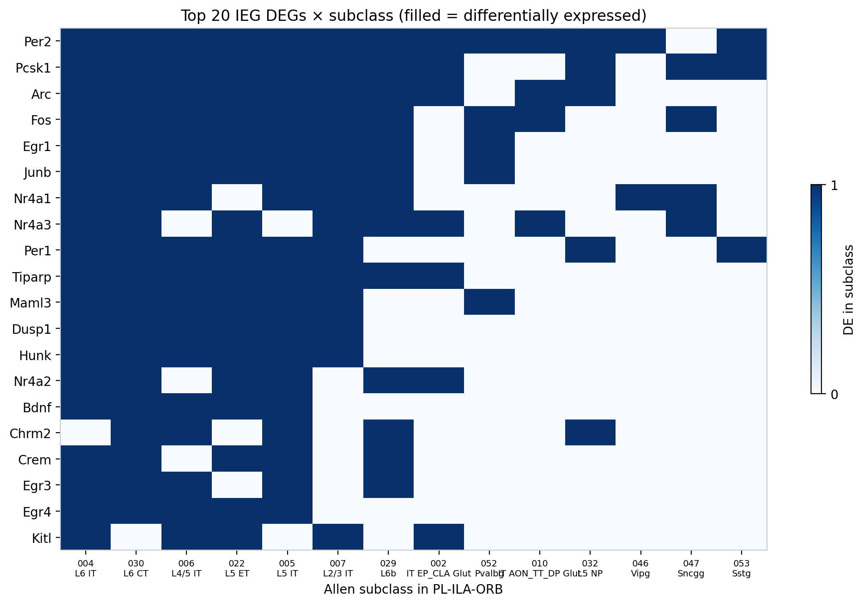
Jesse | top 20 IEG DEGs x subclass
Filled = differentially expressed. Per2 / Pcsk1 / Arc / Fos cut across the main ORBm excitatory types.
ORBm + BMAp Xenium add-on | Jesse Niehaus + Daniel Berg / Scherrer | 14/20

Slide 15
Jesse vs current panel
Core dependence genes are already covered. The missing layer is morphine-state extras.
Already on SHARED
Missing and worth a slot
IEG: Fos Arc Egr1 Junb Nr4a1
Nr4a2 Fosb Npas4 Bdnf
GPCR / opioid: Oprm1 Oprd1
Oprk1 Oprl1 Ntsr1 Grm5
Htr1b Chrm2 Htr1a Htr2c
Enriched ORB GPCRs: 28 / 127
including Cnr1 Drd1/2 Cckbr Oxtr
FREE: Rxfp1 (19 subclasses)
Sema3e Bhlhe40
Broad ORBm DEGs:
Per2 (11) Pcsk1 (9) Per1 (8)
Nr4a3 Dusp1 Egr3 Crem
Optional: Mas1 Gpr68
Hrh1 Grm2 Camk2g
Skip most of the 160 TFs
unless MERFISH is high.
ORBm + BMAp Xenium add-on | Jesse Niehaus + Daniel Berg / Scherrer | 15/20

Slide 16
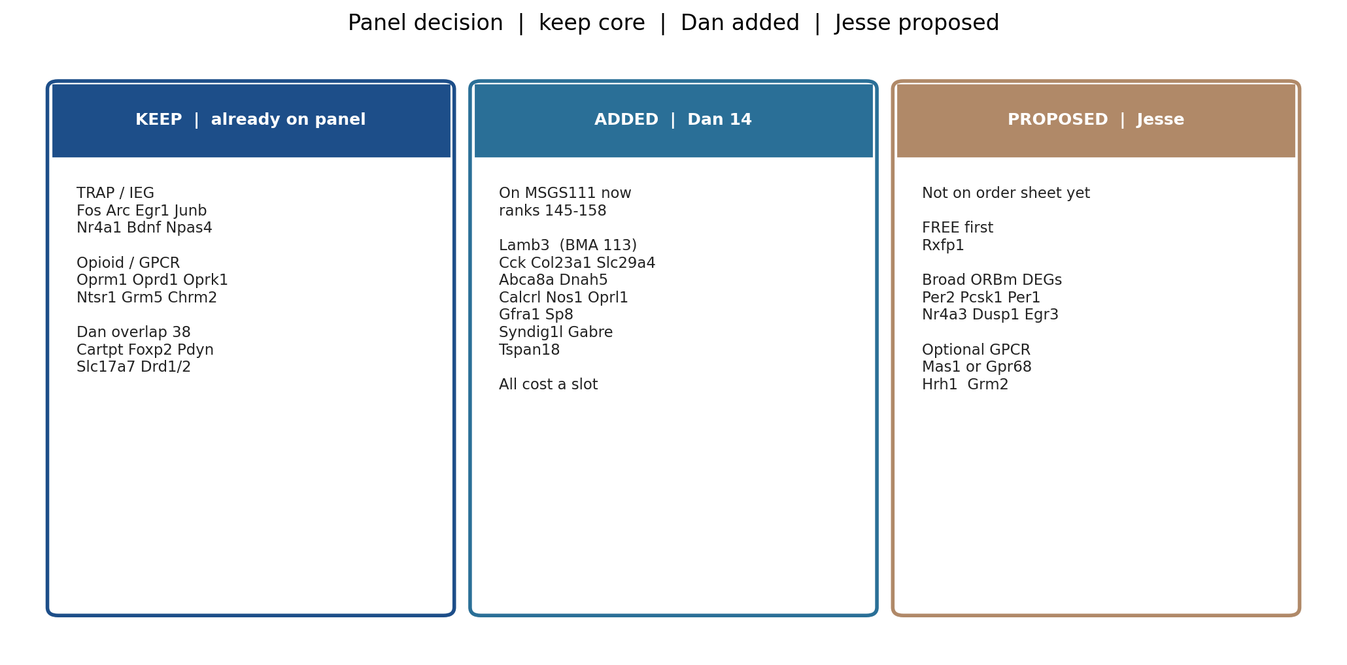
Decision | keep / added / proposed
Dan 14 are already on the workbook. Jesse shortlist is the only open add.
ORBm + BMAp Xenium add-on | Jesse Niehaus + Daniel Berg / Scherrer | 16/20

Slide 17
Genes to add on the custom probe panel
Green = already written onto MSGS111. Gold = recommended next, not yet appended.
Status | Gene | Source | Why | Slot
ADDED | Lamb3 | Dan GSE283418 | Closest true BMAp (113 Ccdc42) | 1 custom
ADDED | Cck, Col23a1, Slc29a4, Abca8a, Dnah5 | Dan | 012 VGLUT1 BMA/MEA border | 5 custom
ADDED | Calcrl, Nos1, Oprl1, Gfra1, Sp8 | Dan | MEA / BST neighbors on the slide | 5 custom
ADDED | Syndig1l, Gabre, Tspan18 | Dan | CEA / SI border; optional | 3 custom
PROPOSED | Rxfp1 | Jesse enriched GPCR | 19 PL-ILA-ORB subclasses | FREE (base)
PROPOSED | Per2, Pcsk1, Per1 | Jesse IEG DEG | Widest ORBm morphine DEGs we lack | 3 custom
PROPOSED | Nr4a3, Dusp1, Egr3 | Jesse IEG | IEG family we only partly cover | 3 custom
PROPOSED | Mas1 or Gpr68; Hrh1; Grm2 | Jesse GPCR / plast. | Optional morphine + ORB GPCR layer | 3-4 custom
ORBm + BMAp Xenium add-on | Jesse Niehaus + Daniel Berg / Scherrer | 17/20

Slide 18
Slot budget
10x Xenium custom add-on cap = 100. Transgenes always cost a slot.
Original shared order: 100 custom + 44 free base = 144 curated genes.
Dan 14 are all custom -> 114 custom if we keep every Dan gene.
Jesse Rxfp1 is FREE (already on Mouse Brain v1 base). Adding it does not use a slot.
Jesse Per2 + Pcsk1 + Per1 + Nr4a3 + Dusp1 + Egr3 = 6 more custom -> 120 if stacked on Dan 14.
If 10x will not go over 100: keep the original 100, add Rxfp1 for free, and swap (do not append) for any Jesse DEG.
Do not drop Fos, Arc, Egr1, Oprm1, Ntsr1, or unique cell-type separators to make room.
ORBm + BMAp Xenium add-on | Jesse Niehaus + Daniel Berg / Scherrer | 18/20

Slide 19
Do not add
From Dan 98
From Jesse lists
Low / CEA / glia / immune
Adora2a Prkcd Ptprc
S100b Itgal Blnk Lgals1
Present but not specific
Rbms3 Rnd2 Pnoc Lpl
Sfrp1 C1ql1/2 Bcan
These do not improve
BMAp cell-type ID.
Most of 160 missing TFs
Arid5b Banp Chd2 zinc-fingers
unless MERFISH is abundant.
Do not replace Fos / Arc /
Oprm1 / Ntsr1 with TFs.
GO plasticity can explode.
Keep the short list only.
ORBm + BMAp Xenium add-on | Jesse Niehaus + Daniel Berg / Scherrer | 19/20

Slide 20
What we need from Mark / Greg
The science is set. The only open choice is slot math and whether morphine-state genes are in-scope.
Keep the original 144. That panel already IDs all 20 types and covers TRAP + opioid receptors.
Confirm keeping the 14 Dan extras on the order (114 custom), or pick a subset (Lamb3 + Cck/Col23a1 first).
Decide whether the Xenium experiment should read a 5-day morphine signature in ORBm.
If yes: add Rxfp1 (free) plus Per2, Pcsk1, Per1. That is the highest-value Jesse block.
If the cap is hard 100: keep 144, add only Rxfp1, and do not append Dan or Jesse without swaps.
ORBm + BMAp Xenium add-on | Jesse Niehaus + Daniel Berg / Scherrer | 20/20

