Slide 1
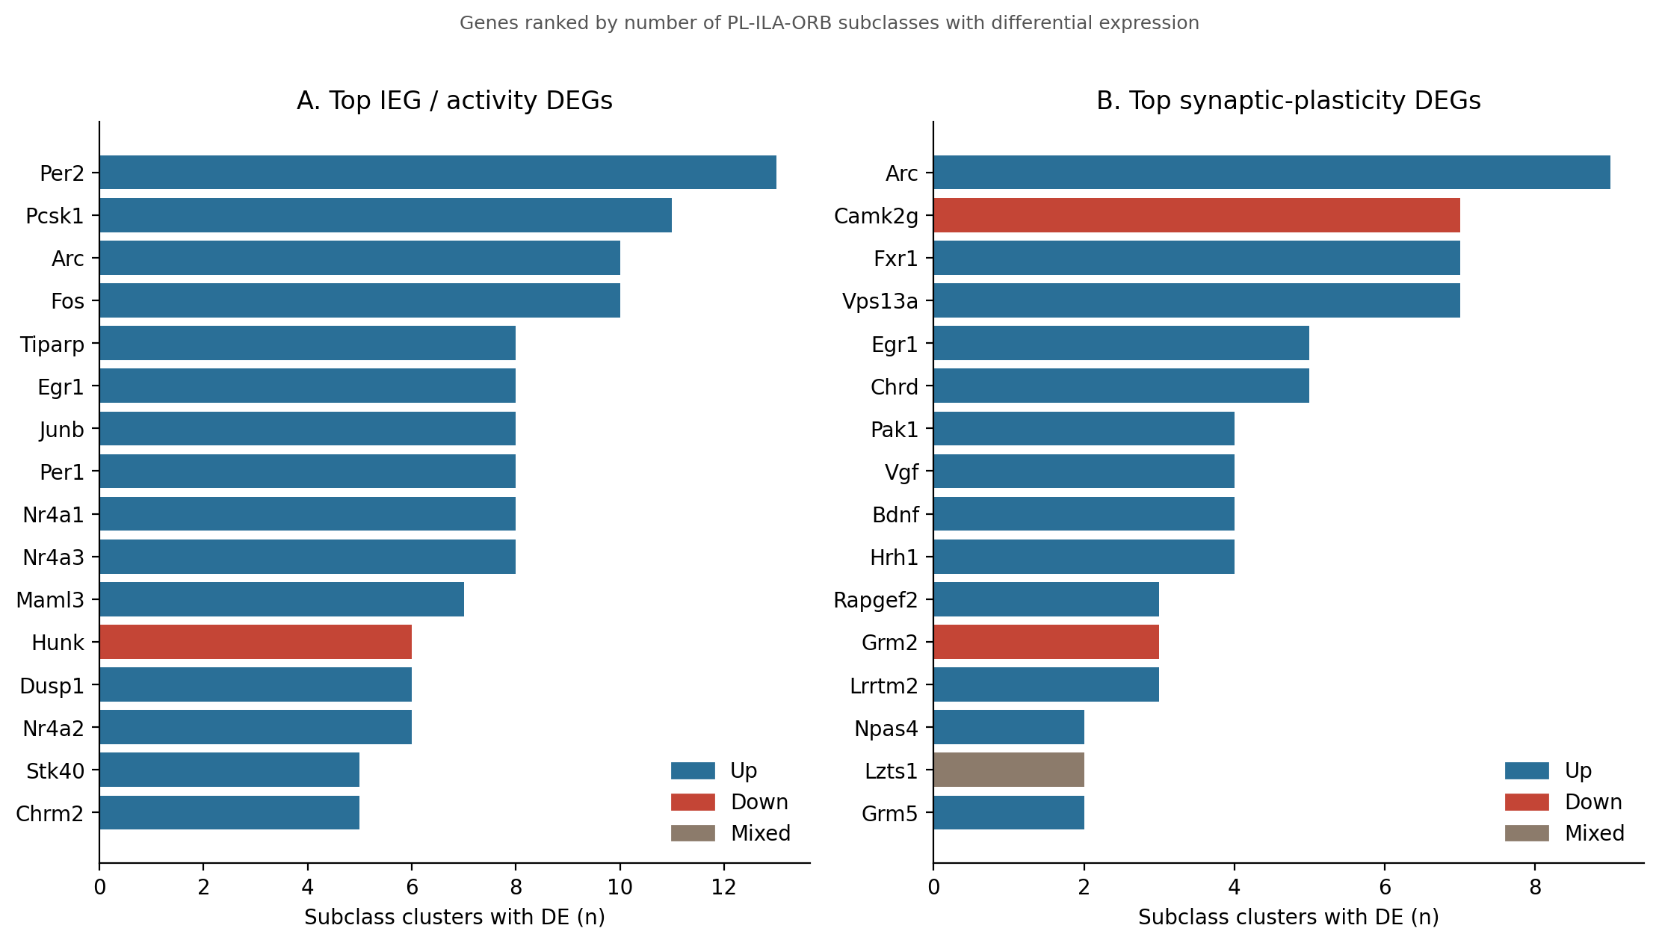
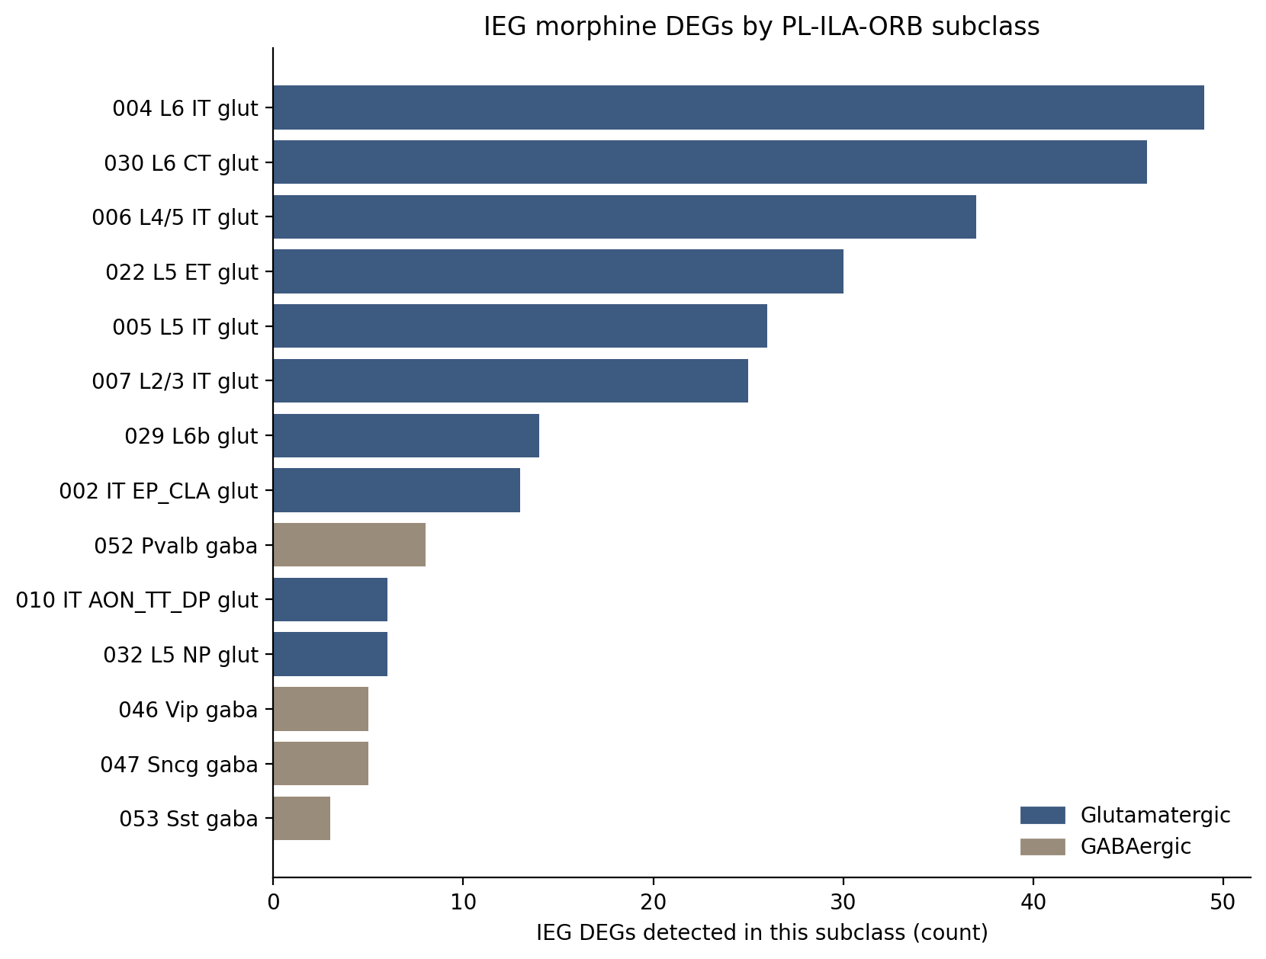
Jesse | how the morphine DEGs look
5-day escalating morphine · DESeq2 subclass pseudobulk, padj 0.1 · PL–ILA–ORB. Left: widest IEGs. Right: which cell types change.
Xenium ORBm + BMAp | same figures as the long collaborator deck | 1/4

Slide 2
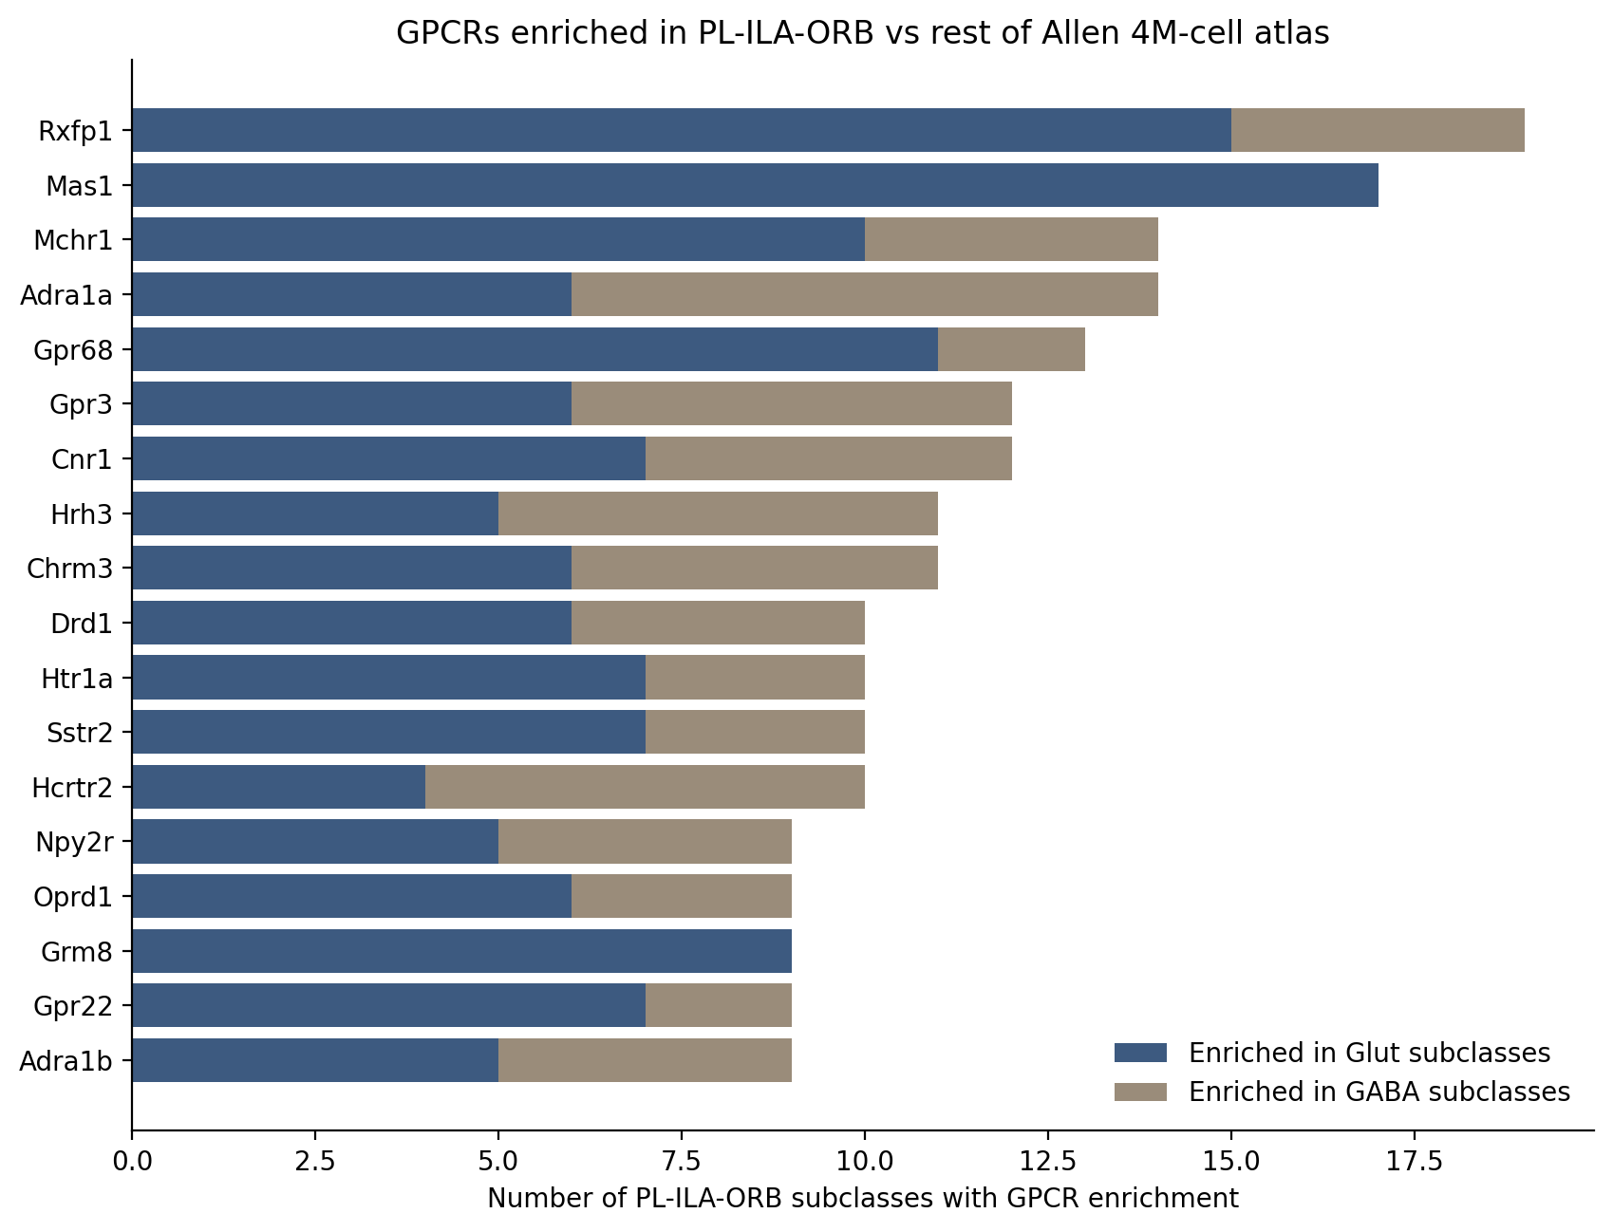
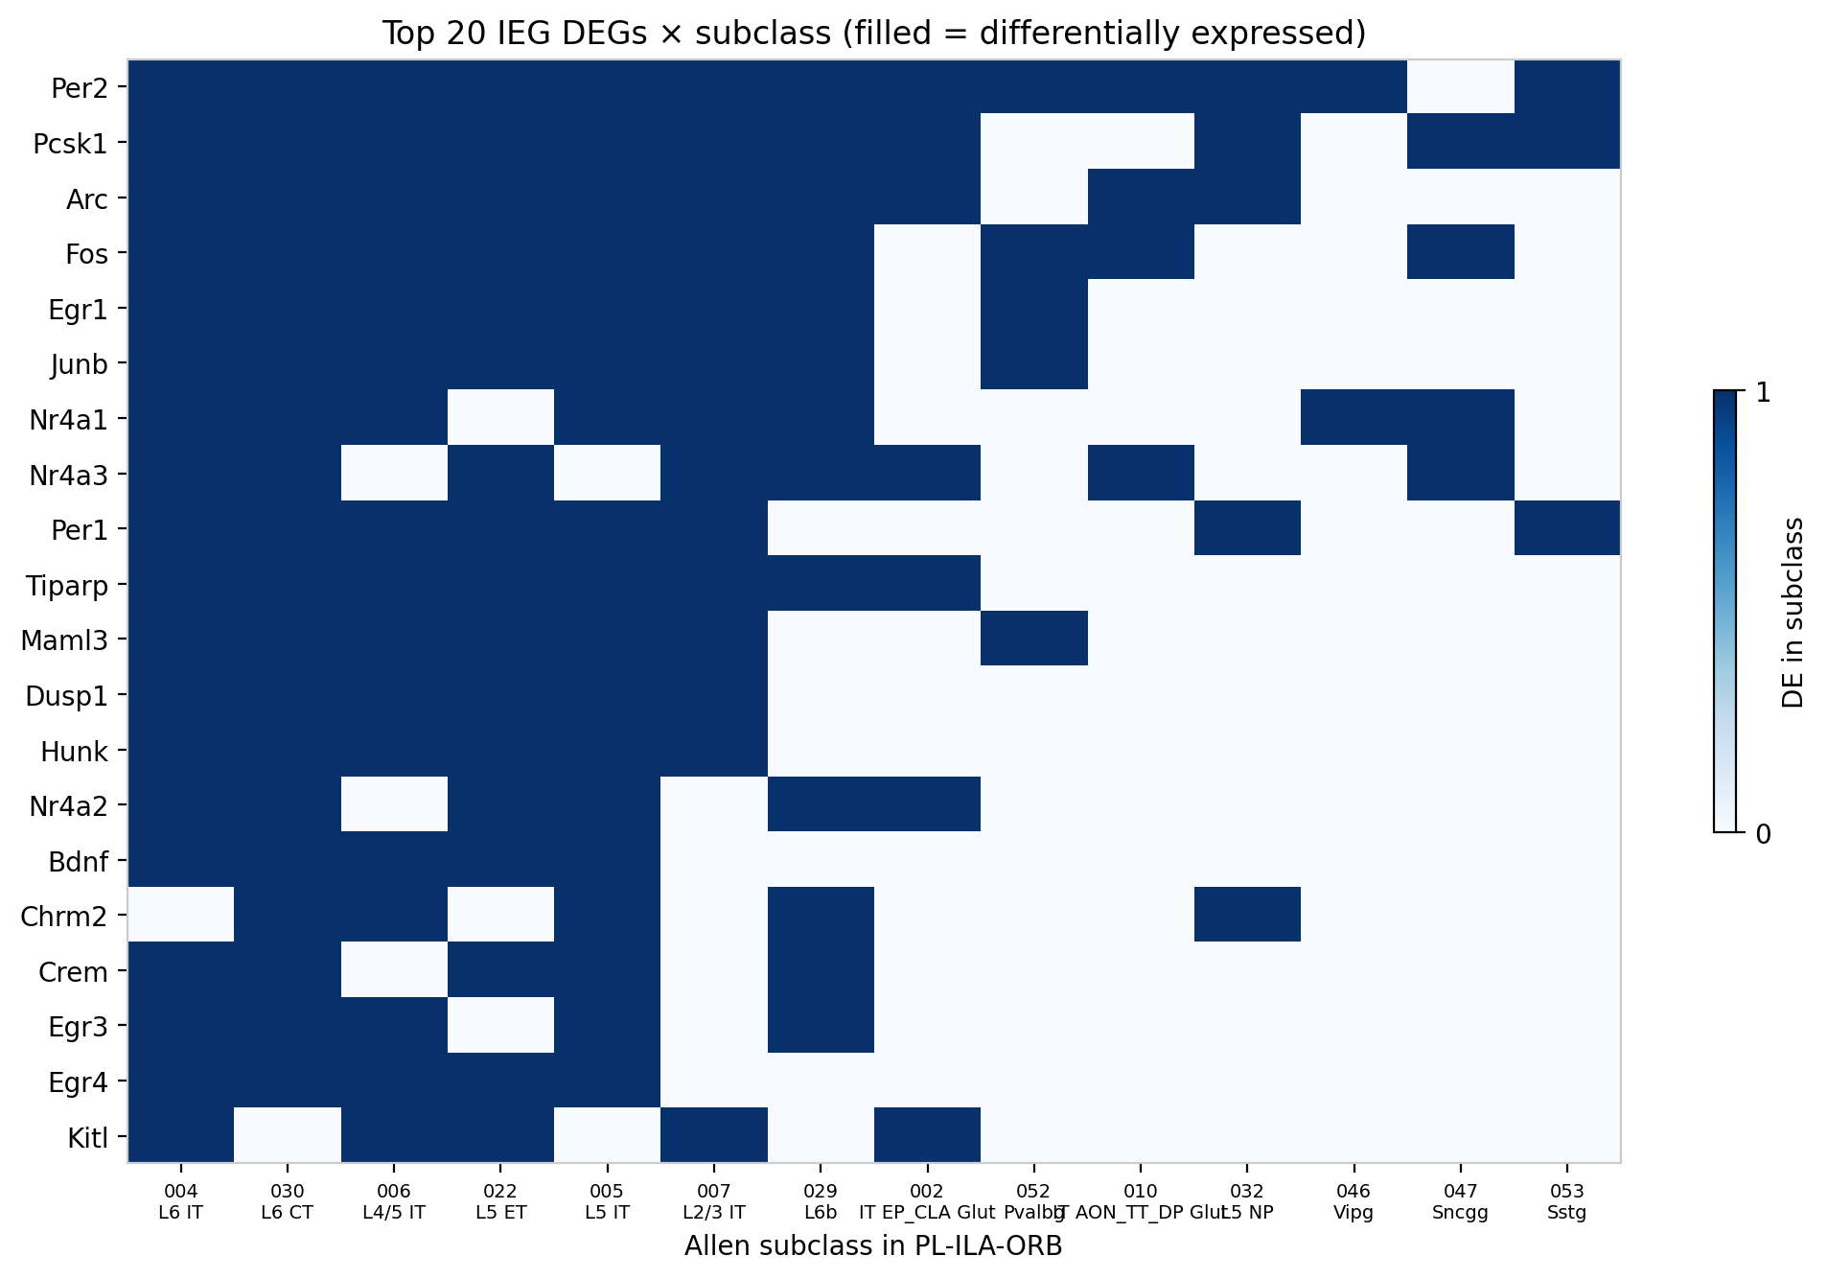
Jesse | how the ORB GPCRs and IEG matrix look
Left: GPCRs enriched in PL–ILA–ORB vs the rest of the atlas (anatomy, not morphine). Right: top IEG DEGs × subclass.
Xenium ORBm + BMAp | same figures as the long collaborator deck | 2/4

Slide 3
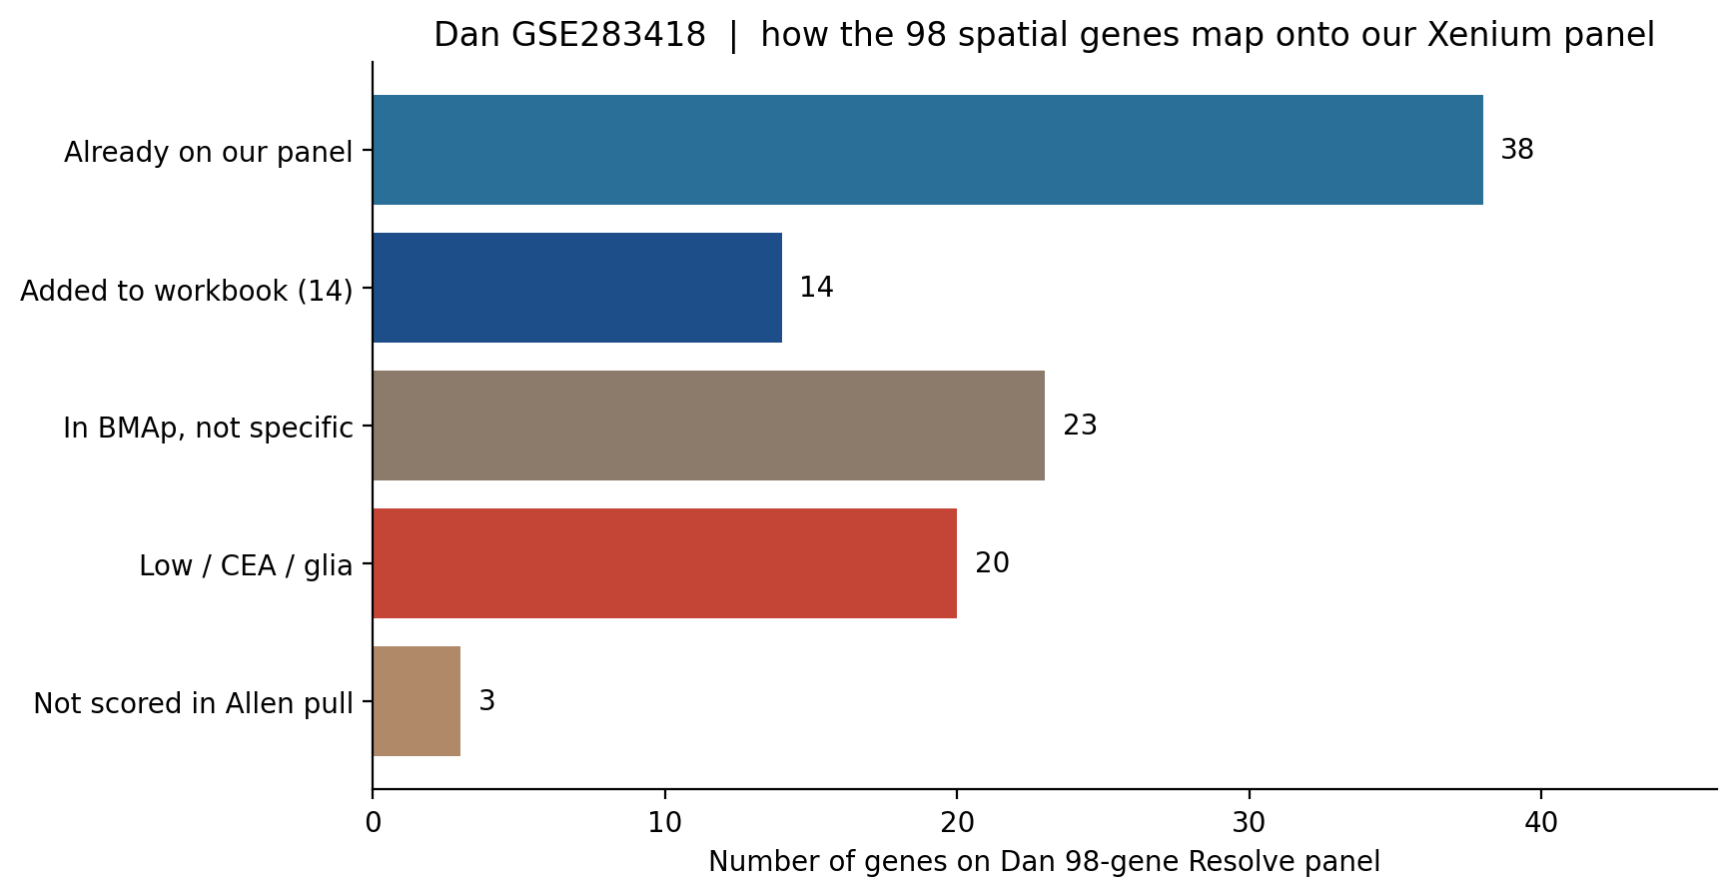
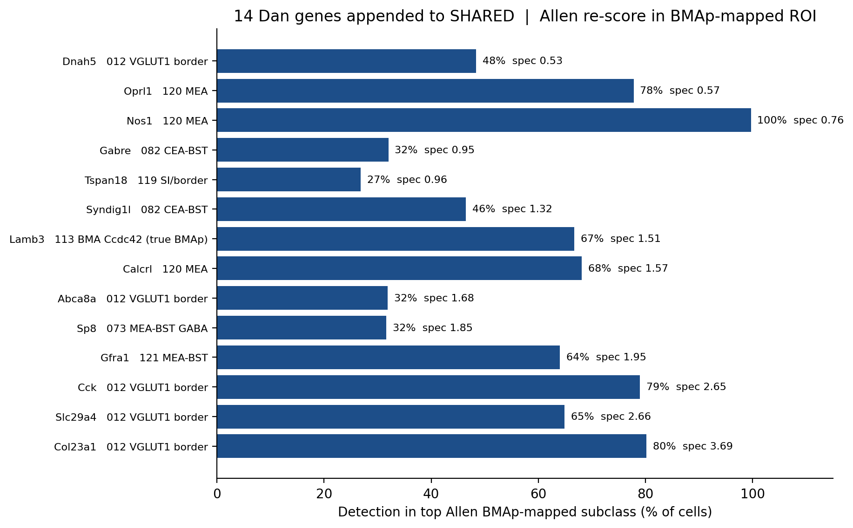
Dan | how the 98-gene spatial panel looks
GSE283418 Resolve smFISH · 98 amygdala genes vs our shared panel, re-scored in Allen BMAp. Left: fate of 98. Right: the 14 extras.
Xenium ORBm + BMAp | same figures as the long collaborator deck | 3/4

Slide 4
Final decision | genes added to the panel
Read from the figures: Jesse’s new IEG program + high-abundance ORB GPCRs. Dan’s 14 are already on MSGS111.
Decision | Genes | Why (from the data on slides 1–3) | Slots
Already on the sheet | Dan 14 Lamb3 Cck Col23a1 … | 38/98 already on the 144. These 14 were the remaining BMAp-informative genes (right plot, slide 3). | 14 done
ADD free | Rxfp1 | Jesse’s top ORB-enriched GPCR (slide 2, left). Already on Xenium Mouse Brain v1. Allen 34% in L5 ET. | 0
ADD | Per2 Pcsk1 Per1 | Widest new IEGs on slide 1 — broader than Fos/Arc. Slide 2 matrix: they cut across ORBm excitatory types. | 3
ADD | Chrm1 Grm8 | ORB-enriched on slide 2. Allen absolute % is 92% and 99% — unlike Mas1 / Gpr68 / Mchr1 (45 / 40 / 32%). | 2
Not added | Mas1 Gpr68 Mchr1 160 TFs | High on Jesse’s relative-enrichment bar, but too low or too generic for a scarce Xenium slot. | —
Final new add: Rxfp1 + Per2 Pcsk1 Per1 + Chrm1 Grm8
Five custom slots on top of Dan 14 → 119 if every Dan gene is kept. If the cap stays 100, drop CEA-border Dan genes first.
Xenium ORBm + BMAp | same figures as the long collaborator deck | 4/4

