Slide 1
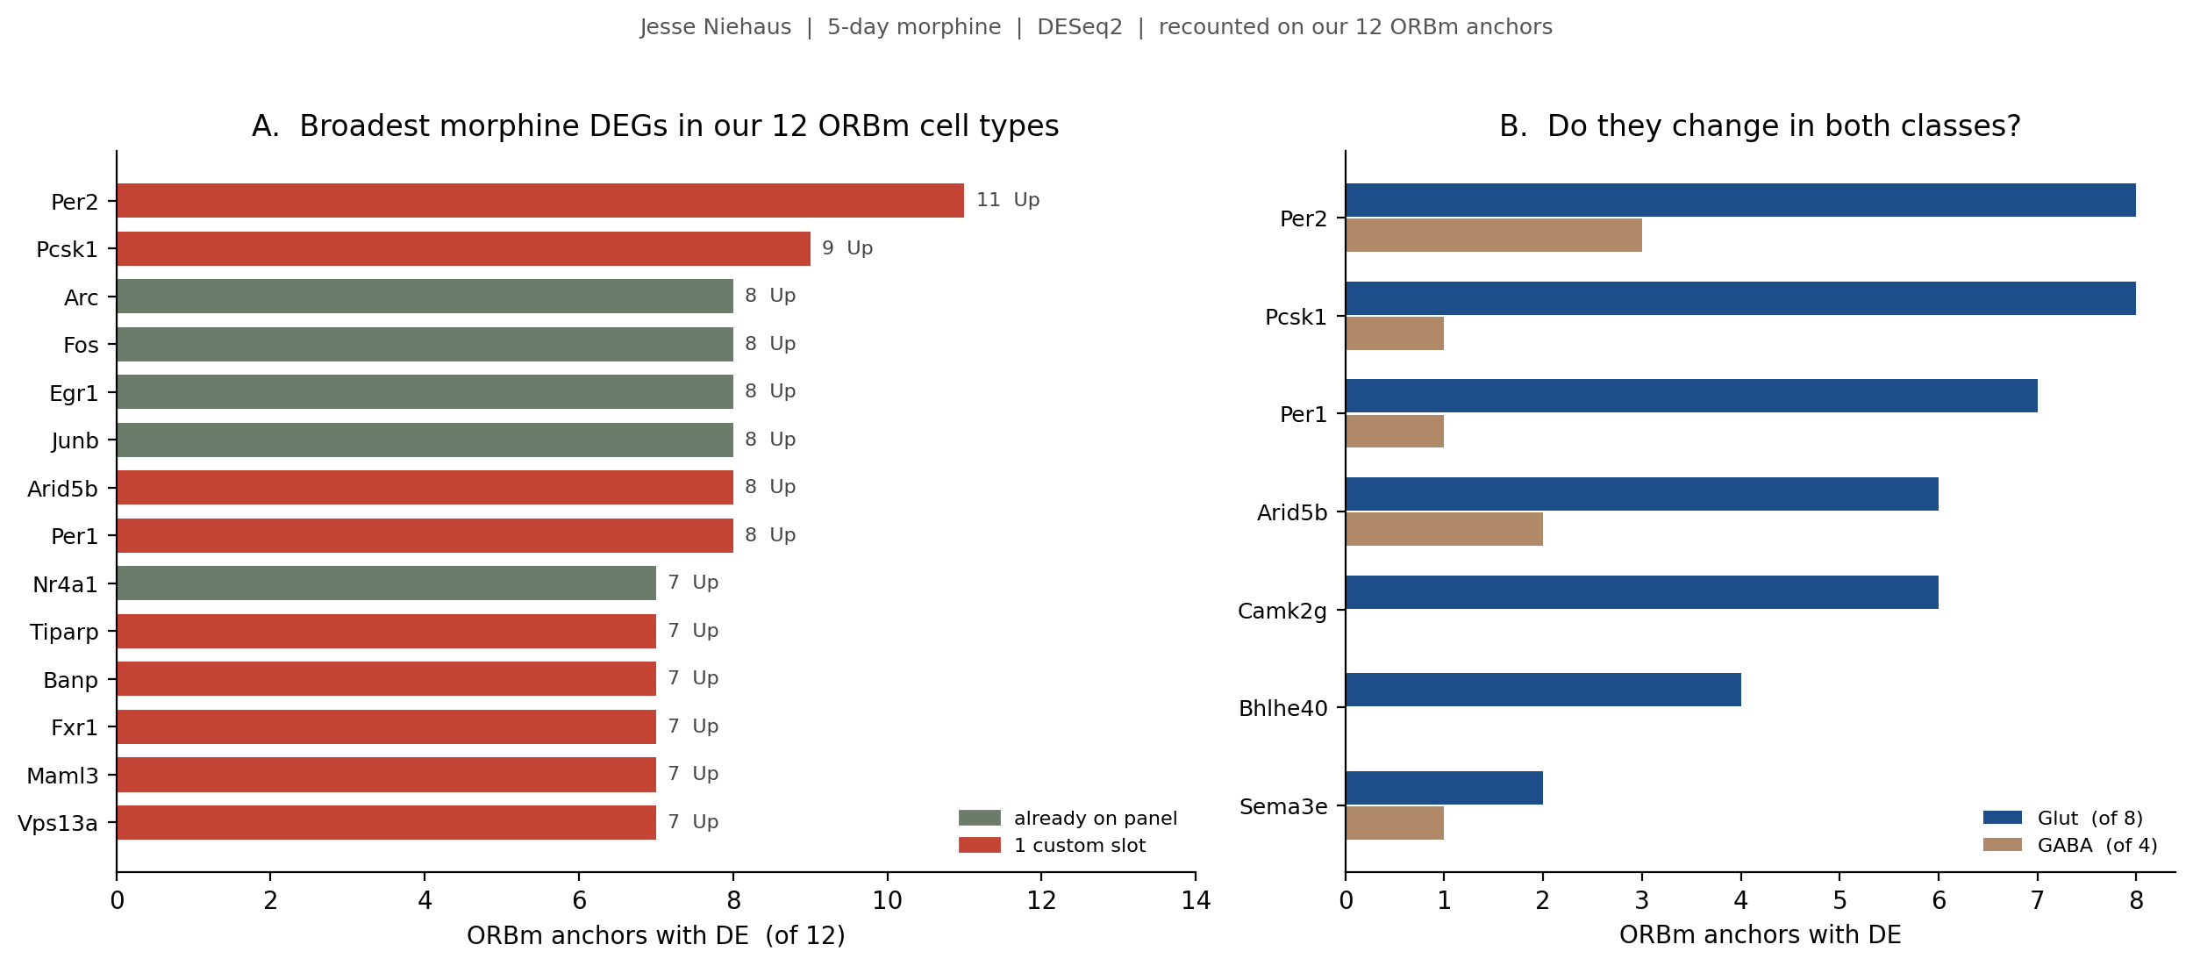
Jesse | how the morphine DEGs look
Recounted on the 12 ORBm cell types we image, not Jesse's raw PL-ILA-ORB cluster count. Lamp5 has no DEG, so 11/12 is the ceiling.
Per2 (11/12) and Pcsk1 (9/12) are the broadest genes in the whole dataset and were both missing. Fos / Arc / Egr1 / Junb start at 8/12 — the activity core is already on the 144.
Considered from this figure: Per2, Pcsk1, Per1 (clock / peptide program). Arid5b is equally broad (8/12) but is a chromatin TF — a weaker use of a custom slot. Camk2g is the strongest Down gene (6/12 glut only).
ORBm + BMAp Xenium | Jesse Niehaus + Daniel Berg / Scherrer + Allen WMB-10X | 1/4

Slide 2
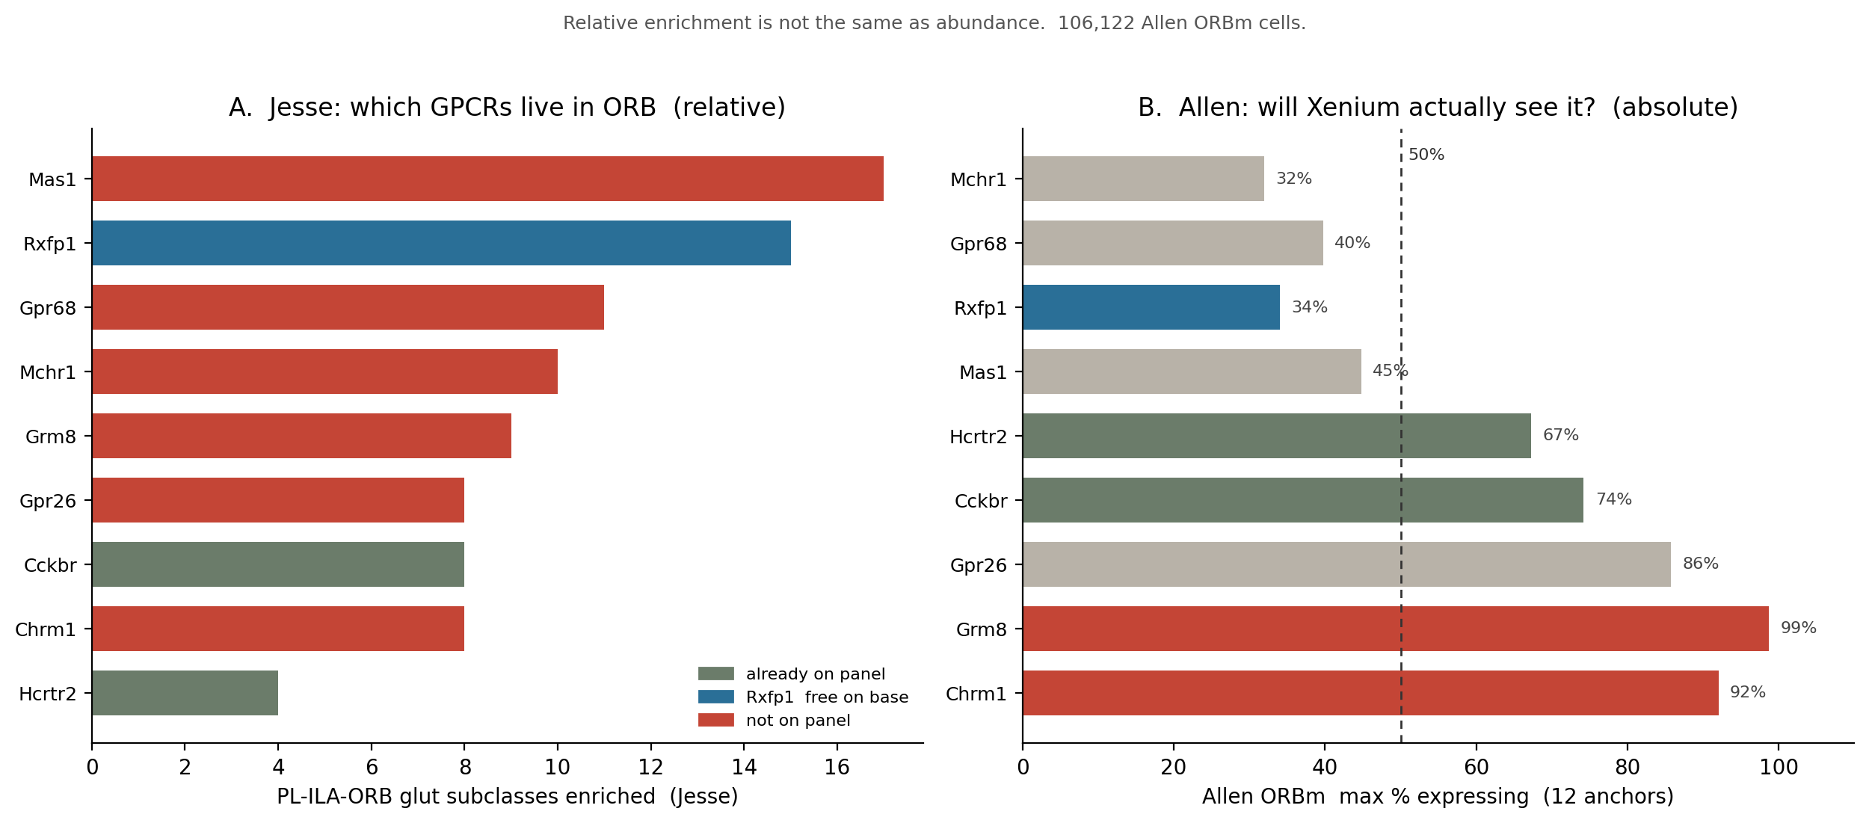
Jesse | how the ORB GPCRs look — relative vs absolute
Left: Jesse's enrichment vs the rest of the atlas. Right: % expressing in 106,122 Allen ORBm cells. These are different questions.
Cckbr and Hcrtr2 are already on the panel and are abundant. Rxfp1 is Jesse's #2 and free on the Xenium base panel (Allen 34%).
Mas1 is Jesse's #1 by enrichment, but only 45% in L5 ET and ~1% in GABA. Chrm1 (92%) and Grm8 (99%) were never in our 40-GPCR pull — they are the genes Xenium will actually see.
ORBm + BMAp Xenium | Jesse Niehaus + Daniel Berg / Scherrer + Allen WMB-10X | 2/4

Slide 3
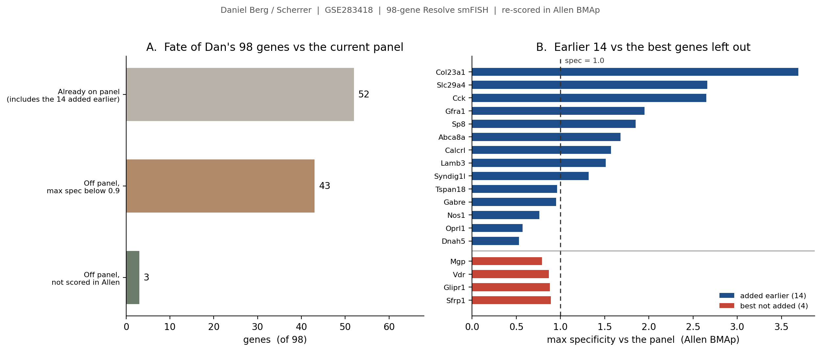
Dan | how the 98-gene spatial panel looks
GSE283418 Resolve smFISH. 52/98 already on the 158-gene sheet. Rule: add only if max_spec > 1.0 (beats a gene we already carry).
Nothing further from Dan. Best leftover is Sfrp1 at spec 0.89. Honest caveat: Nos1 (0.76), Oprl1 (0.57) and Dnah5 (0.53) already on the sheet sit below Sfrp1 / Glipr1 / Vdr. Those three were kept for pharmacology, not specificity.
Glipr1 (0.88) marks true BMAp (113 Ccdc42), but that anchor already has Penk (2.31) and Lamb3 (1.51). Do not add a third, weaker probe.
ORBm + BMAp Xenium | Jesse Niehaus + Daniel Berg / Scherrer + Allen WMB-10X | 3/4

Slide 4
Final decision | genes added to the panel
Jesse DEGs ranked on our 12 anchors + Jesse GPCRs filtered by Allen abundance + Dan stopped at the 14 already on MSGS111.
Decision | Genes | Why (from the figures) | Slots
Already on sheet | Dan 14 + Fos Arc Egr1 Cckbr Hcrtr2 | Cell-type 144 and Dan extras stay. No Dan gene added this round. | done
ADD now | Per2 Pcsk1 Per1 | Slide 1: broadest missing IEGs (11 / 9 / 8 of 12). Morphine-state clock / peptide program. | 3 custom
ADD now | Chrm1 Grm8 Rxfp1 | Slide 2: ORB GPCRs that Allen actually sees (92% / 99% / free 34%). Chrm2 and Grm5 are already on. | 2 + 0
Optional | Camk2g | Slide 1: strongest Down gene, 93% abundant. Add only if you want a direction control. | 1 custom
Free extras | Sema3e Bhlhe40 | On the Xenium base panel. Cheap to curate. Not required for the argument. | 0
Do not add | Arid5b Gadd45a Mas1 Mchr1 more Dan | TF / 1-anchor / low Allen % / spec < 1.0. Spend the slot on Chrm1/Grm8 instead of Arid5b. | —
Final new add: Per2 Pcsk1 Per1 + Chrm1 Grm8 + Rxfp1 (free)
Five custom slots on top of Dan 14 → 119 if every Dan gene is kept. Original cap is 100 — confirm with 10x, or drop CEA-border Dan genes first.
ORBm + BMAp Xenium | Jesse Niehaus + Daniel Berg / Scherrer + Allen WMB-10X | 4/4

