Slide 1
Crystal skull Ca2+ imaging + face poking | 2025-08-13

Slide 2
Every movie is a face-poking session.

Slide 3
There is no baseline (no-poke) recording.

Slide 4
s00 and s01 are the same experiment, recorded twice.

Slide 5
s00 = 8.38 mW/cm2

Slide 6
s01 = 20 mW/cm2

Slide 7
mirror1 and mirror2 are two optical paths (two FOVs at once).

Slide 8
No behavior camera.

Slide 9
Poke time is inferred from mean-frame intensity peaks.

Slide 10
Traces are aligned to peak_idx (t = 0).

Slide 11
peak_idx is the brightness peak — not proven as contact onset.

Slide 12
EXTRACT traces: 33 Hz, full rate.

Slide 13
Window around each poke: -2 s to +3 s.

Slide 14
Test: activity in 0.4–1.2 s vs -2–0 s (signed-rank).

Slide 15
Excited = up after poke. Inhibited = down after poke.

Slide 16
Fig4 is a session-mean picture of the FOV.

Slide 17
Fig4 does not show which neurons responded to poking.

Slide 18
A true region map needs spatial footprints from Omer.

Slide 19
All recordings together

Slide 20

Fig1 Population PSTH | all movies

Slide 21

Fig2 Neuron STA heatmap | all movies

Slide 22

Fig3 Excited vs inhibited cells | all movies

Slide 23
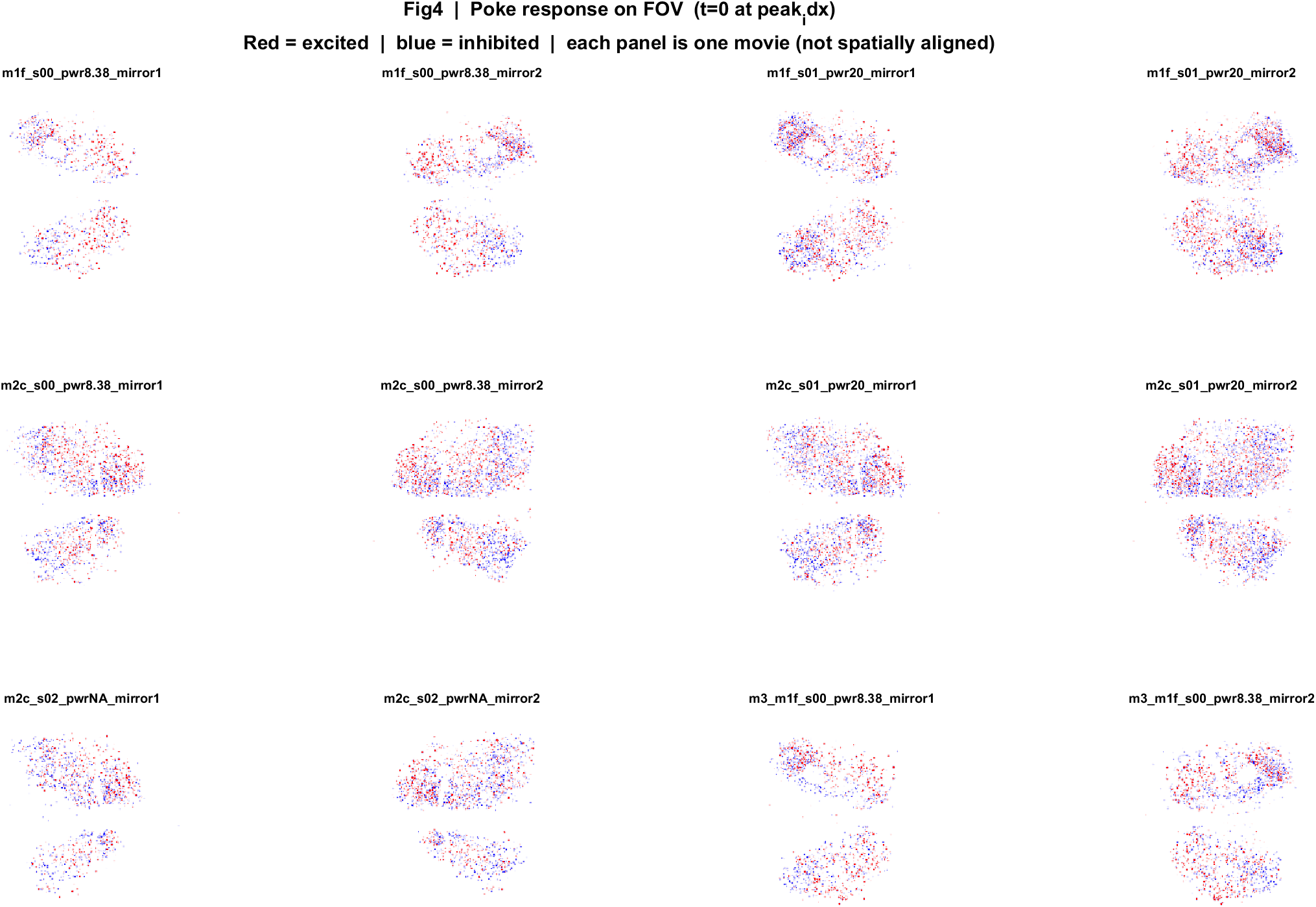
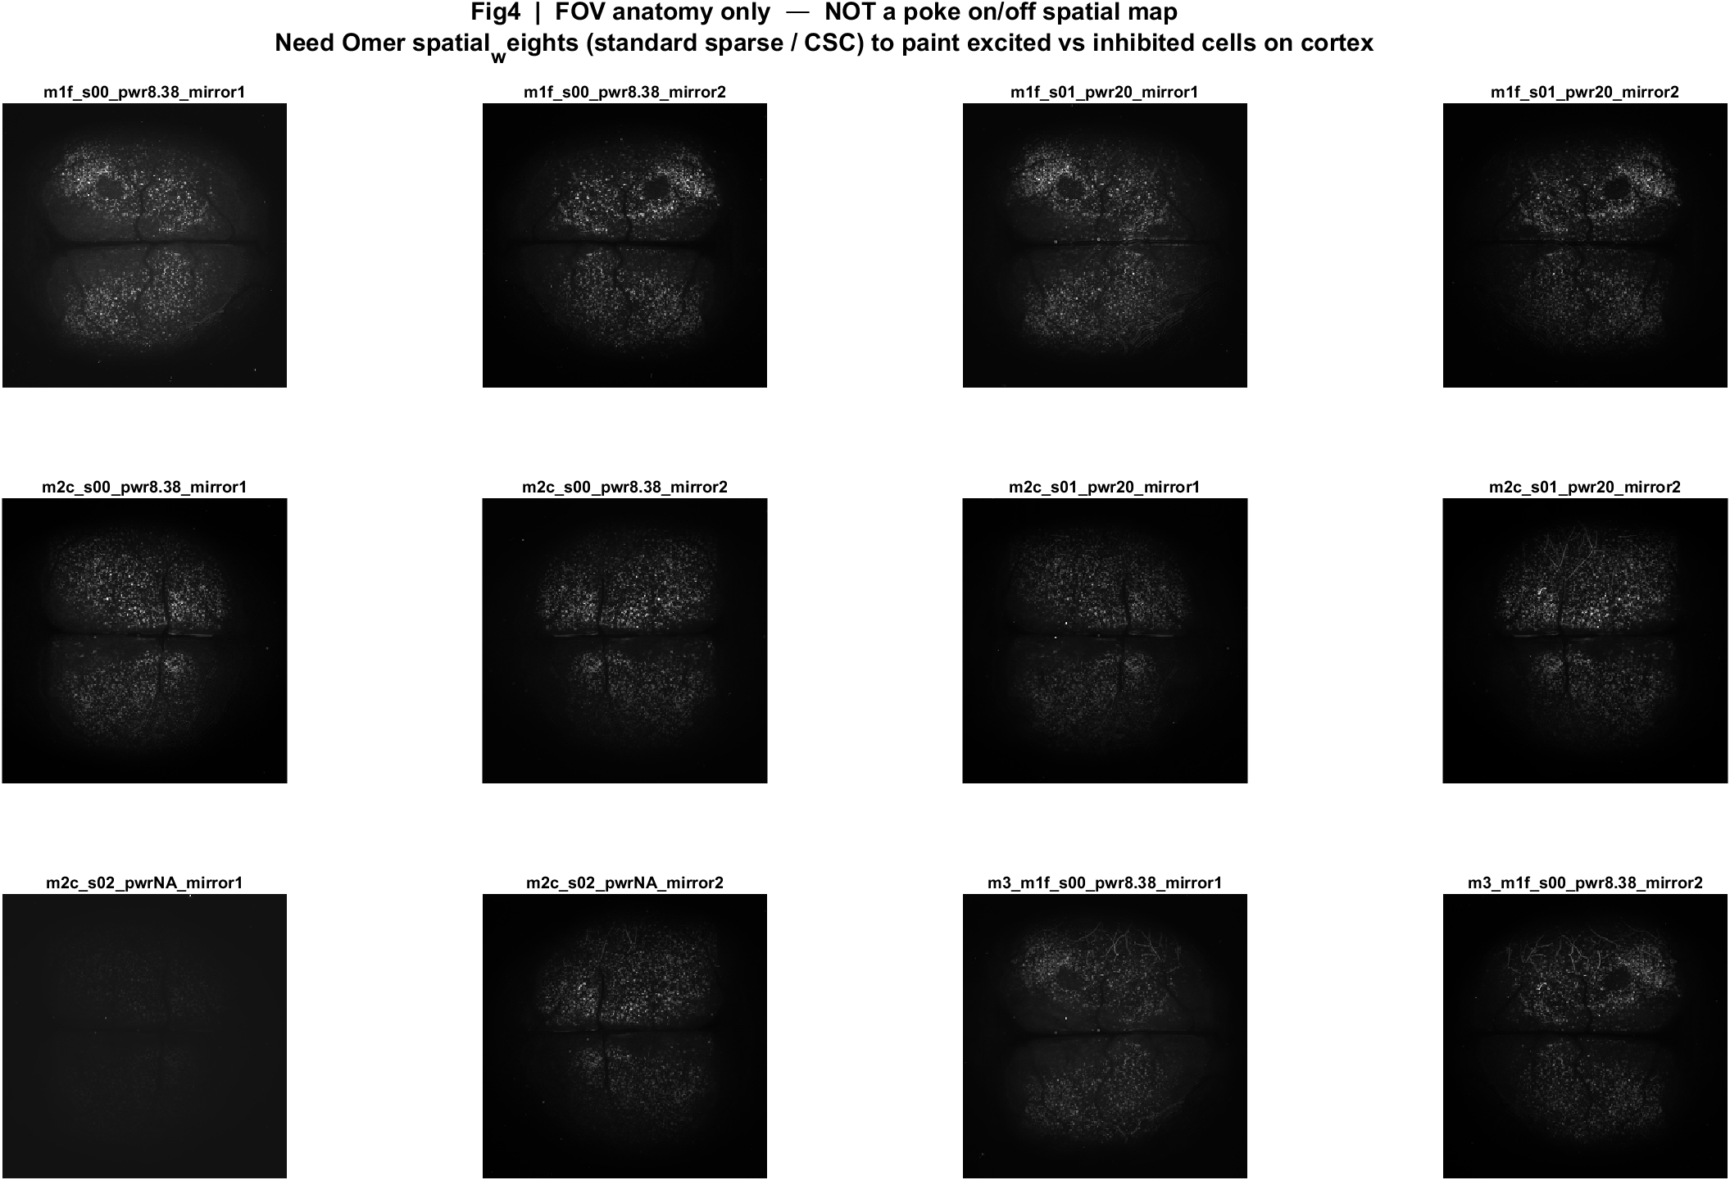
Fig4 FOV anatomy (not a poke-response map) | all movies

Slide 24

Fig5 Trial raster and poke interval | all movies

Slide 25
mouse1f s00 8.38 mW/cm2 mirror1

Slide 26

Fig1 Population PSTH | mouse1f s00 8.38 mW/cm2 mirror1

Slide 27

Fig2 Neuron STA heatmap | mouse1f s00 8.38 mW/cm2 mirror1

Slide 28

Fig3 Excited vs inhibited cells | mouse1f s00 8.38 mW/cm2 mirror1

Slide 29
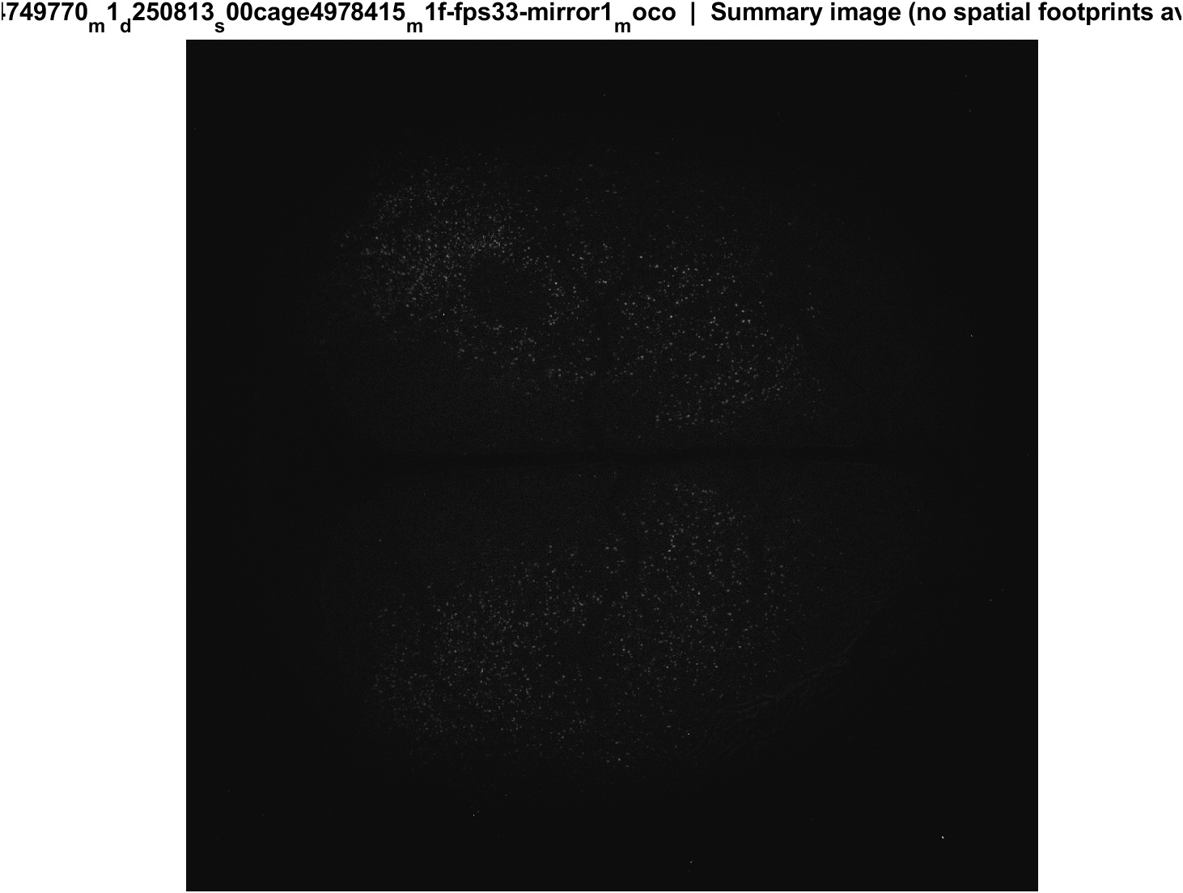
Fig4 FOV anatomy (not a poke-response map) | mouse1f s00 8.38 mW/cm2 mirror1

Slide 30

Fig5 Trial raster and poke interval | mouse1f s00 8.38 mW/cm2 mirror1

Slide 31
mouse1f s00 8.38 mW/cm2 mirror2

Slide 32

Fig1 Population PSTH | mouse1f s00 8.38 mW/cm2 mirror2

Slide 33

Fig2 Neuron STA heatmap | mouse1f s00 8.38 mW/cm2 mirror2

Slide 34

Fig3 Excited vs inhibited cells | mouse1f s00 8.38 mW/cm2 mirror2

Slide 35
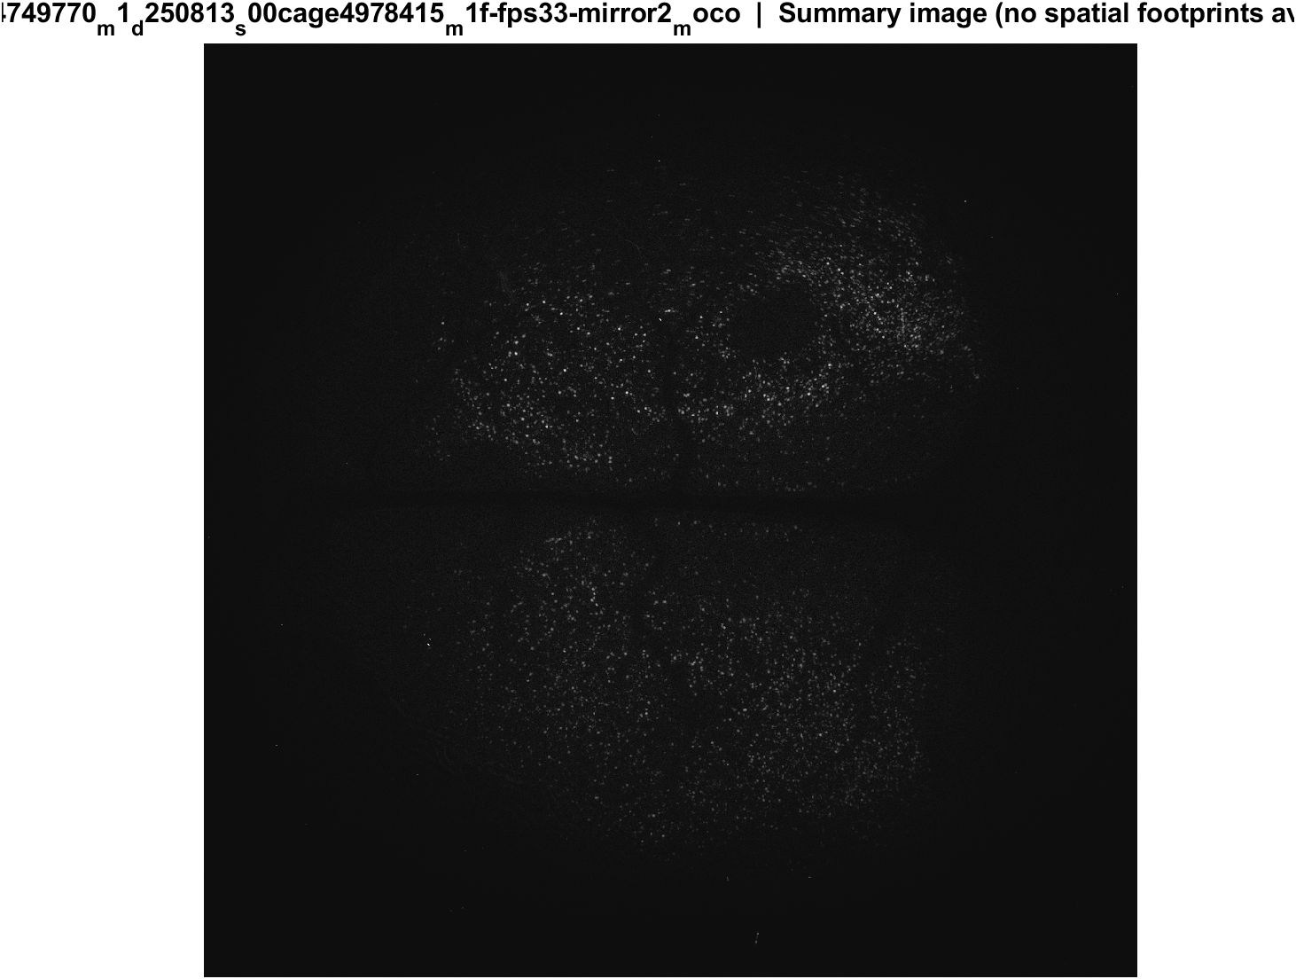
Fig4 FOV anatomy (not a poke-response map) | mouse1f s00 8.38 mW/cm2 mirror2

Slide 36

Fig5 Trial raster and poke interval | mouse1f s00 8.38 mW/cm2 mirror2

Slide 37
mouse1f s01 20 mW/cm2 mirror1

Slide 38

Fig1 Population PSTH | mouse1f s01 20 mW/cm2 mirror1

Slide 39

Fig2 Neuron STA heatmap | mouse1f s01 20 mW/cm2 mirror1

Slide 40

Fig3 Excited vs inhibited cells | mouse1f s01 20 mW/cm2 mirror1

Slide 41
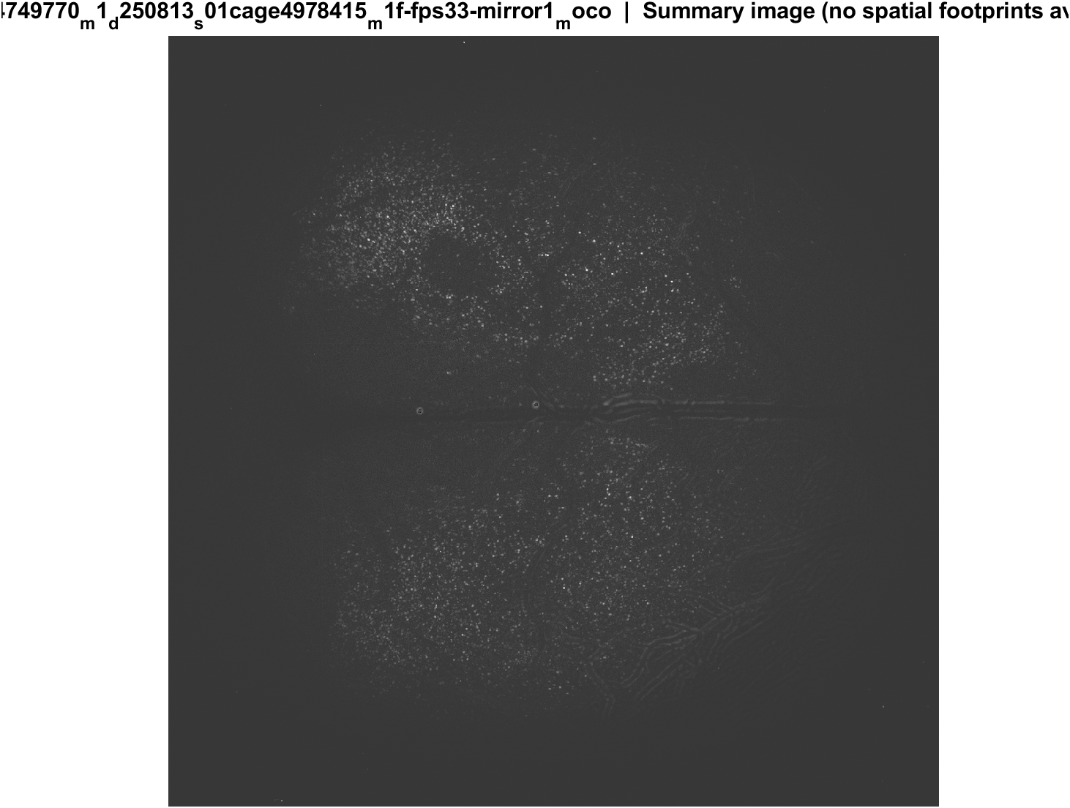
Fig4 FOV anatomy (not a poke-response map) | mouse1f s01 20 mW/cm2 mirror1

Slide 42

Fig5 Trial raster and poke interval | mouse1f s01 20 mW/cm2 mirror1

Slide 43
mouse1f s01 20 mW/cm2 mirror2

Slide 44

Fig1 Population PSTH | mouse1f s01 20 mW/cm2 mirror2

Slide 45

Fig2 Neuron STA heatmap | mouse1f s01 20 mW/cm2 mirror2

Slide 46

Fig3 Excited vs inhibited cells | mouse1f s01 20 mW/cm2 mirror2

Slide 47
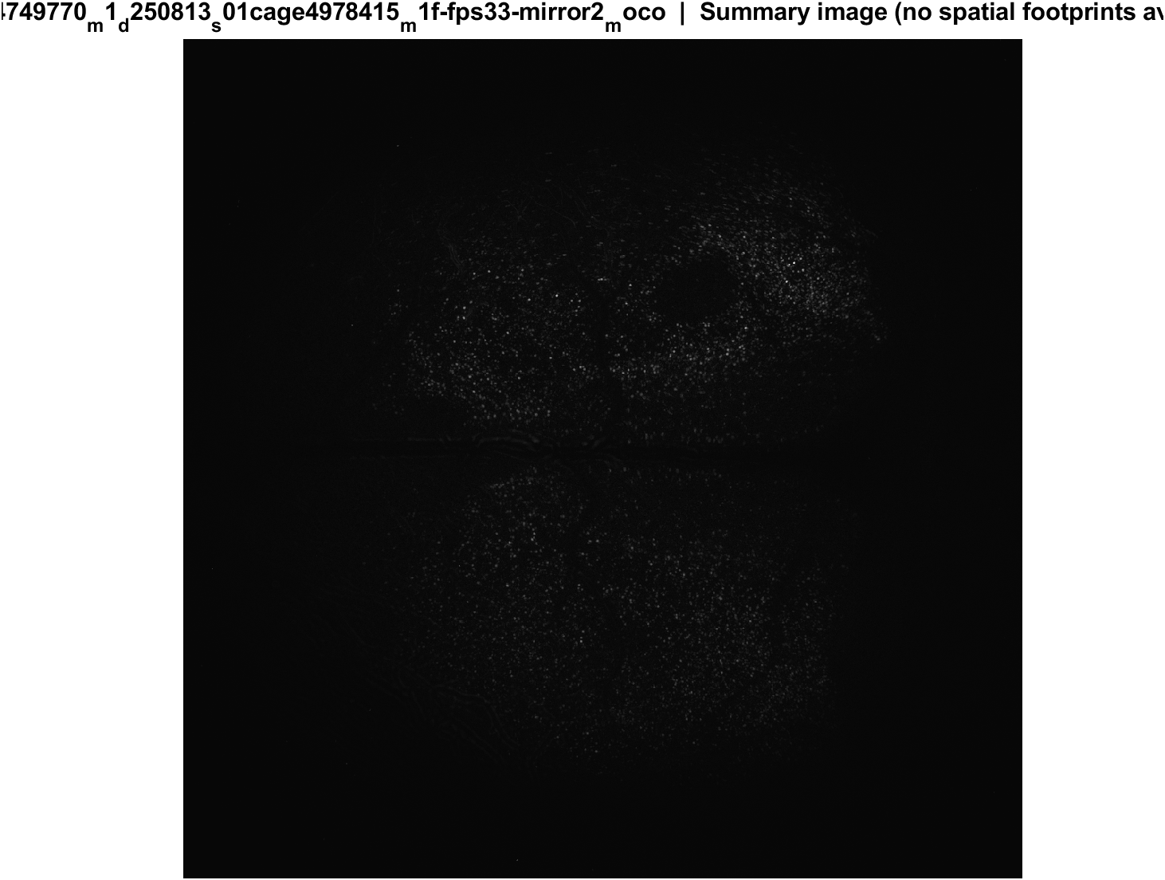
Fig4 FOV anatomy (not a poke-response map) | mouse1f s01 20 mW/cm2 mirror2

Slide 48

Fig5 Trial raster and poke interval | mouse1f s01 20 mW/cm2 mirror2

Slide 49
mouse2c s00 8.38 mW/cm2 mirror1

Slide 50

Fig1 Population PSTH | mouse2c s00 8.38 mW/cm2 mirror1

Slide 51

Fig2 Neuron STA heatmap | mouse2c s00 8.38 mW/cm2 mirror1

Slide 52

Fig3 Excited vs inhibited cells | mouse2c s00 8.38 mW/cm2 mirror1

Slide 53
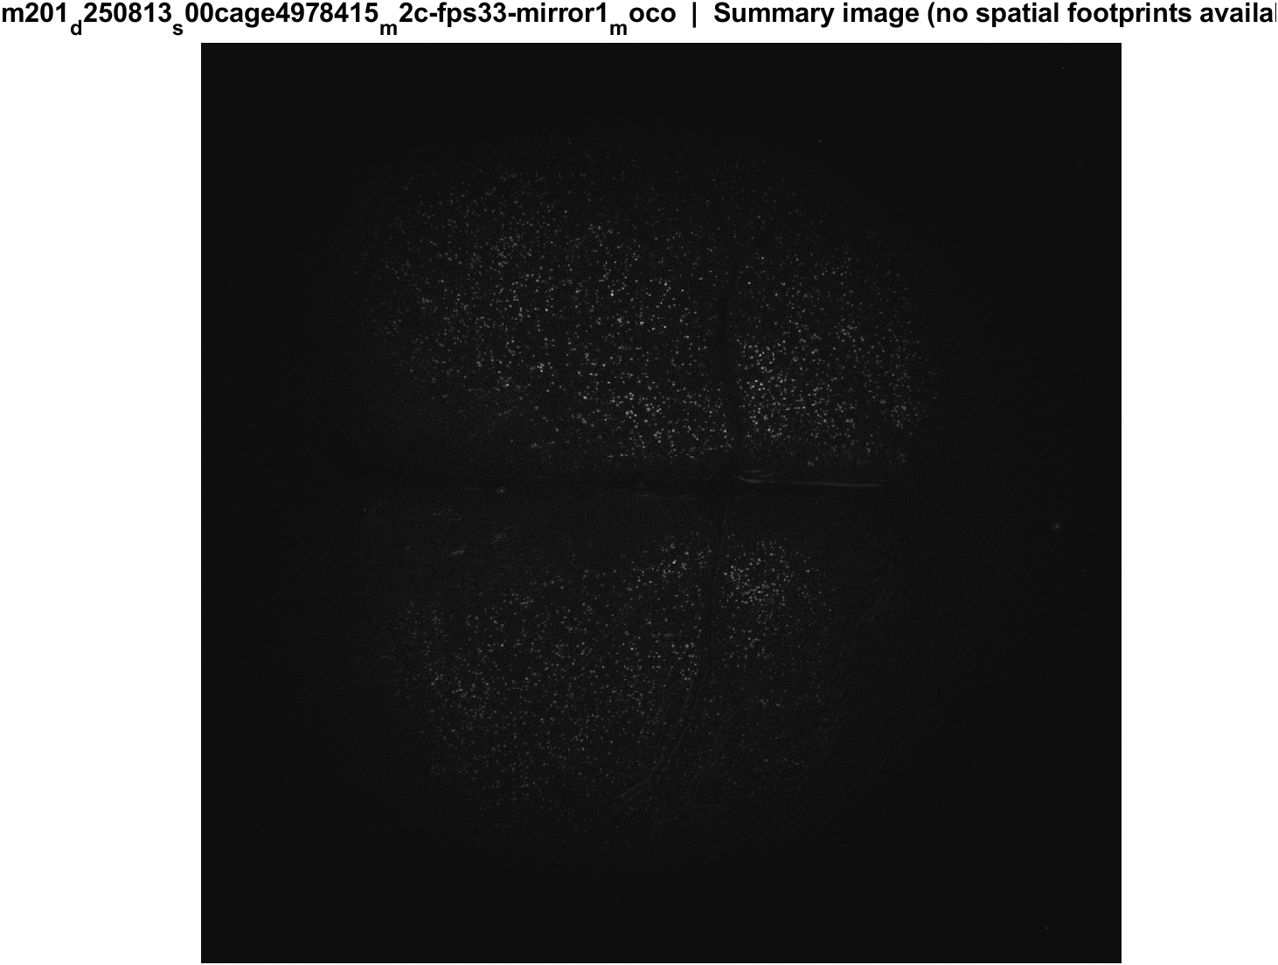
Fig4 FOV anatomy (not a poke-response map) | mouse2c s00 8.38 mW/cm2 mirror1

Slide 54

Fig5 Trial raster and poke interval | mouse2c s00 8.38 mW/cm2 mirror1

Slide 55
mouse2c s00 8.38 mW/cm2 mirror2

Slide 56

Fig1 Population PSTH | mouse2c s00 8.38 mW/cm2 mirror2

Slide 57

Fig2 Neuron STA heatmap | mouse2c s00 8.38 mW/cm2 mirror2

Slide 58

Fig3 Excited vs inhibited cells | mouse2c s00 8.38 mW/cm2 mirror2

Slide 59
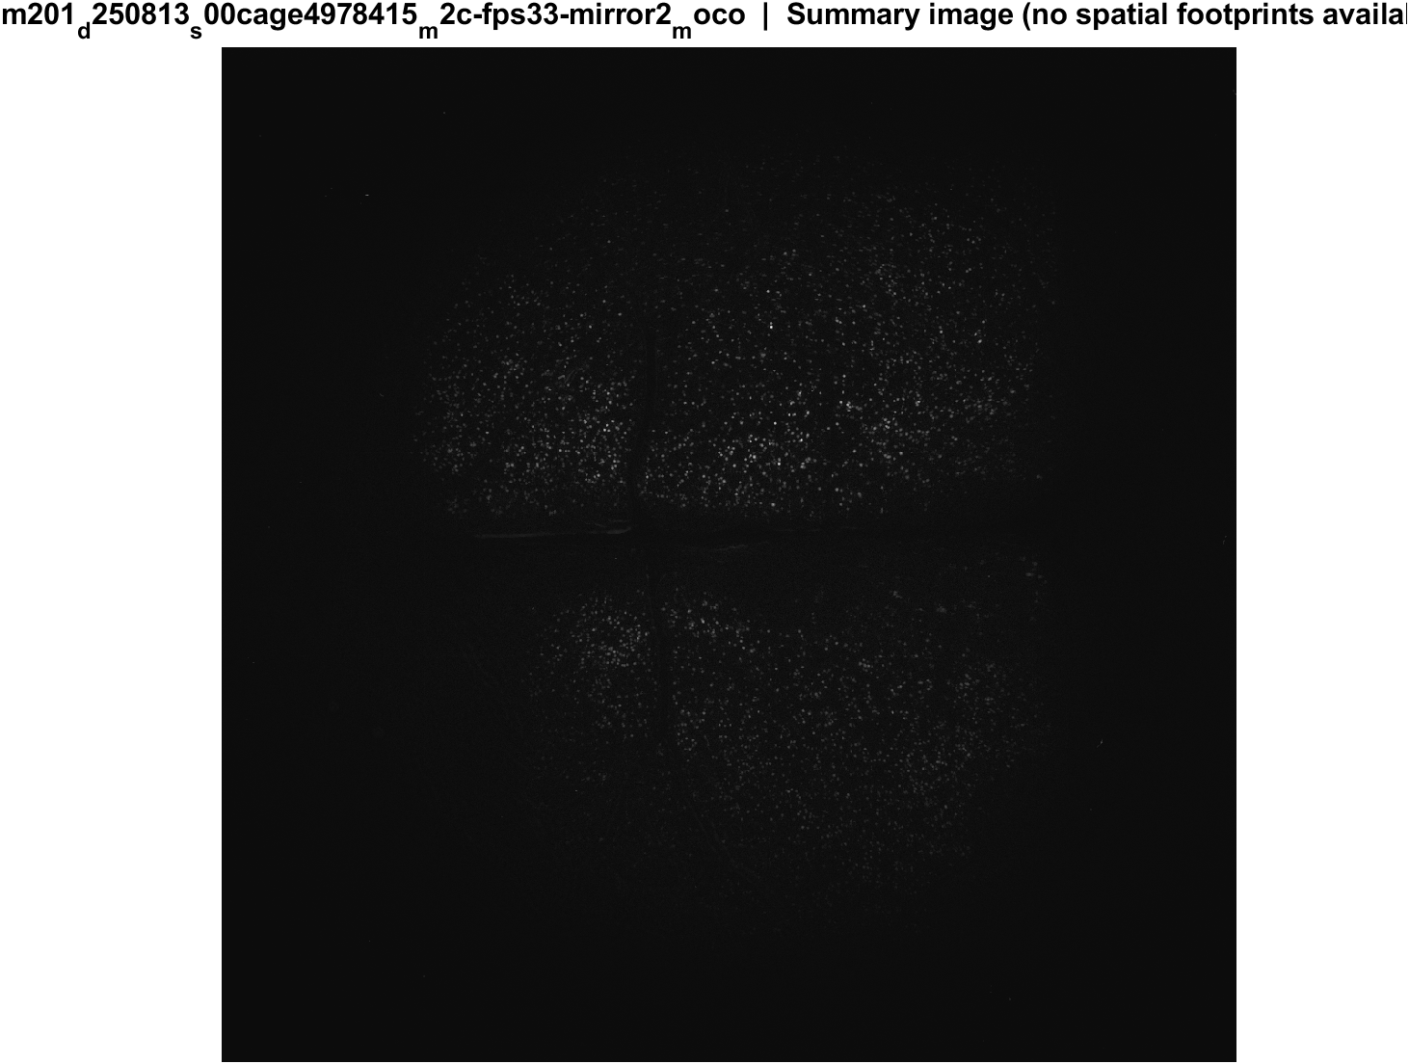
Fig4 FOV anatomy (not a poke-response map) | mouse2c s00 8.38 mW/cm2 mirror2

Slide 60

Fig5 Trial raster and poke interval | mouse2c s00 8.38 mW/cm2 mirror2

Slide 61
mouse2c s01 20 mW/cm2 mirror1

Slide 62

Fig1 Population PSTH | mouse2c s01 20 mW/cm2 mirror1

Slide 63

Fig2 Neuron STA heatmap | mouse2c s01 20 mW/cm2 mirror1

Slide 64

Fig3 Excited vs inhibited cells | mouse2c s01 20 mW/cm2 mirror1

Slide 65
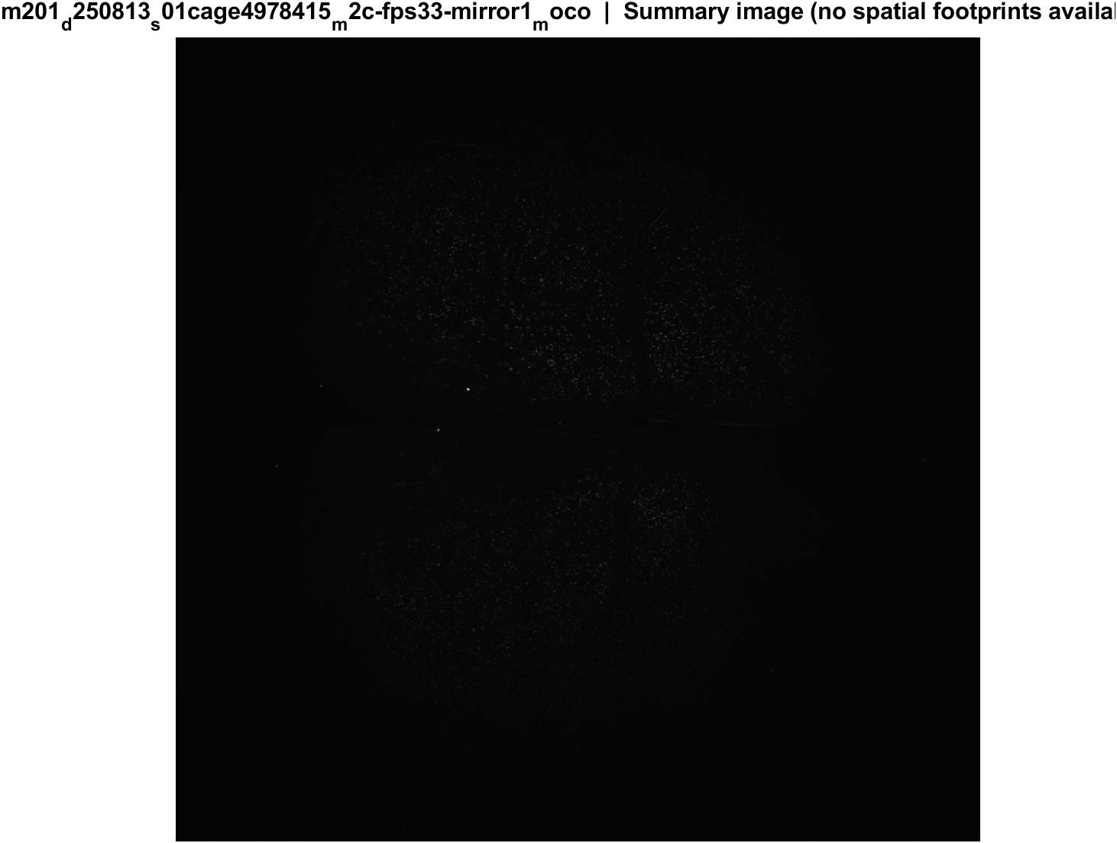
Fig4 FOV anatomy (not a poke-response map) | mouse2c s01 20 mW/cm2 mirror1

Slide 66

Fig5 Trial raster and poke interval | mouse2c s01 20 mW/cm2 mirror1

Slide 67
mouse2c s01 20 mW/cm2 mirror2

Slide 68

Fig1 Population PSTH | mouse2c s01 20 mW/cm2 mirror2

Slide 69

Fig2 Neuron STA heatmap | mouse2c s01 20 mW/cm2 mirror2

Slide 70

Fig3 Excited vs inhibited cells | mouse2c s01 20 mW/cm2 mirror2

Slide 71
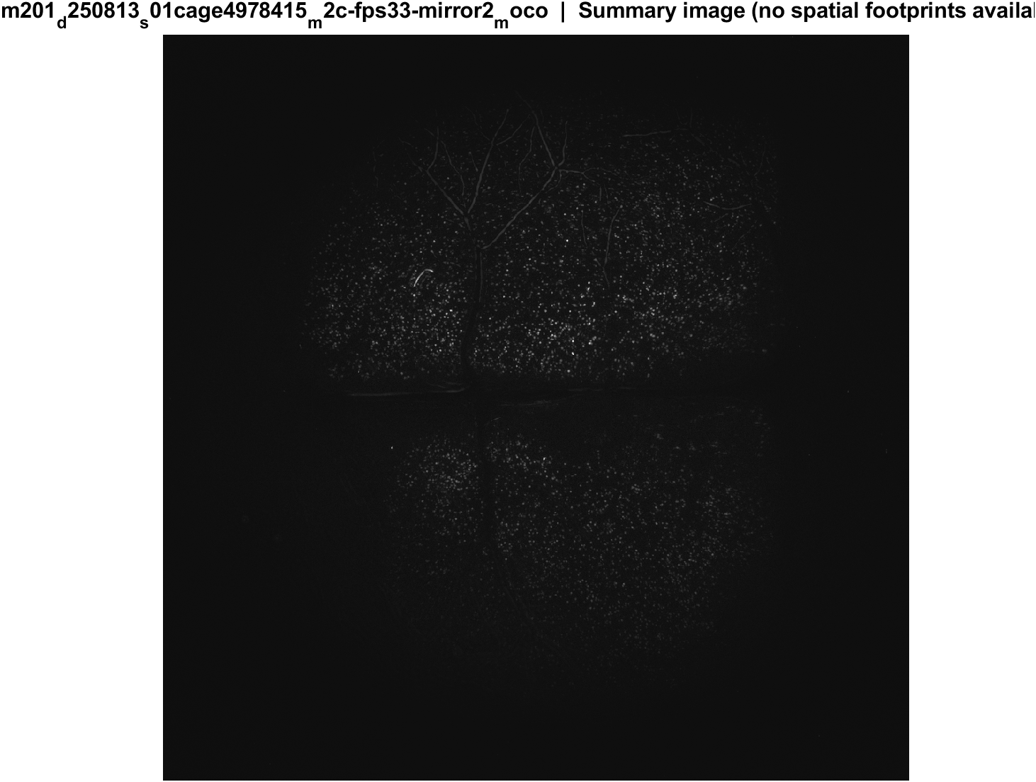
Fig4 FOV anatomy (not a poke-response map) | mouse2c s01 20 mW/cm2 mirror2

Slide 72

Fig5 Trial raster and poke interval | mouse2c s01 20 mW/cm2 mirror2

Slide 73
mouse2c s02 power TBD mirror1

Slide 74

Fig1 Population PSTH | mouse2c s02 power TBD mirror1

Slide 75

Fig2 Neuron STA heatmap | mouse2c s02 power TBD mirror1

Slide 76

Fig3 Excited vs inhibited cells | mouse2c s02 power TBD mirror1

Slide 77

Fig4 FOV anatomy (not a poke-response map) | mouse2c s02 power TBD mirror1

Slide 78

Fig5 Trial raster and poke interval | mouse2c s02 power TBD mirror1

Slide 79
mouse2c s02 power TBD mirror2

Slide 80

Fig1 Population PSTH | mouse2c s02 power TBD mirror2

Slide 81

Fig2 Neuron STA heatmap | mouse2c s02 power TBD mirror2

Slide 82

Fig3 Excited vs inhibited cells | mouse2c s02 power TBD mirror2

Slide 83

Fig4 FOV anatomy (not a poke-response map) | mouse2c s02 power TBD mirror2

Slide 84

Fig5 Trial raster and poke interval | mouse2c s02 power TBD mirror2

Slide 85
m3 (LabVIEW m1f) s00 mirror1

Slide 86

Fig1 Population PSTH | m3 (LabVIEW m1f) s00 mirror1

Slide 87

Fig2 Neuron STA heatmap | m3 (LabVIEW m1f) s00 mirror1

Slide 88

Fig3 Excited vs inhibited cells | m3 (LabVIEW m1f) s00 mirror1

Slide 89

Fig4 FOV anatomy (not a poke-response map) | m3 (LabVIEW m1f) s00 mirror1

Slide 90

Fig5 Trial raster and poke interval | m3 (LabVIEW m1f) s00 mirror1

Slide 91
m3 (LabVIEW m1f) s00 mirror2

Slide 92

Fig1 Population PSTH | m3 (LabVIEW m1f) s00 mirror2

Slide 93

Fig2 Neuron STA heatmap | m3 (LabVIEW m1f) s00 mirror2

Slide 94

Fig3 Excited vs inhibited cells | m3 (LabVIEW m1f) s00 mirror2

Slide 95

Fig4 FOV anatomy (not a poke-response map) | m3 (LabVIEW m1f) s00 mirror2

Slide 96

Fig5 Trial raster and poke interval | m3 (LabVIEW m1f) s00 mirror2

Slide 97
Next: spatial footprints → which cortical regions respond.

