Slide 1
Face poking on crystal skull
2025-08-13 | t = 0 at peak_post_idx (minimum after the brightness peak) | window 0.4–1.2 s vs -2–0 s
Take-home: the neural response happens before this t = 0, so post is a poor onset; the maps still show where significant cells sit.

Slide 2
Experiment
Whole dorsal cortex Ca2+ imaging while a motor arm pokes the face. Every movie on this day is a poking session — there is no no-poke baseline.

Slide 3
Two recordings of the same experiment
s00 = 8.38 mW/cm2, s01 = 20 mW/cm2. mirror1 and mirror2 are two optical paths (two FOVs at the same time).

Slide 4
How poke time is defined
No behavior camera. A blocker on the arm changes mean-frame intensity. t = 0 is peak_post_idx: the intensity minimum just after the positive brightness peak (candidate offset of the light change).

Slide 5
How traces are analyzed
EXTRACT traces at 33 Hz. Cut -2 to +3 s around each poke. A cell is excited or inhibited if 0.4–1.2 s differs from -2–0 s (Wilcoxon signed-rank, p<0.05).

Slide 6
How the spatial map is made
EXTRACT spatial footprints were reconstructed from the file (ndSparse CSC). Each cell’s post−pre z is painted on its footprint. Red = excited, blue = inhibited.

Slide 7
All recordings together
12 movies | t = 0 is peak_post_idx (after the brightness peak)

Slide 8
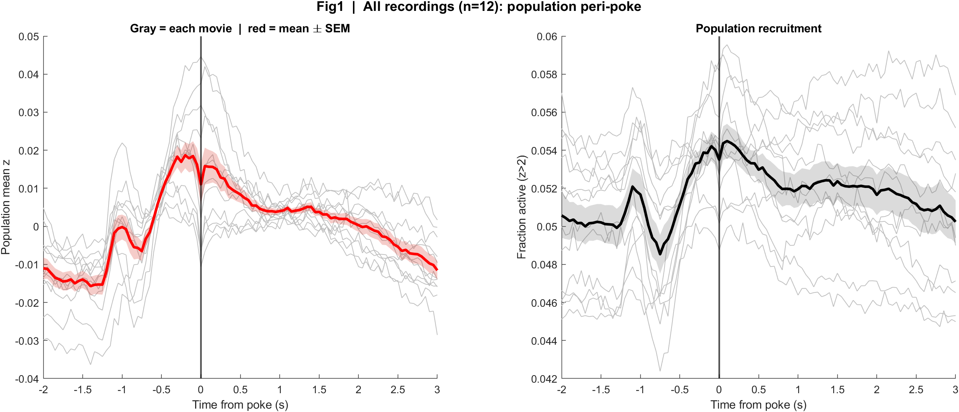
Fig1 Population PSTH | all movies
What: Mean population activity (z-score) and fraction of active cells, aligned to each poke (t = 0 is peak_post_idx).
Result: The main rise is before t = 0 (~0.75 s earlier, at the brightness peak); at t = 0 activity dips, then slowly returns — this marker is after the neural event.

Slide 9
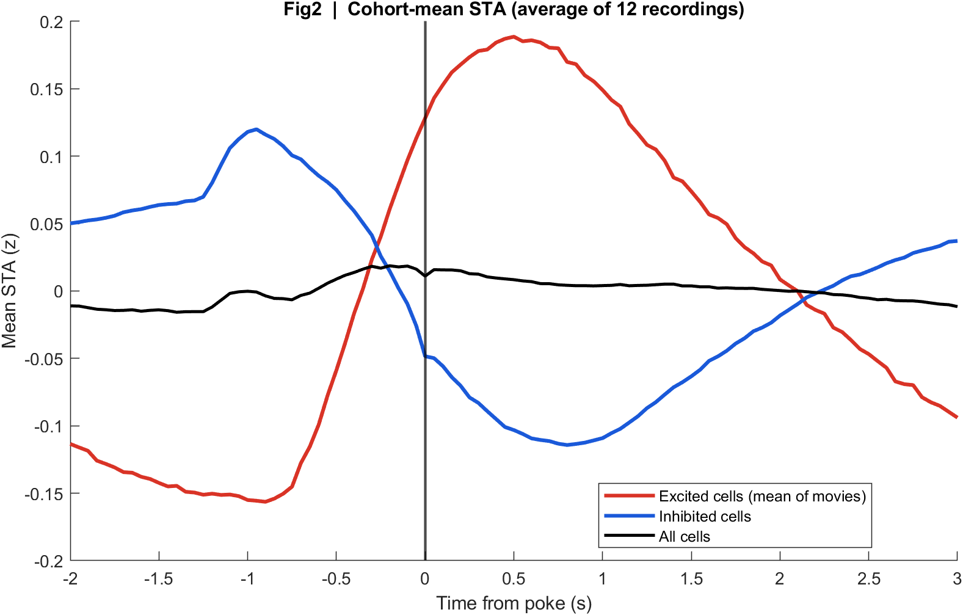
Fig2 Neuron STA | all movies
What: Each neuron’s average trace around the poke, sorted by response size; right panel is the mean of excited vs inhibited cells.
Result: Excited and inhibited groups still split, but their peaks sit before t = 0, so this alignment smears the response into the baseline window.

Slide 10
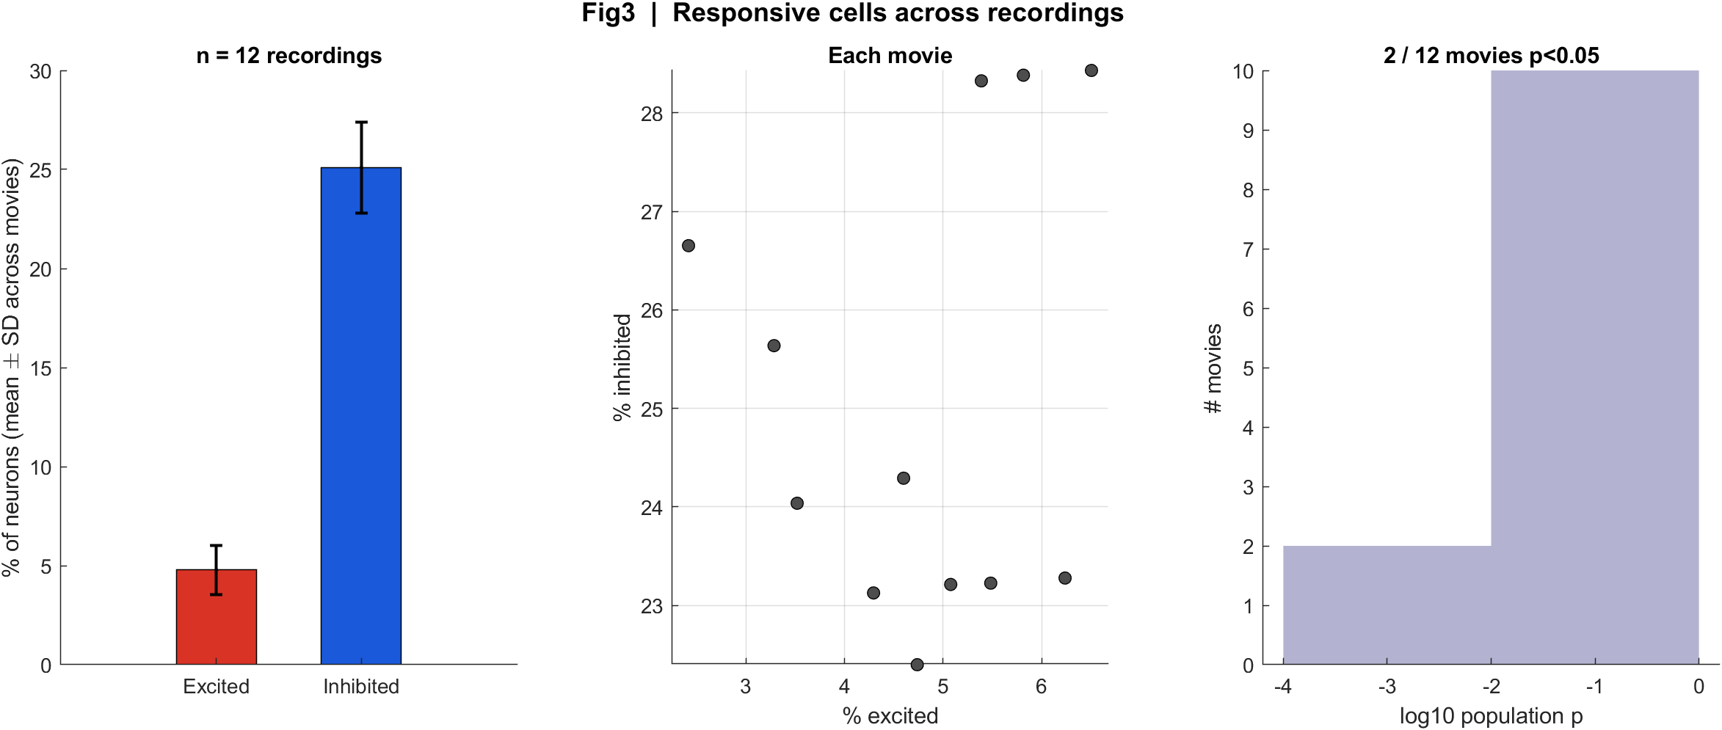
Fig3 Excited vs inhibited cells | all movies
What: Per neuron: mean z in 0.4–1.2 s after t=0 vs -2–0 s before; signed-rank, p<0.05, sign of the difference.
Result: Only 2 of 12 movies pass the population test; excited fraction is low (~2–6%) because the real response is mostly before t = 0.

Slide 11
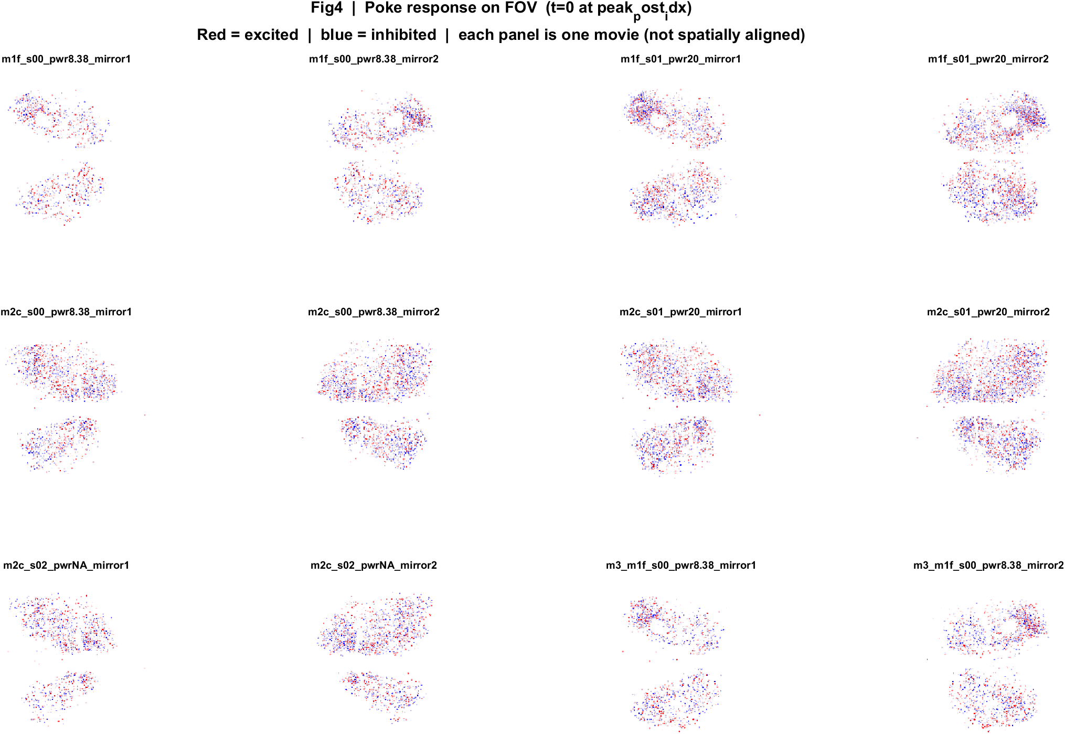
Fig4 Spatial poke-response map | all movies
What: Each neuron’s post−pre amplitude is painted onto its EXTRACT footprint. Red = excited, blue = inhibited. Left: anatomy. Middle: all cells. Right: p<0.05 only.
Result: Excited and inhibited cells are intermingled across dorsal cortex; there is no single on-or-off region in these unaligned FOVs.

Slide 12
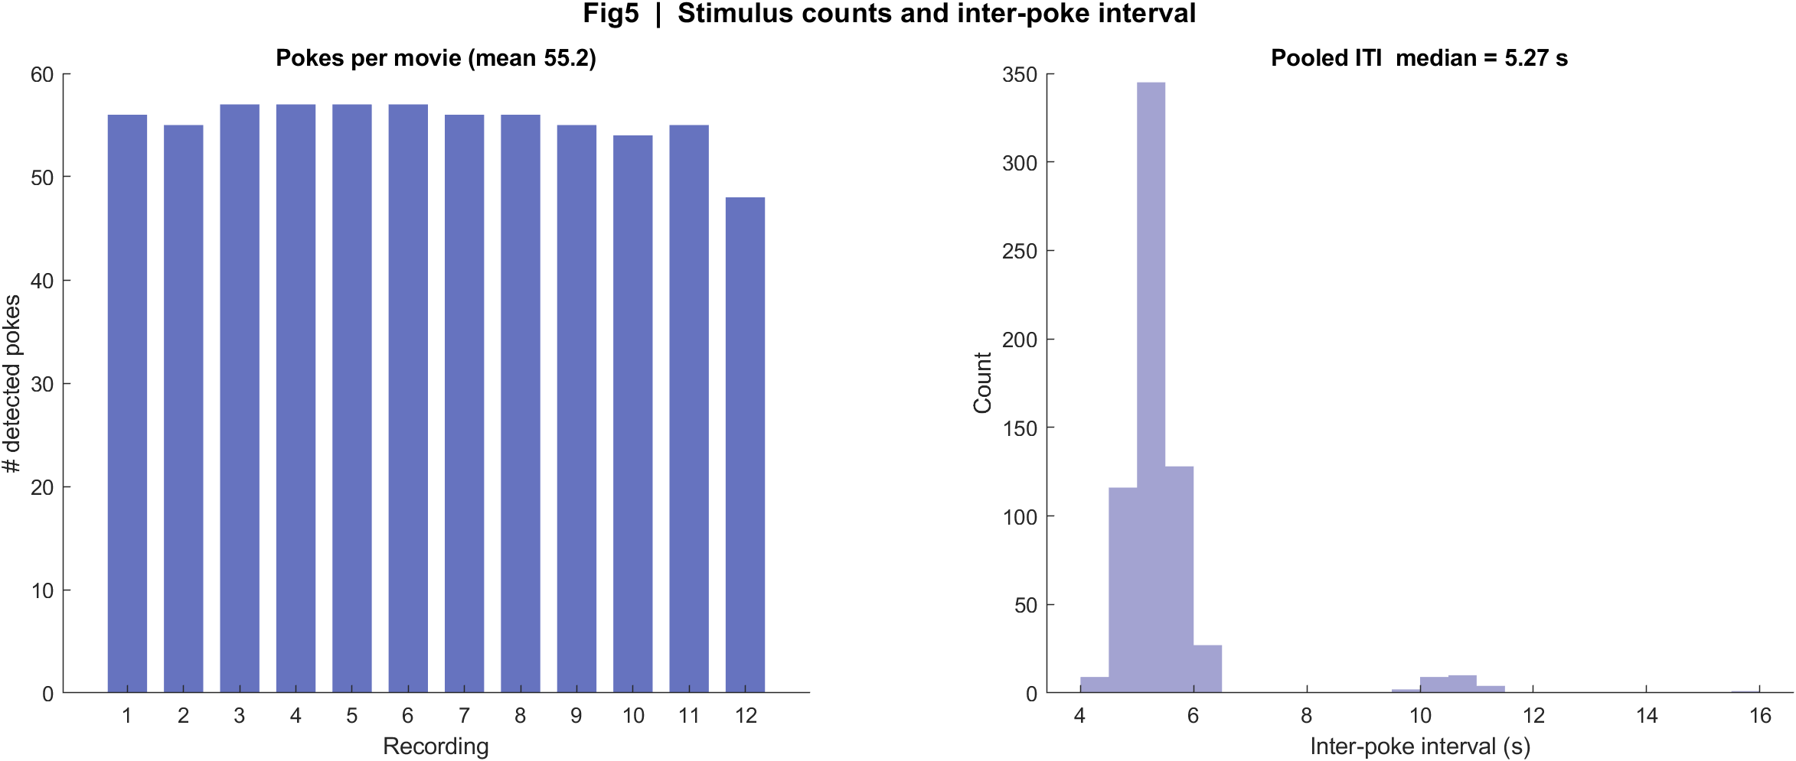
Fig5 Trial raster and poke interval | all movies
What: One row per poke (population z over time) and the histogram of time between detected pokes.
Result: About 48–57 pokes per movie; median interval is 5.3 s (set to 3 s, with mechanical jitter). Long gaps are missed peaks.

Slide 13
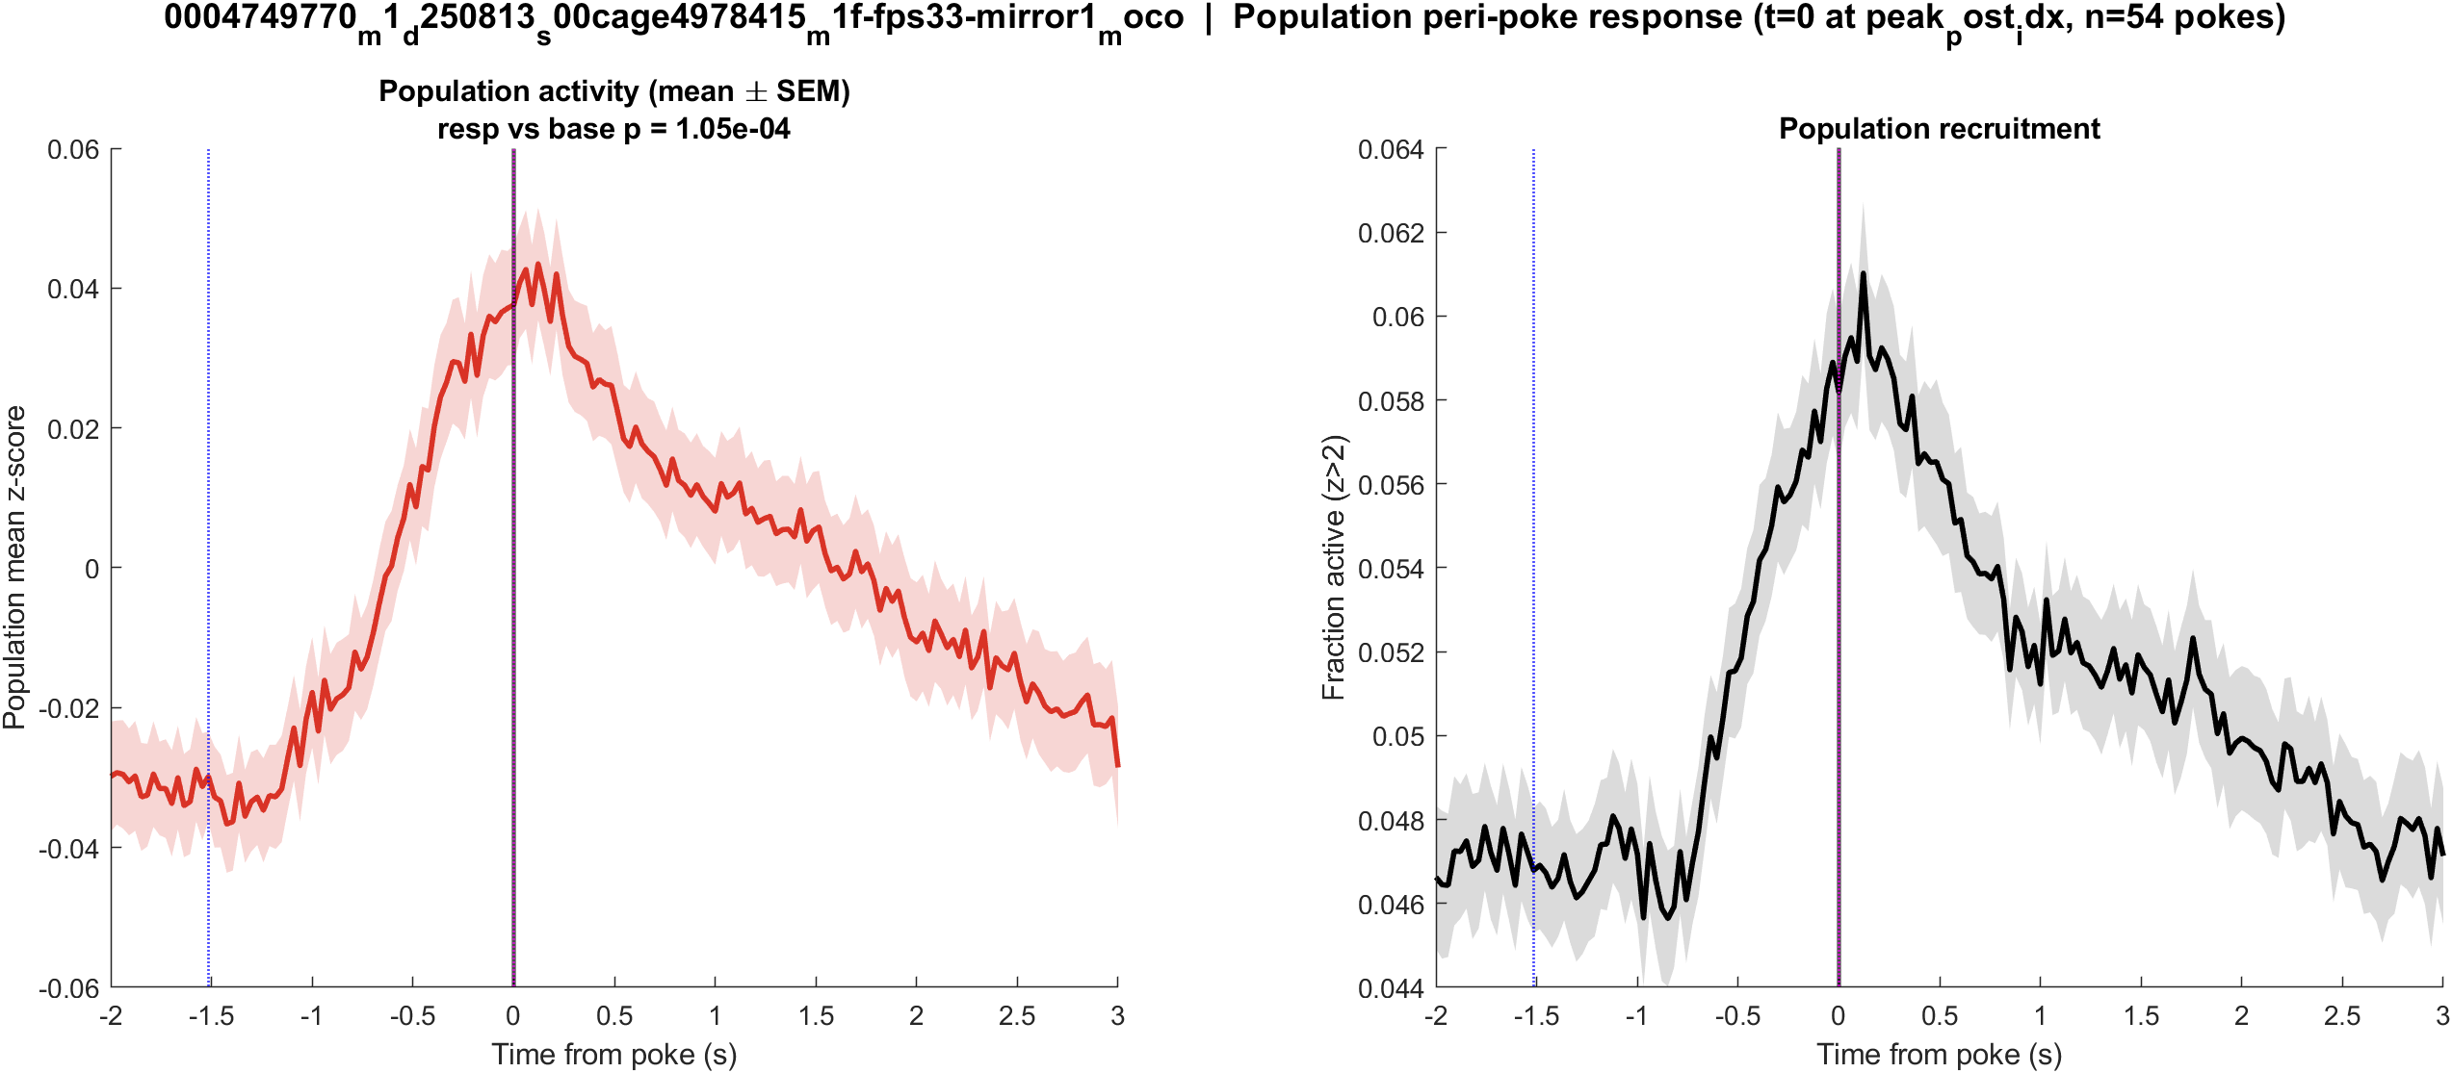
Fig1 Population PSTH | mouse1f s00 8.38 mW/cm2 mirror1
What: Mean population activity (z-score) and fraction of active cells, aligned to each poke (t = 0 is peak_post_idx).
Result: This FOV has 1240 neurons and 56 pokes; the population pre vs post test is significant (p = 1.0e-04).

Slide 14
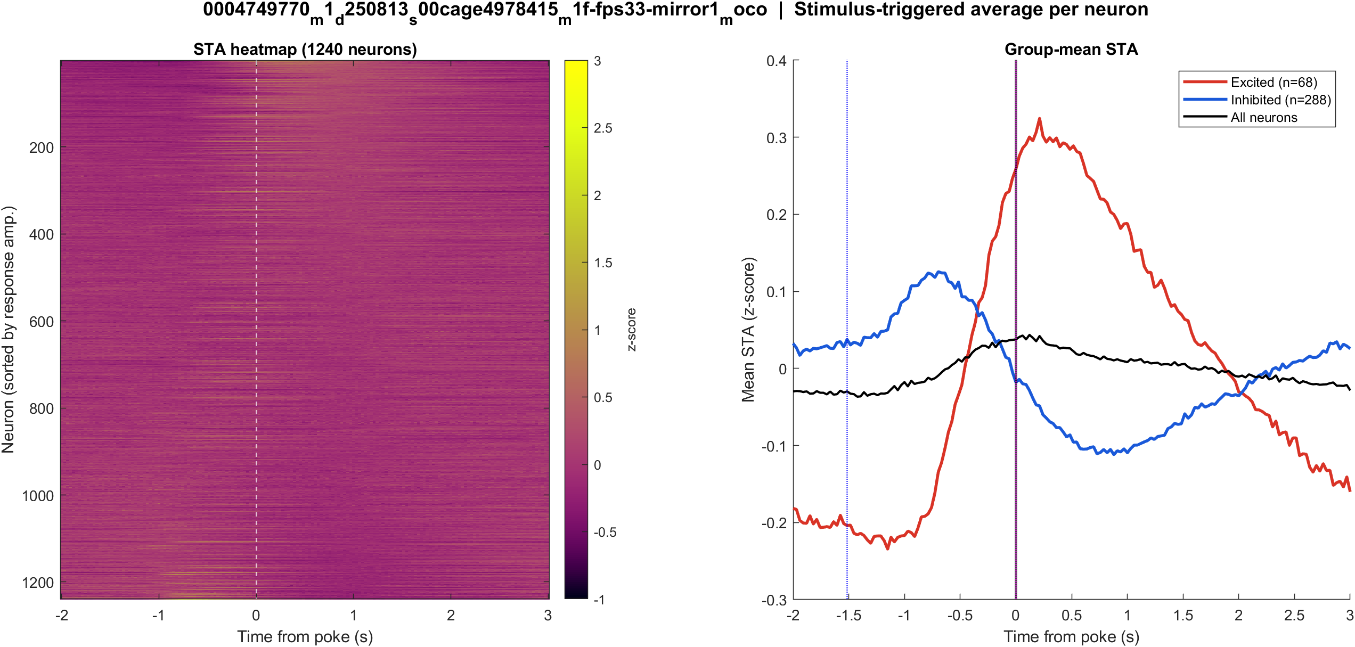
Fig2 Neuron STA | mouse1f s00 8.38 mW/cm2 mirror1
What: Each neuron’s average trace around the poke, sorted by response size; right panel is the mean of excited vs inhibited cells.
Result: Excited 5.5% and inhibited 23.2% of 1240 neurons; see the STA split on the right.

Slide 15
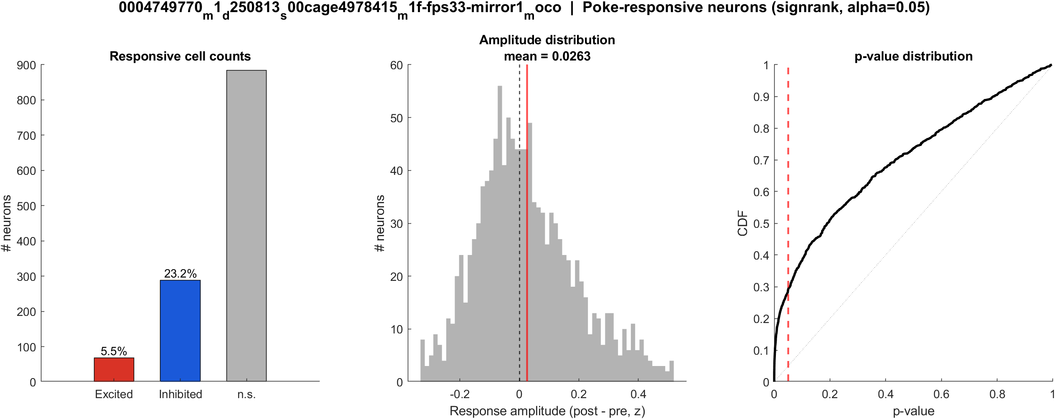
Fig3 Excited vs inhibited cells | mouse1f s00 8.38 mW/cm2 mirror1
What: Per neuron: mean z in 0.4–1.2 s after t=0 vs -2–0 s before; signed-rank, p<0.05, sign of the difference.
Result: 5.5% excited, 23.2% inhibited out of 1240 neurons; population test significant (p = 1.0e-04).

Slide 16

Fig4 Spatial poke-response map | mouse1f s00 8.38 mW/cm2 mirror1
What: Each neuron’s post−pre amplitude is painted onto its EXTRACT footprint. Red = excited, blue = inhibited. Left: anatomy. Middle: all cells. Right: p<0.05 only.
Result: Red = excited, blue = inhibited on this FOV (5.5% exc, 23.2% inh of 1240 neurons).

Slide 17
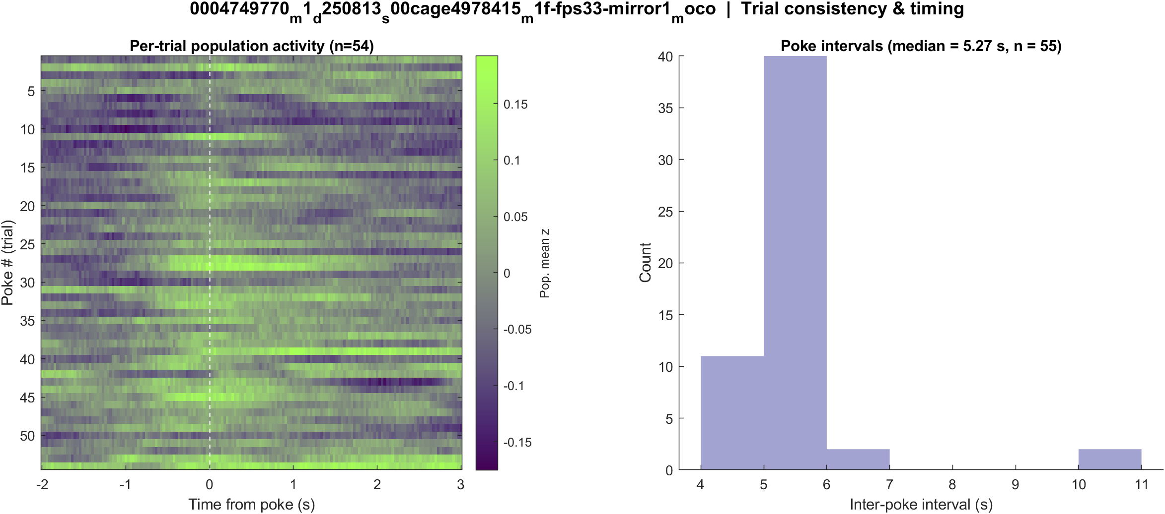
Fig5 Trial raster and poke interval | mouse1f s00 8.38 mW/cm2 mirror1
What: One row per poke (population z over time) and the histogram of time between detected pokes.
Result: 56 pokes detected in this movie; intervals near 5.3 s, with occasional missed peaks.

Slide 18
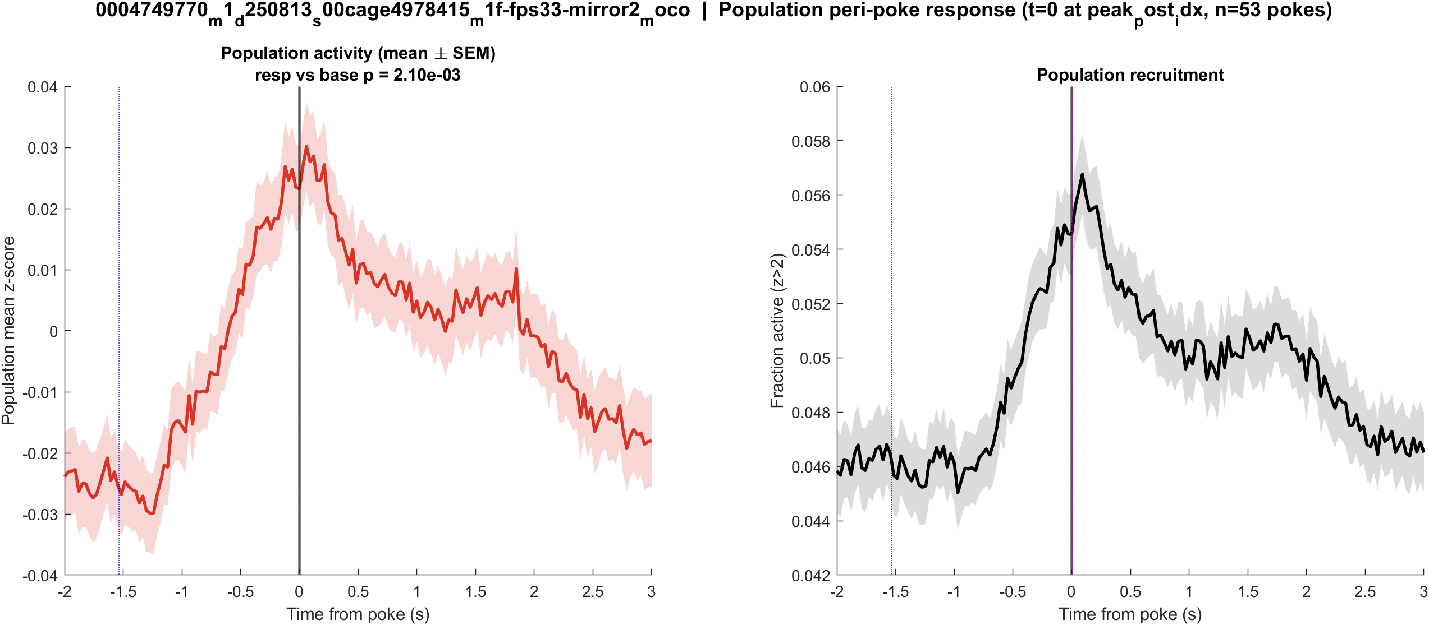
Fig1 Population PSTH | mouse1f s00 8.38 mW/cm2 mirror2
What: Mean population activity (z-score) and fraction of active cells, aligned to each poke (t = 0 is peak_post_idx).
Result: This FOV has 1930 neurons and 55 pokes; the population pre vs post test is significant (p = 0.002).

Slide 19
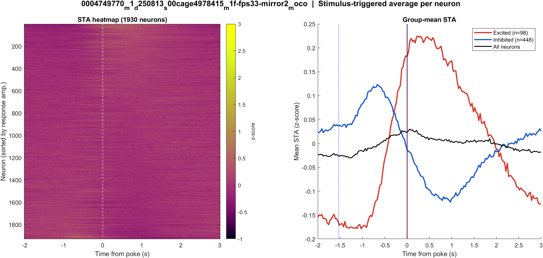
Fig2 Neuron STA | mouse1f s00 8.38 mW/cm2 mirror2
What: Each neuron’s average trace around the poke, sorted by response size; right panel is the mean of excited vs inhibited cells.
Result: Excited 5.1% and inhibited 23.2% of 1930 neurons; see the STA split on the right.

Slide 20
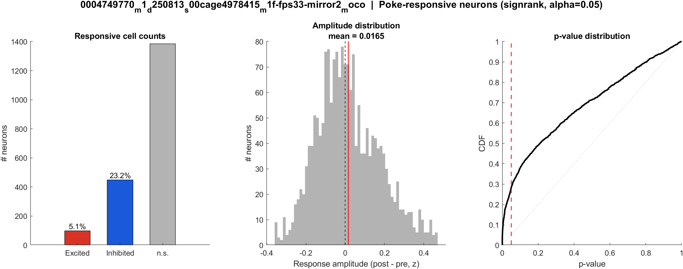
Fig3 Excited vs inhibited cells | mouse1f s00 8.38 mW/cm2 mirror2
What: Per neuron: mean z in 0.4–1.2 s after t=0 vs -2–0 s before; signed-rank, p<0.05, sign of the difference.
Result: 5.1% excited, 23.2% inhibited out of 1930 neurons; population test significant (p = 0.002).

Slide 21

Fig4 Spatial poke-response map | mouse1f s00 8.38 mW/cm2 mirror2
What: Each neuron’s post−pre amplitude is painted onto its EXTRACT footprint. Red = excited, blue = inhibited. Left: anatomy. Middle: all cells. Right: p<0.05 only.
Result: Red = excited, blue = inhibited on this FOV (5.1% exc, 23.2% inh of 1930 neurons).

Slide 22
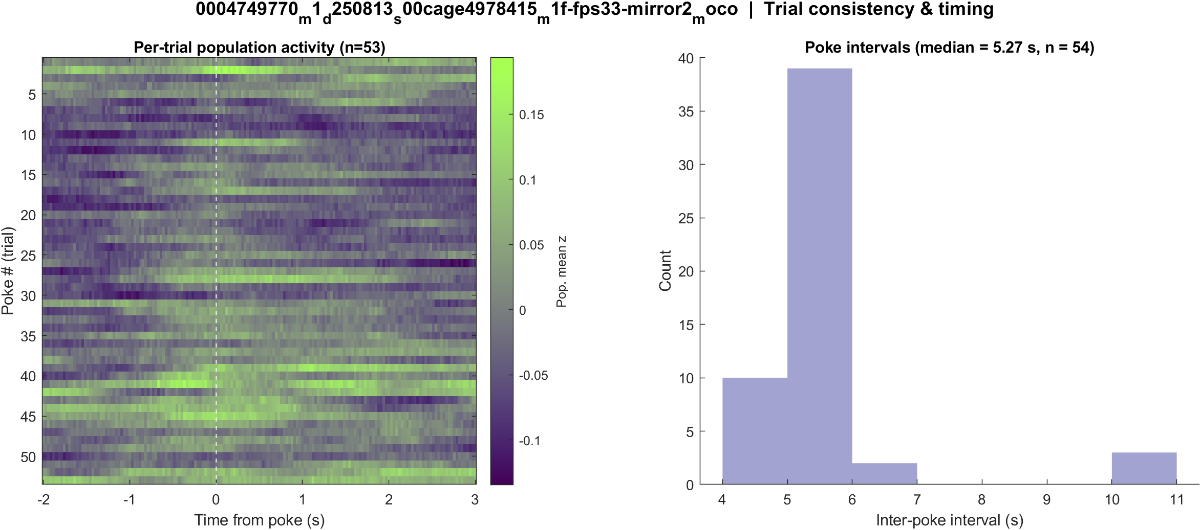
Fig5 Trial raster and poke interval | mouse1f s00 8.38 mW/cm2 mirror2
What: One row per poke (population z over time) and the histogram of time between detected pokes.
Result: 55 pokes detected in this movie; intervals near 5.3 s, with occasional missed peaks.

Slide 23
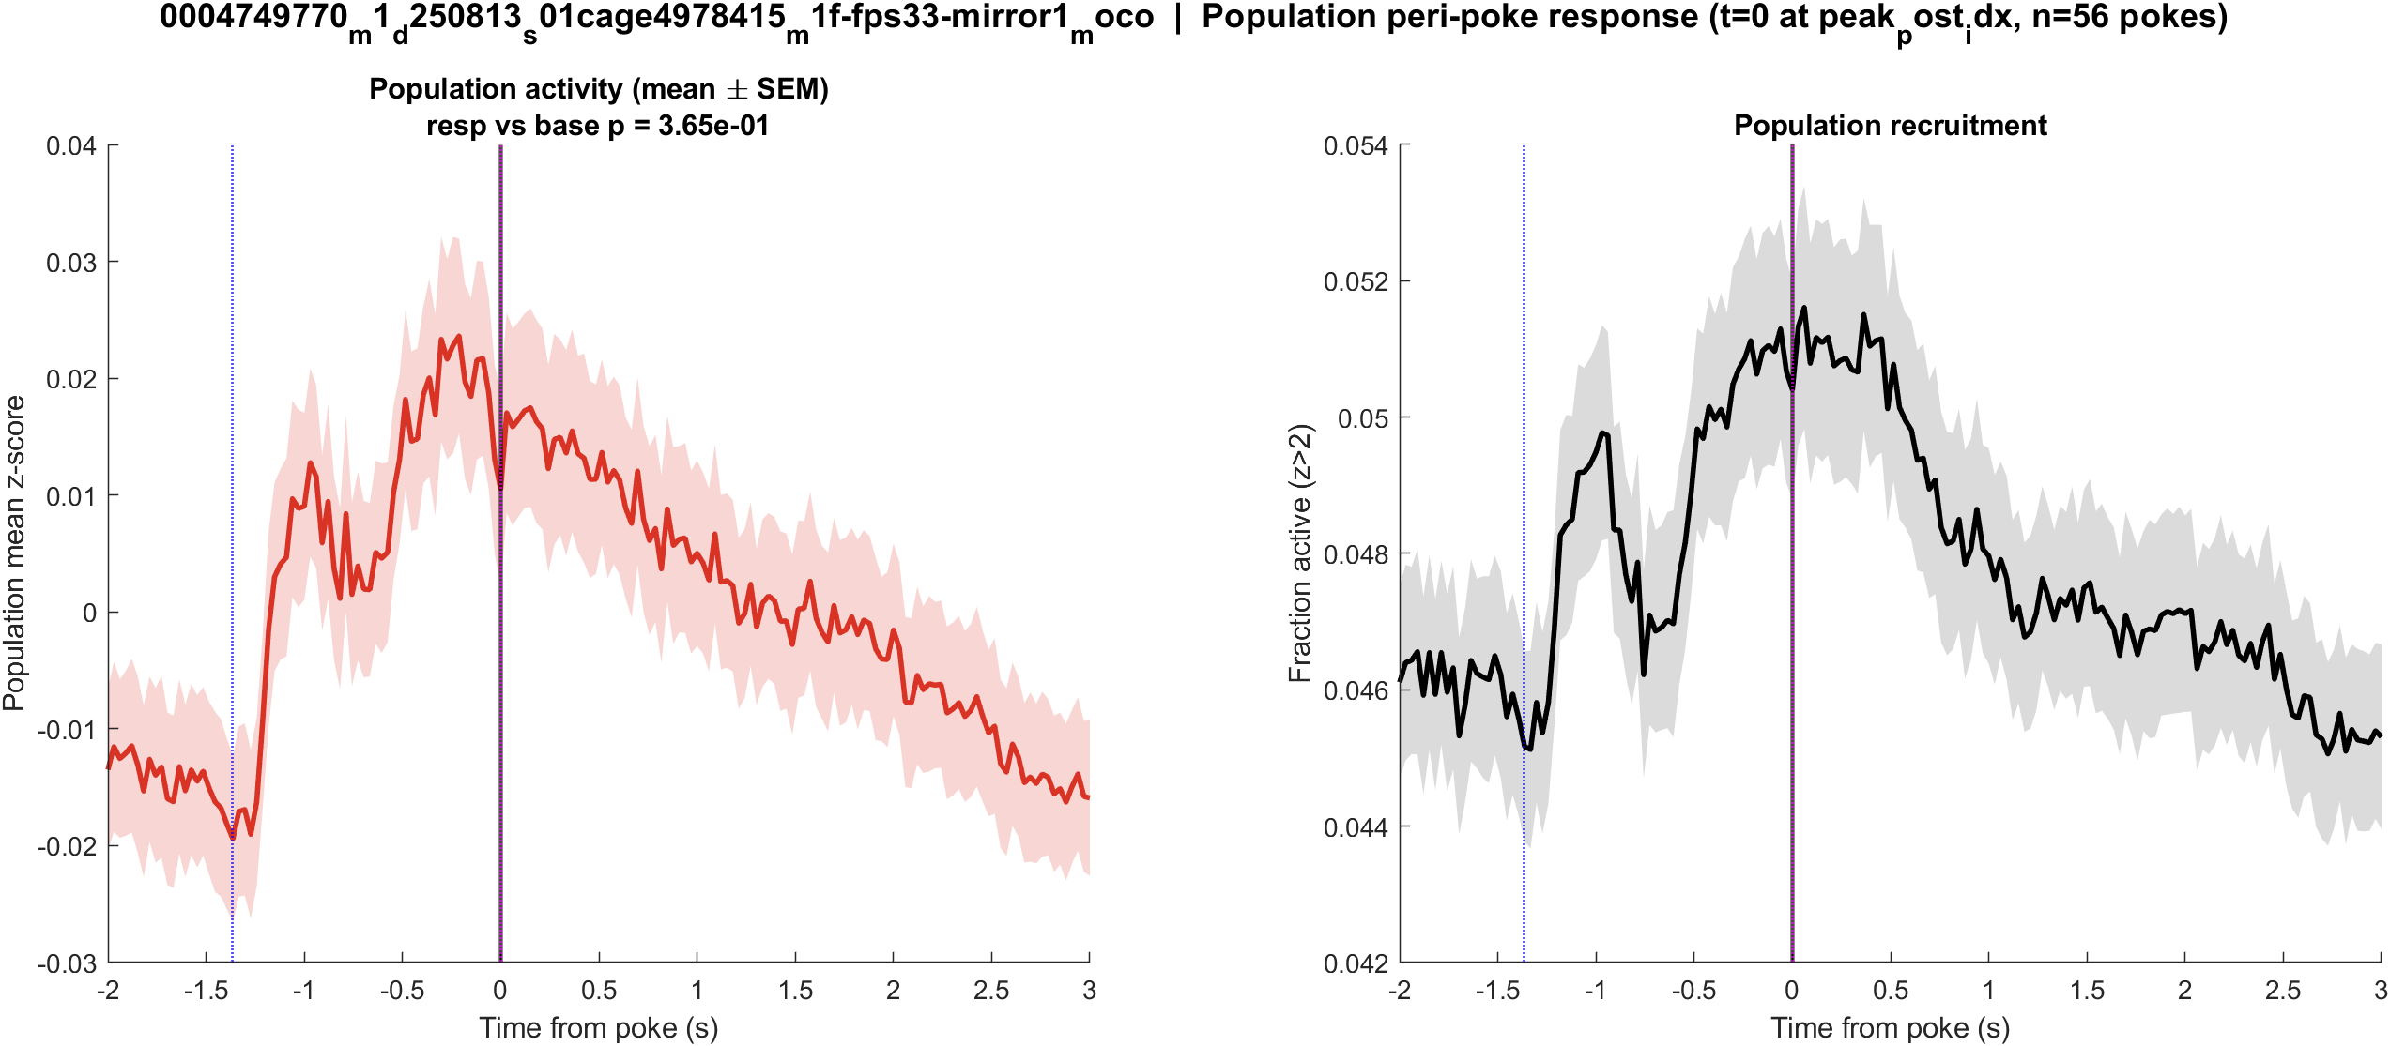
Fig1 Population PSTH | mouse1f s01 20 mW/cm2 mirror1
What: Mean population activity (z-score) and fraction of active cells, aligned to each poke (t = 0 is peak_post_idx).
Result: This FOV has 2786 neurons and 57 pokes; the population pre vs post test is not significant (p = 0.365).

Slide 24
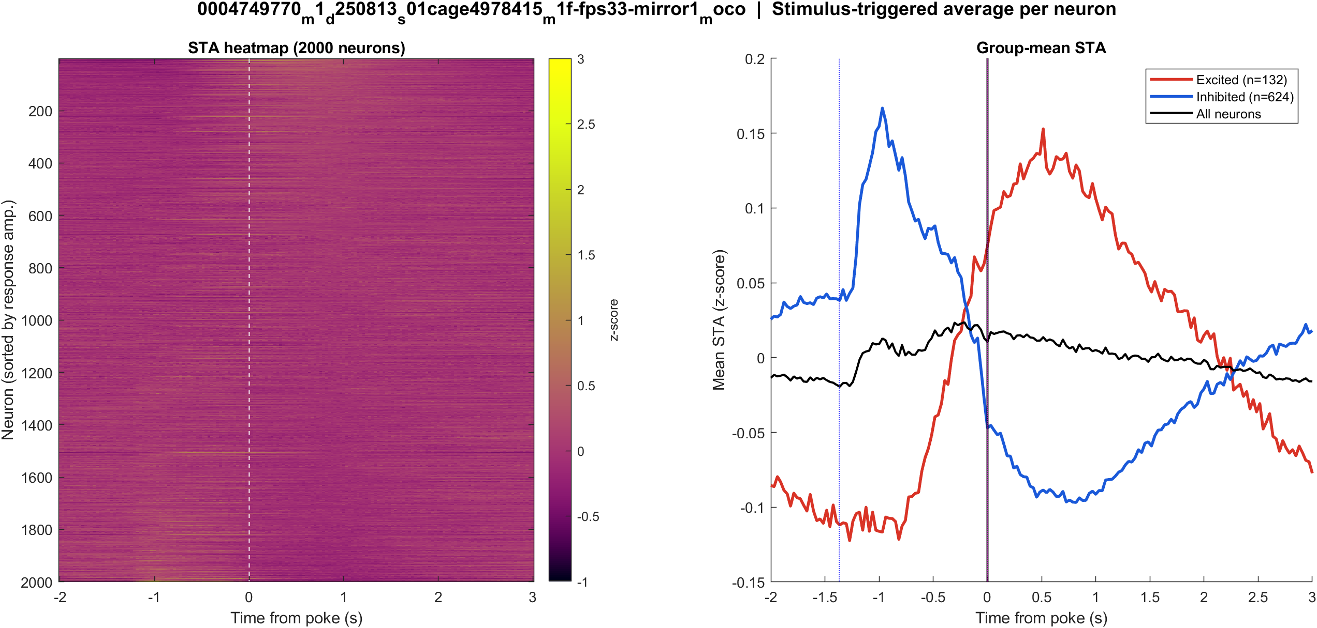
Fig2 Neuron STA | mouse1f s01 20 mW/cm2 mirror1
What: Each neuron’s average trace around the poke, sorted by response size; right panel is the mean of excited vs inhibited cells.
Result: Excited 4.7% and inhibited 22.4% of 2786 neurons; see the STA split on the right.

Slide 25
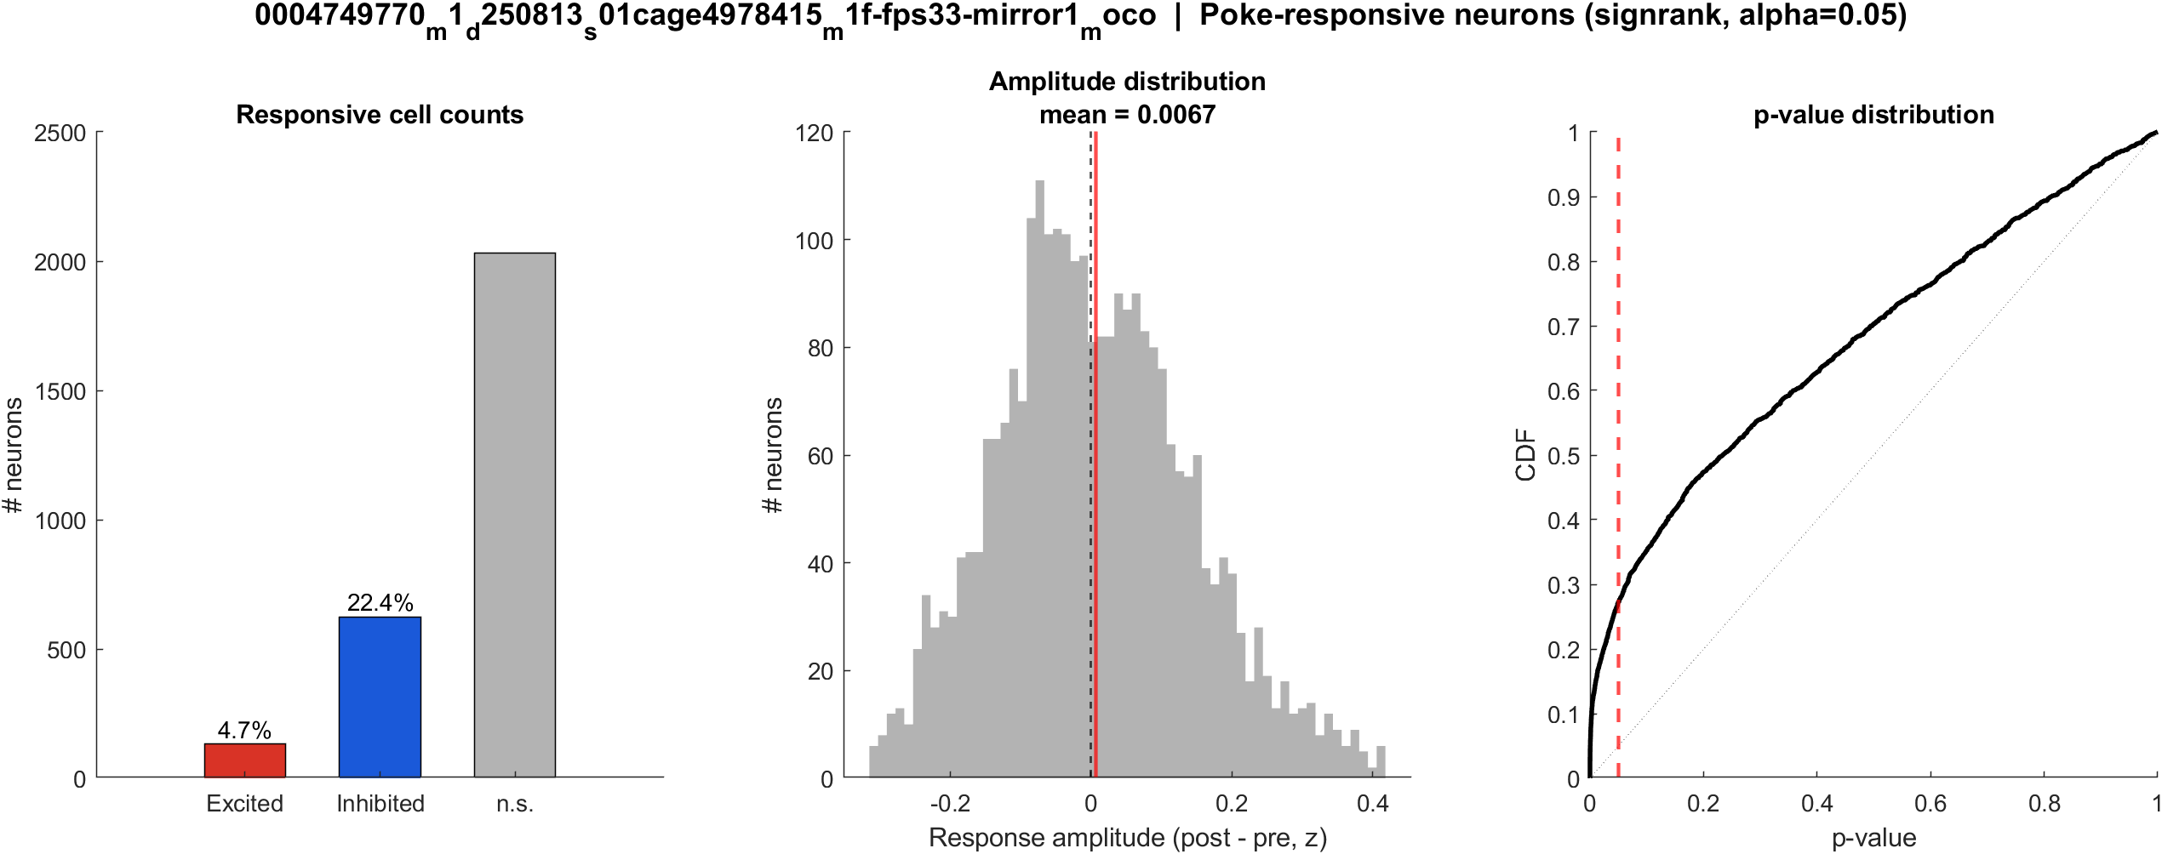
Fig3 Excited vs inhibited cells | mouse1f s01 20 mW/cm2 mirror1
What: Per neuron: mean z in 0.4–1.2 s after t=0 vs -2–0 s before; signed-rank, p<0.05, sign of the difference.
Result: 4.7% excited, 22.4% inhibited out of 2786 neurons; population test not significant (p = 0.365).

Slide 26

Fig4 Spatial poke-response map | mouse1f s01 20 mW/cm2 mirror1
What: Each neuron’s post−pre amplitude is painted onto its EXTRACT footprint. Red = excited, blue = inhibited. Left: anatomy. Middle: all cells. Right: p<0.05 only.
Result: Red = excited, blue = inhibited on this FOV (4.7% exc, 22.4% inh of 2786 neurons).

Slide 27
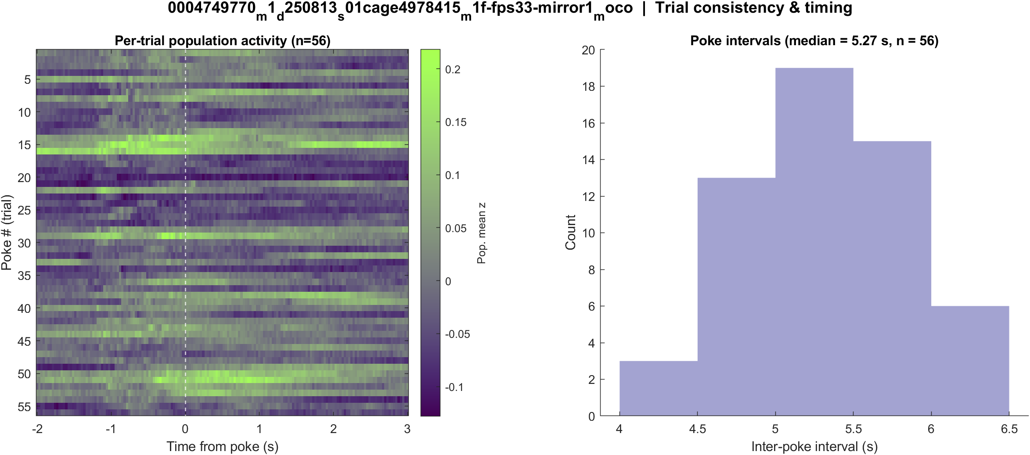
Fig5 Trial raster and poke interval | mouse1f s01 20 mW/cm2 mirror1
What: One row per poke (population z over time) and the histogram of time between detected pokes.
Result: 57 pokes detected in this movie; intervals near 5.3 s, with occasional missed peaks.

Slide 28
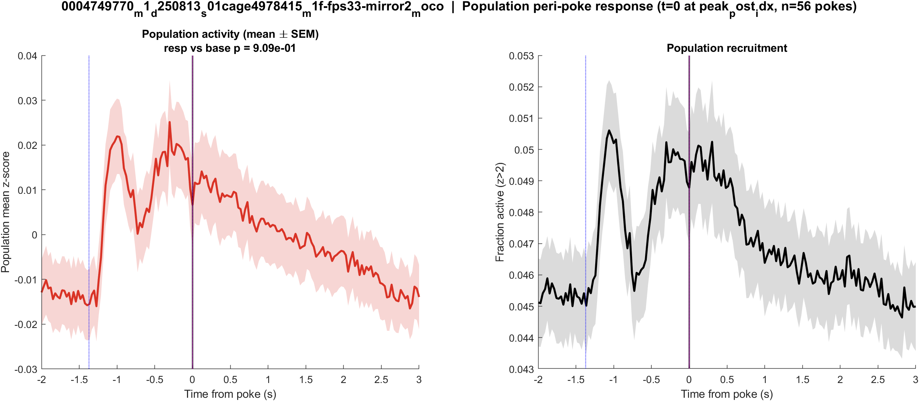
Fig1 Population PSTH | mouse1f s01 20 mW/cm2 mirror2
What: Mean population activity (z-score) and fraction of active cells, aligned to each poke (t = 0 is peak_post_idx).
Result: This FOV has 3749 neurons and 57 pokes; the population pre vs post test is not significant (p = 0.909).

Slide 29
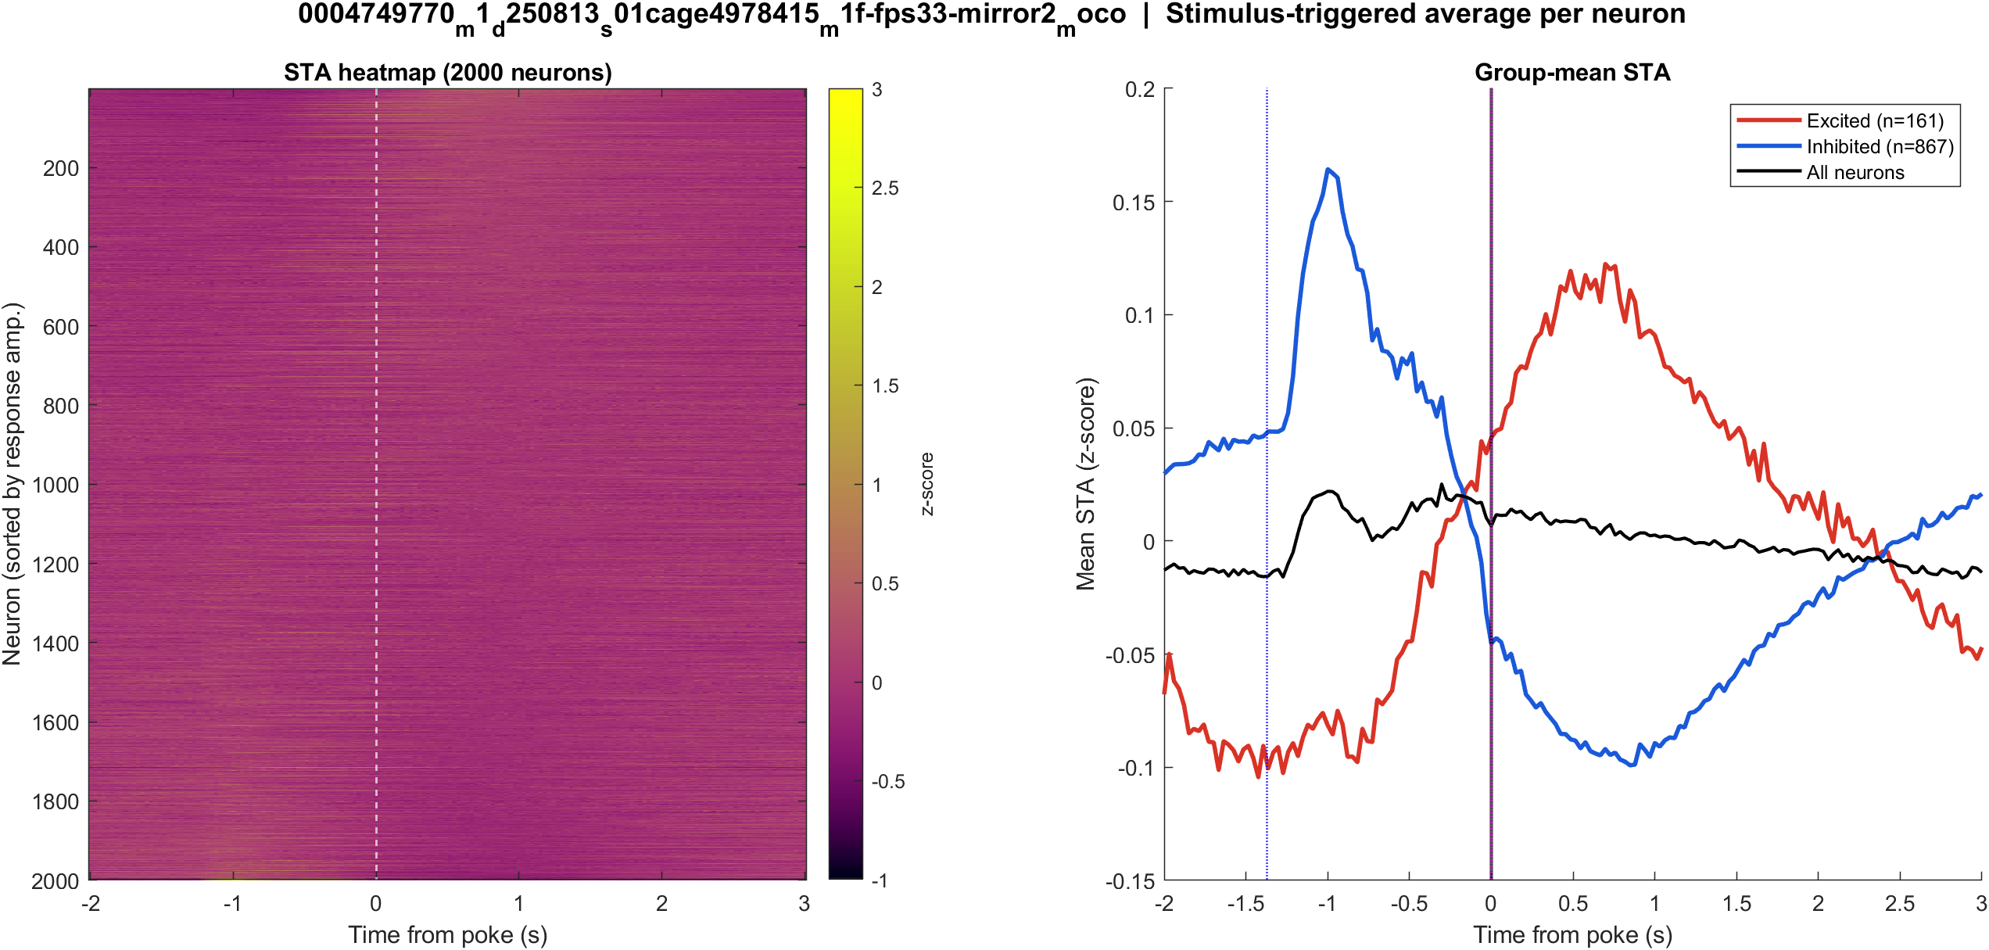
Fig2 Neuron STA | mouse1f s01 20 mW/cm2 mirror2
What: Each neuron’s average trace around the poke, sorted by response size; right panel is the mean of excited vs inhibited cells.
Result: Excited 4.3% and inhibited 23.1% of 3749 neurons; see the STA split on the right.

Slide 30
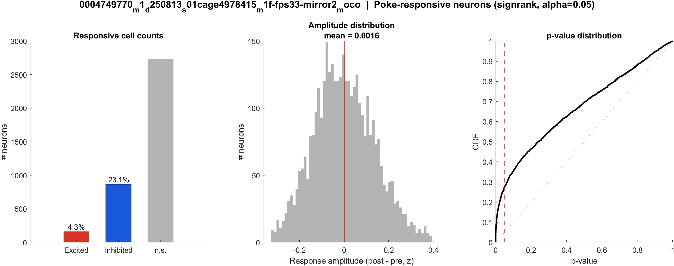
Fig3 Excited vs inhibited cells | mouse1f s01 20 mW/cm2 mirror2
What: Per neuron: mean z in 0.4–1.2 s after t=0 vs -2–0 s before; signed-rank, p<0.05, sign of the difference.
Result: 4.3% excited, 23.1% inhibited out of 3749 neurons; population test not significant (p = 0.909).

Slide 31
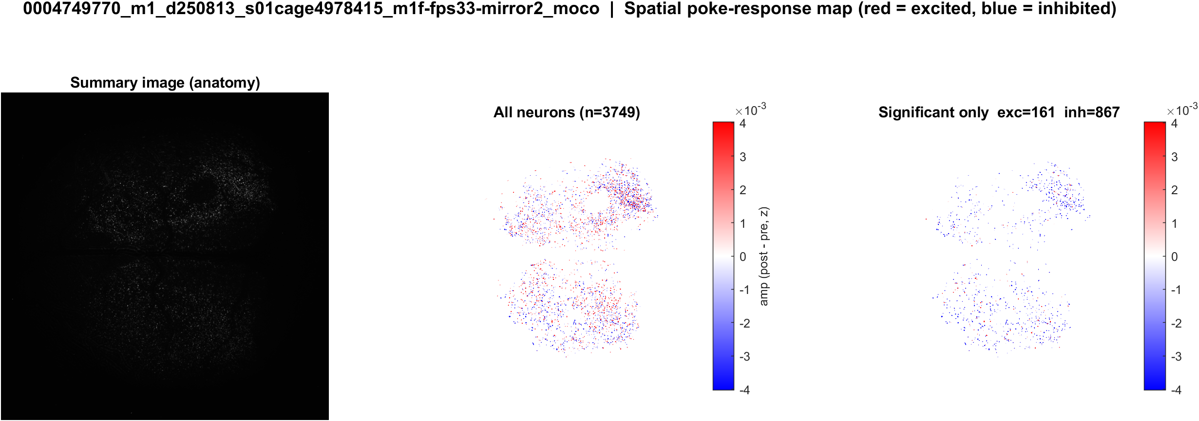
Fig4 Spatial poke-response map | mouse1f s01 20 mW/cm2 mirror2
What: Each neuron’s post−pre amplitude is painted onto its EXTRACT footprint. Red = excited, blue = inhibited. Left: anatomy. Middle: all cells. Right: p<0.05 only.
Result: Red = excited, blue = inhibited on this FOV (4.3% exc, 23.1% inh of 3749 neurons).

Slide 32
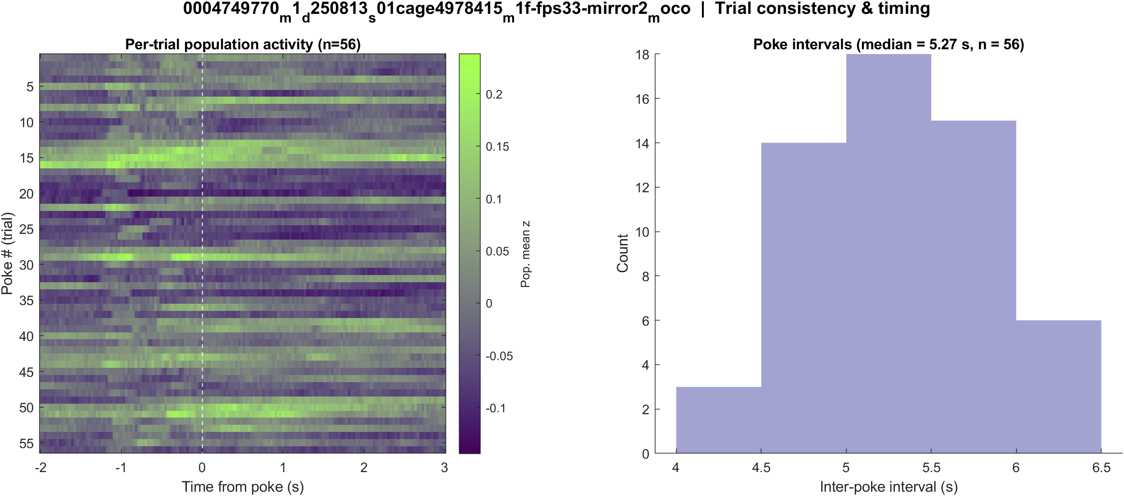
Fig5 Trial raster and poke interval | mouse1f s01 20 mW/cm2 mirror2
What: One row per poke (population z over time) and the histogram of time between detected pokes.
Result: 57 pokes detected in this movie; intervals near 5.3 s, with occasional missed peaks.

Slide 33
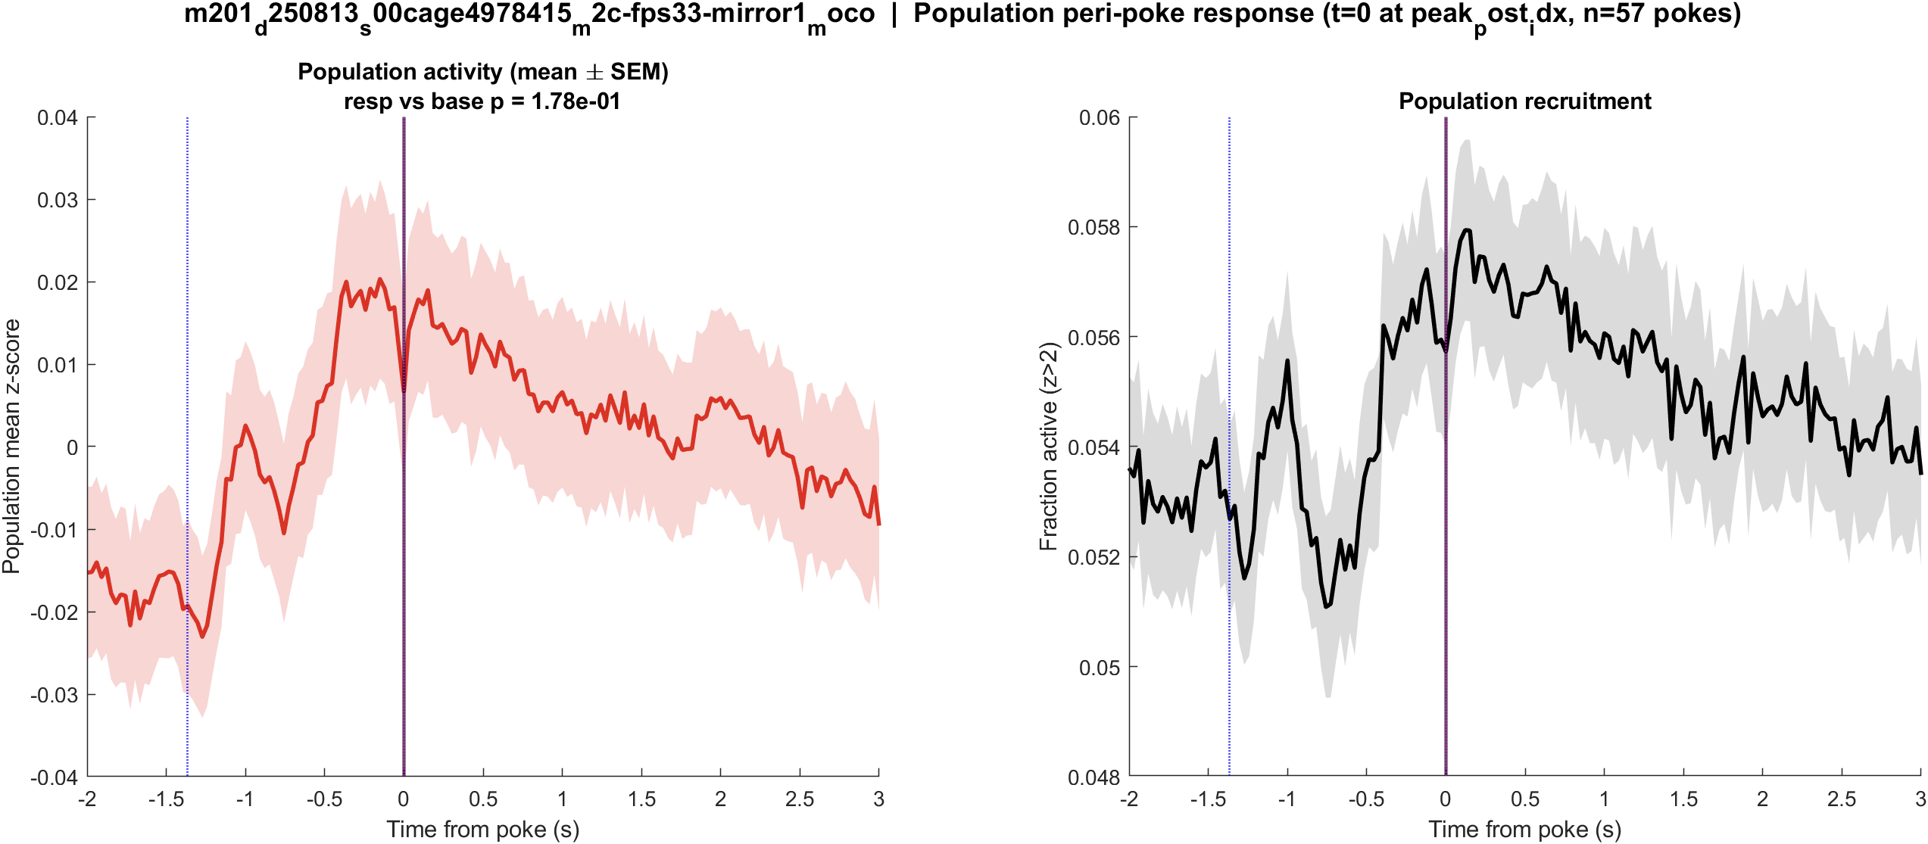
Fig1 Population PSTH | mouse2c s00 8.38 mW/cm2 mirror1
What: Mean population activity (z-score) and fraction of active cells, aligned to each poke (t = 0 is peak_post_idx).
Result: This FOV has 2097 neurons and 57 pokes; the population pre vs post test is not significant (p = 0.178).

Slide 34
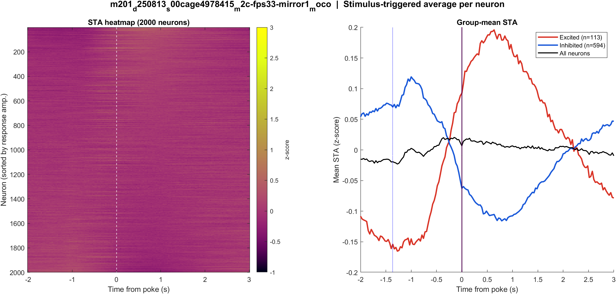
Fig2 Neuron STA | mouse2c s00 8.38 mW/cm2 mirror1
What: Each neuron’s average trace around the poke, sorted by response size; right panel is the mean of excited vs inhibited cells.
Result: Excited 5.4% and inhibited 28.3% of 2097 neurons; see the STA split on the right.

Slide 35
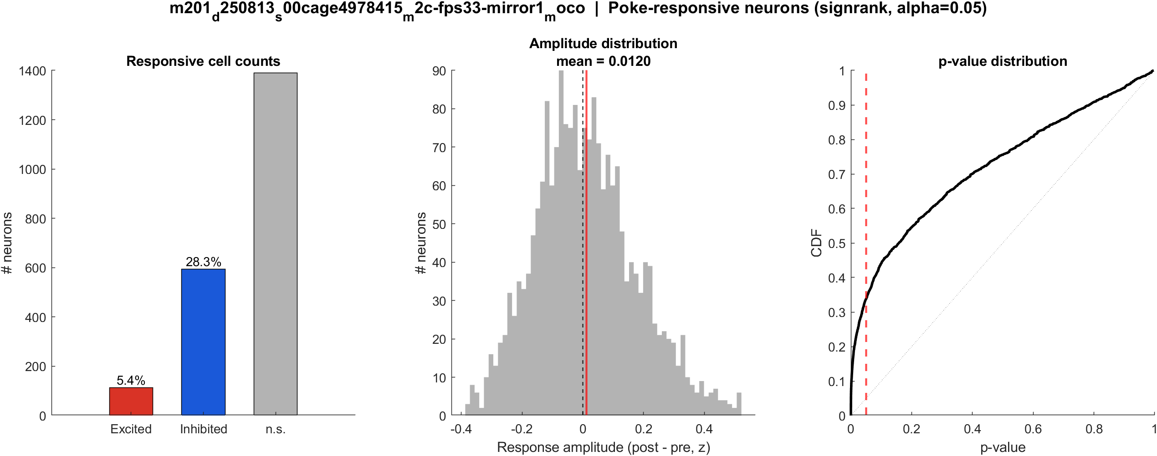
Fig3 Excited vs inhibited cells | mouse2c s00 8.38 mW/cm2 mirror1
What: Per neuron: mean z in 0.4–1.2 s after t=0 vs -2–0 s before; signed-rank, p<0.05, sign of the difference.
Result: 5.4% excited, 28.3% inhibited out of 2097 neurons; population test not significant (p = 0.178).

Slide 36

Fig4 Spatial poke-response map | mouse2c s00 8.38 mW/cm2 mirror1
What: Each neuron’s post−pre amplitude is painted onto its EXTRACT footprint. Red = excited, blue = inhibited. Left: anatomy. Middle: all cells. Right: p<0.05 only.
Result: Red = excited, blue = inhibited on this FOV (5.4% exc, 28.3% inh of 2097 neurons).

Slide 37
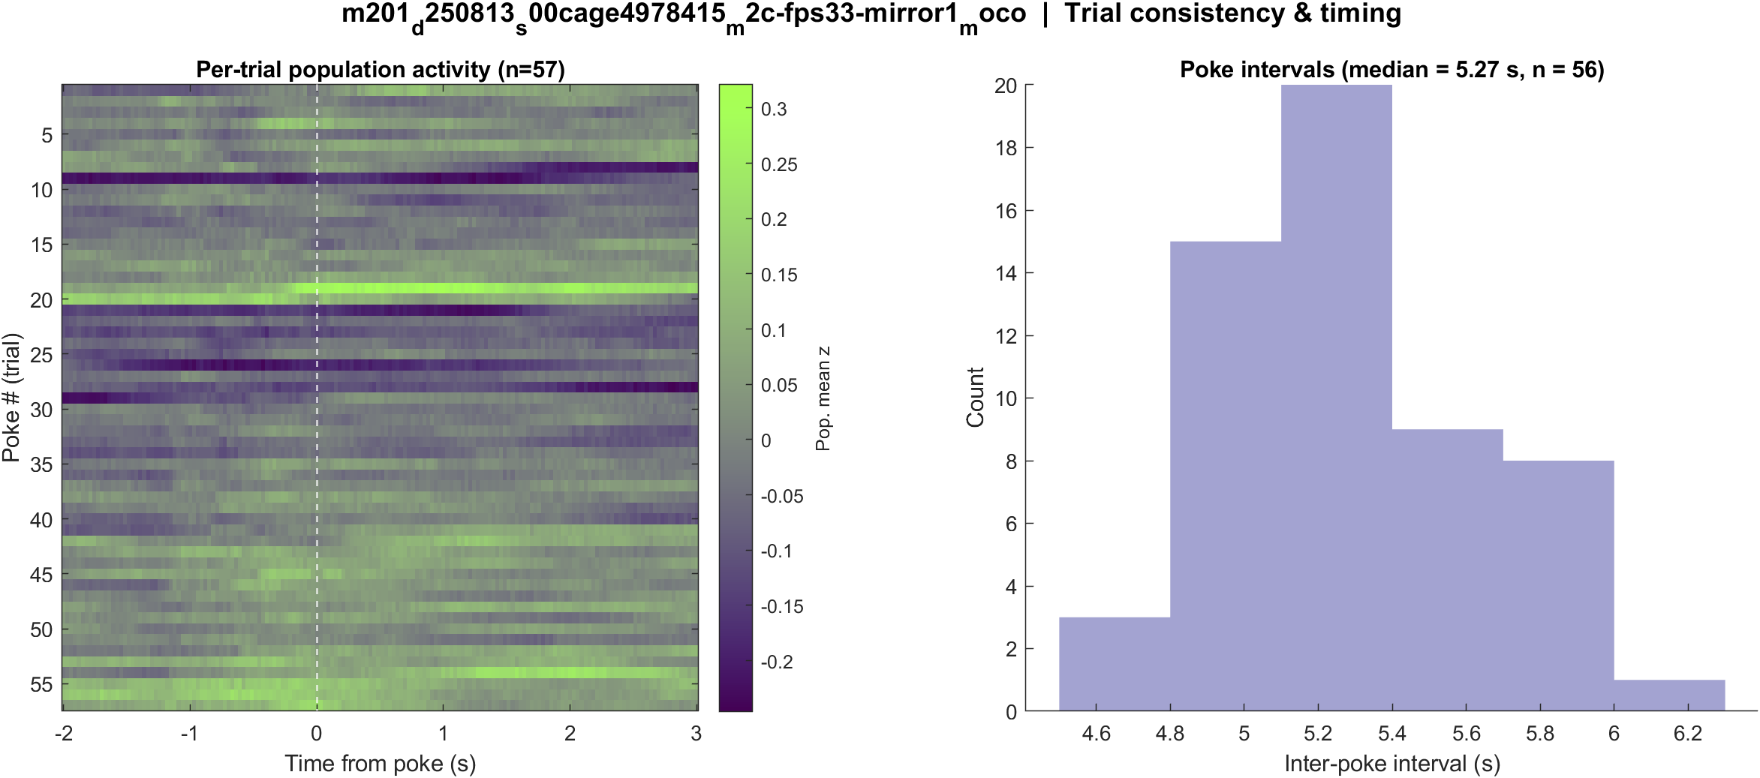
Fig5 Trial raster and poke interval | mouse2c s00 8.38 mW/cm2 mirror1
What: One row per poke (population z over time) and the histogram of time between detected pokes.
Result: 57 pokes detected in this movie; intervals near 5.3 s, with occasional missed peaks.

Slide 38
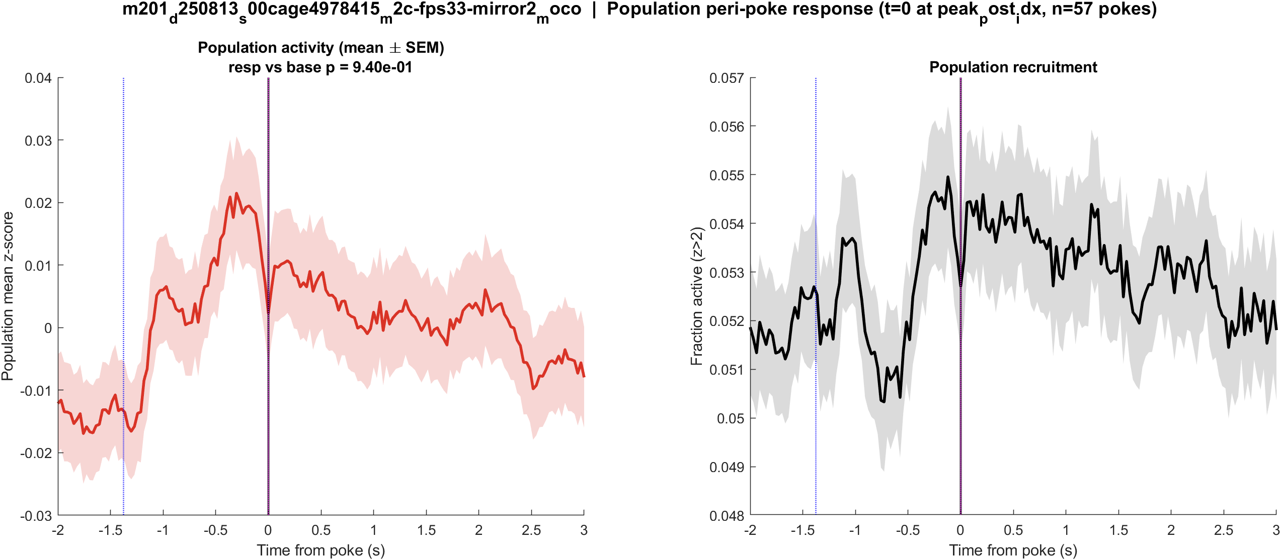
Fig1 Population PSTH | mouse2c s00 8.38 mW/cm2 mirror2
What: Mean population activity (z-score) and fraction of active cells, aligned to each poke (t = 0 is peak_post_idx).
Result: This FOV has 2889 neurons and 57 pokes; the population pre vs post test is not significant (p = 0.940).

Slide 39
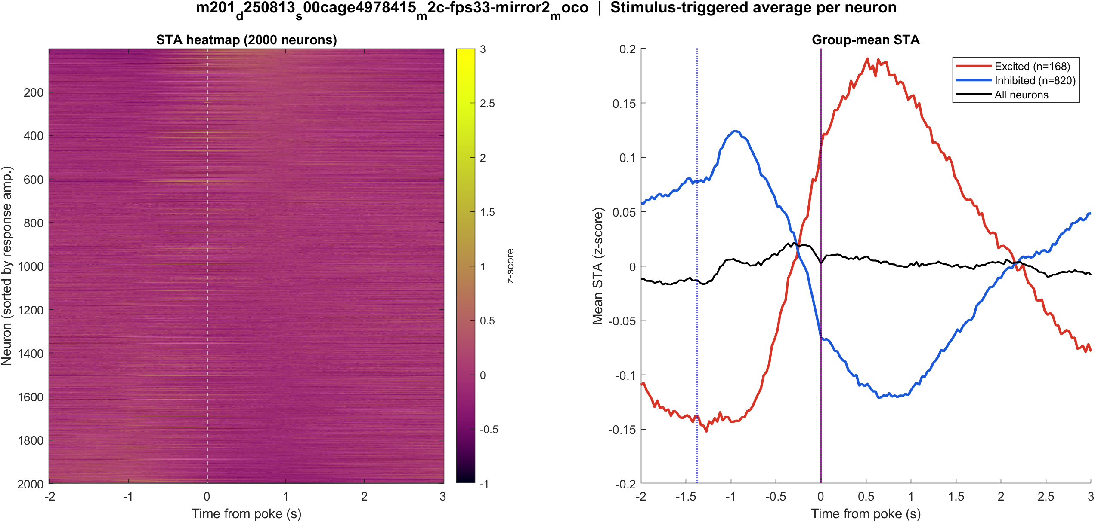
Fig2 Neuron STA | mouse2c s00 8.38 mW/cm2 mirror2
What: Each neuron’s average trace around the poke, sorted by response size; right panel is the mean of excited vs inhibited cells.
Result: Excited 5.8% and inhibited 28.4% of 2889 neurons; see the STA split on the right.

Slide 40
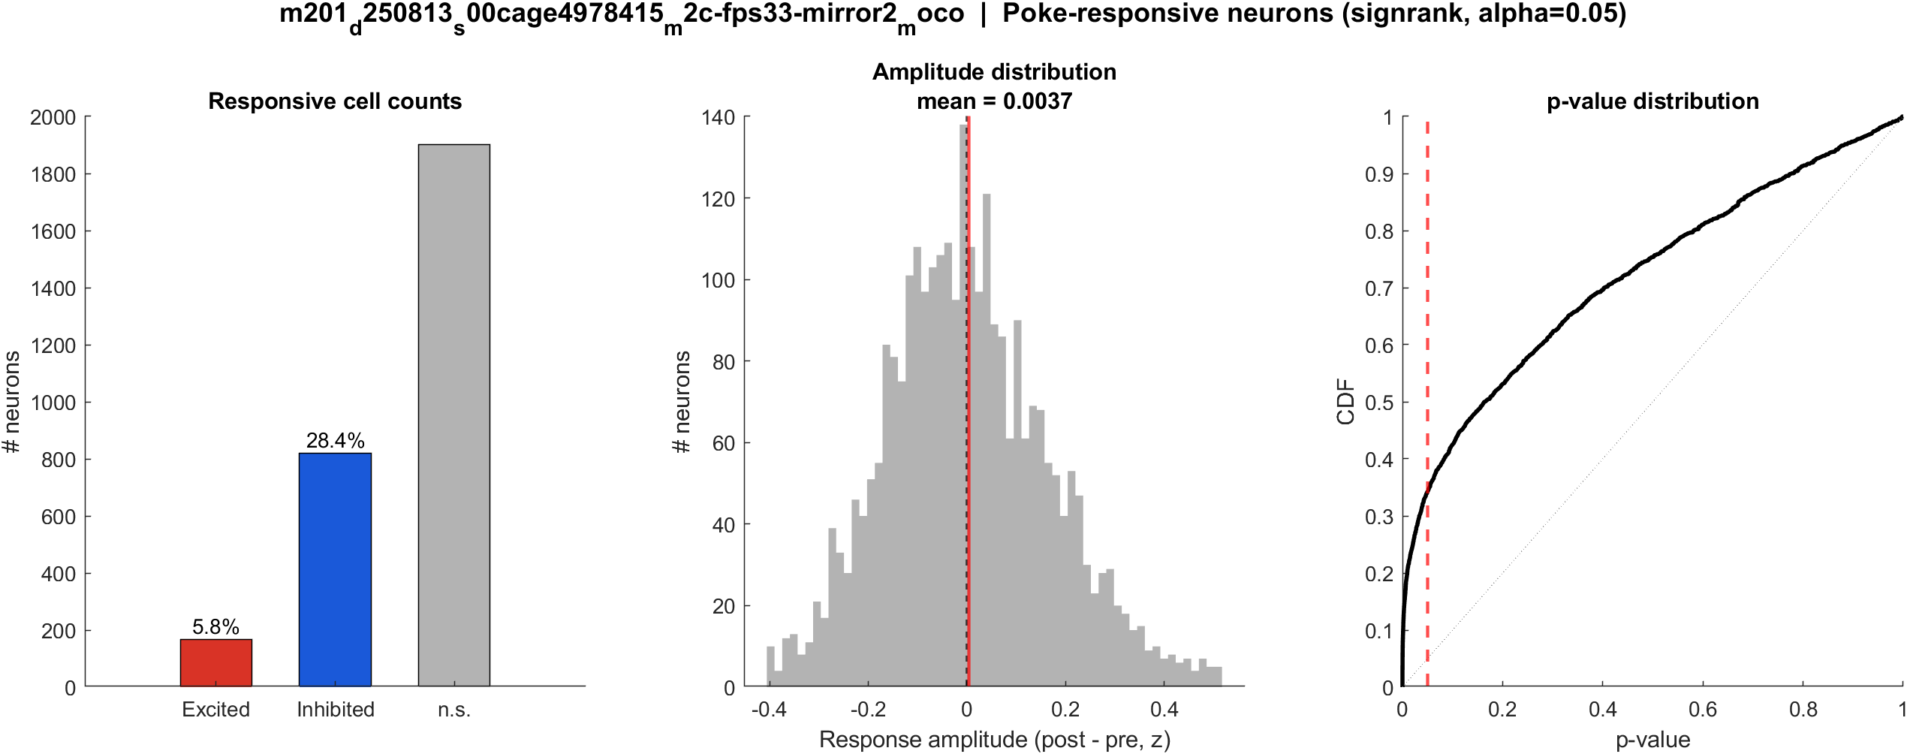
Fig3 Excited vs inhibited cells | mouse2c s00 8.38 mW/cm2 mirror2
What: Per neuron: mean z in 0.4–1.2 s after t=0 vs -2–0 s before; signed-rank, p<0.05, sign of the difference.
Result: 5.8% excited, 28.4% inhibited out of 2889 neurons; population test not significant (p = 0.940).

Slide 41

Fig4 Spatial poke-response map | mouse2c s00 8.38 mW/cm2 mirror2
What: Each neuron’s post−pre amplitude is painted onto its EXTRACT footprint. Red = excited, blue = inhibited. Left: anatomy. Middle: all cells. Right: p<0.05 only.
Result: Red = excited, blue = inhibited on this FOV (5.8% exc, 28.4% inh of 2889 neurons).

Slide 42
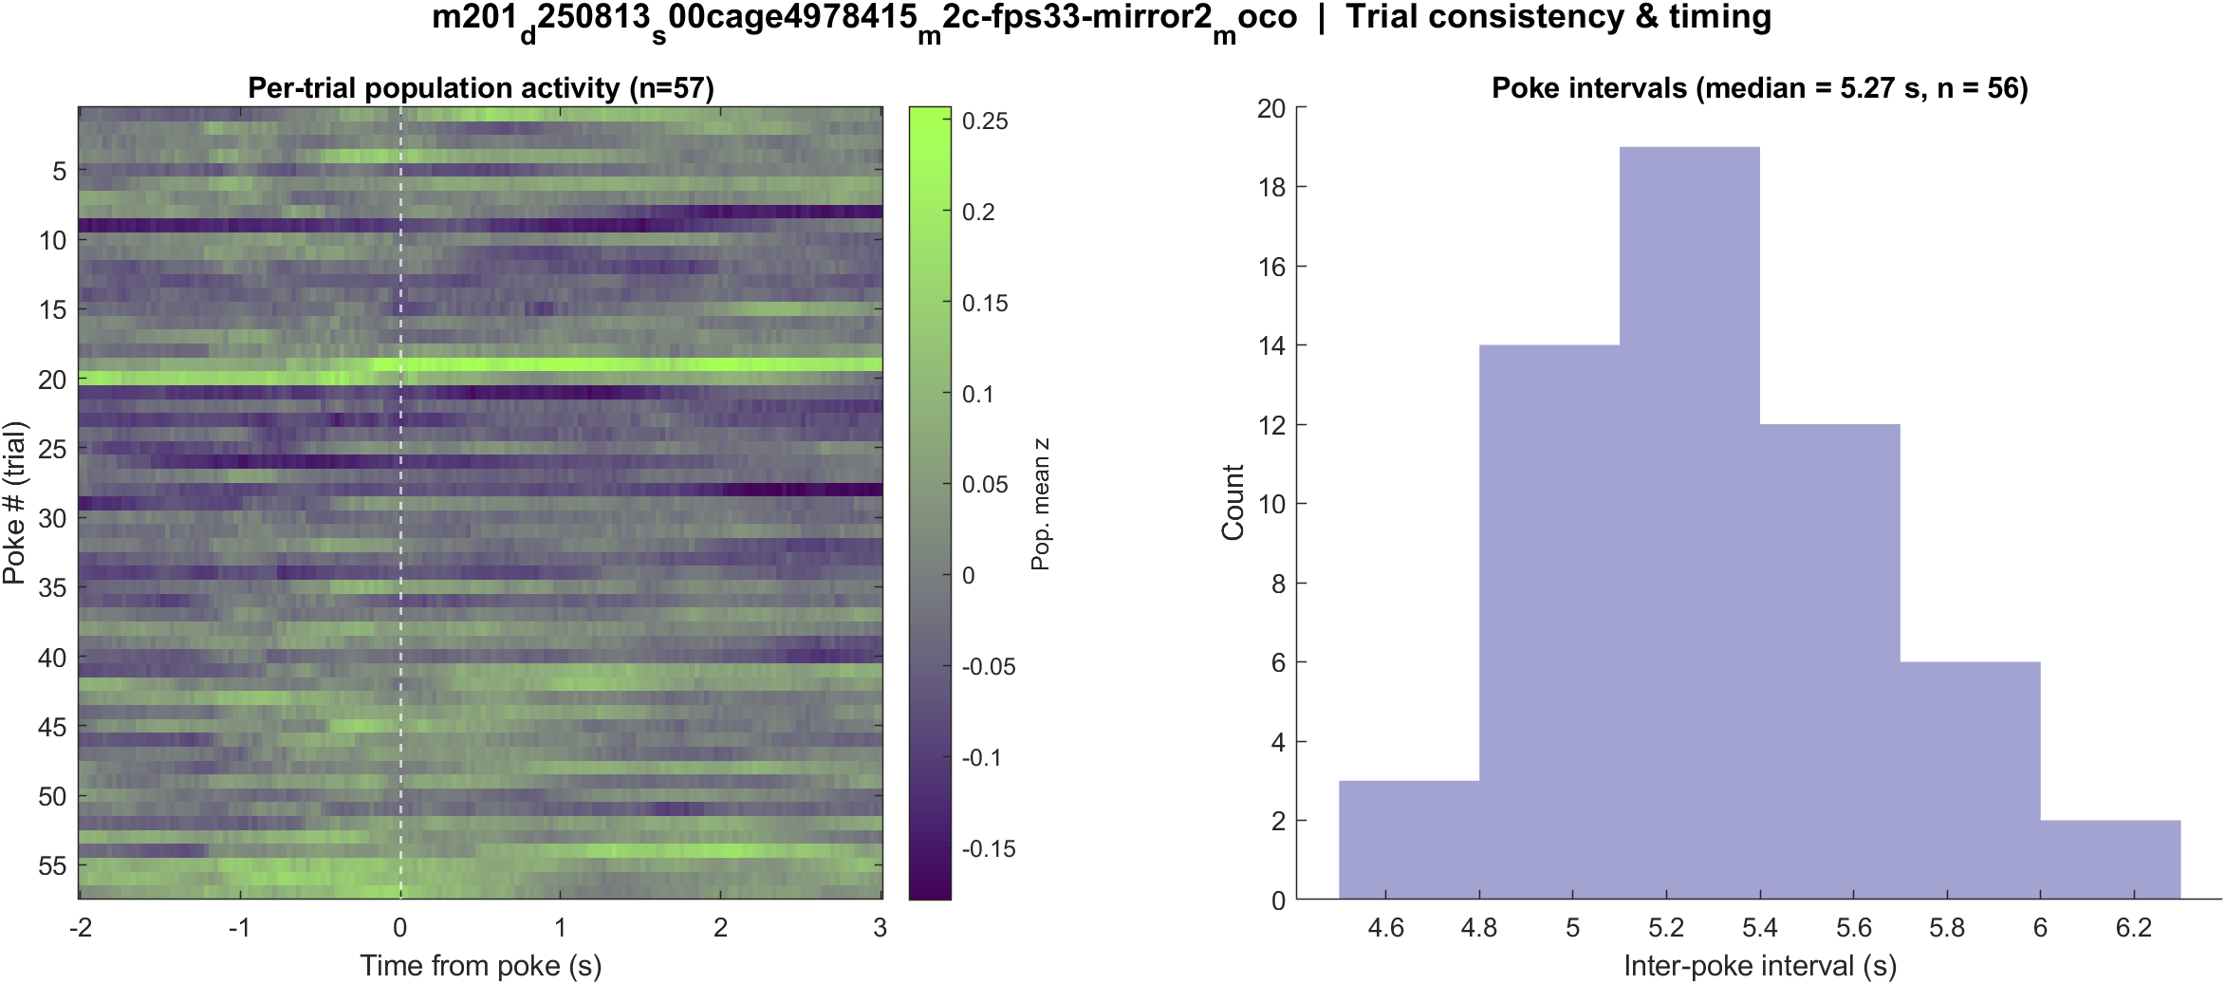
Fig5 Trial raster and poke interval | mouse2c s00 8.38 mW/cm2 mirror2
What: One row per poke (population z over time) and the histogram of time between detected pokes.
Result: 57 pokes detected in this movie; intervals near 5.3 s, with occasional missed peaks.

Slide 43
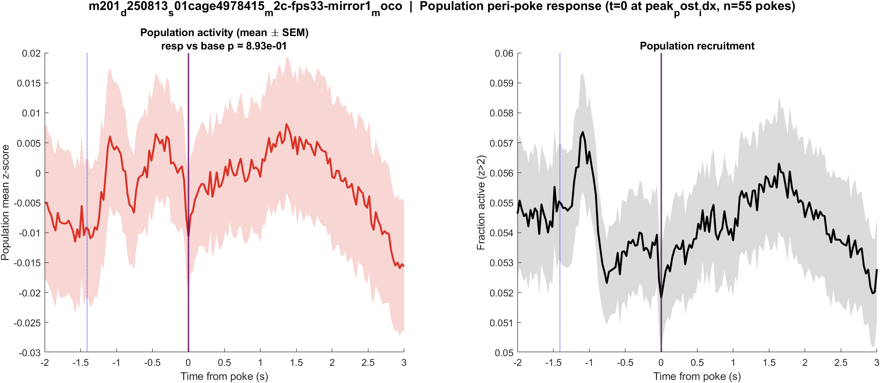
Fig1 Population PSTH | mouse2c s01 20 mW/cm2 mirror1
What: Mean population activity (z-score) and fraction of active cells, aligned to each poke (t = 0 is peak_post_idx).
Result: This FOV has 3012 neurons and 56 pokes; the population pre vs post test is not significant (p = 0.893).

Slide 44

Fig2 Neuron STA | mouse2c s01 20 mW/cm2 mirror1
What: Each neuron’s average trace around the poke, sorted by response size; right panel is the mean of excited vs inhibited cells.
Result: Excited 3.5% and inhibited 24.0% of 3012 neurons; see the STA split on the right.

Slide 45
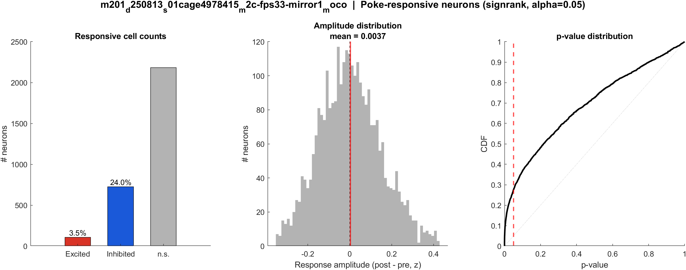
Fig3 Excited vs inhibited cells | mouse2c s01 20 mW/cm2 mirror1
What: Per neuron: mean z in 0.4–1.2 s after t=0 vs -2–0 s before; signed-rank, p<0.05, sign of the difference.
Result: 3.5% excited, 24.0% inhibited out of 3012 neurons; population test not significant (p = 0.893).

Slide 46

Fig4 Spatial poke-response map | mouse2c s01 20 mW/cm2 mirror1
What: Each neuron’s post−pre amplitude is painted onto its EXTRACT footprint. Red = excited, blue = inhibited. Left: anatomy. Middle: all cells. Right: p<0.05 only.
Result: Red = excited, blue = inhibited on this FOV (3.5% exc, 24.0% inh of 3012 neurons).

Slide 47
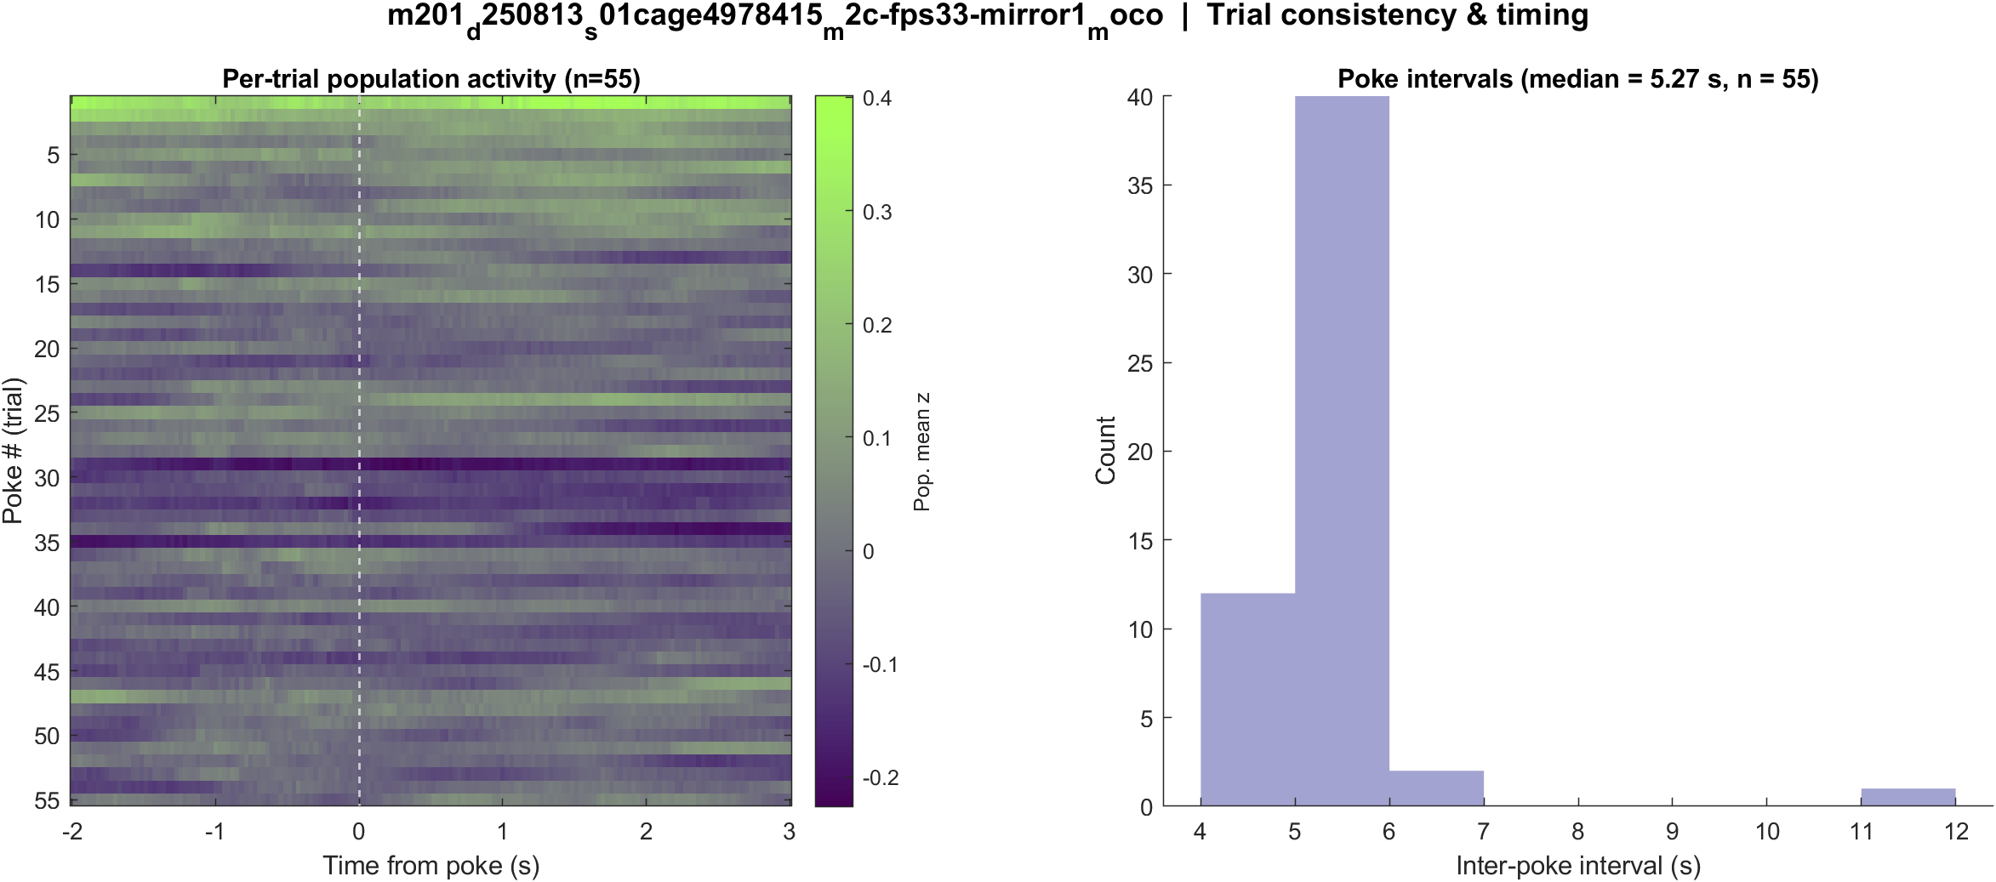
Fig5 Trial raster and poke interval | mouse2c s01 20 mW/cm2 mirror1
What: One row per poke (population z over time) and the histogram of time between detected pokes.
Result: 56 pokes detected in this movie; intervals near 5.3 s, with occasional missed peaks.

Slide 48
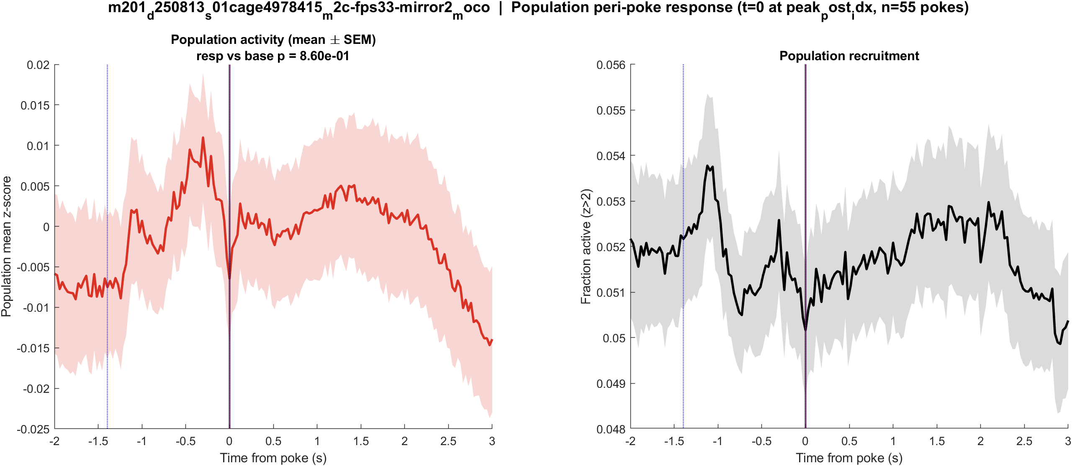
Fig1 Population PSTH | mouse2c s01 20 mW/cm2 mirror2
What: Mean population activity (z-score) and fraction of active cells, aligned to each poke (t = 0 is peak_post_idx).
Result: This FOV has 4022 neurons and 56 pokes; the population pre vs post test is not significant (p = 0.860).

Slide 49
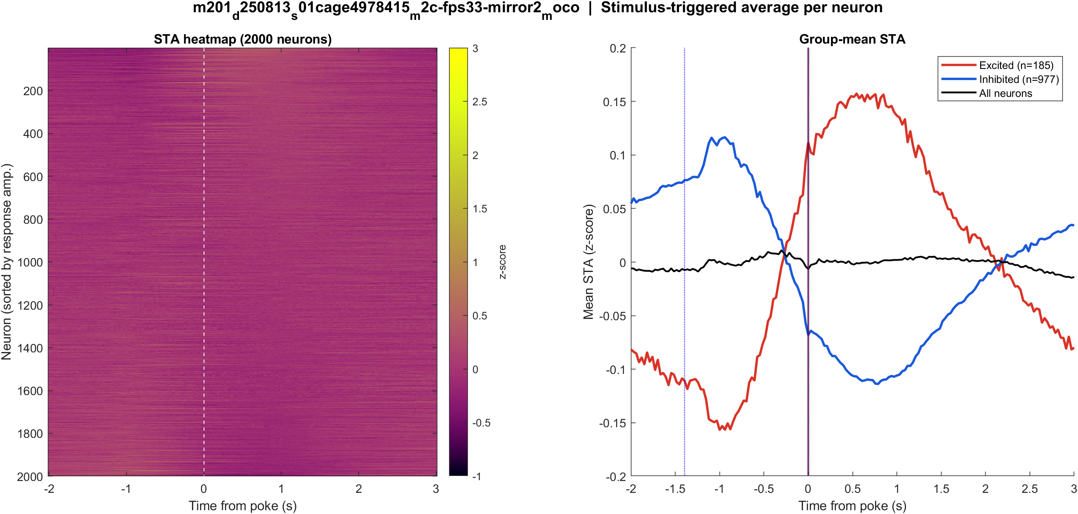
Fig2 Neuron STA | mouse2c s01 20 mW/cm2 mirror2
What: Each neuron’s average trace around the poke, sorted by response size; right panel is the mean of excited vs inhibited cells.
Result: Excited 4.6% and inhibited 24.3% of 4022 neurons; see the STA split on the right.

Slide 50

Fig3 Excited vs inhibited cells | mouse2c s01 20 mW/cm2 mirror2
What: Per neuron: mean z in 0.4–1.2 s after t=0 vs -2–0 s before; signed-rank, p<0.05, sign of the difference.
Result: 4.6% excited, 24.3% inhibited out of 4022 neurons; population test not significant (p = 0.860).

Slide 51
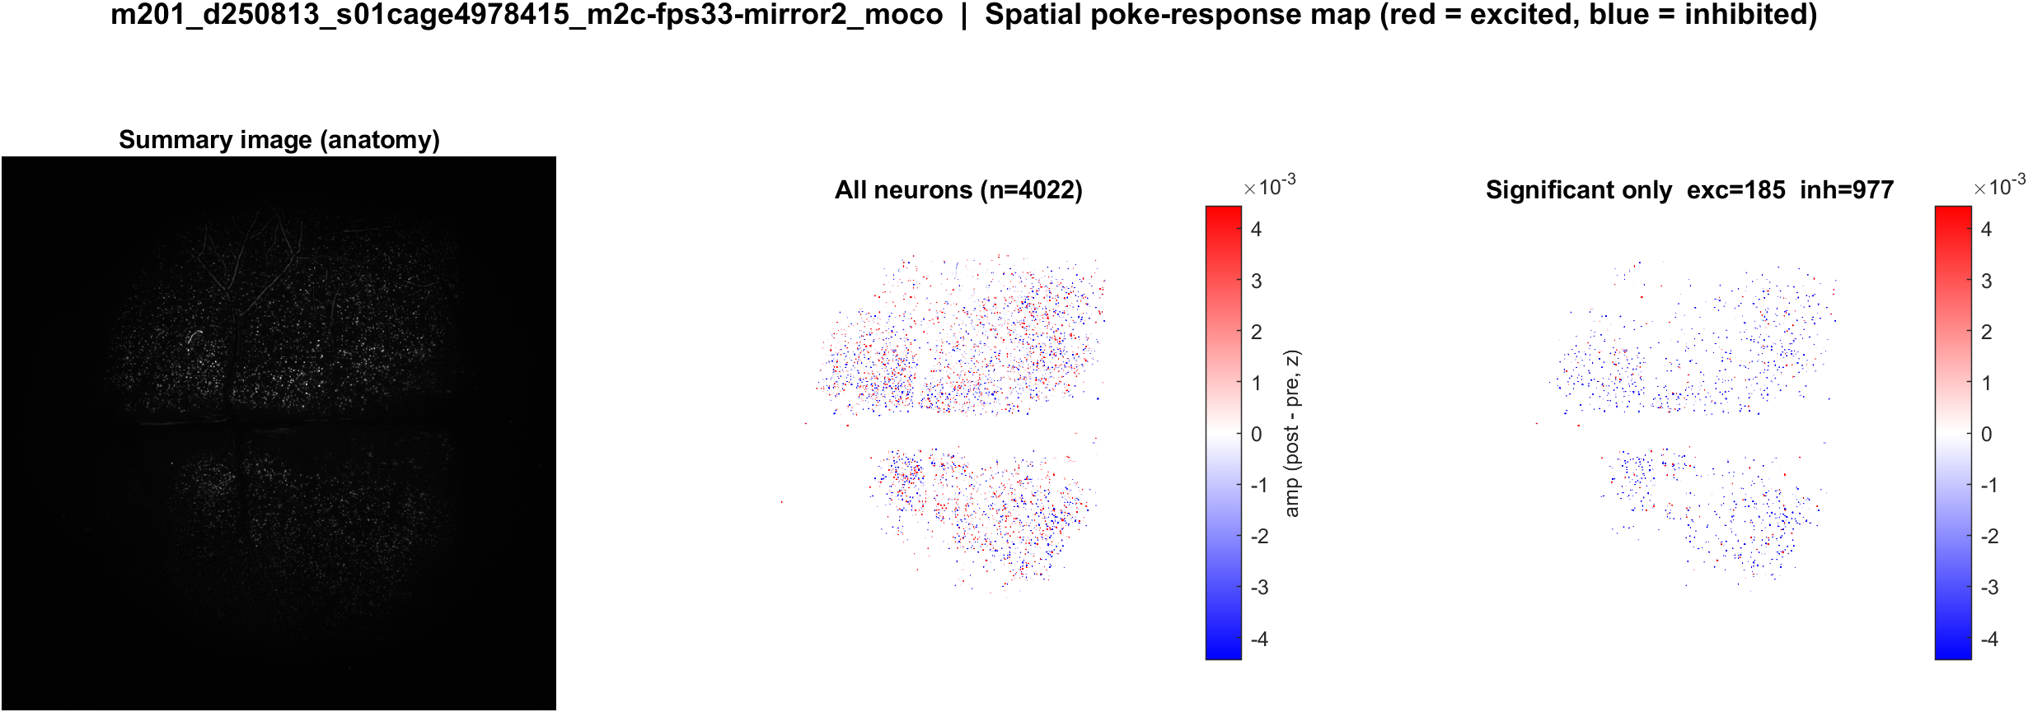
Fig4 Spatial poke-response map | mouse2c s01 20 mW/cm2 mirror2
What: Each neuron’s post−pre amplitude is painted onto its EXTRACT footprint. Red = excited, blue = inhibited. Left: anatomy. Middle: all cells. Right: p<0.05 only.
Result: Red = excited, blue = inhibited on this FOV (4.6% exc, 24.3% inh of 4022 neurons).

Slide 52
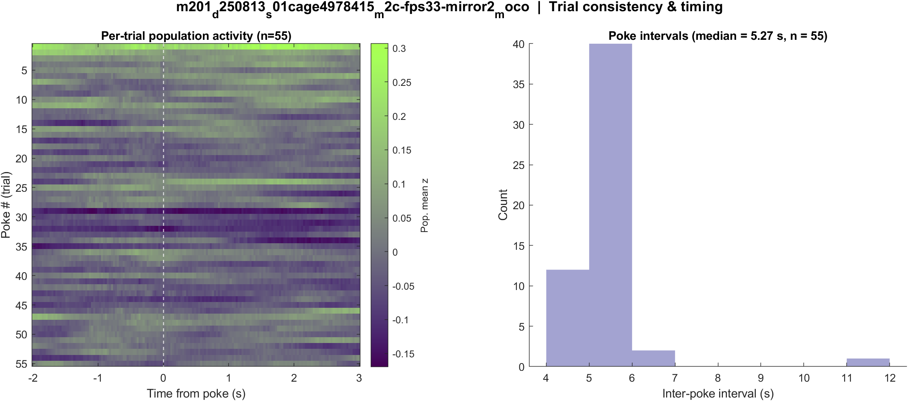
Fig5 Trial raster and poke interval | mouse2c s01 20 mW/cm2 mirror2
What: One row per poke (population z over time) and the histogram of time between detected pokes.
Result: 56 pokes detected in this movie; intervals near 5.3 s, with occasional missed peaks.

Slide 53
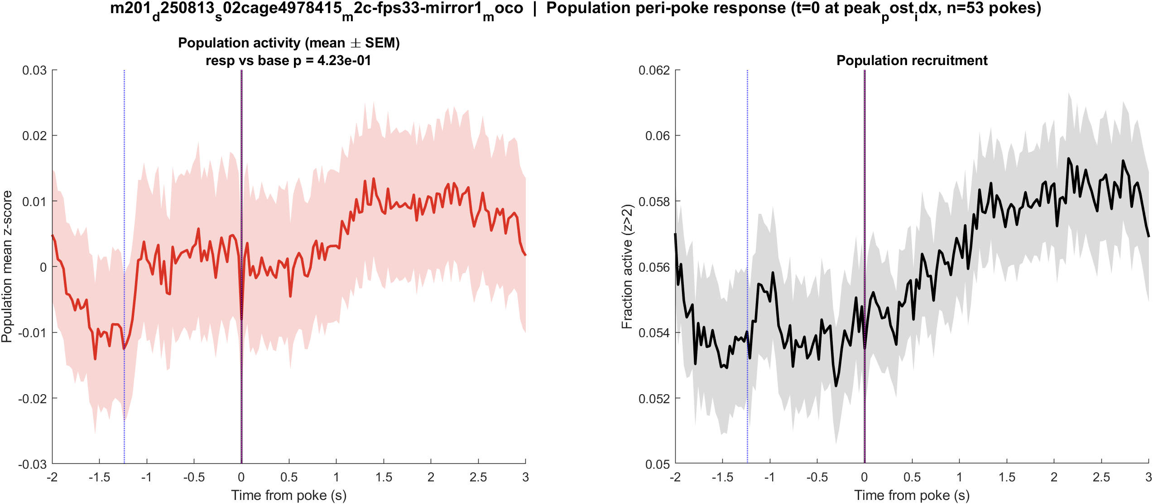
Fig1 Population PSTH | mouse2c s02 power TBD mirror1
What: Mean population activity (z-score) and fraction of active cells, aligned to each poke (t = 0 is peak_post_idx).
Result: This FOV has 1407 neurons and 55 pokes; the population pre vs post test is not significant (p = 0.423).

Slide 54
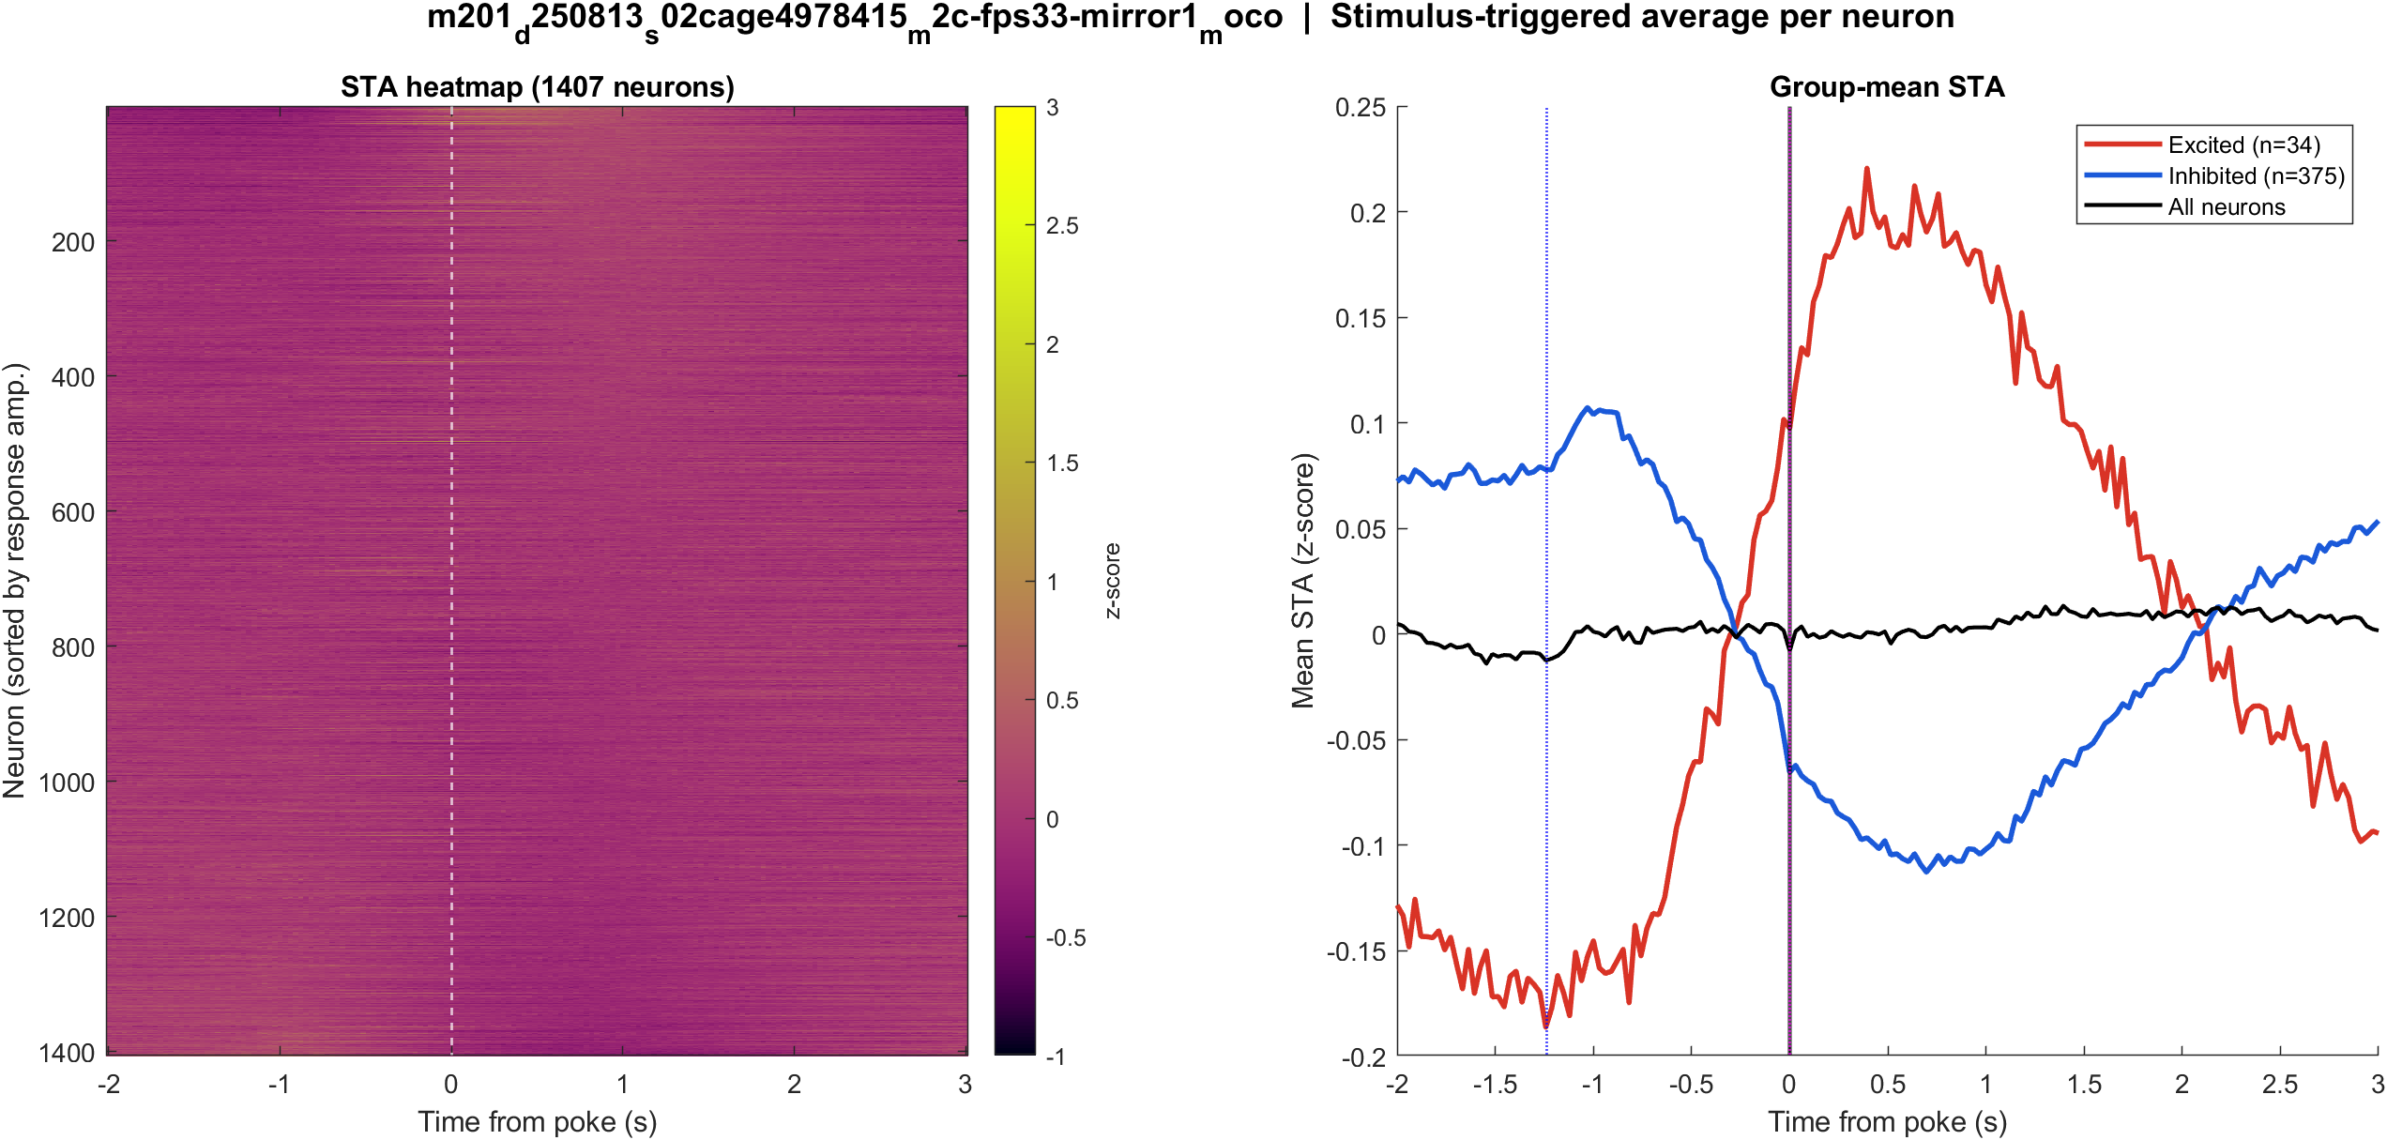
Fig2 Neuron STA | mouse2c s02 power TBD mirror1
What: Each neuron’s average trace around the poke, sorted by response size; right panel is the mean of excited vs inhibited cells.
Result: Excited 2.4% and inhibited 26.7% of 1407 neurons; see the STA split on the right.

Slide 55
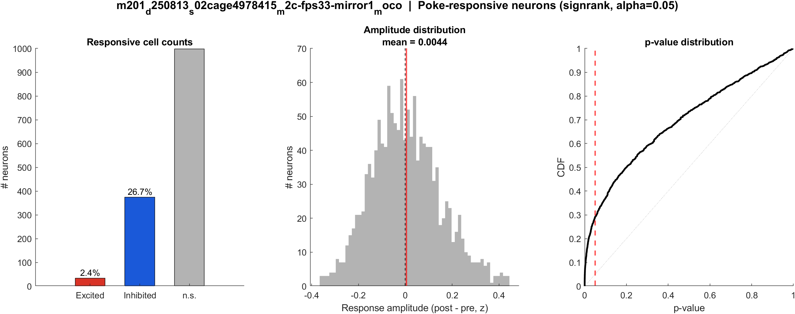
Fig3 Excited vs inhibited cells | mouse2c s02 power TBD mirror1
What: Per neuron: mean z in 0.4–1.2 s after t=0 vs -2–0 s before; signed-rank, p<0.05, sign of the difference.
Result: 2.4% excited, 26.7% inhibited out of 1407 neurons; population test not significant (p = 0.423).

Slide 56

Fig4 Spatial poke-response map | mouse2c s02 power TBD mirror1
What: Each neuron’s post−pre amplitude is painted onto its EXTRACT footprint. Red = excited, blue = inhibited. Left: anatomy. Middle: all cells. Right: p<0.05 only.
Result: Red = excited, blue = inhibited on this FOV (2.4% exc, 26.7% inh of 1407 neurons).

Slide 57
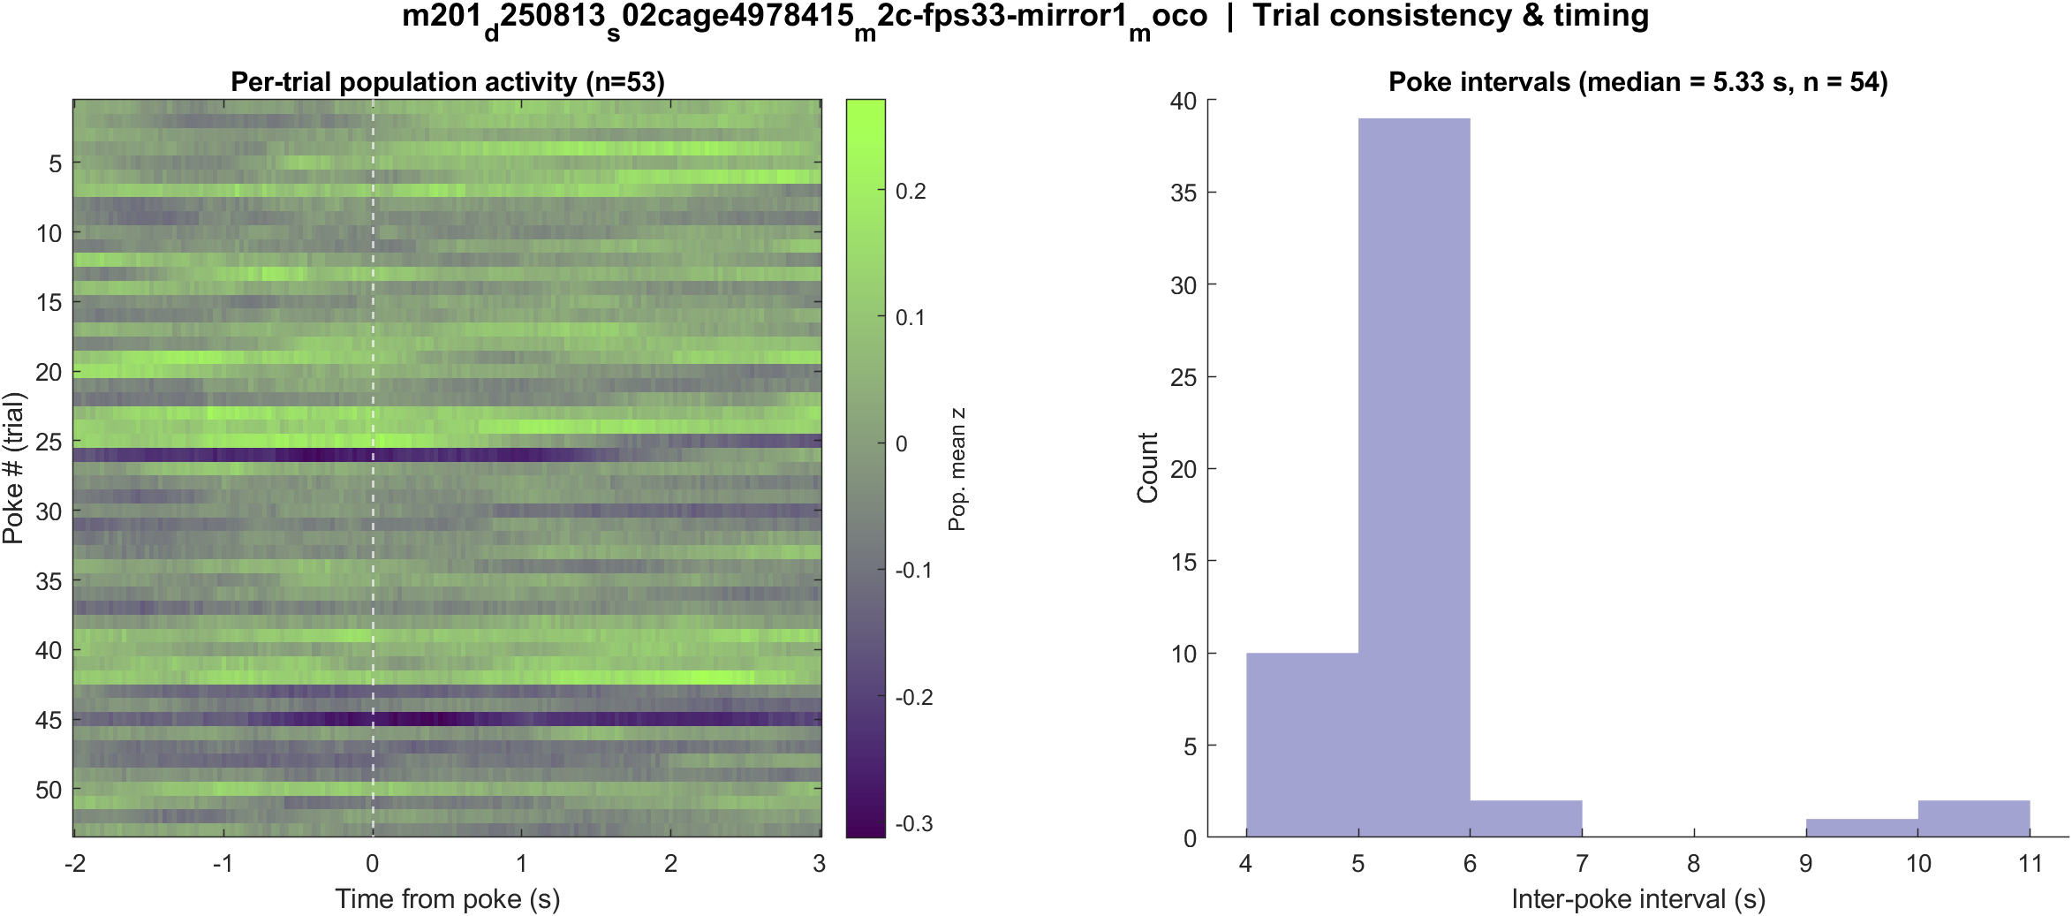
Fig5 Trial raster and poke interval | mouse2c s02 power TBD mirror1
What: One row per poke (population z over time) and the histogram of time between detected pokes.
Result: 55 pokes detected in this movie; intervals near 5.3 s, with occasional missed peaks.

Slide 58
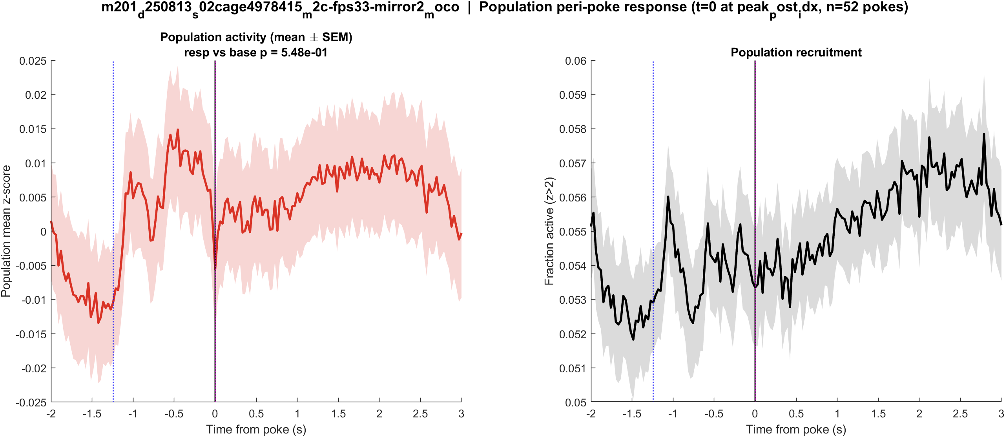
Fig1 Population PSTH | mouse2c s02 power TBD mirror2
What: Mean population activity (z-score) and fraction of active cells, aligned to each poke (t = 0 is peak_post_idx).
Result: This FOV has 2040 neurons and 54 pokes; the population pre vs post test is not significant (p = 0.548).

Slide 59
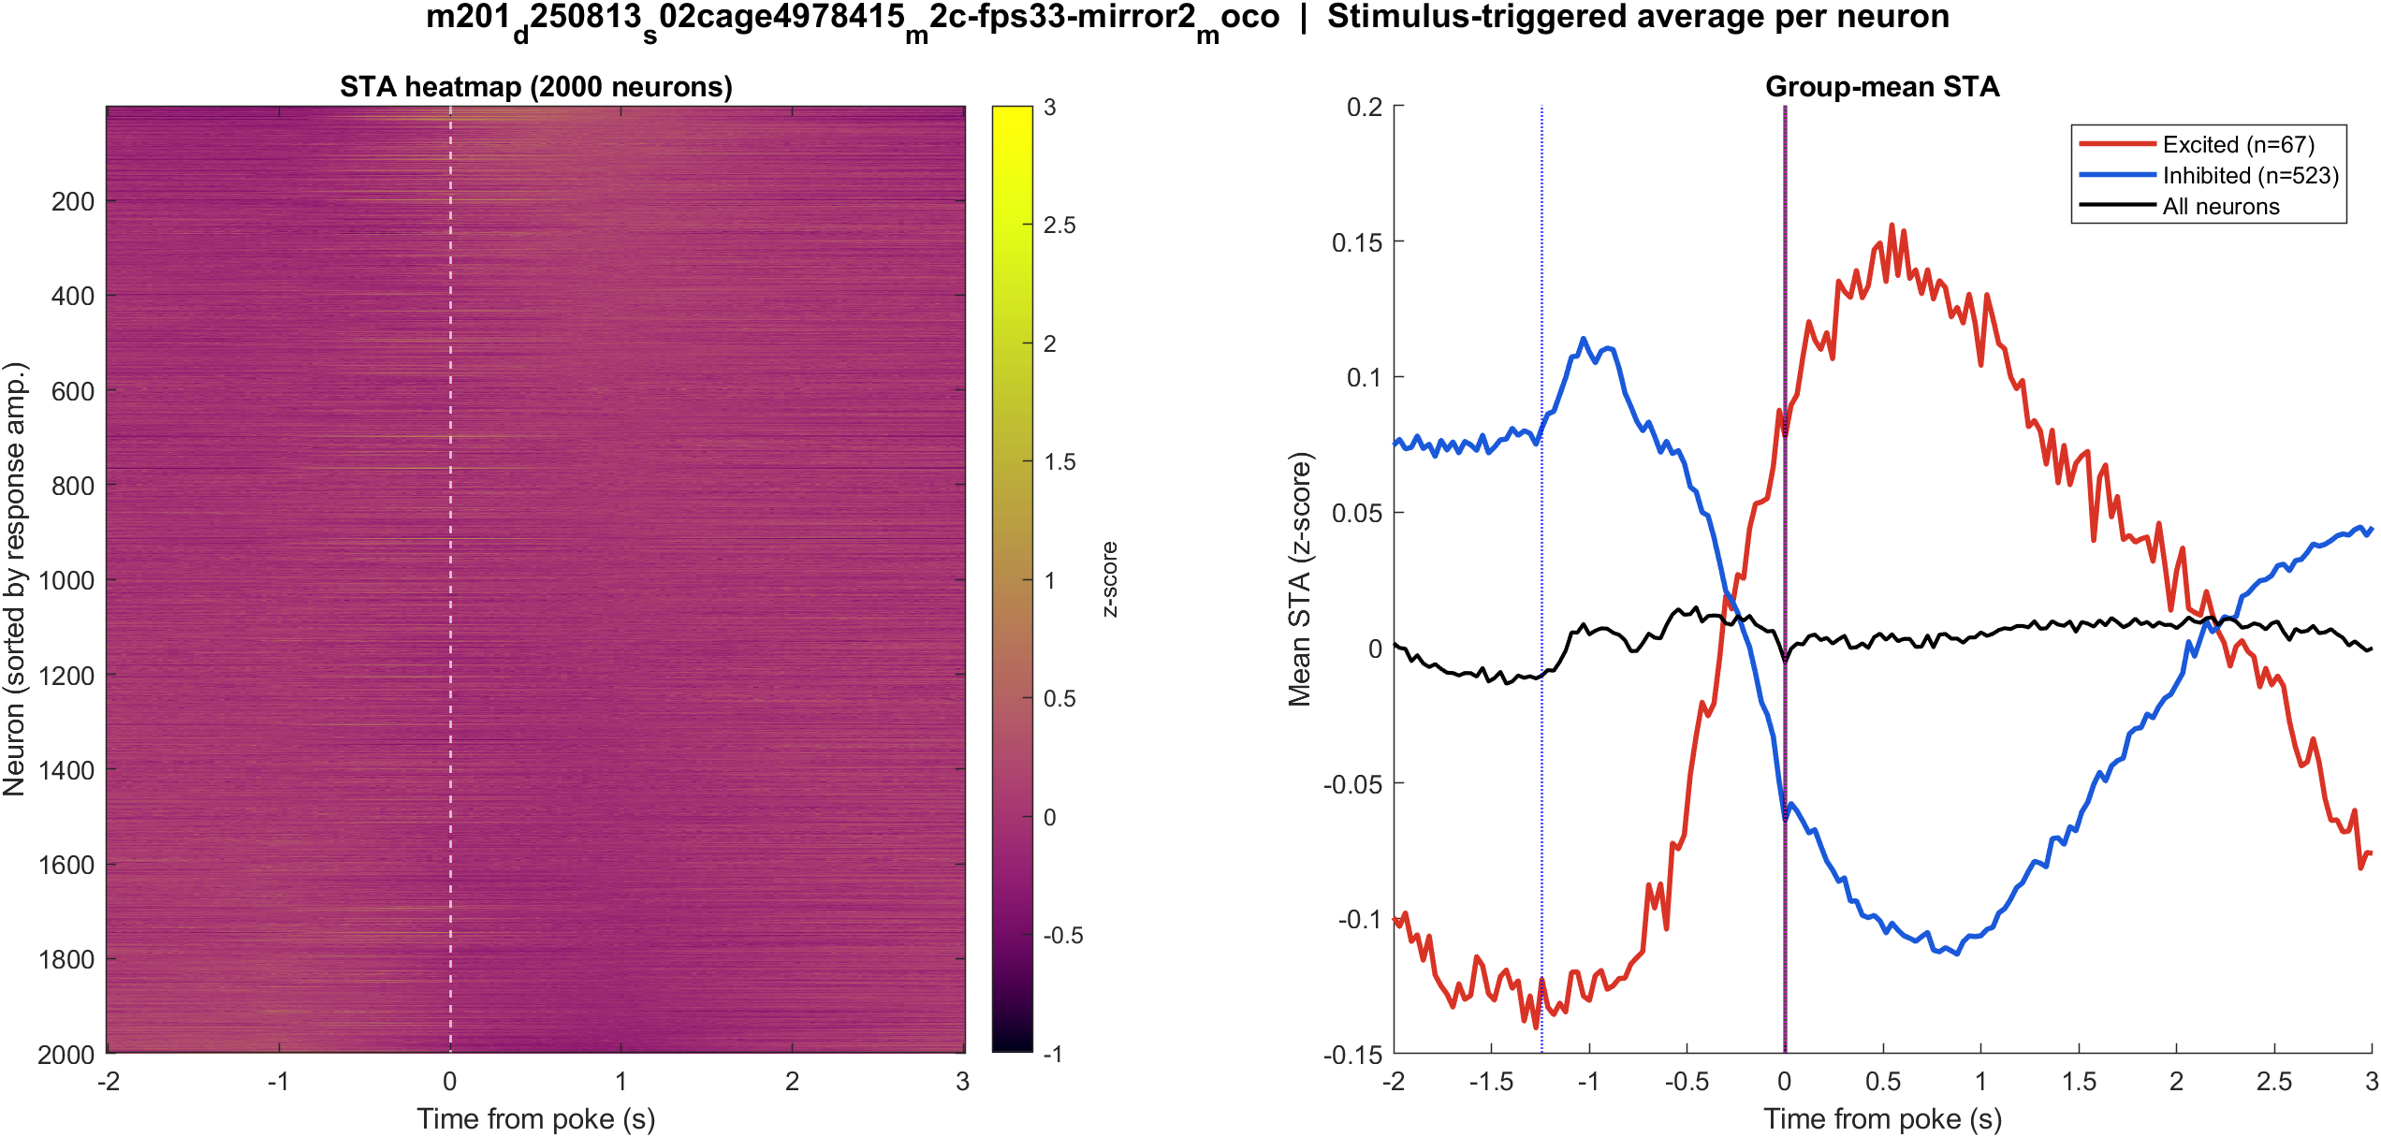
Fig2 Neuron STA | mouse2c s02 power TBD mirror2
What: Each neuron’s average trace around the poke, sorted by response size; right panel is the mean of excited vs inhibited cells.
Result: Excited 3.3% and inhibited 25.6% of 2040 neurons; see the STA split on the right.

Slide 60
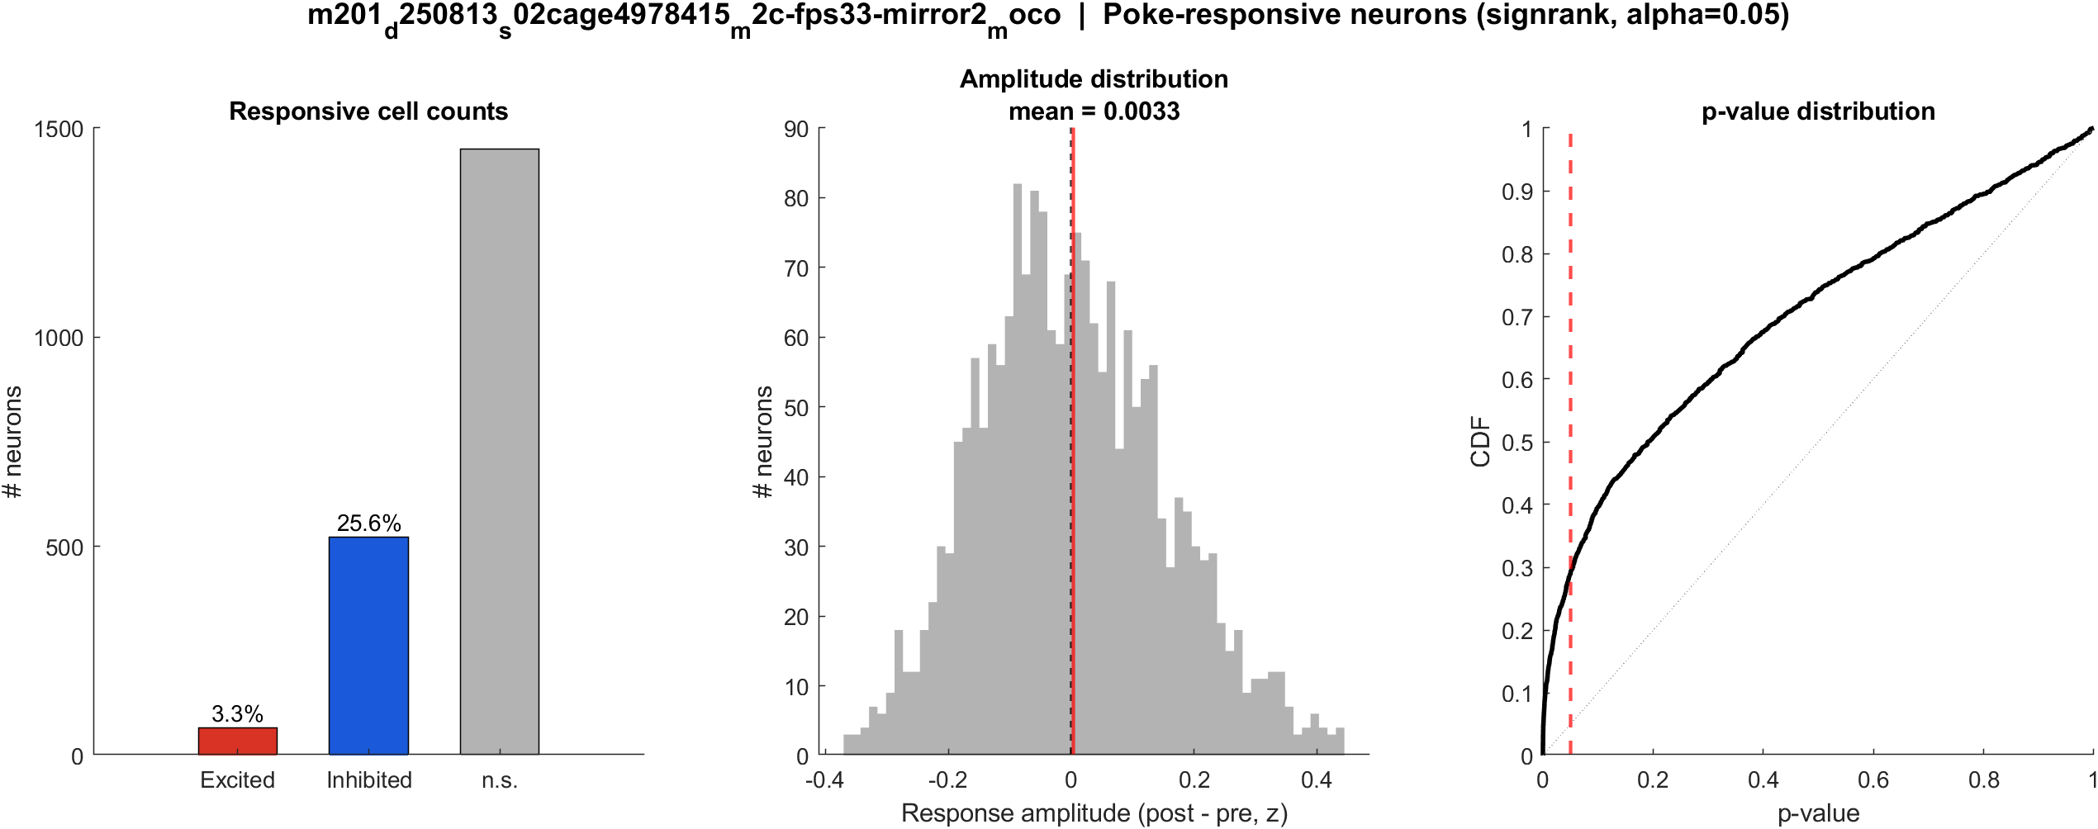
Fig3 Excited vs inhibited cells | mouse2c s02 power TBD mirror2
What: Per neuron: mean z in 0.4–1.2 s after t=0 vs -2–0 s before; signed-rank, p<0.05, sign of the difference.
Result: 3.3% excited, 25.6% inhibited out of 2040 neurons; population test not significant (p = 0.548).

Slide 61

Fig4 Spatial poke-response map | mouse2c s02 power TBD mirror2
What: Each neuron’s post−pre amplitude is painted onto its EXTRACT footprint. Red = excited, blue = inhibited. Left: anatomy. Middle: all cells. Right: p<0.05 only.
Result: Red = excited, blue = inhibited on this FOV (3.3% exc, 25.6% inh of 2040 neurons).

Slide 62
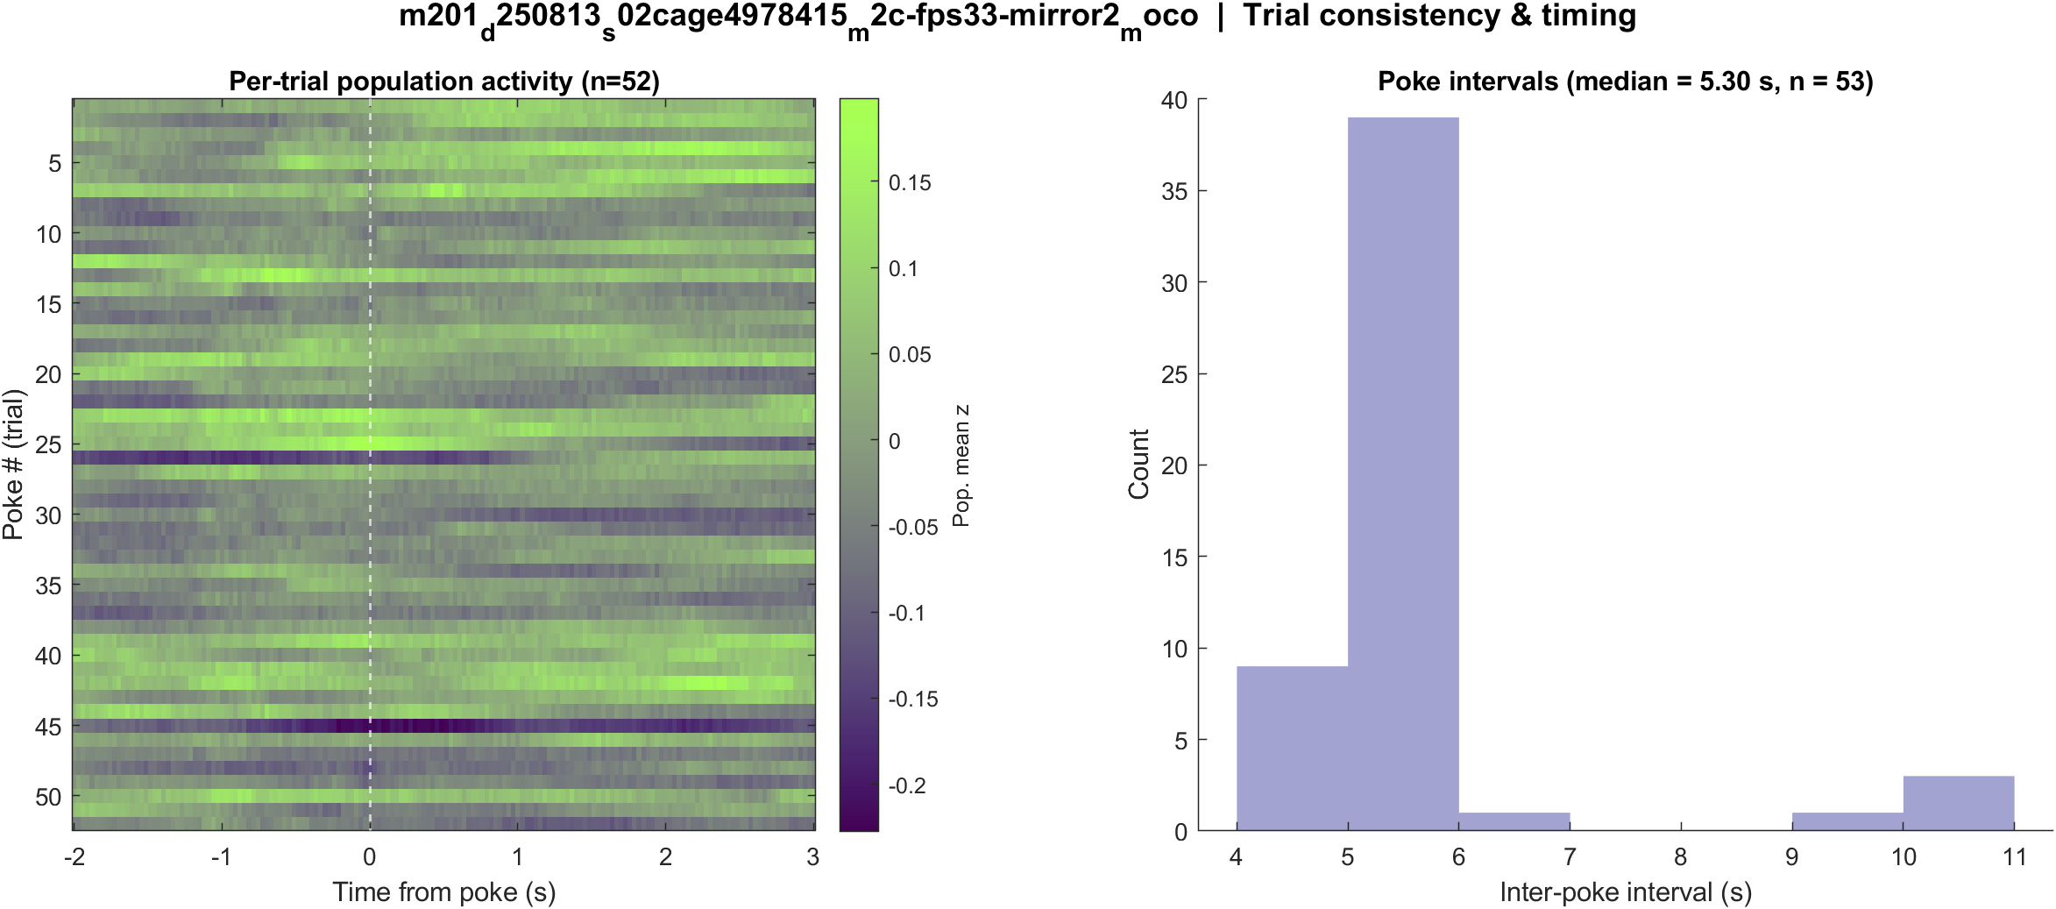
Fig5 Trial raster and poke interval | mouse2c s02 power TBD mirror2
What: One row per poke (population z over time) and the histogram of time between detected pokes.
Result: 54 pokes detected in this movie; intervals near 5.3 s, with occasional missed peaks.

Slide 63
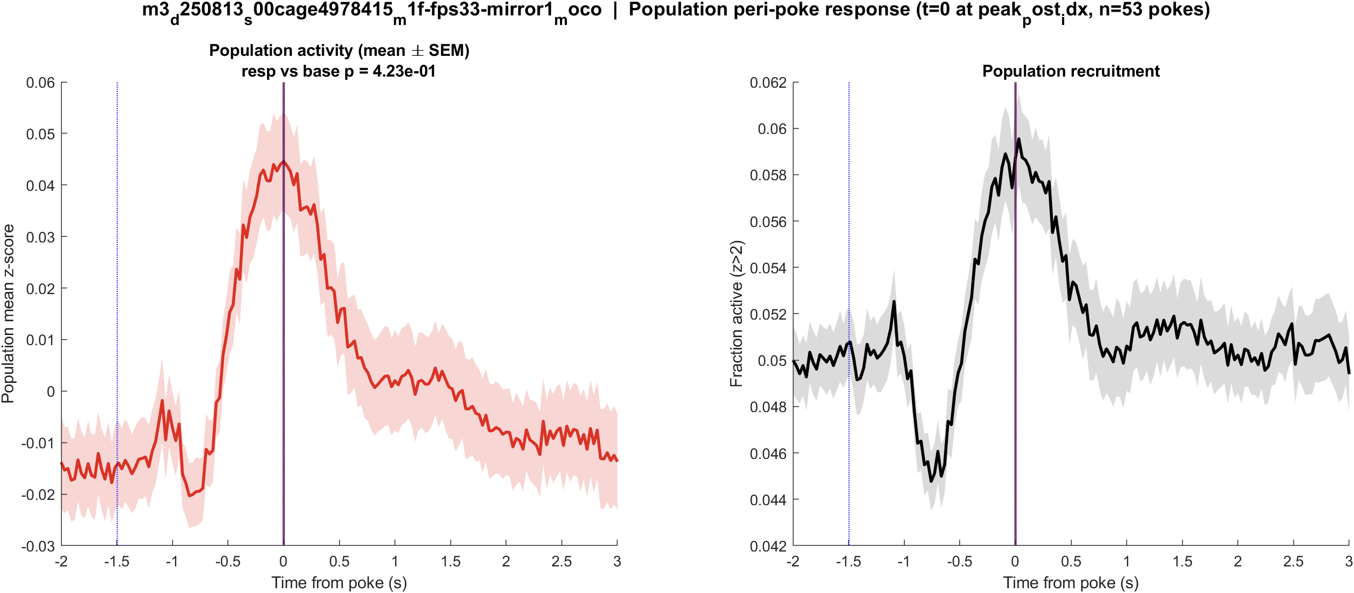
Fig1 Population PSTH | m3 (LabVIEW m1f) s00 mirror1
What: Mean population activity (z-score) and fraction of active cells, aligned to each poke (t = 0 is peak_post_idx).
Result: This FOV has 1537 neurons and 55 pokes; the population pre vs post test is not significant (p = 0.423).

Slide 64
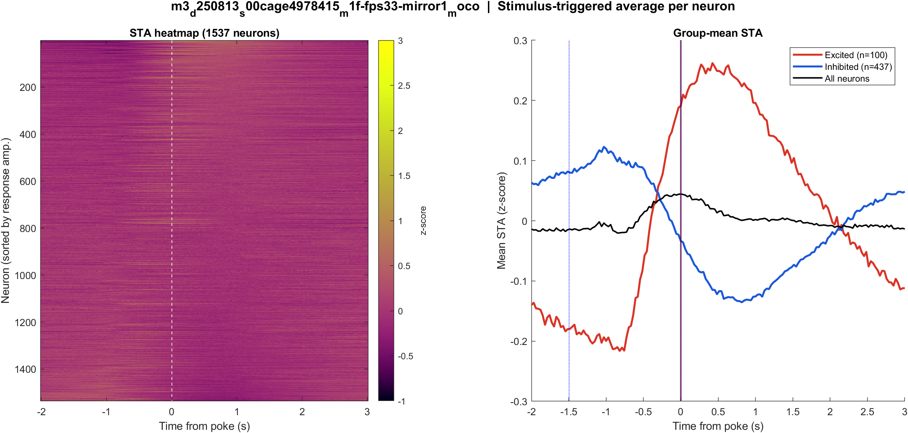
Fig2 Neuron STA | m3 (LabVIEW m1f) s00 mirror1
What: Each neuron’s average trace around the poke, sorted by response size; right panel is the mean of excited vs inhibited cells.
Result: Excited 6.5% and inhibited 28.4% of 1537 neurons; see the STA split on the right.

Slide 65
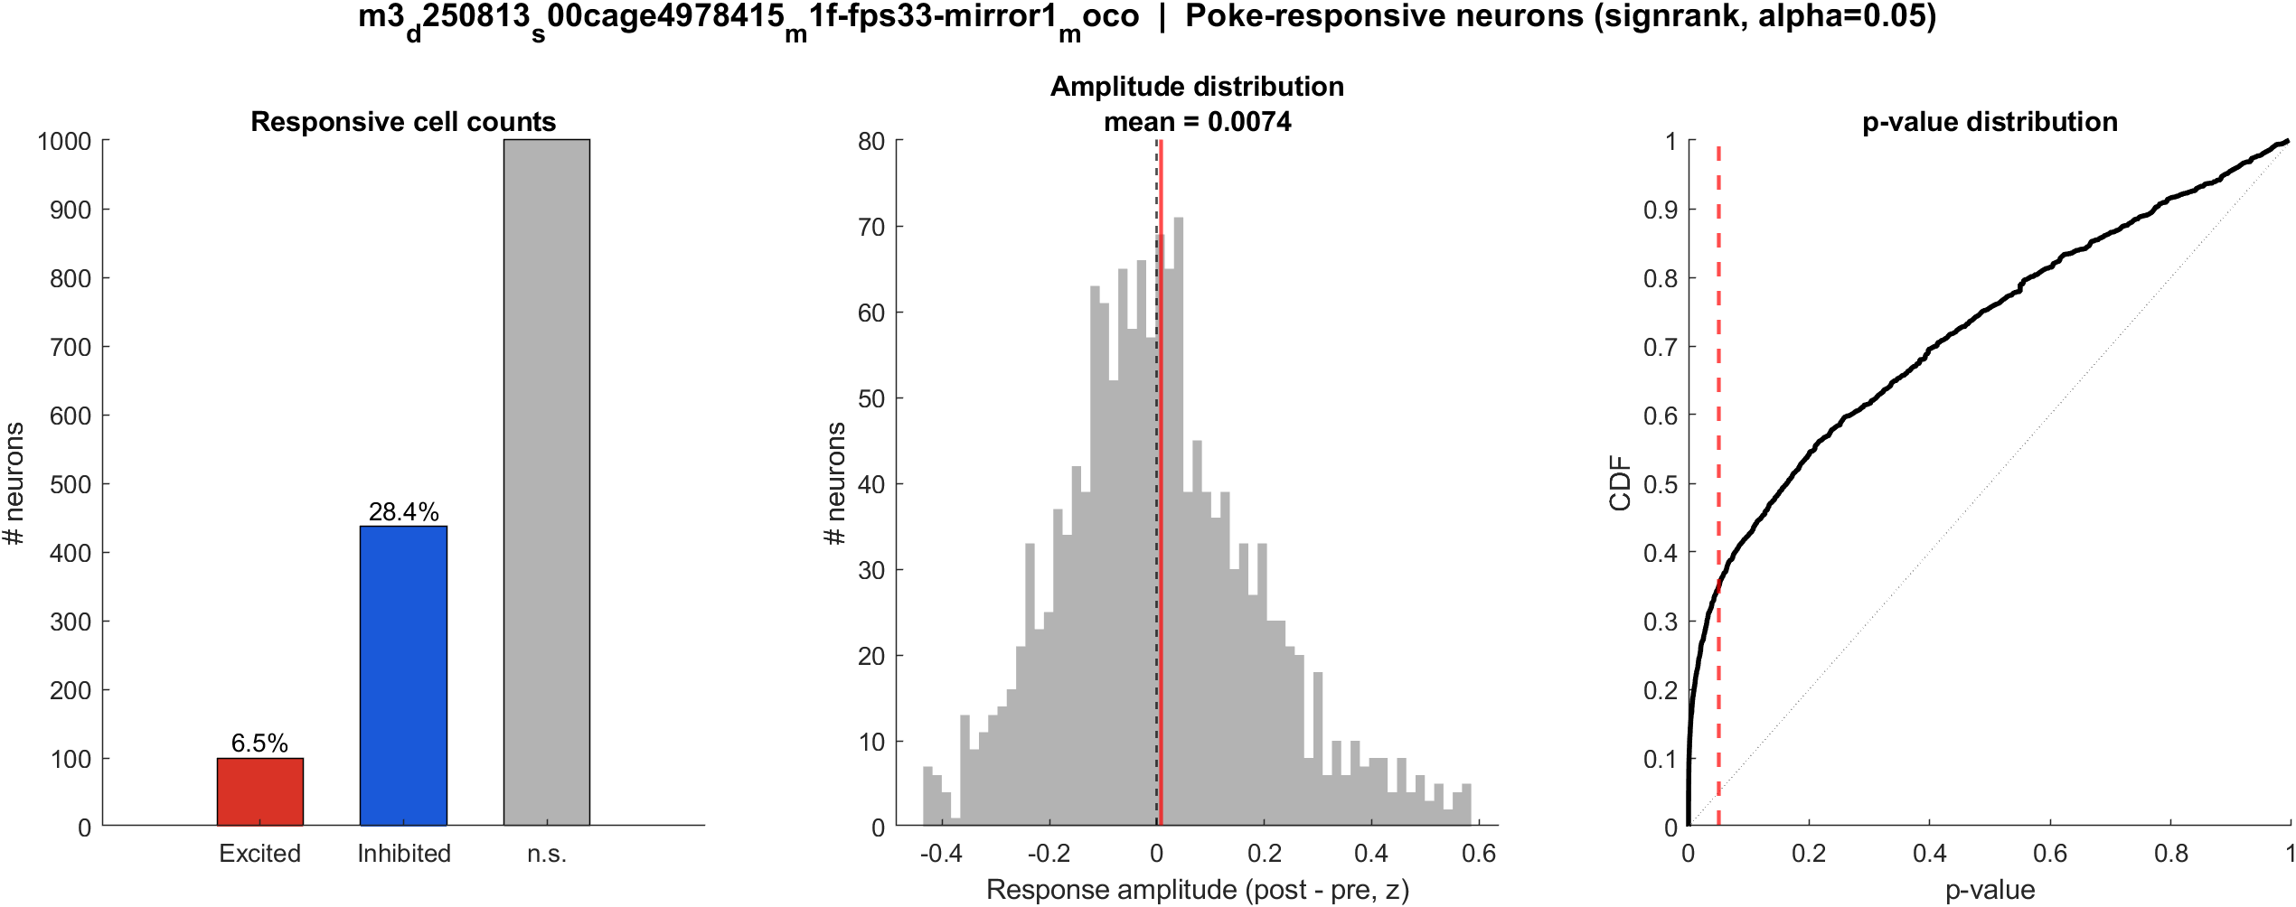
Fig3 Excited vs inhibited cells | m3 (LabVIEW m1f) s00 mirror1
What: Per neuron: mean z in 0.4–1.2 s after t=0 vs -2–0 s before; signed-rank, p<0.05, sign of the difference.
Result: 6.5% excited, 28.4% inhibited out of 1537 neurons; population test not significant (p = 0.423).

Slide 66

Fig4 Spatial poke-response map | m3 (LabVIEW m1f) s00 mirror1
What: Each neuron’s post−pre amplitude is painted onto its EXTRACT footprint. Red = excited, blue = inhibited. Left: anatomy. Middle: all cells. Right: p<0.05 only.
Result: Red = excited, blue = inhibited on this FOV (6.5% exc, 28.4% inh of 1537 neurons).

Slide 67
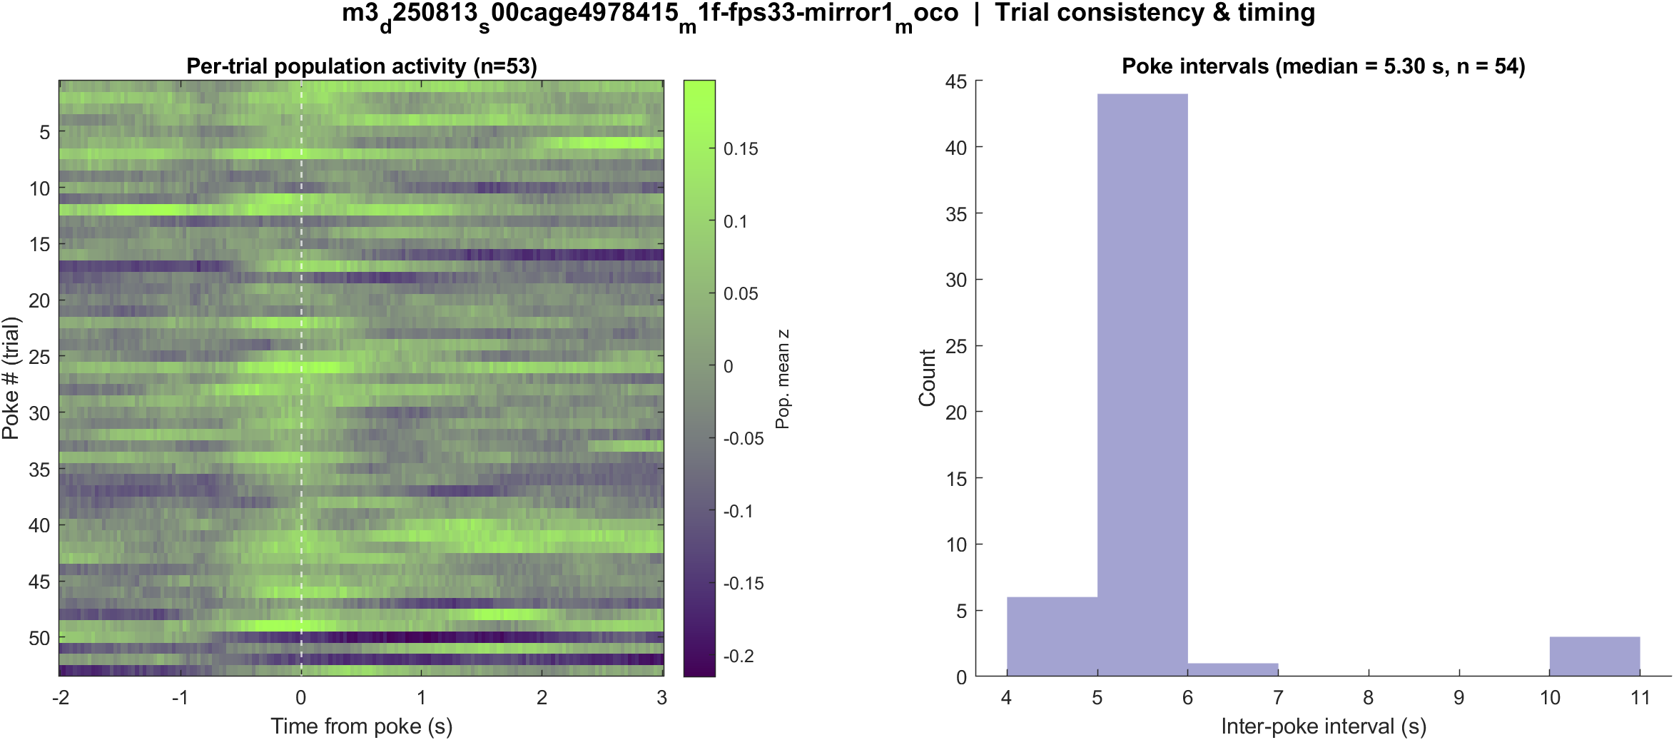
Fig5 Trial raster and poke interval | m3 (LabVIEW m1f) s00 mirror1
What: One row per poke (population z over time) and the histogram of time between detected pokes.
Result: 55 pokes detected in this movie; intervals near 5.3 s, with occasional missed peaks.

Slide 68
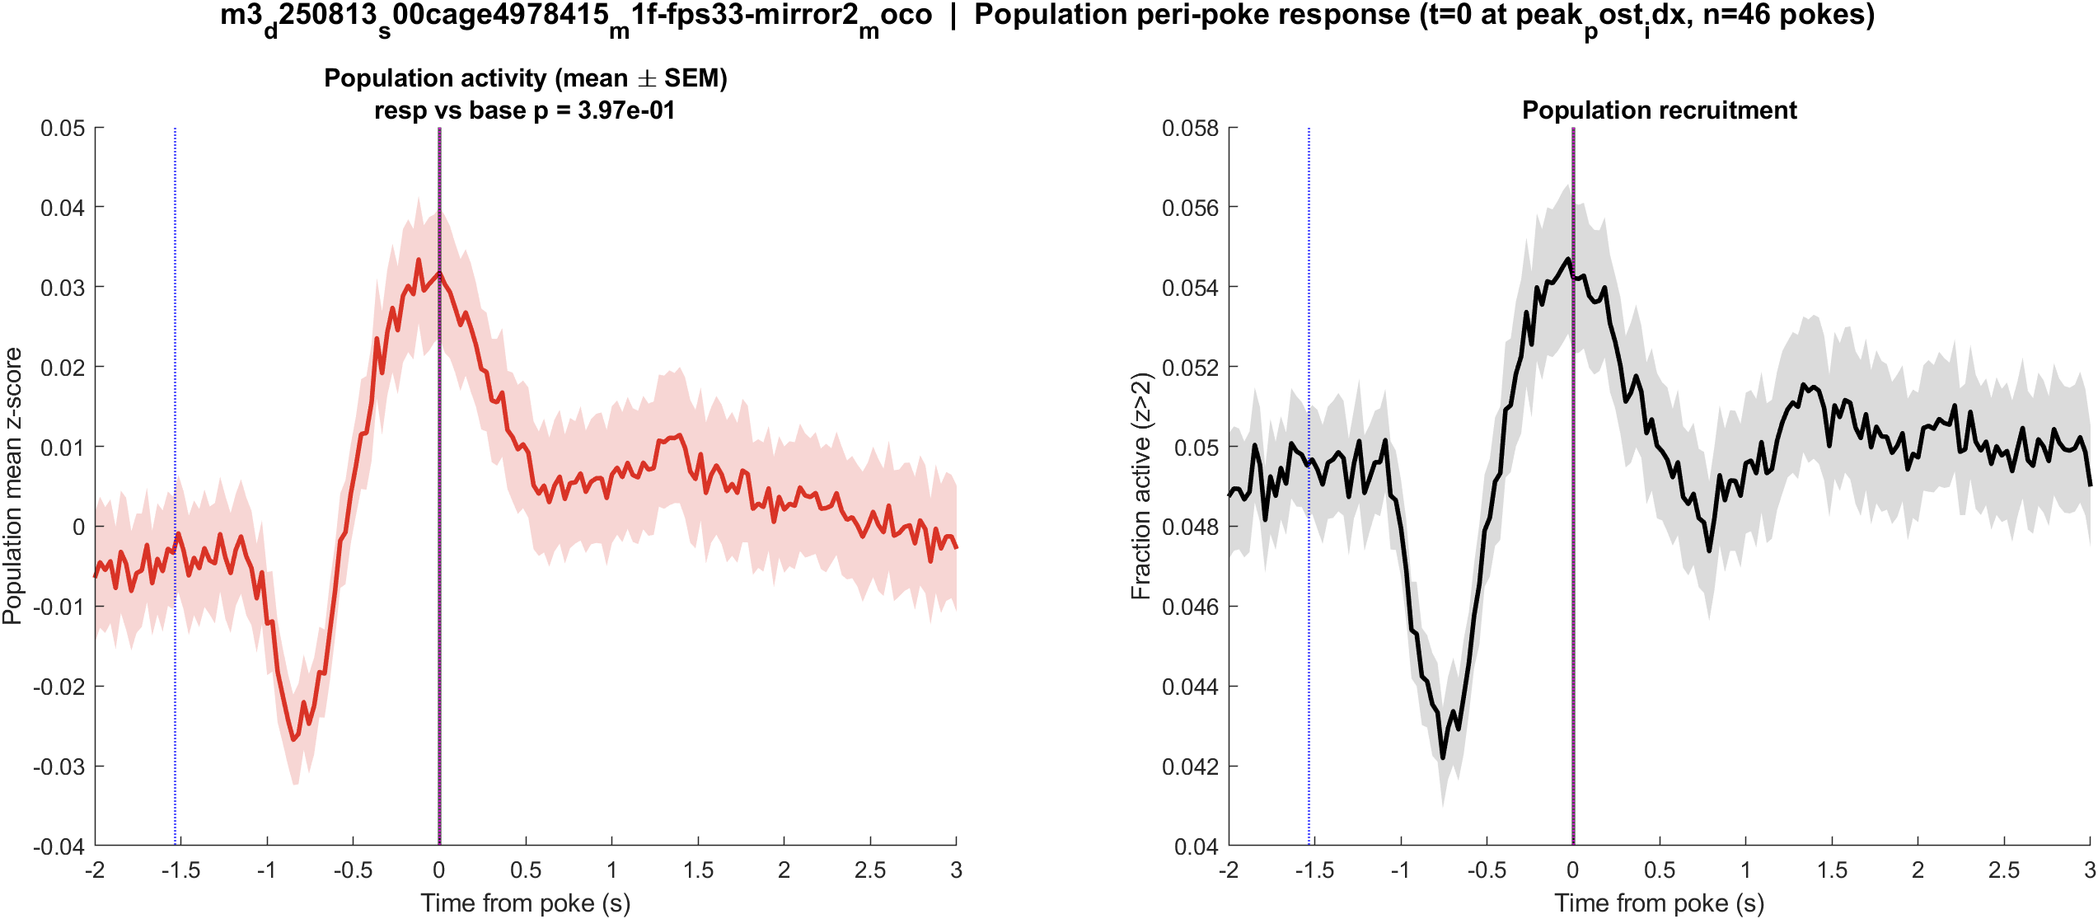
Fig1 Population PSTH | m3 (LabVIEW m1f) s00 mirror2
What: Mean population activity (z-score) and fraction of active cells, aligned to each poke (t = 0 is peak_post_idx).
Result: This FOV has 2148 neurons and 48 pokes; the population pre vs post test is not significant (p = 0.397).

Slide 69

Fig2 Neuron STA | m3 (LabVIEW m1f) s00 mirror2
What: Each neuron’s average trace around the poke, sorted by response size; right panel is the mean of excited vs inhibited cells.
Result: Excited 6.2% and inhibited 23.3% of 2148 neurons; see the STA split on the right.

Slide 70

Fig3 Excited vs inhibited cells | m3 (LabVIEW m1f) s00 mirror2
What: Per neuron: mean z in 0.4–1.2 s after t=0 vs -2–0 s before; signed-rank, p<0.05, sign of the difference.
Result: 6.2% excited, 23.3% inhibited out of 2148 neurons; population test not significant (p = 0.397).

Slide 71

Fig4 Spatial poke-response map | m3 (LabVIEW m1f) s00 mirror2
What: Each neuron’s post−pre amplitude is painted onto its EXTRACT footprint. Red = excited, blue = inhibited. Left: anatomy. Middle: all cells. Right: p<0.05 only.
Result: Red = excited, blue = inhibited on this FOV (6.2% exc, 23.3% inh of 2148 neurons).

Slide 72

Fig5 Trial raster and poke interval | m3 (LabVIEW m1f) s00 mirror2
What: One row per poke (population z over time) and the histogram of time between detected pokes.
Result: 48 pokes detected in this movie; intervals near 5.3 s, with occasional missed peaks.

Slide 73
Next
Compare pre (onset candidate) and peak (strongest neural lock) decks; post is mainly a negative control for timing. FOVs are not aligned across mice or mirrors.

