Slide 1
Face poking on crystal skull
13 Aug vs 18 Aug | same peri-poke analysis | different t = 0
Take-home: cortex is poke-locked on both days, with more inhibited than excited cells and an anterior-excited / posterior-inhibited bias. The PSTH shape change is mostly the timing marker (peak vs dip), not a different behavior.

Slide 2
Experiment
Whole dorsal cortex Ca2+ imaging while a motor arm pokes the face. Both days are poking sessions (no no-poke baseline). m1f and m2c were imaged on both days; m3 only on 13 Aug. mirror1 / mirror2 are two optical paths.

Slide 3
The only intended difference is t = 0
No behavior camera. A blocker on the arm changes mean-frame intensity. 13 Aug peak_idx = positive brightness peak. 18 Aug peak_idx = single-frame intensity DIP (Omer). Analysis windows are identical: -2 to +3 s peri, 0.4–1.2 s vs -2–0 s, Wilcoxon signed-rank.

Slide 4
How traces and maps are made
EXTRACT temporal_weights at 33 Hz. Spatial maps use Omer's EXTRACT spatial_weights (footprints reconstructed from the ndSparse CSC in each *_ext.mat). Red = excited, blue = inhibited. mirror2 is flipped so anterior is on the RIGHT (P left, A right).

Slide 5
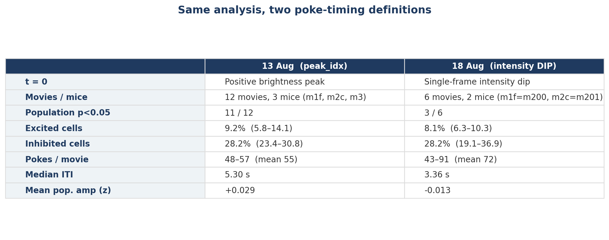
Numbers at a glance
What: Same cell-classification windows on both days. 18 Aug has fewer movies, a shorter ITI, and a dip-based t = 0.
Result: Population lock is tighter on 13 Aug (11/12 movies) than 18 Aug (3/6), but the exc < inh split is the same direction both days.

Slide 6
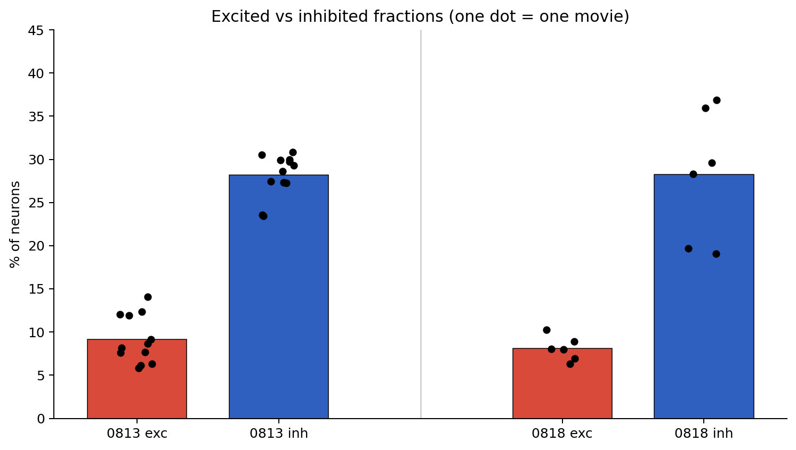
Excited vs inhibited fractions
What: Each black dot is one movie. Red bars = mean % excited; blue bars = mean % inhibited.
Result: Inhibition dominates on both days (~6–14% excited vs ~19–37% inhibited). 18 Aug m201 is especially inhibition-heavy.

Slide 7

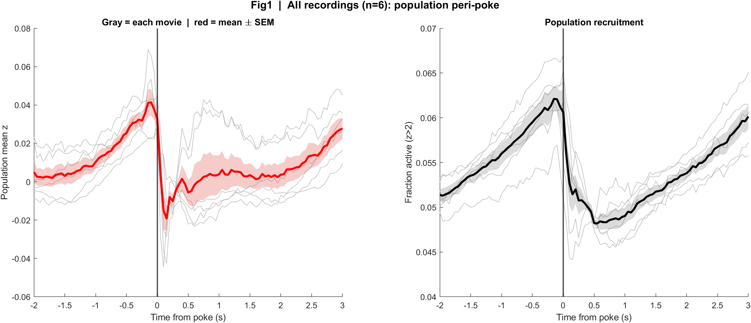
Fig1 Population PSTH
What: Mean population z and fraction active, aligned to each poke.
Result: 13 Aug: sharp transient at t=0, dip, rebound ~0.8 s. 18 Aug: activity already rising before t=0, then a crash at the dip.
13 Aug | t = 0 is the brightness peak
18 Aug | t = 0 is the intensity dip

Slide 8

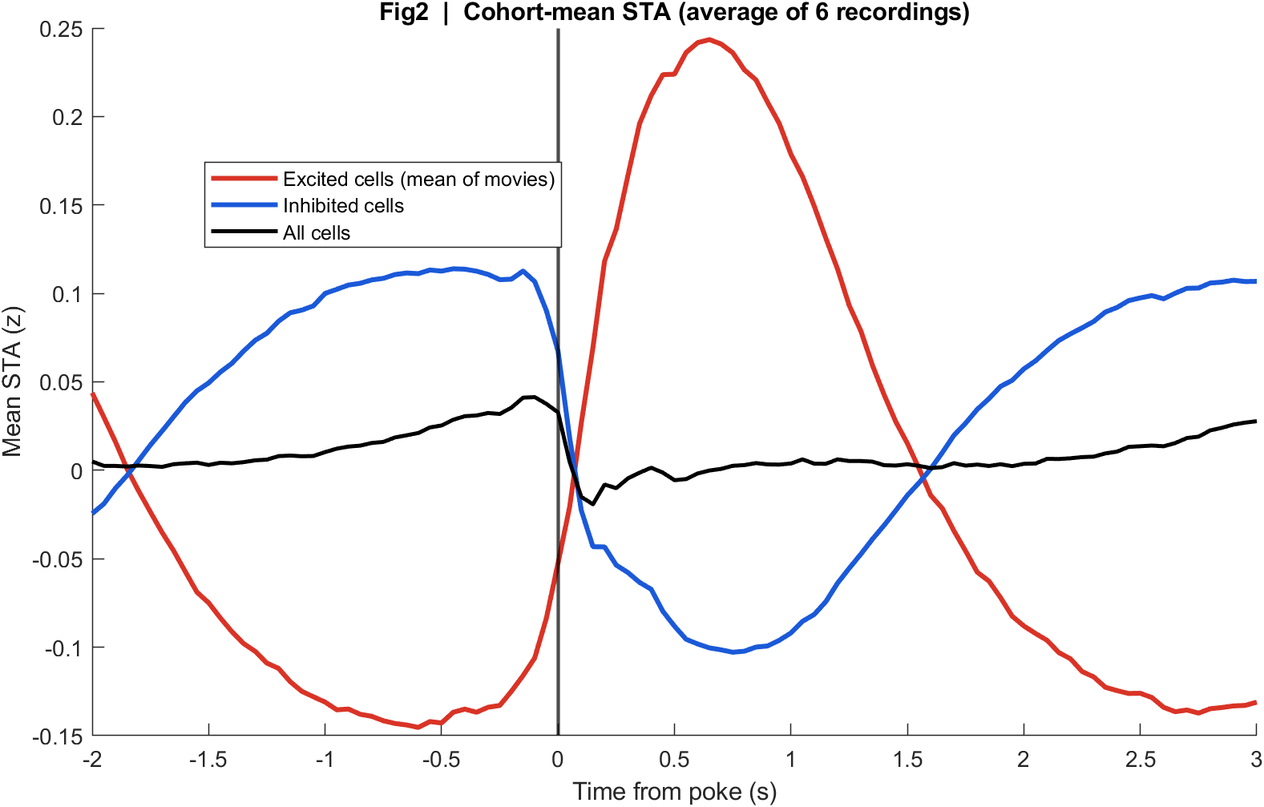
Fig2 Neuron STA
What: Cohort-mean stimulus-triggered averages of excited, inhibited, and all cells.
Result: Both days split into an up group and a down group. The all-cell mean is modest because they cancel — more completely on 18 Aug.
13 Aug
18 Aug

Slide 9

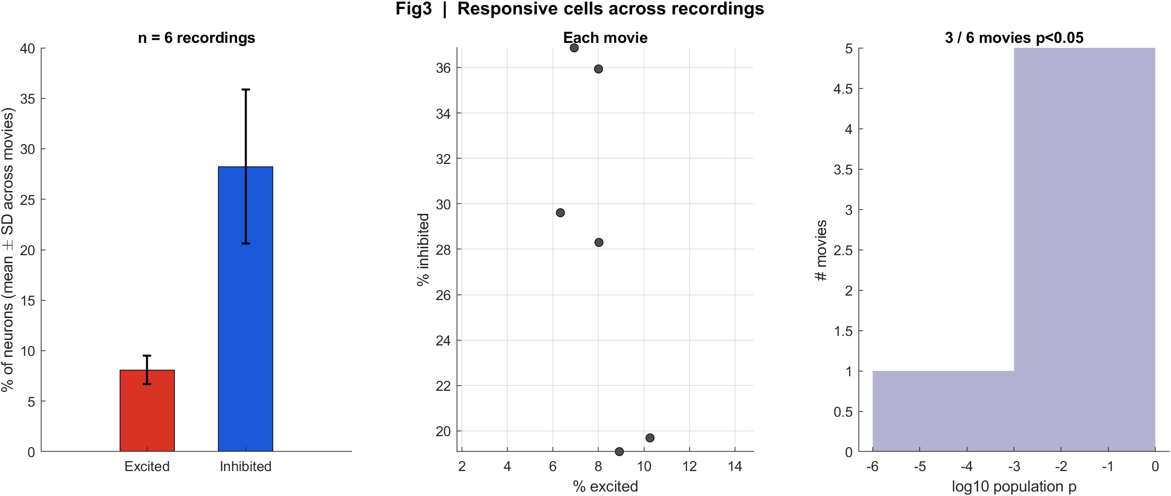
Fig3 Excited vs inhibited cells
What: Per neuron: 0.4–1.2 s after t=0 vs -2–0 s before; signed-rank p<0.05.
Result: 13 Aug: 11/12 movies significant. 18 Aug: 3/6 (both m201 s00, plus m201 s01 mirror1). m200 on 18 Aug is not significant (missed dips).
13 Aug
18 Aug

Slide 10
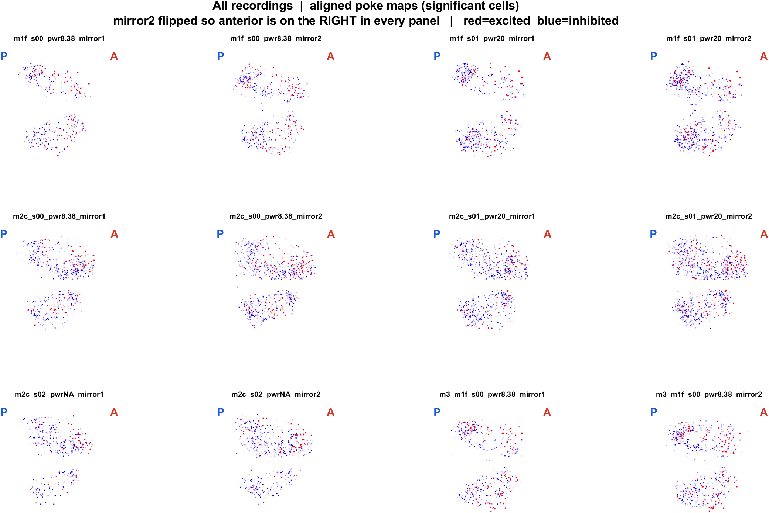
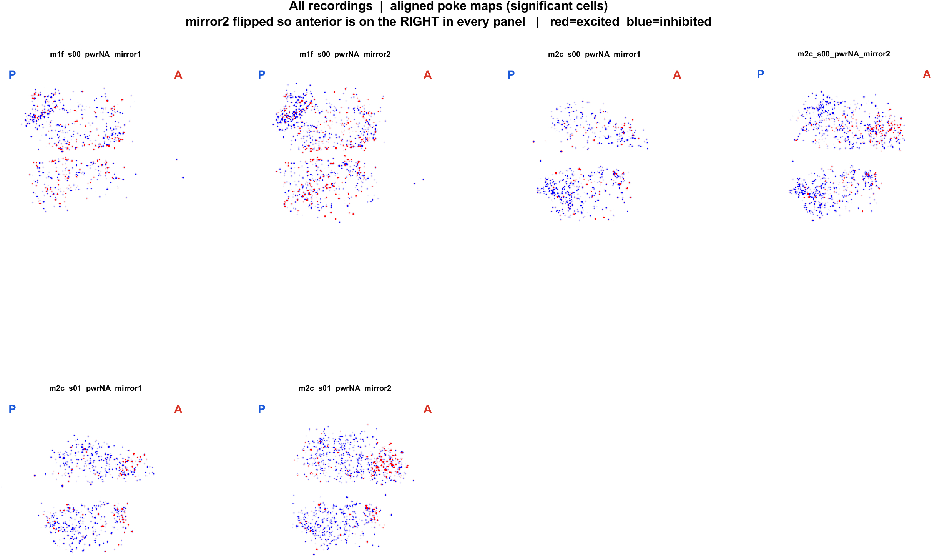
Fig4 Spatial maps (aligned, significant cells)
What: EXTRACT footprints x poke amplitude. mirror2 flipped. P = posterior (left), A = anterior (right).
Result: Cells are locally intermingled on both days. After the same AP alignment, anterior tends to be more excited and posterior more inhibited.
13 Aug | 12 FOVs
18 Aug | 6 FOVs

Slide 11

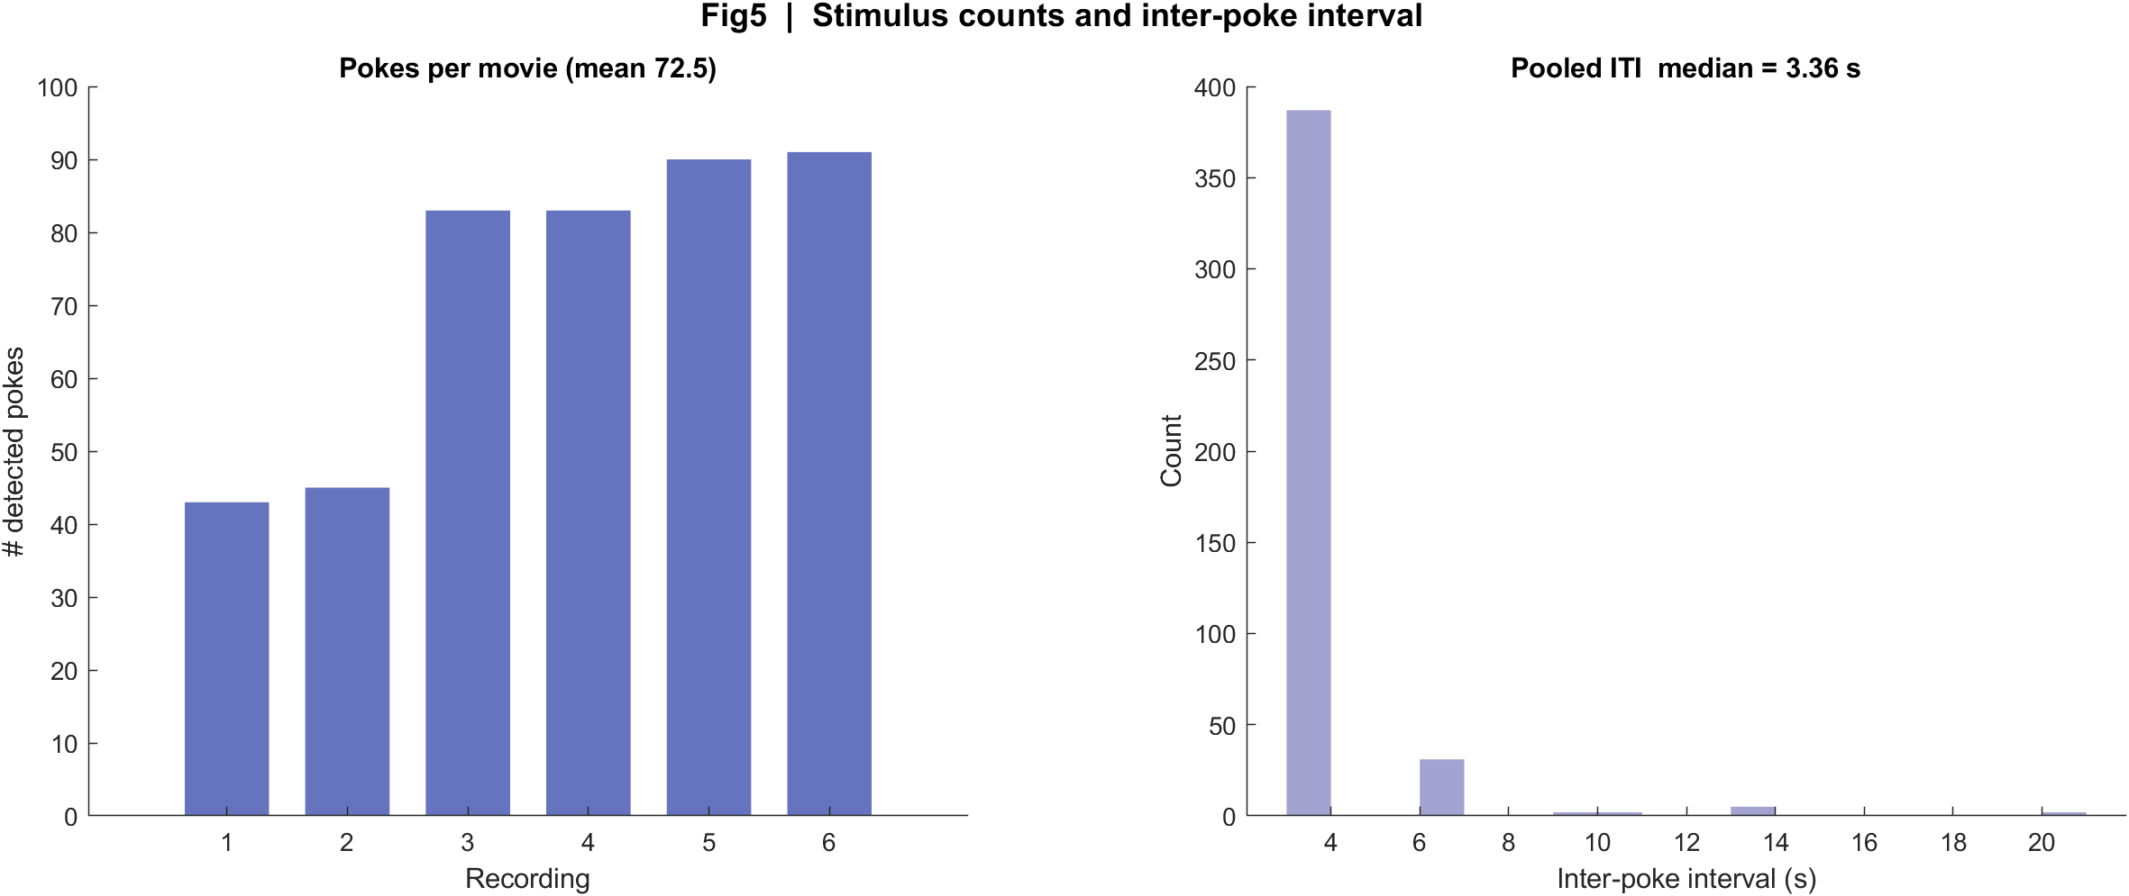
Fig5 Poke counts and interval
What: Detected events per movie and the histogram of time between events.
Result: 13 Aug median ITI 5.30 s (~48–57 pokes). 18 Aug median 3.36 s; m201 is dense (~83–91), m200 has ~20 s gaps from missed dips.
13 Aug
18 Aug

Slide 12
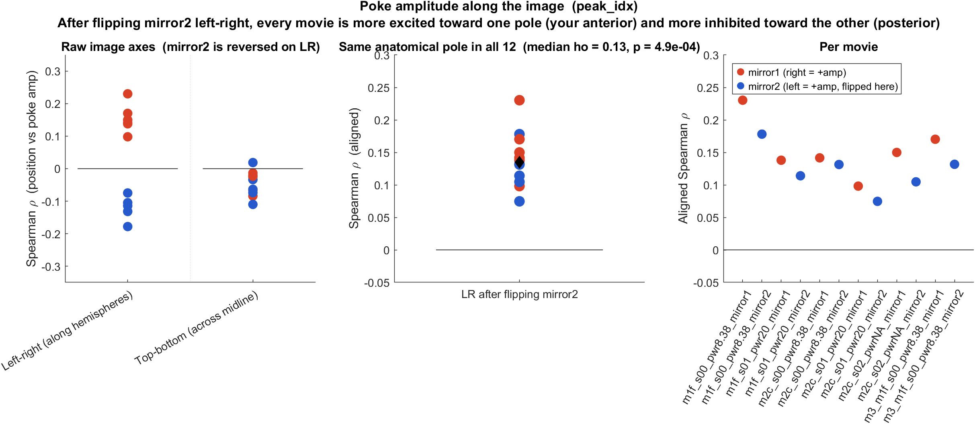
Anterior–posterior bias | 13 Aug
What: Spearman ρ between each cell's LR position and poke amplitude. After flipping mirror2, anterior is to the right in every movie.
Result: 12/12 movies ρ > 0 (median 0.13, signrank p = 4.9e-4): anterior more excited, posterior more inhibited. Not a CCF registration — AP is the LR axis along the hemispheres.

Slide 13
Interpretation
• This is one poking cortex, not two different experiments. The cell split (more inh than exc) and the mixed spatial map repeat across days.
• PSTH shape follows the marker: 13 Aug peak sits on a neural transient; 18 Aug dip sits on a crash after activity has already risen — so the dip is a later (or darker) landmark, not a weaker poke.
• 18 Aug looks statistically weaker (3/6 vs 11/12) for three technical reasons: dip-based t=0, shorter 3.36 s ITI overlapping the [-2, 3] s window, and missed dips on m200.
• Mean population amplitude near zero is cancellation (red vs blue cells), not 'no response'. That is why the maps are more informative than the all-cell PSTH.
• Skin-contact time is still not proven. 13 Aug peak is the strongest neural lock; 18 Aug dip is Omer's physical guess for that day. Do not treat either as ground-truth onset without a behavior camera.

Slide 14
What we should not over-claim
• FOV is not CCF/bregma registered. 'Anterior' means the right side after aligning mirror2 to mirror1, along the hemispheres.
• Power is labeled only on 13 Aug (s00 = 8.38, s01 = 20 mW/cm2). Do not copy those values onto 18 Aug.
• m200 on 18 Aug failing the population test is consistent with missed dips, not evidence that this mouse has no poke map (its spatial map still shows mixed red/blue).
• We reconstructed EXTRACT spatial_weights from the file (CSC). That is Omer's footprint matrix, not a new segmentation.

Slide 15
13 Aug in one place
t = 0 is peak_idx (positive brightness peak) | 12 movies

Slide 16
13 Aug | Fig1 Population PSTH
What: Aligned to the brightness peak.
Result: Transient at t=0, brief dip, rebound ~0.8 s in all 12 movies.

Slide 17
13 Aug | Fig2 Neuron STA
What: Excited vs inhibited vs all cells.
Result: The two groups partly cancel in the population mean.

Slide 18
13 Aug | Fig3 Responsive cells
What: 0.4–1.2 s vs -2–0 s, signed-rank.
Result: 11/12 movies p<0.05; ~9% exc, ~28% inh.

Slide 19
13 Aug | Fig4 Aligned spatial maps
What: P left, A right. Red = excited, blue = inhibited.
Result: Intermingled cells; anterior-excited / posterior-inhibited after the mirror2 flip.

Slide 20
13 Aug | Fig5 Trial timing
What: Pokes per movie and ITI.
Result: Median interval 5.30 s; about 48–57 pokes per movie.

Slide 21
18 Aug in one place
t = 0 is peak_idx (intensity DIP) | 6 movies

Slide 22
18 Aug | Fig1 Population PSTH
What: Aligned to the intensity dip.
Result: Rise into t=0, sharp drop at the dip, slow recovery — same shape in all 6 movies.

Slide 23
18 Aug | Fig2 Neuron STA
What: Excited vs inhibited vs all cells.
Result: Same up/down split; all-cell mean is close to zero because inhibition wins on m201.

Slide 24
18 Aug | Fig3 Responsive cells
What: Same 0.4–1.2 s window as 13 Aug.
Result: 3/6 movies p<0.05; m201 carries the effect, m200 does not.

Slide 25
18 Aug | Fig4 Aligned spatial maps
What: P left, A right. Same EXTRACT footprint method as 13 Aug.
Result: Still mixed red/blue, with the same AP direction after flipping mirror2.

Slide 26
18 Aug | Fig5 Trial timing
What: Detected dips and ITI.
Result: Median 3.36 s. m200 ~43–45 dips with ~20 s gaps; m201 ~83–91.

Slide 27
Next
Keep the two decks separate when discussing timing (peak vs dip). Use this combined deck for the biology that repeats: mixed excitation/inhibition, AP bias, EXTRACT spatial footprints. A behavior camera or a common physical marker would be needed to put both days on one true onset.

