Slide 1
Face poking on crystal skull
Pooled analysis | 18 movies, 43,156 neurons, 1,098 pokes | 13 Aug peak + 18 Aug dip
Take-home: pooling all movies, 14/18 are significant; 8.6% of cells are excited and 27.6% inhibited. The all-cell mean stays near zero because the two groups cancel. The pooled PSTH is a mix of two t=0 definitions, so day means are shown with the grand mean.

Slide 2
Experiment
Whole dorsal cortex Ca2+ imaging while a motor arm pokes the face. Both days are poking sessions (no no-poke baseline). m1f and m2c were imaged on both days; m3 only on 13 Aug. mirror1 / mirror2 are two optical paths.

Slide 3

Population peri-poke response (n = 18 recordings)
What: Each gray line is one recording. Red / black = mean \pm SEM across recordings. Peri-window -2 to +3 s around the poke.
Result: The mean trace is poke-locked: a transient at t = 0, a brief dip, then a rebound. Recordings share the same time course.

Slide 4

Poke-responsive cells (n = 18 recordings)
What: Left: mean STA of excited, inhibited, and all cells. Right: % of neurons in each recording (one dot = one recording). A cell is excited or inhibited if 0.4–1.2 s differs from -2–0 s (signed-rank, p<0.05).
Result: Mean 8.8% excited and 28.2% inhibited. The all-cell STA stays near zero because the two groups cancel. 14 of 18 recordings p<0.05.

Slide 5
The only intended difference is t = 0
No behavior camera. A blocker on the arm changes mean-frame intensity. 13 Aug peak_idx = positive brightness peak. 18 Aug peak_idx = single-frame intensity DIP (Omer). Analysis windows are identical: -2 to +3 s peri, 0.4–1.2 s vs -2–0 s, Wilcoxon signed-rank.

Slide 6
How traces and maps are made
EXTRACT temporal_weights at 33 Hz. Spatial maps use Omer's EXTRACT spatial_weights (footprints reconstructed from the ndSparse CSC in each *_ext.mat). Red = excited, blue = inhibited. mirror2 is flipped so anterior is on the RIGHT (P left, A right).

Slide 7
All 18 movies together
Equal-movie grand mean | 12 from 13 Aug + 6 from 18 Aug

Slide 8
How pooling is done
Each movie contributes one PSTH / STA. The black line is the mean of those 18 traces (equal movie weight). Neuron-weighted and trial-weighted means overlay it. Cells are also pooled: 8.6% excited and 27.6% inhibited of 43,156 neurons. FOVs cannot be averaged, so Fig4 is the full set of aligned maps.

Slide 9
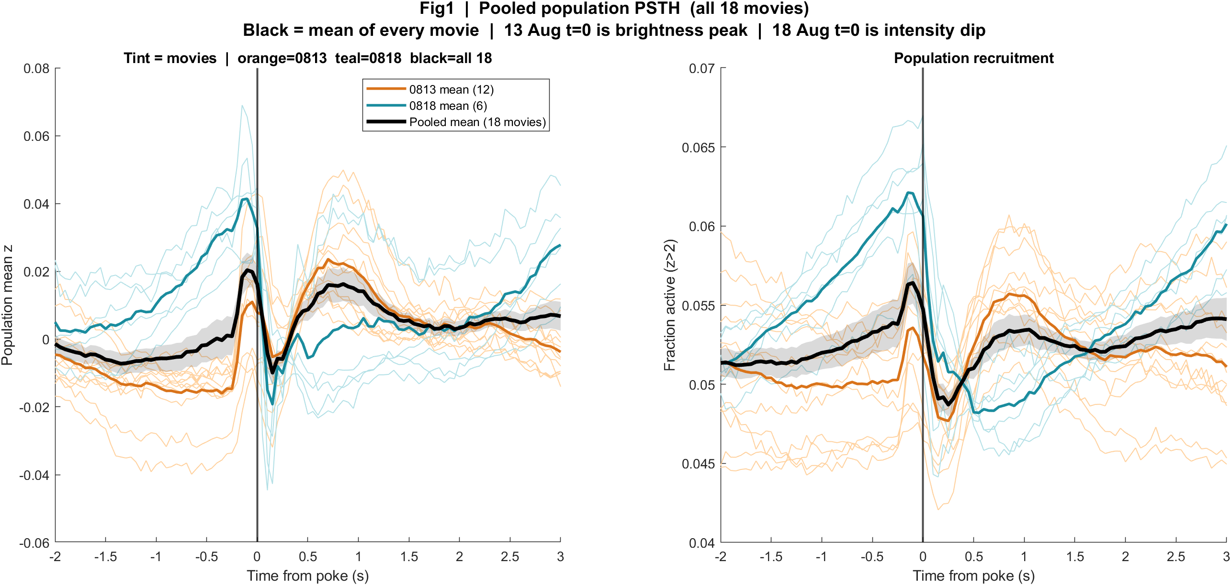
Pooled Fig1 | Average trace of all 18 movies
What: Gray/tint = each movie. Orange = 13 Aug mean. Teal = 18 Aug mean. Black = mean of all 18.
Result: The pooled black line has a small peak near t=0, a dip, and a rebound. That shape is a blend: 13 Aug locks to the peak, 18 Aug rises before the dip. It is not a third biological condition.

Slide 10
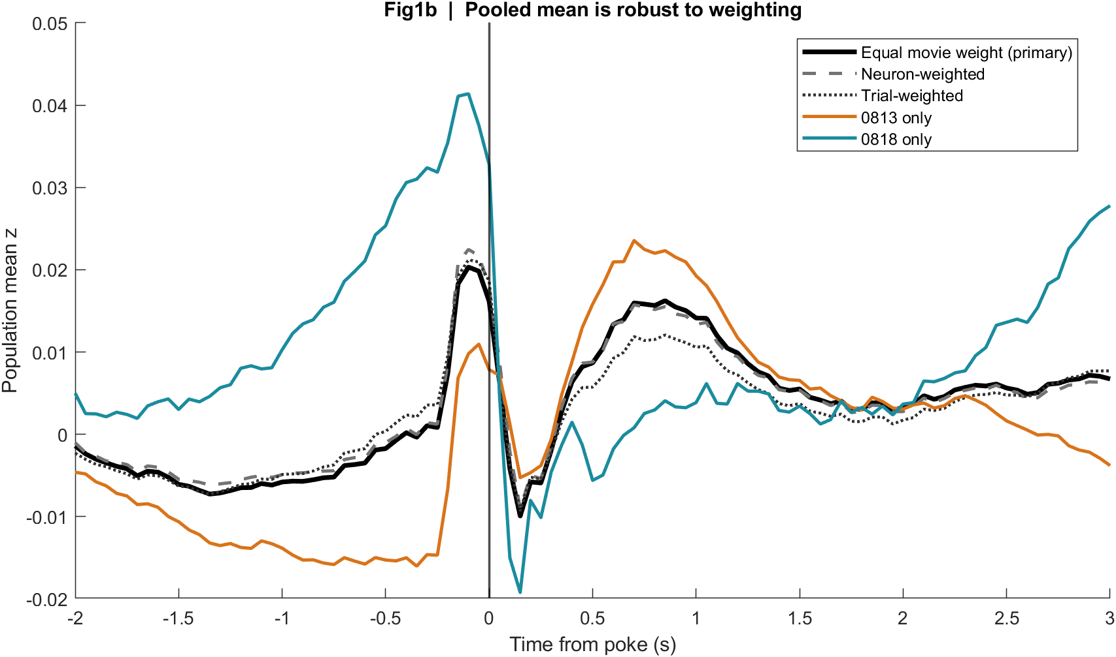
Pooled Fig1b | Weighting check
What: Same 18 movies averaged with equal movie weight, neuron weight, or trial weight.
Result: The three pooled curves sit on top of each other. The grand mean is not an artifact of one large movie.

Slide 11
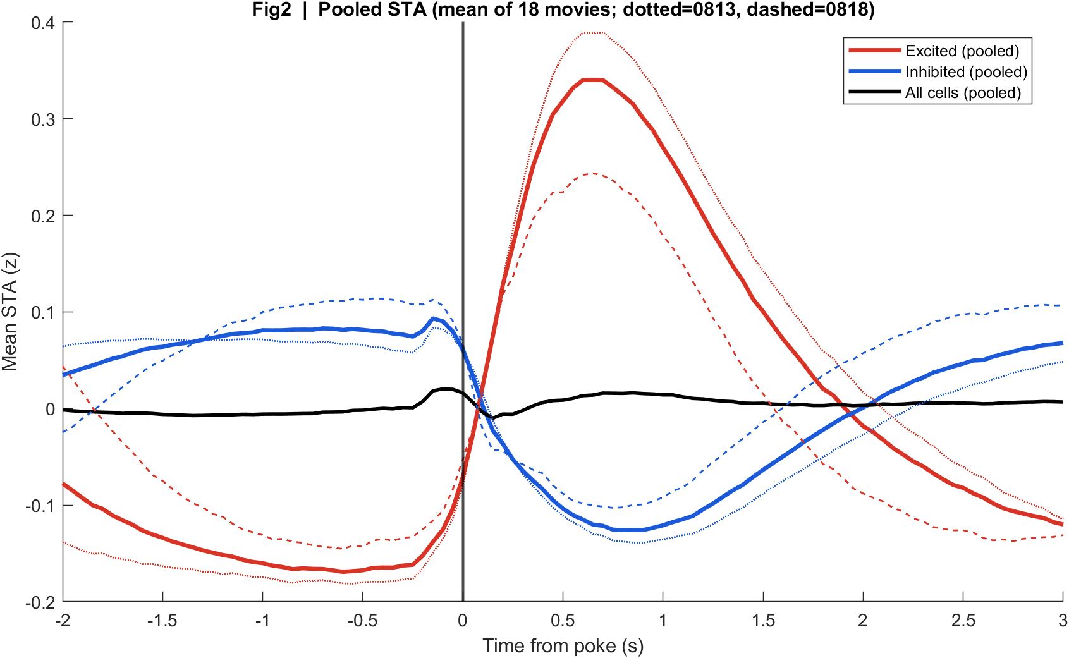
Pooled Fig2 | Average STA of all 18 movies
What: Mean of per-movie excited / inhibited / all-cell STAs. Dotted = 13 Aug, dashed = 18 Aug.
Result: Pooled excited cells rise after t=0; pooled inhibited cells fall. All-cells (black) stay near zero because the groups cancel.

Slide 12
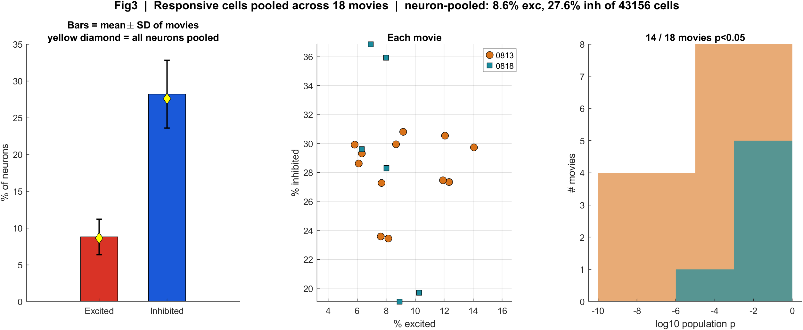
Pooled Fig3 | All cells from all movies
What: Bars = mean ± SD across 18 movies. Yellow diamond = all 43,156 neurons pooled. Orange circles = 13 Aug, teal squares = 18 Aug.
Result: Movie-mean 8.8% exc / 28.2% inh; neuron-pooled 8.6% / 27.6%. 14/18 movies p<0.05.

Slide 13

Pooled Fig4 | All FOVs (cannot pixel-average)
What: Aligned EXTRACT footprint maps for every recording in the pool. P left, A right.
Result: The repeating pattern is mixed red/blue with anterior more excited. There is no single average cortex image because FOVs are not registered.

Slide 14
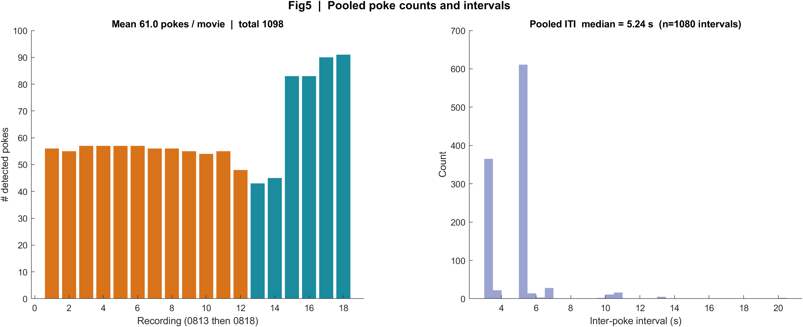
Pooled Fig5 | All pokes together
What: Orange bars = 13 Aug movies, teal = 18 Aug. Histogram = every inter-poke interval from all 18 movies.
Result: 1,098 detected pokes. Pooled ITI median 5.24 s (13 Aug 5.30 s dominates the median; 18 Aug is 3.36 s).

Slide 15
The same numbers, split by day
Because t = 0 is not the same physical marker

Slide 16
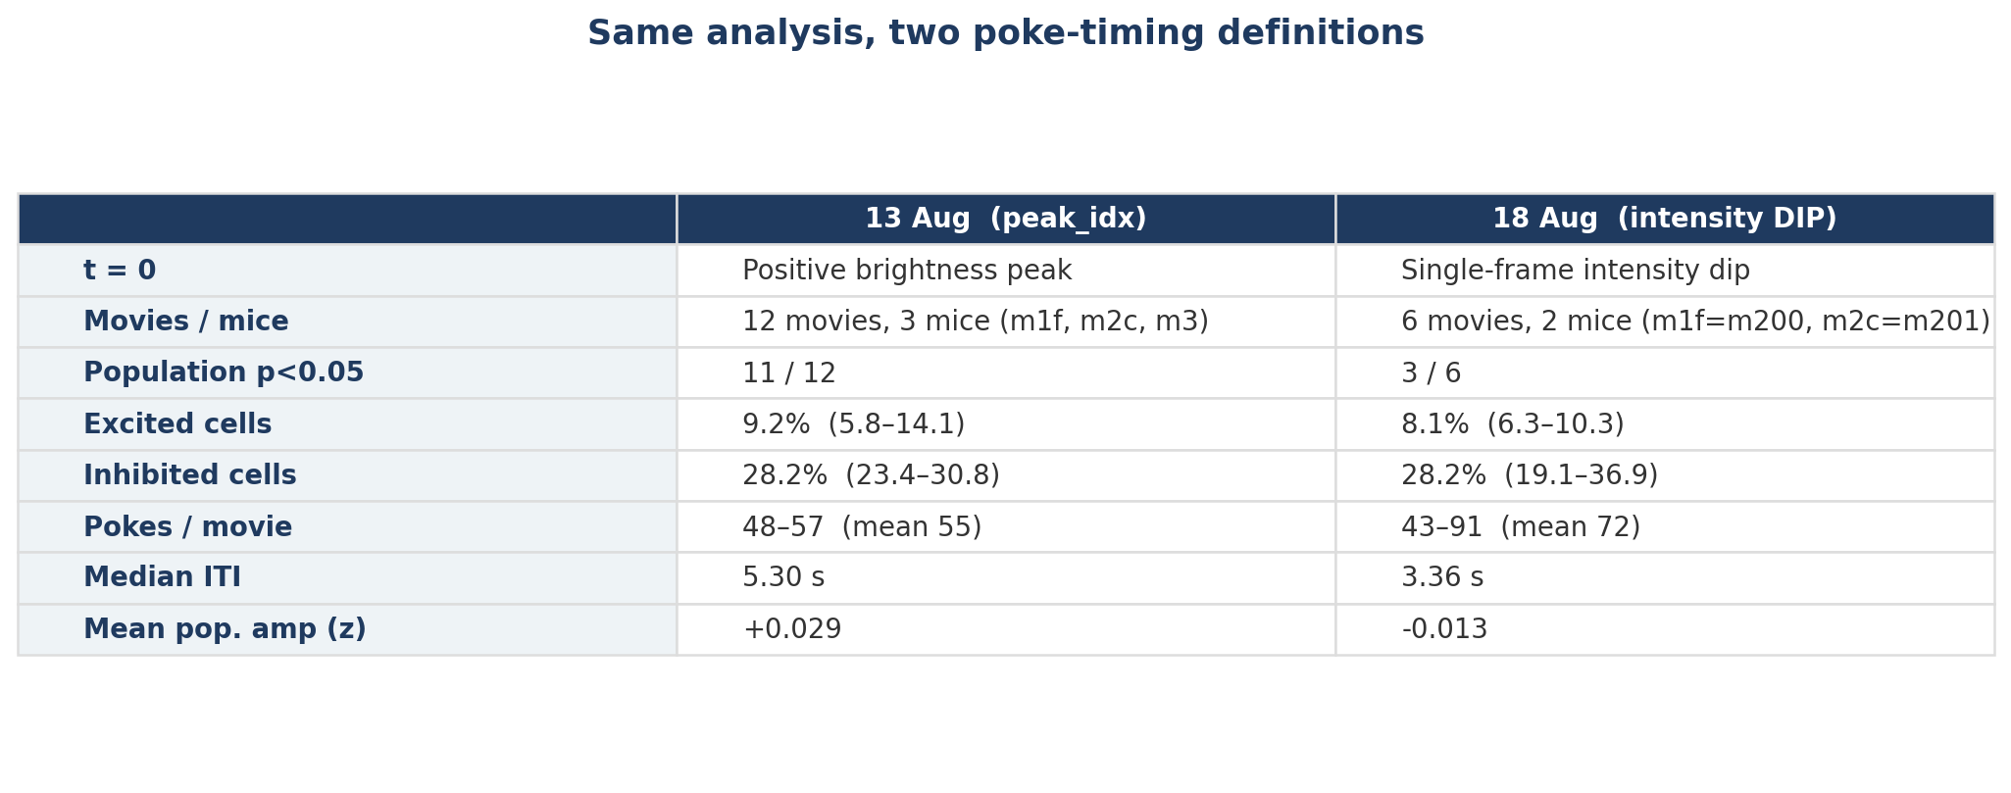
Numbers at a glance
What: Same cell-classification windows on both days. 18 Aug has fewer movies, a shorter ITI, and a dip-based t = 0.
Result: Population lock is tighter on 13 Aug (11/12 movies) than 18 Aug (3/6), but the exc < inh split is the same direction both days.

Slide 17
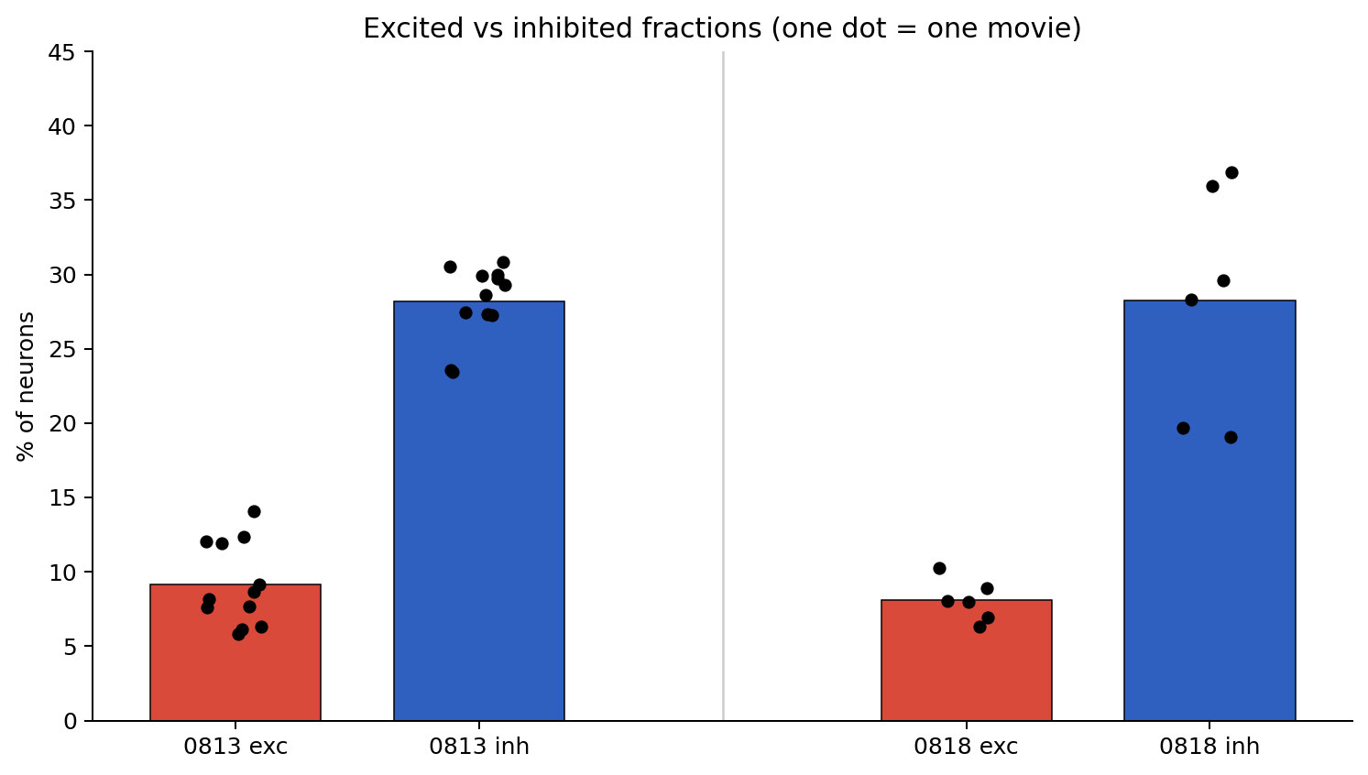
Excited vs inhibited fractions
What: Each black dot is one movie. Red bars = mean % excited; blue bars = mean % inhibited.
Result: Inhibition dominates on both days (~6–14% excited vs ~19–37% inhibited). 18 Aug m201 is especially inhibition-heavy.

Slide 18

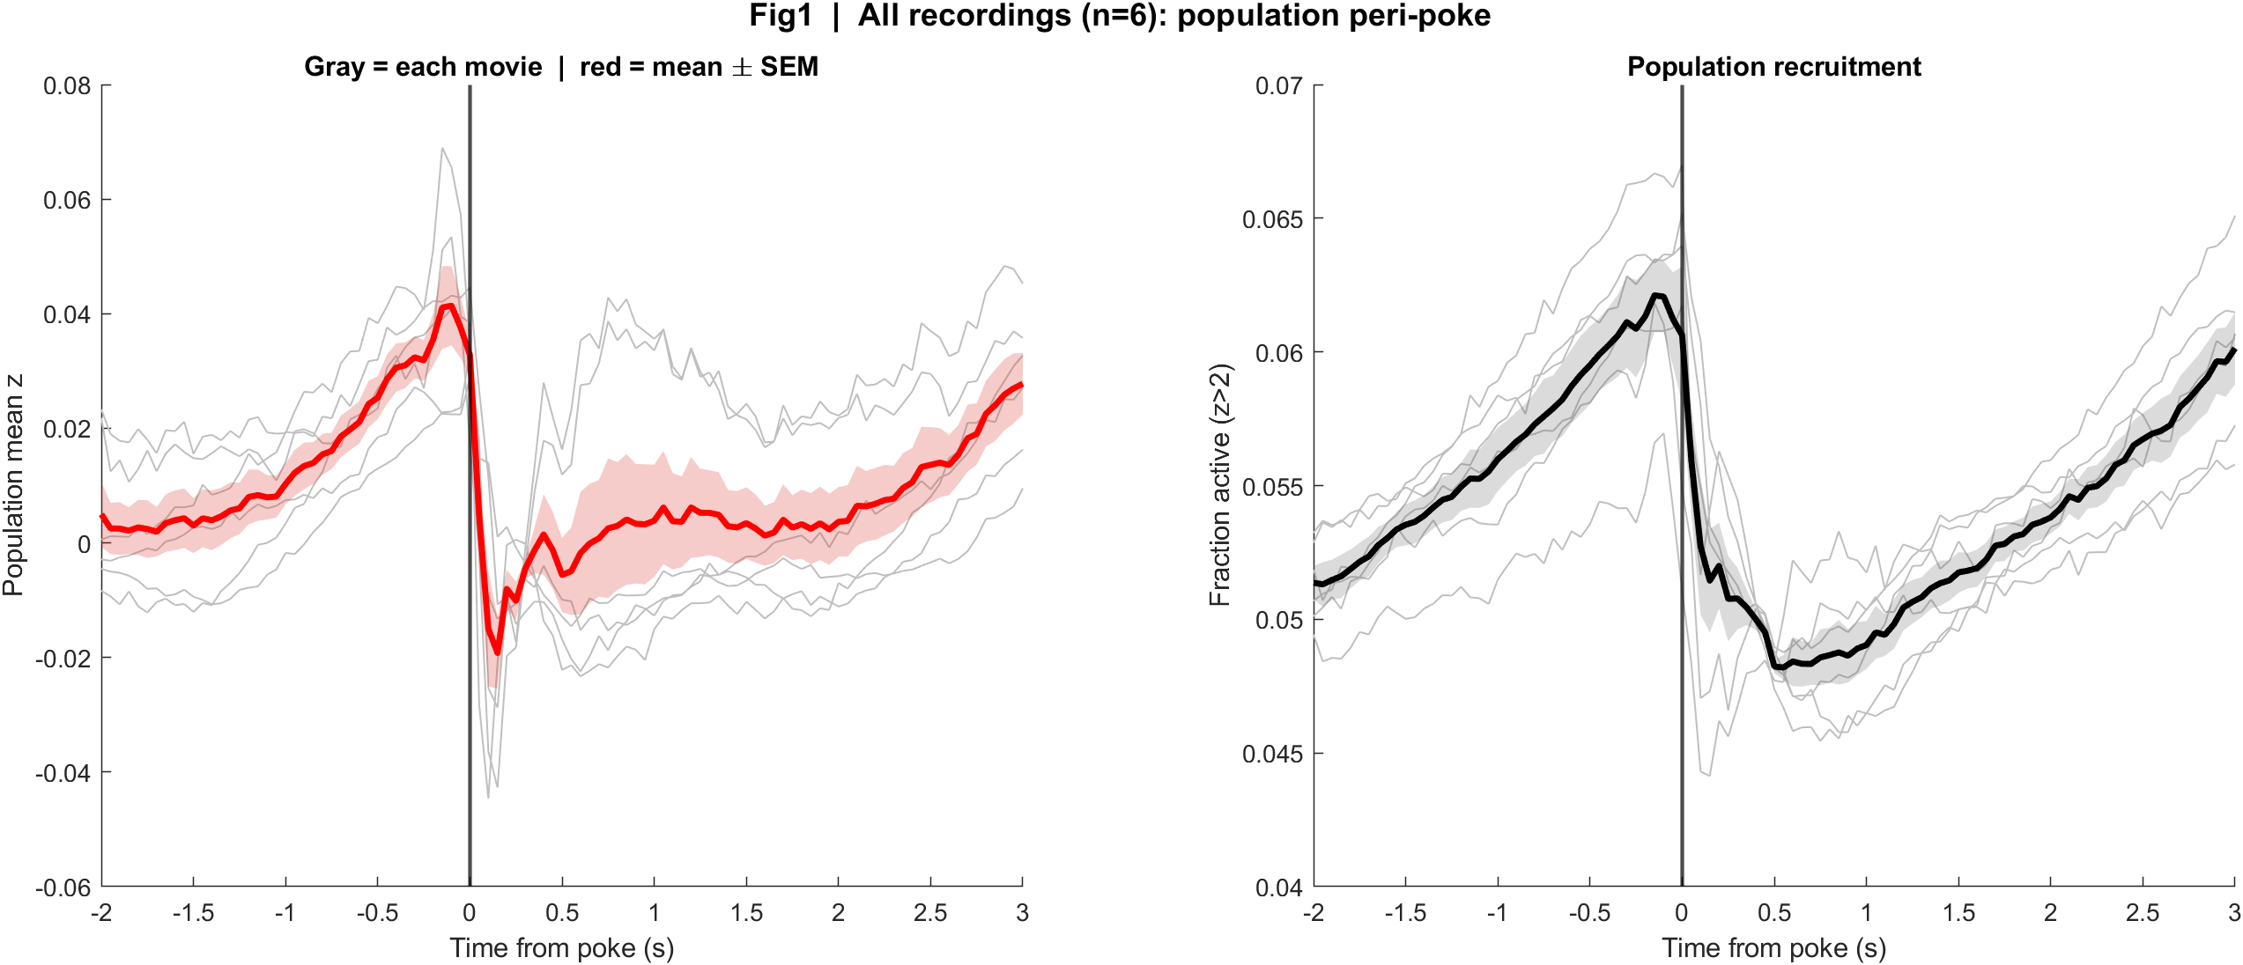
Fig1 Population PSTH
What: Mean population z and fraction active, aligned to each poke.
Result: 13 Aug: sharp transient at t=0, dip, rebound ~0.8 s. 18 Aug: activity already rising before t=0, then a crash at the dip.
13 Aug | t = 0 is the brightness peak
18 Aug | t = 0 is the intensity dip

Slide 19

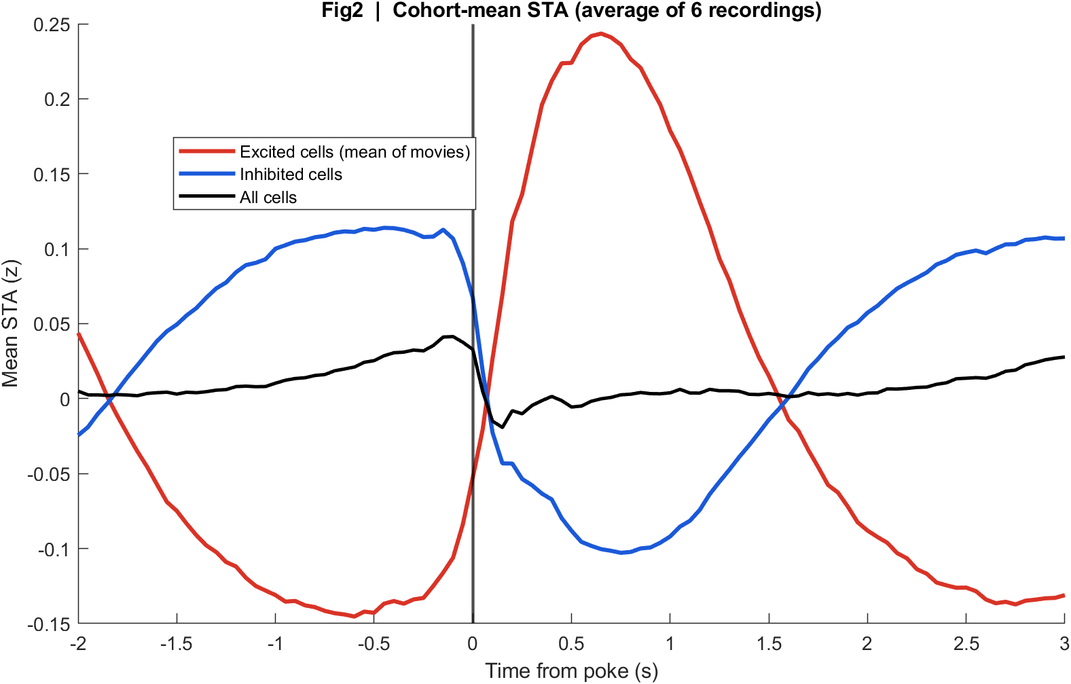
Fig2 Neuron STA
What: Cohort-mean stimulus-triggered averages of excited, inhibited, and all cells.
Result: Both days split into an up group and a down group. The all-cell mean is modest because they cancel — more completely on 18 Aug.
13 Aug
18 Aug

Slide 20

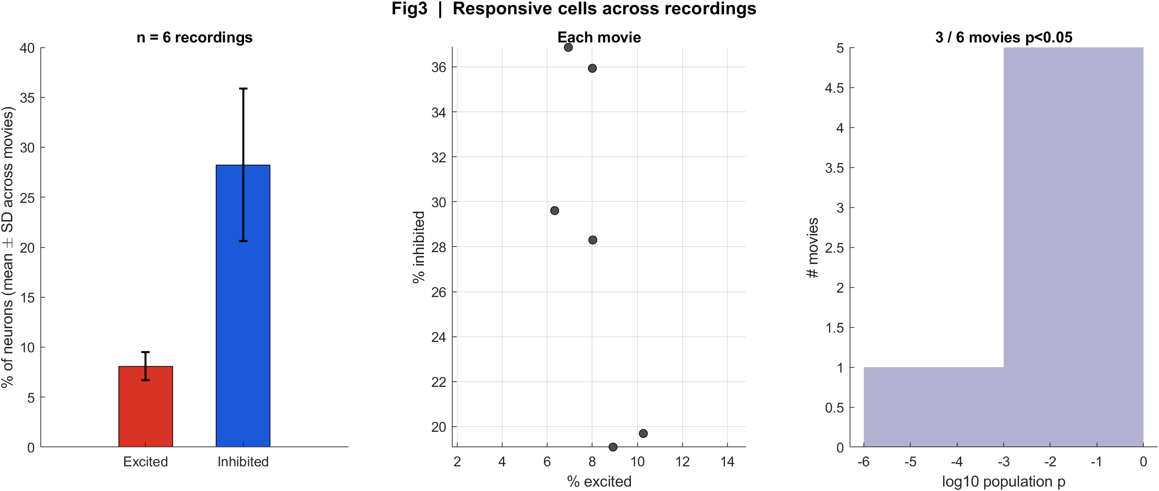
Fig3 Excited vs inhibited cells
What: Per neuron: 0.4–1.2 s after t=0 vs -2–0 s before; signed-rank p<0.05.
Result: 13 Aug: 11/12 movies significant. 18 Aug: 3/6 (both m201 s00, plus m201 s01 mirror1). m200 on 18 Aug is not significant (missed dips).
13 Aug
18 Aug

Slide 21
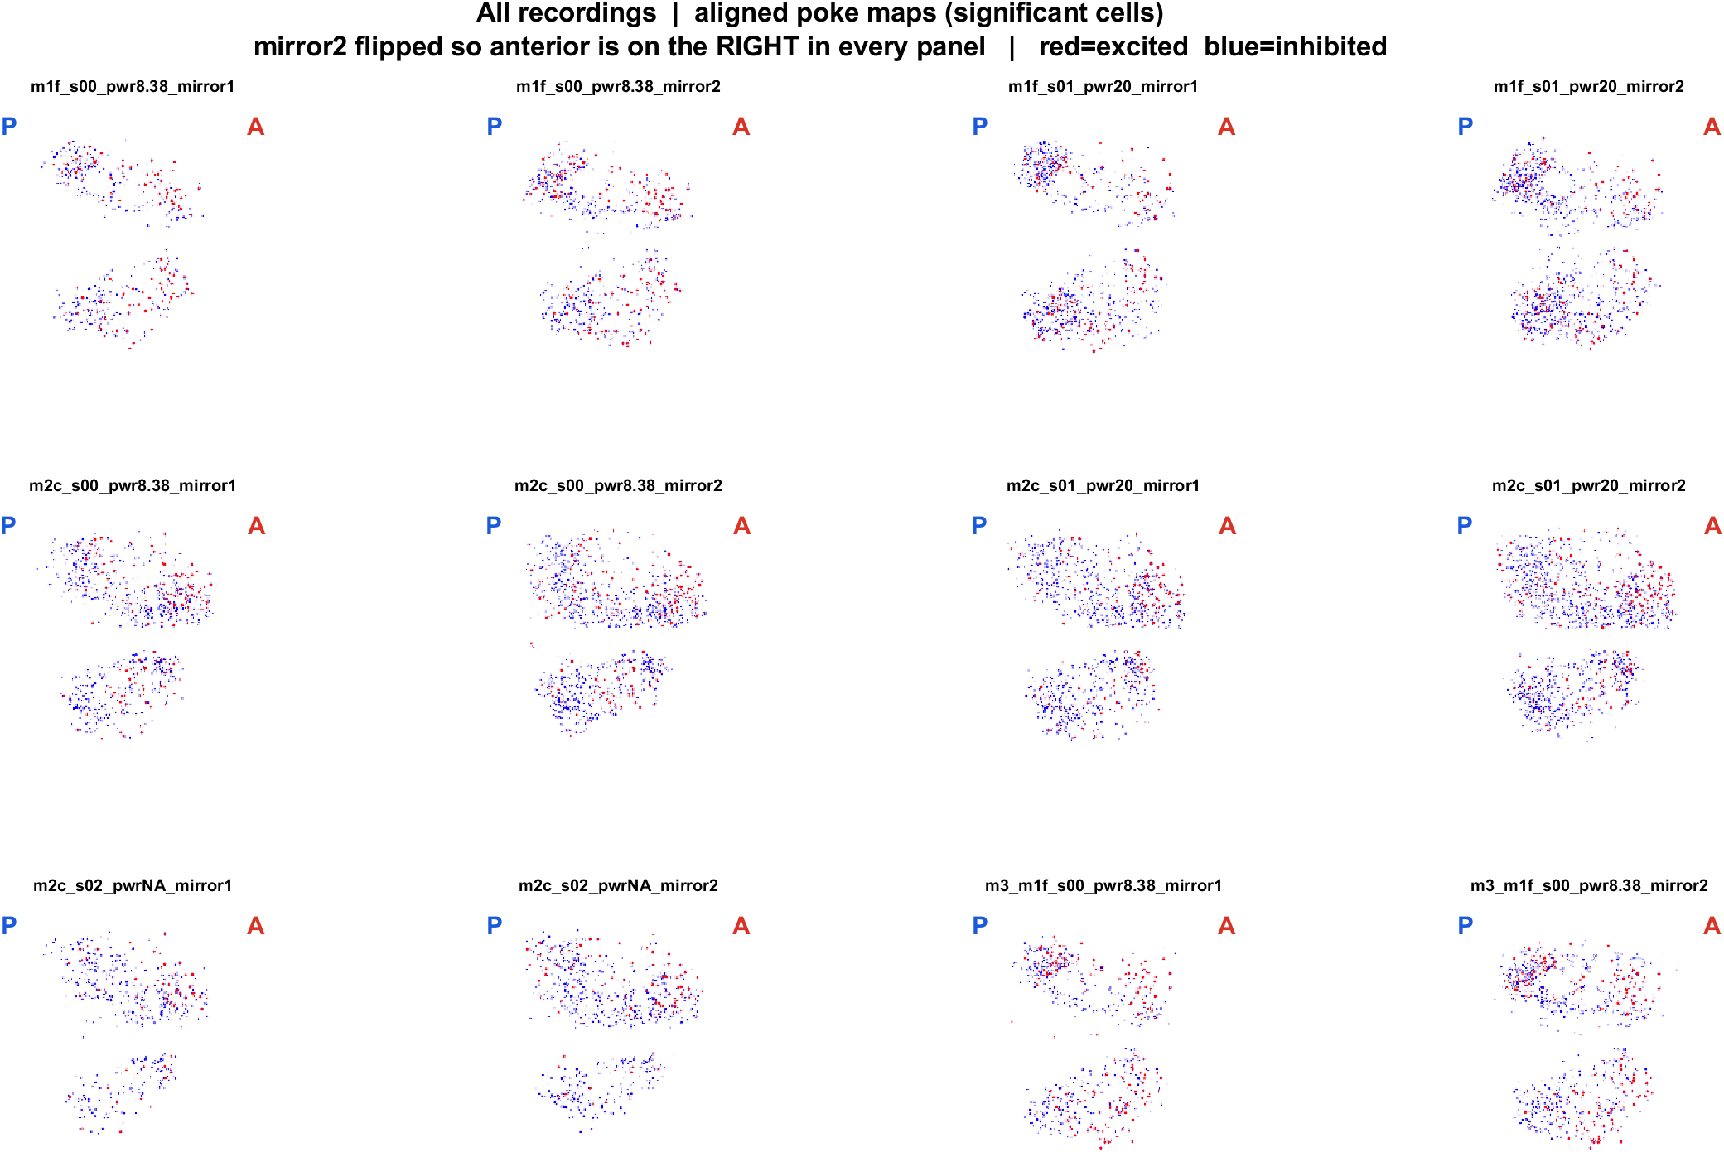
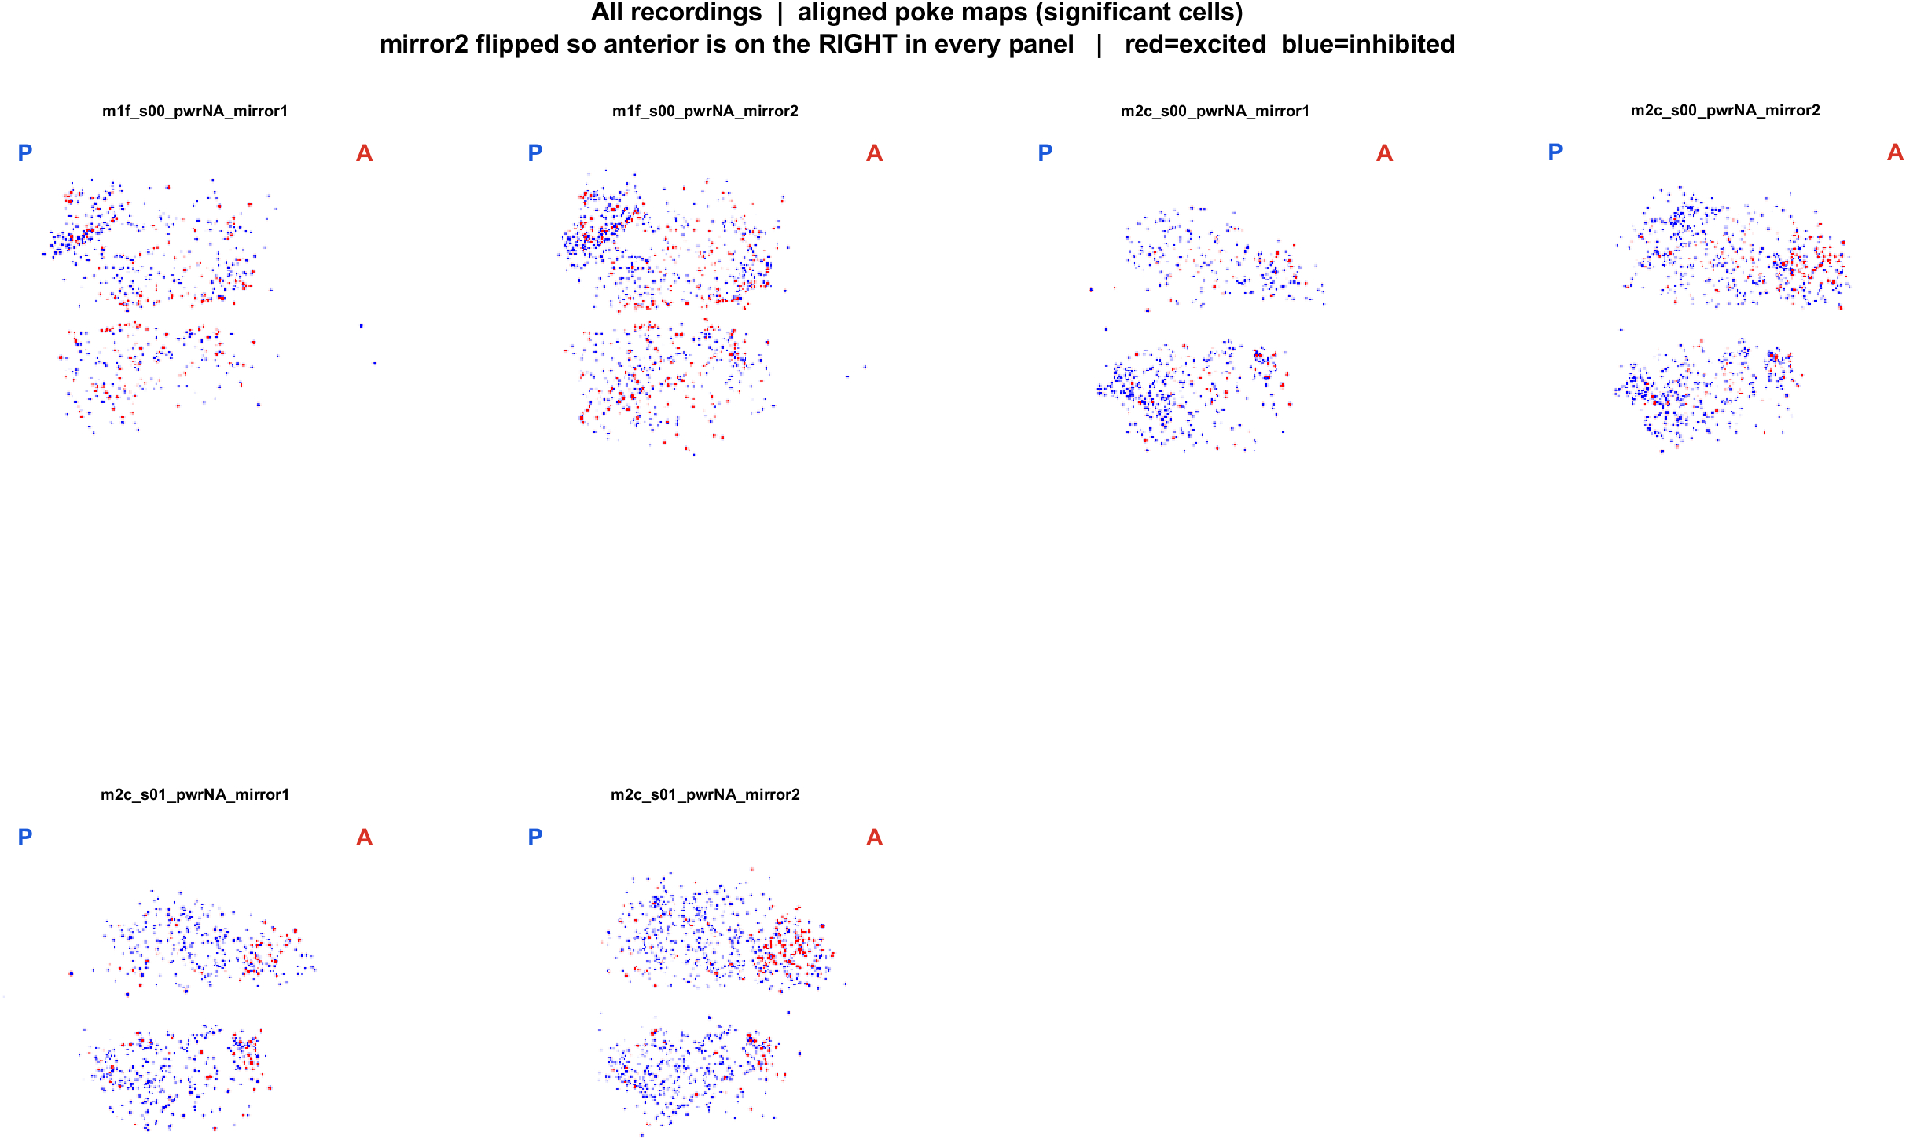
Fig4 Spatial maps (aligned, significant cells)
What: EXTRACT footprints x poke amplitude. mirror2 flipped. P = posterior (left), A = anterior (right).
Result: Cells are locally intermingled on both days. After the same AP alignment, anterior tends to be more excited and posterior more inhibited.
13 Aug | 12 FOVs
18 Aug | 6 FOVs

Slide 22

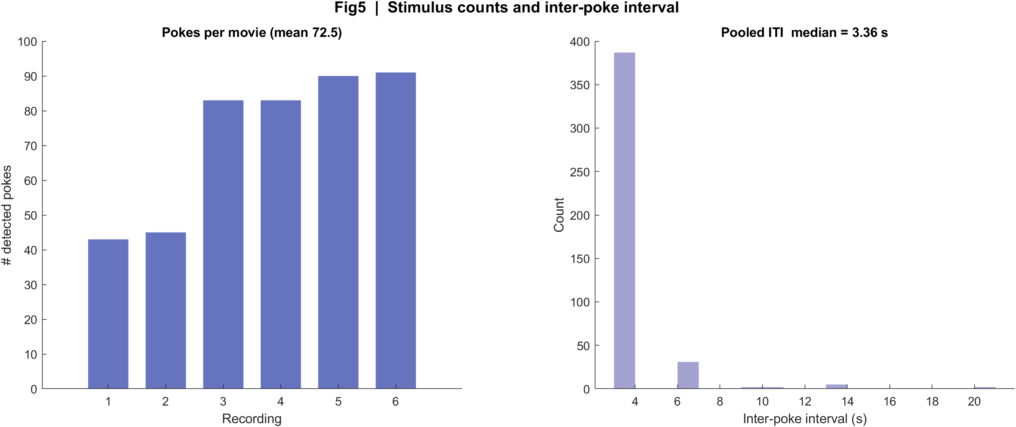
Fig5 Poke counts and interval
What: Detected events per movie and the histogram of time between events.
Result: 13 Aug median ITI 5.30 s (~48–57 pokes). 18 Aug median 3.36 s; m201 is dense (~83–91), m200 has ~20 s gaps from missed dips.
13 Aug
18 Aug

Slide 23
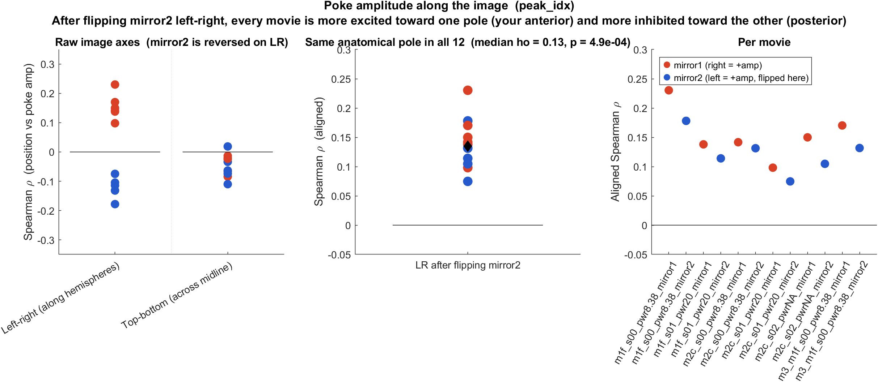
Anterior–posterior bias | 13 Aug
What: Spearman ρ between each cell's LR position and poke amplitude. After flipping mirror2, anterior is to the right in every movie.
Result: 12/12 movies ρ > 0 (median 0.13, signrank p = 4.9e-4): anterior more excited, posterior more inhibited. Not a CCF registration — AP is the LR axis along the hemispheres.

Slide 24
Interpretation
• Pooled across 18 movies / 43,156 cells: 8.6% excited, 27.6% inhibited, 14/18 movies significant. This is the combined biology.
• The pooled black PSTH is the average of two clocks (peak vs dip). Read orange vs teal to see timing; read the yellow-diamond cell counts to see the shared exc/inh split.
• All-cell STA near zero is cancellation, not absence of a poke response. Excited and inhibited groups are both locked; they have opposite sign.
• FOVs cannot be averaged. The pooled spatial result is that the same mixed AP pattern appears in the full set of 18 maps.
• Skin-contact time is still not proven. Do not treat the pooled t=0 as a single physical onset.

Slide 25
What we should not over-claim
• FOV is not CCF/bregma registered. 'Anterior' means the right side after aligning mirror2 to mirror1, along the hemispheres.
• Power is labeled only on 13 Aug (s00 = 8.38, s01 = 20 mW/cm2). Do not copy those values onto 18 Aug.
• m200 on 18 Aug failing the population test is consistent with missed dips, not evidence that this mouse has no poke map (its spatial map still shows mixed red/blue).
• We reconstructed EXTRACT spatial_weights from the file (CSC). That is Omer's footprint matrix, not a new segmentation.

Slide 26
13 Aug in one place
t = 0 is peak_idx (positive brightness peak) | 12 movies

Slide 27
13 Aug | Fig1 Population PSTH
What: Aligned to the brightness peak.
Result: Transient at t=0, brief dip, rebound ~0.8 s in all 12 movies.

Slide 28
13 Aug | Fig2 Neuron STA
What: Excited vs inhibited vs all cells.
Result: The two groups partly cancel in the population mean.

Slide 29
13 Aug | Fig3 Responsive cells
What: 0.4–1.2 s vs -2–0 s, signed-rank.
Result: 11/12 movies p<0.05; ~9% exc, ~28% inh.

Slide 30
13 Aug | Fig4 Aligned spatial maps
What: P left, A right. Red = excited, blue = inhibited.
Result: Intermingled cells; anterior-excited / posterior-inhibited after the mirror2 flip.

Slide 31
13 Aug | Fig5 Trial timing
What: Pokes per movie and ITI.
Result: Median interval 5.30 s; about 48–57 pokes per movie.

Slide 32
18 Aug in one place
t = 0 is peak_idx (intensity DIP) | 6 movies

Slide 33
18 Aug | Fig1 Population PSTH
What: Aligned to the intensity dip.
Result: Rise into t=0, sharp drop at the dip, slow recovery — same shape in all 6 movies.

Slide 34
18 Aug | Fig2 Neuron STA
What: Excited vs inhibited vs all cells.
Result: Same up/down split; all-cell mean is close to zero because inhibition wins on m201.

Slide 35
18 Aug | Fig3 Responsive cells
What: Same 0.4–1.2 s window as 13 Aug.
Result: 3/6 movies p<0.05; m201 carries the effect, m200 does not.

Slide 36
18 Aug | Fig4 Aligned spatial maps
What: P left, A right. Same EXTRACT footprint method as 13 Aug.
Result: Still mixed red/blue, with the same AP direction after flipping mirror2.

Slide 37
18 Aug | Fig5 Trial timing
What: Detected dips and ITI.
Result: Median 3.36 s. m200 ~43–45 dips with ~20 s gaps; m201 ~83–91.

Slide 38
Next
The pooled black line is the biology that repeats (exc/inh split, mixed maps). Keep day means when discussing timing (peak vs dip). A shared physical marker would be needed before treating all 18 t=0 as one onset.

