Slide 1
Face poking on crystal skull
2025-08-13 | t = 0 at peak_idx (positive brightness peak) | window 0.4–1.2 s vs -2–0 s
Take-home: cortex is tightly time-locked to the brightness peak (11/12 movies); a region map still needs spatial footprints.

Slide 2
Experiment
Whole dorsal cortex Ca2+ imaging while a motor arm pokes the face. Every movie on this day is a poking session — there is no no-poke baseline.

Slide 3
How poke time is defined
No behavior camera. A blocker on the arm changes mean-frame intensity. t = 0 is peak_idx: the positive brightness peak. This is the strongest neural alignment, but it is not proven to be the moment of skin contact.

Slide 4
How traces are analyzed
EXTRACT traces at 33 Hz. Cut -2 to +3 s around each poke. A cell is excited or inhibited if 0.4–1.2 s differs from -2–0 s (Wilcoxon signed-rank, p<0.05).

Slide 5
All recordings together
12 movies | t = 0 is peak_idx (brightness peak)

Slide 6

Fig1 Population PSTH | all movies
What: Mean population activity (z-score) and fraction of active cells, aligned to each poke (t = 0 is peak_idx).
Result: A sharp transient at t = 0, a brief dip, then a rebound peaking ~0.8 s — the same shape in all 12 movies.

Slide 7

Fig2 Neuron STA | all movies
What: Each neuron’s average trace around the poke, sorted by response size; right panel is the mean of excited vs inhibited cells.
Result: Excited cells rise after the peak; inhibited cells go down; the all-cell mean is small because the two groups partly cancel.

Slide 8

Fig3 Excited vs inhibited cells | all movies
What: Per neuron: mean z in 0.4–1.2 s after t=0 vs -2–0 s before; signed-rank, p<0.05, sign of the difference.
Result: About 6–14% of cells are excited and 23–31% inhibited; 11 of 12 movies have a significant population response.

Slide 9
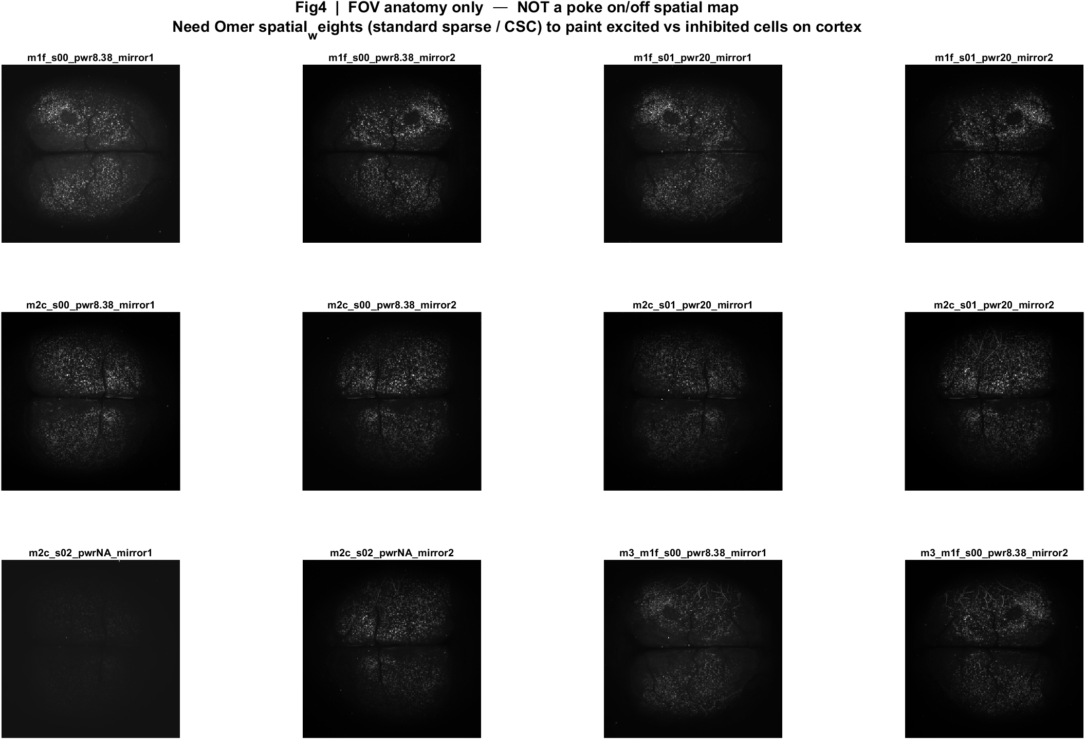
Fig4 FOV anatomy (not a response map) | all movies
What: EXTRACT session-mean image: average brightness over the whole movie, not pre vs post poke.
Result: Cells are dense across dorsal cortex, but this picture cannot say which regions turned on or off after poking.

Slide 10

Fig5 Trial raster and poke interval | all movies
What: One row per poke (population z over time) and the histogram of time between detected pokes.
Result: About 48–57 pokes per movie; median interval is 5.3 s (set to 3 s, with mechanical jitter). Long gaps are missed peaks.

Slide 11

Fig1 Population PSTH | mouse1f s00 8.38 mW/cm2 mirror1
What: Mean population activity (z-score) and fraction of active cells, aligned to each poke (t = 0 is peak_idx).
Result: This FOV has 1240 neurons and 56 pokes; the population pre vs post test is significant (p = 4.9e-10).

Slide 12

Fig2 Neuron STA | mouse1f s00 8.38 mW/cm2 mirror1
What: Each neuron’s average trace around the poke, sorted by response size; right panel is the mean of excited vs inhibited cells.
Result: Excited 12.3% and inhibited 27.3% of 1240 neurons; see the STA split on the right.

Slide 13

Fig3 Excited vs inhibited cells | mouse1f s00 8.38 mW/cm2 mirror1
What: Per neuron: mean z in 0.4–1.2 s after t=0 vs -2–0 s before; signed-rank, p<0.05, sign of the difference.
Result: 12.3% excited, 27.3% inhibited out of 1240 neurons; population test significant (p = 4.9e-10).

Slide 14
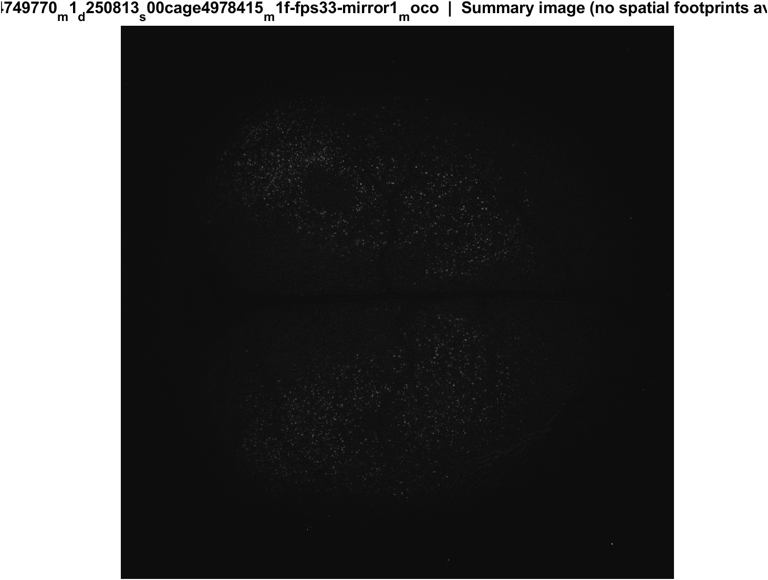
Fig4 FOV anatomy (not a response map) | mouse1f s00 8.38 mW/cm2 mirror1
What: EXTRACT session-mean image: average brightness over the whole movie, not pre vs post poke.
Result: This is only where cells sit in this FOV — not which cells responded to the poke.

Slide 15

Fig5 Trial raster and poke interval | mouse1f s00 8.38 mW/cm2 mirror1
What: One row per poke (population z over time) and the histogram of time between detected pokes.
Result: 56 pokes detected in this movie; intervals near 5.3 s, with occasional missed peaks.

Slide 16

Fig1 Population PSTH | mouse1f s00 8.38 mW/cm2 mirror2
What: Mean population activity (z-score) and fraction of active cells, aligned to each poke (t = 0 is peak_idx).
Result: This FOV has 1930 neurons and 55 pokes; the population pre vs post test is significant (p = 4.0e-09).

Slide 17

Fig2 Neuron STA | mouse1f s00 8.38 mW/cm2 mirror2
What: Each neuron’s average trace around the poke, sorted by response size; right panel is the mean of excited vs inhibited cells.
Result: Excited 11.9% and inhibited 27.5% of 1930 neurons; see the STA split on the right.

Slide 18

Fig3 Excited vs inhibited cells | mouse1f s00 8.38 mW/cm2 mirror2
What: Per neuron: mean z in 0.4–1.2 s after t=0 vs -2–0 s before; signed-rank, p<0.05, sign of the difference.
Result: 11.9% excited, 27.5% inhibited out of 1930 neurons; population test significant (p = 4.0e-09).

Slide 19
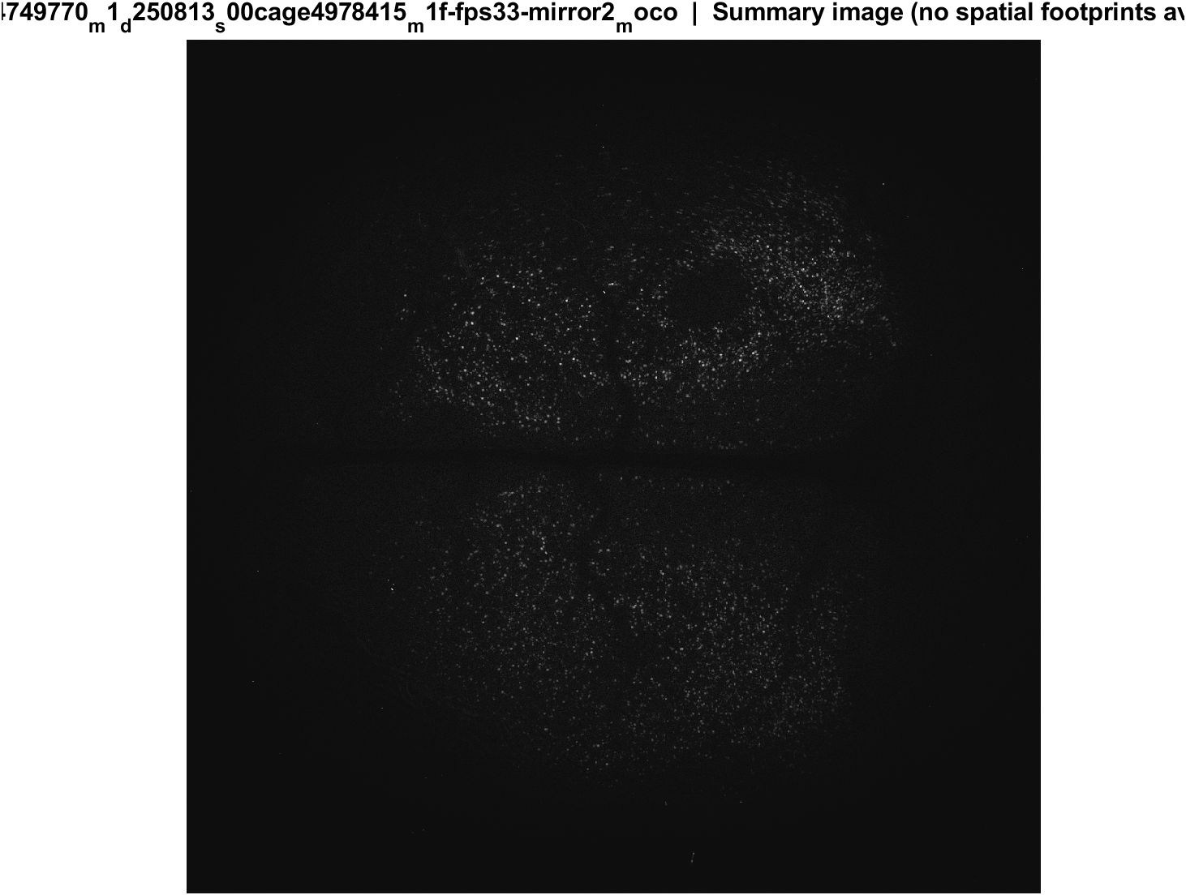
Fig4 FOV anatomy (not a response map) | mouse1f s00 8.38 mW/cm2 mirror2
What: EXTRACT session-mean image: average brightness over the whole movie, not pre vs post poke.
Result: This is only where cells sit in this FOV — not which cells responded to the poke.

Slide 20

Fig5 Trial raster and poke interval | mouse1f s00 8.38 mW/cm2 mirror2
What: One row per poke (population z over time) and the histogram of time between detected pokes.
Result: 55 pokes detected in this movie; intervals near 5.3 s, with occasional missed peaks.

Slide 21

Fig1 Population PSTH | mouse1f s01 20 mW/cm2 mirror1
What: Mean population activity (z-score) and fraction of active cells, aligned to each poke (t = 0 is peak_idx).
Result: This FOV has 2786 neurons and 57 pokes; the population pre vs post test is significant (p = 2.1e-06).

Slide 22

Fig2 Neuron STA | mouse1f s01 20 mW/cm2 mirror1
What: Each neuron’s average trace around the poke, sorted by response size; right panel is the mean of excited vs inhibited cells.
Result: Excited 8.2% and inhibited 23.4% of 2786 neurons; see the STA split on the right.

Slide 23

Fig3 Excited vs inhibited cells | mouse1f s01 20 mW/cm2 mirror1
What: Per neuron: mean z in 0.4–1.2 s after t=0 vs -2–0 s before; signed-rank, p<0.05, sign of the difference.
Result: 8.2% excited, 23.4% inhibited out of 2786 neurons; population test significant (p = 2.1e-06).

Slide 24
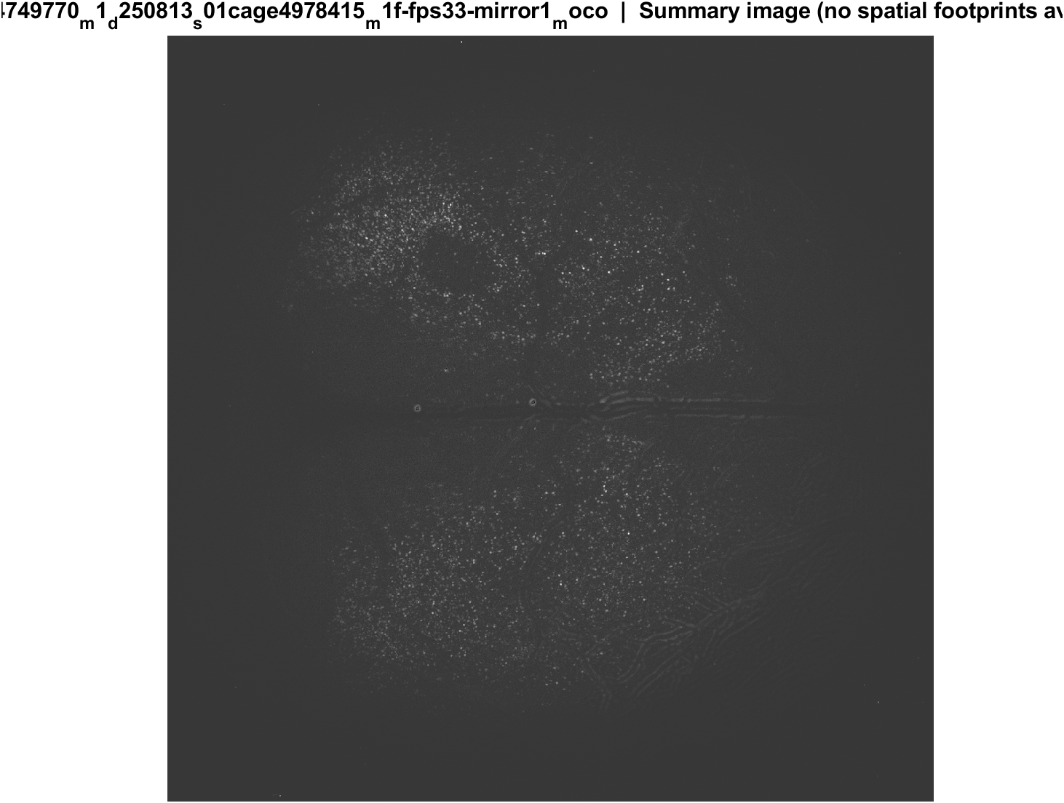
Fig4 FOV anatomy (not a response map) | mouse1f s01 20 mW/cm2 mirror1
What: EXTRACT session-mean image: average brightness over the whole movie, not pre vs post poke.
Result: This is only where cells sit in this FOV — not which cells responded to the poke.

Slide 25

Fig5 Trial raster and poke interval | mouse1f s01 20 mW/cm2 mirror1
What: One row per poke (population z over time) and the histogram of time between detected pokes.
Result: 57 pokes detected in this movie; intervals near 5.3 s, with occasional missed peaks.

Slide 26

Fig1 Population PSTH | mouse1f s01 20 mW/cm2 mirror2
What: Mean population activity (z-score) and fraction of active cells, aligned to each poke (t = 0 is peak_idx).
Result: This FOV has 3749 neurons and 57 pokes; the population pre vs post test is significant (p = 4.8e-04).

Slide 27

Fig2 Neuron STA | mouse1f s01 20 mW/cm2 mirror2
What: Each neuron’s average trace around the poke, sorted by response size; right panel is the mean of excited vs inhibited cells.
Result: Excited 7.6% and inhibited 23.6% of 3749 neurons; see the STA split on the right.

Slide 28

Fig3 Excited vs inhibited cells | mouse1f s01 20 mW/cm2 mirror2
What: Per neuron: mean z in 0.4–1.2 s after t=0 vs -2–0 s before; signed-rank, p<0.05, sign of the difference.
Result: 7.6% excited, 23.6% inhibited out of 3749 neurons; population test significant (p = 4.8e-04).

Slide 29
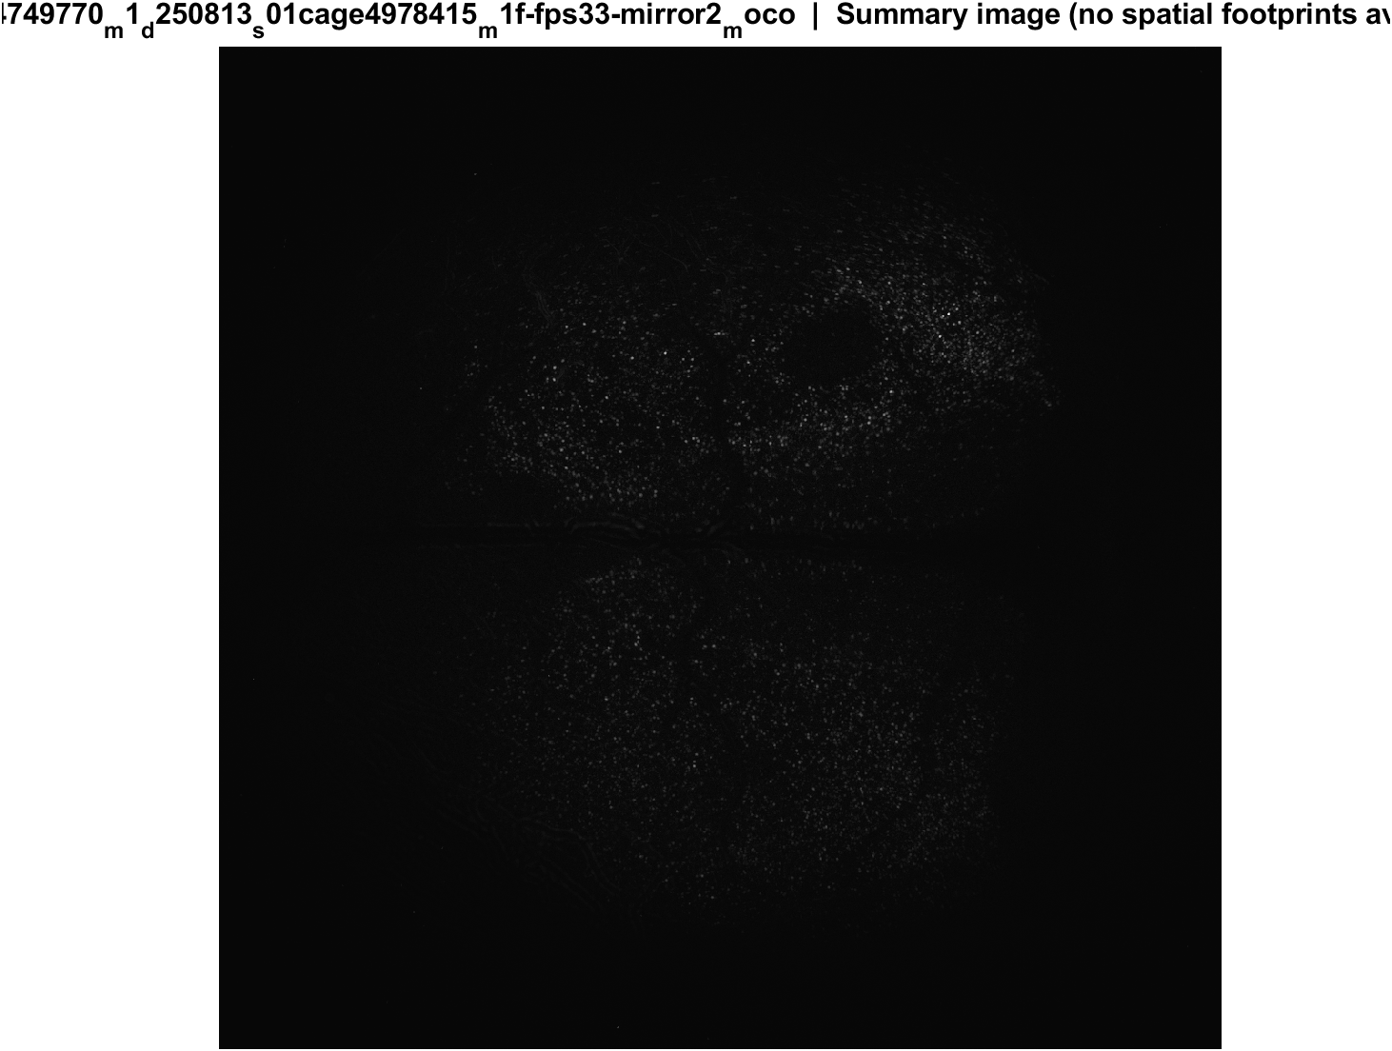
Fig4 FOV anatomy (not a response map) | mouse1f s01 20 mW/cm2 mirror2
What: EXTRACT session-mean image: average brightness over the whole movie, not pre vs post poke.
Result: This is only where cells sit in this FOV — not which cells responded to the poke.

Slide 30

Fig5 Trial raster and poke interval | mouse1f s01 20 mW/cm2 mirror2
What: One row per poke (population z over time) and the histogram of time between detected pokes.
Result: 57 pokes detected in this movie; intervals near 5.3 s, with occasional missed peaks.

Slide 31

Fig1 Population PSTH | mouse2c s00 8.38 mW/cm2 mirror1
What: Mean population activity (z-score) and fraction of active cells, aligned to each poke (t = 0 is peak_idx).
Result: This FOV has 2097 neurons and 57 pokes; the population pre vs post test is significant (p = 1.4e-04).

Slide 32

Fig2 Neuron STA | mouse2c s00 8.38 mW/cm2 mirror1
What: Each neuron’s average trace around the poke, sorted by response size; right panel is the mean of excited vs inhibited cells.
Result: Excited 8.7% and inhibited 29.9% of 2097 neurons; see the STA split on the right.

Slide 33

Fig3 Excited vs inhibited cells | mouse2c s00 8.38 mW/cm2 mirror1
What: Per neuron: mean z in 0.4–1.2 s after t=0 vs -2–0 s before; signed-rank, p<0.05, sign of the difference.
Result: 8.7% excited, 29.9% inhibited out of 2097 neurons; population test significant (p = 1.4e-04).

Slide 34
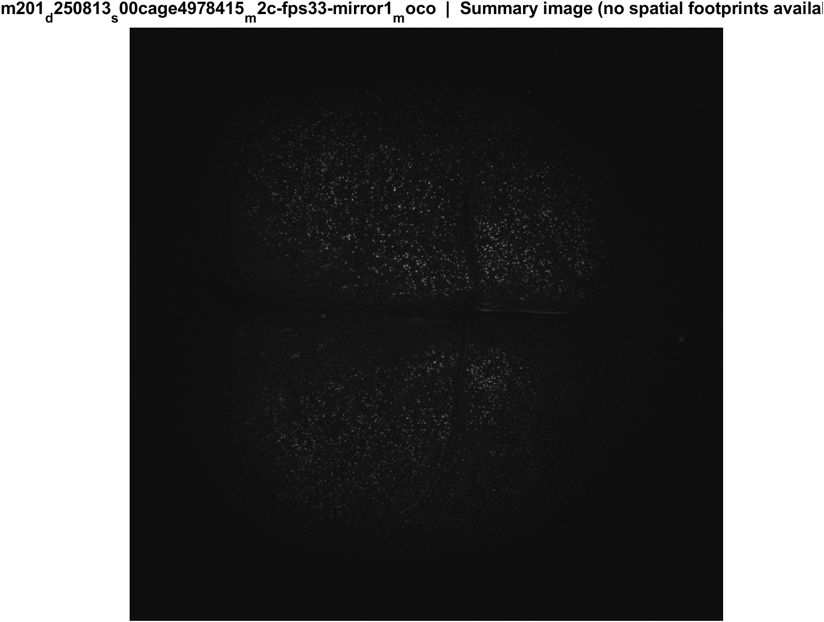
Fig4 FOV anatomy (not a response map) | mouse2c s00 8.38 mW/cm2 mirror1
What: EXTRACT session-mean image: average brightness over the whole movie, not pre vs post poke.
Result: This is only where cells sit in this FOV — not which cells responded to the poke.

Slide 35

Fig5 Trial raster and poke interval | mouse2c s00 8.38 mW/cm2 mirror1
What: One row per poke (population z over time) and the histogram of time between detected pokes.
Result: 57 pokes detected in this movie; intervals near 5.3 s, with occasional missed peaks.

Slide 36

Fig1 Population PSTH | mouse2c s00 8.38 mW/cm2 mirror2
What: Mean population activity (z-score) and fraction of active cells, aligned to each poke (t = 0 is peak_idx).
Result: This FOV has 2889 neurons and 57 pokes; the population pre vs post test is significant (p = 0.006).

Slide 37

Fig2 Neuron STA | mouse2c s00 8.38 mW/cm2 mirror2
What: Each neuron’s average trace around the poke, sorted by response size; right panel is the mean of excited vs inhibited cells.
Result: Excited 9.2% and inhibited 30.8% of 2889 neurons; see the STA split on the right.

Slide 38

Fig3 Excited vs inhibited cells | mouse2c s00 8.38 mW/cm2 mirror2
What: Per neuron: mean z in 0.4–1.2 s after t=0 vs -2–0 s before; signed-rank, p<0.05, sign of the difference.
Result: 9.2% excited, 30.8% inhibited out of 2889 neurons; population test significant (p = 0.006).

Slide 39
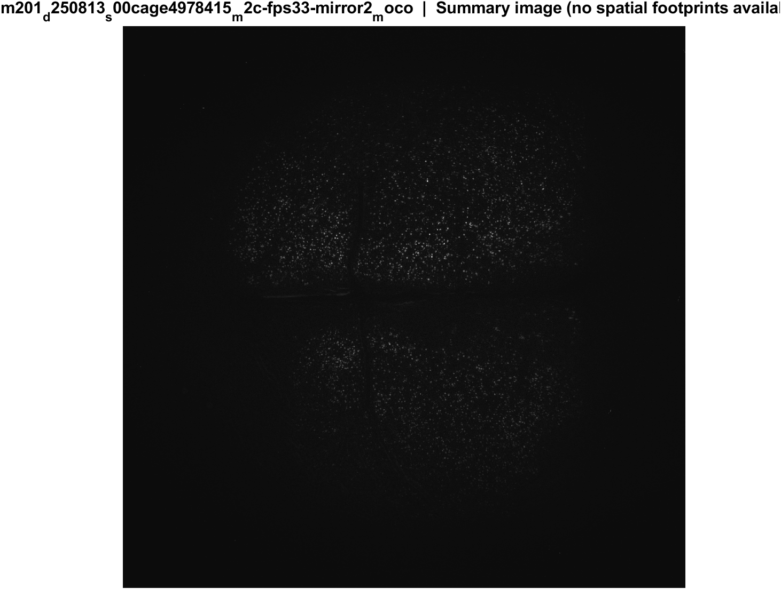
Fig4 FOV anatomy (not a response map) | mouse2c s00 8.38 mW/cm2 mirror2
What: EXTRACT session-mean image: average brightness over the whole movie, not pre vs post poke.
Result: This is only where cells sit in this FOV — not which cells responded to the poke.

Slide 40

Fig5 Trial raster and poke interval | mouse2c s00 8.38 mW/cm2 mirror2
What: One row per poke (population z over time) and the histogram of time between detected pokes.
Result: 57 pokes detected in this movie; intervals near 5.3 s, with occasional missed peaks.

Slide 41

Fig1 Population PSTH | mouse2c s01 20 mW/cm2 mirror1
What: Mean population activity (z-score) and fraction of active cells, aligned to each poke (t = 0 is peak_idx).
Result: This FOV has 3012 neurons and 56 pokes; the population pre vs post test is not significant (p = 0.061).

Slide 42

Fig2 Neuron STA | mouse2c s01 20 mW/cm2 mirror1
What: Each neuron’s average trace around the poke, sorted by response size; right panel is the mean of excited vs inhibited cells.
Result: Excited 6.1% and inhibited 28.6% of 3012 neurons; see the STA split on the right.

Slide 43

Fig3 Excited vs inhibited cells | mouse2c s01 20 mW/cm2 mirror1
What: Per neuron: mean z in 0.4–1.2 s after t=0 vs -2–0 s before; signed-rank, p<0.05, sign of the difference.
Result: 6.1% excited, 28.6% inhibited out of 3012 neurons; population test not significant (p = 0.061).

Slide 44
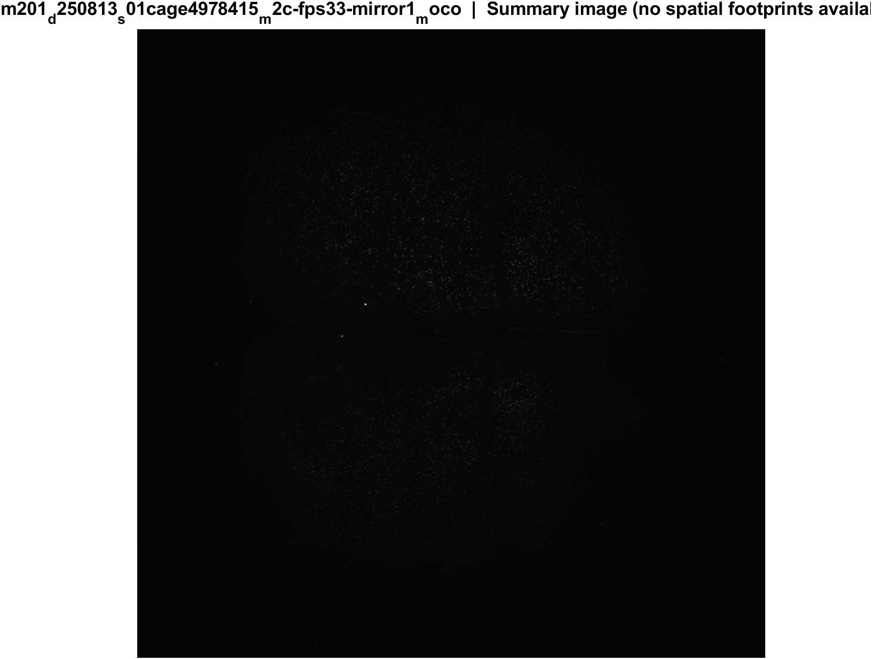
Fig4 FOV anatomy (not a response map) | mouse2c s01 20 mW/cm2 mirror1
What: EXTRACT session-mean image: average brightness over the whole movie, not pre vs post poke.
Result: This is only where cells sit in this FOV — not which cells responded to the poke.

Slide 45

Fig5 Trial raster and poke interval | mouse2c s01 20 mW/cm2 mirror1
What: One row per poke (population z over time) and the histogram of time between detected pokes.
Result: 56 pokes detected in this movie; intervals near 5.3 s, with occasional missed peaks.

Slide 46

Fig1 Population PSTH | mouse2c s01 20 mW/cm2 mirror2
What: Mean population activity (z-score) and fraction of active cells, aligned to each poke (t = 0 is peak_idx).
Result: This FOV has 4022 neurons and 56 pokes; the population pre vs post test is significant (p = 0.024).

Slide 47

Fig2 Neuron STA | mouse2c s01 20 mW/cm2 mirror2
What: Each neuron’s average trace around the poke, sorted by response size; right panel is the mean of excited vs inhibited cells.
Result: Excited 7.7% and inhibited 27.3% of 4022 neurons; see the STA split on the right.

Slide 48

Fig3 Excited vs inhibited cells | mouse2c s01 20 mW/cm2 mirror2
What: Per neuron: mean z in 0.4–1.2 s after t=0 vs -2–0 s before; signed-rank, p<0.05, sign of the difference.
Result: 7.7% excited, 27.3% inhibited out of 4022 neurons; population test significant (p = 0.024).

Slide 49
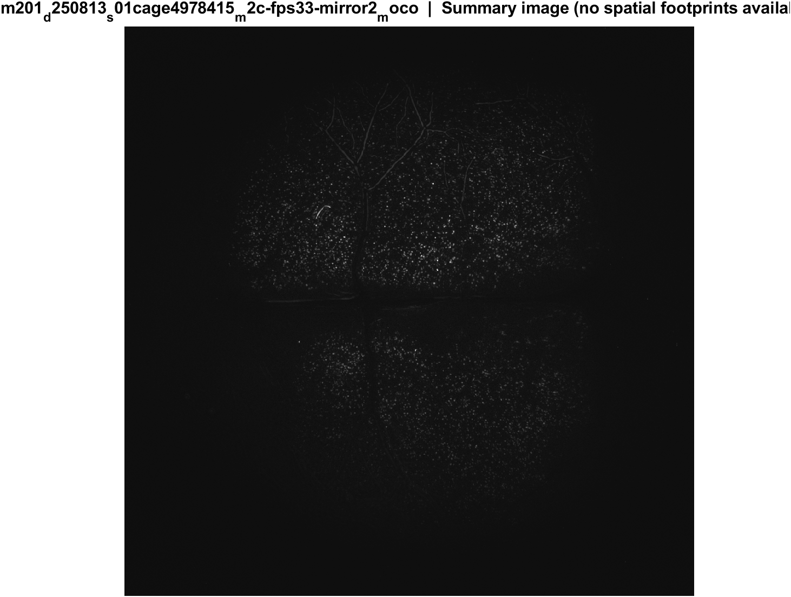
Fig4 FOV anatomy (not a response map) | mouse2c s01 20 mW/cm2 mirror2
What: EXTRACT session-mean image: average brightness over the whole movie, not pre vs post poke.
Result: This is only where cells sit in this FOV — not which cells responded to the poke.

Slide 50

Fig5 Trial raster and poke interval | mouse2c s01 20 mW/cm2 mirror2
What: One row per poke (population z over time) and the histogram of time between detected pokes.
Result: 56 pokes detected in this movie; intervals near 5.3 s, with occasional missed peaks.

Slide 51

Fig1 Population PSTH | mouse2c s02 power TBD mirror1
What: Mean population activity (z-score) and fraction of active cells, aligned to each poke (t = 0 is peak_idx).
Result: This FOV has 1407 neurons and 55 pokes; the population pre vs post test is significant (p = 0.036).

Slide 52

Fig2 Neuron STA | mouse2c s02 power TBD mirror1
What: Each neuron’s average trace around the poke, sorted by response size; right panel is the mean of excited vs inhibited cells.
Result: Excited 5.8% and inhibited 29.9% of 1407 neurons; see the STA split on the right.

Slide 53

Fig3 Excited vs inhibited cells | mouse2c s02 power TBD mirror1
What: Per neuron: mean z in 0.4–1.2 s after t=0 vs -2–0 s before; signed-rank, p<0.05, sign of the difference.
Result: 5.8% excited, 29.9% inhibited out of 1407 neurons; population test significant (p = 0.036).

Slide 54

Fig4 FOV anatomy (not a response map) | mouse2c s02 power TBD mirror1
What: EXTRACT session-mean image: average brightness over the whole movie, not pre vs post poke.
Result: This is only where cells sit in this FOV — not which cells responded to the poke.

Slide 55

Fig5 Trial raster and poke interval | mouse2c s02 power TBD mirror1
What: One row per poke (population z over time) and the histogram of time between detected pokes.
Result: 55 pokes detected in this movie; intervals near 5.3 s, with occasional missed peaks.

Slide 56

Fig1 Population PSTH | mouse2c s02 power TBD mirror2
What: Mean population activity (z-score) and fraction of active cells, aligned to each poke (t = 0 is peak_idx).
Result: This FOV has 2040 neurons and 54 pokes; the population pre vs post test is significant (p = 0.013).

Slide 57

Fig2 Neuron STA | mouse2c s02 power TBD mirror2
What: Each neuron’s average trace around the poke, sorted by response size; right panel is the mean of excited vs inhibited cells.
Result: Excited 6.3% and inhibited 29.3% of 2040 neurons; see the STA split on the right.

Slide 58

Fig3 Excited vs inhibited cells | mouse2c s02 power TBD mirror2
What: Per neuron: mean z in 0.4–1.2 s after t=0 vs -2–0 s before; signed-rank, p<0.05, sign of the difference.
Result: 6.3% excited, 29.3% inhibited out of 2040 neurons; population test significant (p = 0.013).

Slide 59

Fig4 FOV anatomy (not a response map) | mouse2c s02 power TBD mirror2
What: EXTRACT session-mean image: average brightness over the whole movie, not pre vs post poke.
Result: This is only where cells sit in this FOV — not which cells responded to the poke.

Slide 60

Fig5 Trial raster and poke interval | mouse2c s02 power TBD mirror2
What: One row per poke (population z over time) and the histogram of time between detected pokes.
Result: 54 pokes detected in this movie; intervals near 5.3 s, with occasional missed peaks.

Slide 61

Fig1 Population PSTH | m3 (LabVIEW m1f) s00 mirror1
What: Mean population activity (z-score) and fraction of active cells, aligned to each poke (t = 0 is peak_idx).
Result: This FOV has 1537 neurons and 55 pokes; the population pre vs post test is significant (p = 7.0e-07).

Slide 62

Fig2 Neuron STA | m3 (LabVIEW m1f) s00 mirror1
What: Each neuron’s average trace around the poke, sorted by response size; right panel is the mean of excited vs inhibited cells.
Result: Excited 14.1% and inhibited 29.7% of 1537 neurons; see the STA split on the right.

Slide 63

Fig3 Excited vs inhibited cells | m3 (LabVIEW m1f) s00 mirror1
What: Per neuron: mean z in 0.4–1.2 s after t=0 vs -2–0 s before; signed-rank, p<0.05, sign of the difference.
Result: 14.1% excited, 29.7% inhibited out of 1537 neurons; population test significant (p = 7.0e-07).

Slide 64

Fig4 FOV anatomy (not a response map) | m3 (LabVIEW m1f) s00 mirror1
What: EXTRACT session-mean image: average brightness over the whole movie, not pre vs post poke.
Result: This is only where cells sit in this FOV — not which cells responded to the poke.

Slide 65

Fig5 Trial raster and poke interval | m3 (LabVIEW m1f) s00 mirror1
What: One row per poke (population z over time) and the histogram of time between detected pokes.
Result: 55 pokes detected in this movie; intervals near 5.3 s, with occasional missed peaks.

Slide 66

Fig1 Population PSTH | m3 (LabVIEW m1f) s00 mirror2
What: Mean population activity (z-score) and fraction of active cells, aligned to each poke (t = 0 is peak_idx).
Result: This FOV has 2148 neurons and 48 pokes; the population pre vs post test is significant (p = 1.3e-04).

Slide 67

Fig2 Neuron STA | m3 (LabVIEW m1f) s00 mirror2
What: Each neuron’s average trace around the poke, sorted by response size; right panel is the mean of excited vs inhibited cells.
Result: Excited 12.1% and inhibited 30.5% of 2148 neurons; see the STA split on the right.

Slide 68

Fig3 Excited vs inhibited cells | m3 (LabVIEW m1f) s00 mirror2
What: Per neuron: mean z in 0.4–1.2 s after t=0 vs -2–0 s before; signed-rank, p<0.05, sign of the difference.
Result: 12.1% excited, 30.5% inhibited out of 2148 neurons; population test significant (p = 1.3e-04).

Slide 69

Fig4 FOV anatomy (not a response map) | m3 (LabVIEW m1f) s00 mirror2
What: EXTRACT session-mean image: average brightness over the whole movie, not pre vs post poke.
Result: This is only where cells sit in this FOV — not which cells responded to the poke.

Slide 70

Fig5 Trial raster and poke interval | m3 (LabVIEW m1f) s00 mirror2
What: One row per poke (population z over time) and the histogram of time between detected pokes.
Result: 48 pokes detected in this movie; intervals near 5.3 s, with occasional missed peaks.

Slide 71
Next
Export spatial footprints → map excited vs inhibited cells onto cortex. Also compare the peak_pre_idx deck, which is the better physical candidate for stimulus onset.

