Slide 1
Face poking on crystal skull
2025-08-13 | t = 0 at peak_pre_idx (onset candidate) | window 0.4–1.2 s vs -2–0 s
Take-home: cortex is time-locked to the poke; a region map still needs spatial footprints.

Slide 2
Experiment
Whole dorsal cortex Ca2+ imaging while a motor arm pokes the face. Every movie on this day is a poking session — there is no no-poke baseline.

Slide 3
Two recordings of the same experiment
s00 = 8.38 mW/cm2, s01 = 20 mW/cm2. mirror1 and mirror2 are two optical paths (two FOVs at the same time).

Slide 4
How poke time is defined
No behavior camera. A blocker on the arm changes mean-frame intensity. t = 0 is peak_pre_idx: the intensity minimum just before the positive brightness peak (candidate stimulus onset).

Slide 5
How traces are analyzed
EXTRACT traces at 33 Hz. Cut -2 to +3 s around each poke. A cell is excited or inhibited if 0.4–1.2 s differs from -2–0 s (Wilcoxon signed-rank, p<0.05).

Slide 6
What we cannot show yet
Fig4 is a session-average picture of the FOV. To paint which cortical regions are excited vs inhibited, Omer needs to export spatial_weights as a normal sparse matrix.

Slide 7
All recordings together
12 movies | same alignment and windows

Slide 8
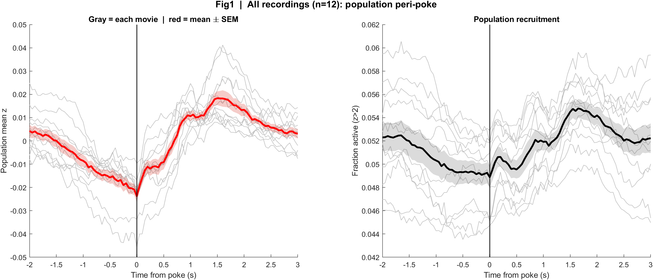
Fig1 Population PSTH | all movies
What: Mean population activity (z-score) and fraction of active cells, aligned to each poke (t = 0 is peak_pre_idx).
Result: Activity dips at poke onset, then rises and peaks about 1.5 s later — a delayed, poke-locked population response.

Slide 9
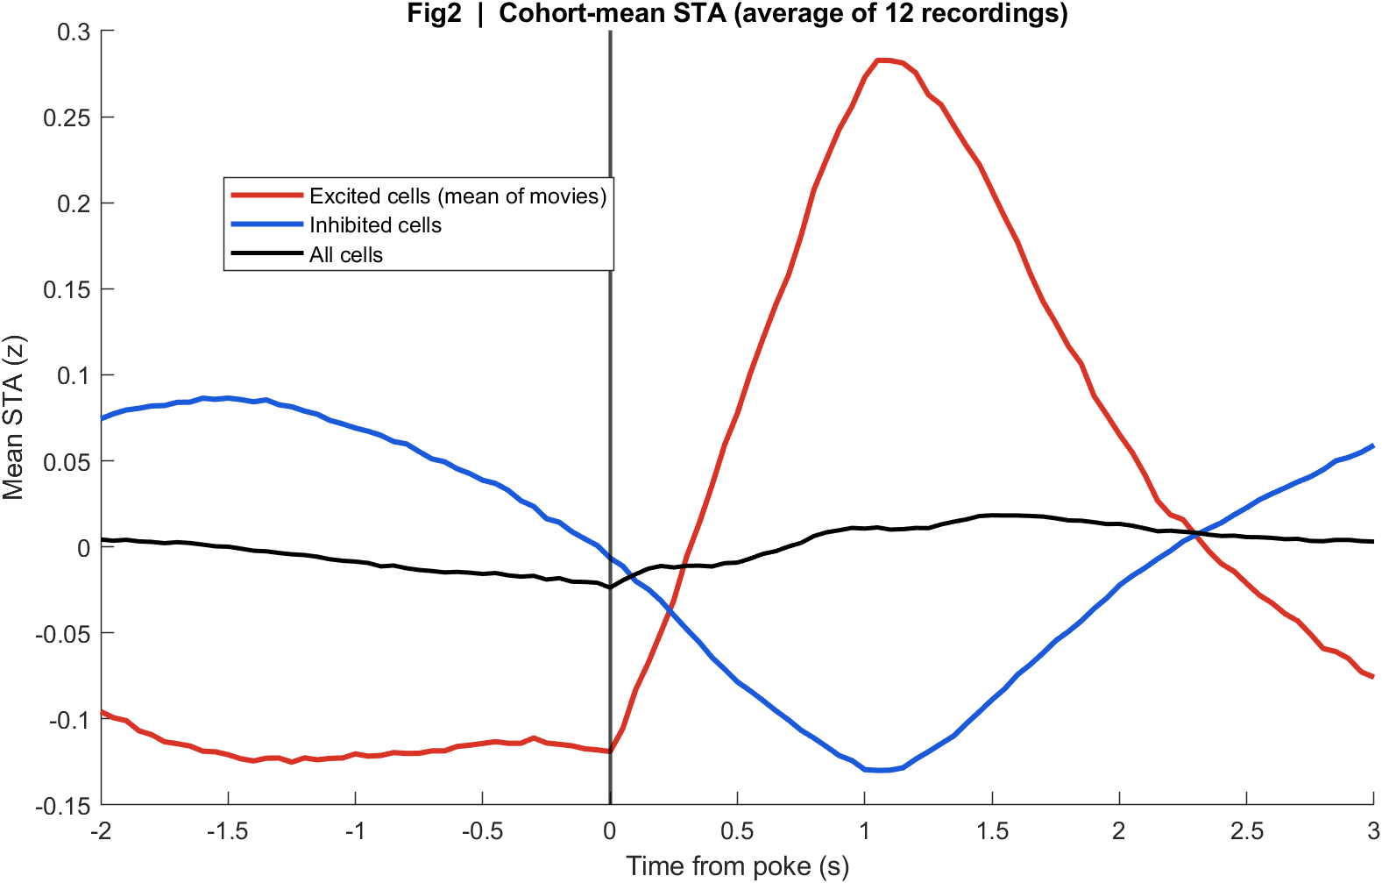
Fig2 Neuron STA | all movies
What: Each neuron’s average trace around the poke, sorted by response size; right panel is the mean of excited vs inhibited cells.
Result: A subset of cells go up after the poke and another subset go down; the all-cell mean is small because they partly cancel.

Slide 10
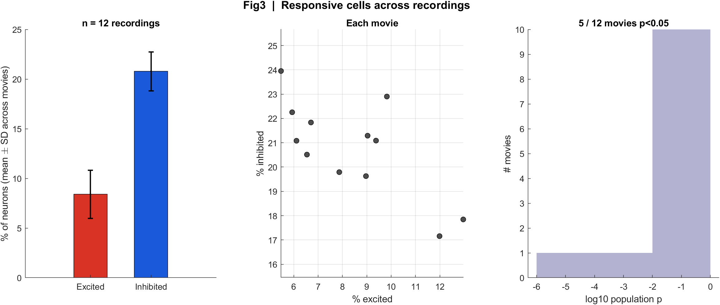
Fig3 Excited vs inhibited cells | all movies
What: Per neuron: mean z in 0.4–1.2 s after t=0 vs -2–0 s before; signed-rank, p<0.05, sign of the difference.
Result: About 5–13% of cells are excited and 17–24% inhibited; only 5 of 12 movies pass the population test with this window.

Slide 11
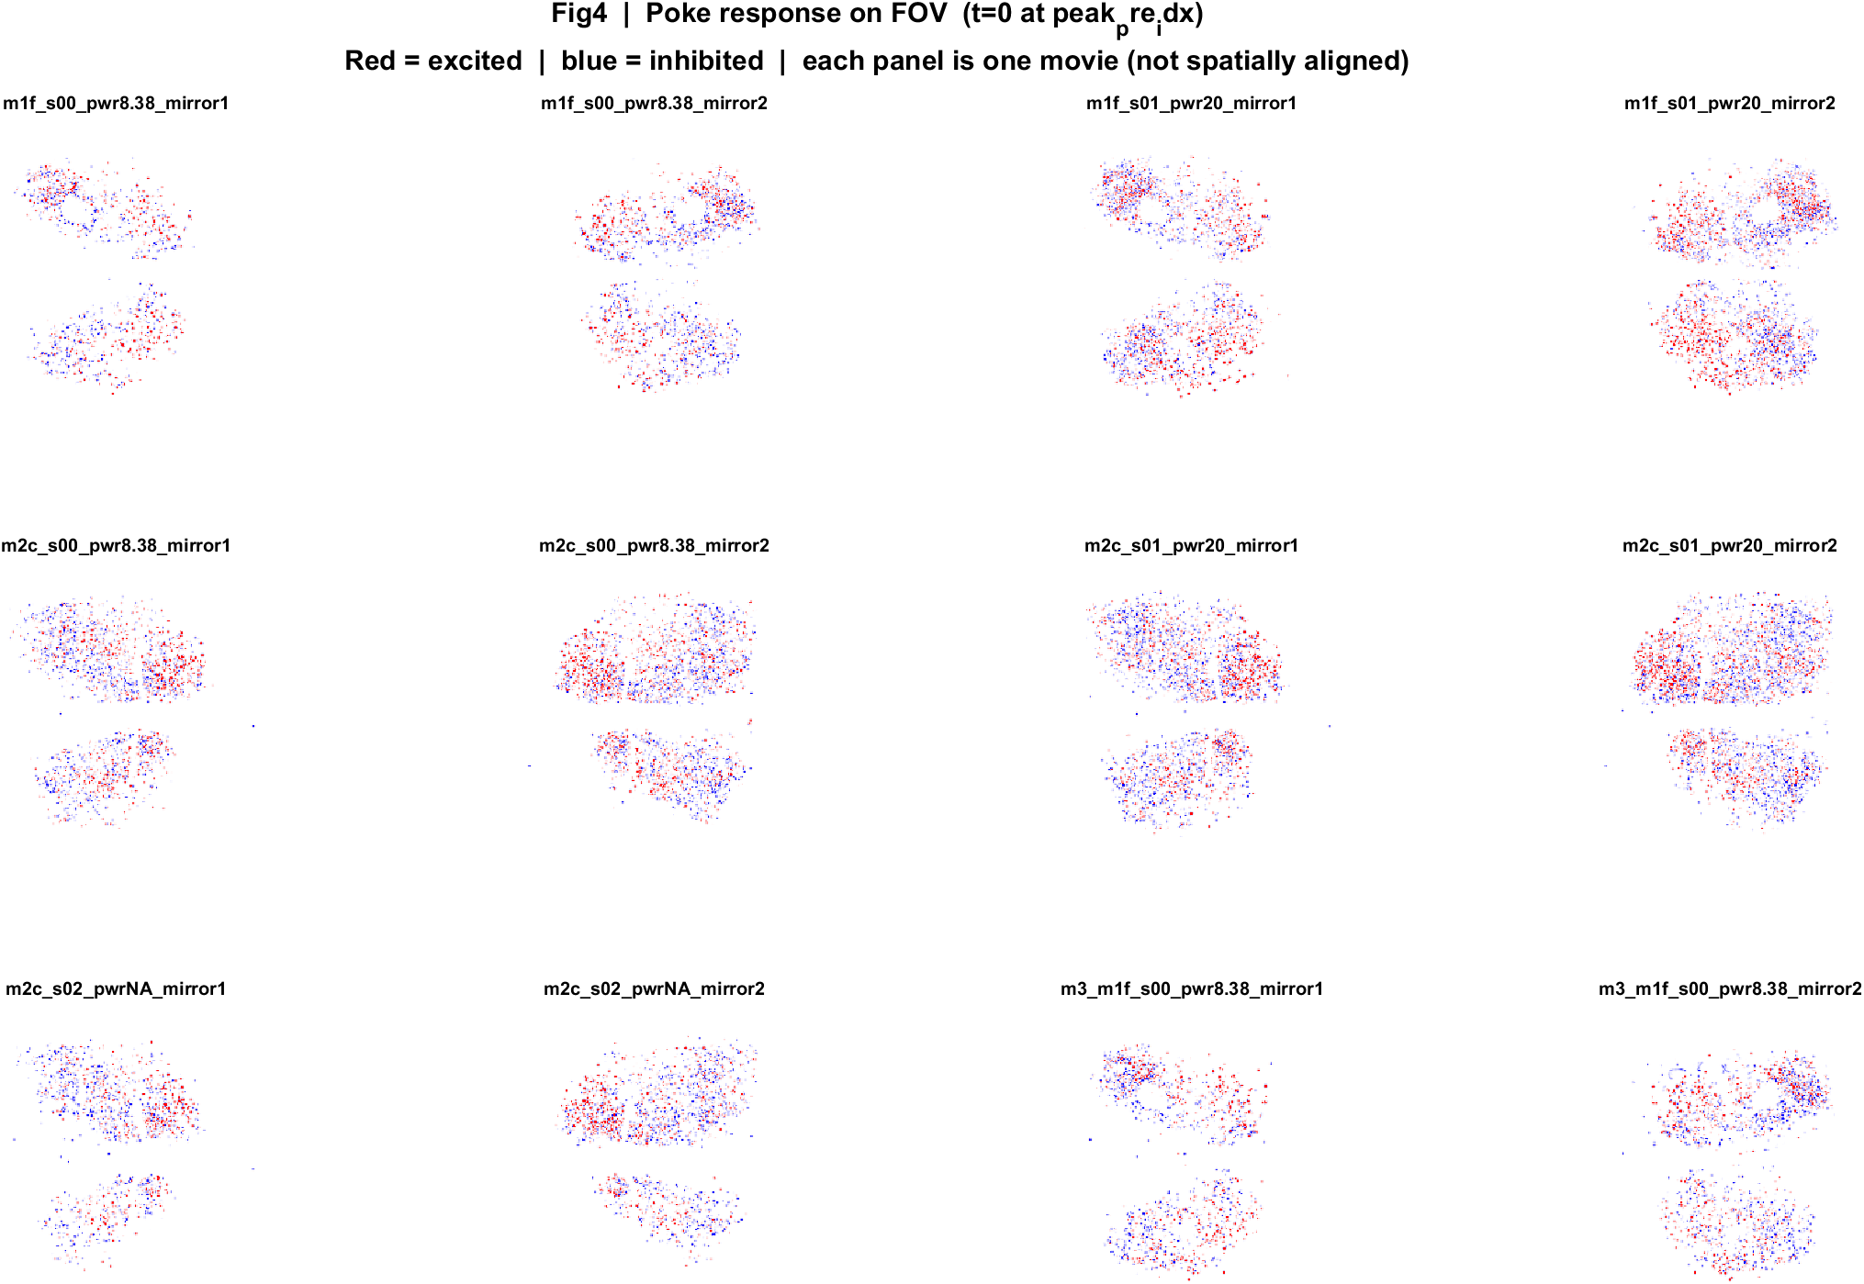
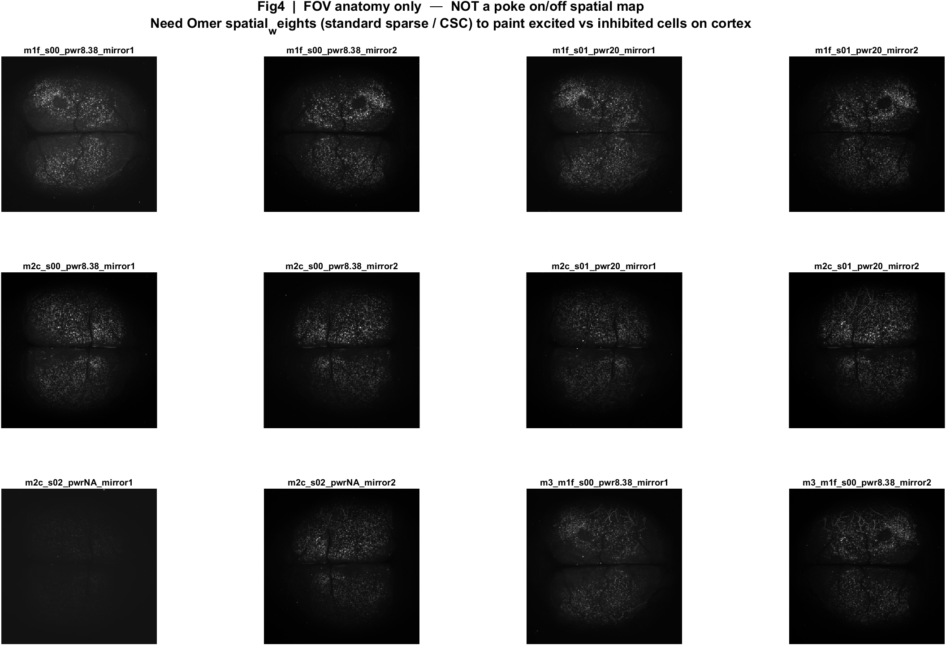
Fig4 Spatial poke-response map | all movies
What: Each neuron's post-pre amplitude is painted onto its EXTRACT footprint. Red = excited, blue = inhibited. Left: anatomy. Middle: all cells. Right: p<0.05 only.
Result: Excited and inhibited cells are intermingled across dorsal cortex; there is no single on-or-off region in these unaligned FOVs.

Slide 12
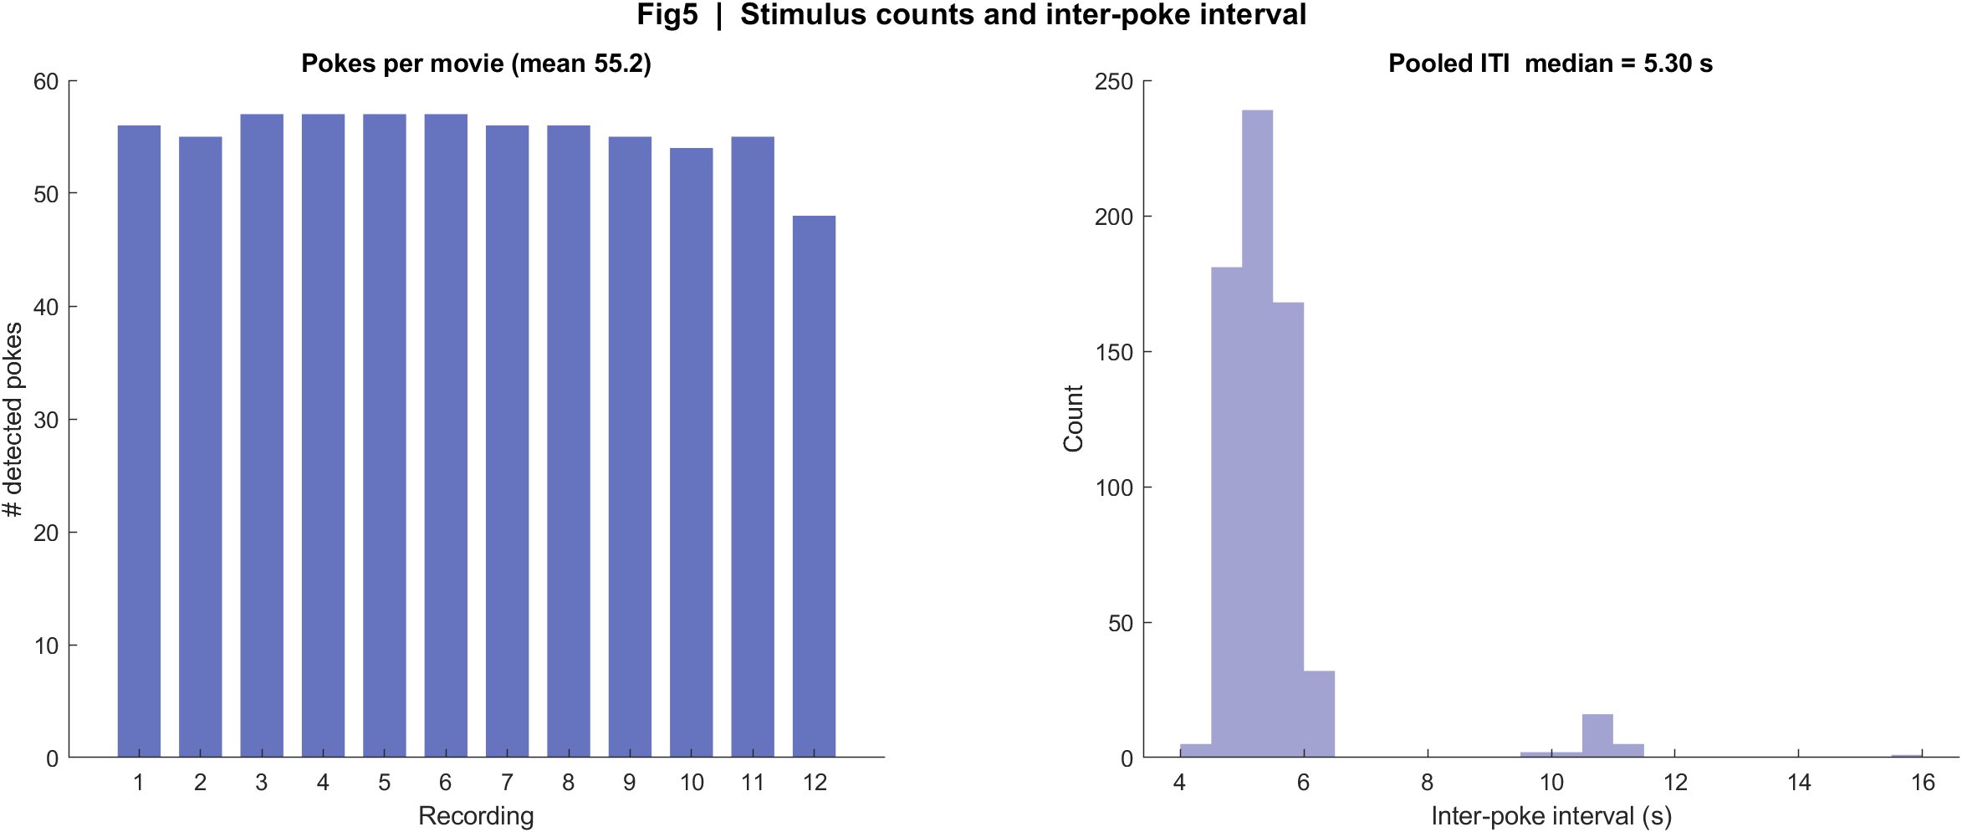
Fig5 Trial raster and poke interval | all movies
What: One row per poke (population z over time) and the histogram of time between detected pokes.
Result: About 48–57 pokes per movie; median interval is 5.3 s (set to 3 s, with mechanical jitter). Long gaps are missed peaks.

Slide 13
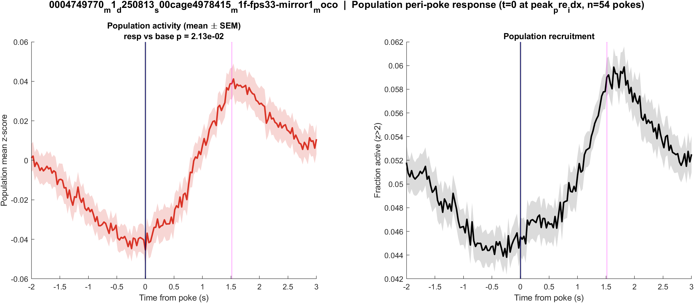
Fig1 Population PSTH | mouse1f s00 8.38 mW/cm2 mirror1
What: Mean population activity (z-score) and fraction of active cells, aligned to each poke (t = 0 is peak_pre_idx).
Result: This FOV has 1240 neurons and 56 pokes; the population pre vs post test is significant (p = 0.021).

Slide 14
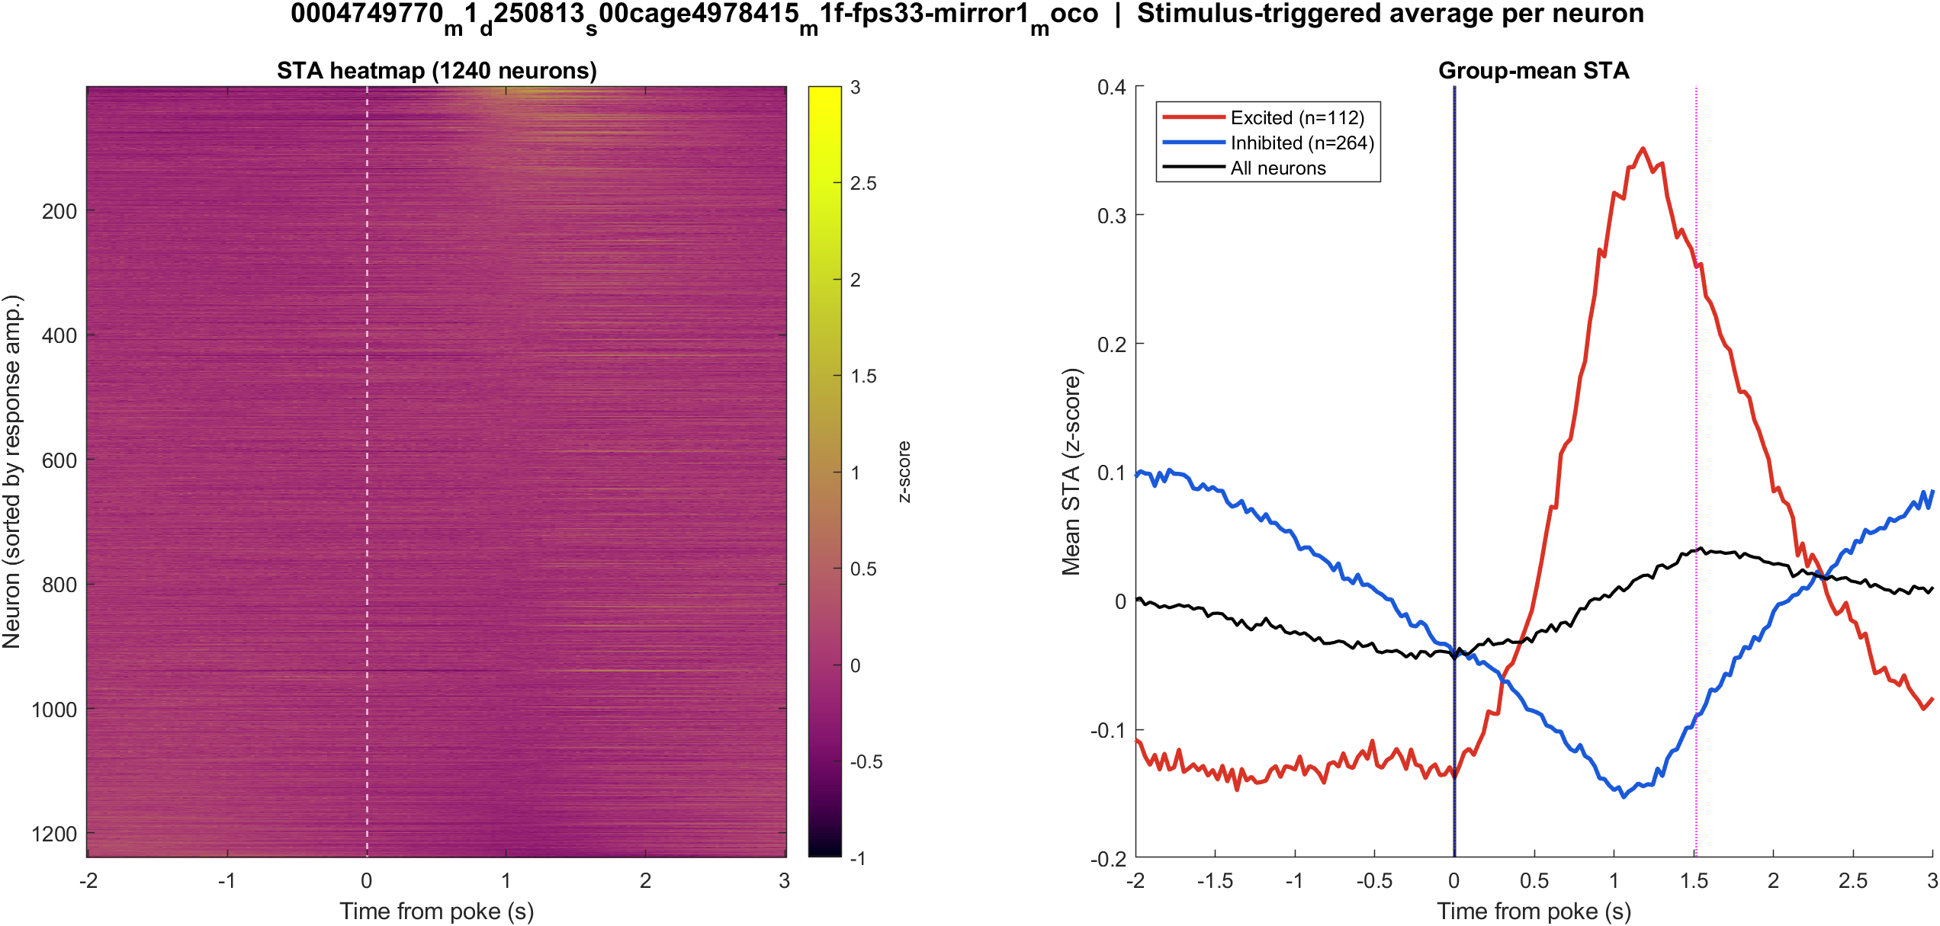
Fig2 Neuron STA | mouse1f s00 8.38 mW/cm2 mirror1
What: Each neuron’s average trace around the poke, sorted by response size; right panel is the mean of excited vs inhibited cells.
Result: Excited 9.0% and inhibited 21.3% of 1240 neurons; see the STA split on the right.

Slide 15
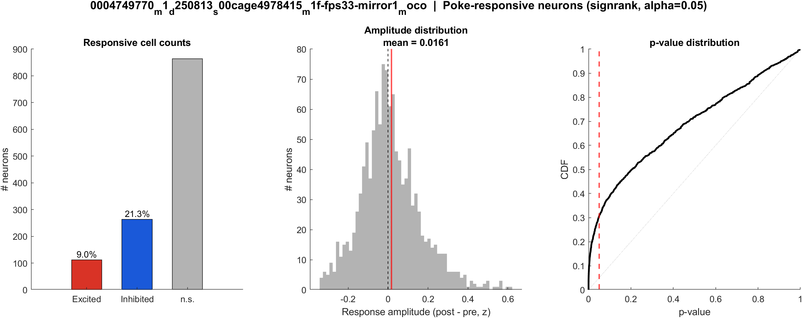
Fig3 Excited vs inhibited cells | mouse1f s00 8.38 mW/cm2 mirror1
What: Per neuron: mean z in 0.4–1.2 s after t=0 vs -2–0 s before; signed-rank, p<0.05, sign of the difference.
Result: 9.0% excited, 21.3% inhibited out of 1240 neurons; population test significant (p = 0.021).

Slide 16

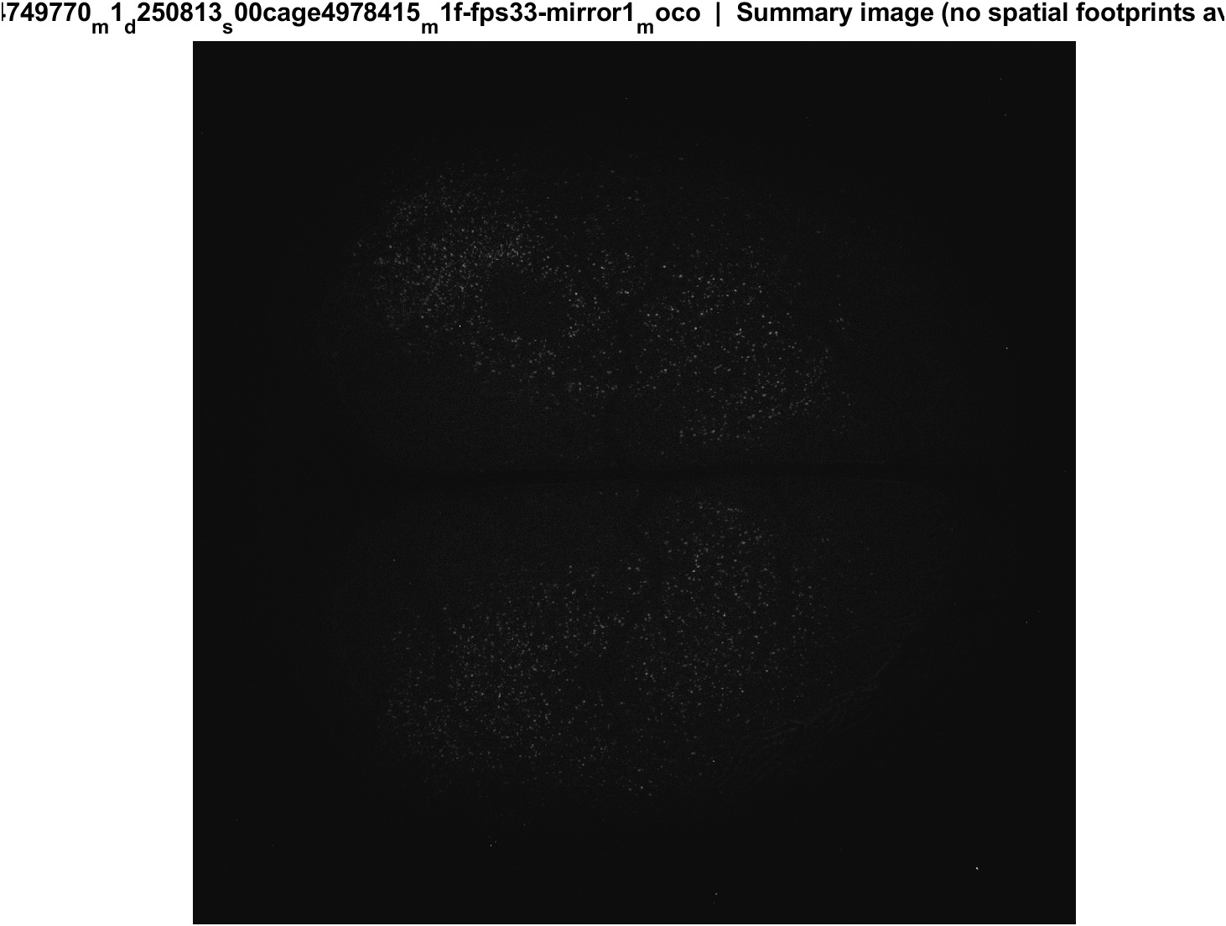
Fig4 Spatial poke-response map | mouse1f s00 8.38 mW/cm2 mirror1
What: Each neuron's post-pre amplitude is painted onto its EXTRACT footprint. Red = excited, blue = inhibited. Left: anatomy. Middle: all cells. Right: p<0.05 only.
Result: Excited and inhibited cells are intermingled across dorsal cortex; there is no single on-or-off region in these unaligned FOVs.

Slide 17
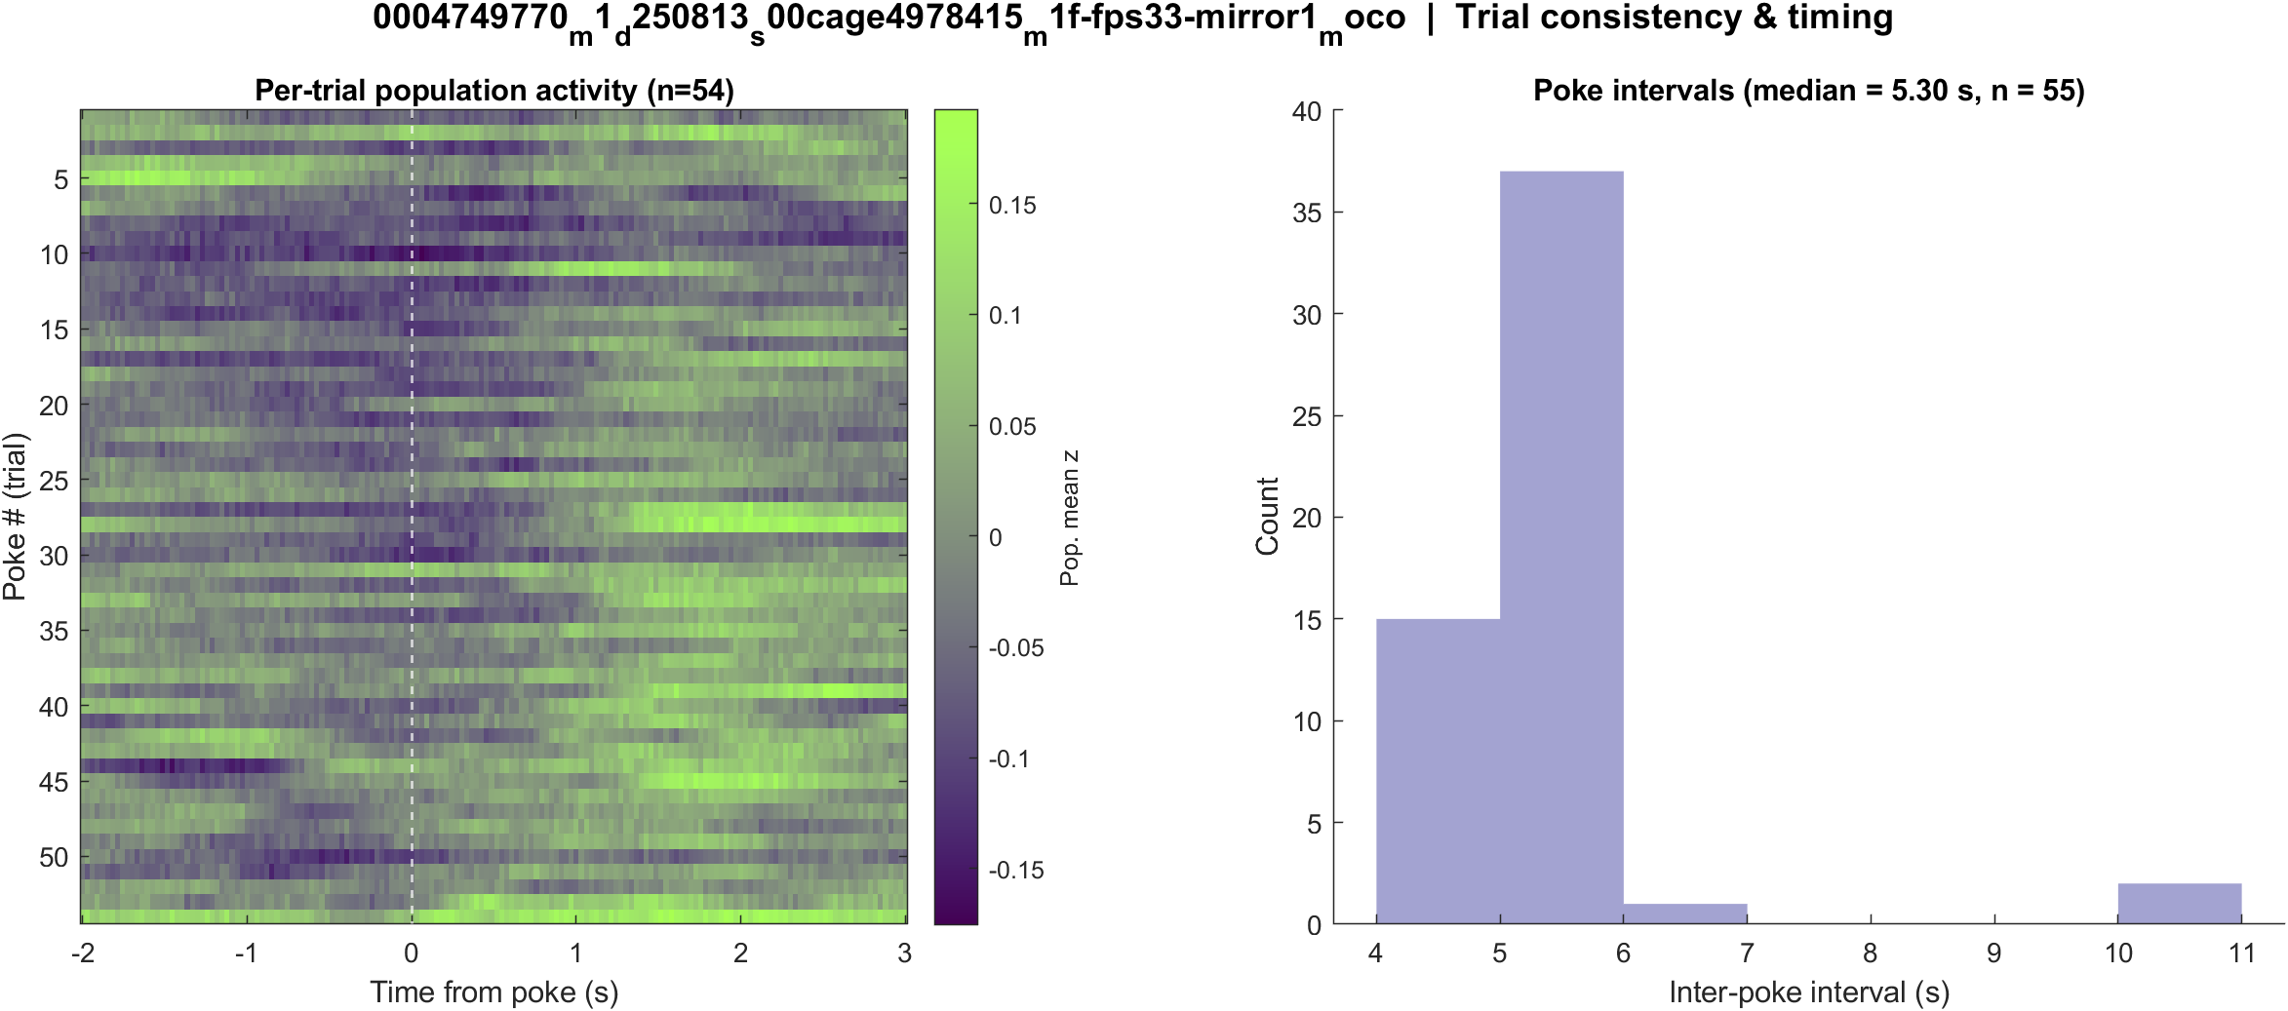
Fig5 Trial raster and poke interval | mouse1f s00 8.38 mW/cm2 mirror1
What: One row per poke (population z over time) and the histogram of time between detected pokes.
Result: 56 pokes detected in this movie; intervals near 5.3 s, with occasional missed peaks.

Slide 18
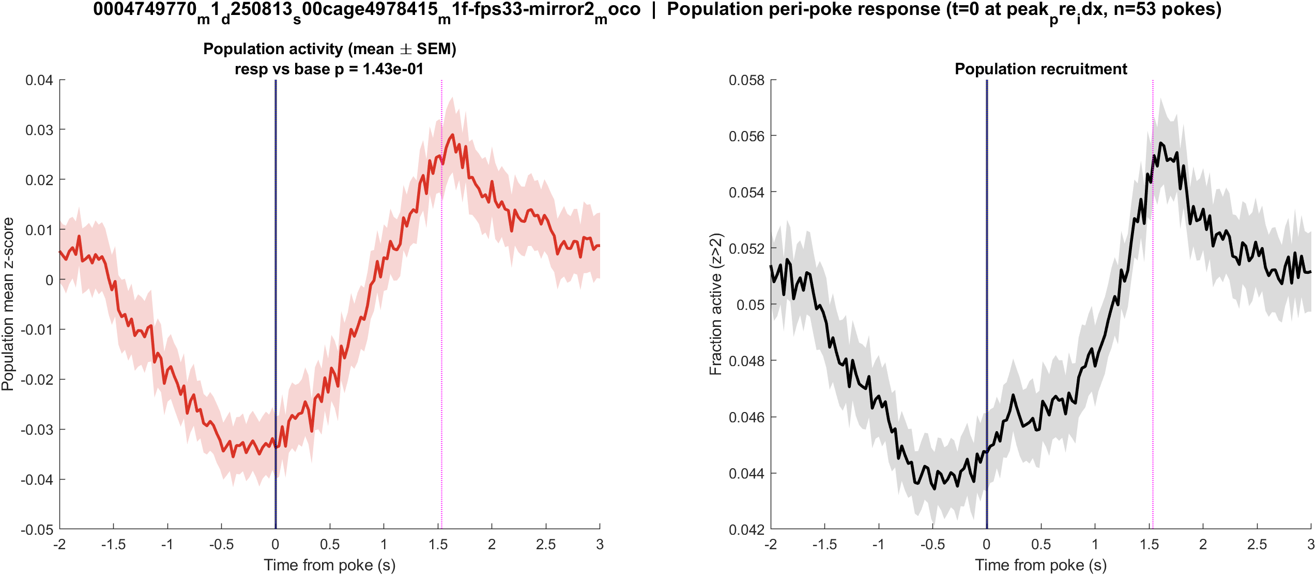
Fig1 Population PSTH | mouse1f s00 8.38 mW/cm2 mirror2
What: Mean population activity (z-score) and fraction of active cells, aligned to each poke (t = 0 is peak_pre_idx).
Result: This FOV has 1930 neurons and 55 pokes; the population pre vs post test is not significant (p = 0.143).

Slide 19

Fig2 Neuron STA | mouse1f s00 8.38 mW/cm2 mirror2
What: Each neuron’s average trace around the poke, sorted by response size; right panel is the mean of excited vs inhibited cells.
Result: Excited 9.4% and inhibited 21.1% of 1930 neurons; see the STA split on the right.

Slide 20
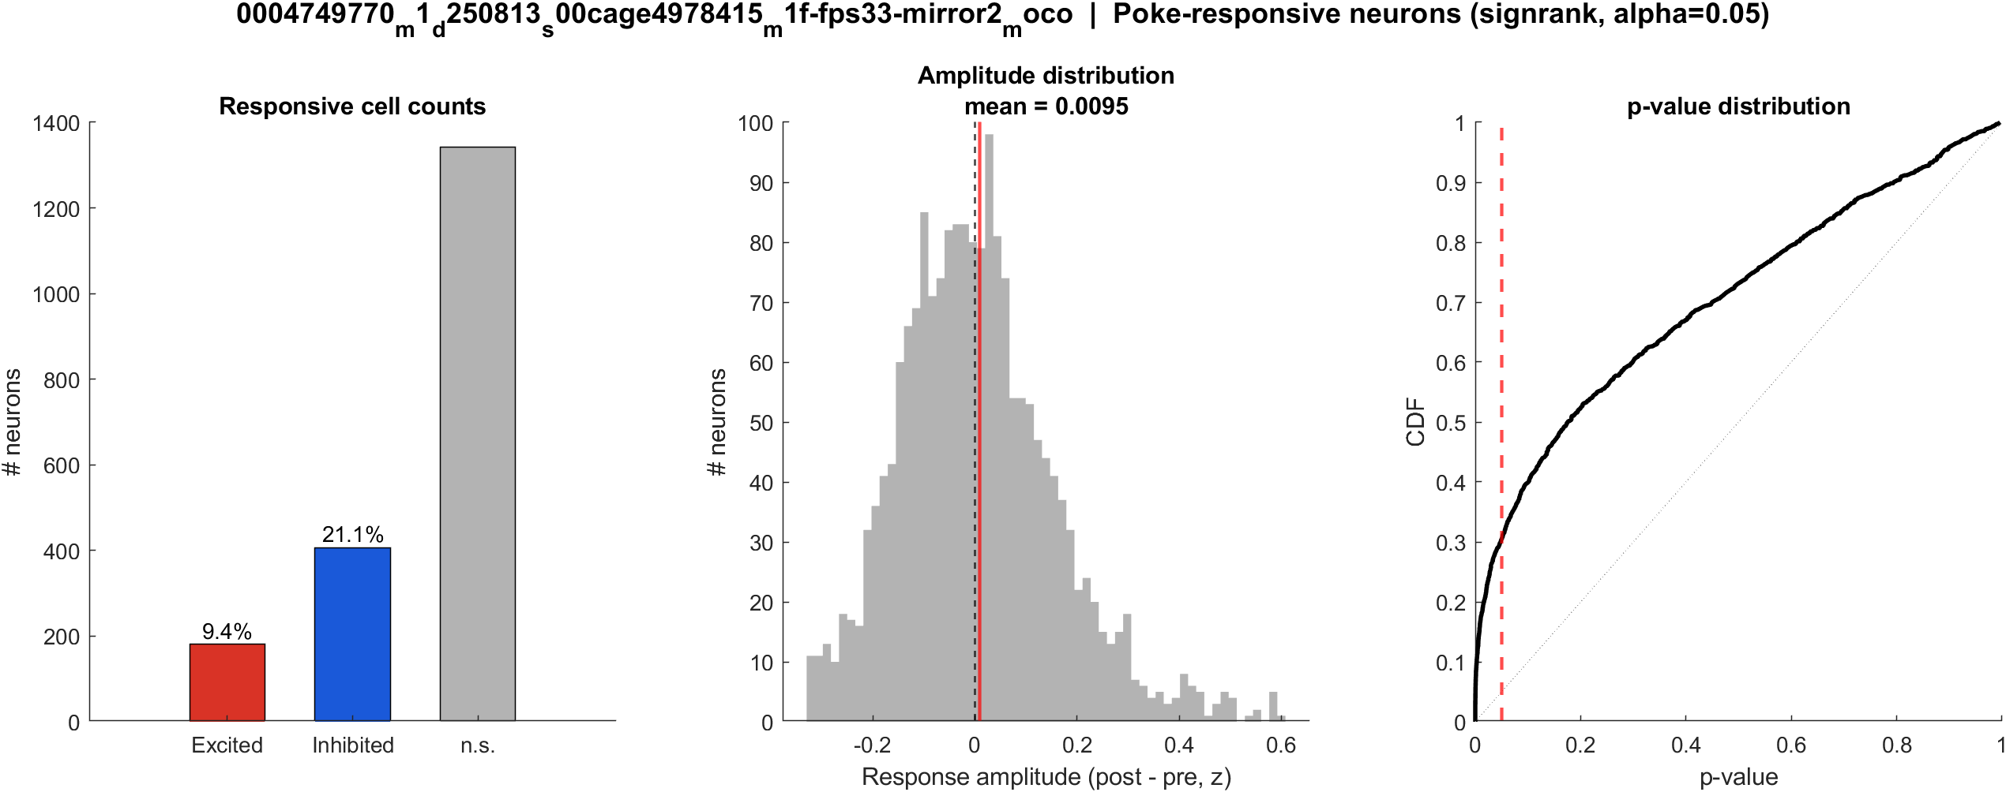
Fig3 Excited vs inhibited cells | mouse1f s00 8.38 mW/cm2 mirror2
What: Per neuron: mean z in 0.4–1.2 s after t=0 vs -2–0 s before; signed-rank, p<0.05, sign of the difference.
Result: 9.4% excited, 21.1% inhibited out of 1930 neurons; population test not significant (p = 0.143).

Slide 21

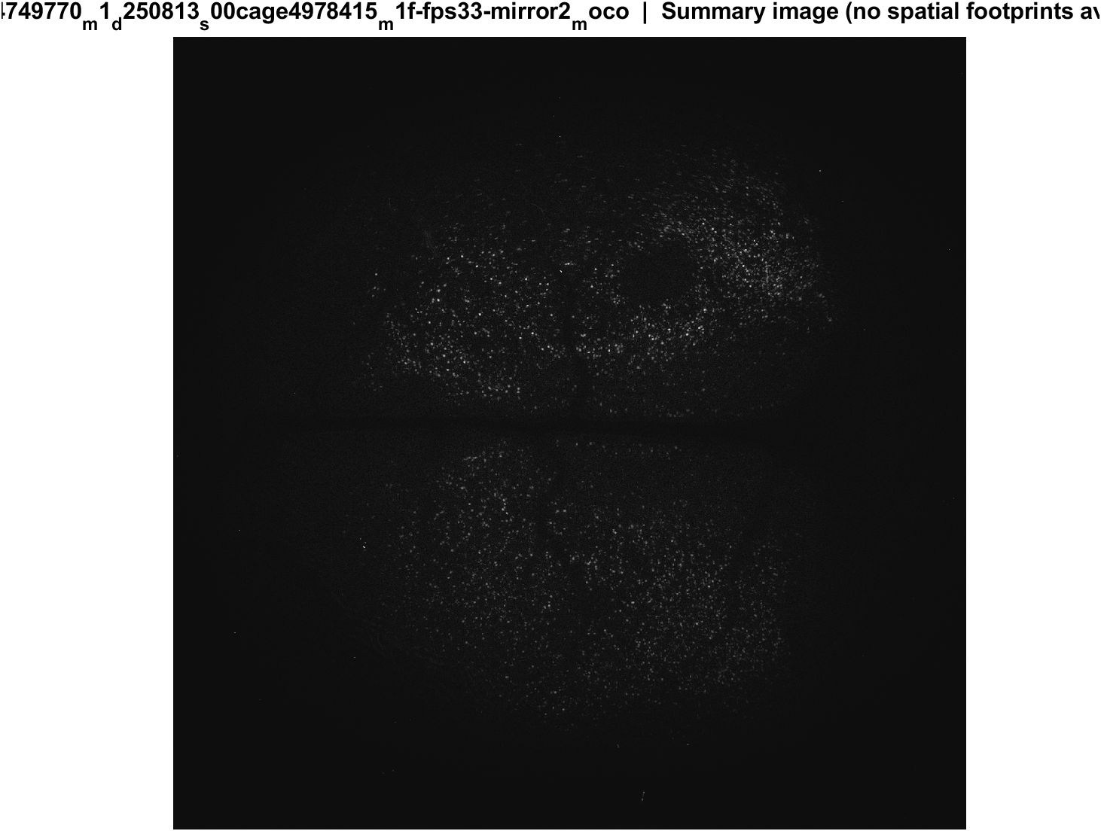
Fig4 Spatial poke-response map | mouse1f s00 8.38 mW/cm2 mirror2
What: Each neuron's post-pre amplitude is painted onto its EXTRACT footprint. Red = excited, blue = inhibited. Left: anatomy. Middle: all cells. Right: p<0.05 only.
Result: Excited and inhibited cells are intermingled across dorsal cortex; there is no single on-or-off region in these unaligned FOVs.

Slide 22
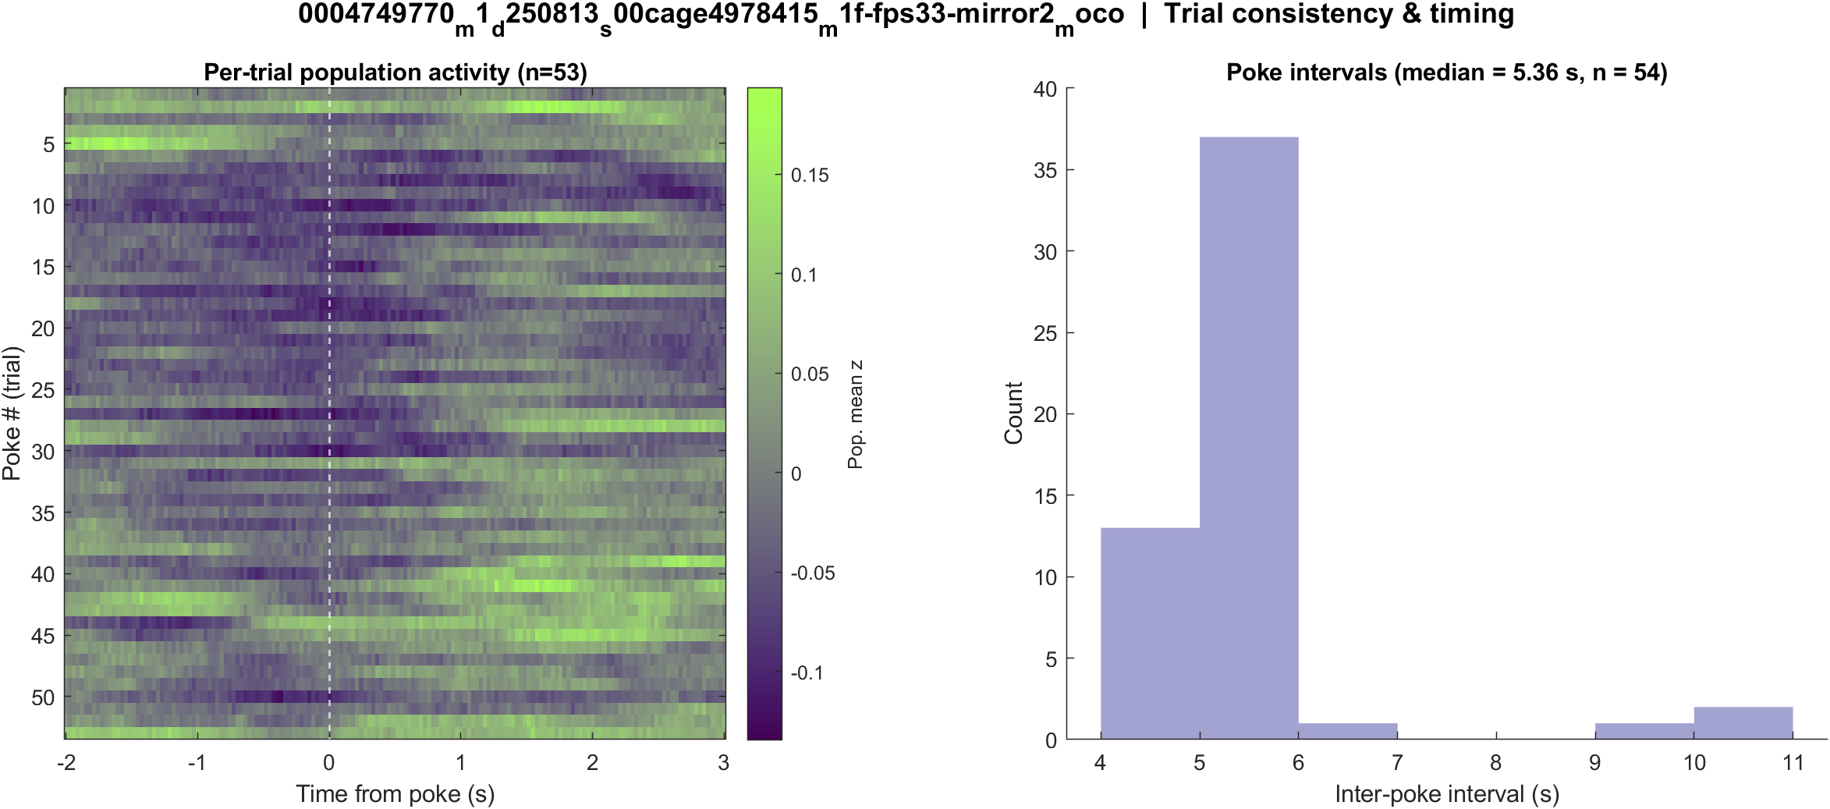
Fig5 Trial raster and poke interval | mouse1f s00 8.38 mW/cm2 mirror2
What: One row per poke (population z over time) and the histogram of time between detected pokes.
Result: 55 pokes detected in this movie; intervals near 5.3 s, with occasional missed peaks.

Slide 23
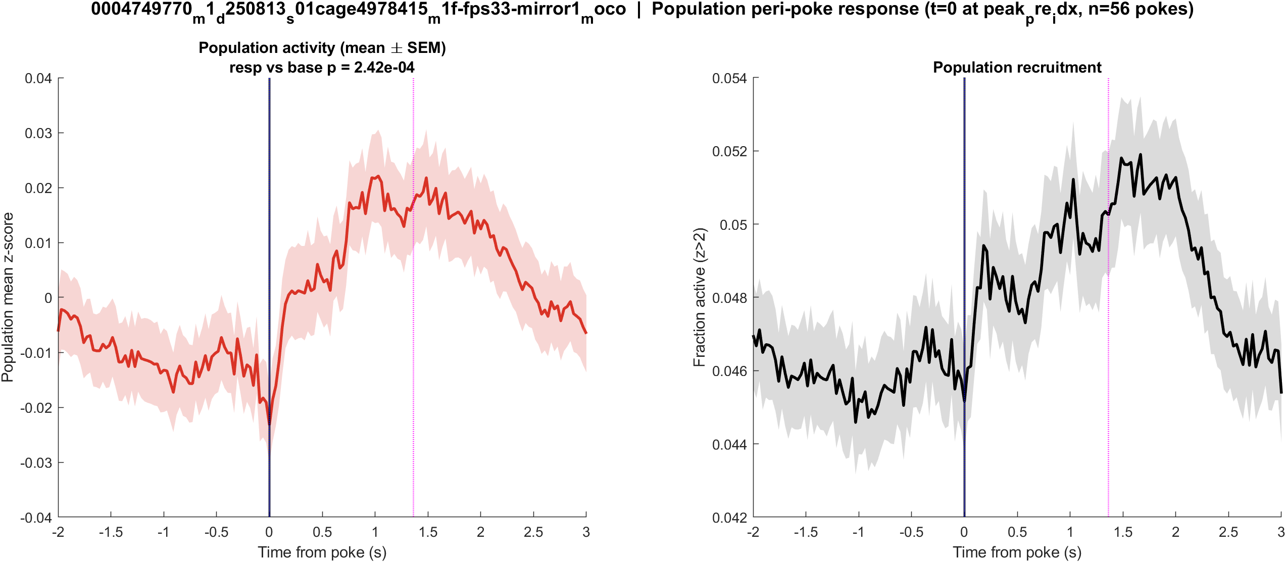
Fig1 Population PSTH | mouse1f s01 20 mW/cm2 mirror1
What: Mean population activity (z-score) and fraction of active cells, aligned to each poke (t = 0 is peak_pre_idx).
Result: This FOV has 2786 neurons and 57 pokes; the population pre vs post test is significant (p = 2.4e-04).

Slide 24
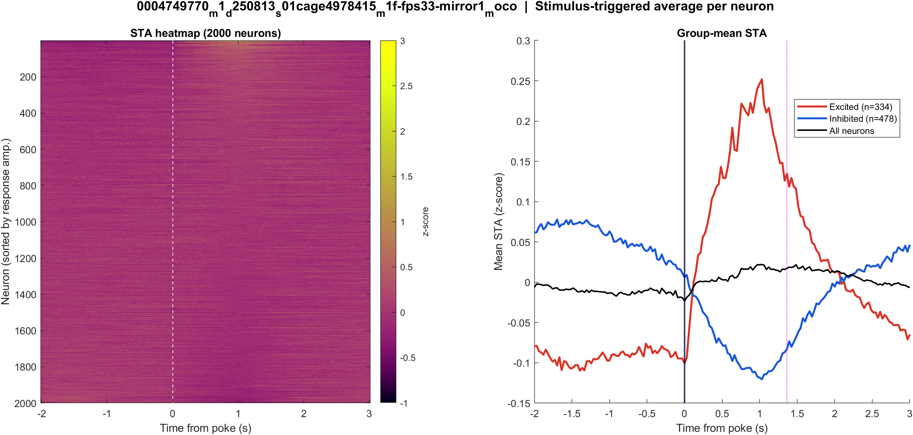
Fig2 Neuron STA | mouse1f s01 20 mW/cm2 mirror1
What: Each neuron’s average trace around the poke, sorted by response size; right panel is the mean of excited vs inhibited cells.
Result: Excited 12.0% and inhibited 17.2% of 2786 neurons; see the STA split on the right.

Slide 25
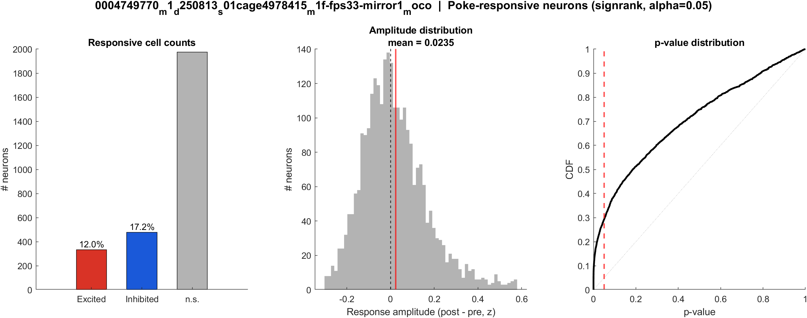
Fig3 Excited vs inhibited cells | mouse1f s01 20 mW/cm2 mirror1
What: Per neuron: mean z in 0.4–1.2 s after t=0 vs -2–0 s before; signed-rank, p<0.05, sign of the difference.
Result: 12.0% excited, 17.2% inhibited out of 2786 neurons; population test significant (p = 2.4e-04).

Slide 26

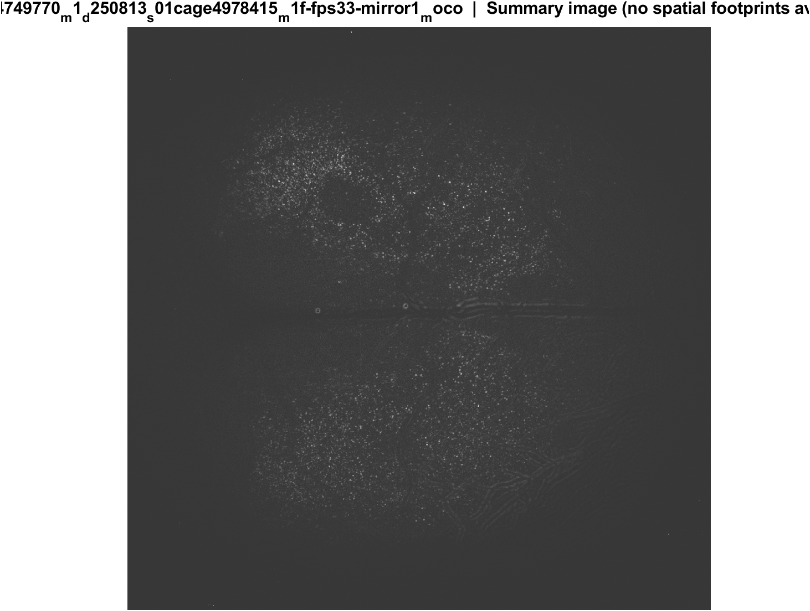
Fig4 Spatial poke-response map | mouse1f s01 20 mW/cm2 mirror1
What: Each neuron's post-pre amplitude is painted onto its EXTRACT footprint. Red = excited, blue = inhibited. Left: anatomy. Middle: all cells. Right: p<0.05 only.
Result: Excited and inhibited cells are intermingled across dorsal cortex; there is no single on-or-off region in these unaligned FOVs.

Slide 27
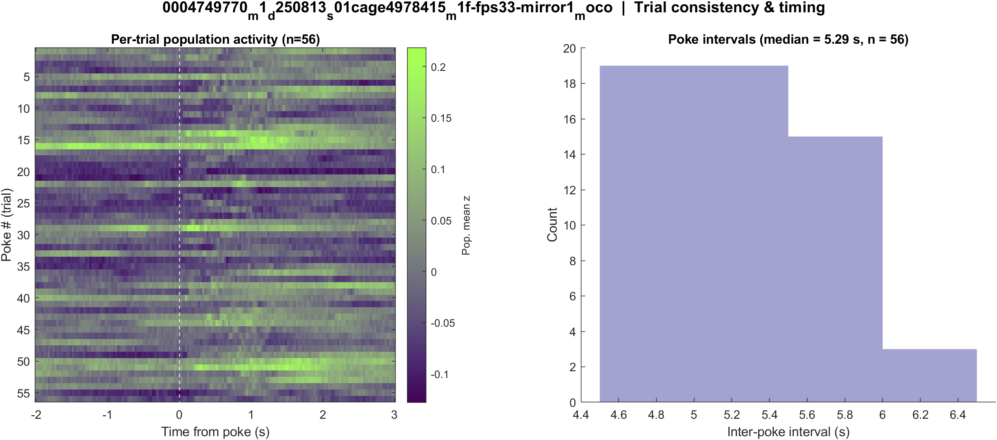
Fig5 Trial raster and poke interval | mouse1f s01 20 mW/cm2 mirror1
What: One row per poke (population z over time) and the histogram of time between detected pokes.
Result: 57 pokes detected in this movie; intervals near 5.3 s, with occasional missed peaks.

Slide 28
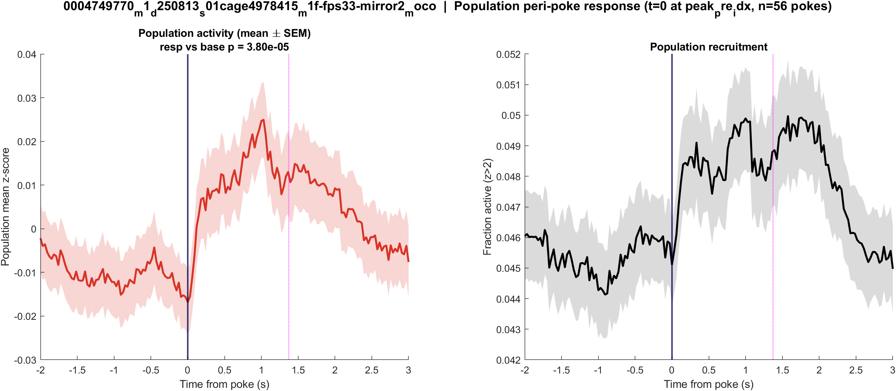
Fig1 Population PSTH | mouse1f s01 20 mW/cm2 mirror2
What: Mean population activity (z-score) and fraction of active cells, aligned to each poke (t = 0 is peak_pre_idx).
Result: This FOV has 3749 neurons and 57 pokes; the population pre vs post test is significant (p = 3.8e-05).

Slide 29
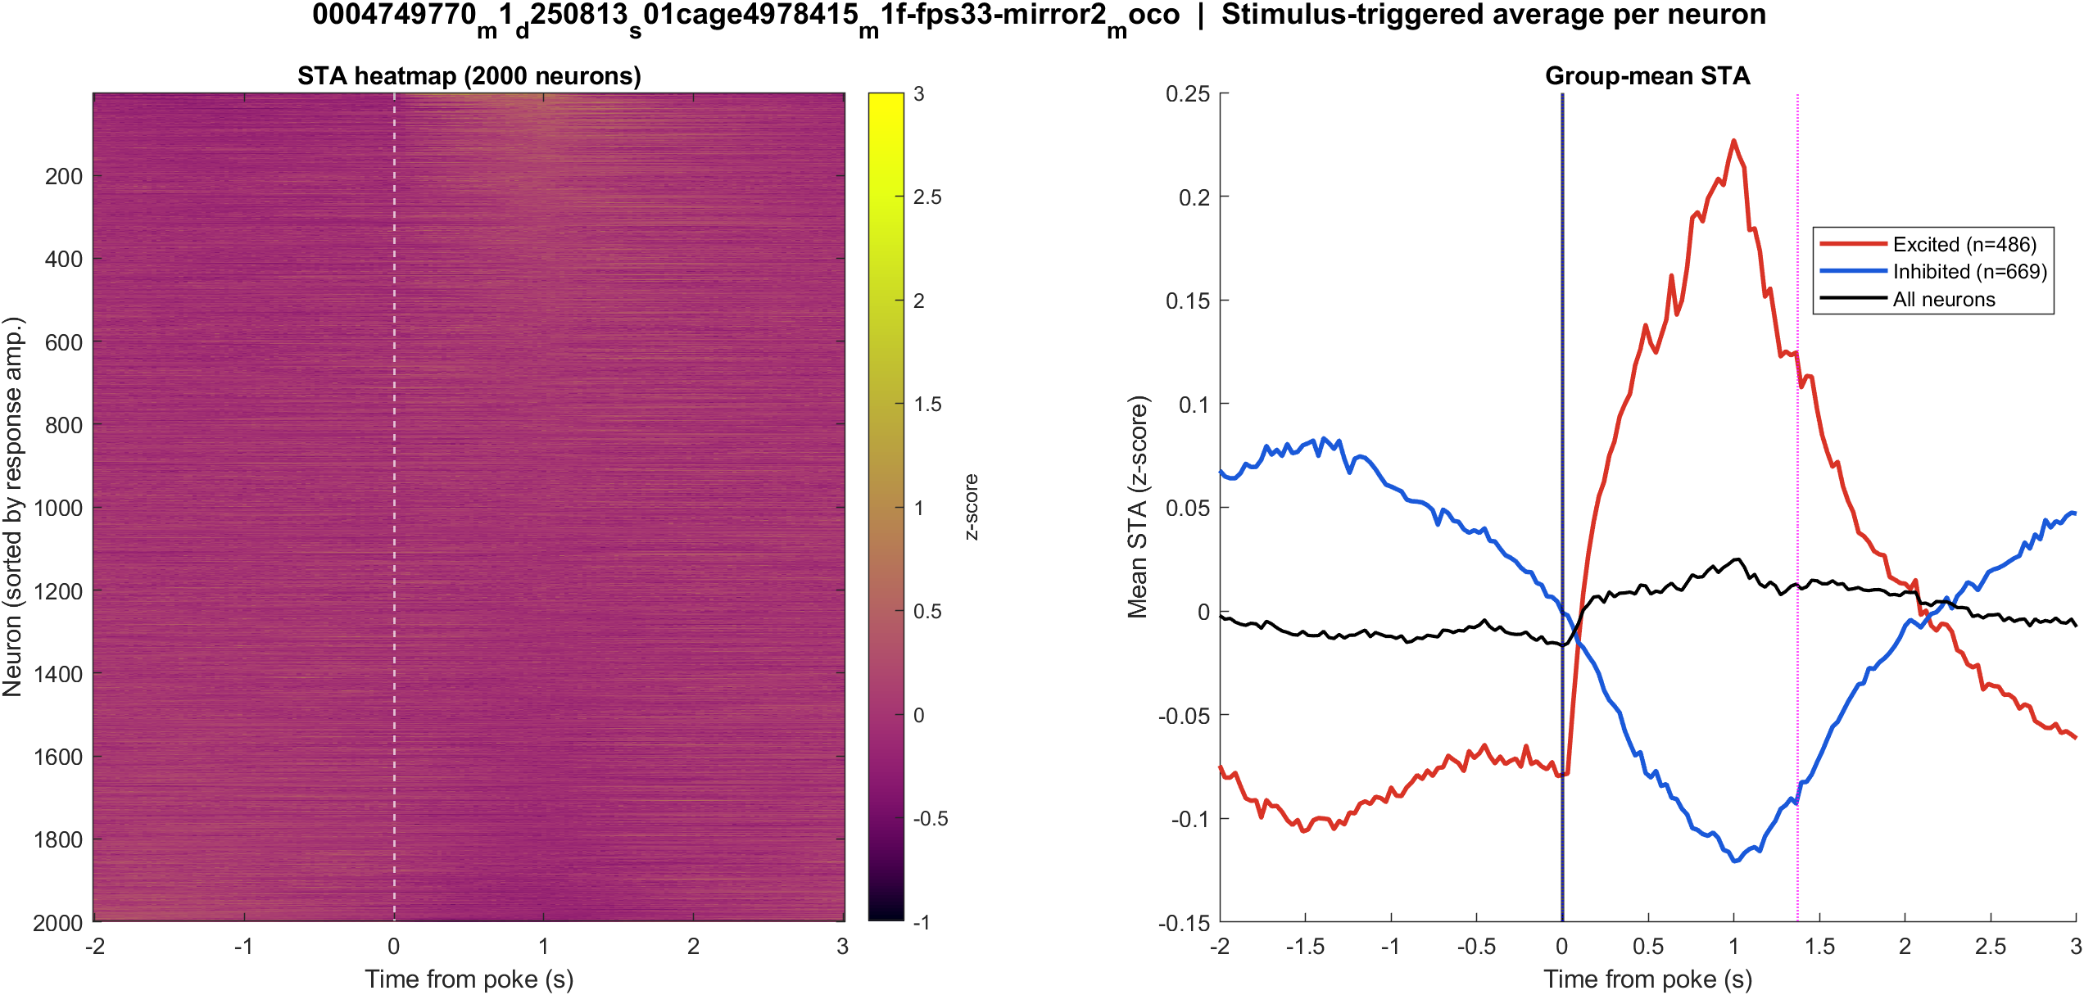
Fig2 Neuron STA | mouse1f s01 20 mW/cm2 mirror2
What: Each neuron’s average trace around the poke, sorted by response size; right panel is the mean of excited vs inhibited cells.
Result: Excited 13.0% and inhibited 17.8% of 3749 neurons; see the STA split on the right.

Slide 30
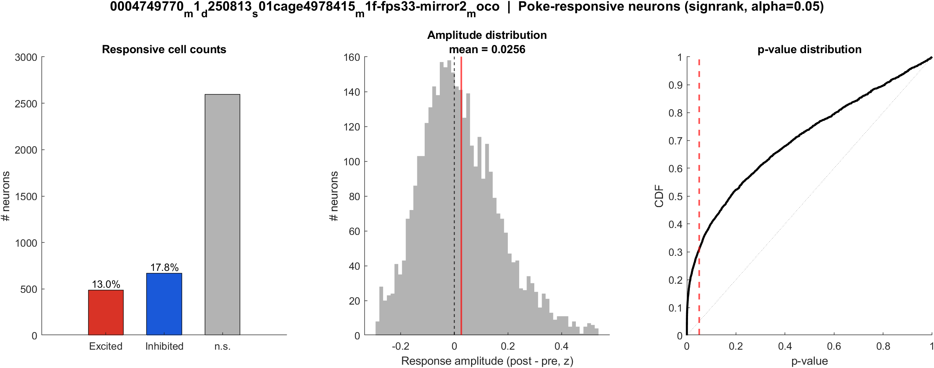
Fig3 Excited vs inhibited cells | mouse1f s01 20 mW/cm2 mirror2
What: Per neuron: mean z in 0.4–1.2 s after t=0 vs -2–0 s before; signed-rank, p<0.05, sign of the difference.
Result: 13.0% excited, 17.8% inhibited out of 3749 neurons; population test significant (p = 3.8e-05).

Slide 31

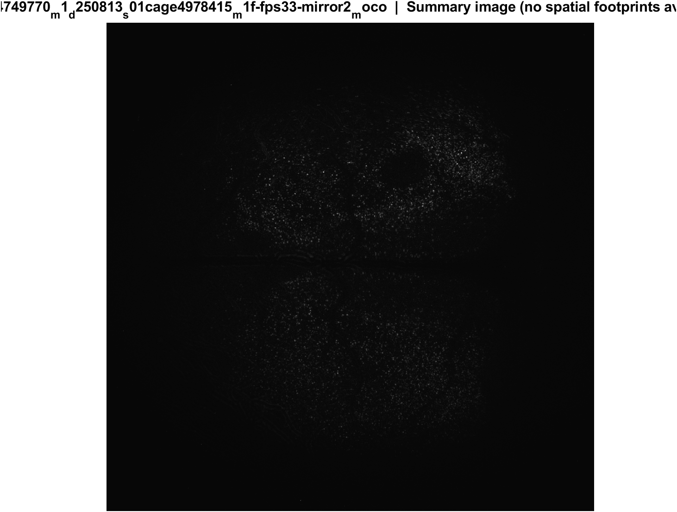
Fig4 Spatial poke-response map | mouse1f s01 20 mW/cm2 mirror2
What: Each neuron's post-pre amplitude is painted onto its EXTRACT footprint. Red = excited, blue = inhibited. Left: anatomy. Middle: all cells. Right: p<0.05 only.
Result: Excited and inhibited cells are intermingled across dorsal cortex; there is no single on-or-off region in these unaligned FOVs.

Slide 32
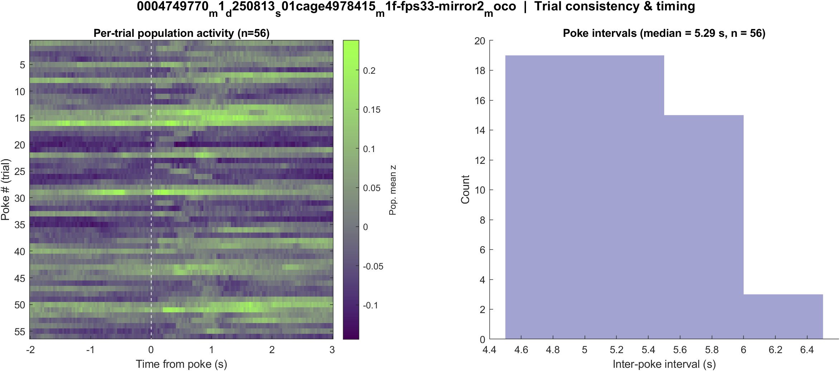
Fig5 Trial raster and poke interval | mouse1f s01 20 mW/cm2 mirror2
What: One row per poke (population z over time) and the histogram of time between detected pokes.
Result: 57 pokes detected in this movie; intervals near 5.3 s, with occasional missed peaks.

Slide 33
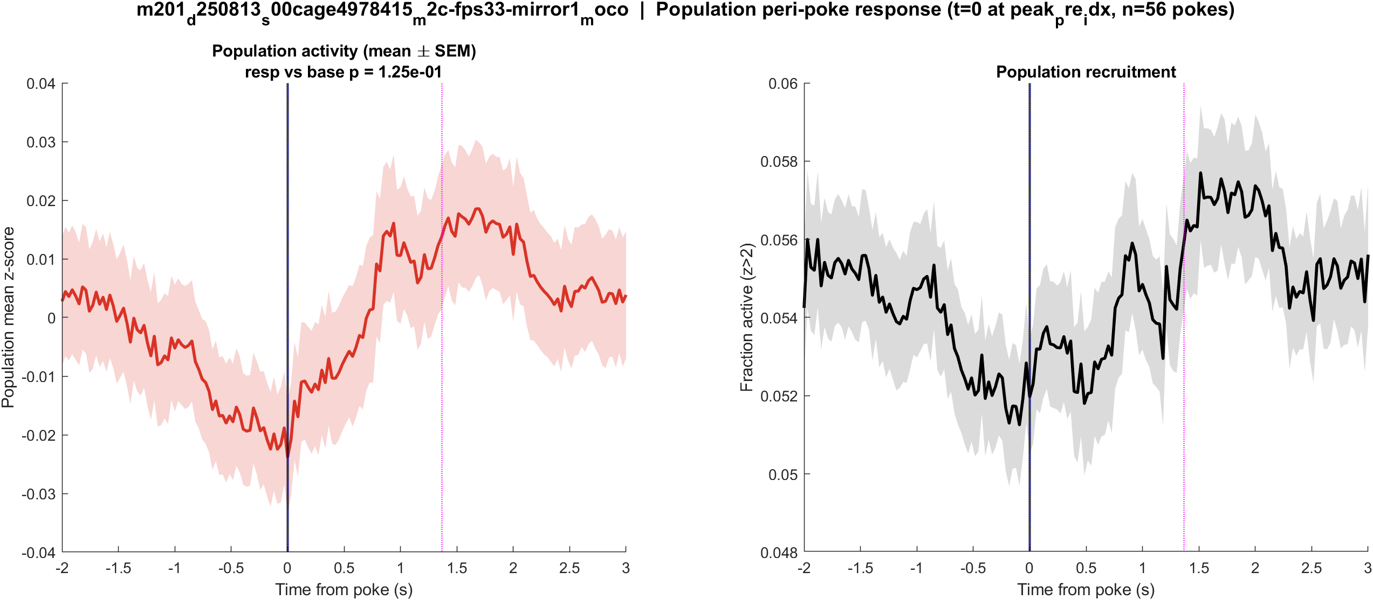
Fig1 Population PSTH | mouse2c s00 8.38 mW/cm2 mirror1
What: Mean population activity (z-score) and fraction of active cells, aligned to each poke (t = 0 is peak_pre_idx).
Result: This FOV has 2097 neurons and 57 pokes; the population pre vs post test is not significant (p = 0.125).

Slide 34
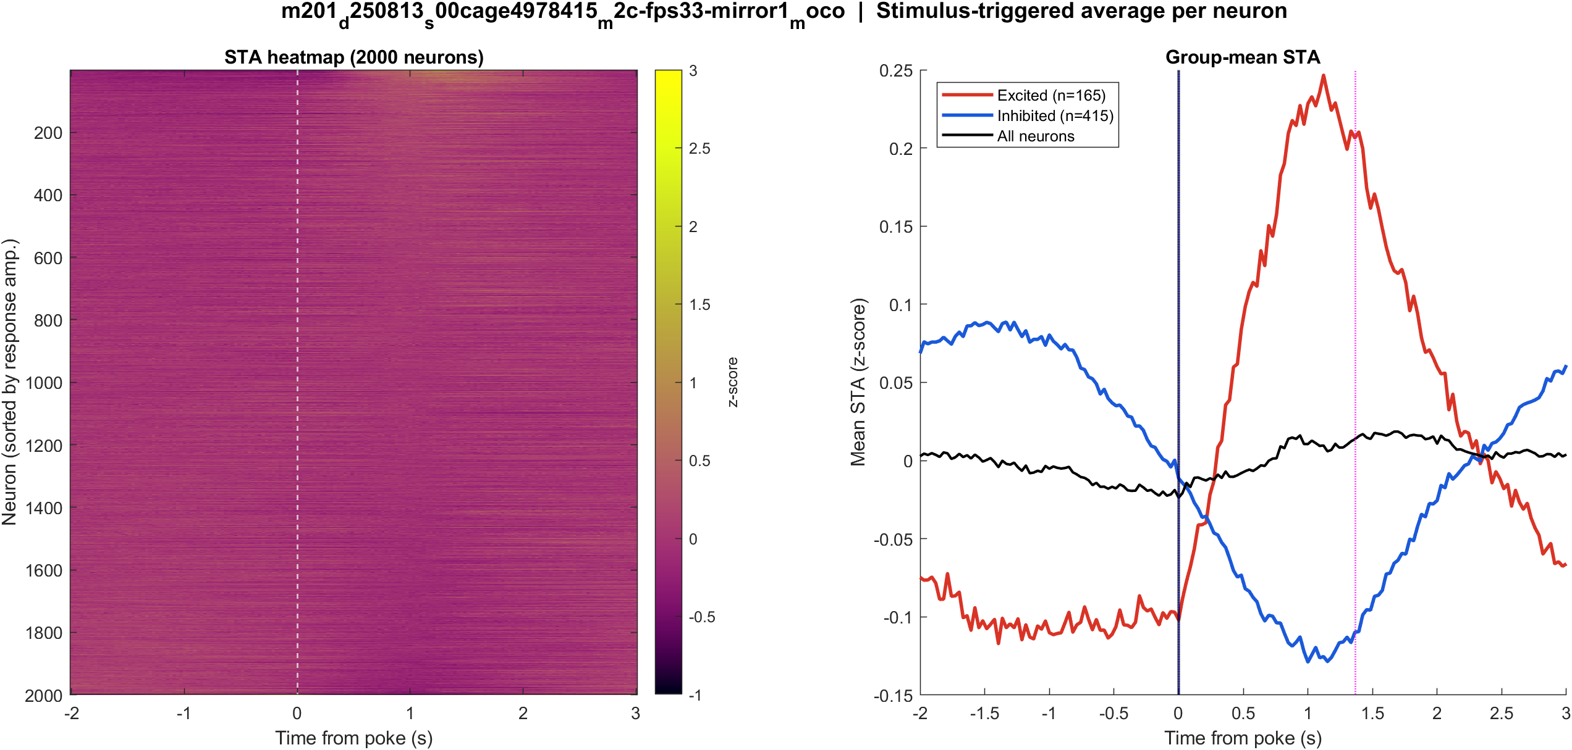
Fig2 Neuron STA | mouse2c s00 8.38 mW/cm2 mirror1
What: Each neuron’s average trace around the poke, sorted by response size; right panel is the mean of excited vs inhibited cells.
Result: Excited 7.9% and inhibited 19.8% of 2097 neurons; see the STA split on the right.

Slide 35
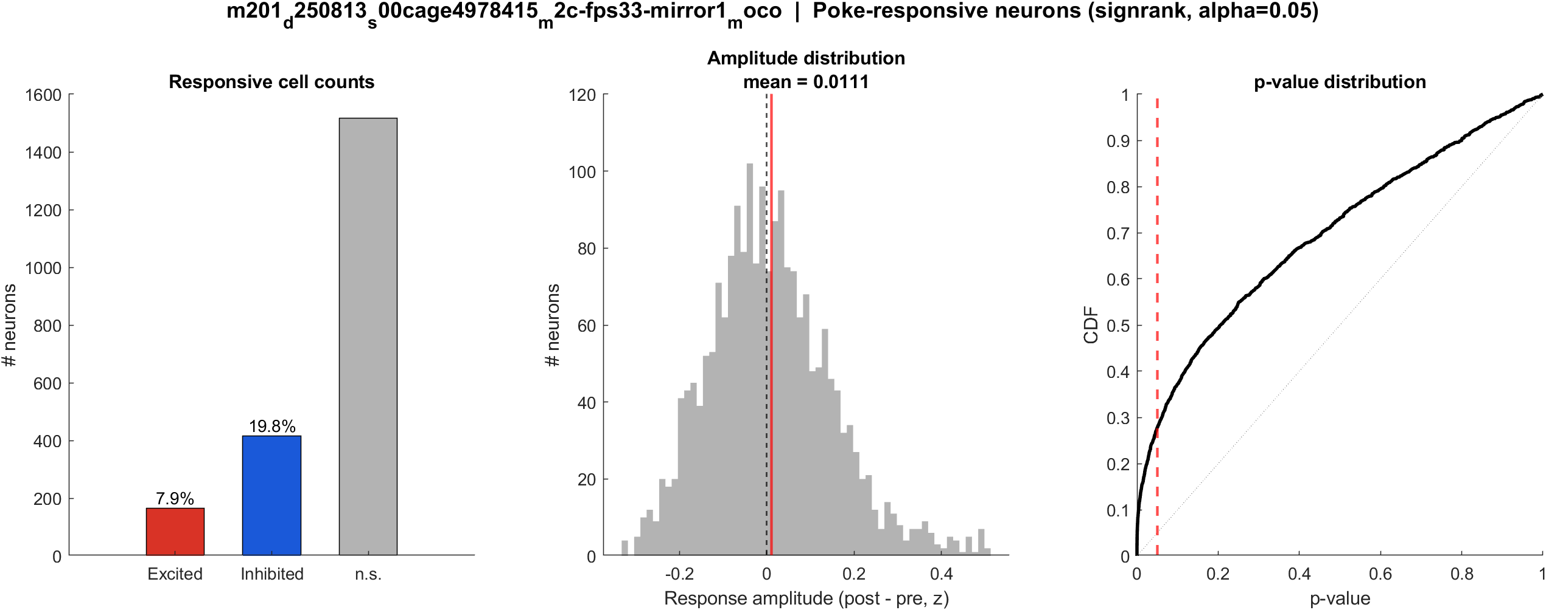
Fig3 Excited vs inhibited cells | mouse2c s00 8.38 mW/cm2 mirror1
What: Per neuron: mean z in 0.4–1.2 s after t=0 vs -2–0 s before; signed-rank, p<0.05, sign of the difference.
Result: 7.9% excited, 19.8% inhibited out of 2097 neurons; population test not significant (p = 0.125).

Slide 36

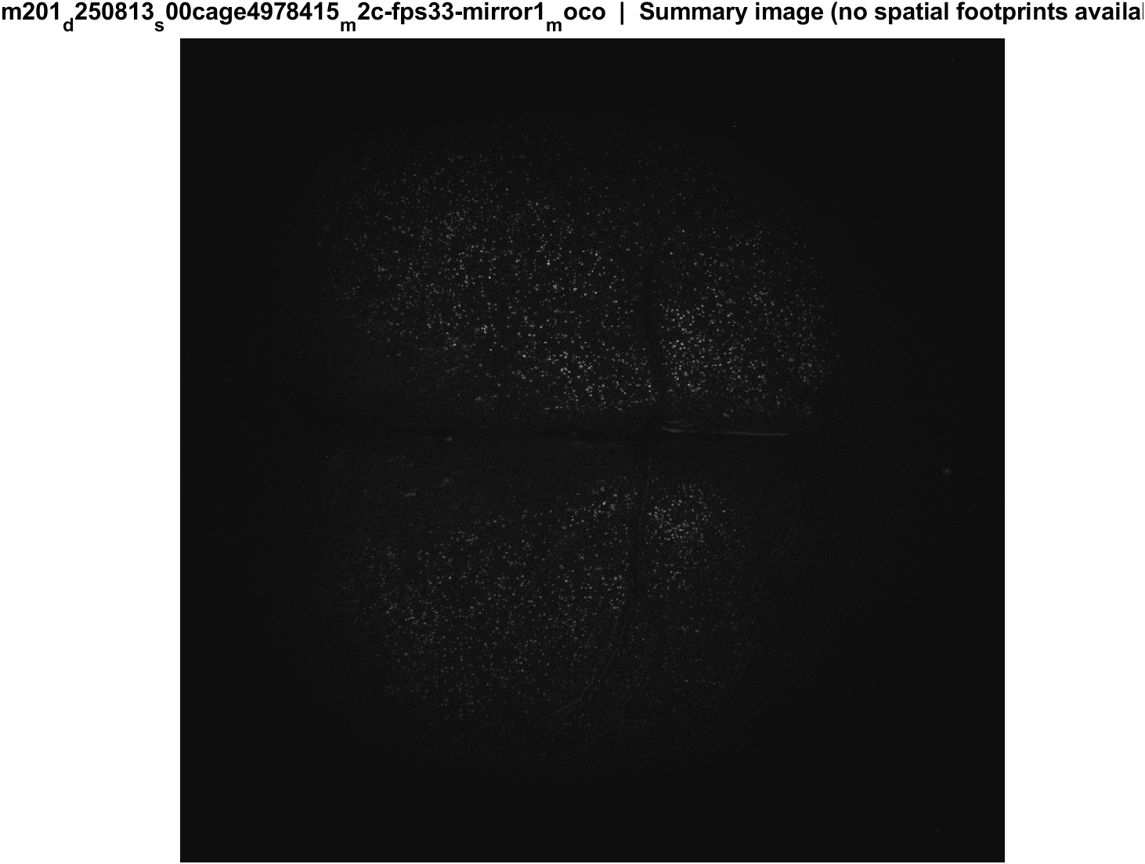
Fig4 Spatial poke-response map | mouse2c s00 8.38 mW/cm2 mirror1
What: Each neuron's post-pre amplitude is painted onto its EXTRACT footprint. Red = excited, blue = inhibited. Left: anatomy. Middle: all cells. Right: p<0.05 only.
Result: Excited and inhibited cells are intermingled across dorsal cortex; there is no single on-or-off region in these unaligned FOVs.

Slide 37
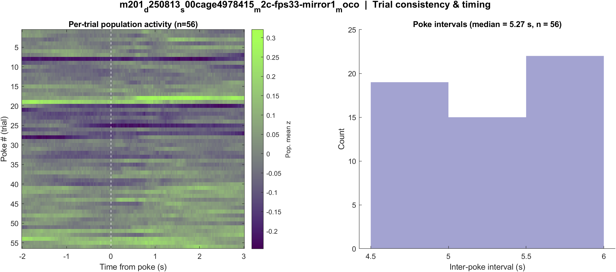
Fig5 Trial raster and poke interval | mouse2c s00 8.38 mW/cm2 mirror1
What: One row per poke (population z over time) and the histogram of time between detected pokes.
Result: 57 pokes detected in this movie; intervals near 5.3 s, with occasional missed peaks.

Slide 38
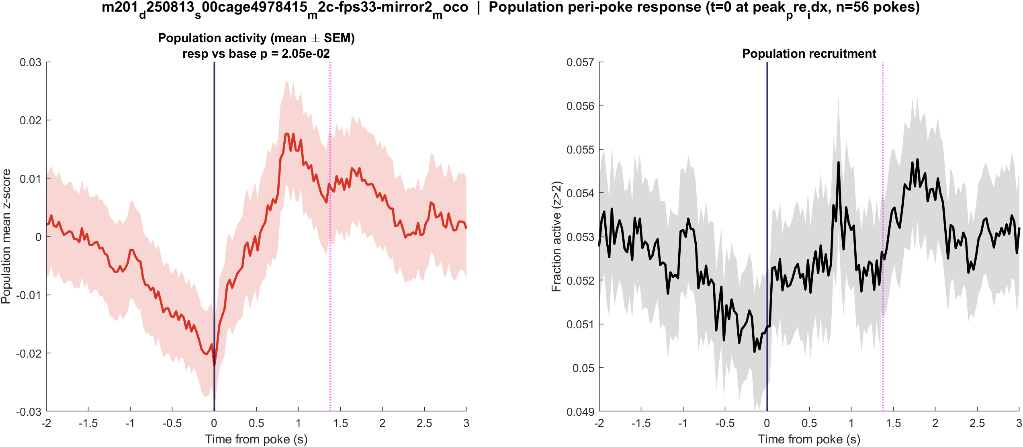
Fig1 Population PSTH | mouse2c s00 8.38 mW/cm2 mirror2
What: Mean population activity (z-score) and fraction of active cells, aligned to each poke (t = 0 is peak_pre_idx).
Result: This FOV has 2889 neurons and 57 pokes; the population pre vs post test is significant (p = 0.021).

Slide 39
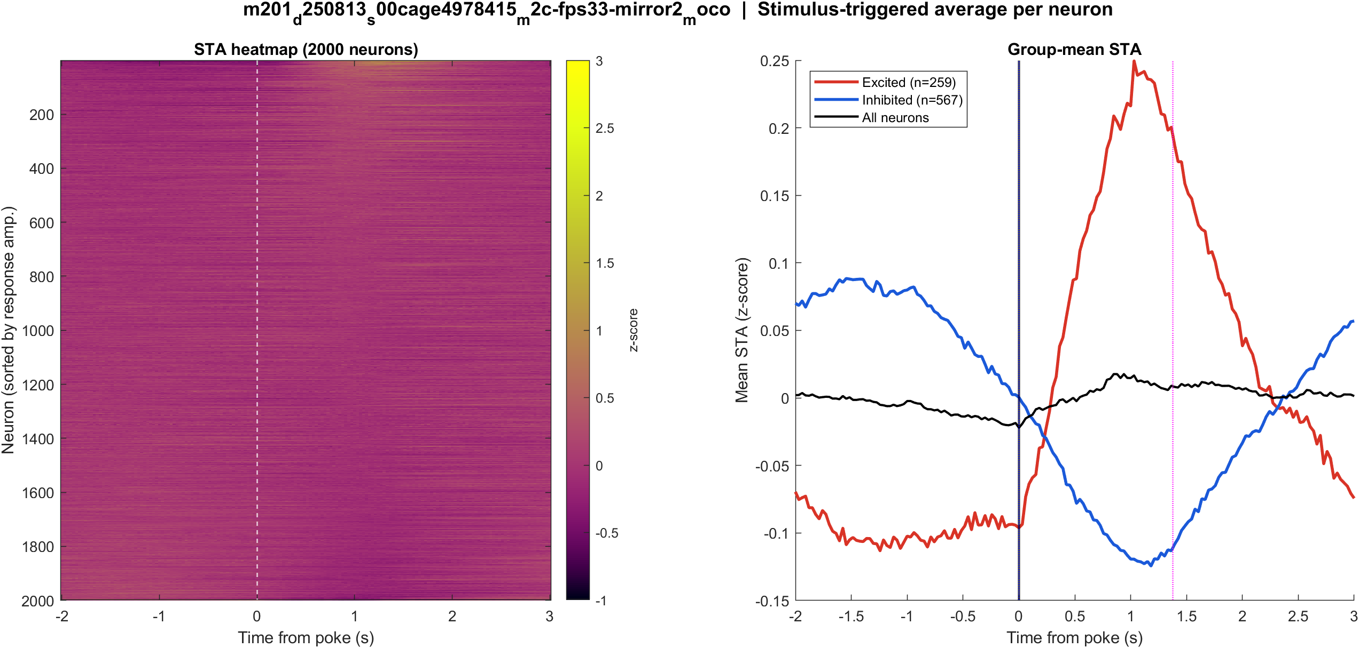
Fig2 Neuron STA | mouse2c s00 8.38 mW/cm2 mirror2
What: Each neuron’s average trace around the poke, sorted by response size; right panel is the mean of excited vs inhibited cells.
Result: Excited 9.0% and inhibited 19.6% of 2889 neurons; see the STA split on the right.

Slide 40
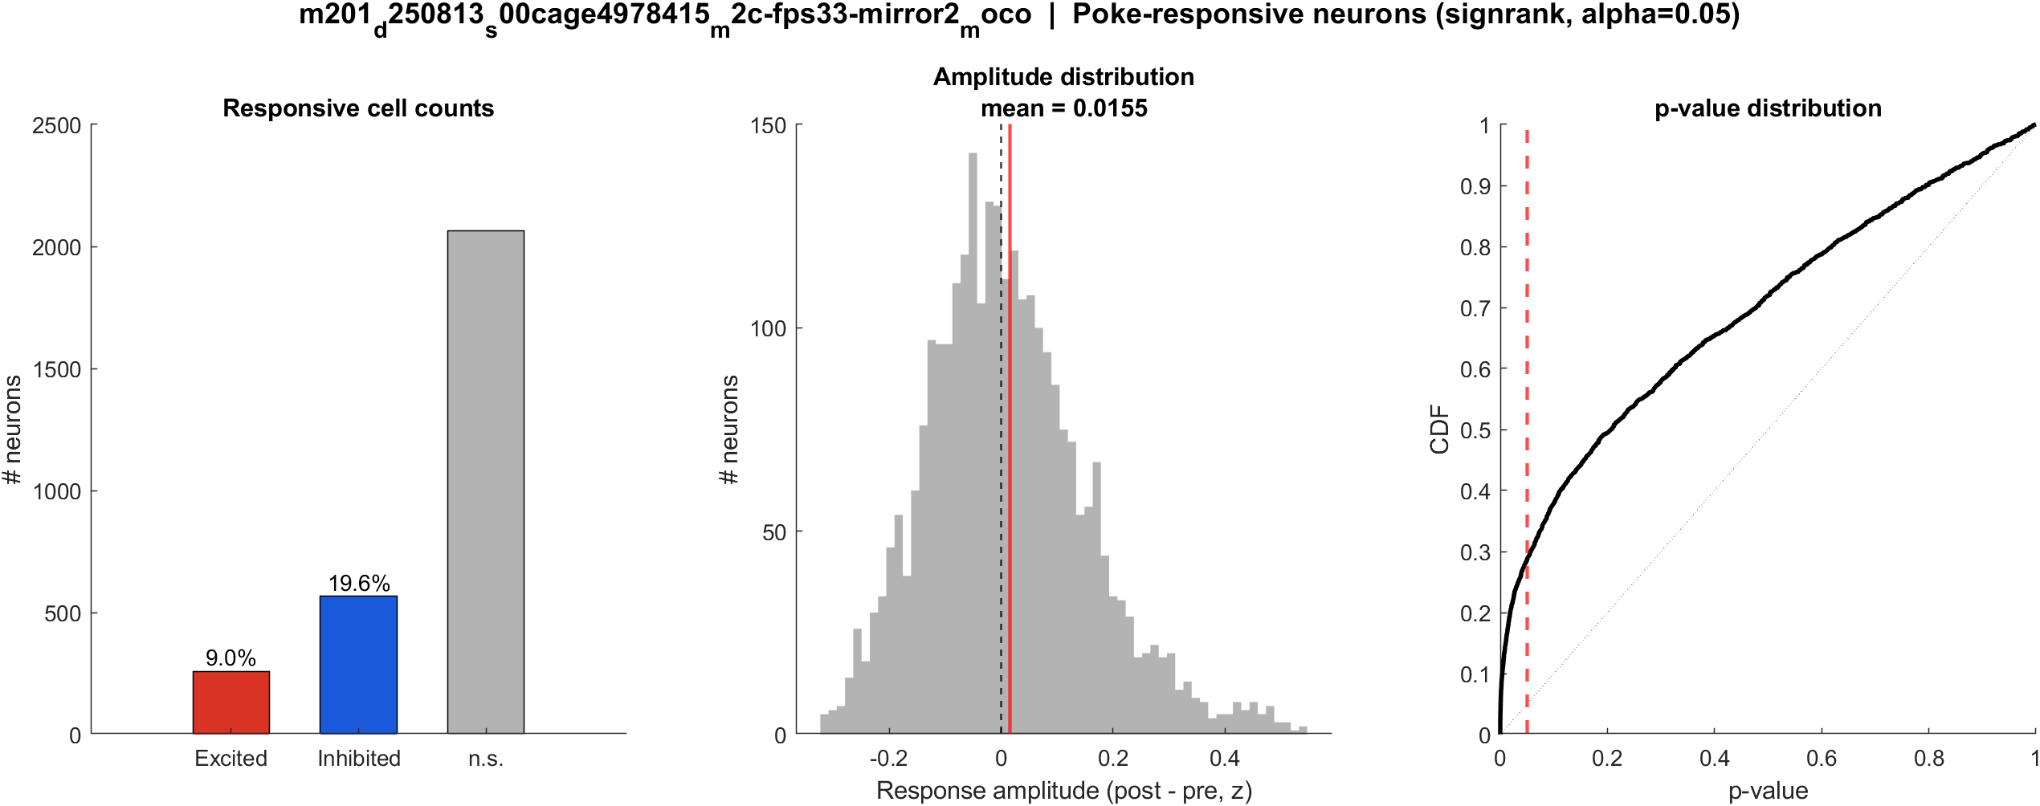
Fig3 Excited vs inhibited cells | mouse2c s00 8.38 mW/cm2 mirror2
What: Per neuron: mean z in 0.4–1.2 s after t=0 vs -2–0 s before; signed-rank, p<0.05, sign of the difference.
Result: 9.0% excited, 19.6% inhibited out of 2889 neurons; population test significant (p = 0.021).

Slide 41

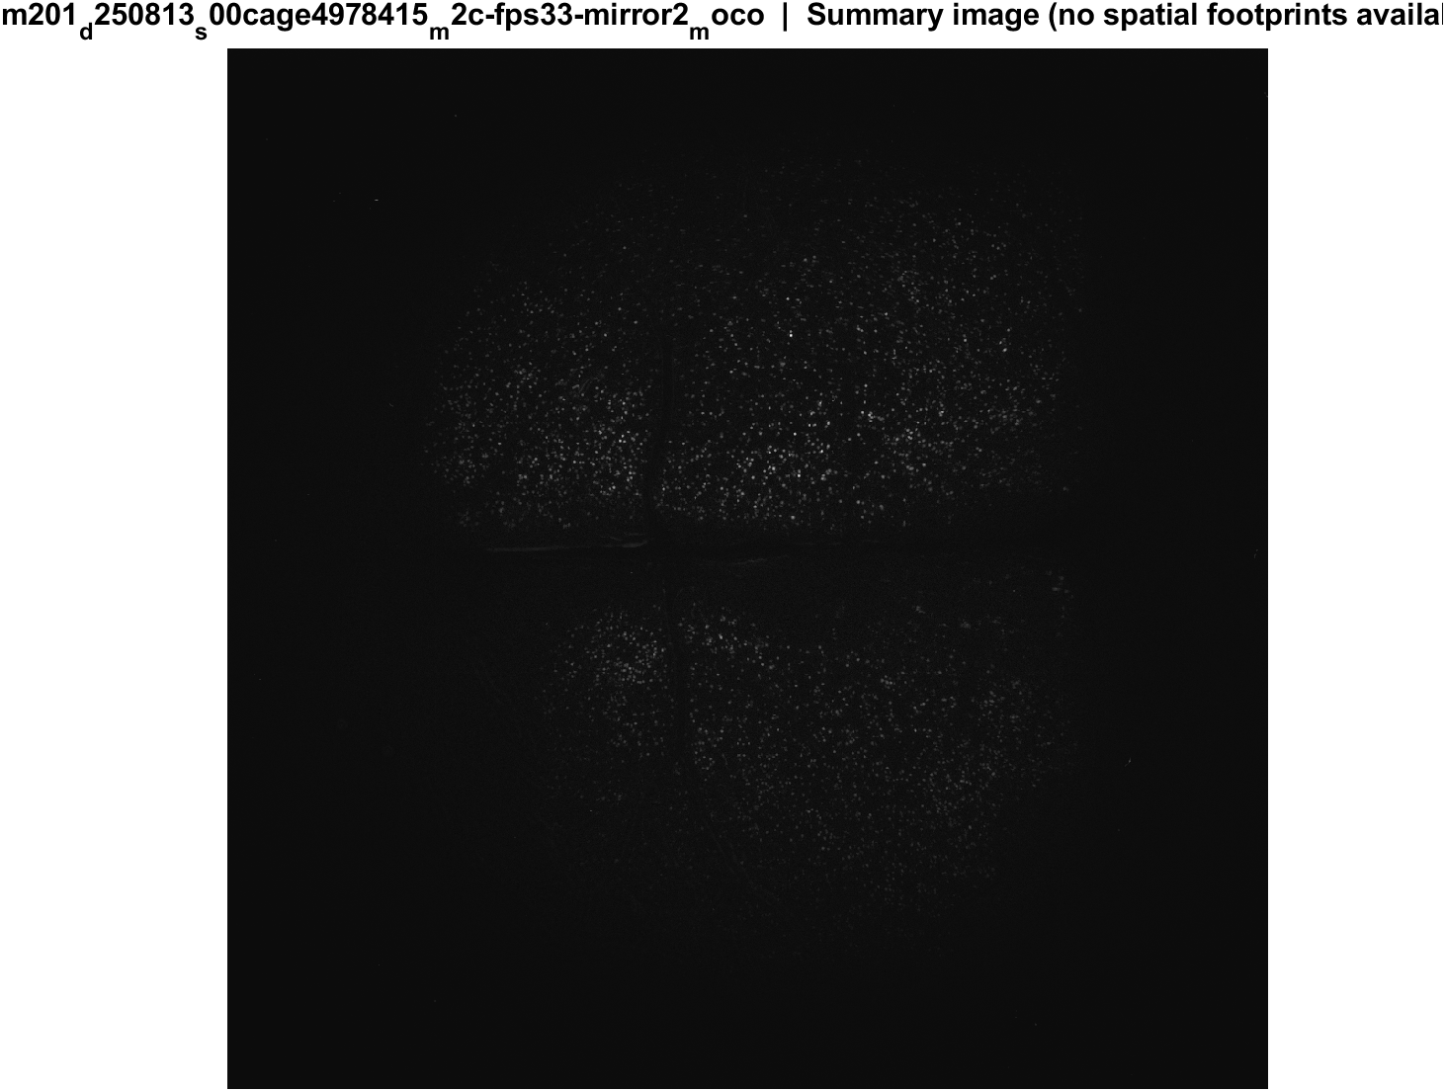
Fig4 Spatial poke-response map | mouse2c s00 8.38 mW/cm2 mirror2
What: Each neuron's post-pre amplitude is painted onto its EXTRACT footprint. Red = excited, blue = inhibited. Left: anatomy. Middle: all cells. Right: p<0.05 only.
Result: Excited and inhibited cells are intermingled across dorsal cortex; there is no single on-or-off region in these unaligned FOVs.

Slide 42
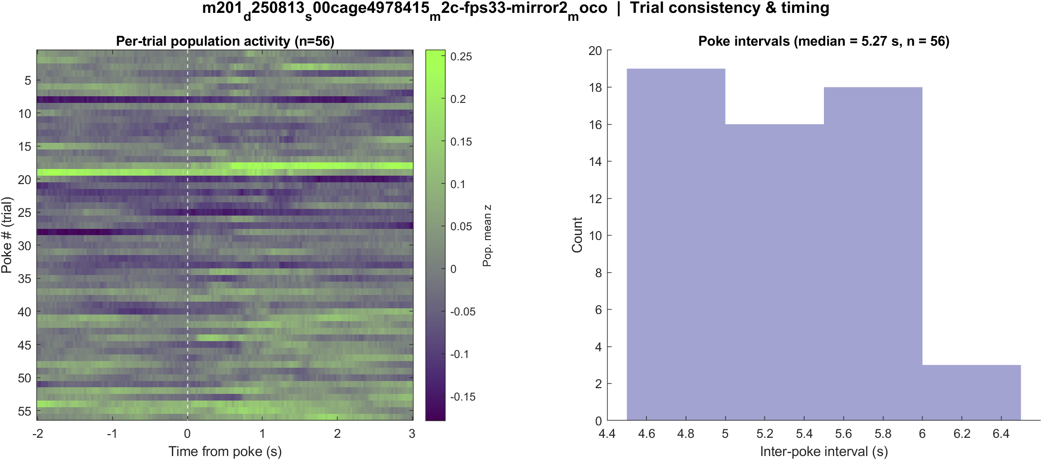
Fig5 Trial raster and poke interval | mouse2c s00 8.38 mW/cm2 mirror2
What: One row per poke (population z over time) and the histogram of time between detected pokes.
Result: 57 pokes detected in this movie; intervals near 5.3 s, with occasional missed peaks.

Slide 43
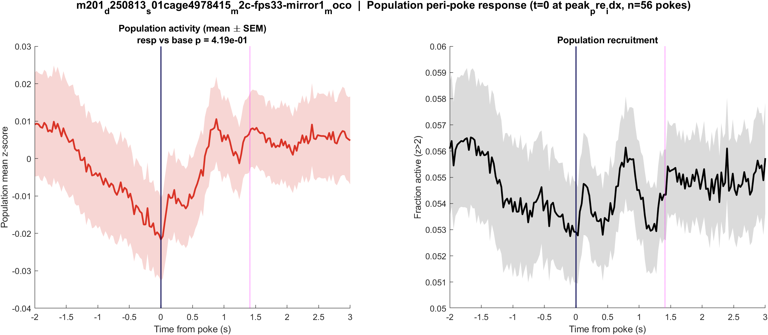
Fig1 Population PSTH | mouse2c s01 20 mW/cm2 mirror1
What: Mean population activity (z-score) and fraction of active cells, aligned to each poke (t = 0 is peak_pre_idx).
Result: This FOV has 3012 neurons and 56 pokes; the population pre vs post test is not significant (p = 0.419).

Slide 44
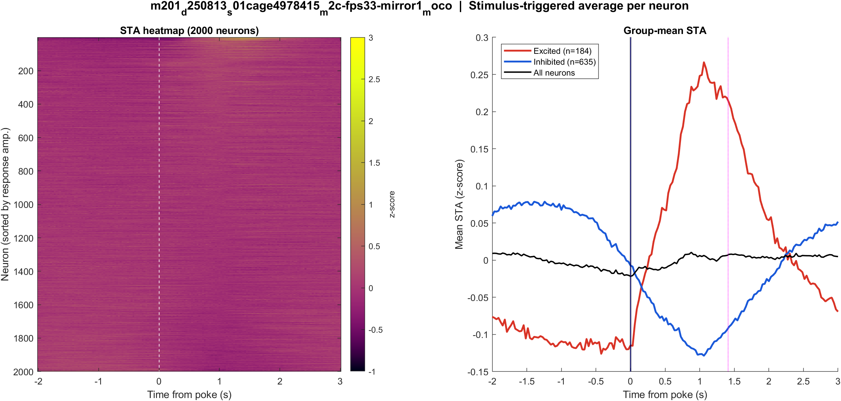
Fig2 Neuron STA | mouse2c s01 20 mW/cm2 mirror1
What: Each neuron’s average trace around the poke, sorted by response size; right panel is the mean of excited vs inhibited cells.
Result: Excited 6.1% and inhibited 21.1% of 3012 neurons; see the STA split on the right.

Slide 45
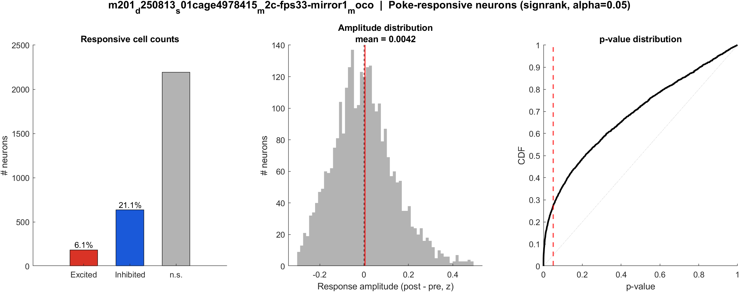
Fig3 Excited vs inhibited cells | mouse2c s01 20 mW/cm2 mirror1
What: Per neuron: mean z in 0.4–1.2 s after t=0 vs -2–0 s before; signed-rank, p<0.05, sign of the difference.
Result: 6.1% excited, 21.1% inhibited out of 3012 neurons; population test not significant (p = 0.419).

Slide 46

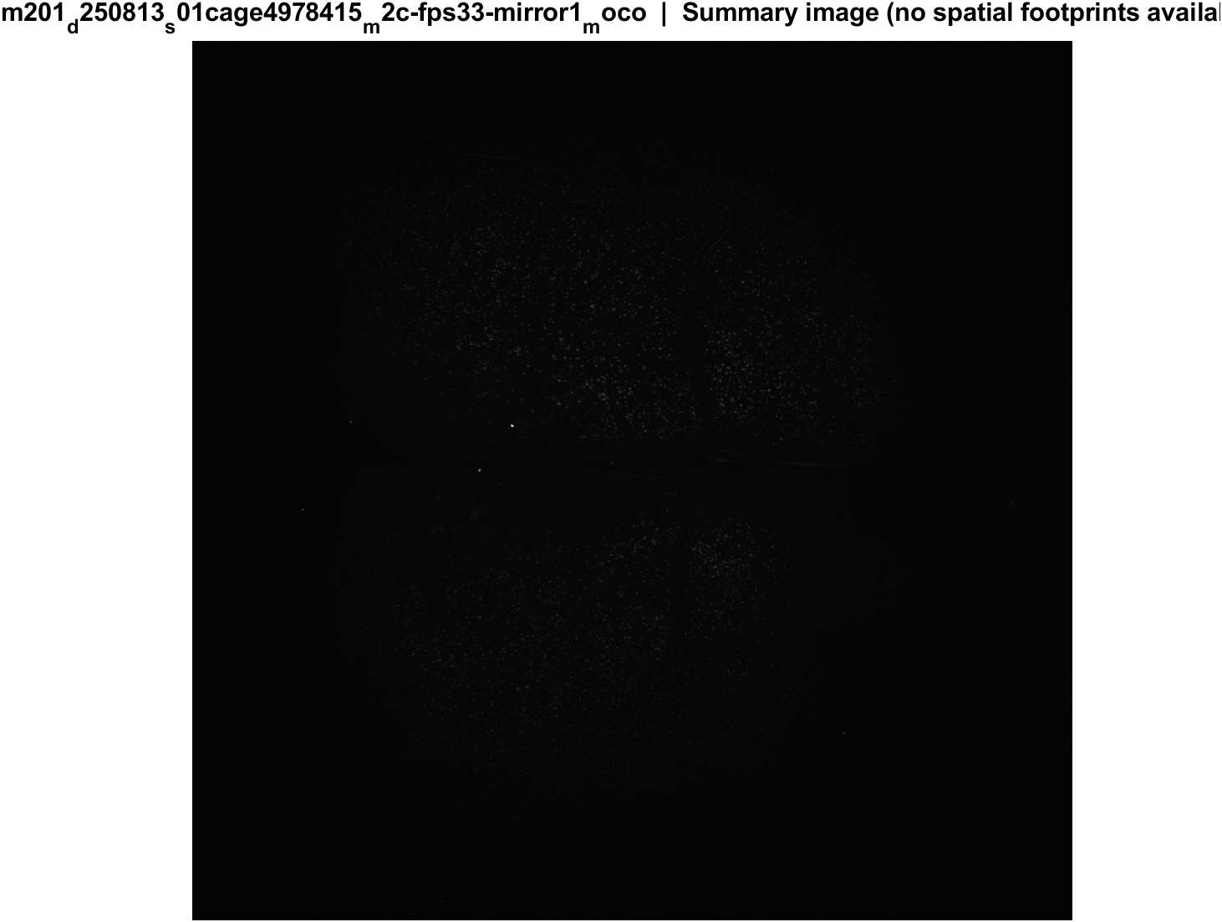
Fig4 Spatial poke-response map | mouse2c s01 20 mW/cm2 mirror1
What: Each neuron's post-pre amplitude is painted onto its EXTRACT footprint. Red = excited, blue = inhibited. Left: anatomy. Middle: all cells. Right: p<0.05 only.
Result: Excited and inhibited cells are intermingled across dorsal cortex; there is no single on-or-off region in these unaligned FOVs.

Slide 47
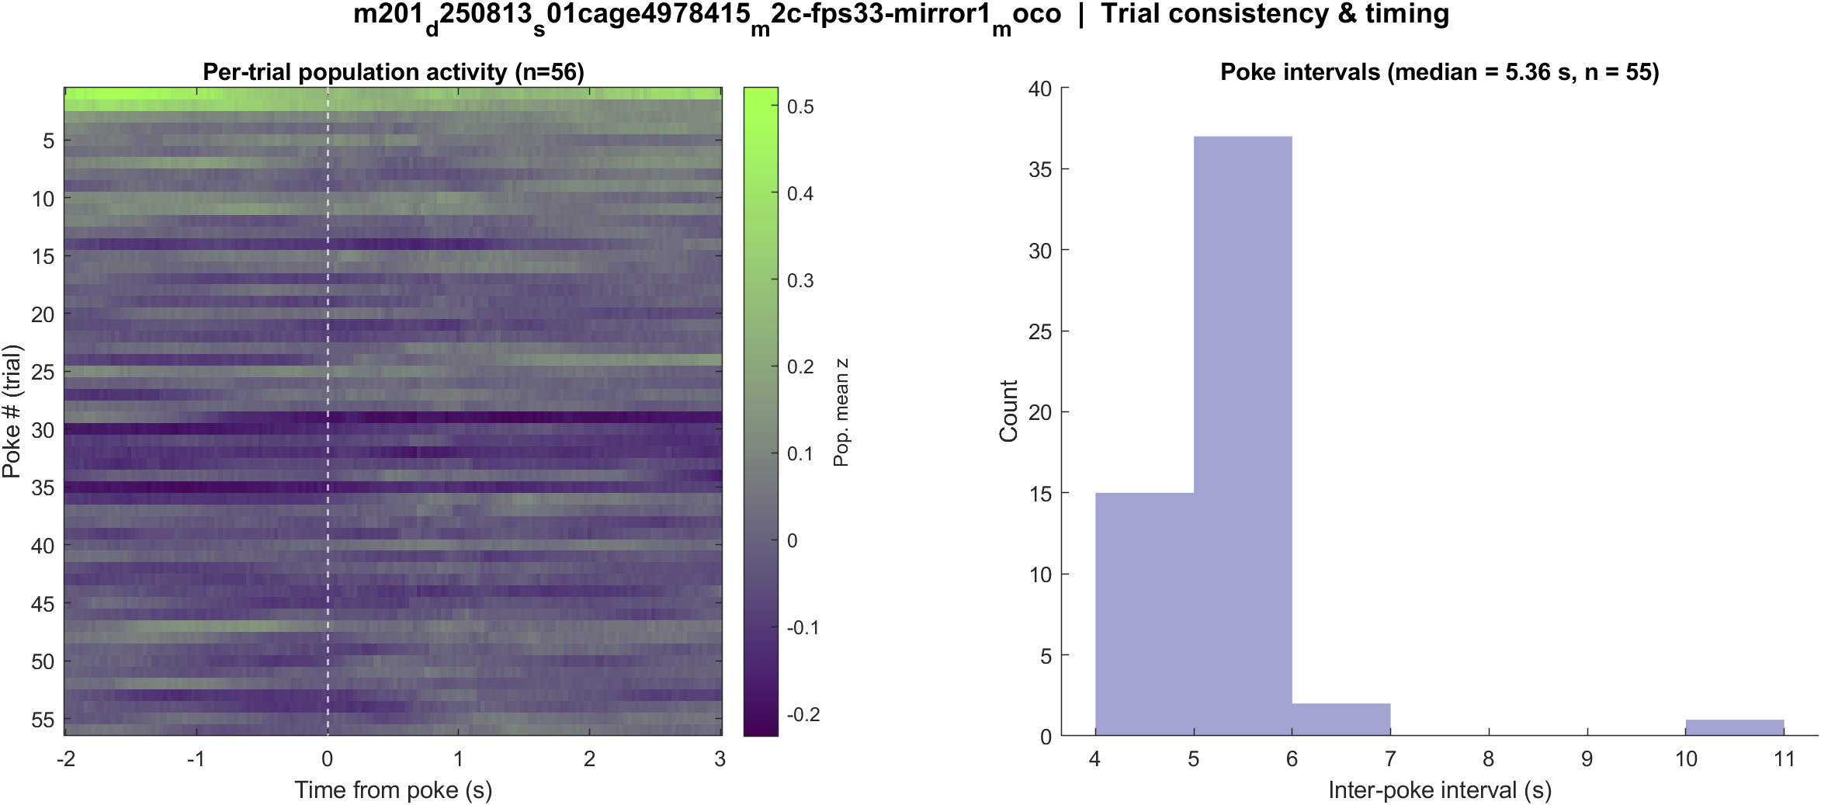
Fig5 Trial raster and poke interval | mouse2c s01 20 mW/cm2 mirror1
What: One row per poke (population z over time) and the histogram of time between detected pokes.
Result: 56 pokes detected in this movie; intervals near 5.3 s, with occasional missed peaks.

Slide 48
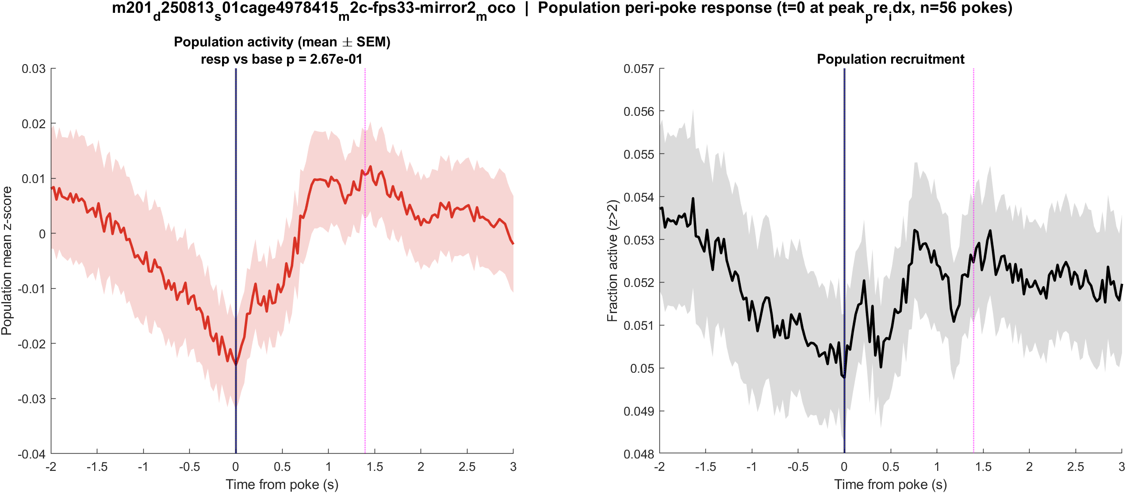
Fig1 Population PSTH | mouse2c s01 20 mW/cm2 mirror2
What: Mean population activity (z-score) and fraction of active cells, aligned to each poke (t = 0 is peak_pre_idx).
Result: This FOV has 4022 neurons and 56 pokes; the population pre vs post test is not significant (p = 0.267).

Slide 49

Fig2 Neuron STA | mouse2c s01 20 mW/cm2 mirror2
What: Each neuron’s average trace around the poke, sorted by response size; right panel is the mean of excited vs inhibited cells.
Result: Excited 6.5% and inhibited 20.5% of 4022 neurons; see the STA split on the right.

Slide 50
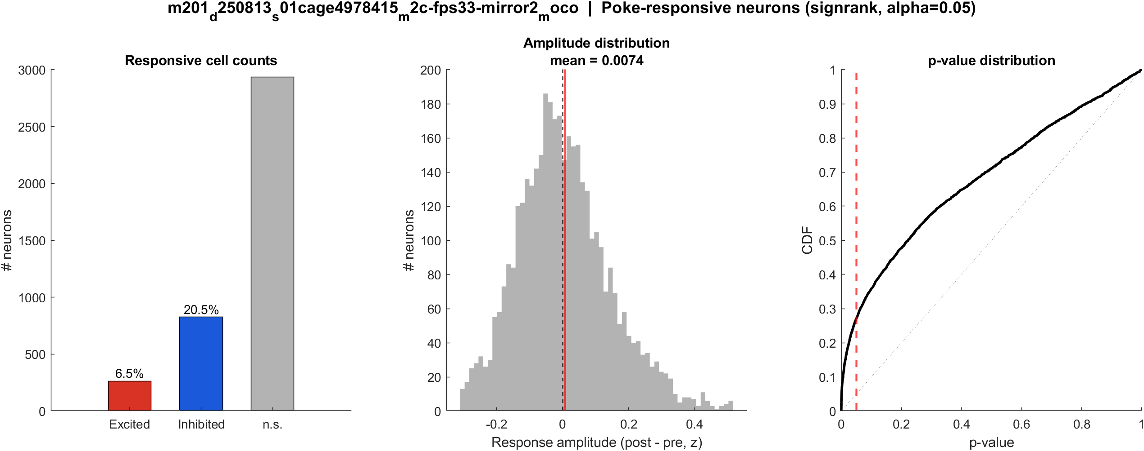
Fig3 Excited vs inhibited cells | mouse2c s01 20 mW/cm2 mirror2
What: Per neuron: mean z in 0.4–1.2 s after t=0 vs -2–0 s before; signed-rank, p<0.05, sign of the difference.
Result: 6.5% excited, 20.5% inhibited out of 4022 neurons; population test not significant (p = 0.267).

Slide 51
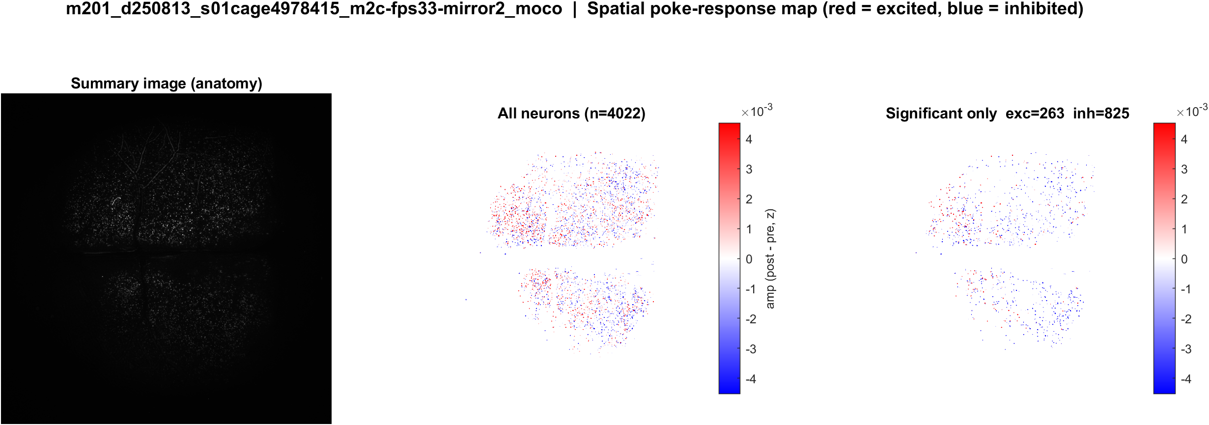
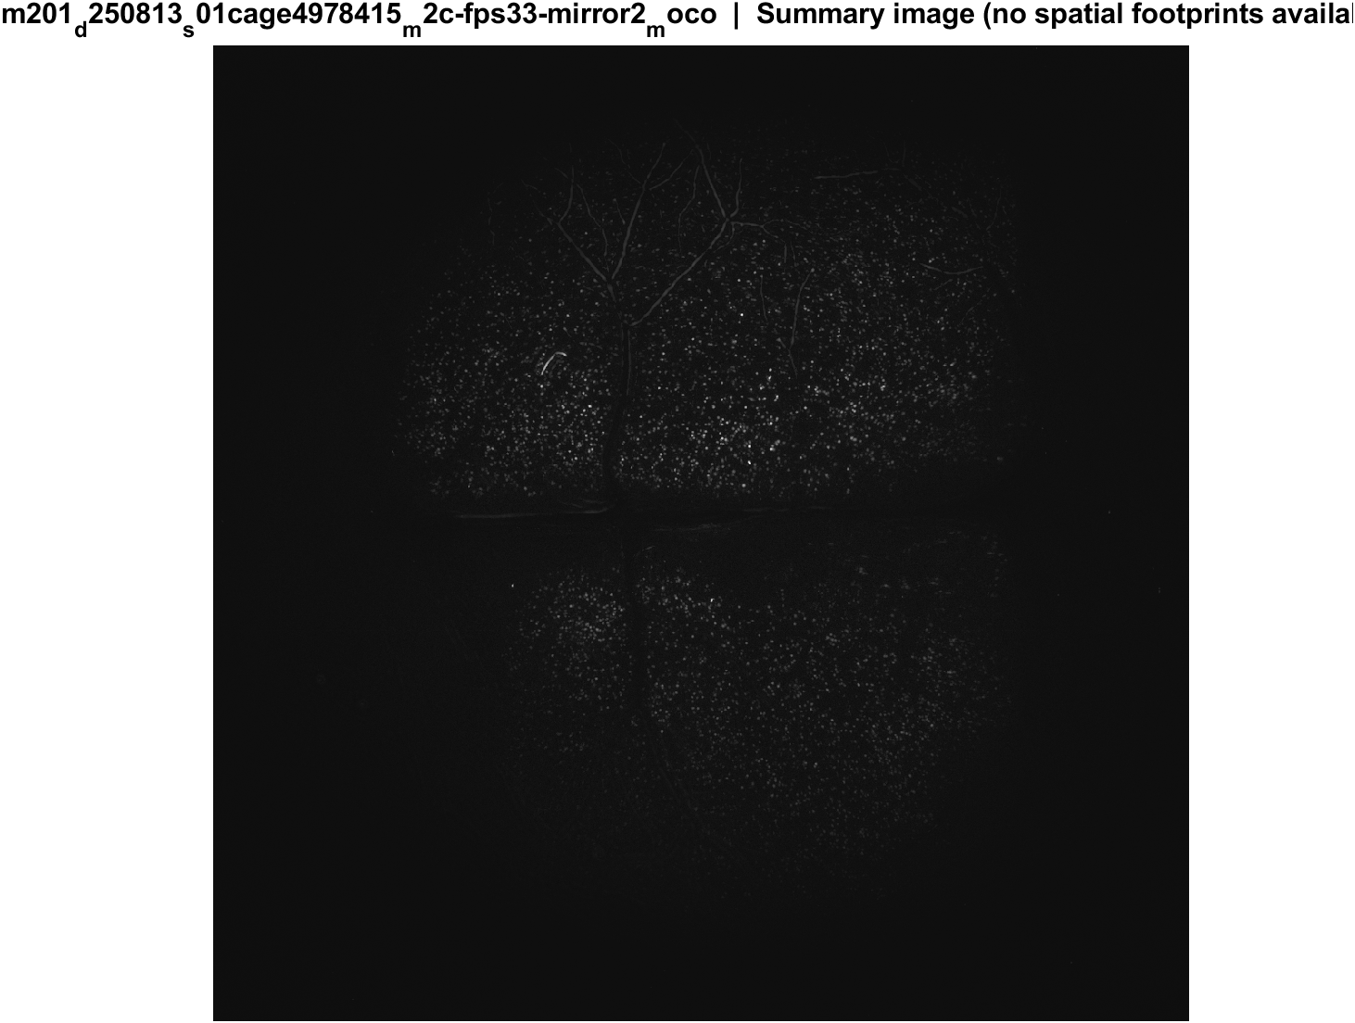
Fig4 Spatial poke-response map | mouse2c s01 20 mW/cm2 mirror2
What: Each neuron's post-pre amplitude is painted onto its EXTRACT footprint. Red = excited, blue = inhibited. Left: anatomy. Middle: all cells. Right: p<0.05 only.
Result: Excited and inhibited cells are intermingled across dorsal cortex; there is no single on-or-off region in these unaligned FOVs.

Slide 52
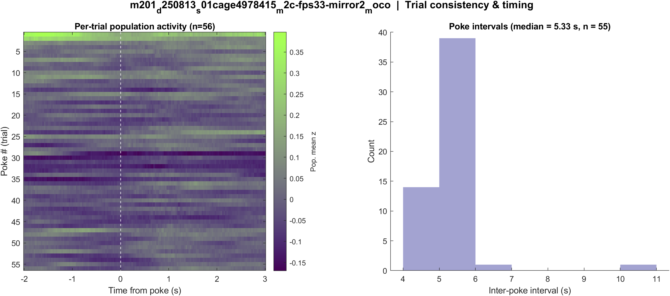
Fig5 Trial raster and poke interval | mouse2c s01 20 mW/cm2 mirror2
What: One row per poke (population z over time) and the histogram of time between detected pokes.
Result: 56 pokes detected in this movie; intervals near 5.3 s, with occasional missed peaks.

Slide 53
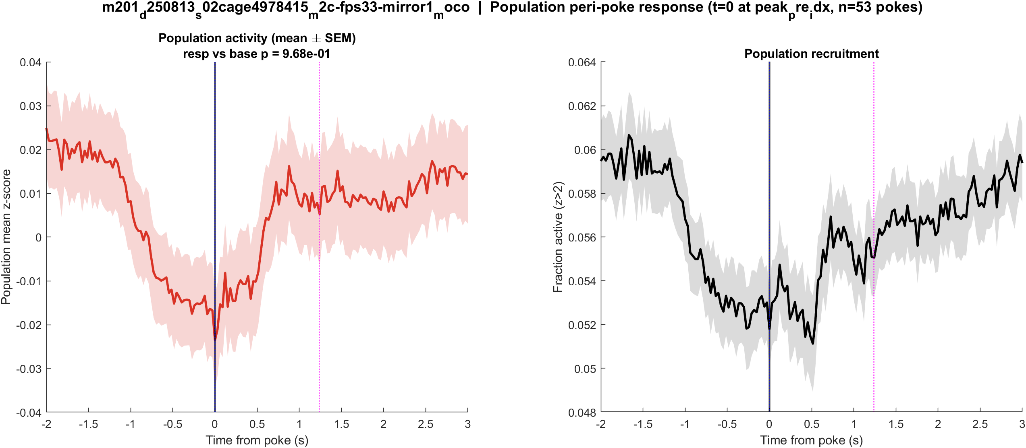
Fig1 Population PSTH | mouse2c s02 power TBD mirror1
What: Mean population activity (z-score) and fraction of active cells, aligned to each poke (t = 0 is peak_pre_idx).
Result: This FOV has 1407 neurons and 55 pokes; the population pre vs post test is not significant (p = 0.968).

Slide 54
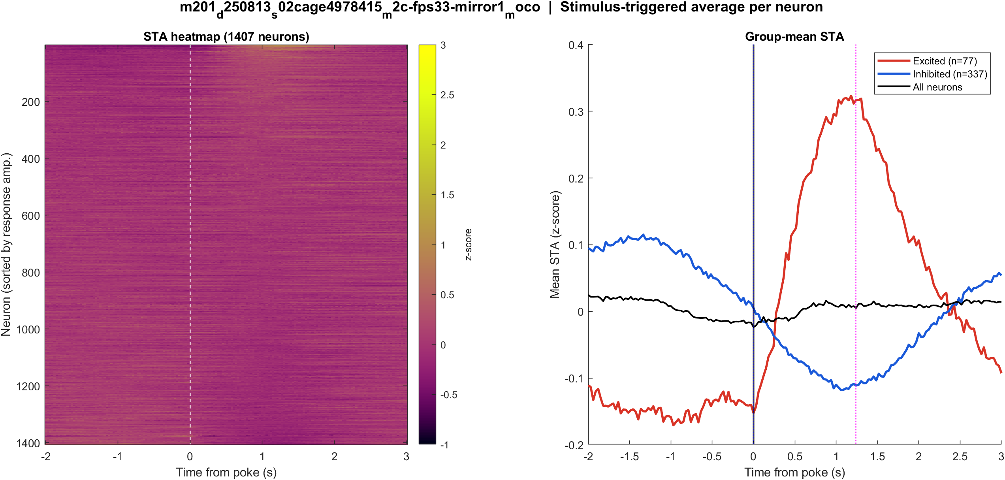
Fig2 Neuron STA | mouse2c s02 power TBD mirror1
What: Each neuron’s average trace around the poke, sorted by response size; right panel is the mean of excited vs inhibited cells.
Result: Excited 5.5% and inhibited 23.9% of 1407 neurons; see the STA split on the right.

Slide 55
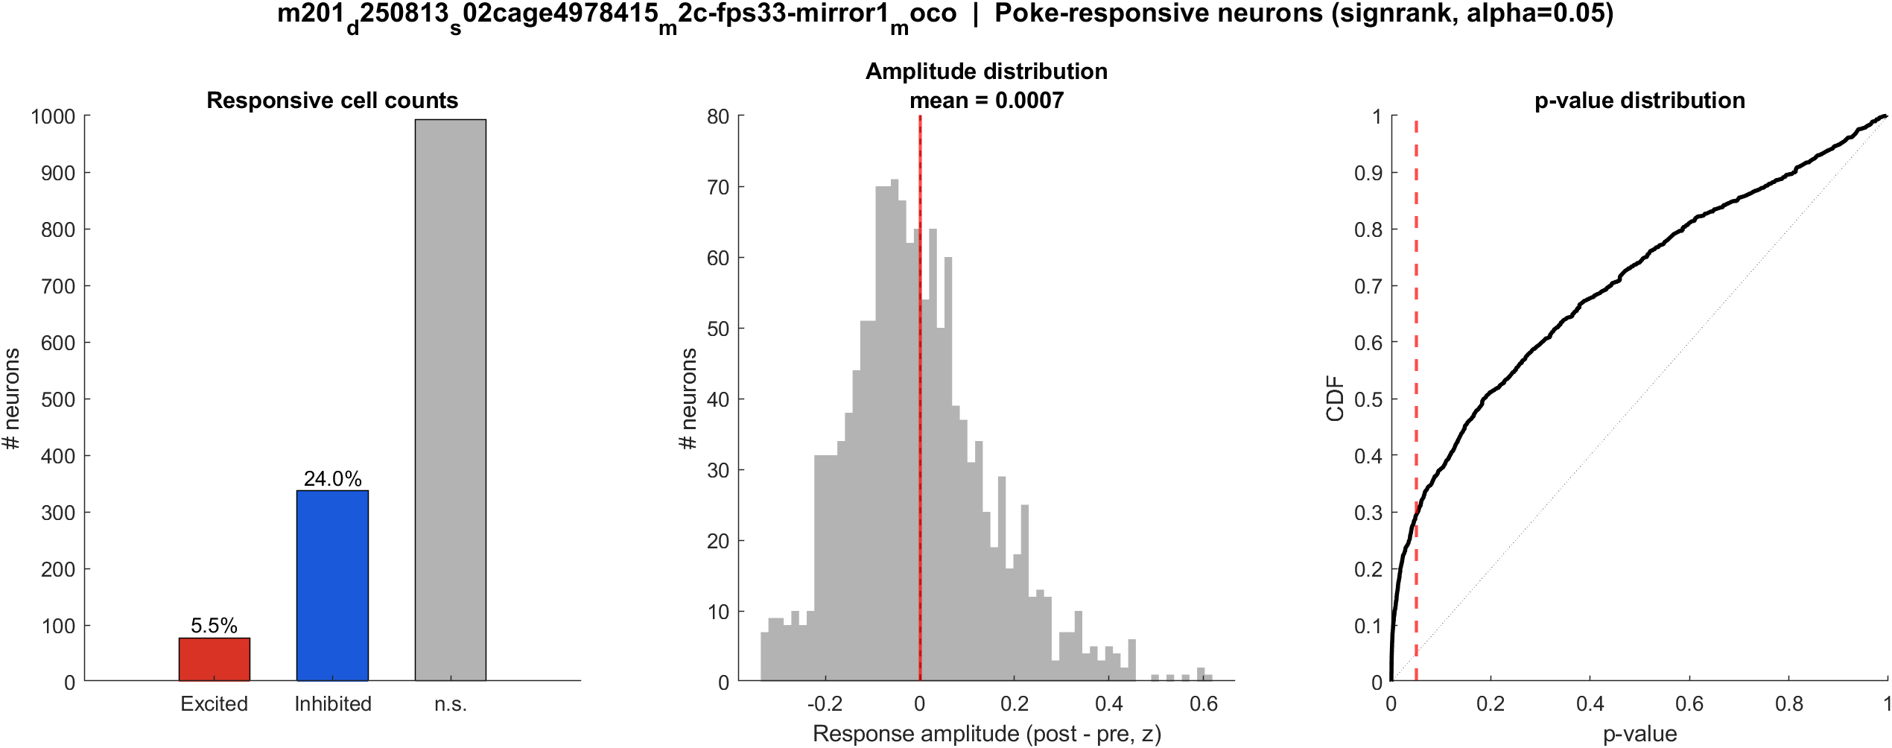
Fig3 Excited vs inhibited cells | mouse2c s02 power TBD mirror1
What: Per neuron: mean z in 0.4–1.2 s after t=0 vs -2–0 s before; signed-rank, p<0.05, sign of the difference.
Result: 5.5% excited, 23.9% inhibited out of 1407 neurons; population test not significant (p = 0.968).

Slide 56


Fig4 Spatial poke-response map | mouse2c s02 power TBD mirror1
What: Each neuron's post-pre amplitude is painted onto its EXTRACT footprint. Red = excited, blue = inhibited. Left: anatomy. Middle: all cells. Right: p<0.05 only.
Result: Excited and inhibited cells are intermingled across dorsal cortex; there is no single on-or-off region in these unaligned FOVs.

Slide 57
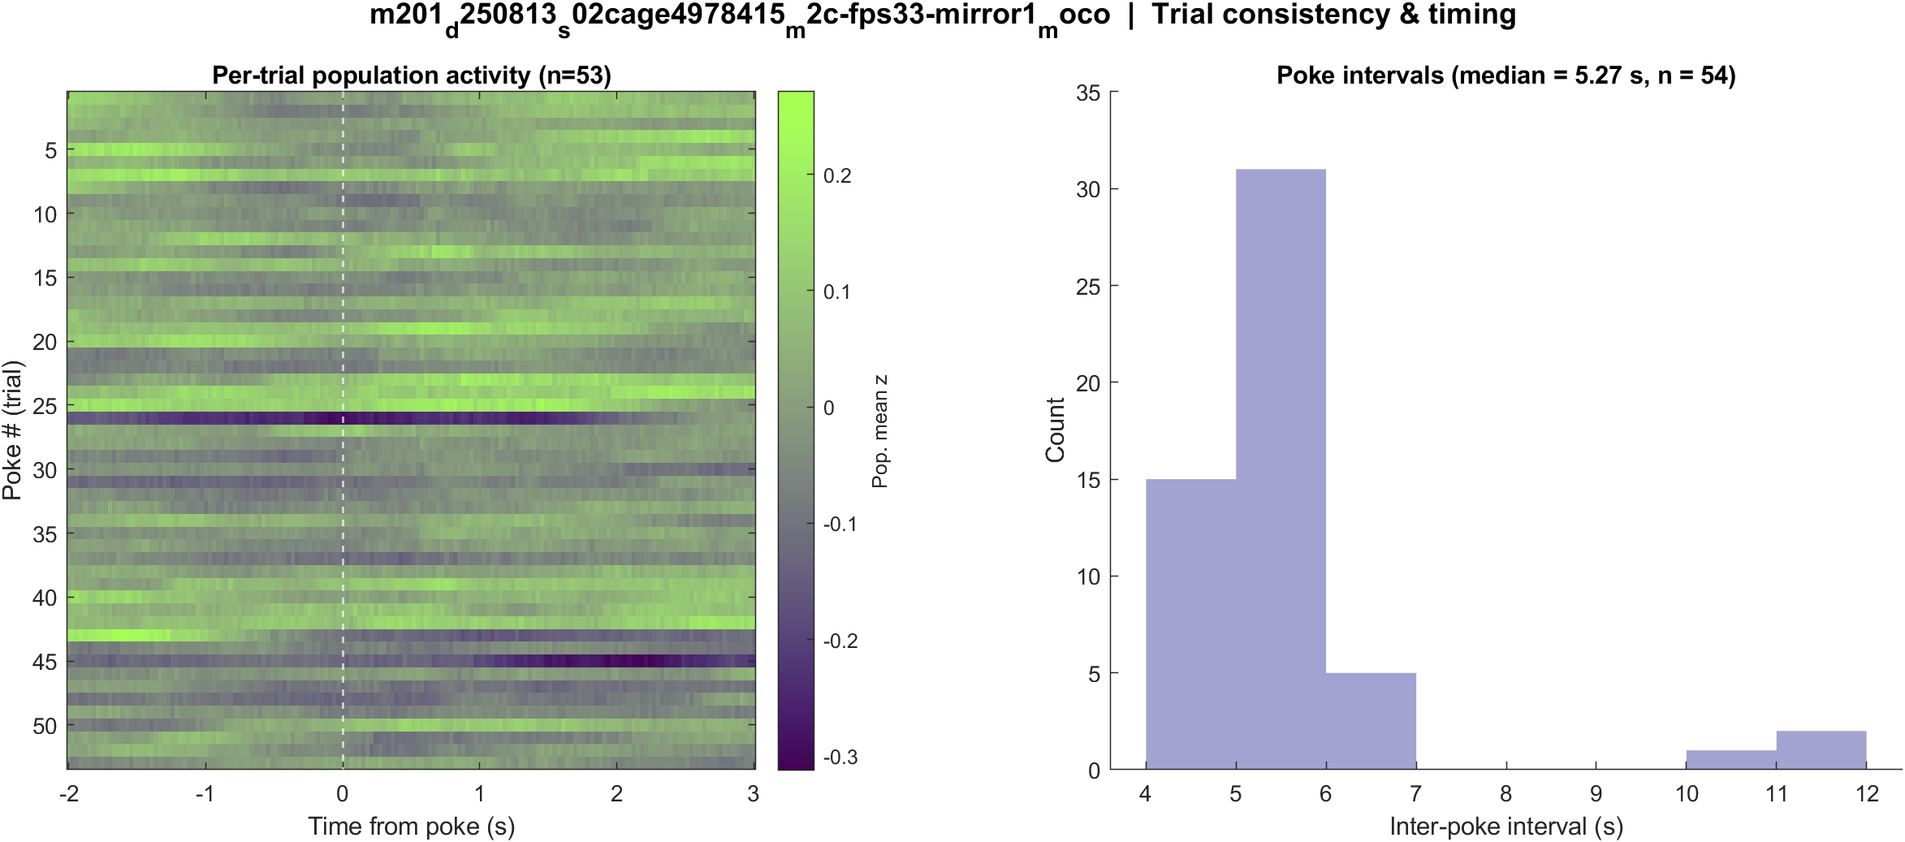
Fig5 Trial raster and poke interval | mouse2c s02 power TBD mirror1
What: One row per poke (population z over time) and the histogram of time between detected pokes.
Result: 55 pokes detected in this movie; intervals near 5.3 s, with occasional missed peaks.

Slide 58
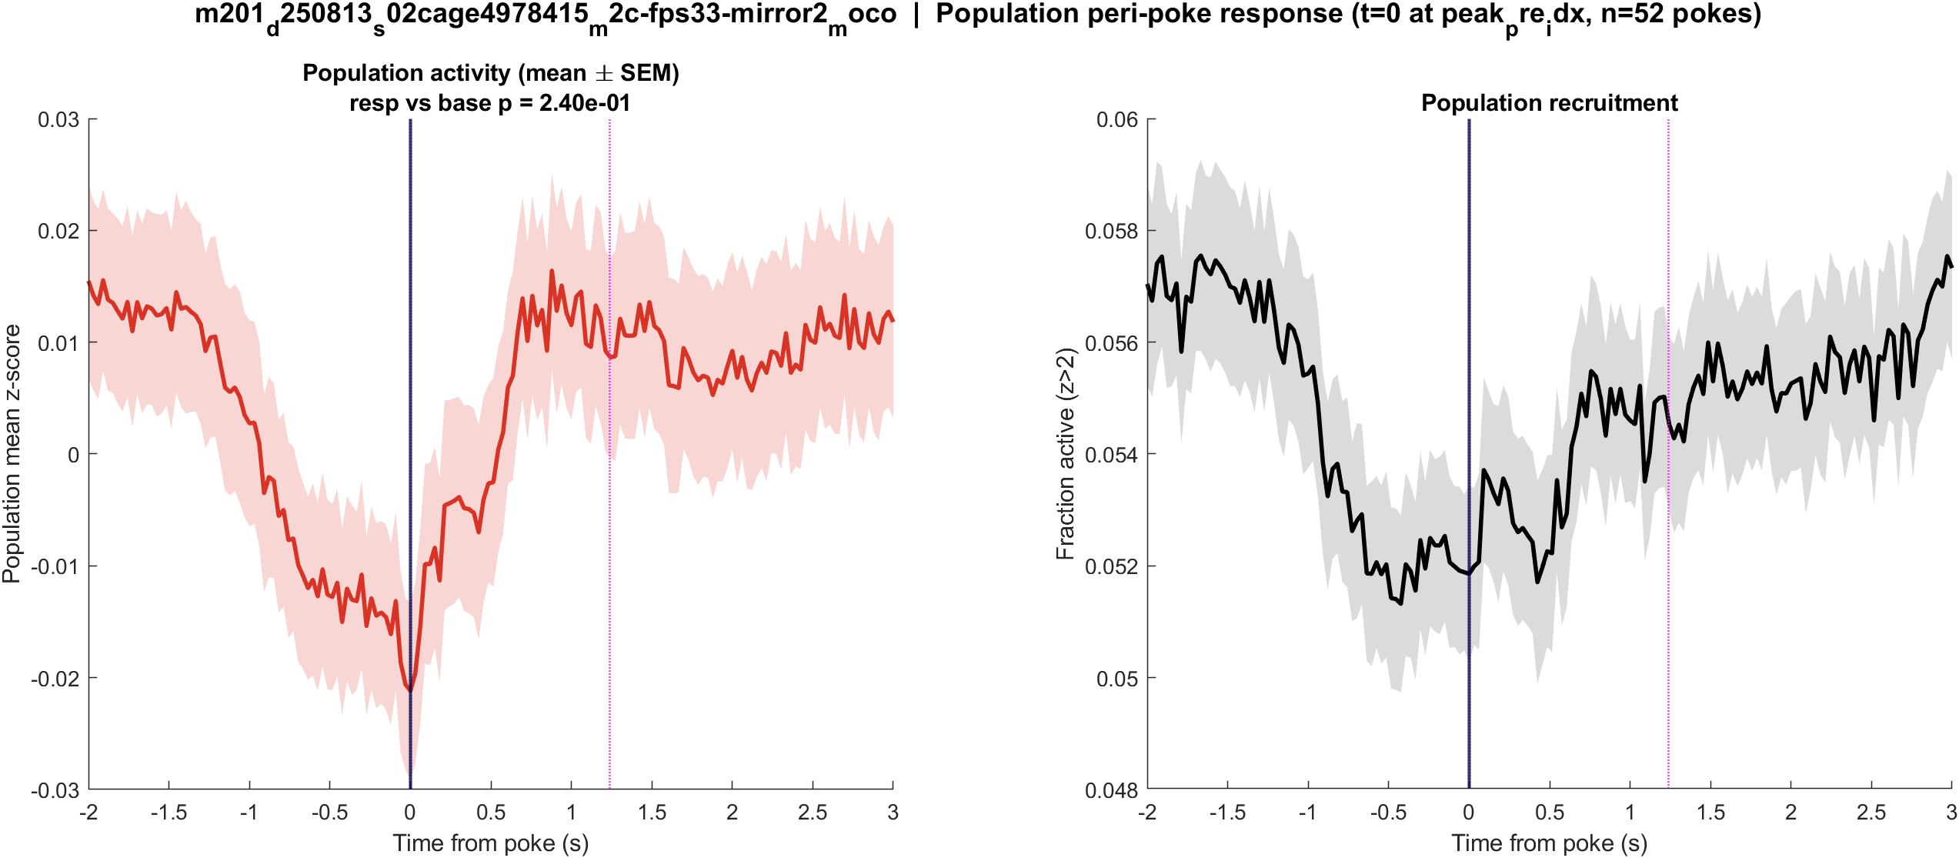
Fig1 Population PSTH | mouse2c s02 power TBD mirror2
What: Mean population activity (z-score) and fraction of active cells, aligned to each poke (t = 0 is peak_pre_idx).
Result: This FOV has 2040 neurons and 54 pokes; the population pre vs post test is not significant (p = 0.240).

Slide 59

Fig2 Neuron STA | mouse2c s02 power TBD mirror2
What: Each neuron’s average trace around the poke, sorted by response size; right panel is the mean of excited vs inhibited cells.
Result: Excited 5.9% and inhibited 22.2% of 2040 neurons; see the STA split on the right.

Slide 60

Fig3 Excited vs inhibited cells | mouse2c s02 power TBD mirror2
What: Per neuron: mean z in 0.4–1.2 s after t=0 vs -2–0 s before; signed-rank, p<0.05, sign of the difference.
Result: 5.9% excited, 22.2% inhibited out of 2040 neurons; population test not significant (p = 0.240).

Slide 61


Fig4 Spatial poke-response map | mouse2c s02 power TBD mirror2
What: Each neuron's post-pre amplitude is painted onto its EXTRACT footprint. Red = excited, blue = inhibited. Left: anatomy. Middle: all cells. Right: p<0.05 only.
Result: Excited and inhibited cells are intermingled across dorsal cortex; there is no single on-or-off region in these unaligned FOVs.

Slide 62

Fig5 Trial raster and poke interval | mouse2c s02 power TBD mirror2
What: One row per poke (population z over time) and the histogram of time between detected pokes.
Result: 54 pokes detected in this movie; intervals near 5.3 s, with occasional missed peaks.

Slide 63

Fig1 Population PSTH | m3 (LabVIEW m1f) s00 mirror1
What: Mean population activity (z-score) and fraction of active cells, aligned to each poke (t = 0 is peak_pre_idx).
Result: This FOV has 1537 neurons and 55 pokes; the population pre vs post test is significant (p = 0.018).

Slide 64

Fig2 Neuron STA | m3 (LabVIEW m1f) s00 mirror1
What: Each neuron’s average trace around the poke, sorted by response size; right panel is the mean of excited vs inhibited cells.
Result: Excited 9.8% and inhibited 22.9% of 1537 neurons; see the STA split on the right.

Slide 65

Fig3 Excited vs inhibited cells | m3 (LabVIEW m1f) s00 mirror1
What: Per neuron: mean z in 0.4–1.2 s after t=0 vs -2–0 s before; signed-rank, p<0.05, sign of the difference.
Result: 9.8% excited, 22.9% inhibited out of 1537 neurons; population test significant (p = 0.018).

Slide 66


Fig4 Spatial poke-response map | m3 (LabVIEW m1f) s00 mirror1
What: Each neuron's post-pre amplitude is painted onto its EXTRACT footprint. Red = excited, blue = inhibited. Left: anatomy. Middle: all cells. Right: p<0.05 only.
Result: Excited and inhibited cells are intermingled across dorsal cortex; there is no single on-or-off region in these unaligned FOVs.

Slide 67

Fig5 Trial raster and poke interval | m3 (LabVIEW m1f) s00 mirror1
What: One row per poke (population z over time) and the histogram of time between detected pokes.
Result: 55 pokes detected in this movie; intervals near 5.3 s, with occasional missed peaks.

Slide 68

Fig1 Population PSTH | m3 (LabVIEW m1f) s00 mirror2
What: Mean population activity (z-score) and fraction of active cells, aligned to each poke (t = 0 is peak_pre_idx).
Result: This FOV has 2148 neurons and 48 pokes; the population pre vs post test is not significant (p = 0.831).

Slide 69

Fig2 Neuron STA | m3 (LabVIEW m1f) s00 mirror2
What: Each neuron’s average trace around the poke, sorted by response size; right panel is the mean of excited vs inhibited cells.
Result: Excited 6.7% and inhibited 21.8% of 2148 neurons; see the STA split on the right.

Slide 70

Fig3 Excited vs inhibited cells | m3 (LabVIEW m1f) s00 mirror2
What: Per neuron: mean z in 0.4–1.2 s after t=0 vs -2–0 s before; signed-rank, p<0.05, sign of the difference.
Result: 6.7% excited, 21.8% inhibited out of 2148 neurons; population test not significant (p = 0.831).

Slide 71


Fig4 Spatial poke-response map | m3 (LabVIEW m1f) s00 mirror2
What: Each neuron's post-pre amplitude is painted onto its EXTRACT footprint. Red = excited, blue = inhibited. Left: anatomy. Middle: all cells. Right: p<0.05 only.
Result: Excited and inhibited cells are intermingled across dorsal cortex; there is no single on-or-off region in these unaligned FOVs.

Slide 72

Fig5 Trial raster and poke interval | m3 (LabVIEW m1f) s00 mirror2
What: One row per poke (population z over time) and the histogram of time between detected pokes.
Result: 48 pokes detected in this movie; intervals near 5.3 s, with occasional missed peaks.

Slide 73
Next
Export spatial footprints → map excited vs inhibited cells onto cortex. Optionally also show the peak_idx alignment, which locks more tightly because the 0.4–1.2 s window was chosen for that peak.

