Slide 1
Spatial poke maps by event
2025-08-13 | same cells, three t = 0 markers: pre / peak / post
Take-home: excited and inhibited cells are mixed in every FOV; the pattern does not flip to one region when the event changes.

Slide 2
How to read these maps
Red = excited, blue = inhibited after the poke. Columns are pre (onset candidate), peak (brightness peak), and post (after the peak). Color scale is shared within each movie.

Slide 3
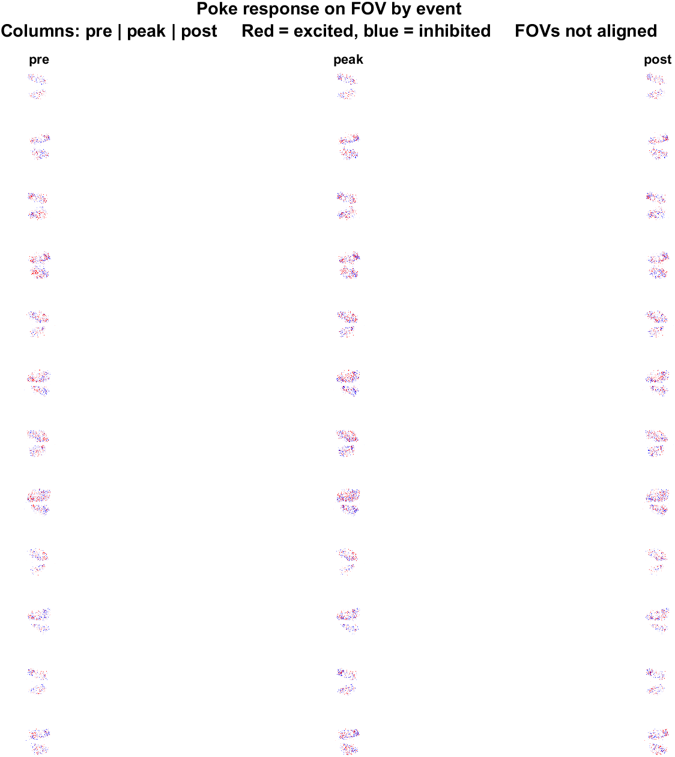
All movies | pre vs peak vs post
What: Same neurons and FOV, three t=0 definitions: pre (onset candidate), peak (brightness peak), post (after the peak). Shared color scale.
Result: The spatial pattern is similar across events: mixed red and blue cells. Peak shows the strongest lock; post is weaker because the response is mostly before t=0.

Slide 4
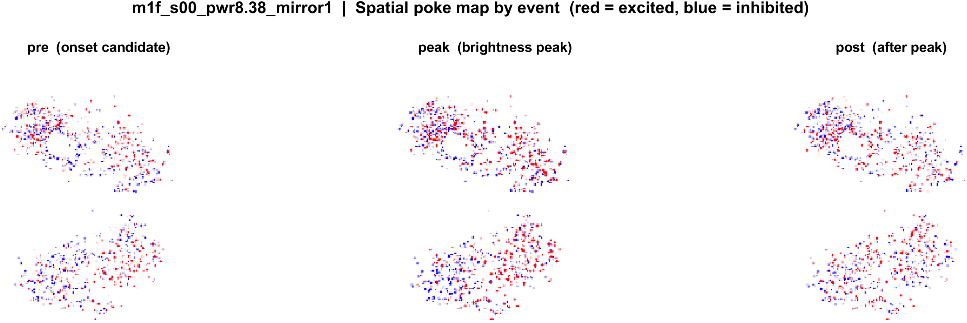
mouse1f s00 8.38 mW/cm2 mirror1
What: Same neurons and FOV, three t=0 definitions: pre (onset candidate), peak (brightness peak), post (after the peak). Shared color scale.
Result: The spatial pattern is similar across events: mixed red and blue cells. Peak shows the strongest lock; post is weaker because the response is mostly before t=0.

Slide 5
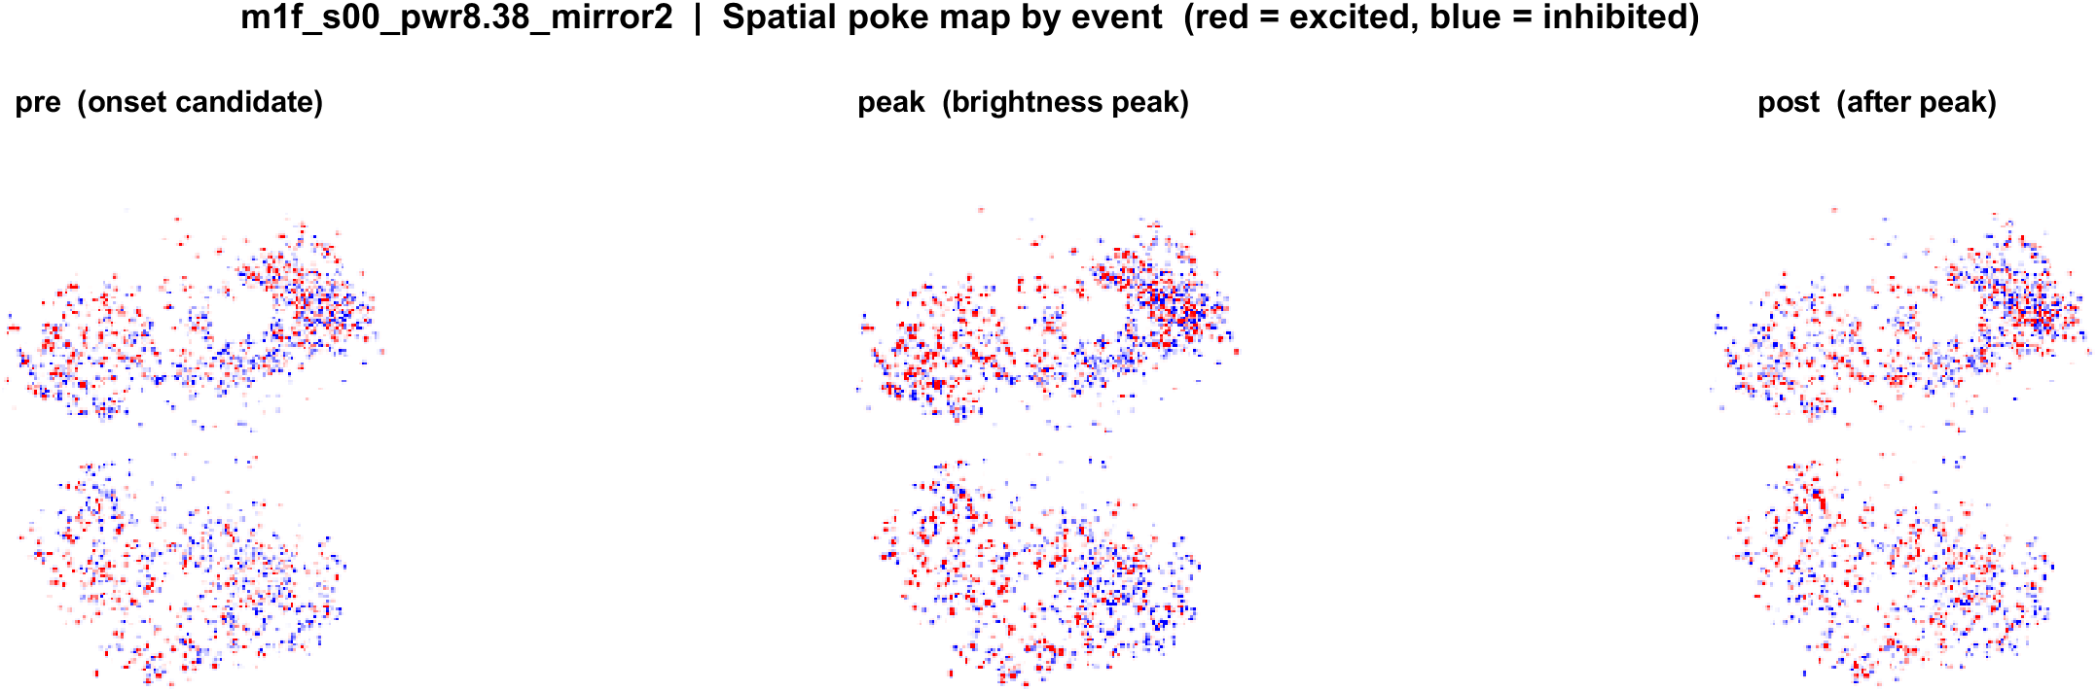
mouse1f s00 8.38 mW/cm2 mirror2
What: Same neurons and FOV, three t=0 definitions: pre (onset candidate), peak (brightness peak), post (after the peak). Shared color scale.
Result: The spatial pattern is similar across events: mixed red and blue cells. Peak shows the strongest lock; post is weaker because the response is mostly before t=0.

Slide 6
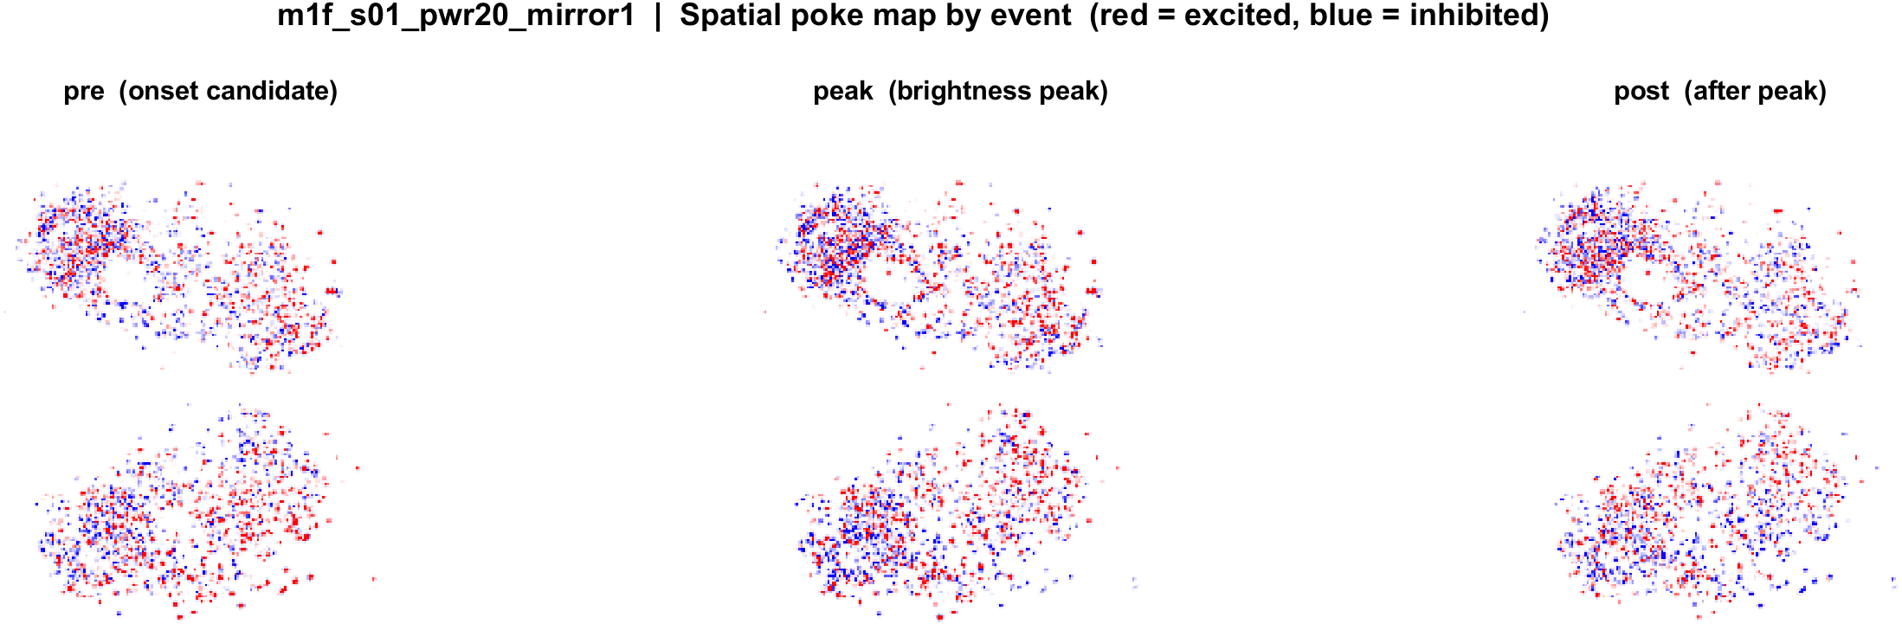
mouse1f s01 20 mW/cm2 mirror1
What: Same neurons and FOV, three t=0 definitions: pre (onset candidate), peak (brightness peak), post (after the peak). Shared color scale.
Result: The spatial pattern is similar across events: mixed red and blue cells. Peak shows the strongest lock; post is weaker because the response is mostly before t=0.

Slide 7
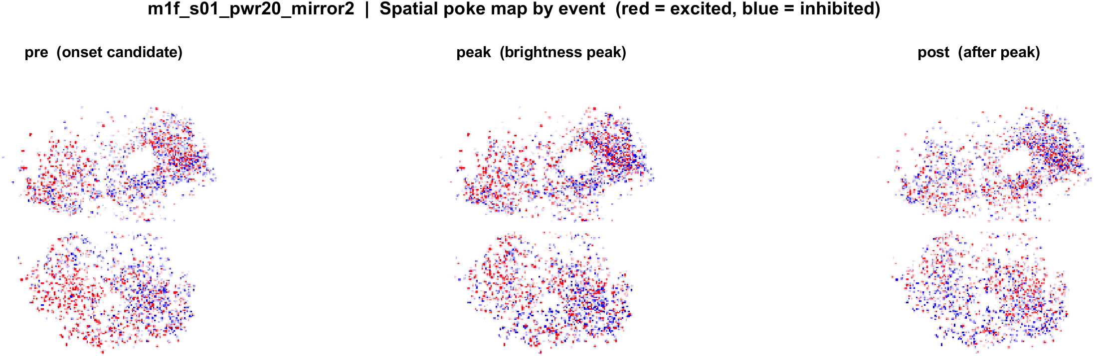
mouse1f s01 20 mW/cm2 mirror2
What: Same neurons and FOV, three t=0 definitions: pre (onset candidate), peak (brightness peak), post (after the peak). Shared color scale.
Result: The spatial pattern is similar across events: mixed red and blue cells. Peak shows the strongest lock; post is weaker because the response is mostly before t=0.

Slide 8
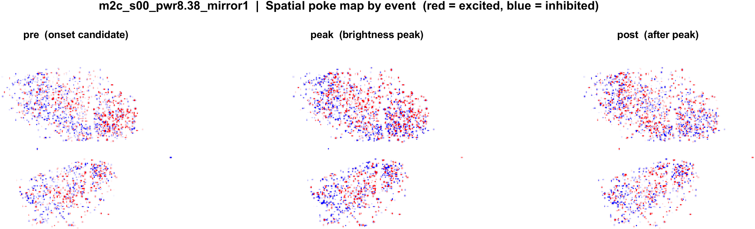
mouse2c s00 8.38 mW/cm2 mirror1
What: Same neurons and FOV, three t=0 definitions: pre (onset candidate), peak (brightness peak), post (after the peak). Shared color scale.
Result: The spatial pattern is similar across events: mixed red and blue cells. Peak shows the strongest lock; post is weaker because the response is mostly before t=0.

Slide 9
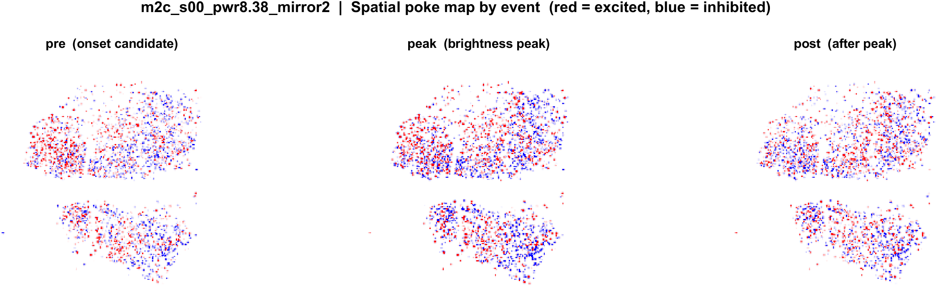
mouse2c s00 8.38 mW/cm2 mirror2
What: Same neurons and FOV, three t=0 definitions: pre (onset candidate), peak (brightness peak), post (after the peak). Shared color scale.
Result: The spatial pattern is similar across events: mixed red and blue cells. Peak shows the strongest lock; post is weaker because the response is mostly before t=0.

Slide 10
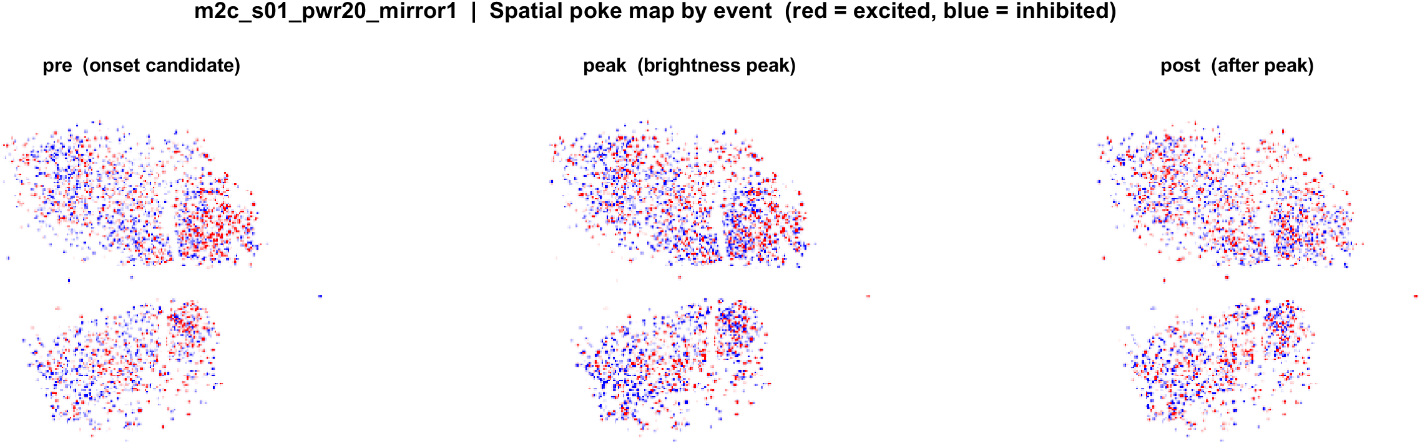
mouse2c s01 20 mW/cm2 mirror1
What: Same neurons and FOV, three t=0 definitions: pre (onset candidate), peak (brightness peak), post (after the peak). Shared color scale.
Result: The spatial pattern is similar across events: mixed red and blue cells. Peak shows the strongest lock; post is weaker because the response is mostly before t=0.

Slide 11
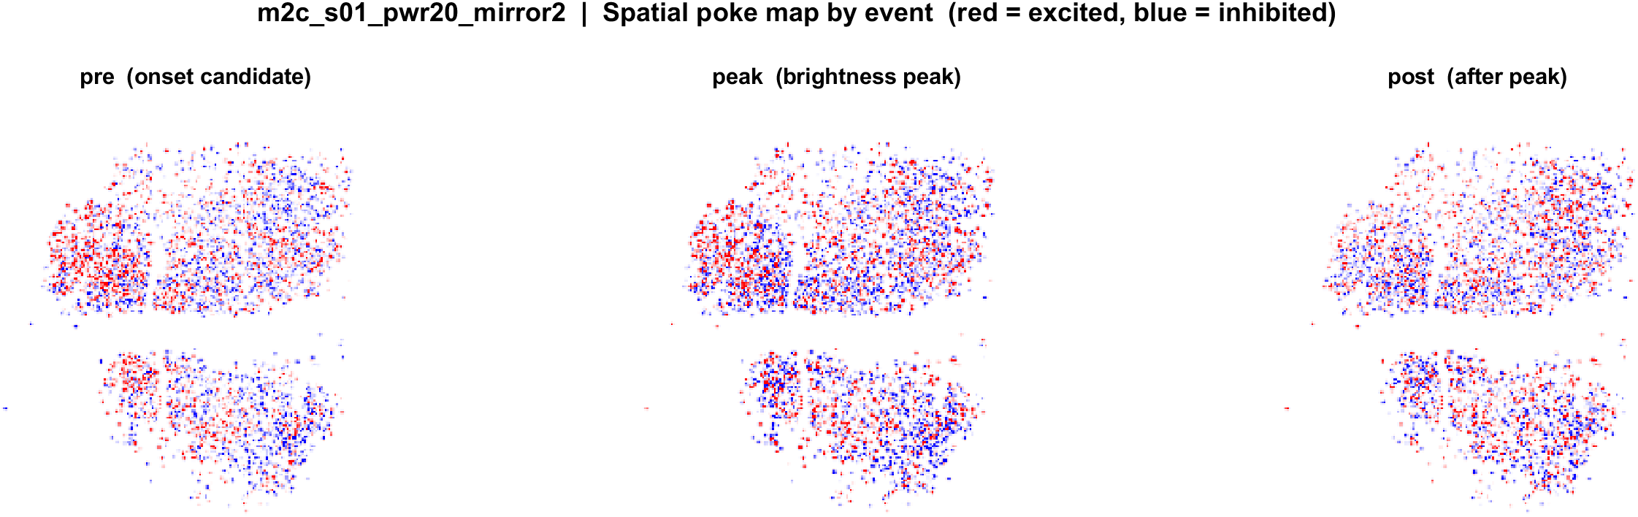
mouse2c s01 20 mW/cm2 mirror2
What: Same neurons and FOV, three t=0 definitions: pre (onset candidate), peak (brightness peak), post (after the peak). Shared color scale.
Result: The spatial pattern is similar across events: mixed red and blue cells. Peak shows the strongest lock; post is weaker because the response is mostly before t=0.

Slide 12
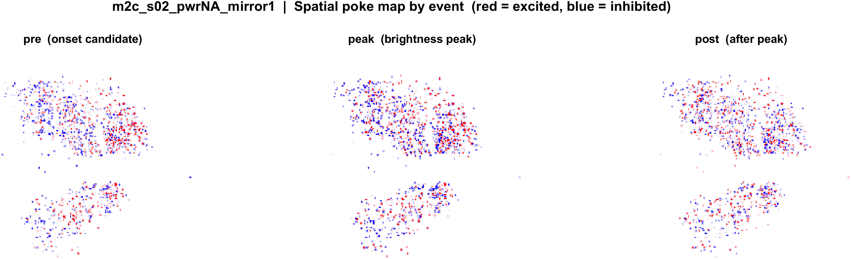
mouse2c s02 power TBD mirror1
What: Same neurons and FOV, three t=0 definitions: pre (onset candidate), peak (brightness peak), post (after the peak). Shared color scale.
Result: The spatial pattern is similar across events: mixed red and blue cells. Peak shows the strongest lock; post is weaker because the response is mostly before t=0.

Slide 13
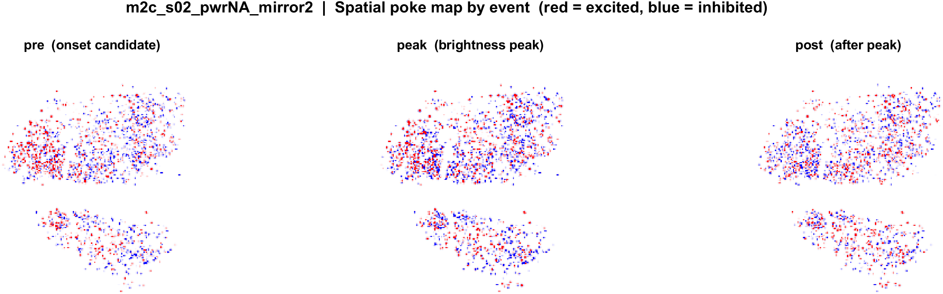
mouse2c s02 power TBD mirror2
What: Same neurons and FOV, three t=0 definitions: pre (onset candidate), peak (brightness peak), post (after the peak). Shared color scale.
Result: The spatial pattern is similar across events: mixed red and blue cells. Peak shows the strongest lock; post is weaker because the response is mostly before t=0.

Slide 14
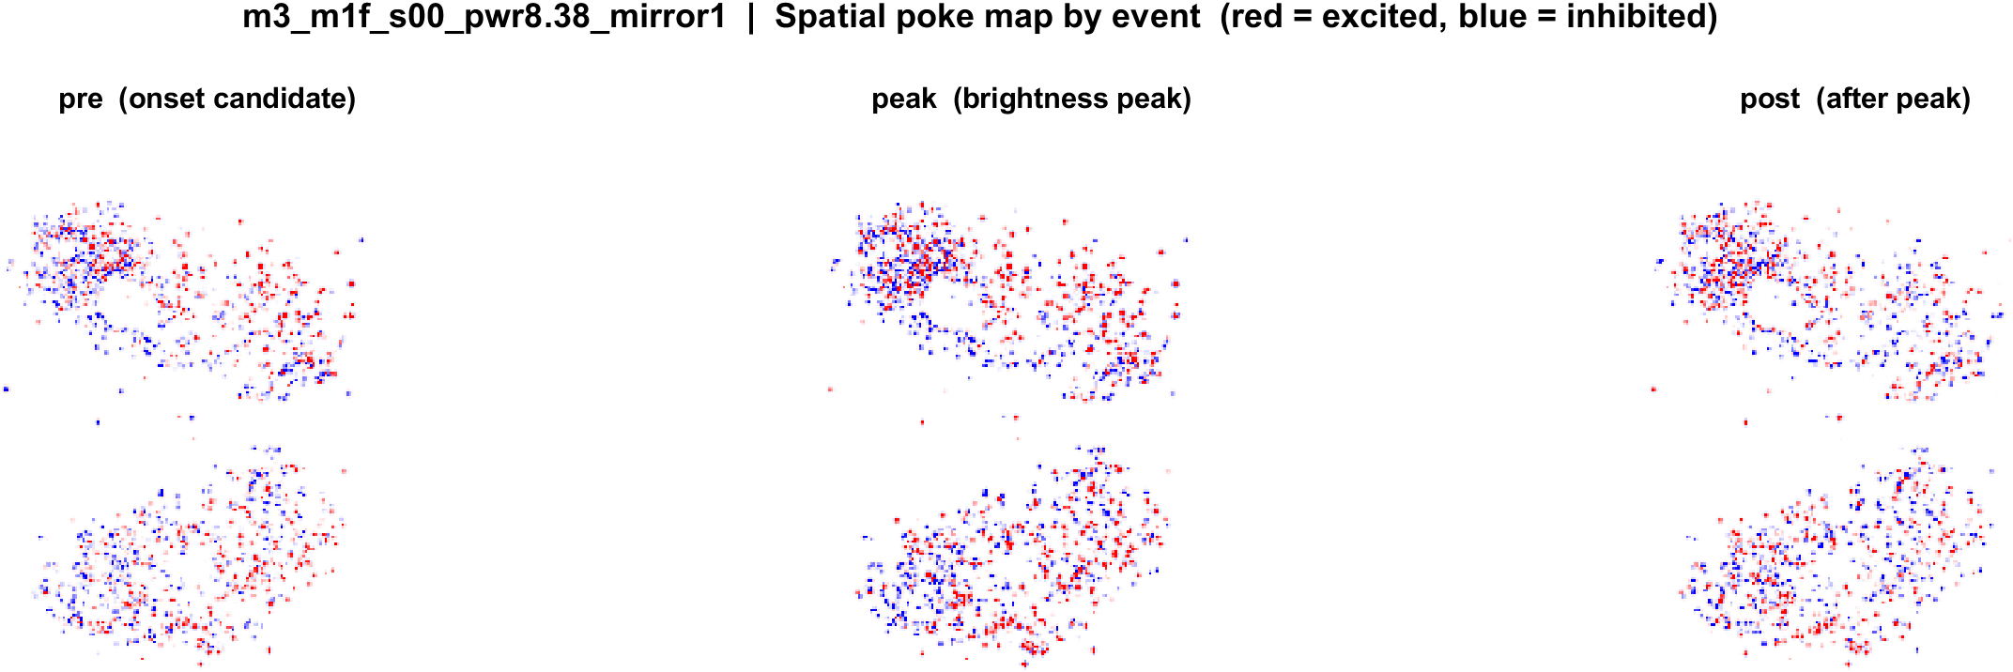
m3 (LabVIEW m1f) s00 mirror1
What: Same neurons and FOV, three t=0 definitions: pre (onset candidate), peak (brightness peak), post (after the peak). Shared color scale.
Result: The spatial pattern is similar across events: mixed red and blue cells. Peak shows the strongest lock; post is weaker because the response is mostly before t=0.

Slide 15
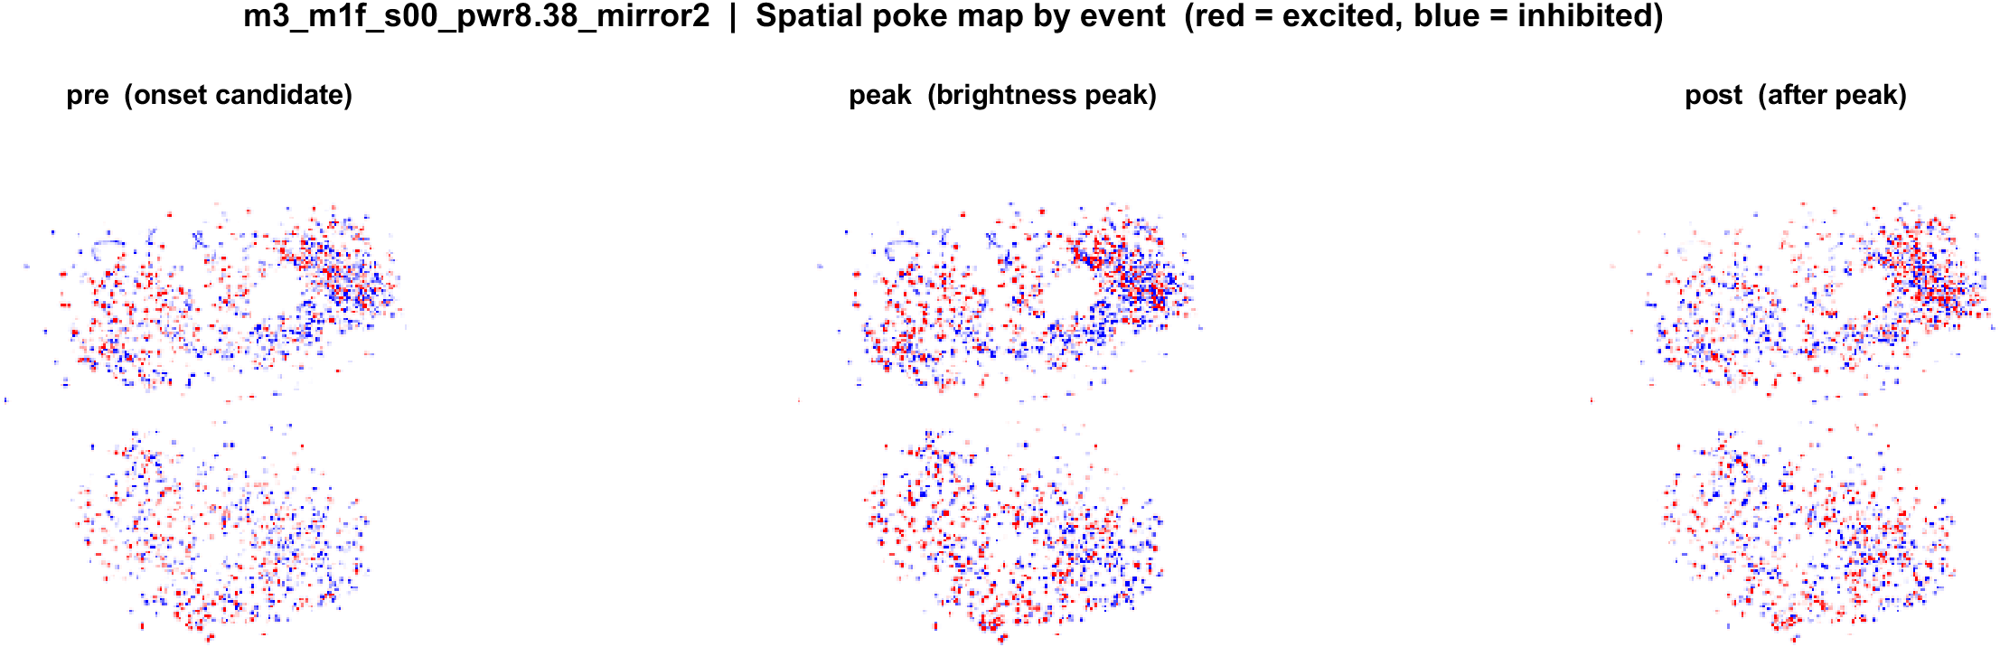
m3 (LabVIEW m1f) s00 mirror2
What: Same neurons and FOV, three t=0 definitions: pre (onset candidate), peak (brightness peak), post (after the peak). Shared color scale.
Result: The spatial pattern is similar across events: mixed red and blue cells. Peak shows the strongest lock; post is weaker because the response is mostly before t=0.

