Slide 1
Face poking on crystal skull
2025-08-18 | t = 0 at peak_idx = intensity DIP | window 0.4–1.2 s vs -2–0 s
Take-home: the dip-aligned movies still show a poke-locked cortex, with more inhibited than excited cells and the same anterior-excited / posterior-inhibited spatial bias after aligning mirror2.

Slide 2
Experiment
Whole dorsal cortex Ca2+ imaging while a motor arm pokes the face. All 6 movies on this day are poking sessions (m200 = mouse1f; m201 = mouse2c). s00/s01 are sequential recordings; power is not labeled for this day. mirror1 and mirror2 are two optical paths.

Slide 3
How poke time is defined
No behavior camera. A blocker on the arm changes mean-frame intensity. On 13 Aug, peak_idx was a positive brightness peak. On 18 Aug, Omer marked peak_idx at the single-frame intensity DIP (the frame that goes dark). Some dips were hard to see; regular ~3.36 s spacing lets missed ones be inferred. Missed dips leave ~20 s gaps, mostly in m200.

Slide 4
How traces are analyzed
EXTRACT traces at 33 Hz. Cut -2 to +3 s around each dip. A cell is excited or inhibited if 0.4–1.2 s differs from -2–0 s (Wilcoxon signed-rank, p<0.05). Same windows as the 13 Aug peak_idx deck.

Slide 5
How the spatial map is made
EXTRACT spatial footprints were reconstructed from the file (ndSparse CSC). Each cell's post-pre z is painted on its footprint. Red = excited, blue = inhibited. mirror2 is flipped left-right so anterior is on the RIGHT in every panel (P left, A right — same as 13 Aug).

Slide 6
All recordings together
6 movies | t = 0 is the intensity dip

Slide 7
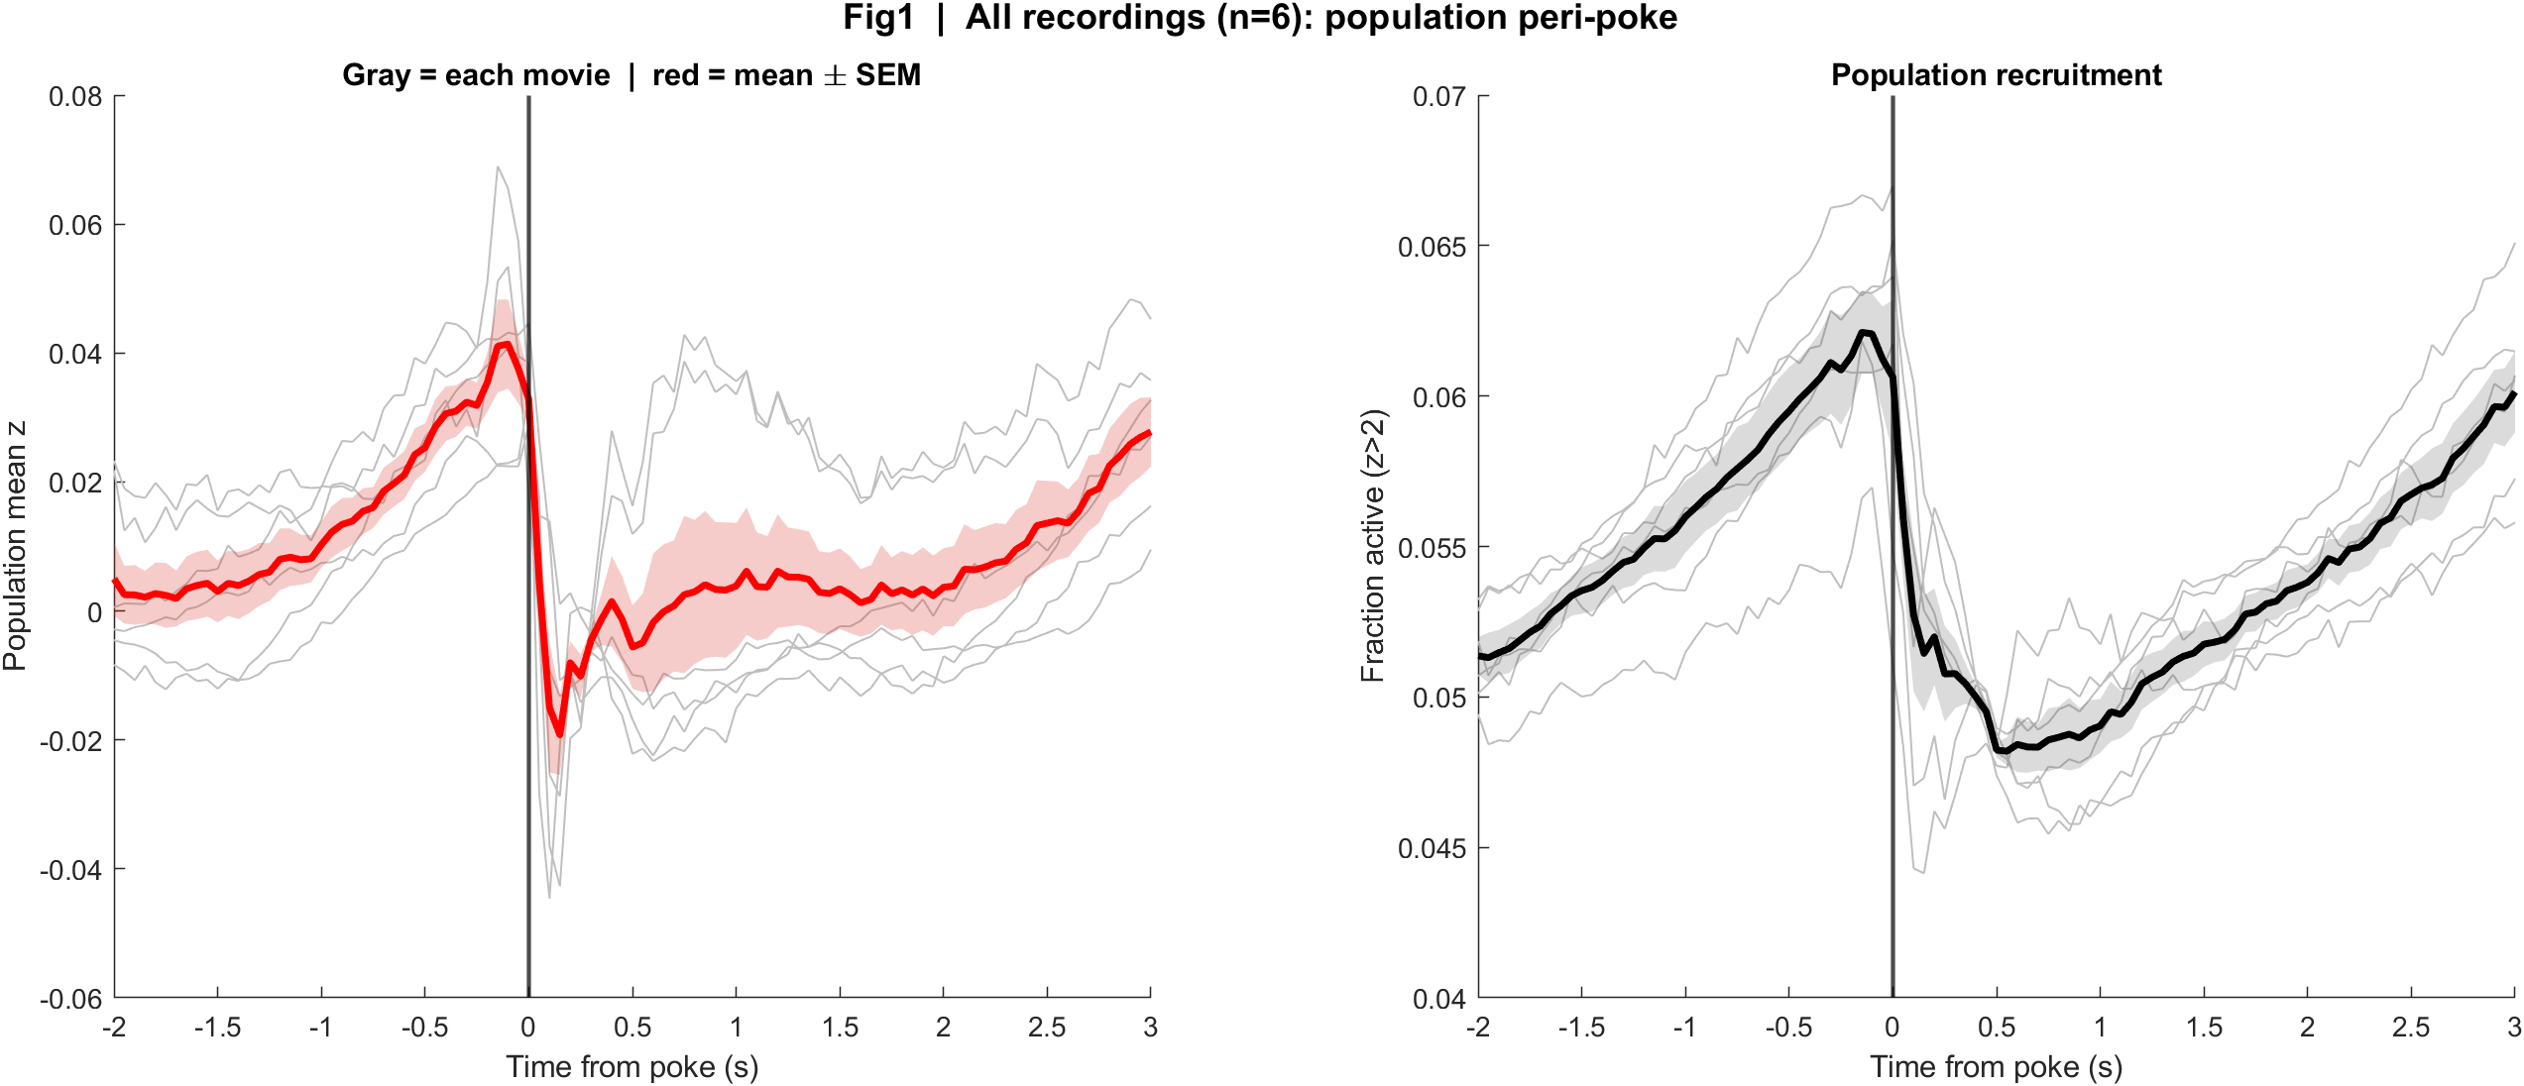
Fig1 Population PSTH | all movies
What: Mean population activity (z-score) and fraction of active cells, aligned to each poke (t = 0 is the intensity dip).
Result: Activity rises into t = 0, then drops sharply at the dip and recovers slowly — the same shape in all 6 movies.

Slide 8
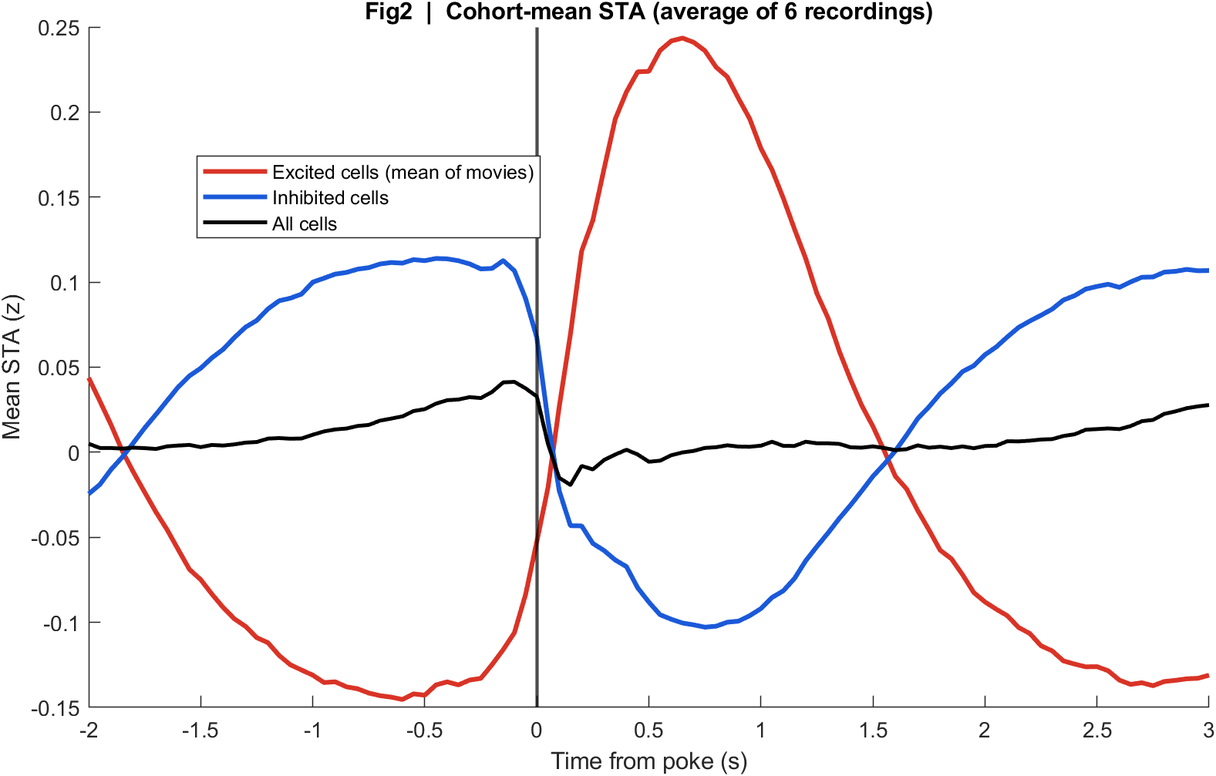
Fig2 Neuron STA | all movies
What: Each neuron's average trace around the poke, sorted by response size; right panel is the mean of excited vs inhibited cells.
Result: A subset of cells go up after the dip and another subset go down; the all-cell mean is modest because they partly cancel.

Slide 9
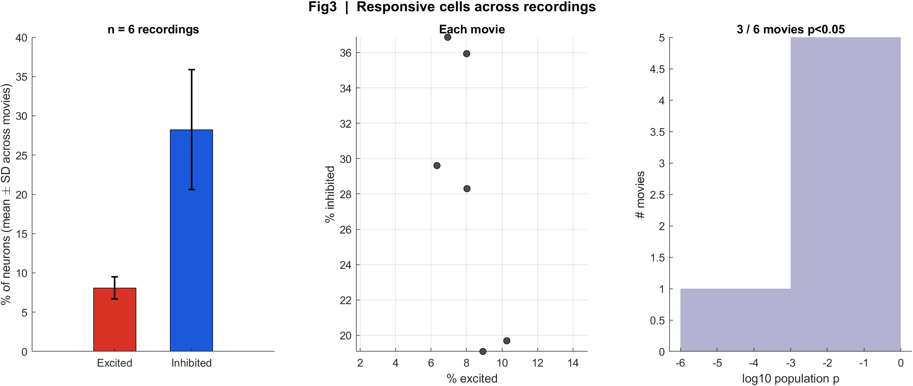
Fig3 Excited vs inhibited cells | all movies
What: Per neuron: mean z in 0.4–1.2 s after t=0 vs -2–0 s before; signed-rank, p<0.05, sign of the difference.
Result: About 6–10% of cells are excited and 19–37% inhibited; 3 of 6 movies have a significant population response.

Slide 10
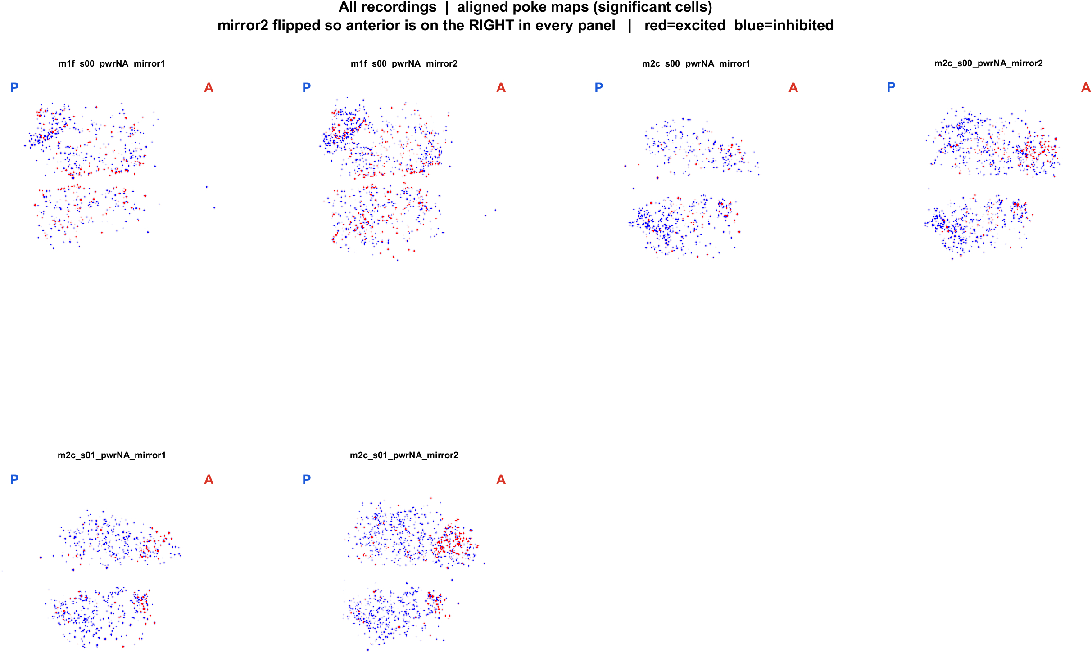
Fig4 Spatial poke-response map (aligned) | all movies
What: Significant cells on each FOV after aligning anterior to the right (mirror2 flipped). Red = excited, blue = inhibited. P = posterior, A = anterior.
Result: Cells are intermingled, with the same anterior-excited / posterior-inhibited bias seen on 13 Aug after this alignment.

Slide 11
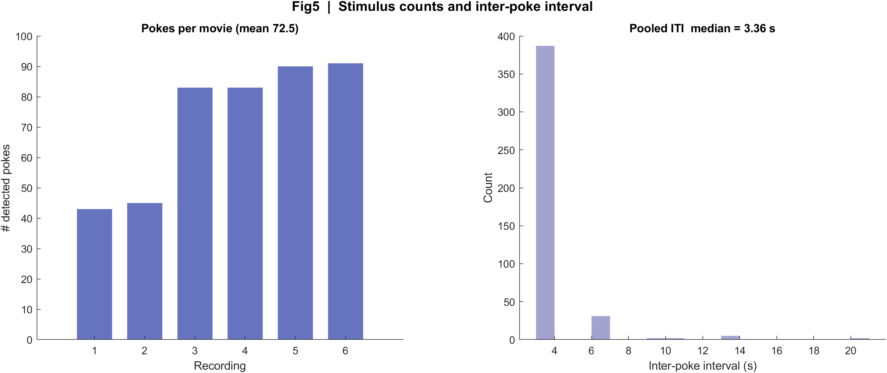
Fig5 Trial raster and poke interval | all movies
What: One row per poke (population z over time) and the histogram of time between detected dips.
Result: Median interval is 3.36 s. m200 has several ~20 s gaps (missed dips); m201 is nearly complete (~83–91 pokes).

Slide 12
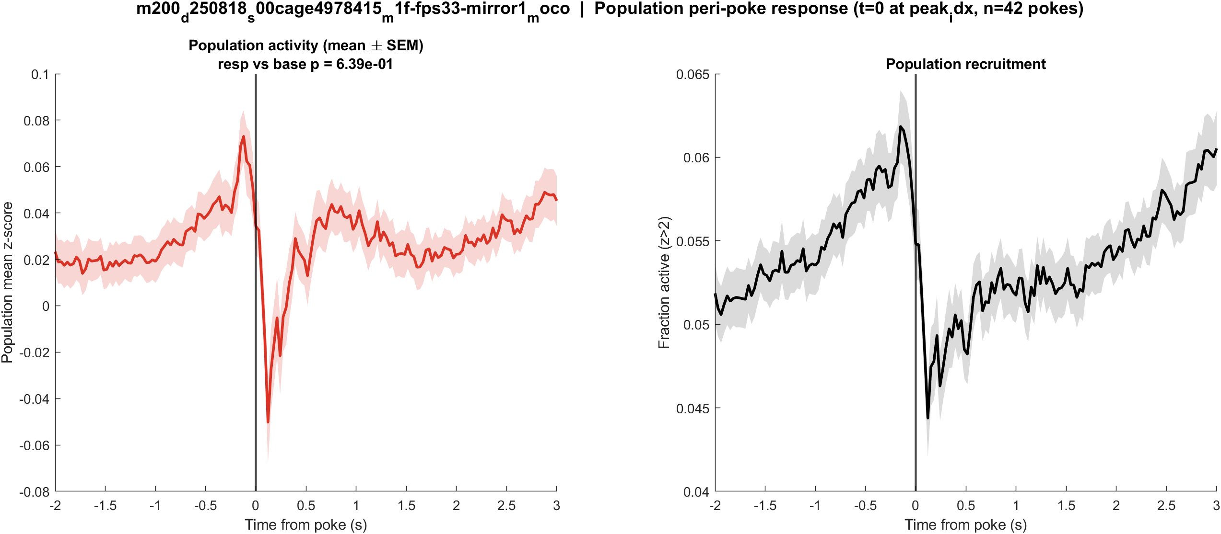
Fig1 Population PSTH | mouse1f (m200) s00 mirror1
What: Mean population activity (z-score) and fraction of active cells, aligned to each poke (t = 0 is the intensity dip).
Result: This FOV has 2253 neurons and 43 detected dips; the population pre vs post test is not significant (p = 0.639).

Slide 13
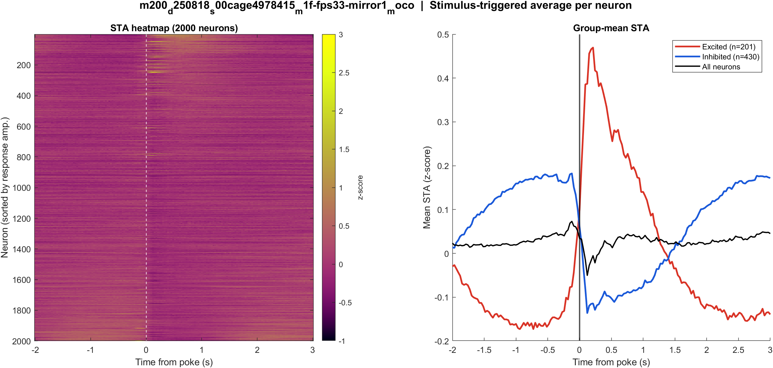
Fig2 Neuron STA | mouse1f (m200) s00 mirror1
What: Each neuron's average trace around the poke, sorted by response size; right panel is the mean of excited vs inhibited cells.
Result: Excited 8.9% and inhibited 19.1% of 2253 neurons; see the STA split on the right.

Slide 14
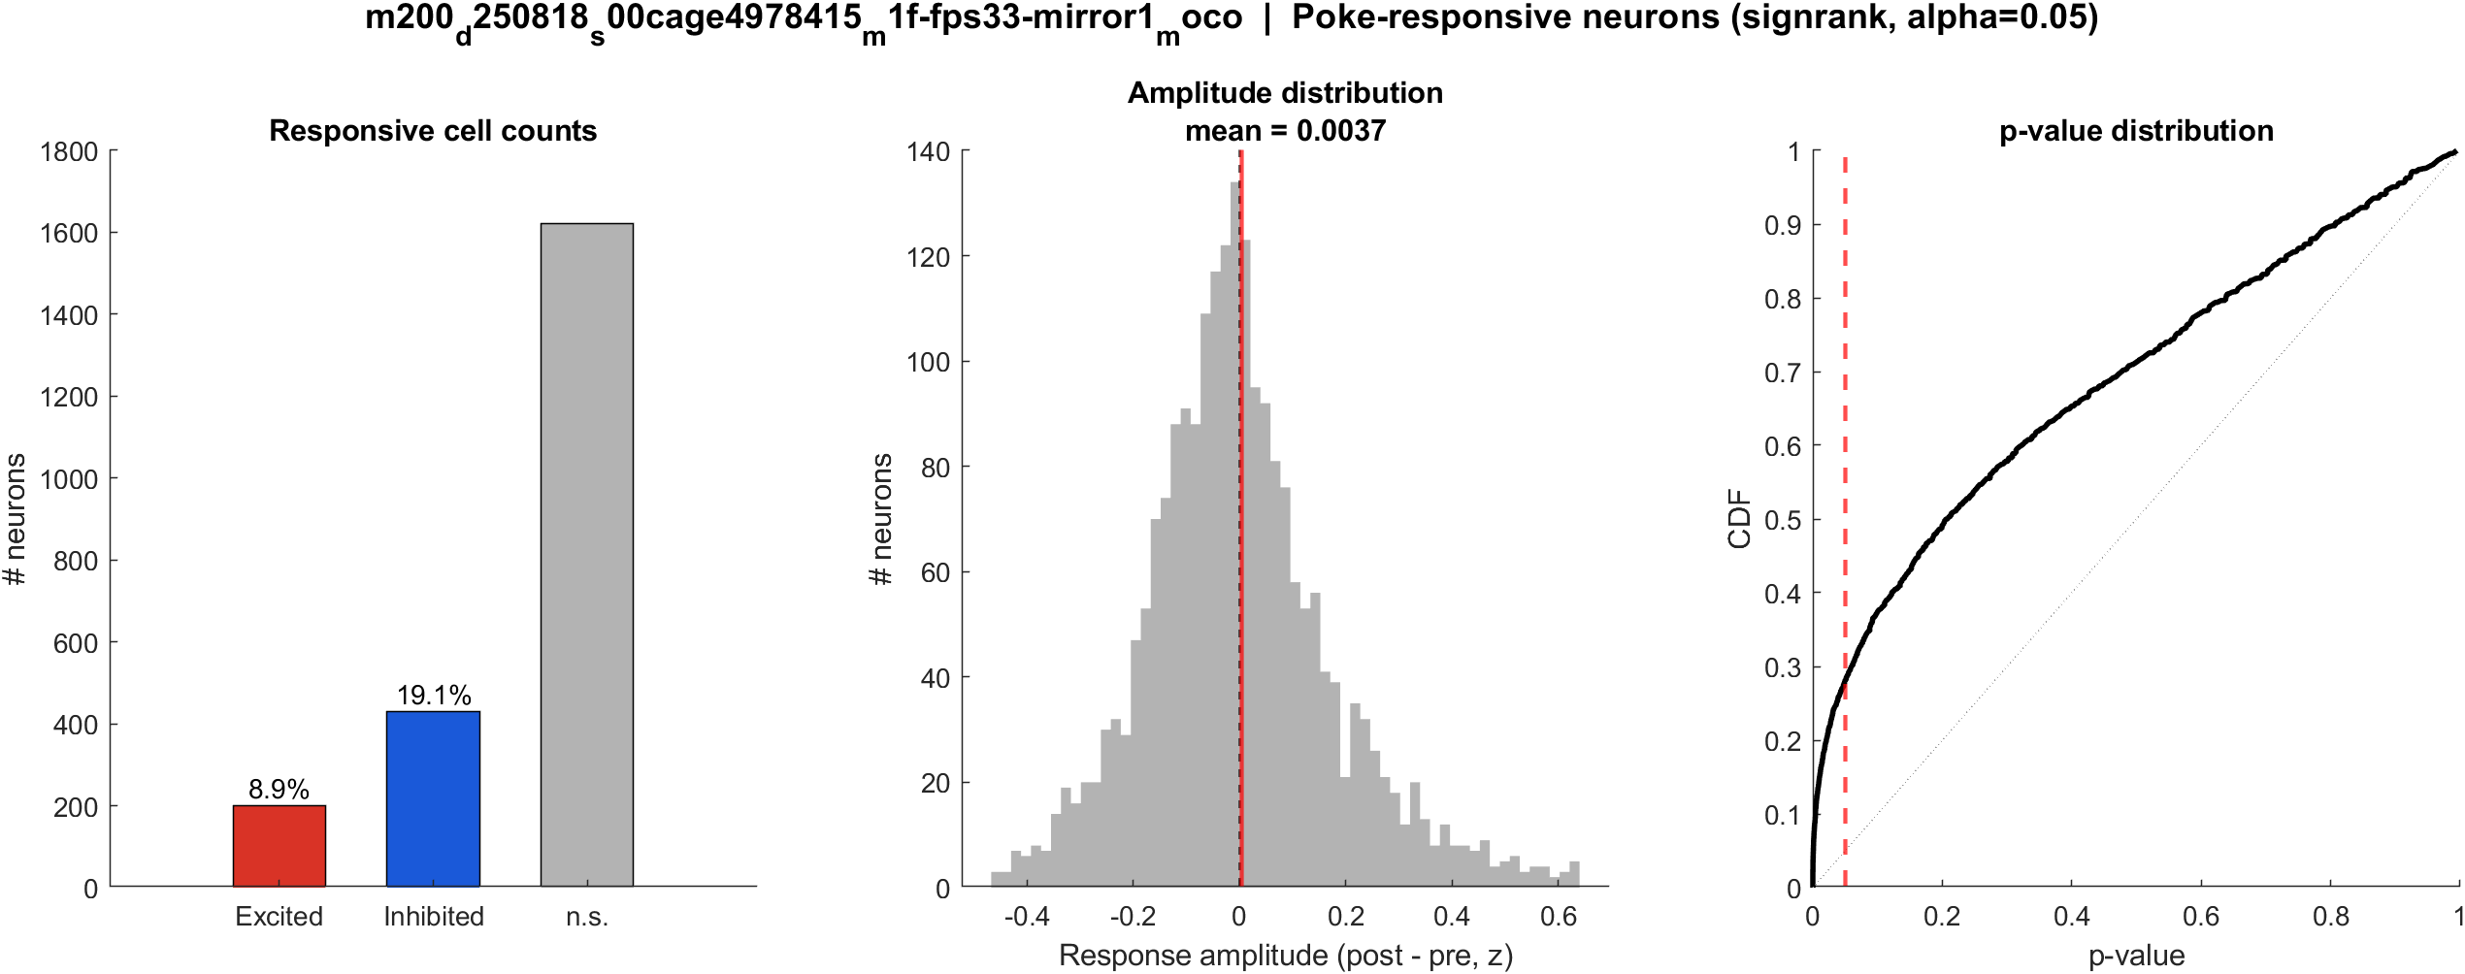
Fig3 Excited vs inhibited cells | mouse1f (m200) s00 mirror1
What: Per neuron: mean z in 0.4–1.2 s after t=0 vs -2–0 s before; signed-rank, p<0.05, sign of the difference.
Result: 8.9% excited, 19.1% inhibited out of 2253 neurons; population test not significant (p = 0.639).

Slide 15
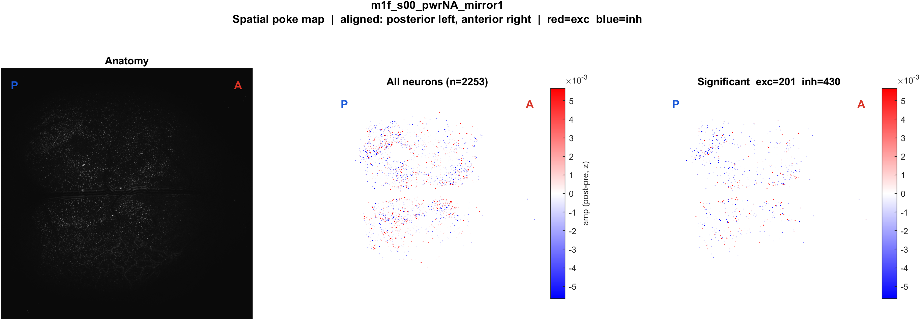
Fig4 Spatial poke-response map (aligned) | mouse1f (m200) s00 mirror1
What: Significant cells on each FOV after aligning anterior to the right (mirror2 flipped). Red = excited, blue = inhibited. P = posterior, A = anterior.
Result: Red = excited, blue = inhibited on this FOV (8.9% exc, 19.1% inh of 2253 neurons). P left, A right.

Slide 16
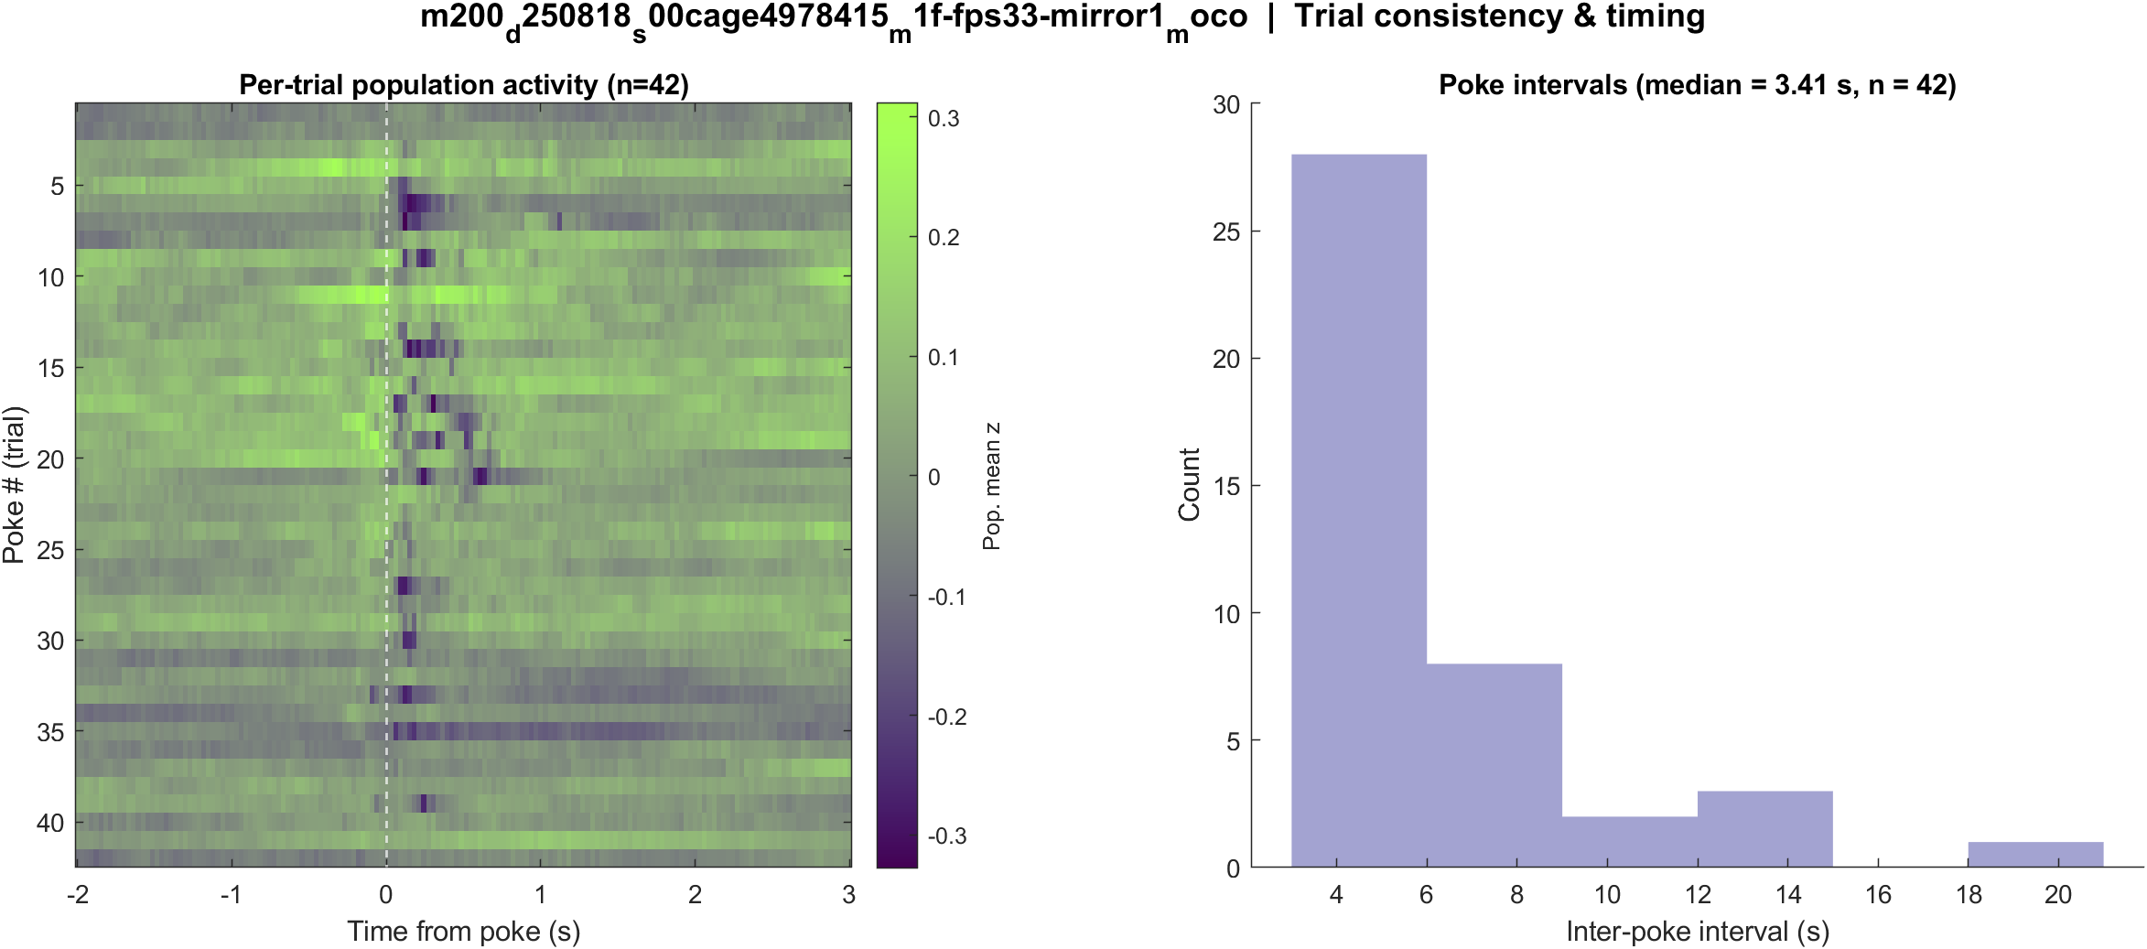
Fig5 Trial raster and poke interval | mouse1f (m200) s00 mirror1
What: One row per poke (population z over time) and the histogram of time between detected dips.
Result: 43 dips detected in this movie; median interval ~3.36 s. Long gaps are missed dips.

Slide 17
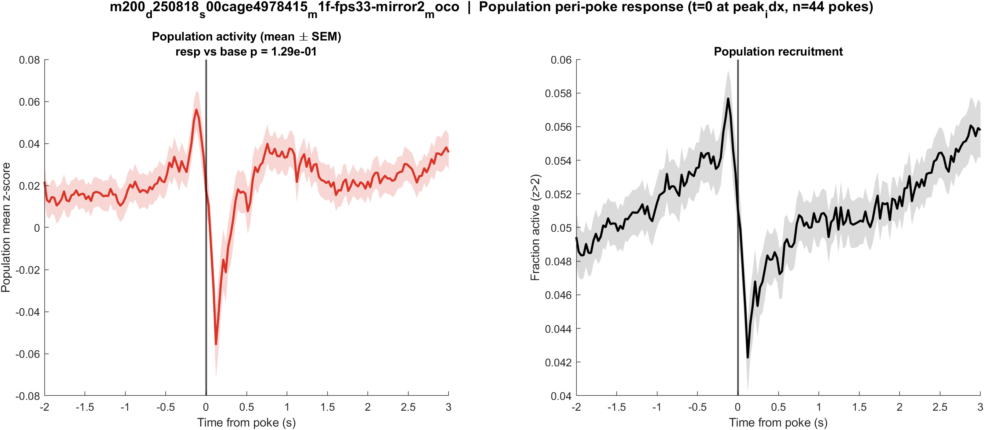
Fig1 Population PSTH | mouse1f (m200) s00 mirror2
What: Mean population activity (z-score) and fraction of active cells, aligned to each poke (t = 0 is the intensity dip).
Result: This FOV has 3428 neurons and 45 detected dips; the population pre vs post test is not significant (p = 0.129).

Slide 18
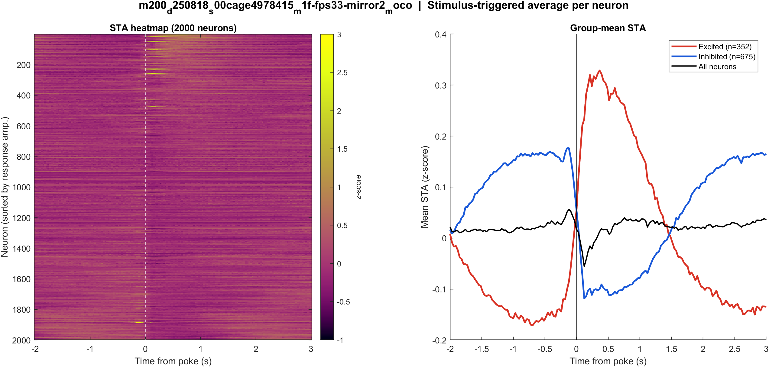
Fig2 Neuron STA | mouse1f (m200) s00 mirror2
What: Each neuron's average trace around the poke, sorted by response size; right panel is the mean of excited vs inhibited cells.
Result: Excited 10.3% and inhibited 19.7% of 3428 neurons; see the STA split on the right.

Slide 19
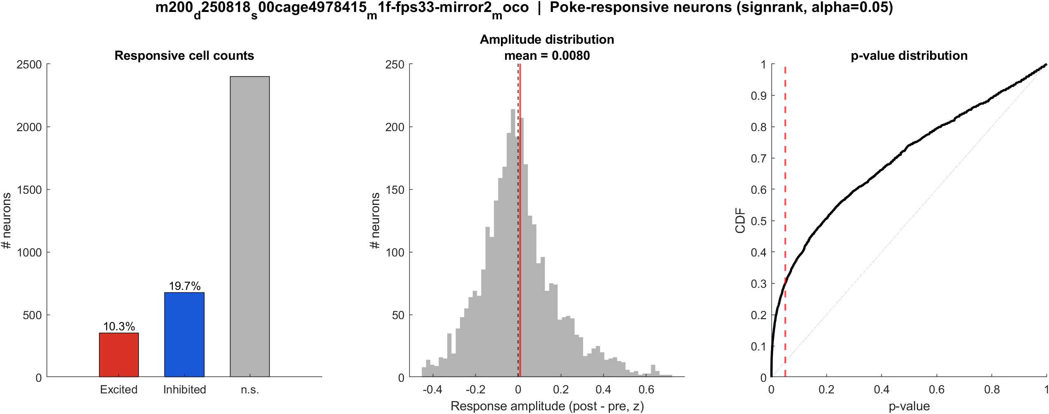
Fig3 Excited vs inhibited cells | mouse1f (m200) s00 mirror2
What: Per neuron: mean z in 0.4–1.2 s after t=0 vs -2–0 s before; signed-rank, p<0.05, sign of the difference.
Result: 10.3% excited, 19.7% inhibited out of 3428 neurons; population test not significant (p = 0.129).

Slide 20

Fig4 Spatial poke-response map (aligned) | mouse1f (m200) s00 mirror2
What: Significant cells on each FOV after aligning anterior to the right (mirror2 flipped). Red = excited, blue = inhibited. P = posterior, A = anterior.
Result: Red = excited, blue = inhibited on this FOV (10.3% exc, 19.7% inh of 3428 neurons). P left, A right.

Slide 21
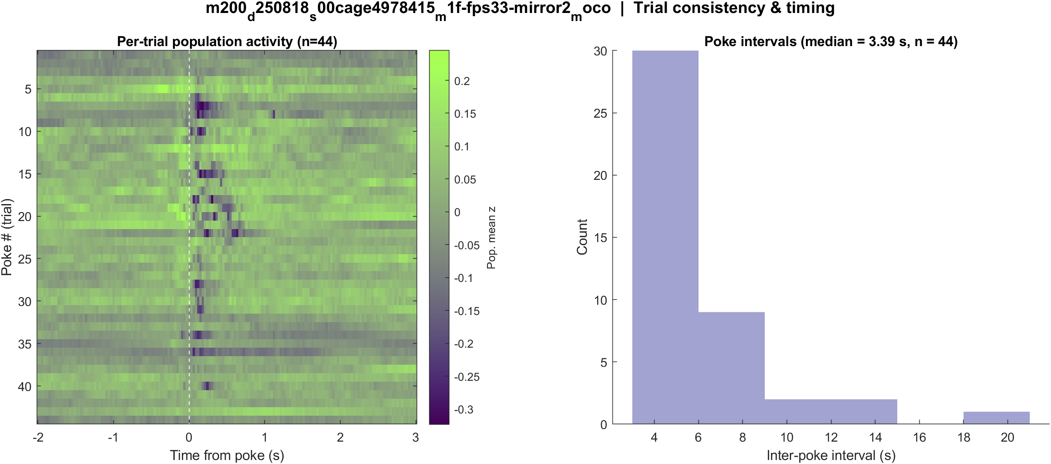
Fig5 Trial raster and poke interval | mouse1f (m200) s00 mirror2
What: One row per poke (population z over time) and the histogram of time between detected dips.
Result: 45 dips detected in this movie; median interval ~3.36 s. Long gaps are missed dips.

Slide 22
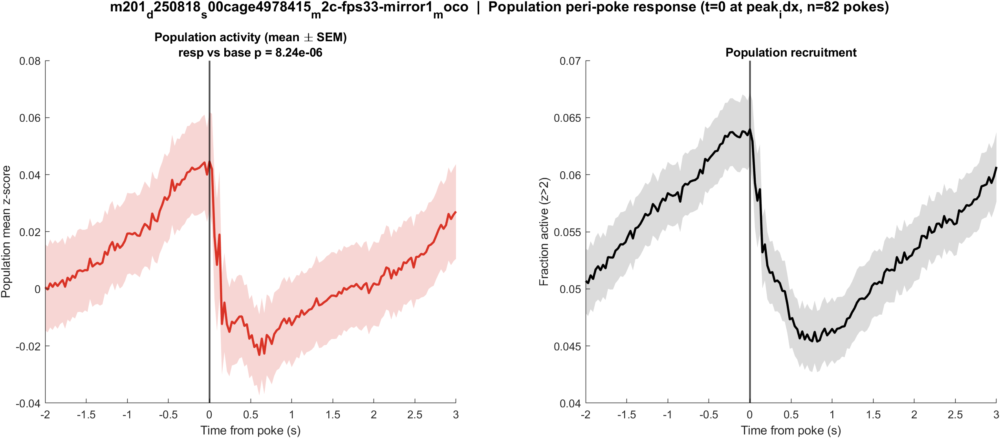
Fig1 Population PSTH | mouse2c (m201) s00 mirror1
What: Mean population activity (z-score) and fraction of active cells, aligned to each poke (t = 0 is the intensity dip).
Result: This FOV has 1770 neurons and 83 detected dips; the population pre vs post test is significant (p = 8.2e-06).

Slide 23
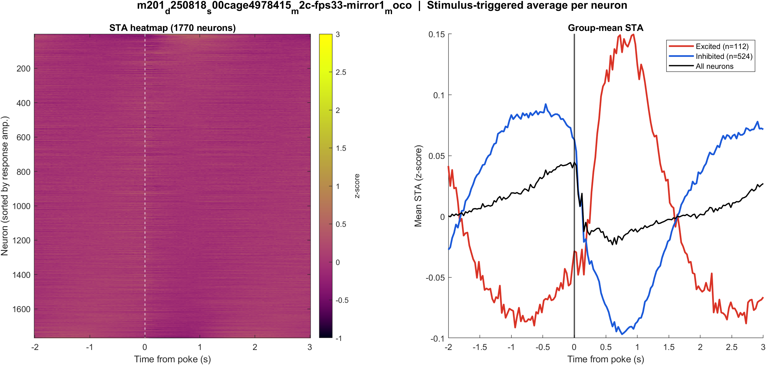
Fig2 Neuron STA | mouse2c (m201) s00 mirror1
What: Each neuron's average trace around the poke, sorted by response size; right panel is the mean of excited vs inhibited cells.
Result: Excited 6.3% and inhibited 29.6% of 1770 neurons; see the STA split on the right.

Slide 24
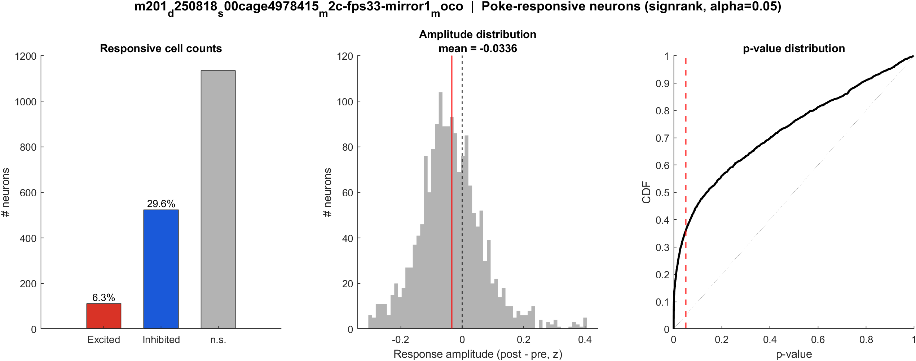
Fig3 Excited vs inhibited cells | mouse2c (m201) s00 mirror1
What: Per neuron: mean z in 0.4–1.2 s after t=0 vs -2–0 s before; signed-rank, p<0.05, sign of the difference.
Result: 6.3% excited, 29.6% inhibited out of 1770 neurons; population test significant (p = 8.2e-06).

Slide 25

Fig4 Spatial poke-response map (aligned) | mouse2c (m201) s00 mirror1
What: Significant cells on each FOV after aligning anterior to the right (mirror2 flipped). Red = excited, blue = inhibited. P = posterior, A = anterior.
Result: Red = excited, blue = inhibited on this FOV (6.3% exc, 29.6% inh of 1770 neurons). P left, A right.

Slide 26
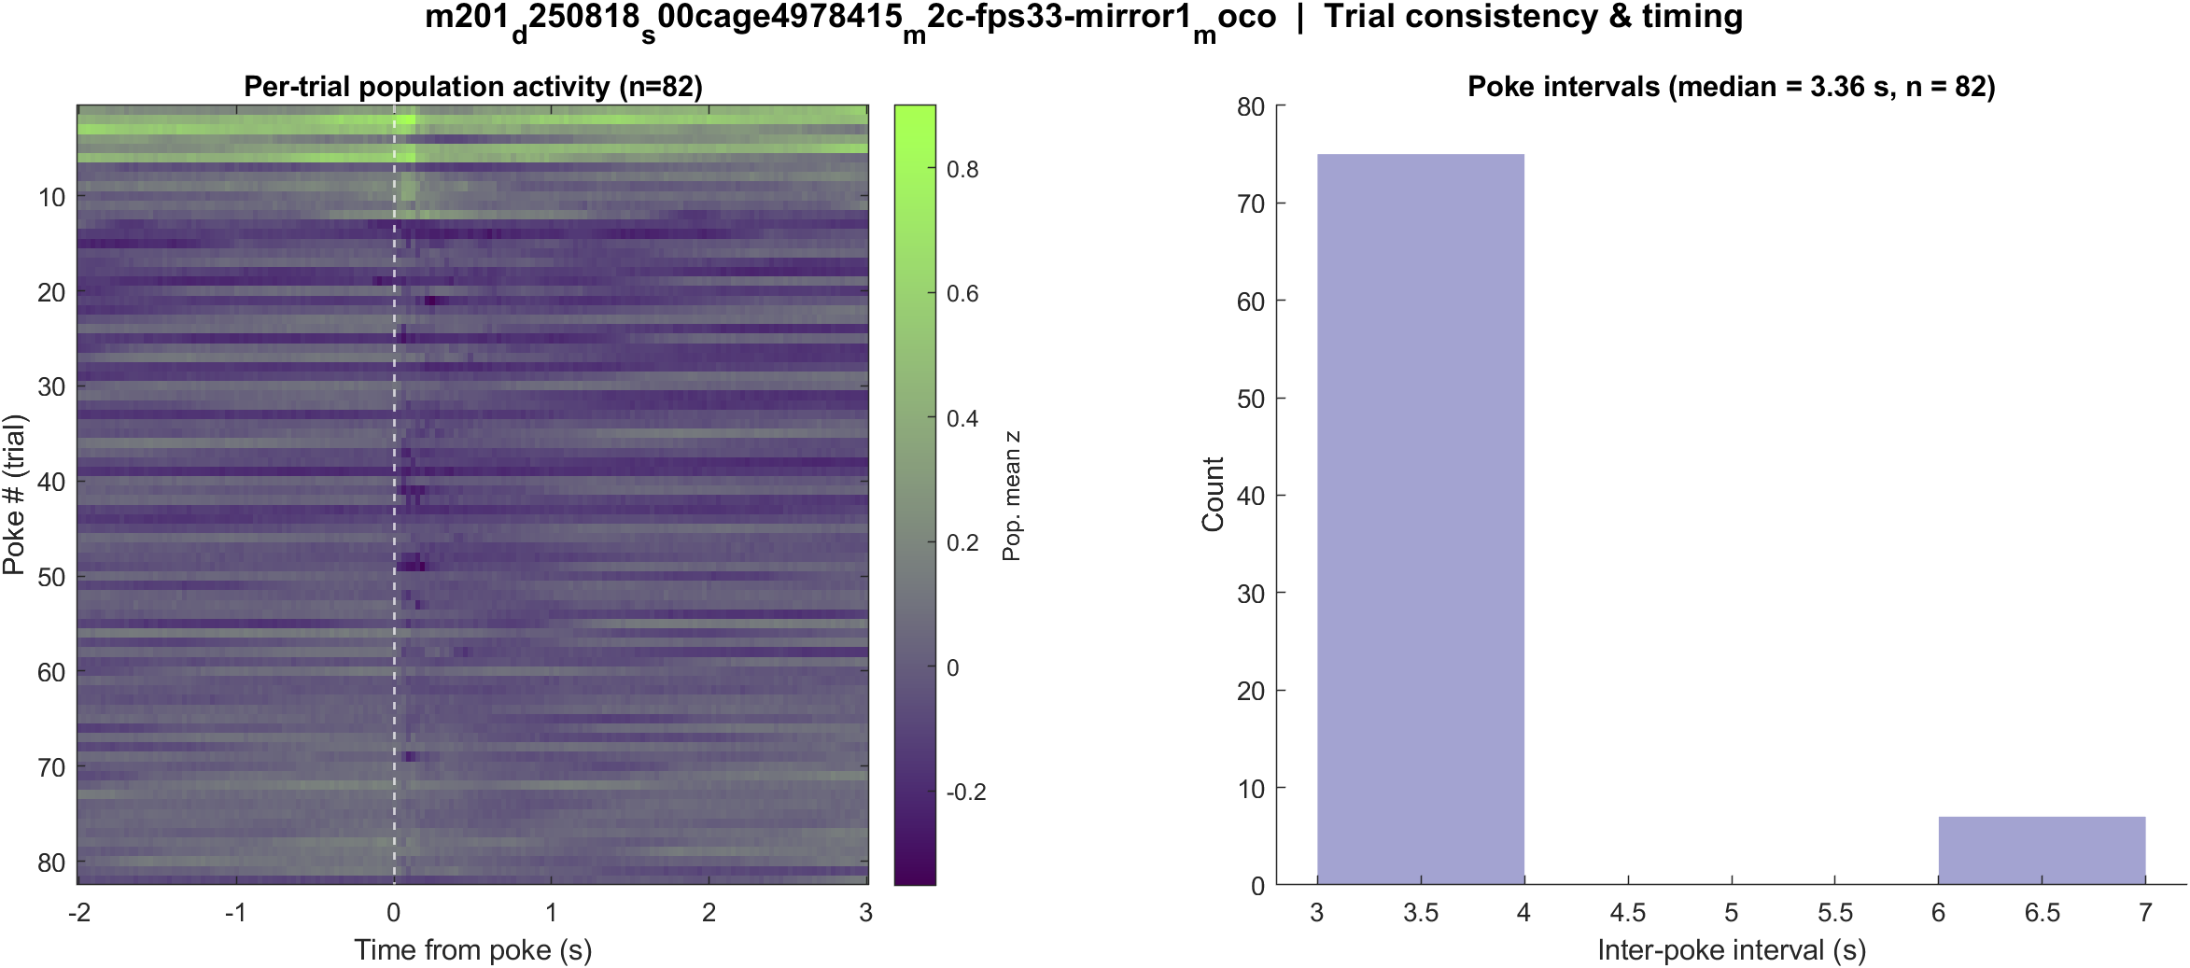
Fig5 Trial raster and poke interval | mouse2c (m201) s00 mirror1
What: One row per poke (population z over time) and the histogram of time between detected dips.
Result: 83 dips detected in this movie; median interval ~3.36 s. Long gaps are missed dips.

Slide 27
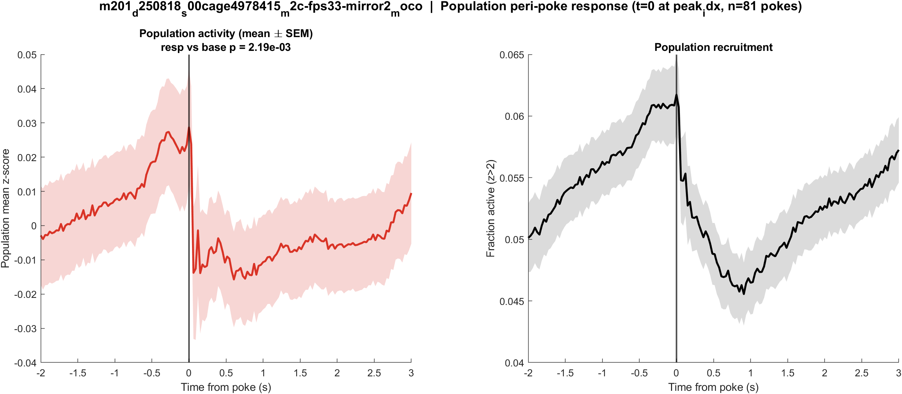
Fig1 Population PSTH | mouse2c (m201) s00 mirror2
What: Mean population activity (z-score) and fraction of active cells, aligned to each poke (t = 0 is the intensity dip).
Result: This FOV has 2767 neurons and 83 detected dips; the population pre vs post test is significant (p = 0.002).

Slide 28
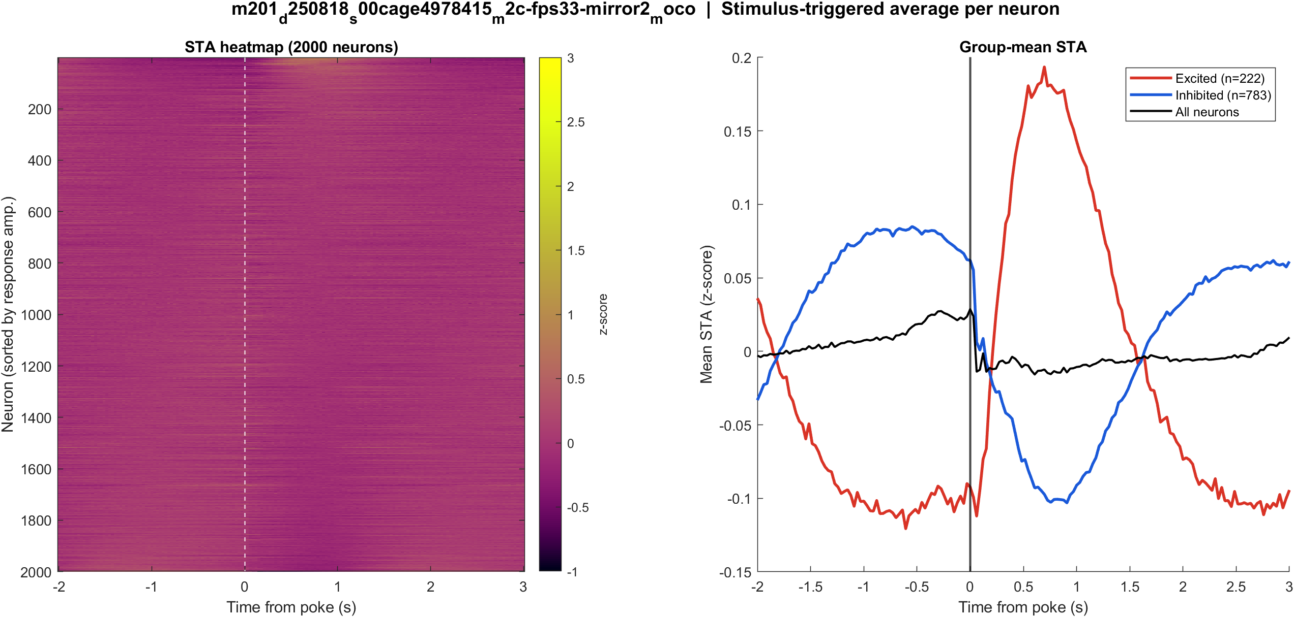
Fig2 Neuron STA | mouse2c (m201) s00 mirror2
What: Each neuron's average trace around the poke, sorted by response size; right panel is the mean of excited vs inhibited cells.
Result: Excited 8.0% and inhibited 28.3% of 2767 neurons; see the STA split on the right.

Slide 29

Fig3 Excited vs inhibited cells | mouse2c (m201) s00 mirror2
What: Per neuron: mean z in 0.4–1.2 s after t=0 vs -2–0 s before; signed-rank, p<0.05, sign of the difference.
Result: 8.0% excited, 28.3% inhibited out of 2767 neurons; population test significant (p = 0.002).

Slide 30

Fig4 Spatial poke-response map (aligned) | mouse2c (m201) s00 mirror2
What: Significant cells on each FOV after aligning anterior to the right (mirror2 flipped). Red = excited, blue = inhibited. P = posterior, A = anterior.
Result: Red = excited, blue = inhibited on this FOV (8.0% exc, 28.3% inh of 2767 neurons). P left, A right.

Slide 31
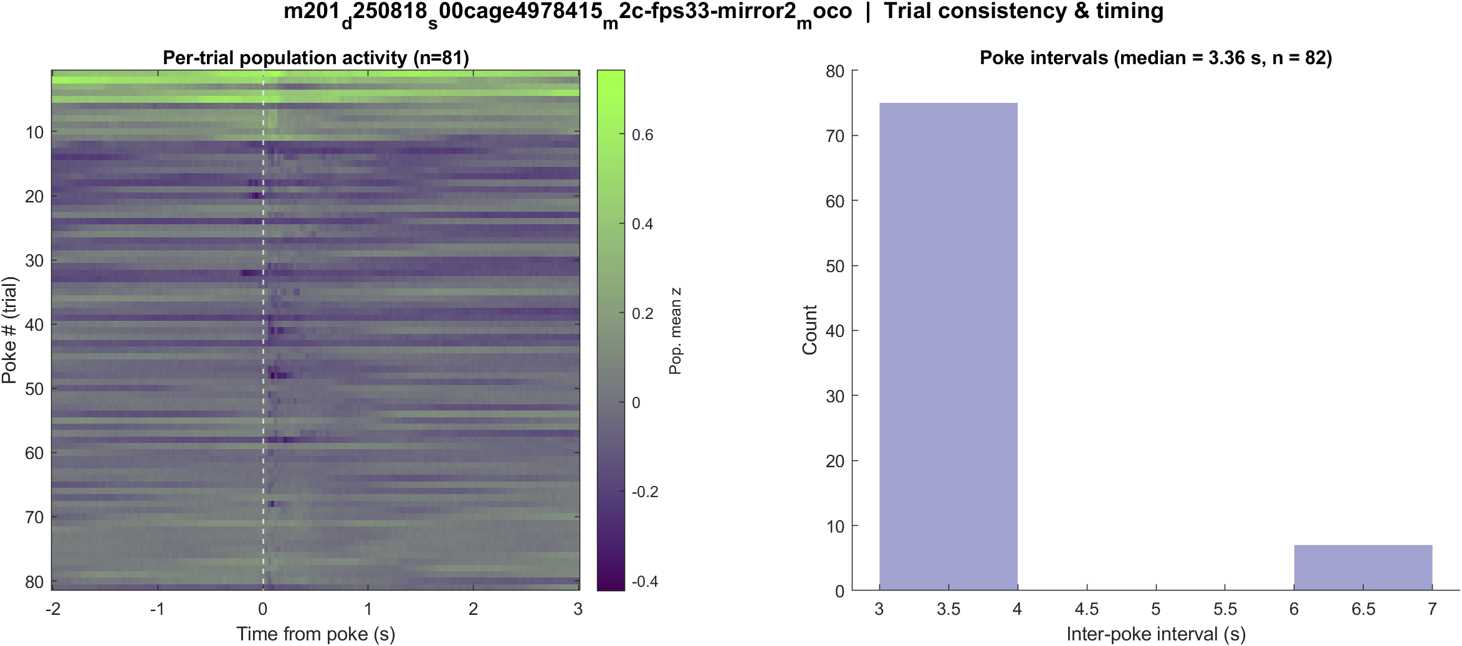
Fig5 Trial raster and poke interval | mouse2c (m201) s00 mirror2
What: One row per poke (population z over time) and the histogram of time between detected dips.
Result: 83 dips detected in this movie; median interval ~3.36 s. Long gaps are missed dips.

Slide 32
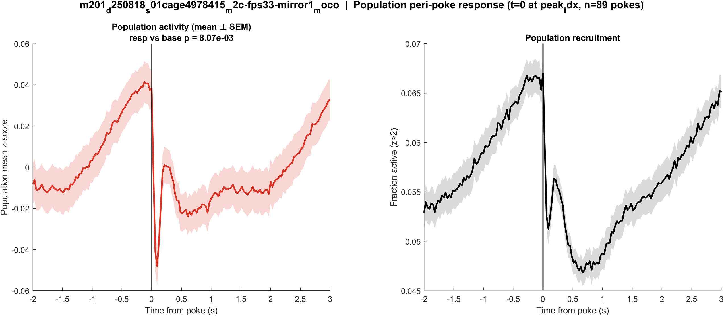
Fig1 Population PSTH | mouse2c (m201) s01 mirror1
What: Mean population activity (z-score) and fraction of active cells, aligned to each poke (t = 0 is the intensity dip).
Result: This FOV has 1557 neurons and 90 detected dips; the population pre vs post test is significant (p = 0.008).

Slide 33
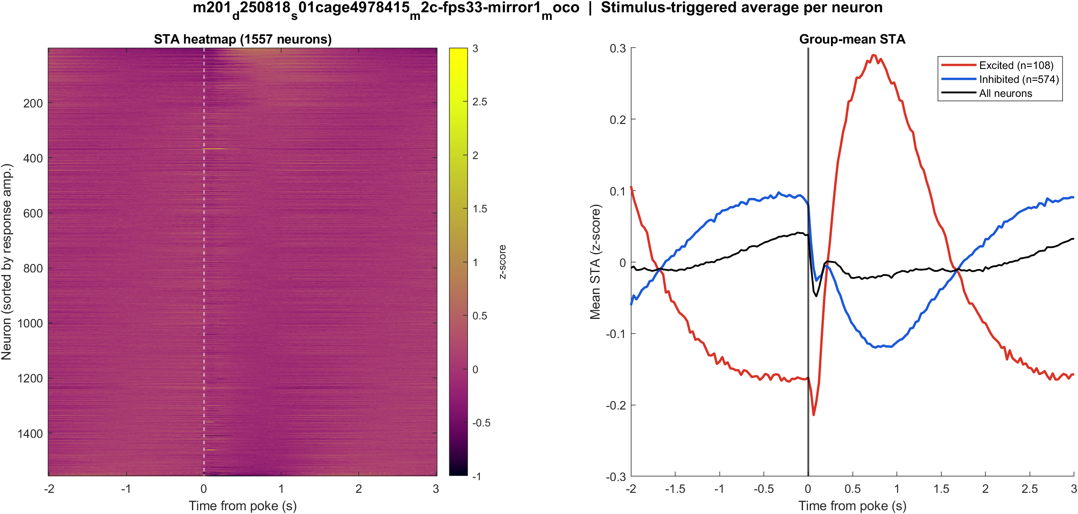
Fig2 Neuron STA | mouse2c (m201) s01 mirror1
What: Each neuron's average trace around the poke, sorted by response size; right panel is the mean of excited vs inhibited cells.
Result: Excited 6.9% and inhibited 36.9% of 1557 neurons; see the STA split on the right.

Slide 34
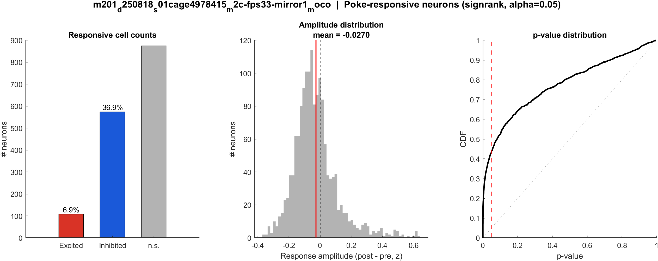
Fig3 Excited vs inhibited cells | mouse2c (m201) s01 mirror1
What: Per neuron: mean z in 0.4–1.2 s after t=0 vs -2–0 s before; signed-rank, p<0.05, sign of the difference.
Result: 6.9% excited, 36.9% inhibited out of 1557 neurons; population test significant (p = 0.008).

Slide 35

Fig4 Spatial poke-response map (aligned) | mouse2c (m201) s01 mirror1
What: Significant cells on each FOV after aligning anterior to the right (mirror2 flipped). Red = excited, blue = inhibited. P = posterior, A = anterior.
Result: Red = excited, blue = inhibited on this FOV (6.9% exc, 36.9% inh of 1557 neurons). P left, A right.

Slide 36
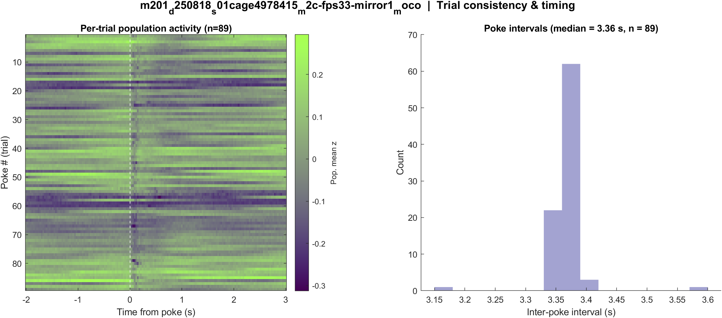
Fig5 Trial raster and poke interval | mouse2c (m201) s01 mirror1
What: One row per poke (population z over time) and the histogram of time between detected dips.
Result: 90 dips detected in this movie; median interval ~3.36 s. Long gaps are missed dips.

Slide 37
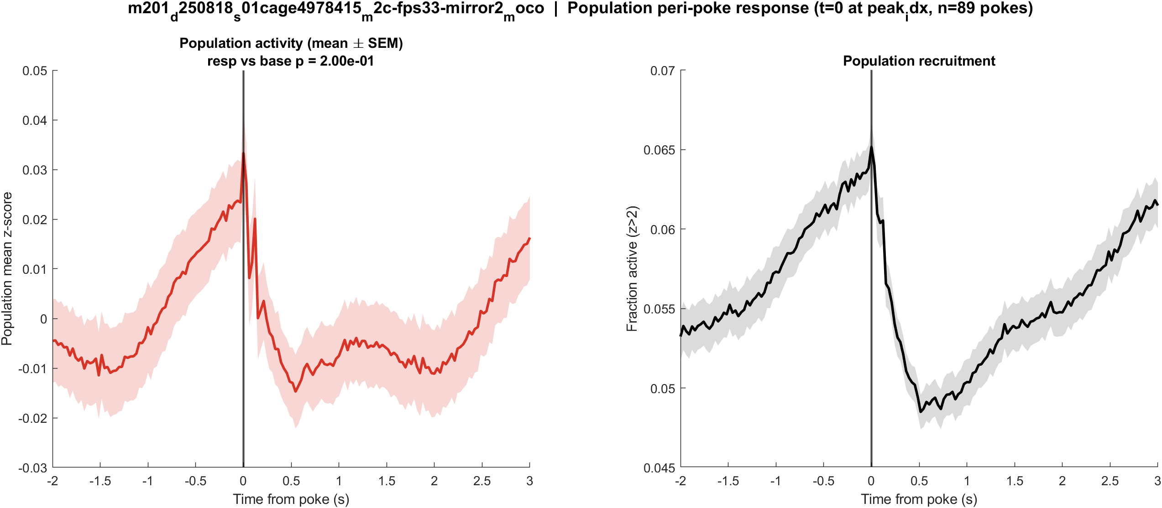
Fig1 Population PSTH | mouse2c (m201) s01 mirror2
What: Mean population activity (z-score) and fraction of active cells, aligned to each poke (t = 0 is the intensity dip).
Result: This FOV has 2524 neurons and 91 detected dips; the population pre vs post test is not significant (p = 0.200).

Slide 38
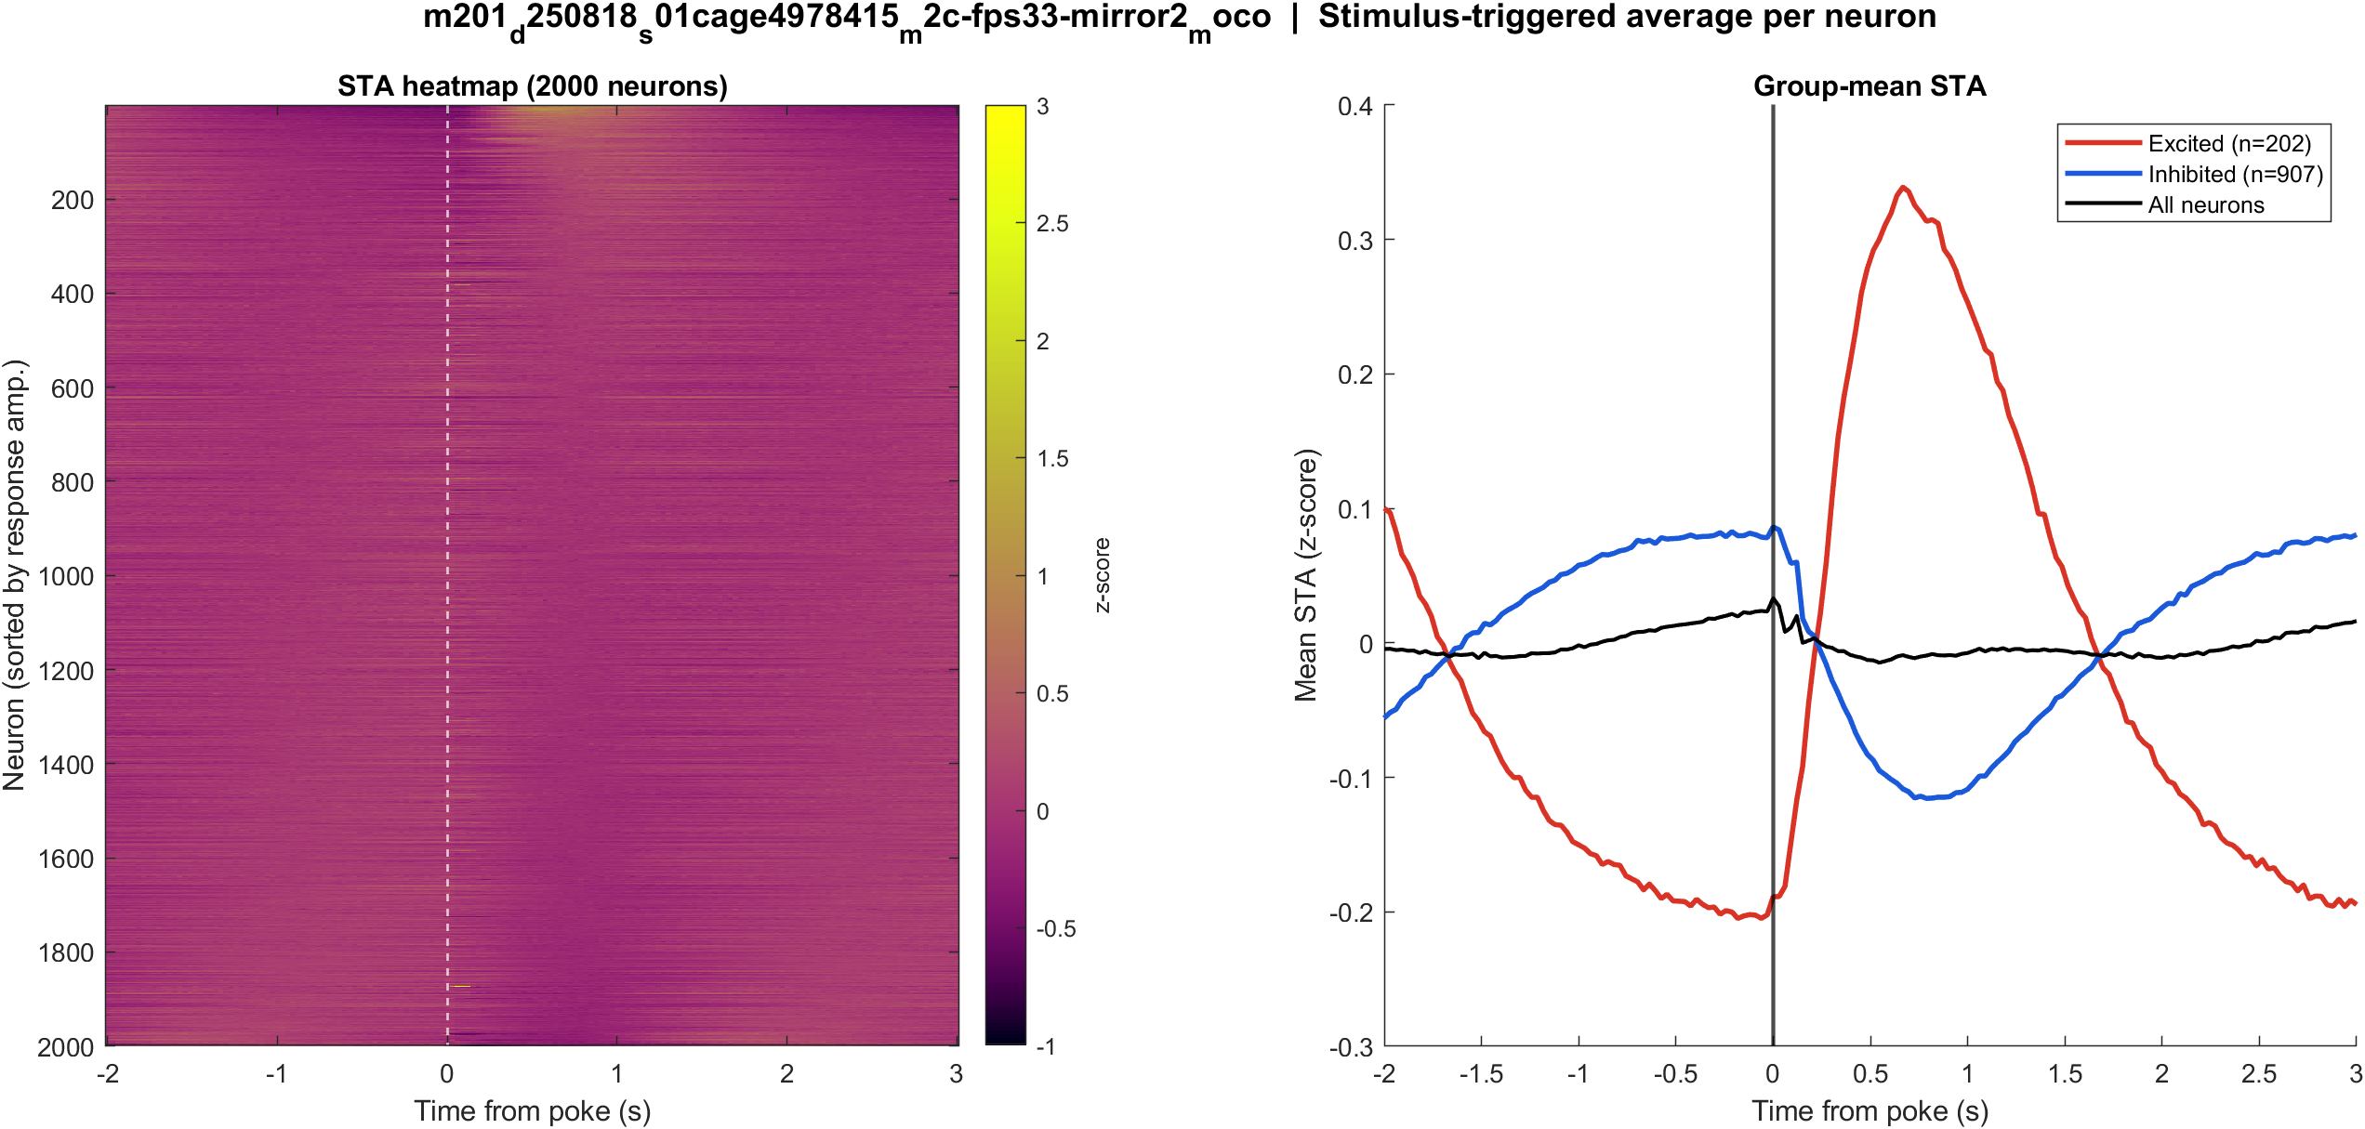
Fig2 Neuron STA | mouse2c (m201) s01 mirror2
What: Each neuron's average trace around the poke, sorted by response size; right panel is the mean of excited vs inhibited cells.
Result: Excited 8.0% and inhibited 35.9% of 2524 neurons; see the STA split on the right.

Slide 39
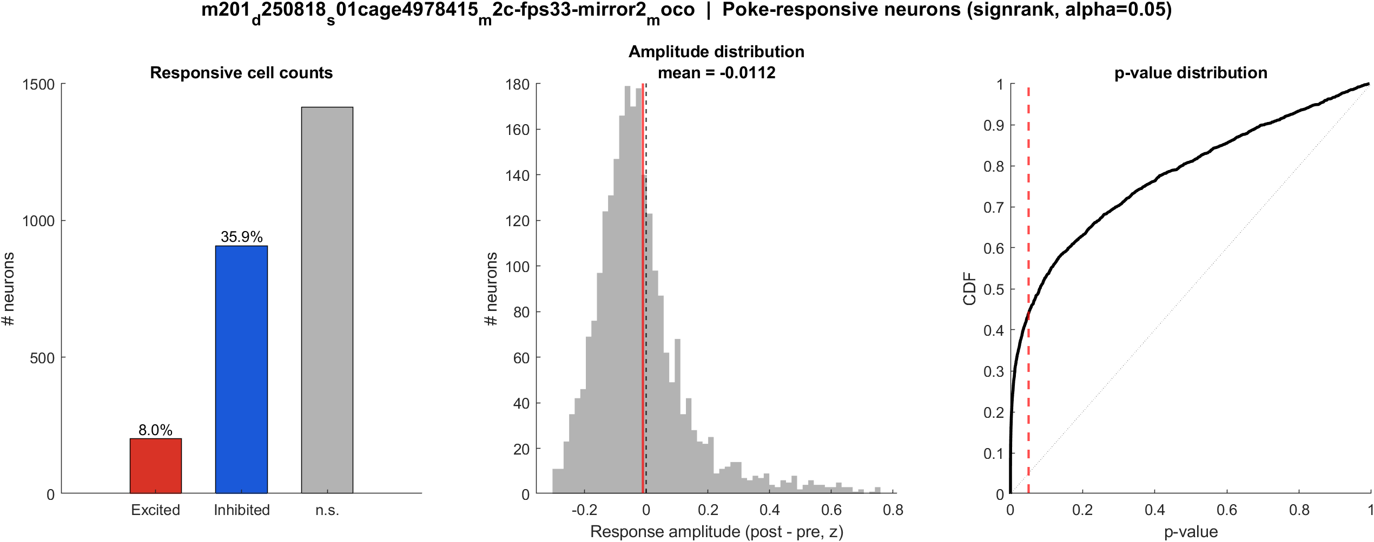
Fig3 Excited vs inhibited cells | mouse2c (m201) s01 mirror2
What: Per neuron: mean z in 0.4–1.2 s after t=0 vs -2–0 s before; signed-rank, p<0.05, sign of the difference.
Result: 8.0% excited, 35.9% inhibited out of 2524 neurons; population test not significant (p = 0.200).

Slide 40

Fig4 Spatial poke-response map (aligned) | mouse2c (m201) s01 mirror2
What: Significant cells on each FOV after aligning anterior to the right (mirror2 flipped). Red = excited, blue = inhibited. P = posterior, A = anterior.
Result: Red = excited, blue = inhibited on this FOV (8.0% exc, 35.9% inh of 2524 neurons). P left, A right.

Slide 41
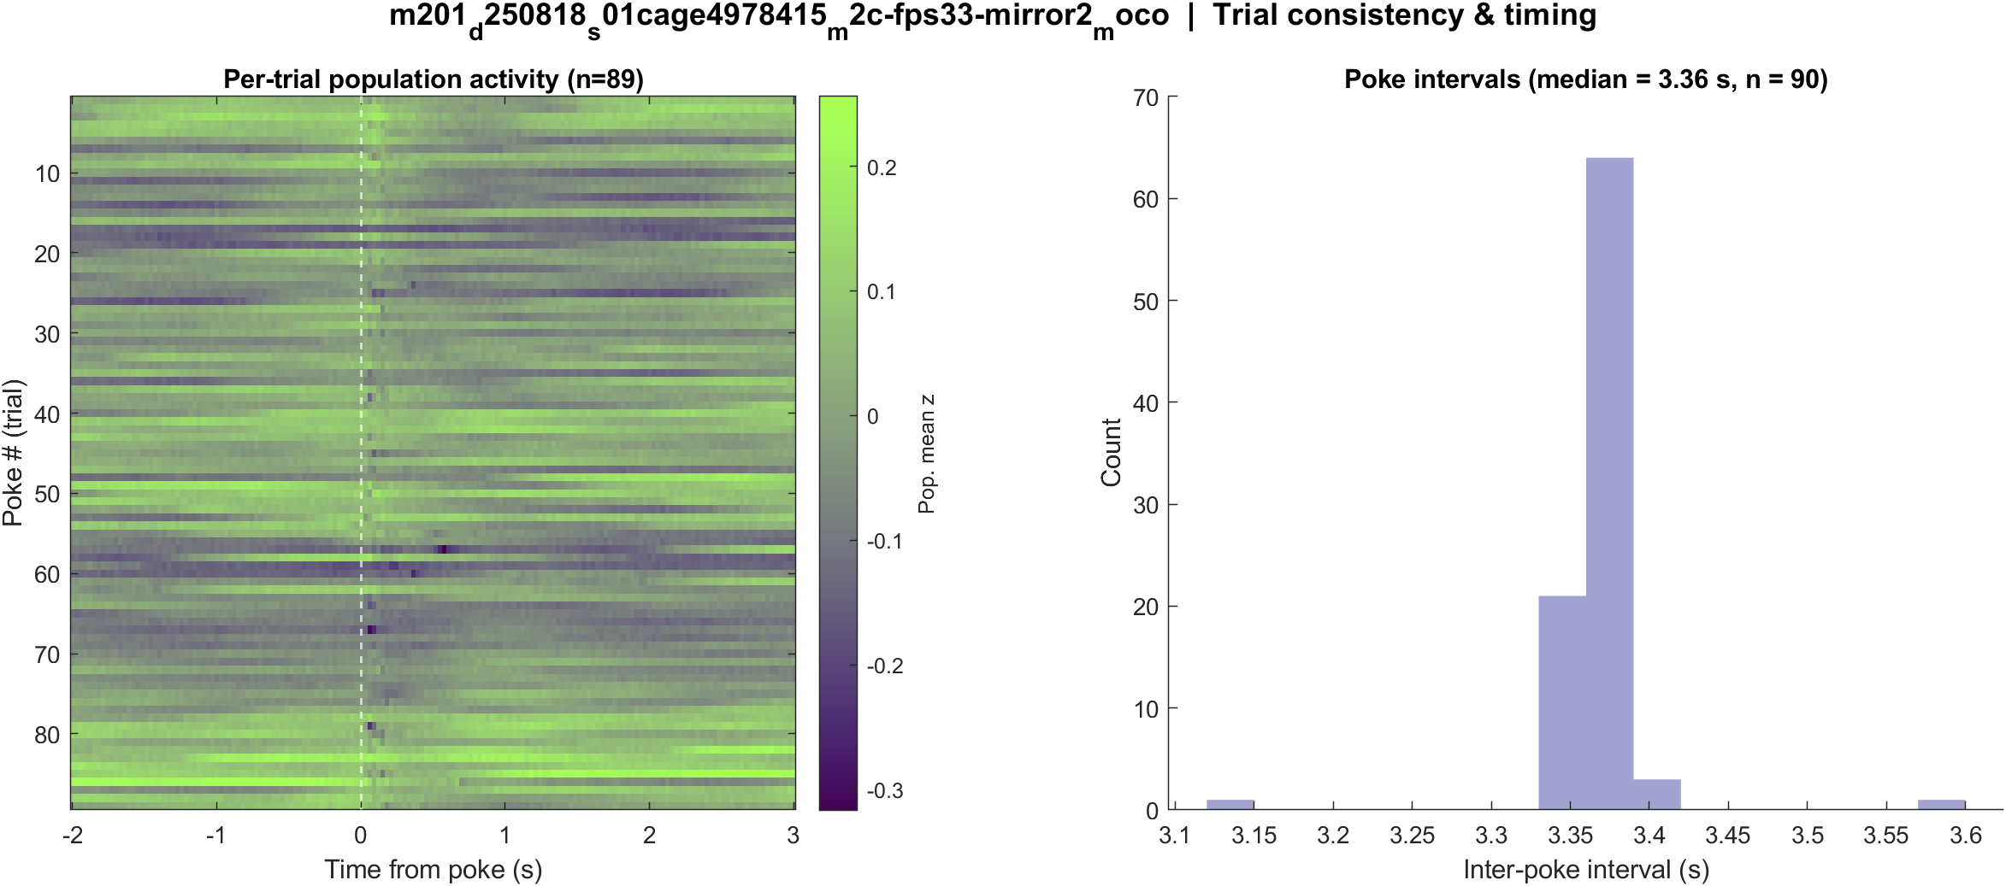
Fig5 Trial raster and poke interval | mouse2c (m201) s01 mirror2
What: One row per poke (population z over time) and the histogram of time between detected dips.
Result: 91 dips detected in this movie; median interval ~3.36 s. Long gaps are missed dips.

Slide 42
Next
Power for s00/s01 on this day is not labeled yet. Compare this dip-aligned deck with the 13 Aug peak_idx deck: same analysis, different t = 0 definition.

