Slide 1
Face poking on crystal skull
Pooled analysis | 18 movies, 43,156 neurons, 1,098 pokes | 13 Aug peak + 18 Aug dip
Take-home: pooling all movies, 14/18 are significant; 8.6% of cells are excited and 27.6% inhibited.

Slide 2
Experiment
Whole dorsal cortex Ca2+ imaging while a motor arm pokes the face. Both days are poking sessions (no no-poke baseline). m1f and m2c were imaged on both days; m3 only on 13 Aug. mirror1 / mirror2 are two optical paths.

Slide 3

Population peri-poke response (n = 18 recordings)
What: Each gray line is one recording. Red / black = mean \pm SEM across recordings. Peri-window -2 to +3 s around the poke.
Result: The mean trace is poke-locked: a transient at t = 0, a brief dip, then a rebound. Recordings share the same time course.

Slide 4

Poke-responsive cells (n = 18 recordings)
What: Left: mean STA of excited, inhibited, and all cells. Right: % of neurons in each recording (one dot = one recording). A cell is excited or inhibited if 0.4–1.2 s differs from -2–0 s (signed-rank, p<0.05).
Result: Mean 8.8% excited and 28.2% inhibited. The all-cell STA stays near zero because the two groups cancel. 14 of 18 recordings p<0.05.

Slide 5

Take-home: anterior excited, posterior inhibited
What: After aligning every FOV (P left, A right), compare cells in the back third vs the front third.
Result: In 18/18 recordings the front is more excited than the back (signrank p = 0.0002).

Slide 6
How traces and maps are made
EXTRACT temporal_weights at 33 Hz. Spatial maps use Omer's EXTRACT spatial_weights (footprints reconstructed from the ndSparse CSC in each *_ext.mat). Red = excited, blue = inhibited. mirror2 is flipped so anterior is on the RIGHT (P left, A right).

Slide 7
All 18 movies together
Equal-movie grand mean | 12 from 13 Aug + 6 from 18 Aug

Slide 8
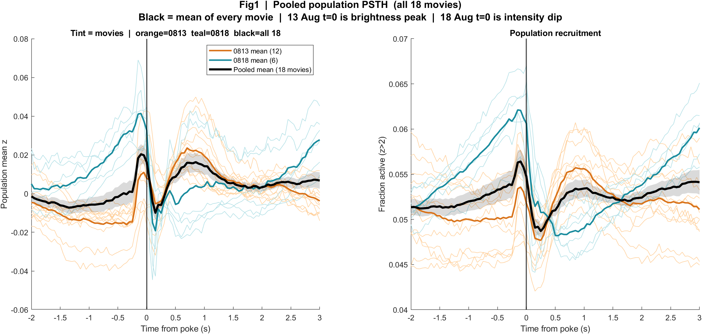
Pooled Fig1 | Average trace of all 18 movies
What: Gray/tint = each movie. Orange = 13 Aug mean. Teal = 18 Aug mean. Black = mean of all 18.
Result: The pooled black line has a small peak near t=0, a dip, and a rebound. That shape is a blend: 13 Aug locks to the peak, 18 Aug rises before the dip. It is not a third biological condition.

Slide 9
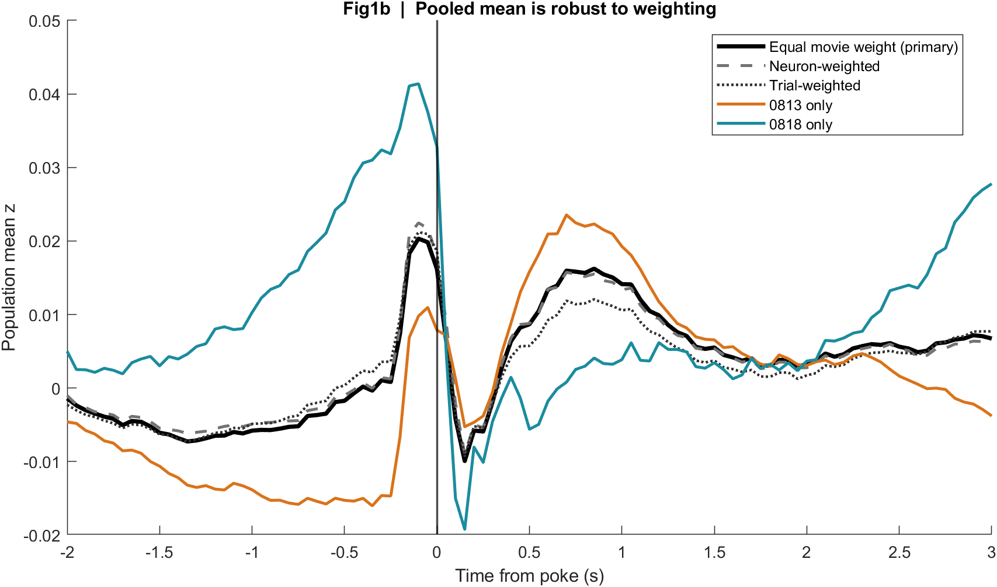
Pooled Fig1b | Weighting check
What: Same 18 movies averaged with equal movie weight, neuron weight, or trial weight.
Result: The three pooled curves sit on top of each other. The grand mean is not an artifact of one large movie.

Slide 10
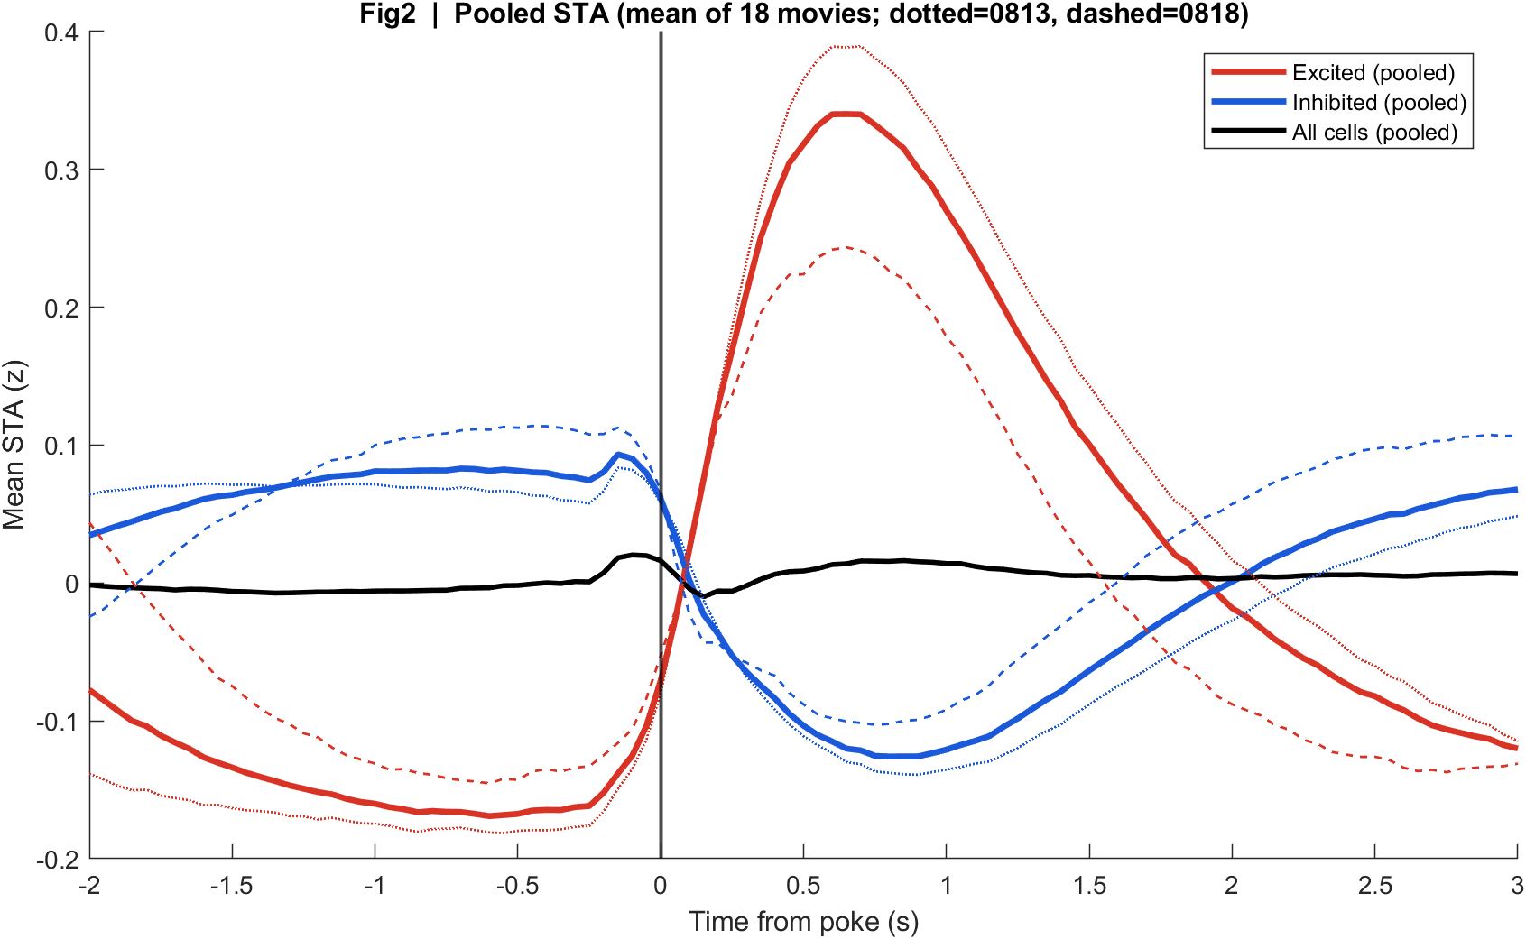
Pooled Fig2 | Average STA of all 18 movies
What: Mean of per-movie excited / inhibited / all-cell STAs. Dotted = 13 Aug, dashed = 18 Aug.
Result: Pooled excited cells rise after t=0; pooled inhibited cells fall. All-cells (black) stay near zero because the groups cancel.

Slide 11
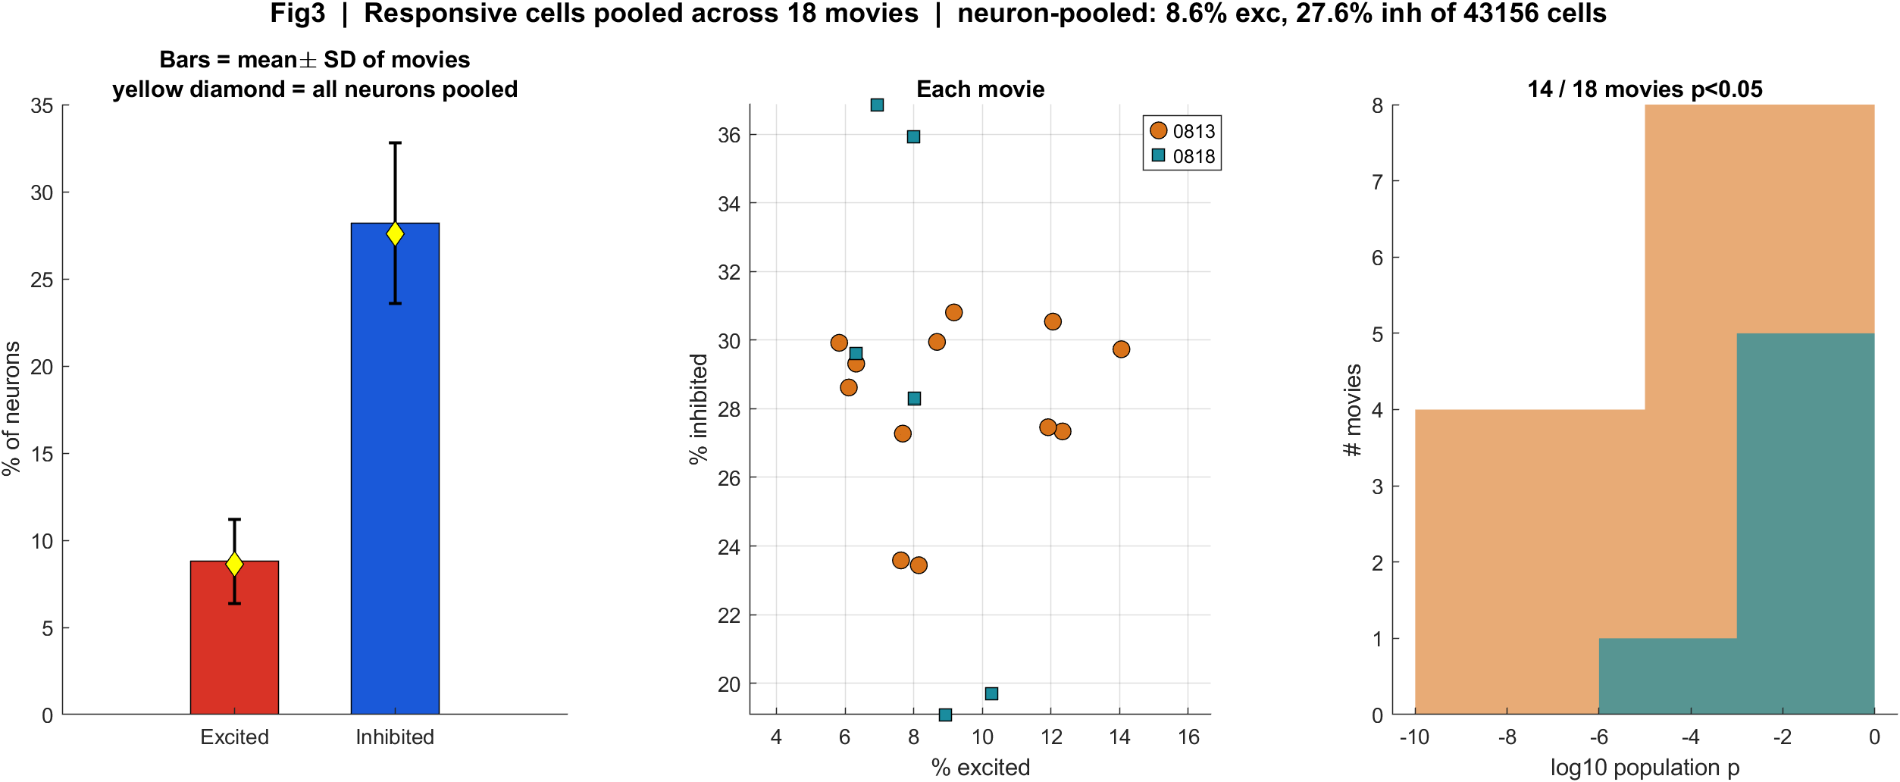
Pooled Fig3 | All cells from all movies
What: Bars = mean ± SD across 18 movies. Yellow diamond = all 43,156 neurons pooled. Orange circles = 13 Aug, teal squares = 18 Aug.
Result: Movie-mean 8.8% exc / 28.2% inh; neuron-pooled 8.6% / 27.6%. 14/18 movies p<0.05.

Slide 12

Pooled Fig4 | All FOVs (cannot pixel-average)
What: Aligned EXTRACT footprint maps for every recording in the pool. P left, A right.
Result: The repeating pattern is mixed red/blue with anterior more excited. There is no single average cortex image because FOVs are not registered.

Slide 13
The same numbers, split by day
Because t = 0 is not the same physical marker

Slide 14
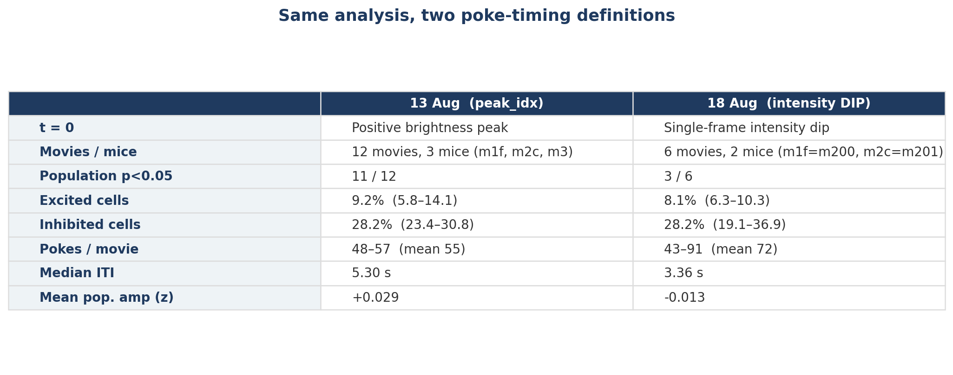
Numbers at a glance
What: Same cell-classification windows on both days. 18 Aug has fewer movies, a shorter ITI, and a dip-based t = 0.
Result: Population lock is tighter on 13 Aug (11/12 movies) than 18 Aug (3/6), but the exc < inh split is the same direction both days.

Slide 15
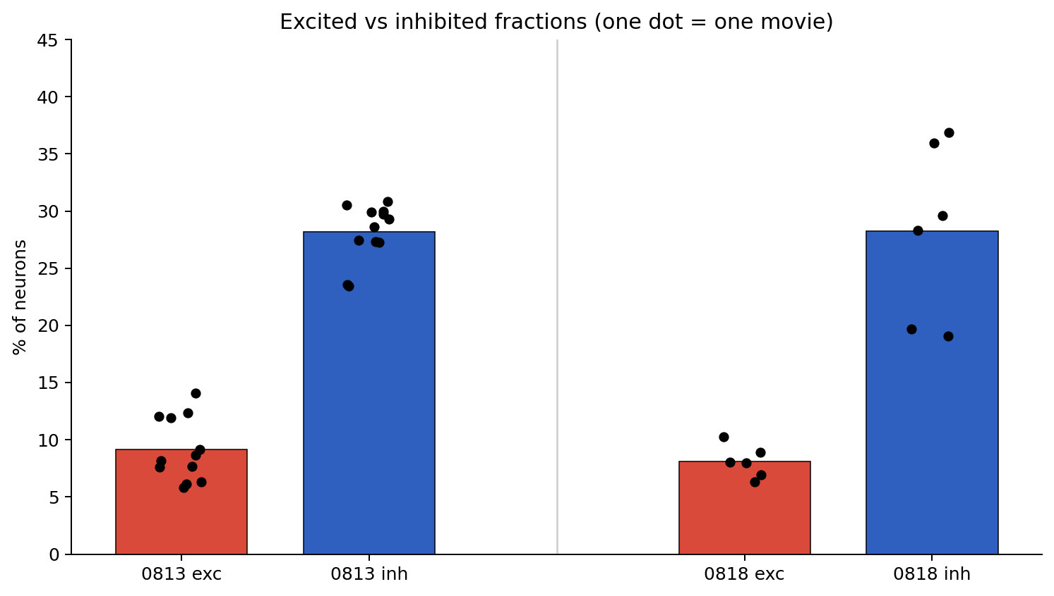
Excited vs inhibited fractions
What: Each black dot is one movie. Red bars = mean % excited; blue bars = mean % inhibited.
Result: Inhibition dominates on both days (~6–14% excited vs ~19–37% inhibited). 18 Aug m201 is especially inhibition-heavy.

Slide 16

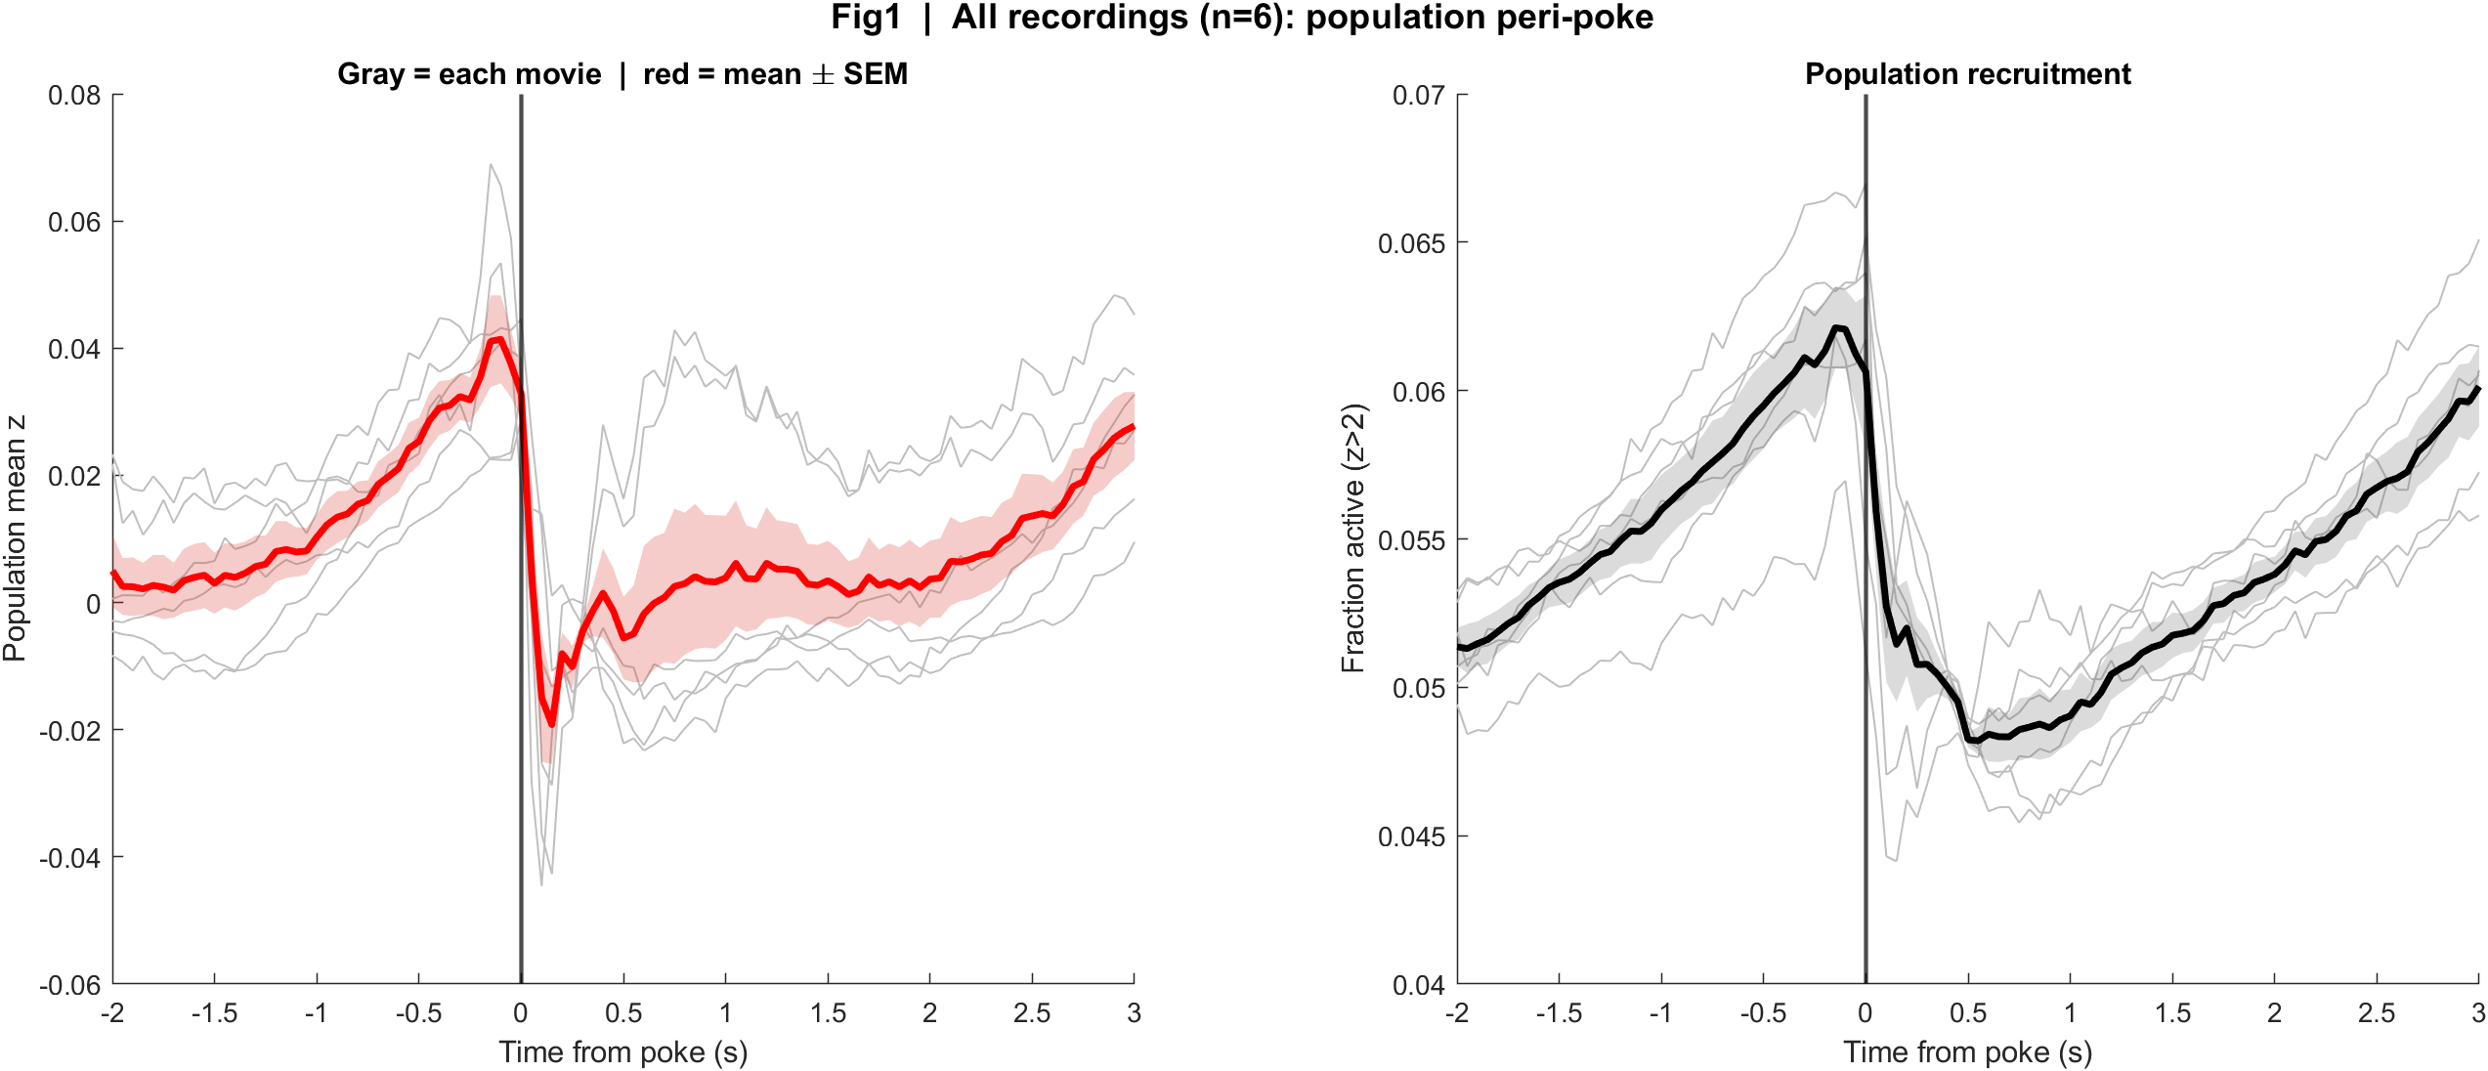
Fig1 Population PSTH
What: Mean population z and fraction active, aligned to each poke.
Result: 13 Aug: sharp transient at t=0, dip, rebound ~0.8 s. 18 Aug: activity already rising before t=0, then a crash at the dip.
13 Aug | t = 0 is the brightness peak
18 Aug | t = 0 is the intensity dip

Slide 17

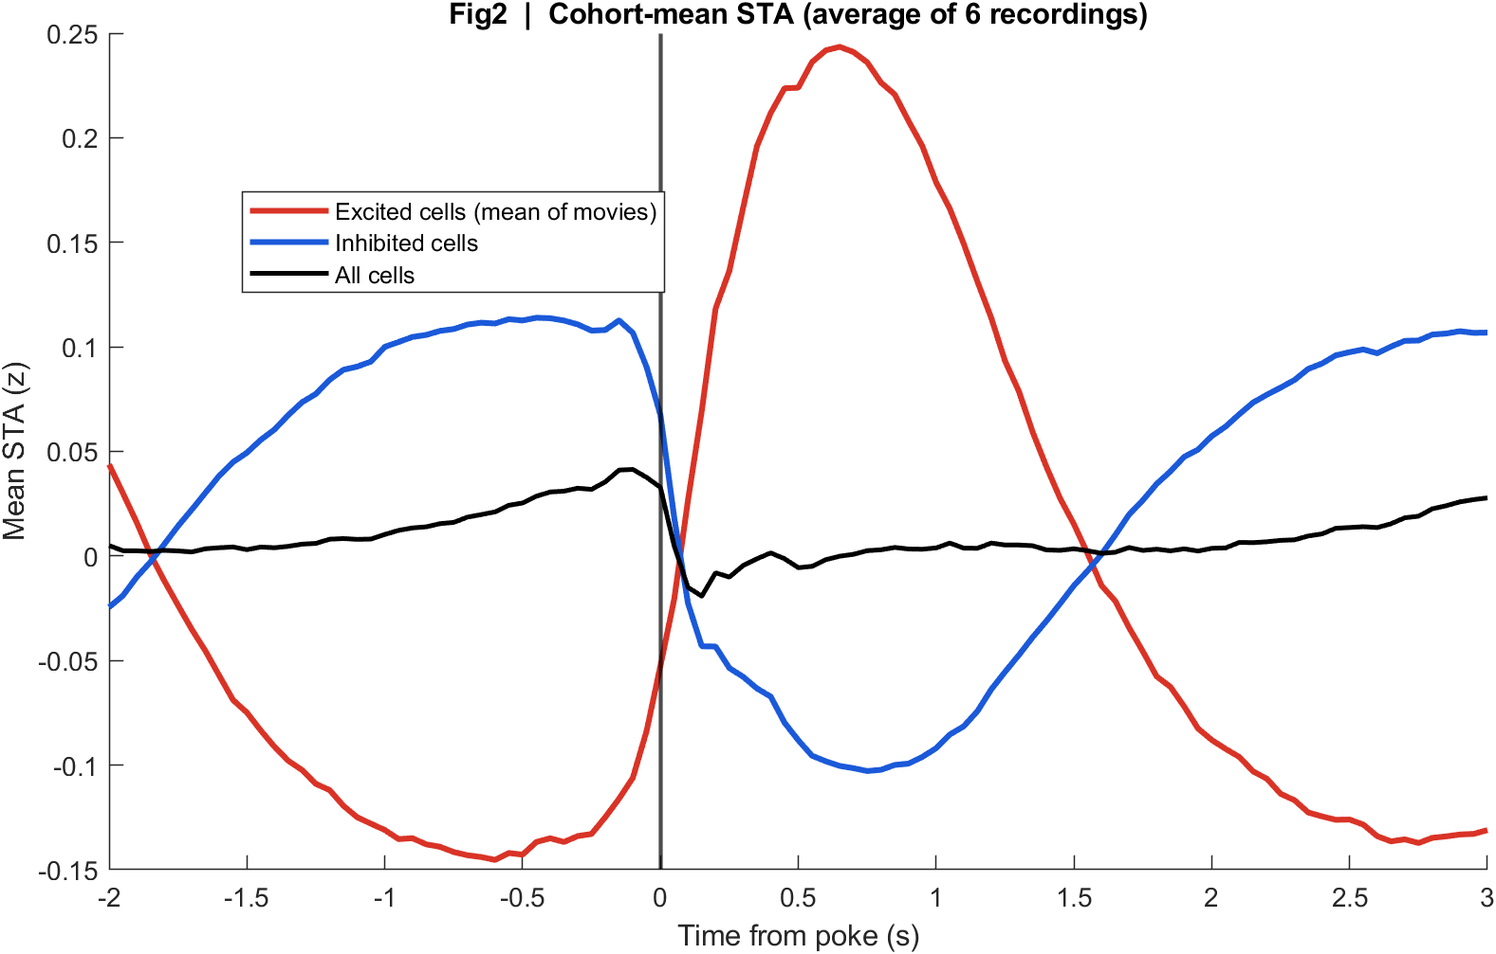
Fig2 Neuron STA
What: Cohort-mean stimulus-triggered averages of excited, inhibited, and all cells.
Result: Both days split into an up group and a down group. The all-cell mean is modest because they cancel — more completely on 18 Aug.
13 Aug
18 Aug

Slide 18

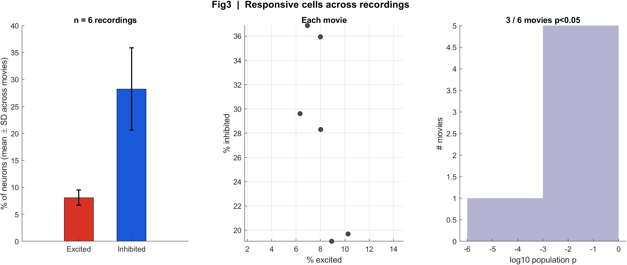
Fig3 Excited vs inhibited cells
What: Per neuron: 0.4–1.2 s after t=0 vs -2–0 s before; signed-rank p<0.05.
Result: 13 Aug: 11/12 movies significant. 18 Aug: 3/6 (both m201 s00, plus m201 s01 mirror1). m200 on 18 Aug is not significant (missed dips).
13 Aug
18 Aug

Slide 19
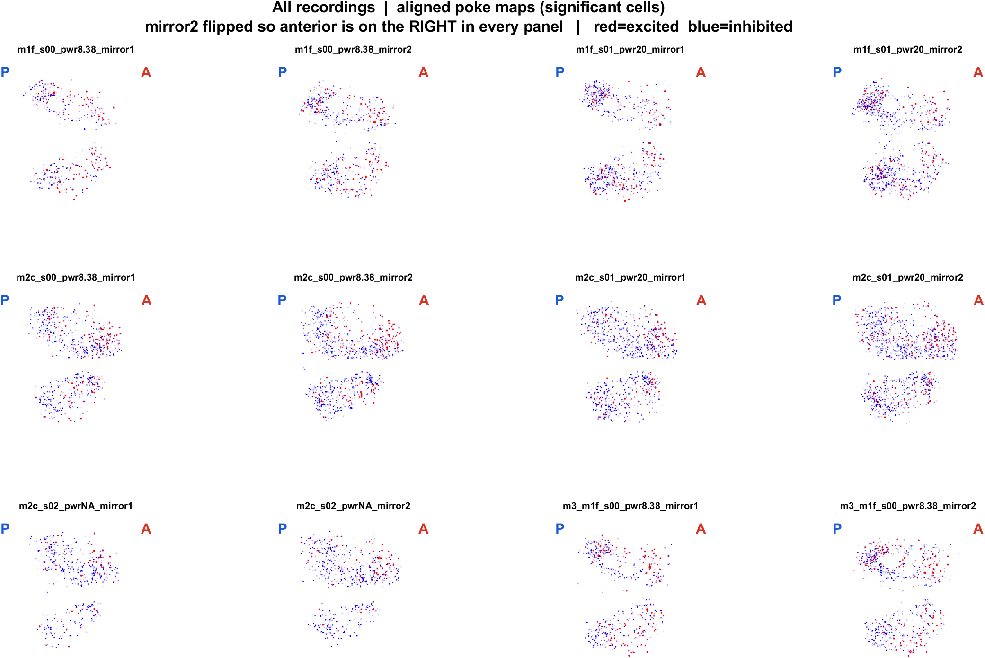
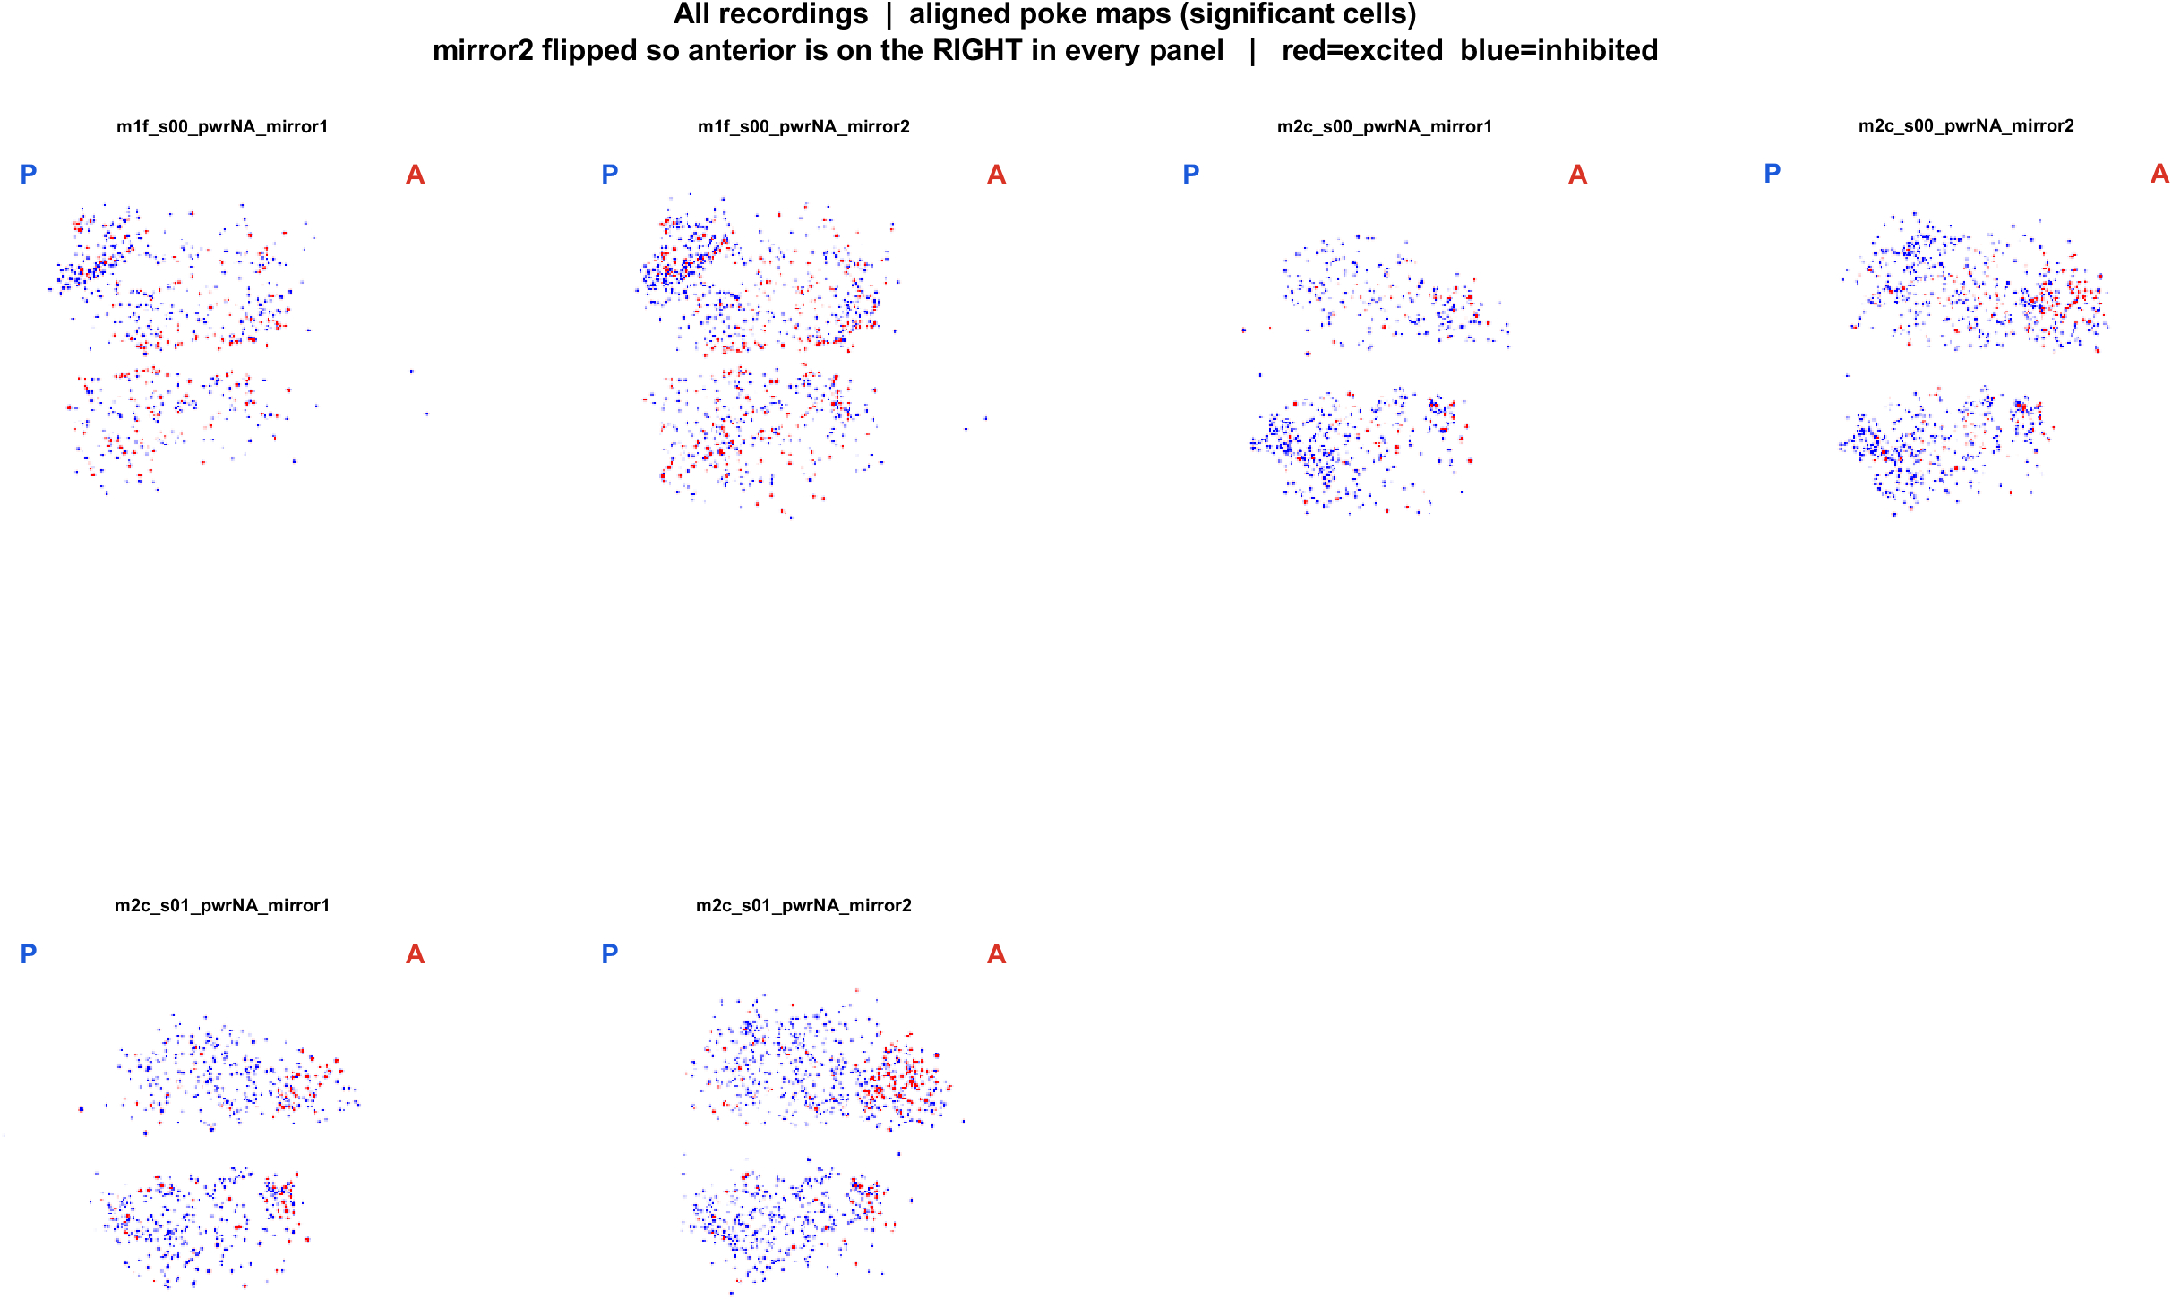
Fig4 Spatial maps (aligned, significant cells)
What: EXTRACT footprints x poke amplitude. mirror2 flipped. P = posterior (left), A = anterior (right).
Result: Cells are locally intermingled on both days. After the same AP alignment, anterior tends to be more excited and posterior more inhibited.
13 Aug | 12 FOVs
18 Aug | 6 FOVs

Slide 20

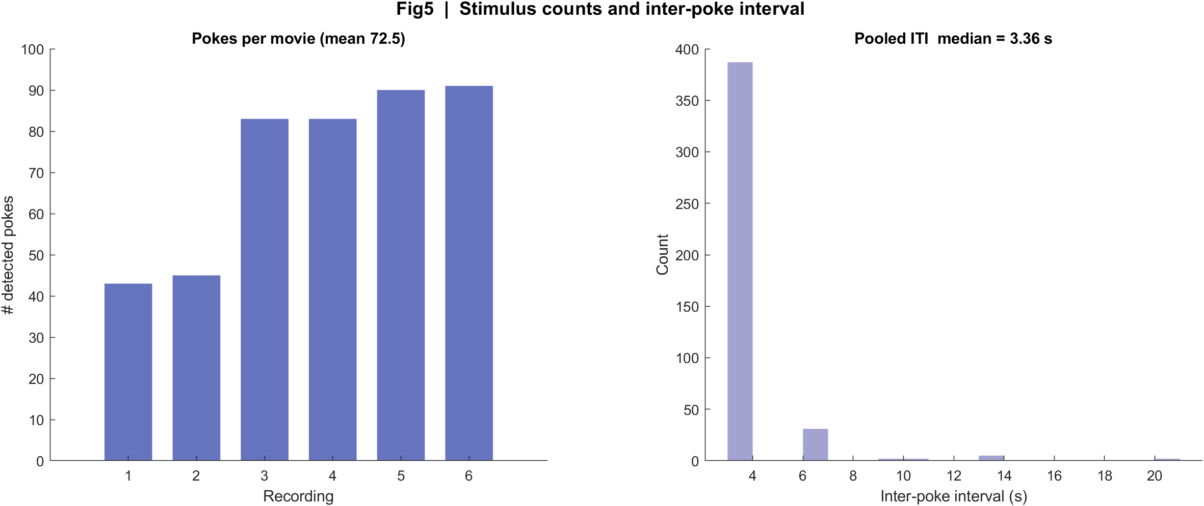
Fig5 Poke counts and interval
What: Detected events per movie and the histogram of time between events.
Result: 13 Aug median ITI 5.30 s (~48–57 pokes). 18 Aug median 3.36 s; m201 is dense (~83–91), m200 has ~20 s gaps from missed dips.
13 Aug
18 Aug

Slide 21
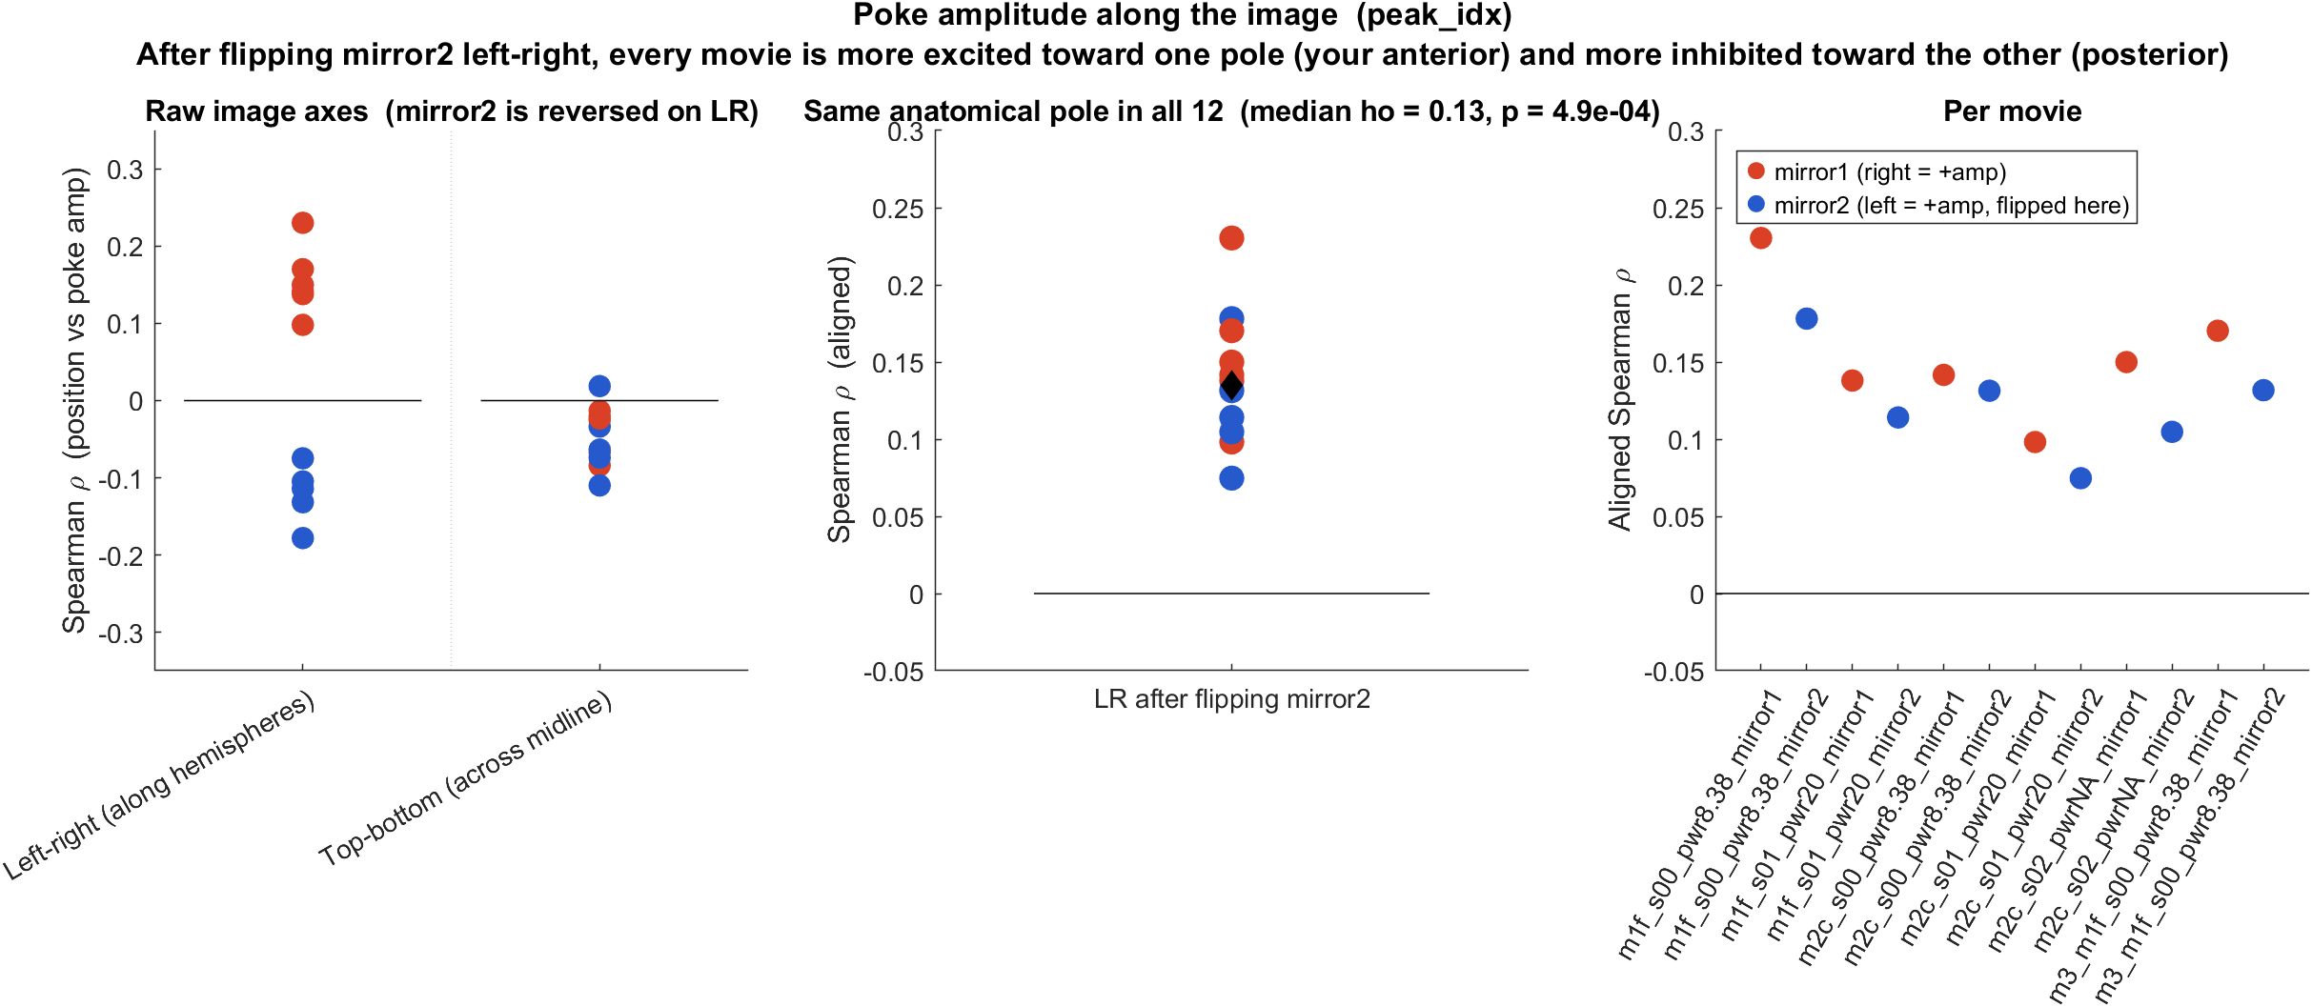
Anterior–posterior bias | 13 Aug
What: Spearman ρ between each cell's LR position and poke amplitude. After flipping mirror2, anterior is to the right in every movie.
Result: 12/12 movies ρ > 0 (median 0.13, signrank p = 4.9e-4): anterior more excited, posterior more inhibited. Not a CCF registration — AP is the LR axis along the hemispheres.

Slide 22
Interpretation
• Pooled across 18 movies / 43,156 cells: 8.6% excited, 27.6% inhibited, 14/18 movies significant. This is the combined biology.
• The pooled black PSTH is the average of two clocks (peak vs dip). Read orange vs teal to see timing; read the yellow-diamond cell counts to see the shared exc/inh split.
• All-cell STA near zero is cancellation, not absence of a poke response. Excited and inhibited groups are both locked; they have opposite sign.
• FOVs cannot be averaged. The pooled spatial result is that the same mixed AP pattern appears in the full set of 18 maps.
• Skin-contact time is still not proven. Do not treat the pooled t=0 as a single physical onset.

