Slide 1
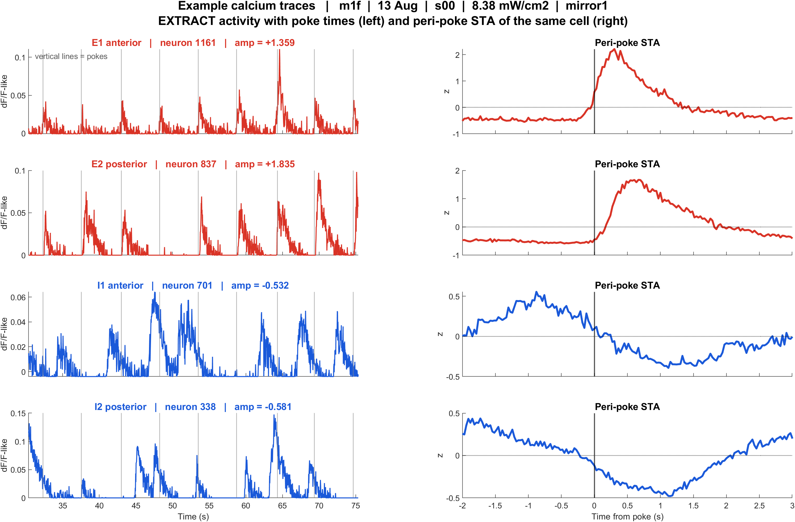
Example calcium traces | one recording, four neurons
What: m1f, 13 Aug, s00, 8.38 mW/cm2, mirror1. Left: EXTRACT traces with poke times. Right: peri-poke STA of the same cell.
Result: Excited cells (E1, E2) rise after each poke. Inhibited cells (I1, I2) dip. Same transient / dip shape as the population mean, but at the single-cell level.

Slide 2
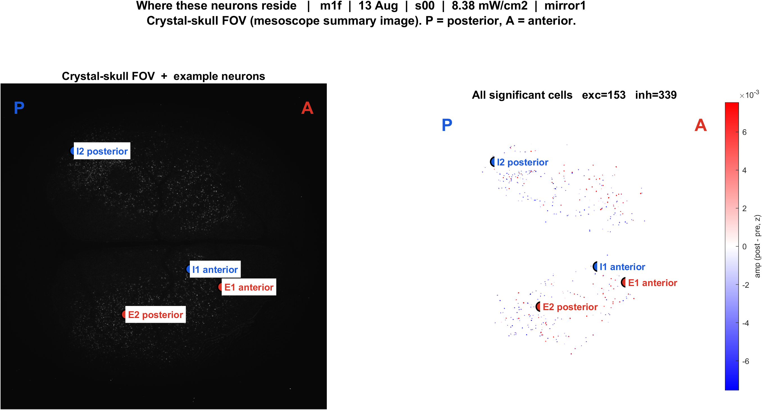
Where these neurons reside | crystal-skull FOV
What: Same four cells on the mesoscope summary image (left) and on all significant EXTRACT footprints (right). P = posterior, A = anterior. FOVs are not CCF-registered.
Result: E1/I1 are more anterior; E2/I2 are more posterior. Excited and inhibited cells are intermingled locally inside one crystal-skull field.

