Slide 1
Example neurons from each recording
13 Aug | 12 movies | 2 excited + 2 inhibited cells per FOV
For each recording: strongest significant excited cell in the anterior half and posterior half, and the same for inhibited cells. Traces are EXTRACT activity with poke times. Maps show those cells on the crystal-skull FOV (P left, A right).

Slide 2
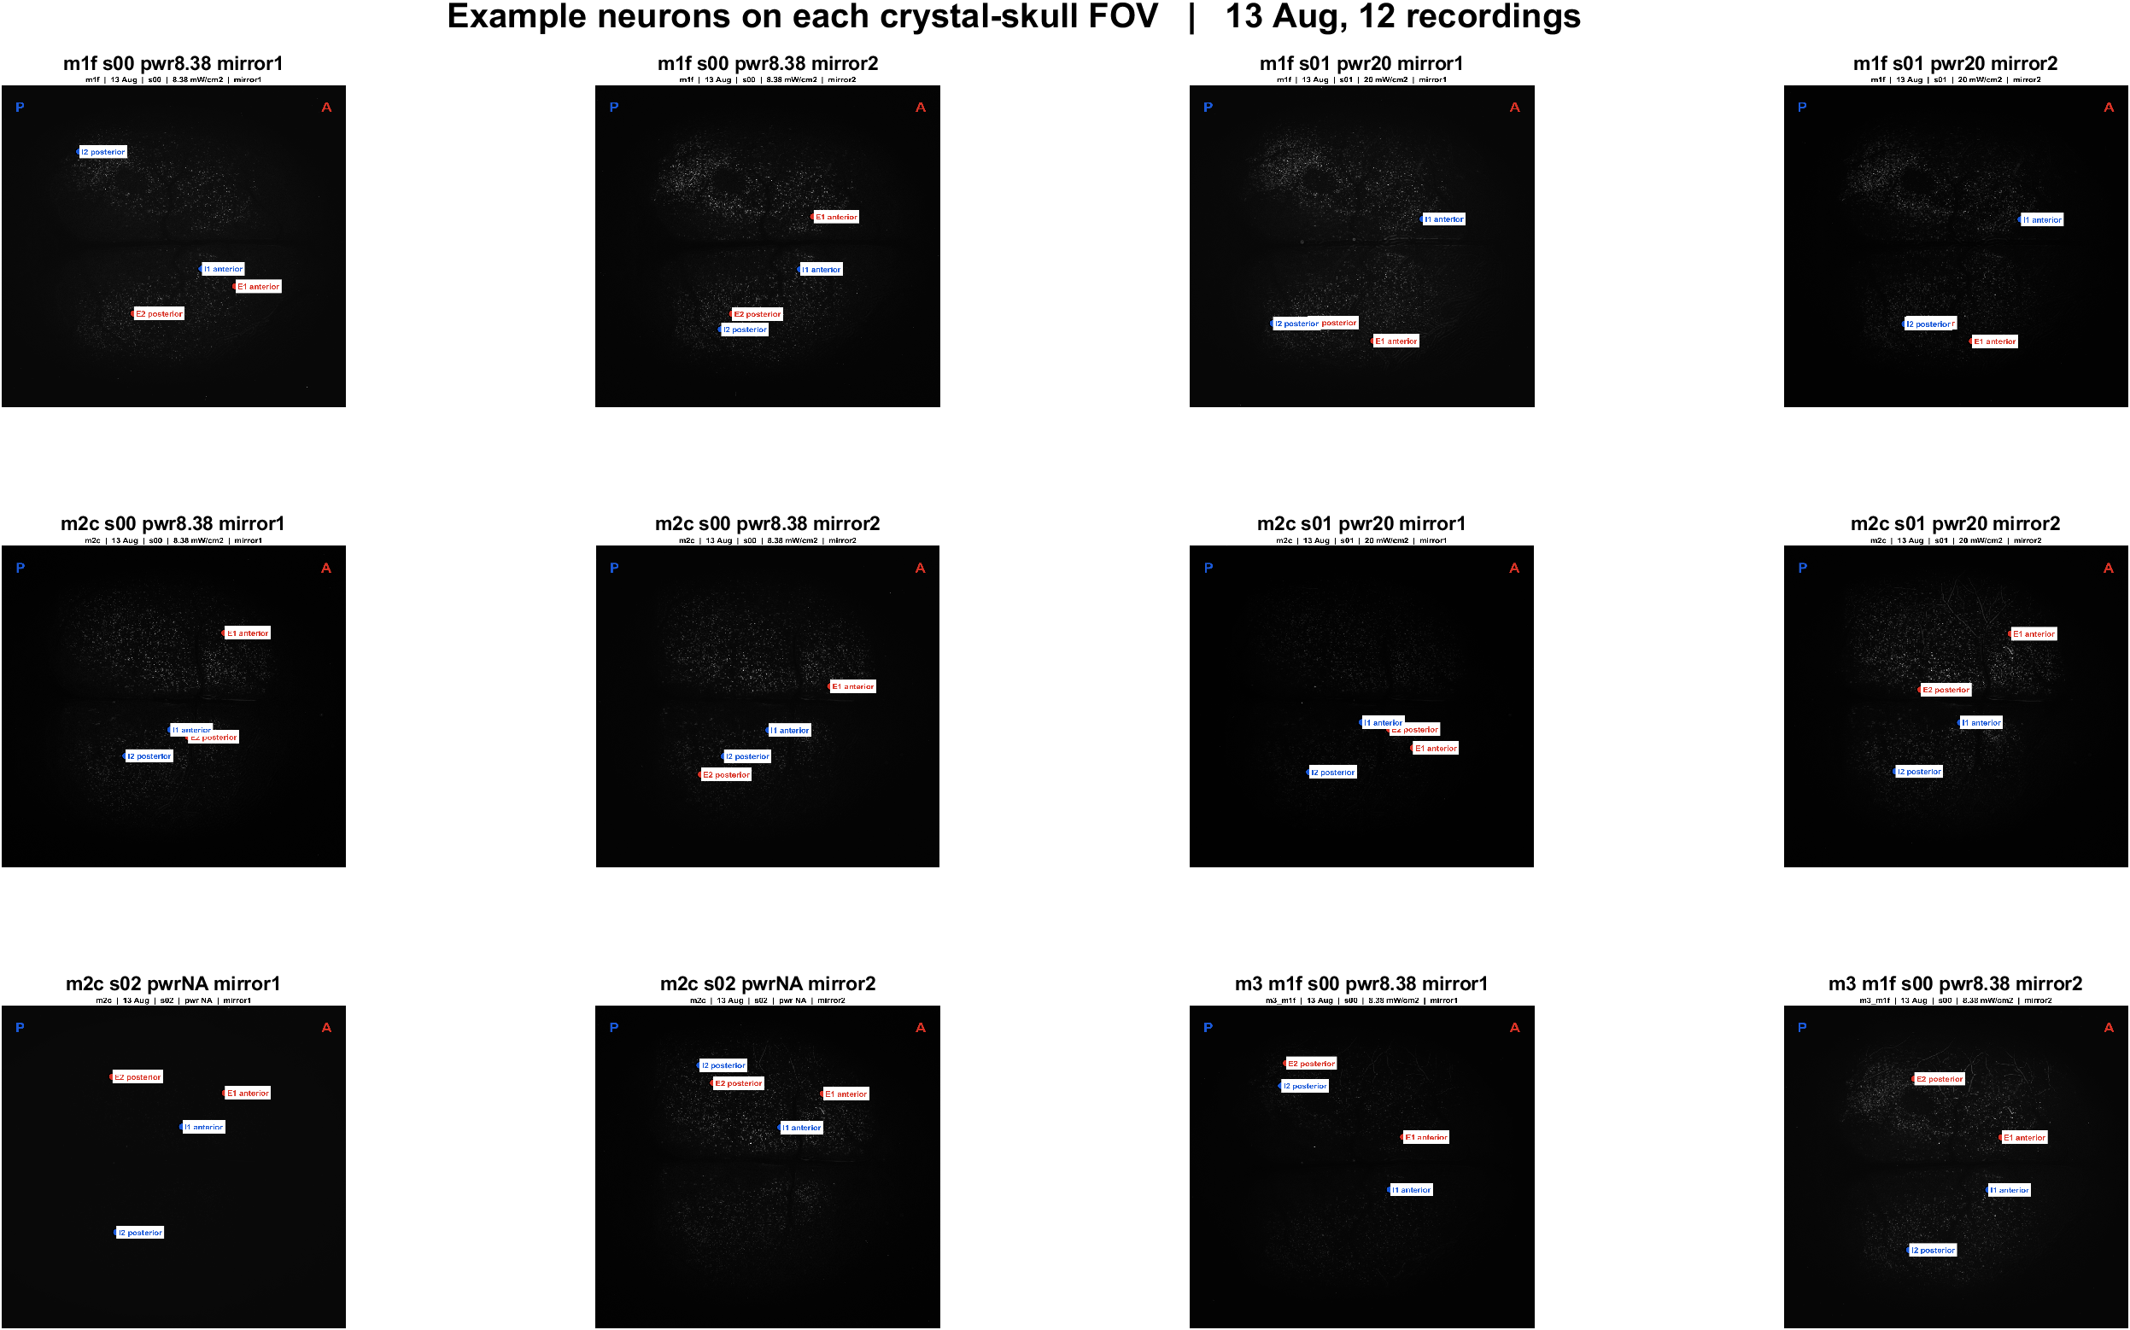
Where the example neurons sit | all 12 FOVs
What: Each panel is one crystal-skull field. Red = excited examples, blue = inhibited examples. P left, A right.
Result: The same local mix appears in every recording: example excited and inhibited cells are intermingled, with E1/I1 more anterior and E2/I2 more posterior.

Slide 3
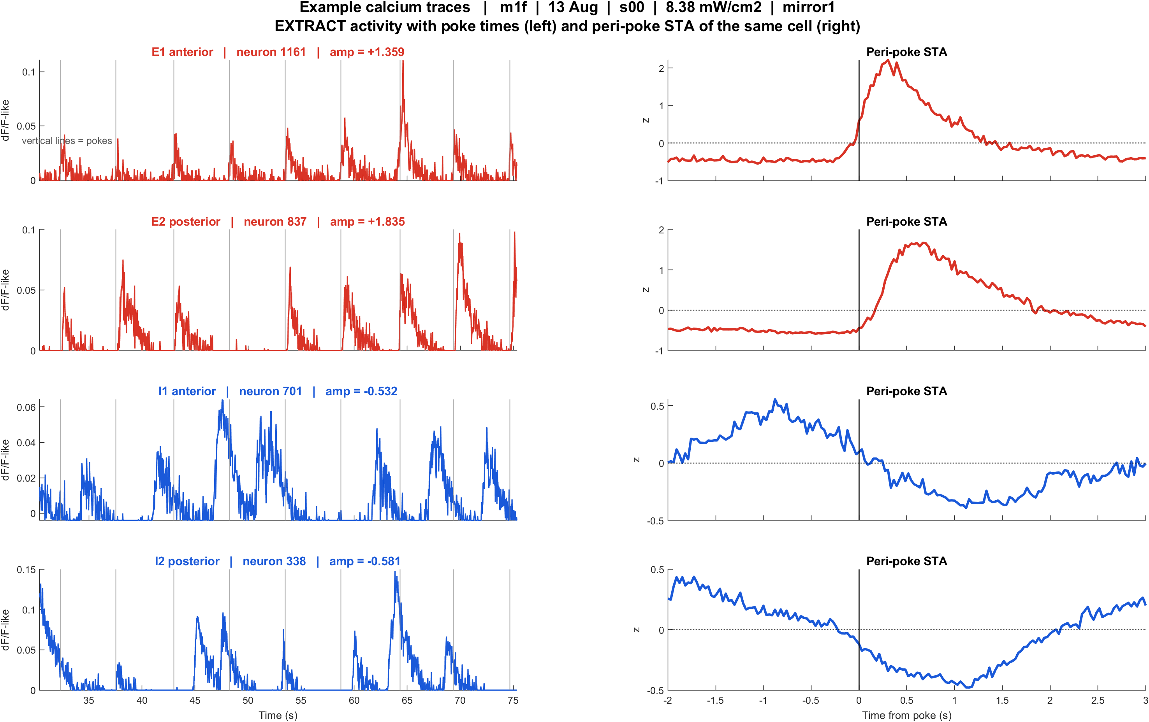
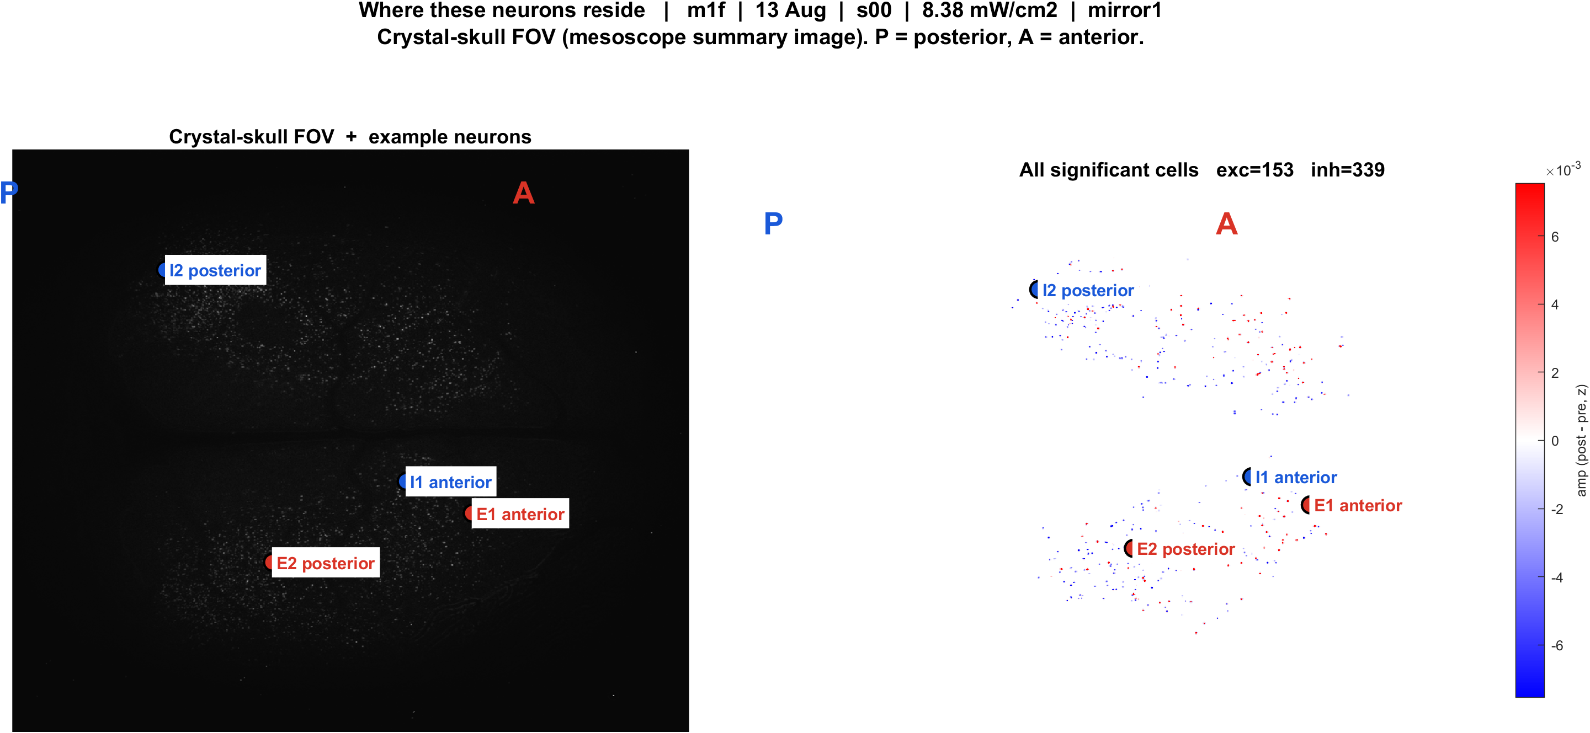
Examples | m1f s00 pwr8.38 mirror1 | 56 pokes
What: m1f, 13 Aug, s00, 8.38 mW/cm2, mirror1. Left: EXTRACT traces + STA. Right: those cells on the crystal-skull FOV.
Result: E1 anterior #1161, E2 posterior #837, I1 anterior #701, I2 posterior #338

Slide 4
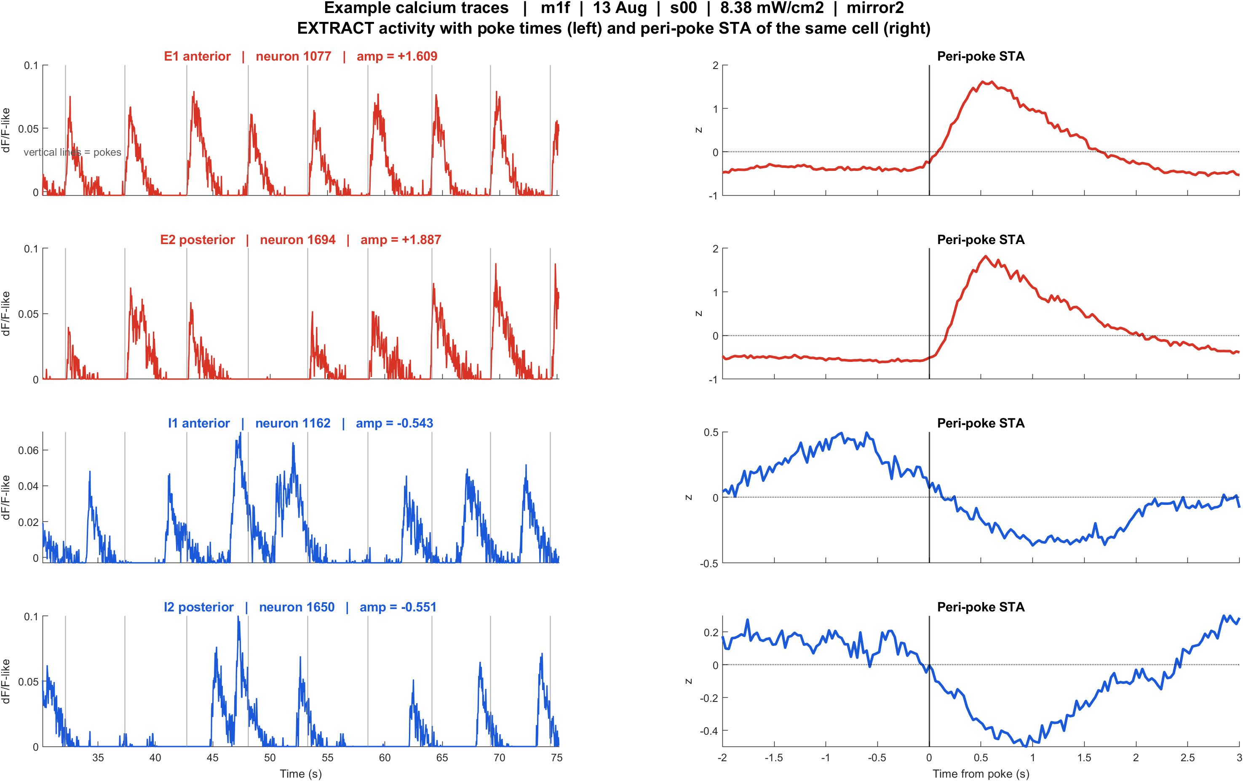
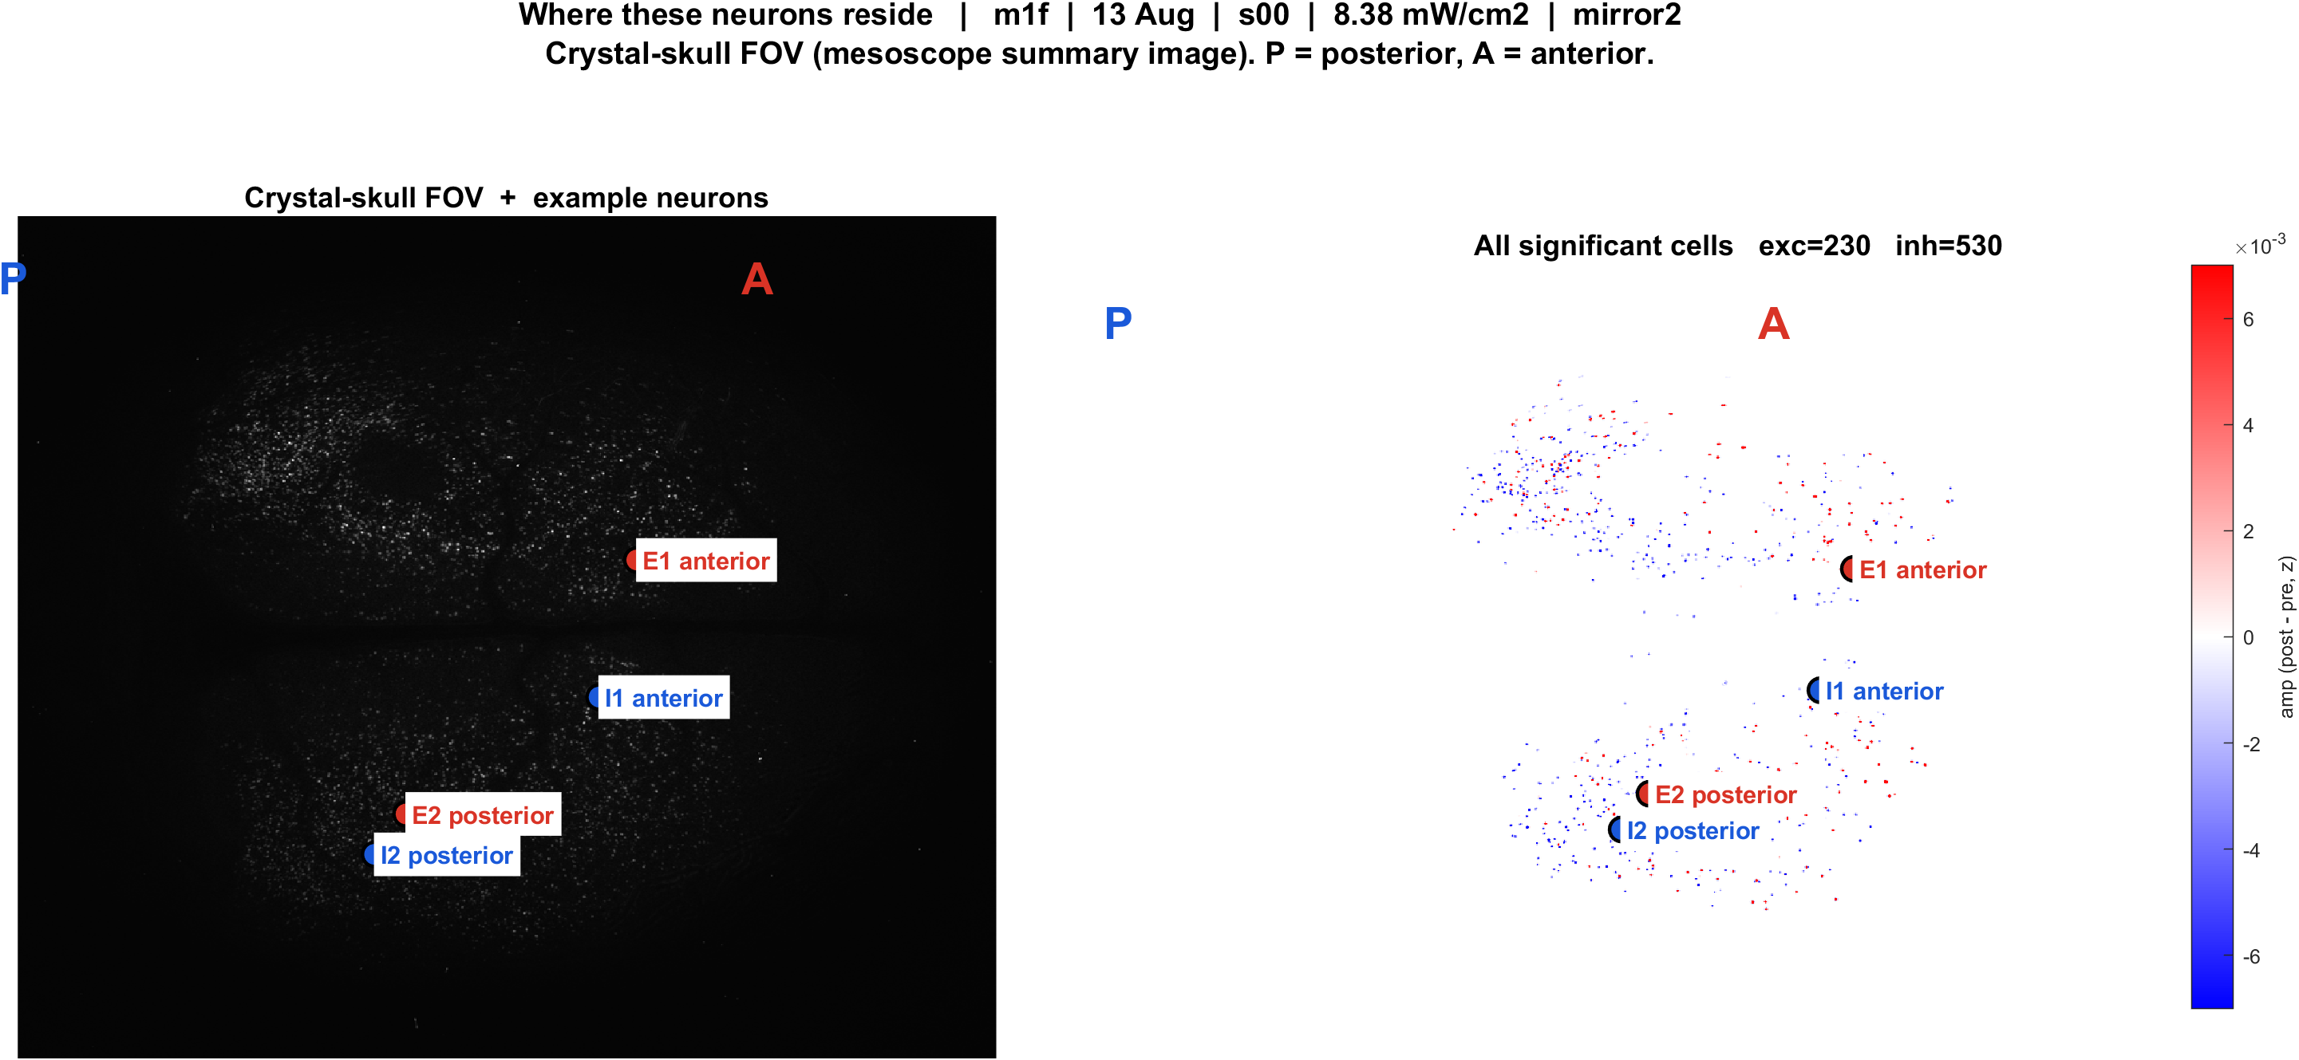
Examples | m1f s00 pwr8.38 mirror2 | 55 pokes
What: m1f, 13 Aug, s00, 8.38 mW/cm2, mirror2. Left: EXTRACT traces + STA. Right: those cells on the crystal-skull FOV.
Result: E1 anterior #1077, E2 posterior #1694, I1 anterior #1162, I2 posterior #1650

Slide 5
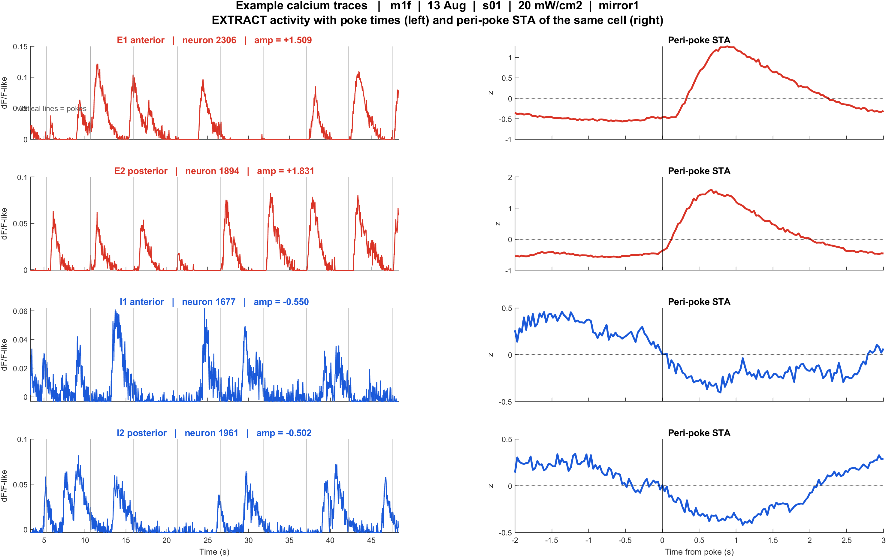
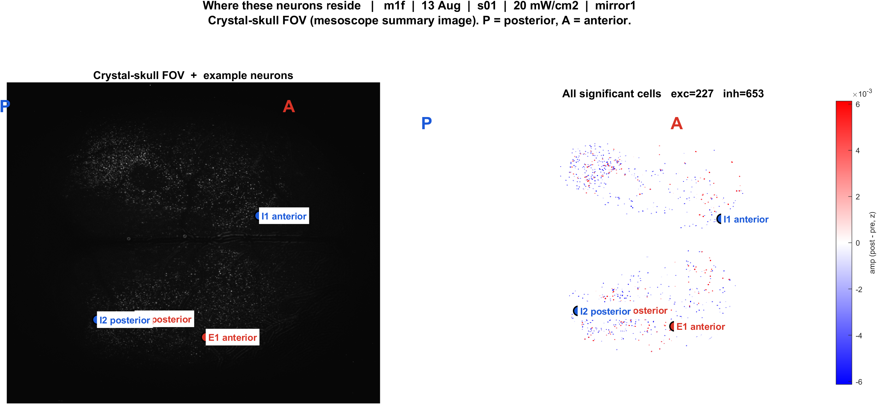
Examples | m1f s01 pwr20 mirror1 | 57 pokes
What: m1f, 13 Aug, s01, 20 mW/cm2, mirror1. Left: EXTRACT traces + STA. Right: those cells on the crystal-skull FOV.
Result: E1 anterior #2306, E2 posterior #1894, I1 anterior #1677, I2 posterior #1961

Slide 6
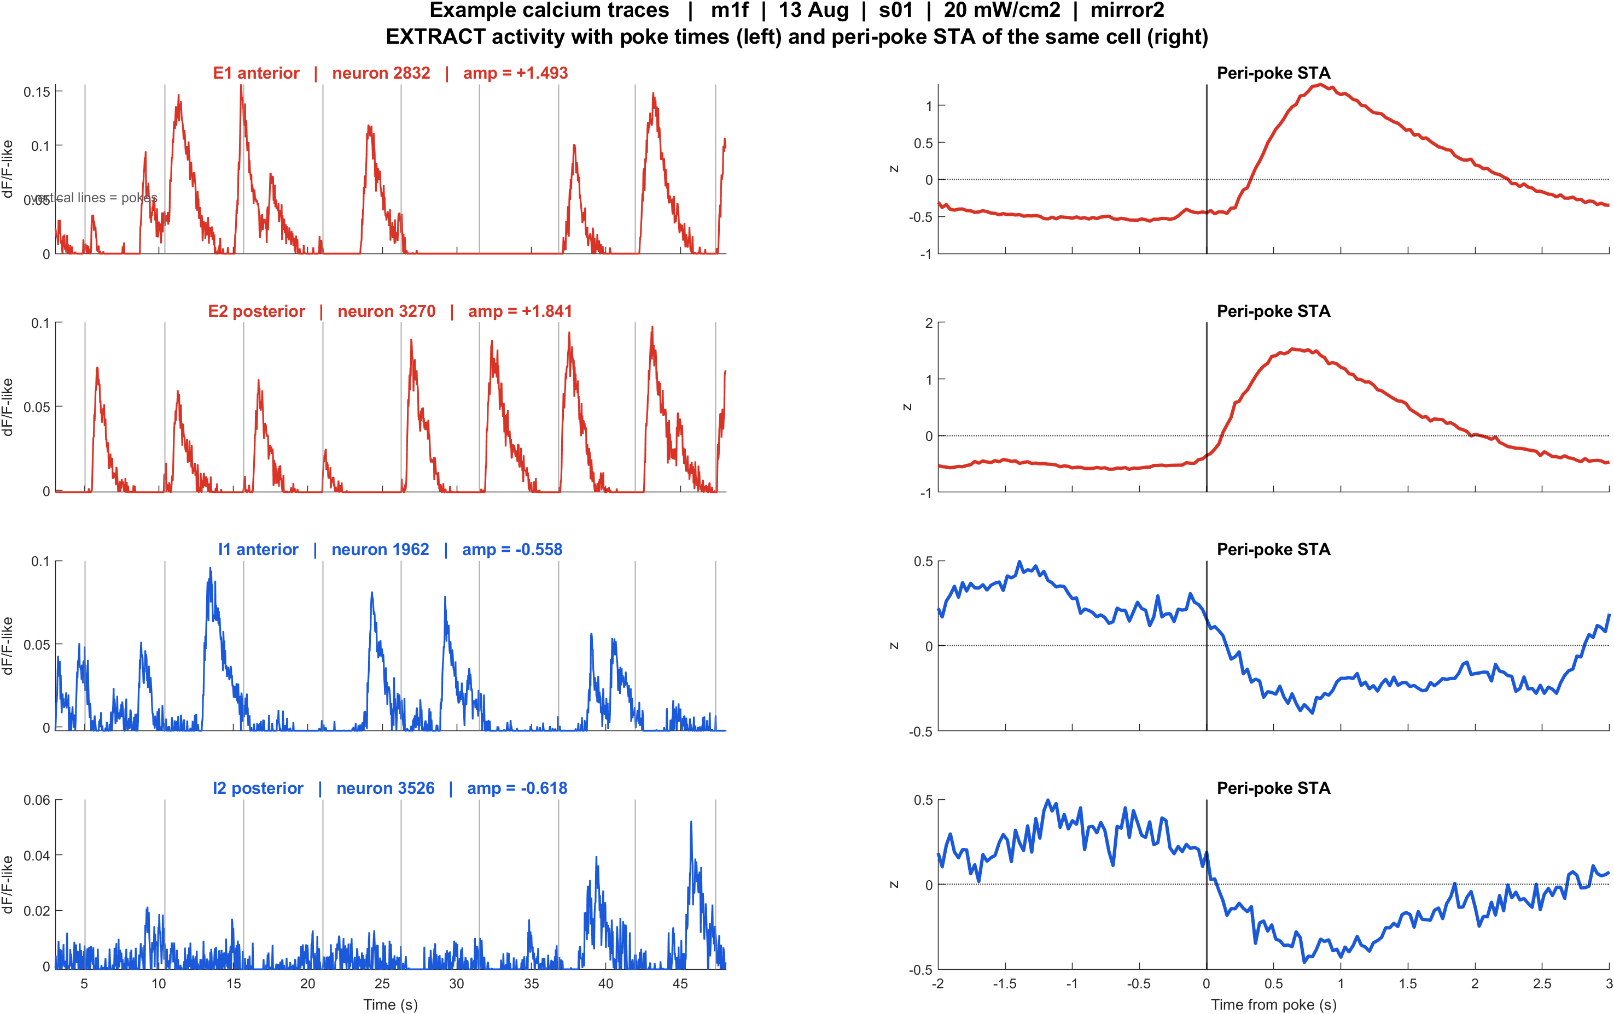
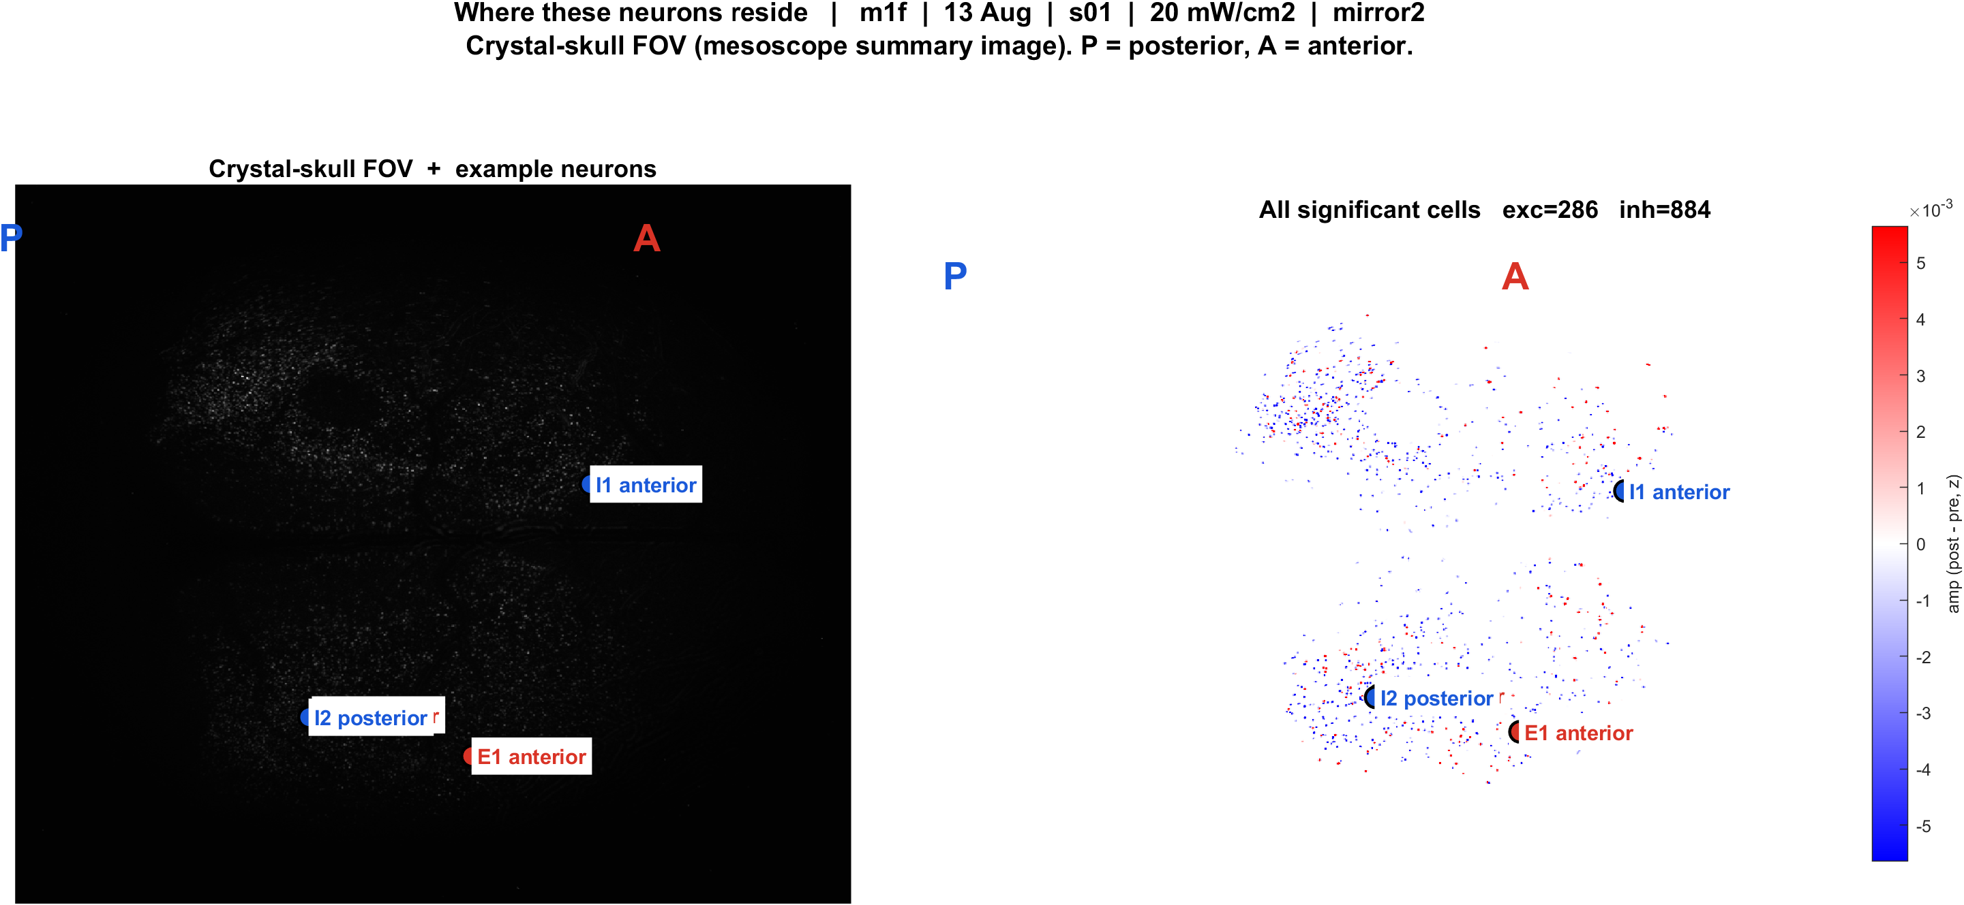
Examples | m1f s01 pwr20 mirror2 | 57 pokes
What: m1f, 13 Aug, s01, 20 mW/cm2, mirror2. Left: EXTRACT traces + STA. Right: those cells on the crystal-skull FOV.
Result: E1 anterior #2832, E2 posterior #3270, I1 anterior #1962, I2 posterior #3526

Slide 7
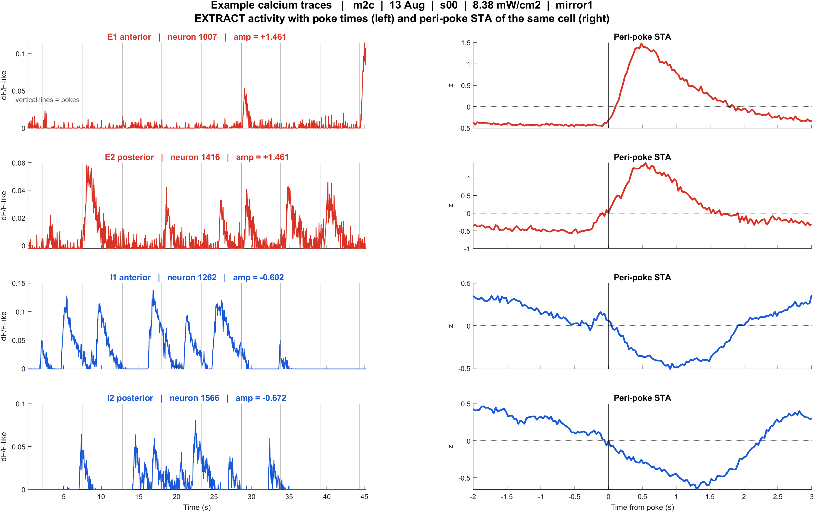
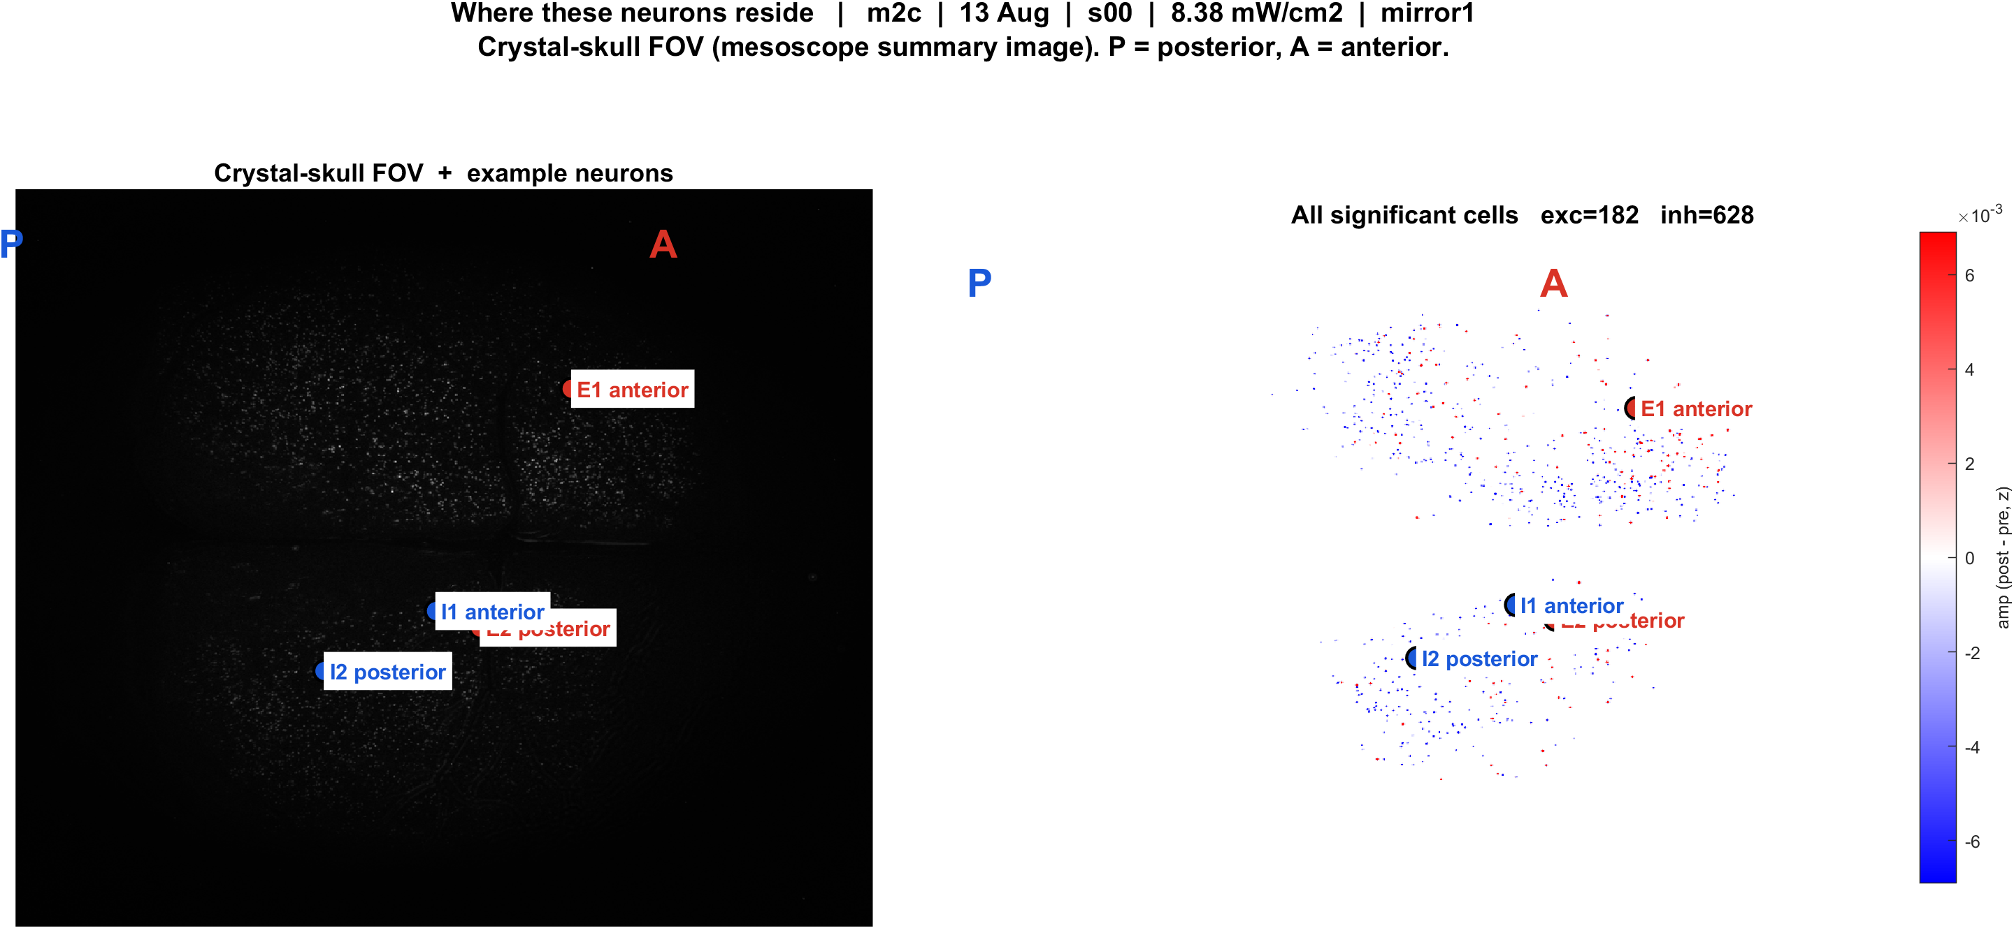
Examples | m2c s00 pwr8.38 mirror1 | 57 pokes
What: m2c, 13 Aug, s00, 8.38 mW/cm2, mirror1. Left: EXTRACT traces + STA. Right: those cells on the crystal-skull FOV.
Result: E1 anterior #1007, E2 posterior #1416, I1 anterior #1262, I2 posterior #1566

Slide 8
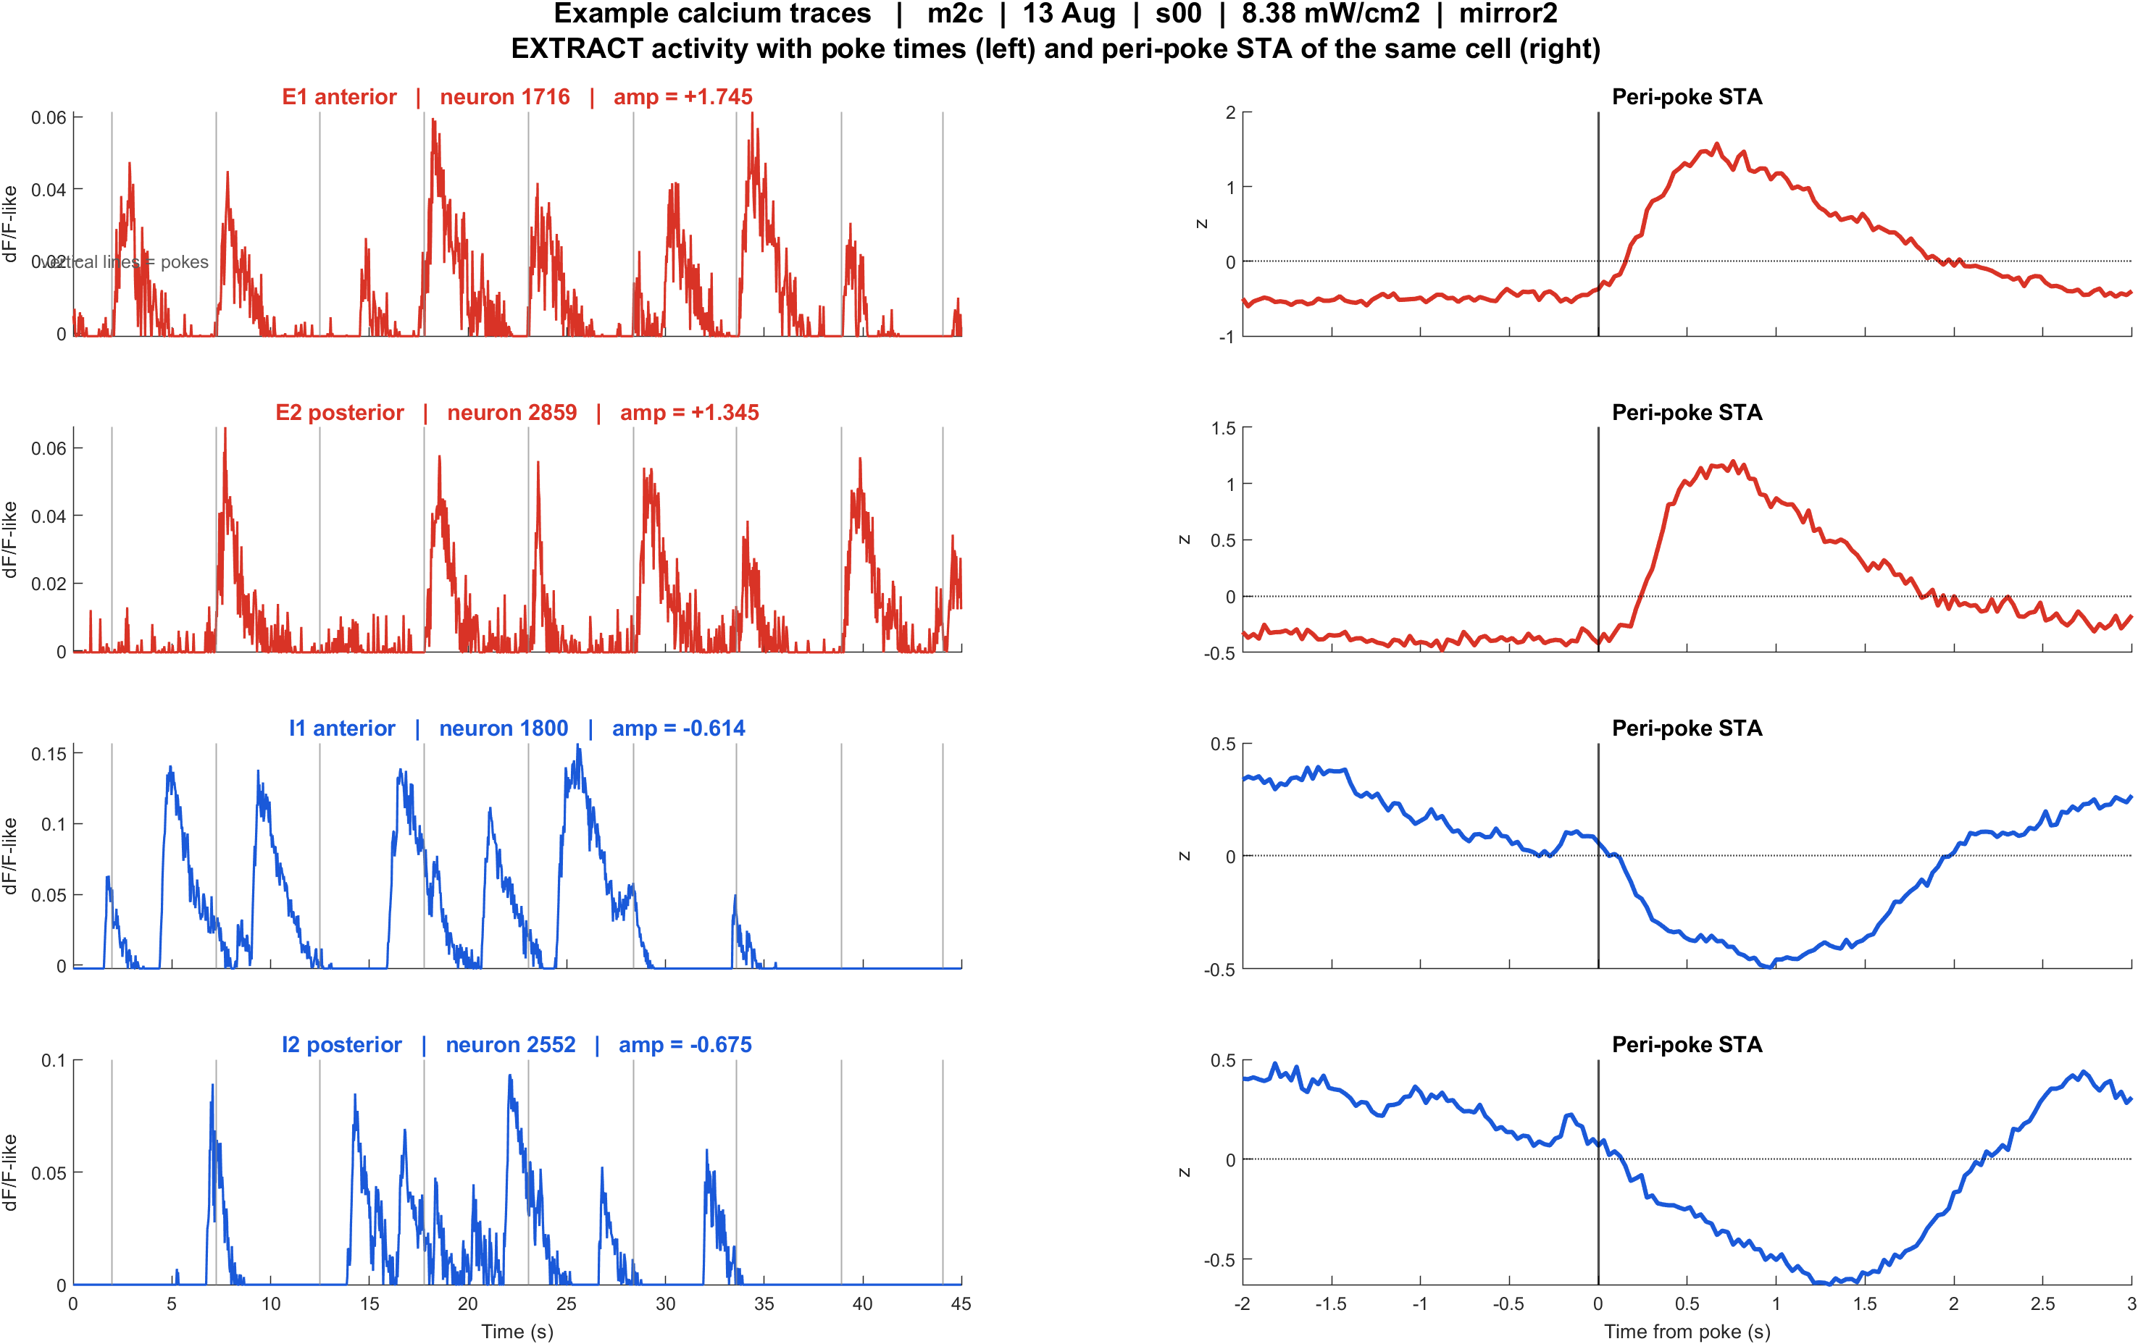
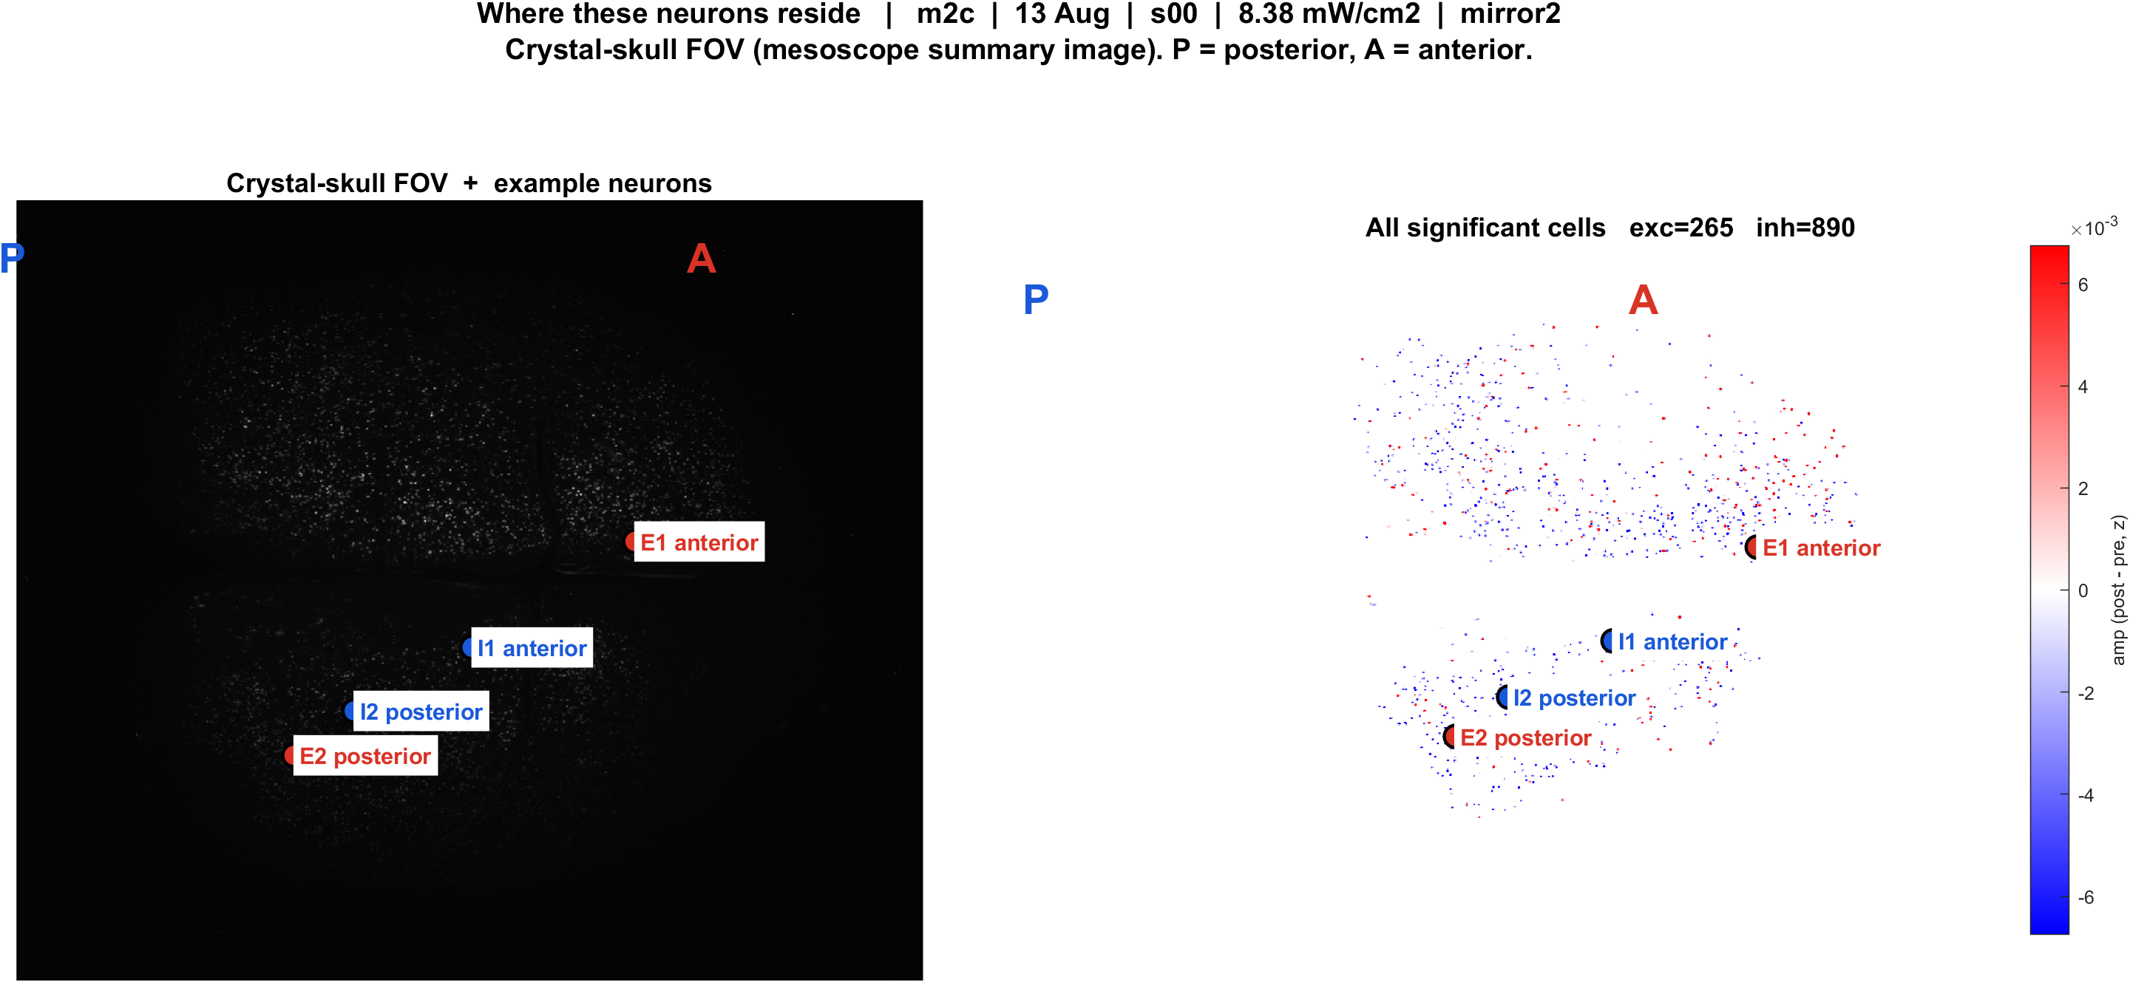
Examples | m2c s00 pwr8.38 mirror2 | 57 pokes
What: m2c, 13 Aug, s00, 8.38 mW/cm2, mirror2. Left: EXTRACT traces + STA. Right: those cells on the crystal-skull FOV.
Result: E1 anterior #1716, E2 posterior #2859, I1 anterior #1800, I2 posterior #2552

Slide 9
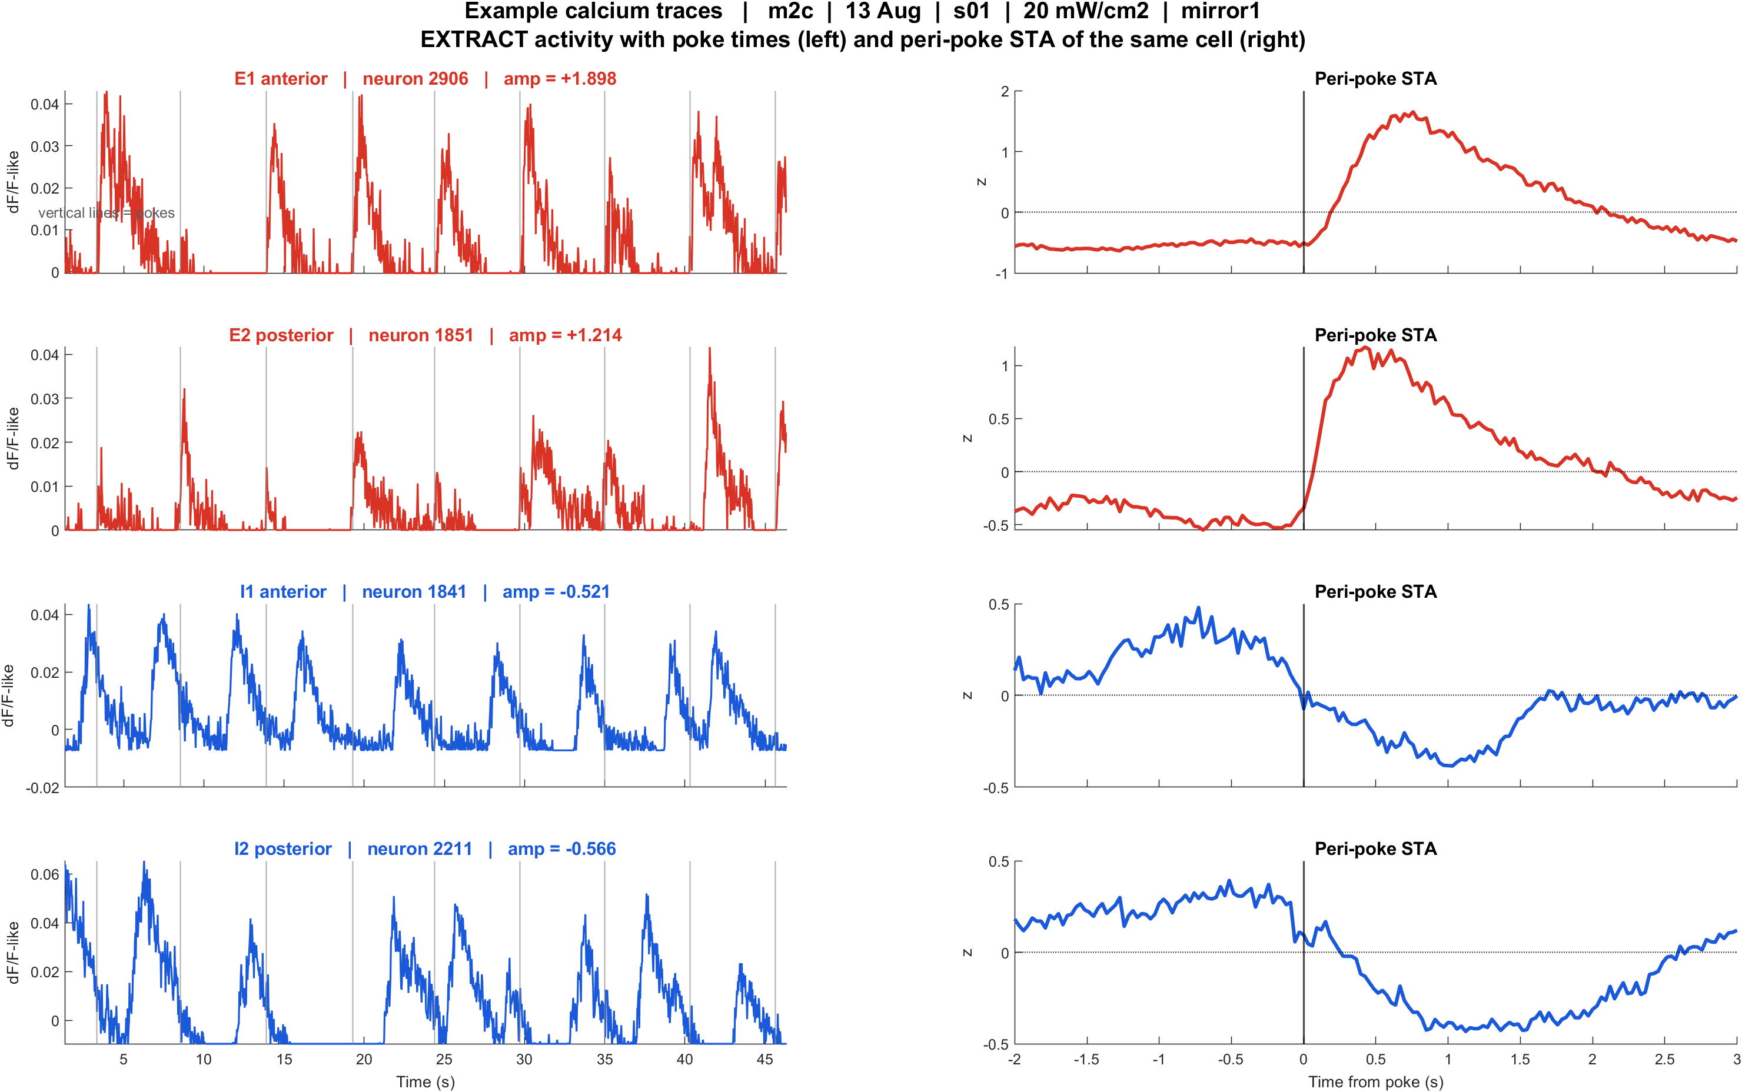
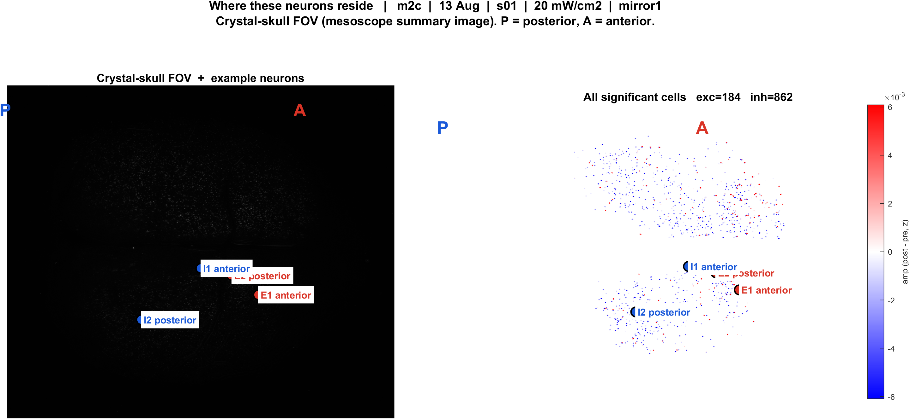
Examples | m2c s01 pwr20 mirror1 | 56 pokes
What: m2c, 13 Aug, s01, 20 mW/cm2, mirror1. Left: EXTRACT traces + STA. Right: those cells on the crystal-skull FOV.
Result: E1 anterior #2906, E2 posterior #1851, I1 anterior #1841, I2 posterior #2211

Slide 10
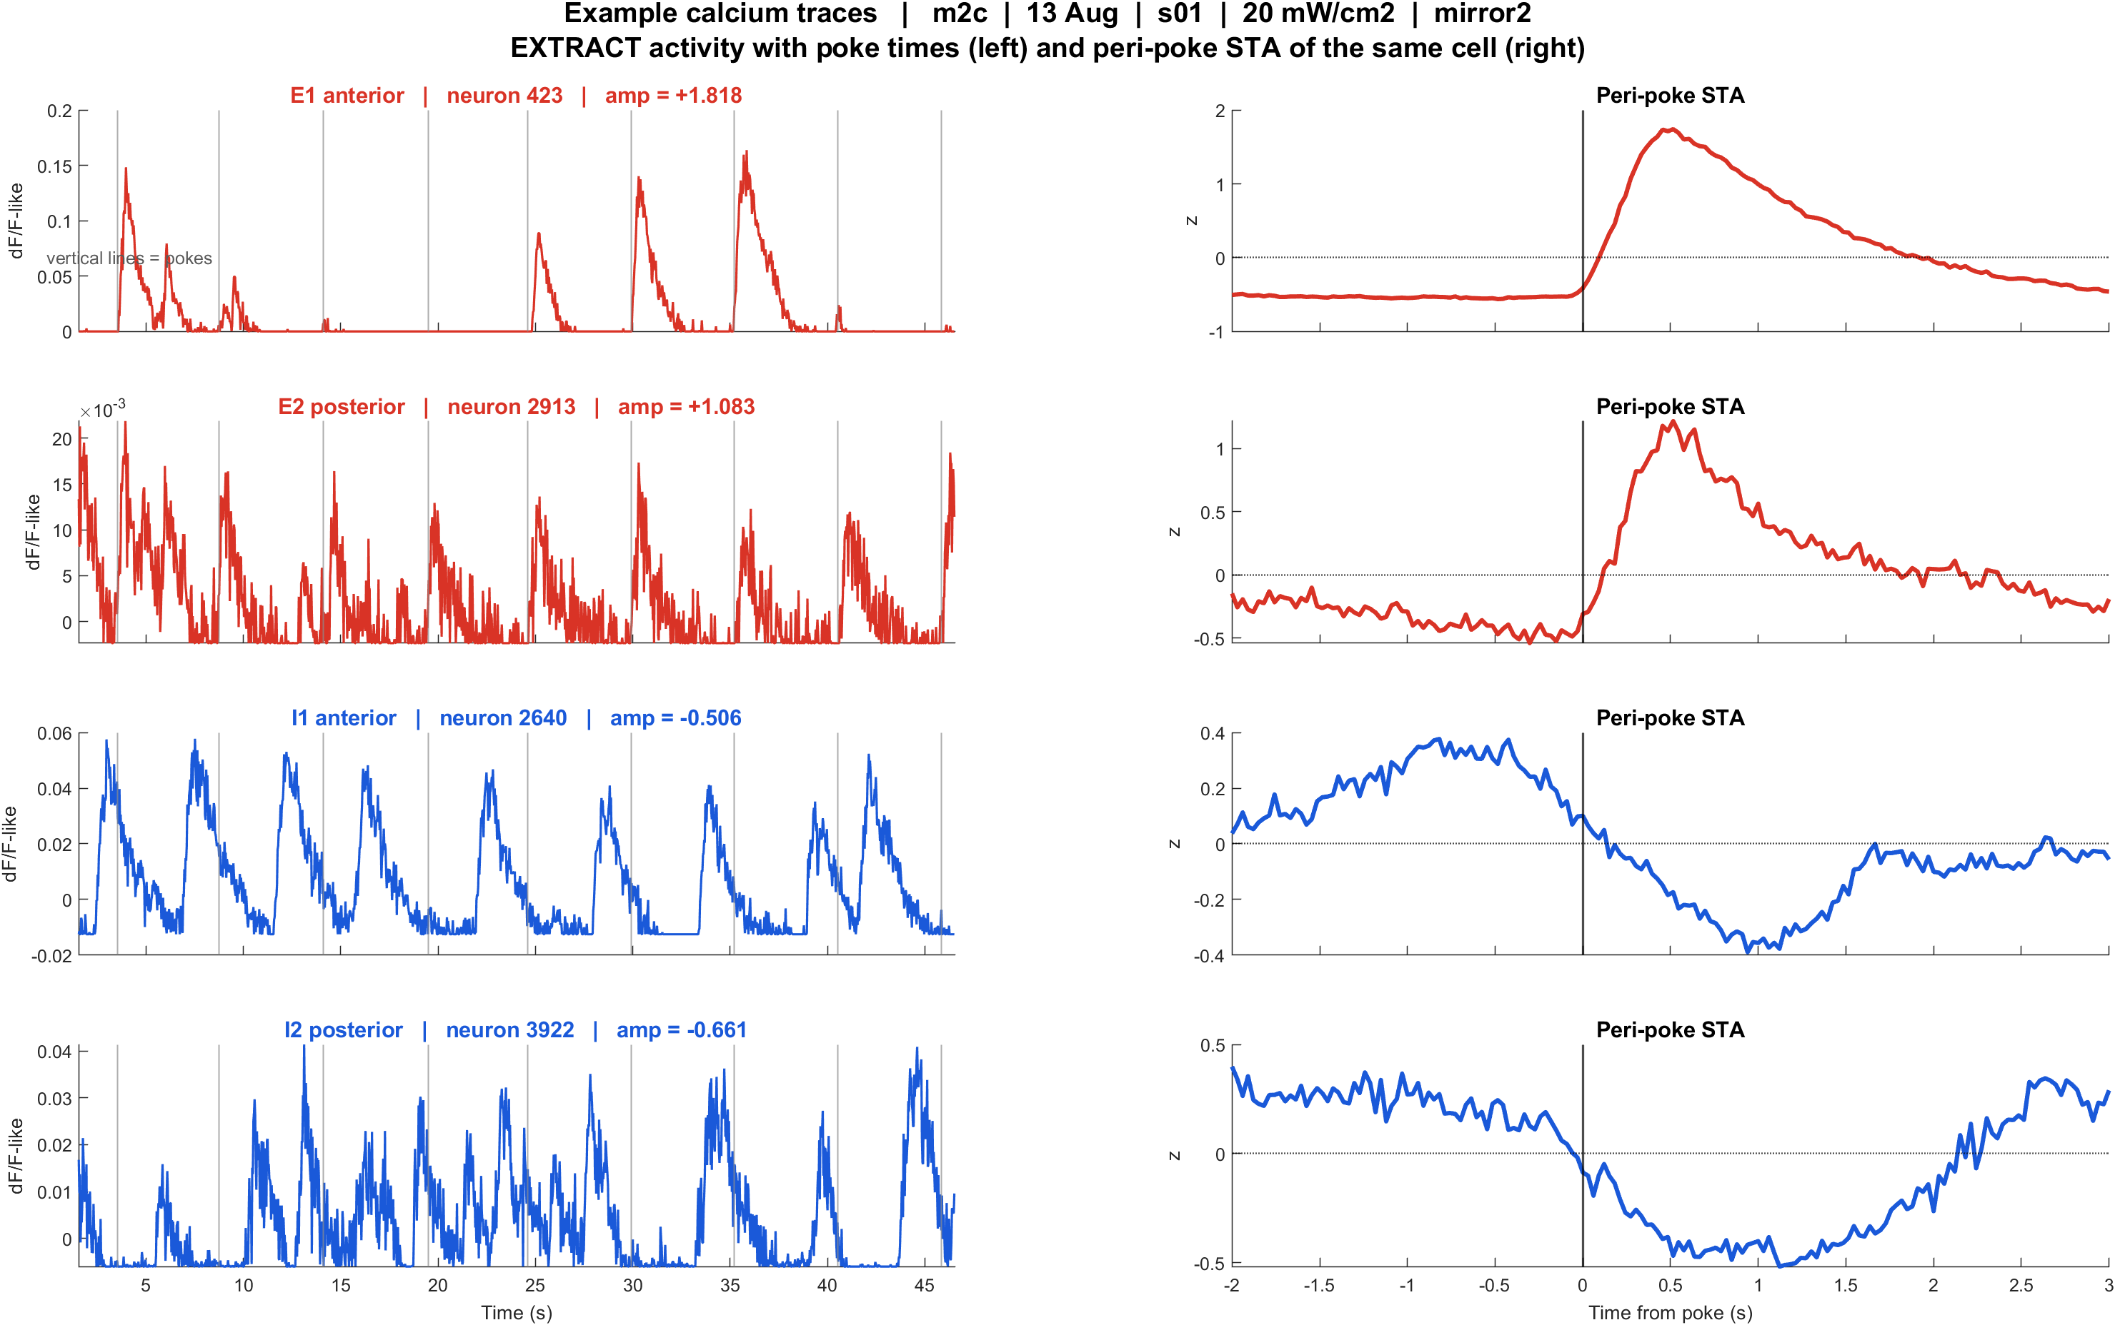
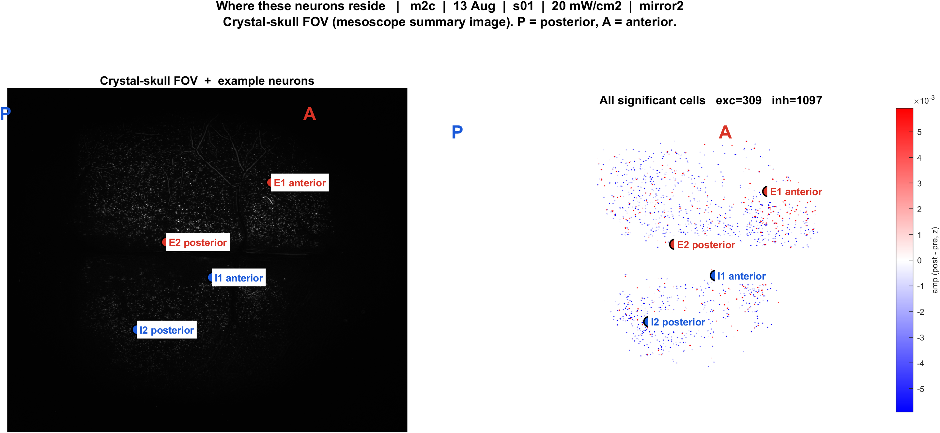
Examples | m2c s01 pwr20 mirror2 | 56 pokes
What: m2c, 13 Aug, s01, 20 mW/cm2, mirror2. Left: EXTRACT traces + STA. Right: those cells on the crystal-skull FOV.
Result: E1 anterior #423, E2 posterior #2913, I1 anterior #2640, I2 posterior #3922

Slide 11
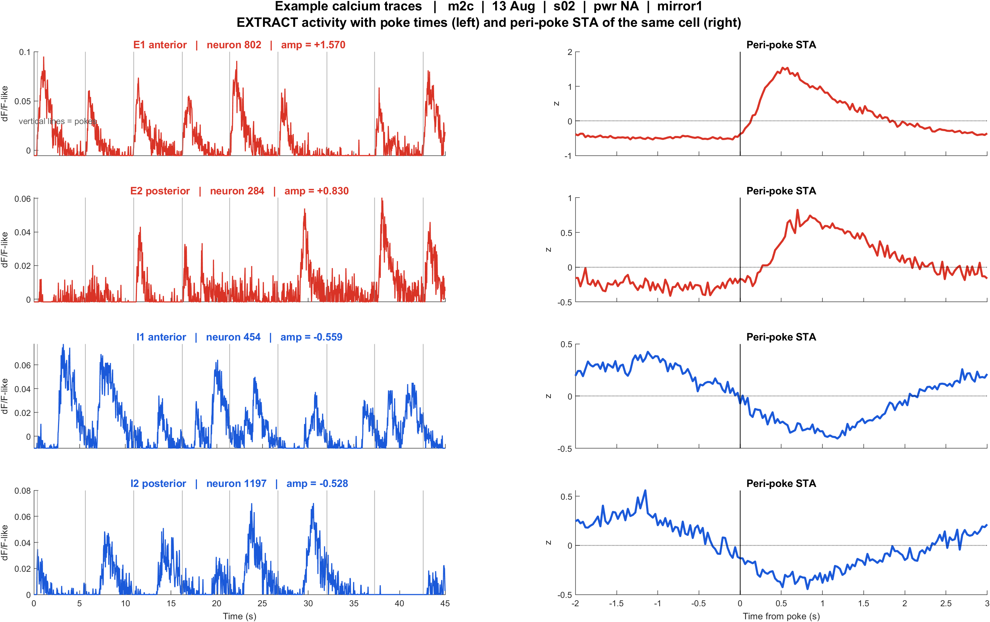
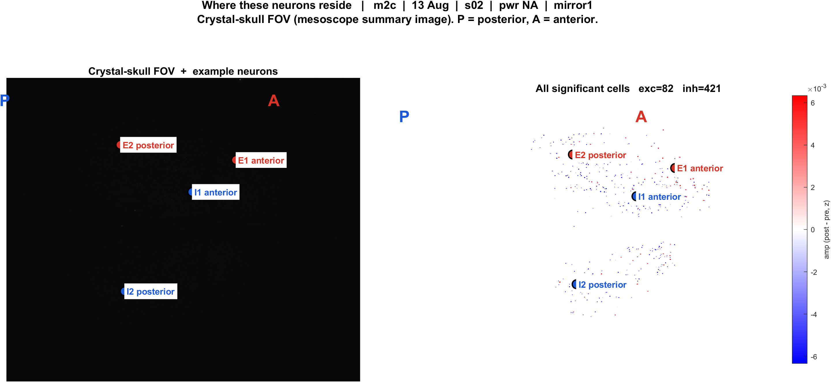
Examples | m2c s02 pwrNA mirror1 | 55 pokes
What: m2c, 13 Aug, s02, pwr NA, mirror1. Left: EXTRACT traces + STA. Right: those cells on the crystal-skull FOV.
Result: E1 anterior #802, E2 posterior #284, I1 anterior #454, I2 posterior #1197

Slide 12
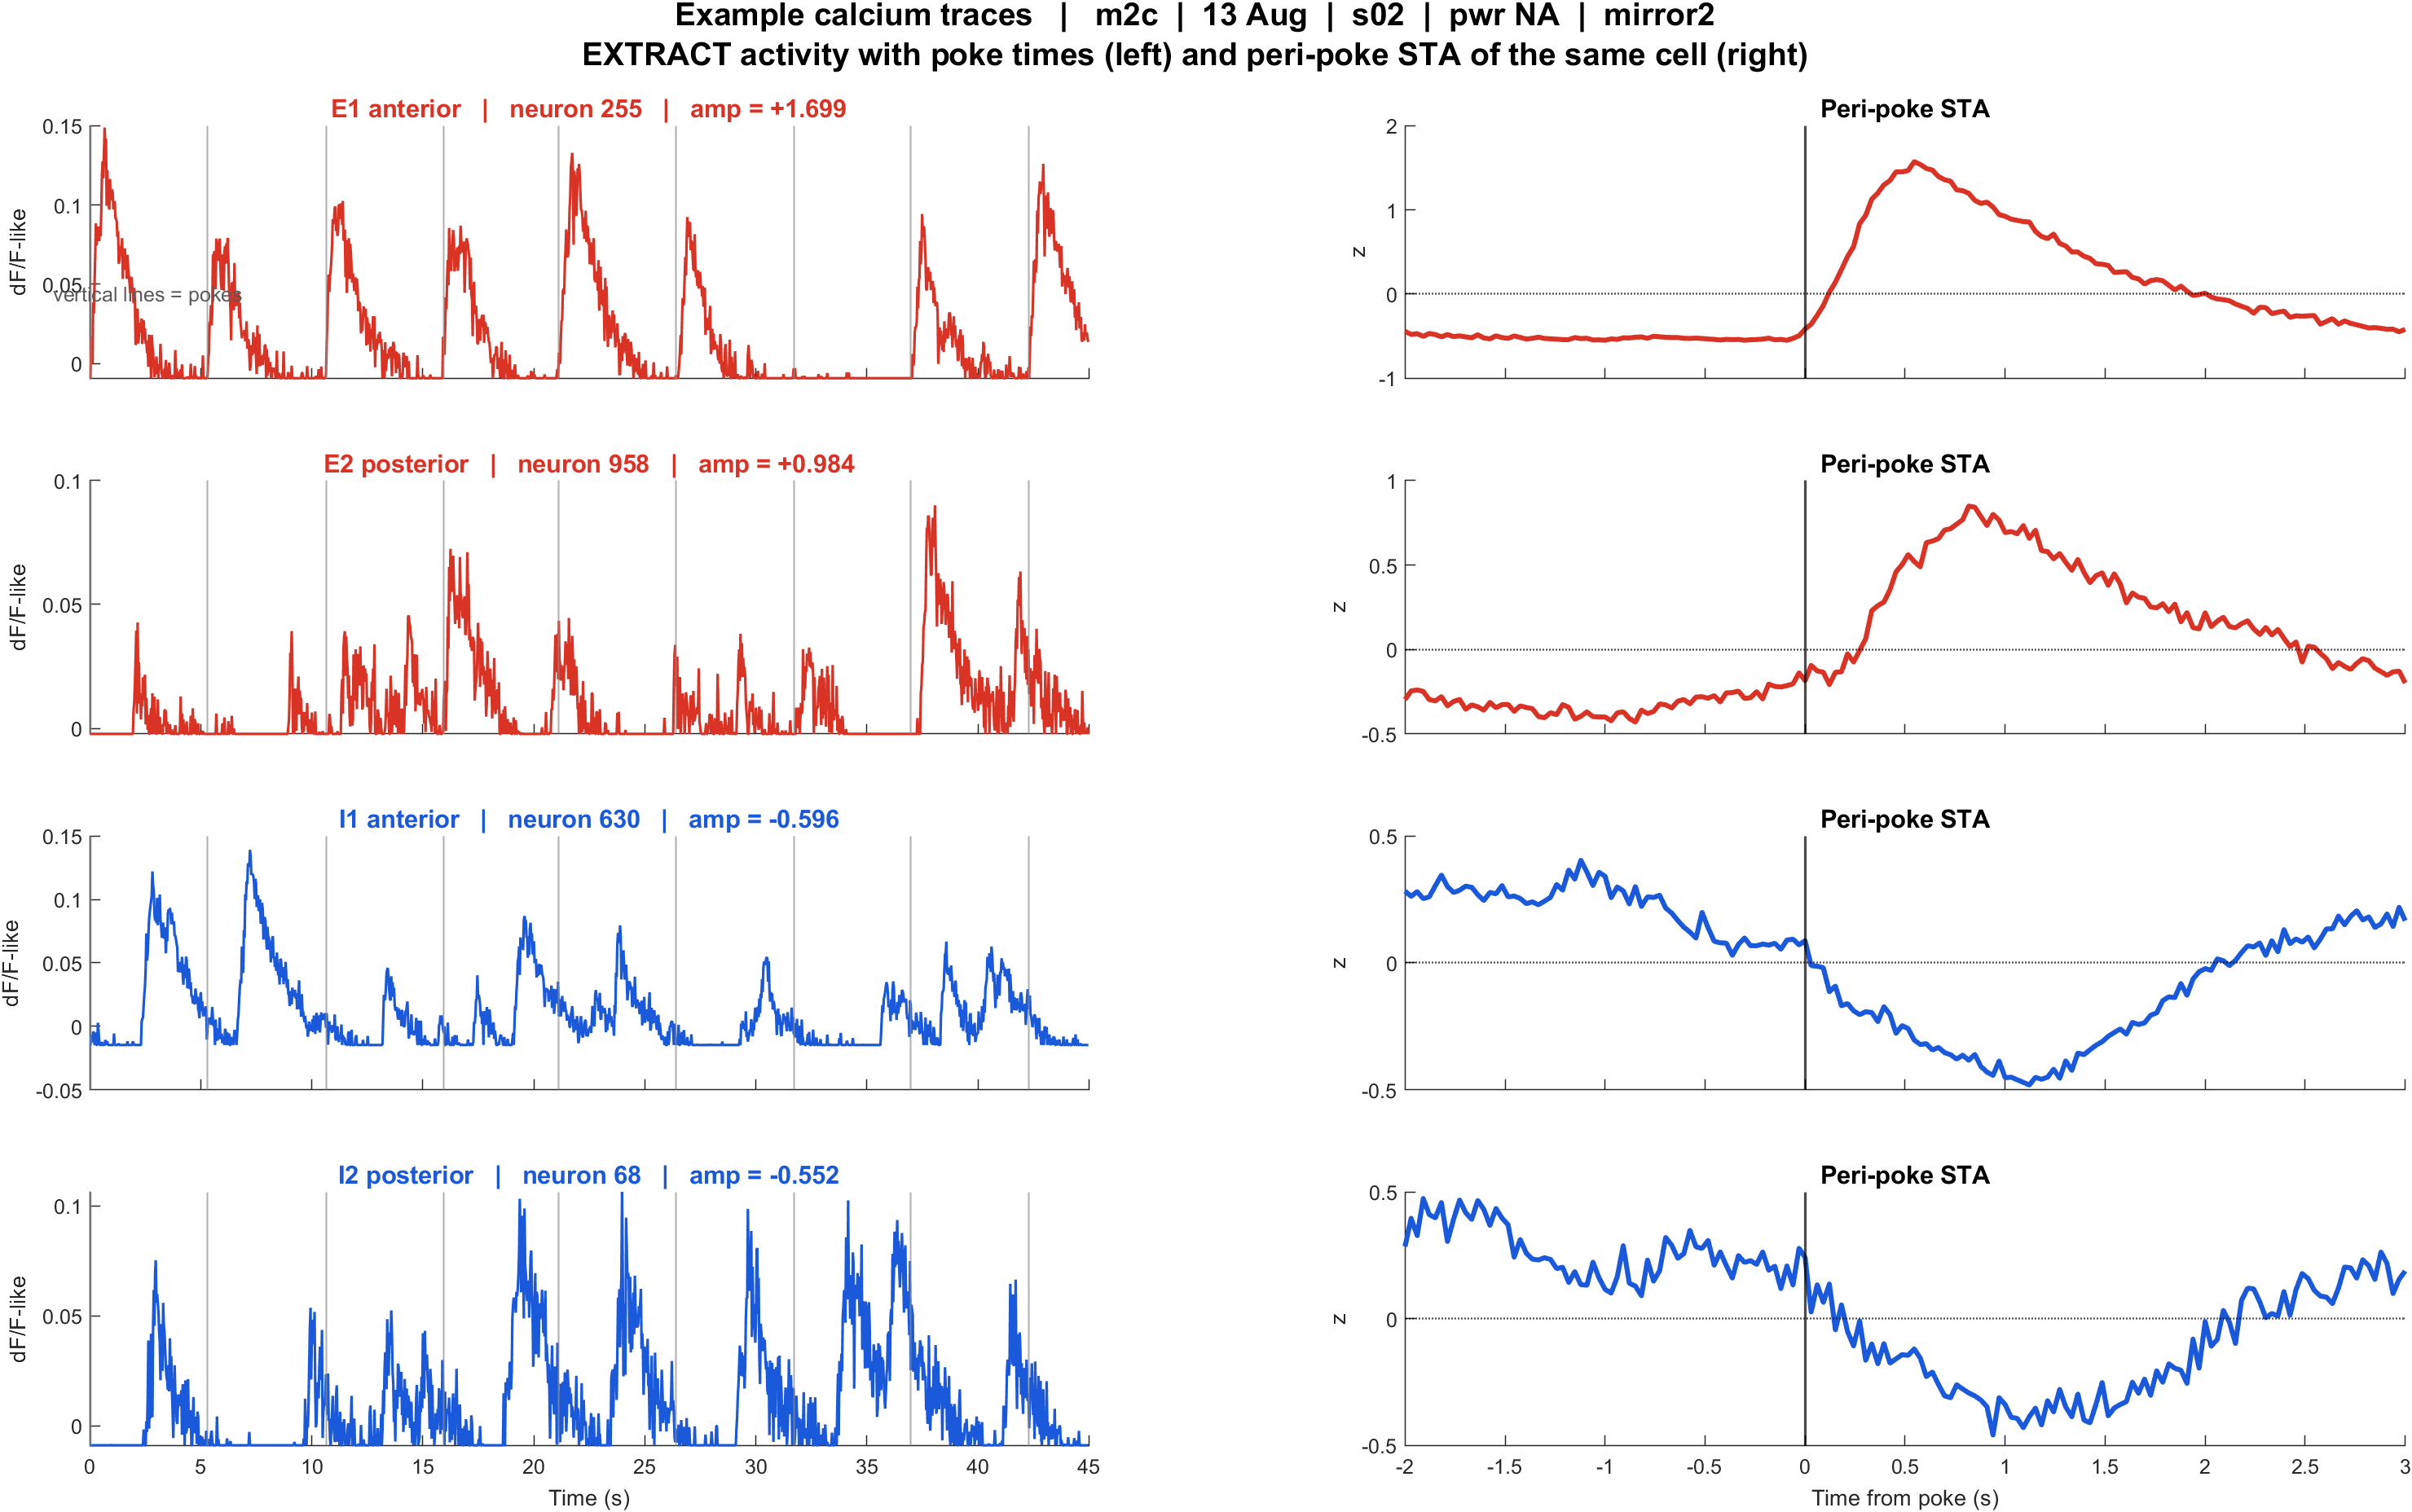
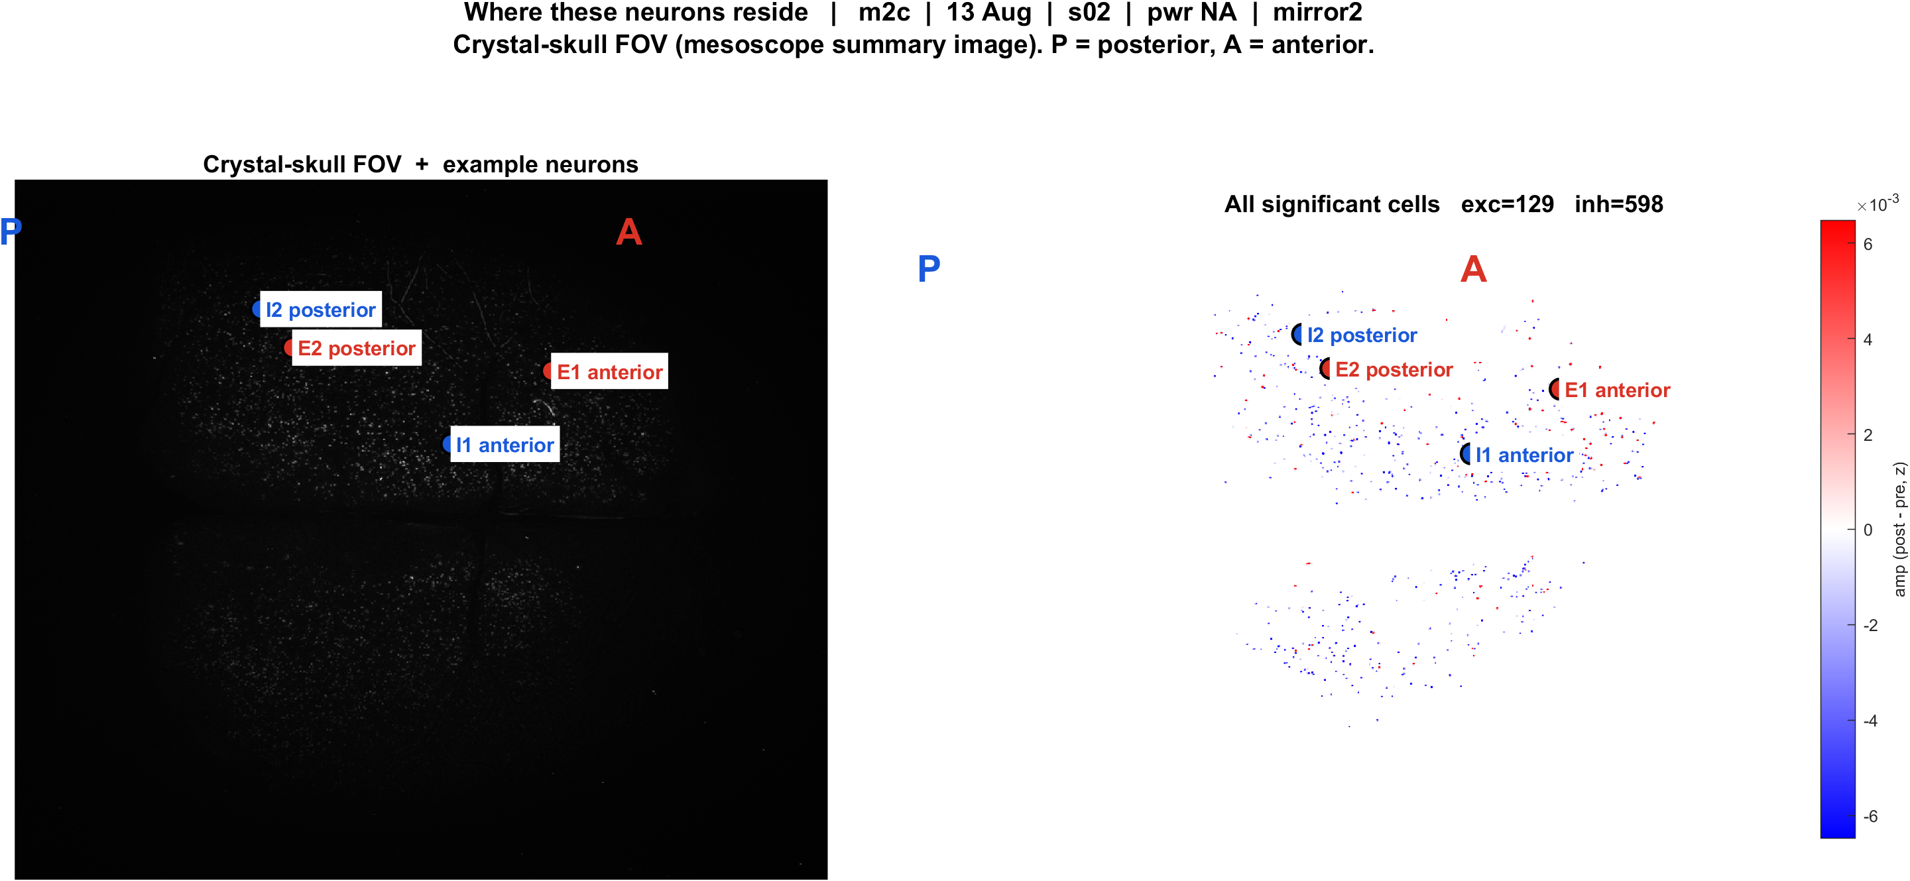
Examples | m2c s02 pwrNA mirror2 | 54 pokes
What: m2c, 13 Aug, s02, pwr NA, mirror2. Left: EXTRACT traces + STA. Right: those cells on the crystal-skull FOV.
Result: E1 anterior #255, E2 posterior #958, I1 anterior #630, I2 posterior #68

Slide 13
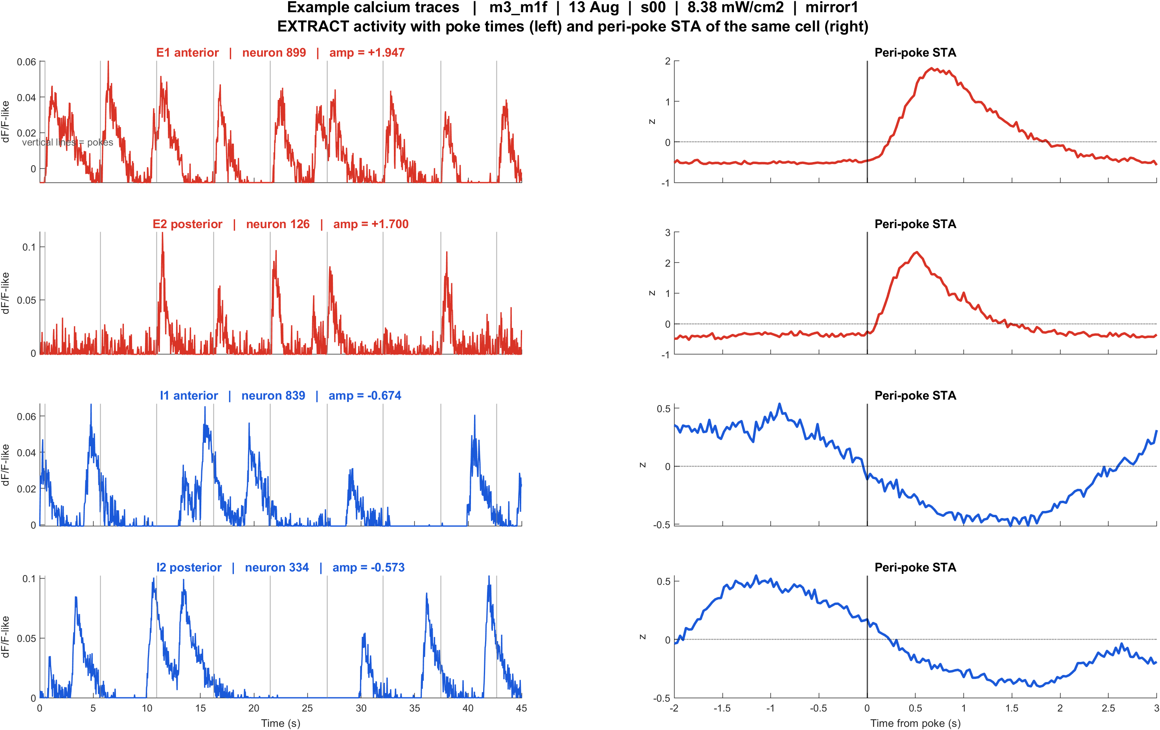
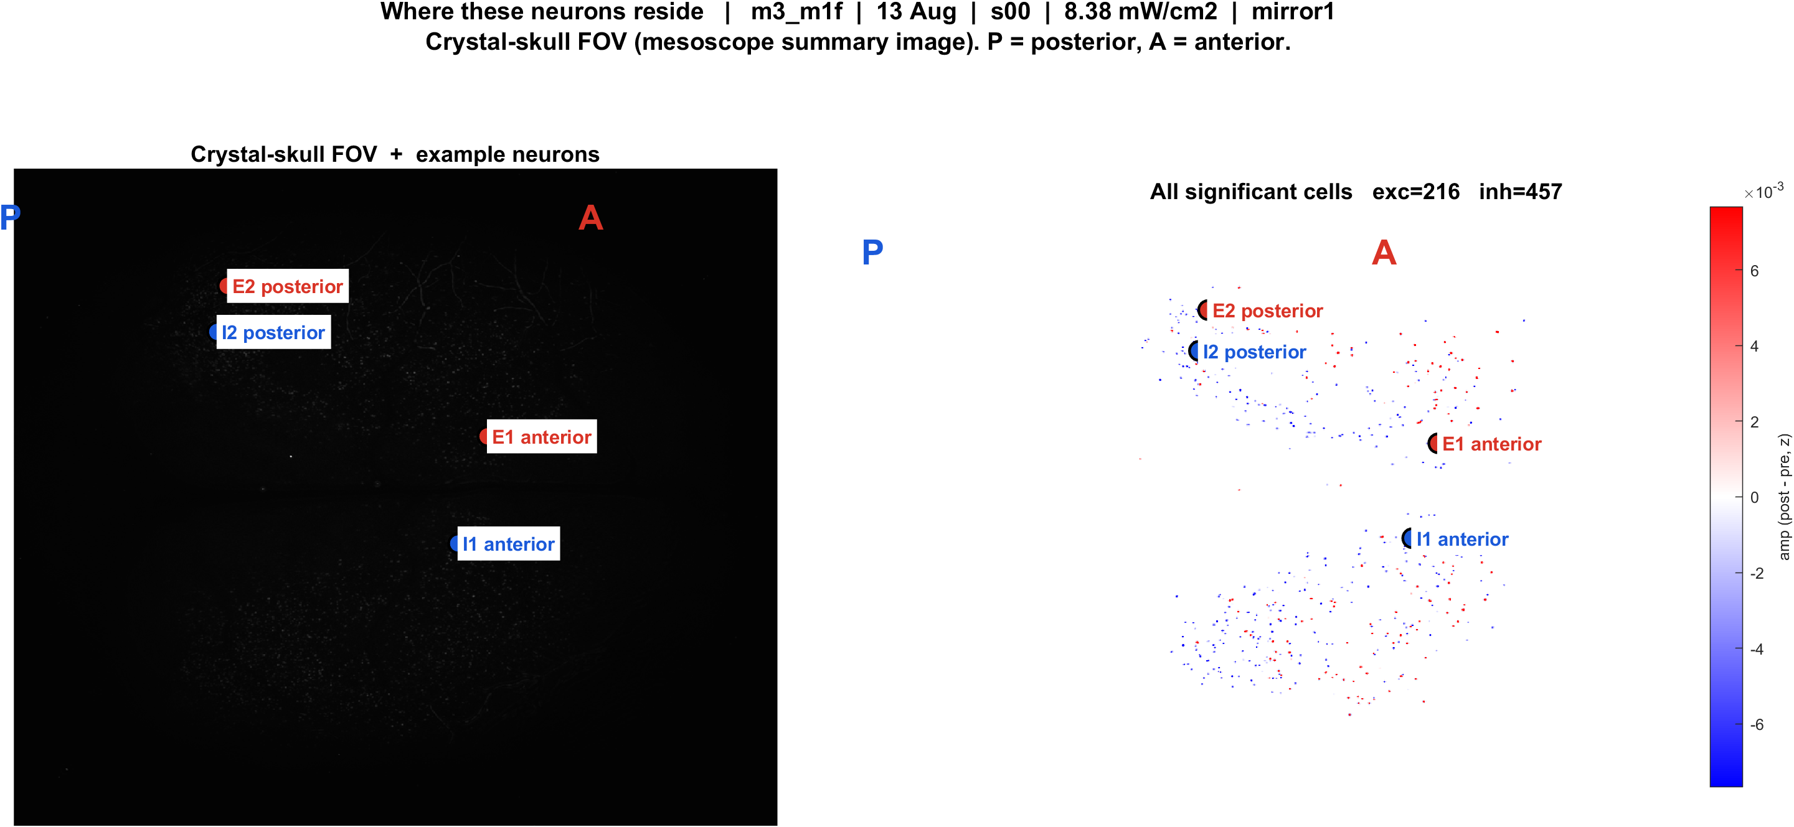
Examples | m3 m1f s00 pwr8.38 mirror1 | 55 pokes
What: m3_m1f, 13 Aug, s00, 8.38 mW/cm2, mirror1. Left: EXTRACT traces + STA. Right: those cells on the crystal-skull FOV.
Result: E1 anterior #899, E2 posterior #126, I1 anterior #839, I2 posterior #334

Slide 14
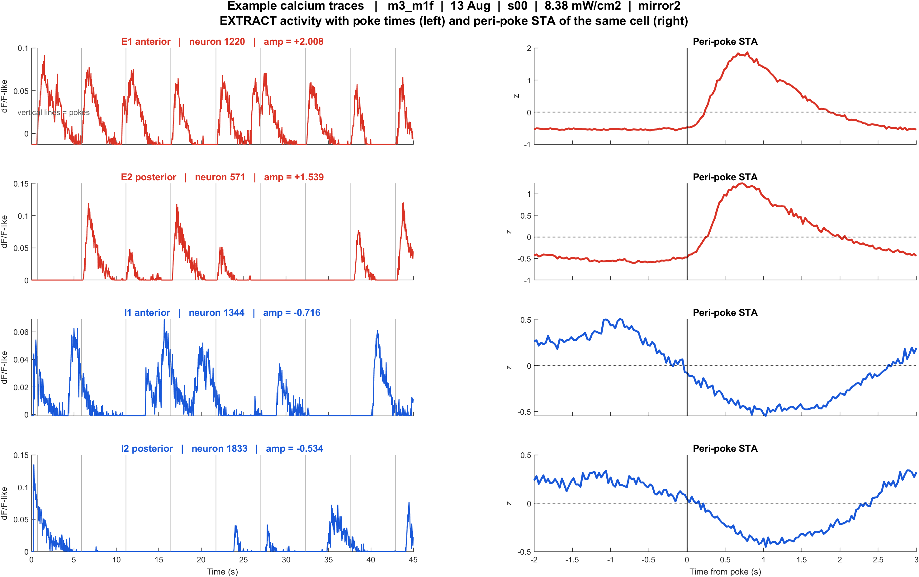
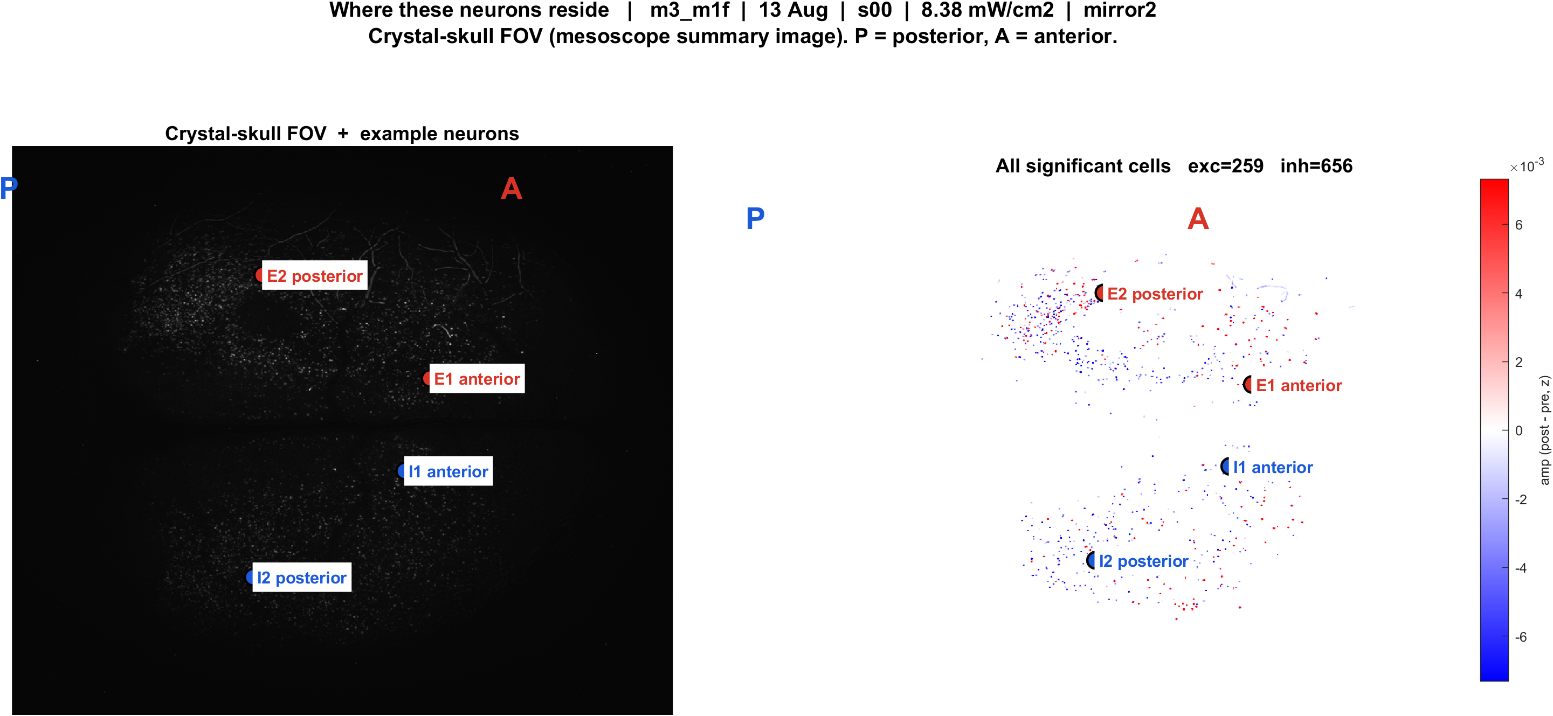
Examples | m3 m1f s00 pwr8.38 mirror2 | 48 pokes
What: m3_m1f, 13 Aug, s00, 8.38 mW/cm2, mirror2. Left: EXTRACT traces + STA. Right: those cells on the crystal-skull FOV.
Result: E1 anterior #1220, E2 posterior #571, I1 anterior #1344, I2 posterior #1833

