Slide 1
Example neurons from each recording
13 Aug (12) + 18 Aug (6) | 18 movies | 2 excited + 2 inhibited cells per FOV
For each recording: strongest significant excited cell in the anterior half and posterior half, and the same for inhibited cells. Traces are EXTRACT activity with poke times. Maps show those cells on a contrast-stretched crystal-skull FOV (P left, A right).

Slide 2
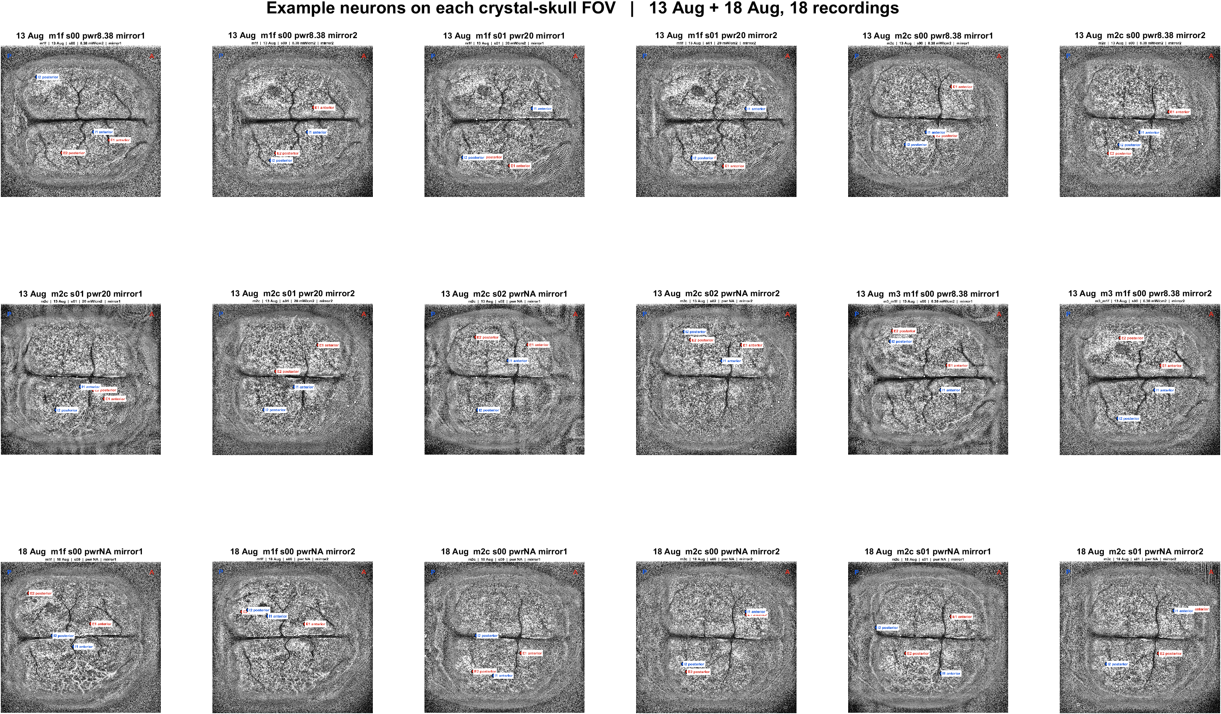
Where the example neurons sit | all 18 FOVs
What: Each panel is one crystal-skull field after contrast stretch. Red = excited examples, blue = inhibited examples. P left, A right.
Result: The same local mix appears in every recording: example excited and inhibited cells are intermingled, with E1/I1 more anterior and E2/I2 more posterior.

Slide 3
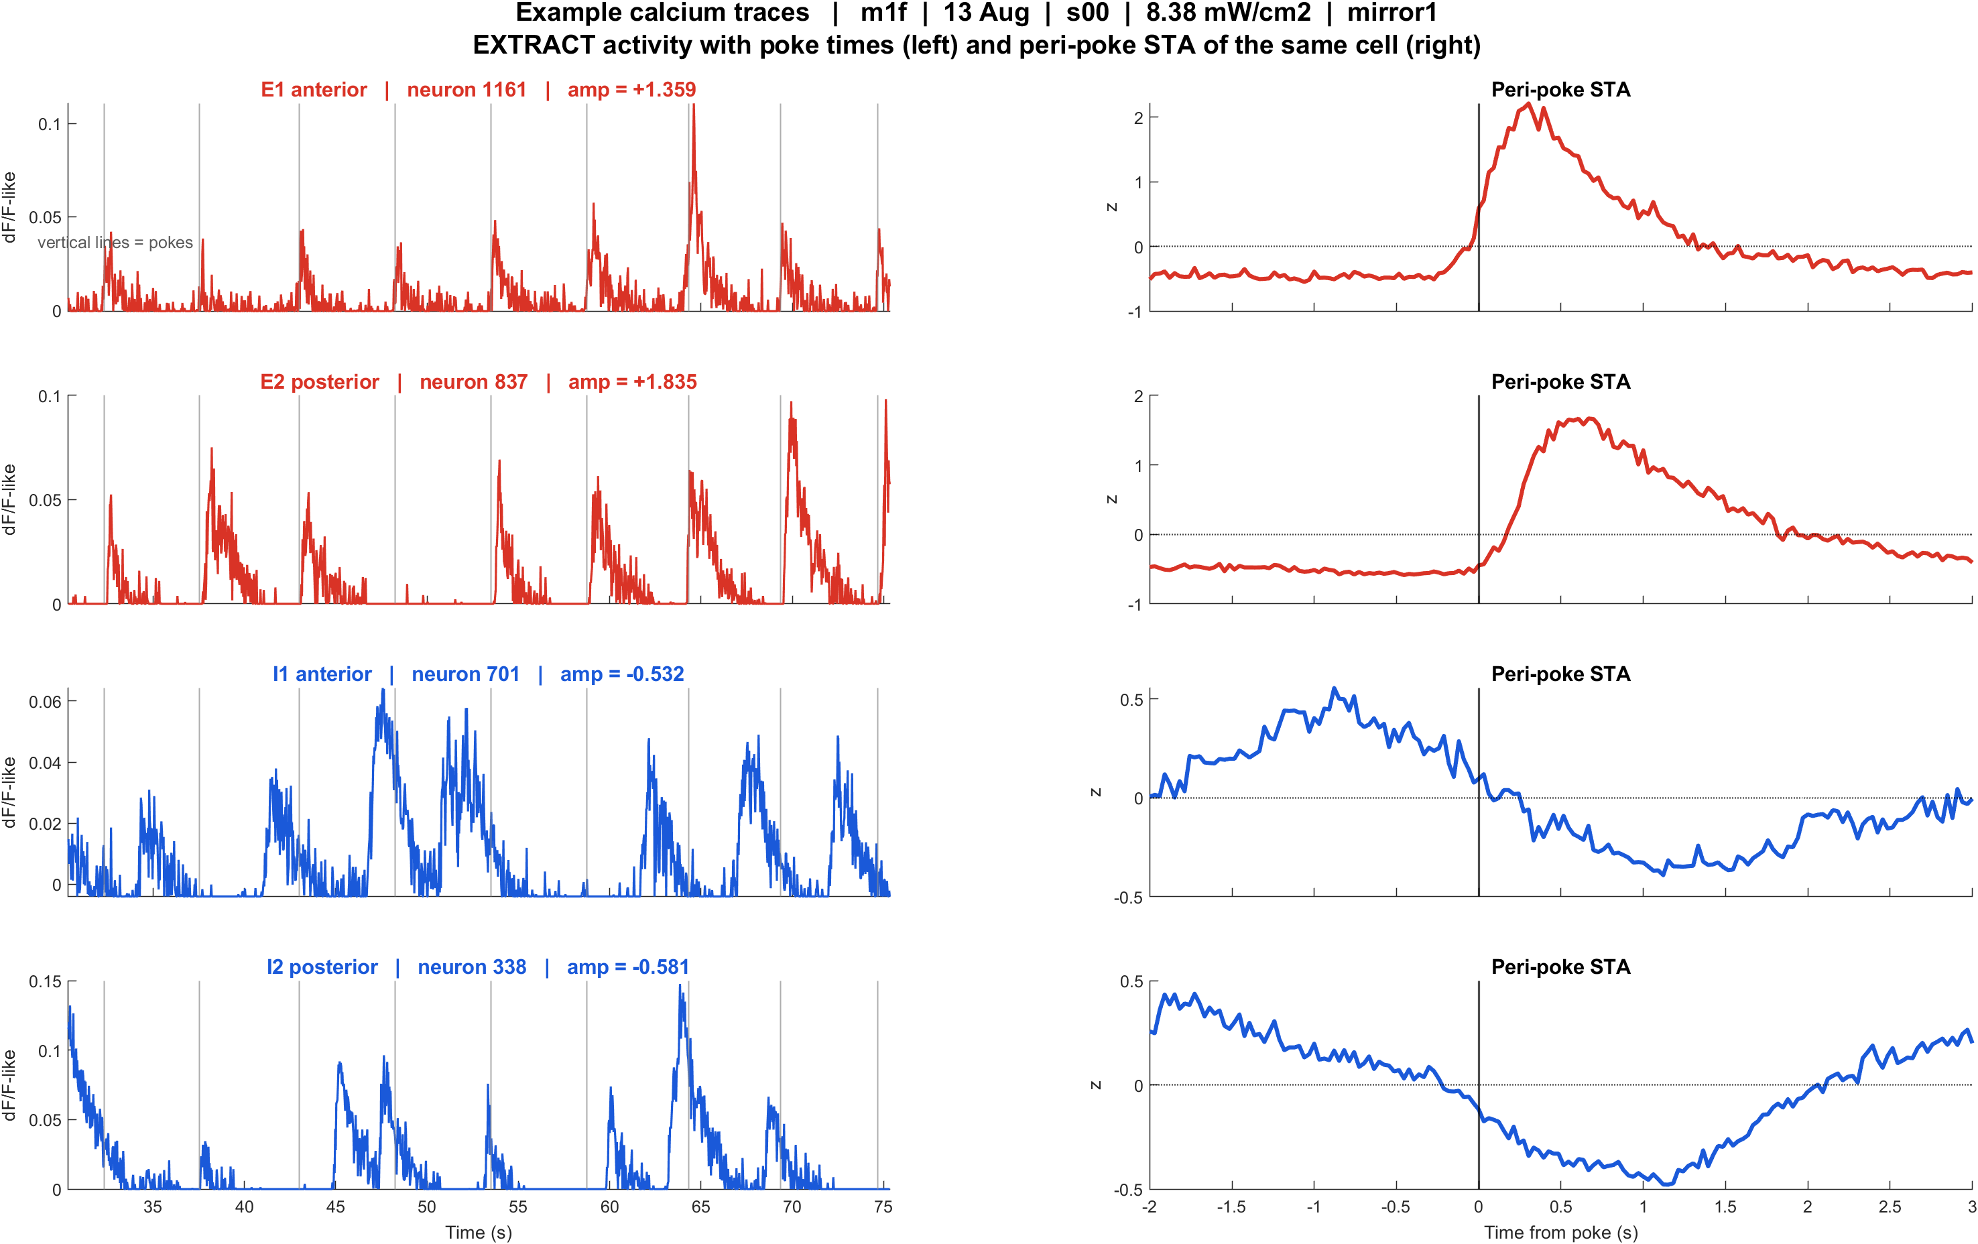
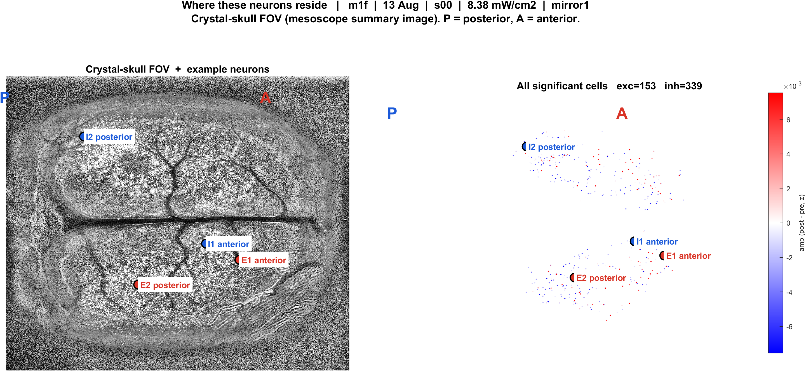
Examples | 13 Aug | m1f s00 pwr8.38 mirror1 | 56 pokes
What: m1f, 13 Aug, s00, 8.38 mW/cm2, mirror1. Left: EXTRACT traces + STA. Right: those cells on the crystal-skull FOV.
Result: E1 anterior #1161, E2 posterior #837, I1 anterior #701, I2 posterior #338

Slide 4
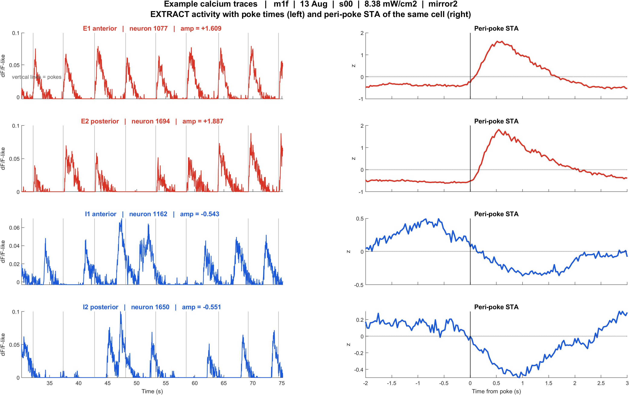
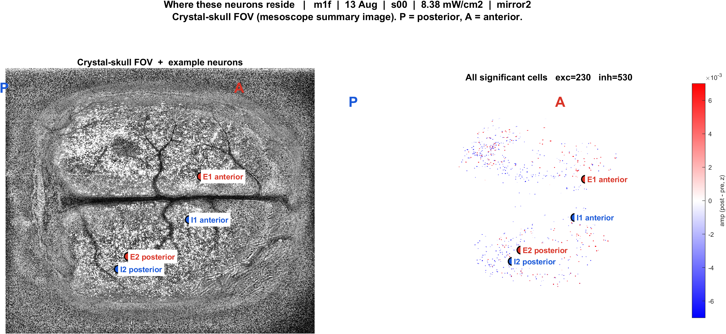
Examples | 13 Aug | m1f s00 pwr8.38 mirror2 | 55 pokes
What: m1f, 13 Aug, s00, 8.38 mW/cm2, mirror2. Left: EXTRACT traces + STA. Right: those cells on the crystal-skull FOV.
Result: E1 anterior #1077, E2 posterior #1694, I1 anterior #1162, I2 posterior #1650

Slide 5
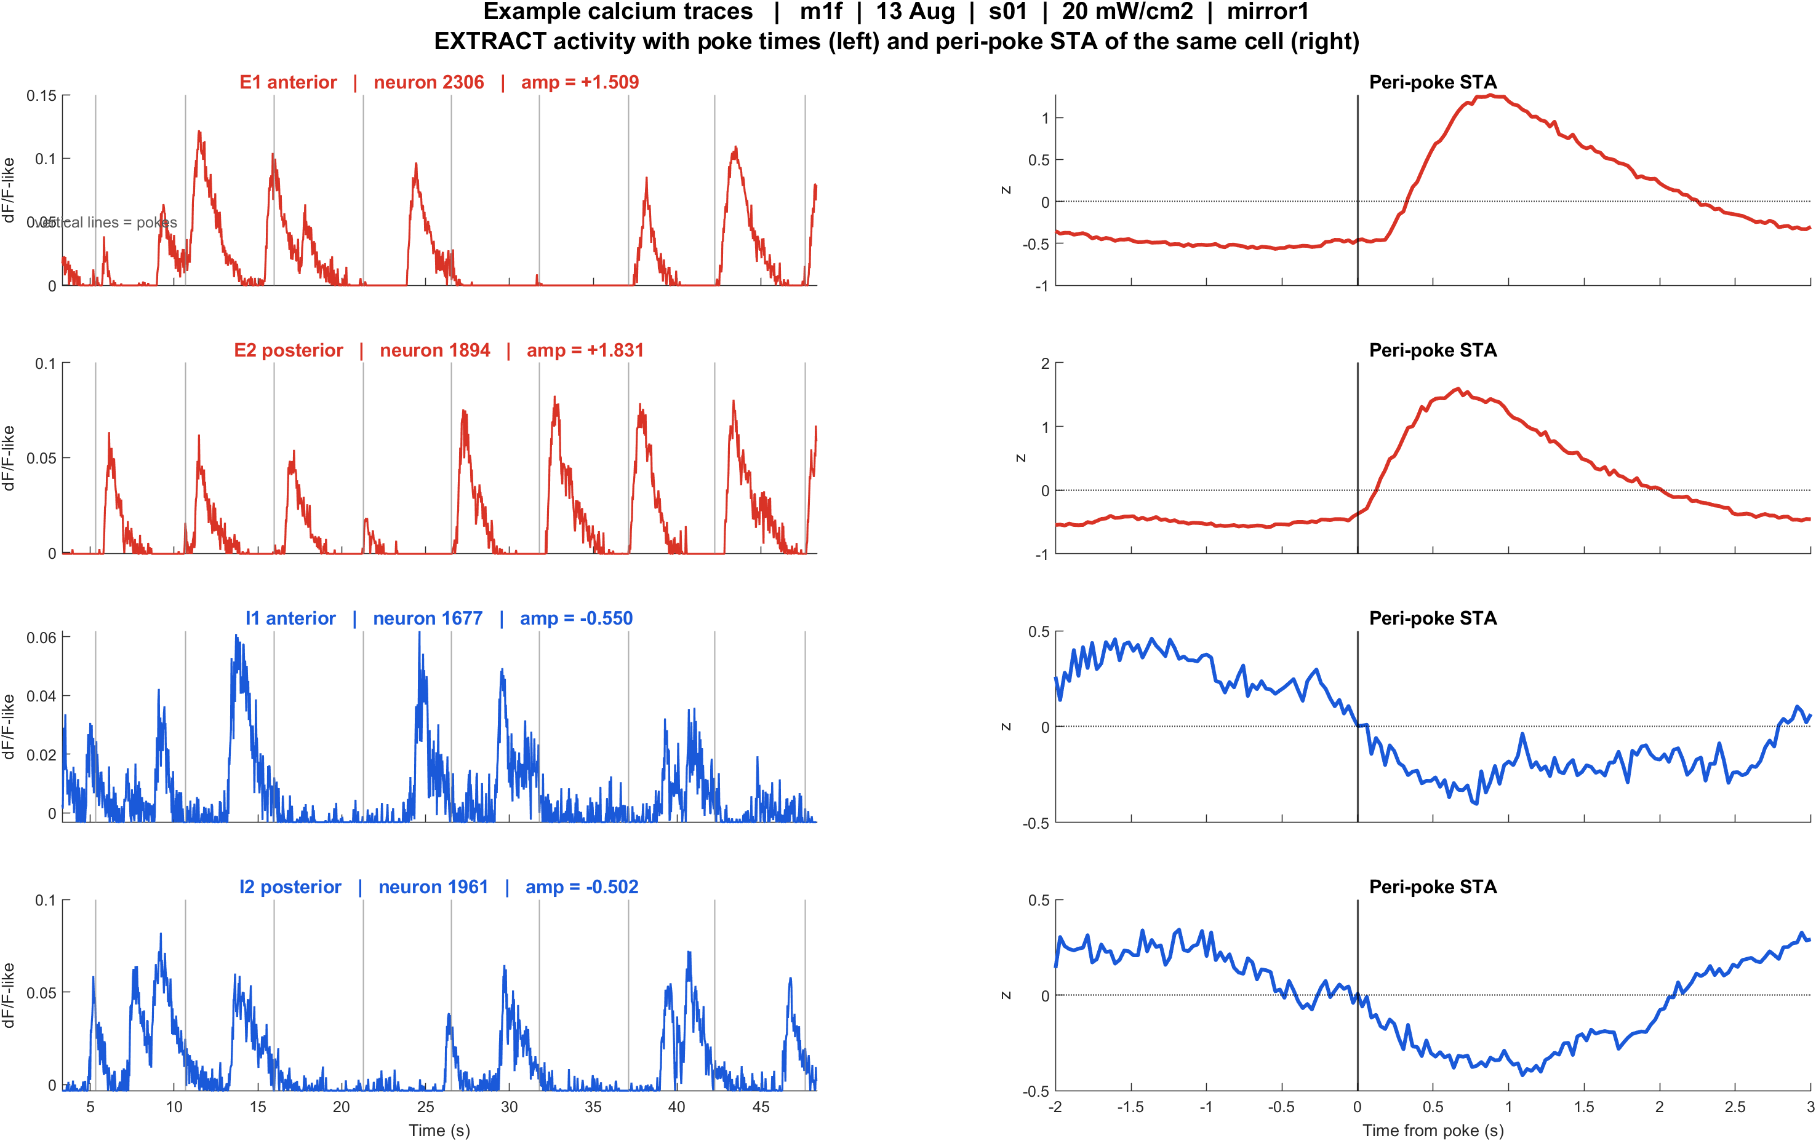
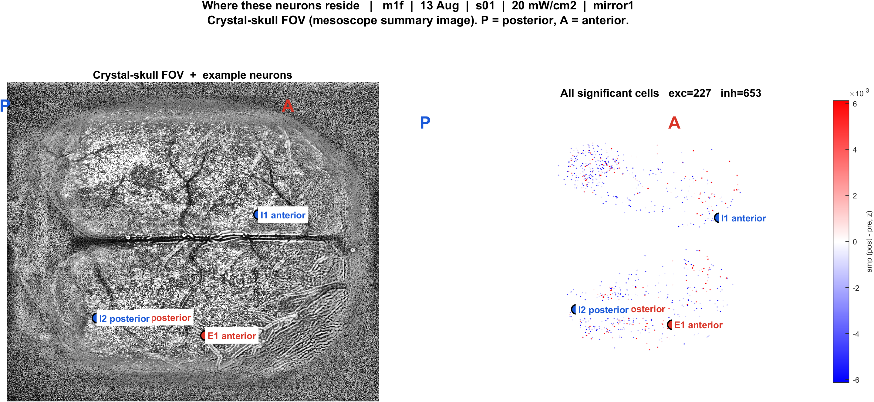
Examples | 13 Aug | m1f s01 pwr20 mirror1 | 57 pokes
What: m1f, 13 Aug, s01, 20 mW/cm2, mirror1. Left: EXTRACT traces + STA. Right: those cells on the crystal-skull FOV.
Result: E1 anterior #2306, E2 posterior #1894, I1 anterior #1677, I2 posterior #1961

Slide 6
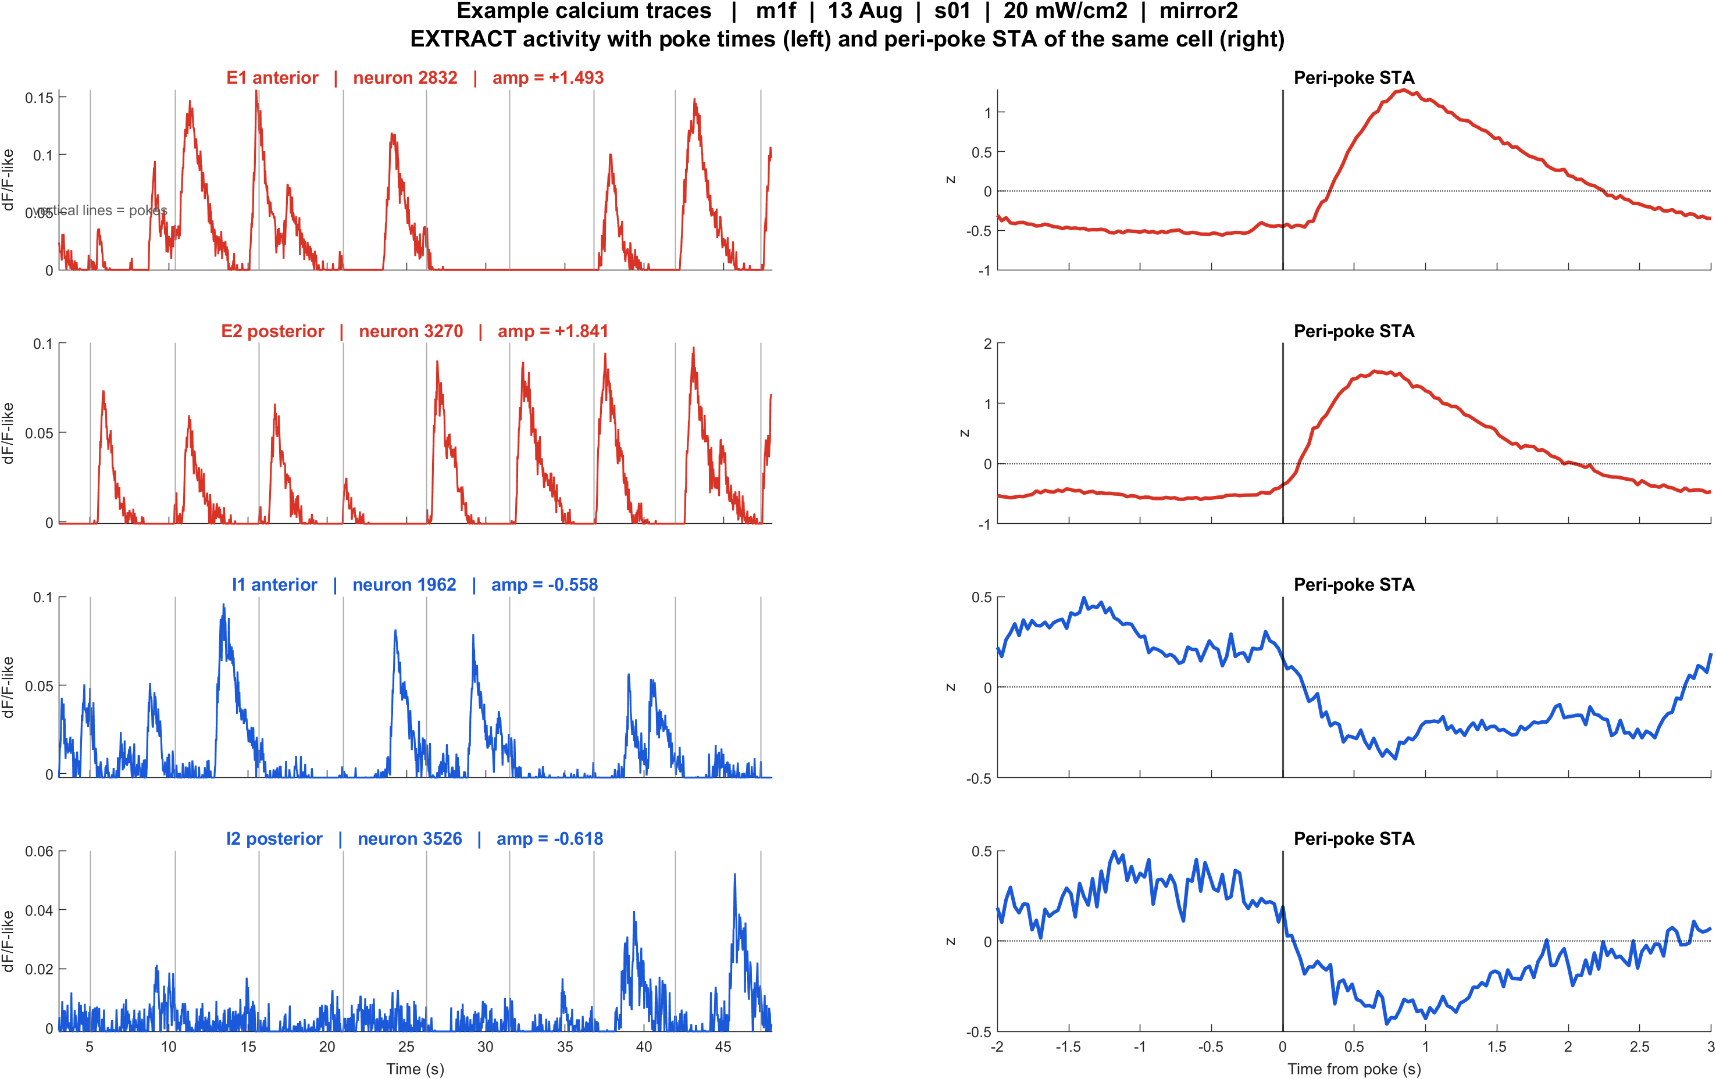
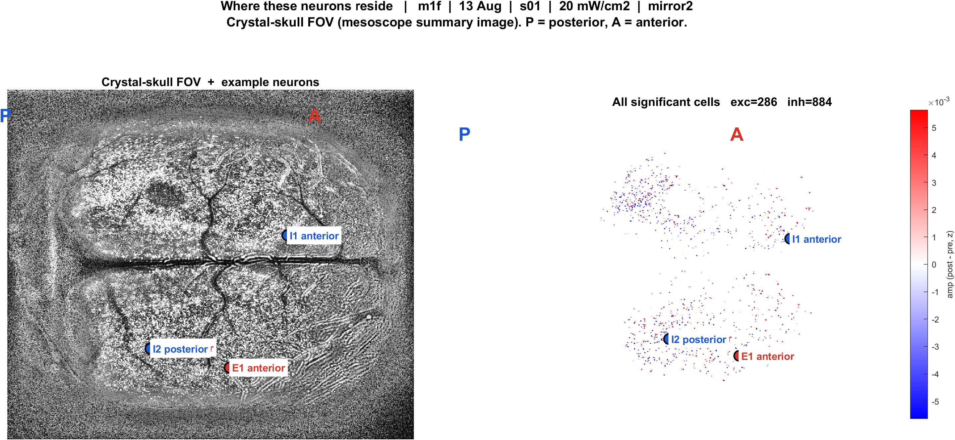
Examples | 13 Aug | m1f s01 pwr20 mirror2 | 57 pokes
What: m1f, 13 Aug, s01, 20 mW/cm2, mirror2. Left: EXTRACT traces + STA. Right: those cells on the crystal-skull FOV.
Result: E1 anterior #2832, E2 posterior #3270, I1 anterior #1962, I2 posterior #3526

Slide 7
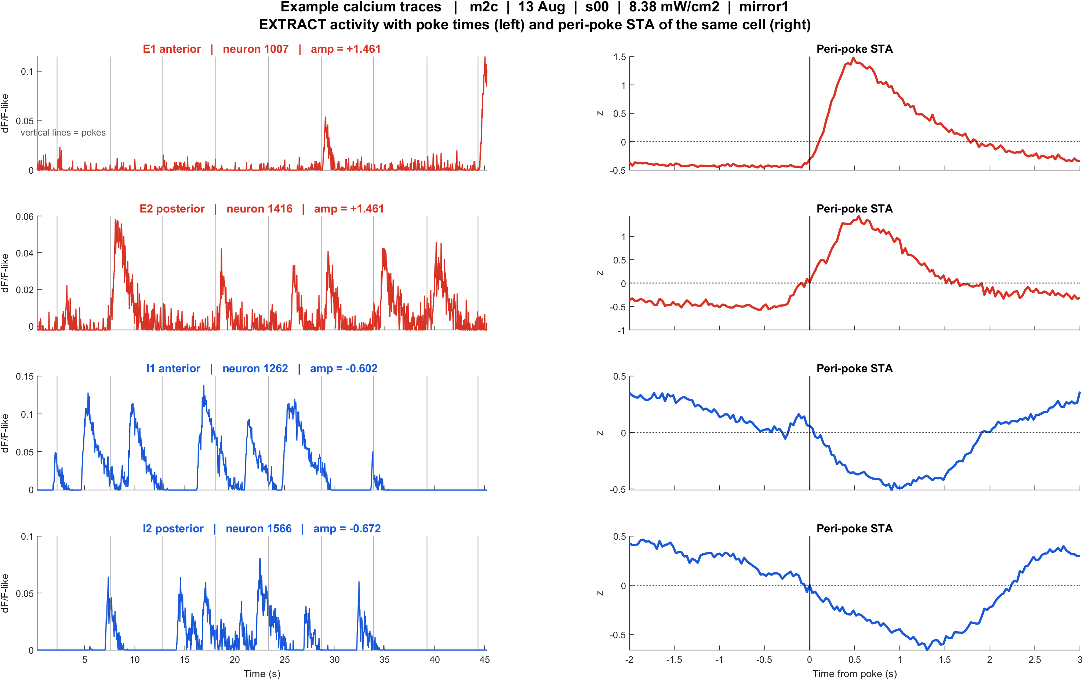
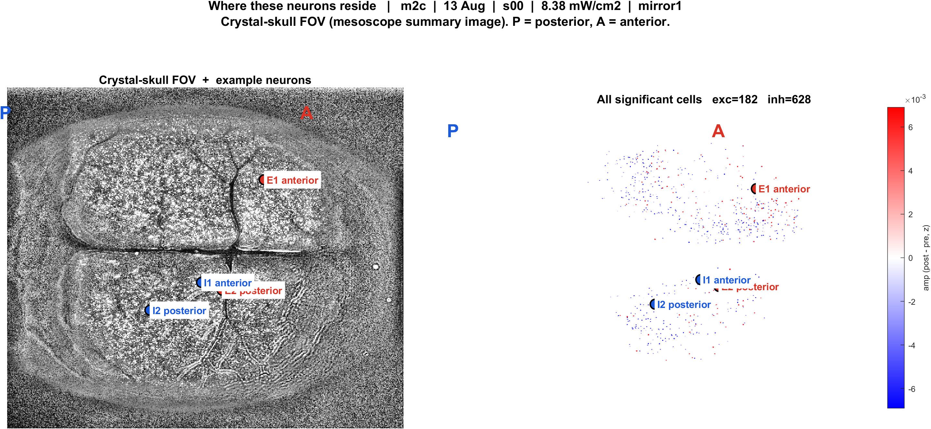
Examples | 13 Aug | m2c s00 pwr8.38 mirror1 | 57 pokes
What: m2c, 13 Aug, s00, 8.38 mW/cm2, mirror1. Left: EXTRACT traces + STA. Right: those cells on the crystal-skull FOV.
Result: E1 anterior #1007, E2 posterior #1416, I1 anterior #1262, I2 posterior #1566

Slide 8
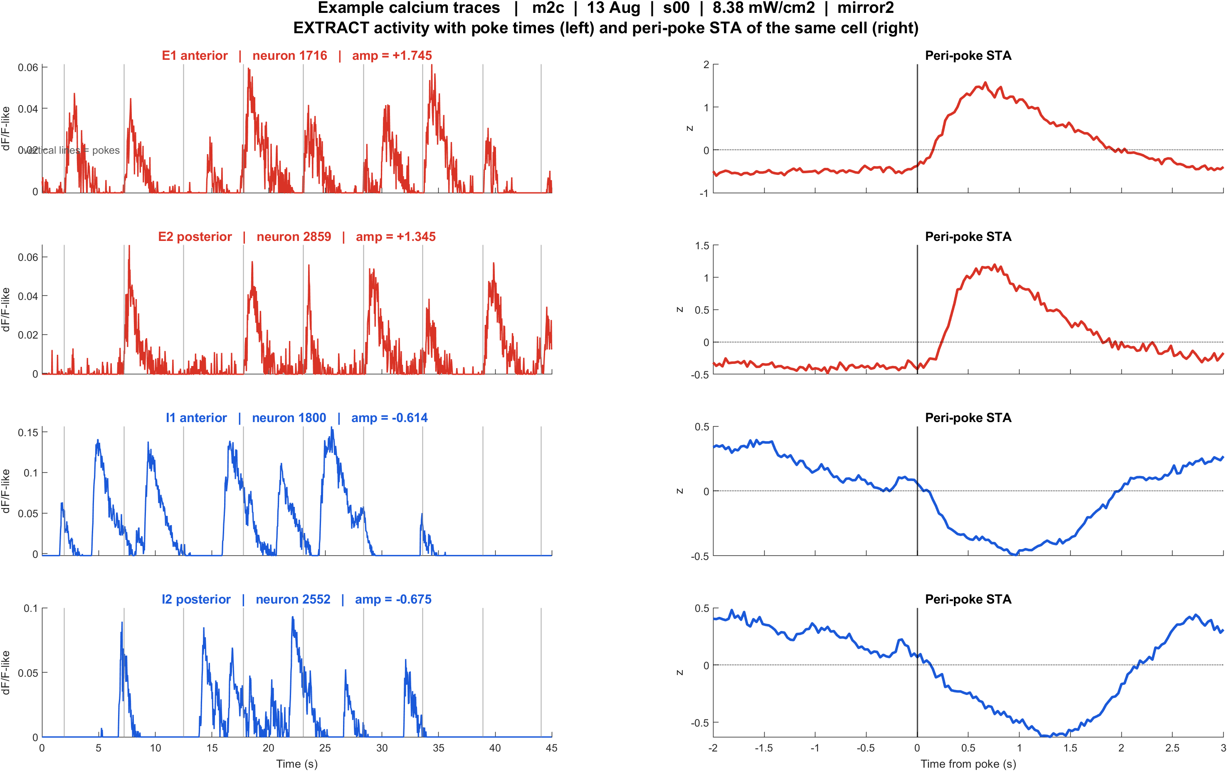
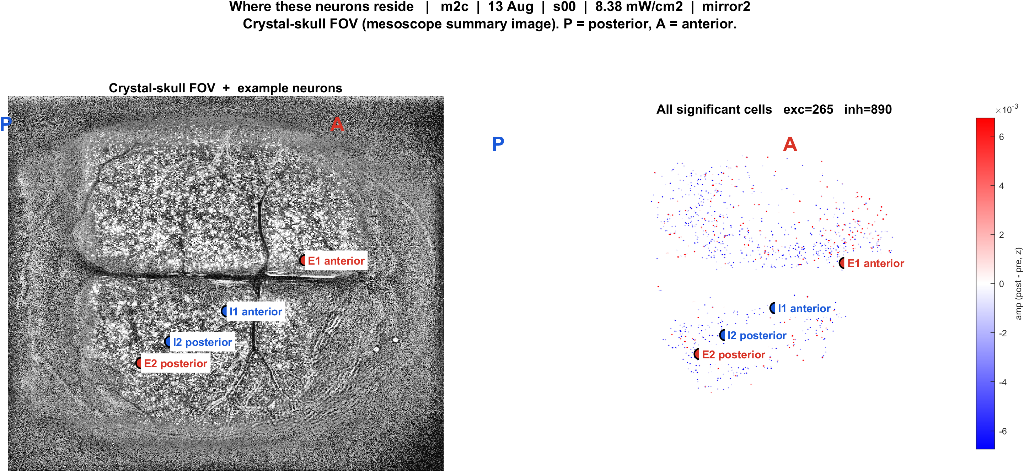
Examples | 13 Aug | m2c s00 pwr8.38 mirror2 | 57 pokes
What: m2c, 13 Aug, s00, 8.38 mW/cm2, mirror2. Left: EXTRACT traces + STA. Right: those cells on the crystal-skull FOV.
Result: E1 anterior #1716, E2 posterior #2859, I1 anterior #1800, I2 posterior #2552

Slide 9
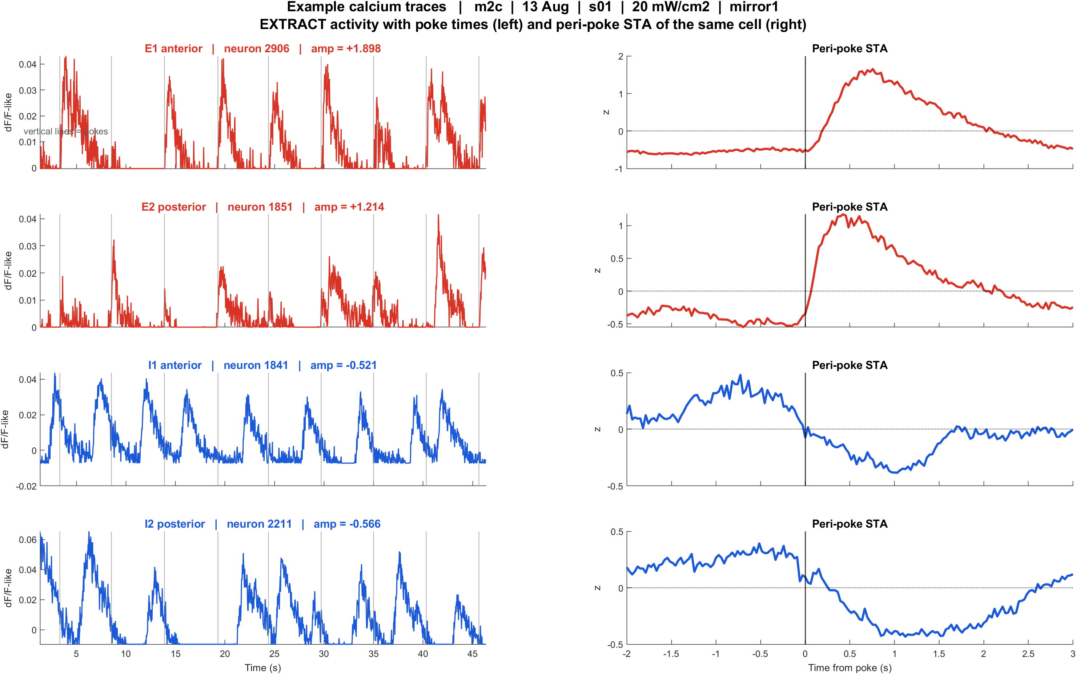
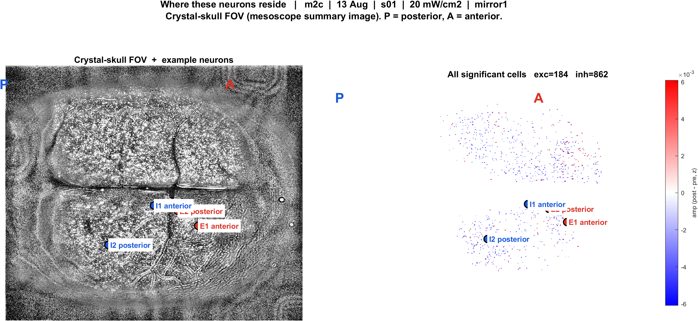
Examples | 13 Aug | m2c s01 pwr20 mirror1 | 56 pokes
What: m2c, 13 Aug, s01, 20 mW/cm2, mirror1. Left: EXTRACT traces + STA. Right: those cells on the crystal-skull FOV.
Result: E1 anterior #2906, E2 posterior #1851, I1 anterior #1841, I2 posterior #2211

Slide 10
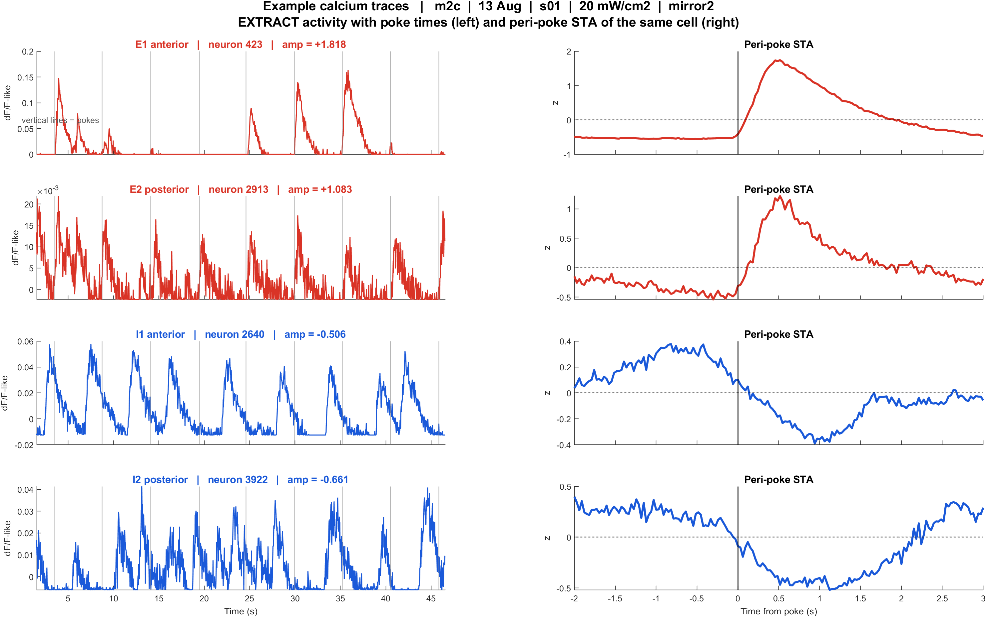
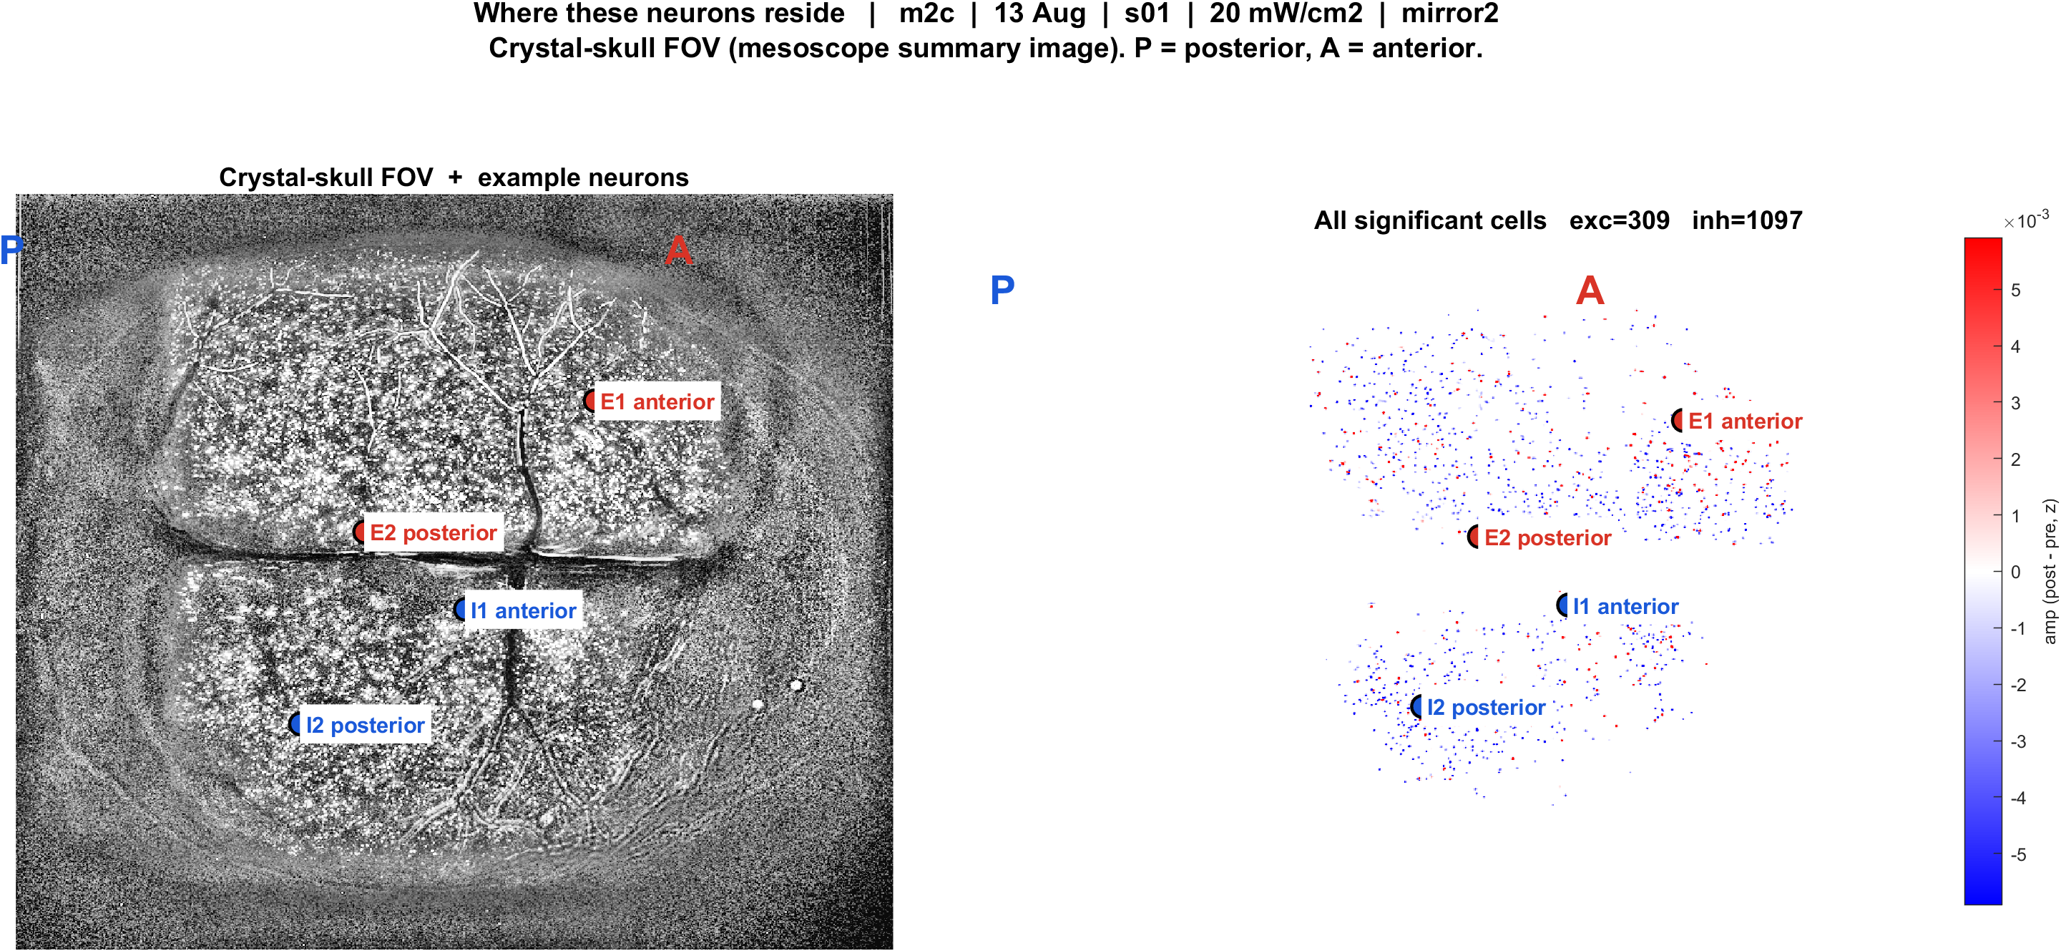
Examples | 13 Aug | m2c s01 pwr20 mirror2 | 56 pokes
What: m2c, 13 Aug, s01, 20 mW/cm2, mirror2. Left: EXTRACT traces + STA. Right: those cells on the crystal-skull FOV.
Result: E1 anterior #423, E2 posterior #2913, I1 anterior #2640, I2 posterior #3922

Slide 11
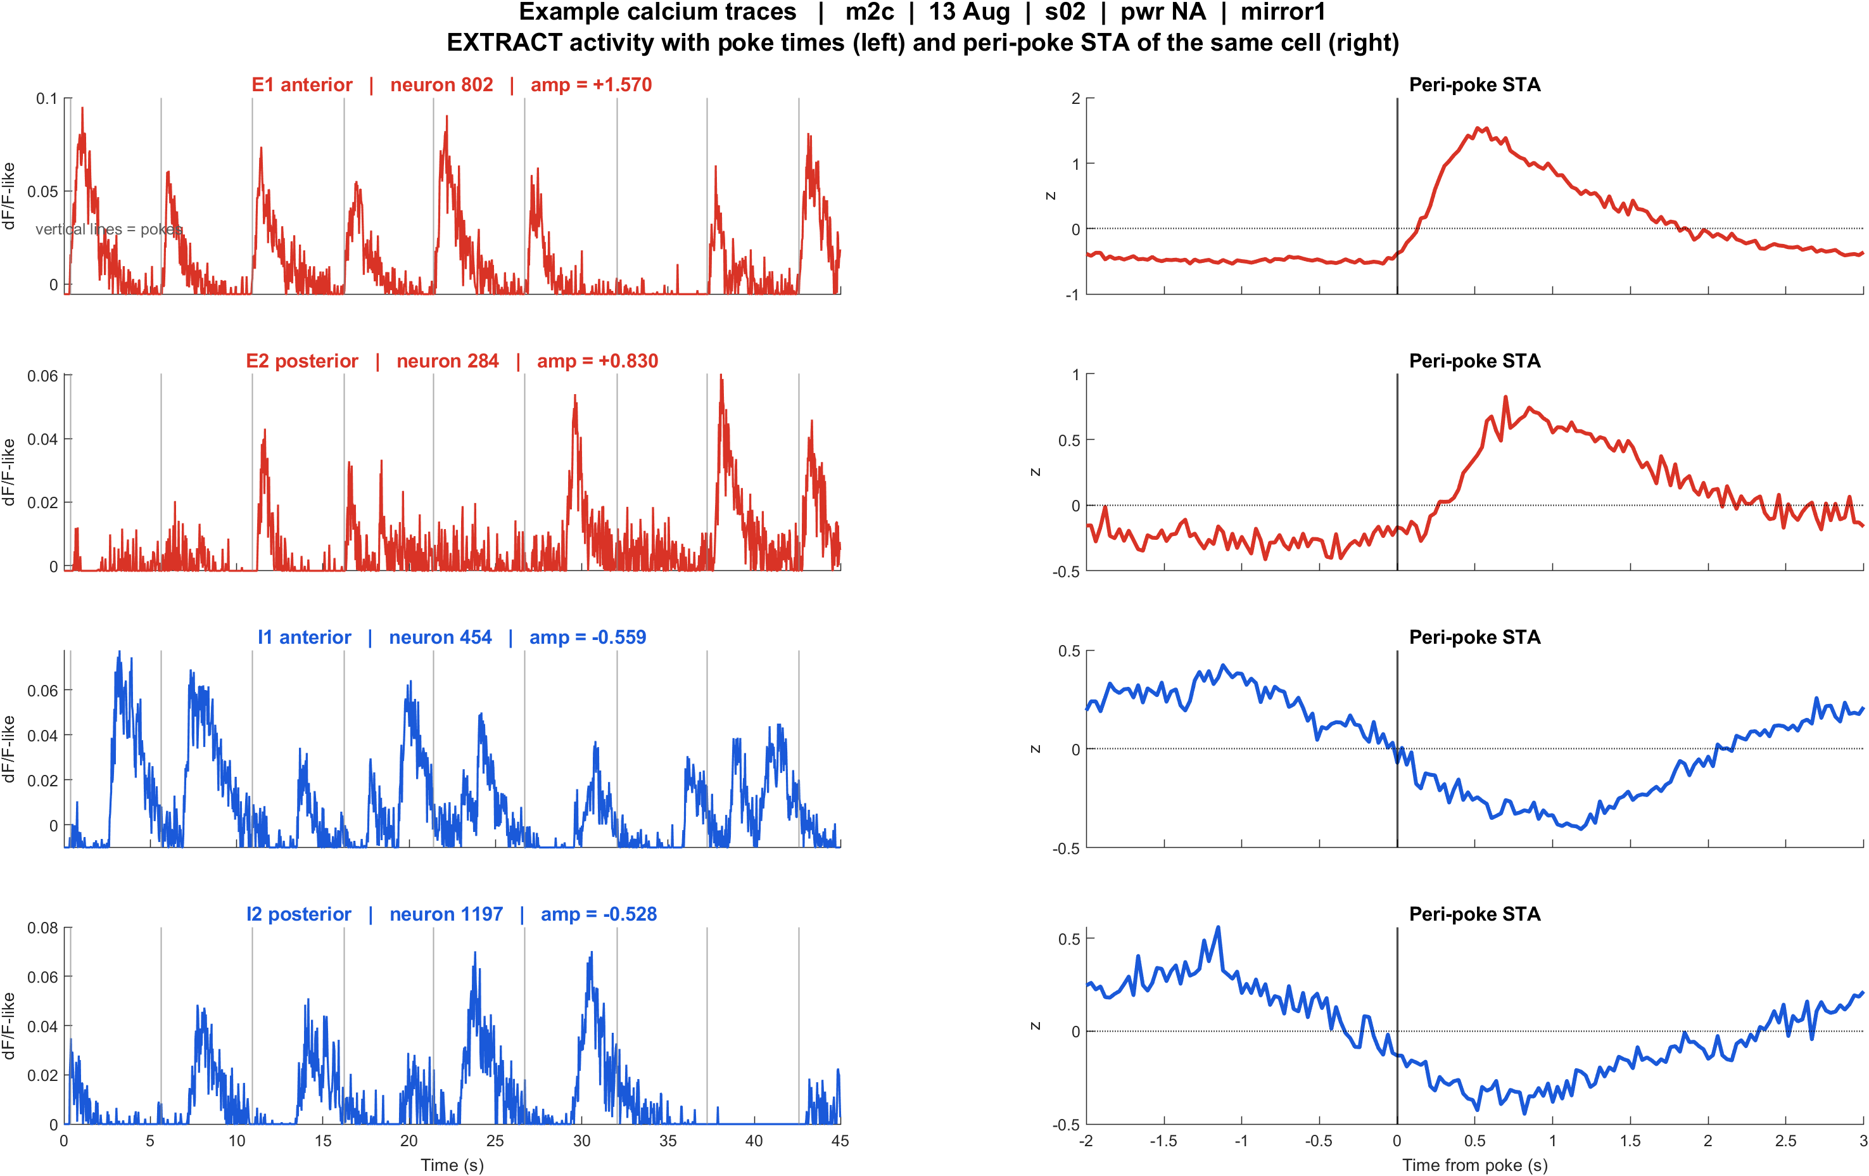
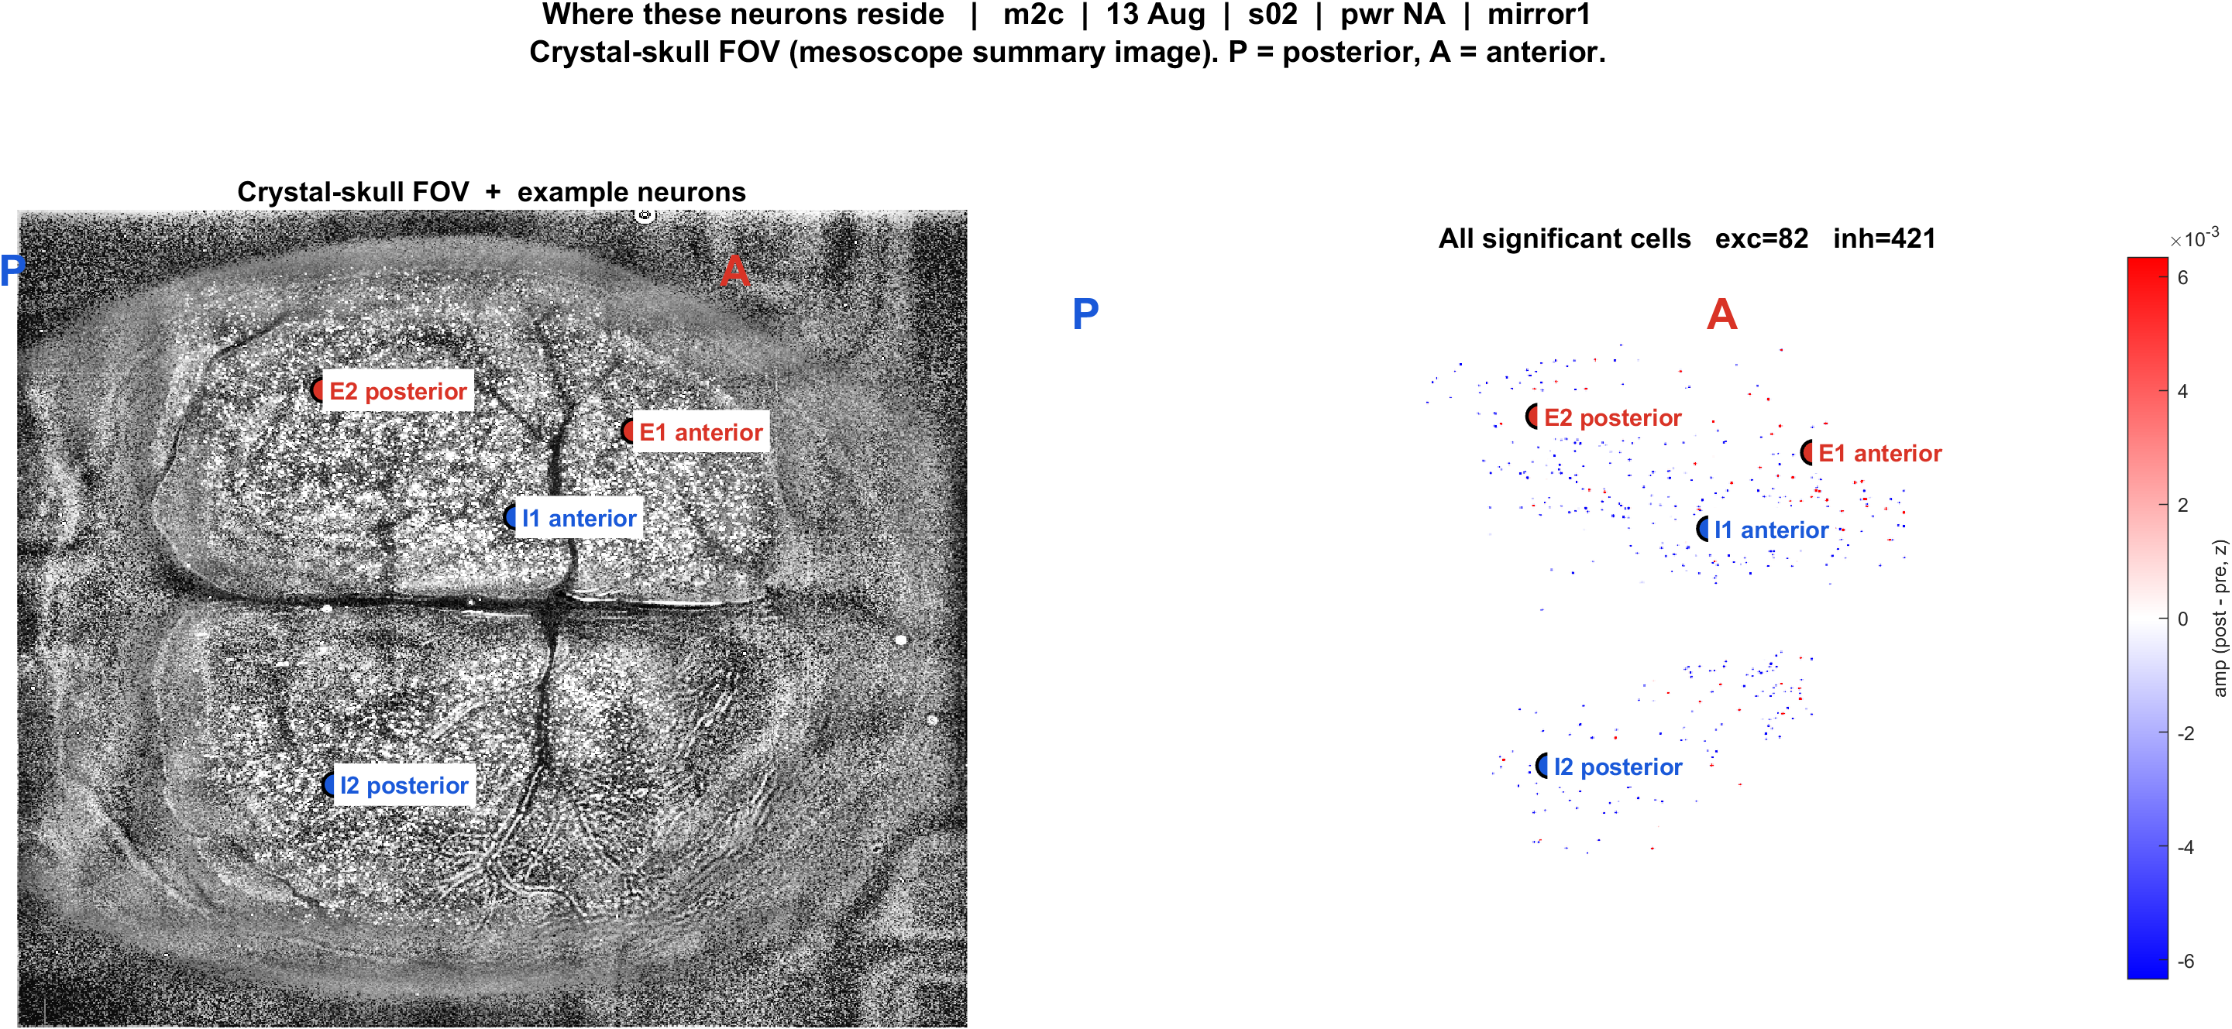
Examples | 13 Aug | m2c s02 pwrNA mirror1 | 55 pokes
What: m2c, 13 Aug, s02, pwr NA, mirror1. Left: EXTRACT traces + STA. Right: those cells on the crystal-skull FOV.
Result: E1 anterior #802, E2 posterior #284, I1 anterior #454, I2 posterior #1197

Slide 12
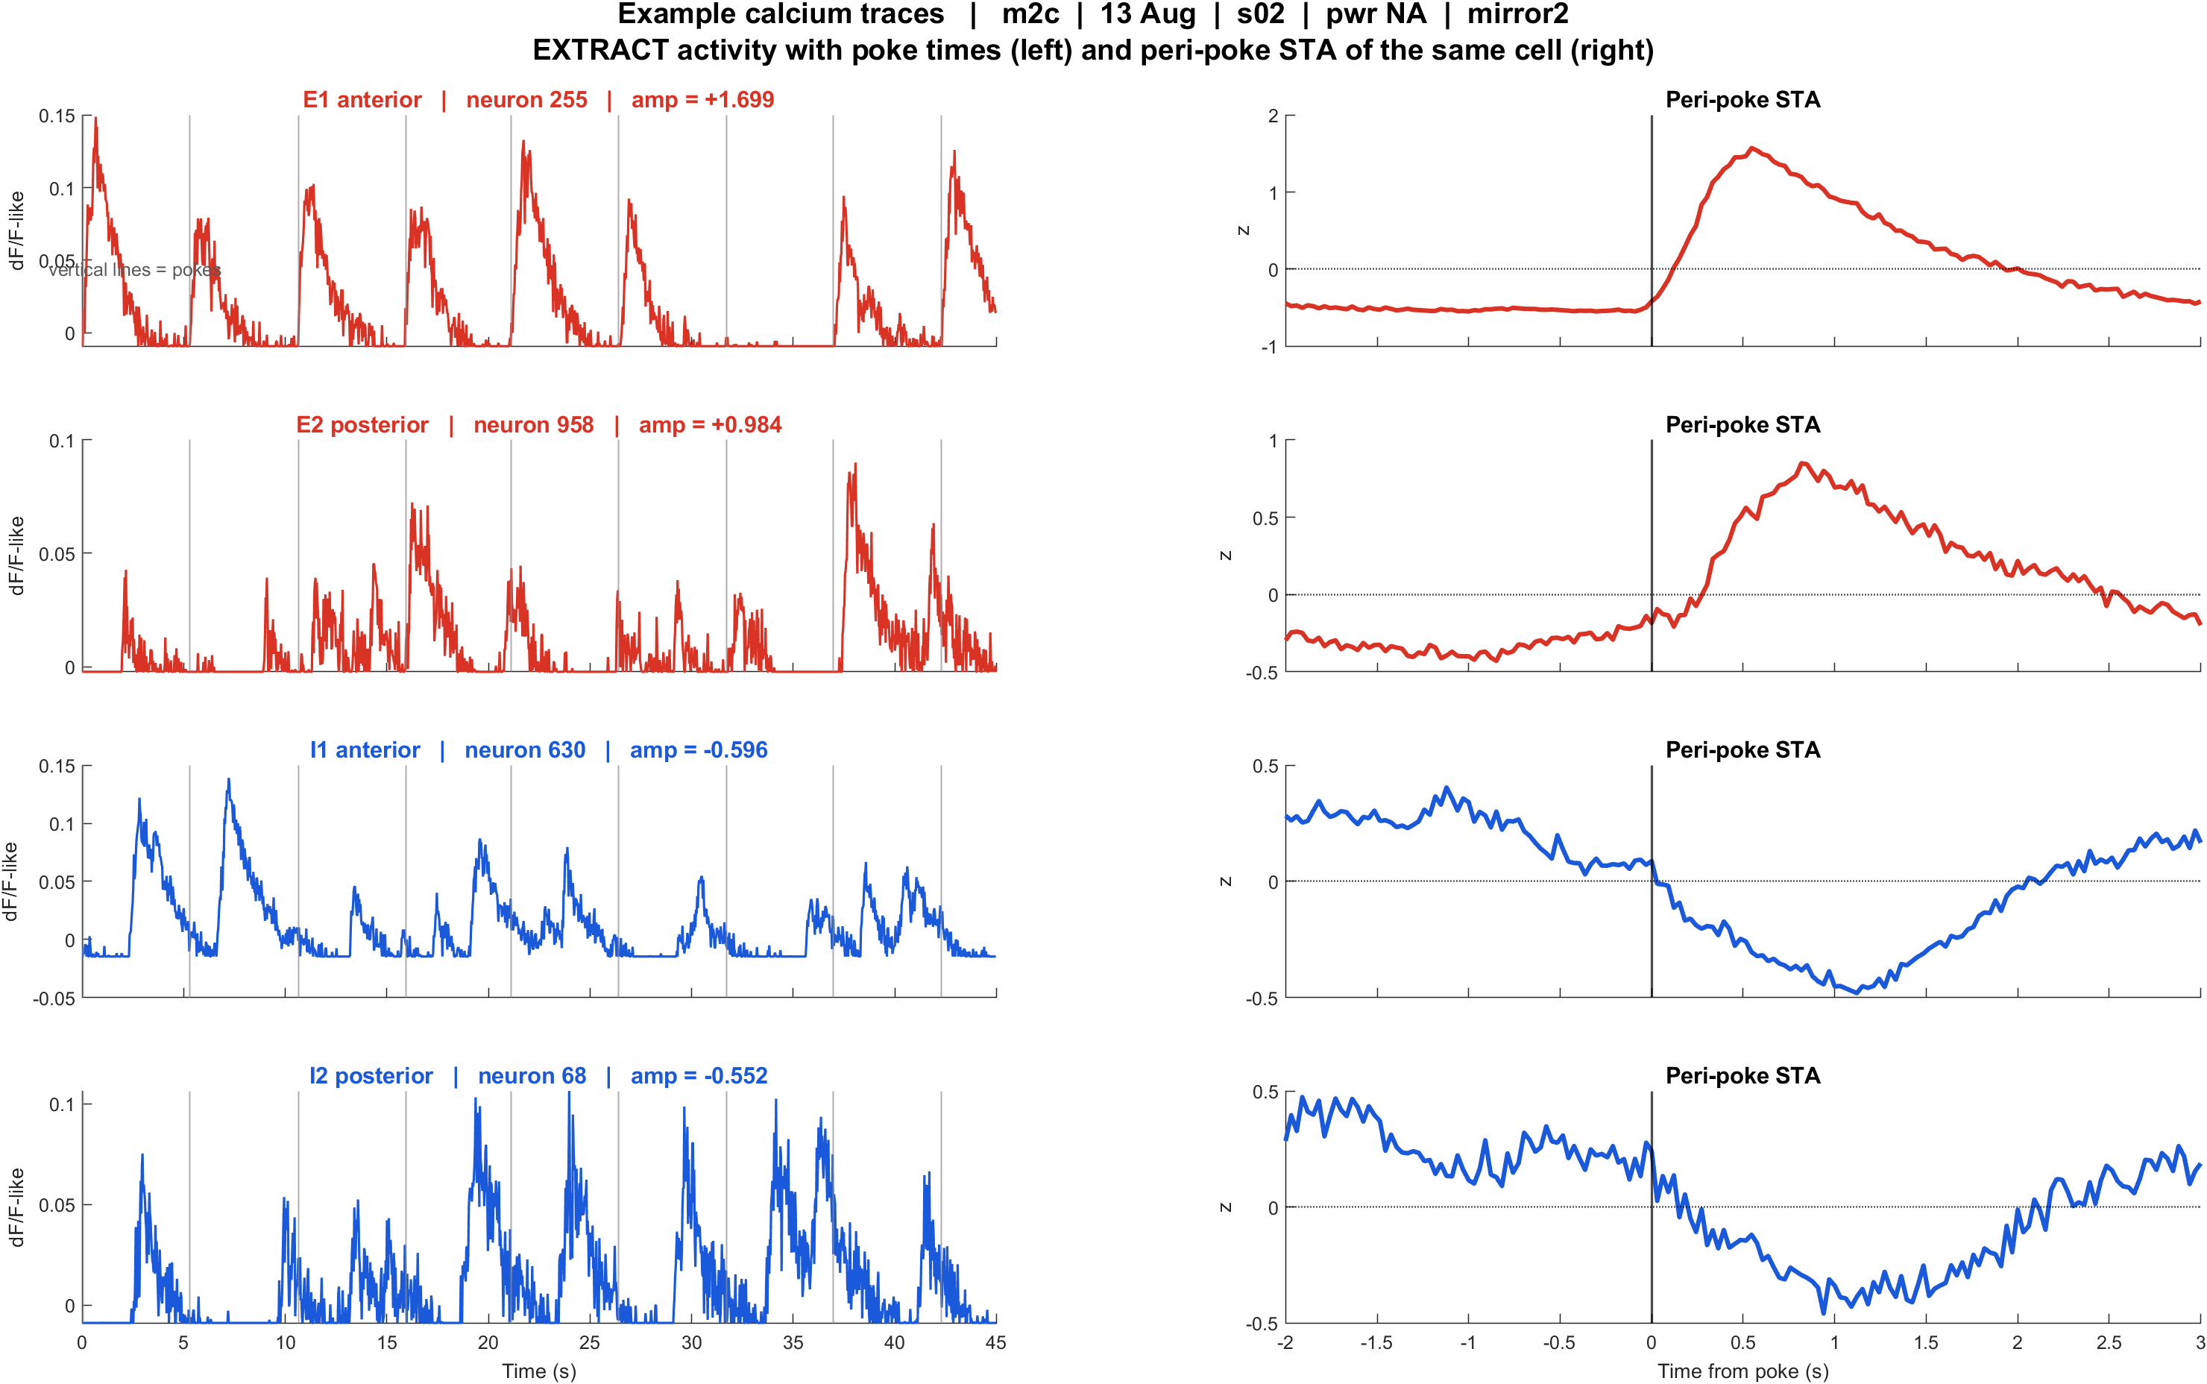
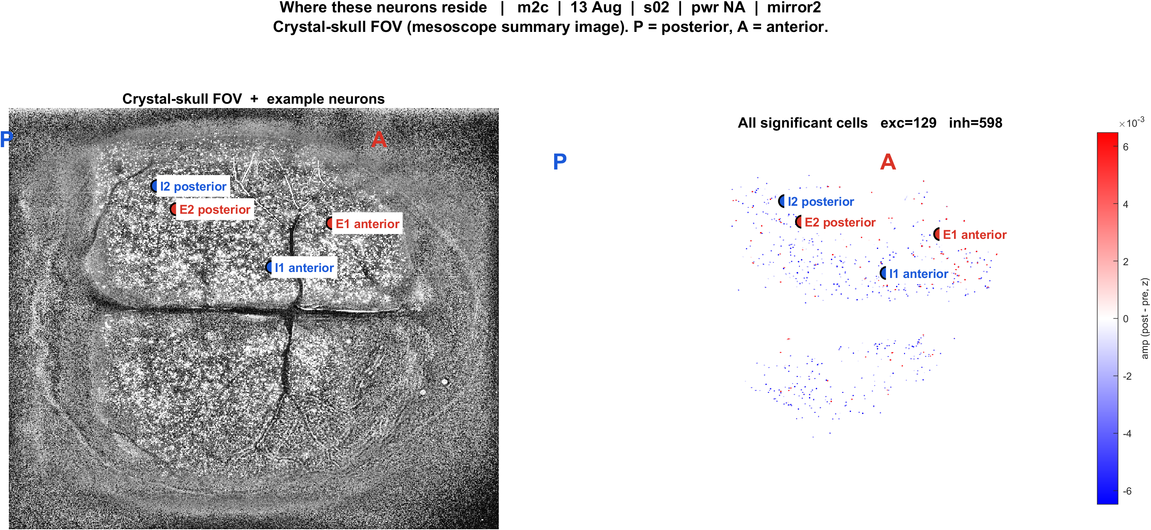
Examples | 13 Aug | m2c s02 pwrNA mirror2 | 54 pokes
What: m2c, 13 Aug, s02, pwr NA, mirror2. Left: EXTRACT traces + STA. Right: those cells on the crystal-skull FOV.
Result: E1 anterior #255, E2 posterior #958, I1 anterior #630, I2 posterior #68

Slide 13
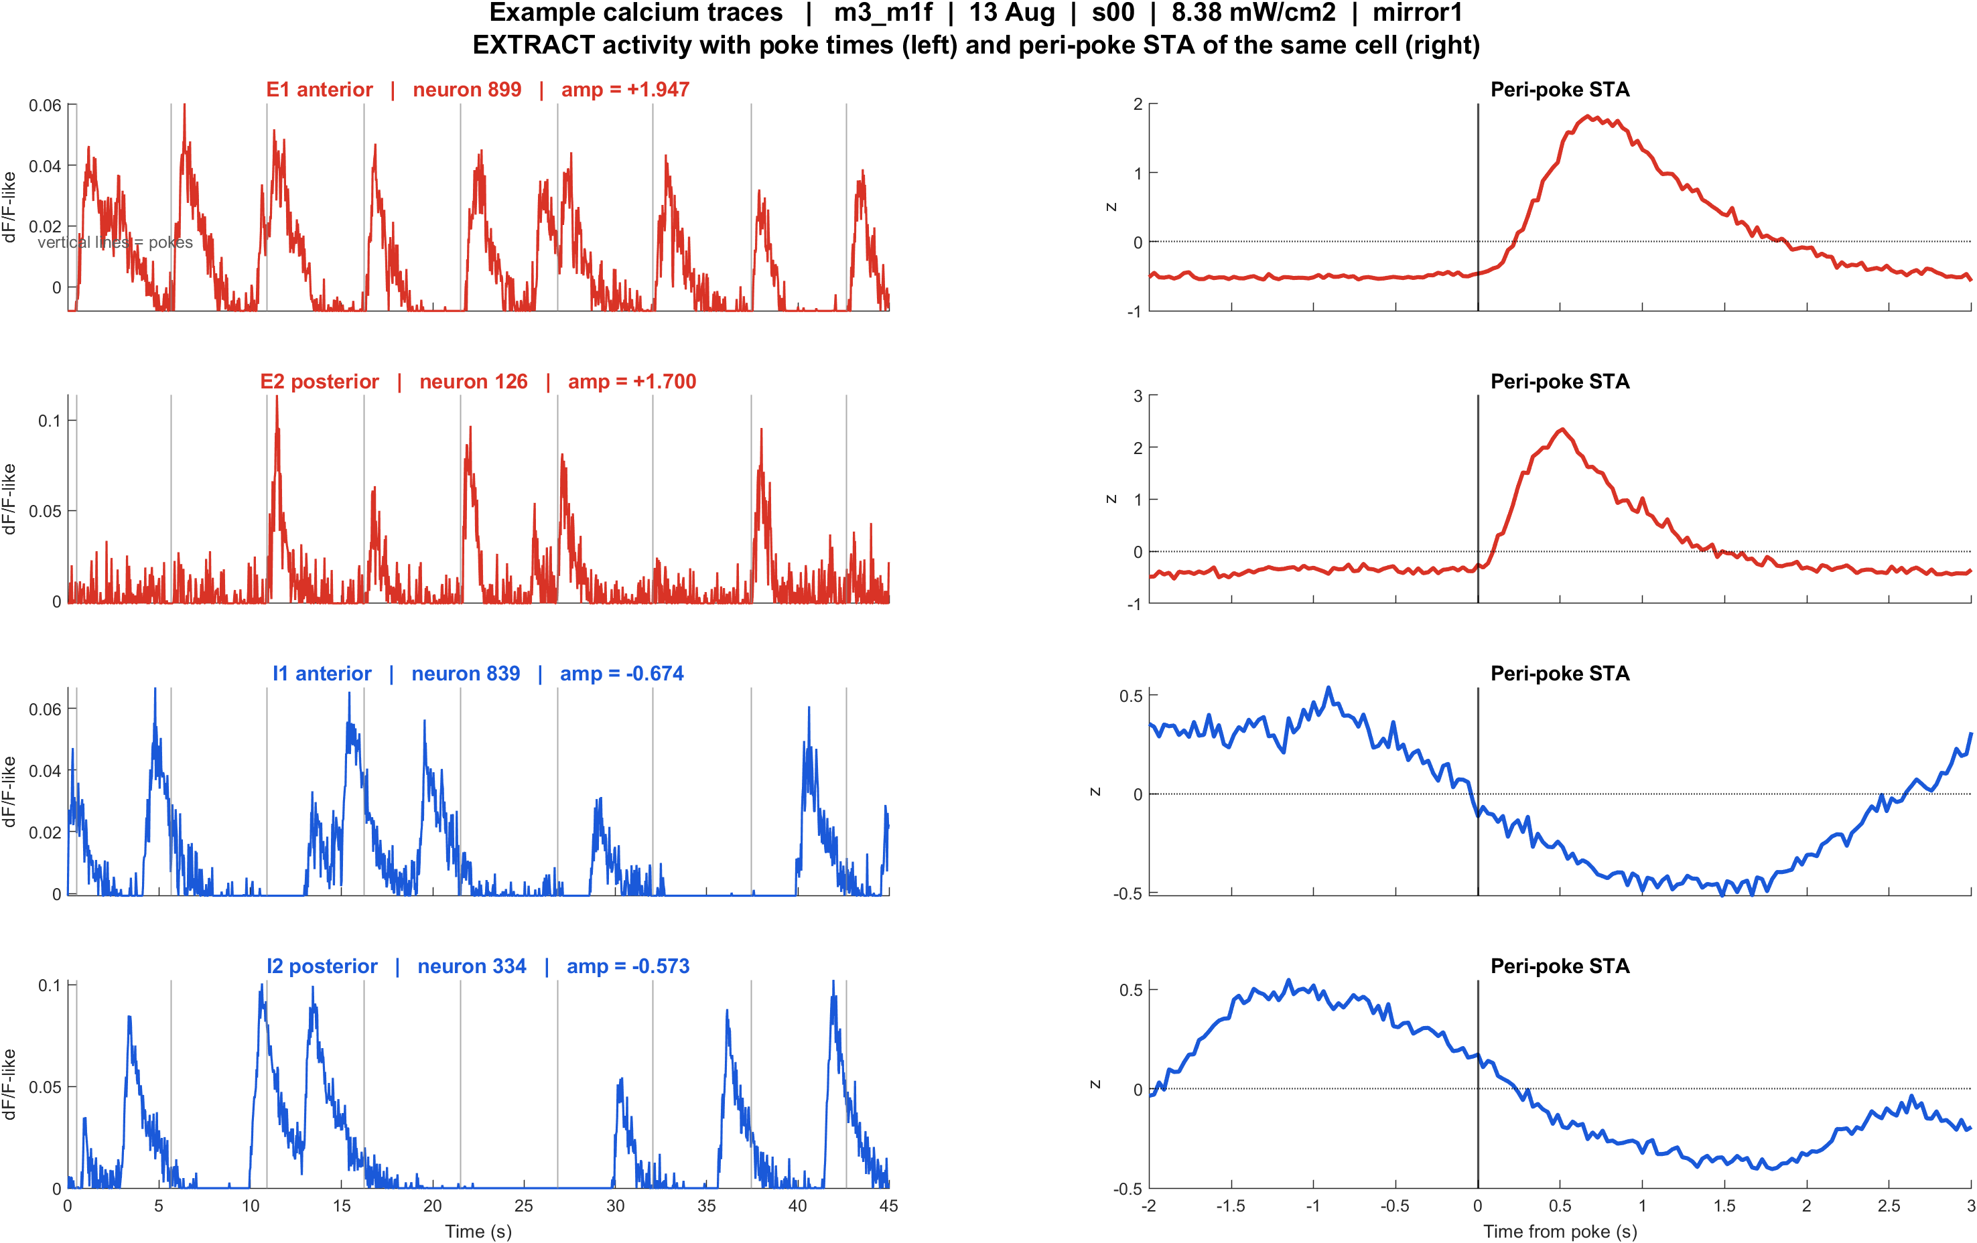
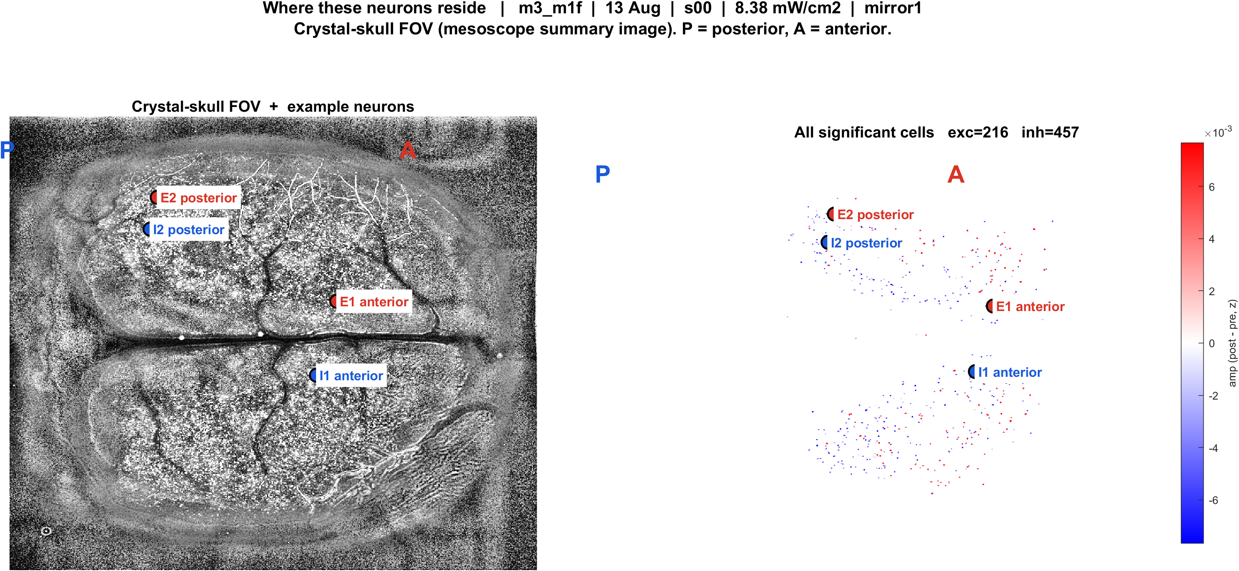
Examples | 13 Aug | m3 m1f s00 pwr8.38 mirror1 | 55 pokes
What: m3_m1f, 13 Aug, s00, 8.38 mW/cm2, mirror1. Left: EXTRACT traces + STA. Right: those cells on the crystal-skull FOV.
Result: E1 anterior #899, E2 posterior #126, I1 anterior #839, I2 posterior #334

Slide 14
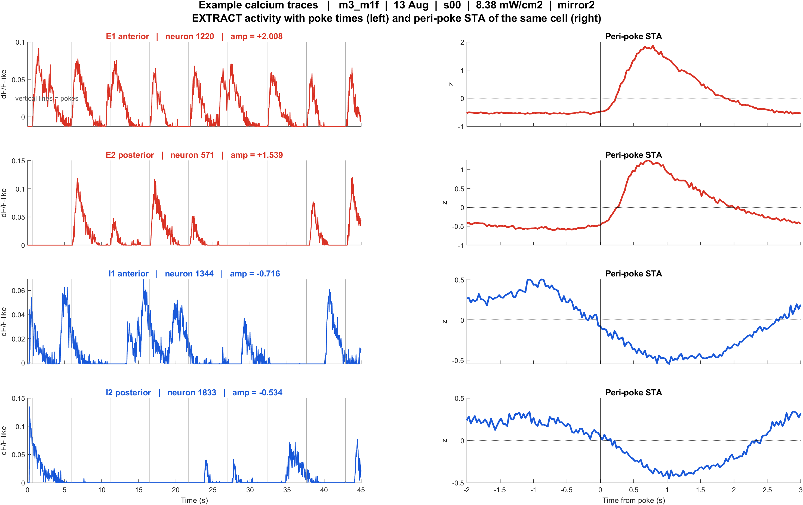

Examples | 13 Aug | m3 m1f s00 pwr8.38 mirror2 | 48 pokes
What: m3_m1f, 13 Aug, s00, 8.38 mW/cm2, mirror2. Left: EXTRACT traces + STA. Right: those cells on the crystal-skull FOV.
Result: E1 anterior #1220, E2 posterior #571, I1 anterior #1344, I2 posterior #1833

Slide 15
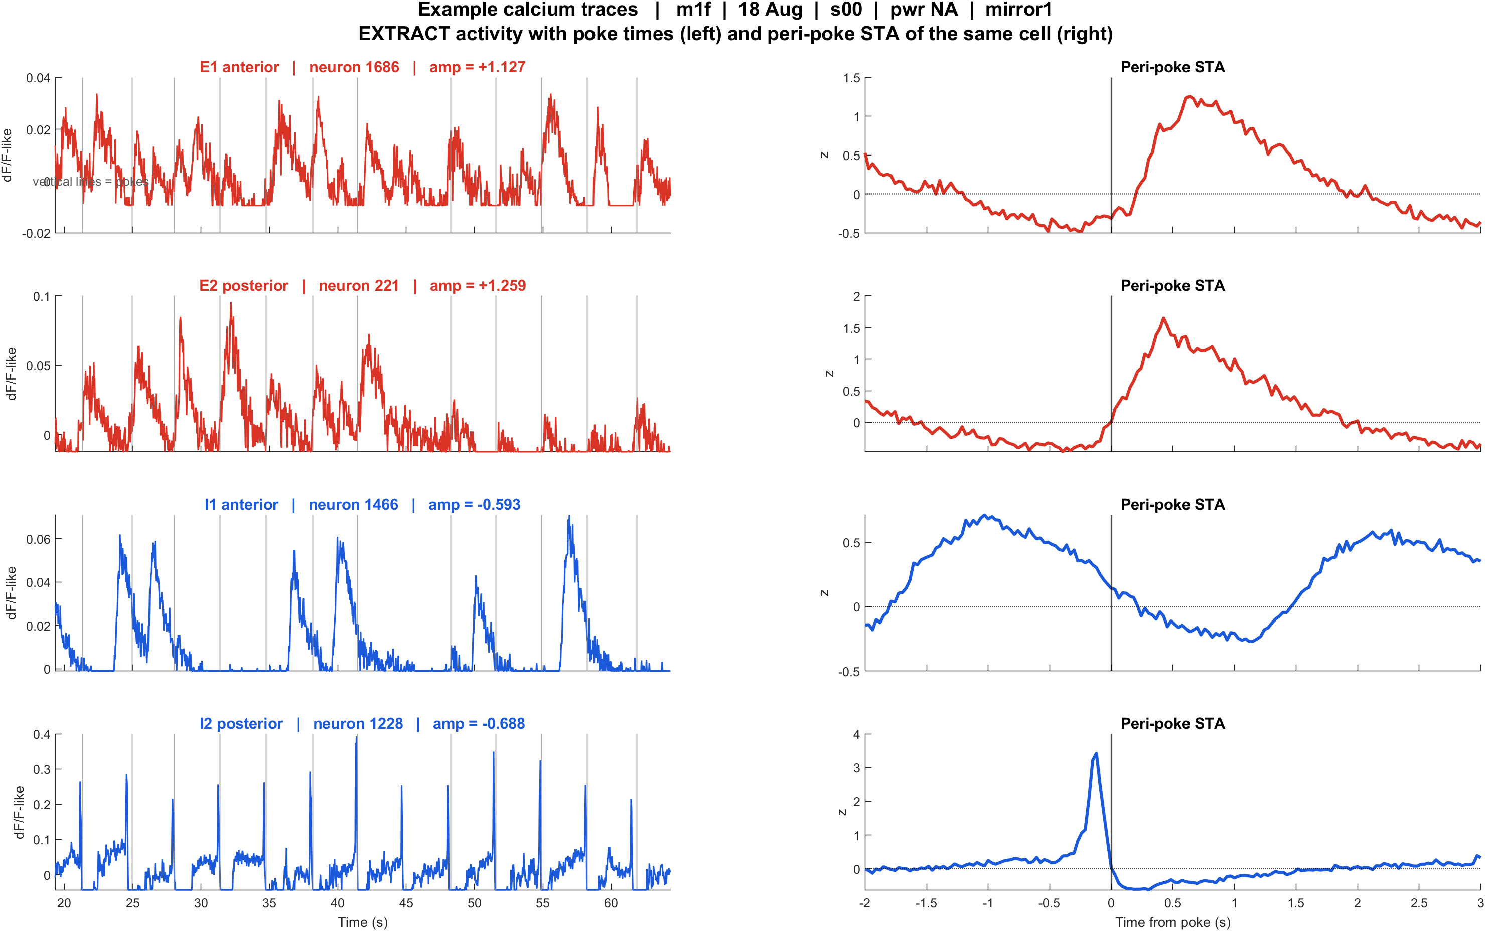
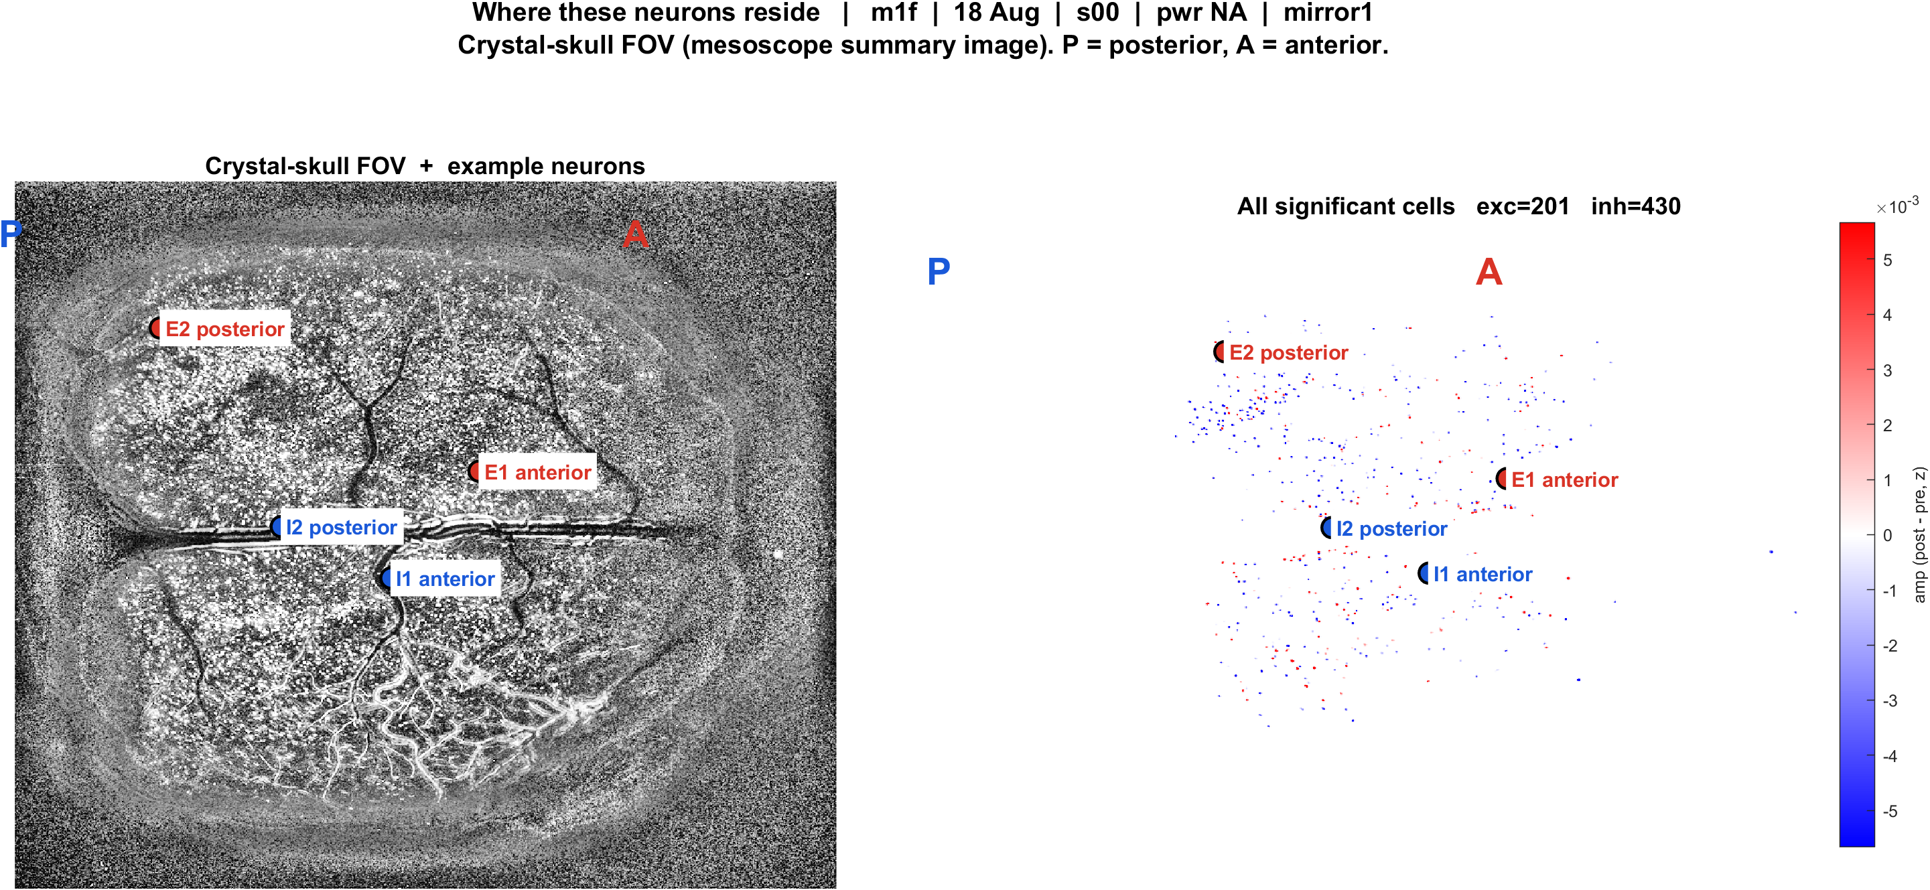
Examples | 18 Aug | m1f s00 pwrNA mirror1 | 43 pokes
What: m1f, 18 Aug, s00, pwr NA, mirror1. Left: EXTRACT traces + STA. Right: those cells on the crystal-skull FOV.
Result: E1 anterior #1686, E2 posterior #221, I1 anterior #1466, I2 posterior #1228

Slide 16
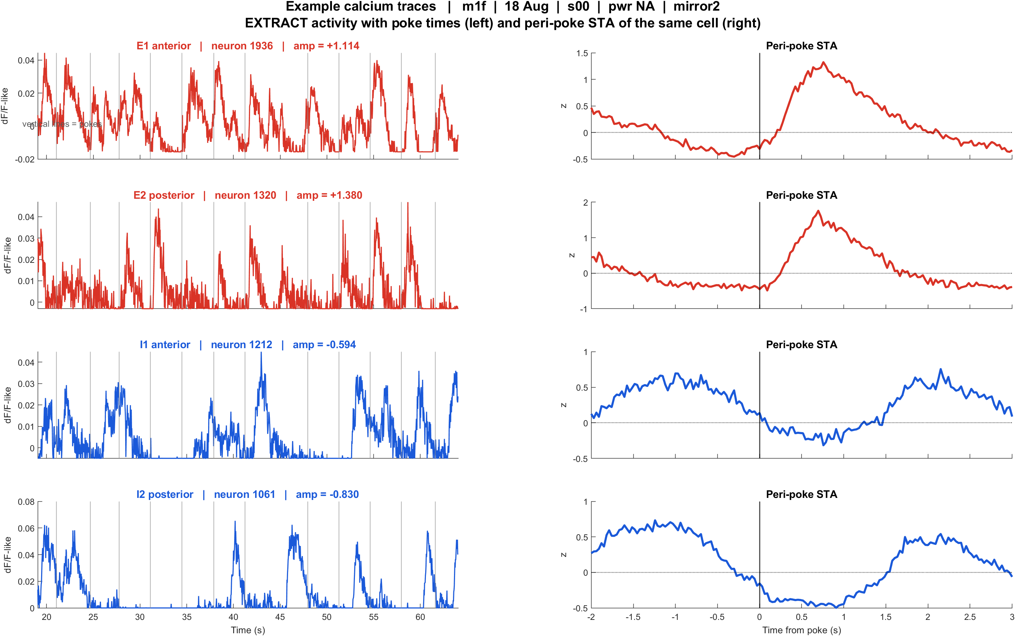
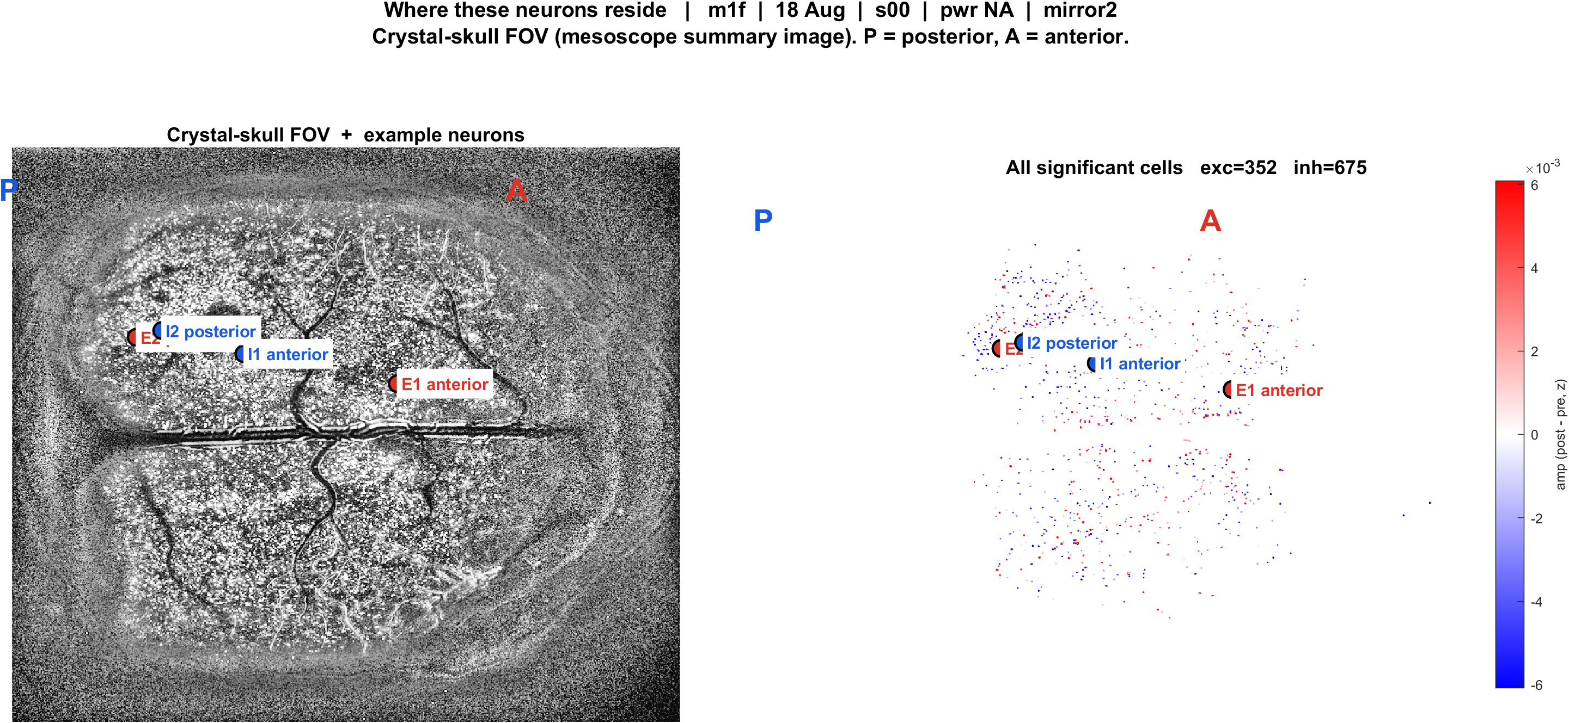
Examples | 18 Aug | m1f s00 pwrNA mirror2 | 45 pokes
What: m1f, 18 Aug, s00, pwr NA, mirror2. Left: EXTRACT traces + STA. Right: those cells on the crystal-skull FOV.
Result: E1 anterior #1936, E2 posterior #1320, I1 anterior #1212, I2 posterior #1061

Slide 17
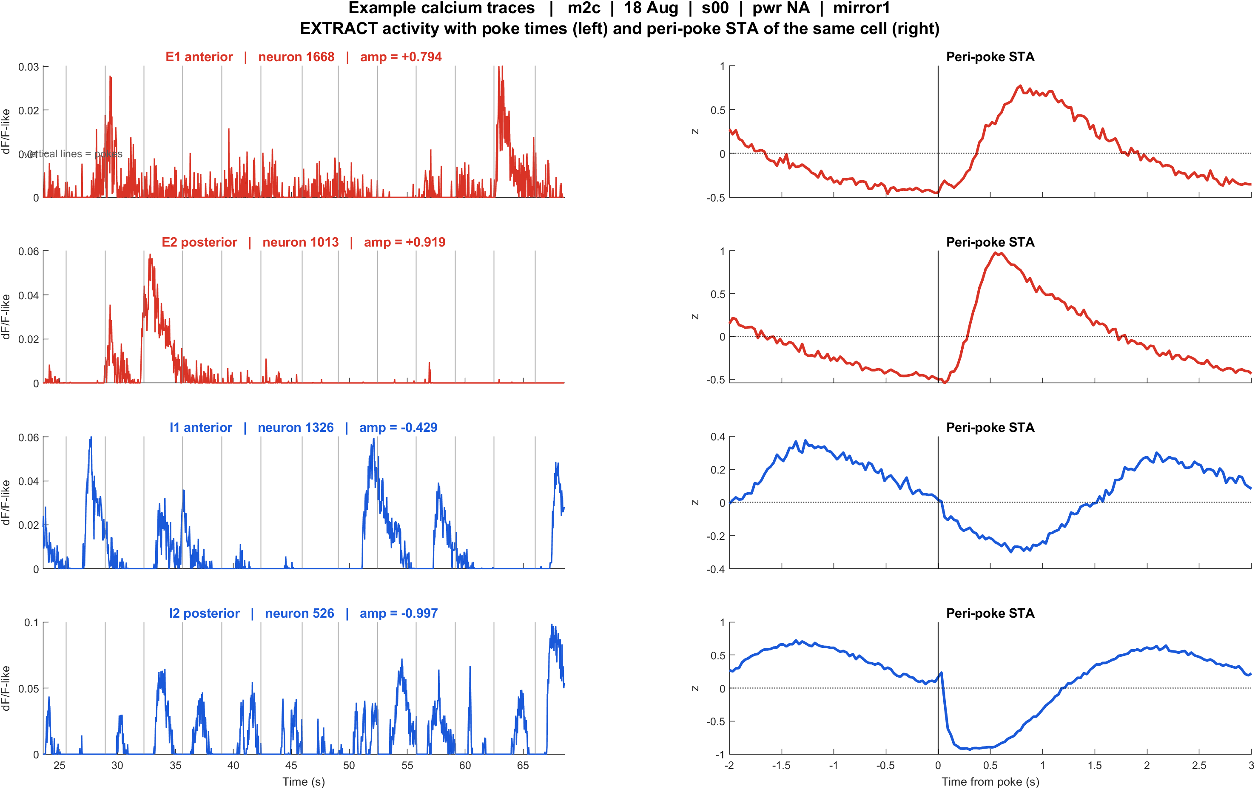
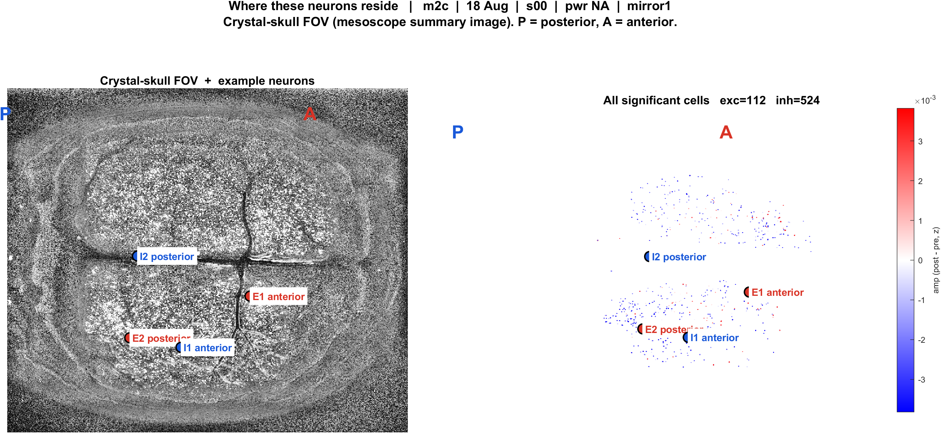
Examples | 18 Aug | m2c s00 pwrNA mirror1 | 83 pokes
What: m2c, 18 Aug, s00, pwr NA, mirror1. Left: EXTRACT traces + STA. Right: those cells on the crystal-skull FOV.
Result: E1 anterior #1668, E2 posterior #1013, I1 anterior #1326, I2 posterior #526

Slide 18
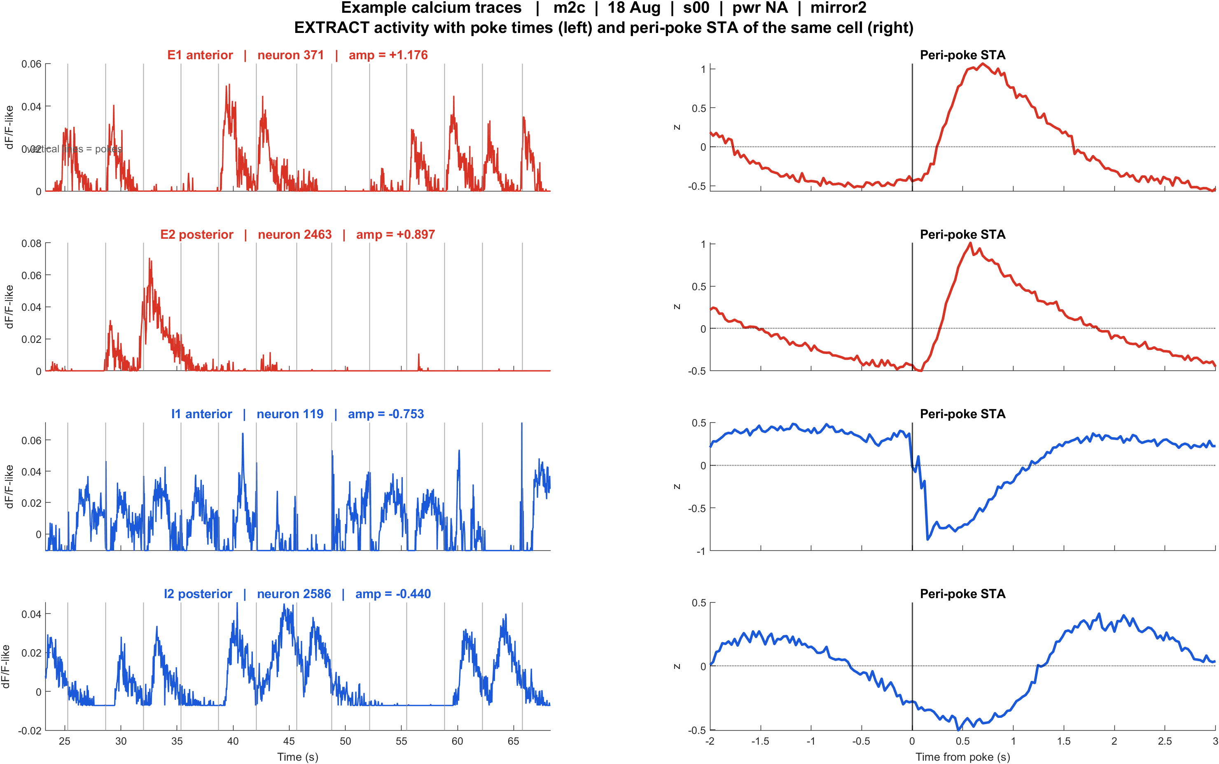
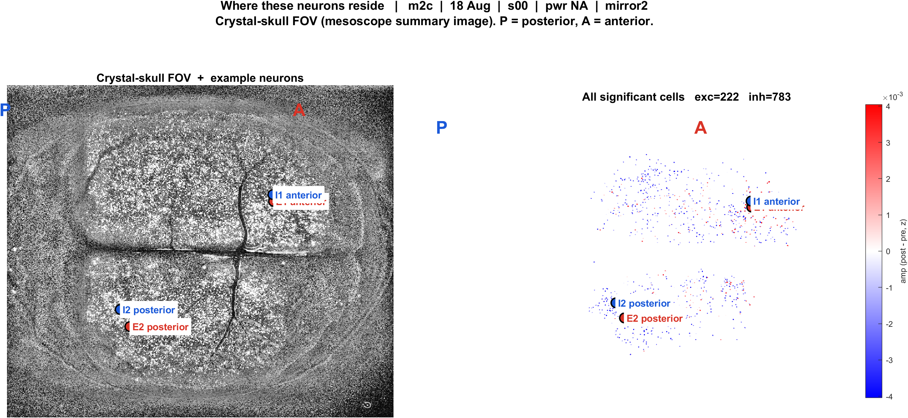
Examples | 18 Aug | m2c s00 pwrNA mirror2 | 83 pokes
What: m2c, 18 Aug, s00, pwr NA, mirror2. Left: EXTRACT traces + STA. Right: those cells on the crystal-skull FOV.
Result: E1 anterior #371, E2 posterior #2463, I1 anterior #119, I2 posterior #2586

Slide 19
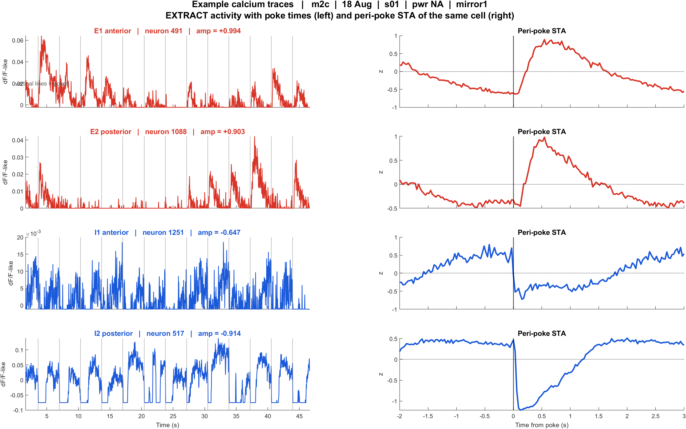
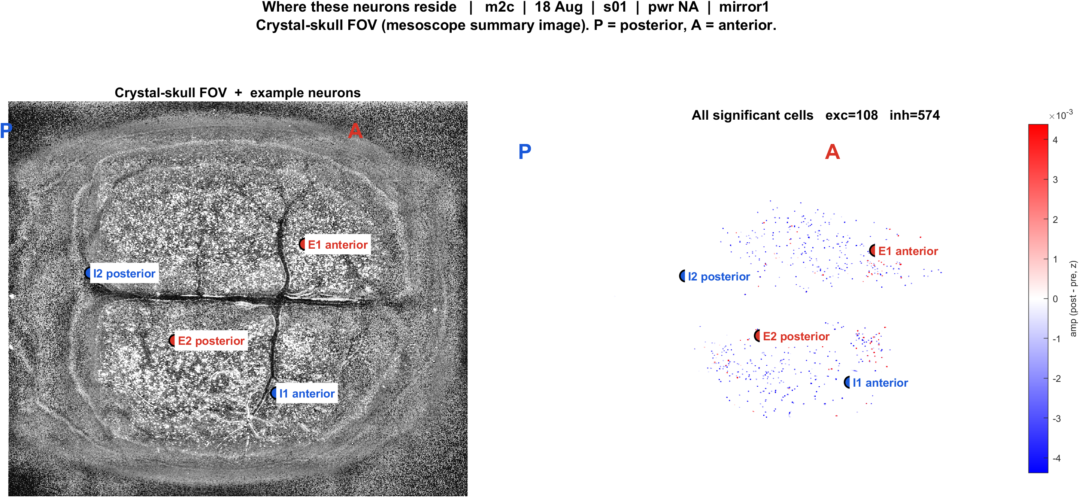
Examples | 18 Aug | m2c s01 pwrNA mirror1 | 90 pokes
What: m2c, 18 Aug, s01, pwr NA, mirror1. Left: EXTRACT traces + STA. Right: those cells on the crystal-skull FOV.
Result: E1 anterior #491, E2 posterior #1088, I1 anterior #1251, I2 posterior #517

Slide 20
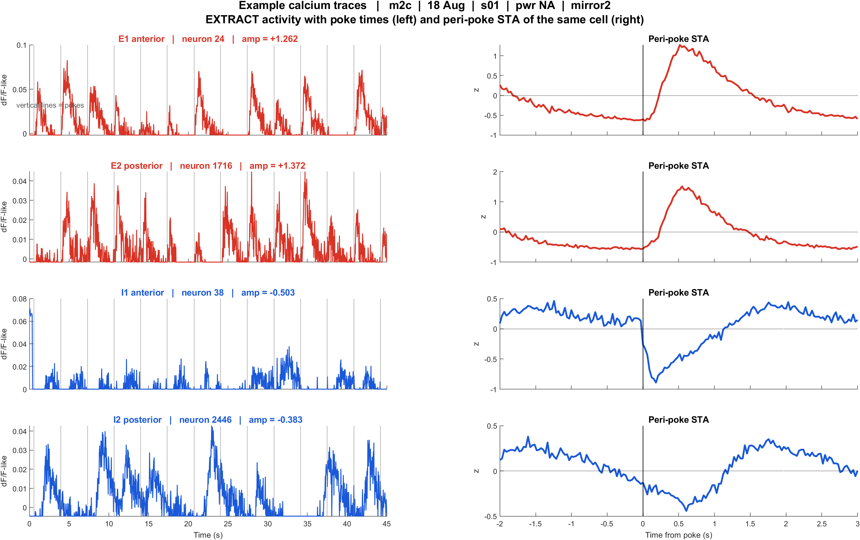
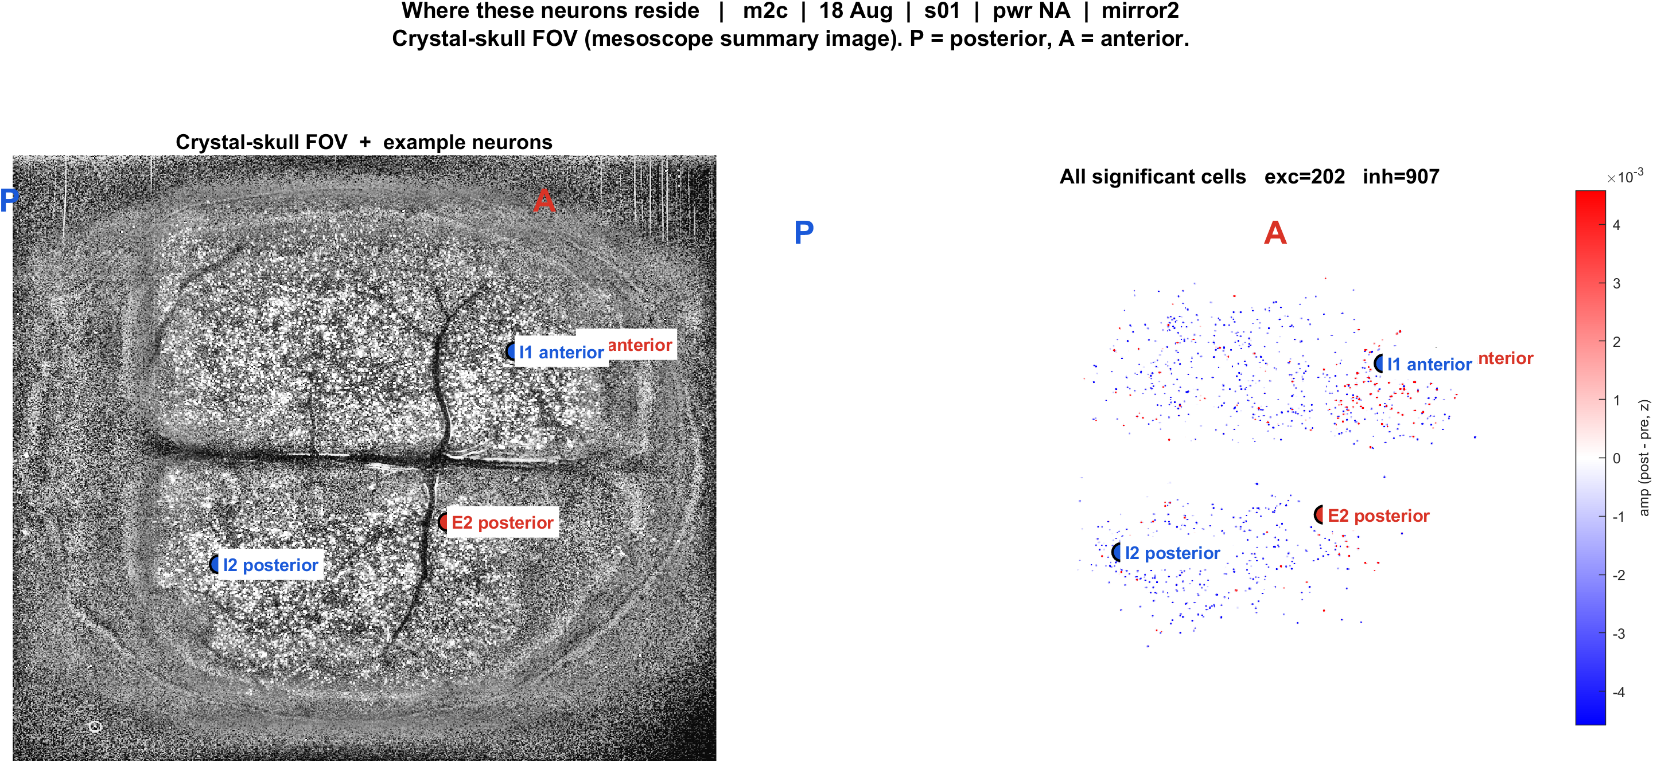
Examples | 18 Aug | m2c s01 pwrNA mirror2 | 91 pokes
What: m2c, 18 Aug, s01, pwr NA, mirror2. Left: EXTRACT traces + STA. Right: those cells on the crystal-skull FOV.
Result: E1 anterior #24, E2 posterior #1716, I1 anterior #38, I2 posterior #2446

