Slide 1
Can automated grimace scoring measure pain in our crystal-skull mice?
Testing GrimACE (Sturman et al., Lab Animal 2026) on our melittin / morphine face videos. 19 sessions, 6 mice, already synchronised to the calcium recordings.
Short answer: not on the footage as currently acquired. The fix is a camera and lighting change, not a machine-learning project.

Slide 2
Part 1 — What the method is
The Mouse Grimace Scale, and how GrimACE automates it.

Slide 3
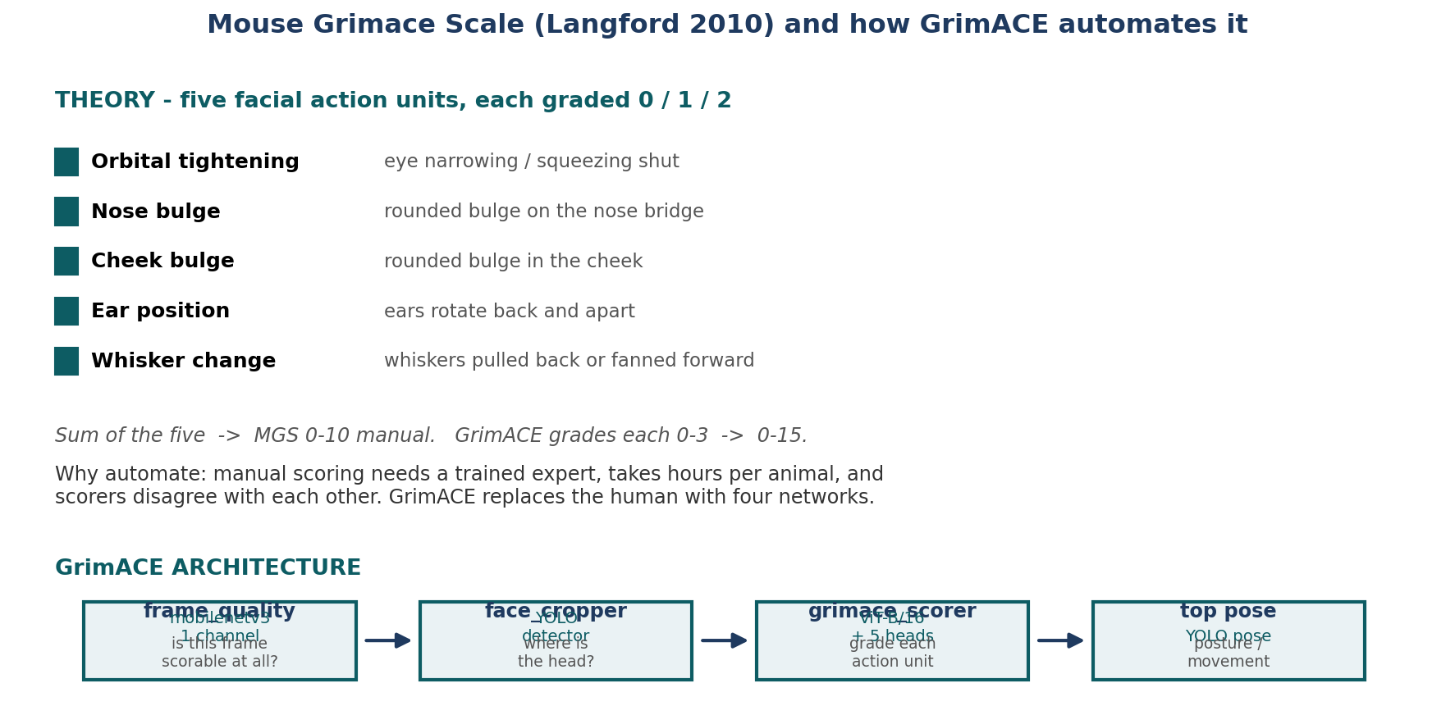
The theory: five facial action units
What: Langford et al. 2010 defined five features that change when a mouse is in pain. A trained human grades each 0/1/2 from still frames. GrimACE replaces the human with four networks.
Result: Manual scoring needs an expert, takes hours per animal, and scorers disagree — that is the problem the paper solves.

Slide 4
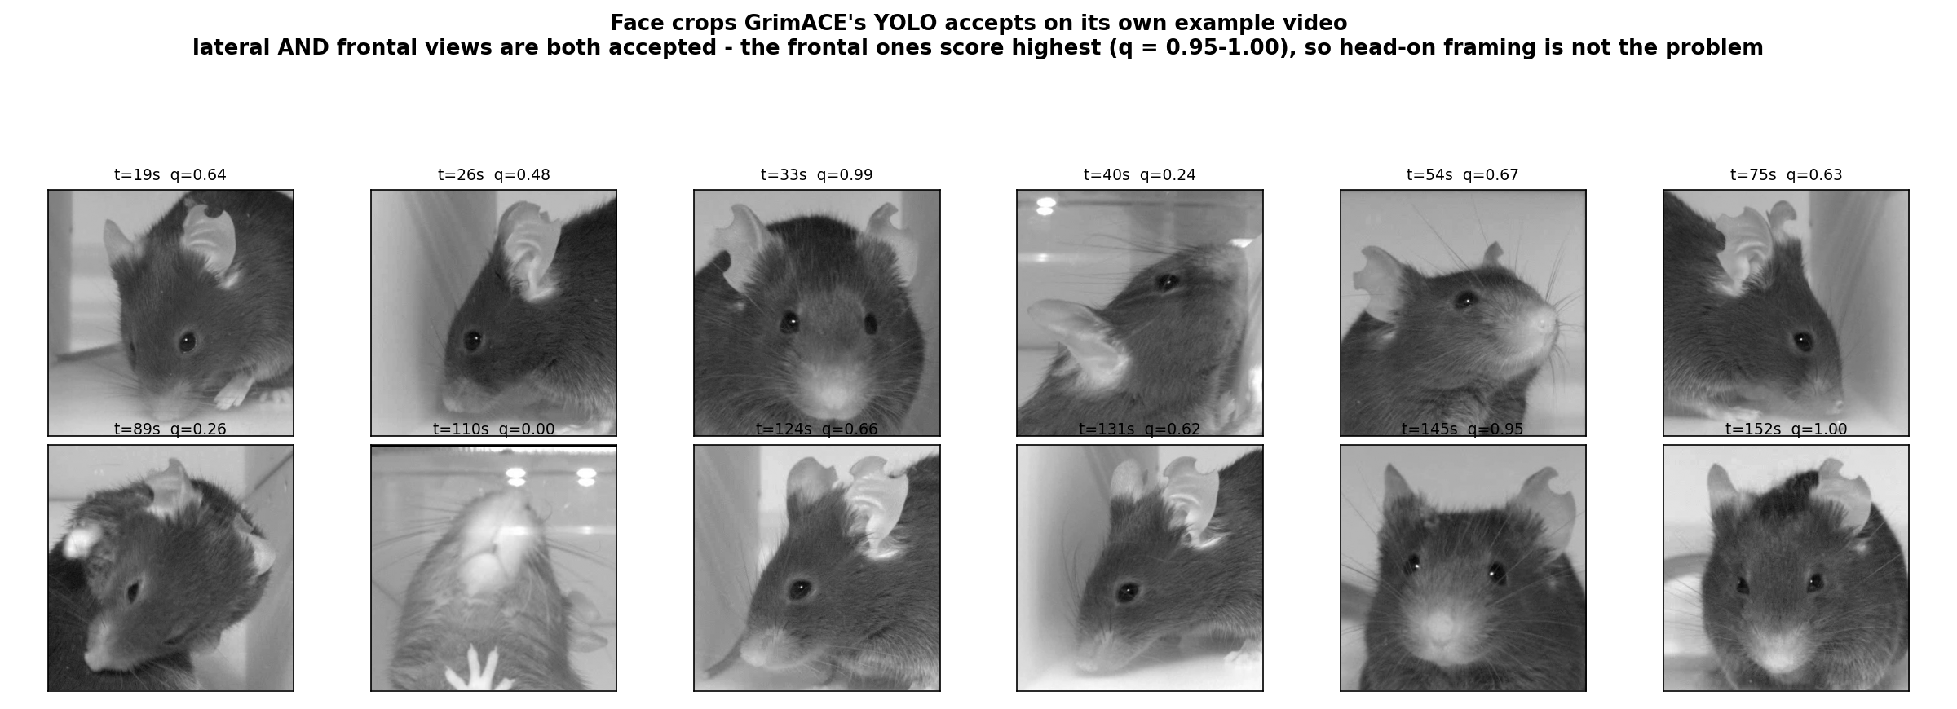
How it performs on its own data
What: GrimACE's published example videos run through the same offline harness I built, so this is their method on their rig.
Result: Works as advertised: frame_quality 0.998, YOLO finds the head at confidence 0.919, MGS = 1/15 for a pre-surgery baseline animal. Their published effect is 0h to 24h = +2.43 MGS (Cohen d = 0.77).

Slide 5
Part 2 — Applying it to our videos
Same models, same code, our footage. Five stages, checked one at a time.

Slide 6
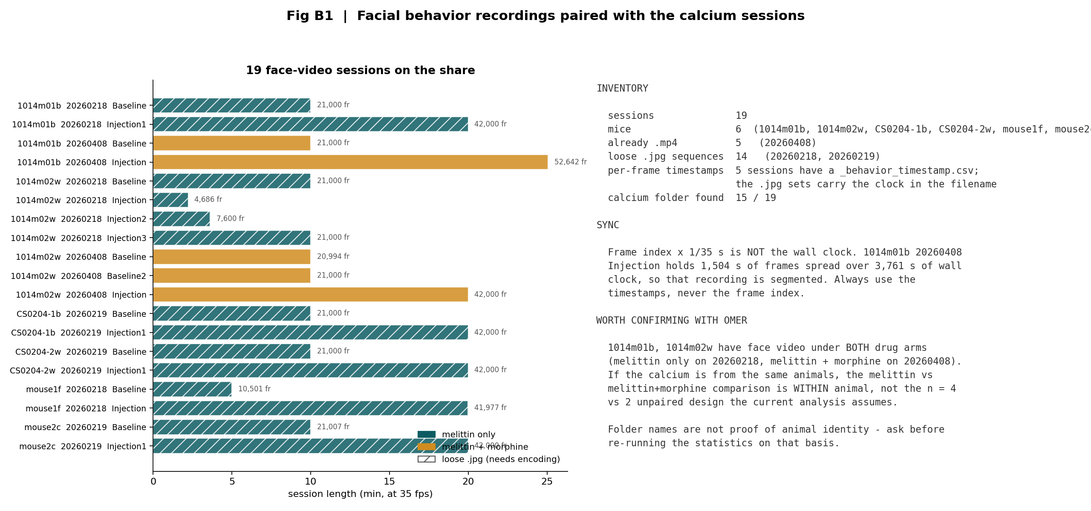
Our data: 19 face-video sessions, all matched to calcium
What: Every behaviour session on the share, indexed and paired with its calcium recording.
Result: 19 sessions, 6 mice. 1014m01b and 1014m02w have video under BOTH drug arms, which you confirmed are the same animals — so melittin vs melittin+morphine is a within-animal comparison.

Slide 7
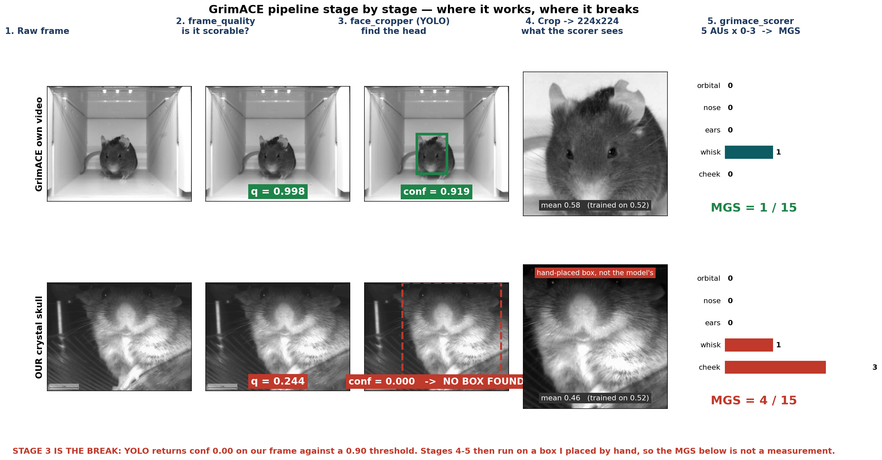
Stage by stage: where it works and where it breaks
What: Each of the five pipeline stages, their video on top, ours below.
Result: Stage 3 fails: the YOLO head detector returns confidence 0.000-0.445 on our frames against a gate of 0.90. Stages 4-5 then run on a box I placed by hand, so those MGS numbers are not a measurement.

Slide 8
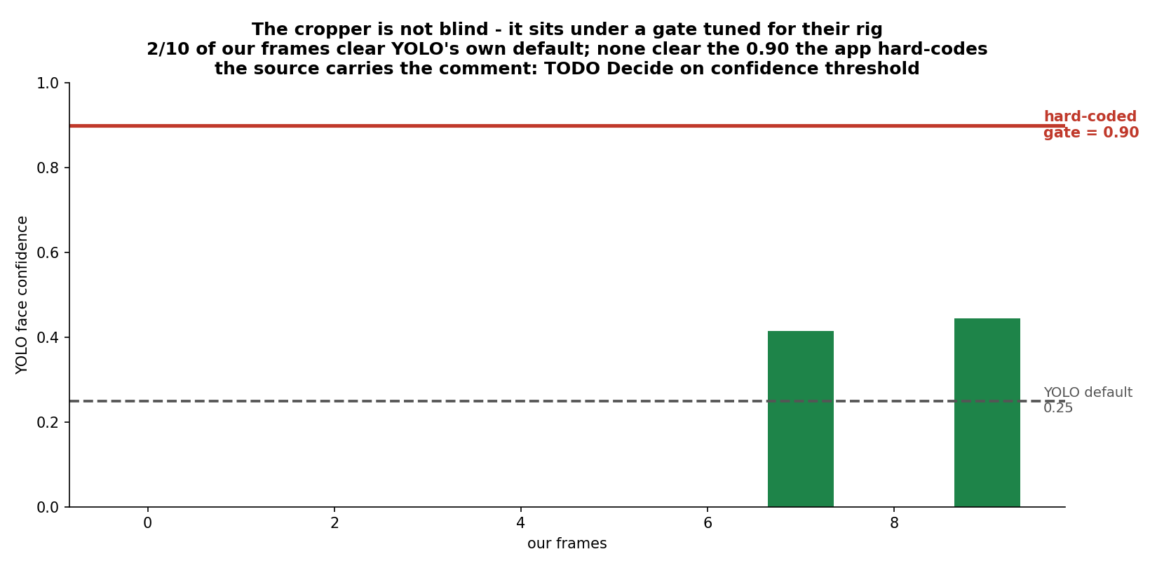
Why stage 3 fails — and why it is less serious than it looks
What: Raw YOLO confidence on our frames, against the 0.90 gate the app hard-codes and YOLO's own 0.25 default.
Result: The detector is not blind. 2/10 of our frames clear YOLO's default threshold; none clear 0.90. The source even carries the comment TODO: Decide on confidence threshold. And our prep is head-fixed (centroid SD 18 px over 10 min), so a fixed crop removes the need for a detector entirely.

Slide 9
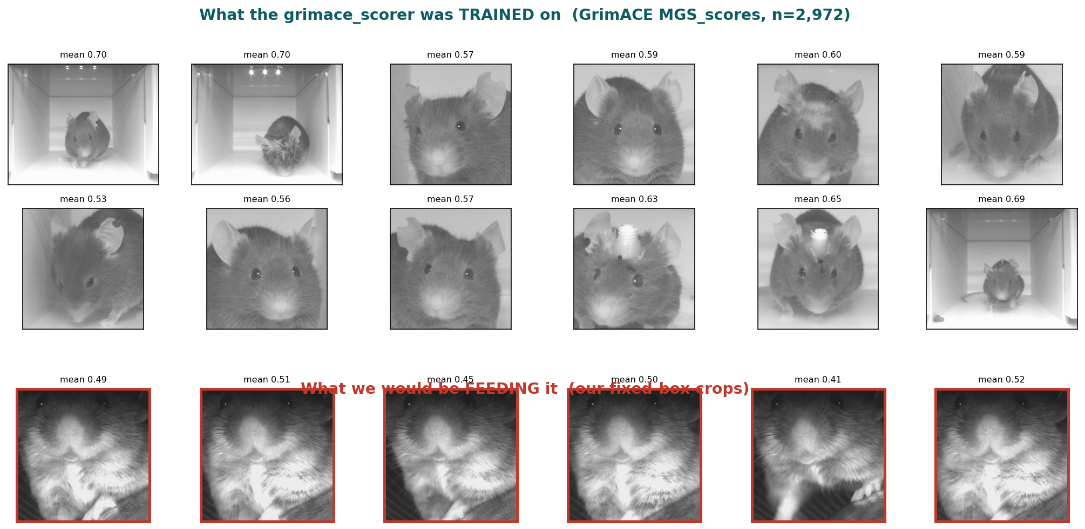
What the scorer was trained on, versus what we would feed it
What: GrimACE's own labelled MGS training images (n = 2,972) against our fixed-box crops.
Result: Closer than expected — their training set is mostly face close-ups framed much like ours, and several of their mice are brown, not black. So framing and coat colour are not the barrier.

Slide 10
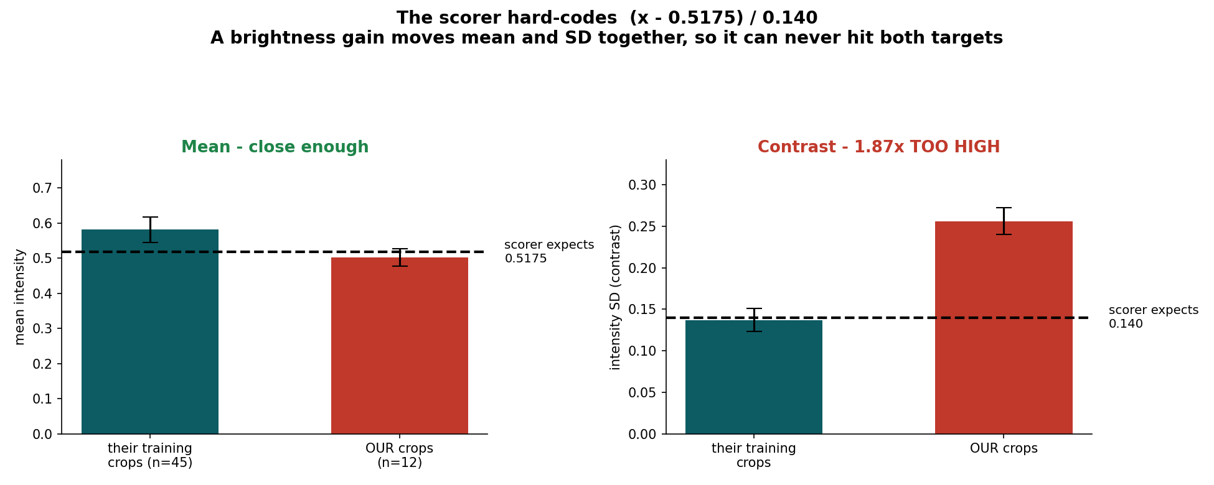
The measurable difference: contrast, not framing
What: Intensity statistics of their training crops versus ours, against the constants the scorer hard-codes.
Result: Mean is close (0.581 vs 0.502, target 0.5175). Contrast is not: our SD is 0.256 against their 0.137 — 1.87x too high. A brightness gain scales mean and SD together, so it can never fix both.

Slide 11
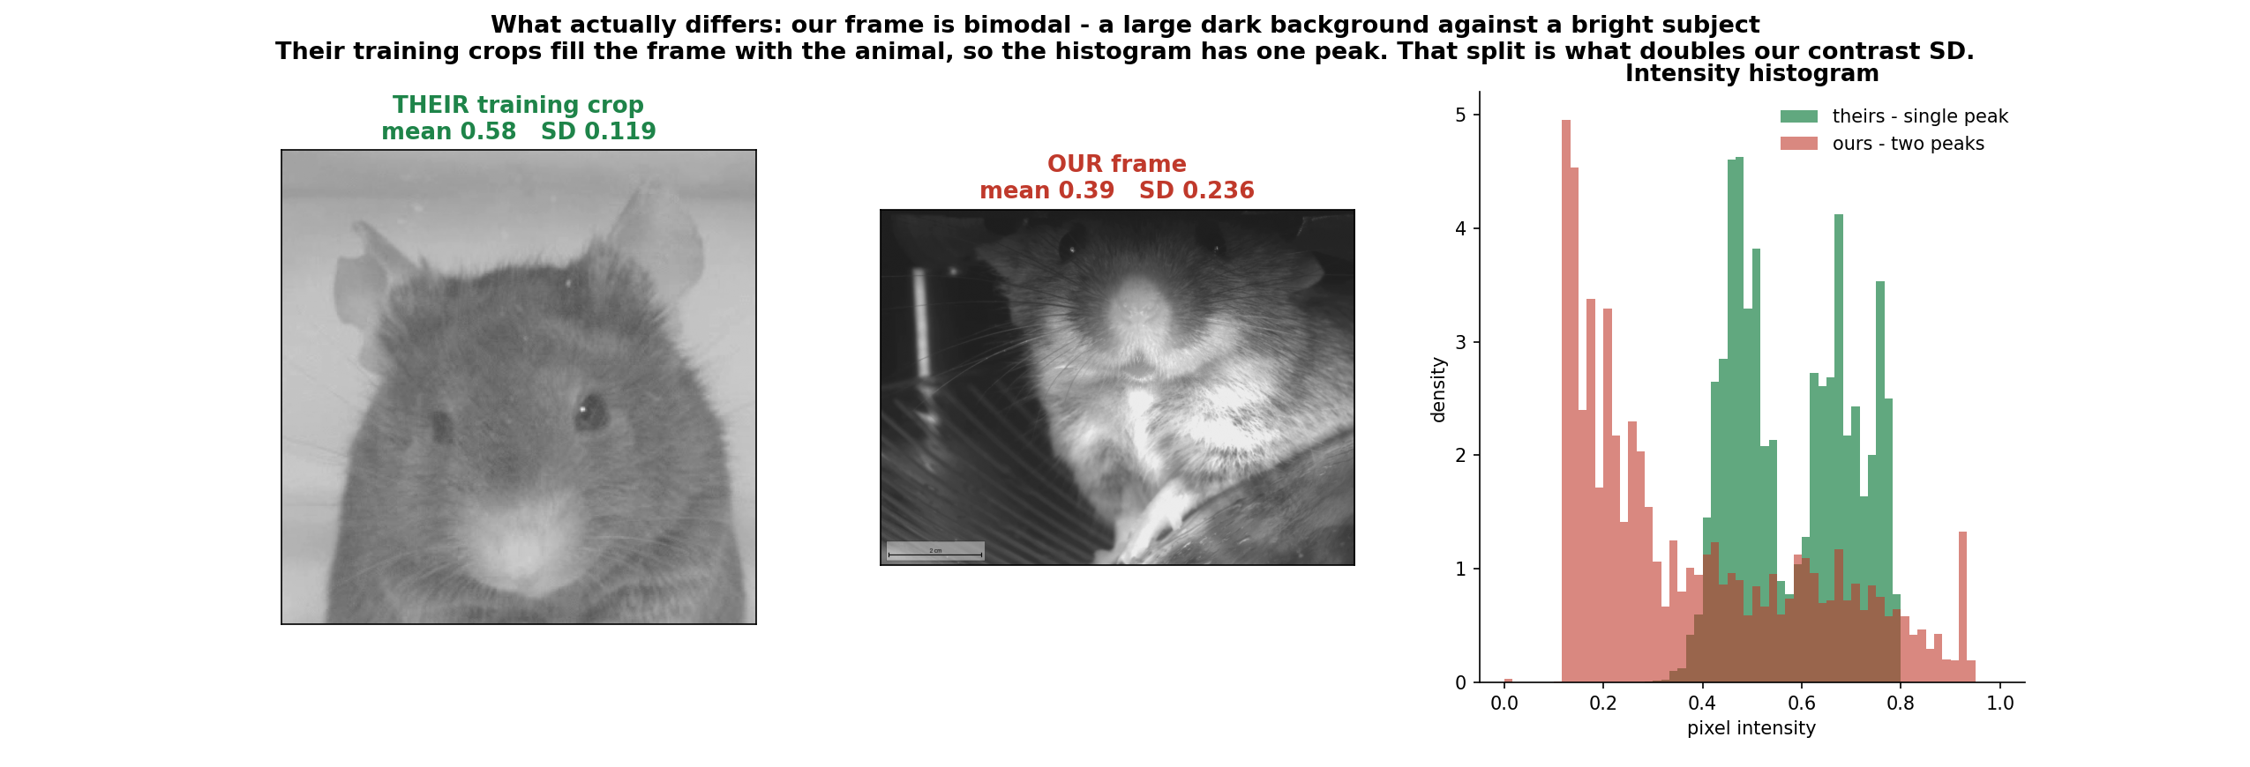
Where our extra contrast comes from
What: The two crops with their intensity histograms.
Result: Their crops are filled by the animal, so the histogram has one peak. Ours splits into a dark background and a bright subject. That bimodality, not saturation, is what doubles our SD.

Slide 12
Part 3 — Results
What the corrected pipeline actually returns, and what that means.

Slide 13
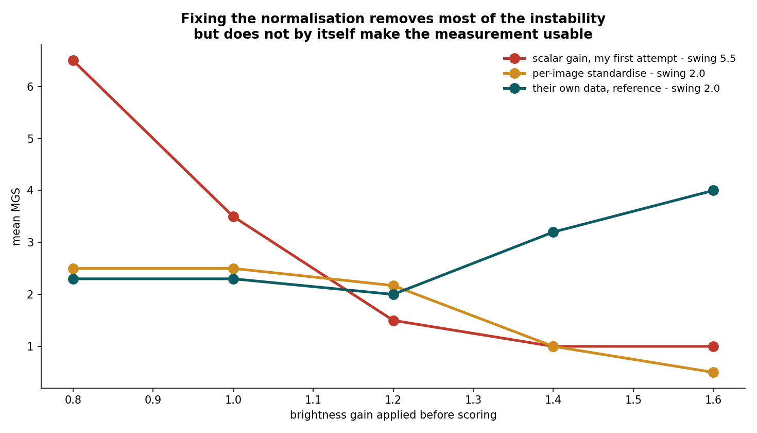
Correcting the normalisation removes most of the instability
What: Mean MGS across a brightness-gain sweep, three ways of normalising.
Result: My first attempt used a scalar gain and MGS swung 5.5 points — that was my error, not a property of the data. Per-image standardisation to the scorer's own constants cuts the swing to 2.0, matching their own data.

Slide 14
The decisive test — and why my first version of it was worthless
I originally tested baseline vs injection in the 20260408 sessions and found no separation.
Two things were wrong with that test:
1. Wrong arm. 20260408 is melittin + MORPHINE. Morphine is an analgesic, so no grimace increase is the expected result there, not evidence of failure.
2. No power. Their own in-domain effect is +2.43 MGS (d = 0.77) with a per-frame SD of 3.2. At 14 frames a session mean carries a 95% CI of about +/-1.8 MGS, so a real effect needs roughly 2.6 MGS to clear noise. My reported effects were +0.43 and -0.43 — indistinguishable from zero either way.
Re-run properly — melittin-only arm, 6 mice, 12 crop x normalisation configurations — there is still no consistent separation (best configuration: mean delta -0.15, positive in 3 of 6 mice).
So the conclusion holds, but for a different reason than I first gave, and the earlier evidence for it should be discarded.

Slide 15
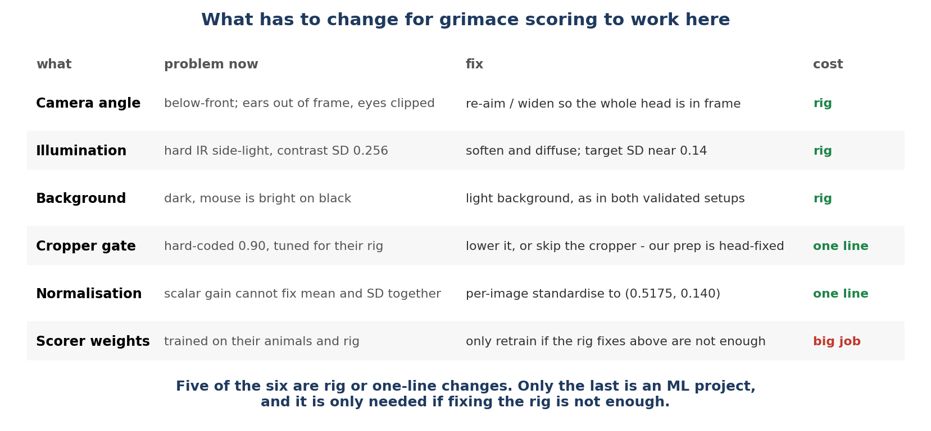
What has to change
What: Every difference between their setup and ours, with what it would take to fix.
Result: Five of the six are rig or one-line software changes. Only retraining the scorer is a real project, and it is only needed if fixing the rig is not enough.

Slide 16
Recommendation
Do not invest in retraining. The models are sound — our acquisition is out of their domain.
When crystal-skull imaging resumes, change three things about the behaviour camera:
• Re-aim or widen so the whole head sits comfortably inside the frame
• Diffuse the IR lighting so nothing saturates — target contrast SD near 0.14, not 0.26
• Light background instead of dark, as in both validated setups
Cost is a lens, a mount and a diffuser. GrimACE publishes its hardware design, so the chamber can be copied directly.
Then both GrimACE and PainFace work off the shelf, with no retraining.
Why this matters for the science: it would give an independent behavioural read-out of whether morphine actually produced analgesia — which is the single biggest gap in the current morphine result, where n = 2 paired mice and nothing confirms the drug worked.

