Slide 1
Crystal skull: face poke vs melittin vs melittin + morphine
One combined analysis of both candidate pain paradigms, so we can pick one for the SBI drug work
Face poke 18 recordings · 4 mice · 43,156 cells (13 + 18 Aug 2025)
Melittin only 8 recordings · 4 mice · 81,834 cells
Melittin + morphine 4 recordings · 2 mice · 62,533 cells
Hansol Lim · Schnitzer lab · 9 Sep 2026

Slide 2
Why this deck
Mark asked four things:
1. How many cells per mouse were excited vs inhibited?
2. Which Allen brain areas do they sit in?
3. How will we separate pain- / touch- / surprise-responsive cells?
4. How were the excited/inhibited cells affected by drug?
Question 4 is the one that decides the project.
Face poke has no drug arm — those 18 recordings were a feasibility test of the paradigm itself. Melittin does have a drug arm. So to answer 4 at all, both datasets are put through the same pipeline and the same figures here.
The deck ends on a decision that you and Greg need to make.

Slide 3
Read this before comparing the numbers
The two paradigms do not measure the same thing, and the percentages are not interchangeable.
Face poke — stimulus-locked, within one session.
A cell counts as excited or inhibited if its peri-poke response differs from its own pre-poke baseline, across ~55 pokes. Same cells throughout. This is a phasic, trial-averaged measure.
Melittin — session-level, baseline movie vs injection movie.
A cell counts as up or down if its mean dF/F over the injection recording differs from the baseline-session mean. Baseline and injection are separate movies with independent EXTRACT IDs, so these are NOT tracked neurons. Both sessions are cropped to the shorter of the two.
Consequence: the melittin fractions are much larger (~27% / ~64%) than the face-poke fractions (~9% / ~28%) largely because a sustained session-level shift is an easier thing to detect than a phasic response. Compare the two paradigms qualitatively, not number against number.

Slide 4
Q1 | Excited vs inhibited cells, per mouse
The direction of the effect is consistent in every animal, in all three conditions

Slide 5
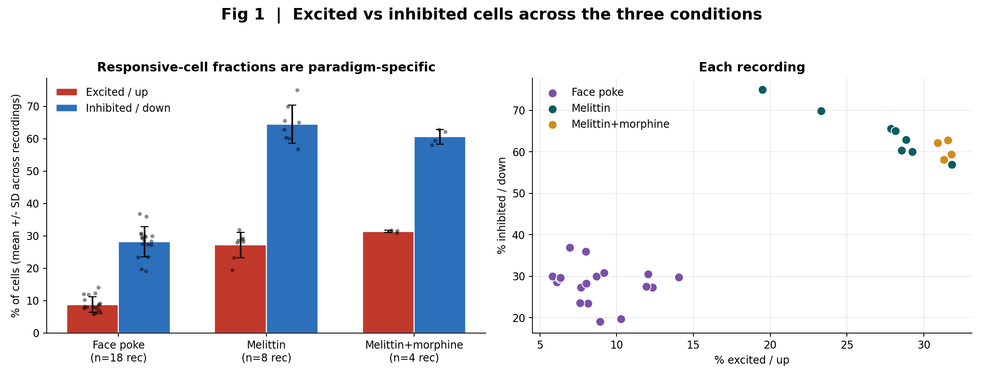
Fig 1 | Excited vs inhibited across the three conditions
What: Per-recording fractions, mean +/- SD, each dot one recording. Right: every recording plotted.
Result: All three conditions are inhibition-dominated. Face poke ~9% up / ~28% down; melittin ~27% / ~64%; adding morphine does not move the split.

Slide 6
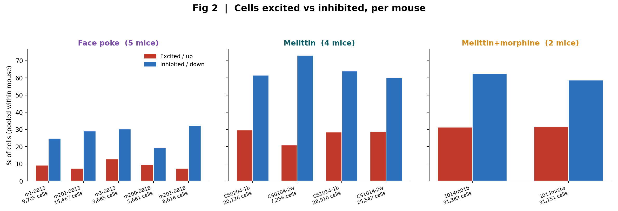
Fig 2 | Cells excited vs inhibited, per mouse (Mark's question 1)
What: Cells pooled within each animal, expressed as % of that animal's cells.
Result: Every mouse shows the same direction. Face poke: inhibition ~3x more common than excitation in 4/4 animals. Melittin: down ~2.3x up in 4/4. No animal reverses.

Slide 7
Q1 numbers — face poke, per animal (18 recordings)
Animal (day) | Rec | Cells | Excited | Inhibited | Pop. sig.
m1 (13 Aug) | 4 | 9,705 | 896 (9.2%) | 2,406 (24.8%) | 4/4
m201 (13 Aug) | 6 | 15,467 | 1,151 (7.4%) | 4,496 (29.1%) | 5/6
m3 (13 Aug) | 2 | 3,685 | 475 (12.9%) | 1,113 (30.2%) | 2/2
m200 (18 Aug) | 2 | 5,681 | 553 (9.7%) | 1,105 (19.5%) | 0/2
m201 (18 Aug) | 4 | 8,618 | 644 (7.5%) | 2,788 (32.4%) | 3/4
All | 18 | 43,156 | 3,719 (8.6%) | 11,908 (27.6%) | 14/18

Slide 8
Q2 | Which Allen areas?
Honest answer: not yet — the FOVs are not registered to the Allen CCF

Slide 9

Q2 | What we can say today: a consistent anterior-posterior gradient
What: Correlation between each cell's A-P position and its poke response, one value per recording, mirror2 flipped to align with mirror1.
Result: Excitation biased anterior, inhibition biased posterior, in 18/18 recordings (median rho = 0.13, range 0.03-0.23). But 'anterior' here is the image axis after the mirror flip, NOT a bregma-referenced coordinate — so no Allen area names yet.

Slide 10
Q2 | What it would take to name Allen areas
Today the crystal-skull FOVs have no CCF registration at all.
Landmark-based warp of each FOV to the Allen dorsal-cortex map: bregma and lambda from the skull image, plus the midline and the transverse sinus as anchors.
That gives per-cell area labels (SSp-bfd, SSp-m, MOp, MOs, RSP, VISp ...) and lets us report excited/inhibited counts per area, per mouse, and compare across animals.
It also links this dataset to the TRAP whole-brain and GPCR atlases, which are already in CCF space.
I would rather build the registration once, on whichever paradigm we commit to, than build it twice. That is one more reason the paradigm decision comes first.

Slide 11
Q3 | Pain vs touch vs surprise
This dataset cannot separate them, and no reanalysis will fix that

Slide 12
Q3 | Why the current face-poke data cannot answer this
There is one stimulus, delivered one way. There is no contrast to dissociate the categories.
A face poke is simultaneously a touch, a noxious event and an unexpected event. Any cell that responds is consistent with all three labels. Splitting them post hoc would be curve-fitting.
What would actually answer it — one session, interleaved trials:
• innocuous brush or air puff -> touch
• calibrated von Frey / noxious pinch or radiant heat -> pain, graded intensity
• unexpected tone or light flash -> surprise, non-somatosensory
• stimulus-omission catch trials -> expectation / prediction error
• same cells across all trial types, so each cell gets a response profile rather than one number
Then a cell is 'pain-responsive' if it scales with noxious intensity and not with brush, rather than because we called the stimulus painful. This is a different experiment from what we have.

Slide 13
Q4 | Drug effect
Face poke: no drug arm at all. Melittin: morphine arm exists, and it points one way — but n = 2 mice

Slide 14
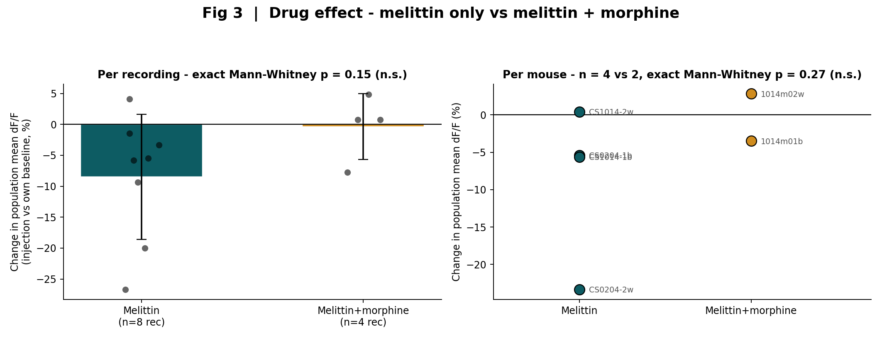
Fig 3 | Melittin only vs melittin + morphine
What: Change in population mean dF/F, injection vs that animal's own baseline, as % of baseline. Left: per recording. Right: per mouse.
Result: Melittin alone lowers population activity in 7/8 recordings (mean -8.5%). With morphine on board the shift is ~0 (-0.3%). But n = 4 vs 2 mice and it is not significant: p = 0.15 per recording, p = 0.27 per mouse.

Slide 15
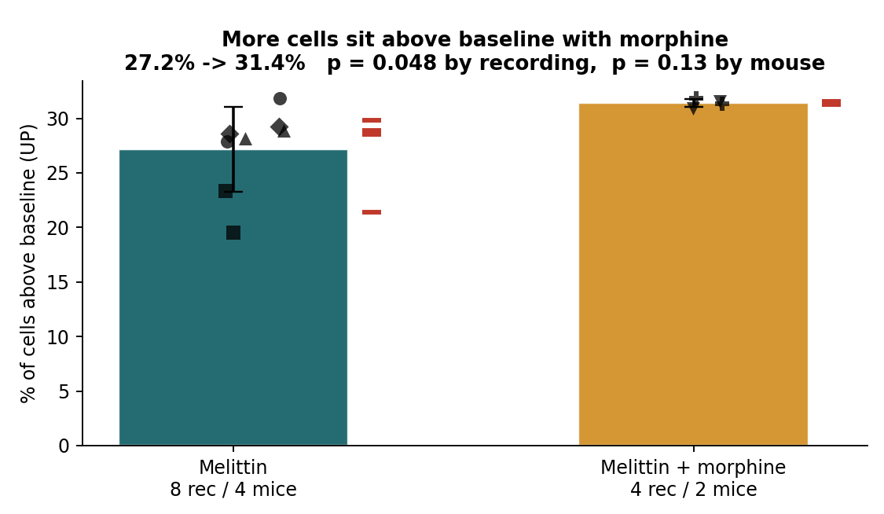
Fig 4 | Which way does morphine move the melittin response?
What: All four measures, melittin-only vs melittin + morphine, tested per recording and again per animal (the two mirrors of a session are not independent samples).
Result: Direction is consistent: every measure that moves, moves toward MORE activity with morphine. Melittin alone suppresses the cortex; with morphine that suppression is gone. But only fraction-UP reaches p < 0.05, and only at the recording level (p = 0.048); per animal it is p = 0.13 and nothing else is close.

Slide 16
Q4 | What we can and cannot say about morphine
Can say — melittin is a strong, repeatable pain read-out.
~27% of cells up and ~64% down relative to baseline, in 4/4 animals, with a net suppression of population activity of -8.5% in 7/8 recordings.
Can say — the direction of the morphine effect is consistent.
With morphine on board there are more cells above baseline (27.2% -> 31.4%) and the net suppression is abolished (-8.5% -> -0.3%). Read physiologically: morphine reverses the melittin-induced cortical suppression. Nothing moves the other way.
Cannot say — that this is an established effect.
Only fraction-UP crosses p < 0.05, and only if the two mirrors of one session are counted as independent samples. At the animal level (n = 4 vs 2) nothing is significant: fraction UP p = 0.13, net population p = 0.27, UP amplitude p = 0.53.
Cannot say — anything about 'the neurons'.
Baseline and injection are separate movies with independent EXTRACT IDs, so no cell is followed across the drug. Every statement here is about populations, not identified neurons.
Fix that is available today: if 1014m01b / 1014m02w are the same animals as CS1014-1b / CS1014-2w on a later day, this becomes a paired within-animal test on the same data. I need someone to confirm the animal identities.

Slide 17
Same visual language, both paradigms
Example single-cell traces and the maps of where those cells sit in the FOV

Slide 18
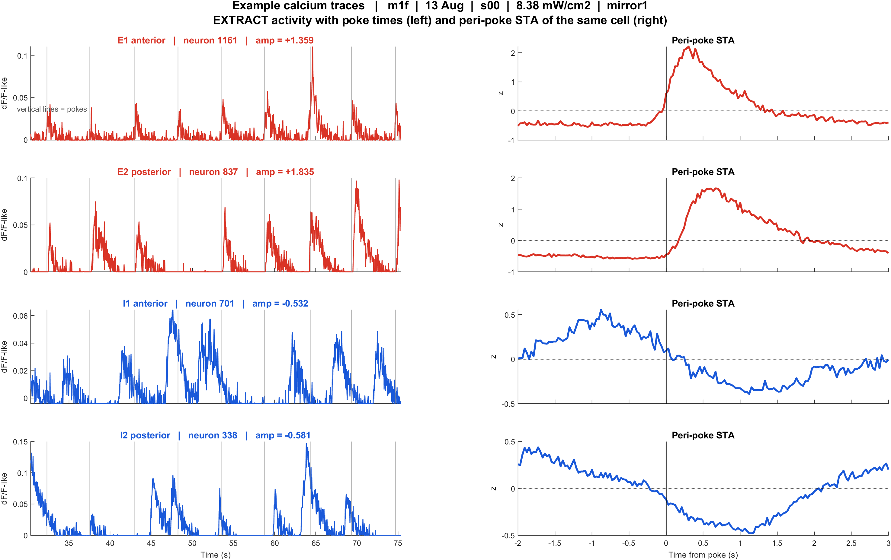
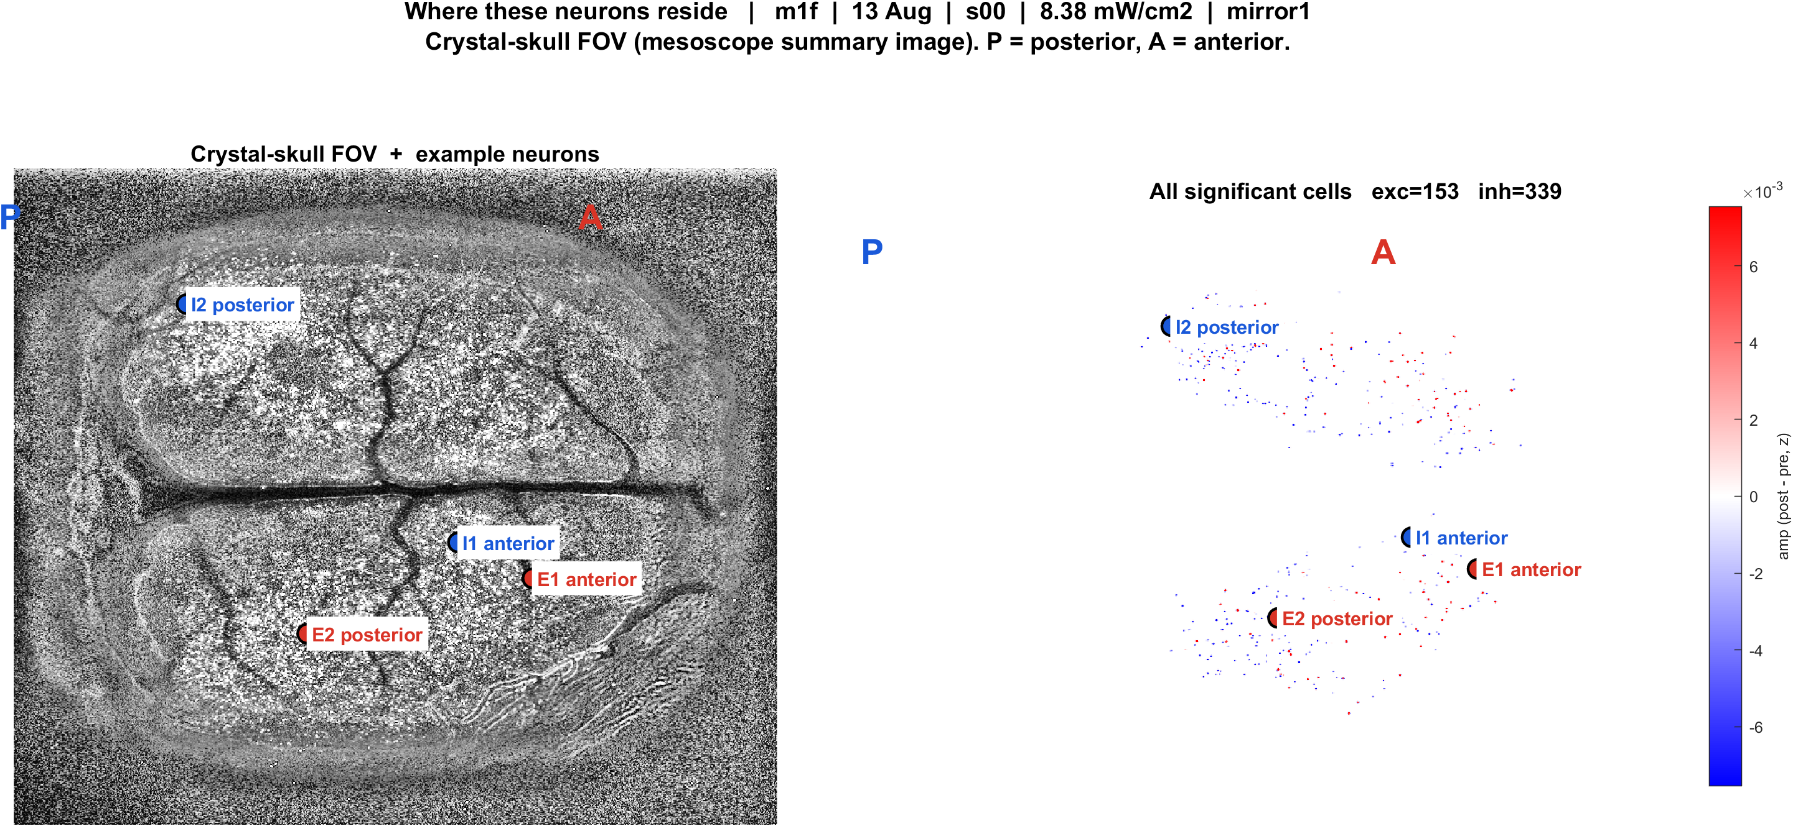
Face poke — example cells and their position in the FOV
What: Two excited and two inhibited cells per movie, EXTRACT activity with poke times, and the same cells marked on the mesoscope FOV (P left, A right).
Result: Poke lock is visible cell by cell: excited cells rise after each poke, inhibited cells dip. E1/I1 more anterior, E2/I2 more posterior.
Traces
FOV map

Slide 19
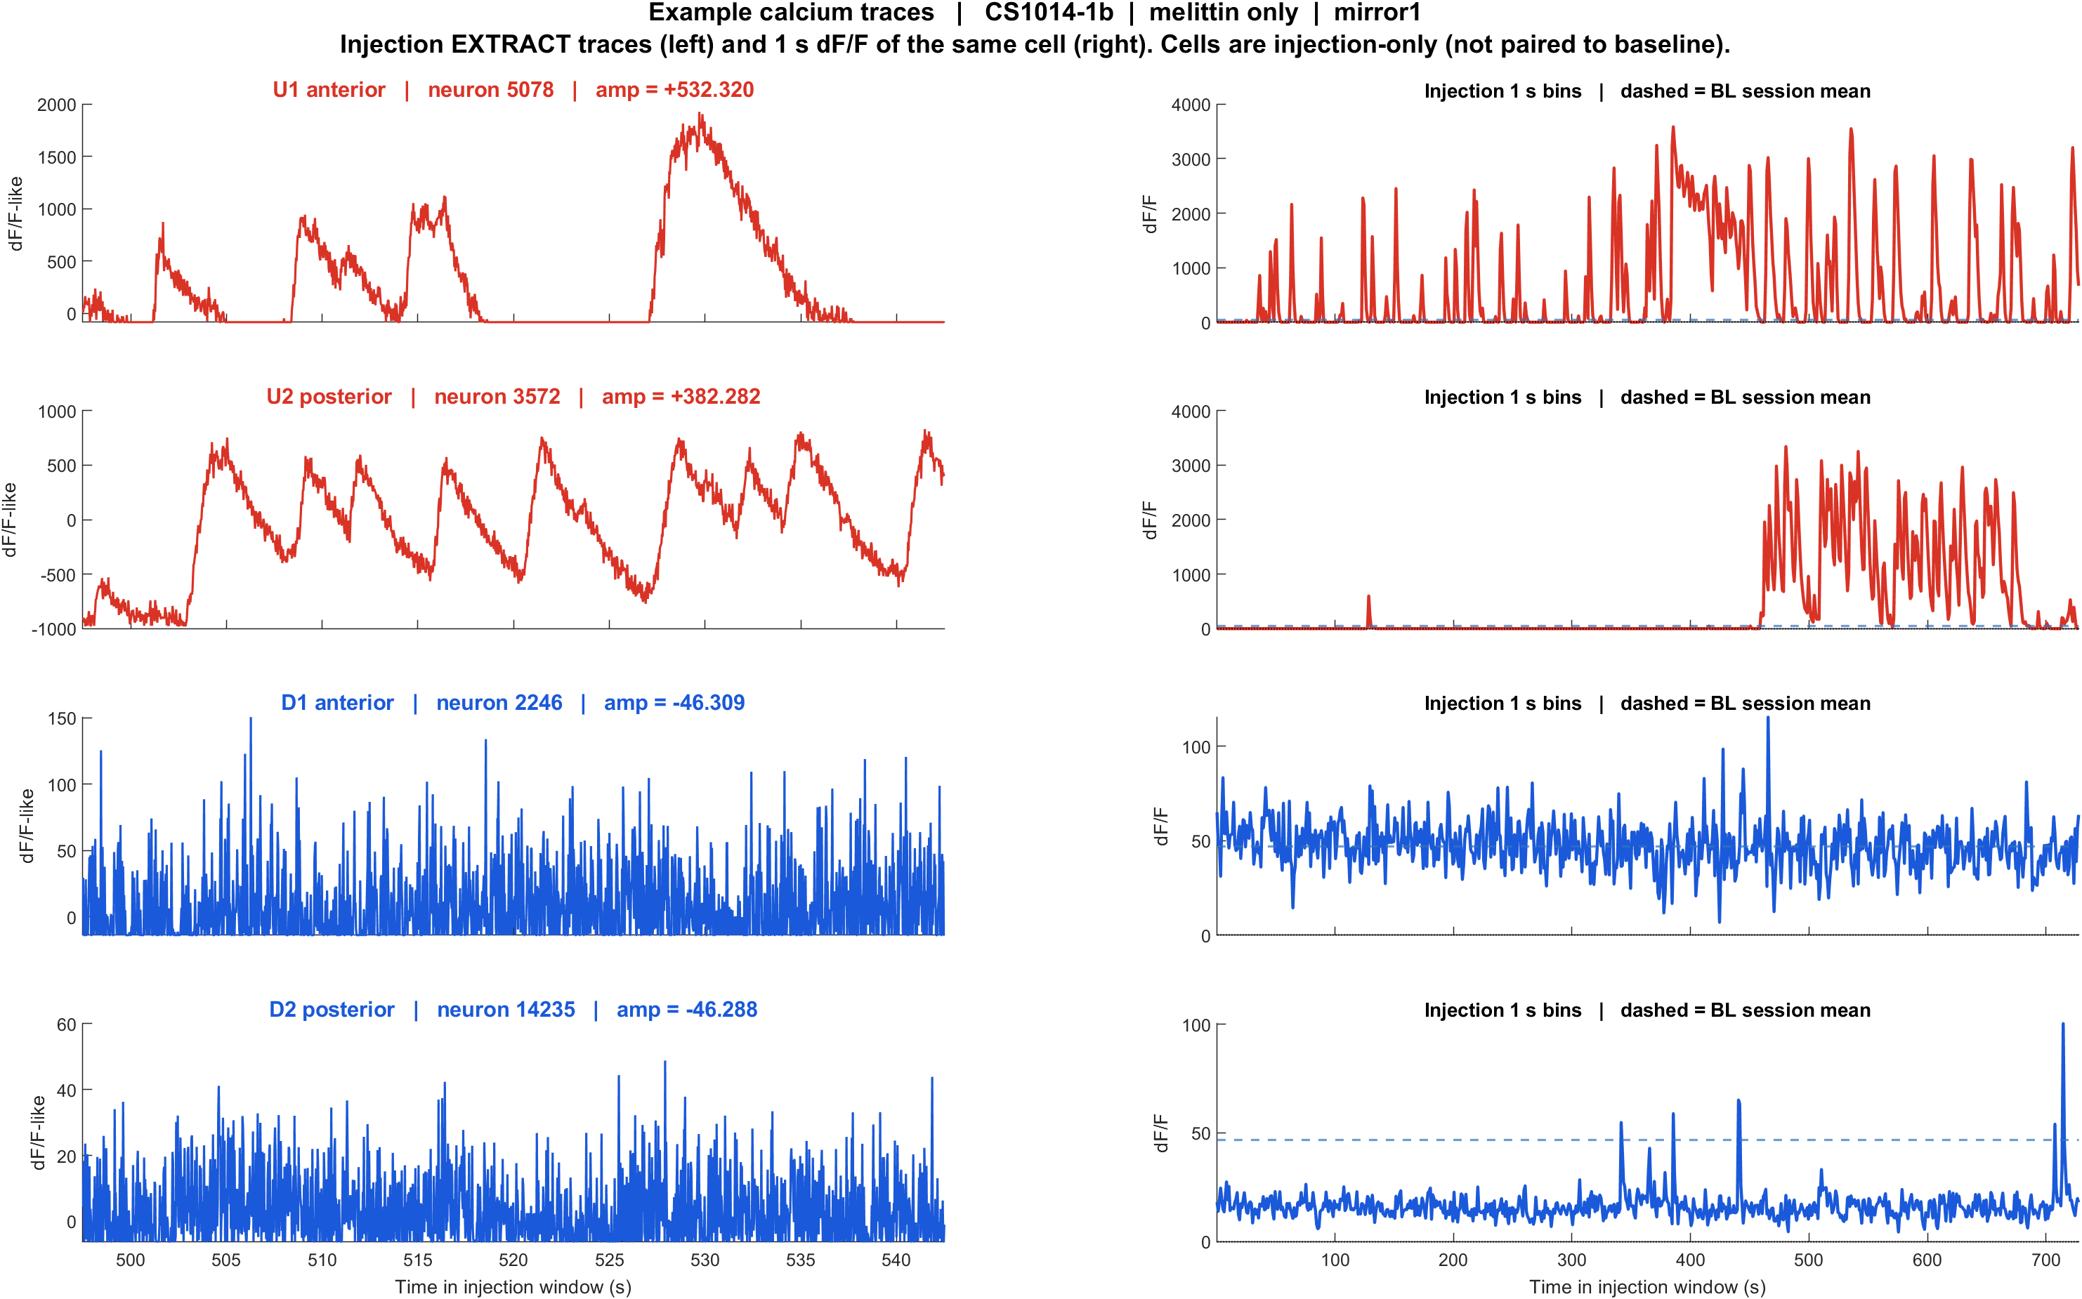
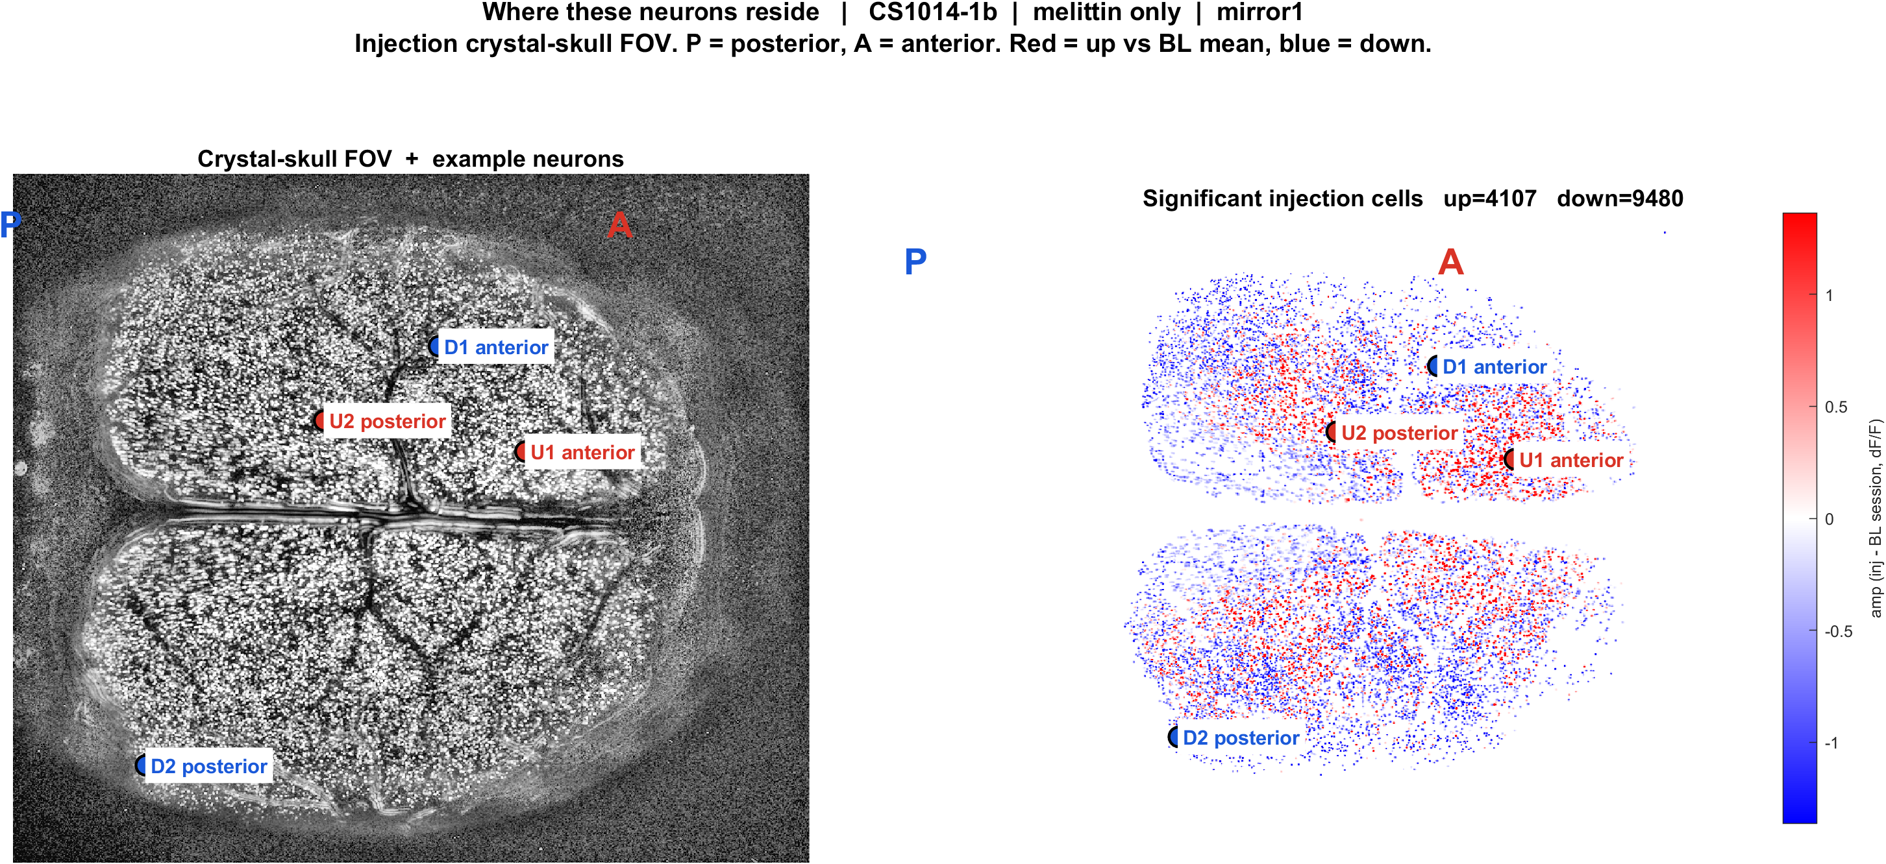
Melittin — example cells and their position in the FOV
What: Same panel design, but the comparison is injection vs baseline session rather than peri-poke, and the cell IDs are injection-session IDs.
Result: Up and down cells are intermingled across the FOV, as with face poke.
Traces
FOV map

Slide 20
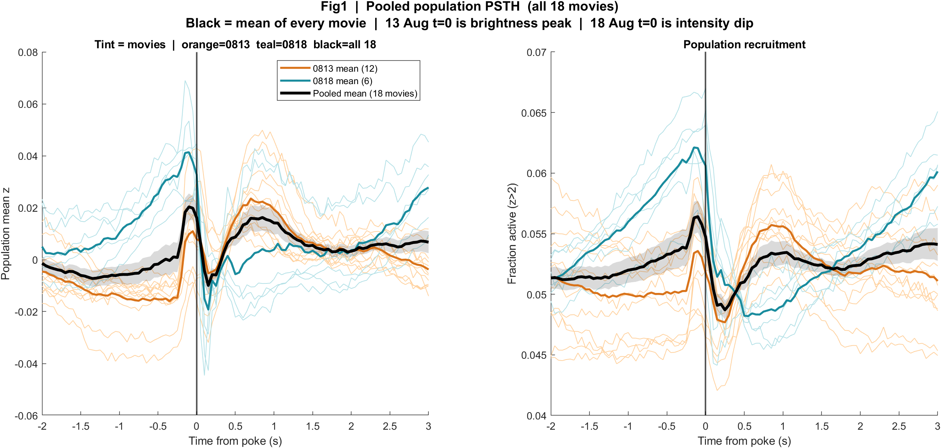
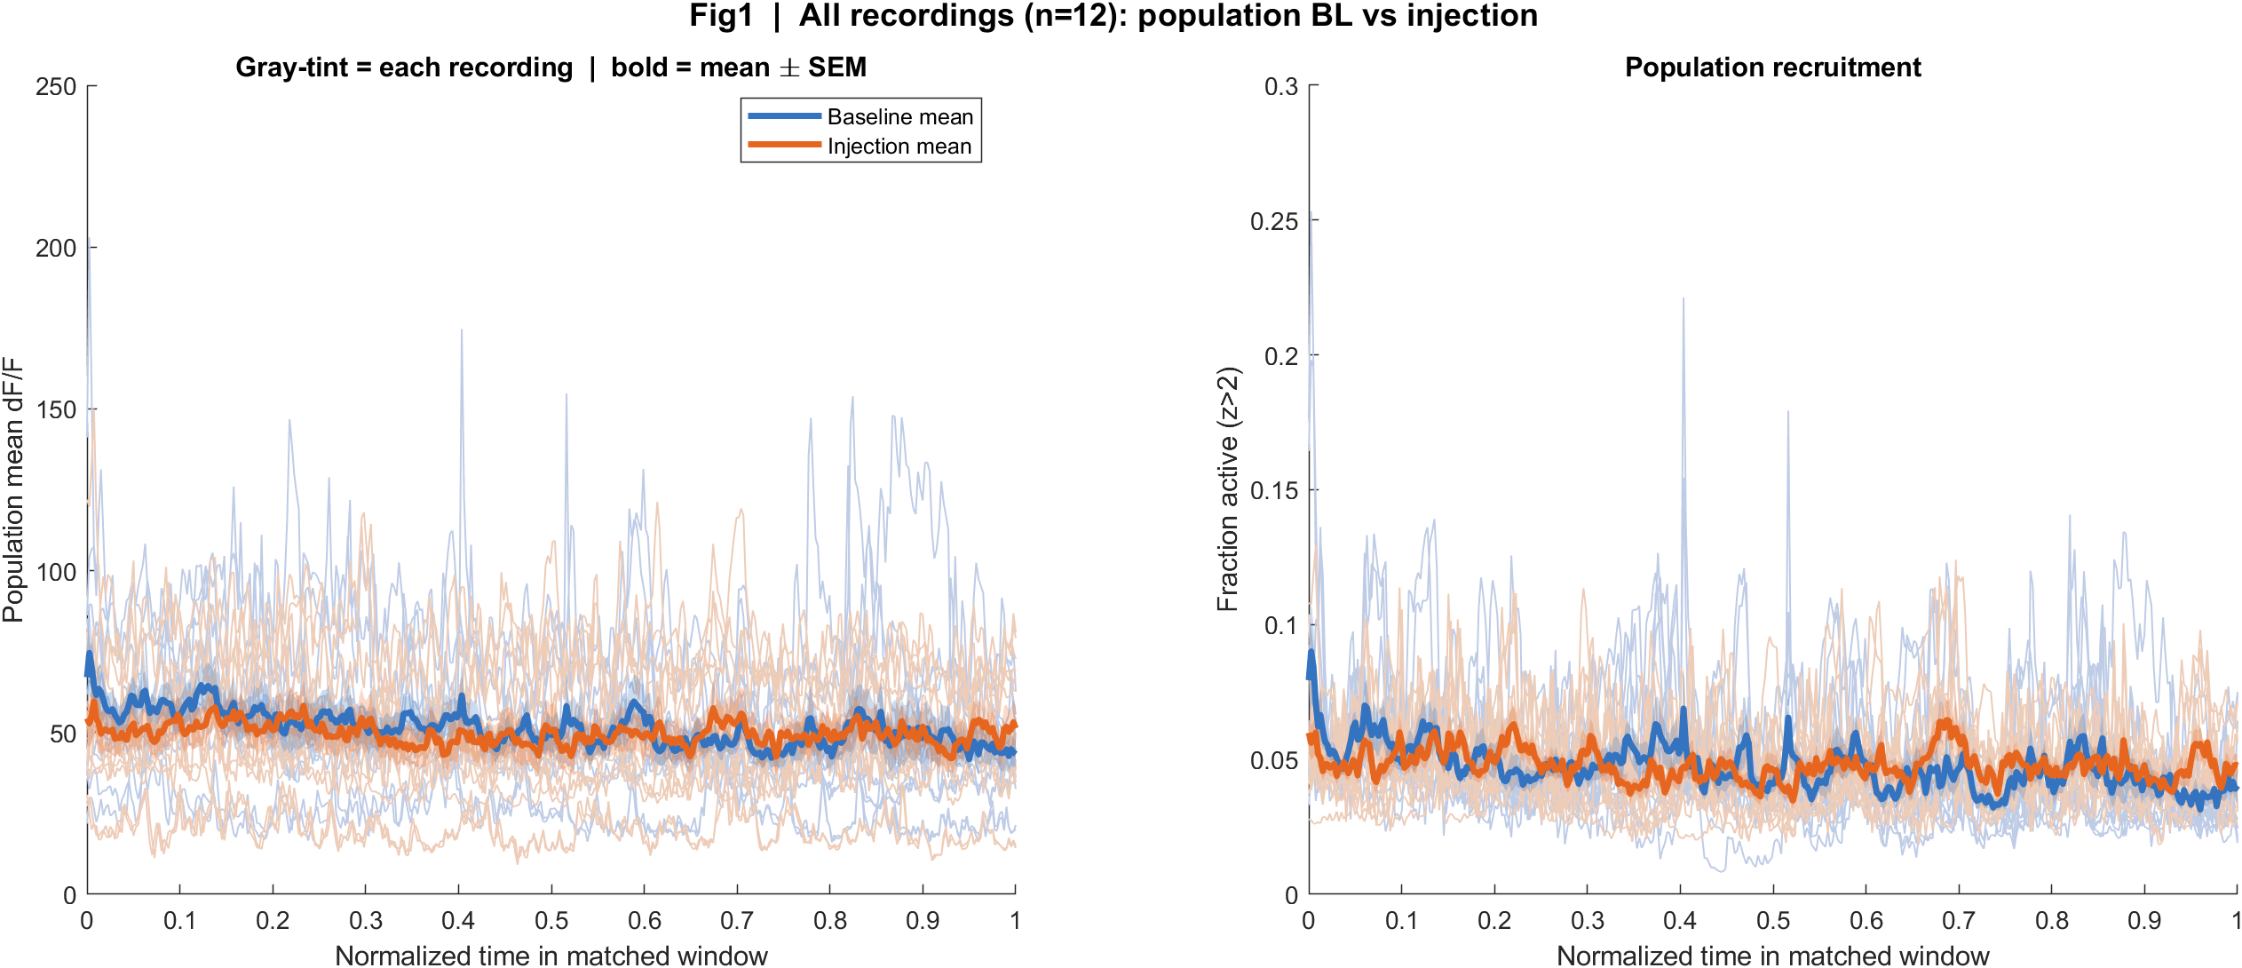
Population view, side by side
What: Left: face-poke peri-stimulus population response, pooled over 18 recordings. Right: melittin baseline vs injection population dF/F.
Result: Face poke gives a brief transient, a short dip, then a rebound, time-locked to the poke. Melittin gives a slow sustained shift with no trial structure.
Face poke (trial-locked)
Melittin (session-level)

Slide 21
The decision
Which paradigm do we build the SBI drug plan around?

Slide 22
Face poke vs melittin — what each buys us
 | Face poke | Melittin
Pain type | Phasic, mixed (touch + nox + surprise) | Sustained inflammatory-type
Trials | ~55 pokes per session, trial-locked | One injection, no trial structure
Cell tracking | Same cells throughout session | Independent IDs BL vs INJ
Statistics | Clean per-cell trial statistics | Session-level only
Drug arm | None — no drug data at all | Morphine exists (n = 2 mice, n.s.)
Throughput | Fast, repeatable, same animal over days | Slow, one shot per session
Best fit for | Circuit mapping, stimulus panel designs | Analgesic efficacy over time

Slide 23
What I need from Mark and Greg
Pick the paradigm. These are two different experimental plans and we should commit to one.
If melittin: the immediate job is a proper drug design — vehicle arm, within-animal morphine, enough mice to power it. The current morphine data is suggestive at best and I would not build on it as it stands.
If face poke: the immediate job is the stimulus panel from Q3, so pain / touch / surprise is answerable by design, plus a drug arm which currently does not exist.
Either way I will add the Allen CCF registration once, on the chosen paradigm.
I have paused crystal-skull imaging until this is settled — I would rather hold than collect another 18 recordings on the paradigm we end up not using.

Slide 24
Take home
1. Every mouse, in every condition, is inhibition-dominated. Face poke 8.6% excited vs 27.6% inhibited across 43,156 cells; melittin 27% up vs 64% down. No animal reverses.
2. No Allen area names yet — the FOVs are not CCF-registered. What is solid is the anterior-excited / posterior-inhibited gradient, 18/18 recordings.
3. Pain vs touch vs surprise cannot be separated in this dataset. It needs an interleaved stimulus panel, not more analysis.
4. Morphine moves the melittin response toward more activity, not less: more cells above baseline (27.2% -> 31.4%) and the net cortical suppression abolished (-8.5% -> -0.3%). The direction is consistent across every measure, but at the animal level (n = 4 vs 2, no vehicle arm) it is not significant. It is a trend worth designing for, not a result to build on.
5. So the drug question is still open on both paradigms, and the decision on which one to use is the blocking step.

