Slide 1
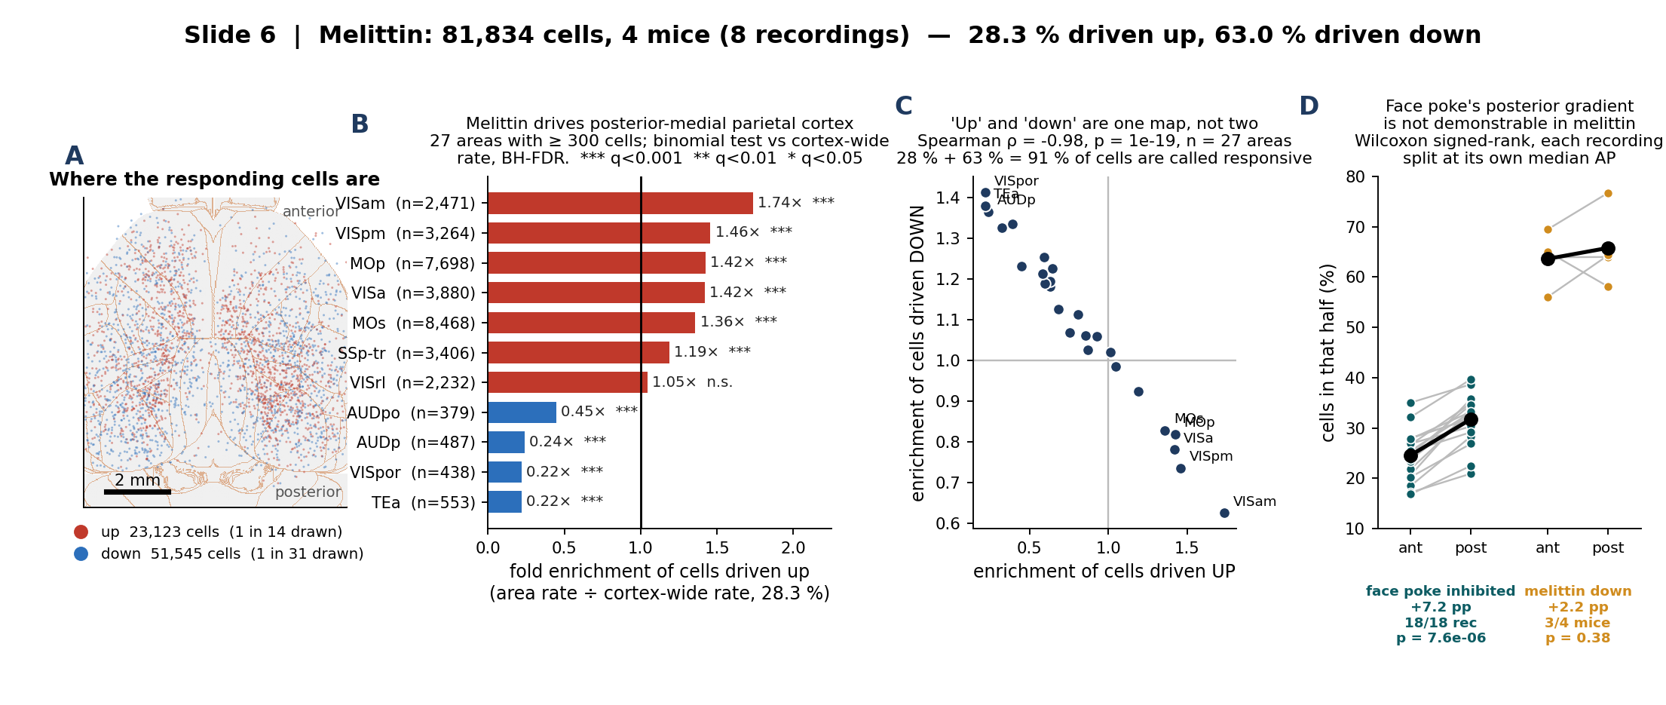
3. Melittin: posterior-medial parietal and motor cortex
What we did: ran exactly the face-poke region analysis on the melittin-only arm (81,834 cells, 4 mice), expressing each Allen area's response rate as a fold enrichment over that arm's own cortex-wide rate so the two paradigms can be read side by side.
What we found: melittin drives posterior-medial parietal cortex (VISam 1.74×, VISpm 1.46×, VISa 1.42×) and motor cortex (MOp 1.42×, MOs 1.36×), and spares lateral temporal and auditory areas (TEa, VISpor, AUDp all ≈ 0.22–0.24×). 'Up' and 'down' are near-perfect mirrors of each other (ρ = −0.98), so they carry one map and not two; and face poke's posterior inhibition gradient is not demonstrable here.
Notes:
WHY THIS SLIDE MIRRORS SLIDE 2 EXACTLY
Same enrichment recipe, same >= 300 cell floor, same binomial + BH-FDR, same colour meanings. The only thing that differs is which arm the cells come from. That is deliberate: it is the only way the two paradigms can be compared by eye.
PANEL C IS THE IMPORTANT ONE
The up-enrichment and down-enrichment maps correlate at Spearman rho = -0.98 (p = 1e-19, 27 areas). They are the same map with the sign flipped, so reporting both is reporting one number twice.
The reason is in the base rates: 28.3% of cells are called up and 63.0% down, which is 91.3% of all cells called responsive. The melittin test uses time bins as its sample, so df is in the thousands and nearly every cell crosses p<0.05 in one direction or the other. An area that is high on 'up' is therefore mechanically low on 'down'. Supplement S2 has the full argument.
This is why the absolute 28% / 63% must never be compared with the face-poke 8.6% / 27.6% as biology. The enrichment ratios ARE comparable, because each is divided by its own arm's cortex-wide rate - that is what slide 6 (dissociation) rests on.
PANEL D - NO GRADIENT, AND WHY THAT IS NOT THE SAME AS 'NO EFFECT'
Face poke: +7.2 pp posterior, 18/18 recordings, p = 7.6e-06.
Melittin: +2.2 pp posterior, 3/4 mice, p = 0.38.
Two separate reasons not to read the melittin result as a demonstrated absence:
1. the effect is 3x smaller, and
2. a two-sided Wilcoxon signed-rank on n = 4 has a FLOOR of p = 0.125. Even if all 4 animals had agreed, this test could not have reached p < 0.05. It is structurally incapable of significance at this n.
Running it over the 8 recordings instead of the 4 mice would clear that floor, but mirror1 and mirror2 are two recordings of the SAME session covering the same bilateral FOV - they are technical replicates, and using them as n = 8 is pseudoreplication. The honest statement is 'not demonstrable', not 'absent'.
PER-MOUSE CHECK
CS0204-1b 29.7% up, CS0204-2w 20.9%, CS1014-1b 28.5%, CS1014-2w 28.9%. CS0204-2w sits low and also has the fewest cells (7,256), so it carries the least weight in the pooled number - the pooled 28.3% is not driven by one animal.

Slide 2
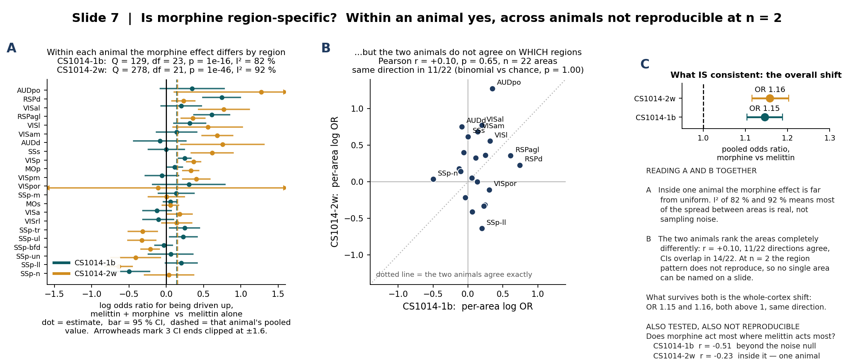
5. Is morphine region-specific? Not reproducibly, at n = 2
What we did: asked the question in the two layers it needs — first, within each of the two animals recorded under both arms, does the morphine effect differ between Allen areas (Cochran's Q on the per-area log odds ratio); second, do the two animals agree on which areas.
What we found: within each animal the effect is strongly region-dependent (I² = 82 % and 92 %, p = 1e-16 and 1e-46), but the two animals rank the areas completely differently (r = +0.10, p = 0.65; 11/22 directions agree, which is chance). Only the whole-cortex shift reproduces: OR 1.15 and 1.16, both above 1. No individual area can be named from n = 2.
Notes:
FIRST, THE DESIGN CONSTRAINT
There is NO morphine-alone arm and NO morphine + face-poke arm in this dataset. Morphine only ever appears as melittin + morphine, on 20260408, in two animals: 1014m01b and 1014m02w, which Hansol confirmed are CS1014-1b and CS1014-2w from the melittin-only cohort. So every morphine statement is a within-animal melittin -> melittin+morphine comparison in those two mice.
WHY TWO LAYERS AND NOT ONE
Panel A alone would support a headline like 'morphine acts region-specifically' - and the statistics for it are overwhelming, Q = 129 and 278. But the sample in that test is CELLS within one animal. It is the right test for 'do regions differ inside this animal', and it says nothing at all about whether the pattern is a property of morphine or a property of that animal's particular FOV and cell sampling. Panel B is what distinguishes those, and it comes out flat.
THE NUMBERS
CS1014-1b: pooled log OR +0.136 (OR 1.145), Q = 129, df = 23, p = 9.5e-17, I2 = 82%, 9/24 areas individually significant after BH.
CS1014-2w: pooled log OR +0.147 (OR 1.158), Q = 278, df = 21, p = 9.6e-47, I2 = 92%, 17/22 areas individually significant after BH.
Cross-animal: Pearson r = +0.10 (p = 0.65), Spearman rho = +0.10 (p = 0.65), 11/22 directions agree (binomial vs 0.5, p = 1.00), CIs overlap in 14/22.
WHAT THE FOREST PLOT SHOWS IF SOMEONE LOOKS CLOSELY
The areas at the top (AUDpo, RSPd, VISal, RSPagl, VISl) and at the bottom (SSp-n, SSp-ll, SSp-un) are ordered by the MEAN of the two animals, which is why they look tidy. Look at the individual bars and the two colours disagree constantly: AUDd is +0.75 in one animal and -0.09 in the other, SSp-ll is +0.20 and -0.64, SSp-n is -0.50 and +0.04. That disagreement is panel B.
VISpor in CS1014-2w has a CI running past +/- 4 because its up-rate is near zero; the axis is clipped at +/- 1.6 and three CI ends are marked with arrowheads.
A THIRD ANALYSIS, ALSO NEGATIVE
Does morphine act most where melittin already acts most? Correlating each area's melittin-alone up-rate against its morphine-minus-melittin change gives r = -0.51 in CS1014-1b and -0.23 in CS1014-2w. A negative correlation is EXPECTED here even under no real effect, because the noise in x re-enters y with a minus sign. I simulated that null (2,000 draws, both arms resampled at the pooled per-area rate): the null mean is about -0.10 with a 95% range of roughly -0.48 to +0.31. CS1014-1b's -0.51 sits at the 2nd percentile, outside the artifact; CS1014-2w's -0.23 sits at the 27th, inside it. One animal yes, one no - the same n = 2 problem, so it is not on the slide as a finding.
WHAT WOULD SETTLE IT
Two more paired animals. With n = 4, the cross-animal correlation of per-area log ORs becomes interpretable, and a sign test on the whole-cortex shift can reach p = 0.125; with n = 6 it can reach p = 0.031.

Slide 3
S6. Methods — the region-level tests on slides 3 and 5
ENRICHMENT (slides 2, 3, 6)
Fold enrichment = that Allen area's response rate ÷ the cortex-wide rate of the SAME arm. Areas with ≥ 300 cells only. Two-sided binomial test of each area against the cortex-wide rate, Benjamini-Hochberg FDR across the areas tested (19 for face poke, 27 for melittin).
Dividing by each arm's own base rate is what makes the two paradigms comparable despite base rates of 8.6 % and 28.3 % — see supplement S2.
A–P GRADIENT (slides 2, 3)
Each recording is split at its OWN median AP_mm, so the result does not depend on how far forward that FOV happened to sit. Wilcoxon signed-rank on the paired anterior/posterior fractions.
Unit of analysis: face poke n = 18 recordings; melittin n = 4 mice, because mirror1 and mirror2 are two recordings of the SAME session covering the same bilateral FOV. They are technical replicates, not independent samples.
At n = 4 a two-sided signed-rank test floors at p = 0.125, so it cannot reach significance however consistent the animals are. 'Not demonstrable' ≠ 'absent'.
WITHIN-ANIMAL REGION HETEROGENEITY (slide 5, panel A)
Per isocortical area with ≥ 100 cells in both arms, the 2×2 table (up / not-up) × (melittin / melittin+morphine) gives a log odds ratio and its SE, with a Haldane–Anscombe 0.5 correction so a zero count cannot break the log.
Inverse-variance pooling gives that animal's overall log OR.
Cochran's Q = Σ wᵢ(logORᵢ − logOR_pool)², wᵢ = 1/SEᵢ², df = K−1, χ². I² = (Q−df)/Q.
A significant Q means the effect differs between areas.
WHAT COCHRAN'S Q DOES AND DOES NOT LICENSE
The sample in that test is CELLS inside one animal. That is the right unit for asking whether regions differ within that animal, and the wrong unit for asking whether morphine is region-specific in general. Treating cells as independent animals would turn Q = 129 into a false headline — which is why slide 5 has a panel B.
CROSS-ANIMAL REPRODUCIBILITY (slide 5, panel B)
Per-area log ORs from the two animals, same 22 areas, correlated with Pearson and Spearman. Direction agreement tested against chance with a two-sided binomial (null 0.5). 95 % CI overlap counted per area.
All four read the same way: r = +0.10, ρ = +0.10, 11/22 directions, CIs overlap in 14/22.
THE REGRESSION-TO-THE-MEAN NULL (not on the slide)
Correlating an area's melittin rate (x) against its morphine-minus-melittin change (y) is biased negative by construction: the noise in x re-enters y with a minus sign. Both arms were resampled 2,000× at each area's pooled rate (default_rng(0)) to size that bias. Null mean ≈ −0.10, 95 % range ≈ −0.48 to +0.31; the observed values sit at the 2nd and 27th percentile.
DESIGN LIMIT, STATED ONCE
No morphine-alone arm, no morphine + face-poke arm. Morphine exists only as melittin + morphine, in two animals. Every morphine number inherits that n = 2.
Notes:
This slide exists so slides 3 and 5 can stay readable. If Mark asks 'how did you decide an area is enriched' or 'why is n = 4 and not 8', the answer is here.

