Slide 1
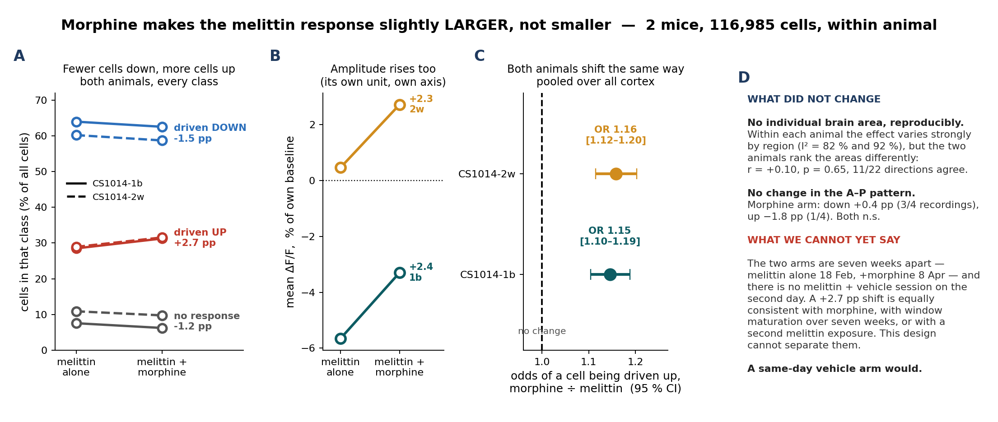
4b. What morphine changed — and what it did not
What we did: compared melittin alone with melittin + morphine on every measure we have, in the two mice recorded under both arms, so between-animal variance drops out.
What we found: all four measures move the same way and all by a small amount — more cells driven up, fewer driven down, higher amplitude, pooled odds ratio 1.15 and 1.16 — so morphine does not quieten the melittin response. No individual area changes reproducibly, and because the two arms sit seven weeks apart with no same-day vehicle control, this shift cannot yet be attributed to morphine rather than to the session.
Notes:
THE NUMBERS BEHIND PANEL A
CS1014-1b: up 28.5 -> 31.3 (+2.8 pp), down 63.9 -> 62.5 (-1.4), no response 7.6 -> 6.2, amplitude -5.7 -> -3.3 (+2.4 % of baseline). Cells: 28,910 melittin, 31,382 morphine.
CS1014-2w: up 28.9 -> 31.6 (+2.6 pp), down 60.2 -> 58.7 (-1.5), no response 10.9 -> 9.8, amplitude +0.5 -> +2.7 (+2.3 % of baseline). Cells: 25,542 melittin, 31,151 morphine.
WHY NO P VALUE ON THE WHOLE-CORTEX SHIFT
n = 2 paired animals. A two-sided sign test floors at p = 0.5 and a paired Wilcoxon cannot go below p = 0.5 either. The odds ratios in panel C DO carry CIs, but those CIs are computed over cells within one animal, so they say the shift is real inside that animal - not that it generalises. Two more paired animals would make the across-animal claim testable.
WHY THE SHIFT IS SMALL
+2.7 pp on a base of 28.7 % is a 9 % relative increase, OR 1.15. The no-response fraction barely moves (7.6 -> 6.2 and 10.9 -> 9.8), so this is not morphine silencing cells; it is a small number of cells moving from the down class to the up class.
THE SEVEN-WEEK CONFOUND - EXPECT THIS QUESTION
melittin only was recorded 20260218, melittin + morphine 20260408. Separate sessions, separate EXTRACT runs, no cell tracking across them, and no melittin + vehicle session on the second day. Window maturation, GCaMP expression drift, and a second melittin exposure are all confounded with the drug. Nothing in this dataset separates them.
WHAT WOULD FIX IT, IN ORDER OF VALUE
1. a same-day melittin + vehicle arm, ideally within-session crossover - this removes the day confound entirely and is the single most valuable addition
2. two more paired animals, which makes the region question testable
3. registering the baseline and injection EXTRACT runs to each other so cells can be tracked, which would also fix the inflated 28 % / 63 % responsive rates discussed in supplement S2
This slide is an addition. Slides 1-7 and supplements S1-S6 are unchanged.

