Slide 1
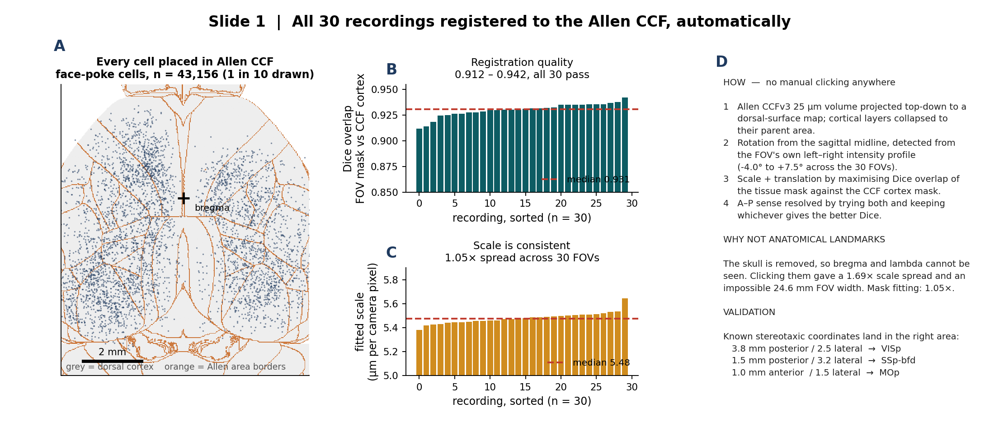
1. All 30 recordings registered to the Allen CCF — no manual landmarks
What we did: registered all 30 FOVs (18 face-poke + 12 melittin) to the Allen CCFv3 dorsal-surface map by maximising the Dice overlap between the tissue mask and the atlas cortex mask, after detecting the sagittal midline from the image itself.
What we found: all 30 pass (Dice 0.912–0.942, median 0.931) and the fitted scale agrees to within 1.05× across every FOV, so a cell's Allen area label is now a usable variable in the analysis.
Notes:
METHOD
Atlas: BrainGlobe allen_mouse_25um_v1.2, 'asr' orientation, 528 x 320 x 456. Projected top-down; the first labelled voxel along each dorsal ray gives the surface area, and cortical layers are collapsed to their parent area.
Registration is a similarity transform (rotation, isotropic scale, translation). Rotation comes from the auto-detected midline plus the fixed 90 deg between the FOV frame (A-P horizontal) and the atlas frame (A-P vertical). Scale and translation are found by maximising Dice. A-P sense is resolved by running both and keeping the better Dice.
WHY NOT LANDMARKS
I first asked Hansol to click bregma and lambda. That was my error - the skull is removed in this preparation, so neither is visible. The clicked registrations gave a 1.69x spread in fitted scale and an implied FOV width of 24.6 mm, which is impossible. The mask method needs no clicking and gives 1.05x.
WHAT 'DICE' MEANS HERE
2 x |A and B| / (|A| + |B|) between the binarised FOV tissue mask and the atlas cortex mask, after transform. 1.0 is perfect; 0.912 is the worst of the 30.
VALIDATION
Cerebellum mislabels dropped from 25% of posterior cells to 0%. Three known stereotaxic coordinates each land in the correct Allen area (see panel D).
FILES
Transforms: C:\Users\hsollim\behavior_task\crystal_skull_analysis\ccf_registration\transforms\*.mat (30 files, each with dice, um_per_px, midline_angle_deg, ap_flipped).
QC table: ...\final_deck\reg_qc.csv

Slide 2
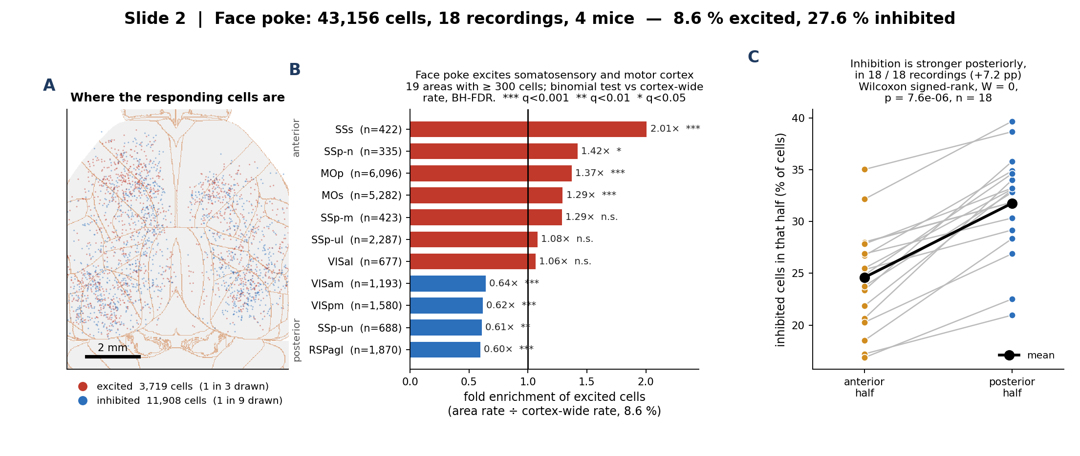
2. Face poke: somatosensory excitation, posterior inhibition
What we did: classified each of 43,156 cells (18 recordings, 4 mice) as excited or inhibited by comparing the 0–2 s window after each poke with the 2 s before it, trial-paired within cell, then asked which Allen areas are over-represented.
What we found: 8.6 % of cells are excited and 27.6 % inhibited; excitation concentrates in SSs (2.01×), SSp-n (1.42×) and MOp (1.37×), and inhibition is stronger in the posterior half of the FOV in 18 of 18 recordings (+7.2 pp, Wilcoxon signed-rank p = 7.6e-06).
Notes:
RESPONSE CLASSIFICATION (face poke)
Per cell, per poke: mean dF/F in the response window 0 to +2 s minus mean dF/F in the base window -2 to 0 s. Amplitude = the mean of that difference across trials. Two-sided t across trials, uncorrected p < 0.05; sign of the amplitude gives excited vs inhibited. This is a within-cell, trial-paired design.
Note that an uncorrected alpha of 0.05 would call about 2.5% of cells excited and 2.5% inhibited by chance alone. 8.6% and 27.6% are both above that floor, but the excited fraction is only ~3x chance, so I would not lean on the absolute number - the regional comparison is the robust part, because the same test is applied everywhere.
PANEL B - ENRICHMENT
Fold enrichment = that area's excited-cell rate divided by the cortex-wide rate of 8.6%. 19 areas have at least 300 cells. Two-sided binomial test of each area against the cortex-wide rate, Benjamini-Hochberg across the 19. Stars: *** q<0.001, ** q<0.01, * q<0.05. Red = enriched, blue = depleted.
PANEL C - A-P GRADIENT
Each recording is split at its own median AP coordinate, so the test does not depend on how far forward that FOV happened to sit. Wilcoxon signed-rank over the 18 recordings, W = 0 (every single recording moves the same way), p = 7.6e-06.
The 4 animals are 0004749770_m1, m200, m201 and m3, derived from the movie name. The 'mouse' column in the recording index holds the FOV label (m1f / m2c) and would have collapsed these to 3.

Slide 3
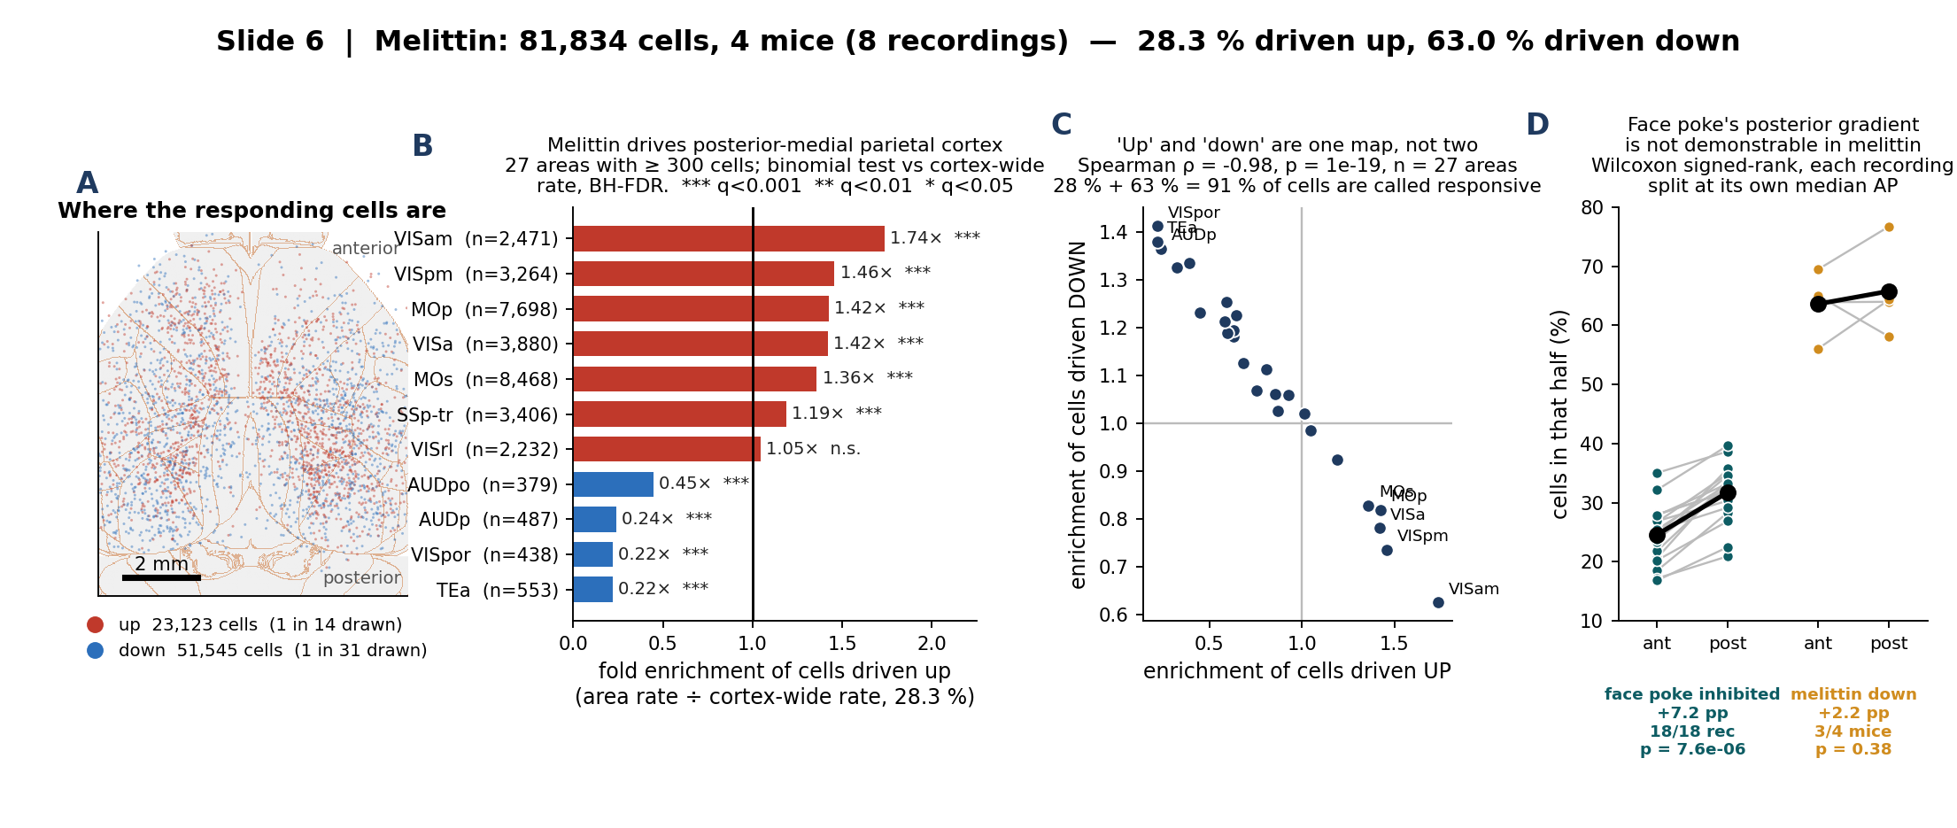
3. Melittin: posterior-medial parietal and motor cortex
What we did: ran exactly the face-poke region analysis on the melittin-only arm (81,834 cells, 4 mice), expressing each Allen area's response rate as a fold enrichment over that arm's own cortex-wide rate so the two paradigms can be read side by side.
What we found: melittin drives posterior-medial parietal cortex (VISam 1.74×, VISpm 1.46×, VISa 1.42×) and motor cortex (MOp 1.42×, MOs 1.36×), and spares lateral temporal and auditory areas (TEa, VISpor, AUDp all ≈ 0.22–0.24×). 'Up' and 'down' are near-perfect mirrors of each other (ρ = −0.98), so they carry one map and not two; and face poke's posterior inhibition gradient is not demonstrable here.
Notes:
WHY THIS SLIDE MIRRORS SLIDE 2 EXACTLY
Same enrichment recipe, same >= 300 cell floor, same binomial + BH-FDR, same colour meanings. The only thing that differs is which arm the cells come from. That is deliberate: it is the only way the two paradigms can be compared by eye.
PANEL C IS THE IMPORTANT ONE
The up-enrichment and down-enrichment maps correlate at Spearman rho = -0.98 (p = 1e-19, 27 areas). They are the same map with the sign flipped, so reporting both is reporting one number twice.
The reason is in the base rates: 28.3% of cells are called up and 63.0% down, which is 91.3% of all cells called responsive. The melittin test uses time bins as its sample, so df is in the thousands and nearly every cell crosses p<0.05 in one direction or the other. An area that is high on 'up' is therefore mechanically low on 'down'. Supplement S2 has the full argument.
This is why the absolute 28% / 63% must never be compared with the face-poke 8.6% / 27.6% as biology. The enrichment ratios ARE comparable, because each is divided by its own arm's cortex-wide rate - that is what slide 6 (dissociation) rests on.
PANEL D - NO GRADIENT, AND WHY THAT IS NOT THE SAME AS 'NO EFFECT'
Face poke: +7.2 pp posterior, 18/18 recordings, p = 7.6e-06.
Melittin: +2.2 pp posterior, 3/4 mice, p = 0.38.
Two separate reasons not to read the melittin result as a demonstrated absence:
1. the effect is 3x smaller, and
2. a two-sided Wilcoxon signed-rank on n = 4 has a FLOOR of p = 0.125. Even if all 4 animals had agreed, this test could not have reached p < 0.05. It is structurally incapable of significance at this n.
Running it over the 8 recordings instead of the 4 mice would clear that floor, but mirror1 and mirror2 are two recordings of the SAME session covering the same bilateral FOV - they are technical replicates, and using them as n = 8 is pseudoreplication. The honest statement is 'not demonstrable', not 'absent'.
PER-MOUSE CHECK
CS0204-1b 29.7% up, CS0204-2w 20.9%, CS1014-1b 28.5%, CS1014-2w 28.9%. CS0204-2w sits low and also has the fewest cells (7,256), so it carries the least weight in the pooled number - the pooled 28.3% is not driven by one animal.

Slide 4
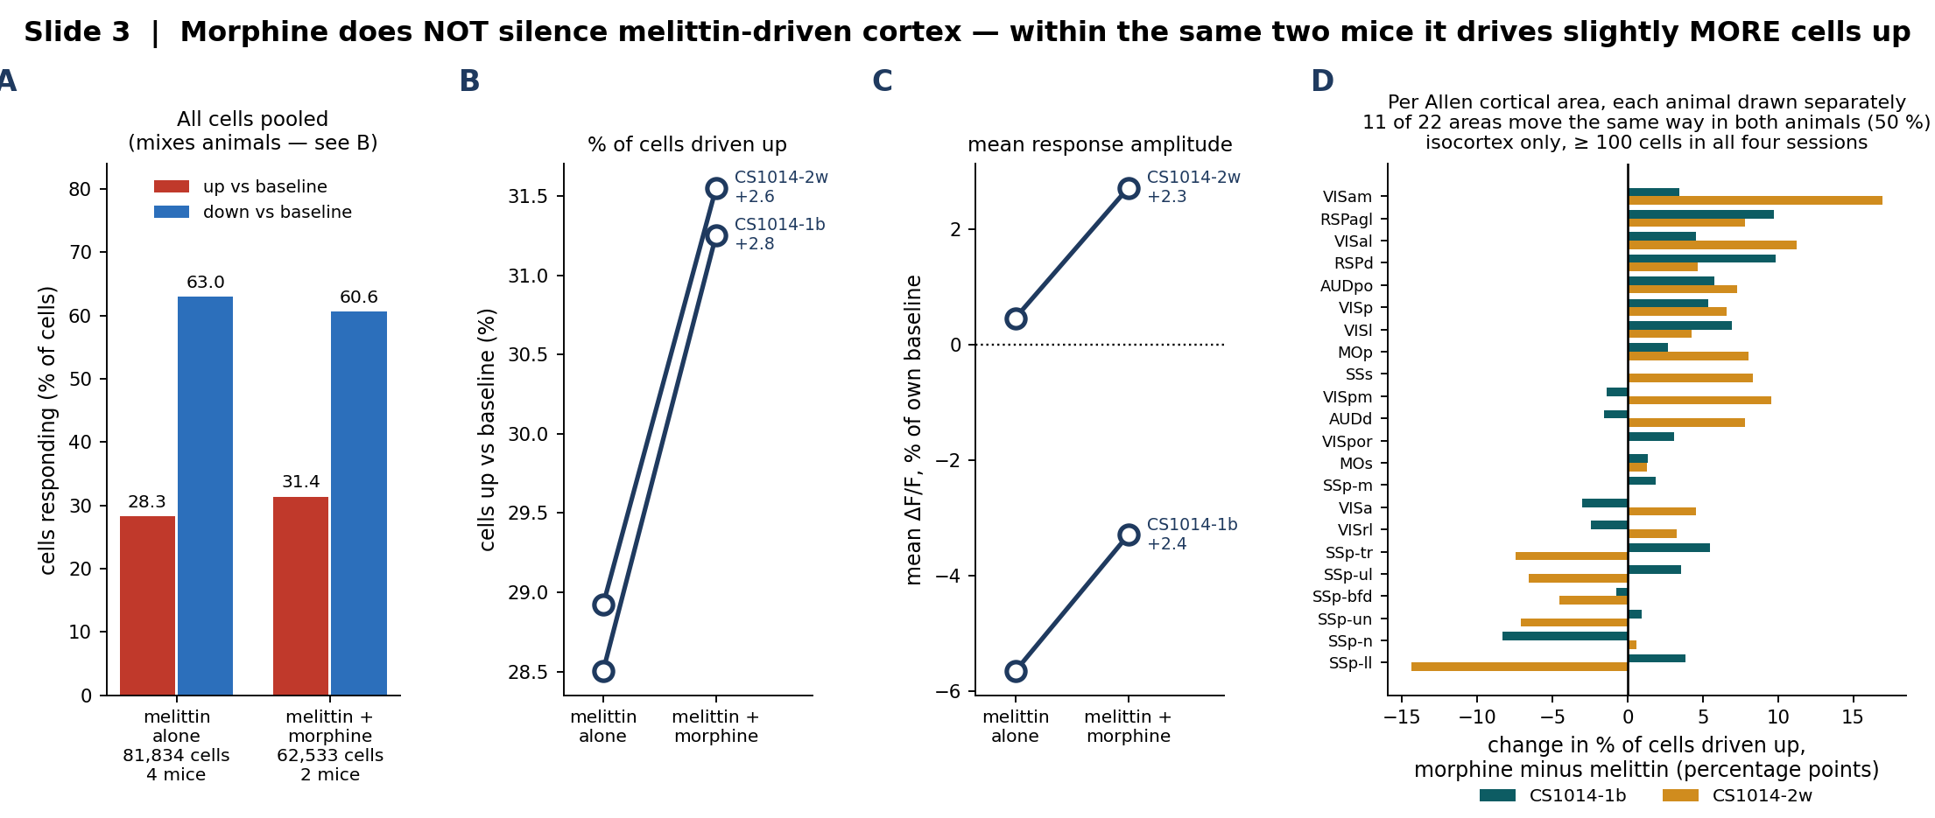
4. Morphine does not silence the melittin response (within animal)
What we did: compared melittin alone with melittin + morphine in the two animals (CS1014-1b, CS1014-2w) that were recorded under both arms, which removes the between-animal variance that dominates the pooled comparison.
What we found: in both animals the fraction of cells driven up rose (+2.8 and +2.6 pp) and mean amplitude rose (+2.4 and +2.3 % of baseline). With n = 2 pairs no p value is meaningful, so none is quoted — the pairing sharpens the estimate, it does not supply the evidence.
Notes:
WHY PAIRED
Hansol confirmed CS1014-1b = 1014m01b and CS1014-2w = 1014m02w. Every earlier version of this comparison treated the two arms as independent groups (n = 4 vs 2, unpaired Mann-Whitney). For these two animals that was the wrong design. The unpaired estimate was roughly 3x larger, inflated by one outlier animal (CS0204-2w); the within-animal effect is +2.7 pp on average.
WHY NO P VALUE
A two-sided sign test on n = 2 has a floor of p = 0.5, and a paired Wilcoxon on n = 2 cannot go below p = 0.5 either. Quoting any p here would be theatre. Two more paired animals would make this testable.
RESPONSE CLASSIFICATION (melittin) - IMPORTANT CAVEAT
Baseline and injection are separate EXTRACT runs, so cells are NOT tracked across the injection. Each injection cell's amplitude is its mean dF/F minus the grand mean over all baseline cells, tested with a t across time bins. Because there are thousands of time bins, that test has enormous degrees of freedom and calls a very large fraction of cells responsive - which is why panel A shows 28% up and 63% down, far above the face-poke numbers. Those absolute percentages are NOT comparable to slide 2 and should not be read as biology.
What IS valid is the comparison between the two arms and between areas, because the identical test is applied to both sides. That is what panels B, C and D show.
PANEL D
Isocortex only, areas with at least 100 cells in all four sessions. Leaving every labelled area in pulls in SCzo (superior colliculus) and an 'outside' bin, which do not belong in a cortical claim.

Slide 5
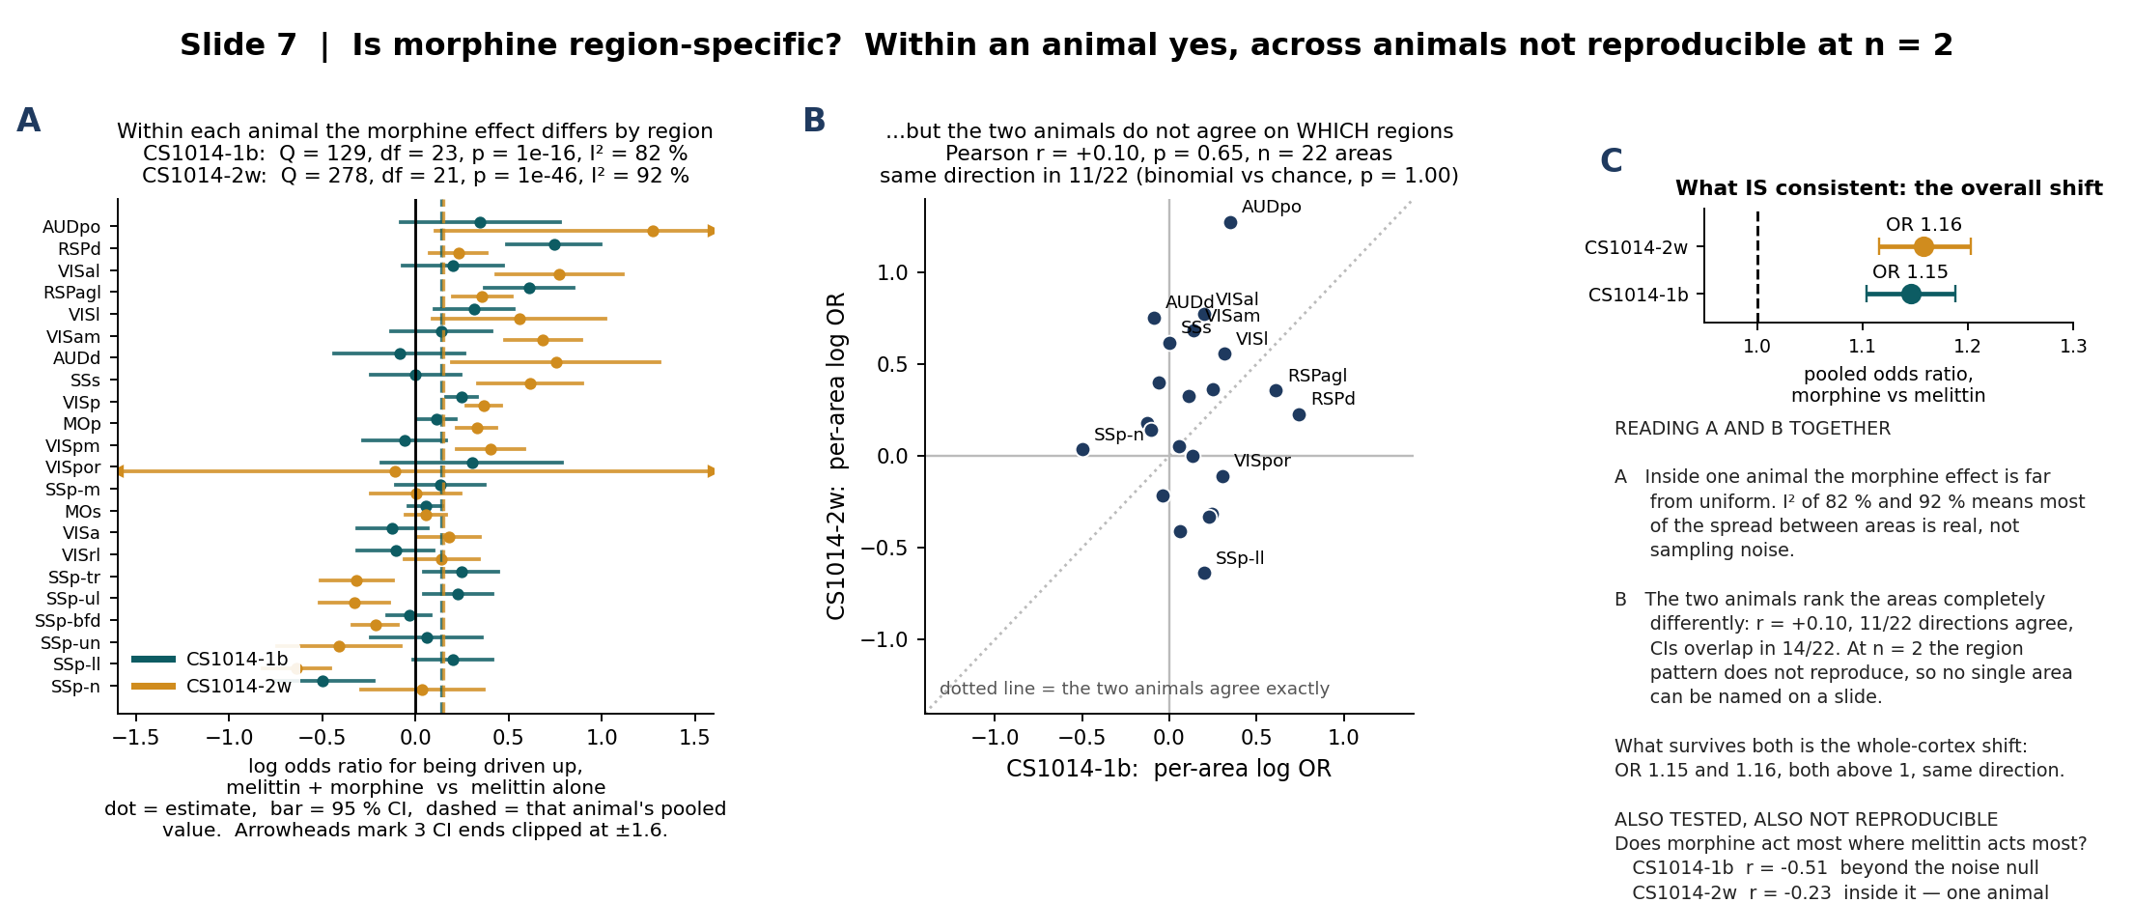
5. Is morphine region-specific? Not reproducibly, at n = 2
What we did: asked the question in the two layers it needs — first, within each of the two animals recorded under both arms, does the morphine effect differ between Allen areas (Cochran's Q on the per-area log odds ratio); second, do the two animals agree on which areas.
What we found: within each animal the effect is strongly region-dependent (I² = 82 % and 92 %, p = 1e-16 and 1e-46), but the two animals rank the areas completely differently (r = +0.10, p = 0.65; 11/22 directions agree, which is chance). Only the whole-cortex shift reproduces: OR 1.15 and 1.16, both above 1. No individual area can be named from n = 2.
Notes:
FIRST, THE DESIGN CONSTRAINT
There is NO morphine-alone arm and NO morphine + face-poke arm in this dataset. Morphine only ever appears as melittin + morphine, on 20260408, in two animals: 1014m01b and 1014m02w, which Hansol confirmed are CS1014-1b and CS1014-2w from the melittin-only cohort. So every morphine statement is a within-animal melittin -> melittin+morphine comparison in those two mice.
WHY TWO LAYERS AND NOT ONE
Panel A alone would support a headline like 'morphine acts region-specifically' - and the statistics for it are overwhelming, Q = 129 and 278. But the sample in that test is CELLS within one animal. It is the right test for 'do regions differ inside this animal', and it says nothing at all about whether the pattern is a property of morphine or a property of that animal's particular FOV and cell sampling. Panel B is what distinguishes those, and it comes out flat.
THE NUMBERS
CS1014-1b: pooled log OR +0.136 (OR 1.145), Q = 129, df = 23, p = 9.5e-17, I2 = 82%, 9/24 areas individually significant after BH.
CS1014-2w: pooled log OR +0.147 (OR 1.158), Q = 278, df = 21, p = 9.6e-47, I2 = 92%, 17/22 areas individually significant after BH.
Cross-animal: Pearson r = +0.10 (p = 0.65), Spearman rho = +0.10 (p = 0.65), 11/22 directions agree (binomial vs 0.5, p = 1.00), CIs overlap in 14/22.
WHAT THE FOREST PLOT SHOWS IF SOMEONE LOOKS CLOSELY
The areas at the top (AUDpo, RSPd, VISal, RSPagl, VISl) and at the bottom (SSp-n, SSp-ll, SSp-un) are ordered by the MEAN of the two animals, which is why they look tidy. Look at the individual bars and the two colours disagree constantly: AUDd is +0.75 in one animal and -0.09 in the other, SSp-ll is +0.20 and -0.64, SSp-n is -0.50 and +0.04. That disagreement is panel B.
VISpor in CS1014-2w has a CI running past +/- 4 because its up-rate is near zero; the axis is clipped at +/- 1.6 and three CI ends are marked with arrowheads.
A THIRD ANALYSIS, ALSO NEGATIVE
Does morphine act most where melittin already acts most? Correlating each area's melittin-alone up-rate against its morphine-minus-melittin change gives r = -0.51 in CS1014-1b and -0.23 in CS1014-2w. A negative correlation is EXPECTED here even under no real effect, because the noise in x re-enters y with a minus sign. I simulated that null (2,000 draws, both arms resampled at the pooled per-area rate): the null mean is about -0.10 with a 95% range of roughly -0.48 to +0.31. CS1014-1b's -0.51 sits at the 2nd percentile, outside the artifact; CS1014-2w's -0.23 sits at the 27th, inside it. One animal yes, one no - the same n = 2 problem, so it is not on the slide as a finding.
WHAT WOULD SETTLE IT
Two more paired animals. With n = 4, the cross-animal correlation of per-area log ORs becomes interpretable, and a sign test on the whole-cortex shift can reach p = 0.125; with n = 6 it can reach p = 0.031.

Slide 6
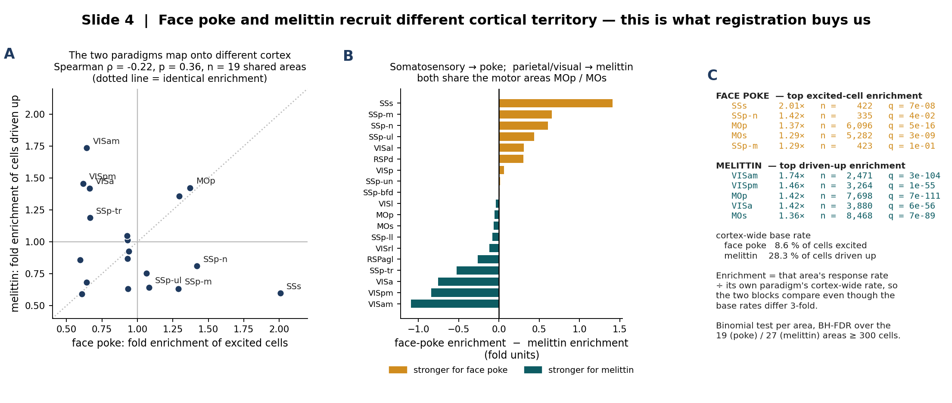
6. Face poke and melittin recruit different cortical territory
What we did: put the two paradigms on the same axis by expressing each area's response rate as a fold enrichment over its own paradigm's cortex-wide rate, so the 3-fold difference in base rate cancels.
What we found: face poke is strongest in somatosensory cortex (SSs 2.01×, SSp-n 1.42×) while melittin is strongest in posterior-medial parietal / visual areas (VISam 1.74×, VISpm 1.46×, VISa 1.42×); the two area maps are uncorrelated (Spearman ρ = −0.22, p = 0.36, 19 shared areas), and only MOp / MOs are enriched in both.
Notes:
WHY FOLD ENRICHMENT AND NOT RAW RATES
The two paradigms use different response tests (see slide 3 notes), so their cortex-wide rates differ 3-fold: 8.6% excited for face poke, 28.3% driven up for melittin. Dividing each area by its own paradigm's cortex-wide rate removes that offset and leaves the spatial pattern, which is the thing we want to compare.
STATISTICS
Two-sided binomial test per area against the cortex-wide rate of that paradigm, Benjamini-Hochberg FDR across the 19 (face poke) and 27 (melittin) areas that have at least 300 cells. Spearman rank correlation across the 19 areas present in both lists.
HOW TO READ THE SPEARMAN RESULT
rho = -0.22 with p = 0.36 means the two maps are UNCORRELATED, not anti-correlated. The honest statement is that knowing an area's face-poke enrichment tells you nothing about its melittin enrichment. With 19 areas this test has limited power, so a modest true correlation would not be detected.
SANITY CHECK
SSs at 2.01x for face poke comes from 422 cells, which is the smallest n in the enriched set. It survives FDR (q = 7e-08), but it is the one number on this slide I would most want a second cohort to confirm.
The melittin side uses the melittin-only arm (81,834 cells, 4 mice), not the morphine arm, so the comparison is drug-free on both sides.

Slide 7
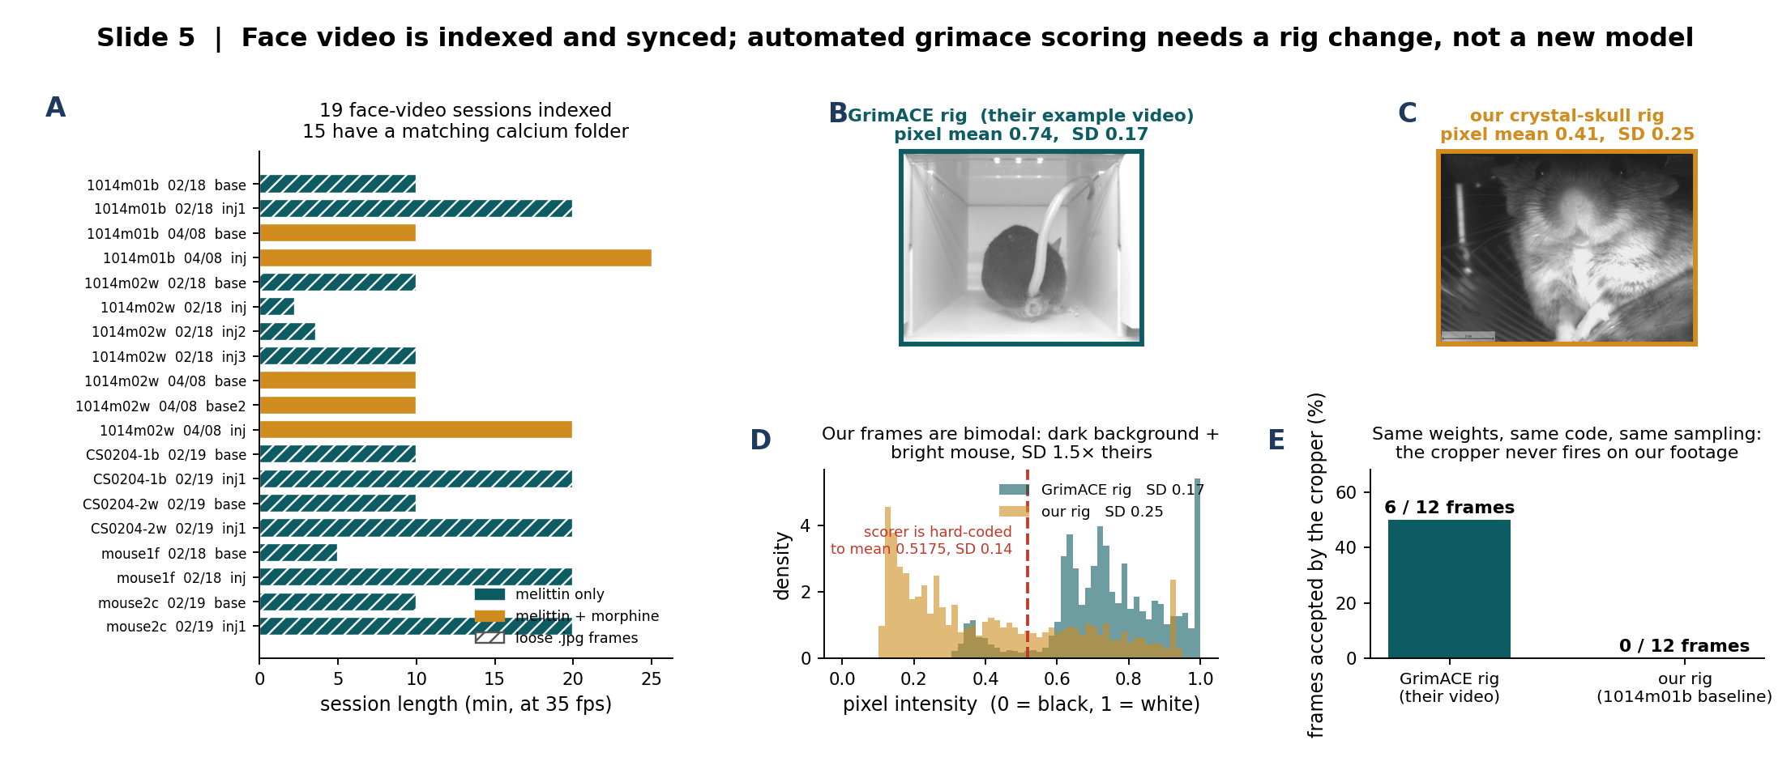
7. Face video is indexed and synced; grimace scoring needs a rig change
What we did: indexed all 19 facial-video sessions against the calcium recordings, then ran the published GrimACE model chain (frame quality → face cropper → ViT grimace scorer, authors' own weights and code) first on GrimACE's own example video as a control, then on ours.
What we found: it works on their footage (6/12 frames accepted) and finds no face at all in ours (0/12). Our frames are bimodal — dark IR background, bright mouse, SD 1.5× theirs — against a scorer that hard-codes an input mean of 0.5175 and SD of 0.14, so this is a rig mismatch, not a software problem.
Notes:
WHAT WAS ACTUALLY RUN
The GitHub repo ships no weights (only models/.gitkeep). The trained weights and the labelled dataset are on Zenodo record 15119195: grimace_scorer.pt 341.5 MB, top_pose_estimator_l.pt 85.4 MB, top_pose_estimator.pt 22.8 MB, face_cropper.pt 21.5 MB, frame_quality.pt 21.1 MB, 493 MB in total, plus 2,970 human-scored PNG frames and 15 score tables from 3 independent scorers. Those weights were dropped into the cloned repo's models/ folder and driven from a GUI-free runner (run_grimace_offline.py) so no camera is needed.
THE CONTROL RUN MATTERS
Running on their own example video first is what makes the negative result interpretable. The install is correct; the footage is the difference.
WHY A GAIN CANNOT FIX IT
The scorer normalises with hard-coded constants (x - 0.5175) / 0.14. A scalar gain moves the mean and the SD together, so it cannot match both. An earlier gain sweep I ran looked like evidence of scorer instability; it was arithmetic, not evidence, and I am not showing it.
RECOMMENDATION
1. light background behind the mouse 2. diffuse IR with no specular hot spot 3. wider framing so both ears stay in frame. With those three, either GrimACE or PainFace should run with no retraining.
PAINFACE
PainFace (Zylka lab, UNC) is the alternative and is a web service - it needs an account that only Hansol can create, at painface.net. Converted clips are already staged at ...\behavior_sync\painface_upload\.
SYNC WARNING
Frame index x 1/35 s is NOT wall clock. 1014m01b 20260408 Injection holds 1,504 s of frames spread over 3,761 s of wall clock, so that recording is segmented. Always use the per-frame timestamps.

Slide 8
S1. Methods — registration to the Allen CCF
ATLAS
BrainGlobe allen_mouse_25um_v1.2 annotation volume, 'asr' orientation, 528 × 320 × 456 voxels at 25 µm.
A top-down ray through each dorsal column takes the first labelled voxel as the surface area. Cortical layers are collapsed to their parent area, so SSp-bfd2/3 and SSp-bfd5 both become SSp-bfd.
Bregma sits at atlas row 216, column 228.
TRANSFORM
Similarity: rotation, one isotropic scale, translation. Four degrees of freedom.
• rotation = auto-detected sagittal midline + the fixed 90° between the FOV frame (A–P horizontal) and the atlas frame (A–P vertical). Detected angles ran −4.0° to +7.5° over the 30 FOVs.
• scale + translation = maximise Dice between the binarised FOV tissue mask and the atlas cortex mask.
• A–P sense = run both, keep the better Dice.
No cell coordinates enter the fit. The transform is estimated from the FOV silhouette alone, then applied to the EXTRACT footprint centroids.
WHY NOT LANDMARK CLICKING
The skull is removed in this preparation, so bregma and lambda cannot be seen. An initial clicked-landmark pass gave a 1.69× spread in fitted scale and an implied FOV width of 24.6 mm. The mask method gives 1.05× and needs no input.
QUALITY, ALL 30 RECORDINGS
Dice median 0.931, range 0.912 – 0.942
Scale median 5.48 µm/px, range 5.38 – 5.65, spread 1.05×
Midline angle −4.0° to +7.5°
VALIDATION
• cerebellum mislabels among posterior cells: 25 % → 0 %
• 3.8 mm posterior / 2.5 lateral → VISp
• 1.5 mm posterior / 3.2 lateral → SSp-bfd
• 1.0 mm anterior / 1.5 lateral → MOp
A known failure that was fixed: the first midline detector succeeded on only 12/30 and reported confidence 1.00 everywhere, because the score was clipped at 1 and the connected-component step split one hemisphere. The projection-based detector with an unclipped score succeeds on 30/30.
Notes:
This supplement exists so slide 1 does not have to carry it.

Slide 9
S2. Methods — how a cell is called excited or inhibited
The two paradigms use DIFFERENT tests, so their responsive-cell percentages are NOT comparable to each other. Read this slide before quoting either number.
FACE POKE — within-cell, trial-paired
For each cell and each poke:
amplitude = mean dF/F over 0 to +2 s − mean dF/F over −2 to 0 s
The per-cell amplitude is the mean of that difference over trials. Two-sided t across trials, uncorrected p < 0.05. Sign of the amplitude gives excited vs inhibited.
Peri-stimulus window −2 to +3 s; only pokes whose full window lies inside the recording are used.
Result: 8.6 % excited, 27.6 % inhibited, of 43,156 cells.
MELITTIN — across-session, cells NOT tracked
Baseline and injection are separate EXTRACT runs, so there is no cell correspondence across the injection.
amplitude = that injection cell's mean dF/F − the grand mean over all baseline cells
tested with a t across time bins, uncorrected p < 0.05.
Result: 28.3 % up, 63.0 % down (melittin only).
WHY THE MELITTIN PERCENTAGES ARE SO MUCH HIGHER
The melittin test uses time bins as its sample, so the degrees of freedom are in the thousands and almost any consistent offset reaches p < 0.05. The face-poke test uses trials, which is both the correct unit and a far smaller n.
So: 28 % up / 63 % down and 8.6 % / 27.6 % are NOT the same measurement and must not be compared to each other as biology.
WHAT REMAINS VALID
Every comparison in this deck is made between conditions or between areas that were run through the SAME test, so the test's bias cancels:
• slide 2, areas within face poke
• slide 3, melittin vs melittin+morphine, same test both sides
• slide 4, each paradigm normalised by its own cortex-wide rate
WHAT WOULD FIX IT
Register the baseline and injection EXTRACT runs to each other so cells can be tracked across the injection, then run the melittin arm as a within-cell paired test like the face-poke arm. That is the single biggest methodological upgrade available on this dataset.
Notes:
If Mark asks one hard question about this deck, it will be this one.

Slide 10
S3. Every statistic in the deck, in one place
SLIDE 1 — registration
Dice, 30 recordings: median 0.931, range 0.912–0.942. Descriptive, no test.
Scale: median 5.48 µm/px, 1.05× spread. Descriptive.
SLIDE 2 — face poke, 43,156 cells / 18 recordings / 4 mice
Excited 8.6 %, inhibited 27.6 % (per-cell t across trials, p < 0.05 uncorrected).
Area enrichment: two-sided binomial vs the 8.6 % cortex-wide rate, BH-FDR over 19 areas with ≥ 300 cells.
SSs 2.01× q = 7e-08 SSp-n 1.42× q = 4e-02
MOp 1.37× q = 5e-16 MOs 1.29× q = 3e-09
SSp-ul 0.66× q = 4e-25 RSPagl 0.60× q = 7e-08
A–P gradient: inhibited fraction, posterior half vs anterior half, each recording split at its own median AP. Wilcoxon signed-rank, W = 0, p = 7.6e-06, n = 18; 18/18 recordings move the same way; mean +7.2 pp.
SLIDE 3 — melittin, 144,367 cells total
melittin only: 81,834 cells, 4 mice, 28.3 % up / 63.0 % down
melittin+morphine: 62,533 cells, 2 mice, 31.4 % up / 60.6 % down
Paired, within animal (n = 2 pairs, NO p value quoted):
CS1014-1b up 28.5 → 31.3 (+2.8 pp) amp −5.7 → −3.3 (+2.4)
CS1014-2w up 28.9 → 31.6 (+2.6 pp) amp +0.5 → +2.7 (+2.3)
By area: 11 of 22 isocortical areas (≥100 cells in all four sessions) agree in direction between the two animals — 50 %, i.e. chance.
SLIDE 4 — paradigm comparison
Enrichment computed separately per paradigm against its own cortex-wide rate (face poke 8.6 % excited; melittin 28.3 % driven up), binomial + BH-FDR over 19 and 27 areas respectively.
Spearman rank correlation across the 19 shared areas: ρ = −0.22, p = 0.36. Uncorrelated, not anti-correlated.
SLIDE 5 — behaviour
19 sessions indexed, 15 with a matching calcium folder.
GrimACE face cropper, identical weights and code and sampling:
their example video 6 / 12 frames accepted
our 1014m01b baseline 0 / 12 frames accepted
Frame statistics: GrimACE rig mean 0.74 SD 0.17; our rig mean 0.41 SD 0.25 (SD 1.5× theirs). Scorer hard-codes mean 0.5175, SD 0.14.
Descriptive; no inferential test is run on the grimace arm, and none should be until the cropper works.
MULTIPLE COMPARISONS
Benjamini-Hochberg is applied within each enrichment family (the 19 or 27 areas of one paradigm). It is NOT applied across slides — the per-cell p < 0.05 that defines a responsive cell is uncorrected, by design, and is discussed in S2.

Slide 11
S4. Data inventory and where everything lives
CALCIUM — face poke
18 recordings, 4 animals (0004749770_m1, m200, m201, m3), 43,156 cells.
Cell table:
C:\Users\hsollim\behavior_task\crystal_skull_analysis\ccf_registration\n18\cell_ccf_all.csv
CALCIUM — melittin
12 recordings, 6 mice, 144,367 cells.
melittin only CS0204-1b, CS0204-2w, CS1014-1b, CS1014-2w
melittin+morphine 1014m01b, 1014m02w (= CS1014-1b, CS1014-2w)
Cell table:
C:\Users\hsollim\behavior_task\crystal_skull_analysis\ccf_registration\melittin_ccf\cell_ccf_all.csv
REGISTRATION
C:\Users\hsollim\behavior_task\crystal_skull_analysis\ccf_registration\transforms\ (30 .mat + 30 QC .png)
Atlas map: ...\ccf_registration\allen_dorsal_map.mat
QC table: ...\final_deck\reg_qc.csv
BEHAVIOUR VIDEO
19 sessions on \\stg-tnr50a1.stanford.edu\crystal_skull\
20260408 5 × .mp4
20260218, 20260219 14 × loose .jpg sequences
Manifest:
C:\Users\hsollim\behavior_task\crystal_skull_analysis\behavior_sync\behavior_calcium_manifest.csv
PainFace staging: ...\behavior_sync\painface_upload\
THIS DECK
C:\Users\hsollim\behavior_task\crystal_skull_analysis\final_deck\
CrystalSkull_summary_5slides_for_Mark.pptx
make_final_figures.py, make_s5.py (figures)
compute_stats.py (every number on the slides)
stats.json, reg_qc.csv (the computed values)
figures\S1..S5*.png
EARLIER DECKS, STILL ON DISK AND UNCHANGED
...\mark_brief\CrystalSkull_facepoke_vs_melittin_Mark_with Allen CCF_hansol_v2.pptx (29 slides)
...\combined_paradigm\CrystalSkull_facepoke_vs_melittin_vs_morphine_v2.pptx (24 slides)
...\behavior_sync\GrimACE_feasibility_for_Mark.pptx (16 slides)
Plus figures_v2\fig1–fig17 and behavior_sync\figures\figB1–B8, figC1–C6.

Slide 12
S5. What each claim still needs
STRONG AS IT STANDS
• The registration. 30/30, Dice 0.931, 1.05× scale spread, three independent coordinate checks. Nothing here depends on a judgement call.
• The face-poke A–P gradient. 18/18 recordings, W = 0. This does not depend on the responsive-cell threshold, because the same threshold is applied to both halves of the same recording.
• The face-poke somatosensory enrichment. Survives FDR comfortably for SSs, MOp and MOs.
NEEDS MORE ANIMALS
• Morphine. n = 2 paired animals. The direction is consistent and the effect is small (+2.7 pp). Two more paired animals would make this testable; at n = 4 a sign test can reach p = 0.125, at n = 6 it can reach p = 0.031.
• SSp-n at 1.42× rests on 335 cells, SSs at 2.01× on 422. Both survive FDR but are the thinnest numbers in the deck.
NEEDS A METHOD CHANGE
• The melittin responsive-cell percentages. Cells are not tracked across the injection, so the test compares each injection cell to the baseline population mean using time bins as the sample. Registering the two EXTRACT runs to each other would let the melittin arm use the same within-cell paired test as face poke, and would make its percentages directly comparable to slide 2.
• Grimace scoring. Blocked on the rig, not on the model: light background, diffuse IR, wider framing.
OPEN AND WAITING ON SOMEONE ELSE
• PainFace needs an account at painface.net that only Hansol can create. The converted clips are already staged.
• Whether the 4 face-poke animals overlap with any melittin animal has not been confirmed. If they do, slide 4 could be made within-animal too.
NOT CLAIMED ANYWHERE IN THIS DECK
• That any of these cells are nociceptive specifically. The face-poke paradigm does not separate pain from touch or from surprise; that separation needs the behavioural arm working.

Slide 13
S6. Methods — the region-level tests on slides 3 and 5
ENRICHMENT (slides 2, 3, 6)
Fold enrichment = that Allen area's response rate ÷ the cortex-wide rate of the SAME arm. Areas with ≥ 300 cells only. Two-sided binomial test of each area against the cortex-wide rate, Benjamini-Hochberg FDR across the areas tested (19 for face poke, 27 for melittin).
Dividing by each arm's own base rate is what makes the two paradigms comparable despite base rates of 8.6 % and 28.3 % — see supplement S2.
A–P GRADIENT (slides 2, 3)
Each recording is split at its OWN median AP_mm, so the result does not depend on how far forward that FOV happened to sit. Wilcoxon signed-rank on the paired anterior/posterior fractions.
Unit of analysis: face poke n = 18 recordings; melittin n = 4 mice, because mirror1 and mirror2 are two recordings of the SAME session covering the same bilateral FOV. They are technical replicates, not independent samples.
At n = 4 a two-sided signed-rank test floors at p = 0.125, so it cannot reach significance however consistent the animals are. 'Not demonstrable' ≠ 'absent'.
WITHIN-ANIMAL REGION HETEROGENEITY (slide 5, panel A)
Per isocortical area with ≥ 100 cells in both arms, the 2×2 table (up / not-up) × (melittin / melittin+morphine) gives a log odds ratio and its SE, with a Haldane–Anscombe 0.5 correction so a zero count cannot break the log.
Inverse-variance pooling gives that animal's overall log OR.
Cochran's Q = Σ wᵢ(logORᵢ − logOR_pool)², wᵢ = 1/SEᵢ², df = K−1, χ². I² = (Q−df)/Q.
A significant Q means the effect differs between areas.
WHAT COCHRAN'S Q DOES AND DOES NOT LICENSE
The sample in that test is CELLS inside one animal. That is the right unit for asking whether regions differ within that animal, and the wrong unit for asking whether morphine is region-specific in general. Treating cells as independent animals would turn Q = 129 into a false headline — which is why slide 5 has a panel B.
CROSS-ANIMAL REPRODUCIBILITY (slide 5, panel B)
Per-area log ORs from the two animals, same 22 areas, correlated with Pearson and Spearman. Direction agreement tested against chance with a two-sided binomial (null 0.5). 95 % CI overlap counted per area.
All four read the same way: r = +0.10, ρ = +0.10, 11/22 directions, CIs overlap in 14/22.
THE REGRESSION-TO-THE-MEAN NULL (not on the slide)
Correlating an area's melittin rate (x) against its morphine-minus-melittin change (y) is biased negative by construction: the noise in x re-enters y with a minus sign. Both arms were resampled 2,000× at each area's pooled rate (default_rng(0)) to size that bias. Null mean ≈ −0.10, 95 % range ≈ −0.48 to +0.31; the observed values sit at the 2nd and 27th percentile.
DESIGN LIMIT, STATED ONCE
No morphine-alone arm, no morphine + face-poke arm. Morphine exists only as melittin + morphine, in two animals. Every morphine number inherits that n = 2.
Notes:
This slide exists so slides 3 and 5 can stay readable. If Mark asks 'how did you decide an area is enriched' or 'why is n = 4 and not 8', the answer is here.

