Slide 1
Two crystal-skull assays
Face poking vs melittin (± morphine)
Same visual language: population traces, up vs down cells, FOV maps. Face poke is peri-event. Melittin is baseline vs injection (not time-locked, cells not matched). For SBI: which paradigm?

Slide 2
How to read the two assays
Face poke (13+18 Aug): 18 movies, 3 mice. t=0 is the poke. Excited/inhibited = 0.4–1.2 s vs −2–0 s, signed-rank p<0.05. No drug. Melittin: 12 BL/INJ recordings. Both arms cropped to the shorter duration. Up/down = injection cell vs baseline session mean (independent EXTRACT IDs). Melittin+morphine uses the same CS1014 mice on a different day.

Slide 3
1. Face poking
No drug | poke-locked | 18 movies

Slide 4

Face poke | population peri-poke (n = 18)
What: Gray = one movie. Red/black = mean ± SEM. Peri-window −2 to +3 s.
Result: A brief transient, a dip, then a rebound. 14/18 movies p<0.05. The all-cell mean is modest because excited and inhibited cells cancel.

Slide 5

Face poke | excited vs inhibited cells
What: Left: mean STA. Right: % of neurons per movie. Same 0.4–1.2 s vs −2–0 s rule.
Result: Movie-mean ~8.8% excited / 28.2% inhibited. Pooled: 3,719 / 43,156 excited (8.6%) and 11,908 inhibited (27.6%).

Slide 6
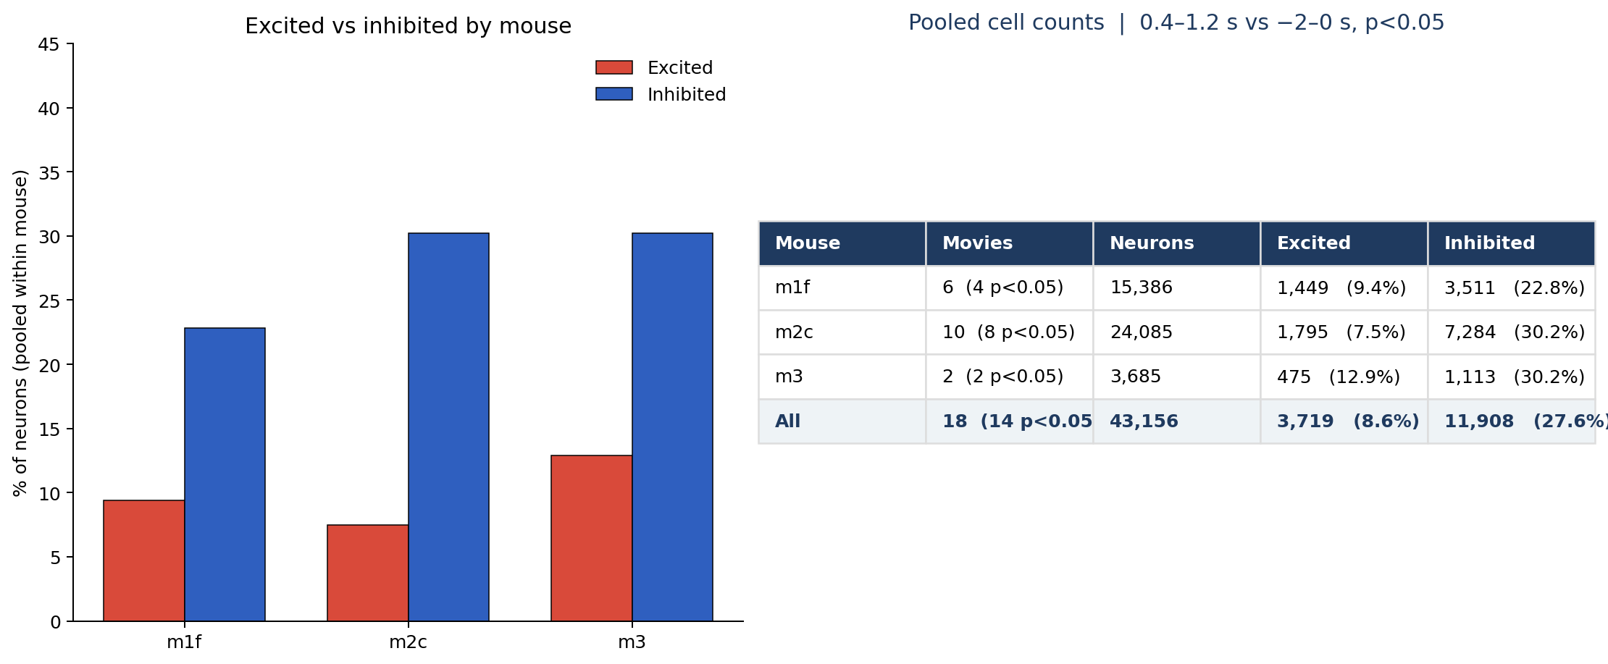
Face poke | how many cells per mouse
What: Pooled within mouse across movies (both days). Excited/inhibited as above.
Result: 14/18 movies p<0.05. Every mouse has more inhibited than excited cells.

Slide 7


Face poke | where they sit
What: Left: all FOVs (P left, A right). Right: AP bias of poke amplitude. Not CCF/Allen registered.
Result: Excited and inhibited cells are intermingled. 18/18 recordings: more excitation anterior, more inhibition posterior.

Slide 8
2. Melittin ± morphine
Not poke-locked | BL vs injection | matched to the shorter duration

Slide 9
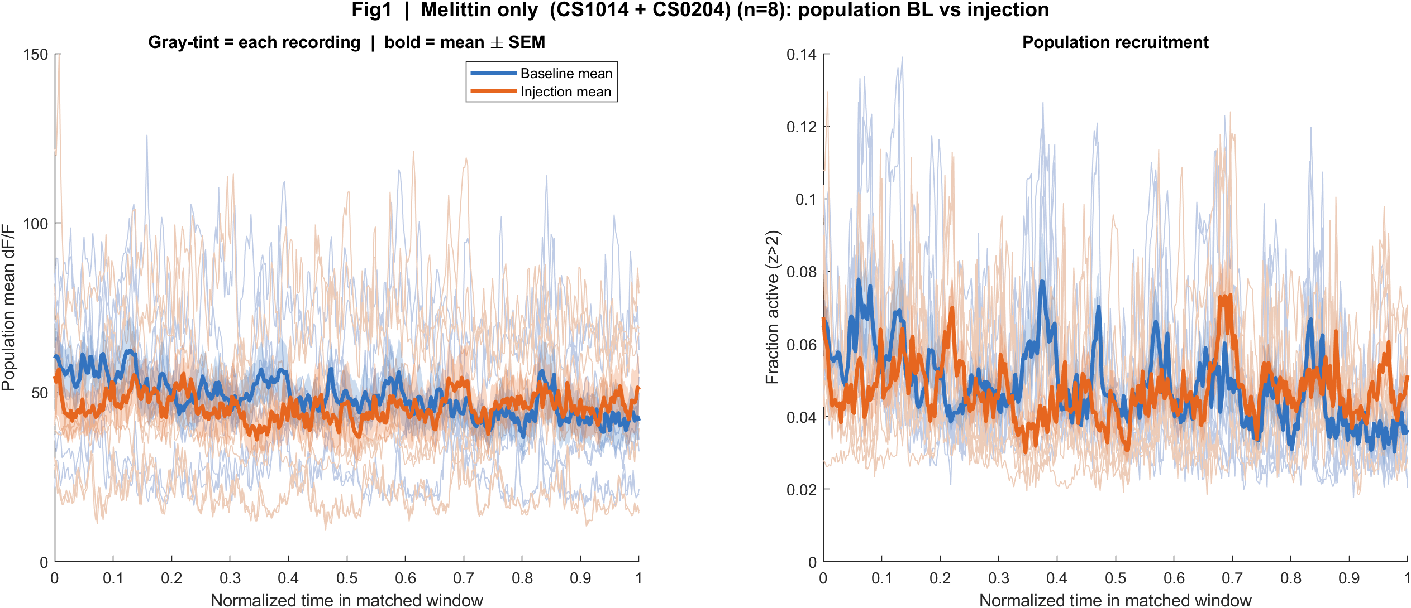
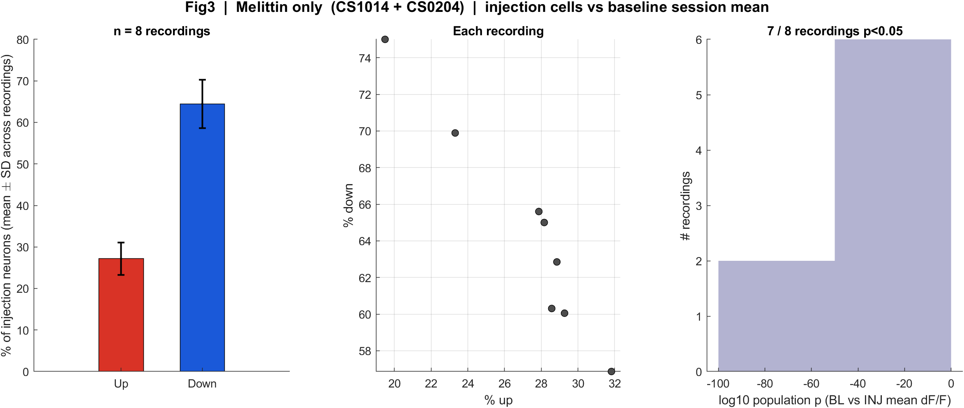
Melittin only | baseline vs injection (n = 8)
What: Same layout as face-poke Fig1/Fig3. Time is the recording, not a poke. Gray-tint = each recording.
Result: Population mean activity falls after injection in 7/8 recordings. Down cells outnumber up cells, as in face poke.

Slide 10
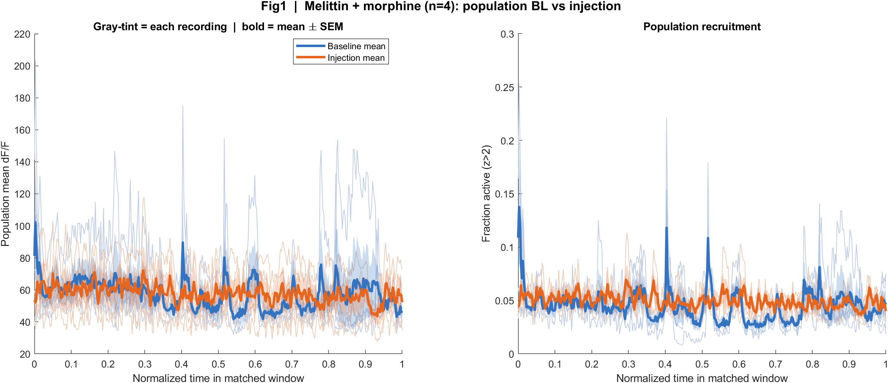
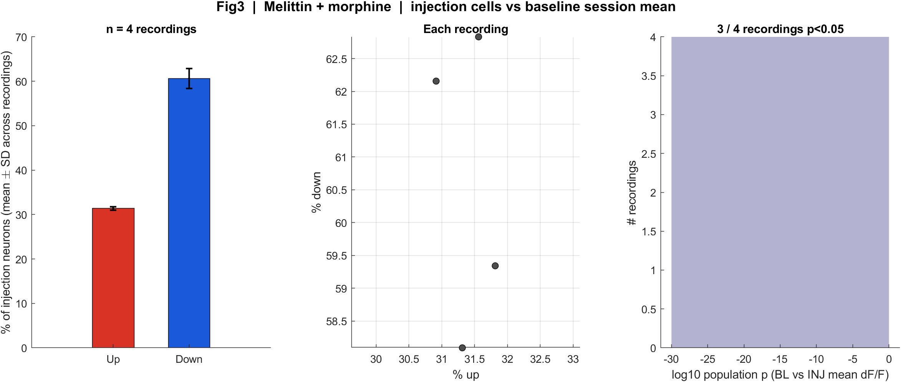
Melittin + morphine | baseline vs injection (n = 4)
What: Same CS1014 mice as the melittin-only pair, different day. Same crop-to-shorter-duration rule.
Result: Direction splits: 1/4 recordings Δ < 0. This is exploratory (small n).

Slide 11
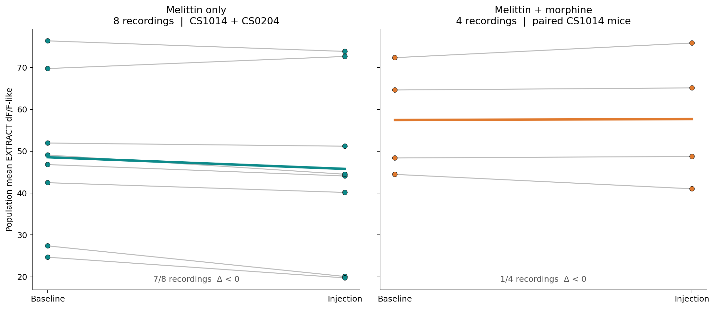
Three cases | baseline → injection
What: Each line is one recording. Left: melittin only. Right: melittin + morphine. Y = population mean EXTRACT activity (8th-pct dF/F-like).
Result: Melittin only: 7/8 go down. Morphine: 1/4. The thick line is the cohort mean.

Slide 12
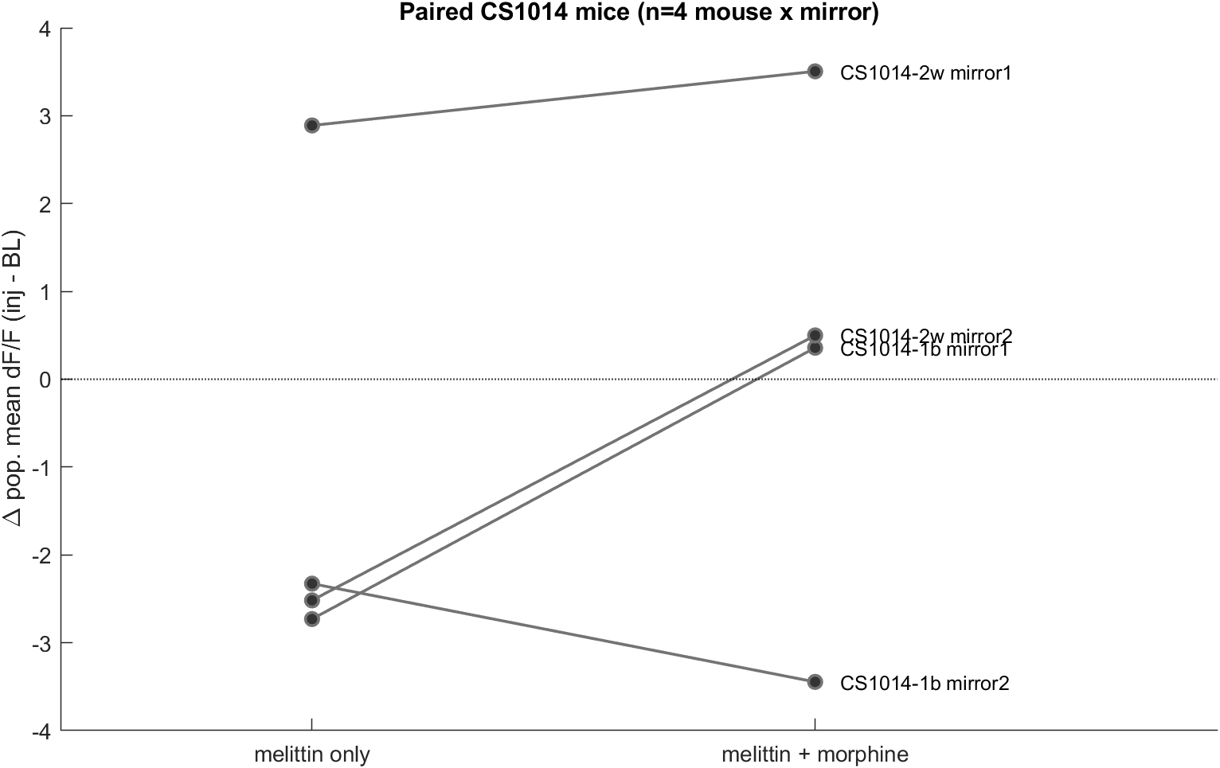
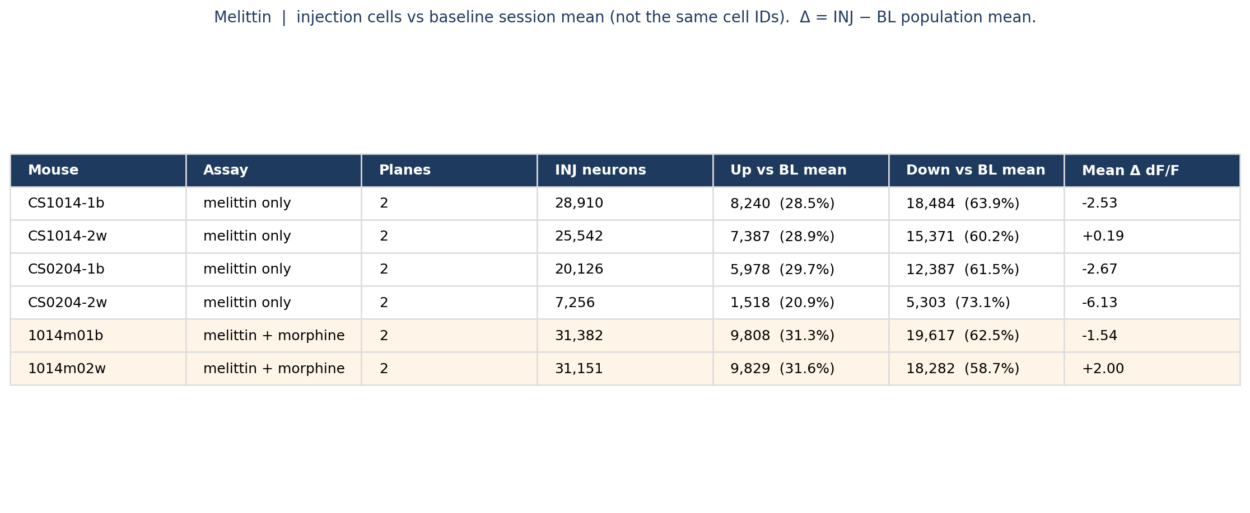
Melittin | per mouse, and paired CS1014
What: Left: injection-cell up/down vs BL session mean (not the same cells). Right: paired Δ (INJ − BL) for CS1014-1b/2w vs 1014m01b/02w.
Result: Melittin-only Δ is negative in every plane. In 3/4 paired CS1014 mouse×mirror lines, morphine is less suppressed or reversed.

Slide 13
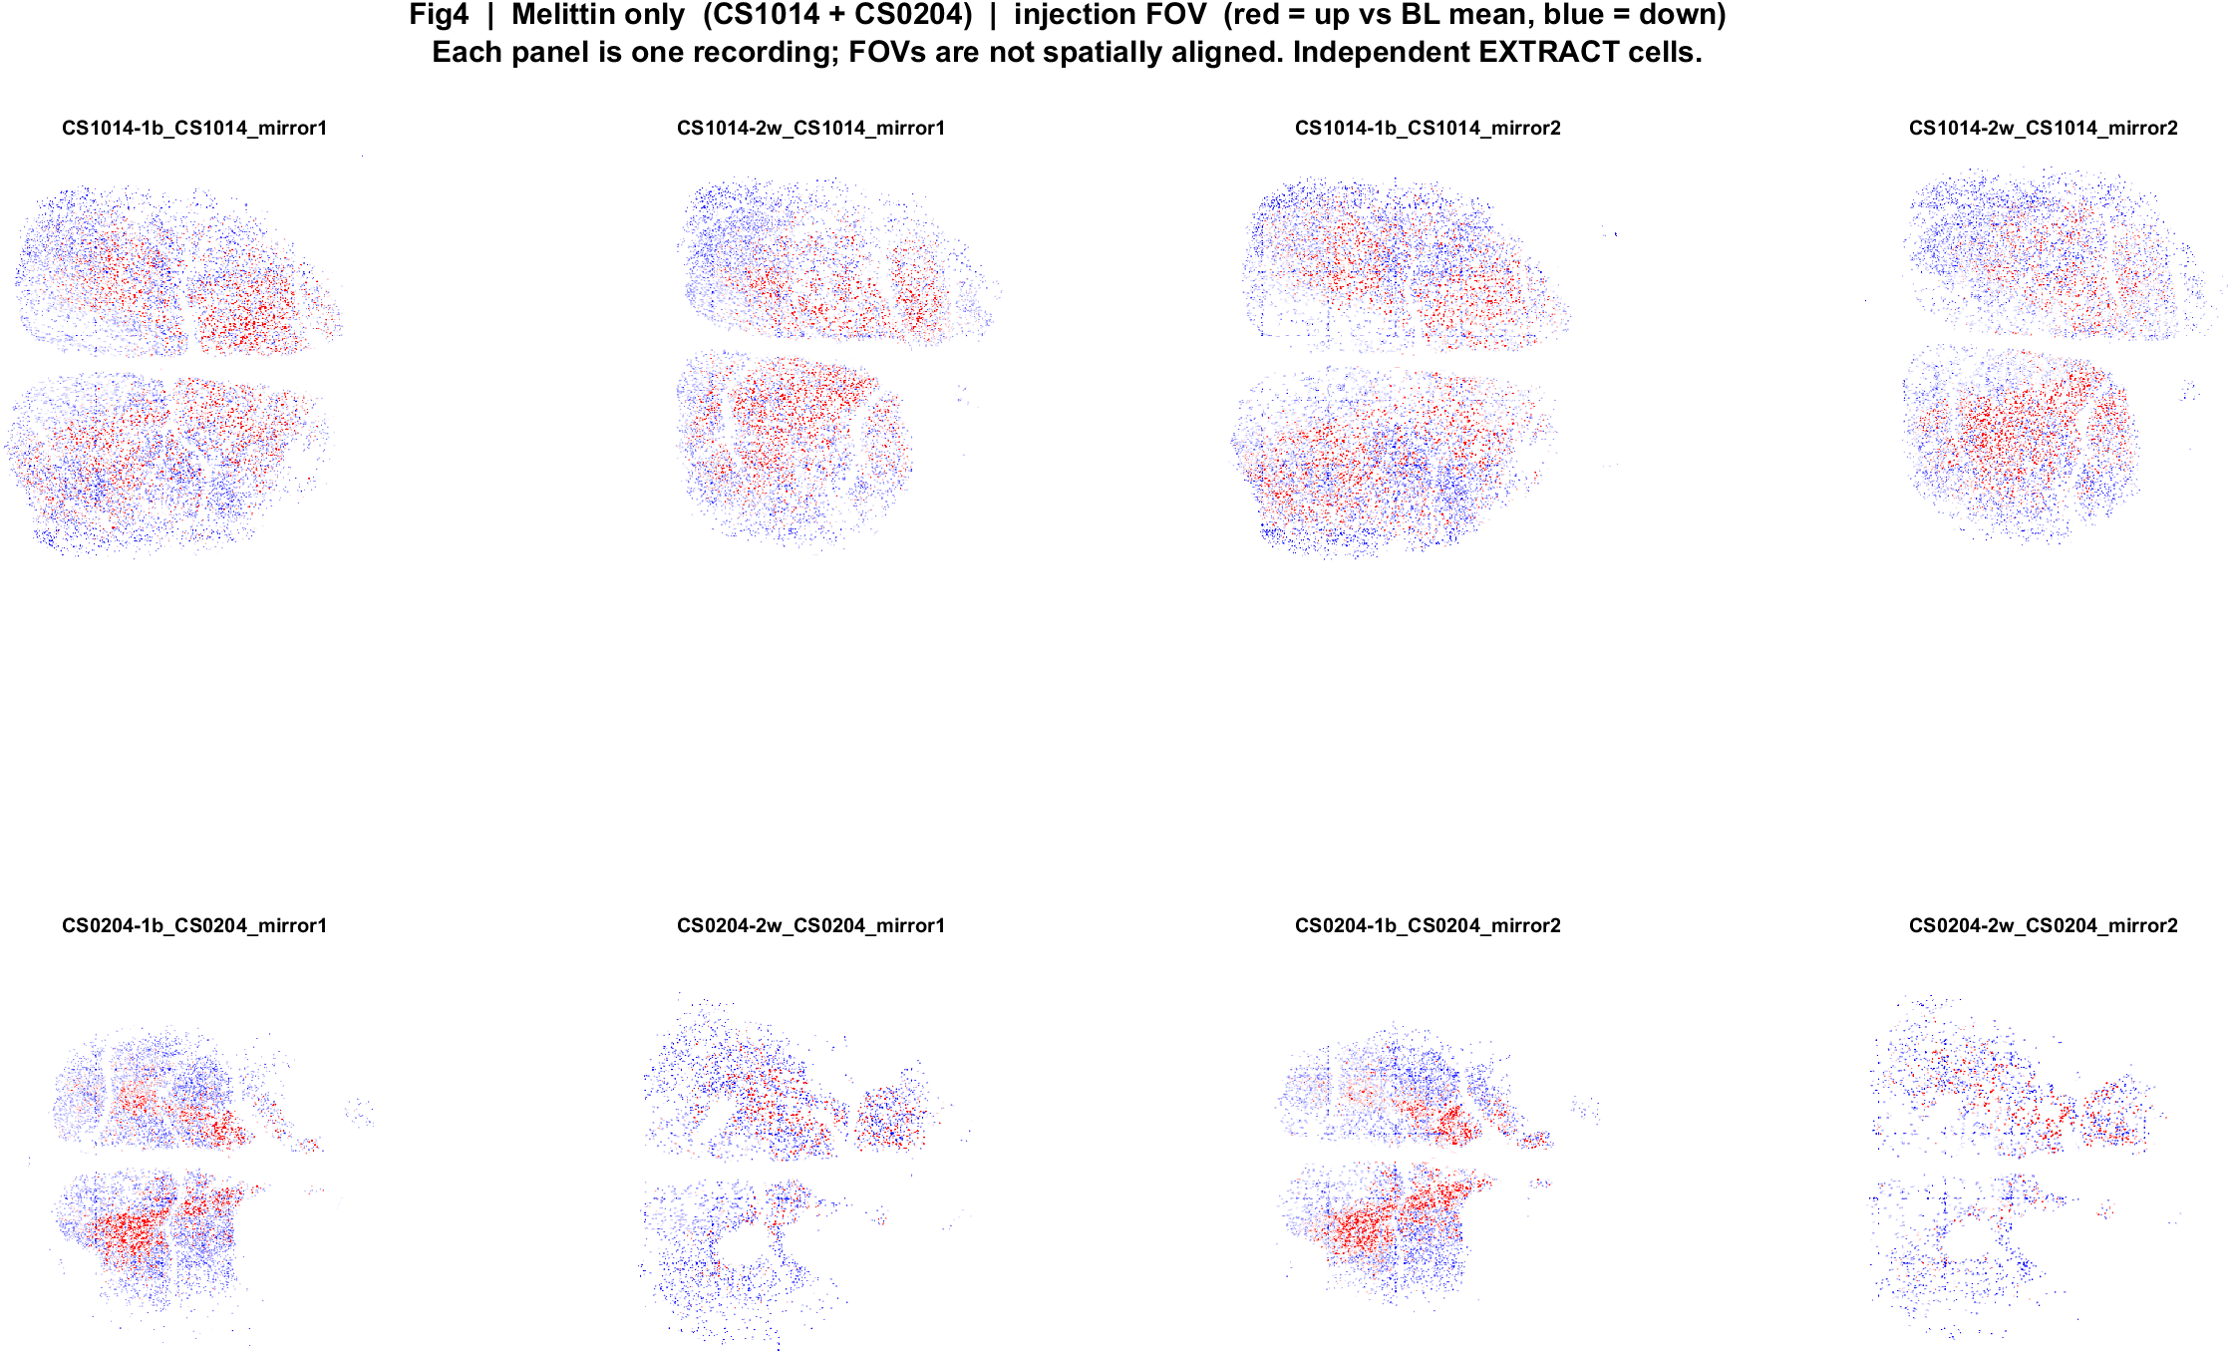
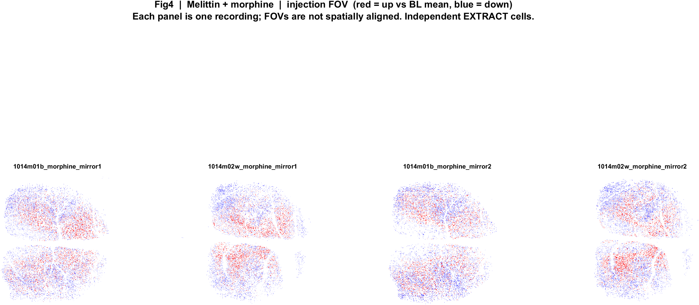
Melittin | FOV maps (same red/blue language)
What: EXTRACT footprints × amp. Red = up vs BL mean, blue = down. P left, A right. Cells are not matched to baseline.
Result: Local mix of up and down, as in face poke. Do not read this as a poke map.

Slide 14
What this does and does not say
• Face poke: every mouse has ~7–13% excited and ~23–30% inhibited poke-locked cells. No Allen/CCF areas yet — only AP on the skull.
• Face poke cannot split pain vs touch vs surprise. There is no drug on those movies.
• Melittin is a different assay. Baseline and injection EXTRACT IDs are independent, so we cannot follow the same cell into morphine.
• Session-level: melittin alone lowers population activity in 7/8 recordings (one CS1014-2w plane goes up after matching durations). Morphine pairing: 3/4 mouse×mirror lines less suppressed or reversed. Small n.
• Please confirm which paradigm to take forward for SBI (face poke vs melittin). Imaging is paused until then.

Slide 15
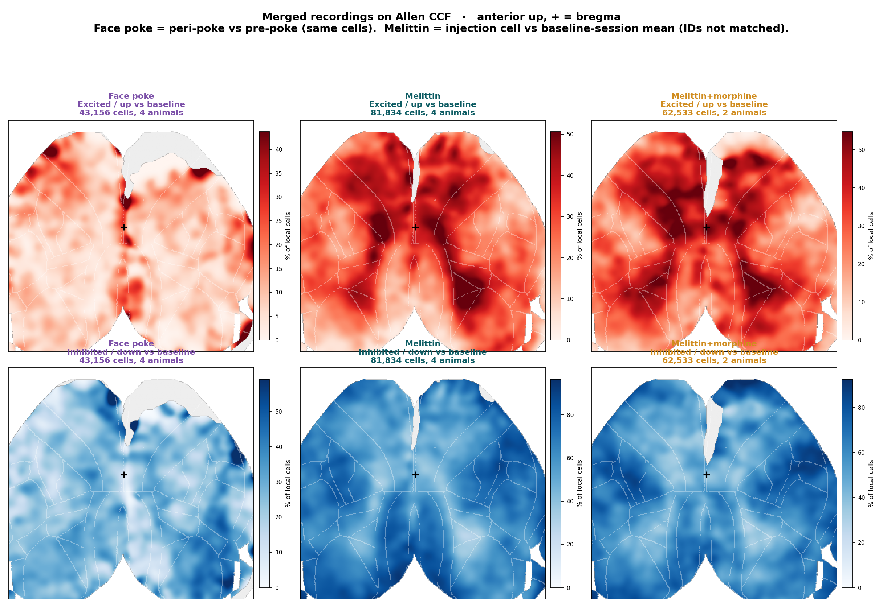
Allen CCF | all recordings merged

Slide 16
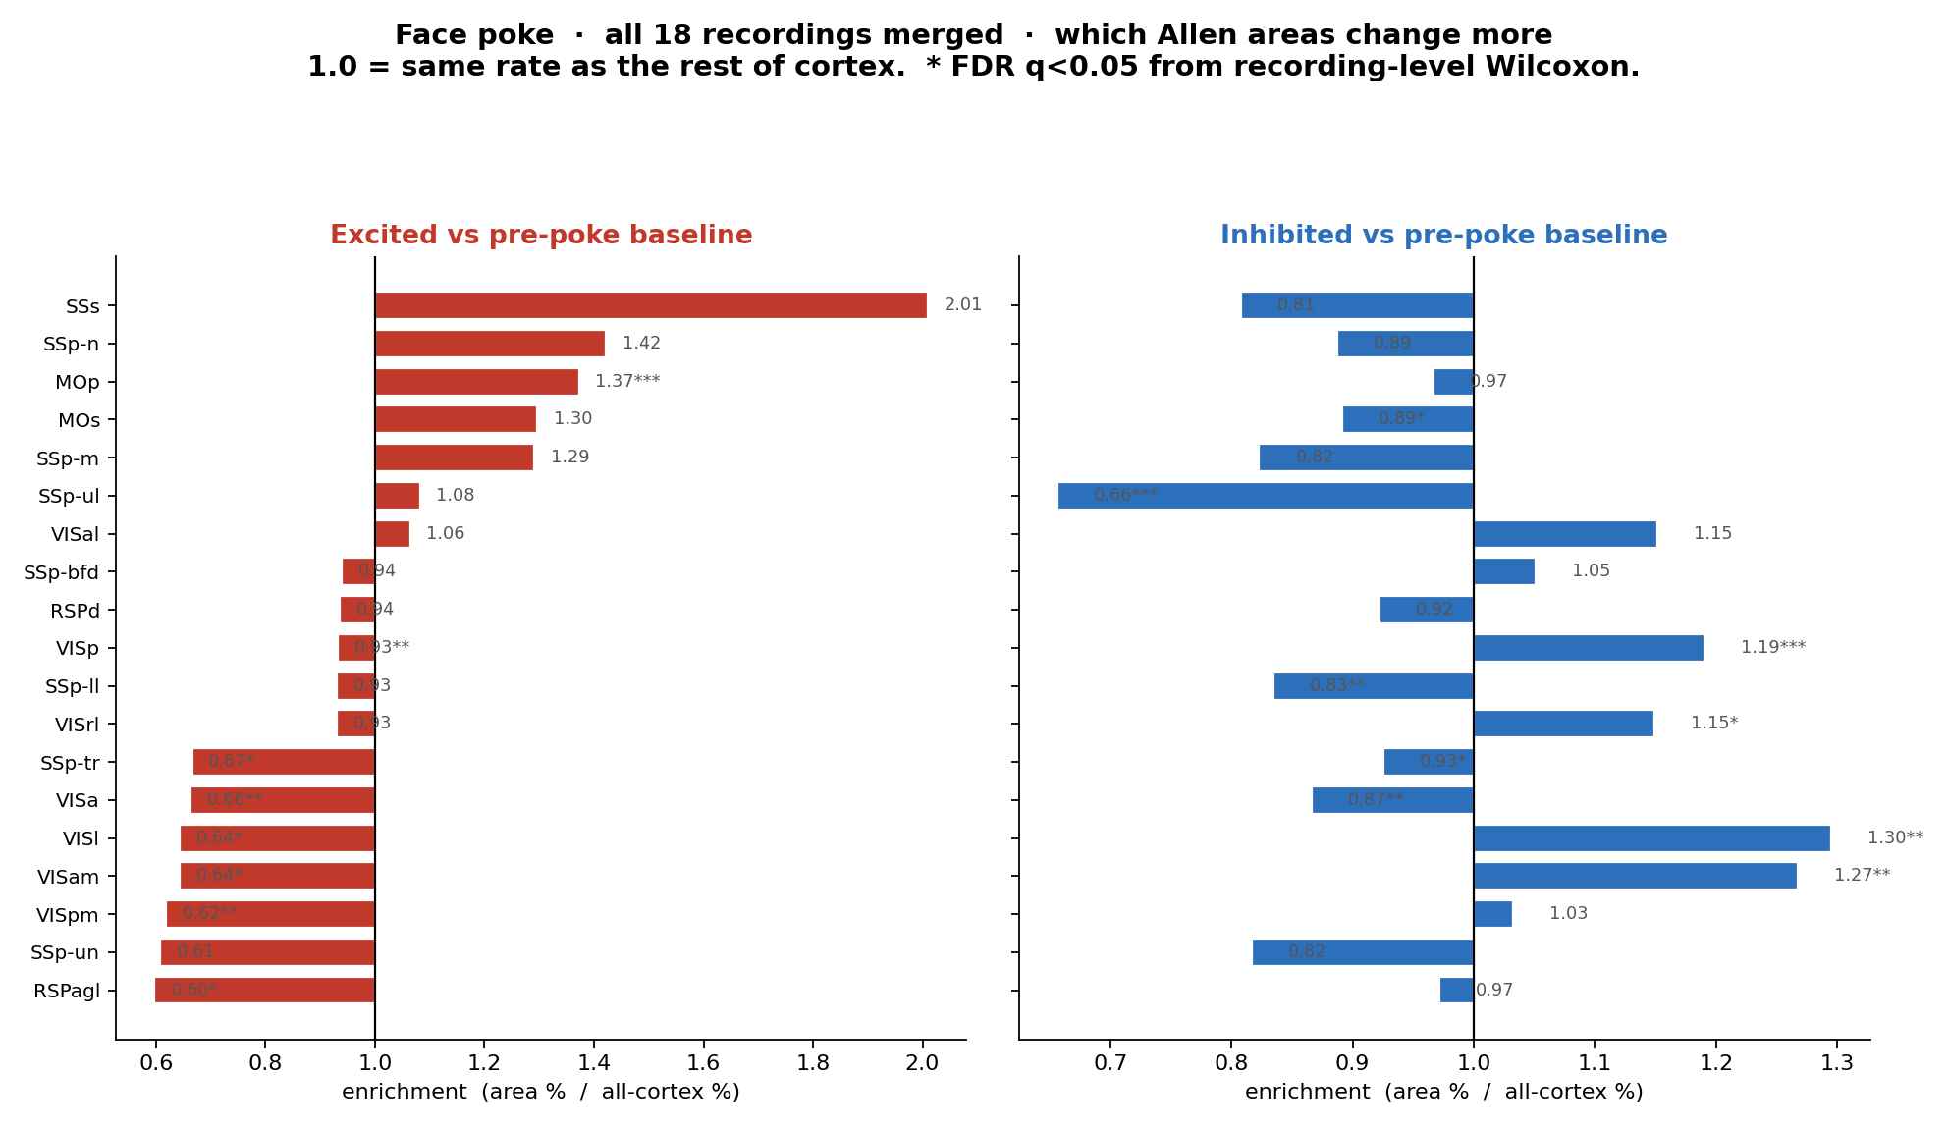
Face poke | region enrichment vs rest of cortex

Slide 17
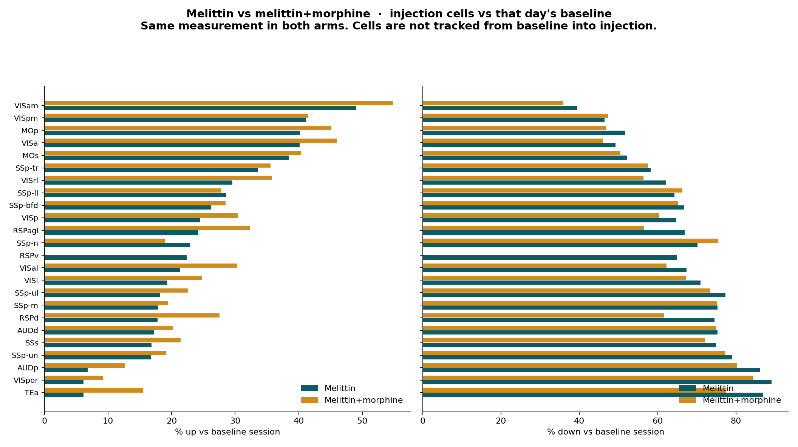
Melittin vs melittin+morphine | % up/down by area

Slide 18
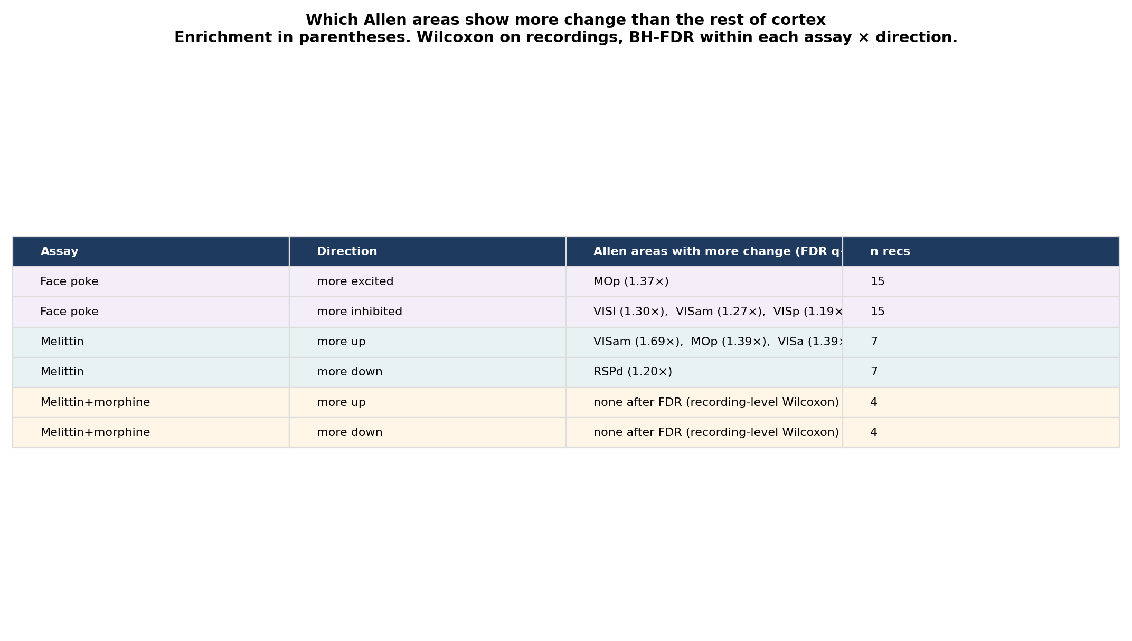
Which areas change more (FDR, recording-level)

Slide 19
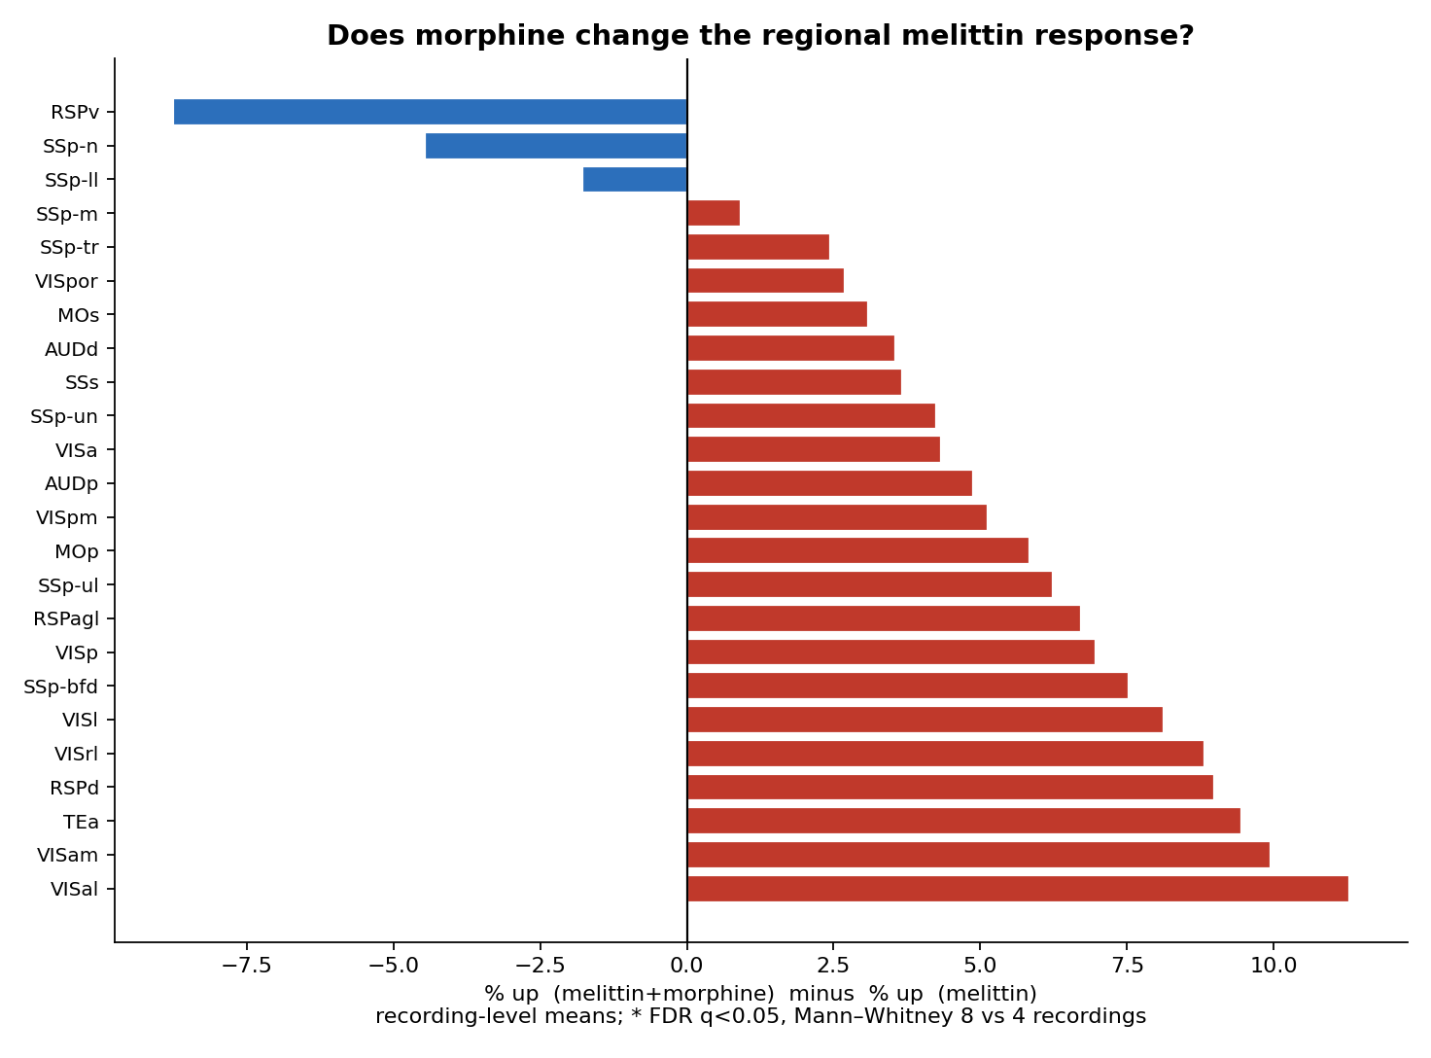
Morphine minus melittin | by Allen area

