Slide 1
Melittin on crystal skull
Baseline vs injection | 12 recordings | 144,367 injection neurons
Same visual language as face poking: population traces, up vs down cells, FOV maps, and example neurons. This is not poke-aligned. Baseline and injection EXTRACT cells are independent (not the same IDs).

Slide 2
Experiment
Whole dorsal cortex Ca2+ after melittin (bee venom) injection, with or without morphine. Each mouse has Baseline and Injection folders, mirror1path and mirror2path. CS1014 and CS0204 are melittin only; 1014m01/m02 are melittin + morphine.

Slide 3
Do not mix this with face poking
Face poking is peri-poke on 13 Aug / 18 Aug. These movies have no poke times. Baseline and injection were extracted separately, so neuron #k in injection is not the same cell as neuron #k in baseline.

Slide 4
How traces and maps are made
EXTRACT /T at the session frame rate (~29 Hz), binned to 1 s. Injection uses the last N seconds matched to baseline length. Maps use frr /S footprints on the injection summary image (percentile stretch + gamma + CLAHE). mirror2 is flipped so P is left and A is right.

Slide 5
How a cell is called up or down
amp = injection-cell mean dF/F minus the mean of all baseline-cell mean dF/F. Up/down if that cell's 1 s bins differ from the baseline session mean (t-test p<0.05). Population p is a rank-sum of 1 s population mean dF/F, baseline vs injection.

Slide 6
All recordings together
Melittin only (CS1014 + CS0204) and melittin + morphine

Slide 7
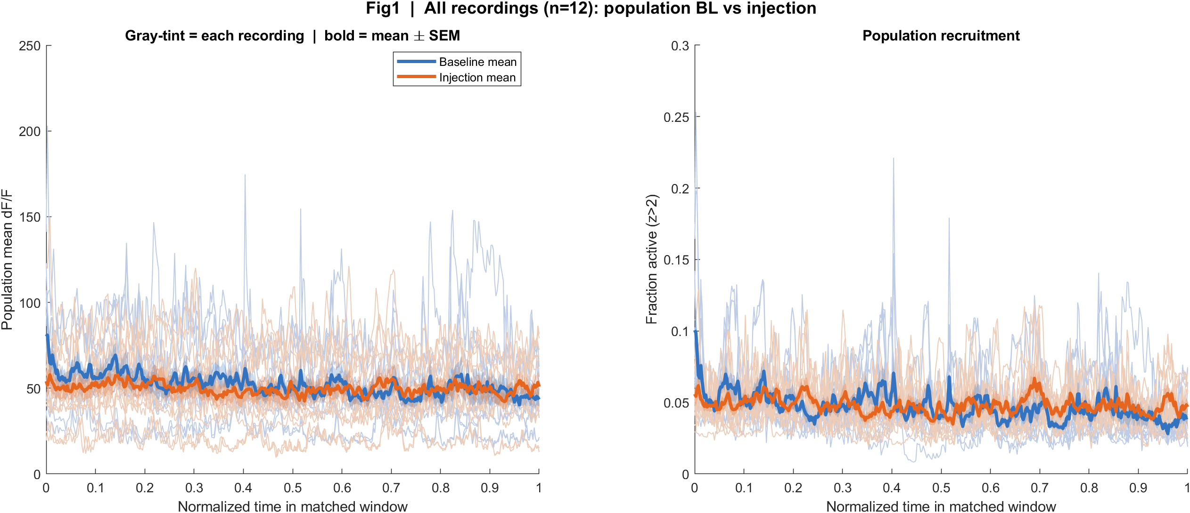
Population baseline vs injection (n = 12 recordings)
What: Each tinted line is one recording, time normalized 0-1 inside the matched window. Blue = baseline mean, orange = injection mean.
Result: 11/12 recordings have population p<0.05. Mean session Delta dF/F = -2.4375.

Slide 8
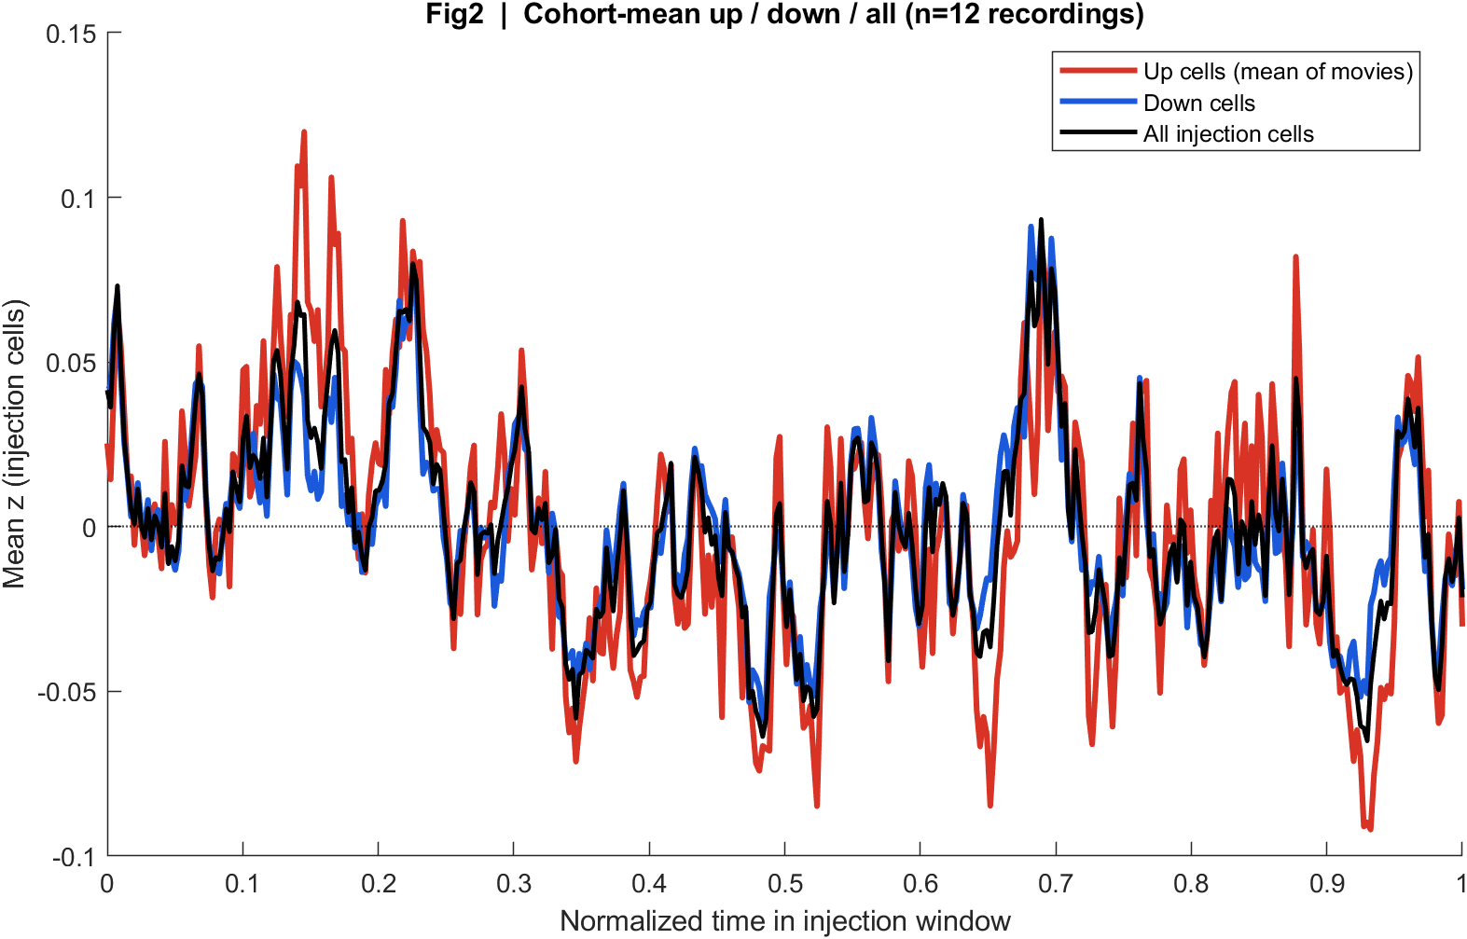
Injection up vs down cells (mean of recordings)
What: Left analog of the poke STA: mean z of injection cells classified up or down vs the baseline session mean. Black = all injection cells.
Result: The two groups have opposite sign by construction. The all-cell mean is the residual after they cancel.

Slide 9
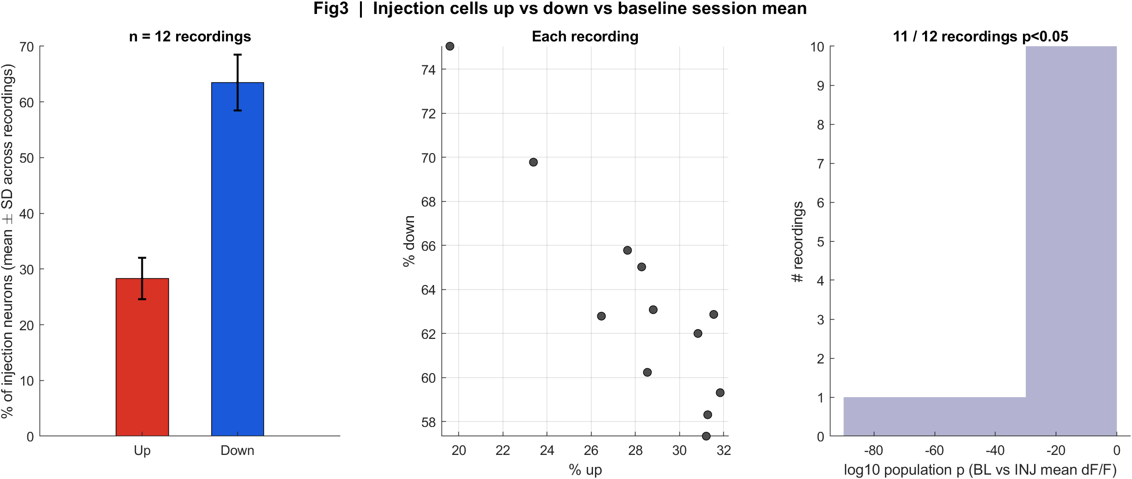
Up vs down fractions (n recordings)
What: An injection cell is up or down if its 1 s dF/F bins differ from the baseline session mean (p<0.05). One dot = one recording.
Result: Movie-mean 28.3% up and 63.5% down. 11/12 recordings p<0.05 at the population level.

Slide 10
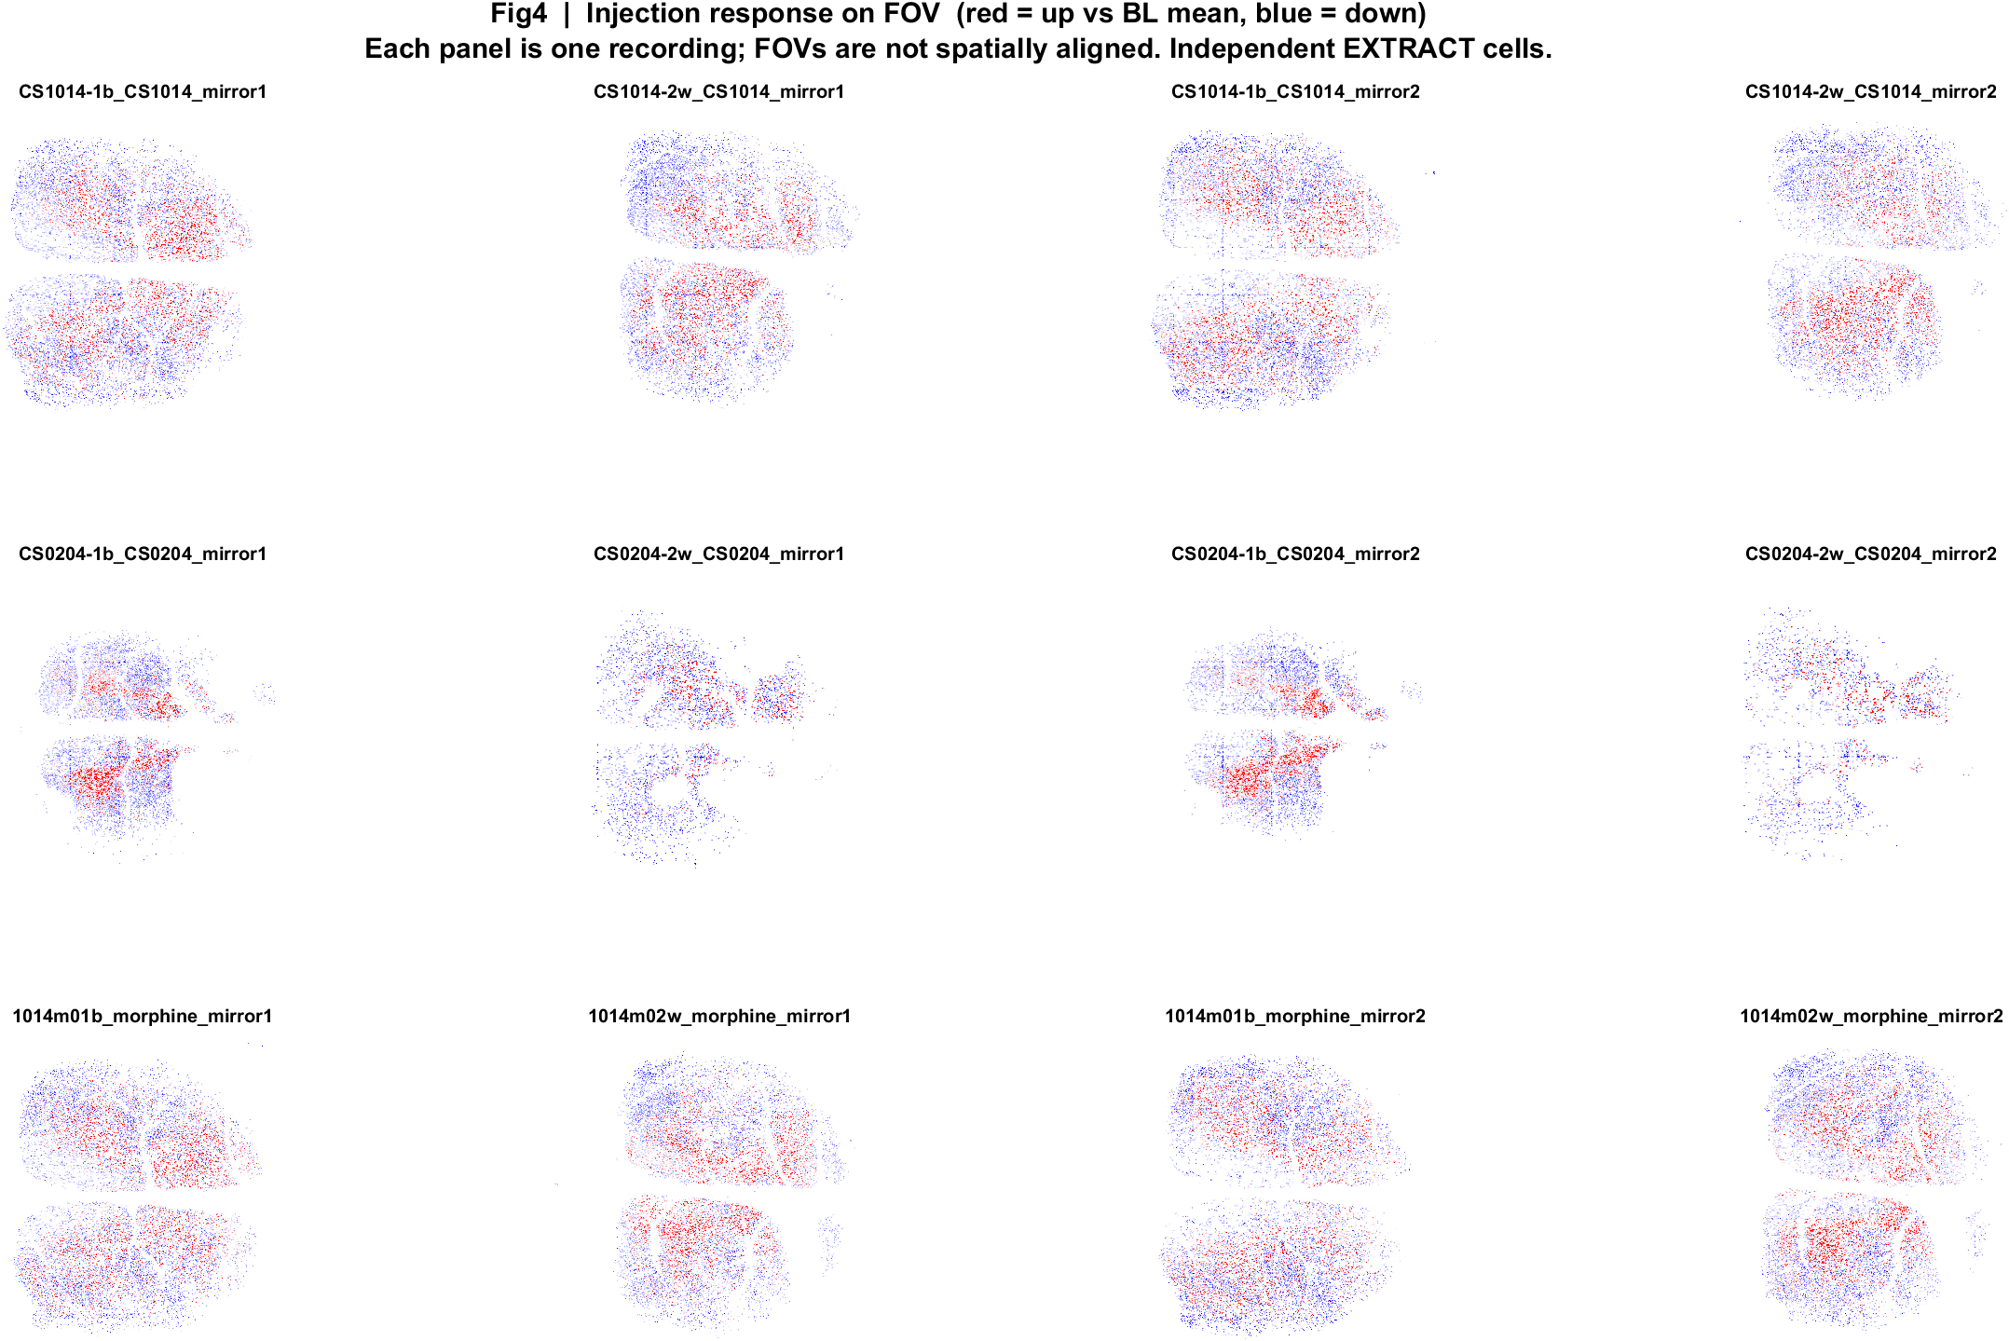
Injection FOV maps (cannot pixel-average)
What: EXTRACT footprints x amp. Red = up vs baseline mean, blue = down. P left, A right after flipping mirror2. FOVs are not CCF aligned.
Result: The same local mix appears across recordings. There is no single average cortex image.

Slide 11
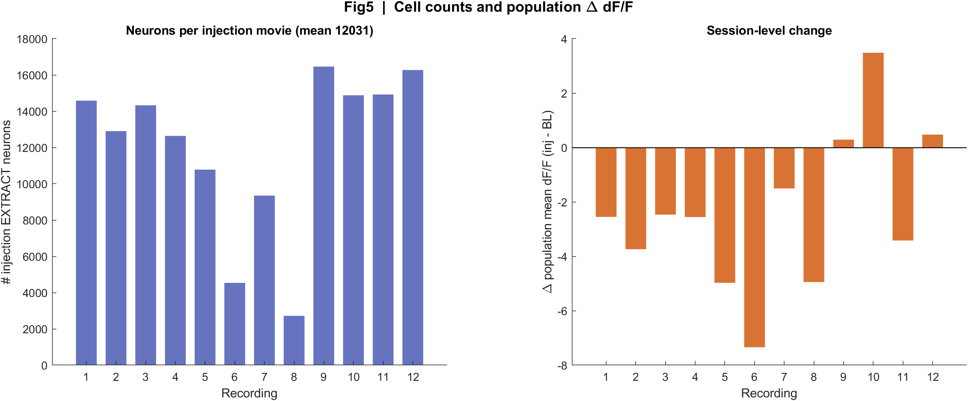
Cell counts and session Delta
What: Left: EXTRACT neuron count in each injection movie. Right: population mean dF/F (injection minus baseline).
Result: Independent cell counts. Use the Delta bars, not matched-cell before/after.

Slide 12
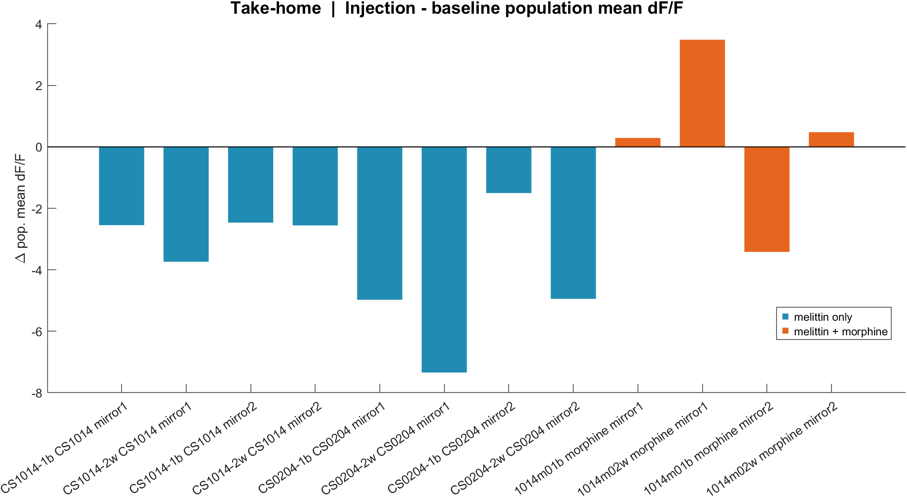
Take-home | session Delta dF/F
What: One bar per recording. Teal = melittin only. Orange = melittin + morphine.
Result: Melittin only n=8, mean Delta -3.7598. Melittin+morphine n=4, mean Delta +0.2072.

Slide 13
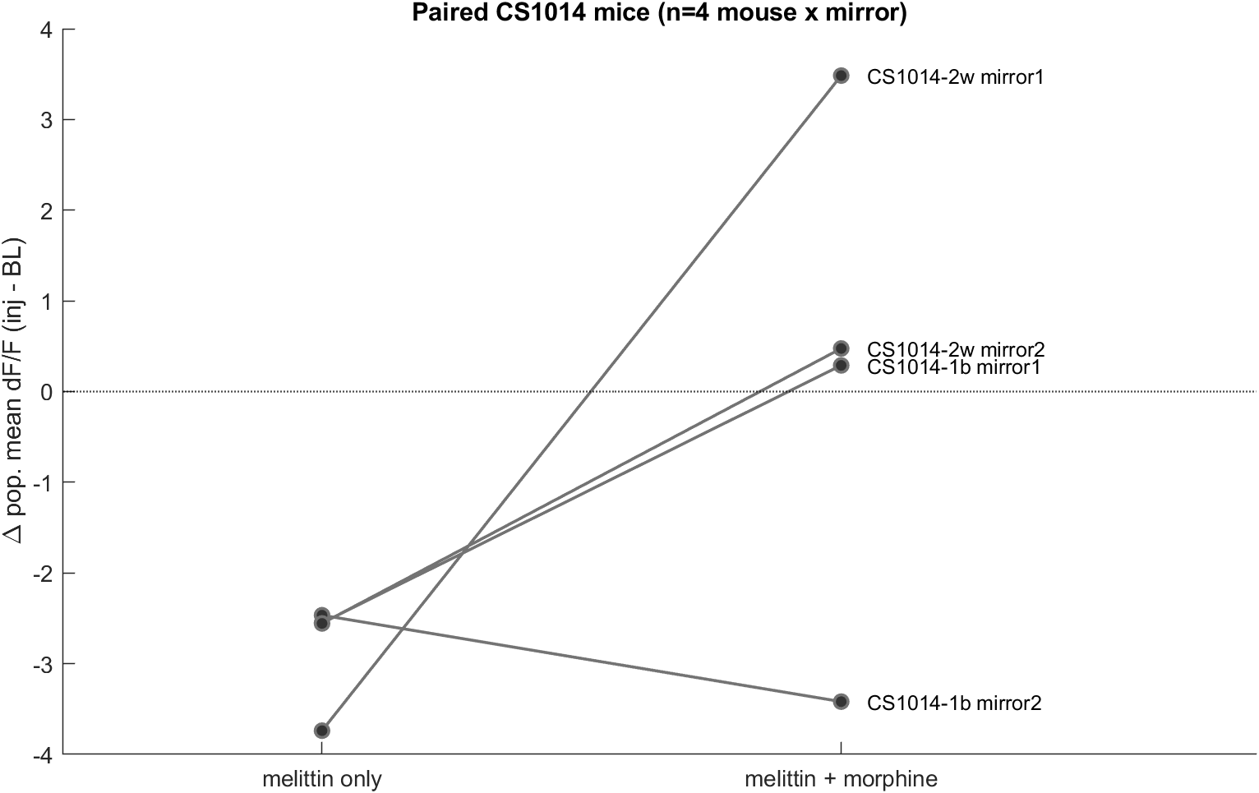
Take-home | paired CS1014 mice
What: Same biological mouse and mirror: CS1014-1b with 1014m01b, CS1014-2w with 1014m02w. CS0204 has no morphine pair in this pack.
Result: Lines connect the two drug conditions. Small n; treat as exploratory.

Slide 14
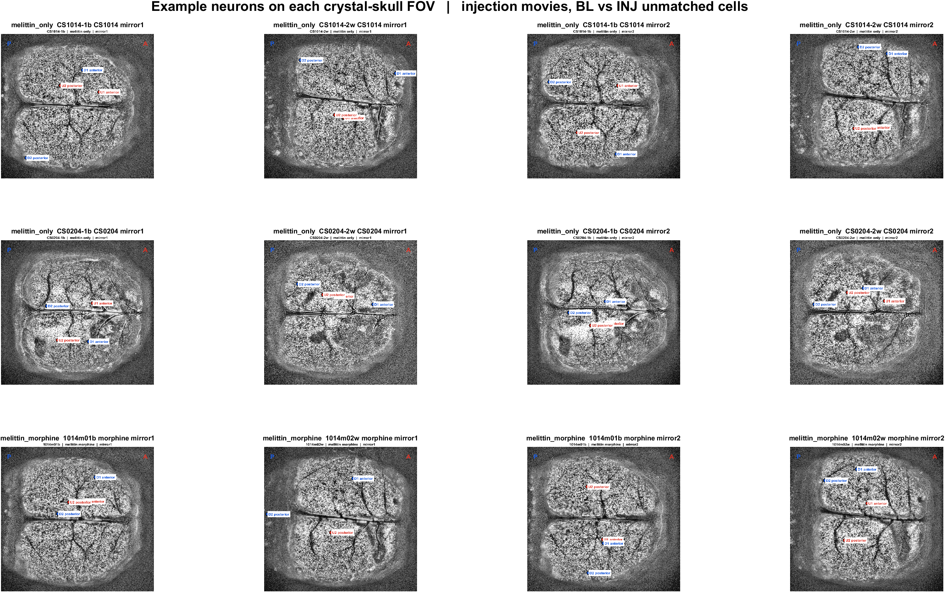
Where the example neurons sit | all injection FOVs
What: Each panel is one contrast-stretched crystal-skull field. Red = up examples, blue = down examples. P left, A right.
Result: Example up and down cells are intermingled. U1/D1 are more anterior; U2/D2 more posterior.

Slide 15
Example neurons
Two up + two down injection cells per recording (not paired to baseline)

Slide 16
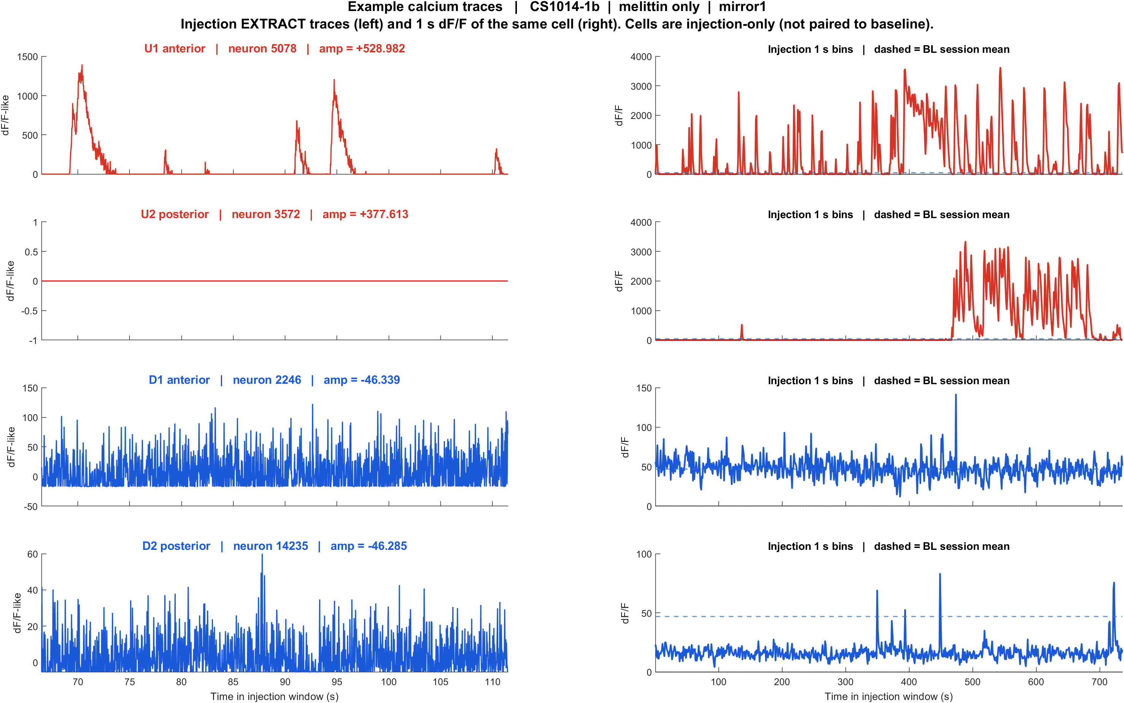
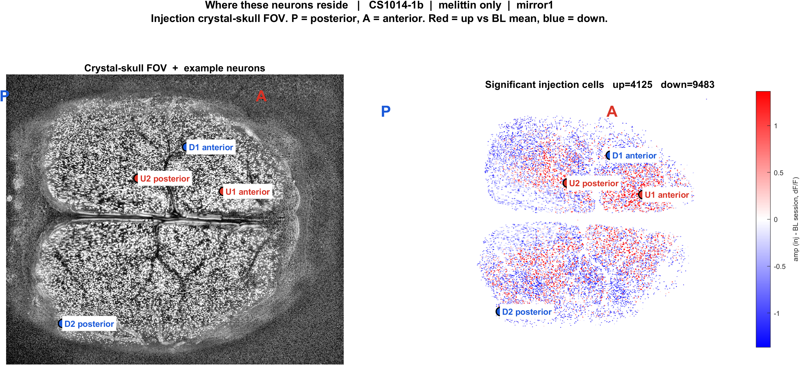
Examples | CS1014-1b CS1014 mirror1 | melittin_only
What: CS1014-1b, mirror1path. Left: injection EXTRACT traces. Right: those cells on the injection FOV. Not the same IDs as baseline.
Result: U1 anterior #5078, U2 posterior #3572, D1 anterior #2246, D2 posterior #14235

Slide 17
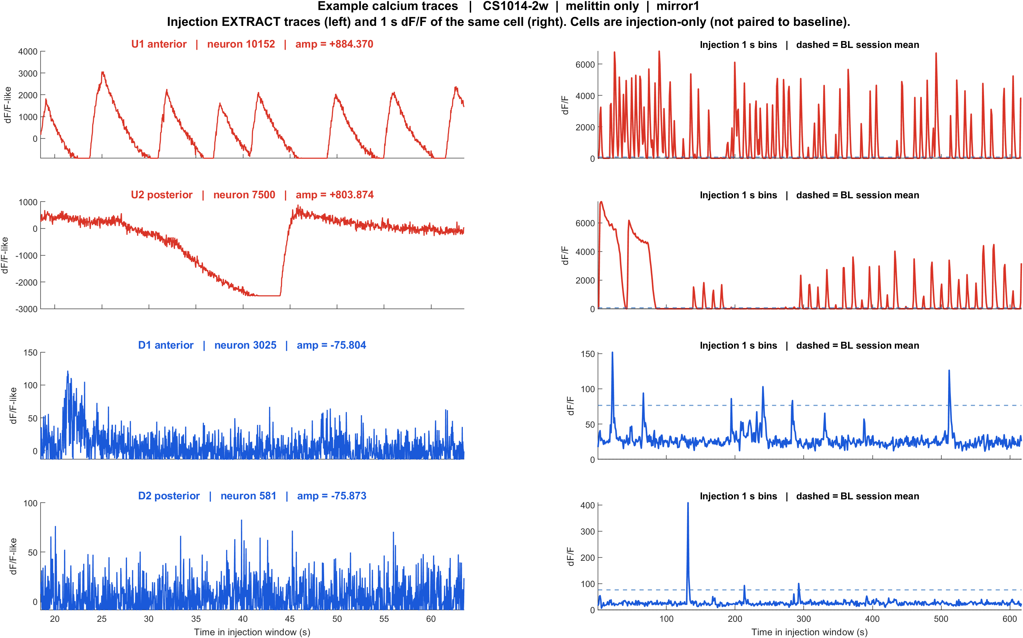
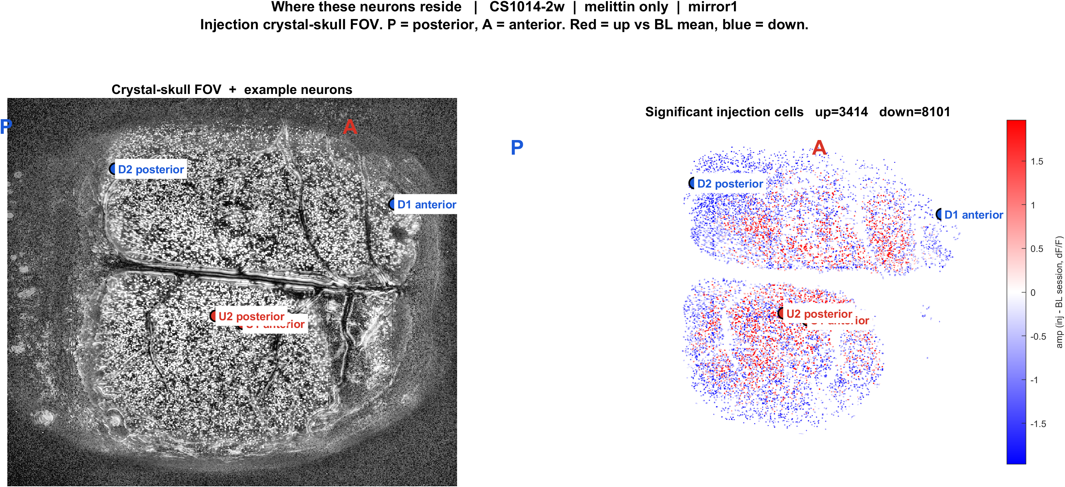
Examples | CS1014-2w CS1014 mirror1 | melittin_only
What: CS1014-2w, mirror1path. Left: injection EXTRACT traces. Right: those cells on the injection FOV. Not the same IDs as baseline.
Result: U1 anterior #10152, U2 posterior #7500, D1 anterior #3025, D2 posterior #581

Slide 18
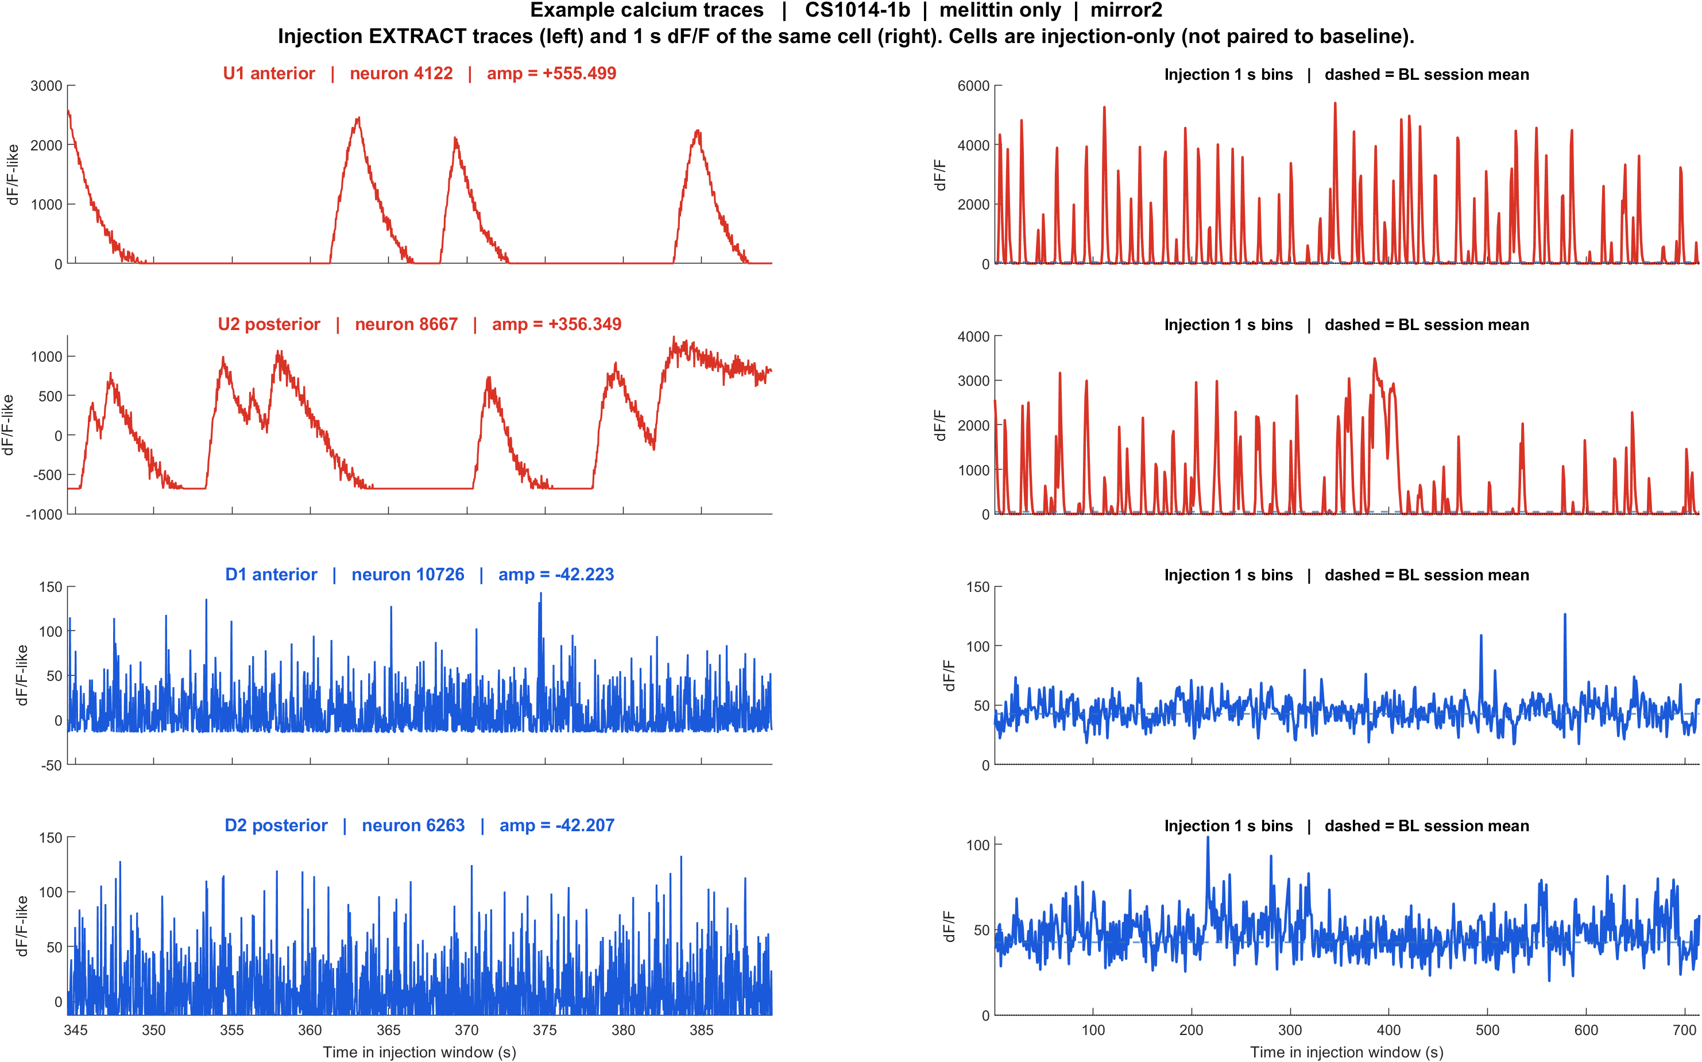
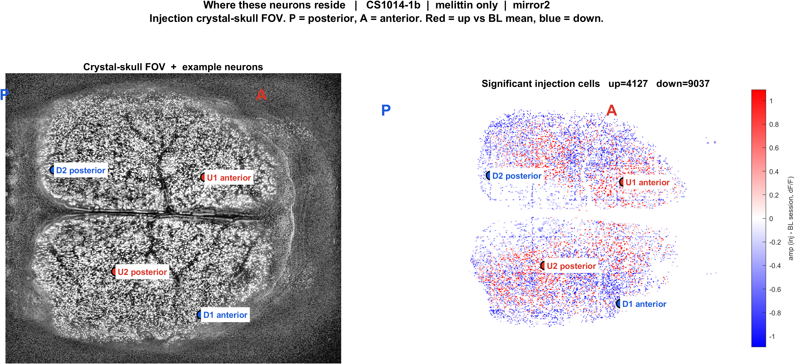
Examples | CS1014-1b CS1014 mirror2 | melittin_only
What: CS1014-1b, mirror2path. Left: injection EXTRACT traces. Right: those cells on the injection FOV. Not the same IDs as baseline.
Result: U1 anterior #4122, U2 posterior #8667, D1 anterior #10726, D2 posterior #6263

Slide 19
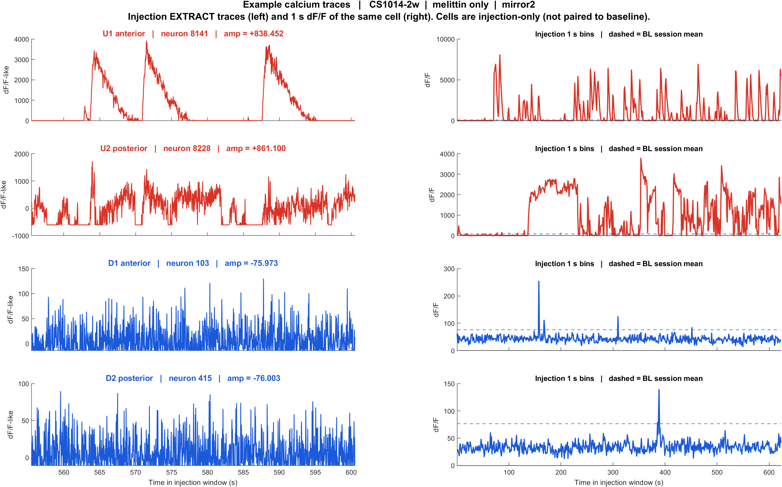
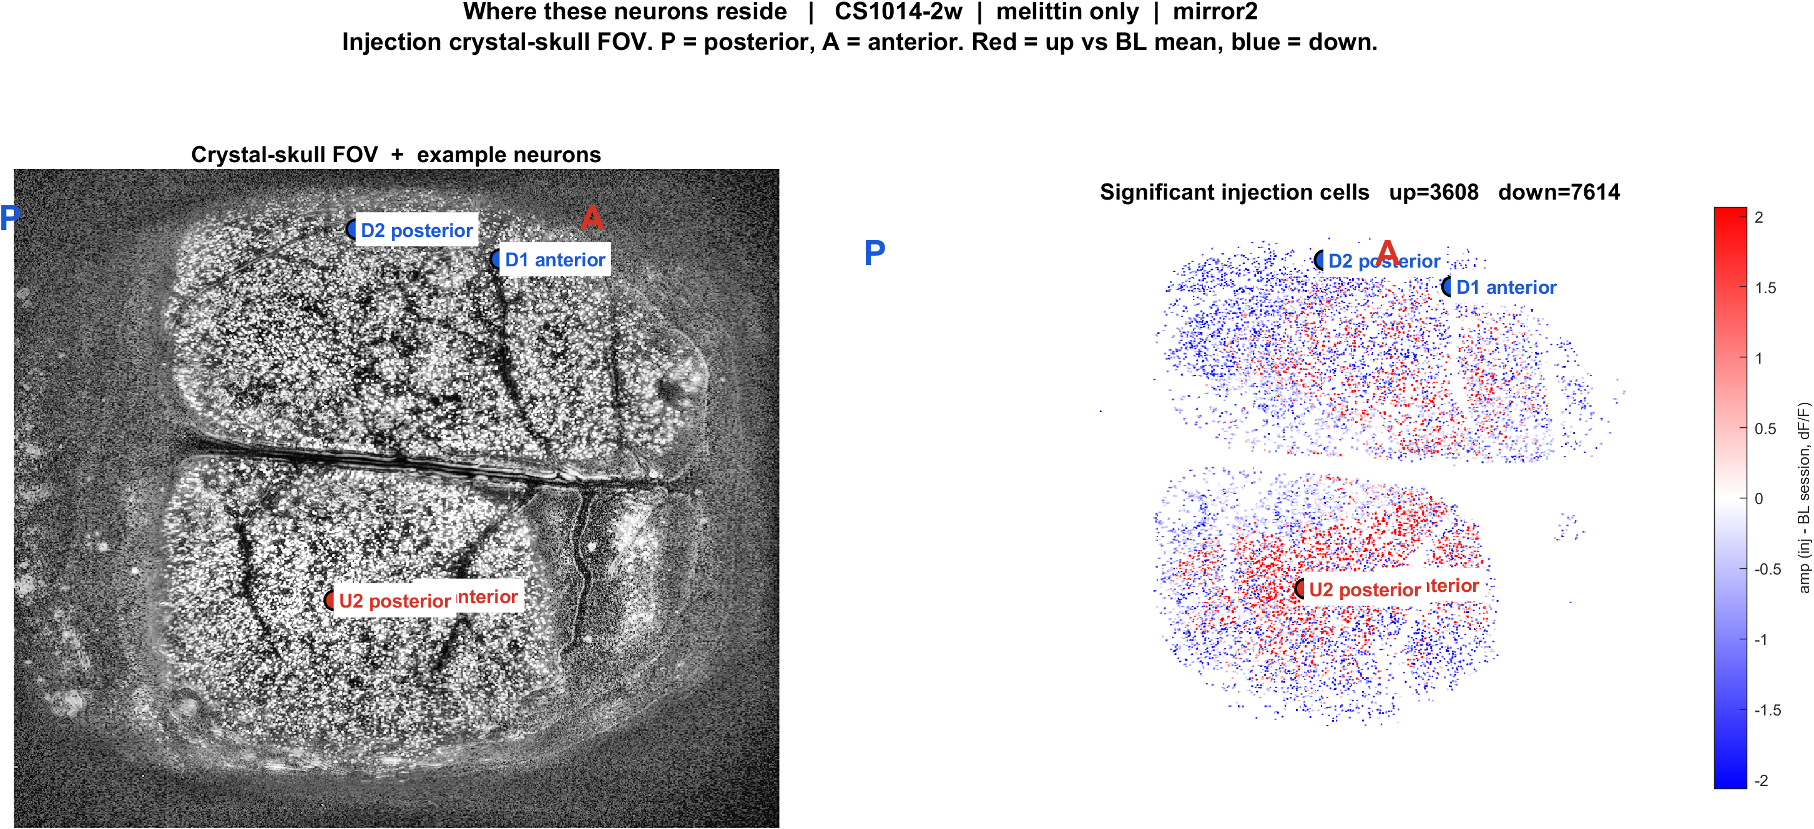
Examples | CS1014-2w CS1014 mirror2 | melittin_only
What: CS1014-2w, mirror2path. Left: injection EXTRACT traces. Right: those cells on the injection FOV. Not the same IDs as baseline.
Result: U1 anterior #8141, U2 posterior #8228, D1 anterior #103, D2 posterior #415

Slide 20
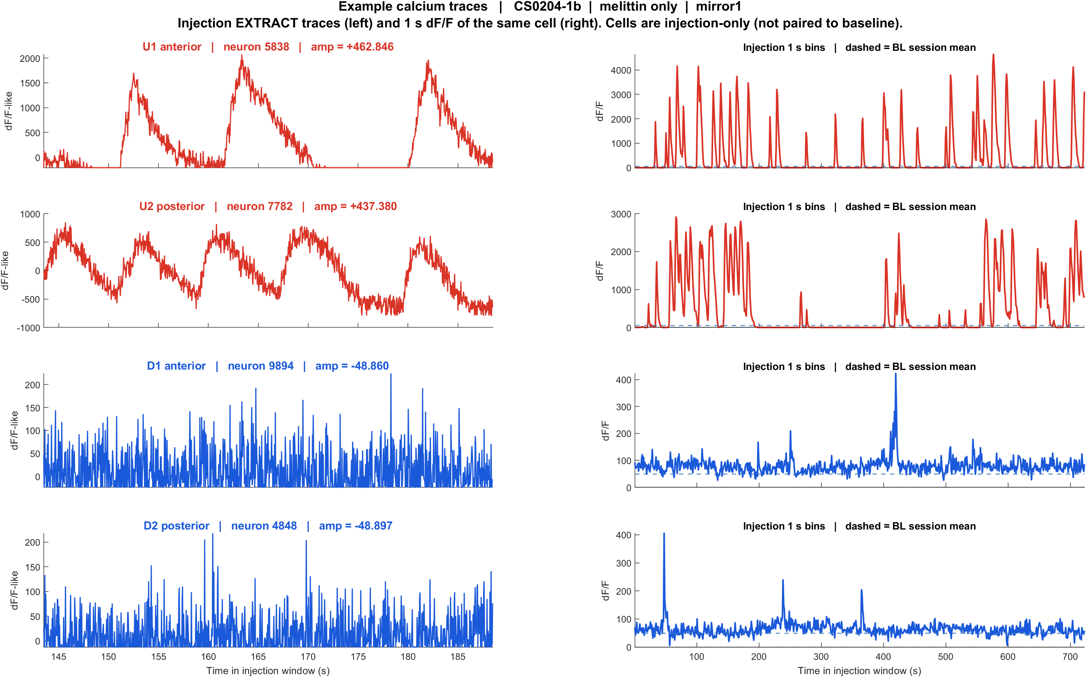
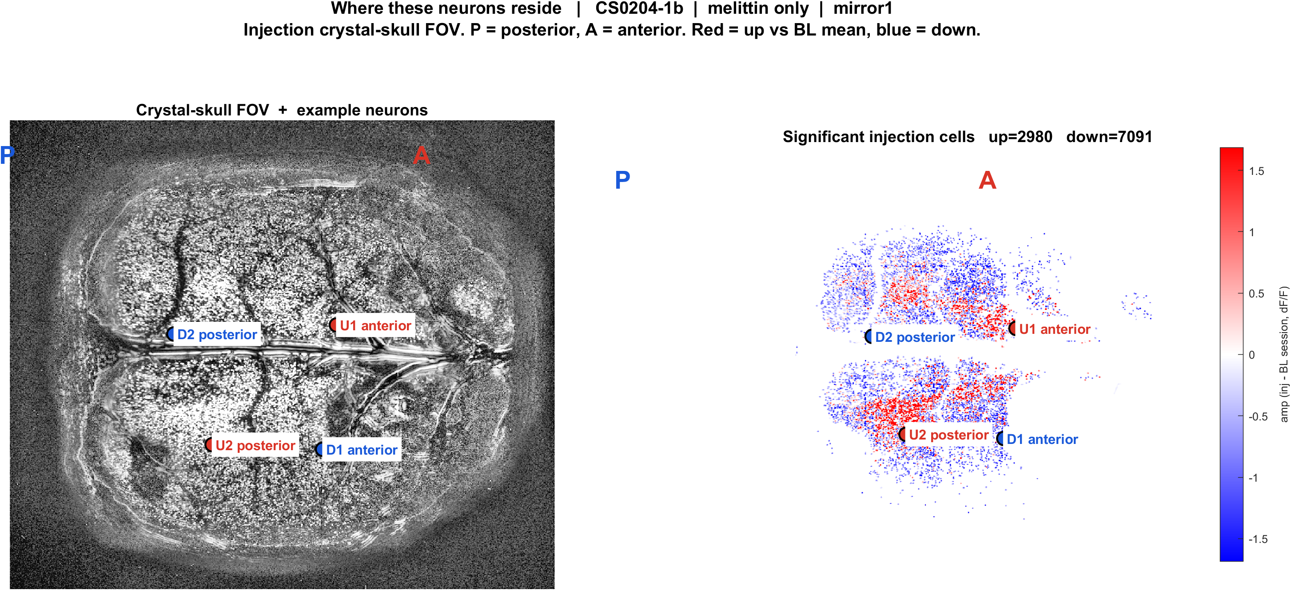
Examples | CS0204-1b CS0204 mirror1 | melittin_only
What: CS0204-1b, mirror1path. Left: injection EXTRACT traces. Right: those cells on the injection FOV. Not the same IDs as baseline.
Result: U1 anterior #5838, U2 posterior #7782, D1 anterior #9894, D2 posterior #4848

Slide 21
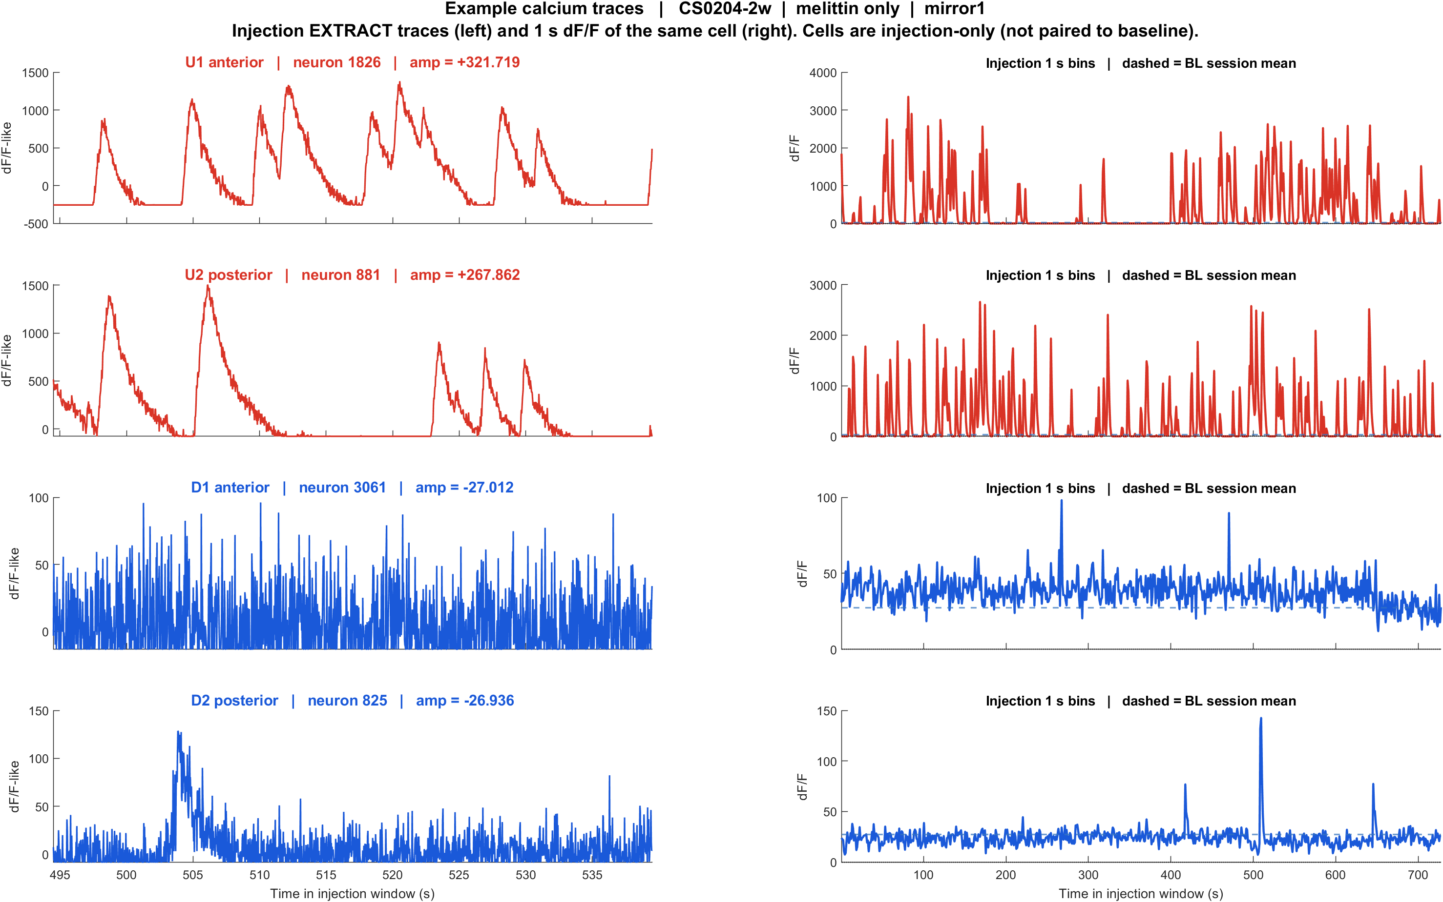
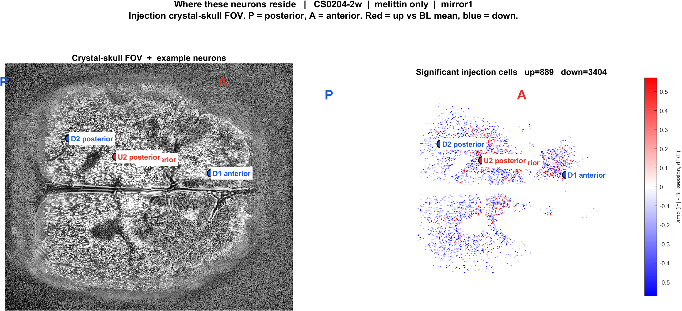
Examples | CS0204-2w CS0204 mirror1 | melittin_only
What: CS0204-2w, mirror1path. Left: injection EXTRACT traces. Right: those cells on the injection FOV. Not the same IDs as baseline.
Result: U1 anterior #1826, U2 posterior #881, D1 anterior #3061, D2 posterior #825

Slide 22
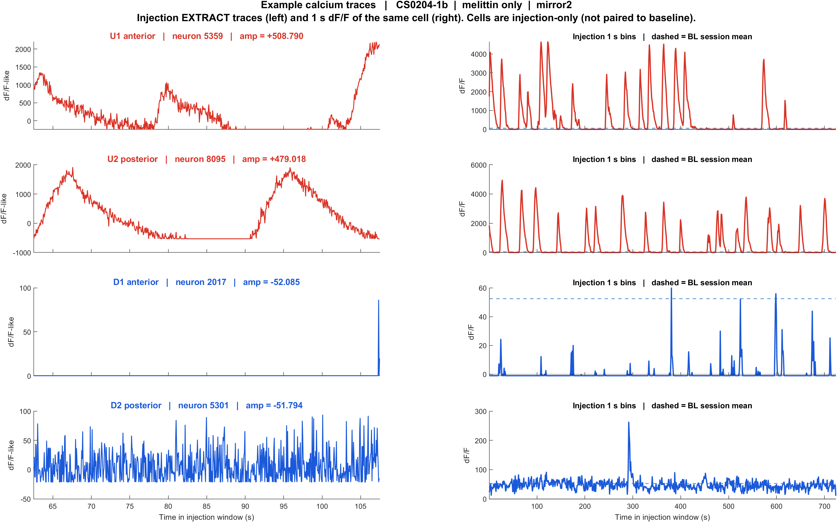
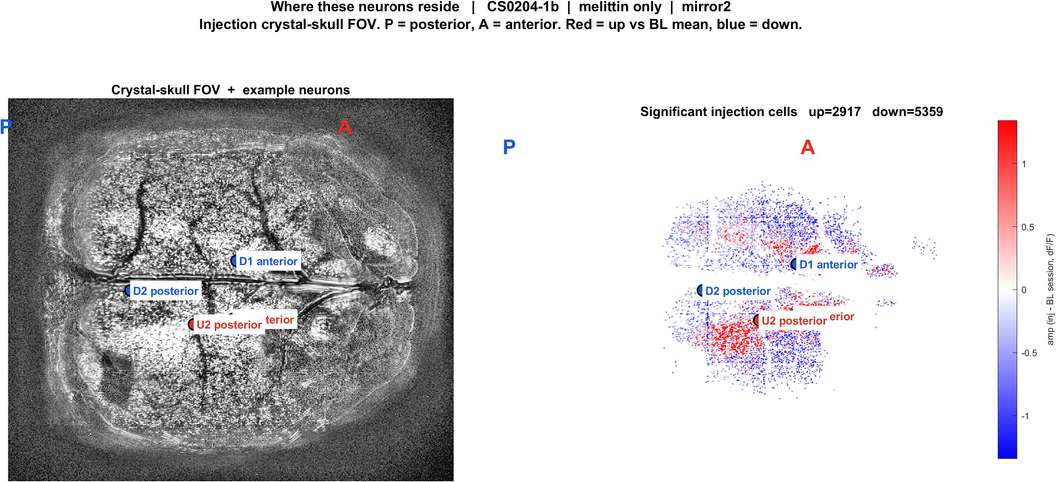
Examples | CS0204-1b CS0204 mirror2 | melittin_only
What: CS0204-1b, mirror2path. Left: injection EXTRACT traces. Right: those cells on the injection FOV. Not the same IDs as baseline.
Result: U1 anterior #5359, U2 posterior #8095, D1 anterior #2017, D2 posterior #5301

Slide 23
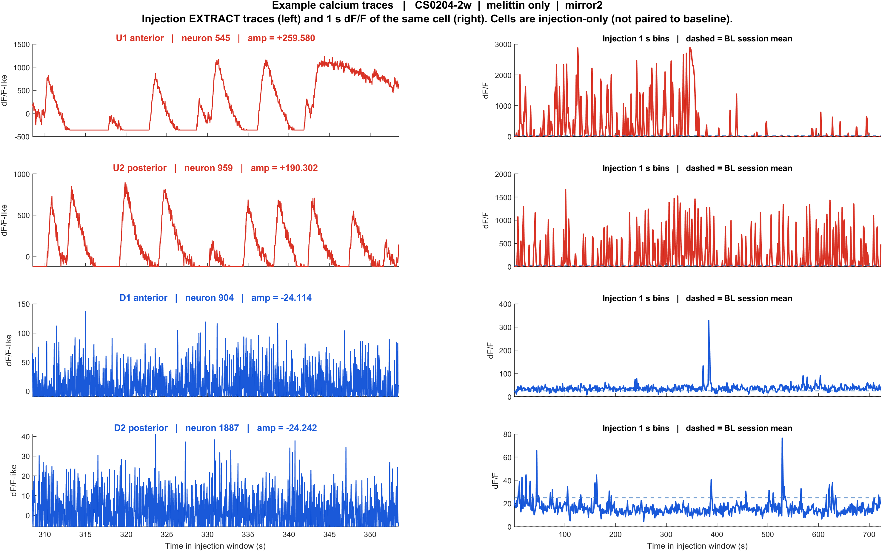
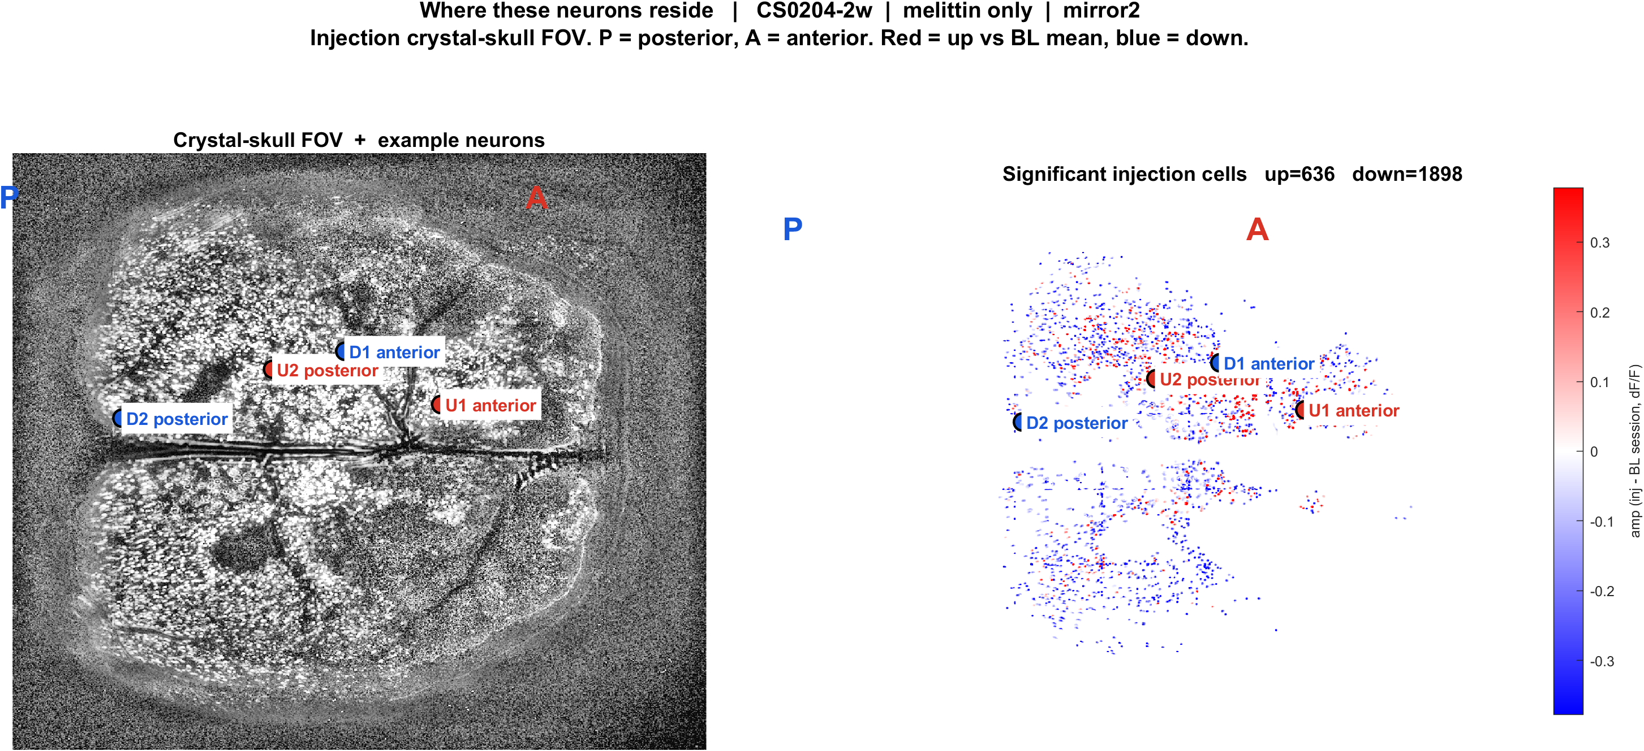
Examples | CS0204-2w CS0204 mirror2 | melittin_only
What: CS0204-2w, mirror2path. Left: injection EXTRACT traces. Right: those cells on the injection FOV. Not the same IDs as baseline.
Result: U1 anterior #545, U2 posterior #959, D1 anterior #904, D2 posterior #1887

Slide 24
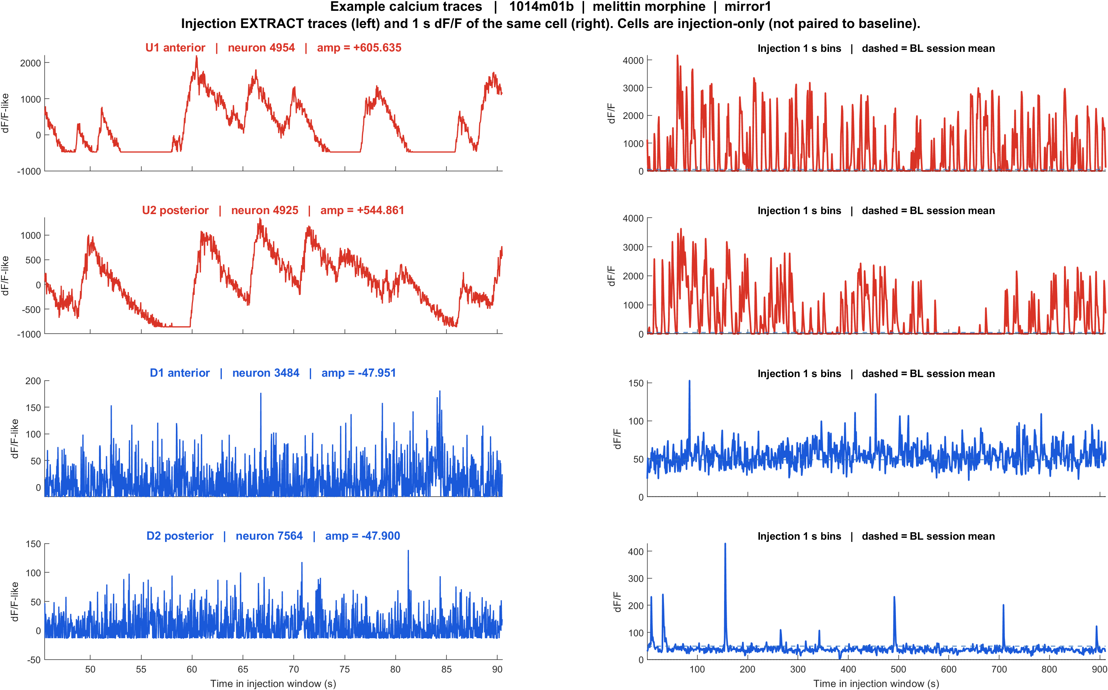
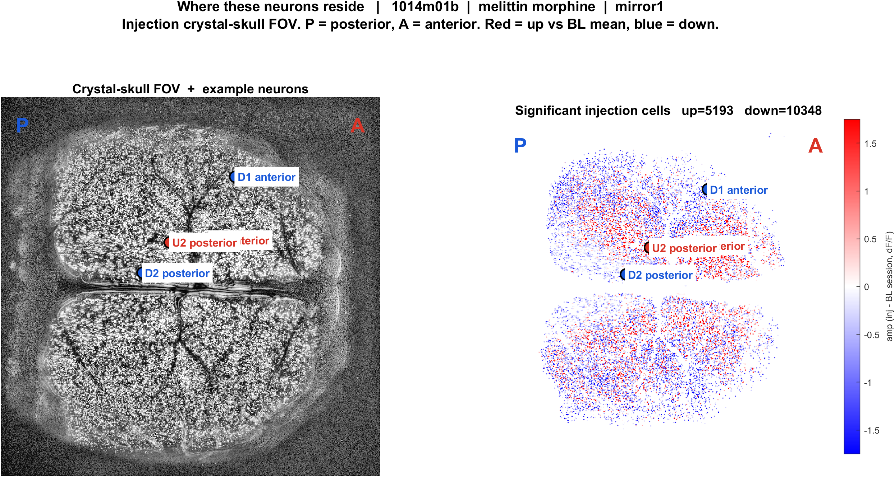
Examples | 1014m01b morphine mirror1 | melittin_morphine
What: 1014m01b, mirror1path. Left: injection EXTRACT traces. Right: those cells on the injection FOV. Not the same IDs as baseline.
Result: U1 anterior #4954, U2 posterior #4925, D1 anterior #3484, D2 posterior #7564

Slide 25
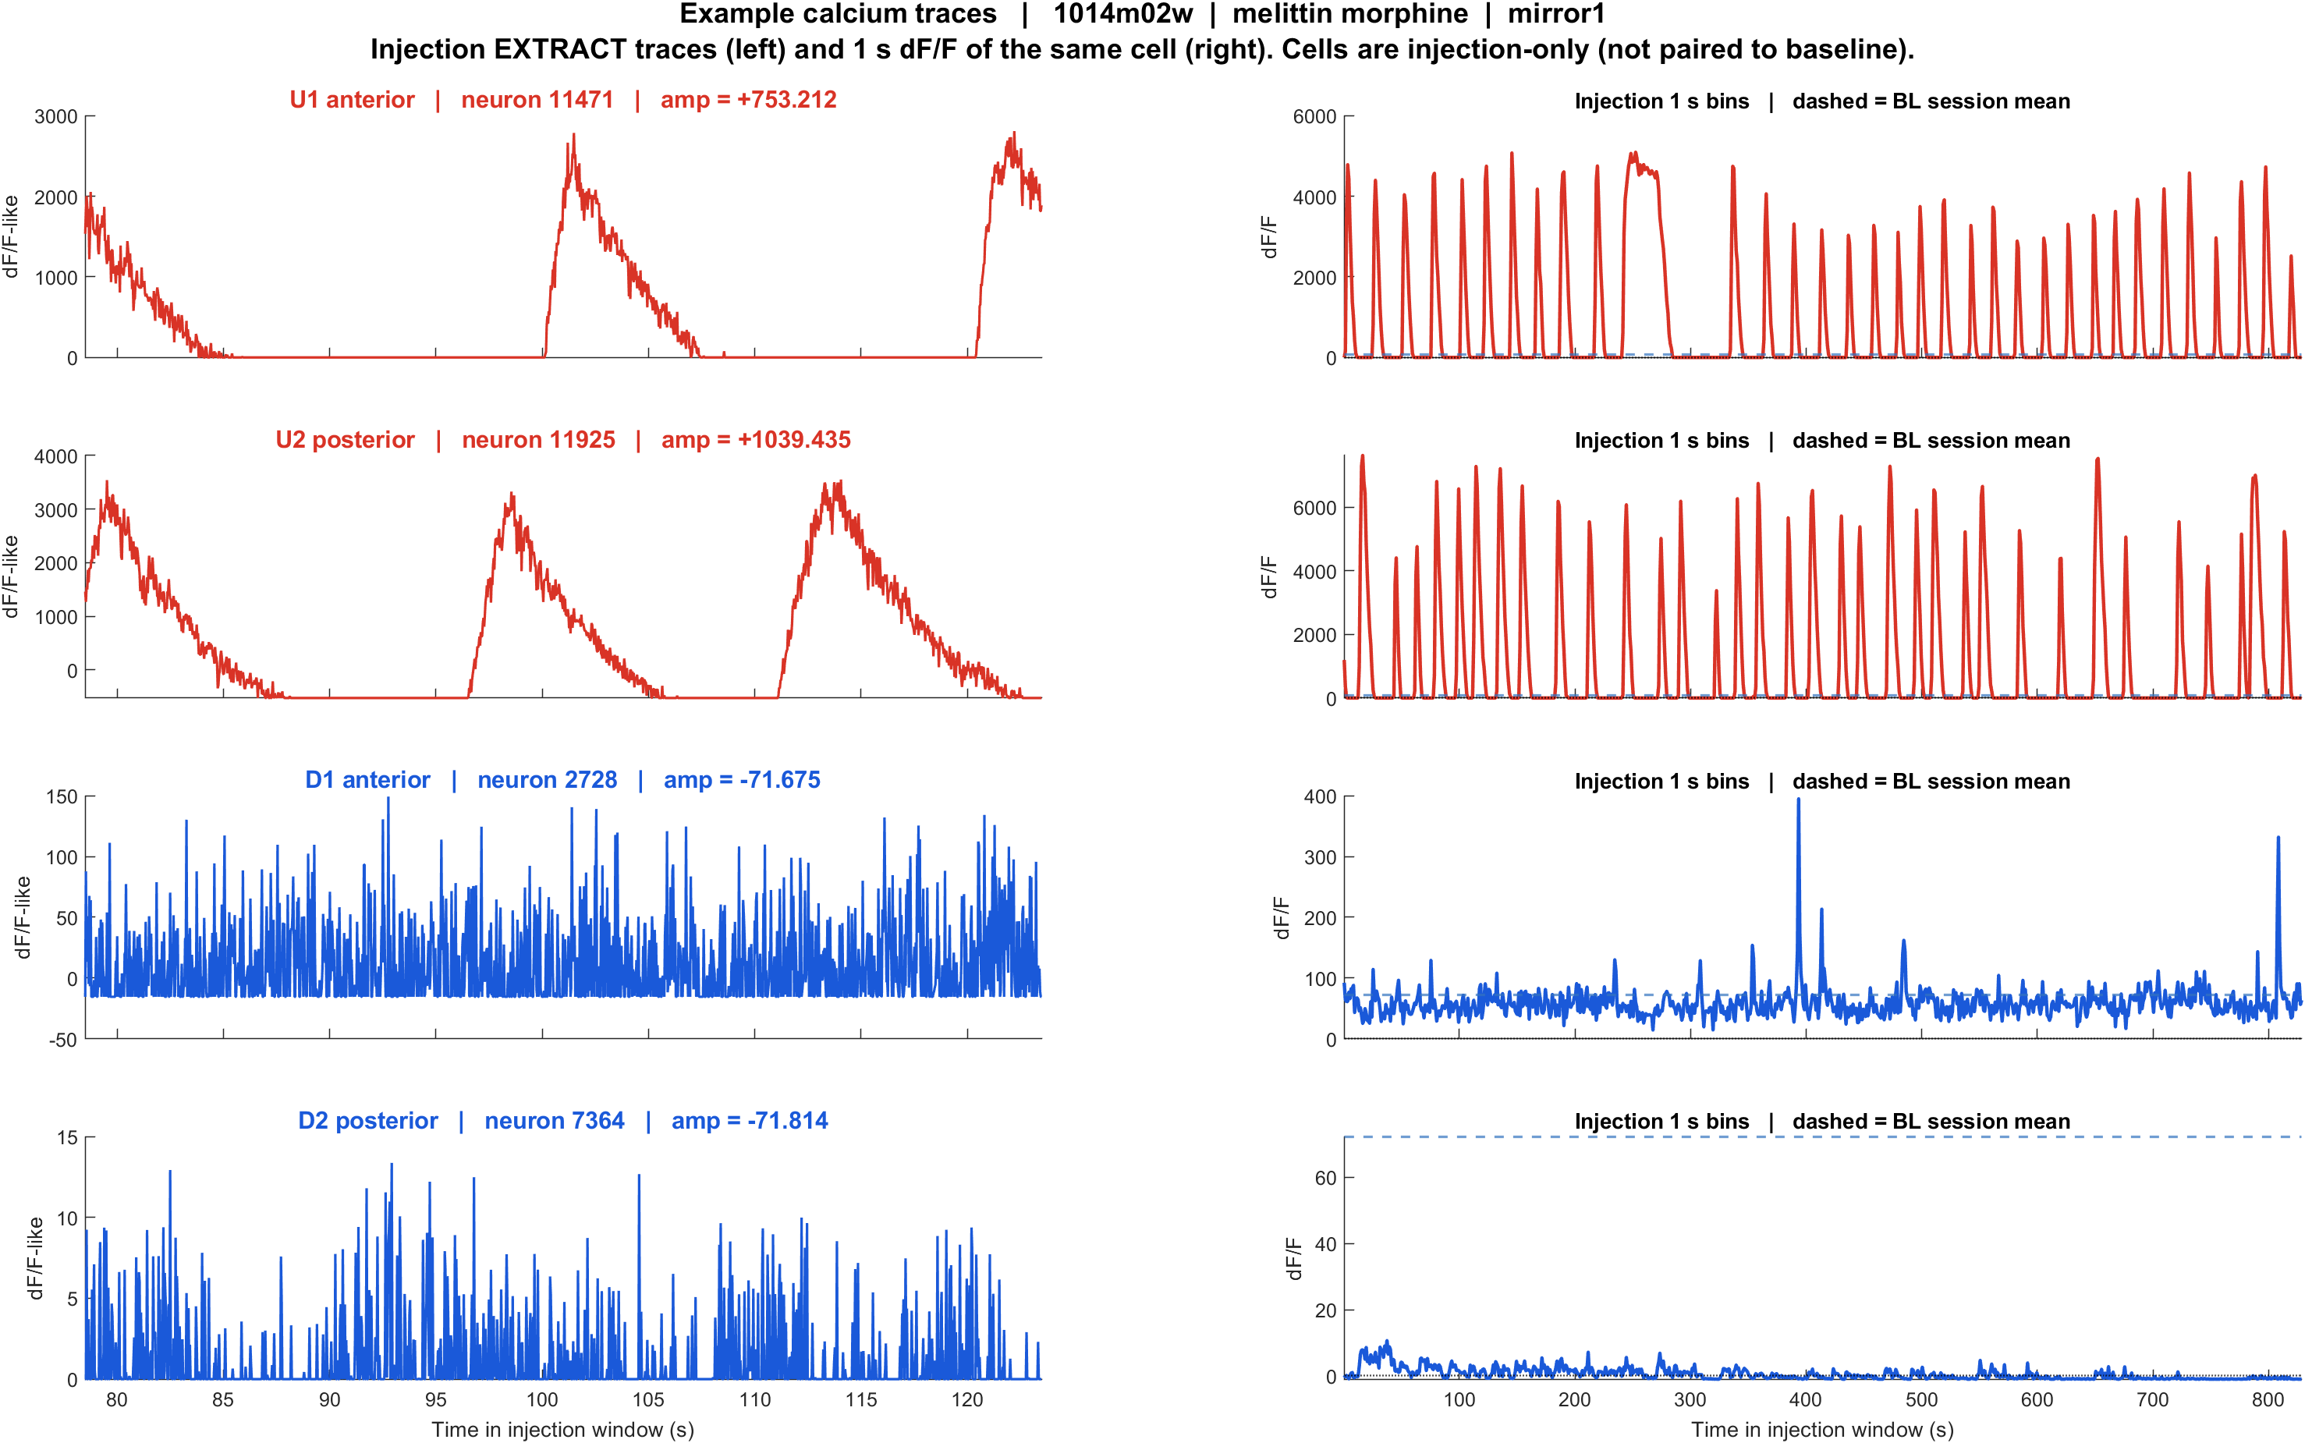
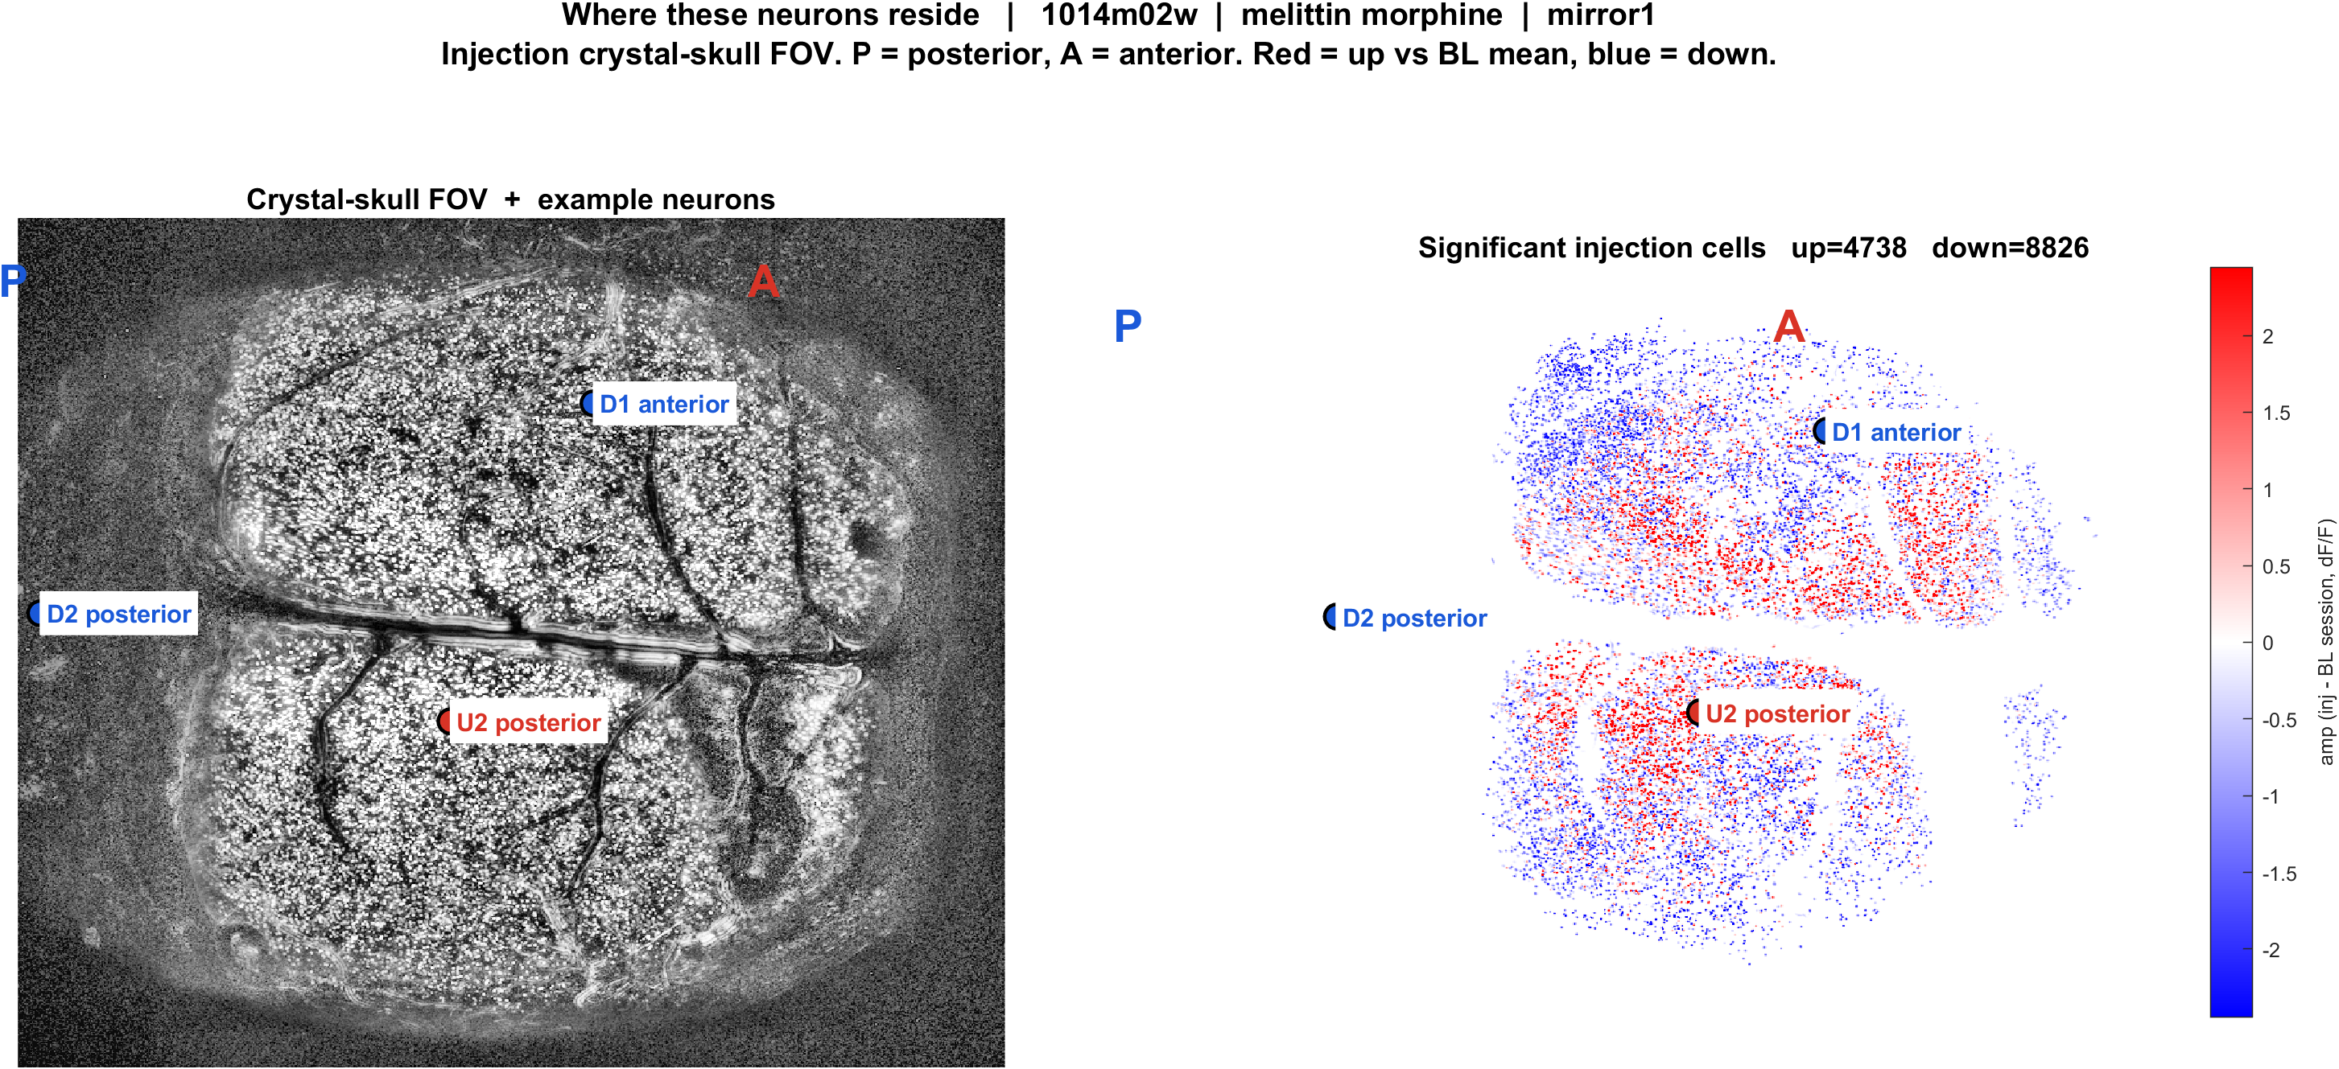
Examples | 1014m02w morphine mirror1 | melittin_morphine
What: 1014m02w, mirror1path. Left: injection EXTRACT traces. Right: those cells on the injection FOV. Not the same IDs as baseline.
Result: U1 anterior #11471, U2 posterior #11925, D1 anterior #2728, D2 posterior #7364

Slide 26
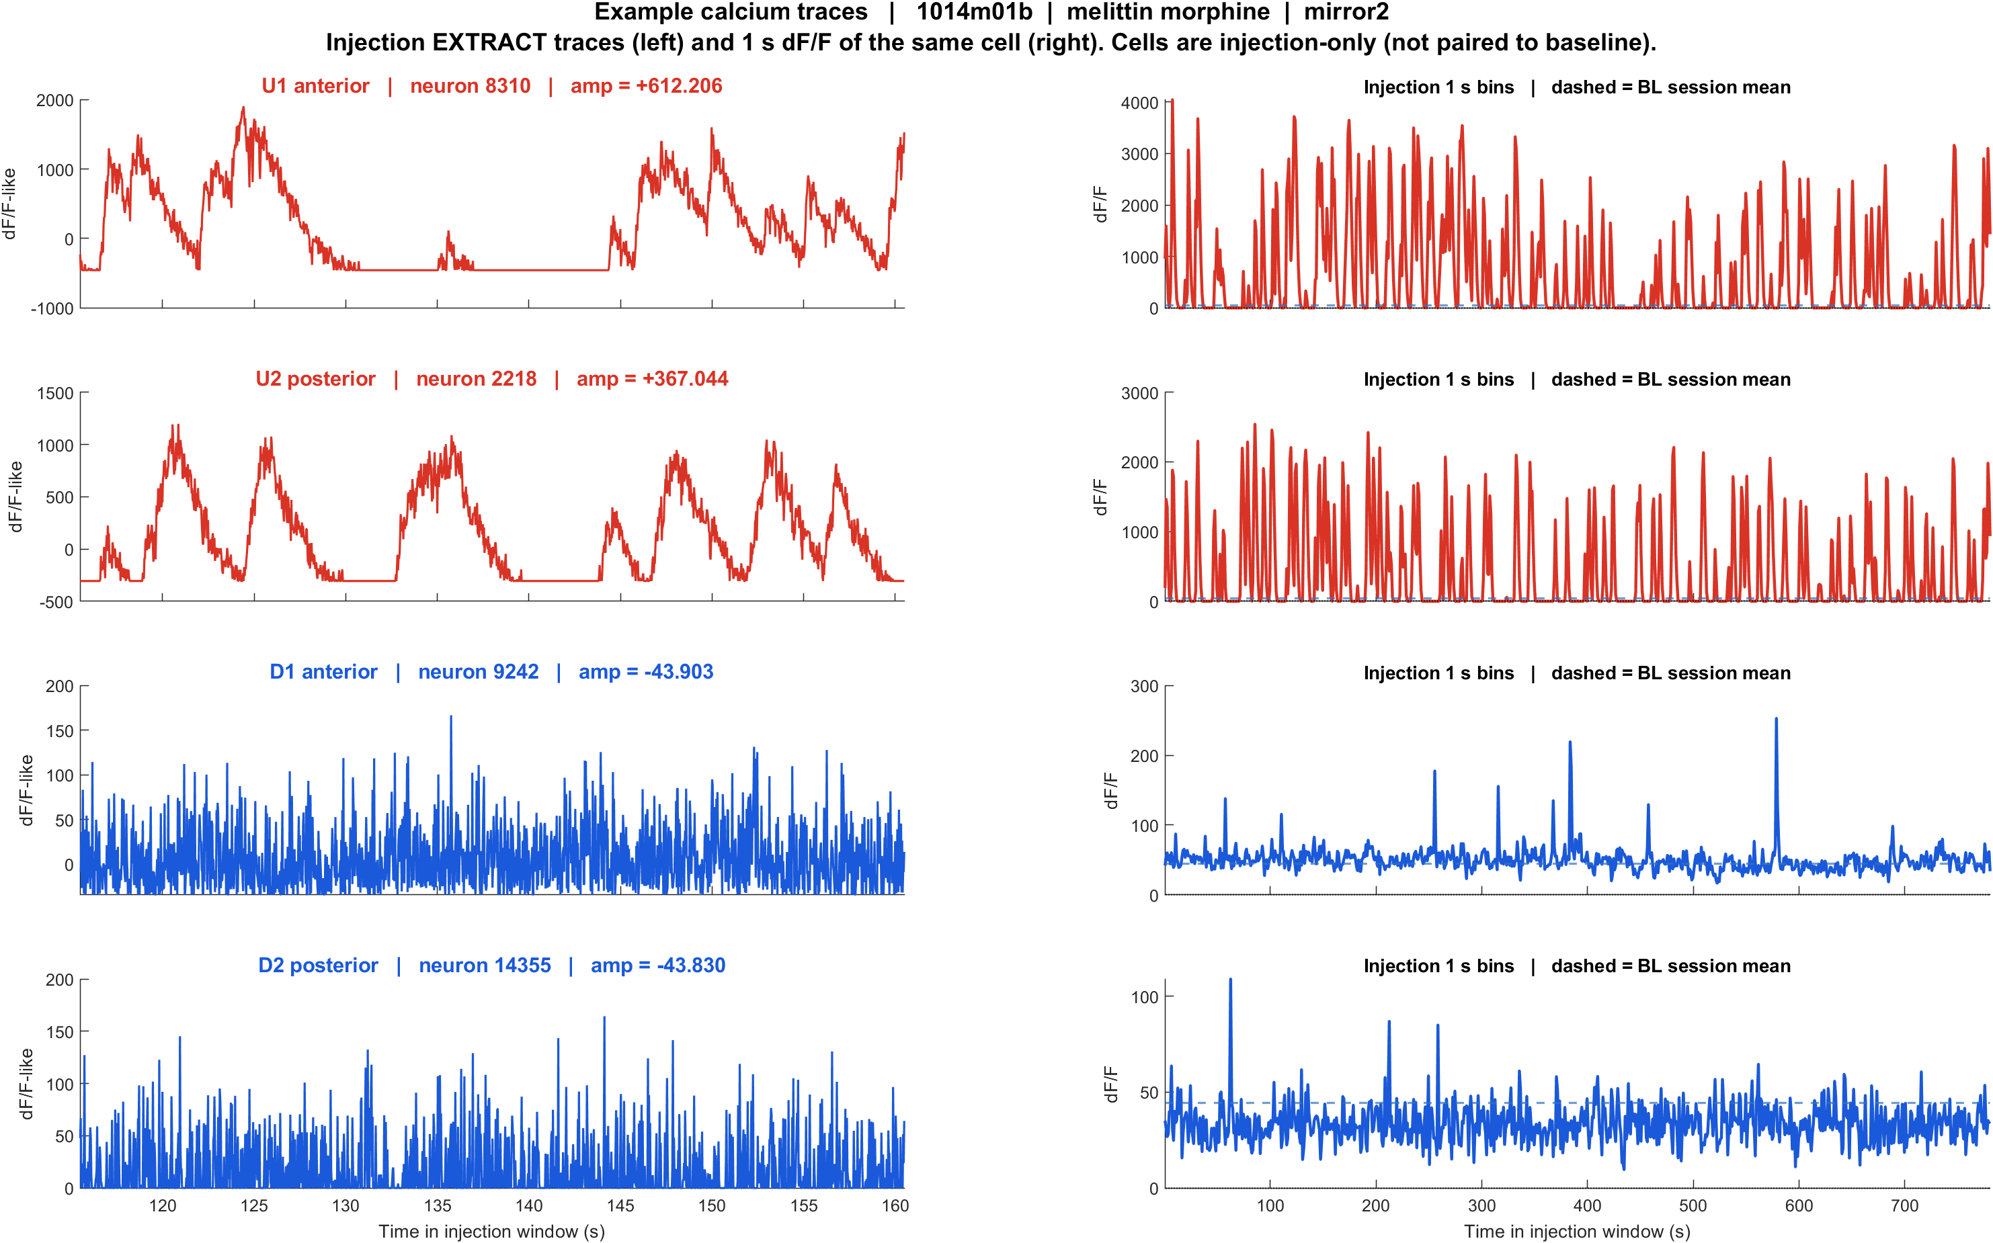

Examples | 1014m01b morphine mirror2 | melittin_morphine
What: 1014m01b, mirror2path. Left: injection EXTRACT traces. Right: those cells on the injection FOV. Not the same IDs as baseline.
Result: U1 anterior #8310, U2 posterior #2218, D1 anterior #9242, D2 posterior #14355

Slide 27
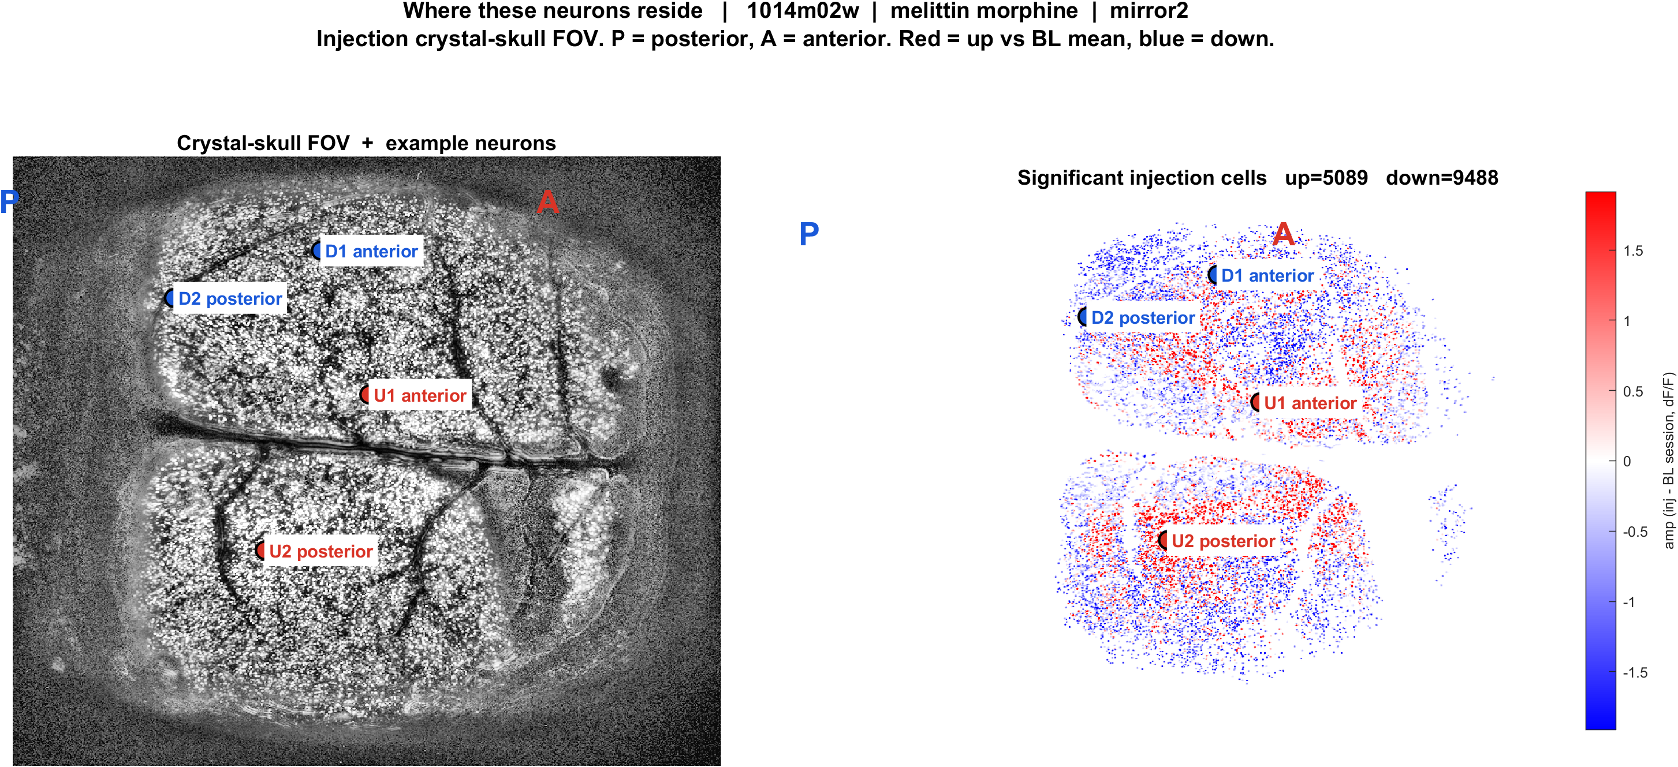
Examples | 1014m02w morphine mirror2 | melittin_morphine
What: 1014m02w, mirror2path. Left: injection EXTRACT traces. Right: those cells on the injection FOV. Not the same IDs as baseline.
Result: U1 anterior #5767, U2 posterior #11752, D1 anterior #2440, D2 posterior #4412

Slide 28
Interpretation
• This pack answers the same visual questions as face poking, but the clock is the recording, not a poke.
• Up/down is each injection cell versus the baseline session mean, not the same cell before versus after.
• Population Delta dF/F is the honest mouse/plane comparison (injection minus baseline).
• Morphine pairing is only CS1014-1b/2w vs 1014m01b/02w. CS0204 is extra melittin-only.

Slide 29
What we should not over-claim
• FOVs are not CCF/bregma registered. Anterior means the right side after the mirror2 flip.
• Do not report a matched-cell trajectory from baseline to injection; EXTRACT IDs were not matched.
• dF/F here uses an 8th-percentile baseline on 1 s bins of EXTRACT /T, not the slow rolling F0 of extract_analysis2.
• Do not mix these numbers with the 13 Aug / 18 Aug face-poke PSTHs.

