Slide 1
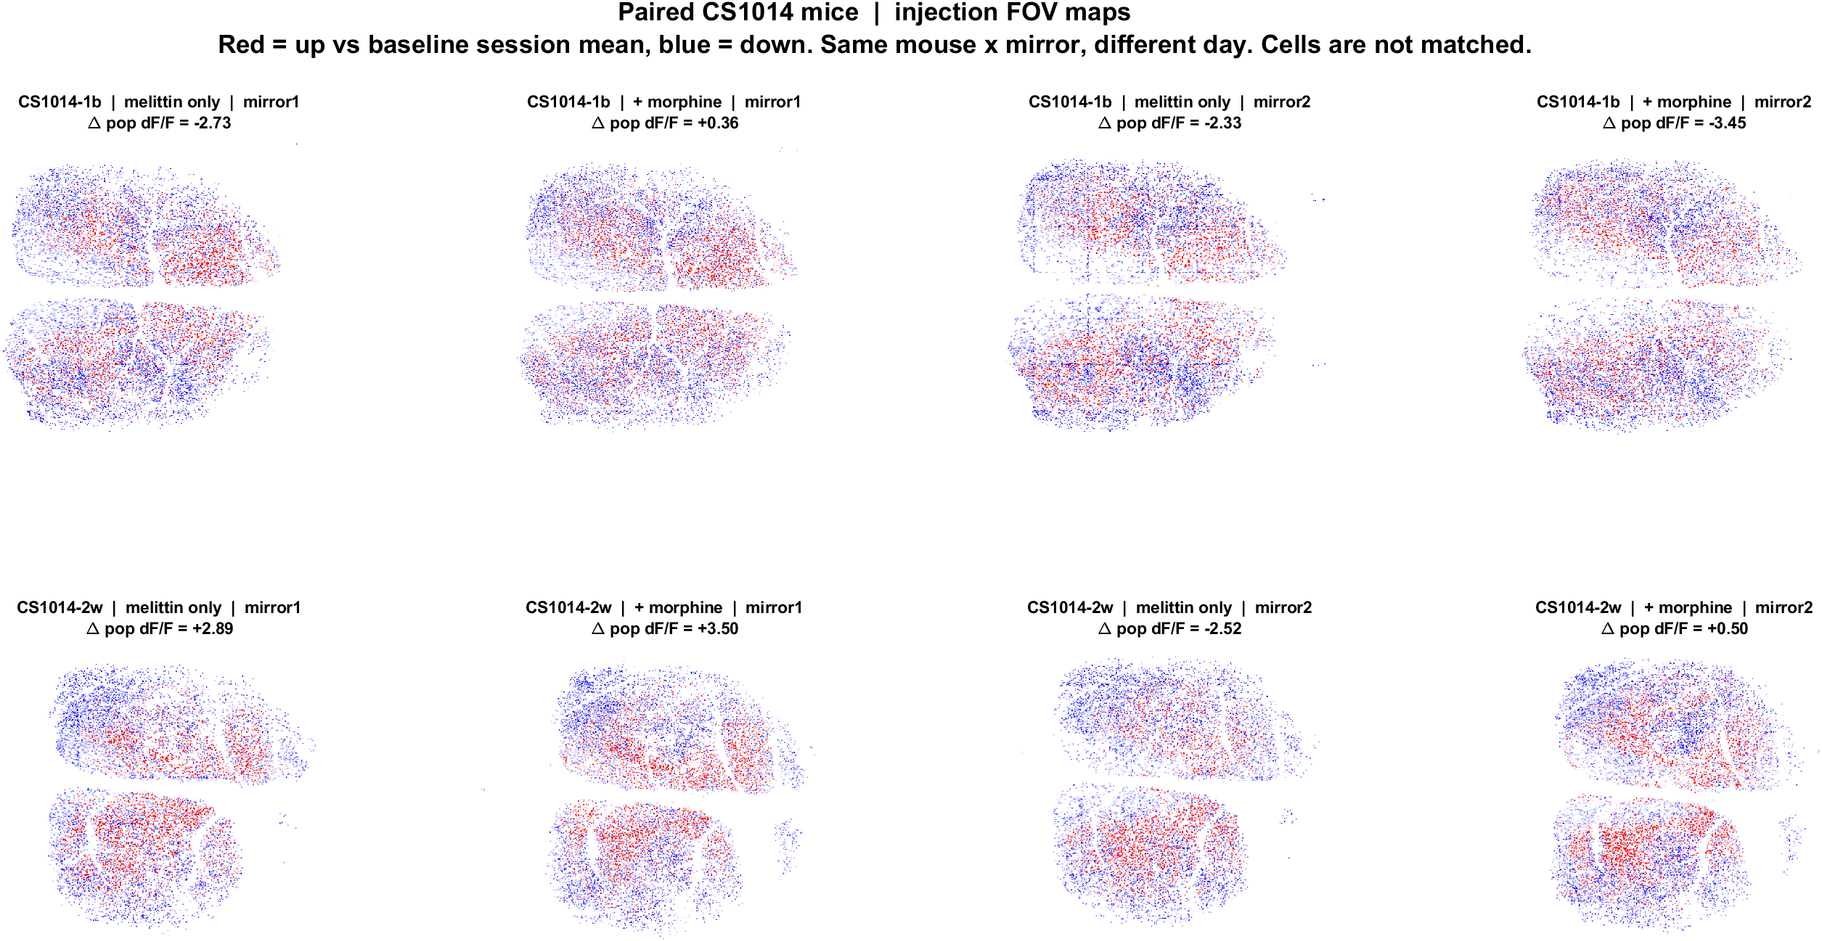
Melittin vs melittin + morphine | the two mice that have both (CS1014)
What: Same biological mouse and mirror. Left of each pair = melittin only. Right = melittin + morphine. Red = up vs BL mean, blue = down. EXTRACT IDs are not matched across days.
Result: 3/4 pairs shift toward less suppression or net increase with morphine (CS1014-1b mirror2 is the exception). CS0204 is omitted; those mice have no morphine day.

