Slide 1
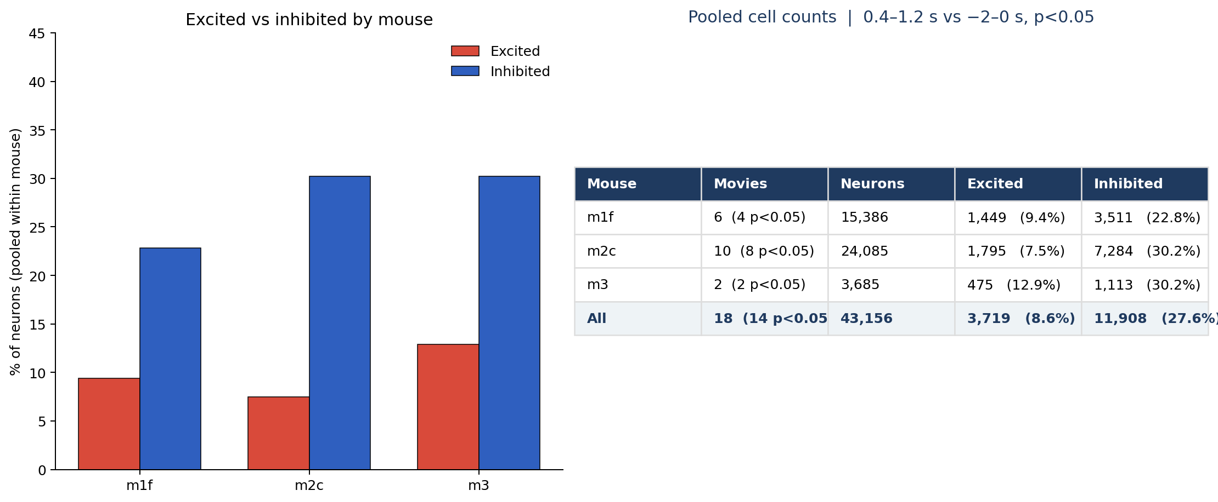
Face poke | excited vs inhibited cells per mouse (n = 18)
What: Pooled within mouse. Excited/inhibited if 0.4–1.2 s after the poke differs from −2–0 s (signed-rank p<0.05).
Result: Every mouse has more inhibited than excited cells: m1f 9.4% vs 22.8%, m2c 7.5% vs 30.2%, m3 12.9% vs 30.2%. Pooled 8.6% / 27.6% of 43,156 neurons; 14/18 movies p<0.05.

