Slide 1
CEA-Ntsr1 two-plane calcium imaging
Pipeline, QC and first results - sessions of 2026-09-11
pain, 10 min pin prick + heat | open field, 5.4 min
Everything below is measured on these two recordings.
Still to do: manual scoring of the pain video, then event-locked responses.
code C:\Users\hsollim\OneDrive\Desktop\cursor\pain_2plane_split | results <session>\output_split\

Slide 2
The data
Both sessions image the SAME two depths, frame-interleaved - recorded in the TDMS, not assumed
 | open field | pain
raw frames per channel | 3000 | 6000
frames per plane | 1500 | 3000
duration | 325.5 s | 651.2 s
rate per plane | 4.6054 Hz | 4.6054 Hz
FOV | 440 x 512 px at 0.898 um/px | same
plane A = Slice 1 | ETL 65 um (139.6 abs) | same
plane B = Slice 2 | ETL 15 um (89.6 abs), +109 ms | same
lost frames | 0 | 0
behaviour camera | 25 Hz, 8159 frames | 25 Hz, 16299 / 16296
CellVideo_CHA_Info.tdms carries a Slice channel, so which depth
each frame belongs to is recorded by the acquisition software.
Measured: Slice alternates 1,2,1,2 strictly in both sessions and
odd raw frames are Slice 1 - exactly what the split step assumes.
etl1data.csv is byte-identical between the sessions, so the
"(100_50um)" in the open-field folder name is not the depths.
Same depths in both sessions is what makes cross-session cell
matching possible at all (slides 19-20).
<session>\CellVideo1\Information-CHA.txt , CellVideo_CHA_Info.tdms , etl1data.csv

Slide 3
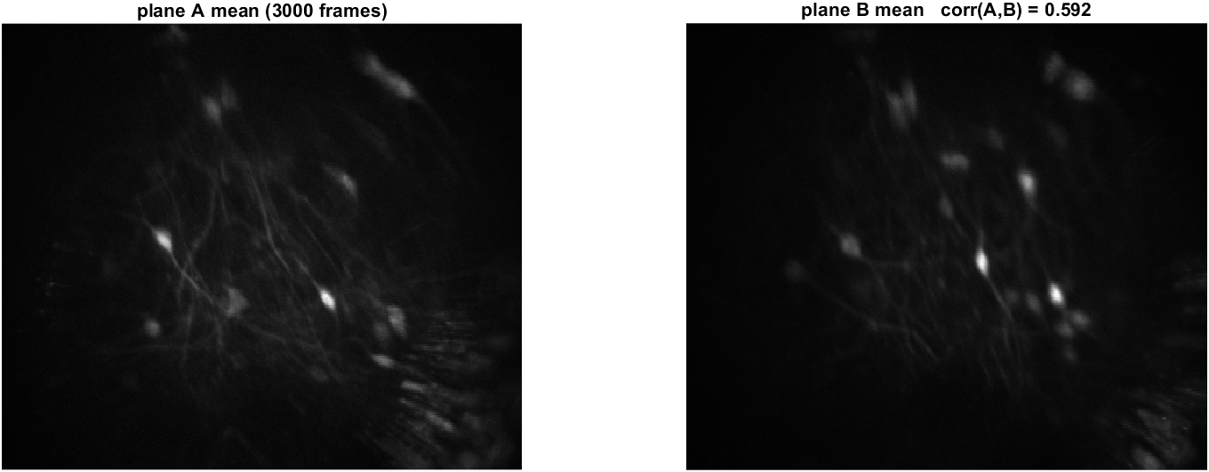
Step 1 - split the two depths
The previous pipeline max-projected them, which merges neurons
Why not max-project
5 of 17 cells at one depth sit within a cell radius of a cell
at the other, so ~29 % get merged, and max() is nonlinear - the
projected value flips between the two neurons in 50 % of
consecutive frames.
Result
corr(mean A, mean B) = 0.592 pain, 0.564 open field, well below
1, so the depths hold different cells.
pain 6000 -> 3000 frames per plane in 27 s | open field 3000 -> 1500 in 17 s | 0 frames lost
pain_2plane_step1_split_planes.m -> <session>\output_split\plane_A.tif , plane_B.tif

Slide 4
Blocker - ActSort was silently replacing EXTRACT's code
EXTRACT died on every plane; the cause was the MATLAB path, not the data
Not enough input arguments.
get_circularity_metrics line 12
remove_redundant line 22
run_extract line 471
extractor line 408
shadowed file | EXTRACT | ActSort
get_circularity_metrics.m | 25 lines, 3 args | 46 lines, 4 args
get_trace_noise.m | 49 lines | 6 lines
kappa_of_epsilon.m | 22 lines | 3 lines
estimate_noise_std, get_trace_snr, | all differ | all differ
filter_images, smooth_images, ... | (20 files)
ActSort ships its own fork of 20 EXTRACT helper files, 19 of which
differ. addpath prepends, so ActSort won every name. Its
get_circularity_metrics takes a 4th argument 'parallel' that
EXTRACT never passes - and line 12 is "if parallel".
Worse than a crash: the 73 and 60 candidate cells had already been
found using ActSort's noise and SNR estimators. It corrupts the
numbers before it stops. ActSort is in the SAVED MATLAB path
(15 folders), so this affects every MATLAB session on this PC.
Fix: rmpath every ActSort folder, then assert that all 141 EXTRACT
functions resolve inside the EXTRACT tree. Load ActSort only after
extraction, in a fresh session.
After the fix all four planes completed: 234 s and 209 s (pain),
123 s and 112 s (open field).
mini2p_toolbox_paths.m (the guard) | EXTRACT_QC_20260911.md Finding 7

Slide 5
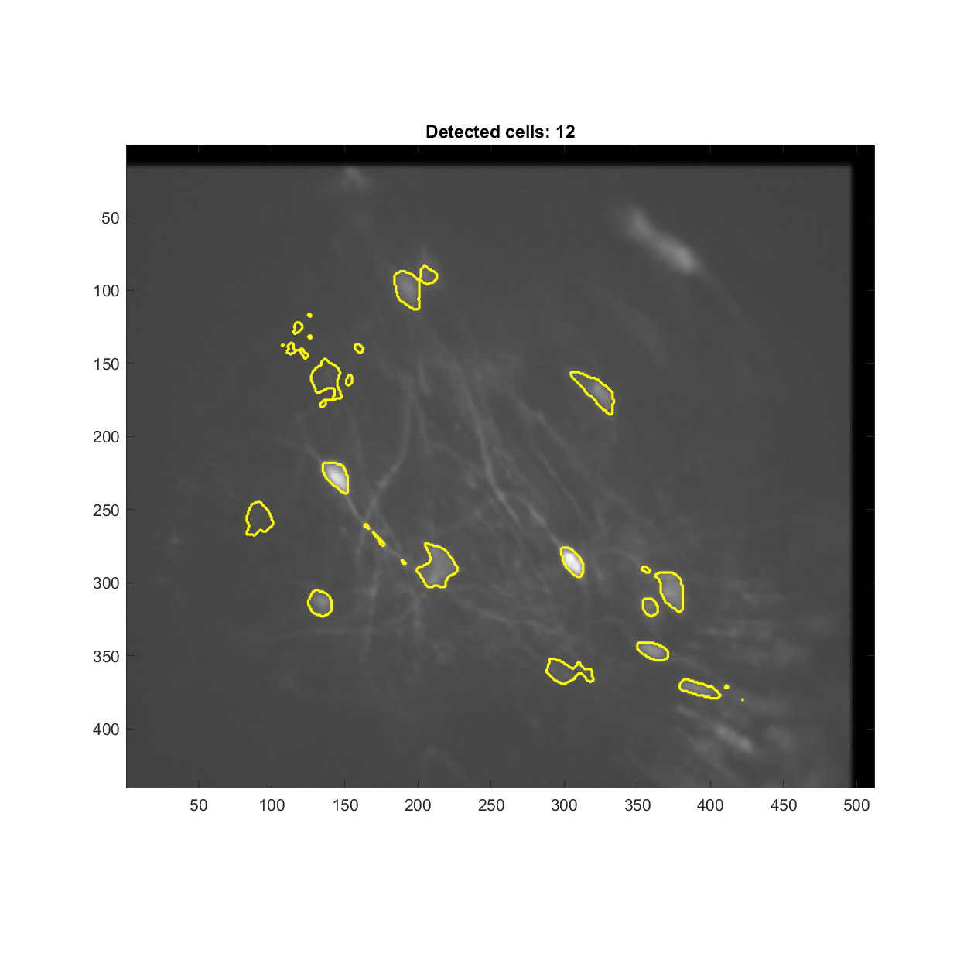
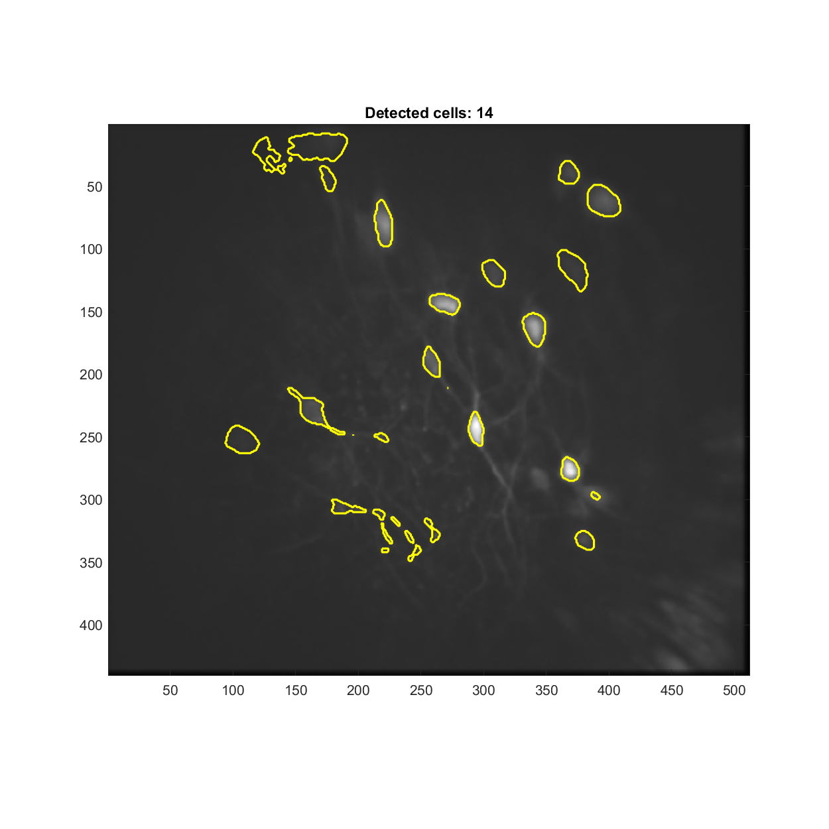
Step 2 - EXTRACT per plane
Cells found on the 4x binned movie, traces re-solved at the full 4.6 Hz
 | OF A | OF B | PA A | PA B
frames | 1500 | 1500 | 3000 | 3000
noise std | 14.2 | 14.3 | 20.7 | 21.3
candidates | 38 | 58 | 73 | 60
after quality | 17 | 14 | 14 | 18
after morphology | 14 | 14 | 12 | 15
Settings that matter
use_zscore_before_extract = false, so (F-F0)/F0 is real dF/F
find on binned / trace on unbinned, so a 2 s window holds
9 samples instead of 2
preset low_snr, avg_cell_radius 8 (measured median 7.9 px)
The open-field movie is the cleaner one: noise std 14.2 against
20.8, background lag-1 autocorrelation 0.07 against 0.40.
pain plane A, 12 cells
open field plane B, 14 cells
pain_2plane_step2_extract.m , split_master.m -> <session>\output_split\plane_A\ , plane_B\

Slide 6
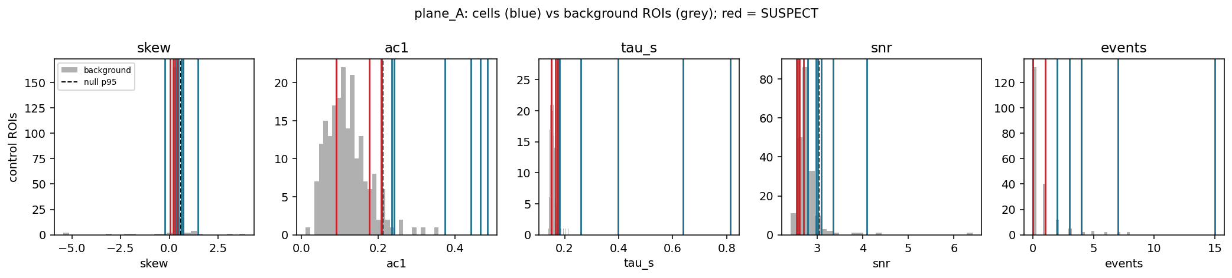
Step 3 - is it a cell, or background?
At 4.6 Hz and SNR 0.75 a real cell's trace also looks like noise by eye, so the null is measured
Method 200 control ROIs cut from the SAME motion-corrected movie, with the SAME
footprint shapes moved to places >= 12 px from any detected cell, traces taken
by the identical weighted average. Metrics on detrended dF/F (20 s running
median): background raw autocorrelation is 0.40, so without detrending the
test measures drift, not calcium.
Test Fisher combination of the empirical p-values for skew and lag-1
autocorrelation, calibrated on the same statistic over the 200 controls.
Kept at p <= 0.05, so 5 % of background would pass by construction.
verdict | OF A | OF B | PA A | PA B | all
curated cells | 12 | 16 | 11 | 16 | 55
active | 5 | 5 | 6 | 6 | 22
silent | 7 | 9 | 4 | 10 | 30
SUSPECT | 0 | 2 | 1 | 0 | 3
usable | 4 | 5 | 6 | 6 | 21
silent = no signal but the footprint IS brighter than its surround: a real soma that did not fire
extract_qc_cells.py --curated -> <plane>\curated\qc_cells\

Slide 7
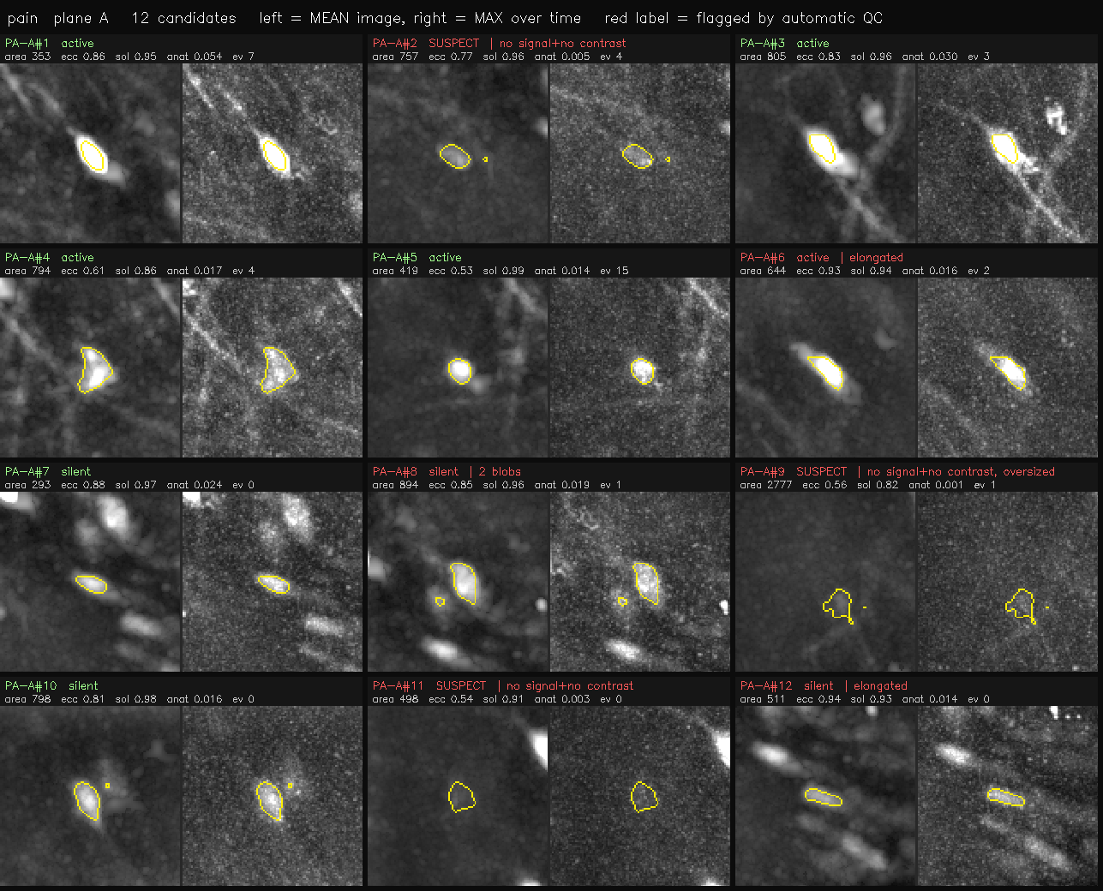
Step 4 - manual curation, decided on these sheets
The automatic QC measures brightness against the surround and says nothing about SHAPE, so a bright fibre passes it
Left half of each tile = MEAN image, right half = MAX over time.
Brightness stretched on the WHOLE plane, never per crop, so a dim
candidate looks dim.
Eccentricity was added after this view: pain A #6 and #12 are
visibly fibres and are the two highest eccentricities in the plane
(0.934, 0.941), just under the 0.95 the filter allowed.
plane | before | decision | after
OF A | 14 | discard 7, 13 | 12
OF B | 14 | discard 9; trim 14 to its large blob; add N3, N4, N5 (missed somata) | 16
PA A | 12 | discard 9 (contour empty, anat 0.001) | 11
PA B | 15 | split 11 into two cells 11a / 11b | 16
An interactive page was used to click these: curation_select.html
cell_curation_sheet.py , make_curation_page.py -> <session>\output_split\curation\

Slide 8
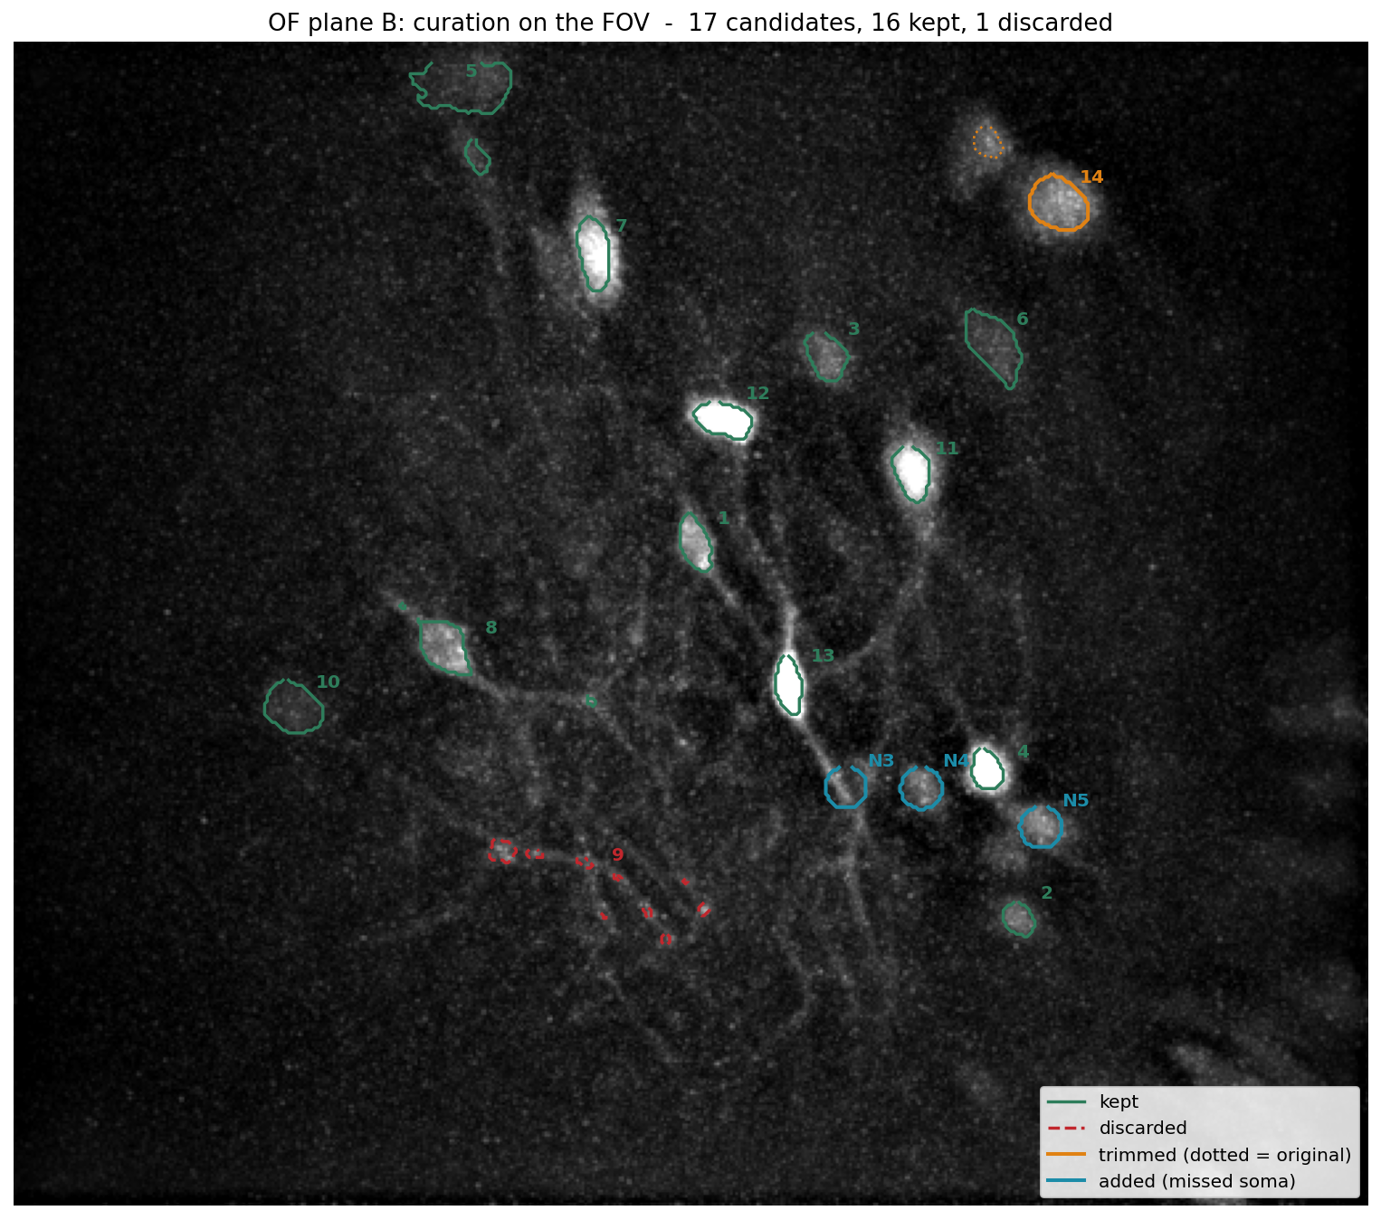
Step 4 - the decisions on the field of view
open field plane B: 1 discarded, 1 trimmed, 3 added
Green = kept. Red dashed = discarded (#9 sits on fibrous texture, not a soma). Orange = trimmed, dotted outline is the original two blobs and solid is the large one that was kept. Cyan = the three somata EXTRACT missed.
plot_curation_on_fov.py -> <plane>\curated\curation_on_fov.png

Slide 9
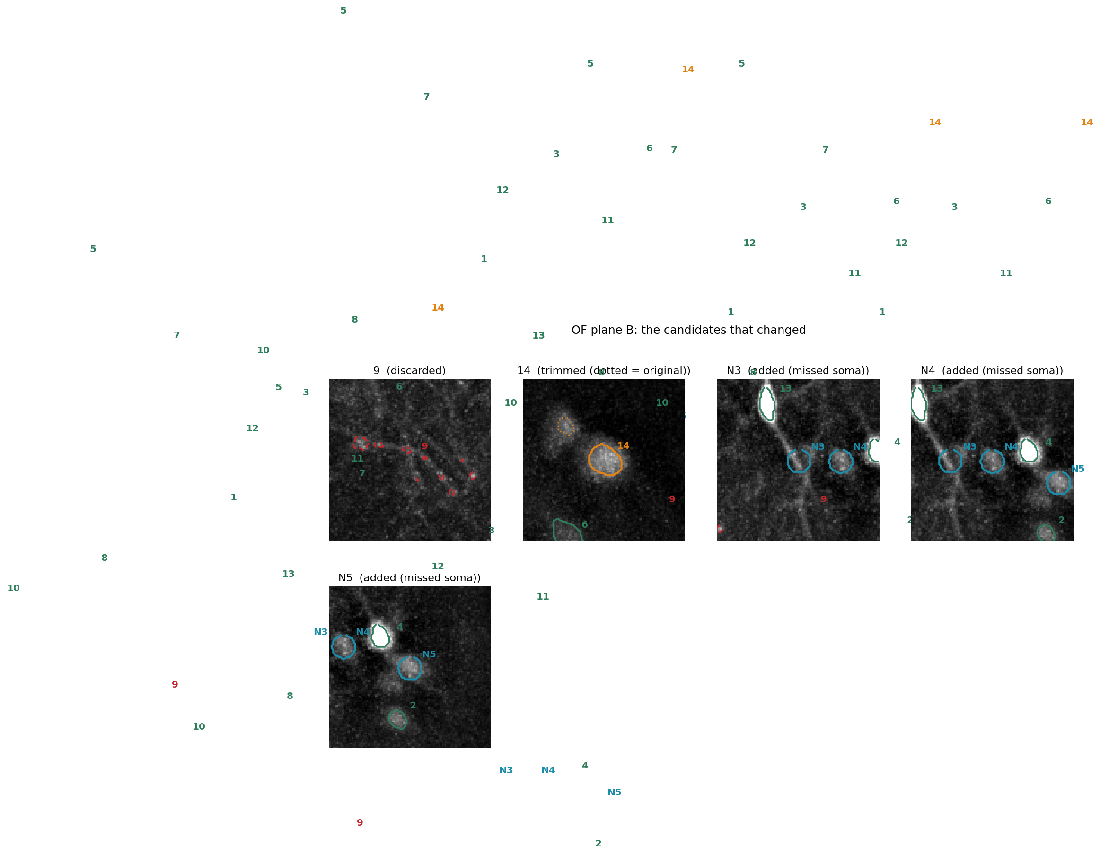
Step 4 - zoom on what changed
trim and the three added somata, open field plane B
N3 and N4 are faint (band-pass peak 1.6 and 2.2 against 3.5 for N5 and 17.2 for #4), so whether they are dim cells or neuropil is left to the QC on their traces - both came out silent.
<plane>\curated\curation_on_fov_zoom.png

Slide 10
A bug I introduced, and how it was caught
The curated export was scrambled by array order; detection itself was never touched
one footprint, N3 | blobs | largest area | row span
intended | 1 | 212 px | 274-289
what MATLAB built | 17 | 16 px | 0-439 (whole FOV)
Verification now runs as a gate
verify_curation.py checks the curated set against three
independent sources - the original detection, the decisions typed
in code, and the applied result - and exits non-zero on any
mismatch. All checks pass:
original detection unchanged in all four planes
every curated footprint compact (row span 9-43 px)
discards exactly as decided
kept-unchanged footprints numerically identical to the original
trim 14: 2 blobs -> 1, 482 -> 371 px, subset of the original
N3, N4, N5 within 0.0 px of the requested positions
split 11 -> 11a 364 px + 11b 258 px = 622 px, a disjoint
partition of the original support, weights preserved exactly
numpy ravels row-major; MATLAB's reshape fills column-major. With
440 != 512 it is not even a transpose - one soma scatters into
stripes. Nothing errored, and every trace solved against it was
wrong. Hansol spotted the stripes in the FOV figure.
Two fixes
1 convert to Fortran order once, at the file boundary
2 MATLAB now asserts each footprint is one compact blob and
fails loudly, naming the likely cause, if it is not
One earlier conclusion is RETRACTED. I had reported that EXTRACT's
S-step relocates footprints by 127-143 px, making its T-step
unusable. That was measured against the scrambled set. With the
order fixed the movement is 0.8-8.1 px: EXTRACT was fine.
verify_curation.py , apply_curation.py + .m

Slide 11
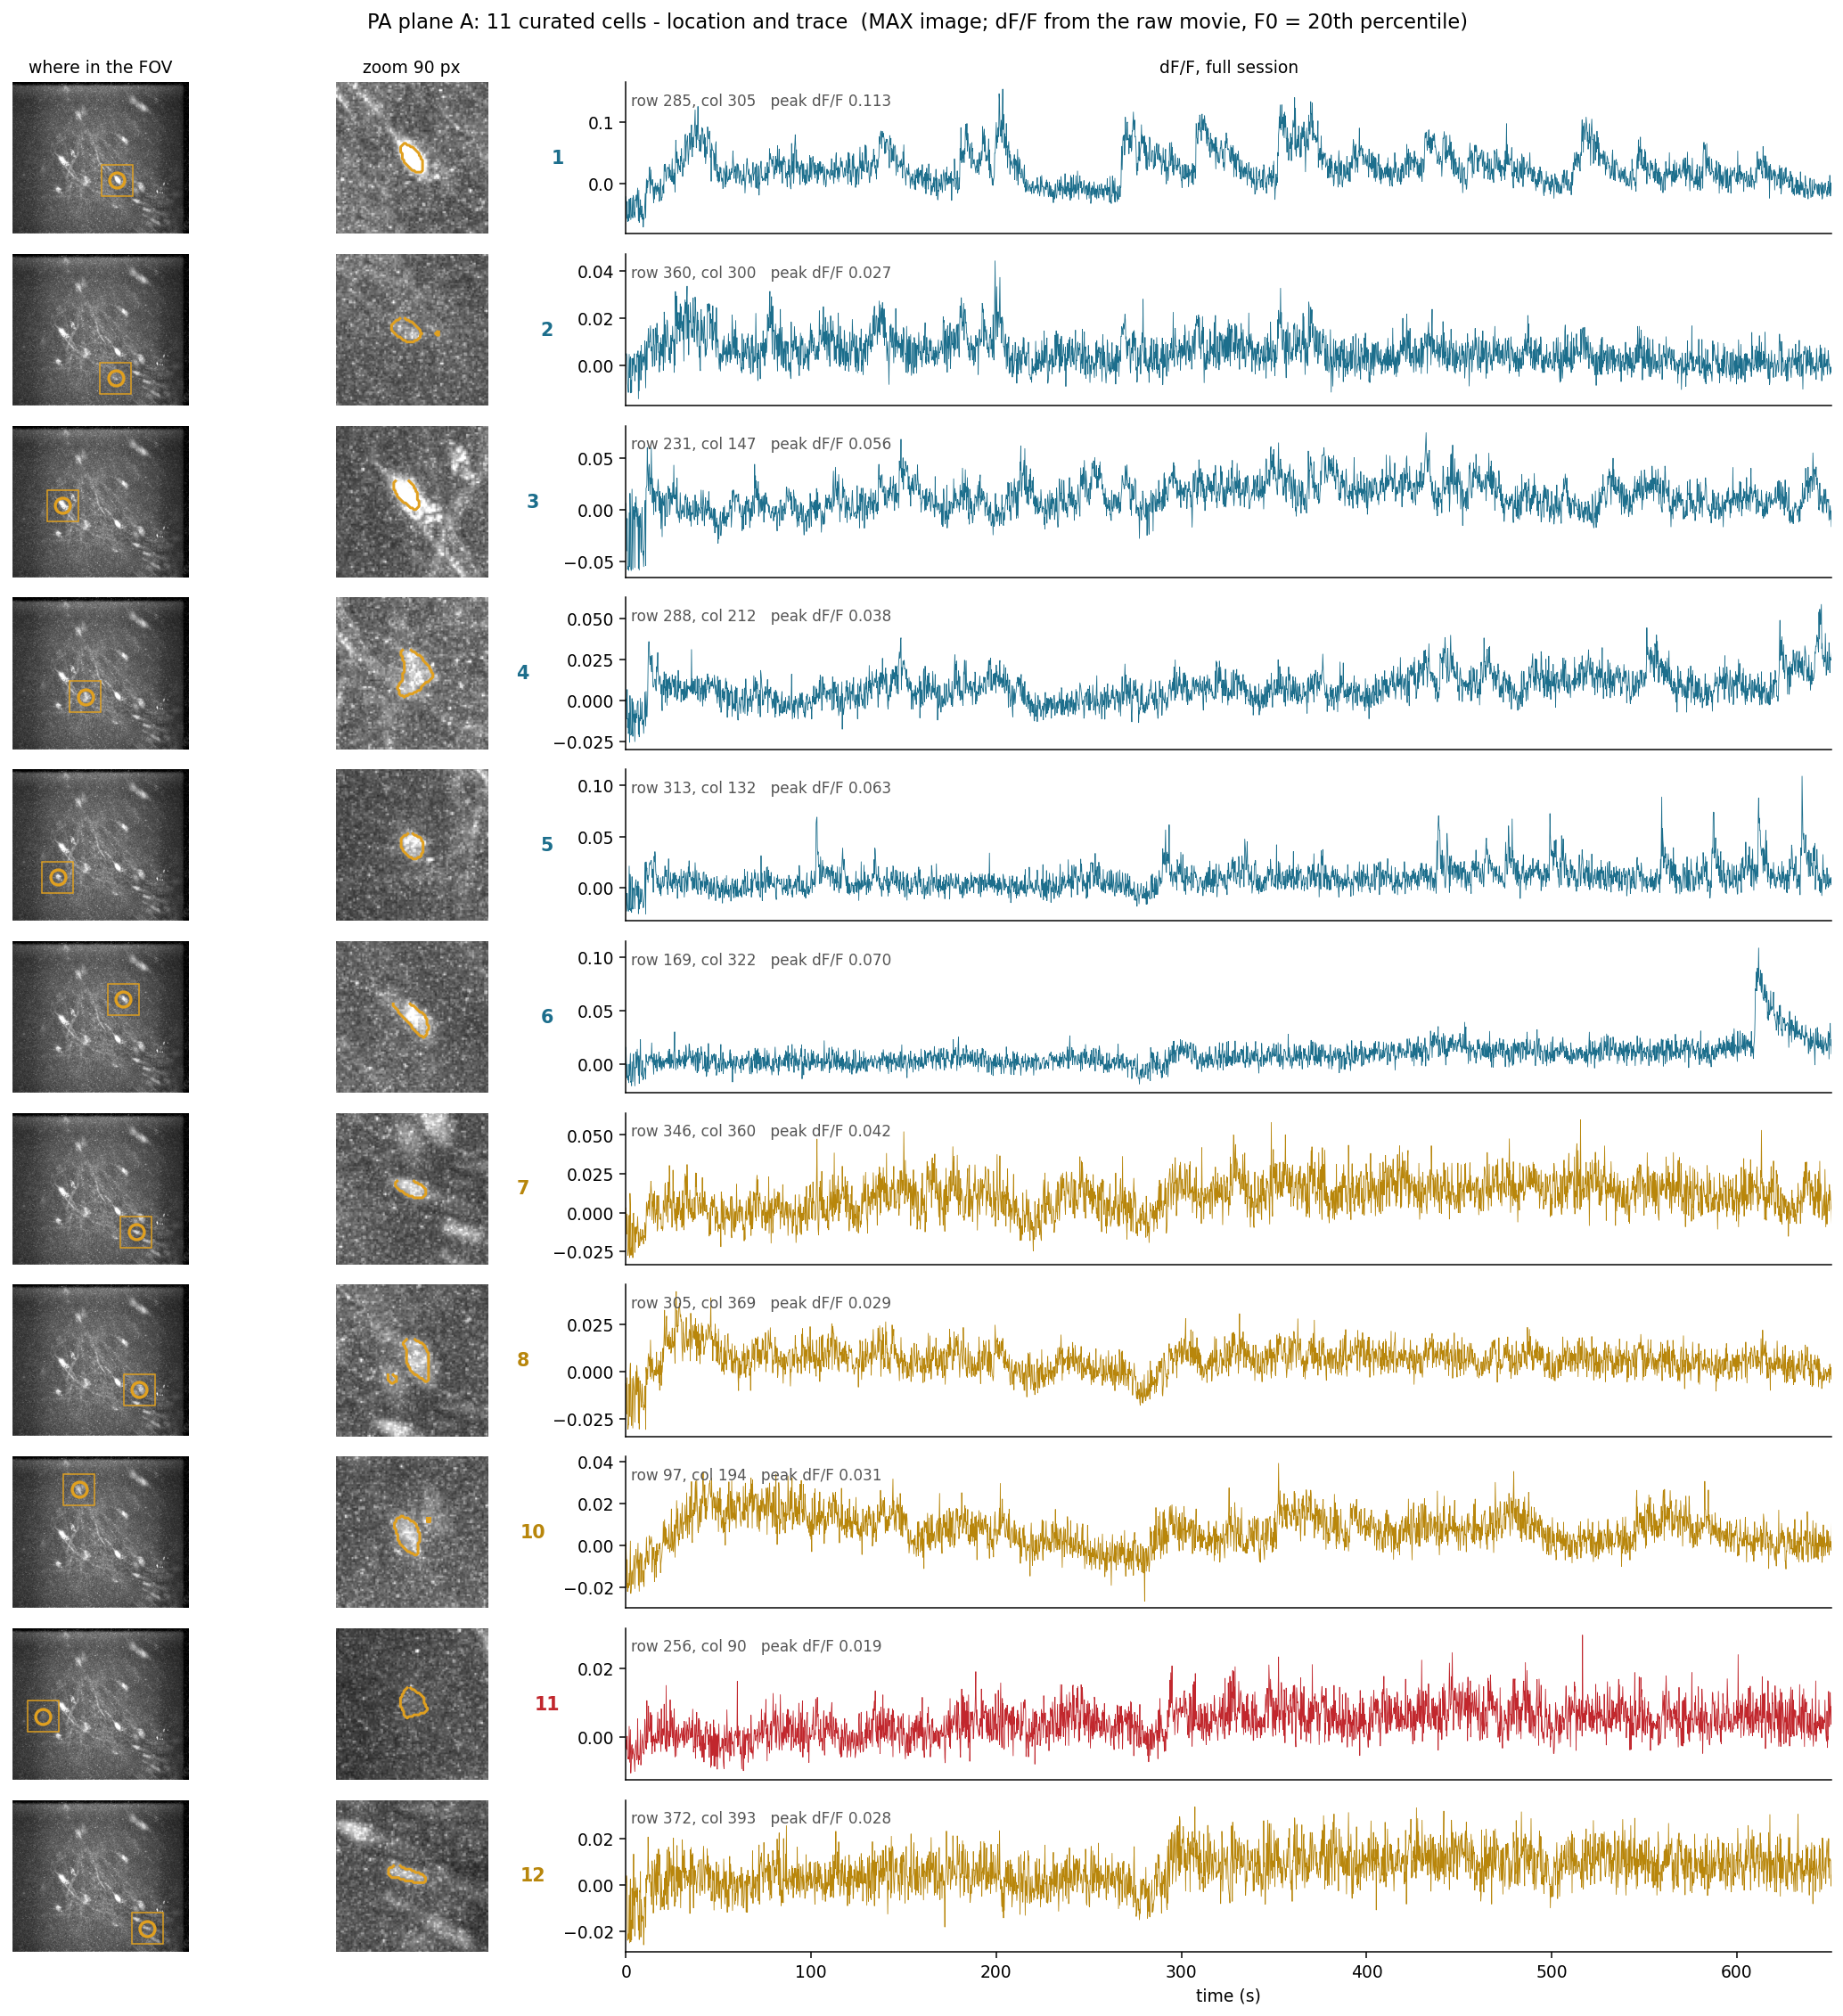
Per cell - where it is and what it does
pain plane A, 11 curated cells
dF/F is pulled from the RAW denoised movie with the curated footprints, F0 = 20th percentile. Traces are solved jointly across all footprints, so an overlapping neighbour does not leak in - measured to matter only for the one pair 25 px apart (r 0.93); every other cell is unchanged (r = 1.000).
plot_cell_by_cell.py -> <plane>\curated\cell_by_cell_location_trace.png

Slide 12
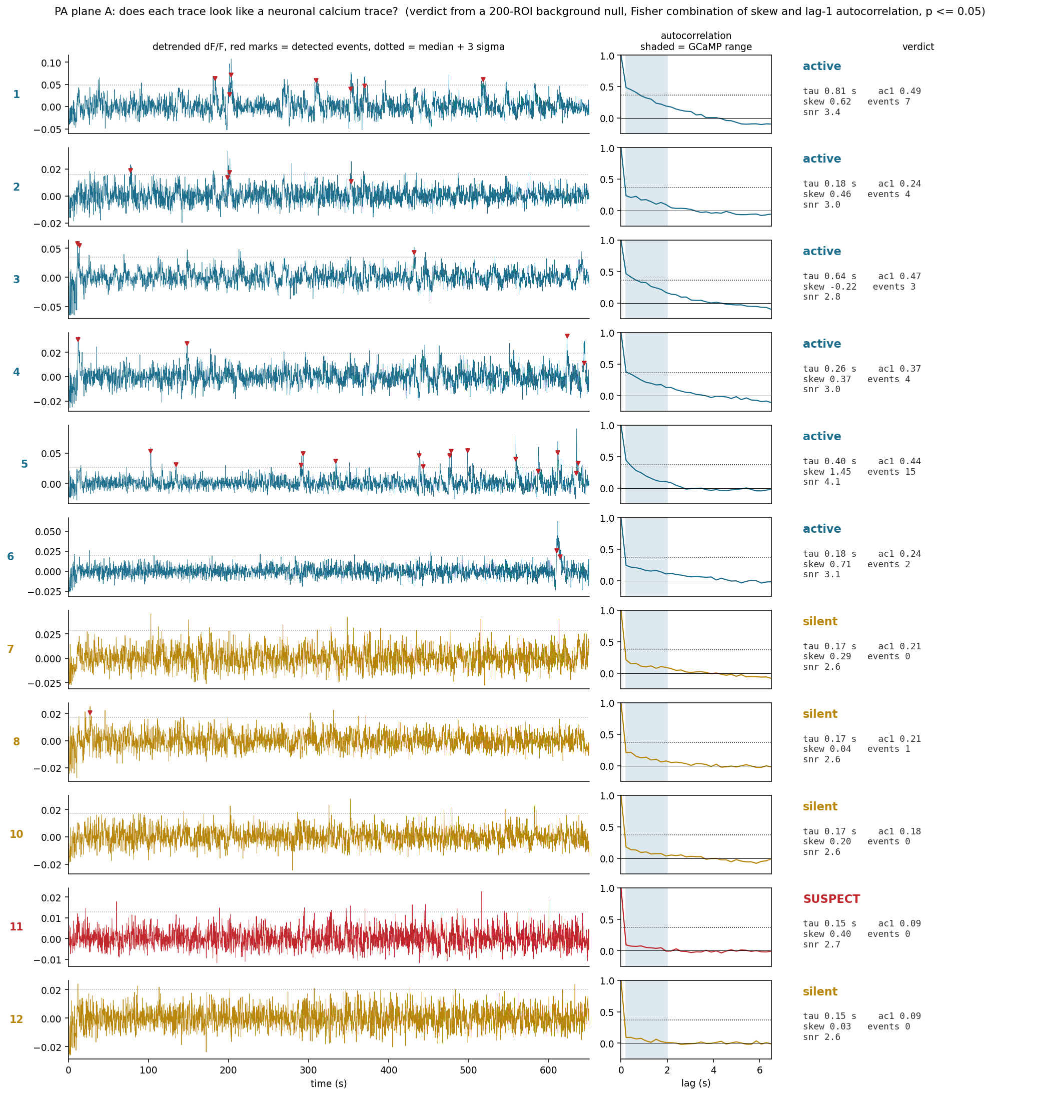
Per cell - does the trace look like a calcium trace?
pain plane A: 6 active, 4 silent, 1 SUSPECT
Red marks = detected events. Shaded band on the autocorrelation = the plausible GCaMP decay range. Cells 1 and 5 show repeated transients; cell 6 has a single clean one at 620 s. Cells 7, 8, 10, 12 sit at tau 0.15-0.17 s, which is one frame - white noise. tau alone does not separate every cell (active runs 0.16-1.37 s), so the verdict uses skew and autocorrelation jointly against the background null.
<plane>\curated\cell_by_cell_evaluation.png

Slide 13
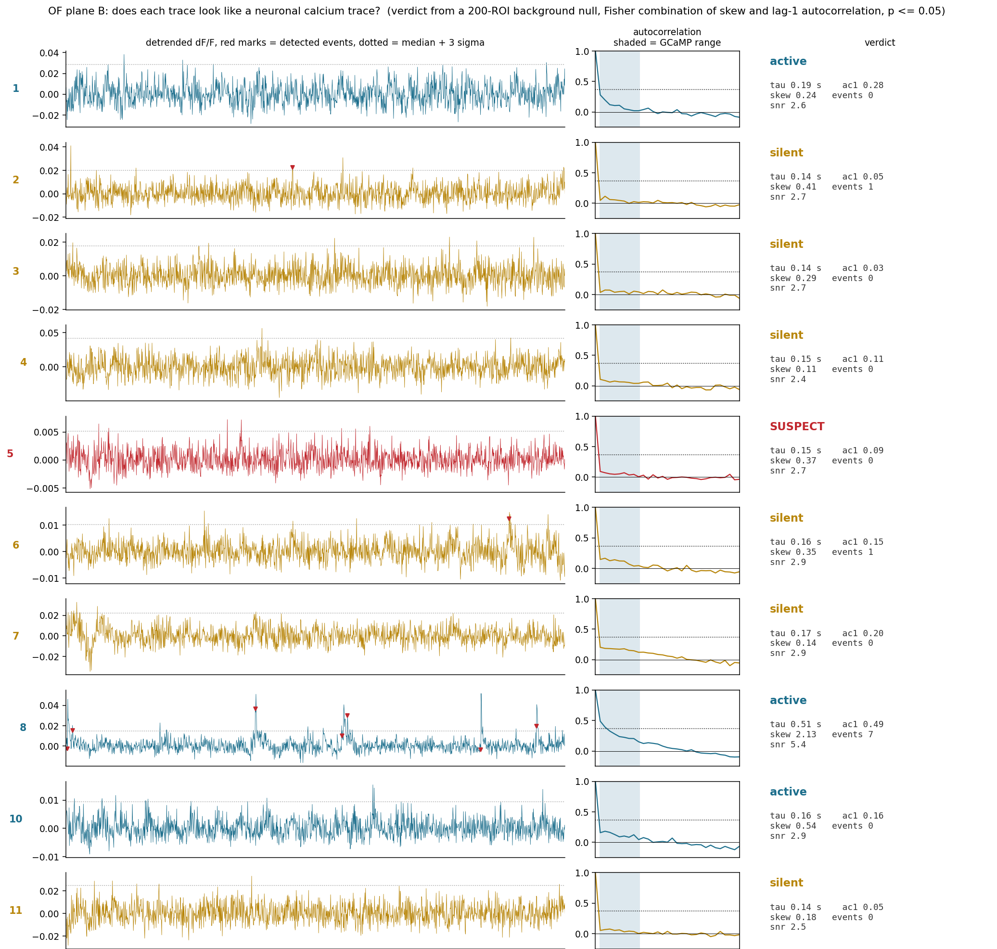
Per cell - open field plane B
16 curated cells including the three added somata (N3, N4, N5) and the trimmed #14
All three added cells came out silent, and N4 is SUSPECT - the footprints are on real somata but they did not fire in 326 s. Adding them cost nothing and settled the question with data.
<plane>\curated\cell_by_cell_evaluation.png

Slide 14
Step 5 - one time base for both depths and the cameras
Two clocks ~37 s apart, and the behaviour cameras dropped frames
stream | clock | start - session start
imaging CHA/Time | imaging | -36.64 s OF, -36.21 s pain
SignalSync_N/Time | imaging | -37.41 s OF, -37.07 s pain
MiceVideoN/Ref Time | behaviour | +0.21 s OF, +0.56 s pain
camera | saved | gaps | missing | sync pulses
OF MiceVideo2 | 8159 | 5 | 6 | 8166
PA MiceVideo1 | 16299 | 8 | 11 | 16311
PA MiceVideo2 | 16296 | 10 | 12 | 16310
This is NOT a 37 s misalignment of the data. The spans agree to
within 0.05 s, so the recordings are simultaneous - only the
timestamp clocks differ. Aligning by ABSOLUTE timestamps across the
two clocks would put the data 37 s out; aligning by relative
seconds from each stream's own start is off by only -0.58 s.
saved + missing reproduces the span to within 2-4 ms and lands 1-2
pulses short of the sync count, so the residual alignment
uncertainty is 40-80 ms, not the ~0.3 s a raw count difference
would suggest.
In the pain session BOTH cameras drop at the same frame indices
(~2103-2107, 8799-8801, 13823-13830) - a system stall, not a camera
fault. So behaviour frame index / 25 is NOT time; the error is
cumulative and reaches 0.24-0.48 s by the end. My own open-field
tracking output had that bug and was corrected by up to 775 ms.
Result: 100 % of the imaging in both sessions has simultaneous behaviour video.
split_timestamps.py -> <session>\output_split\timestamps\

Slide 15
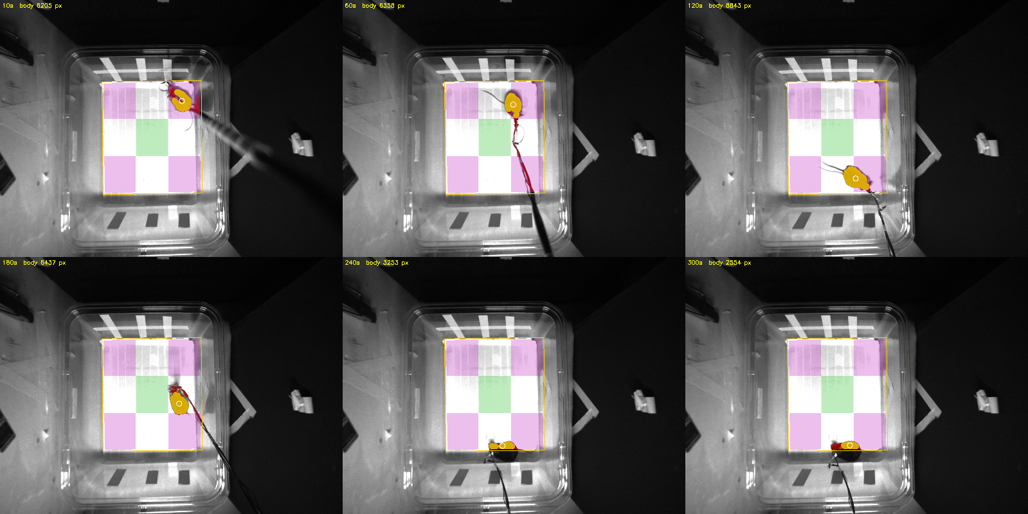
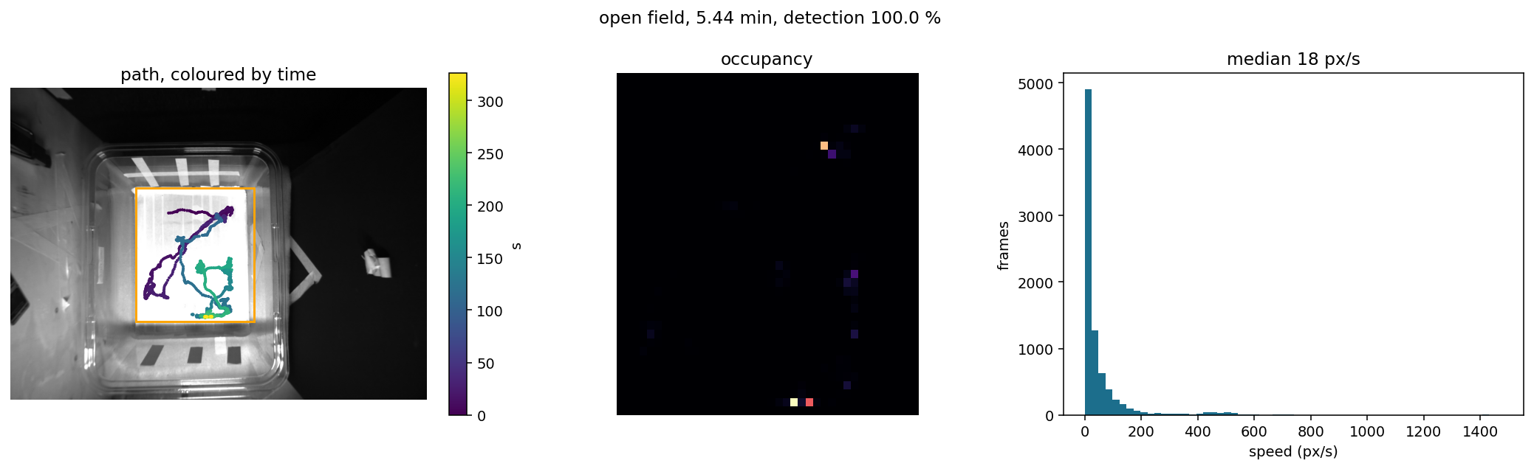
Result 1 - open-field tracking
The FOV is 8x the arena; only the white floor counts
"Largest dark blob in the frame" tracked the dark right-hand
background: a body of 923,038-955,852 px (half the frame) sitting
still at x~1060, for 1632 of 1632 sampled frames.
Threshold sweep on the session median image:
>180 640x680 climbs into the white wall tape
>220 571x625 ragged right edge
>245 469x527 the floor, clean
Mask is the fitted rectangle, eroded 8 px; zones are the standard
3x3 grid of the floor.
metric | value
white floor | 454 x 516 px = 11.9 % of FOV
frames analysed | 8159 of 8159 (5.44 min)
detection rate | 99.96 %
body area | median 6411 px (827-10875)
distance | 16476 px
time moving | 46.0 % (>20 px/s)
centre / corner / edge | 5.6 % / 41.4 % / 53.0 %
body clipped at wall | 45.1 % of frames, flagged
openfield_track.py -> <session>\output_split\tracking\

Slide 16
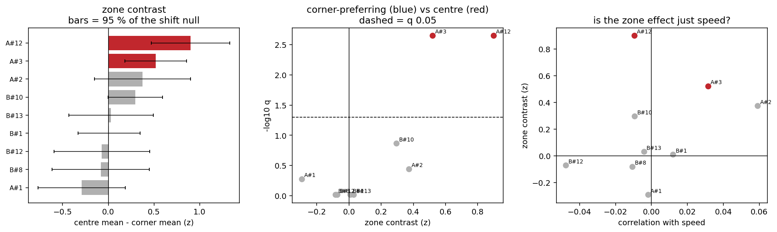
Result 2 - centre versus corner neurons
9 usable cells tested; 2 prefer the centre, 0 prefer the corners
Statistics Zone contrast is the centre mean minus the corner mean of the detrended
z-scored dF/F. Its p-value is two-sided against a CIRCULAR-SHIFT null, which
keeps the trace's autocorrelation and the animal's occupancy and destroys
only the pairing. A t-test across frames would treat each frame as
independent and is not valid for calcium. 2000 surrogates, minimum shift
10 s. q-values are Benjamini-Hochberg across the 9 cells.
Speed reported per cell with its own shift test, because a "centre cell" could
just be a speed cell. 0 of 9 are speed-significant, so the zone effects
are not speed in disguise.
cell | contrast | q | preference
A#12 | +0.900 | 0.0022 | centre
A#3 | +0.520 | 0.0022 | centre
B#10 | +0.295 | 0.1364 | none
A#2 | +0.373 | 0.3632 | none
other 5 | -0.29 to +0.03 | > 0.5 | none
Centre occupancy is only 5.6 % (83 imaging frames against 623 in the corners), so a centre effect is much harder to detect than a corner one - absence of corner cells is weak evidence.
openfield_place_cells.py -> <session>\output_split\place\

Slide 17
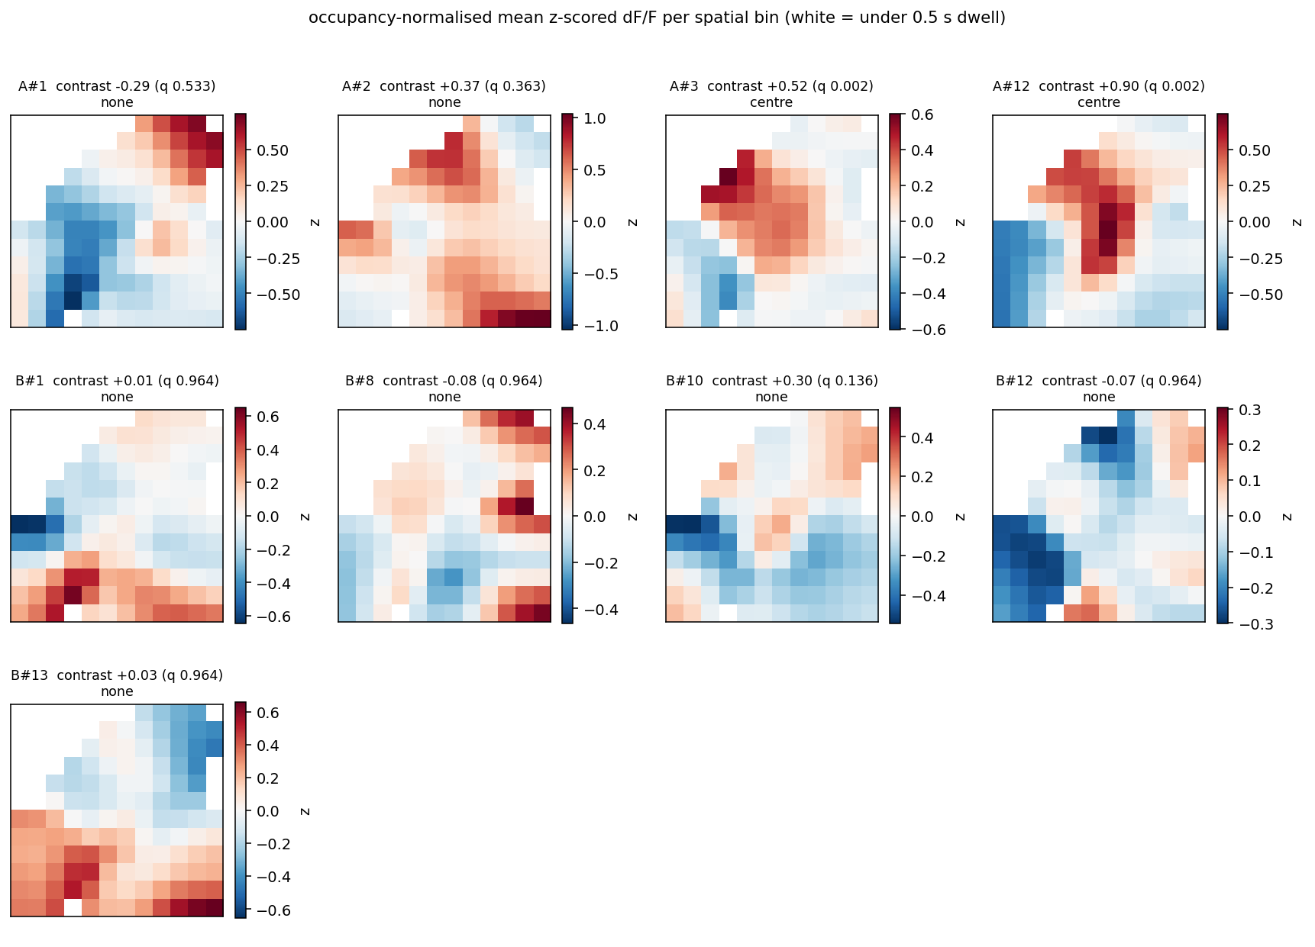
Result 2 - occupancy-normalised rate maps
mean z-scored dF/F per spatial bin; white = under 0.5 s dwell
A#12 and A#3 are the two with a red centre. The maps are divided by occupancy, so the centre is not just brighter for being visited less.
<session>\output_split\place\place_ratemaps.png

Slide 18
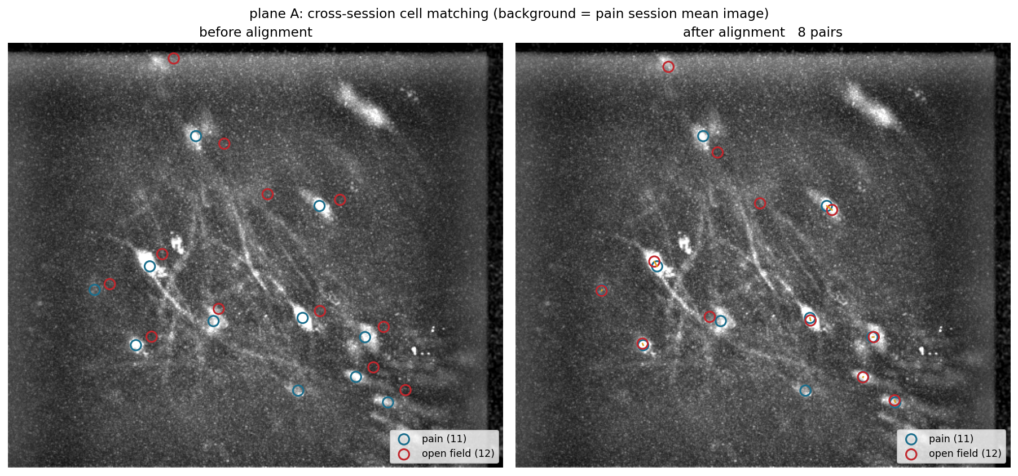
Result 3 - following the same neuron across the two sessions
By pixel position, after registering the fields - the cell IDs themselves do NOT correspond
 | plane A | plane B
registration shift | dy +9, dx -17 px | dy -11, dx -7 px
image correlation there | +0.872 | +0.876
same depth, wrong session | - | -
against the OTHER depth | +0.328 | +0.435
pairs within 8 px | 8 of 11 | 13 of 16
median residual | 1.98 px | 2.00 px
footprint shape r >= 0.5 | 5 of 8 | 8 of 13
Each depth matches ITSELF across the two sessions at r ~ 0.87, against 0.33-0.44
for the wrong depth - the same optical planes really were imaged 29 minutes apart.
Two gates, because position alone is not enough in a dense plane:
position within one cell radius (8 px) after registration
shape footprint correlation >= 0.5 after alignment
13 of 21 position pairs pass both and are treated as the same neuron.
Phase correlation was tried first and failed: it returned contradictory shifts
between the depths (0 px for B, -21.7 px for A) and found no pairs at all. I had
reported "no cell can be followed across sessions" on that basis; that conclusion
is RETRACTED. A direct correlation search over shifts is what the numbers above
come from, and it can be checked - which is why the wrong-depth controls are shown.
match_sessions.py -> <pain session>\output_split\match\

Slide 19
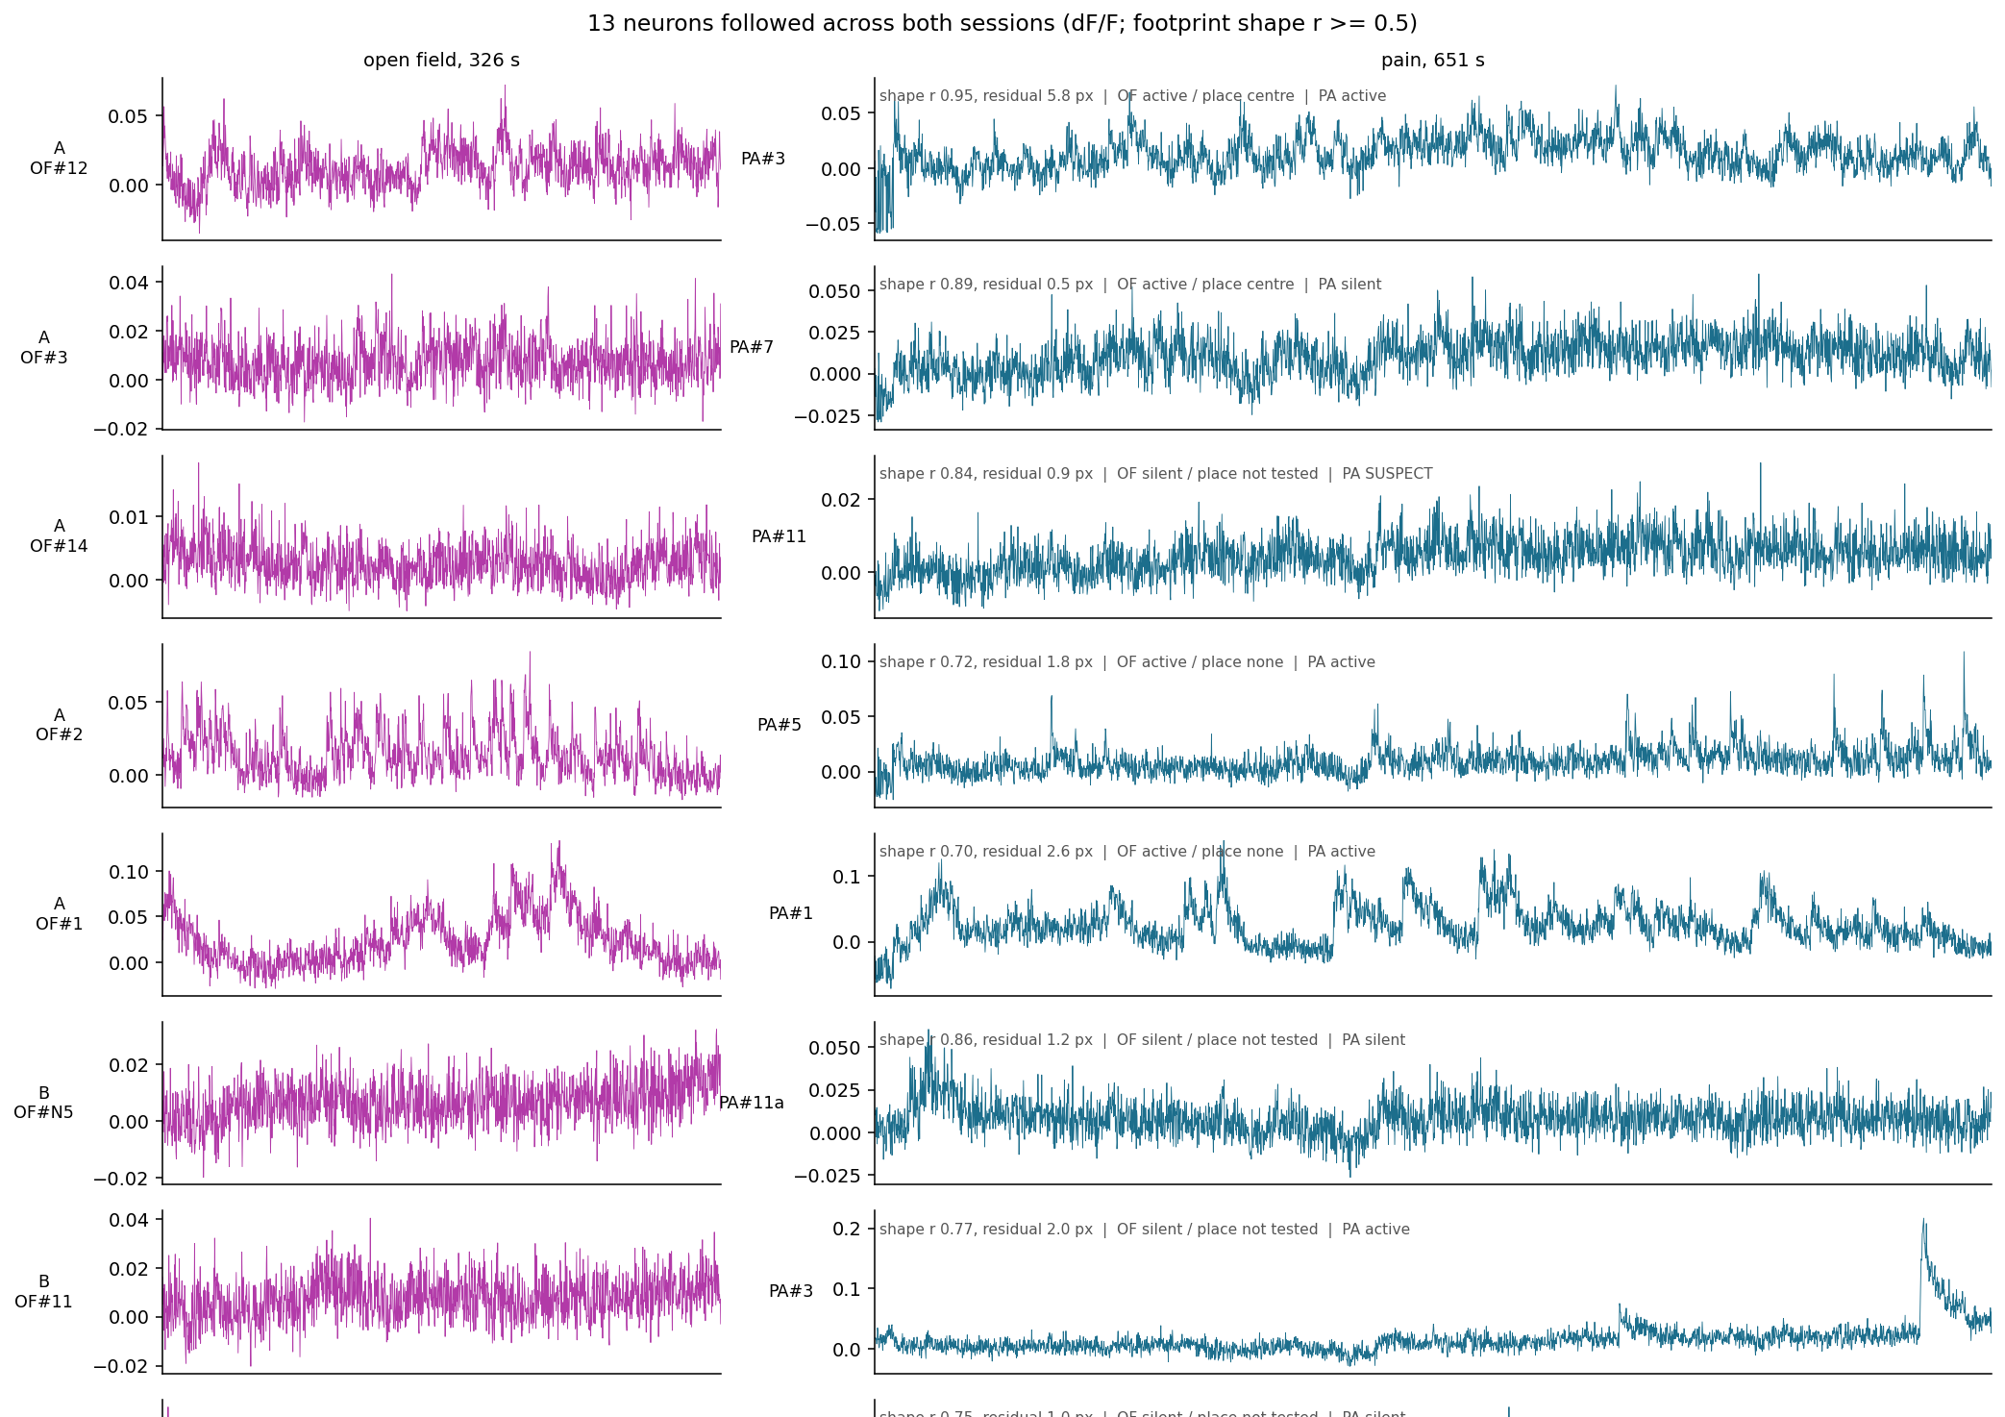
Result 3 - the join that makes the question askable
13 neurons followed across both sessions; 4 usable in both
open field | place | contrast | q | -> pain | shape r | pain
A#12 | centre | +0.900 | 0.0022 | A#3 | 0.953 | active
A#3 | centre | +0.520 | 0.0022 | A#7 | 0.890 | silent
A#2 | none | +0.373 | 0.3632 | A#5 | 0.719 | active
A#1 | none | -0.293 | 0.5325 | A#1 | 0.696 | active
B#13 | none | +0.030 | 0.9635 | B#7 | 0.746 | active
Both centre-preferring cells could be followed into the pain
session. A#12 - the strongly centre-preferring one - is A#3 there
and is ACTIVE, so once the video is scored the question becomes
directly answerable:
was the neuron that preferred the exposed centre also
pin-prick responsive?
Caveat: "same neuron" rests on a footprint correlation of 0.5 in a
dense plane, with residuals of 2-7 px against an 8 px radius.
Treat the pairs as probable, not certain.
linked_cells_report.py -> <pain session>\output_split\match\linked_cells.csv , linked_cells.png

Slide 20
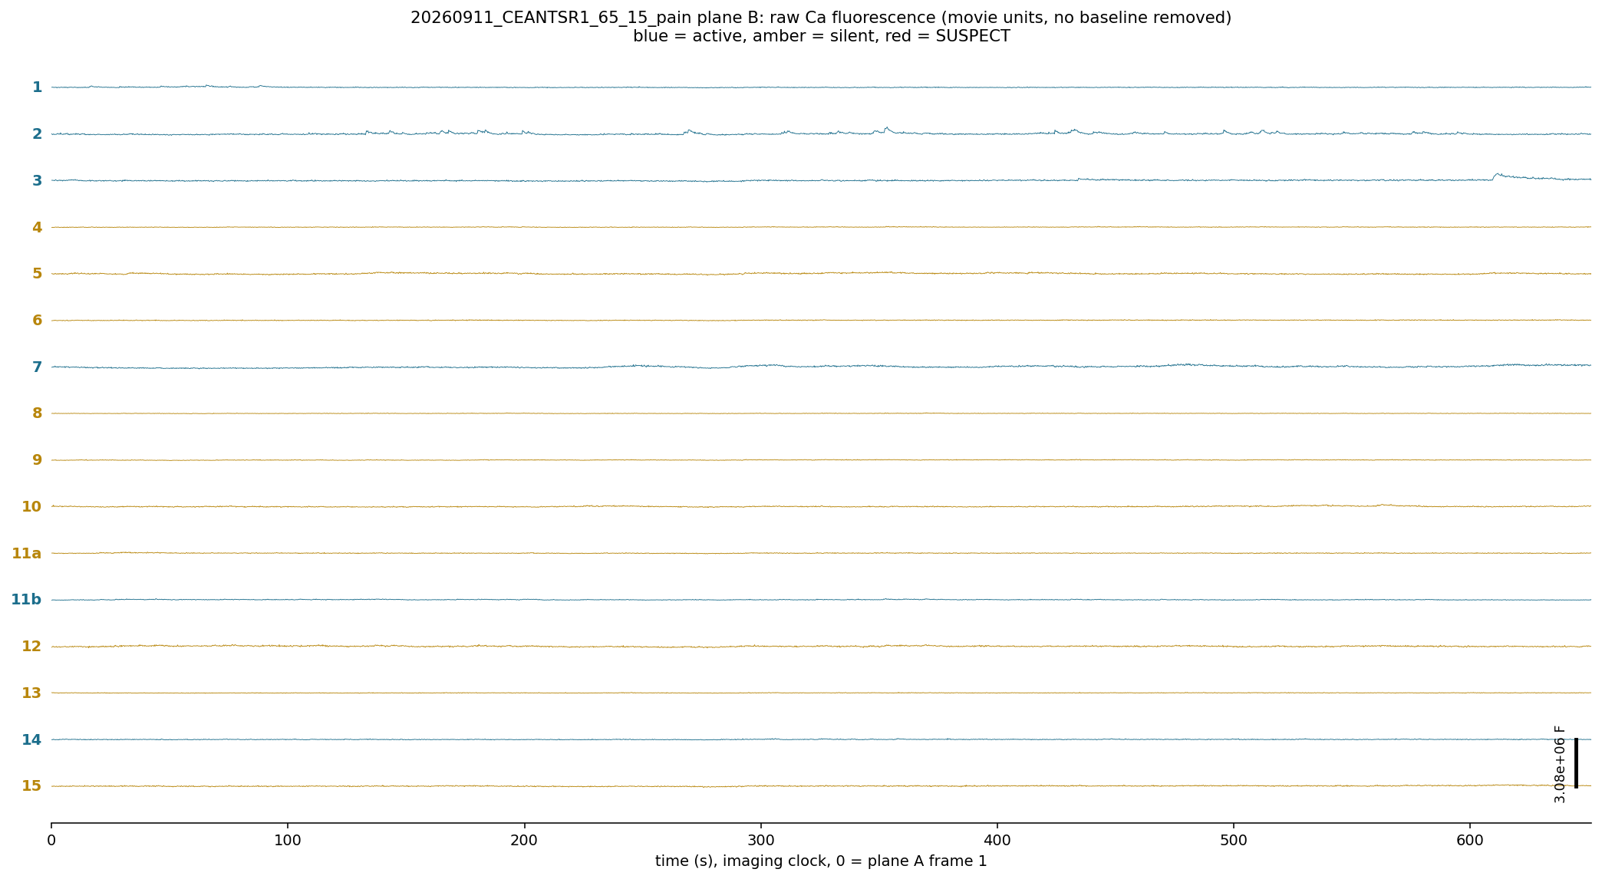
Result 4 - pain session, raw Ca per cell
pain plane B, 16 curated cells, fluorescence in movie units with no baseline removed
Raw F shows absolute brightness, bleaching and drift, which dF/F hides. Blue = active, amber = silent, red = SUSPECT.
pain_cell_traces.py -> <plane>\curated\pain_traces_raw.png , pain_traces.mat

Slide 21
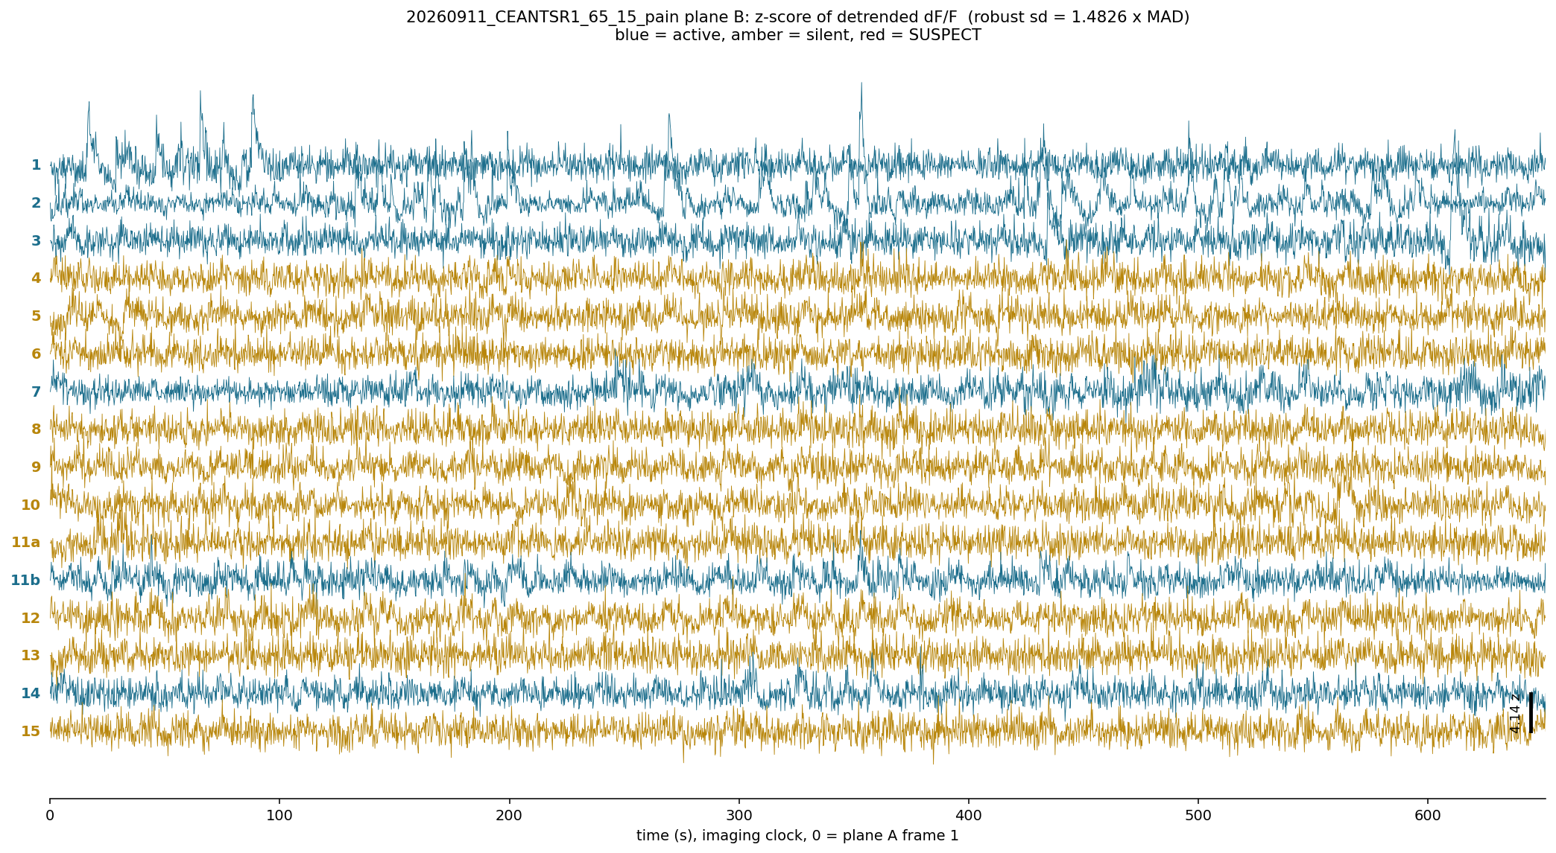
Result 4 - pain session, z-score per cell
detrended dF/F divided by its robust sd (1.4826 x MAD)
Detrended with a 20 s running median first, because background ROIs here carry a raw lag-1 autocorrelation of 0.40 - without that the z-score is dominated by drift. Amplitudes are now comparable between cells with different baselines; |z| reaches 13.2.
<plane>\curated\pain_traces_zscore.png , pain_traces.csv

Slide 22
Ready for event locking, and where everything is
What is waiting on the manual scoring
Every trace already carries a time vector on the same base as the behaviour cameras
(seconds since plane A frame 1, imaging clock), so a stimulus time in that base
indexes straight into it. lock_events() in pain_cell_traces.py takes the scored
times and returns (cells x events x lag) windows, dropping a window rather than
padding it if it would run off either end.
Then: pin-prick / heat / non-responsive / behaviour-responsive per cell, and the
linked table lets a single neuron carry both its open-field and its pain answer.
what | where
all code | C:\Users\hsollim\OneDrive\Desktop\cursor\pain_2plane_split\
measured QC report | ...\pain_2plane_split\EXTRACT_QC_20260911.md
EXTRACT per plane | <session>\output_split\plane_A\ , plane_B\
curated cells, traces, per-cell figures | <plane>\curated\
cell QC against background | <plane>\curated\qc_cells\
curation sheets and the click page | <session>\output_split\curation\
timestamps | <session>\output_split\timestamps\
open-field tracking / place cells | <session>\output_split\tracking\ , place\
cross-session matching | <pain session>\output_split\match\
nothing in <session>\output\ is touched - that is the other agent's max-projection pipeline

