Slide 1
CEA-Ntsr1 two-plane imaging
Four visualisations, for confirmation
1 processing raw movie to what EXTRACT sees, with the quality measured at each stage
2 cell detection every footprint against its own local control, so the test can be seen
3 place coding how a centre or corner cell is decided, observed value against its own null
4 across sessions the same neuron in the pain and open-field sessions, one row per cell
Each figure opens with the whole field of view, then goes to detail. Methods and statistics
are written into each figure's own legend, so these slides stay short.
Pain responsiveness is not here: it needs the manual scoring. Everything else is in place
for it to drop straight into set 4.
code C:\Users\hsollim\OneDrive\Desktop\cursor\pain_2plane_split | figures <session>\output_split\

Slide 2
Set 1 - processing
Does each step actually improve the movie? Measured, not asserted.
Three rows: the whole field at every stage, then the same 140 px crop at every stage, then three measurements.
Each measurement judges ONE stage - the one it is supposed to fix - and the grey band marks which:
frame-to-mean correlation -> motion correction
temporal SNR in cells -> denoising
cell over surround -> the spatial band-pass
Plotting one metric across all stages and calling the rise an improvement is easy and wrong: a spatial
blur raises frame-to-frame correlation for free. That is why it is deliberately not shown.
Headline: before motion correction the cell contrast is NEGATIVE (-0.30 SD) - motion smeared the somata until they were dimmer than their own surround. Correction flips it to +2.95 SD.
fig1_processing.py -> <plane>\curated\fig1_processing.png

Slide 3
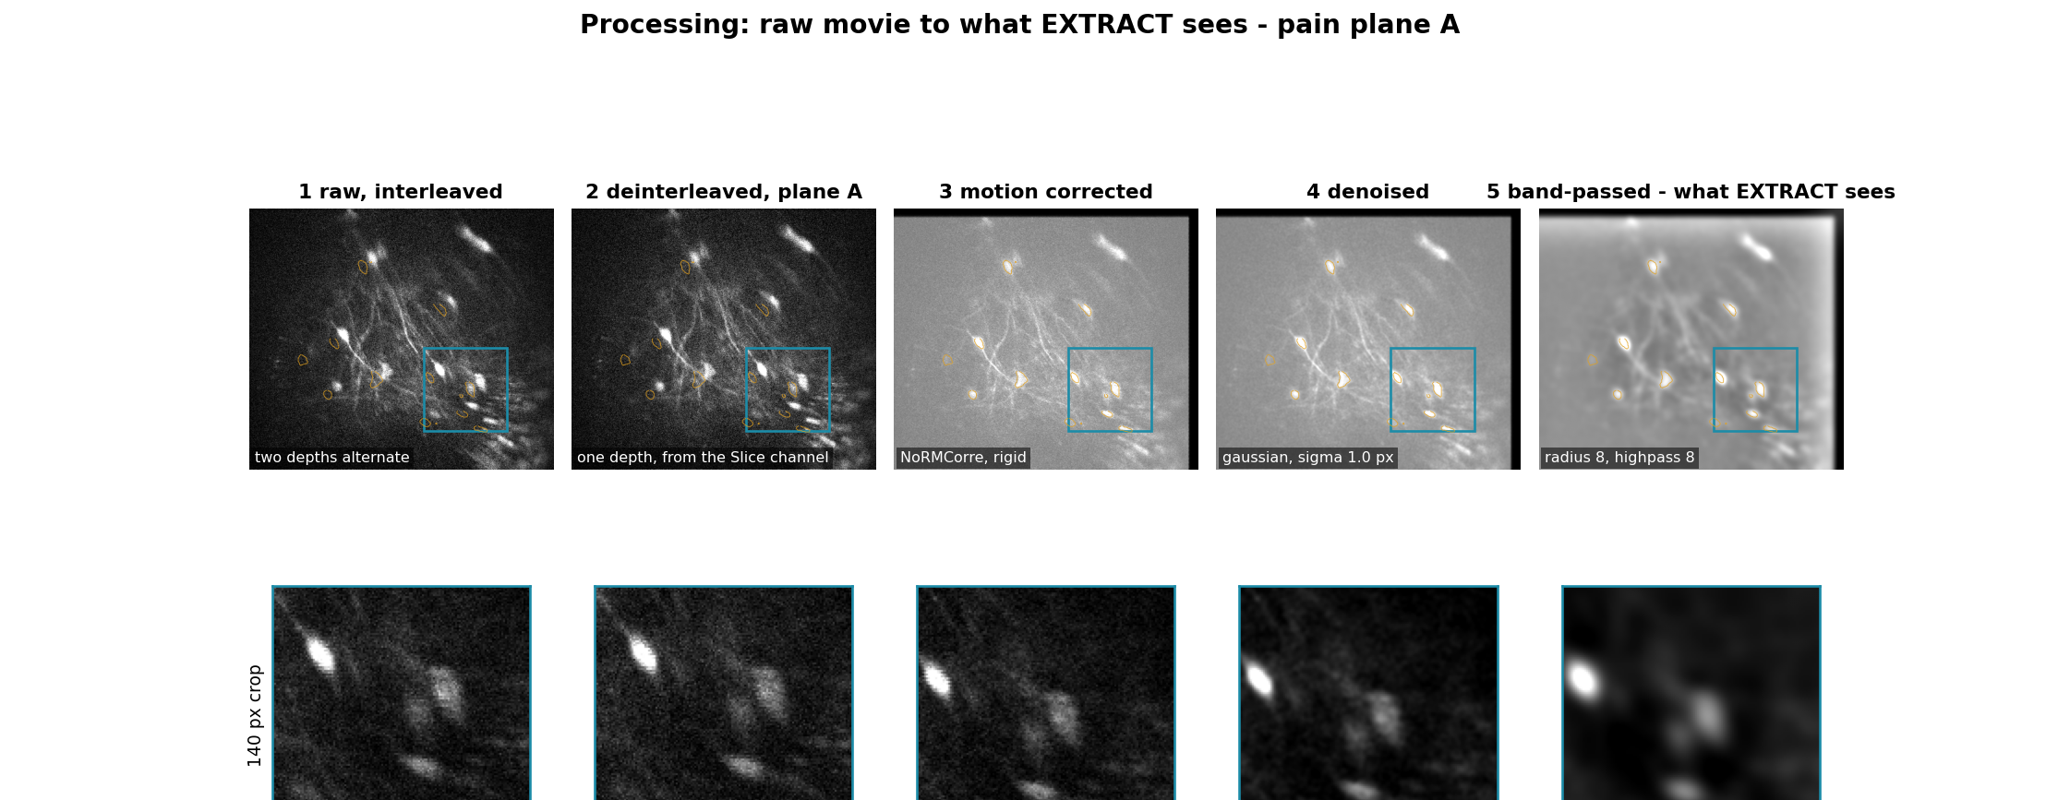
Set 1 - pain plane A (1 of 2)
Follow one soma across the crops: smeared at stages 1-2, crisp from stage 3 on.
<pain>\output_split\plane_A\curated\fig1_processing.png

Slide 4
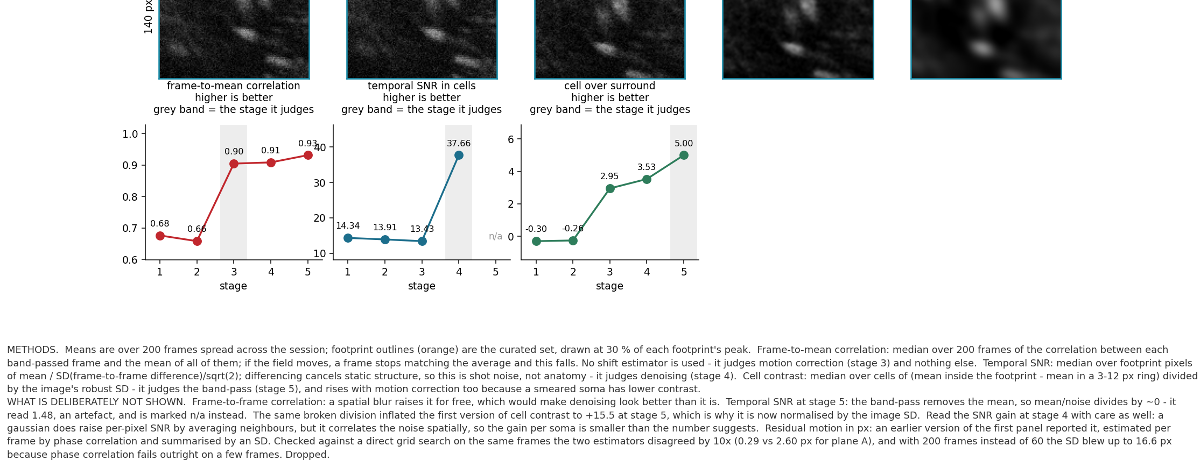
Set 1 - pain plane A (2 of 2)
continued
<pain>\output_split\plane_A\curated\fig1_processing.png

Slide 5
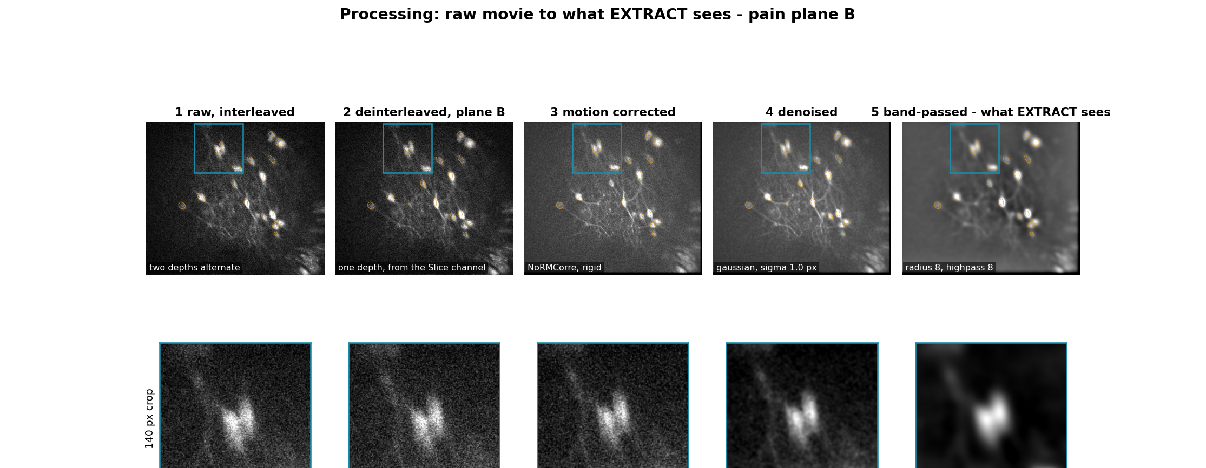
Set 1 - pain plane B (1 of 2)
Plane B was already steadier: frame-to-mean correlation 0.74 before correction against 0.66 in plane A.
<pain>\output_split\plane_B\curated\fig1_processing.png

Slide 6
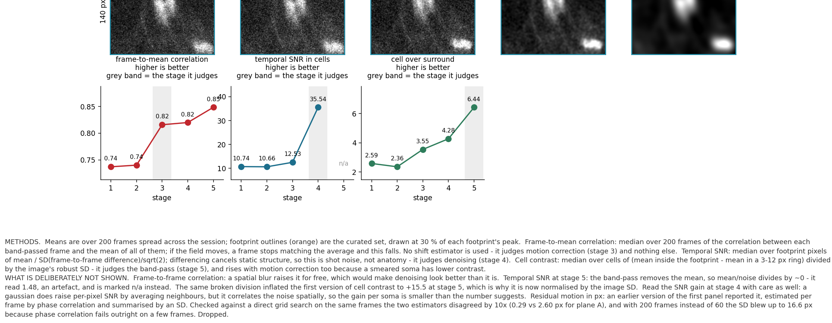
Set 1 - pain plane B (2 of 2)
continued
<pain>\output_split\plane_B\curated\fig1_processing.png

Slide 7
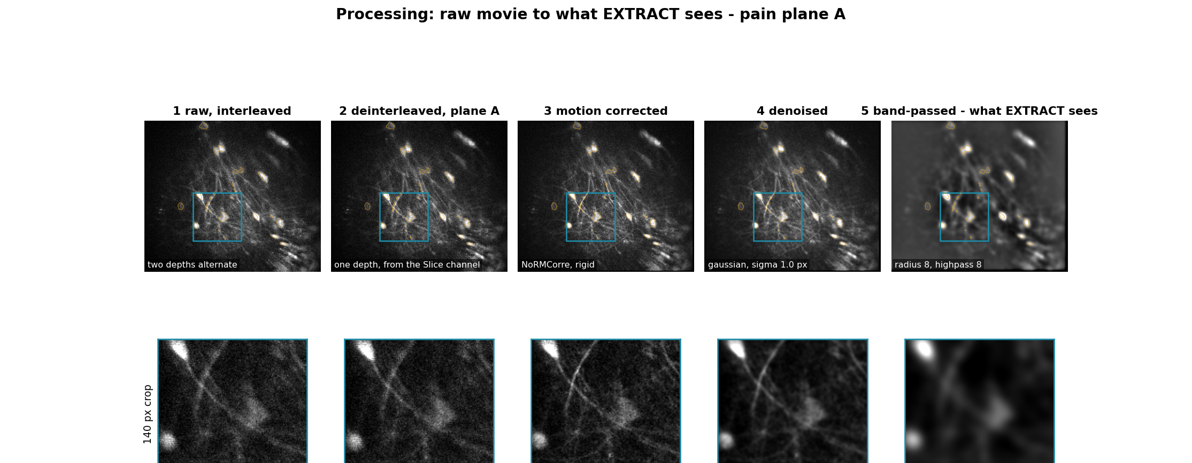
Set 1 - open field plane A (1 of 2)
Same pipeline, the cleaner recording: noise std 14.2 against 20.8 in the pain session.
<open field>\output_split\plane_A\curated\fig1_processing.png

Slide 8

Set 1 - open field plane A (2 of 2)
continued
<open field>\output_split\plane_A\curated\fig1_processing.png

Slide 9
Set 2 - cell detection
Show the comparison the statistics make, instead of asking anyone to trust a p-value.
Each cell is put next to ITS OWN control: the same footprint shape, moved to the nearest place in the
same movie with no detected cell (28-52 px away). Same tissue, same depth, same shot noise, same
extraction - only the soma is missing. If the cells look different from their controls, the detection is
doing something real and you can see it.
Nearest rather than random on purpose: a control in distant tissue has different brightness and noise,
which would make the comparison easy in the wrong way.
Result, pain plane A: lag-1 autocorrelation higher in the cell than in its own control for 11 of 11
robust SNR higher for 8 of 11
skew higher for only 6 of 11
So in this plane one of the two metrics is doing the work. That is stated rather than smoothed over - it is also why the verdict combines them against a measured null instead of relying on either alone.
fig2_detection.py -> <plane>\curated\fig2_detection.png

Slide 10
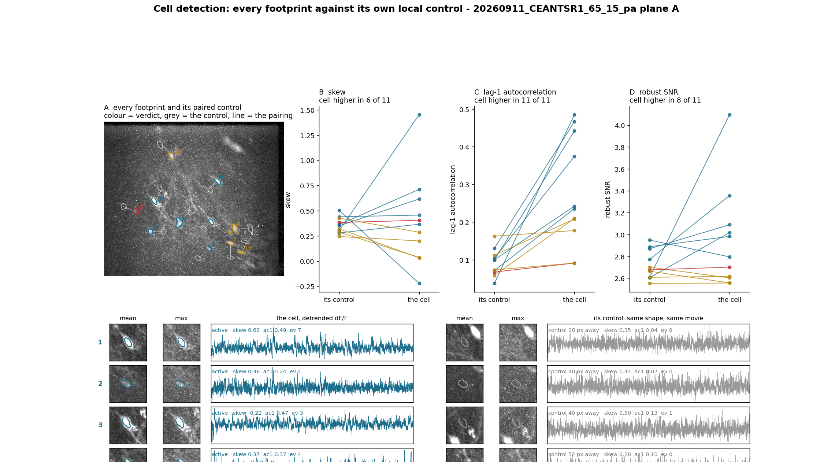
Set 2 - pain plane A (1 of 2)
Panel C is the argument: 11 of 11 blue lines rise. Amber (silent) rise a little, the red SUSPECT line barely at all.
<pain>\output_split\plane_A\curated\fig2_detection.png

Slide 11
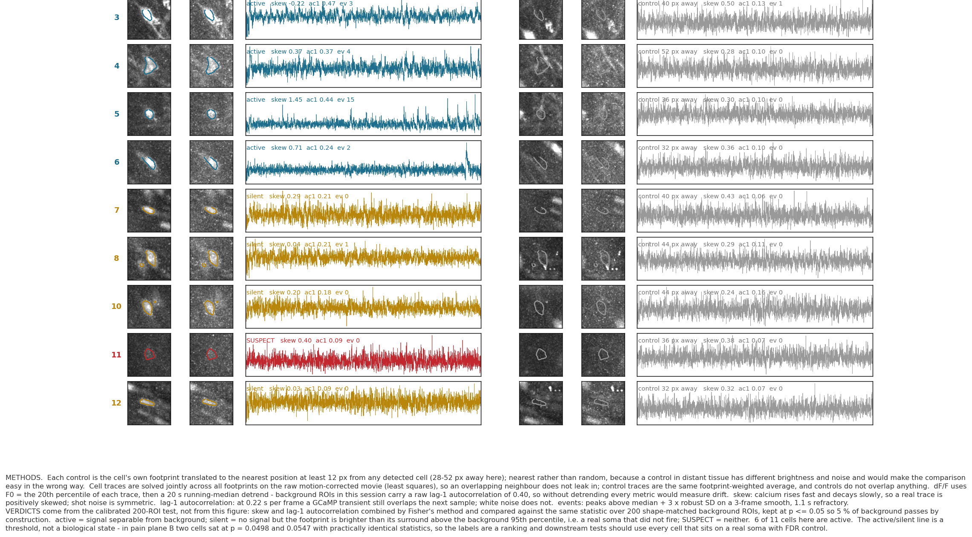
Set 2 - pain plane A (2 of 2)
continued
<pain>\output_split\plane_A\curated\fig2_detection.png

Slide 12
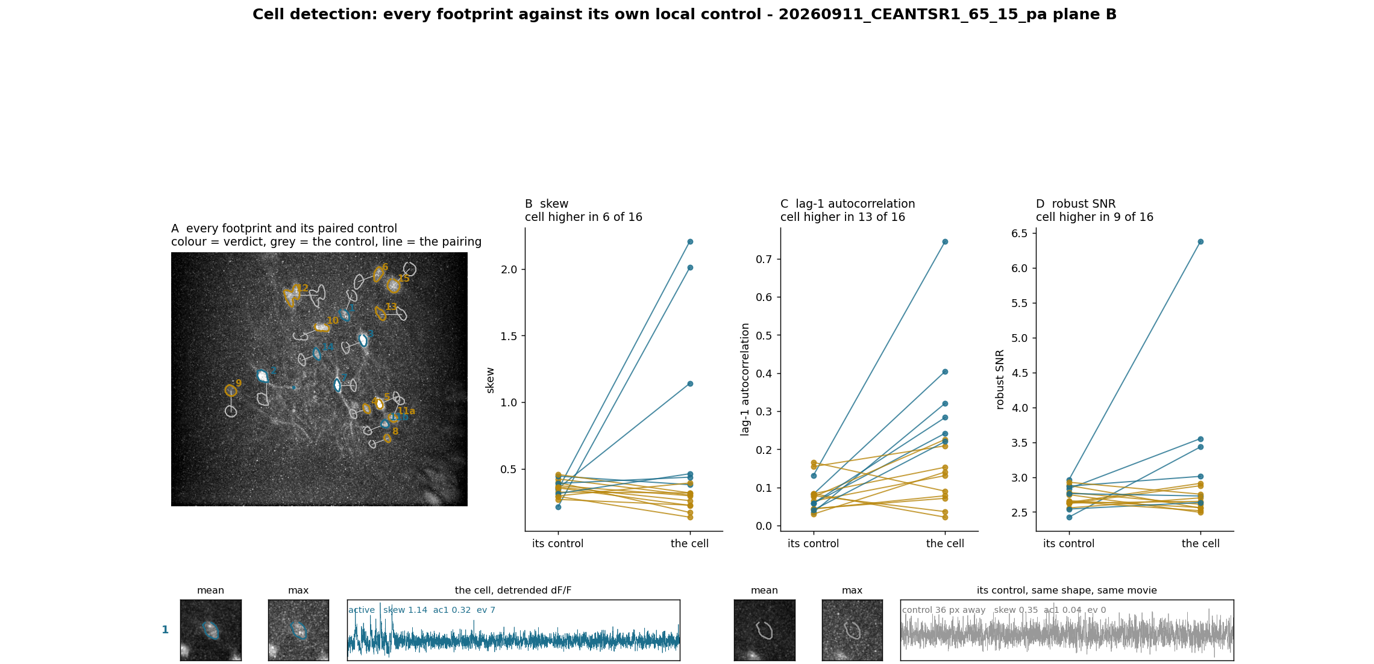
Set 2 - pain plane B (1 of 3)
Cell 11a and 11b are the split pair - both compared against their own controls.
<pain>\output_split\plane_B\curated\fig2_detection.png

Slide 13
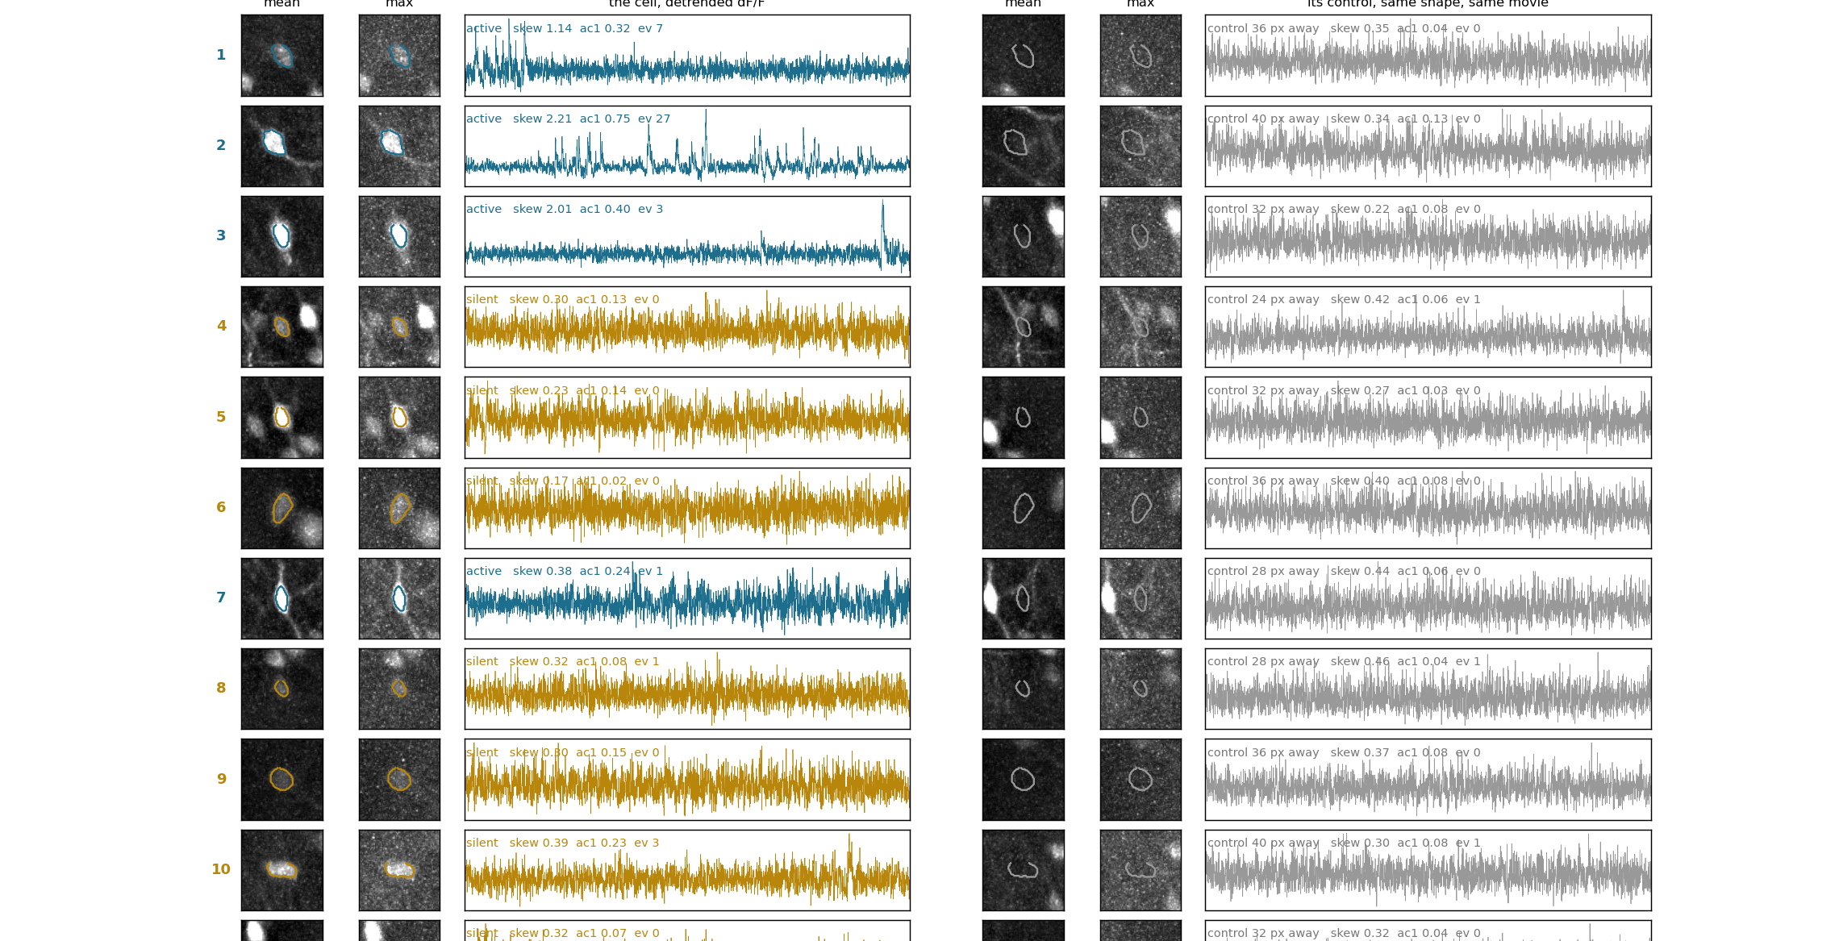
Set 2 - pain plane B (2 of 3)
continued
<pain>\output_split\plane_B\curated\fig2_detection.png

Slide 14
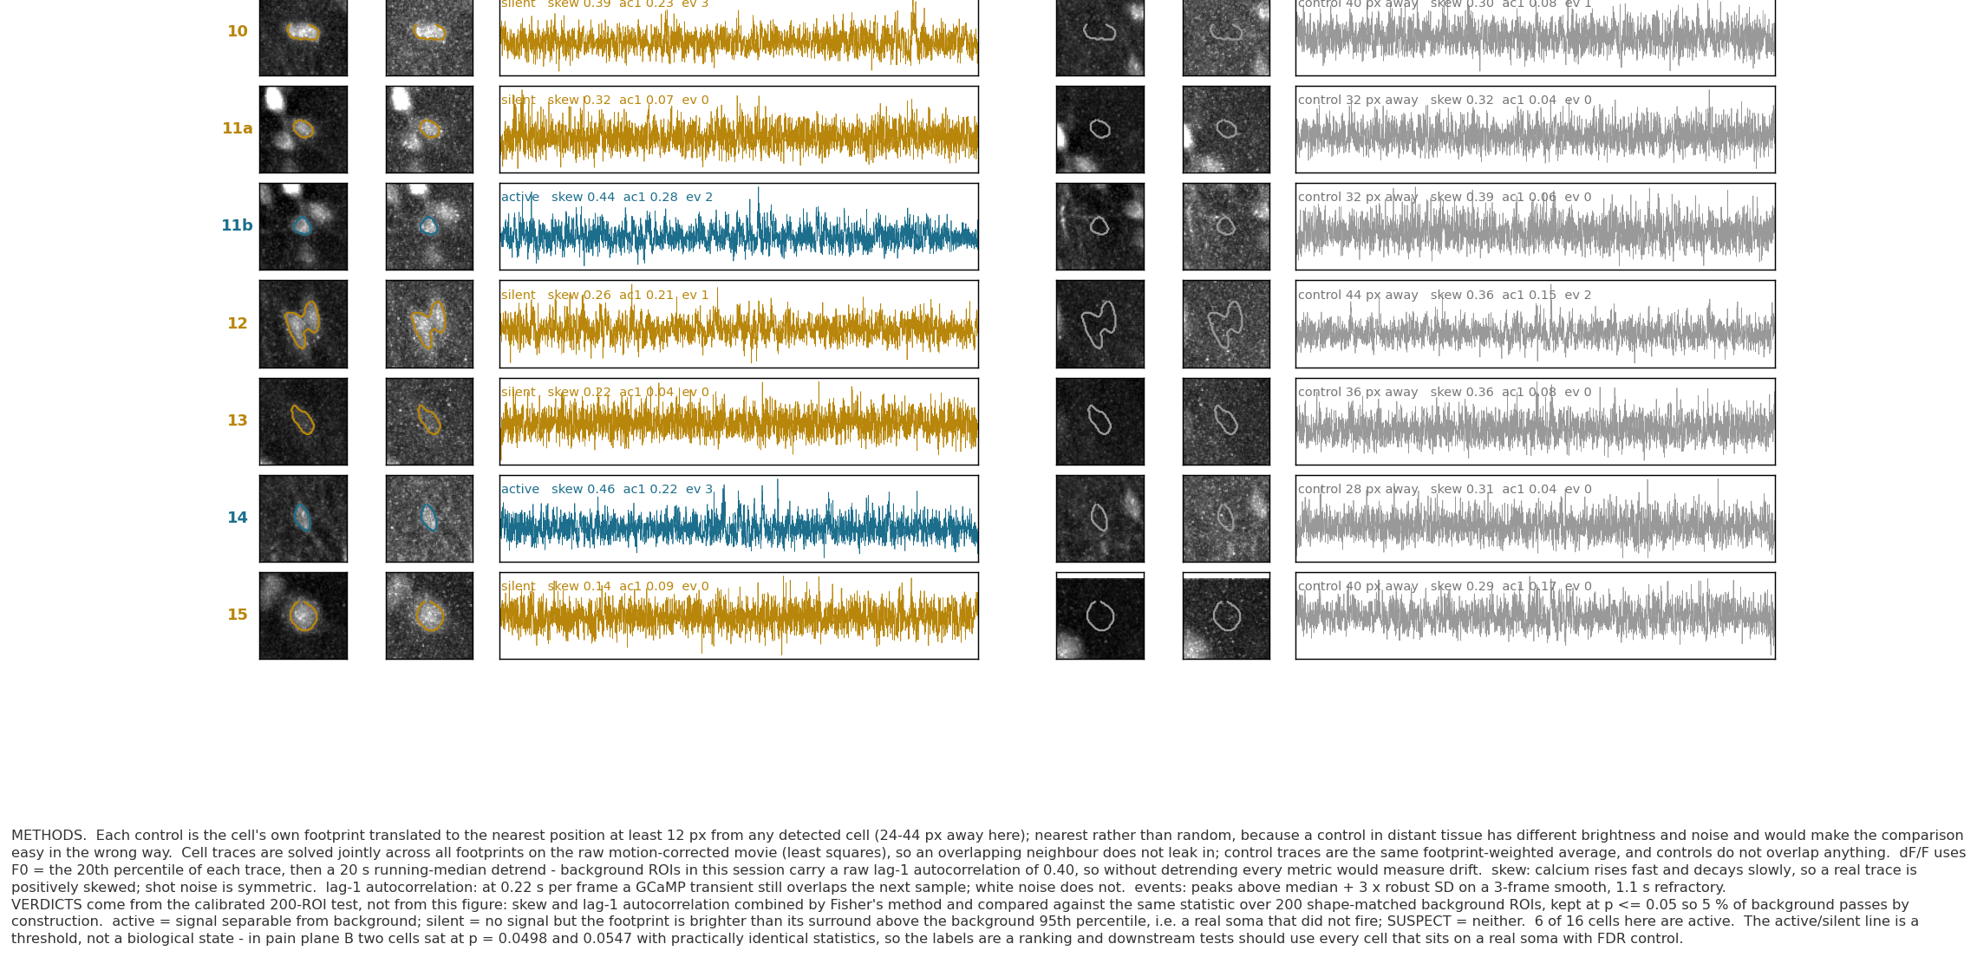
Set 2 - pain plane B (3 of 3)
continued
<pain>\output_split\plane_B\curated\fig2_detection.png

Slide 15
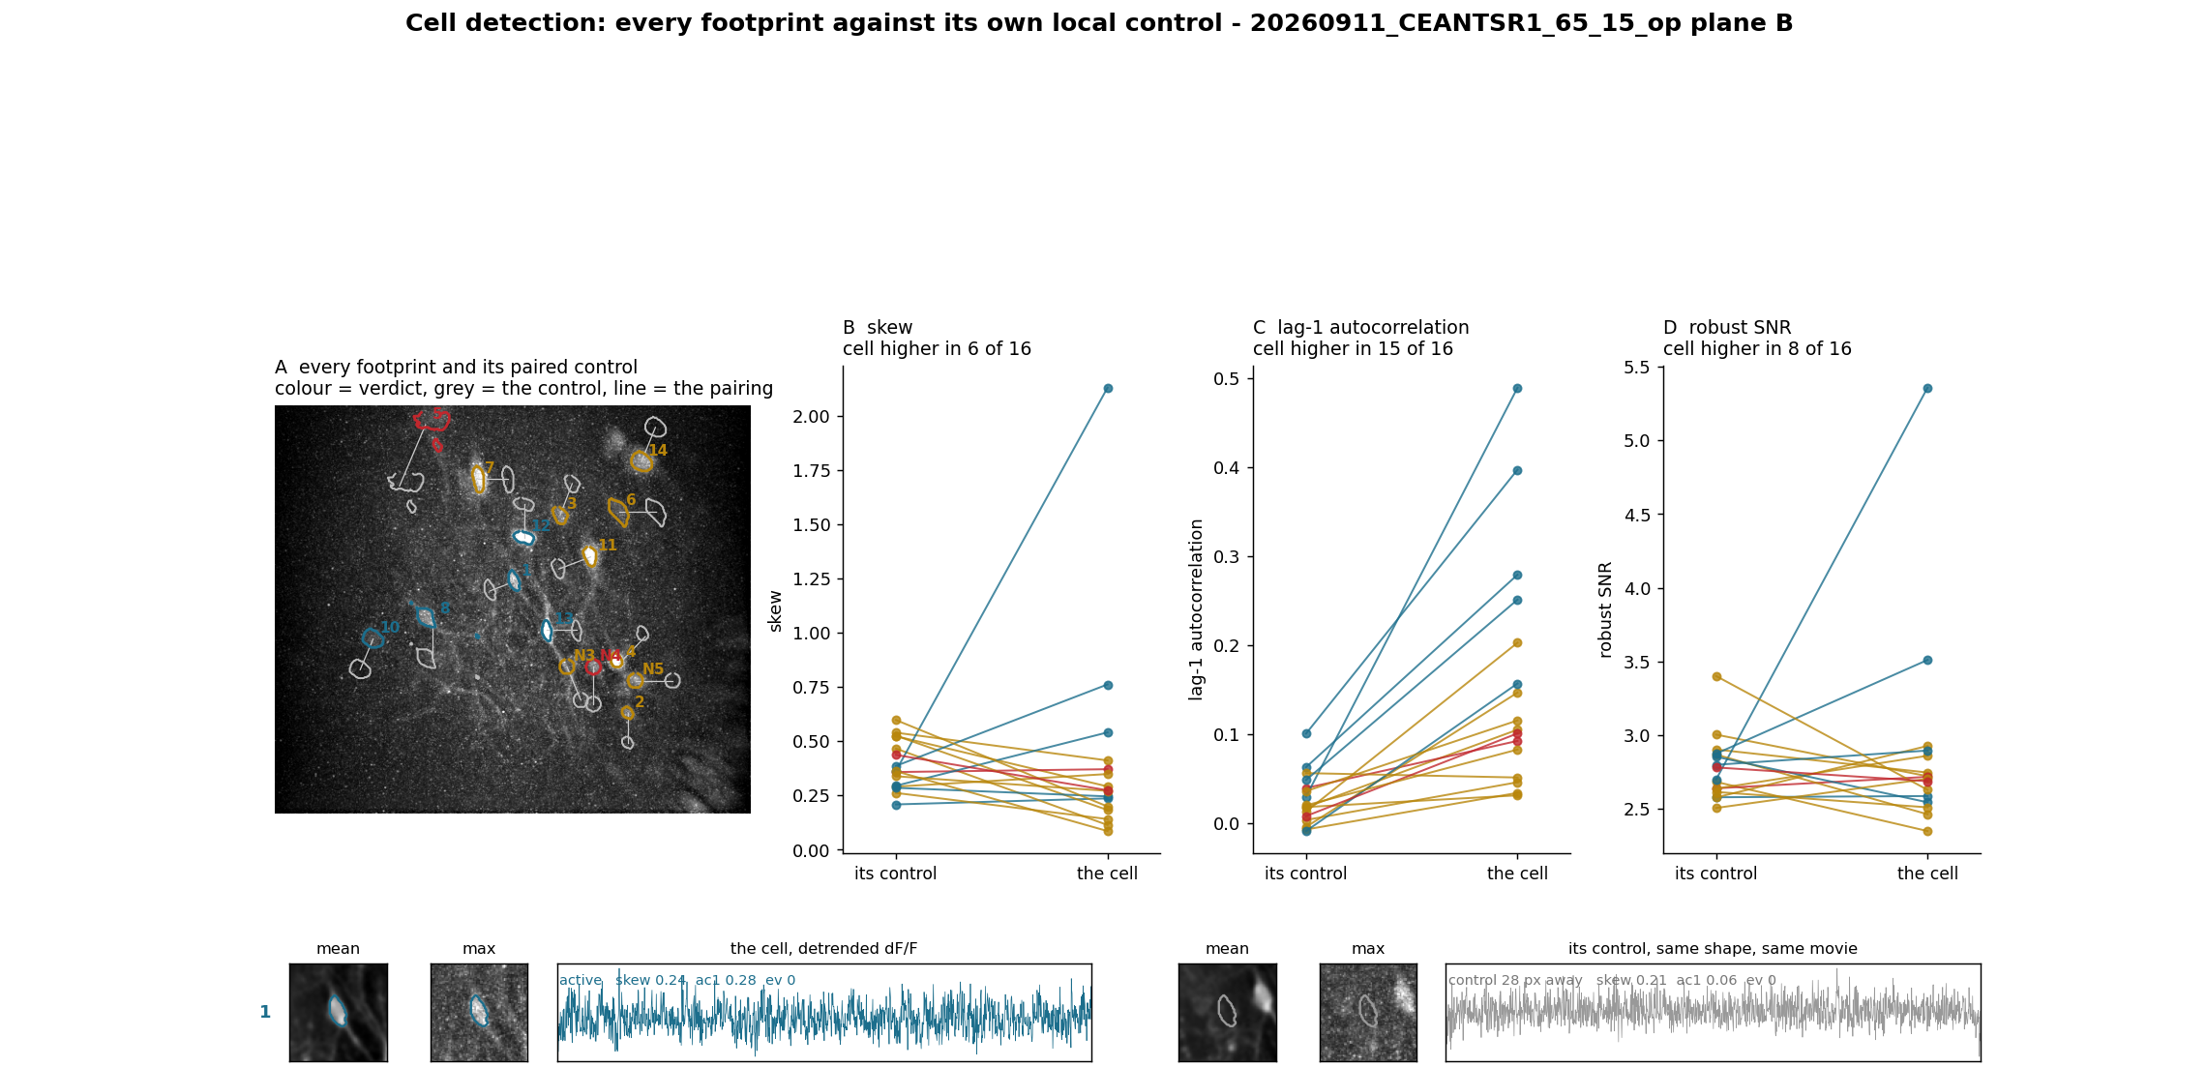
Set 2 - open field plane B (1 of 3)
N3, N4 and N5 are the somata added by hand. All three came out silent: real footprints, no signal in 326 s.
<open field>\output_split\plane_B\curated\fig2_detection.png

Slide 16
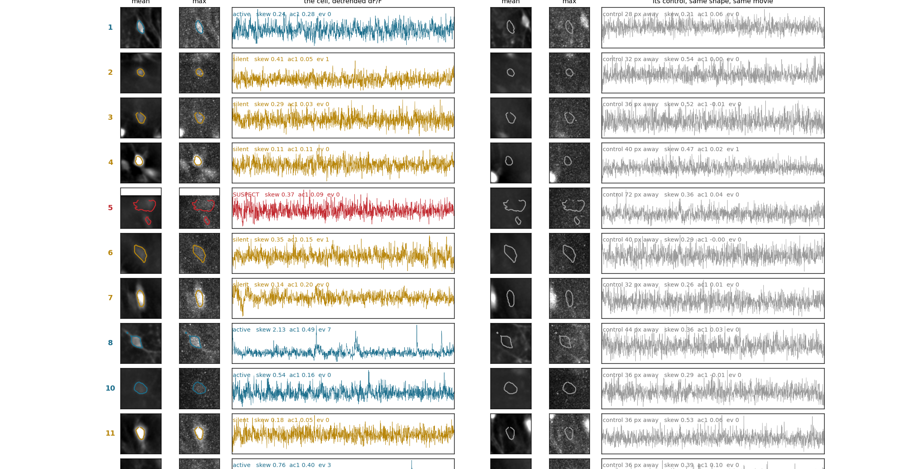
Set 2 - open field plane B (2 of 3)
continued
<open field>\output_split\plane_B\curated\fig2_detection.png

Slide 17
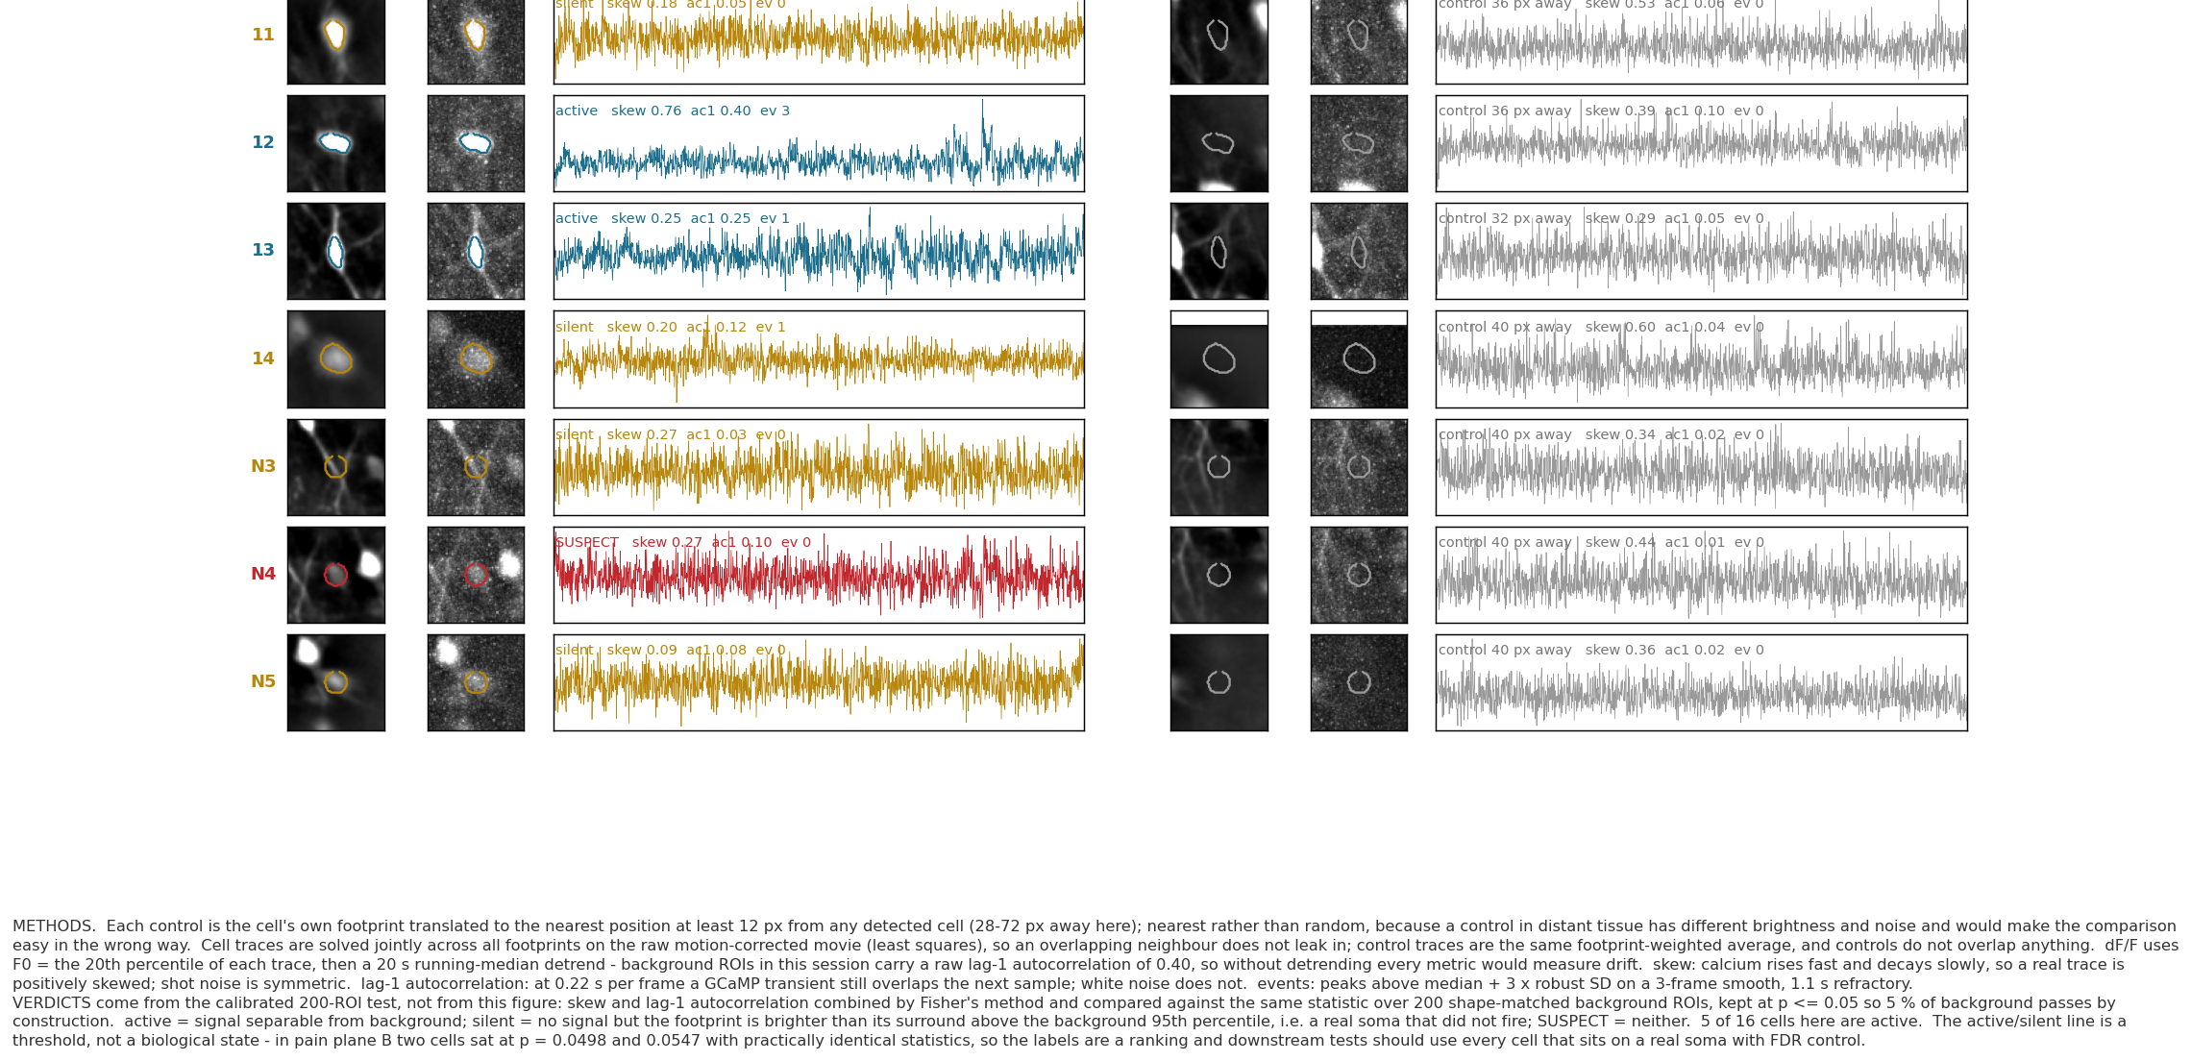
Set 2 - open field plane B (3 of 3)
continued
<open field>\output_split\plane_B\curated\fig2_detection.png

Slide 18
Set 3 - centre versus corner
The previous figure showed the answer. This one shows the evidence.
Top row, before any neuron is mentioned: where the mouse went, how long it spent there, and the
3x3 zones drawn on the real floor.
Then one row per cell. Left: that cell's activity per place, divided by how long the mouse spent in
each bin. Right: the observed centre-minus-corner contrast (red) on top of the 2000 circular shifts
it was compared against (grey). A cell is called when the red line falls outside the grey.
The null is a circular shift of the trace against the behaviour, not a t-test across frames. One calcium
transient spans several frames, so a t-test treats each frame as new information and calls noise
significant. Rolling the trace keeps its autocorrelation and the animal's occupancy exactly, and
destroys only the pairing.
Result: 2 of 28 union cells prefer the centre (A3, A7), 0 prefer the corners (none). No cell is both zone- and speed-significant, so the zone effects are not speed in disguise.
fig3_place.py -> <open field>\output_split\place\fig3_place.png

Slide 19
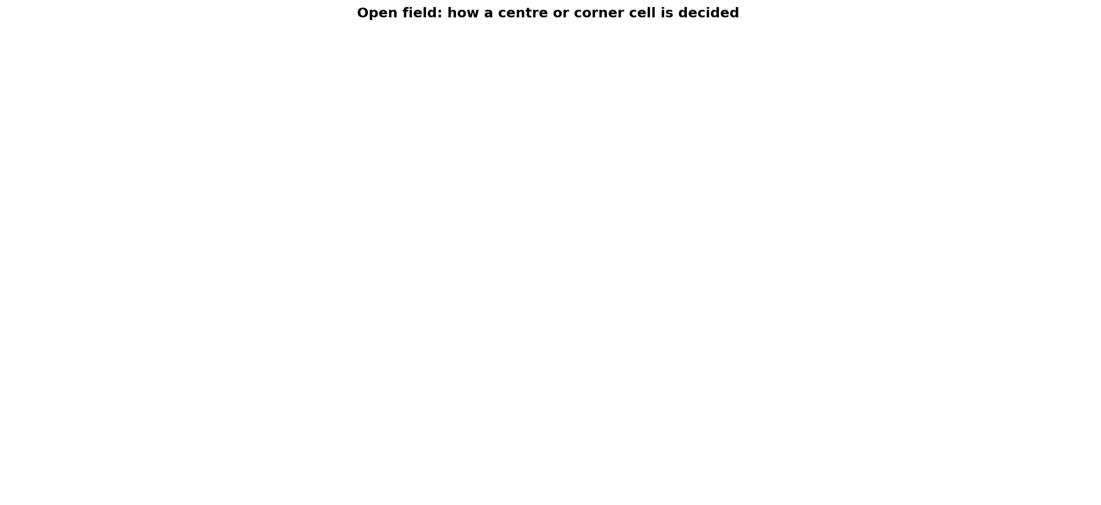
Set 3 - the decision, drawn (1 of 10)
A#3 and A#12 are the only red lines outside their grey nulls. Everyone else sits inside.
<open field>\output_split\place\fig3_place.png

Slide 20
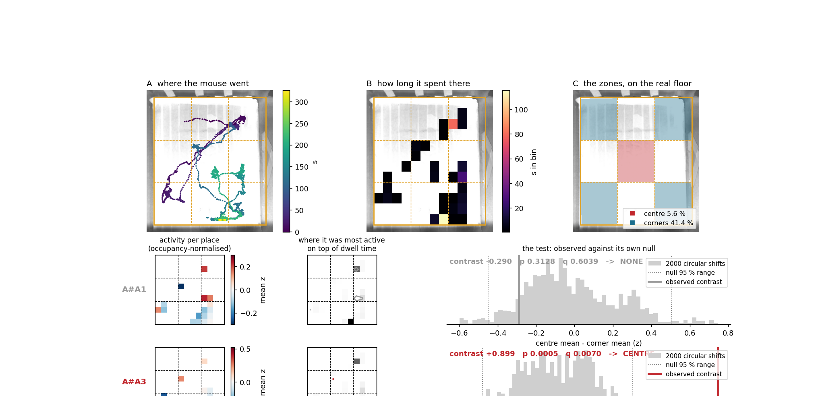
Set 3 - the decision, drawn (2 of 10)
continued
<open field>\output_split\place\fig3_place.png

Slide 21
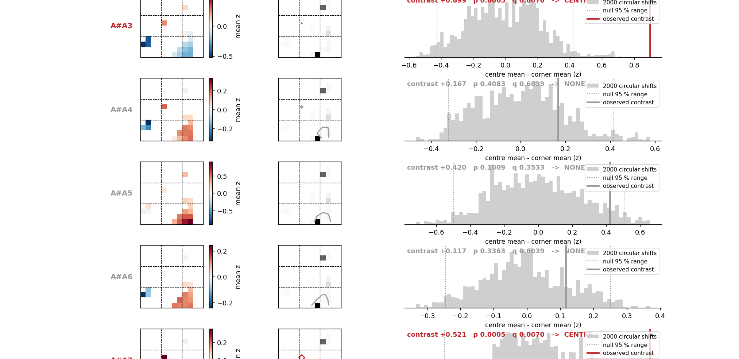
Set 3 - the decision, drawn (3 of 10)
continued
<open field>\output_split\place\fig3_place.png

Slide 22
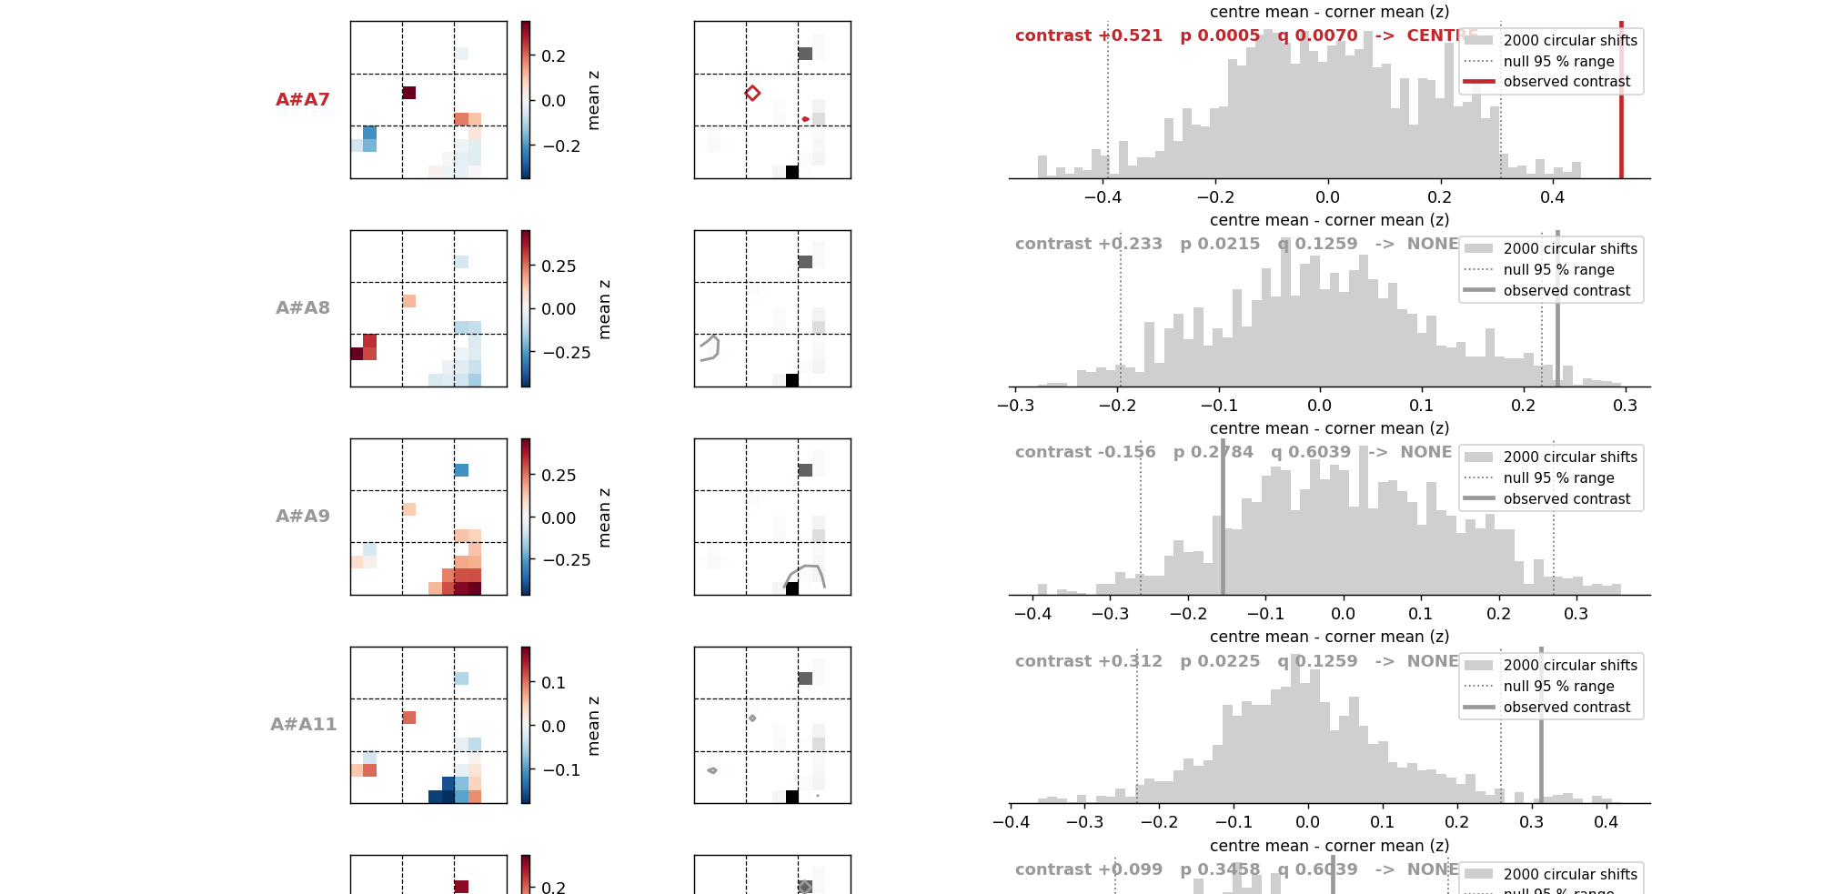
Set 3 - the decision, drawn (4 of 10)
continued
<open field>\output_split\place\fig3_place.png

Slide 23
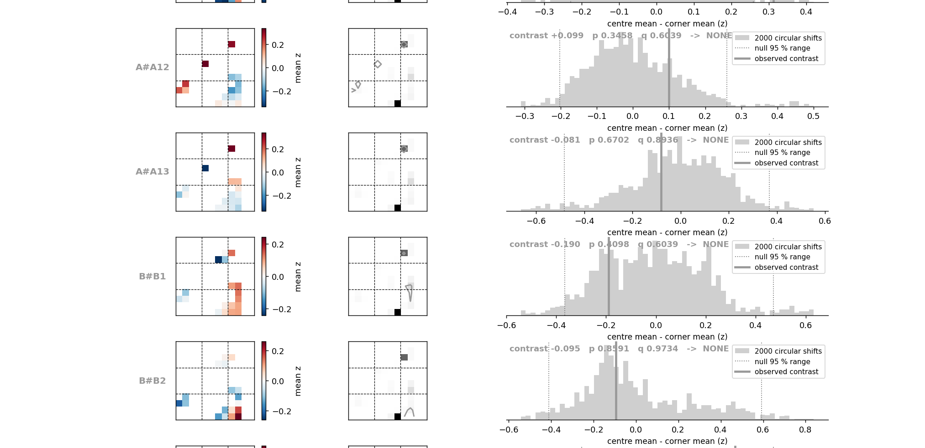
Set 3 - the decision, drawn (5 of 10)
continued
<open field>\output_split\place\fig3_place.png

Slide 24
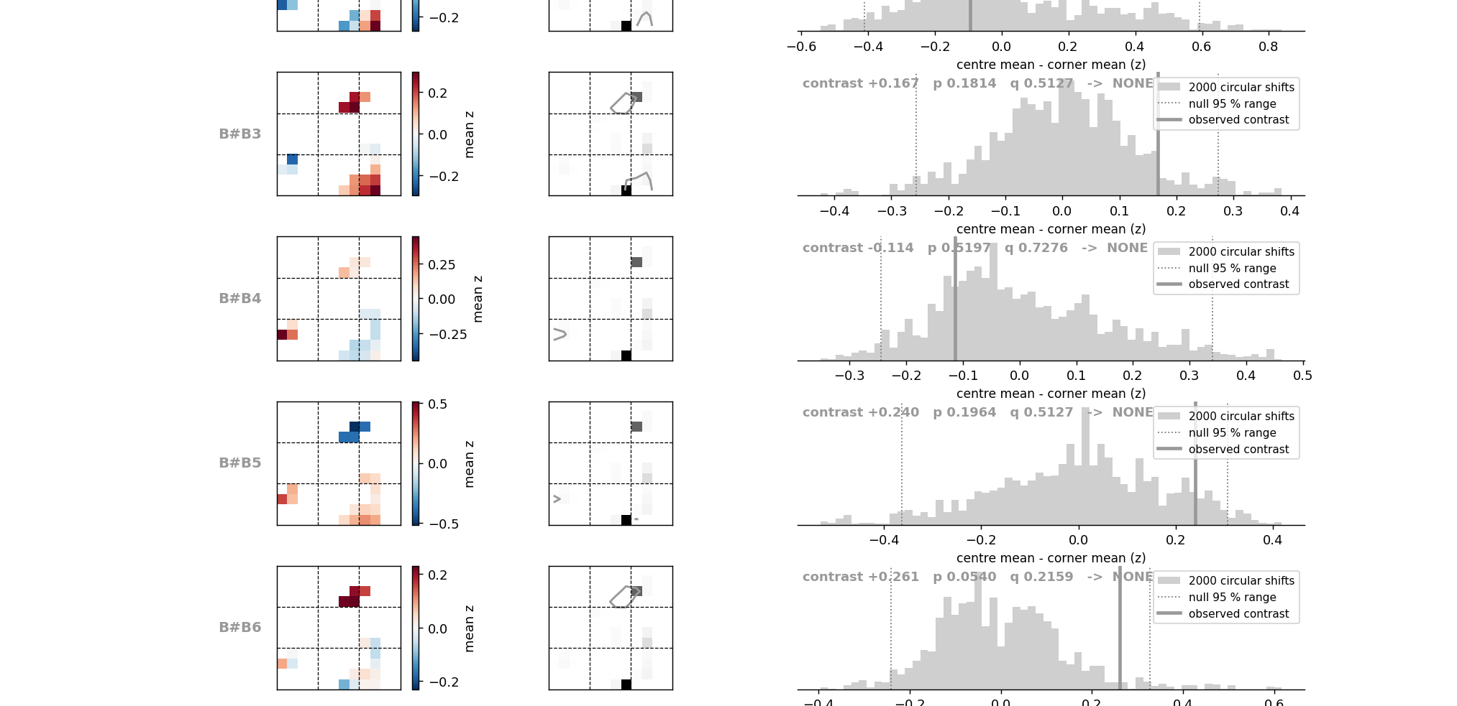
Set 3 - the decision, drawn (6 of 10)
continued
<open field>\output_split\place\fig3_place.png

Slide 25
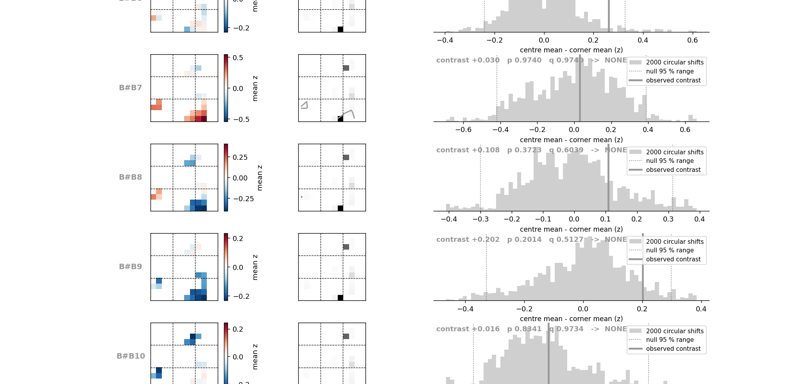
Set 3 - the decision, drawn (7 of 10)
continued
<open field>\output_split\place\fig3_place.png

Slide 26
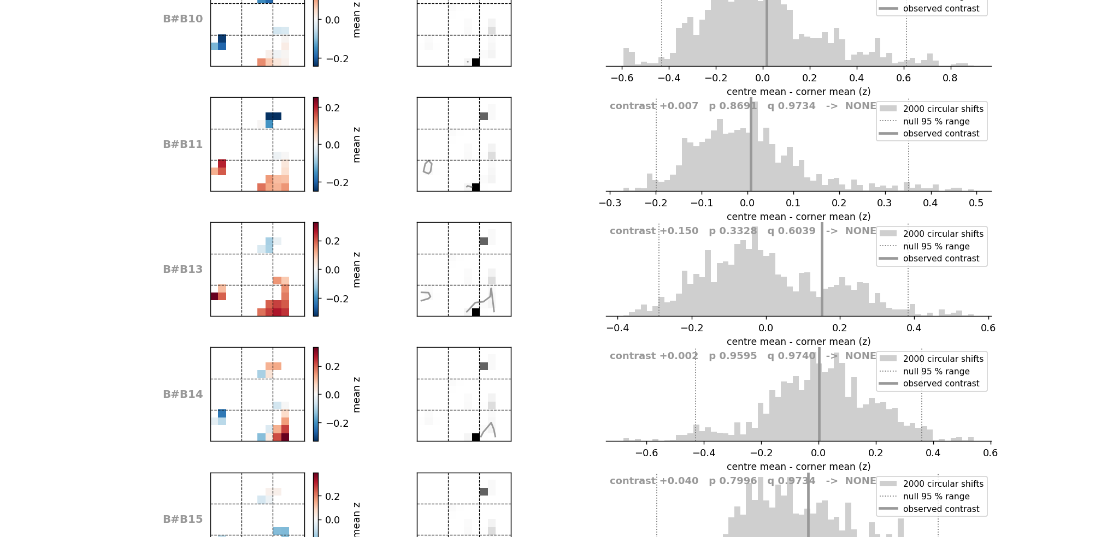
Set 3 - the decision, drawn (8 of 10)
continued
<open field>\output_split\place\fig3_place.png

Slide 27
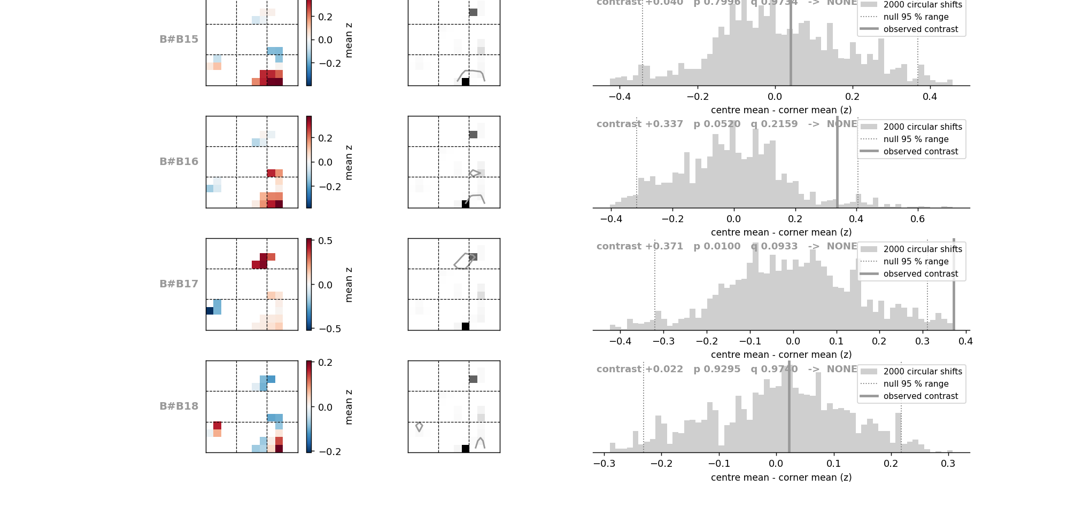
Set 3 - the decision, drawn (9 of 10)
continued
<open field>\output_split\place\fig3_place.png

Slide 28
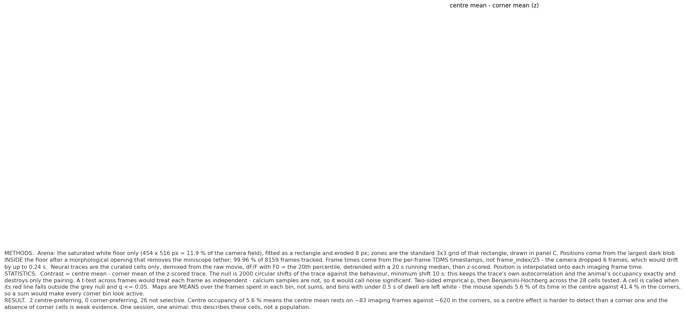
Set 3 - the decision, drawn (10 of 10)
continued
<open field>\output_split\place\fig3_place.png

Slide 29
Set 4 - the same neuron in both sessions
Row N is one neuron. EXTRACT's own numbering is not comparable across sessions.
Same-numbered cells across the two sessions sat a median of 197 px (plane A) and 145 px (plane B)
apart - 18 to 25 cell radii. So a unified id is assigned per plane: matched pairs first, best footprint
agreement first, then cells seen only in the pain session, then only in the open field. Row A1 is then
one neuron in both columns by construction.
A pair must clear two gates. Position: within one cell radius (8 px) after registering the two sessions'
mean images. Shape: footprint correlation at least 0.5 after alignment - position alone pairs
neighbours in a dense plane.
Registration is a direct correlation search over shifts. Each depth matches ITSELF across sessions at
r about 0.87, against 0.33-0.44 for the wrong depth, so the same optical planes really were imaged
29 minutes apart.
Result: 31 union neurons (plane A 13, plane B 18), each with a trace in both sessions; 17 of them detected independently twice, 26 on a soma in both. All 2 centre-preferring cells could be followed into the pain session.
fig4_matched.py -> <pain>\output_split\match\fig4_matched_*.png , fig4_unified_cells.csv

Slide 30
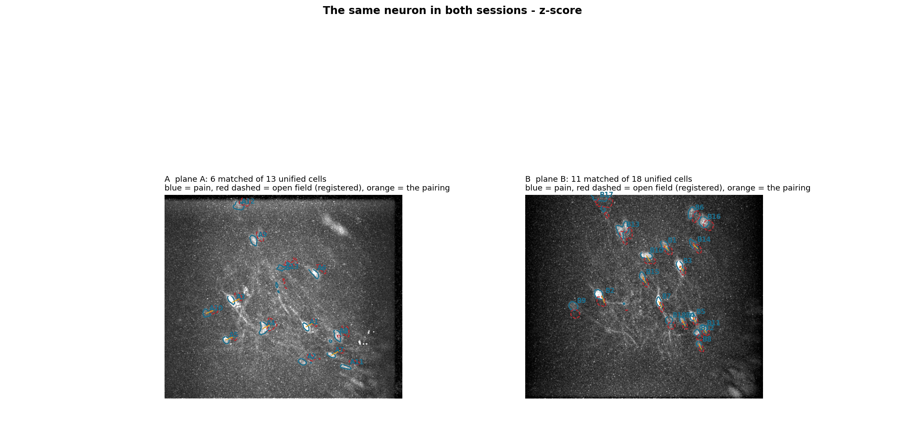
Set 4 - z-score (1 of 4)
Every row on the same scale, so trace heights mean the same thing between cells. Plane A rows first, then plane B.
<pain>\output_split\match\fig4_matched_z.png

Slide 31
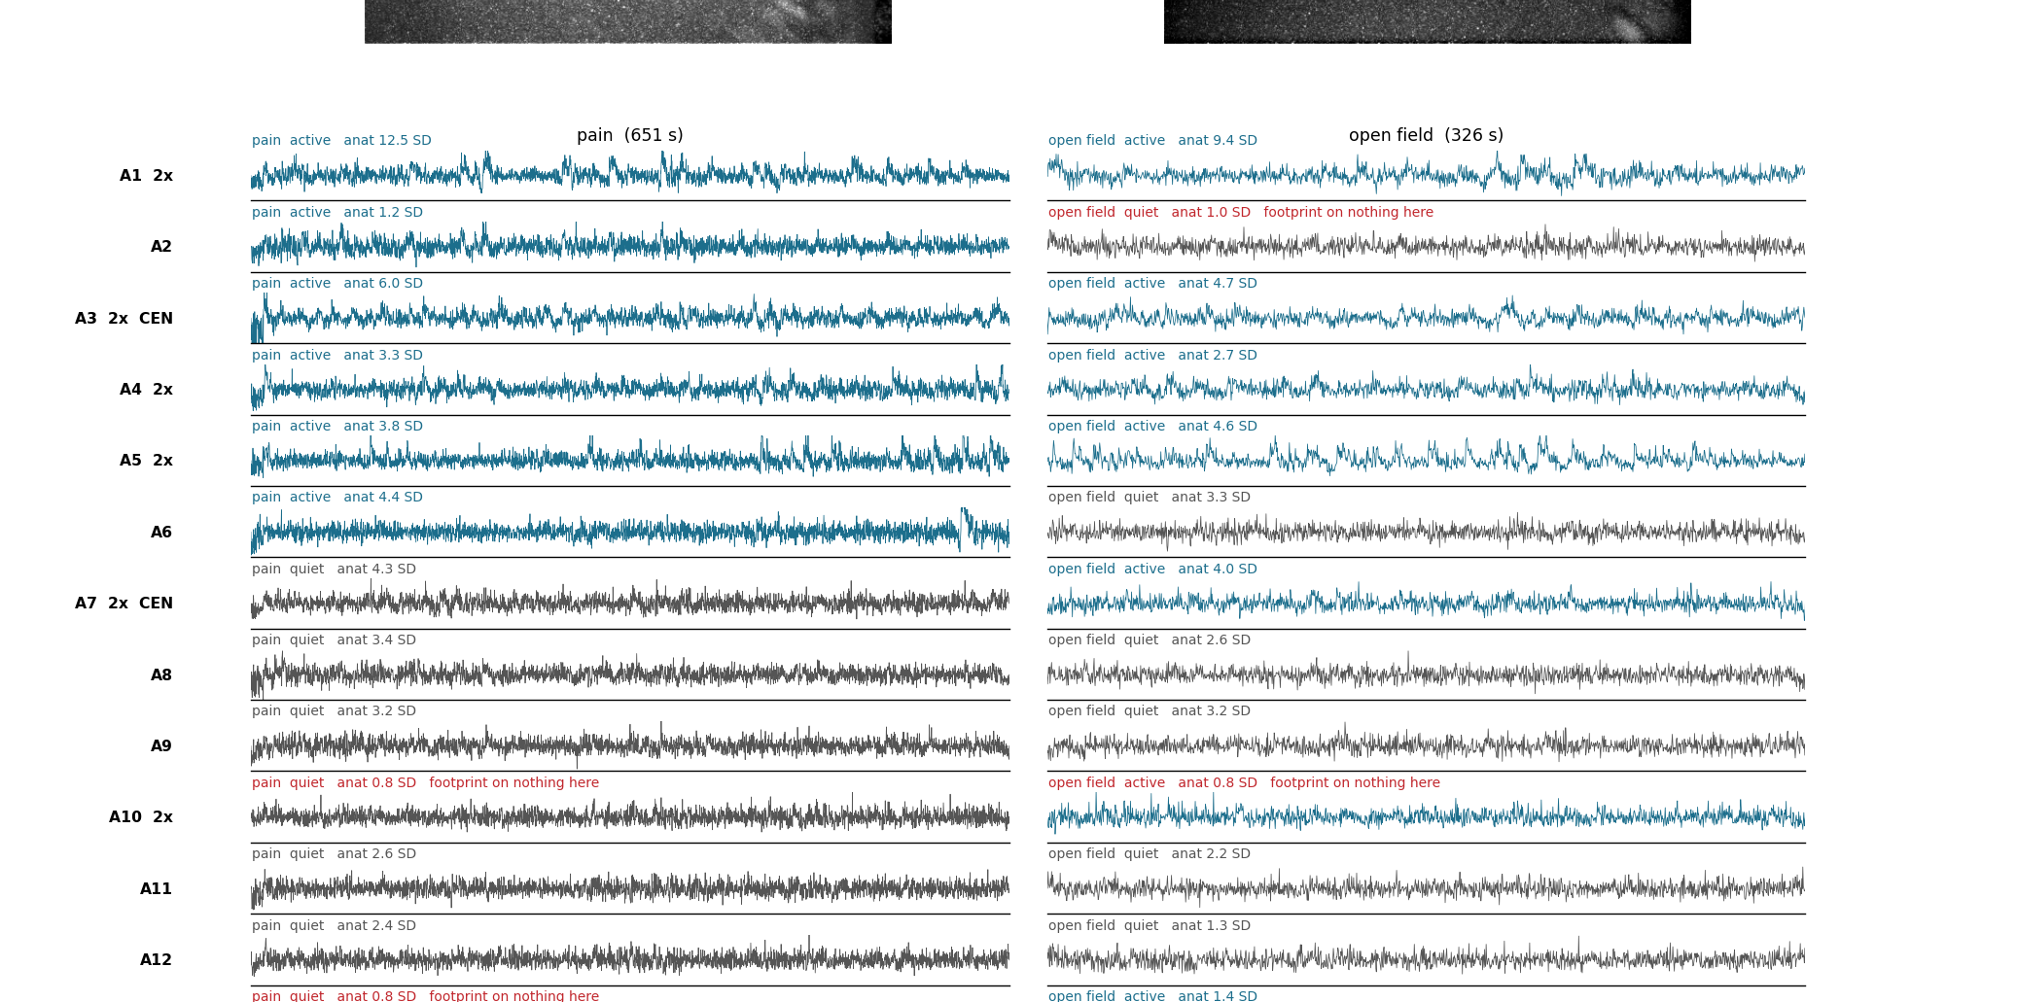
Set 4 - z-score (2 of 4)
continued
<pain>\output_split\match\fig4_matched_z.png

Slide 32
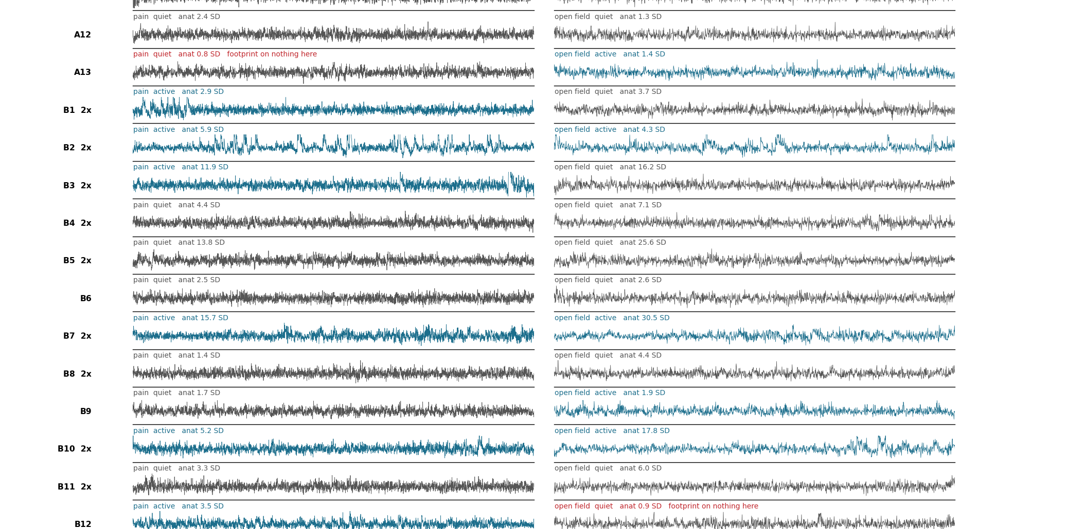
Set 4 - z-score (3 of 4)
continued
<pain>\output_split\match\fig4_matched_z.png

Slide 33
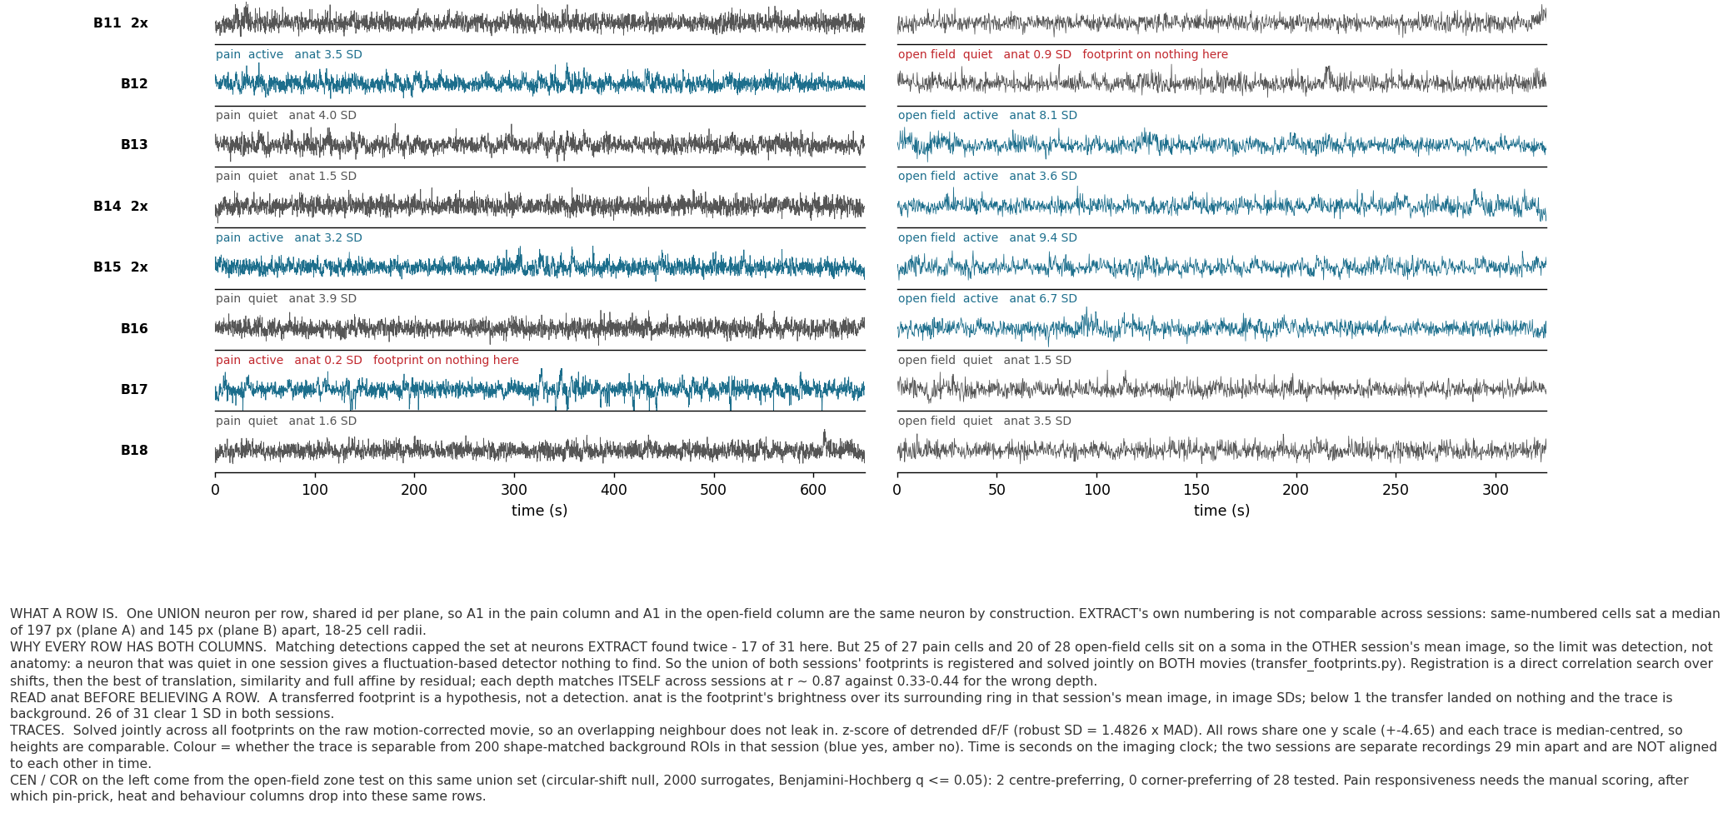
Set 4 - z-score (4 of 4)
continued
<pain>\output_split\match\fig4_matched_z.png

Slide 34
Set 4 - the same rows in dF/F and in raw fluorescence
Identical row order; only the y quantity changes. Too tall to read on a slide, so they are files.
fig4_matched_z.png the previous slides. Detrended dF/F over its robust SD, so amplitudes are
comparable BETWEEN cells. Use this to compare one cell against another.
fig4_matched_dff.png (F - F0) / F0, F0 = the 20th percentile of that cell's own raw trace.
Comparable within a cell over time, not between cells with different baselines.
fig4_matched_rawF.png raw movie units, no baseline removed. The only one that shows absolute
brightness, bleaching and slow drift - dF/F hides all three by construction.
fig4_unified_cells.csv the row table: unified id, plane, pain cell, open-field cell, footprint
agreement, both verdicts, and the open-field place preference. This is the
file the pain-responsiveness columns get added to after the scoring.
<pain>\output_split\match\

Slide 35
Set 4 QC - a mistake this deck had in it, and how it was found
The union was built wrong the first time. Reported here because it changed the results.
What was wrong
The union took every pain footprint plus every open-field footprint that was not a shape-confirmed
match. An open-field footprint can sit ON TOP of a pain footprint and still fail the shape test, so the
same soma entered the design matrix twice.
Why that is not a small problem
Traces come from one joint least-squares solve. Two near-identical footprints give it no way to choose,
so it pays for the soma's transient with a positive trace on one copy and a negative trace on the other.
Measured, by re-running the solve both ways: 7 of the 8 pairs came out anti-correlated at r = -0.25 to
-0.83, one cell's raw F was negative in every frame of both sessions, and cond(S'S) was 49 instead of 5.
What it cost
The two 'corner-preferring' cells in the earlier version of this deck were the negative halves of
centre-preferring cells (r = -0.82 and -0.84). Centre minus corner is negative for a sign-flipped centre
cell by construction - so they were an artefact of the bug, not corner cells.
How it is caught now
Overlap is measured between footprints AS REGRESSORS, which is what decides whether least squares can
separate them - not the distance between centres. Over 361 footprint pairs within a curated session
the worst pair of distinct neurons reaches 0.167, so the cut at 0.30 is calibrated rather than chosen.
8 footprints failed it and are recorded as merged_of instead of added. transfer_footprints.py now
refuses to save a union that still contains an inseparable pair.
transfer_footprints.py , fig5_separability.py

Slide 36
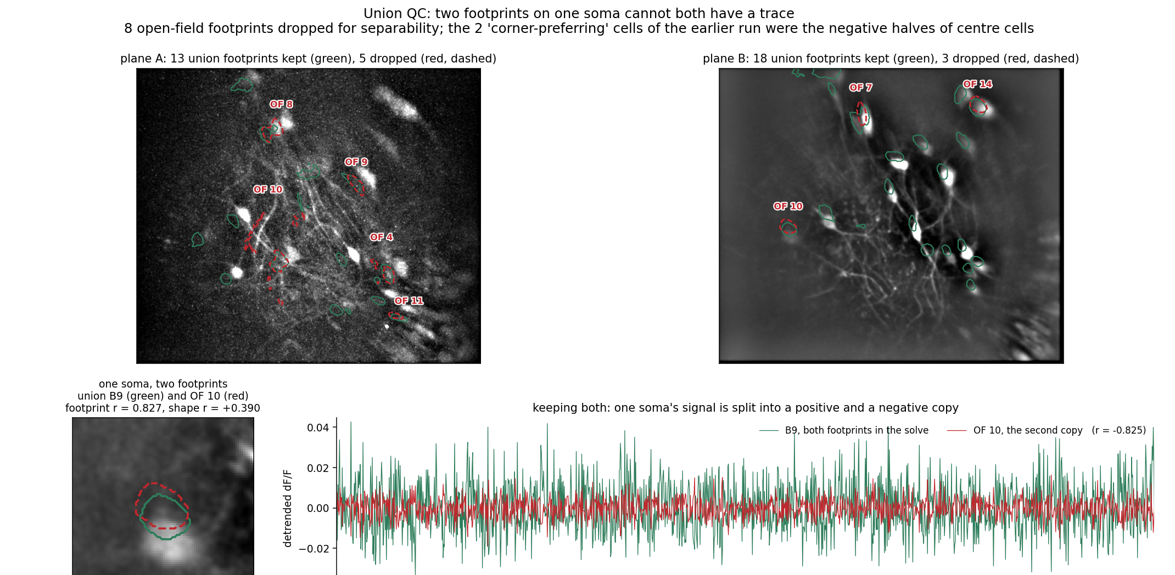
Set 4 QC - shown (1 of 2)
Top: the whole field, kept footprints green, dropped red. Then one pair close up, the two traces the bad solve produces for it, and the calibration.
<pain>\output_split\match\fig5_separability.png

Slide 37
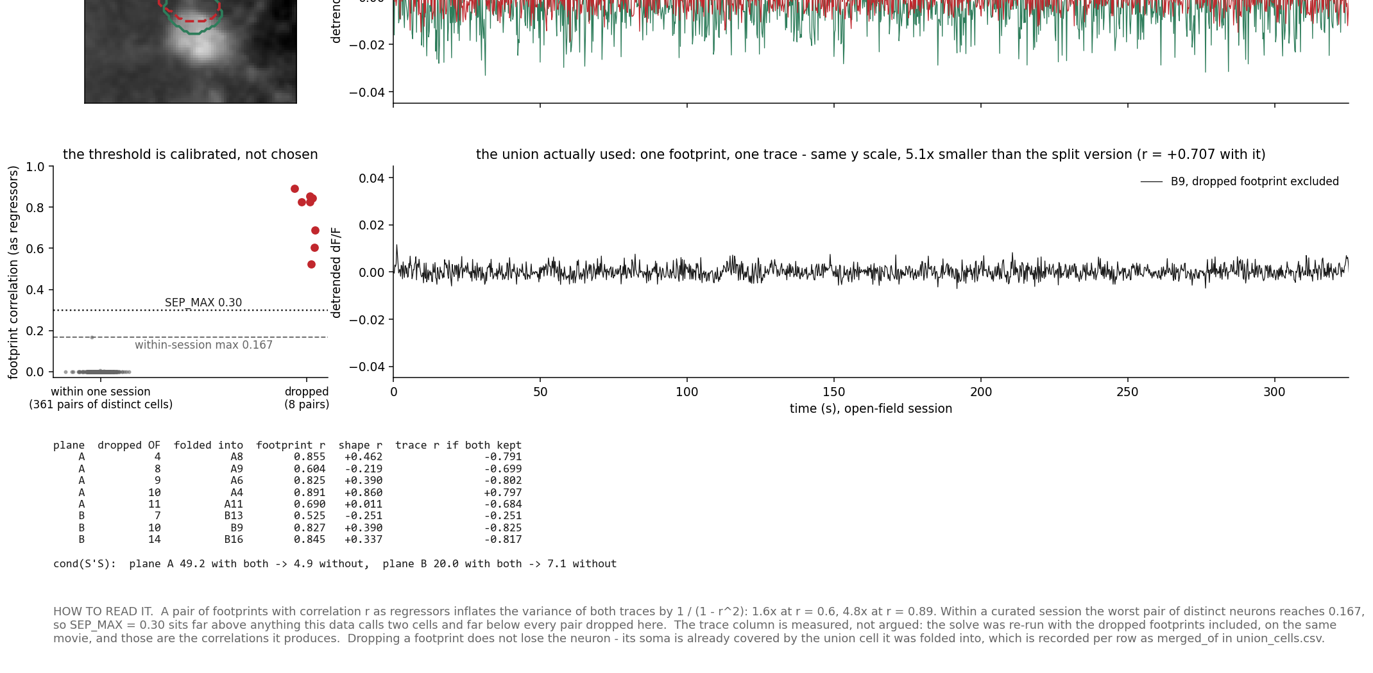
Set 4 QC - shown (2 of 2)
continued
<pain>\output_split\match\fig5_separability.png

Slide 38
What is ready, and what is waiting
Ready
55 curated cells across four planes, verified against the curation decisions by verify_curation.py
every trace in three forms - raw F, dF/F, z - on one time base shared with the behaviour cameras
31 union neurons measured in BOTH sessions (17 of them detected twice by EXTRACT)
2 centre-preferring and 0 corner-preferring cells of 28 tested, all followable into the pain session
Waiting on the manual scoring
pin-prick / heat / behaviour-responsive classification, event-locked to the scored times
lock_events(t_s, z, stimulus_times) in pain_cell_traces.py takes the times and returns
(cells x events x lag) windows; stimulus times must be on the same imaging clock as t_s
Then the question becomes one row of set 4: was the neuron that preferred the exposed centre
also pin-prick responsive? For plane A that row is A1 - open field #12, pain #3, footprint
agreement 0.95, and active in both sessions.
nothing in <session>\output\ is touched - that is the other agent's max-projection pipeline

