Slide 1
Acute pain assay under mini1p imaging
Day 1 baseline, six mice — what the behaviour looks like
before we add SBI-553
Hansol Lim · 2026-09-03

Slide 2
What this deck covers
four things to take away
Day 1 is real data, six mice, fully scored and QC'd
all four stimulus blocks clean in all six sessions
Day 2 is a planned comparison, shown with synthetic numbers
so the figures and the statistics are agreed before the experiment, not after
Every measure is total event number / total stimulus delivery
never a raw count - the number of taps is not fixed, 16 to 31 for pin prick on Day 1 alone
Statistics at two levels
population: six mice, paired. individual: each mouse's own ~90 deliveries

Slide 3
Method
design, behaviours, and what the scoring actually captures

Slide 4
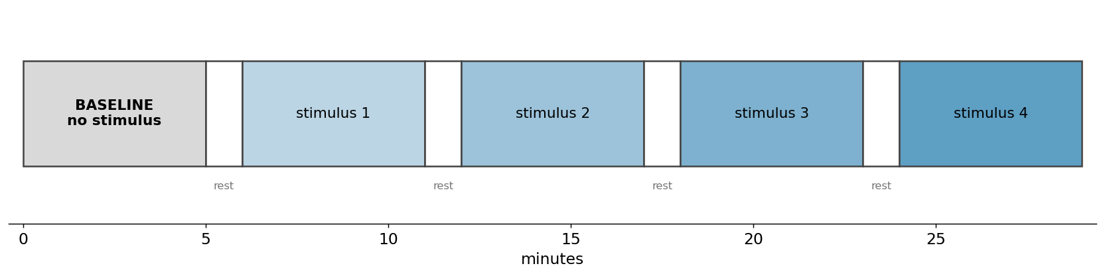
Session design
5 min baseline, then four 5 min stimulus blocks on a fixed clock, 1 min rest between
Block order is randomised per mouse, so stimulus identity is not confounded with time in the session.

Slide 5
Six behaviours, two classes - kept separate on purpose
Corder / Scherrer framework
REFLEXIVE paw withdrawal, flinch
spinally mediated, locked to contact. Scored as taps, 3 s response window.
AFFECTIVE-MOTIVATIONAL paw attending, licking / biting, guarding
supraspinal, builds over 1-8 s after contact. 10 s window.
ESCAPE / REARING scored, but read as exploration
baseline rate is 3.8 per min and it DECREASES under stimulation. Not a pain measure.
Never summed into one pain score
a biased agonist is expected to move the affective class without matching the reflexive one - summing would hide exactly that.

Slide 6
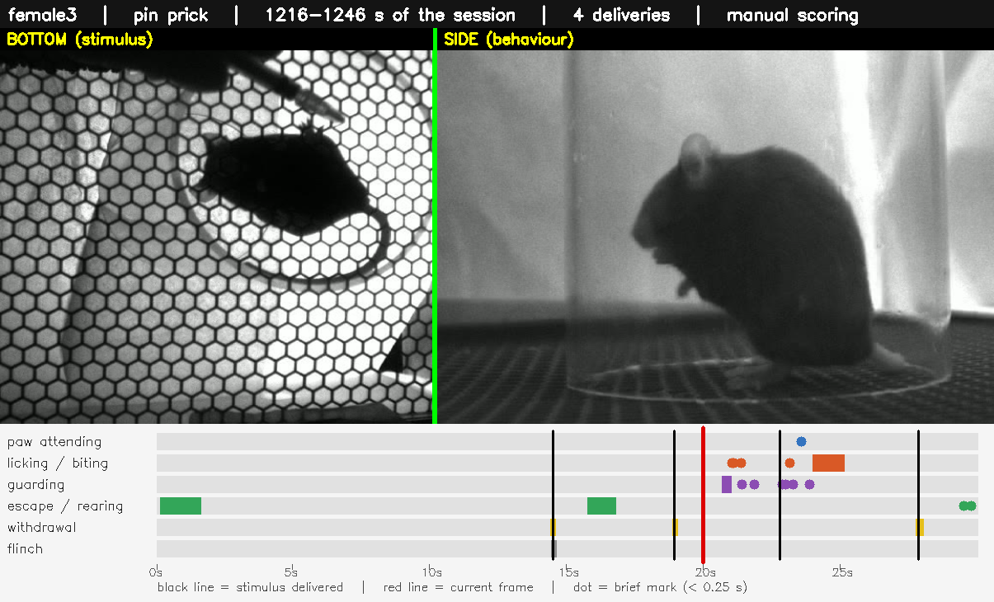
What the scoring looks like
30 s, both cameras, labels burned in
click to play · side view is the analysis view; the bottom view cannot resolve individual paws

Slide 7
Day 1 QC outcome
nothing was inferred or filled in; every correction is traceable to the block clock
 | result
Sessions scored | 6 of 6, all four stimulus blocks clean
Stimulus mis-keys resolved | 18 of 18, using the fixed block clock
Fast repeated taps merged | corrected copy only, counts unchanged
Original scoring | never modified - corrections go to a separate folder
Deliveries per mouse | 83 to 100 across the session
Remaining flags | 2, informational only (typed vs sheet stimulus names)

Slide 8
Why total event number / total stimulus delivery
the one methodological point that everything else rests on

Slide 9
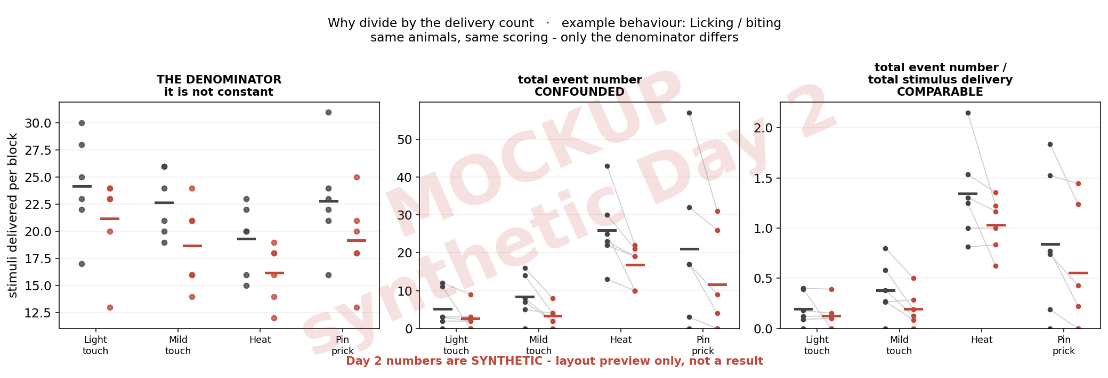
The denominator is not constant
Ten flinches from ten taps and ten flinches from twenty taps are the same raw count and a different animal - 10/10 = 1.00 vs 10/20 = 0.50. Every figure from here on divides by the delivery count.

Slide 10
How long is a stimulus block?
behaviour does not stop when the stimulus does, so the 1 min rest was tested both ways

Slide 11
Two block definitions, both computed
both versions are in the repository; the figures below use the 5 min version unless stated
5 min - the stimulus period only
the block's first delivery plus 300 s
6 min - the stimulus period plus the 1 min rest that follows it
the rest is attributed to the block before it, because nothing else caused it and the next block has not started
The denominator is identical in both
the rest minute contains no deliveries, so total events / total stimulus delivery is directly comparable between the two
events per MINUTE is not comparable between them
the divisor changes 5 to 6, so that rate drops about 17 % mechanically even if nothing changed

Slide 12
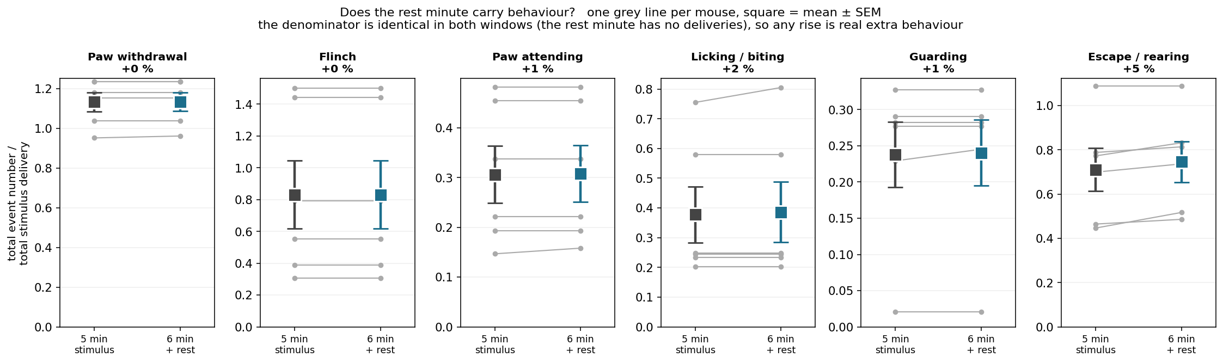
The rest minute adds almost nothing - except rearing
Pain behaviours are flat (+0 to +2 %). Escape / rearing rises +5 % in every mouse - consistent with it being exploration that resumes once the stimulus stops, not pain.

Slide 13
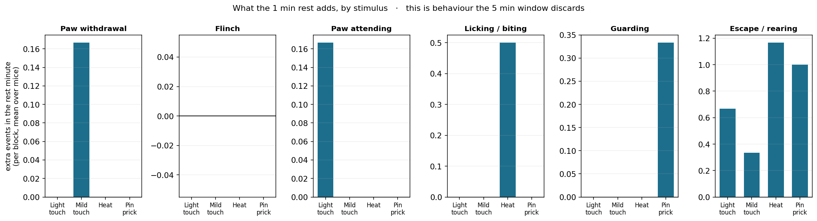
Why the rest minute contributes so little
Because the 5 min window ALREADY contains a mean of 45 s of quiet time: deliveries finish before the 300 s mark (first-to-last span, median 256 s). The extra minute lands further out, where behaviour has already subsided.

Slide 14
Day 1
six mice, no drug - what the assay measures

Slide 15
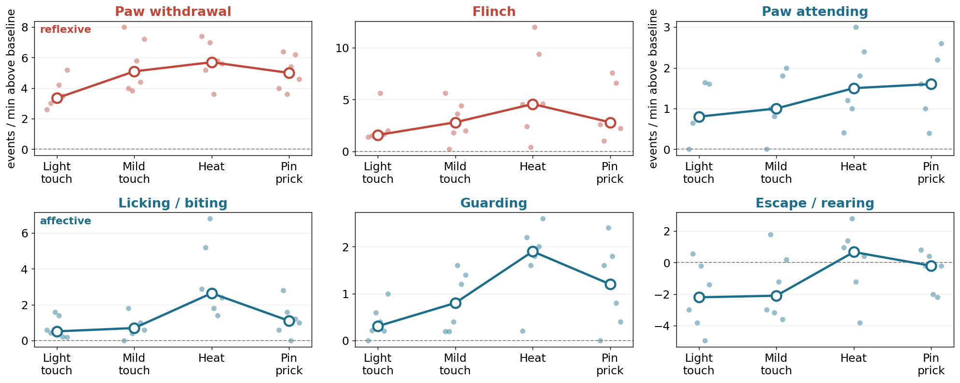
Response by stimulus
rate per minute within each 5 min block
Light touch smallest and Heat largest for every behaviour; pin prick sits between them. Not monotonic with nominal intensity.

Slide 16
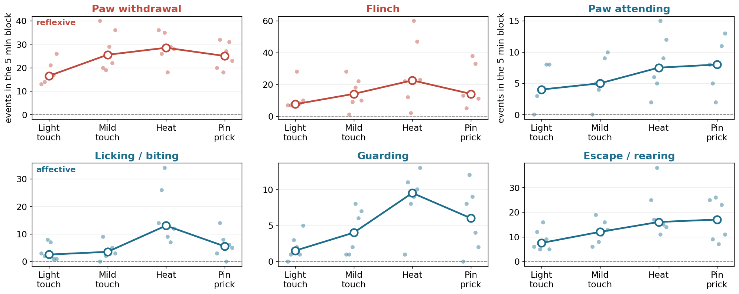
Raw event counts per block
the unnormalised view, shown for completeness
Read with the previous slide in mind: the block is a fixed 300 s but the number of taps inside it is not.

Slide 17
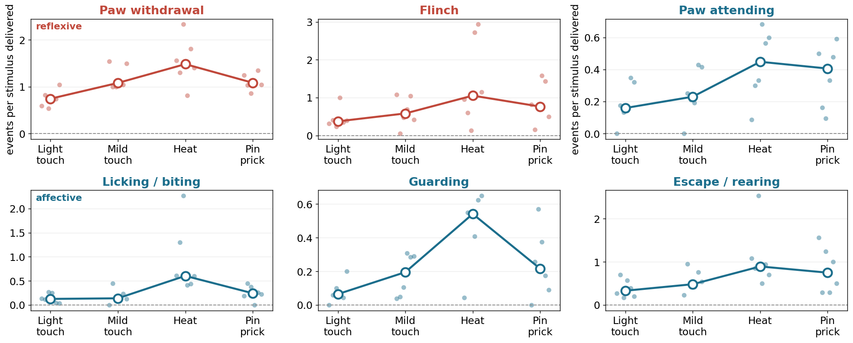
Total event number / total stimulus delivery
each mouse divided by its own delivery count
This is the comparable version of the previous slide.

Slide 18
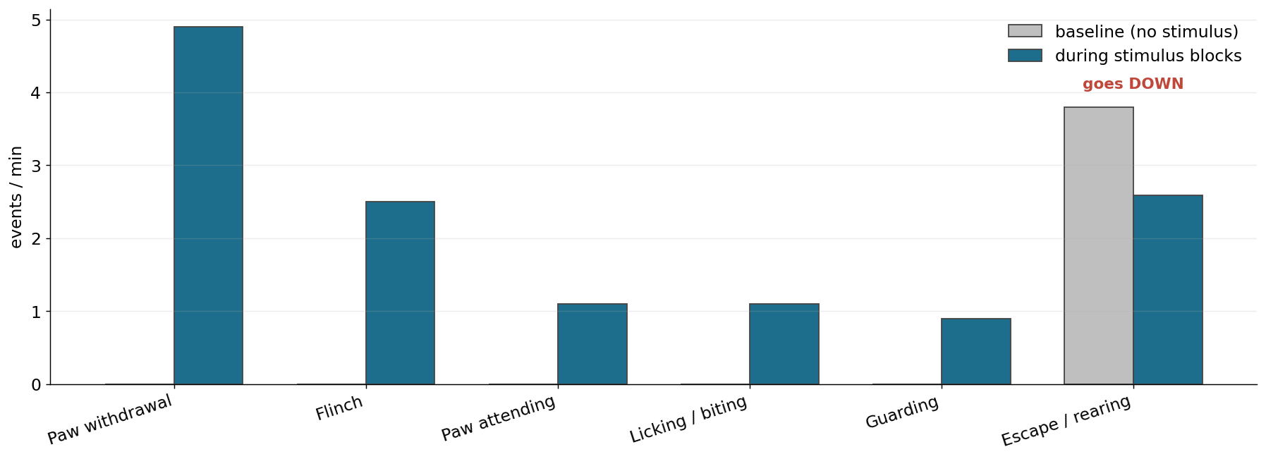
Stimulus blocks against each animal's own baseline
5 min baseline vs the four stimulus blocks
Escape / rearing goes DOWN under stimulation - the clearest evidence it is exploration rather than pain.

Slide 19
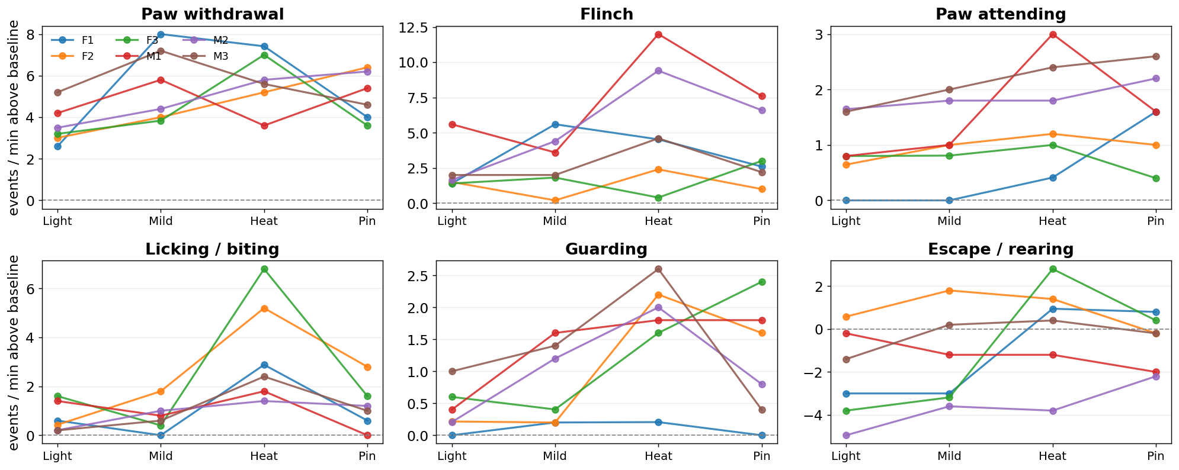
Every mouse individually
no averaging - one panel per animal
Between-animal spread is large. It is the reason the paired design matters more than the group size.

Slide 20
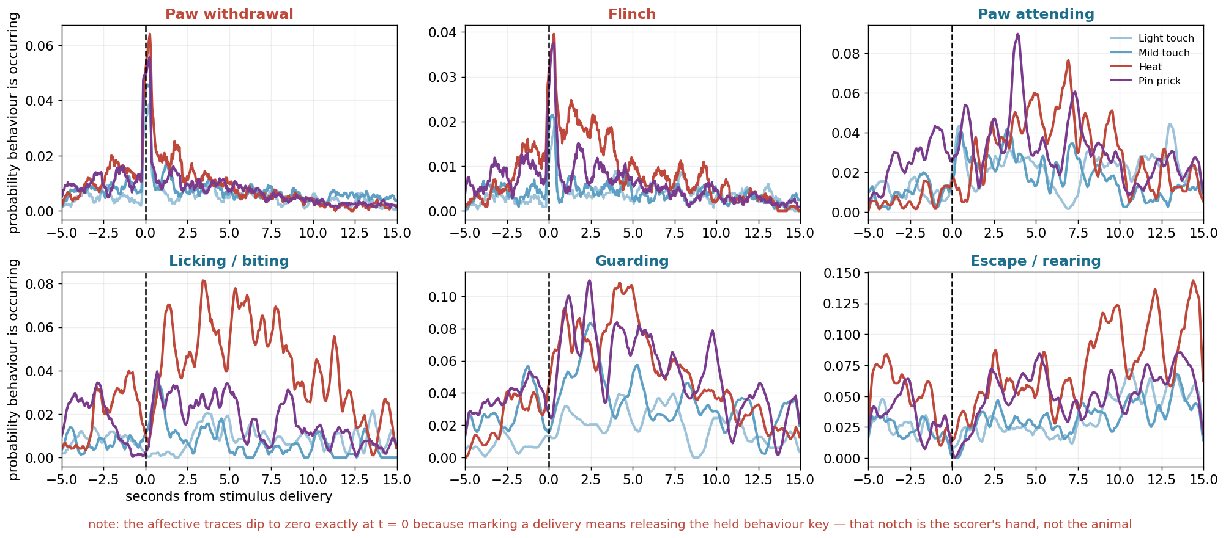
Response time course around each delivery
peri-stimulus histogram, aligned to stimulus contact
Reflexes are locked to contact; affective behaviour builds over several seconds. This is what sets the two response windows.

Slide 21
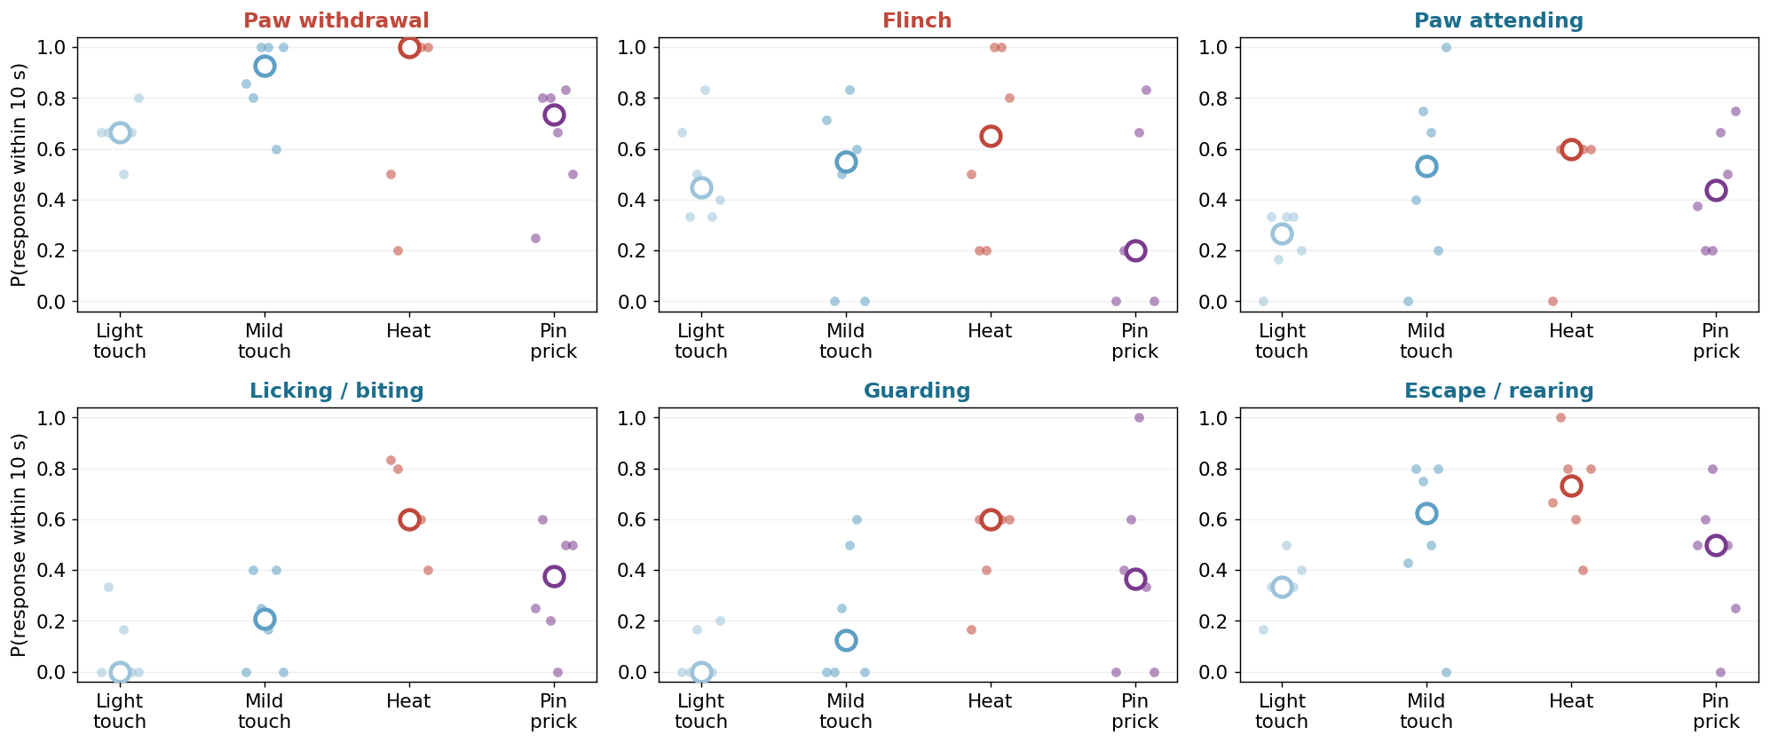
Probability of responding to a single delivery
10 s window, restricted to deliveries with 10 s of clearance
A 3 s window put Heat BELOW light touch for attending - it cut the affective response off before it started. 10 s reverses that (0.600 vs 0.267).

Slide 22
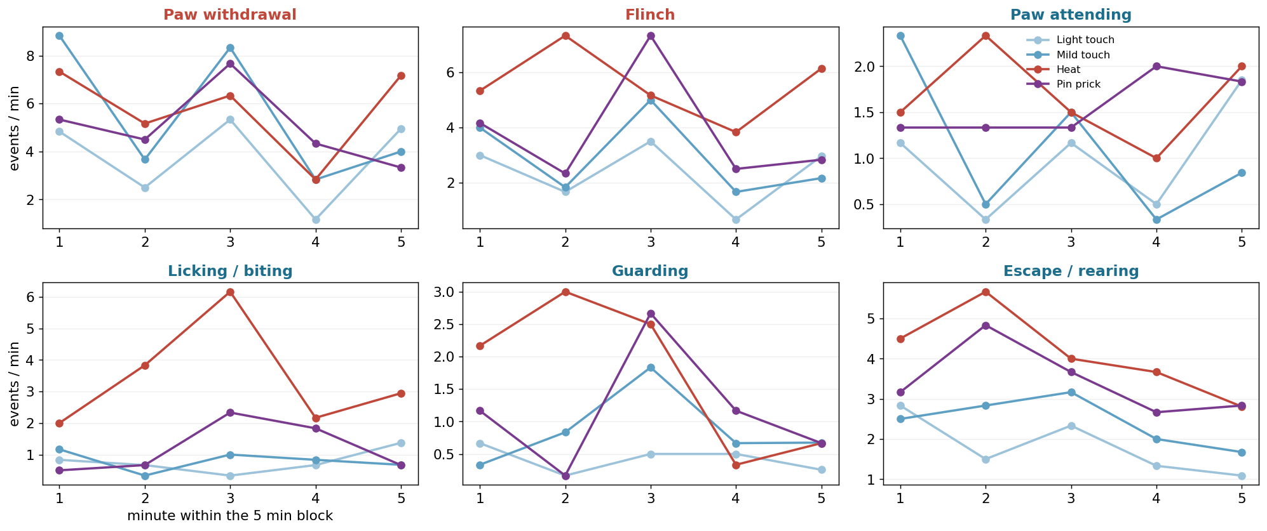
Does the response fade within a block?
1 min bins across each 5 min stimulus block
Worth watching on Day 2: a drug can lower the level or steepen the fade, and those are different mechanisms.

Slide 23
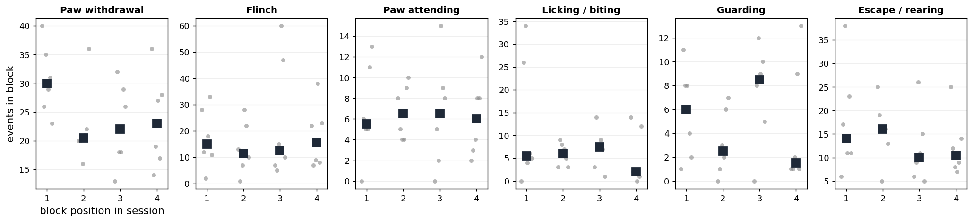
Control: block position does not drive the result
response by position in the session, ignoring which stimulus it was
Flat, which is what validates the randomised block order.

Slide 24
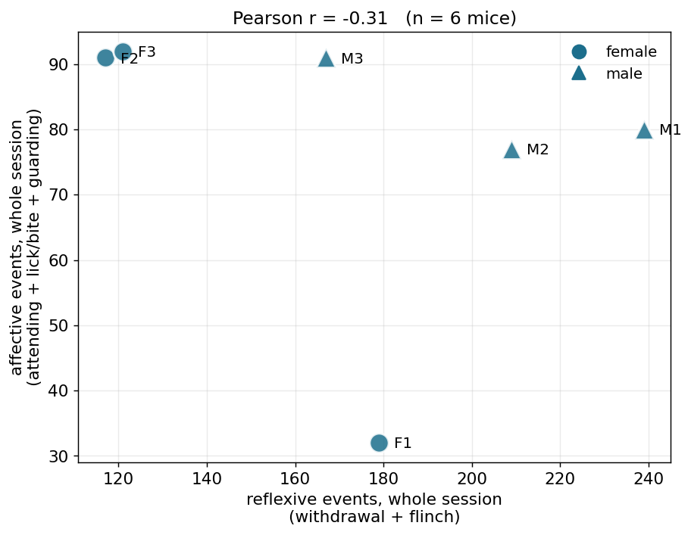
Reflexive against affective, per mouse
the two classes are not interchangeable
The axis SBI-553 is supposed to move: affective down without a matching reflexive change.

Slide 25
Day 1, what we can say
real data, six mice
The assay separates stimulus intensities
light touch smallest, heat largest, for all six behaviours
Reflexive and affective responses have different time courses
locked to contact vs building over 1-8 s - so different windows
Escape / rearing is exploration, not pain
3.8 per min at baseline and it falls under stimulation
Block position is not a confound
the randomisation works
Between-animal spread is the limiting factor, not scoring noise
median CV 0.49 across mice - which is why Day 2 must be paired

Slide 26
Day 2 plan
EVERY NUMBER IN THIS SECTION IS SYNTHETIC.
The figures below were generated from a fake Day 2 with a known 40 % affective reduction injected, escape left unchanged, and one deliberate non-responder. They exist to settle the layout and the statistics in advance - and, as it turns out, to show that n = 6 is fragile.

Slide 27
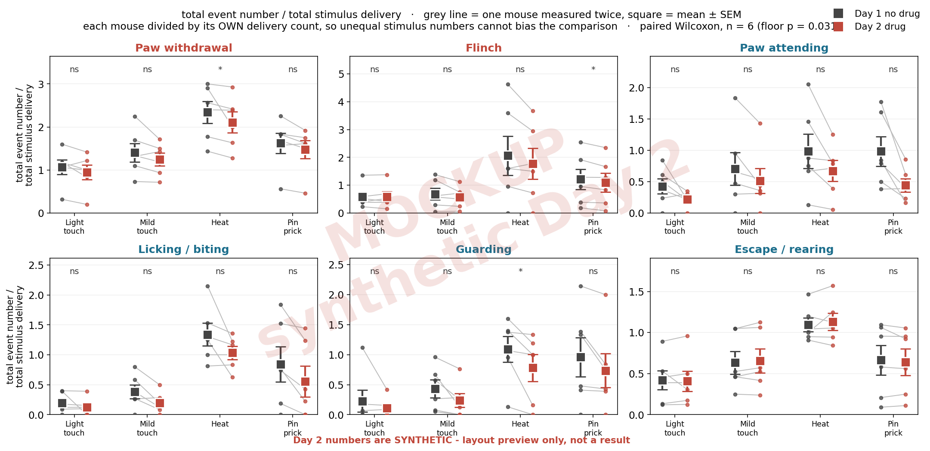
Primary figure: total event number / total stimulus delivery, both days
MOCKUP - the Day 2 numbers are synthetic. This slide shows the layout and the statistics, not a result.

Slide 28
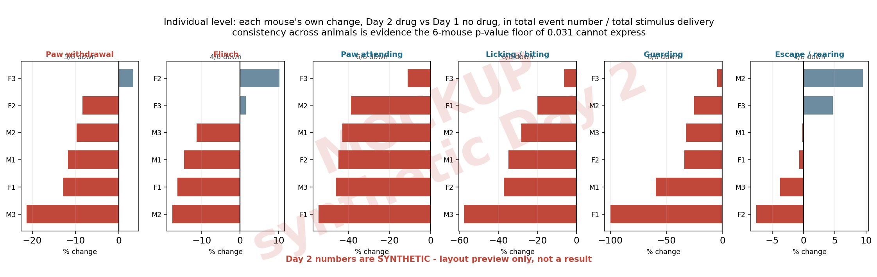
Individual level: each mouse's own change
MOCKUP - the Day 2 numbers are synthetic. This slide shows the layout and the statistics, not a result.

Slide 29
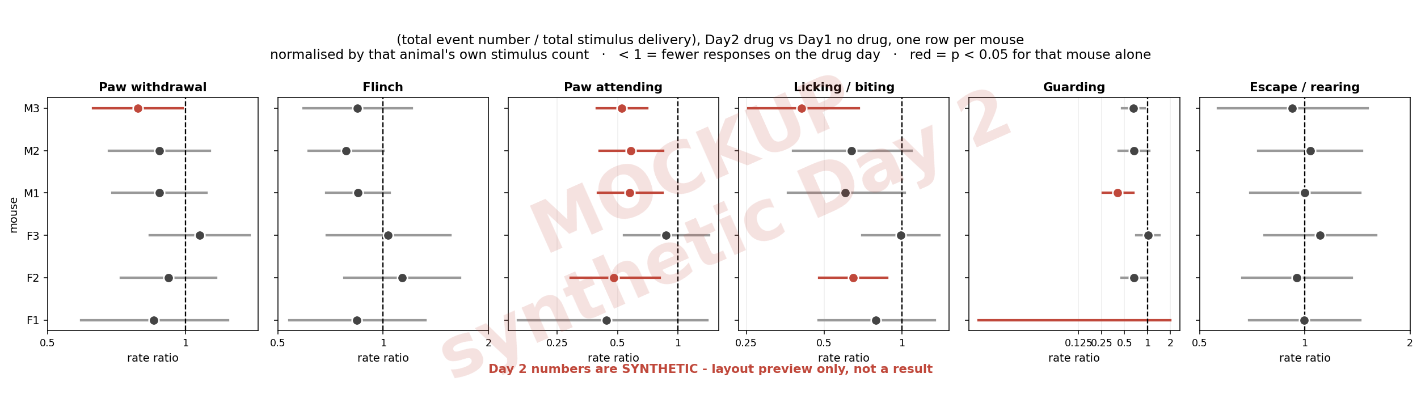
Individual level with statistics
MOCKUP - the Day 2 numbers are synthetic. This slide shows the layout and the statistics, not a result.

Slide 30
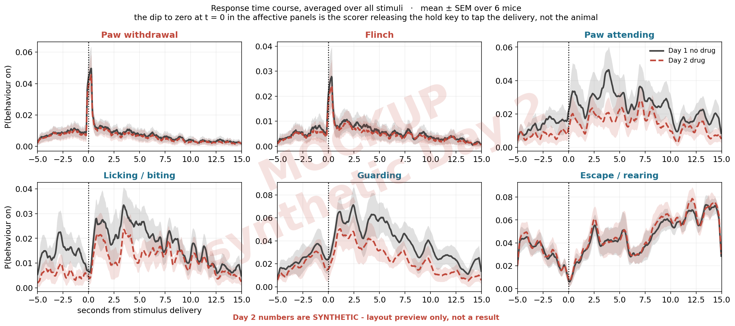
Does the drug change the response shape?
MOCKUP - the Day 2 numbers are synthetic. This slide shows the layout and the statistics, not a result.

Slide 31
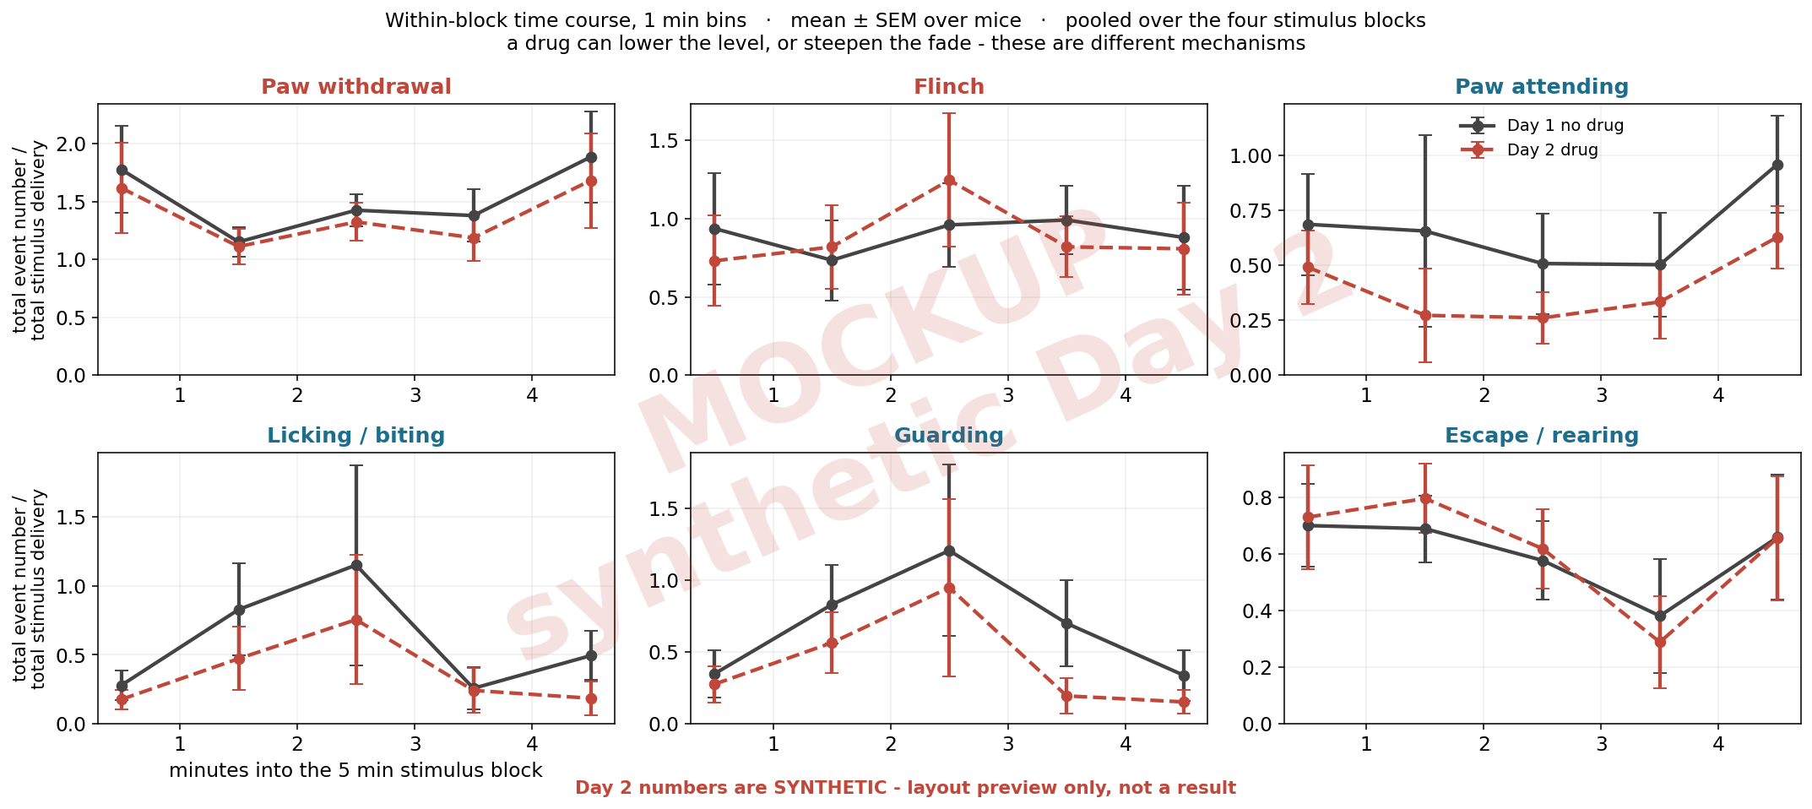
Does the drug change the within-block fade?
MOCKUP - the Day 2 numbers are synthetic. This slide shows the layout and the statistics, not a result.

Slide 32
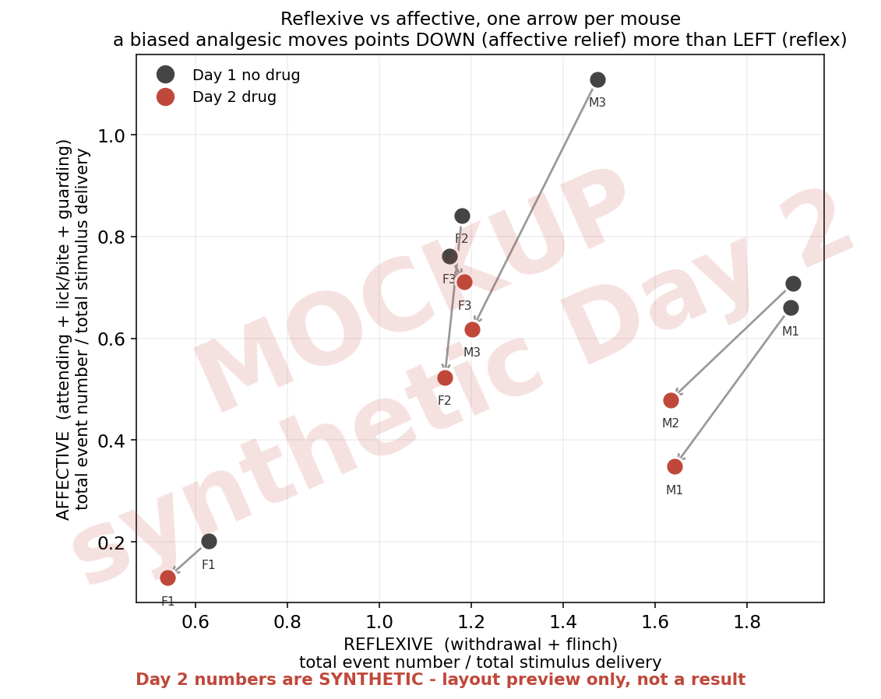
The dissociation the drug is meant to produce
MOCKUP - the Day 2 numbers are synthetic. This slide shows the layout and the statistics, not a result.

Slide 33
What the mockup revealed
this part is NOT synthetic - it comes from the Day 1 variability and from the arithmetic of the test

Slide 34
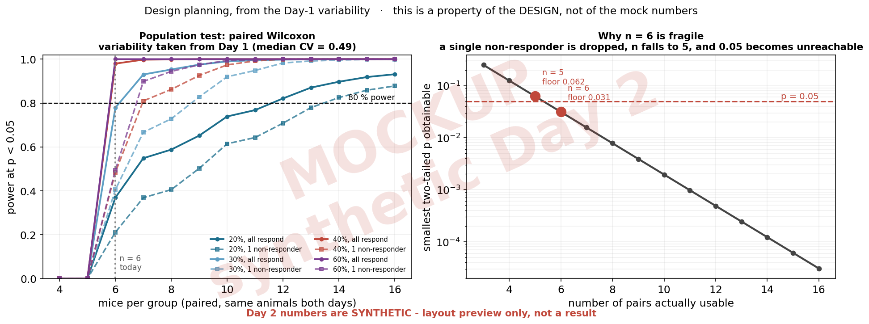
n = 6 may not be enough
Left: with one non-responder, power for a 40 % effect at n = 6 falls from 0.98 to about 0.49. Right: the exact paired test floors at 2/2^n, so at n = 5 usable pairs p < 0.05 is arithmetically impossible.

Slide 35
Two levels of statistics, and what each can deliver
the population test is the design; the per-mouse test is what rescues it at n = 6
level | unit | n | test | what limits it
Population | the mouse | 6 | paired Wilcoxon (primary) | floors at p = 0.031; one non-responder raises it to 0.062
Population | the mouse | 6 vs 6 | Mann-Whitney (secondary) | reaches 0.0022, but ignores the pairing the design bought
Individual | one delivery | ~90 per mouse per day | Fisher exact / rate ratio | well powered for reflexes, detects only large shifts for affective
Direction | the mouse | 6 | how many moved the same way | not a p-value, but survives the floor

Slide 36
Decisions needed before Day 2
open questions, not conclusions
Animal number
n = 6 gives ~0.49 power for a 40 % effect if one animal does not respond. n = 8-10 is robust.
Keep the delivery count as even as possible between days
normalisation handles unequal counts, but it cannot recover power that was never there
Add a TTL or LED marker on the applicator
solves stimulus timing, identity and camera sync at once, and removes the scorer from the delivery mark entirely
Decide now: second baseline block at session end?
it would separate drug effect from time-in-session drift
Pick the primary outcome before Day 2 is scored
one behaviour, one stimulus, one measure - everything else is then explicitly secondary

