Slide 1
SBI-553 on the acute pain assay
A general reduction in behaviour, not selective analgesia
Escape / rearing is exploration, not pain — and it was the ONLY behaviour significantly
reduced in all six mice. The reflexes fell least. A selective analgesic predicts the
opposite ordering.
Day 1 no drug vs Day 2 SBI-553, same six mice, dosed 10 min before the assay. No vehicle group.
change index = (total events ÷ total stimuli) on Day 2 ÷ the same on Day 1
Hansol Lim · 2026-09-03 · every number recomputed from the scoring files and cross-checked

Slide 2
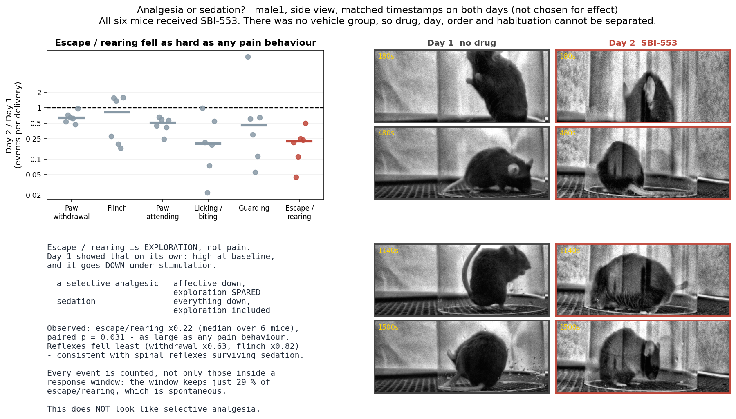
Everything fell, including the behaviour that is not pain
METHOD Change index per behaviour, one dot per mouse, bar = MEDIAN of the six per-mouse indices. Counts every event in the WHOLE SESSION (baseline and rest included), divided by that mouse's total stimulus count. Log axis. Paired Wilcoxon over the six mice (exact, n = 6, smallest possible p = 0.031).
Medians: licking/biting ×0.20 and escape/rearing ×0.22 fell most, paw withdrawal ×0.63 and flinch ×0.82 least (attending ×0.51, guarding ×0.45). Escape/rearing is exploration — Day 1 showed it is high at baseline and DECREASES under stimulation — so a selective analgesic should have spared it. It did not.
Paw withdrawal looks close to the line only because the axis is logarithmic: ×0.63 is a 37 % decrease, in all six mice, paired p = 0.031. It is significantly reduced AND the least reduced of the six.

Slide 3
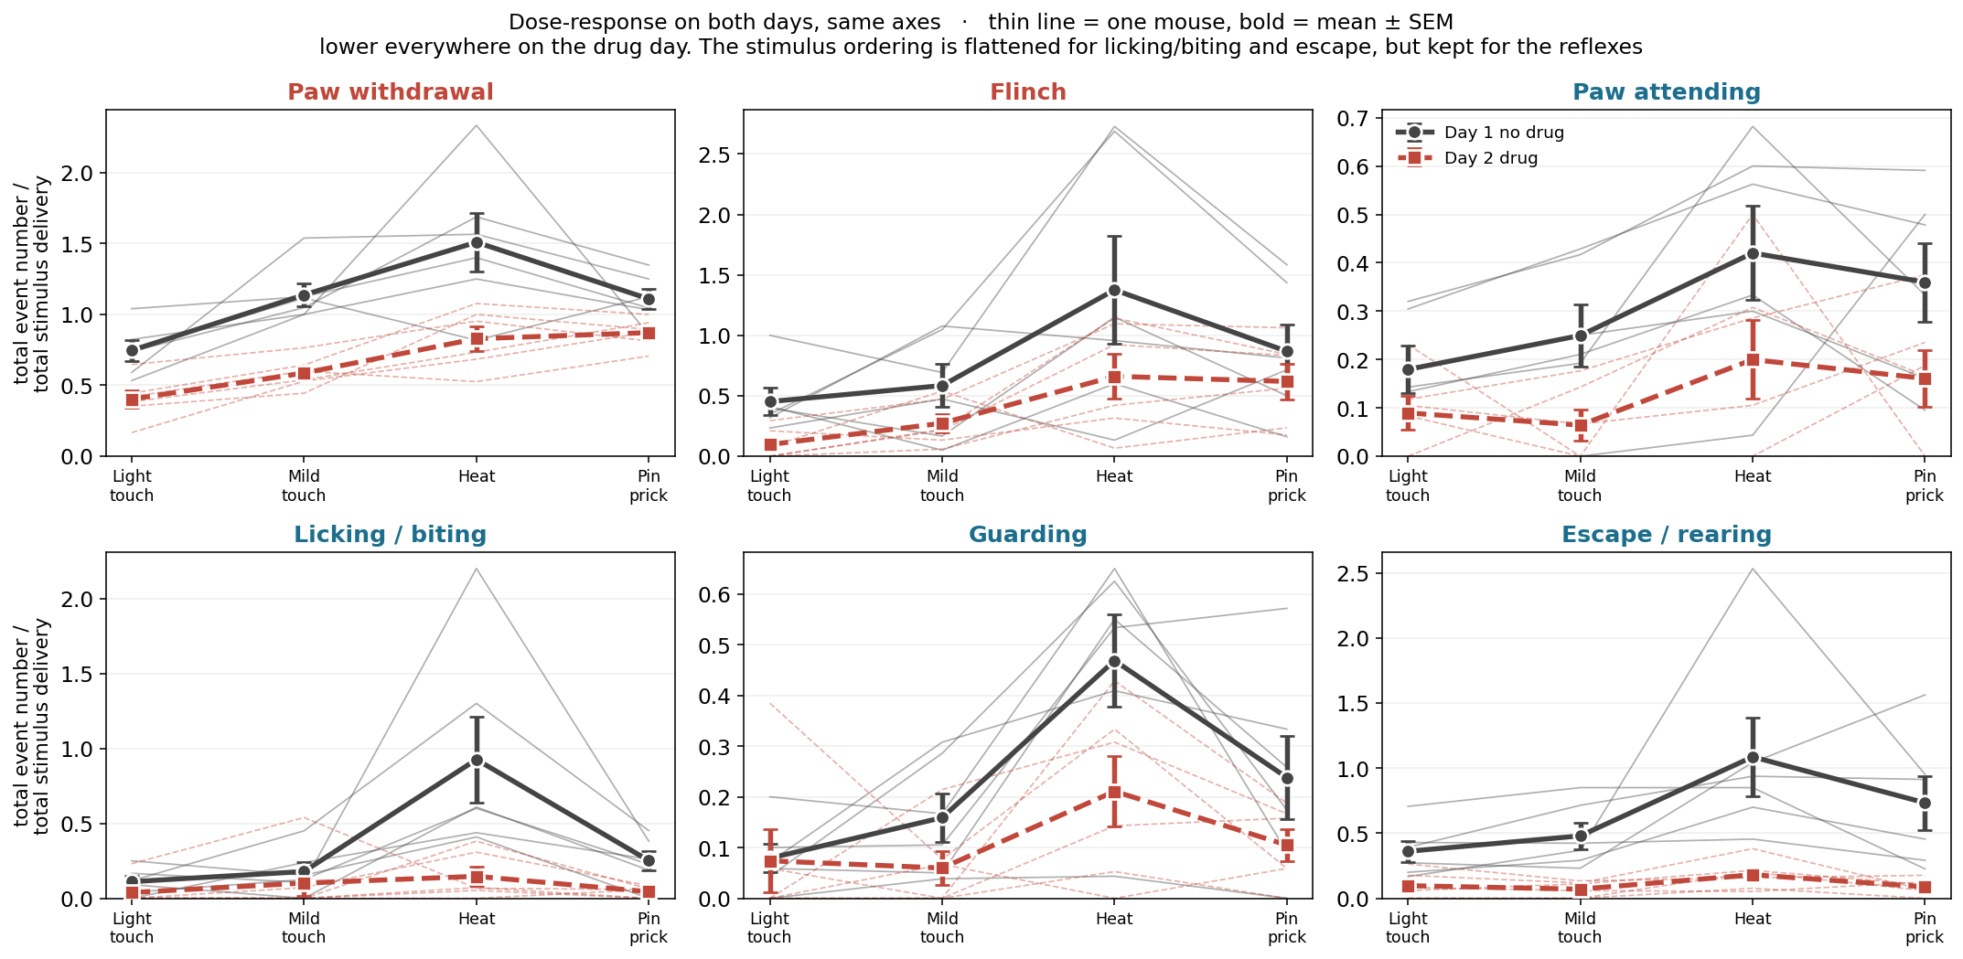
Lower on the drug day, in every behaviour
METHOD Events per stimulus delivery against stimulus type. Thin line = one mouse, bold = mean ± SEM over six mice. Both days on shared axes so the size of the drop is comparable. No statistical test on this panel — it is descriptive.
Day 1 rises from light touch to heat in every behaviour. On Day 2 that ordering is flattened for licking/biting and escape/rearing but kept for the reflexes, whose curve simply sits lower.

Slide 4
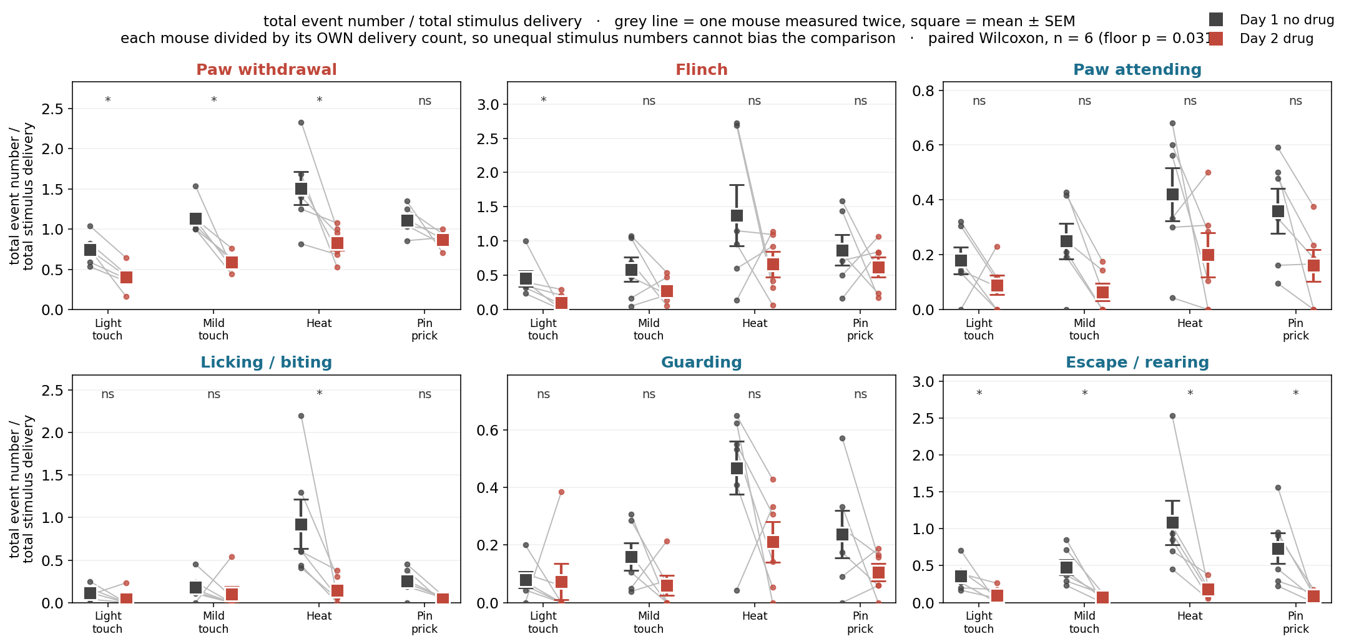
Escape/rearing falls at every stimulus, in every mouse
METHOD Same measure, paired within animal. Grey line joins the two days for one mouse; square = mean ± SEM. Paired Wilcoxon per behaviour × stimulus (exact, n = 6, floor p = 0.031). * p < 0.05, ns = not significant.
Escape/rearing is significant at all four stimuli. Paw withdrawal is significant at three of four. Guarding and flinch are not significant per stimulus — with six mice the test cannot go below 0.031, so a non-significant cell here means underpowered, not unchanged.

Slide 5
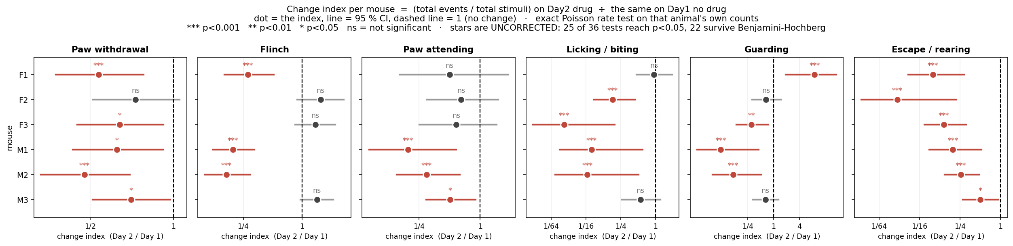
Only escape/rearing changed in all six mice
METHOD Change index per mouse, dot = the index, line = 95 % CI from the Poisson variance of the totals. Counts events inside the four STIMULUS BLOCKS only — so these indices are slightly lower than slide 1, which also counts baseline and rest. EXACT POISSON RATE TEST on that animal's own counts: conditional on the n₁+n₂ events in total, the number landing on Day 2 is Binomial(n₁+n₂, t₂/(t₁+t₂)) if the two rates are equal. Stars are uncorrected — 25 of 36 tests reach p<0.05, 22 survive Benjamini-Hochberg.
Each animal received 57–100 stimuli, which is what makes a single-animal test possible. Decreased in / significantly decreased in: escape 6/6 and 6/6 · withdrawal 6/6 and 5 · lick-bite 6/6 and 4 · attending 6/6 and 3 · guarding 5/6 and 3 · flinch 3/6 and 3 (the other three went UP). Guarding has one animal moving the other way: F1 rose nine-fold (2/87 → 12/58, p = 0.0006), so four significant does not mean four decreased.

Slide 6
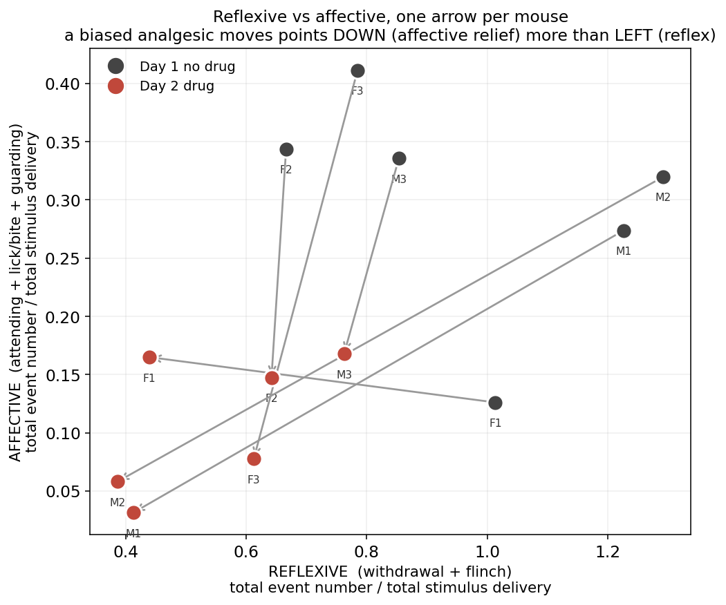
Affective and reflexive pain fell together
METHOD Affective (attending + licking/biting + guarding) against reflexive (withdrawal + flinch), both as events per stimulus delivery. One arrow per mouse, Day 1 to Day 2. Descriptive — no test on this panel.
A selective affective effect would move every arrow straight DOWN. F2, F3 and M3 do move mostly down; M1 and M2 move down AND left; F1 moves left and slightly up. Combined with escape/rearing falling hardest, the pattern is a general reduction in activity rather than a clean affective-only effect.

Slide 7
What these five figures do NOT establish
1. That the change is caused by SBI-553.
All six mice received it. With no vehicle group, drug, day, block order and
habituation cannot be separated.
2. That it is analgesia.
Escape/rearing is not a pain measure and fell hardest. Movement measured from
the video was already halved during the 5 min baseline, before any stimulus
(×0.47, 6/6 mice, p = 0.031) — there is no pain to relieve there.
3. That analgesia is absent.
A general reduction in activity could hide it. A lower dose or a later time point,
with a vehicle arm, would separate the two.
4. Anything about the face.
The side view is a backlit silhouette: ears are visible as outlines, the eye is not
resolved, so the Mouse Grimace Scale cannot be scored. And grimace cannot
distinguish pain from sedation in any case — both produce orbital tightening.

