Slide 1
Acute pain assay
Day 1 Vehicle
Day 2 SBI-553
same six mice. SBI-553 given 10 min before the Day 2 assay.
Hansol Lim · 2026-09-03

Slide 2
The drug reduced everything, not just pain
Every behaviour fell after SBI-553
Escape / rearing fell to 22 % of Day 1 — as far as licking/biting (20 %), the joint largest drop. Reflexes fell least
(withdrawal to 63 %, flinch to 82 %).
That pattern is what sedation looks like, not selective analgesia. Vehicle was given on Day 1 and SBI-553 on Day 2, so the injection is controlled but the fixed order is not.

Slide 3
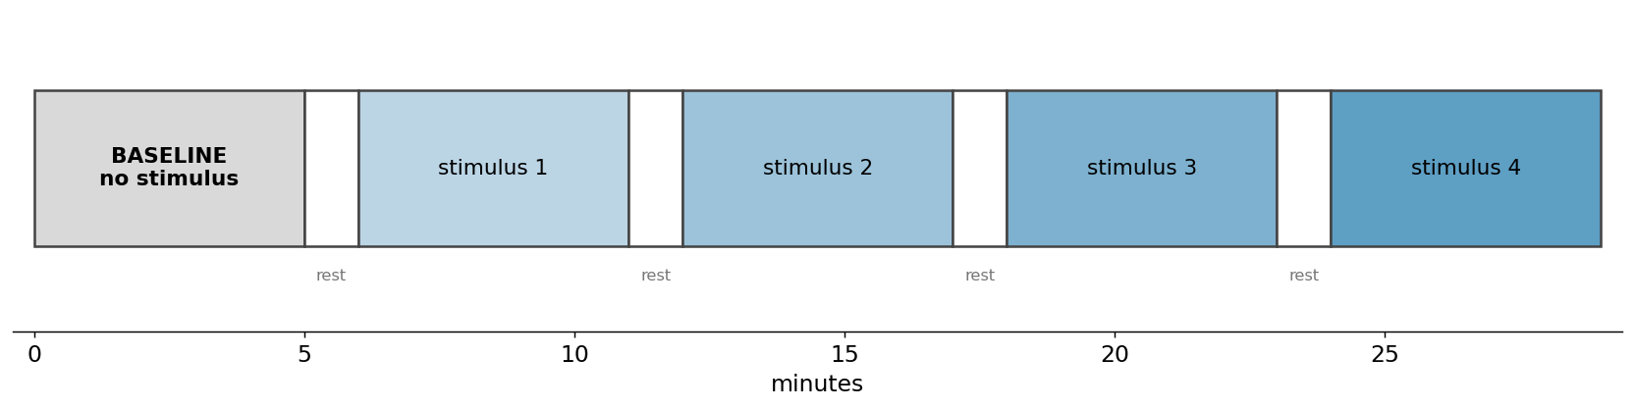
How one session runs
5 min baseline, then four 5 min stimulus blocks on a fixed clock, 1 min rest between
Block order is randomised per mouse, so stimulus identity is not confounded with time in the session.

Slide 4
What we score, and why we keep two lists
Corder / Scherrer framework
REFLEXIVE paw withdrawal, flinch
AFFECTIVE-MOTIVATIONAL paw attending, licking / biting, guarding
ESCAPE / REARING scored, but read as exploration

Slide 5
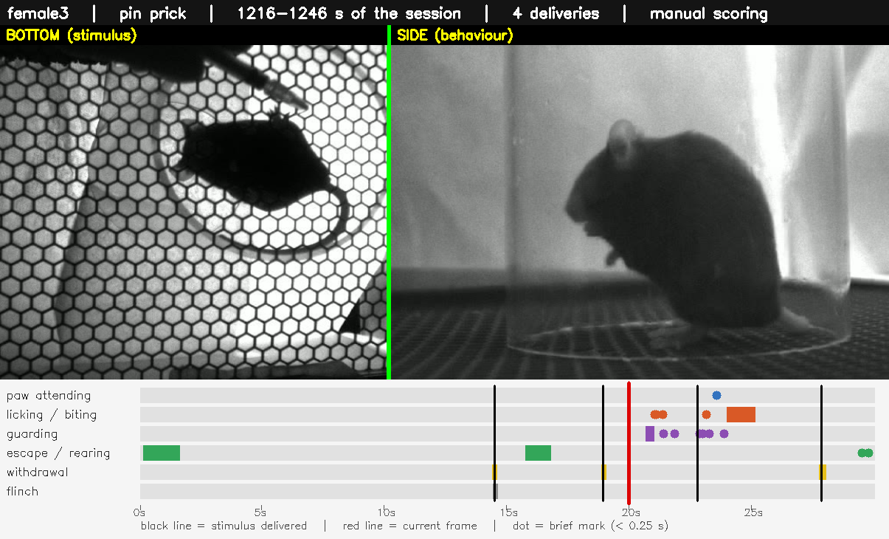
What one scored session looks like
30 s, both cameras, labels burned in

Slide 6
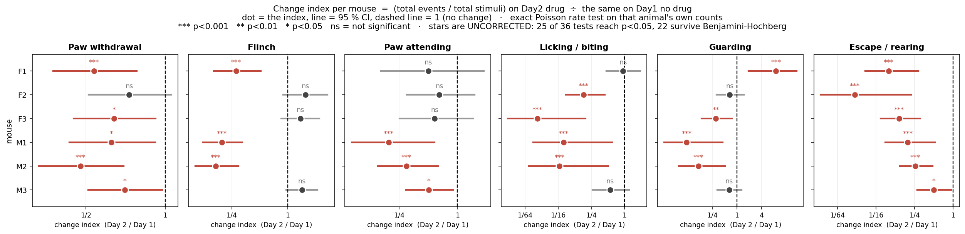
Every mouse, every behaviour
Escape/rearing fell in all 6 mice, the only behaviour significant in every one. Licking/biting, attending and withdrawal also fell in 6/6. Reflexes fell least. One mouse (F1) increased guarding 9-fold.
change index = (total events ÷ total stimuli) on Day 2 ÷ the same on Day 1
METHOD One dot per mouse, line = 95 % CI. Exact Poisson rate test on that animal's own counts (57–100 stimuli each). Events counted inside the four stimulus blocks. *** p<0.001 ** p<0.01 * p<0.05. Stars uncorrected: 25 of 36 reach p<0.05, 22 survive Benjamini-Hochberg.

Slide 7
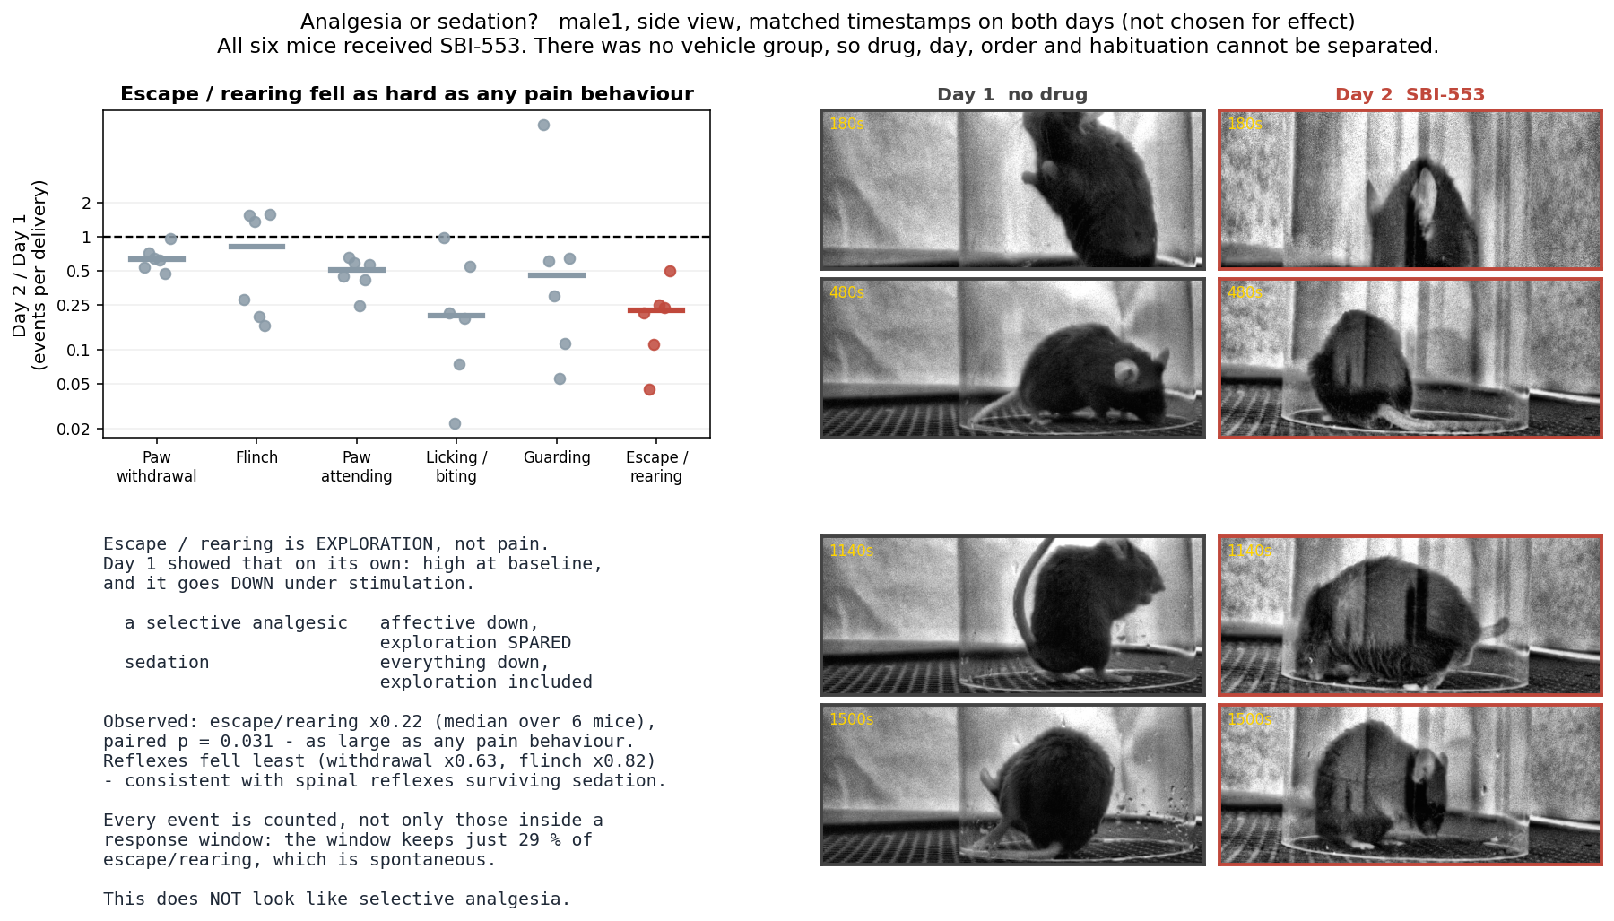
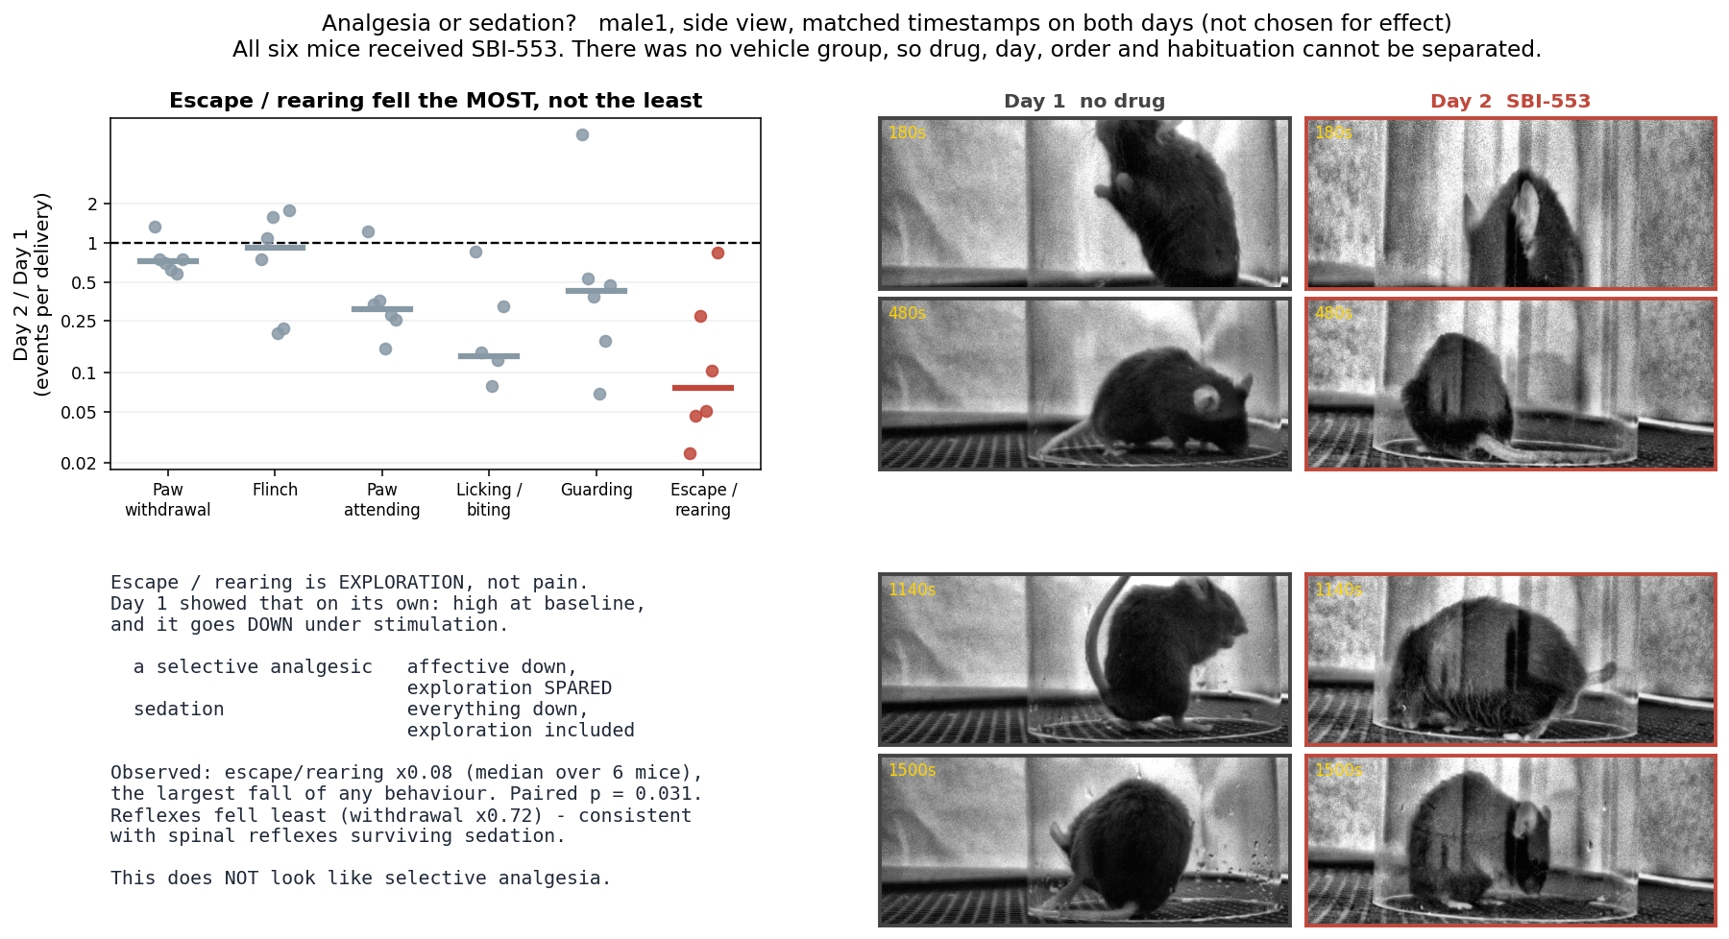
Exploration fell as much as pain
Medians: licking/biting ×0.20 and escape/rearing ×0.22 fell most; withdrawal ×0.63 and flinch ×0.82 least. Escape/rearing is exploration, not pain — a selective analgesic should have spared it.
Paw withdrawal sits near the line only because the axis is logarithmic: ×0.63 is a 37 % fall, in all six mice, p = 0.031.

Slide 8
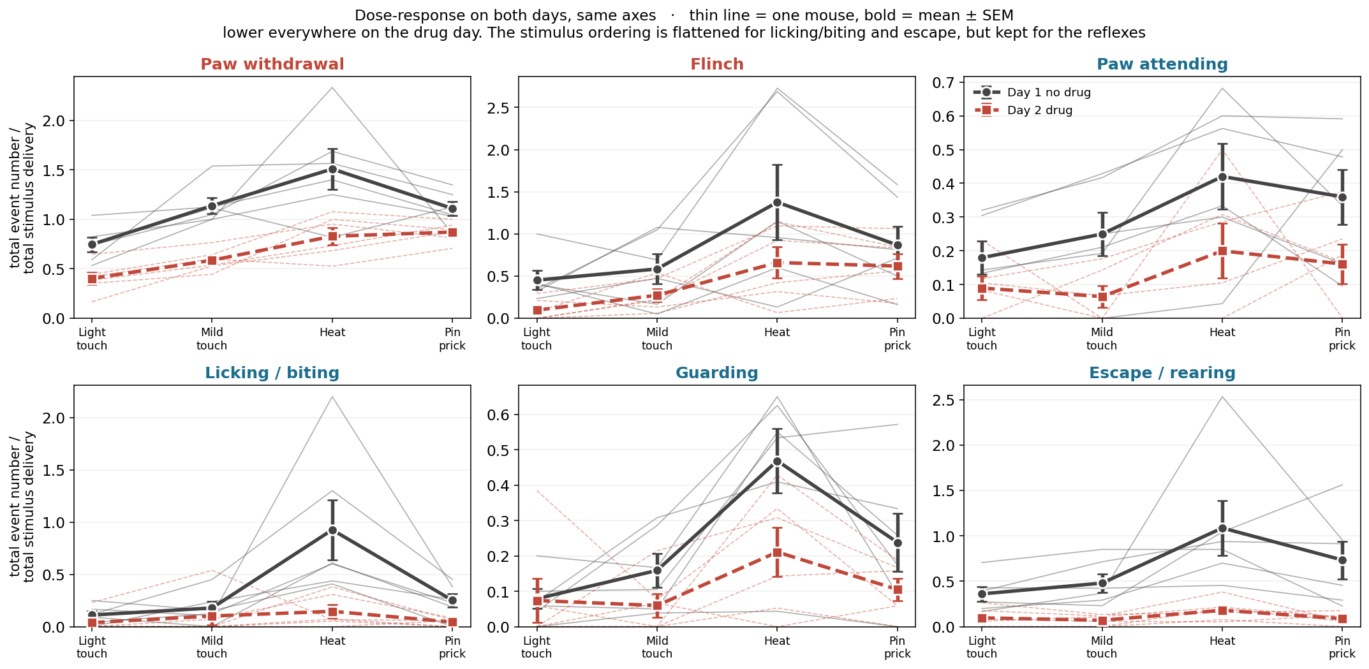
Lower on the drug day, every behaviour
METHOD Events per stimulus delivery against stimulus type. Thin line = one mouse, bold = mean ± SEM over six mice. Both days on shared axes so the size of the drop is comparable. No statistical test on this panel — it is descriptive.
Day 1 rises from light touch to heat in every behaviour. On Day 2 that ordering is flattened for licking/biting and escape/rearing but kept for the reflexes, whose curve simply sits lower.

Slide 9
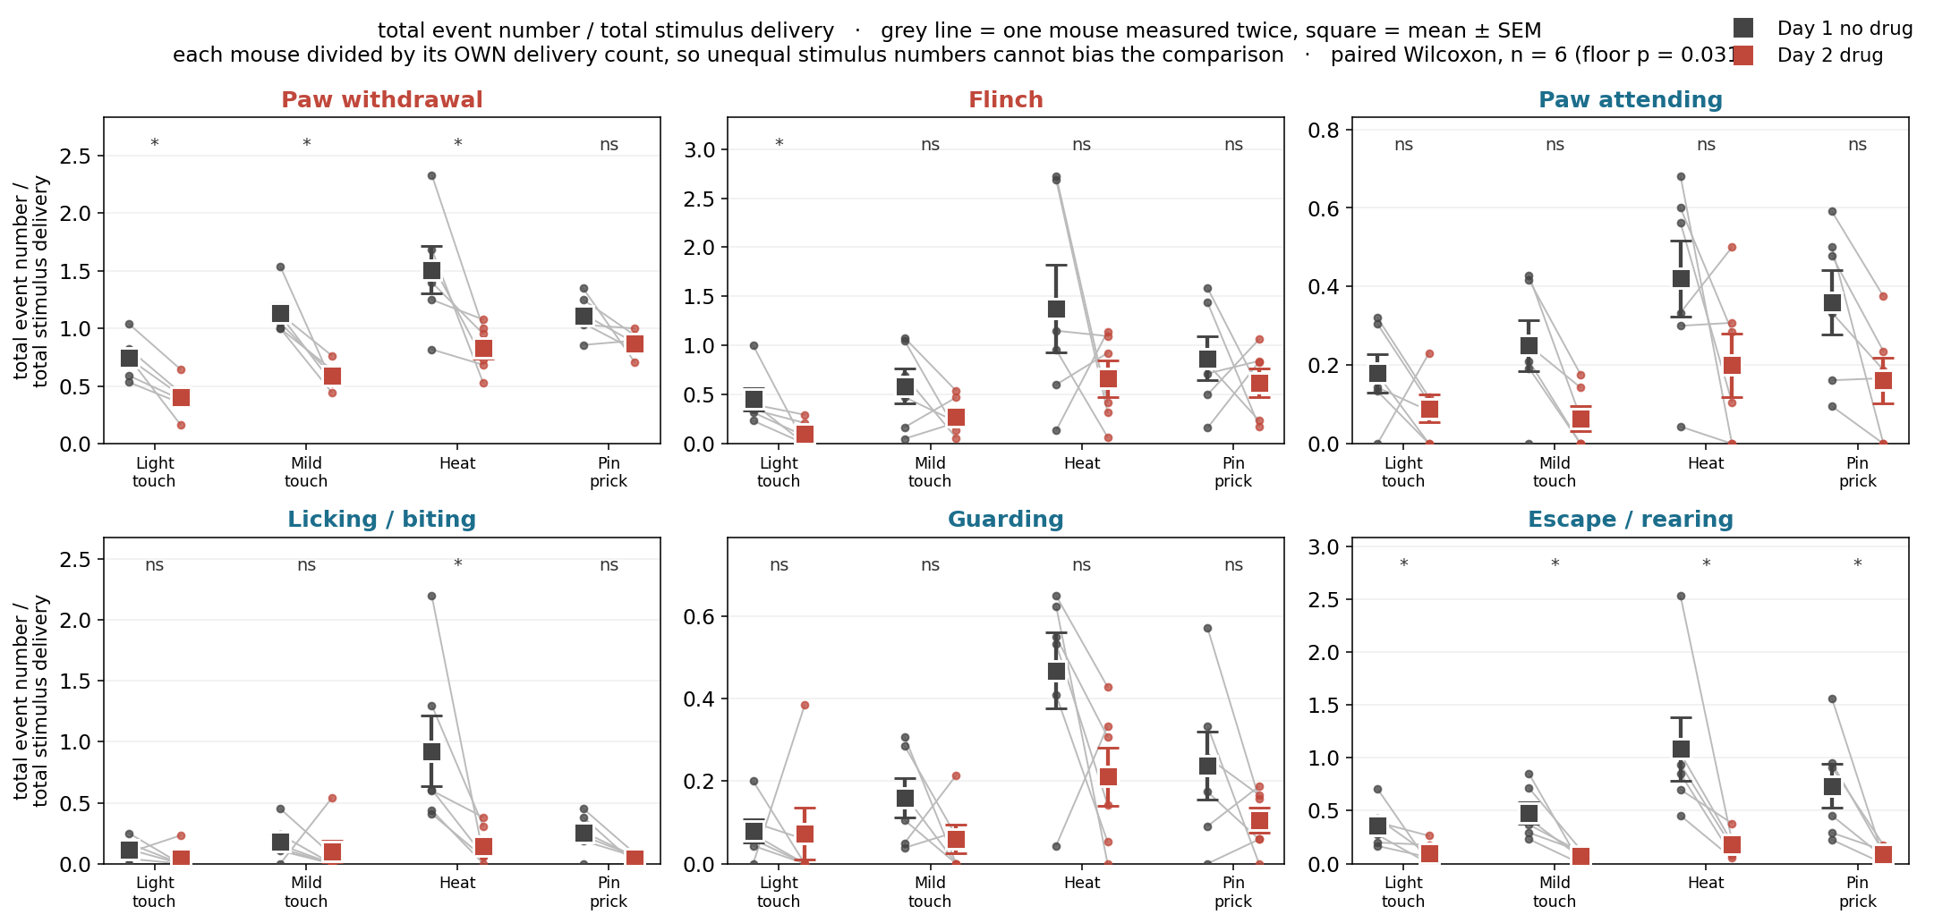
Same mouse, both days
METHOD Same measure, paired within animal. Grey line joins the two days for one mouse; square = mean ± SEM. Paired Wilcoxon per behaviour × stimulus (exact, n = 6, floor p = 0.031). * p < 0.05, ns = not significant.
Escape/rearing is significant at all four stimuli, withdrawal at three of four. With six mice the test cannot go below p = 0.031, so a blank cell means underpowered, not unchanged.

Slide 10
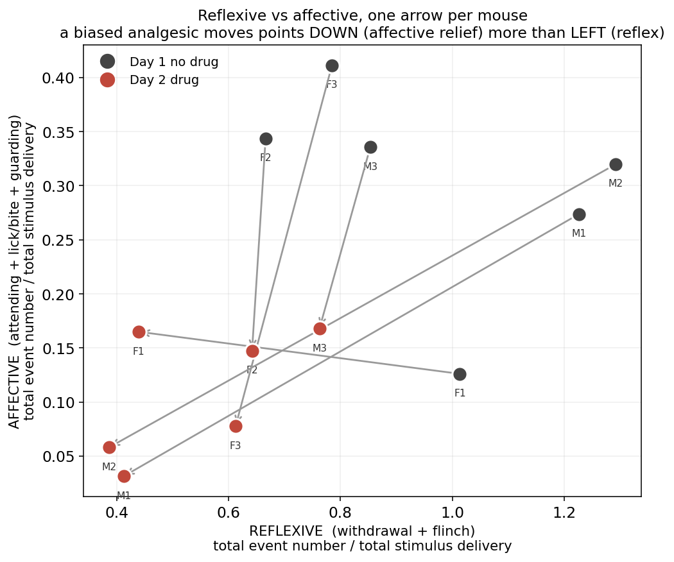
Affective and reflexive pain fell together
METHOD Affective (attending + licking/biting + guarding) against reflexive (withdrawal + flinch), both as events per stimulus delivery. One arrow per mouse, Day 1 to Day 2. Descriptive — no test on this panel.
A selective affective effect would move every arrow straight DOWN. Most move down AND left, so both classes fell together — a general reduction in activity.

Slide 11
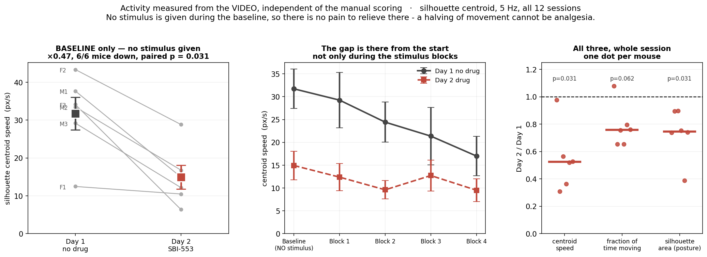
Already slower before any stimulus
No stimulus is delivered during the baseline, so there is no pain to relieve. Movement was already halved there in 6/6 mice (p = 0.031). That cannot be analgesia.

