Slide 1
SBI-553 on the acute pain assay
Day 1 no drug vs Day 2 SBI-553, same six mice, dosed 10 min before the assay
Five figures. Every number recomputed from the scoring files and cross-checked.
change index = (total events ÷ total stimuli) on Day 2 ÷ the same on Day 1
All six mice received SBI-553. There was no vehicle group.
Hansol Lim · 2026-09-03

Slide 2
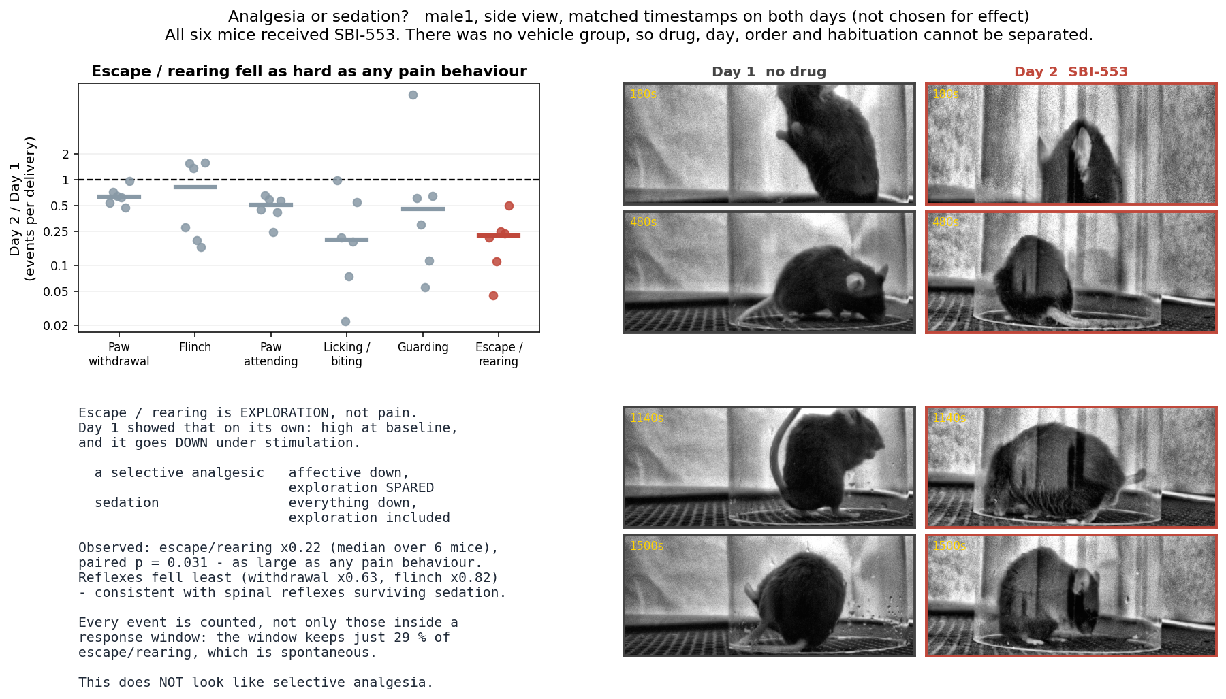
Every behaviour fell — including escape/rearing, which is not a pain measure
METHOD Change index per behaviour, one dot per mouse, bar = MEDIAN of the six per-mouse indices. Every event in the stimulus block counted, each mouse divided by its own stimulus count. Log axis. Paired Wilcoxon over the six mice (exact, n = 6, smallest possible p = 0.031).
Medians: licking/biting ×0.20 and escape/rearing ×0.22 fell most, paw withdrawal ×0.63 and flinch ×0.82 least (attending ×0.51, guarding ×0.45). Escape/rearing is exploration — Day 1 showed it is high at baseline and DECREASES under stimulation — so a selective analgesic should have spared it. It did not.
Paw withdrawal looks close to the line only because the axis is logarithmic: ×0.63 is a 37 % decrease, in all six mice, paired p = 0.031. It is significantly reduced AND the least reduced of the six.

Slide 3
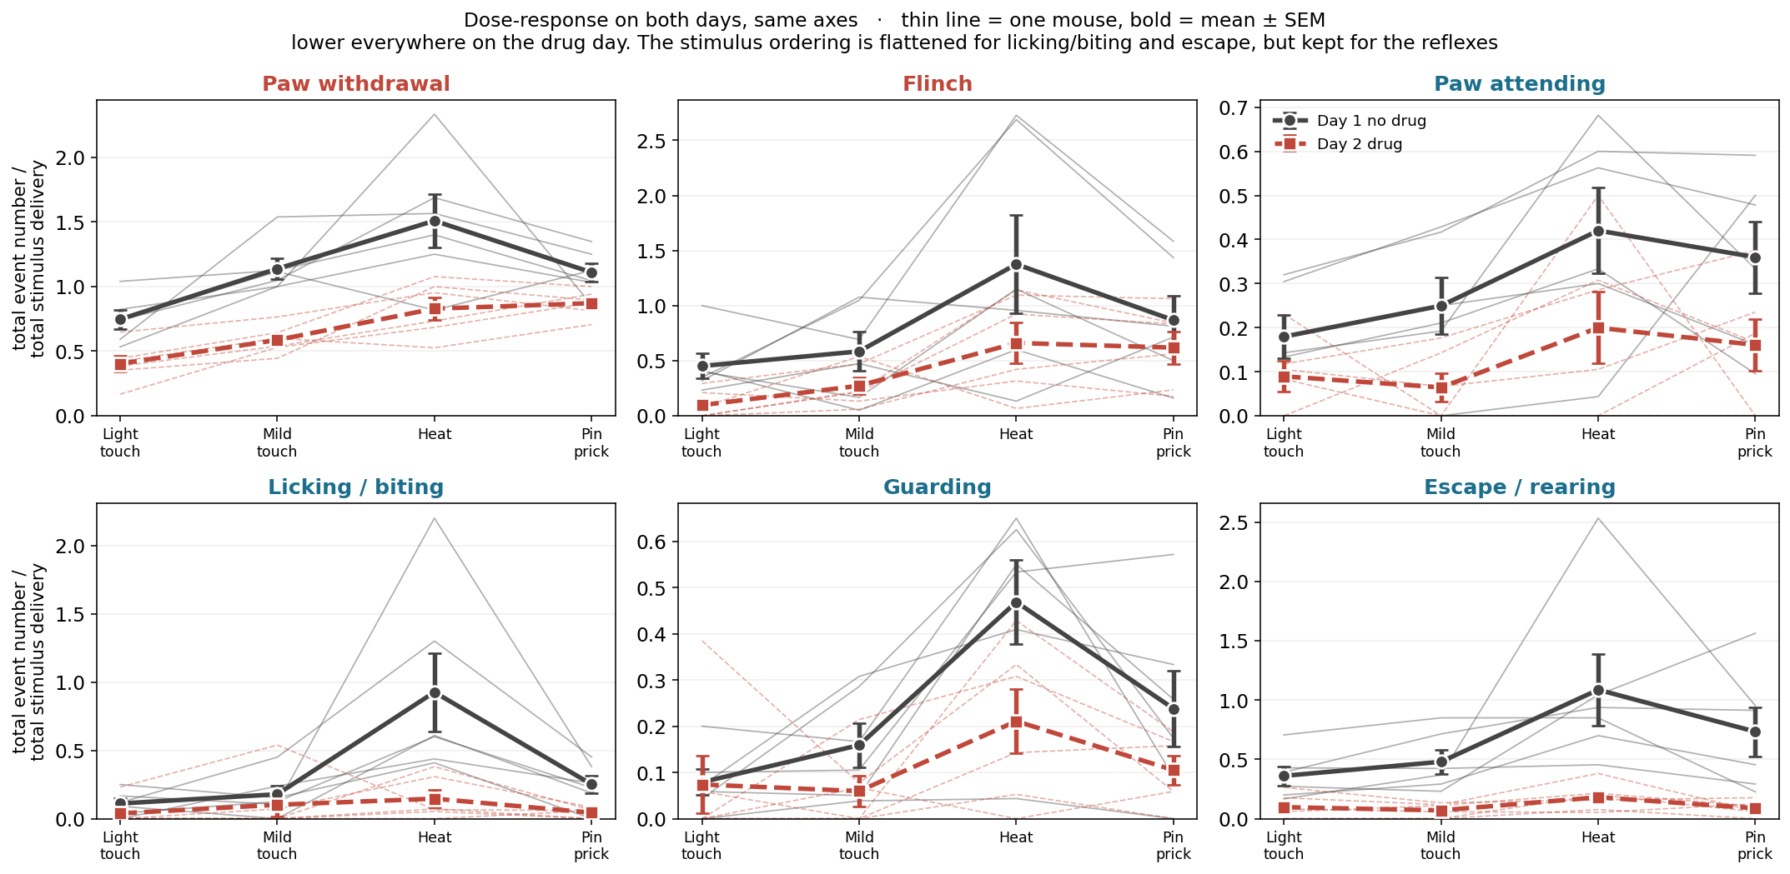
Lower on the drug day for all six behaviours, and flatter for the affective ones
METHOD Events per stimulus delivery against stimulus type. Thin line = one mouse, bold = mean ± SEM over six mice. Both days on shared axes so the size of the drop is comparable. No statistical test on this panel — it is descriptive.
Day 1 rises from light touch to heat in every behaviour. On Day 2 that ordering is flattened for licking/biting and escape/rearing but kept for the reflexes, whose curve simply sits lower.

Slide 4
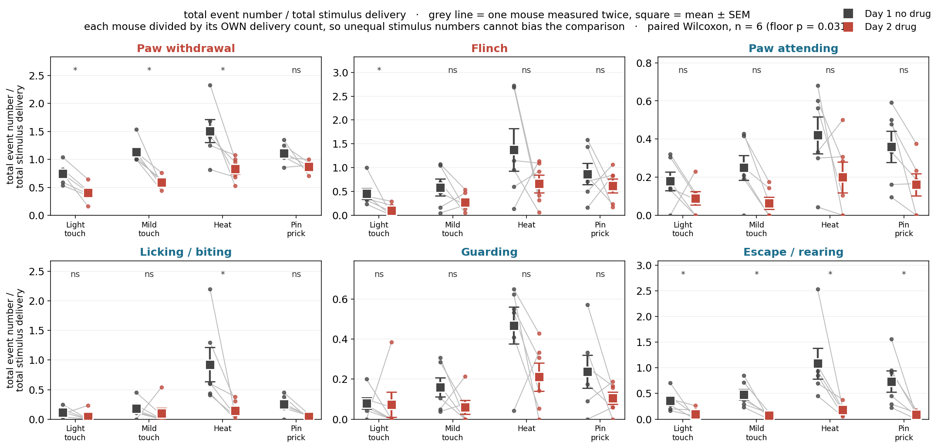
Paired mouse by mouse: paw withdrawal and escape/rearing move in every animal
METHOD Same measure, paired within animal. Grey line joins the two days for one mouse; square = mean ± SEM. Paired Wilcoxon per behaviour × stimulus (exact, n = 6, floor p = 0.031). * p < 0.05, ns = not significant.
Escape/rearing is significant at all four stimuli. Paw withdrawal is significant at three of four. Guarding and flinch are not significant per stimulus — with six mice the test cannot go below 0.031, so a non-significant cell here means underpowered, not unchanged.

Slide 5
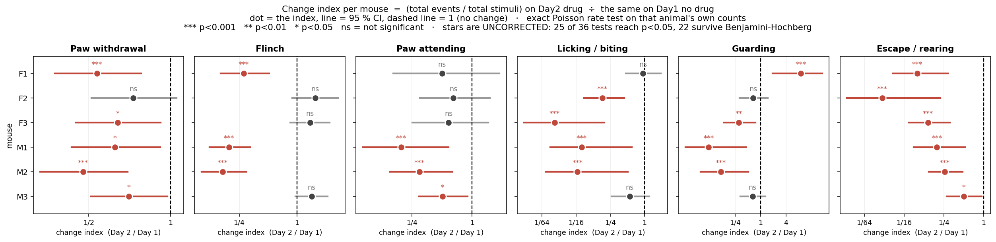
Each animal tested on its own: escape/rearing falls in all six mice, 5 of 6 after correction
METHOD Change index per mouse, dot = the index, line = 95 % CI from the Poisson variance of the totals. EXACT POISSON RATE TEST on that animal's own counts: conditional on the n₁+n₂ events in total, the number landing on Day 2 is Binomial(n₁+n₂, t₂/(t₁+t₂)) if the two rates are equal; the two-sided binomial p is exact. Stars are uncorrected — 25 of 36 tests reach p<0.05, 22 survive Benjamini-Hochberg.
Worked example, M2 escape: 60 events / 83 stimuli on Day 1 versus 13 / 70 on Day 2, index 0.26. If the rates were equal, 33 of the 73 events would be expected on Day 2; 13 were seen, p = 7.7×10⁻⁷. Escape/rearing: 6/6 significant uncorrected, 5/6 after FDR (M3 p = 0.032 becomes q = 0.082).

Slide 6
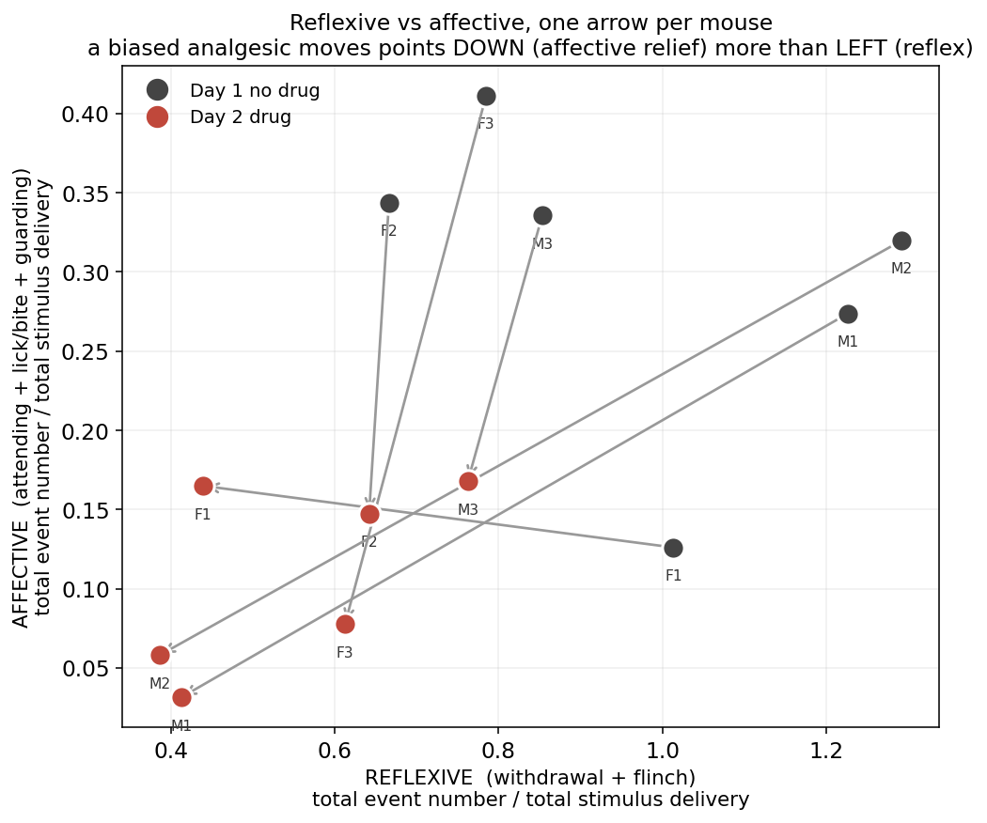
The affective/reflexive dissociation a biased agonist predicts is not what happened
METHOD Affective (attending + licking/biting + guarding) against reflexive (withdrawal + flinch), both as events per stimulus delivery. One arrow per mouse, Day 1 to Day 2. Descriptive — no test on this panel.
A selective affective effect would move every arrow straight DOWN. F2, F3 and M3 do move mostly down; M1 and M2 move down AND left; F1 moves left and slightly up. Combined with escape/rearing falling hardest, the pattern is a general reduction in activity rather than a clean affective-only effect.

Slide 7
What these five figures do NOT establish
1. That the change is caused by SBI-553.
All six mice received it. With no vehicle group, drug, day, block order and
habituation cannot be separated.
2. That it is analgesia.
Escape/rearing is not a pain measure and fell hardest. Movement measured from
the video was already halved during the 5 min baseline, before any stimulus
(×0.47, 6/6 mice, p = 0.031) — there is no pain to relieve there.
3. That analgesia is absent.
A general reduction in activity could hide it. A lower dose or a later time point,
with a vehicle arm, would separate the two.
4. Anything about the face.
The side view is a backlit silhouette: ears are visible as outlines, the eye is not
resolved, so the Mouse Grimace Scale cannot be scored. And grimace cannot
distinguish pain from sedation in any case — both produce orbital tightening.

