Slide 1
How to read the Day 2 numbers
Supplement to the main deck · the rate ratio, the forest plot, Day 2 on its own,
and the activity measured from the video
Hansol Lim · 2026-09-03

Slide 2
1. The rate ratio
one number per mouse per behaviour, and how it is built

Slide 3
Step 1: count events, and count the stimuli that caused them
real numbers, mouse M2, escape / rearing
Day 1 no drug Day 2 SBI-553
escape events 69 6
stimuli delivered 83 70
The stimulus is delivered by hand, so the number of taps is NOT the same on the two days:
83 on Day 1, 70 on Day 2. Comparing 69 events against 6 events would mix the change in
behaviour with the change in how many chances the animal was given.

Slide 4
Step 2: divide by that animal's own stimulus count
this is the number every figure uses
Day 1 69 events / 83 stimuli = 0.83 events per stimulus
Day 2 6 events / 70 stimuli = 0.09 events per stimulus
In words: on Day 1 this mouse tried to escape about 8 times out of every 10 stimuli.
On Day 2, about 1 time out of every 10.
This is what the axis label “total event number / total stimulus delivery” means.
Each mouse is divided by ITS OWN count, never by a group average.

Slide 5
Step 3: the rate ratio is Day 2 divided by Day 1
so 1 means no change
rate ratio = 0.09 / 0.83 = 0.10
Read it as a multiplier:
1.0 no change
0.5 halved
0.10 down to a tenth — this mouse
2.0 doubled
Why a ratio and not a per-cent change: per cent is bounded at −100 % but unbounded upwards,
so one animal that went up 650 % flattens every other bar. A ratio on a log axis treats halving
and doubling as the same distance.

Slide 6
Why the per-mouse test is possible at all
this is the payoff of scoring every delivery rather than every block
 | value | what it buys
Stimuli per mouse per day | 58 to 100 | each delivery is one trial, so a single animal has ~60-100 trials
Test used | Mann-Whitney on that mouse's own deliveries | no group needed - the mouse is its own experiment
Confidence interval | from the Poisson variance of the totals | the horizontal line in the forest plot
If we had used block means instead | 4 numbers per mouse per day | no per-mouse test would be possible at all

Slide 7
2. The forest plot
one row per mouse, one panel per behaviour

Slide 8
How to read it
Each row is one mouse
F1 at the top, M3 at the bottom, the SAME order in every panel - so you can follow one animal left to right
The dot is that mouse's rate ratio
Day 2 ÷ Day 1 in events per stimulus
The horizontal line is the 95 % confidence interval
a short line means that mouse gave many consistent trials; a long line means few or scattered
The dashed vertical line is 1 = no change
left of it = fewer events on the drug day
Red means p < 0.05 for THAT MOUSE ALONE
not the group - this is a within-animal test on its own ~60-100 deliveries
The axis is logarithmic
1/4 is as far from 1 as 4 is, so increases and decreases are comparable

Slide 9
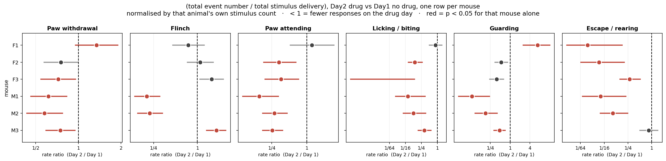
The forest plot itself
Read across a row to follow one animal. M1 and M2 are red in every panel. F1 is the exception: unchanged or up for the pain behaviours, but still down for escape / rearing.

Slide 10
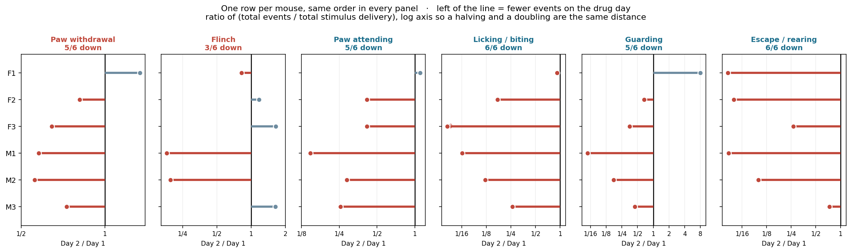
The same thing without confidence intervals
Simpler version of the previous slide: dot and stick, no statistics. Useful when the point is only the direction and size.

Slide 11
3. Day 2 on its own
the same descriptive figures we made for Day 1, computed from the drug day only

Slide 12
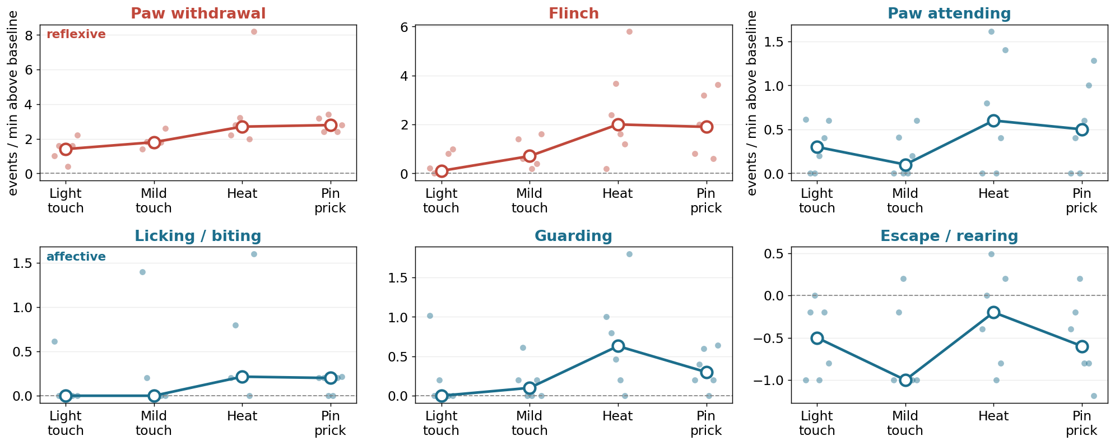
Day 2 only: response by stimulus
the Day-1 ordering (light touch smallest, heat largest) is largely flattened

Slide 13
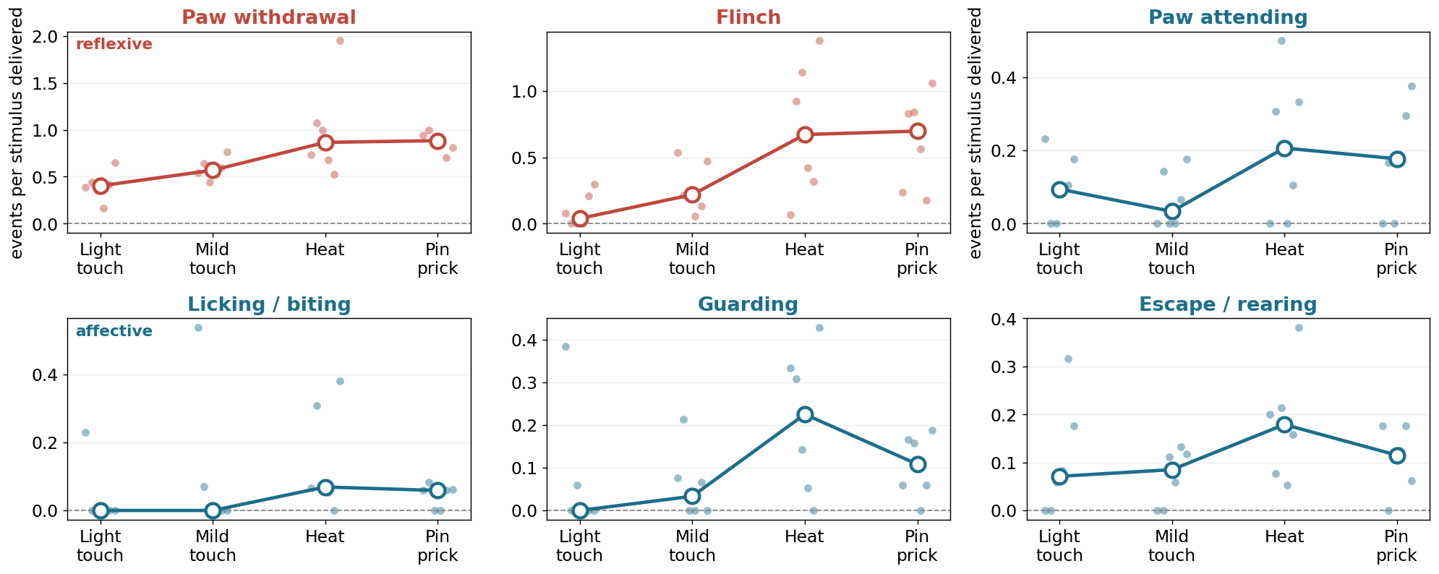
Day 2 only: total event number / total stimulus delivery
the comparable version - each mouse divided by its own delivery count

Slide 14
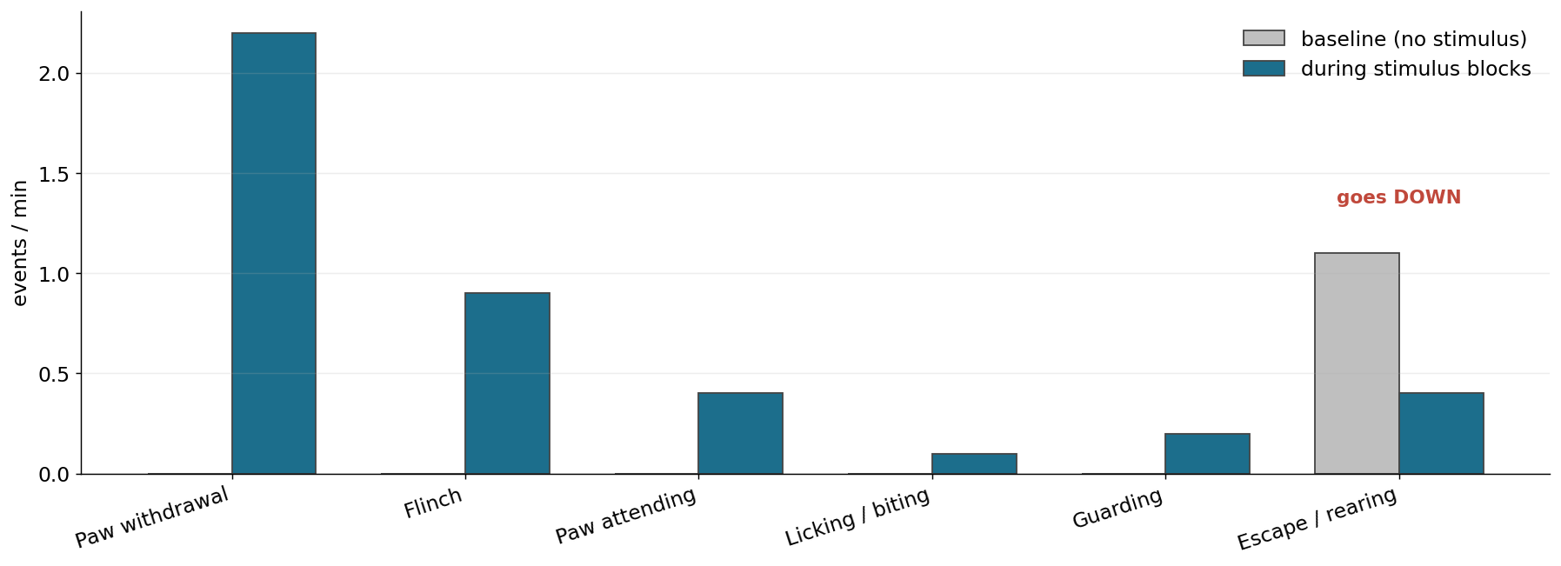
Day 2 only: stimulus blocks against each animal's own baseline
worth comparing with the Day-1 version: escape / rearing no longer has a high baseline to fall from

Slide 15
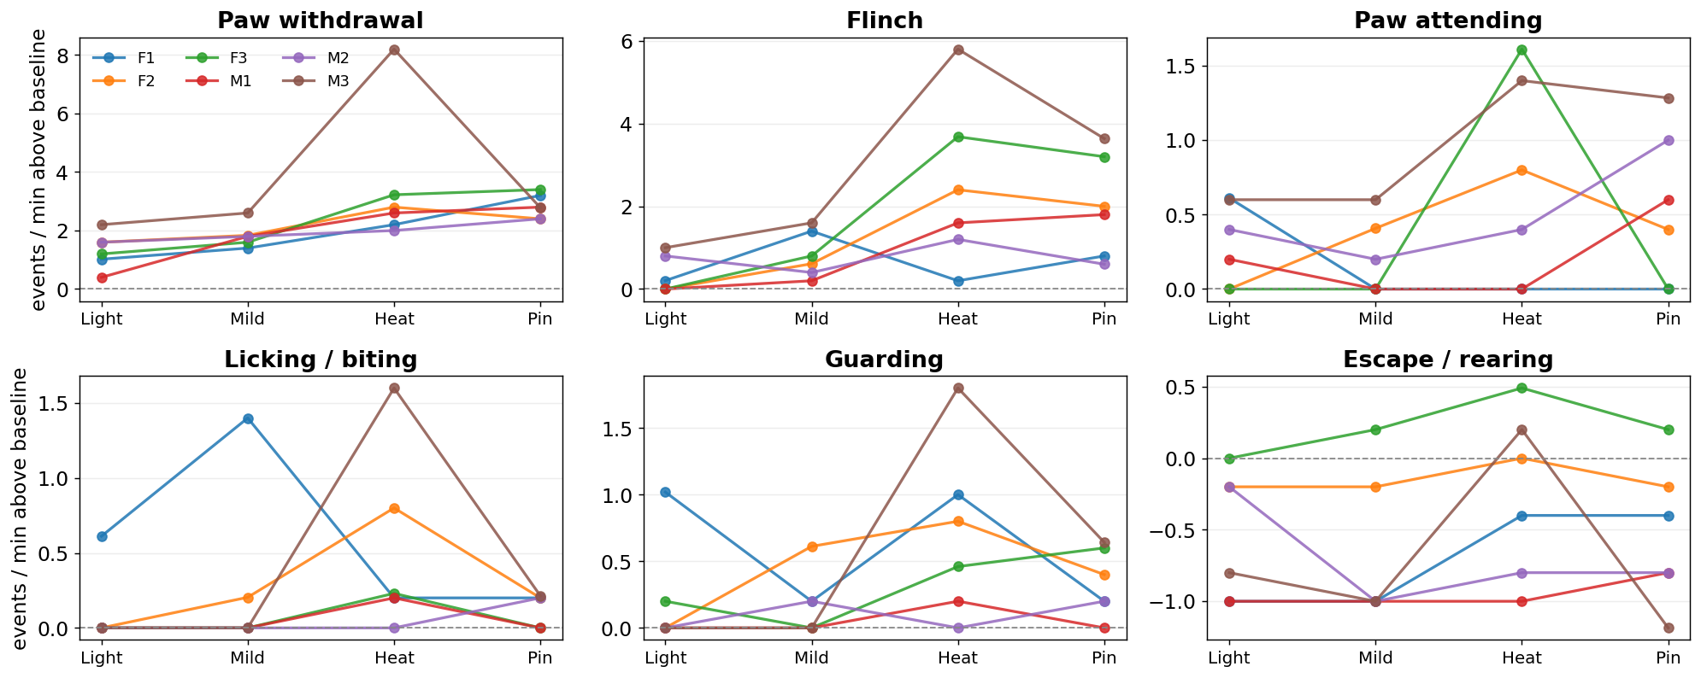
Day 2 only: every mouse individually
one panel per animal, no averaging

Slide 16
4. Activity measured from the video
independent of the manual scoring - it comes from the pixels

Slide 17
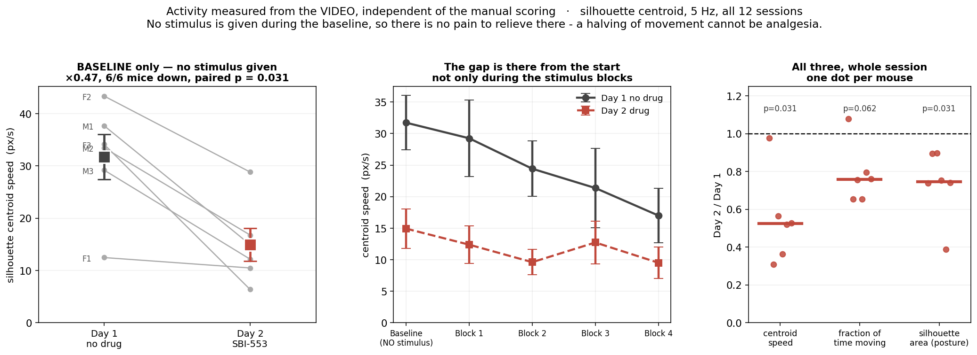
The baseline is the decisive comparison
No stimulus is delivered during the baseline, so there is no pain to relieve. Movement was already halved there in 6/6 mice (p = 0.031). That cannot be analgesia.

Slide 18
What the video measured, baseline only
the first 5 minutes of the session, before any stimulus
measure | Day 1 | Day 2 | ratio | mice down | p
centroid speed (px/s) | 31.7 | 14.9 | 0.47 | 6 / 6 | 0.031
fraction of time moving | 0.72 | 0.52 | 0.73 | 6 / 6 | 0.031
silhouette area (posture) | 30536 | 23167 | 0.76 | 6 / 6 | 0.031

Slide 19
Putting it together
the conclusion the data supports
Three independent lines point the same way
escape/rearing from the scoring (×0.08), baseline movement from the video (×0.47), and the reduction being the same size in every period
A selective analgesic predicts none of that
it should spare exploration and act only when a stimulus is applied
So the honest description is a general reduction in activity
at this dose and 10 min after injection
What it does NOT rule out
analgesia could be present as well and simply hidden. A lower dose, a later time point, and a vehicle group would separate them.

