Slide 1
Acute pain assay under mini1p imaging
Day 1 baseline, six mice — what the behaviour looks like
before we add SBI-553
Hansol Lim · 2026-09-03

Slide 2
Day 2 result, in one line
Every behaviour fell after SBI-553 — including the one that is NOT a pain measure.
Escape / rearing is exploration. On Day 1 it went DOWN under stimulation, so it is not
pain. It fell to 8 % of Day 1 — the largest drop of any behaviour. Reflexes fell least
(withdrawal to 72 %).
That pattern is what sedation looks like, not selective analgesia. All six mice got
SBI-553, so there is no vehicle group to separate drug from day, order or habituation.

Slide 3
How to read this deck
four things that make the rest of the slides readable
Day 1 = no drug, Day 2 = SBI-553 10 min before the assay
same six mice, same four stimuli, block order randomised
Every number is total events ÷ total stimuli delivered
the stimulus is hand-delivered so the count is never fixed: 83–100 taps on Day 1, 58–71 on Day 2
Two behaviour classes, never added together
REFLEXIVE withdrawal + flinch · AFFECTIVE attending + lick/bite + guarding · and escape/rearing as the exploration control
n = 6, paired. The smallest p this test can give is 0.031
so 0.031 means ‘all six moved the same way’, which is the strongest statement the design supports

Slide 4
Method
design, behaviours, and what the scoring actually captures

Slide 5
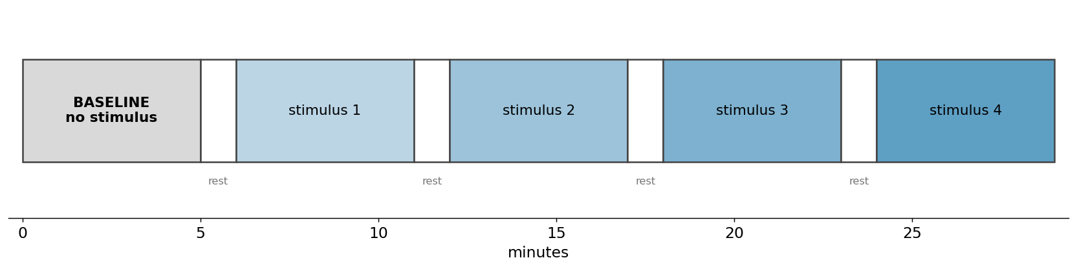
Session design
5 min baseline, then four 5 min stimulus blocks on a fixed clock, 1 min rest between
Block order is randomised per mouse, so stimulus identity is not confounded with time in the session.

Slide 6
Six behaviours, two classes - kept separate on purpose
Corder / Scherrer framework
REFLEXIVE paw withdrawal, flinch
spinally mediated, locked to contact. Scored as taps, 3 s response window.
AFFECTIVE-MOTIVATIONAL paw attending, licking / biting, guarding
supraspinal, builds over 1-8 s after contact. 10 s window.
ESCAPE / REARING scored, but read as exploration
baseline rate is 3.8 per min and it DECREASES under stimulation. Not a pain measure.
Never summed into one pain score
a biased agonist is expected to move the affective class without matching the reflexive one - summing would hide exactly that.

Slide 7
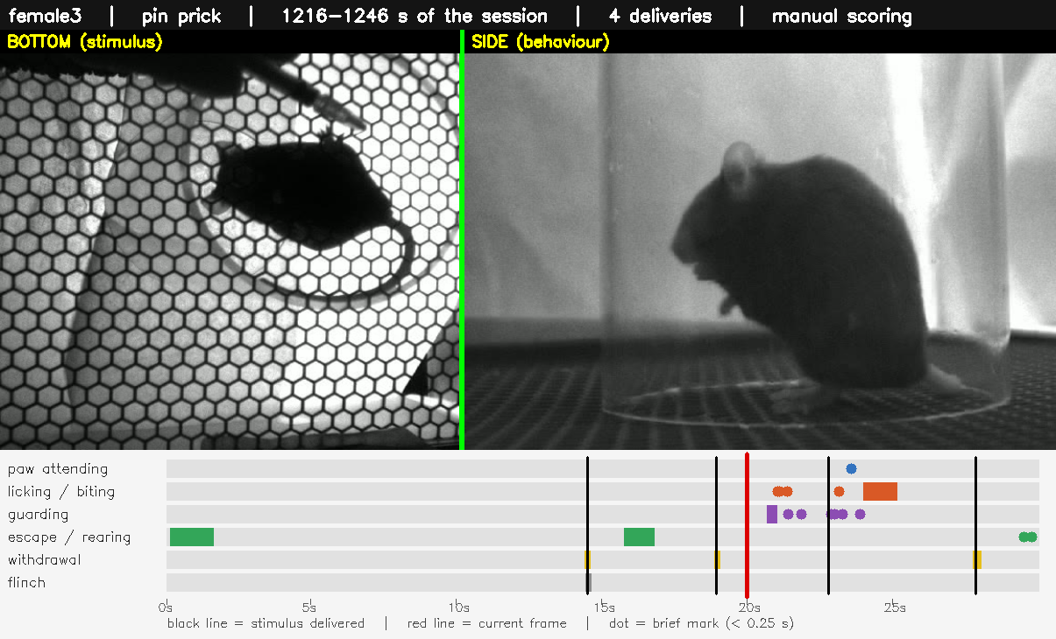
What the scoring looks like
30 s, both cameras, labels burned in
click to play · side view is the analysis view; the bottom view cannot resolve individual paws

Slide 8
Day 1 QC outcome
nothing was inferred or filled in; every correction is traceable to the block clock
 | result
Sessions scored | 6 of 6, all four stimulus blocks clean
Stimulus mis-keys resolved | 18 of 18, using the fixed block clock
Fast repeated taps merged | corrected copy only, counts unchanged
Original scoring | never modified - corrections go to a separate folder
Deliveries per mouse | 83 to 100 across the session
Remaining flags | 2, informational only (typed vs sheet stimulus names)

Slide 9
Why total event number / total stimulus delivery
the one methodological point that everything else rests on

Slide 10
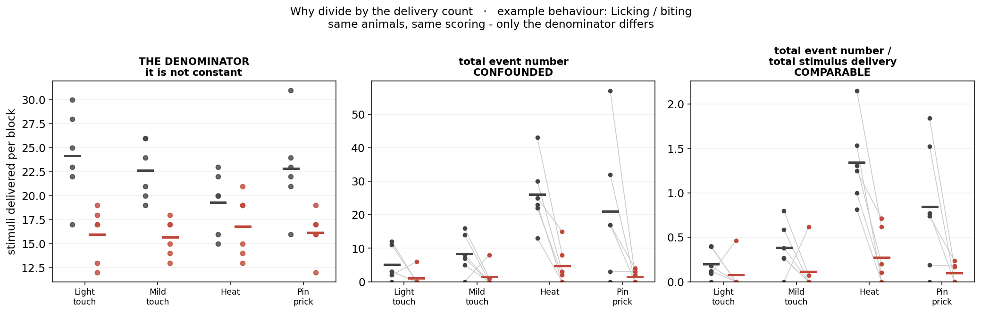
The denominator is not constant
Ten flinches from ten taps and ten flinches from twenty taps are the same raw count and a different animal - 10/10 = 1.00 vs 10/20 = 0.50. Every figure from here on divides by the delivery count.

Slide 11
How long is a stimulus block?
behaviour does not stop when the stimulus does, so the 1 min rest was tested both ways

Slide 12
Two block definitions, both computed
both versions are in the repository; the figures below use the 5 min version unless stated
5 min - the stimulus period only
the block's first delivery plus 300 s
6 min - the stimulus period plus the 1 min rest that follows it
the rest is attributed to the block before it, because nothing else caused it and the next block has not started
The denominator is identical in both
the rest minute contains no deliveries, so total events / total stimulus delivery is directly comparable between the two
events per MINUTE is not comparable between them
the divisor changes 5 to 6, so that rate drops about 17 % mechanically even if nothing changed

Slide 13
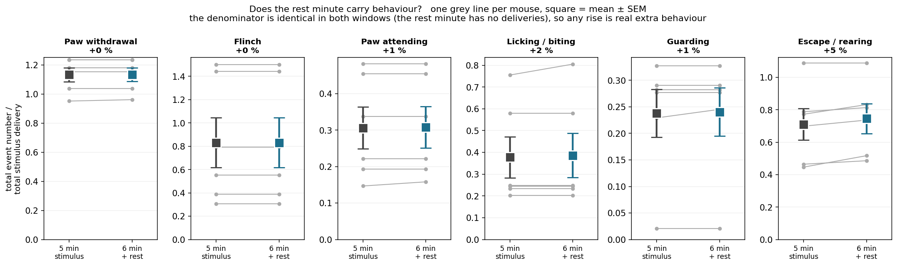
The rest minute adds almost nothing - except rearing
Pain behaviours are flat (+0 to +2 %). Escape / rearing rises +5 % in every mouse - consistent with it being exploration that resumes once the stimulus stops, not pain.

Slide 14
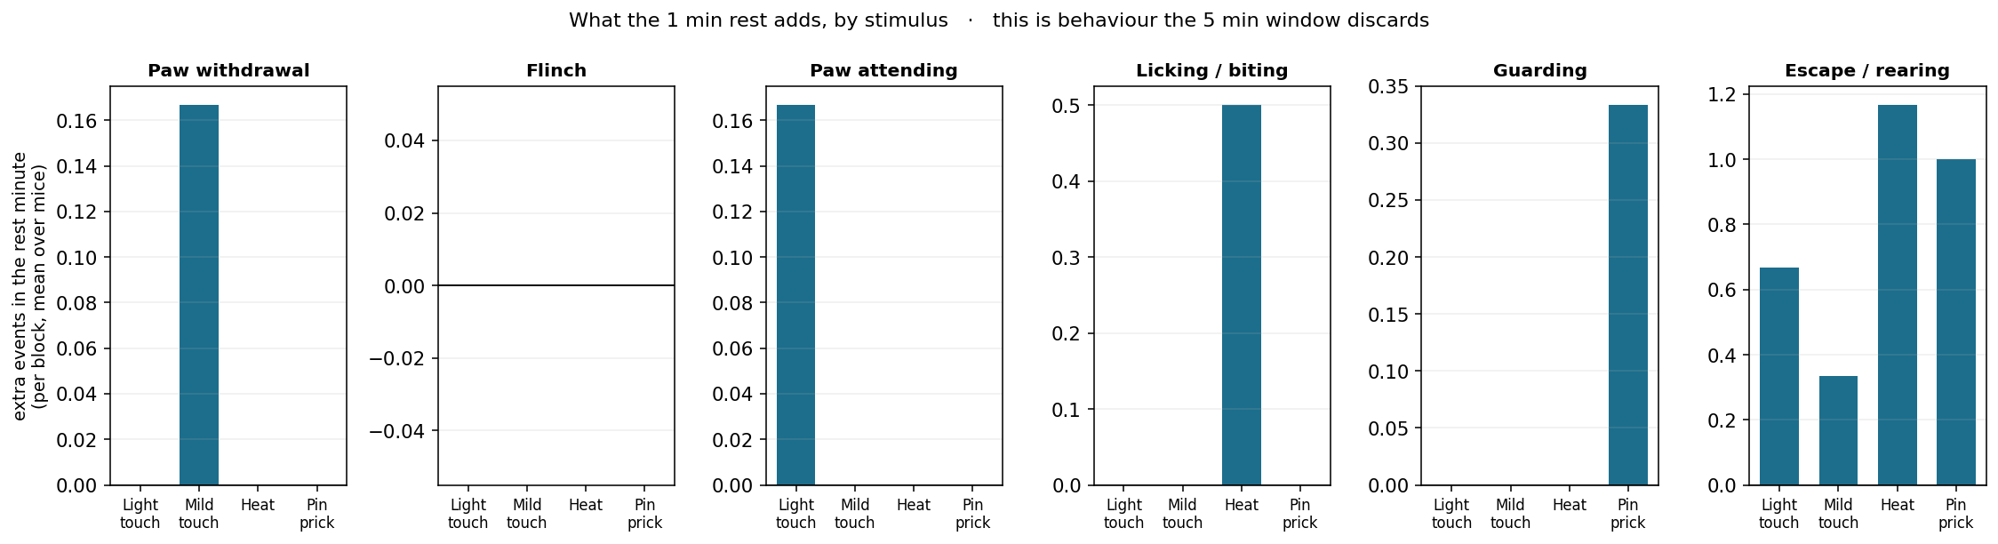
Why the rest minute contributes so little
Because the 5 min window ALREADY contains a mean of 45 s of quiet time: deliveries finish before the 300 s mark (first-to-last span, median 256 s). The extra minute lands further out, where behaviour has already subsided.

Slide 15
Day 1
six mice, no drug - what the assay measures

Slide 16
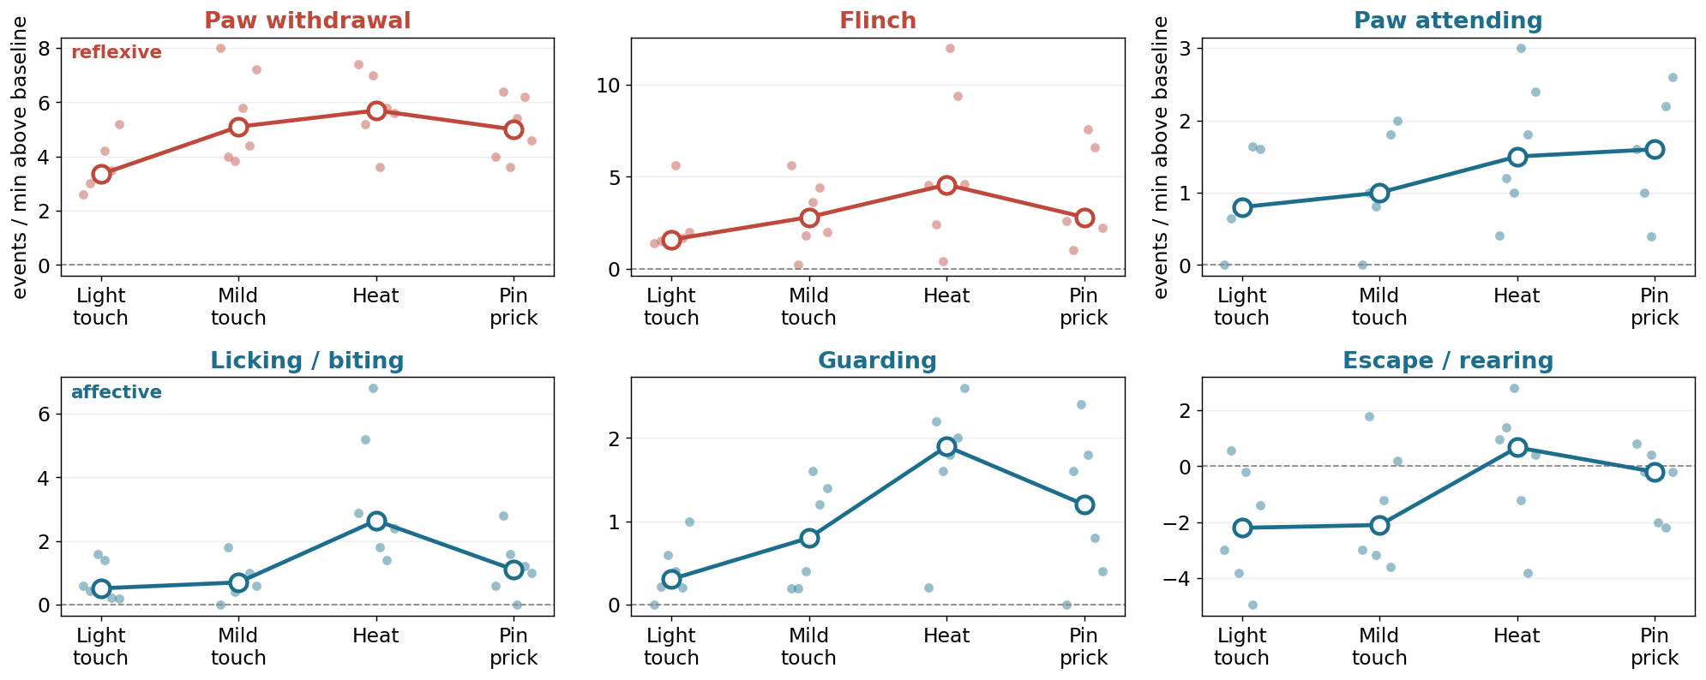
Response by stimulus
rate per minute within each 5 min block
Light touch smallest and Heat largest for every behaviour; pin prick sits between them. Not monotonic with nominal intensity.

Slide 17
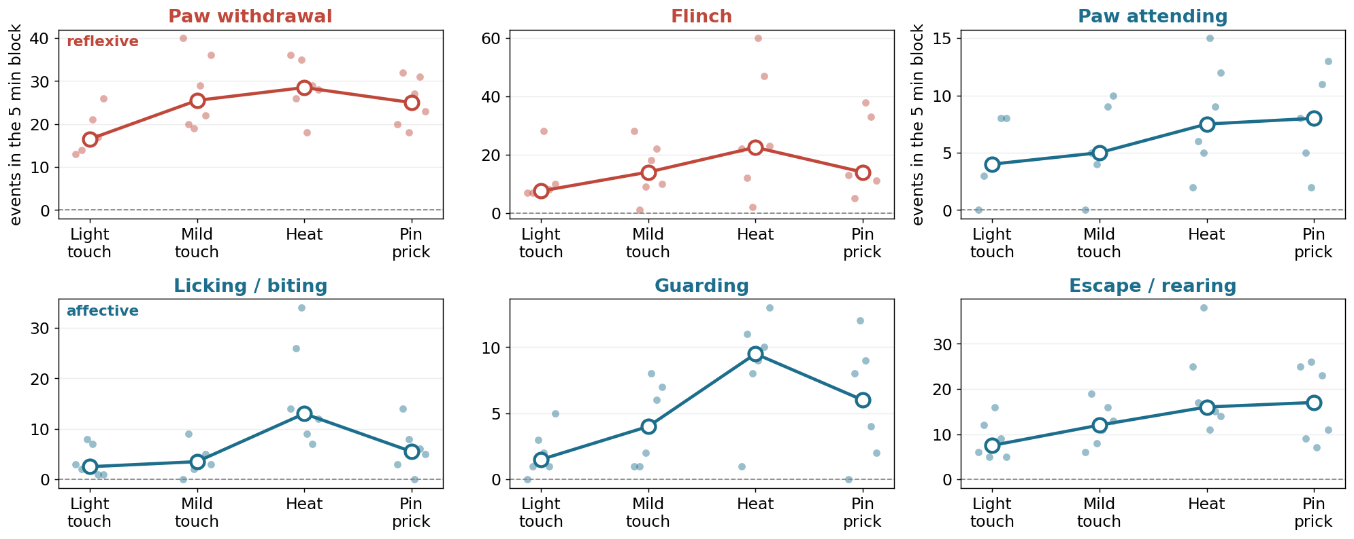
Raw event counts per block
the unnormalised view, shown for completeness
Read with the previous slide in mind: the block is a fixed 300 s but the number of taps inside it is not.

Slide 18
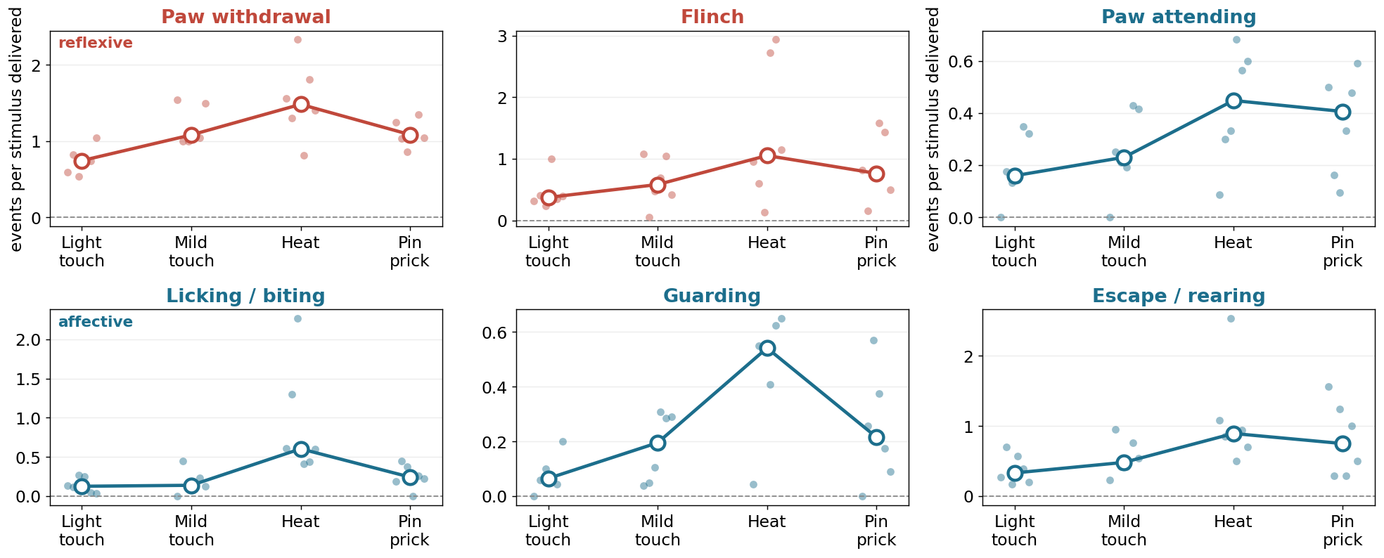
Total event number / total stimulus delivery
each mouse divided by its own delivery count
This is the comparable version of the previous slide.

Slide 19
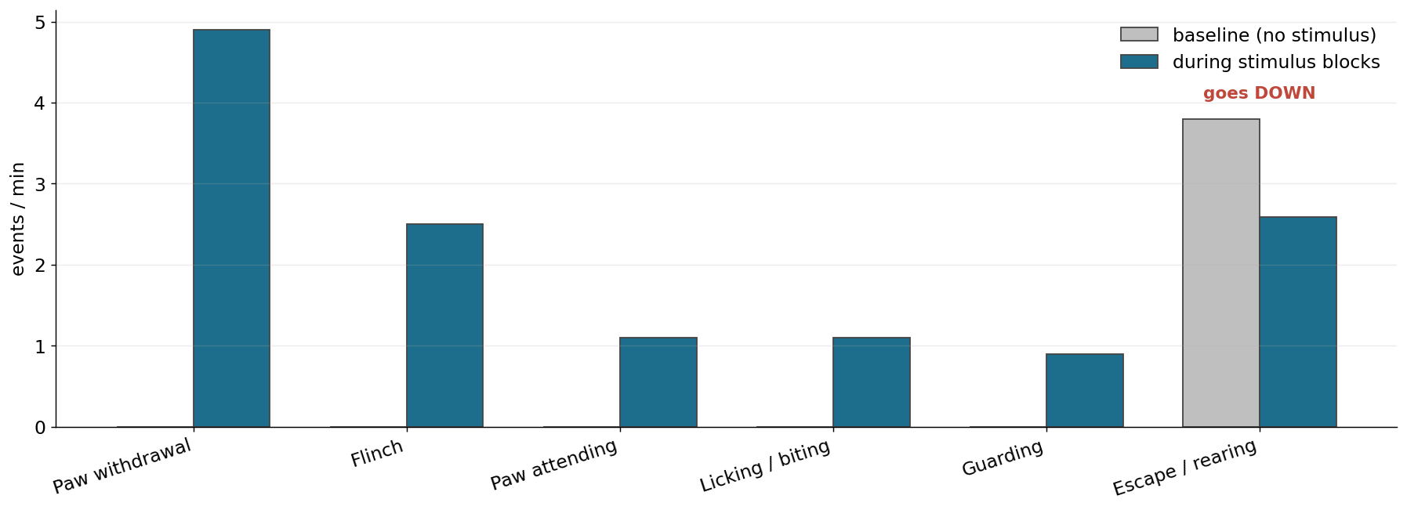
Stimulus blocks against each animal's own baseline
5 min baseline vs the four stimulus blocks
Escape / rearing goes DOWN under stimulation - the clearest evidence it is exploration rather than pain.

Slide 20
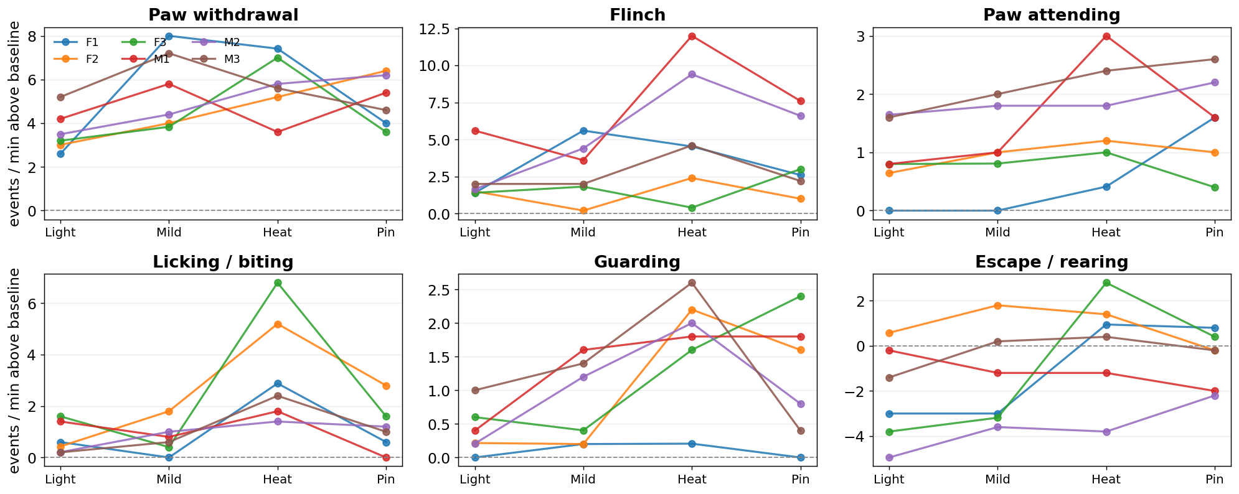
Every mouse individually
no averaging - one panel per animal
Between-animal spread is large. It is the reason the paired design matters more than the group size.

Slide 21
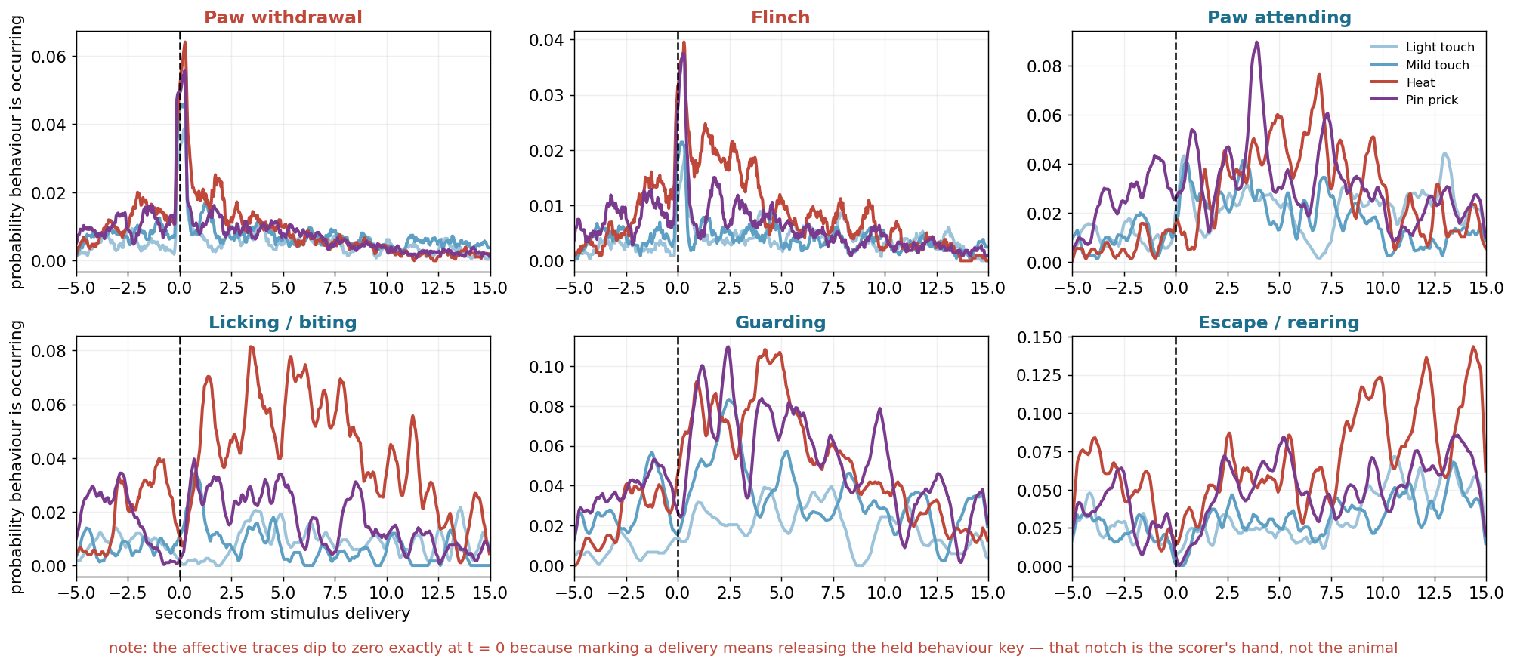
Response time course around each delivery
peri-stimulus histogram, aligned to stimulus contact
Reflexes are locked to contact; affective behaviour builds over several seconds. This is what sets the two response windows.

Slide 22
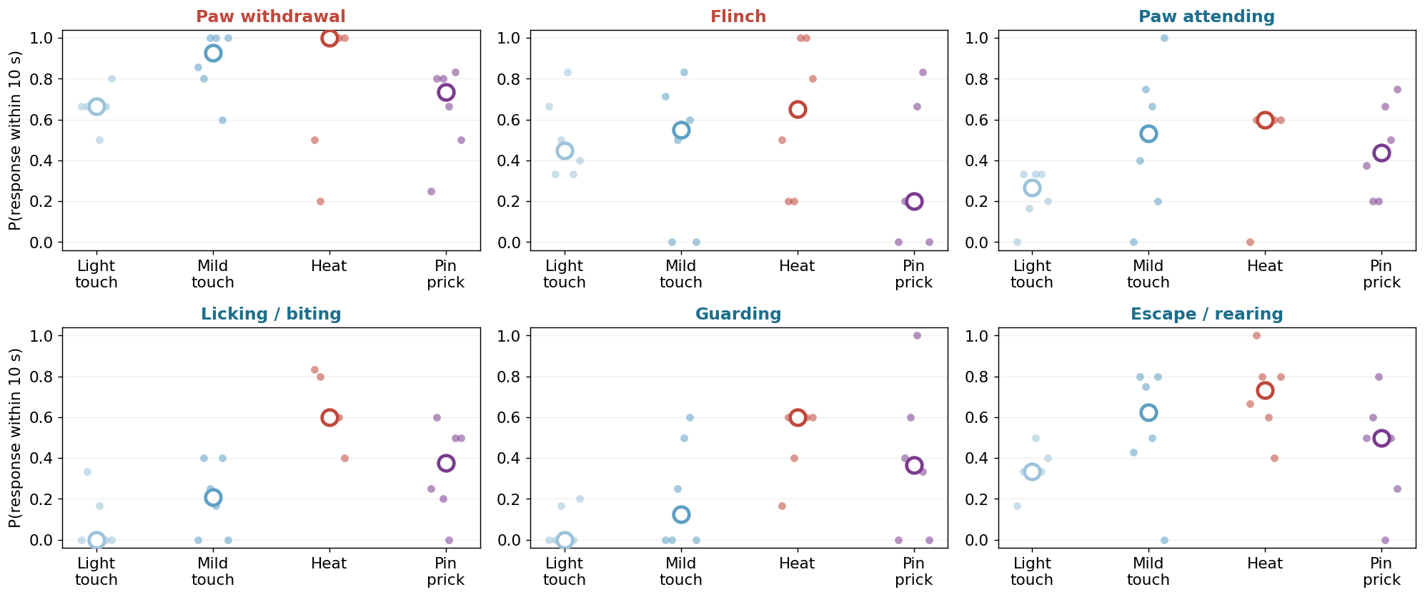
Probability of responding to a single delivery
10 s window, restricted to deliveries with 10 s of clearance
A 3 s window put Heat BELOW light touch for attending - it cut the affective response off before it started. 10 s reverses that (0.600 vs 0.267).

Slide 23
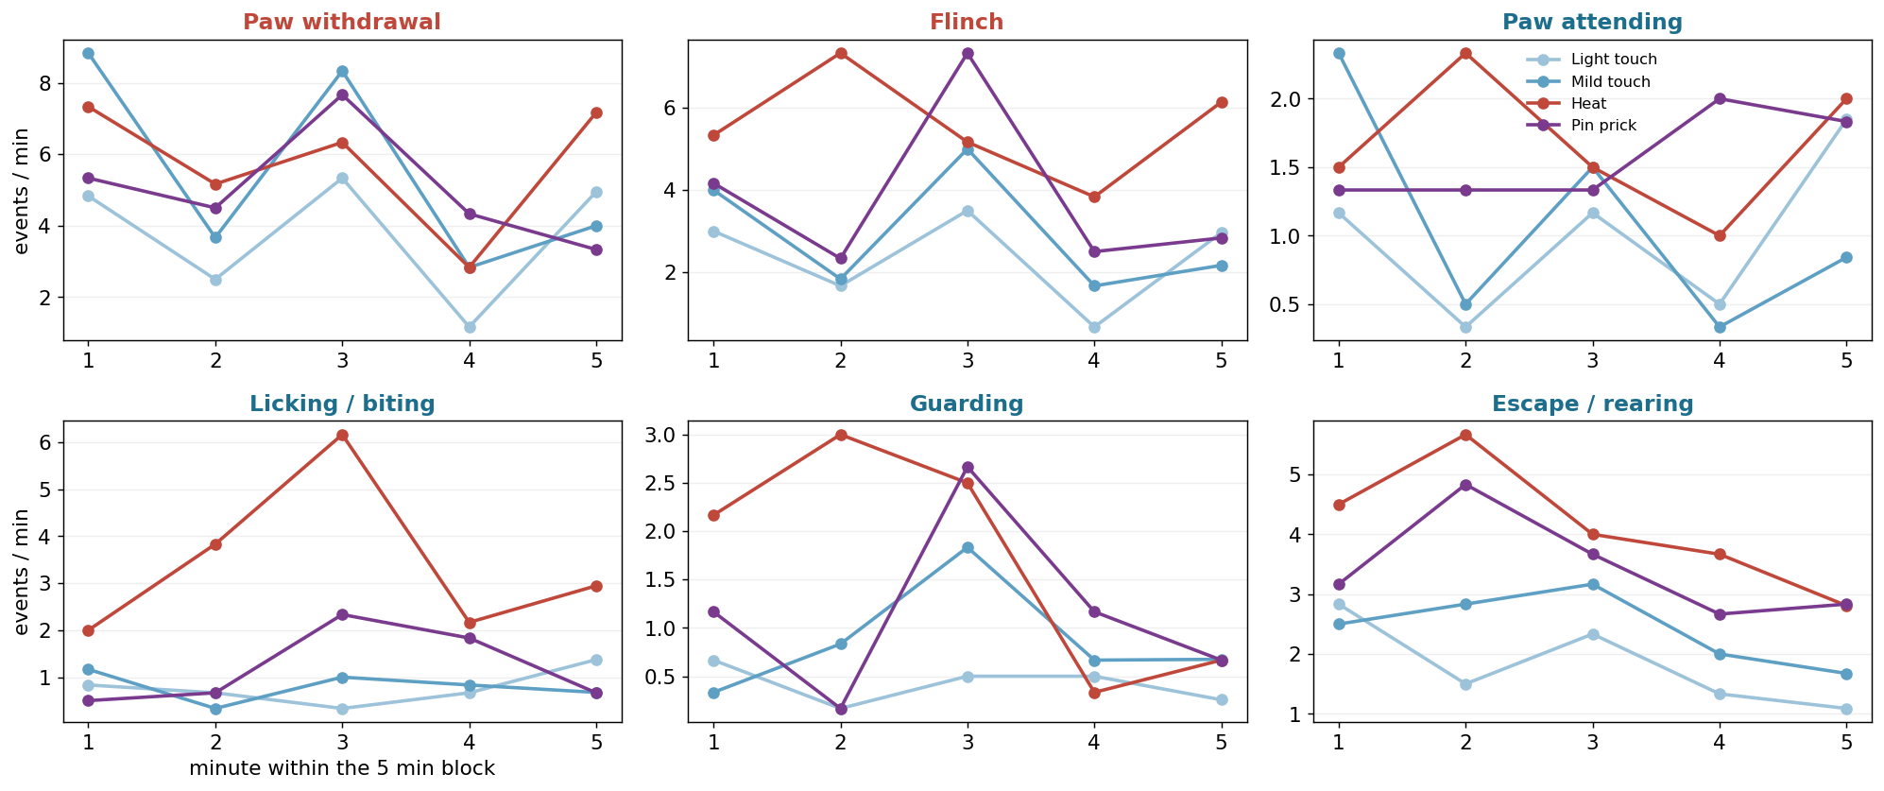
Does the response fade within a block?
1 min bins across each 5 min stimulus block
Worth watching on Day 2: a drug can lower the level or steepen the fade, and those are different mechanisms.

Slide 24
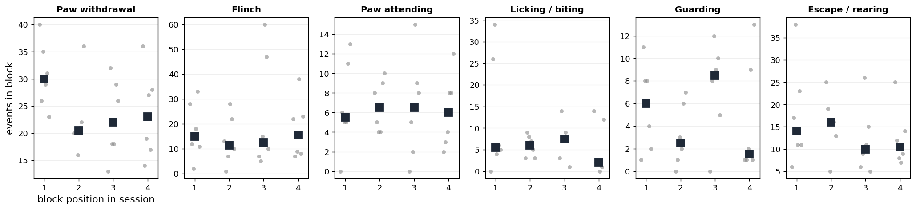
Control: block position does not drive the result
response by position in the session, ignoring which stimulus it was
Flat, which is what validates the randomised block order.

Slide 25
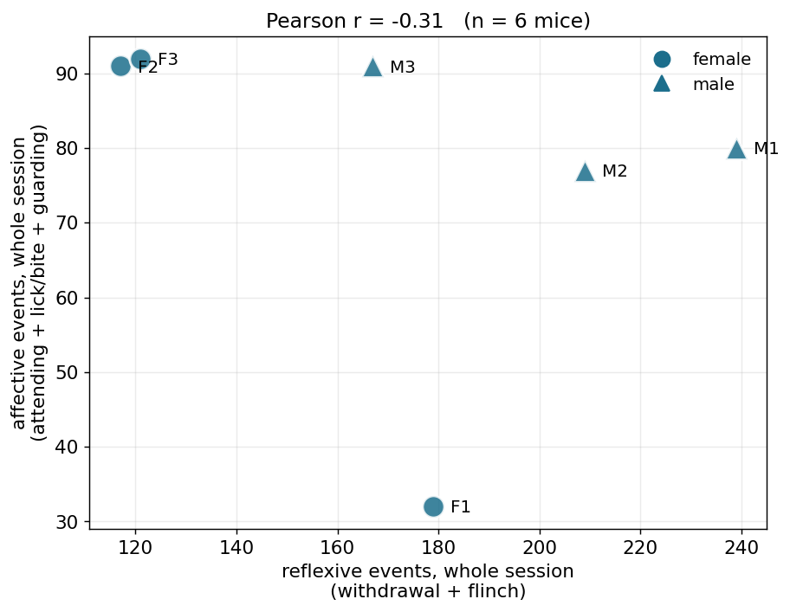
Reflexive against affective, per mouse
the two classes are not interchangeable
The axis SBI-553 is supposed to move: affective down without a matching reflexive change.

Slide 26
Day 1, what we can say
real data, six mice
The assay separates stimulus intensities
light touch smallest, heat largest, for all six behaviours
Reflexive and affective responses have different time courses
locked to contact vs building over 1-8 s - so different windows
Escape / rearing is exploration, not pain
3.8 per min at baseline and it falls under stimulation
Block position is not a confound
the randomisation works
Between-animal spread is the limiting factor, not scoring noise
median CV 0.49 across mice - which is why Day 2 must be paired

Slide 27
Day 2 SBI-553
same six mice, dosed 10 min before the assay. No vehicle group.

Slide 28
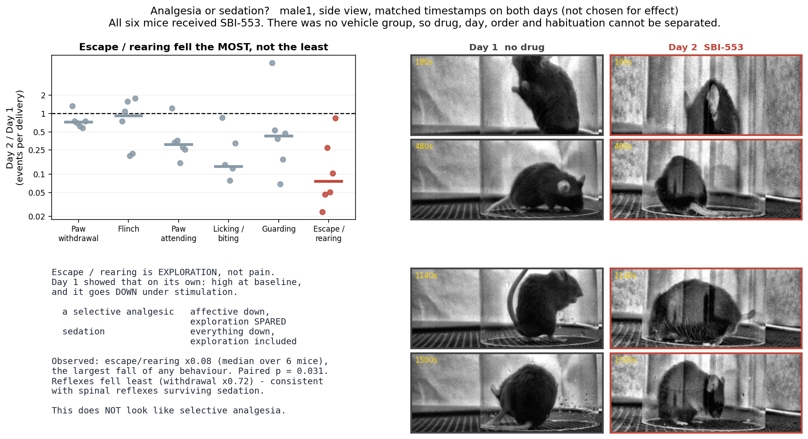
Analgesia or sedation? The exploration control answers it
Escape / rearing is not a pain measure, and it fell hardest (to 8 %). Reflexes fell least (to 72 %). A selective analgesic would have spared exploration.

Slide 29
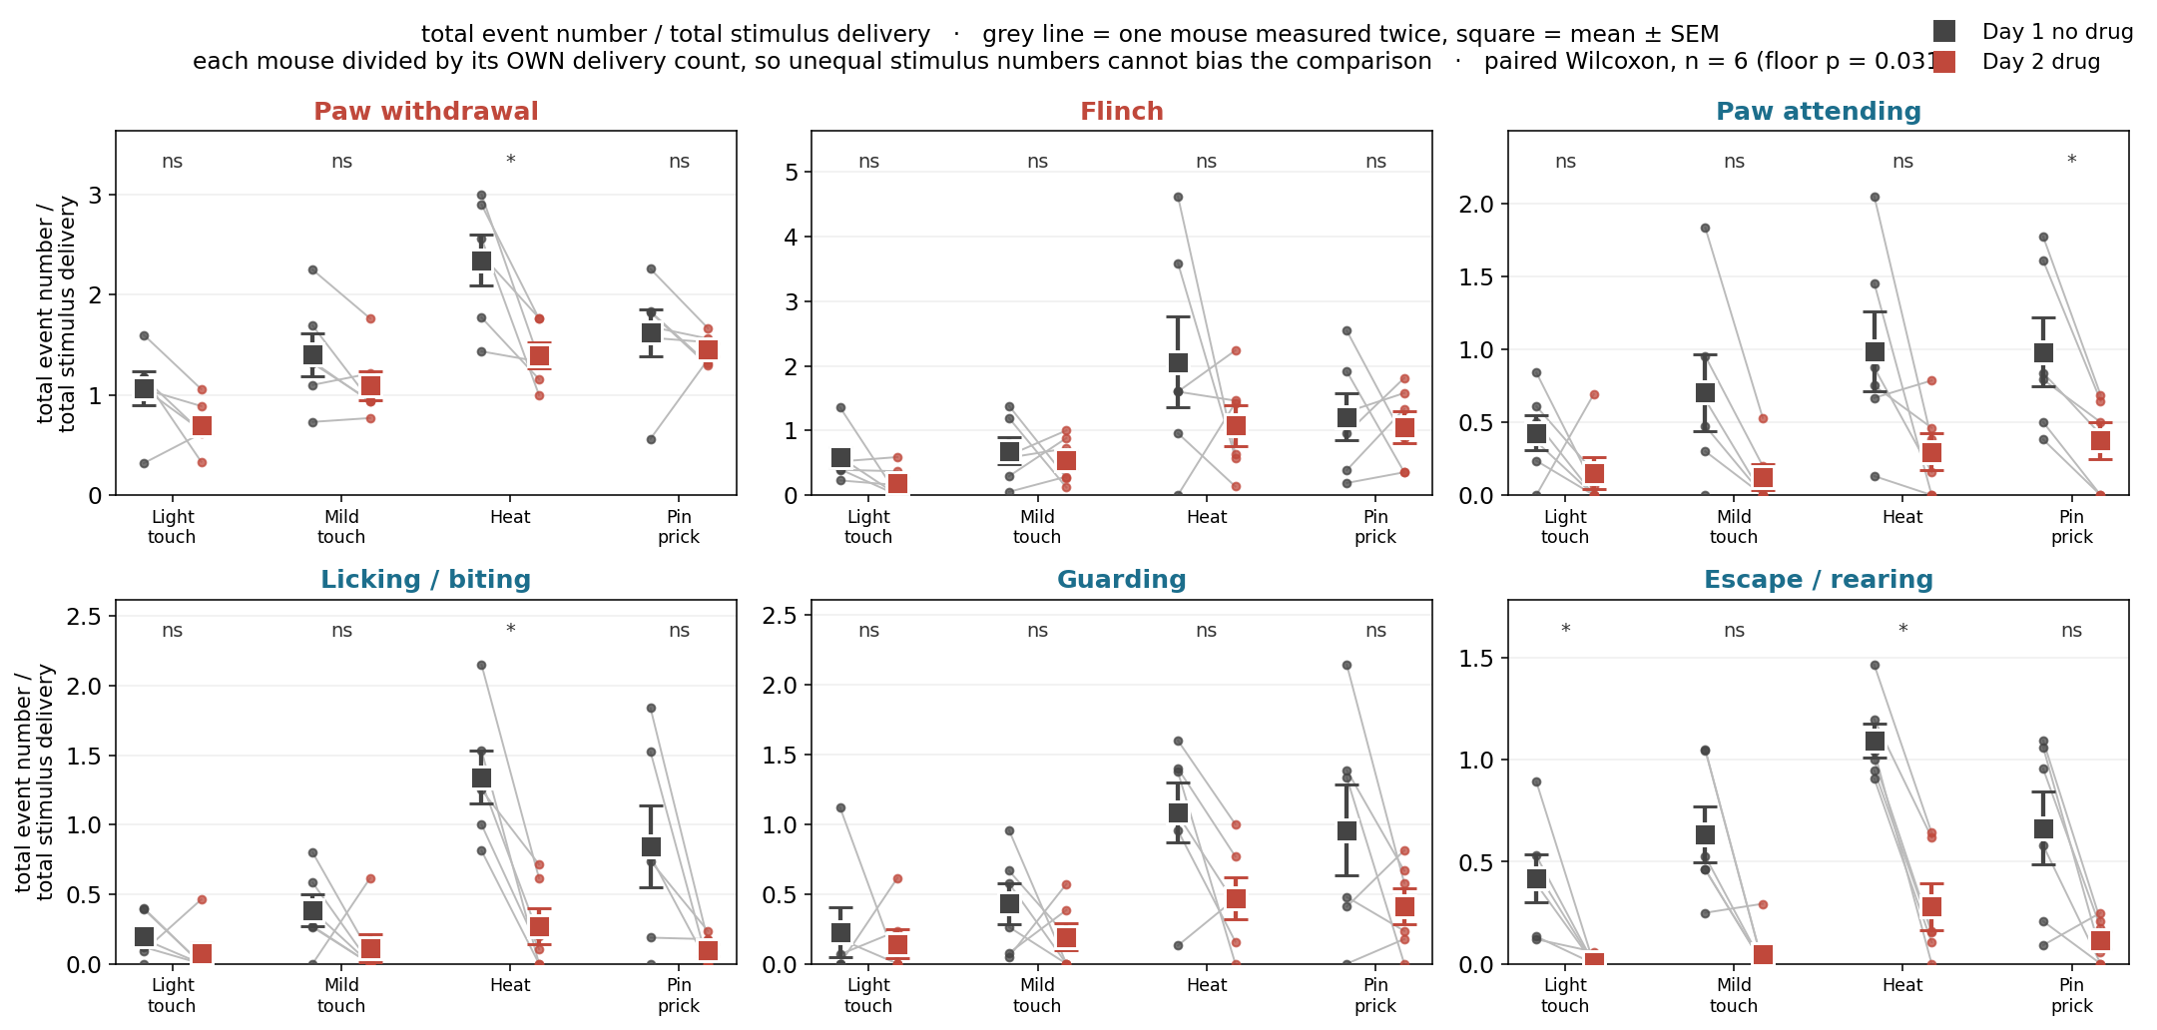
Primary figure: total event number / total stimulus delivery, both days
grey line = one mouse measured twice

Slide 30
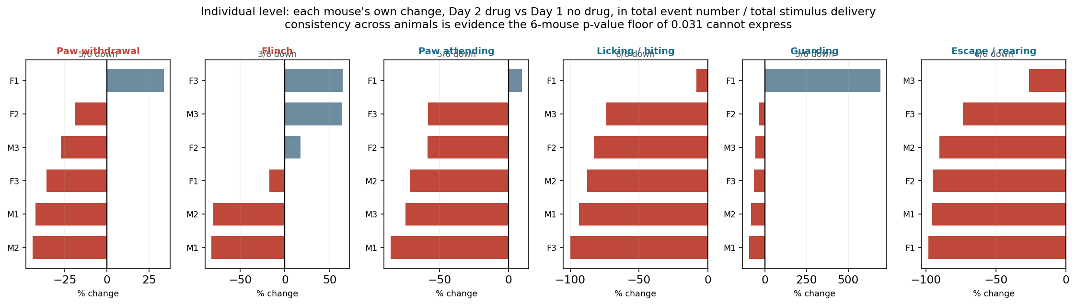
Individual level: each mouse's own change
consistency across animals is evidence the six-mouse p-value floor cannot express

Slide 31
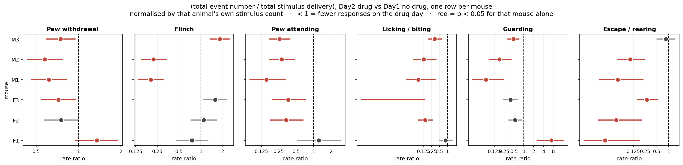
Individual level with statistics
a per-mouse test is possible only because each delivery is a trial

Slide 32
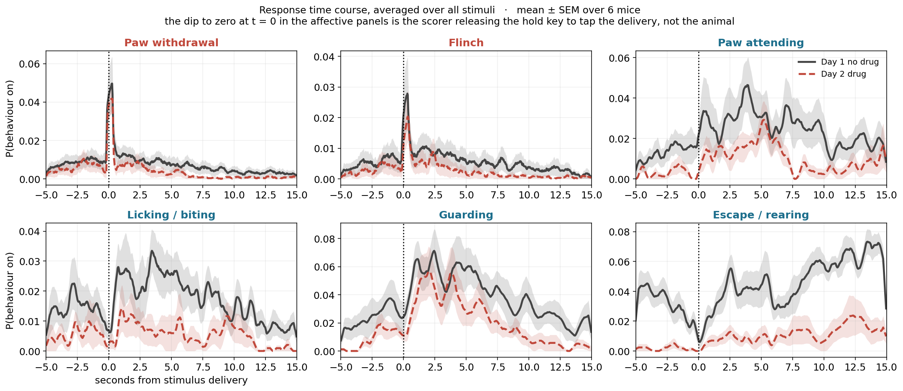
Does the drug change the response shape?
amplitude, latency and duration are separable here

Slide 33
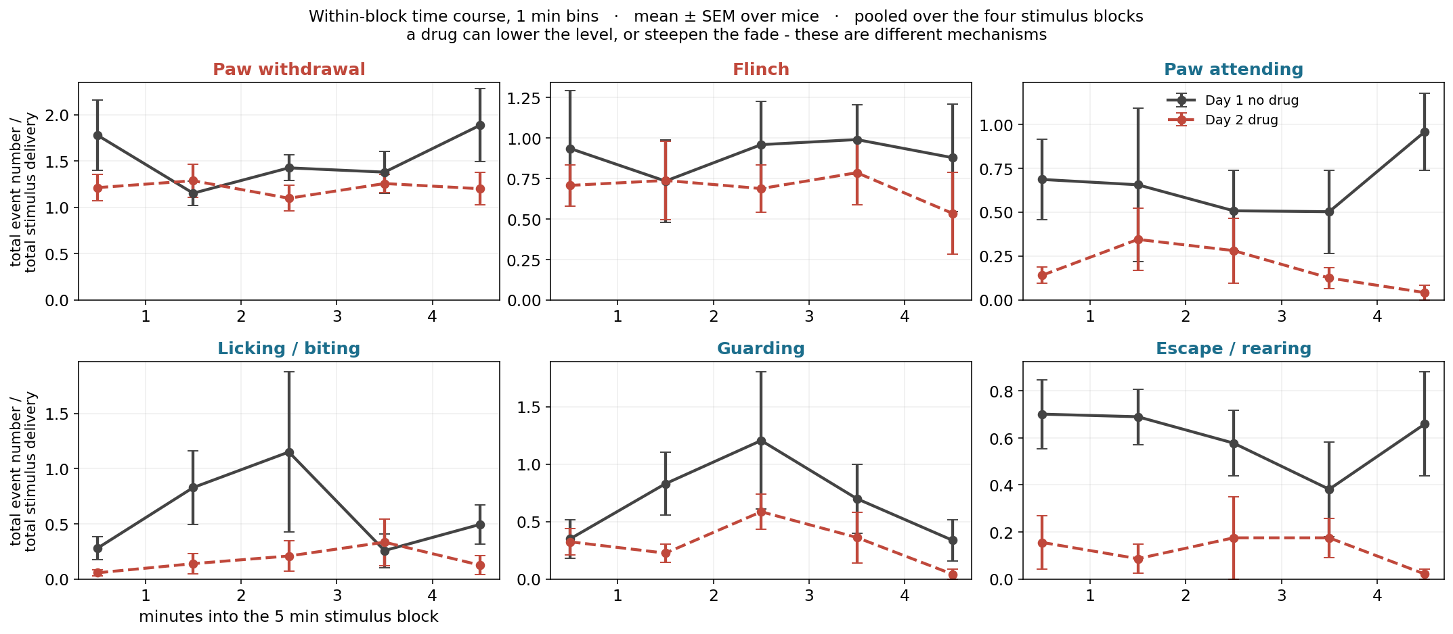
Does the drug change the within-block fade?
a lower level and a steeper fade are different mechanisms

Slide 34
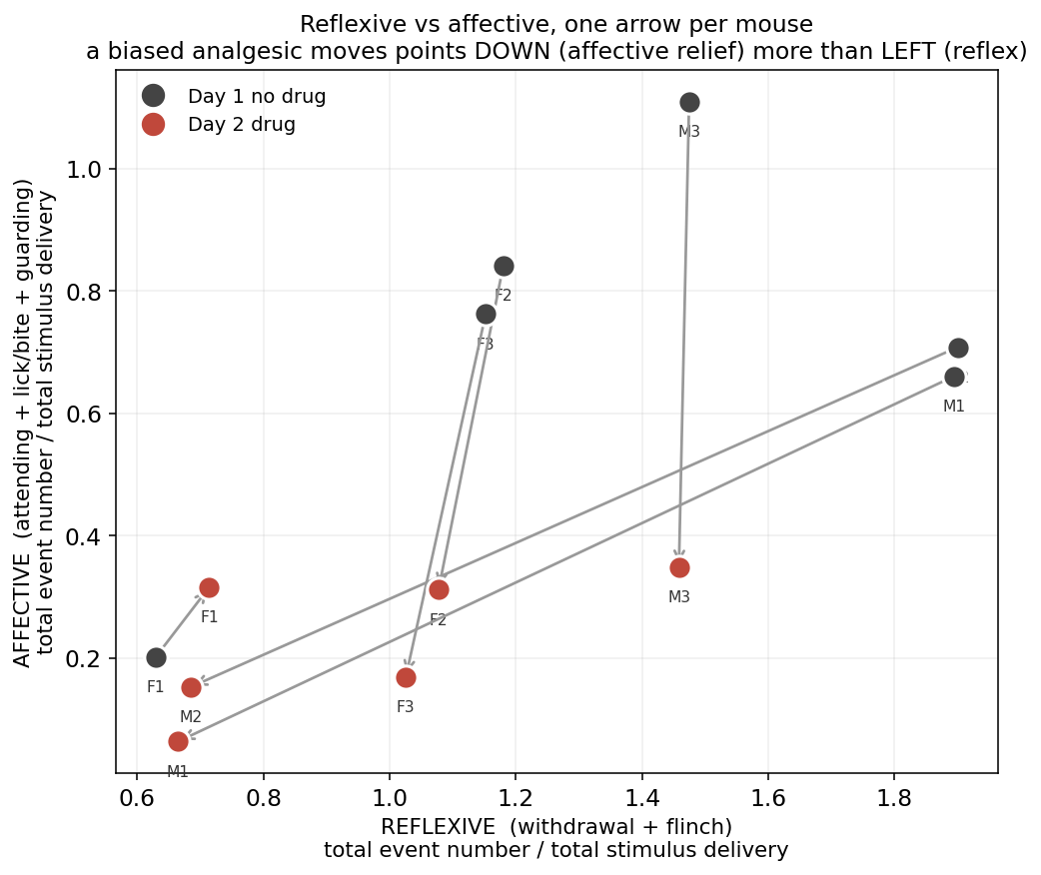
The dissociation the drug is meant to produce
a biased agonist moves points DOWN more than LEFT

Slide 35
How much can n = 6 actually show?
from the measured between-mouse variability and from the arithmetic of the exact test

Slide 36
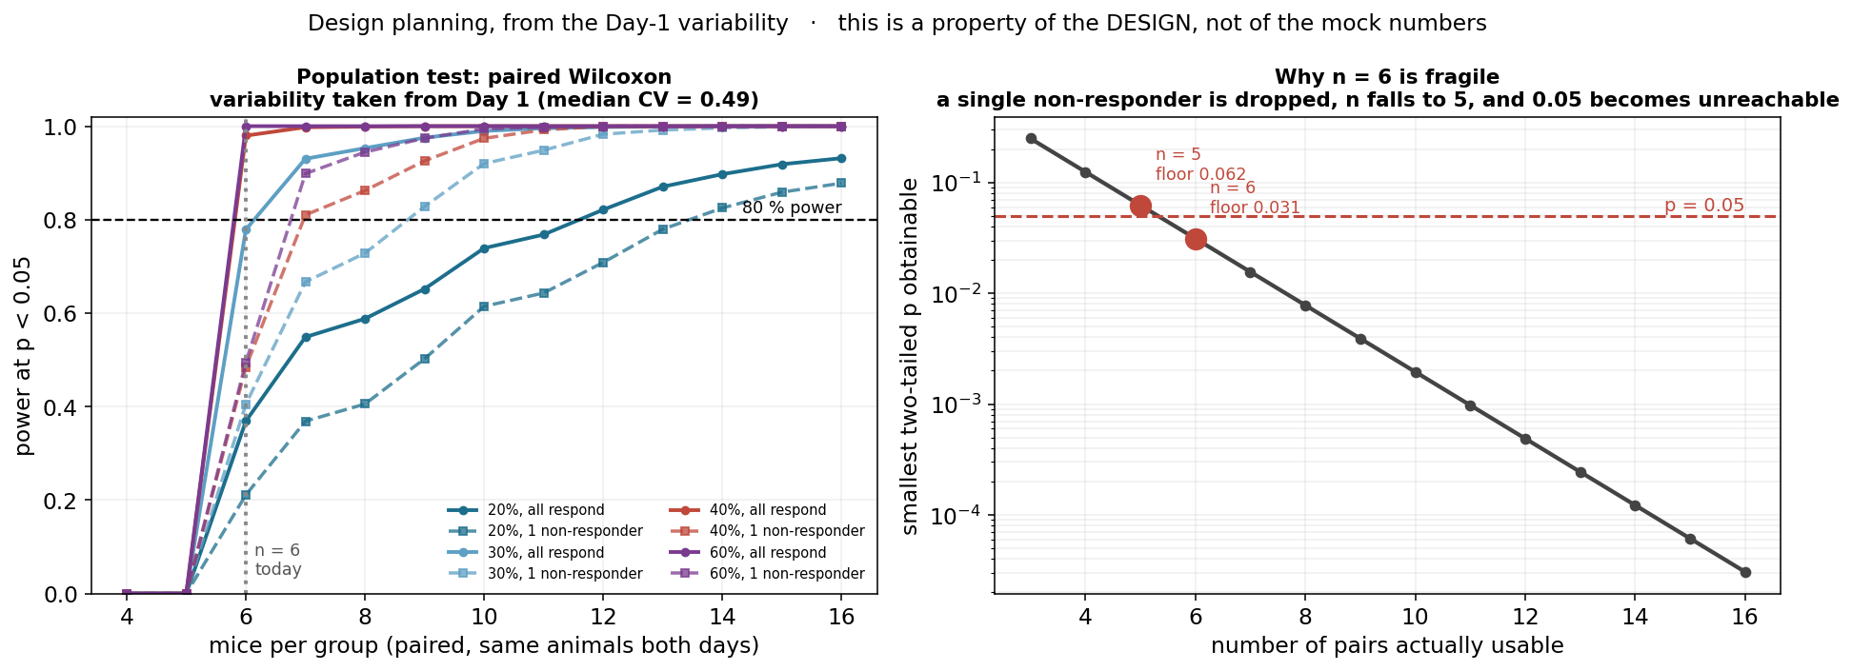
n = 6 may not be enough
Left: with one non-responder, power for a 40 % effect at n = 6 falls from 0.98 to about 0.49. Right: the exact paired test floors at 2/2^n, so at n = 5 usable pairs p < 0.05 is arithmetically impossible.

Slide 37
Two levels of statistics, and what each can deliver
the population test is the design; the per-mouse test is what rescues it at n = 6
level | unit | n | test | what limits it
Population | the mouse | 6 | paired Wilcoxon (primary) | floors at p = 0.031; one non-responder raises it to 0.062
Population | the mouse | 6 vs 6 | Mann-Whitney (secondary) | reaches 0.0022, but ignores the pairing the design bought
Individual | one delivery | ~90 per mouse per day | Fisher exact / rate ratio | well powered for reflexes, detects only large shifts for affective
Direction | the mouse | 6 | how many moved the same way | not a p-value, but survives the floor

Slide 38
What this experiment cannot tell us yet
the honest list, so nobody over-reads the result
A vehicle group. All six mice got SBI-553
so drug, day, block order and habituation are confounded. The next cohort must have a vehicle arm.
Whether the drop is analgesia at all
escape / rearing fell to 8 % - the exploration control fell hardest. A locomotion or body-temperature readout would settle it directly.
A dose that separates the two
if 10 min post-dose is peak sedation, a lower dose or a later time point may show analgesia without hypoactivity
Animal number
n = 6 gives ~0.49 power for a 40 % effect if one animal does not respond. n = 8-10 is robust.
A hardware stimulus marker (TTL or LED on the applicator)
solves timing, stimulus identity and camera sync at once, and takes the scorer out of the delivery mark

Slide 39
What it does show
what the data supports as it stands
The assay works and the scoring is reliable
four clean stimulus blocks in all twelve sessions, and the stimuli separate on Day 1
SBI-553 at this dose and timing produces a large, consistent behavioural reduction
6/6 mice for lick/bite and escape, paired p = 0.031 - the floor of the test
The reduction is NOT selective for pain behaviours
reflexes fell least (x0.72), exploration fell most (x0.08). That ordering is the opposite of a biased analgesic.
The per-delivery design makes per-mouse tests possible
escape / rearing is individually significant in 5 of the 6 animals on their own ~60-100 deliveries

