Slide 1


Land Price Evaluation
KUALA LUMPUR
The Elementals

Slide 2
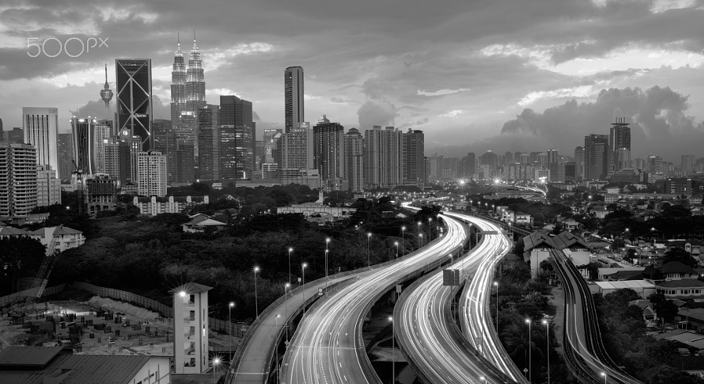

CFLD
AGENDA
1
Business Objectives
2
Methodology
3
Model Selection Process
4
Key Business Insights
5
Optimal Investment Strategy

Slide 3
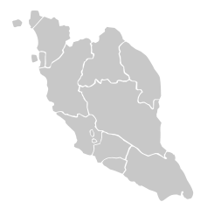
Business Objective
Understand KL’s land viability for development
Identify determinants for land price appreciation
Strategic decision making based on key analytics insights

Slide 4
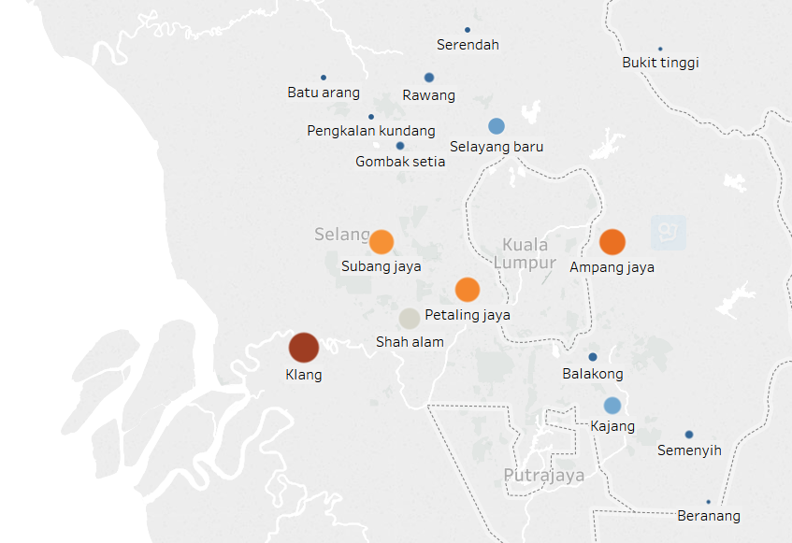






Kuala Lumpur – the 2nd most viable location for business
Target City/Town
50km to KL city center
15 potential cities/towns
Ampang jaya | Kajang | Selayang baru
Balakong | Klang | Semenyih
Batu arang | Pengkalan | Serendah
Beranang | Petaling jaya | Shah alam
Bukit tinggi | Rawang | Subang jaya
50km
Industrial Focus
Electrical & Electronics
Transport Equipment
Life Sciences
Food & Beverages Manufacturing
Machinery & Equipment
Notes:
Add symbols for each cities/location based on industrial focus. Refer to Eric’s research in Google Drive

Slide 5


Key Business Value
Innovative Data Sourcing
Creative Solutions
Business Significance
Extracting land and property prices separately
Evaluating viability using profit and ROI
Key Predictor Recommendations
Google API for automated data collection
Property price forecast using projected predictors
Optimal Investment Strategy

Slide 6
CFLD
AGENDA
1
Business Objectives
2
Methodology
3
Model Selection Process
4
Key Business Insights
5
Optimal Investment Strategy

Slide 7
methodology
Profit
ROI
Property Premium – Empty Land Price
Investment Profit / Investment Cost
Predicted by
Random Forest Model
Real Property Gains Tax as a measure to realize returns
Fitted to City/Town
Demographics
Land Use
NPV
Economics
 | First 3 years |  |  | 4th year | 5th year | 6th+ years
Invest | Initial Invest
Cost | Construction Cost |  |  | Operation Cost | Operation Cost | Operation Cost
Revenue | Property Sales + Rental + Management Fee
EBITDA | Revenue - Operating Expenses
(RPGT) | 30% | 30% | 30% | 20% | 15% | 5%
Building Type
Building Type
Infrastructure
Manufacturing
Plot size
Source: http://www.mahwengkwai.com/understanding-how-real-property-gains-tax-rpgt-applies-to-you-in-malaysia/

Slide 8


thought process
What do we want to learn from the model?
How to most efficiently gather the data?
What information will be good predictors of land and property price?
What assumptions we need to make when processing the data?
What level of granularity should the data be collected?
Inclusion in Model
Land & property prices at date of transaction
Various property & land types, uses and characteristics
Address level amenities and connectedness data
Town level population & economic census data

Slide 9
CFLD
AGENDA
1
Business Objectives
2
Methodology
3
Model Selection Process
4
Key Business Insights
5
Optimal Investment Strategy

Slide 10
model selection process
Data Sourcing
Predictor mapping
Model Analysis
Data Scraping from property websites, market reports, official census data
Determine possible predictors influencing land prices
Selection of model based on accuracy and interpretability
Geocoding to extract and map physical address to coordinates
Variable selection through studying correlation & by elimination
Random Forest was selected to be the model of choice
Google API used to automate predictor data mining based on coordinates
Build an assortment of models to identify predictor relationship
Variable importance plot provides key predictors of property price
Notes:
Combine data sourcing + approach in previous slide into data preparation

Slide 11
CFLD
AGENDA
1
Business Objectives
2
Methodology
3
Model Selection Process
4
Key Business Insights
5
Optimal Investment Strategy

Slide 12
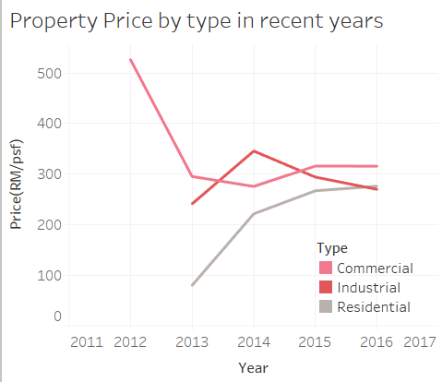
property prices by type changes differently over time
Trend
Slight growth in recent years
Type
Residential Price increased fast

Slide 13
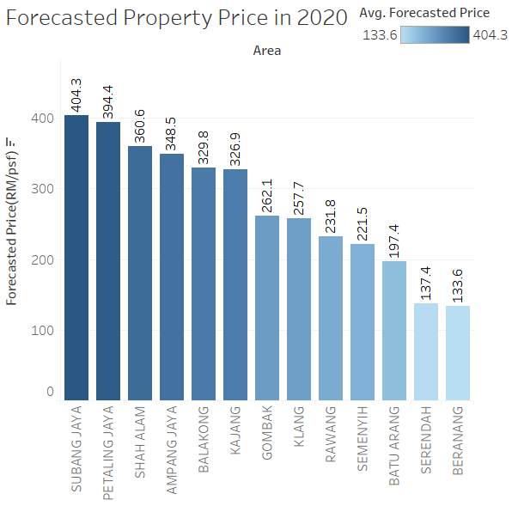
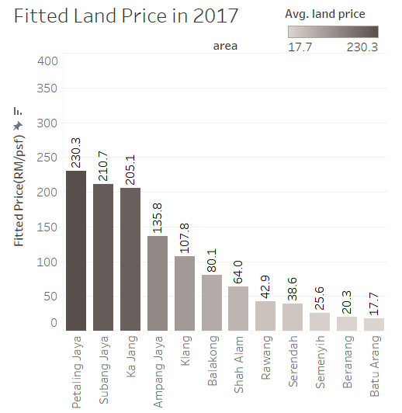
property and land price varies between Cities

Slide 14
profits from predicted property and land price
Shah Alam, Balakong, Ampang Jaya are identified as the key focus area for urban development
Property Premium
in 2020
Empty Land Price
in 2017
City/Town | Forecasted Property Price (RM/psf) | Fitted Land Price (RM/psf) | Profit (psf) | Annual ROI (%)
Shah Alam | 360.6 | 64.0 | 296.6 | 91.9
Balakong | 329.8 | 80.1 | 249.7 | 58.2
Ampang Jaya | 348.5 | 135.8 | 212.7 | 23.7
Semenyih | 221.5 | 25.6 | 195.9 | 158.6
Subang Jaya | 404.3 | 210.7 | 193.6 | 9.3
Rawang | 231.8 | 42.9 | 189.0 | 86.9
Batu Arang | 197.4 | 17.7 | 179.7 | 214.0
Petaling Jaya | 394.4 | 230.3 | 164.0 | 4.7
Klang | 257.7 | 107.8 | 149.9 | 19.8
Ka Jang | 326.9 | 205.1 | 121.8 | 2.1
Beranang | 133.6 | 20.3 | 113.3 | 112.6
Serendah | 137.4 | 38.6 | 98.7 | 45.7

Slide 15


what predicts property price?
Land use
City
Top Predictors
Proximity to Amenities
Connectedness

Slide 16
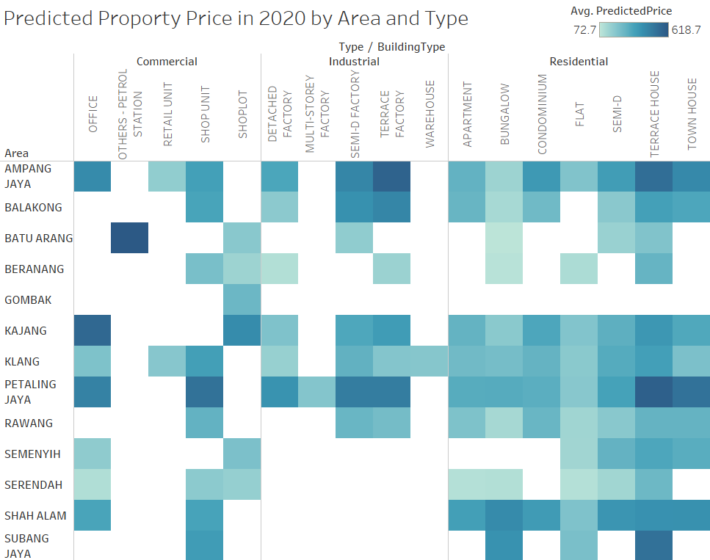

property type & area accurately predicts property price
Result From Model
4 potential cities in terms of profit/ROI
Building Type and Area as top 2 important predictors
Building Type
Breakdown to property → building type
Variation between different types
Development
Avoid saturated area like Petaling Jaya
Avoid less developed land like Gombak

Slide 17
CFLD
AGENDA
1
Business Objectives
2
Methodology
3
Model Selection Process
4
Key Business Insights
5
Optimal Investment Strategy

Slide 18
optimal investment strategy
City to focus
Shah Alam | significantly higher profit
 | presence of established infrastructure critical for future development
Property to build
Different types of properties can be built minimize volatility between different types of property prices
Residential properties gives higher returns comparing to industrial & commercial types
Expansion plan
Self-contained industrial township which acts a key strategic element for potential economic zone
Industry Focus
State capital of Selangor guarantee Infrastructure & Finance Supporting
Smart City for Great Kuala Lumpur Plan
Status of the city
Electrical & Electronics
Transport Equipment
Life Sciences
Machinery & Equipment
Notes:
Self-contained industrial township with modern facilities such as ready-built factories, land parcels for commercial and residential development

Slide 19
summary
CHLITINA
Land Price Evaluation
Target Area Background
Company analysis
Visualize the skill, beautify the service
Property Premium – Empty Land Price
Predicting Profits with Machine Learning Model
Data
Economics
Geographic
Demographic
Land Type
Modelling
Lasso
Random Forest
Evaluation
Top focusing cities
Investment Strategy
Property Types
Industrial focus
Price & Predictors
Forecasted Price
Profit, ROI, NPV
Development Insight

Slide 20
Thank You!
Q&A
The Elementals

Slide 21
CFLD
Appendix

Slide 22
Random forest model
Random forest is an ensemble learning method using multiple decision trees to make predictions.
27 Predictors are used to predict the land price per square feet.
Predictors
Area within Greater KL | Year | Building Type
Land Area Size (km2) | City Area (km2) | State
City/Town/Village | Population Density | Consumer Price Index
Distance to KL city center | Travelling time to KL city center | Distance to KL International Airport
Travelling time to KL International Airport | Minimum distance to hospital/clinics | Minimum distance to Educational Institutions
Minimum distance to Shops | Minimum distance to Train Station | Minimum distance to Bus stop
Minimum distance to Police Station | Number of hospital/clinics within 2km radius | Number of Educational Institutions within 1km radius
Number of shops within 2km radius | Number of Train Stations within 2km radius | Number of Bus Stops within 500m radius
Number of Police Station within 2km radius | Number of Manufacturing sites within 500m radius | Number of Manufacturing sites within 1km radius

Slide 23
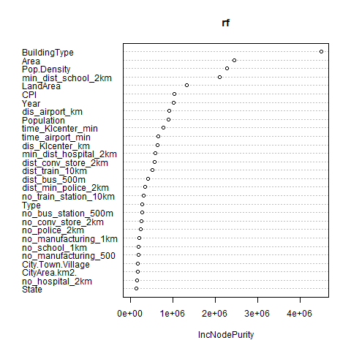
Random Forest Model
Optimisation of the model based on cross validation was performed to improve model performance
The variable importance in terms of prediction are listed in descending order.

Slide 24
Industry distribution by city
 | Electrical & Electronics | Transport Equipment | Life Sciences | Food & Beverages Manufacturing | Machinery & Equipment
Ampang Jaya | Semiconductor | Aerospace | Biotechnology
Balakong | LED Technologies, Industrial/Integrated Electronics |  | Biotechnology |  | Metalworking M&E, General industrial M&E
Batu Arang
Beranang | Industrial/Integrated Electronics | Automotive
Gombak |  | Automotive
Kajang |  |  |  |  | Metalworking M&E
Klang | Solar, LED Technologies, Industrial/Integrated Electronics | Automotive, Maritime | Pharmaceuticals, Medical Devices, Specialty Chemicals | Halal Food | General industrial M&E
Rawang | Industrial/Integrated Electronics
Selayang Baru
Semenyih | Solar, Industrial/Integrated Electronics |  | Biotechnology | Halal Food | Metalworking M&E
Serendah |  | Aerospace
Shah Alam | Semiconductor, Solar, Industrial/Integrated Electronics | Aerospace, Automotive, Maritime | Pharmaceuticals, Medical Devices, Specialty Chemicals, Biotechnology |  | Power Generating M&E, Metalworking M&E, General industrial M&E
Subang Jaya | LED Technologies, Industrial/Integrated Electronics | Aerospace | Specialty Chemicals |  | Power Generating M&E, Metalworking M&E
Petaling Jaya | Semiconductor, Solar, Industrial/Integrated Electronics | Aerospace | Pharmaceuticals, Medical Devices, Specialty Chemicals, Biotechnology | Halal Food | Power Generating M&E, General industrial M&E

Slide 25
Geocoding and Google API for predictors mining
Address
Geocode
Coordinates (lat,long)
GoogleAPI- PlacesService
NearbyPlaces
Distance to amenities
calculation

Slide 26
ROI calculation
Extrapolation
Predicted 2020 predictors data
Time based data
Random Forest model
Predicted Property Prices
ROI
calculation

