Slide 1
A close look at stock price prediction
Shane Lim
SAAS

Slide 2

Concepts
=
Efficient Market Hypothesis + Behavioral Finance
Adaptive Market Hypothesis
Notes:
Economists believe that stock prices cannot fully capture behavioural finance. For example, if a lot of economists are uncertain about a company’s stock, the stock prices cannot fully capture that. That is why we can leverage on this inefficiency to invest and profit from stocks.

Slide 3


Concepts
Technical Analysis
Fundamental Analysis

Slide 4


Project Overview
Technical indicators
+
Historical prices
Predicted behavior of stocks
Stats/ML models
Comparing the effectiveness of multivariate predictive models against univariate models
ie. How effective is it to consider more factors/indicators when predicting stock prices

Slide 5
Methodology
STATS/ML
MODELS
ANALYSING X AND Y
SETTING X AND Y VARIABLES

Slide 6

STATS/ML
MODELS
ANALYSING X AND Y
Data Selection
Feature Selection
Target Variable Selection
SETTING X AND Y VARIABLES

Slide 7
Setting up Variables
FEATURES (X)
TARGET VARIABLE (y)
Av. True Range
Rate of Change
Next day Percentage change in Price
VS
Next Day Open Price
Momentum
Volatility
Trend
Volume
MACD
Acc/Dis Index

Slide 8

STATS/ML
MODELS
Identifying Correlations
ANALYSING X AND Y
SETTING X AND Y VARIABLES

Slide 9
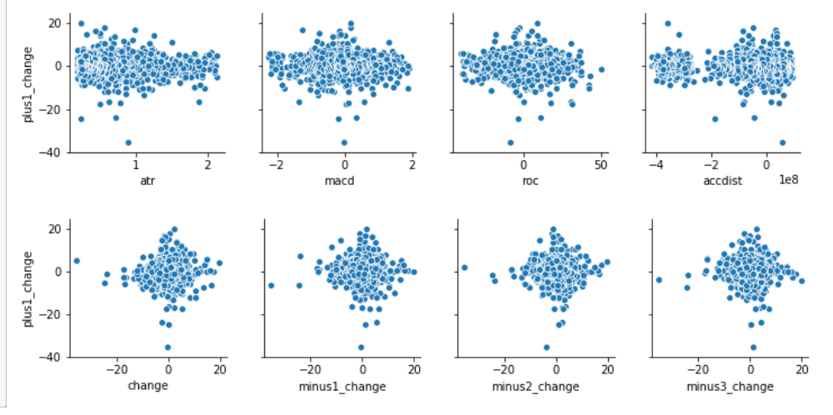
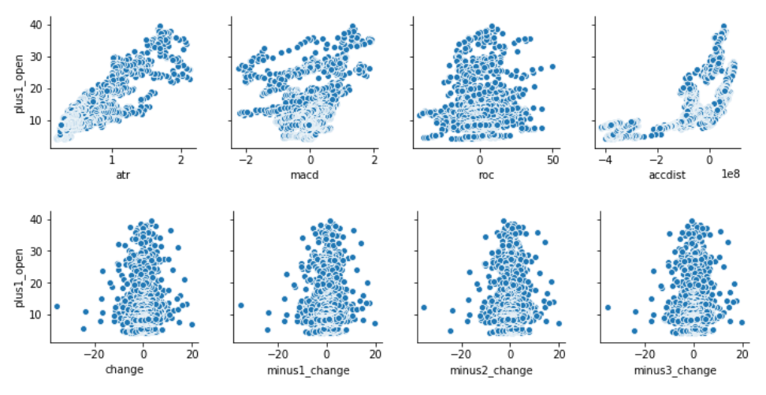
Analysing X and Y
PERCENTAGE CHANGE IN PRICE
OPEN PRICE
1. Independently, weak relationships
2. Linear/polynomial relationships

Slide 10

Model Selection
Model Evaluation
Comparing Models
STATS/ML
MODELS
ANALYSING X AND Y
SETTING X AND Y VARIABLES

Slide 11



Statistical/ML models
ARIMA
RANDOM FOREST
MULTIPLE LINEAR REGRESSION
univariate
multivariate
multivariate

Slide 12
Comparing Models
1. CROSS VALIDATION

Slide 13
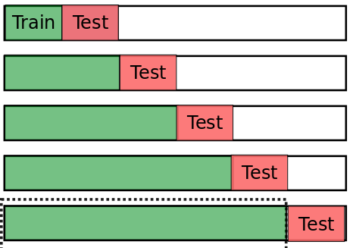
Comparing Models – cross validation
ARIMA
Calculate Mean Squared Error
RANDOM FOREST
MULTIPLE LINEAR REGRESSION

Slide 14
Comparing Models – cross validation
1. Tech Indicators stronger relationship with Open price
The technical indicators have a stronger relationship with Open Price as compared to Percentage Change in price.
2. ARIMA(univariate) performs worse

Slide 15
Comparing Models
2. PERFORMANCE ON TEST SET

Slide 16
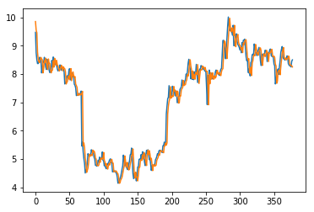
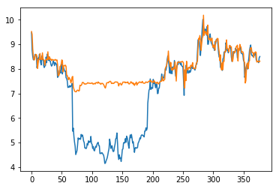
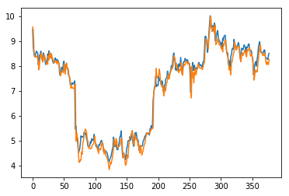
Comparing Models – Test Set Performance(Open Price)
True | Predicted
9.47 | 9.850626
8.75 | 9.54952
8.5 | 9.456747
8.37 | 8.773576
8.37 | 8.507013
8.5 | 8.427631
8.59 | 8.398466
8.55 | 8.50787
8.52 | 8.585021
MSE = 0.10055298544685407
MSE = 2.180492684733636
MSE = 0.07614759576954827
2. Prediction is still inaccurate
1. Linear regression(multivariate) outperforms
ARIMA
RANDOM FOREST
MULTIPLE LINEAR REGRESSION
univariate
multivariate
multivariate

Slide 17

Conclusion – what did I achieve?
Create a precise prediction model to trade stocks

Slide 18




Conclusion – what did I achieve?
Designed a methodology for stock price analysis
How to select right features
How to cross validate (time series)
Possible ML models and their limitations
Compared the effectiveness of different models
Proved the potential of technical analysis
Multivariate models can outperform univariate ones

Slide 19
THANK YOU
Shane Lim
SAAS

Slide 20
Methodology
X AND Y VARIABLES
ANALYSING X AND Y
STATISTICAL/ML MODELS
Data Selection
Feature Selection
Target Variable Selection
Identifying Correlations
Model Selection
Model Evaluation
Comparing Models

