Slide 1
Fake Shop
Yumi Lim

Slide 2
Table of contents.
01 | Demo
02 | Class Diagram
03 | Code Review
04 | Summary

Slide 3
Demo
01

Slide 4
Class Diagram
02

Slide 5
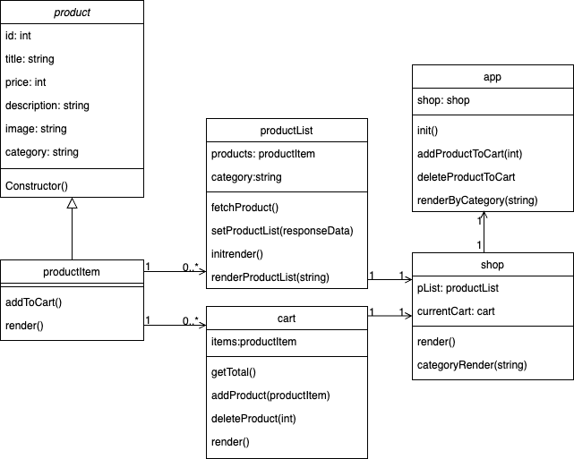
Class Diagram

Slide 6
Code Review
03

Slide 7
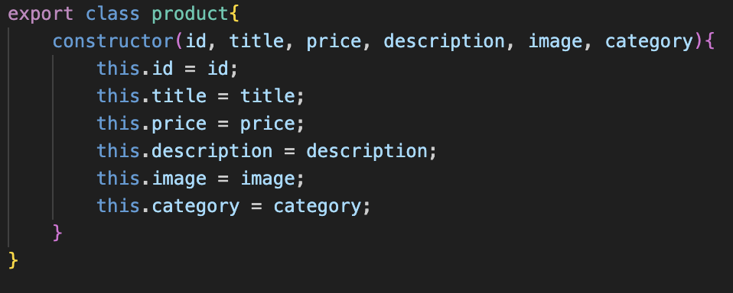
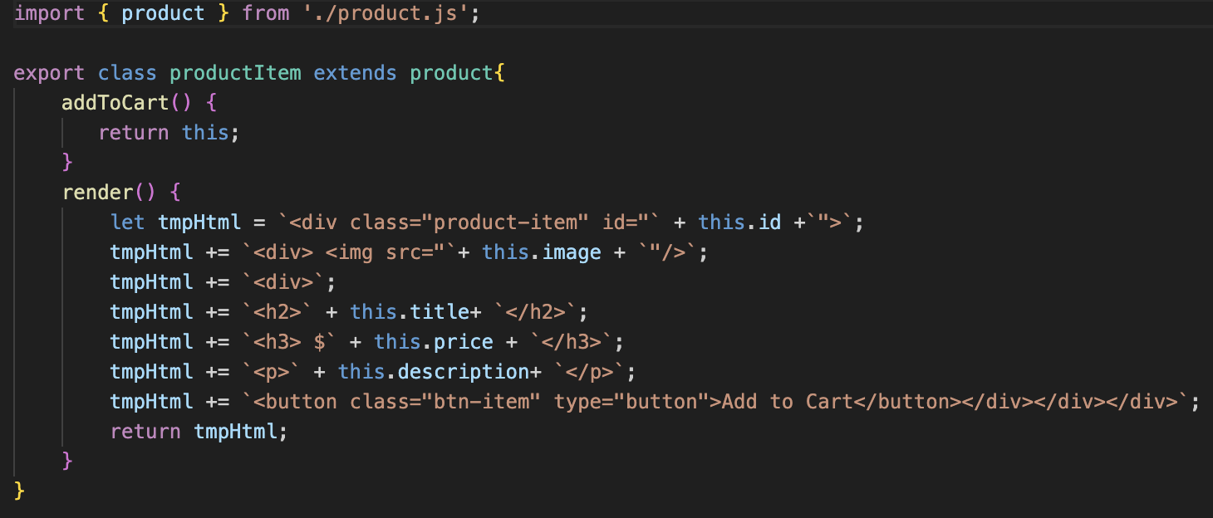
Code Review
productItem
product

Slide 8
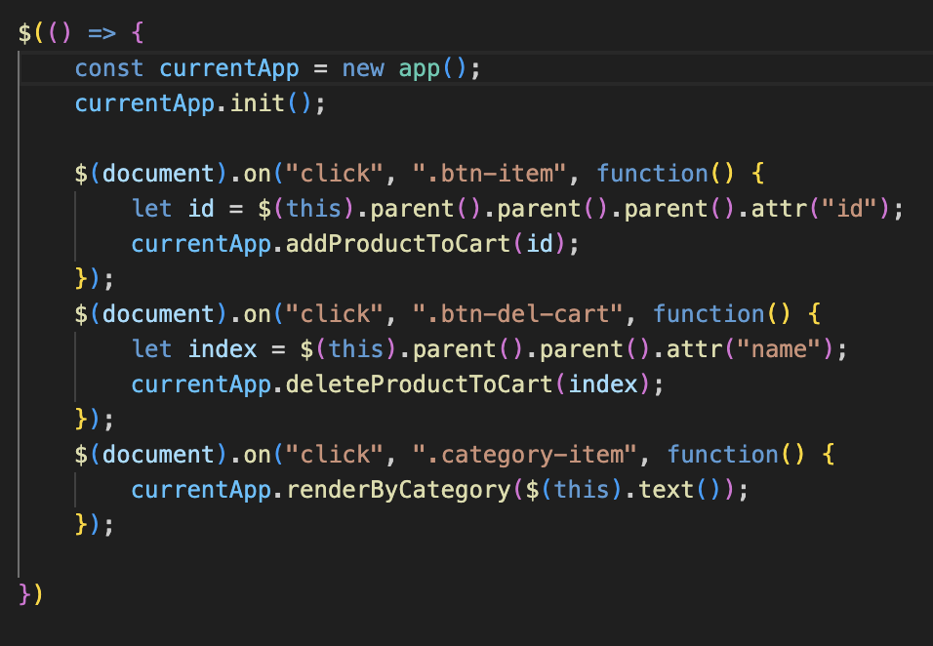
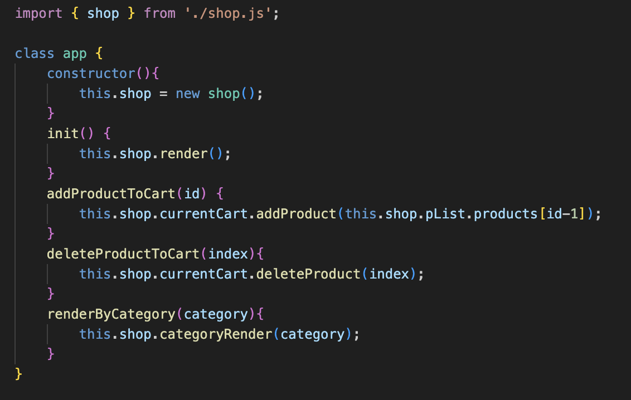
Code Review
Application Init and render
app.js

Slide 9
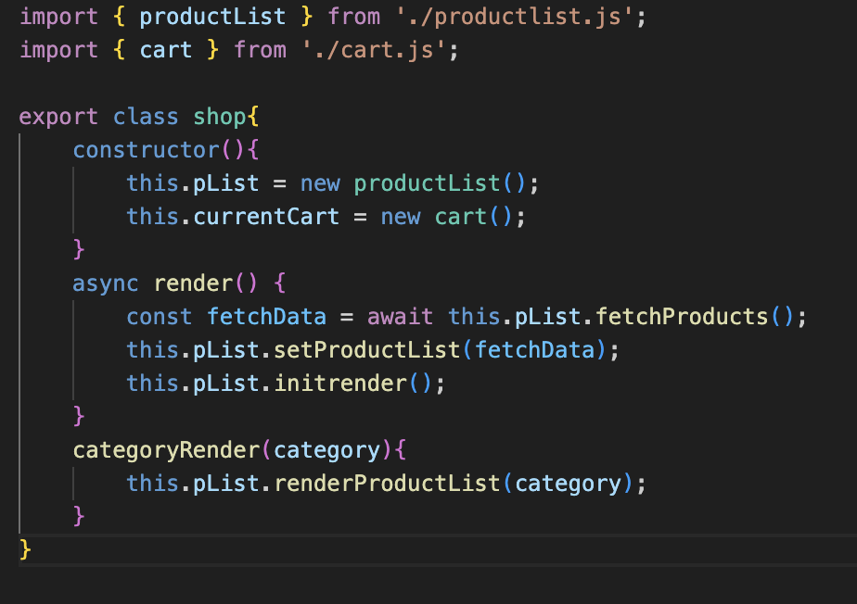
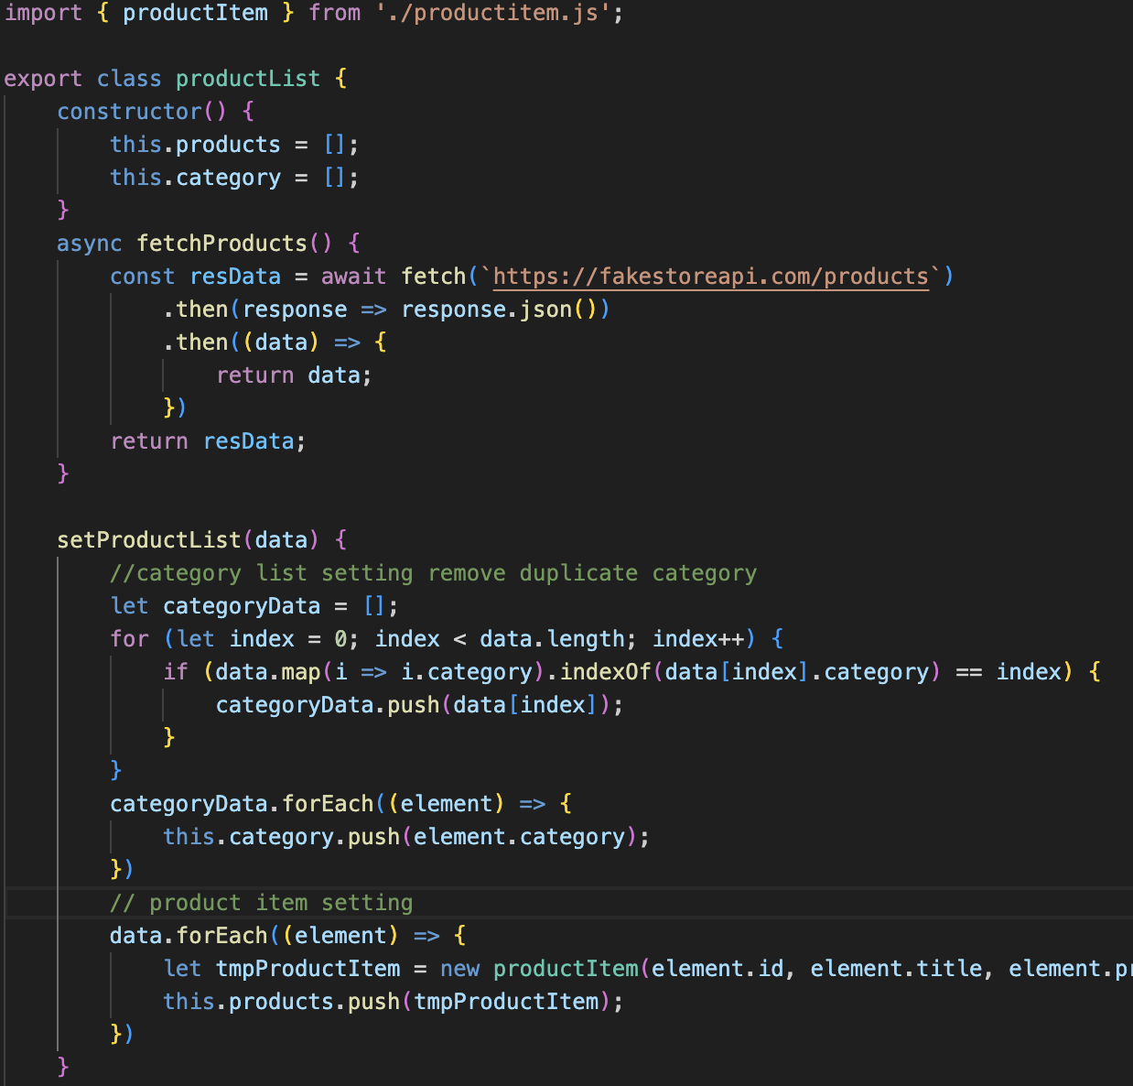
Code Review
Application Init and render
productList and Shop

Slide 10
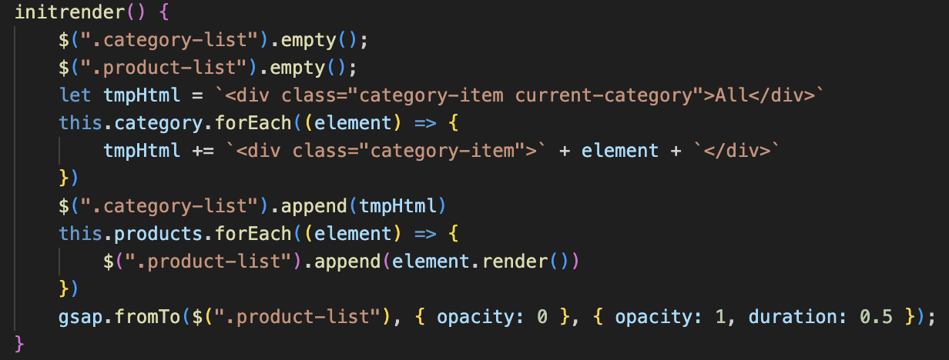
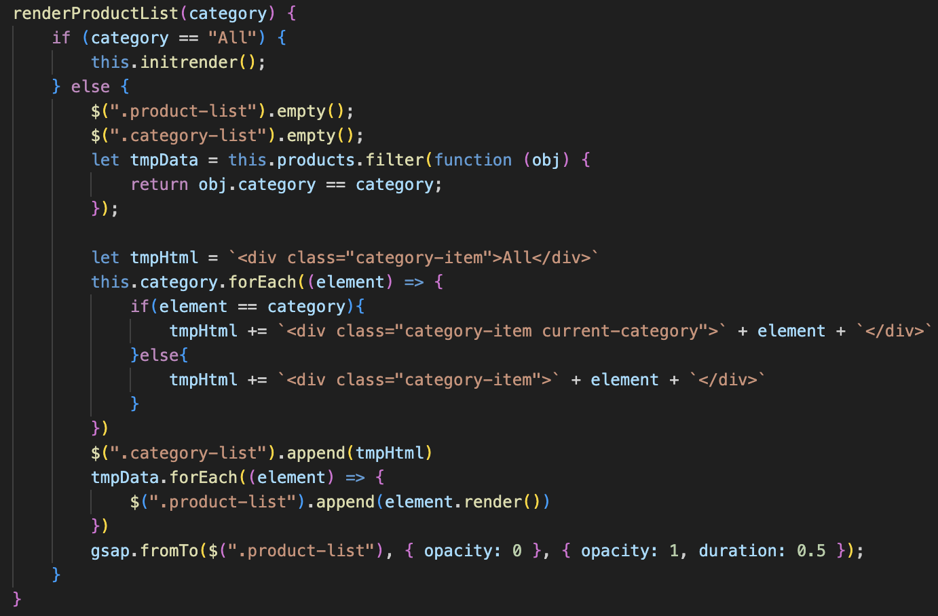
Code Review
Application Init and render
productList Render

Slide 11
Code Review
Cart working
app.js

Slide 12
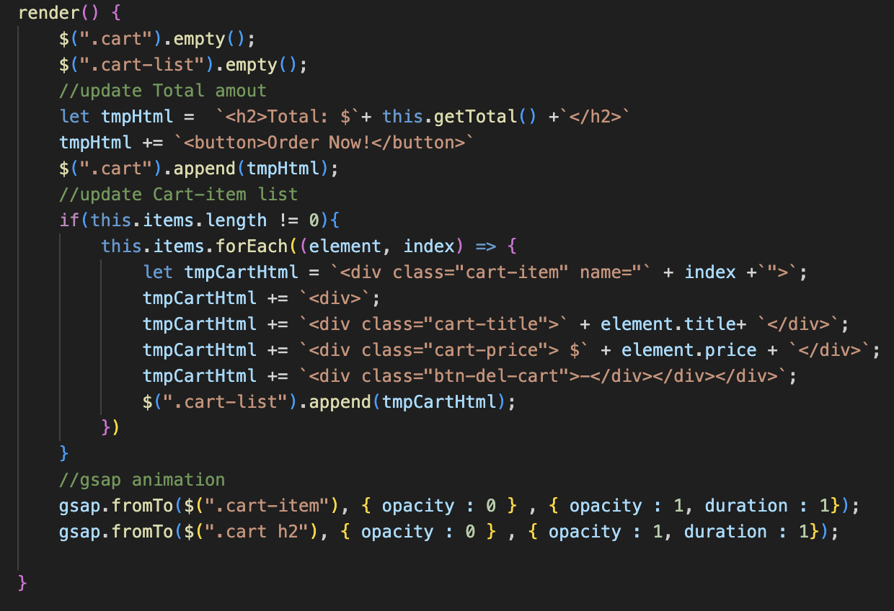
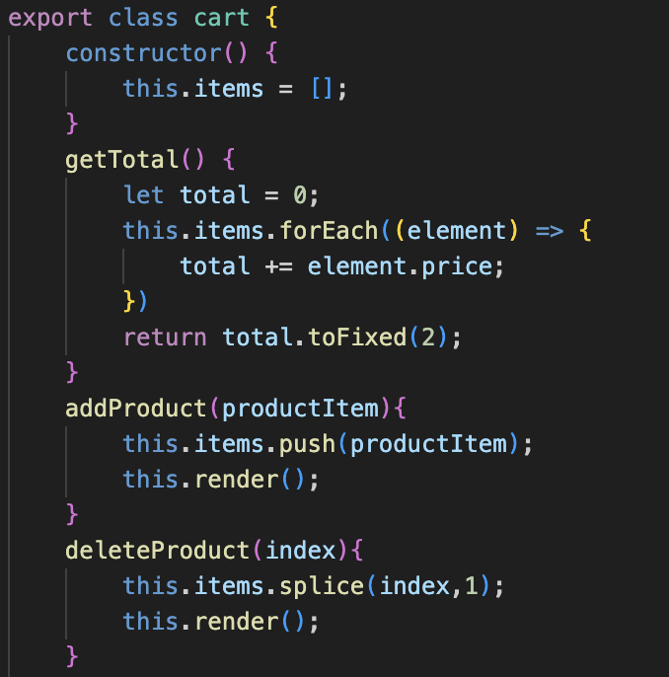
Code Review
Cart working
Cart.js

Slide 13
Summary
04

Slide 14
Summary
Struggle
Learning
How to control
Dynamic Render HTML Tag
How to use Class in Javascript

Slide 15
Thank you!
Do you have any questions?

