Slide 1
Cambridge Road Safety
Priorities
Where should the city begin pedestrian
and cyclist safety audits?
Six provisional intersections for investigation
Reported crash patterns from 2023–2025
A five-minute decision briefing and live website demonstration
CAMBRIDGE ROAD SAFETY / PS01 / 2023–2025
01
Notes:
0:00–0:25 | 25 seconds
This project asks where Cambridge should begin pedestrian and cyclist safety audits. The intended users are senior city leaders and transportation decision-makers. Using public crash reports from 2023 through 2025, it identifies six provisional locations for investigation. The goal is to focus fieldwork while making the evidence and its limits visible.
Sources: CPD Crash Log https://data.cambridgema.gov/d/h6fp-bp8s and detailed cross-check https://data.cambridgema.gov/d/gb5w-yva3. Downloads September 17, 2026. Calculations from supplied project CSVs. Local site http://127.0.0.1:8765/ inspected September 19, 2026.

Slide 2
696 crashes define the study population
438 cyclist-involved 260 pedestrian-involved
Two crashes involve both groups. Combined totals count each crash once.
2023–2025
All 36 months represented
CPD is the counting source.
Overlapping files stay separate.
Units: reported crashes. Calendar coverage does not prove complete reporting.
CAMBRIDGE ROAD SAFETY / PS01 / 2023–2025
02
Notes:
0:25–1:05 | 40 seconds
I obtained two CSVs from Cambridge’s public portal. They overlap, so the CPD Crash Log supplies the counts and the larger file serves as a cross-check. The study uses the latest three complete years represented in the downloads. Of 4,924 CPD records, 696 involve a pedestrian or cyclist. There are 438 cyclist-involved and 260 pedestrian-involved crashes, with two in both categories. Only 430 have explicit intersection pairs. The remaining 266 are an important source of uncertainty, because incomplete locations could change the shortlist.
Sources: CPD Crash Log https://data.cambridgema.gov/d/h6fp-bp8s and detailed cross-check https://data.cambridgema.gov/d/gb5w-yva3. Downloads September 17, 2026. Calculations from supplied project CSVs. Local site http://127.0.0.1:8765/ inspected September 19, 2026.

Slide 3
Six intersection labels account for 42 crashes
9.8%
of the 430 crashes
with explicit pairs
Three locations tie
at six crashes.
All remain on
the shortlist.
Provisional counts by recorded street pair. Unresolved aliases can split one physical location.
CAMBRIDGE ROAD SAFETY / PS01 / 2023–2025
03
Notes:
1:05–2:00 | 55 seconds
The leading recorded pair is Massachusetts Avenue and Albany Street, with nine crashes, followed by Massachusetts and Windsor with eight and Cambridge and Prospect with seven. Three other pairs tie at six, so I retain six candidates rather than make an arbitrary top-five cutoff. Together they represent 42 crashes, or 9.8 percent of the explicitly located group. Recurrence matters too: Windsor has two, three and three crashes over the period. Columbia and Hampshire has five, one and zero. These are different audit contexts. Neither pattern proves a trend or an intervention effect. Unresolved street-name variants mean these are recorded-label counts, not a complete physical-location ranking.
Sources: CPD Crash Log https://data.cambridgema.gov/d/h6fp-bp8s and detailed cross-check https://data.cambridgema.gov/d/gb5w-yva3. Downloads September 17, 2026. Calculations from supplied project CSVs. Local site http://127.0.0.1:8765/ inspected September 19, 2026.

Slide 4
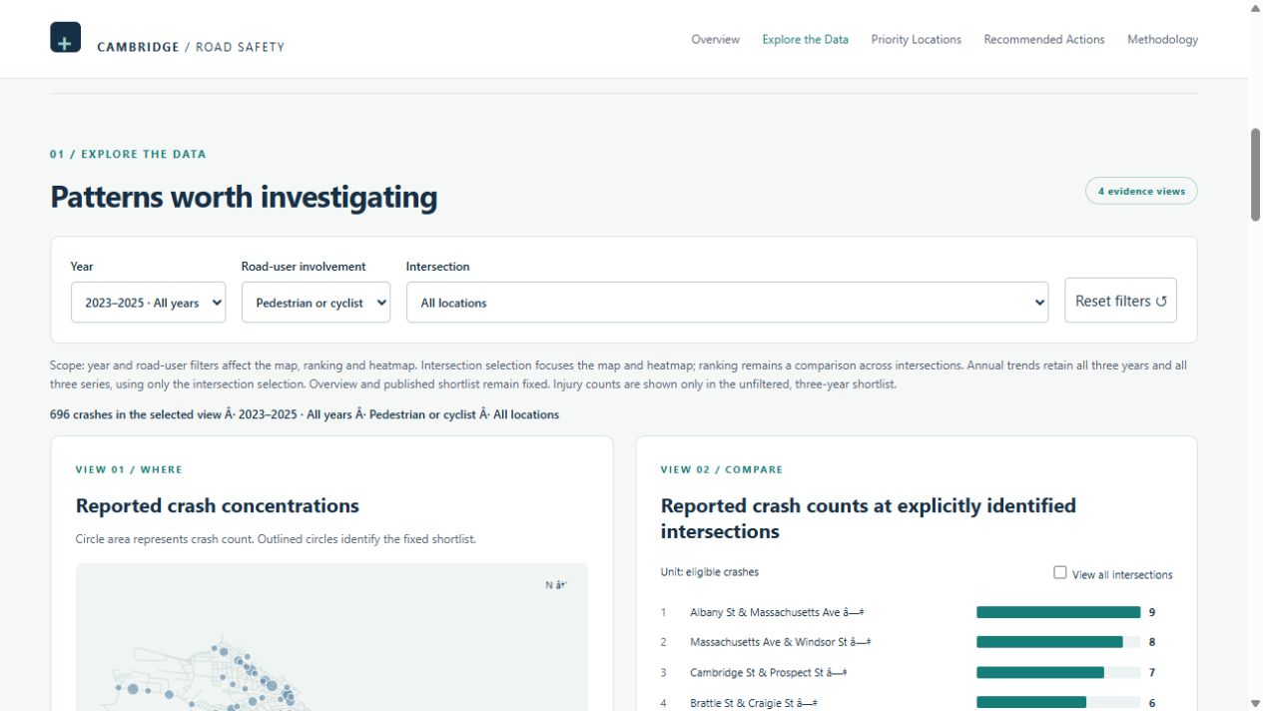
Live website demonstration
100 seconds in the browser
1 Change year and road user
2 Compare map and ranking
3 Select Windsor and inspect time patterns
4 Reset and show sources
Local preview: http://127.0.0.1:8765/ • Publication pending
CAMBRIDGE ROAD SAFETY / PS01 / 2023–2025
04
Notes:
2:00–3:40 | 100 seconds | LIVE DEMONSTRATION
Before presenting, start the local site, open http://127.0.0.1:8765/ in a browser and keep it ready. This address works only on the hosting computer while its server runs. After publication, use the public URL instead.
0–20 seconds: switch to the browser and click Explore the Data. Point out the year, road-user and intersection controls. Set Year to 2025 and Road-user involvement to Pedestrian-involved. Explain that the map, ranking and heatmap update, while the headline study totals and fixed shortlist stay unchanged.
20–45 seconds: show the map and ranking. Explain that the full-study map contains 322 of the 696 crashes, across 200 matched GIS nodes. A missing marker does not mean no crashes.
45–75 seconds: Reset filters, select Massachusetts Ave & Windsor St under Intersection, and scroll to the weekday/hour heatmap and annual trends. Explain that intersection selection focuses the map, heatmap and annual trend, while the ranking remains a comparison across locations. Trends retain all three years and mode series. Counts of two, three and three describe recurrence without measuring risk per trip.
75–100 seconds: Reset filters. Open Priority Locations to show the fixed shortlist, then Methodology to show official source links, definitions and the aggregate CSV download. Return to the slides.
Screenshot source: actual local preview, captured September 19, 2026. If the live site becomes unavailable, use this screenshot and describe the controls without claiming a live demonstration occurred.
Sources: CPD Crash Log https://data.cambridgema.gov/d/h6fp-bp8s and detailed cross-check https://data.cambridgema.gov/d/gb5w-yva3. Downloads September 17, 2026. Calculations from supplied project CSVs. Local site http://127.0.0.1:8765/ inspected September 19, 2026.

Slide 5
Annual counts fluctuate within a narrow range
Counts cannot establish
risk per traveler
No walking, cycling or
vehicle exposure counts
Incomplete reporting
and unresolved locations
Street changes need
independent review
All pedestrian- or cyclist-involved reported crashes. Axis starts at zero.
CAMBRIDGE ROAD SAFETY / PS01 / 2023–2025
05
Notes:
3:40–4:20 | 40 seconds
Annual totals are 231, 238 and 227. The chart begins at zero to avoid exaggerating these differences. We cannot conclude that Cambridge became safer or more dangerous because we do not know how travel volumes changed, and reporting may be incomplete. We also have not reviewed recent street interventions. Likewise, an injury flag does not establish severity or identify the injured road user. These constraints limit capital-allocation conclusions, but they still allow targeted investigation.
Sources: CPD Crash Log https://data.cambridgema.gov/d/h6fp-bp8s and detailed cross-check https://data.cambridgema.gov/d/gb5w-yva3. Downloads September 17, 2026. Calculations from supplied project CSVs. Local site http://127.0.0.1:8765/ inspected September 19, 2026.

Slide 6
Next steps for city decision-makers
01 Commission field safety audits
Start with the six provisional candidates. Examine current crossings,
visibility and turning interactions, and check recent street changes.
02 Strengthen the evidence before investment
Reconcile street labels and addresses. Collect exposure counts.
Use the additional evidence to select and evaluate interventions.
CAMBRIDGE ROAD SAFETY / PS01 / 2023–2025
06
Notes:
4:20–5:00 | 40 seconds
I recommend two actions. First, commission field safety audits at the six provisional candidates, using current conditions and each location’s recurrence pattern to guide questions. Second, reconcile street names and incomplete addresses and collect pedestrian, cyclist and vehicle volumes before comparing risk or choosing investments. The website makes this distinction visible: the present evidence supports where to investigate, while engineering judgment and further data are needed to decide what to build.
Sources: CPD Crash Log https://data.cambridgema.gov/d/h6fp-bp8s and detailed cross-check https://data.cambridgema.gov/d/gb5w-yva3. Downloads September 17, 2026. Calculations from supplied project CSVs. Local site http://127.0.0.1:8765/ inspected September 19, 2026.

