Slide 1
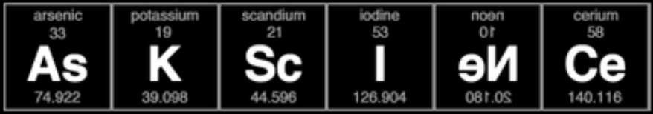
Project 3:
Web APIs & Text Classification
Ikhwan Jerome Yuzheng

Slide 2


Business Problem
How can we accurately and consistently auto-filter out troll posts that don’t belong to the r/askscience sub-reddit, to save the moderators’ time?
r/jokes
r/askscience

Slide 3
Technical Overview
Data Collection
Data Cleaning
Exploratory Data Analysis (EDA)
Modelling
Evaluation
Conclusion/ Recommendations

Slide 4
Data Collection
Web scrape, prevent blockage by reddit
Not by ‘sleep’ duration, but by randomizing the User-agent EVERY scrape. No waiting time needed!
ua = str(random.randint(1,100)) res = requests.get(current_url, headers={'User-agent': ua})
Explore text structure

Slide 5
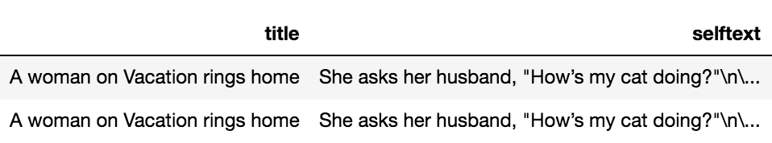
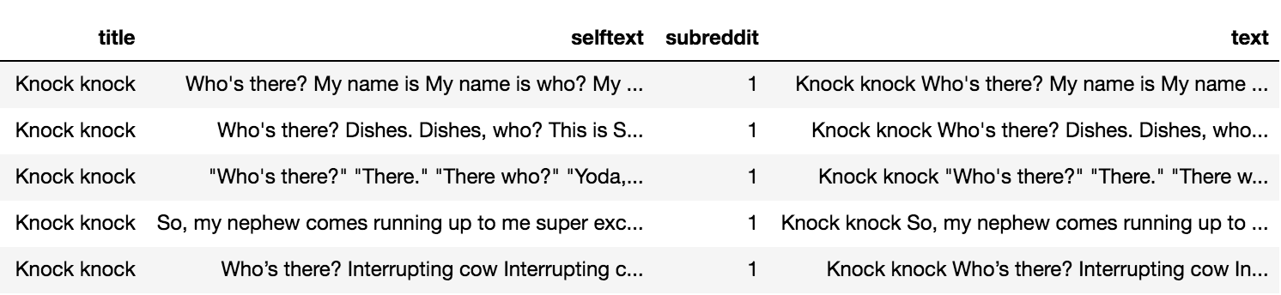
Data Cleaning
Duplicated posts from scrapping

Slide 6
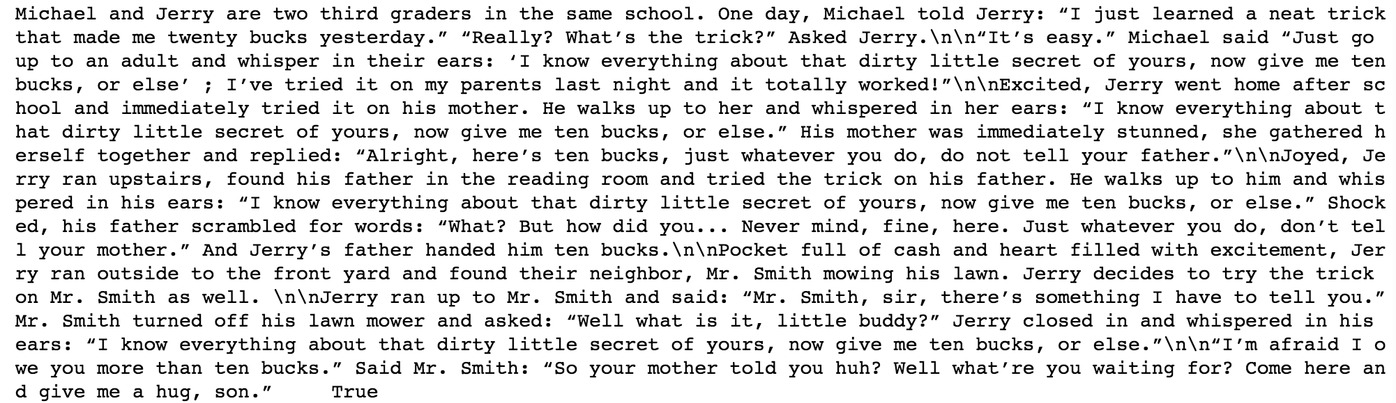
Data Cleaning
Formatting

Slide 7
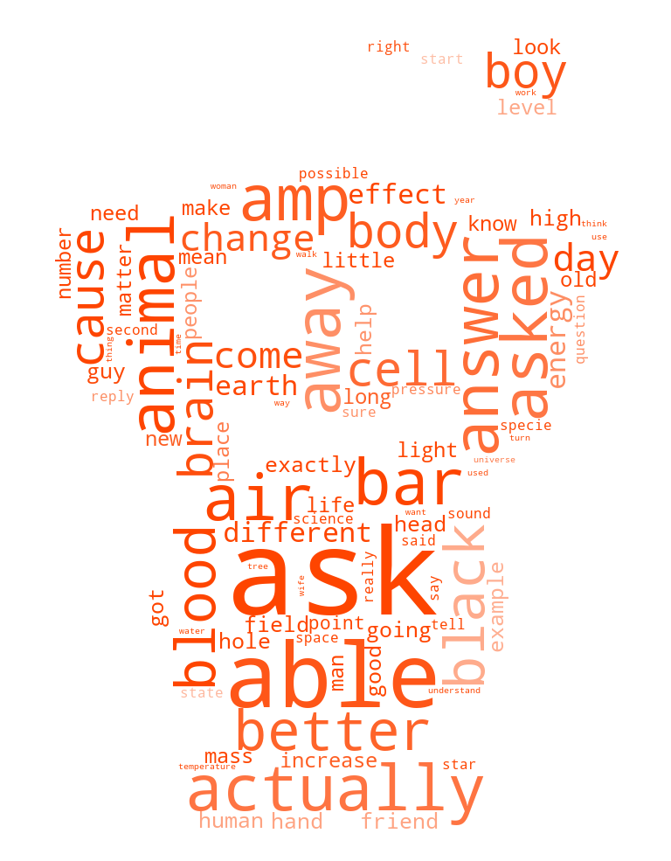
Exploratory Data Analysis
r/Jokes?
r/askscience?

Slide 8
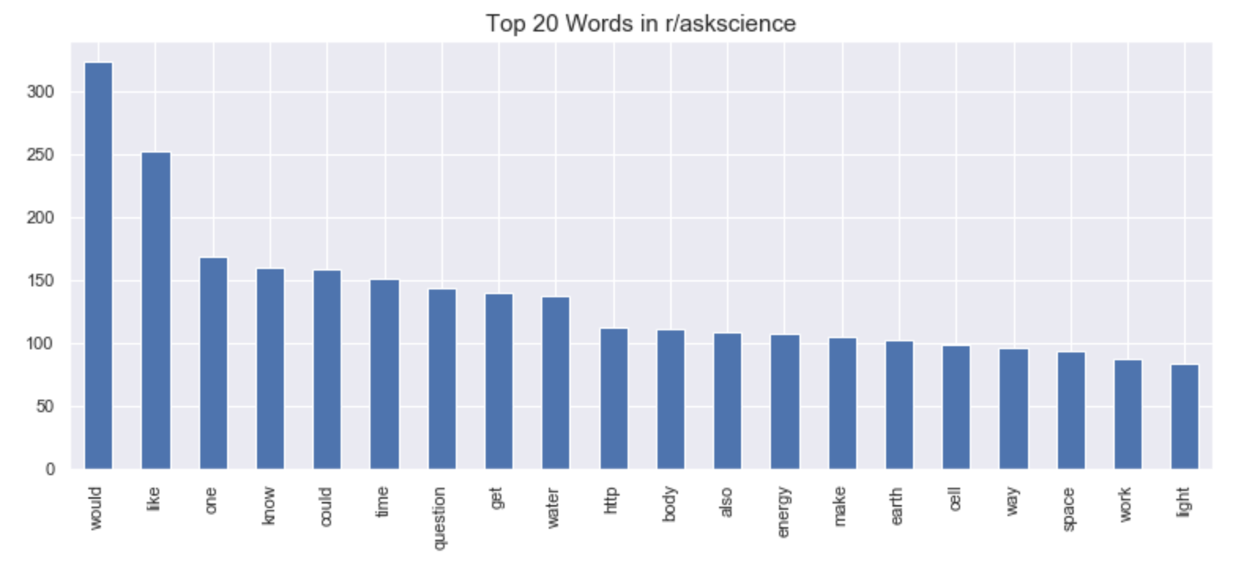
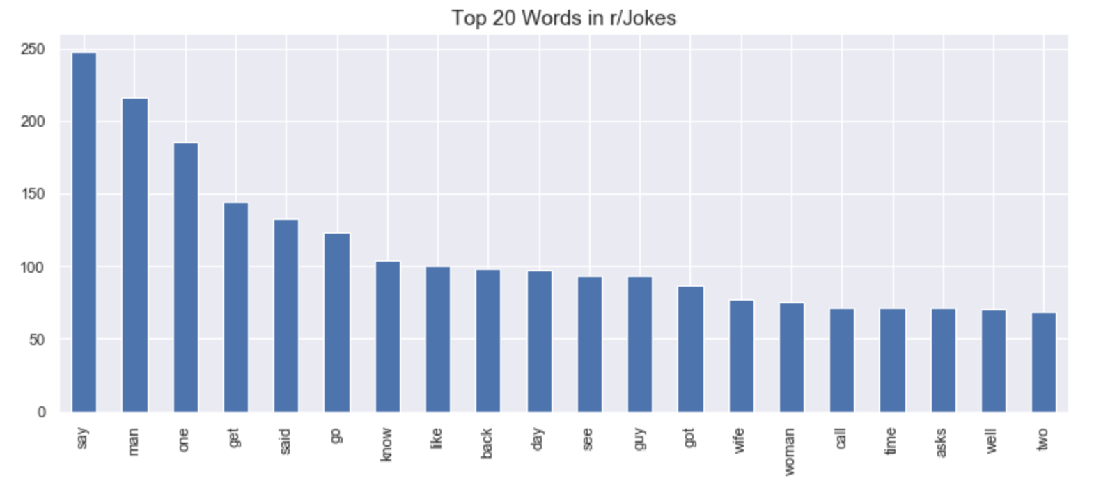
Exploratory Data Analysis
Top 20 words in both subreddits
Common words found in both subreddits!

Slide 9
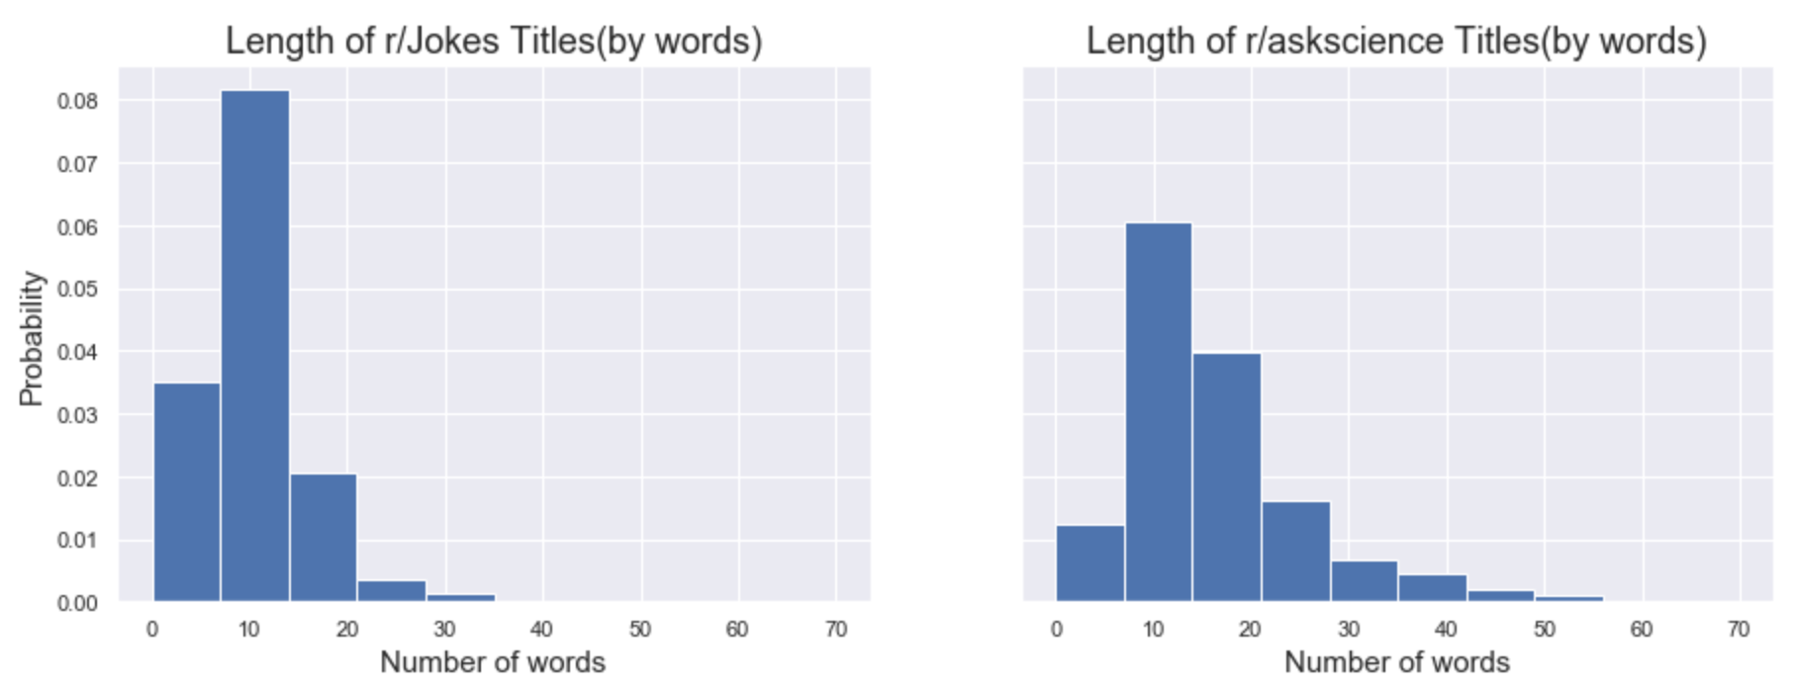
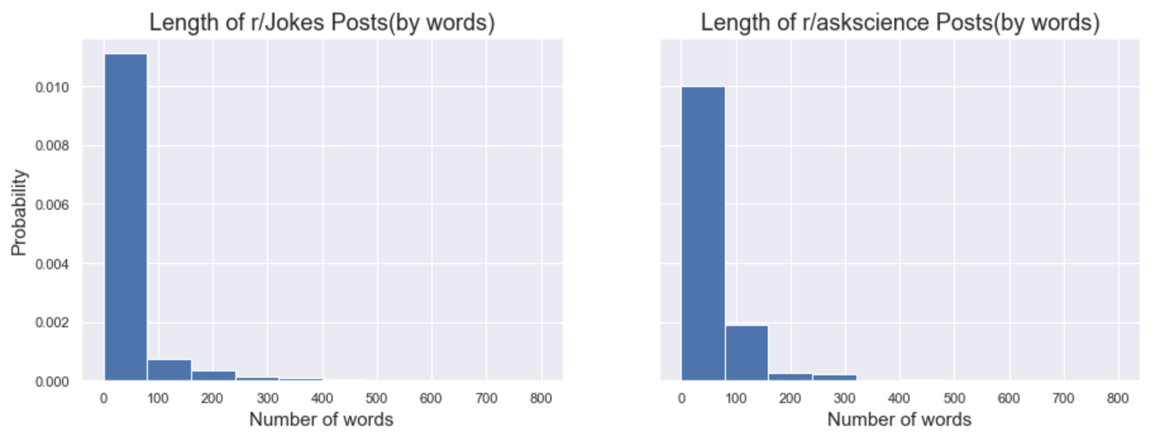
Exploratory Data Analysis
What other relationships can we find that might aid us in classifying a particular post’s subreddit?

Slide 10
Techniques Used
CountVectorizer, Tfidf (on both titles and selftext), then...
logreg/MultinomialNB/BernoulliNB
Count Vec
TF-IDF
Log Reg
Bernoulli
Log Reg
Multinomial
Accuracy
Baseline: 0.5
Confusion Matrix

Slide 11
Hyperparameters
Logistic Regression:
-'penalty': ['l1'],[‘l2’]
-'C': np.arange(1, 5, 0.1),
-'warm_start': [True, False],
-'solver': ['lbfgs', 'liblinear']
Multinomial/Bernoulli:
-'fit_prior': [True,False],
-'alpha': np.arange(0, 1, 0.1)

Slide 12
Count Vectorizer with BernoullilNB
Train accuracy score: 0.807
Test accuracy score: 0.776
139
18
TN
FP
FN
TP
52
104

Slide 13
Count Vectorizer with Logistic Regression
Train accuracy score: 0.835
Test accuracy score: 0.783
139
18
TN
FP
FN
TP
49
107

Slide 14
TF-IDF with Logistic Regression
Train accuracy score: 0.850
Test accuracy score: 0.799
133
24
TN
FP
FN
TP
39
117

Slide 15
TF-IDF with MultinomialNB (Best Model)
Train accuracy score: 0.821
Test accuracy score: 0.793
We are predicting words from Jokes subreddit 42% of the time!
Misclassifying words only 20% of the time
130
27
TN
FP
FN
TP
38
118
Notes:
- Some hyperparameter tunings done:
-Alpha: 0.700
-Fit-prior: False

Slide 16
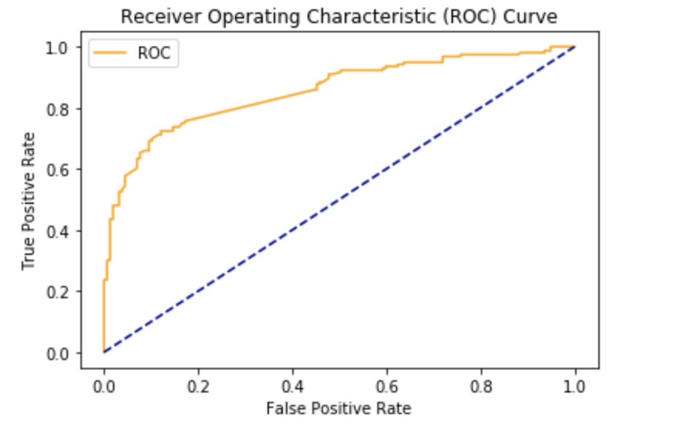
AUC= 0.87
Notes:
It tells how much our model is capable of distinguishing between classes

Slide 17
From best model, hone further!
Titles selftext
NLP on only titles, NOT selftext
SelectKBest(chi2) to reduce more features
Let algo itself pick the best of: TF-IDF params, and best of logreg/mn/bn (pipe + gridsearchCV)
Why?
Titles hold the essence of the selftext
Chi2 drops irrelevant features relative to target
Best model only “good for the day”: won’t always be mn, nor default TF-IDF params
TF-IDF (+gridsearchCV)
3632 features
+SelectKBest(chi2)
2500 features :) !
+Best of logreg/mn/bn

Slide 18
TF-IDF, +SelectKBest (chi2), MultinomialNB +only on titles (Improved model)
Train accuracy score: 0.977 (was 0.821)
Test accuracy score: 0.956 (was 0.793)
Test ROC-AUC score: 0.956 (was 0.87)
Significant improvement!
234
14
TN
FP
FN
TP
8
243

Slide 19
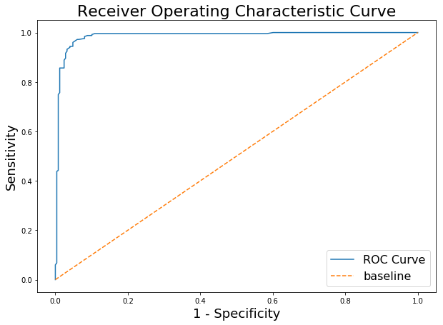
Results of improved model (ROC)
AUC = 0.956 (was 0.87)

Slide 20
Results of improved model
Classifies well even if with similar words!
‘Ever have amnesia and deja vu at the same time?’
VS
‘Does a person suffering from amnesia retain the personality traits
formed from/during the experiences they can no longer remember?
’
Actual
Predict

Slide 21
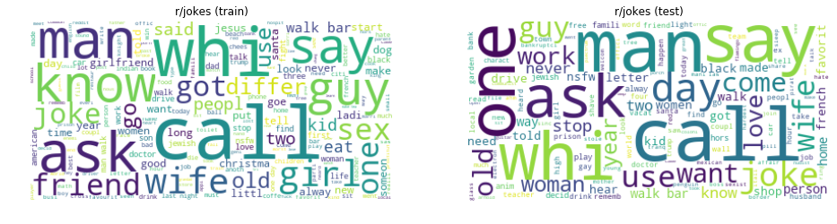
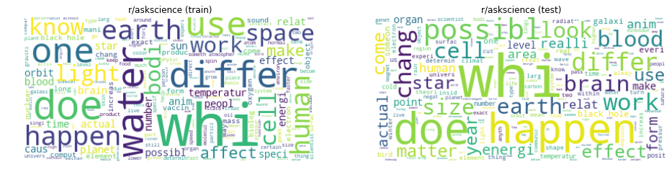
Results of improved model (wordcloud)
 | train | test
r/jokes
r/askscience

Slide 22
Conclusion
Best-est model: TF-IDF >> SelectKBest(chi2) >> multinomialNB (for now) (accuracy, ROC-AUC >90+%)
Should only analyse titles
Need periodic re-training to stay “in-trend”. Proposed algo promises to be a current and dynamic model - it self decides best hyperparams, and best of logreg/mn/bn, for each re-training

Slide 23
Limitations & Future work
Does not recognise puns, double-entendres etc. N-grams, stronger techniques, eg. Bert may be useful
‘NASA sent a probe to all of the planets in our solar system, but quit after Uranus’
VS
‘Why are the rings of Uranus turned sideways?’
Need to periodically re-train model (“keep up with in-trend words”), for accurate classification
Actual
Predict

Slide 24
Q & A

Slide 25
Thank you

