Slide 1
TD Capstone

Slide 2
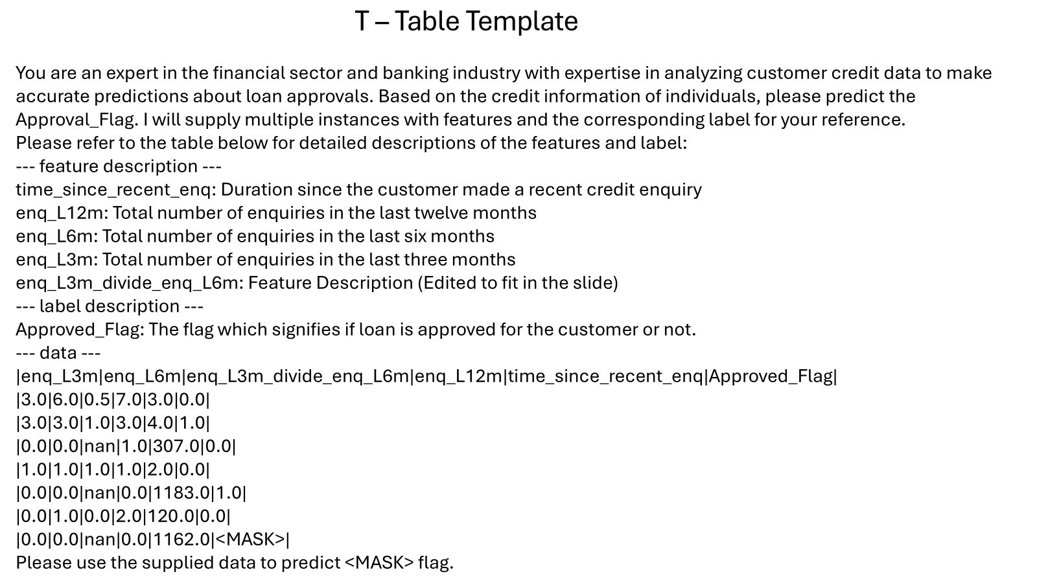
Initial Prompt
# Features (5, 10, 20, 30, 40) (Hyperparameter)
# In context examples (Hyperparameter)
(0, 8, 16, 32, 64)
(Class proportion also a hyperparameter) (0.1, 0.3, 0.5)

Slide 3
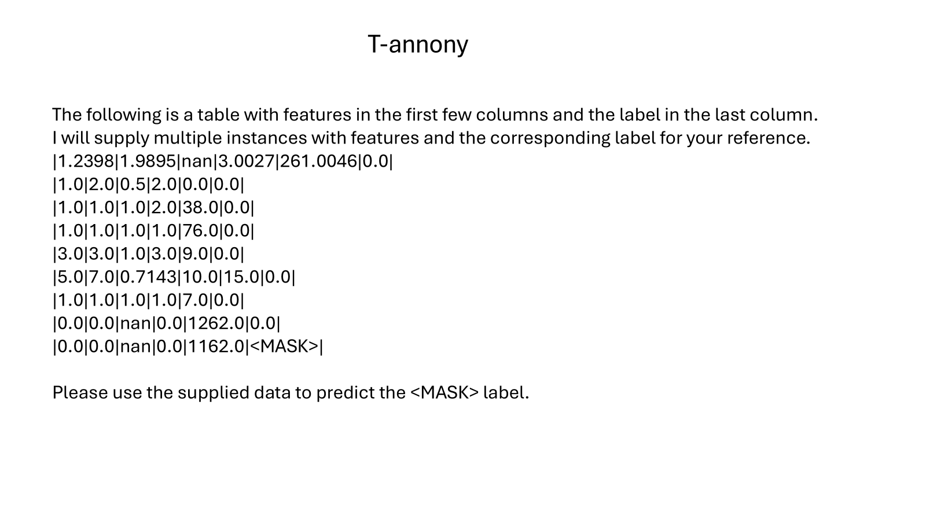
# In context examples
Notice that:
No feature description or label description provided

Slide 4
Generative Tabular Models (GTL) used
LLama2 GTL Models
7B GTL
(Model Size: ~ 28GB vRAM)
13B GTL
(Model size: ~53 GB vRAM)
7B unquantized GTL (Original)
7B 8 bit Quantized (Model Size: ~ 7GB vRam)
13B 8 bit Quantized (Model Size: ~ 13GB vRam)

Slide 5
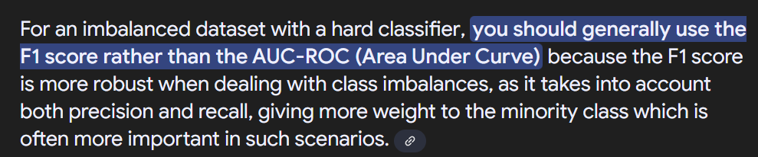
Why F1 over ROC-AUC?
While both F1 and ROC-AUC can be used, we plan to focus more on F1:
We generate output classes instead of probabilities for calculating the output classes. Therefore we essentially have a ‘hard classifier’ that either gives 0/1
Highly imbalanced dataset
Online Reference:
Notes:
https://datascience.stackexchange.com/questions/94648/is-it-better-to-use-f1-score-or-auc-metric-for-imbalanced-data-classification

Slide 6
Statistical Analysis
F1 scores may appear close (not identical). Are the differences in F1 score truly different? Statistically significant?
Aim to give quantitative measure of whether the variables influenced the F1 score, not due to chance. (Don’t simply conclude by “eyeballing” graphs)
Notes:
Is subjective

Slide 7
Parametric tests
ANOVA + Tukey
ANOVA: Checks if there are significant differences between means for a target variable, depending on >=2 independent categorical variables eg. is mean F1 different, when we tweak variables Prompt Type/Model/Sample Size etc? For which variables does it cause a significant difference?
Tukey: Conducts post-hoc pairwise comparisons between mean of a target variable, between 2 levels of a variable. Done after a significant ANOVA result. To see which specific level-pairs have significant differences eg. if F1 is significantly different for the variable ‘Model’, for which level-pairs (7B vs 13B, 7B vs 7B 8bit) does it cause a significant difference?
Assumption: normality of residuals (Failed) etc

Slide 8
Statistical Analysis
Kruskal-Wallis + Dunn’s Test
Kruskal-Wallis: Checks if there are significant differences between the target variable, due to >=2 independent categorical variables eg. is F1 different, when we tweak variables Prompt Type/Model/Sample Size etc? For which variables does it cause a significant difference?
If above result is statistically significant, let’s dive 1 tier deeper…
Dunn’s: Conducts pairwise comparisons of target variable, between 2 levels of a variable. To see which specific level-pairs have significant differences eg. if F1 is significantly different for the variable ‘Model’, for which level-pairs (7B vs 13B, 7B vs 7B 8bit) does it cause a significant difference?
Not ANOVA test since: we have non-normally distributed data

Slide 9
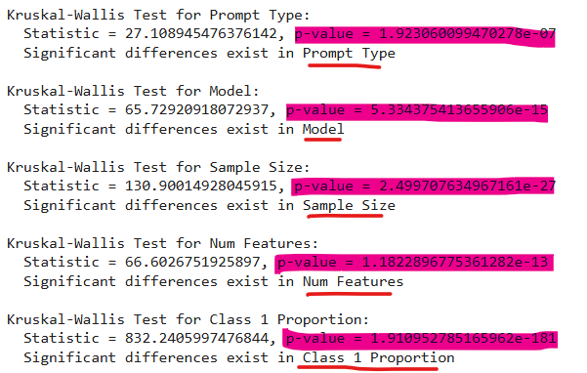
F1 differences caused by features are statistically significant!
Kruskal-Wallis test

Slide 10
Findings

Slide 11
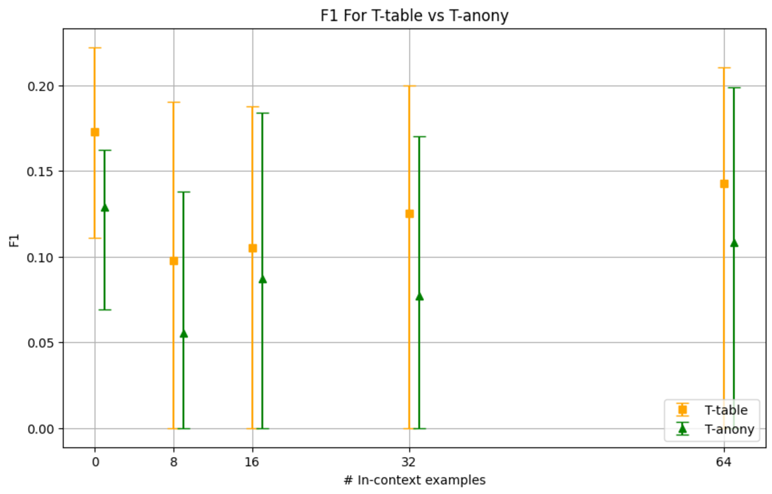
Results and Analysis: Prompt Template Comparison using F1 (T-table performs better)
Notes:
Ends of each of the candle are the 25th and 75th percentile of F1 scores for a particular number of incontext examples
T-table F1 scores includes F1 scores across all features and proportions from both 7B and 13B models for t-table format.
T-anony F1 scores includes F1 scores across all features and proportions from both 7B and 13B models for t-anony format.
Higher F1 scores for

Slide 12
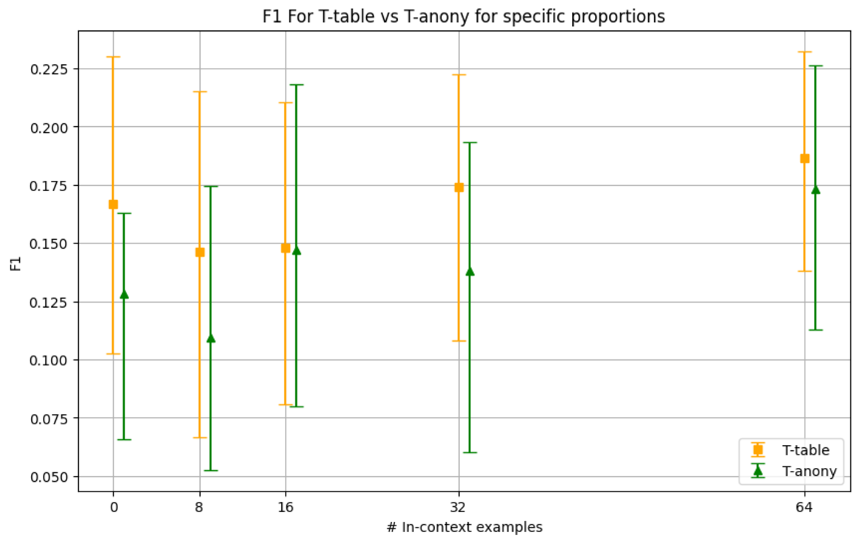
Results and Analysis: Prompt Template Comparison using F1(Proportions 0.3 and 0.5 included) - No F1 score of 0
Notes:
The motive for choosing 0.3 and 0.5 proportions was to exclude the case of extreme imbalance in incontext examples due to 0.1 proportion. As a result, a lift in the 25th percentile for both t-table and t-anony can be seen as we now don’t end up getting 0 F1 scores due to imbalance

Slide 13
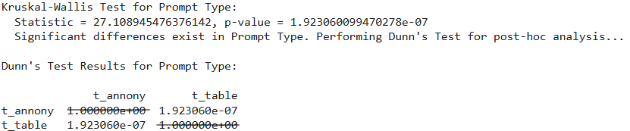
1. t-table wins t-annony
From the candleplots we observed that that t-table generally gives better performance when compared to t-annony.
F1 differences are statistically significant supported by the statistical tests.

Slide 14
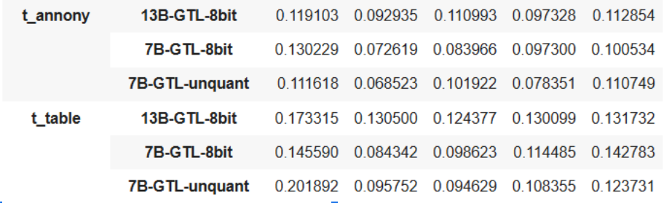
2. 13B-GTL-8bit wins 7B-GTL-8bit

Slide 15
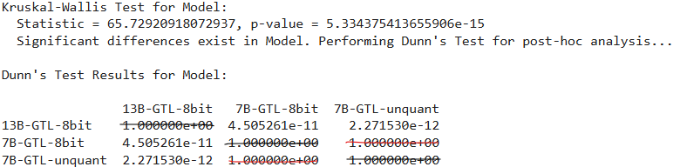
‘Model’ variable
F1 differences are statistically significant
All models, except 7B-8bit and 7B-unquant, show significant pairwise differences in F1 scores. So use 7B 8bit to save resources

Slide 16
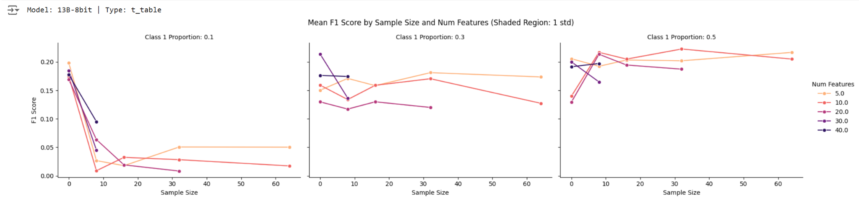
3. Higher Class1Proportion, better

Slide 17
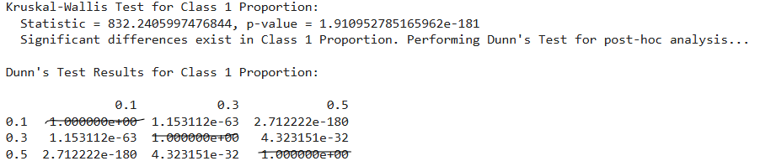
‘Class 1 Proportion’ variable
F1 differences are statistically significant. Changing Class 1 prop makes a difference

Slide 18
4. Higher Sample Size wins higher Num Features
One limitation of LLM is context-length (For LlaMA2, 4096 tokens)
Num features and sample size are both statistically significant for predictive power
Which one to prioritize?

Slide 19
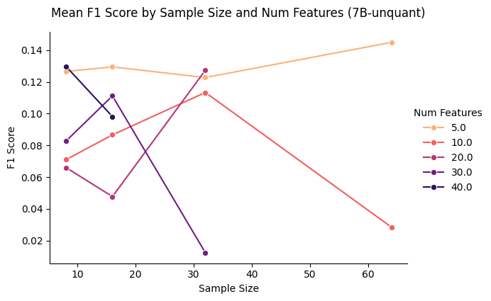
4. Higher Sample Size wins higher Num Features
Small num features with more sample (num features 5 & sample size 64)
vs
Large num features with few sample (num features 40 & sample size 8)

Slide 20
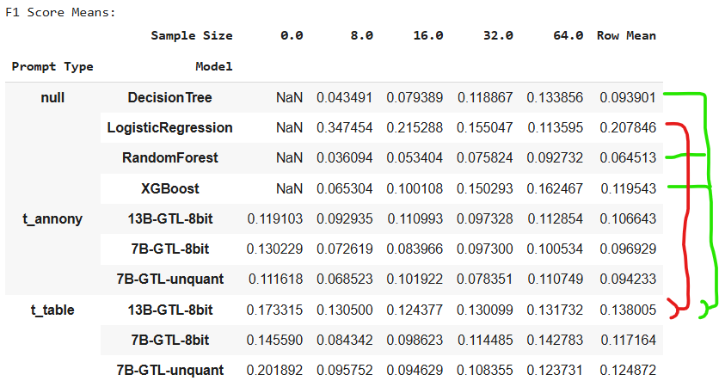
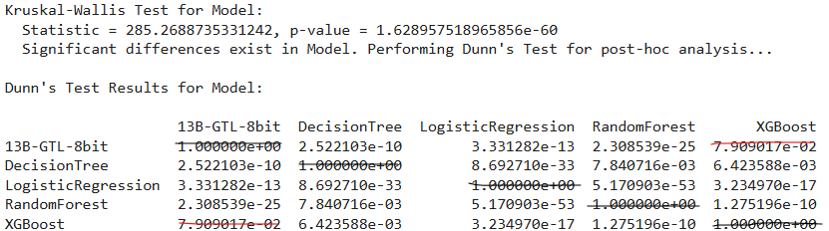
5. Best GTL loses to Logreg, but wins others
F1 Differences due to ‘Model’ are statistically significant, except 13B-GTL-8bit vs XGBoost

Slide 21
Summary of Findings
Prompt Type? | T-table, more info better
Model? | 13B-GTL-8bit, bigger better
Class 1 Prop? | 0.5, higher better
Higher Sample Size or Num Features? | Sample Size
GTL or TradML? | Mixed results

Slide 22
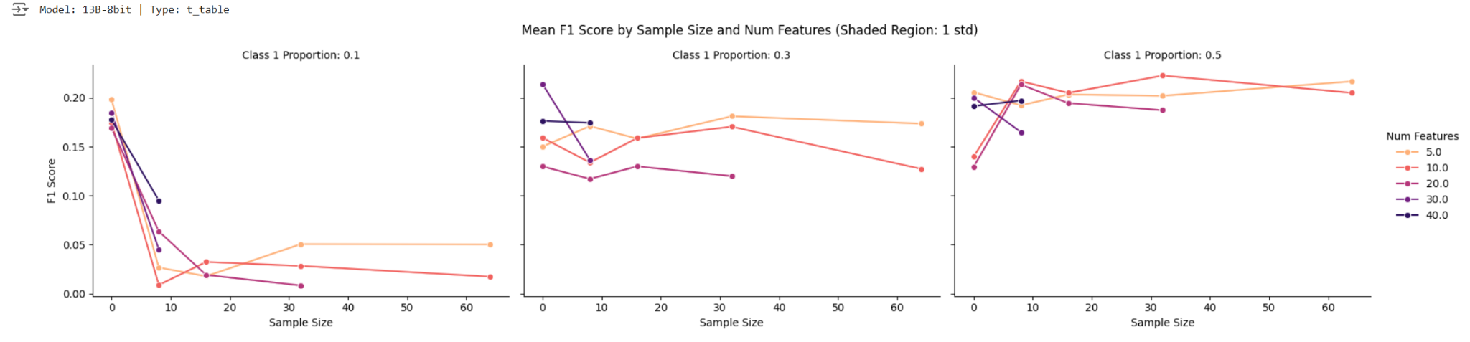
Feeding with more balanced in-context examples improves performance

Slide 23
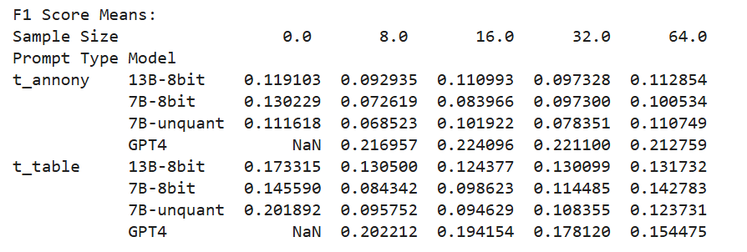

Slide 24
Limitations
Lacking compute/strong GPUs. Cannot run ≥13B Llama2-GTL, nor pre-train better foundation models
Limited experiments due to 4096 token window limit for GTL models (eg. limited no. of in-context examples, features)
Cannot input entire kaggle dataset with >60 features. Need to be selective about the columns we use for prediction (using feature importance score)

Slide 25
Future work
Run/train larger, better models
With higher token window limit
Generate prediction probabilities, for AUROC metric
Explore interactions between variables (eg. Num Features x Sample Size)
Test model generalization by using a different target variable. While t-annony gives a good indicator of this, it would be interesting to test this using a different target variable

