Slide 1
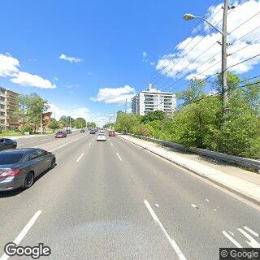
ResNet50-FC
ResNet-50
LTS
FC
FC
Softmax
Street view image
(224 x 224)
Image embedding
(pretrained)
1000-D
100-D
4-D

Slide 2
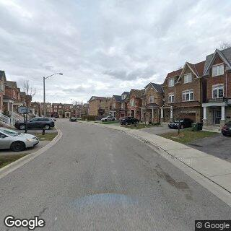

Neural Network
Contrastive
Loss
A Pretext Task
Neural Network
LTS Prediction
FC
Softmax
LTS
Frozen
A simple network

