Slide 1
HTML Fundamentals
9/4/2021

Slide 2
Course Materials
https://lin-chen-langley.github.io/Volunteer/Programming/
In-class exercises
No mandatory homework
Term project

Slide 3
Coding Editor
Do not use Microsoft Word
Windows
Sublime, https://www.sublimetext.com/3
Notepad
Mac
Sublime, https://www.sublimetext.com/3
Vim
Linux
Sublime, https://www.sublimetext.com/3
Vim

Slide 4
What is HTML and Why
HTML is the standard markup language for creating Web pages
.txt
Simple, pure text
No format
.html
.docx
Pure text
Defined format
Need web browser
For Internet
Defined format
Need compatible software
For local

Slide 5
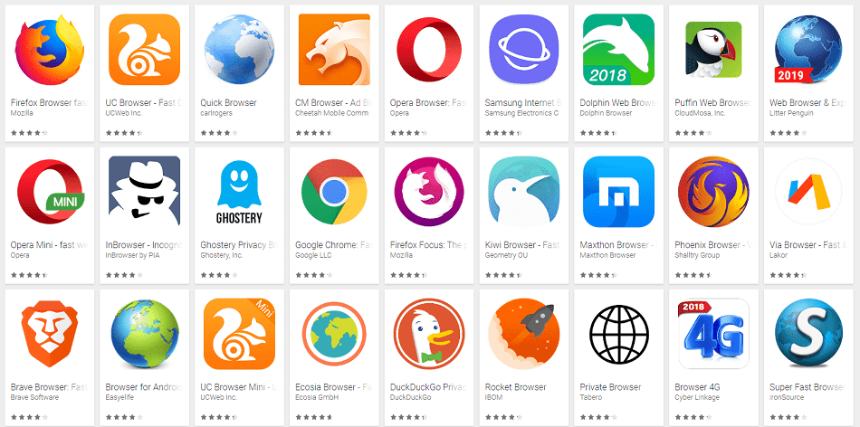
Who Define HTML
World Wide Web Consortium (W3C)
HTML 5

Slide 6
Access a HTML Webpage
Website Server
Download a html file
Local Computer
Interpret
Web Browser

Slide 7
A Simple HTML Document
document type declaration
<!DOCTYPE html>
start html
<html>
</html>
<head> <title>Page Title</title> </head>
head section
<body> <h1>My First Heading</h1> <p>My first paragraph.</p> </body>
body section
end html

Slide 8
Create a HTML File
Let’s create a folder for Class 1
2. Open Sublime
Tip:
Open Sublime
Save as “[name].html” to create a html file
c. type in “html”, then press “tab” key, sublime will create a html template
3. Write html code
4. Save it as [name].htm or [name].html

Slide 9
Validation
https://validator.w3.org/
Visualize the source code of a webpage
Visualize a page with Chrome’s developer tool

Slide 10
HTML Element
Regular Elements
<tagname>Display content on web browser</tagname>
<h1>My First Heading</h1>
e.g., html, head, body, h1, p
Empty HTML Elements
no content
<img src=“StarWars.jpg">
e.g., br, img

Slide 11
Nested Structure
Elements can contain other elements
<body> <h1>My First Heading</h1> <p>My first paragraph.</p> </body>

