Slide 1
Python Coding for Teenagers
Google Search
Version 0.1, 08.15.2018

Slide 2
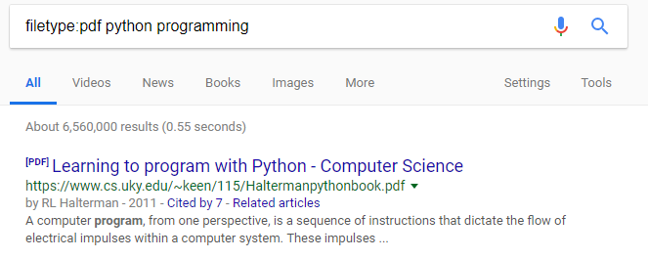
Python Coding for Teenagers
Search a specific type of links
Find pdf files: search for textbook, search for scientific journal papers
Open google web browser
Type in filetype:pdf python programming in the search bar, press Enter key
The pdf files relating to “python programming” will be listed
Version 0.1, 08.15.2018

Slide 3
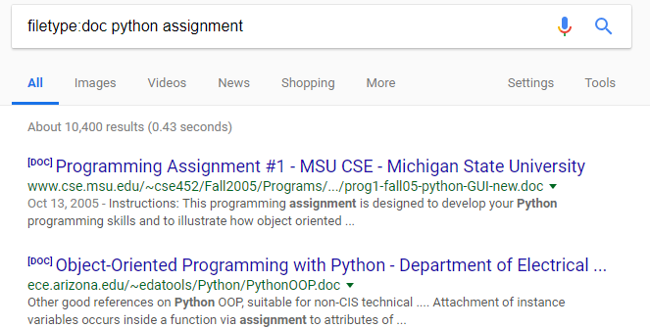
Python Coding for Teenagers
Search a specific type of links
Find doc/docx files: search for assingments
Open google web browser
Type in filetype:doc python assignment in the search bar, press Enter key
The doc files related to key words “python assignment” will be listed
Version 0.1, 08.15.2018

Slide 4
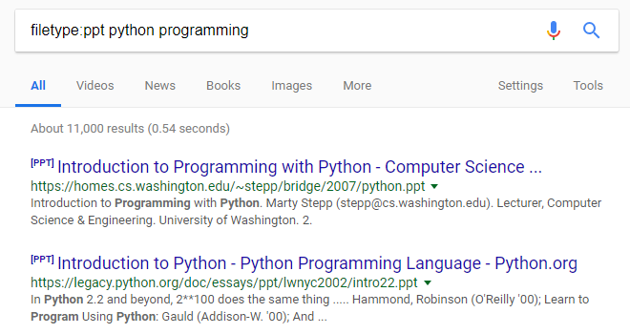
Python Coding for Teenagers
Search a specific type of links
Find ppt/pptx files: search for lectures and presentations
Open google web browser
Type in filetype:ppt python programming in the search bar, press Enter key
The ppt files relating to “python programming” will be listed
Version 0.1, 08.15.2018

Slide 5
Python Coding for Teenagers
Search a specific type of links
Exercise
Search “fish” in pdf format
Version 0.1, 08.15.2018

Slide 6
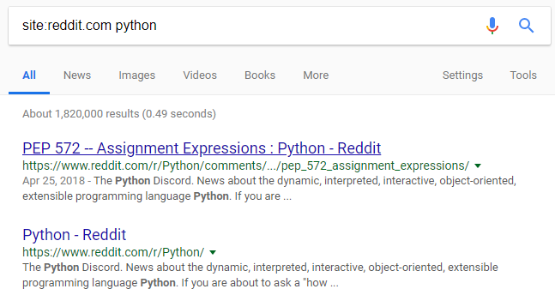
Python Coding for Teenagers
Search information within a specific web site
Search information at www.reddit.com
Open google web browser
Type in site:reddit.com python in the search bar, press Enter key
Version 0.1, 08.15.2018

Slide 7
Python Coding for Teenagers
Search information within a specific web site
Exercise
Search “fish”at www.quora.com
Version 0.1, 08.15.2018

Slide 8
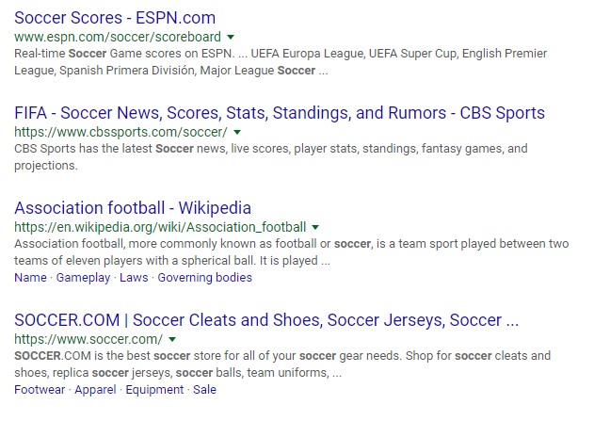
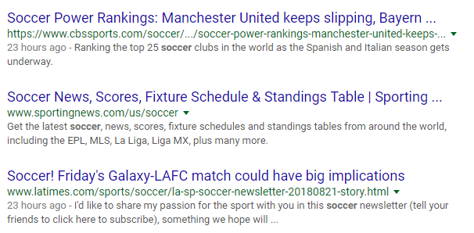
Python Coding for Teenagers
Logical operations
- operation, precede the terms you do not want to appear in results
Search “soccer”
Search “soccer -FIFA”
The records related to “FIFA” have been removed
Version 0.1, 08.15.2018

Slide 9
Python Coding for Teenagers
Logical operations
| operation, logical OR
Search “tahiti Hawaii”
Search “tahiti | Hawaii”
The links containing both key words are
listed on top
Search either “tahiti” or “Hawaii”
Version 0.1, 08.15.2018

Slide 10
Python Coding for Teenagers
Google Search Cheat Sheet
http://www.googleguide.com/print/adv_op_ref.pdf
Version 0.1, 08.15.2018

