Slide 1
HTML Fundamentals

Slide 2
Inline CSS
Create a style for each element
<div style="height: 500px; width: 30%; float:left">
<div style = "width: 90%; color: white;">Introduction</div>
<div style = "width: 90%; color: white;">Running</div>
</div>

Slide 3
Internal CSS
Create styles in head
Make the html code readable
Can be shared by many elements
<style>
.button {width: 90%; color: white; border-radius: 40px;}
</style>
<div class = "button">
Introduction
</div>
<div class = "button">
Introduction
</div>

Slide 4
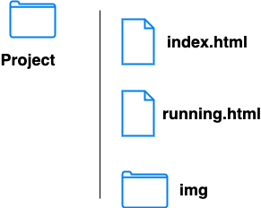
Links
The start page of a website is named as index.html by convention

Slide 5
Buttons
Regular
Hover
Click
The regular style
The style when move
the cursor on the element
The style when click
the element

Slide 6
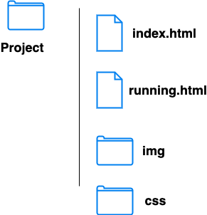
External CSS
Create styles in css style files
Html files of the website share the css style files

