Slide 1
HTML Fundamentals

Slide 2
Insert Youtube Video
iframe
Embed another document within the current HTML document
<iframe width="900" height="600"
src="https://www.youtube.com/embed/u-xS-dkz3a0"
title="YouTube video player"
frameborder="0"
allow="accelerometer; autoplay; clipboard-write; encrypted-media; gyroscope; picture-in-picture”
allowfullscreen></iframe>
https://www.w3schools.com/tags/tag_iframe.asp

Slide 3
Insert Youtube Video
Youtube API Parameters
<iframe width="900" height="600"
src="https://www.youtube.com/embed/u-xS-dkz3a0?autoplay=1&mute=1"
title="YouTube video player"
frameborder="0"
allow="accelerometer; autoplay; clipboard-write; encrypted-media; gyroscope; picture-in-picture”
allowfullscreen></iframe>
https://www.w3schools.com/tags/tag_iframe.asp

Slide 4
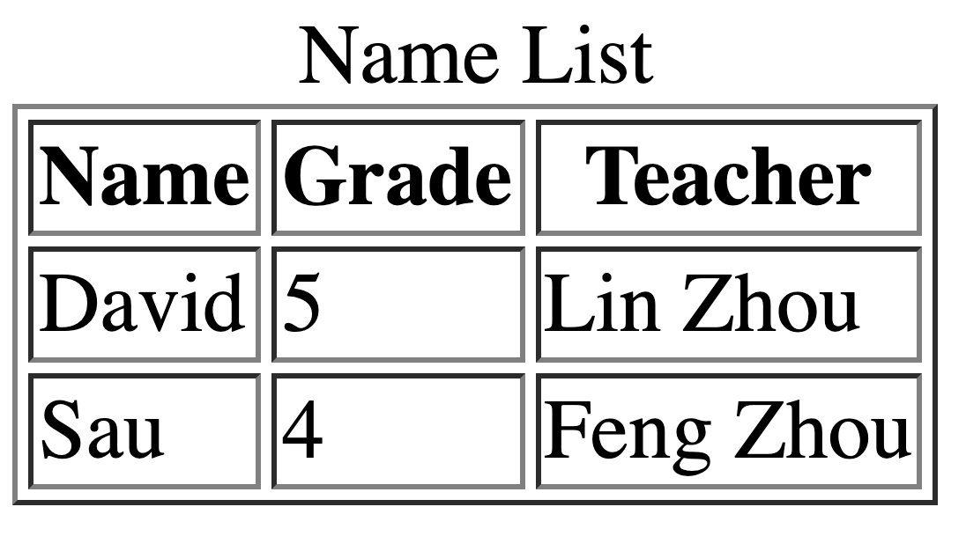
Table
Caption
Header
Row
Row

Slide 5
Table
<table border>
</table>
<caption>Name List</caption>
<tr>
<th>Name</th>
<th>Grade</th>
<th>Teacher</th>
</tr>
Header
<tr>
<td>David</td>
<td>5</td>
<td>Lin Chen</td>
</tr>
Row
<tr>
<td>Sau</td>
<td>4</td>
<td>Feng Zhou</td>
</tr>
Row

Slide 6
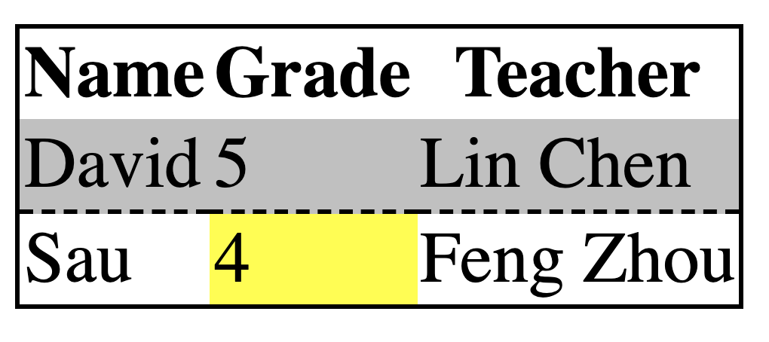
Table Decoration
<table style="border: 1px solid black; border-collapse: collapse;”>
</table>
<tr>
<th>Name</th>
<th>Grade</th>
<th>Teacher</th>
</tr>
<tr style="background: silver; border-bottom: 1px dashed black">
<td>David</td>
<td>5</td>
<td>Lin Chen</td>
</tr>
<tr>
<td>Sau</td>
<td style="background:yellow">4</td>
<td>Feng Zhou</td>
</tr>

