Slide 1
HTML Fundamentals

Slide 2
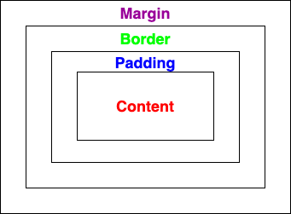
Box Model
Content
Content size
By width and height
Padding
Space between content and border
By padding
Border
Border size
By border
Margin
Space between the current element and the neighbor element
By margin

Slide 3
Box Model
width:200px;
height:100px;
padding: 20px;
border:10px solid black;
margin: 20px
padding
margin
WIDTH = 200 + 2*20+2*10+2*20
= 300
border
HEIGHT = 100 + 2*20+2*10+2*20
= 200

Slide 4
Padding
Generate space around content
padding: 20px; # space on four direction
padding: 10px 20px 30px 40px; # space for top, right, bottom, left
padding-top: 20px; # space on top
padding-right: 20px; # space on right
padding-bottom: 20px; # space on bottom
padding-left: 20px; # space on left
Absolute - px, pt, cm, etc.
Relative - %

Slide 5
Margin
Generate space around elements
margin: 20px; # space on four direction
margin : 10px 20px 30px 40px; # space for top, right, bottom, left
margin -top: 20px; # space on top
margin -right: 20px; # space on right
margin -bottom: 20px; # space on bottom
margin -left: 20px; # space on left
Absolute - px, pt, cm, etc.
Relative - %

Slide 6
Border
style
Define border
border: 1px solid black; # border on four direction
width
style
border-top: 1px solid black; # border on top
border-right: 1px solid black; # border on right
border-bottom: 1px solid black; # border on bottom
border-left: 1px solid black; # border on left
Round border corner
border-radius: 25px;
Border Style, https://www.w3schools.com/cssref/pr_border-style.asp

Slide 7
Center Element
Horizontal Center
margin: auto;
or
margin-left: auto; margin-right: auto;
Vertical Center
Adjust padding of parent element
padding-top

Slide 8
Center Text
Horizontal Center
text-align: center

Slide 9
Background
Background Color
background: blue
Background Image
background-image: url(…)

