Slide 1
HTML Fundamentals

Slide 2
Prerequisites
Install Git
https://www.atlassian.com/git/tutorials/install-git
Create a Github account
https://github.com/

Slide 3
Steps
Create ssh keys
Add public key to Github
Start ssh-agent
Add private key to ssh-agent
Local
Github
Local
Local
One Time
Add git system to project
Create a repository
Add repository URL to project
Local
Github
Local
Make Commit
Push project to repository
Repeat
Local
Local

Slide 4
Step 1. Add SSH Key (local)
# Create ssh keys
# private key, /Users/myname/.ssh/id_rsa
# public key, /Users/myname/.ssh/id_rsa.pub
ssh-keygen -t rsa
# Start ssh-agent
eval $(ssh-agent -s)
# Add private key to ssh-agent
ssh-add ~/.ssh/id_rsa
https://lin-chen-langley.github.io/Git/ssh.htm

Slide 5
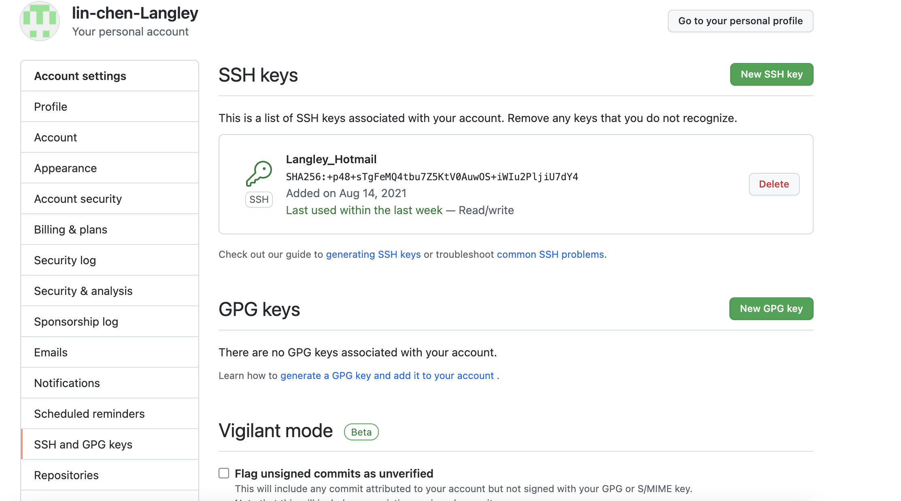
Step 2. Add SSH Key (github)
https://docs.github.com/en/authentication/connecting-to-github-with-ssh/adding-a-new-ssh-key-to-your-github-account

Slide 6
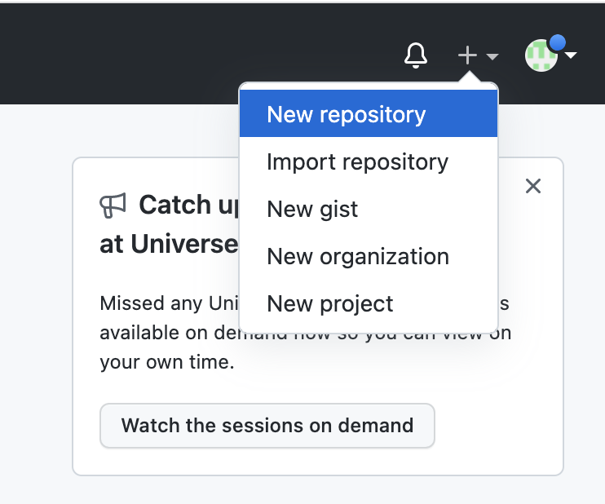
Step 3. Create a repository (github)

Slide 7
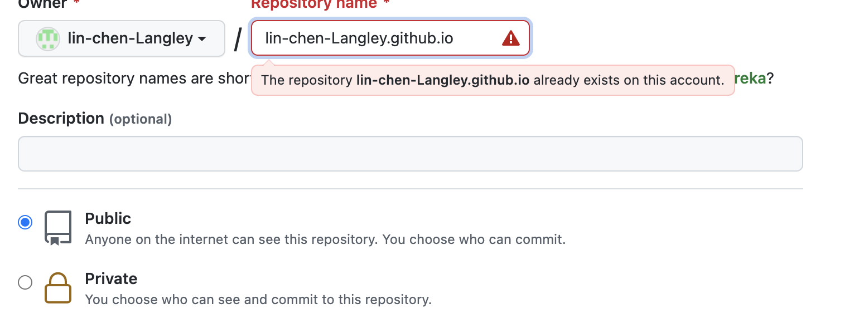
Step 3. Create a repository (github)
Repository namne should be [username].github.io

Slide 8
Step 4. Create Git System for the project (local)
# Enter the project directory
cd my-project/
# Create a git system for the project
git init
# Add the repository URL to git system
git remote add origin git@github.com:[user-name]/[user-name].git

Slide 9
Step 5. Push Code to Repository (local)
# Save a version
git add .
git commit -m "first commit”
# Push the code to the repository
git push -u origin master

Slide 10
Step 6. Access Website
# Access the website
https://[user-name].github.io/

Slide 11
Update Website
# Update the website
# Save the updated version
git add .
git commit -m ”update commit”
# Push the code to the repository
git push -u origin master

