Slide 1
Induction and recursion
Chapter 5
With Question/Answer Animations

Slide 2
Mathematical Induction
Section 5.1

Slide 3
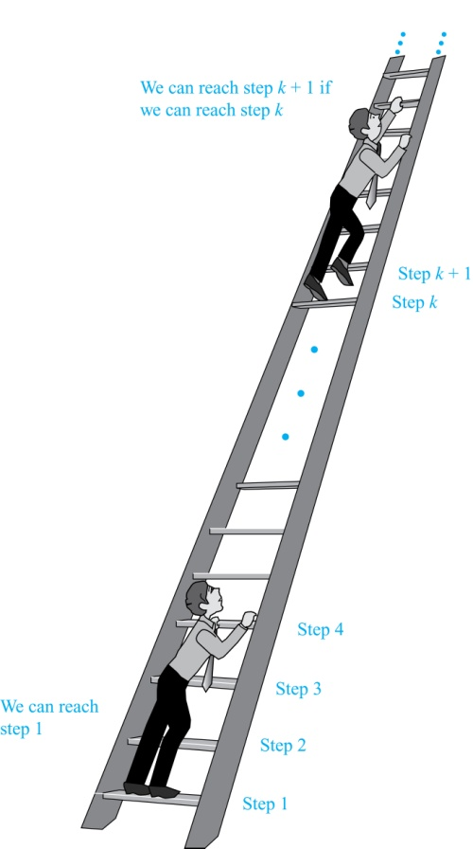
Climbing an Infinite Ladder
Suppose we have an infinite ladder:
We can reach the first rung of the ladder.
If we can reach a particular rung of the ladder, then we can reach the next rung.
From (1), we can reach the first rung. Then by applying (2), we can reach the second rung. Applying (2) again, the third rung. And so on. We can apply (2) any number of times to reach any particular rung, no matter how high up.
This example motivates proof by mathematical induction.

Slide 4
Principle of Mathematical Induction
Principle of Mathematical Induction: To prove that P(n) is true for all positive integers n, we complete these steps:
Basis Step: Show that P(1) is true.
Inductive Step: Show that P(k) → P(k + 1) is true for all positive integers k.
Conclusion: P(n) is true for all positive inters n
To complete the inductive step, assuming the inductive hypothesis that P(k) holds for an arbitrary integer k, show that must P(k + 1) be true.
Climbing an Infinite Ladder Example:
BASIS STEP: By (1), we can reach rung 1.
INDUCTIVE STEP: Assume the inductive hypothesis that we can reach rung k. Then by (2), we can reach rung k + 1.
Hence, P(k) → P(k + 1) is true for all positive integers k. We can reach every rung on the ladder.

Slide 5
Important Points About Using Mathematical Induction
Mathematical induction can be expressed as the rule of inference
where the domain is the set of positive integers.
In a proof by mathematical induction, we don’t assume that P(k) is true for all positive integers! We show that if we assume that P(k) is true, then P(k + 1) must also be true.
Proofs by mathematical induction do not always start at the integer 1. In such a case, the basis step begins at a starting point b where b is an integer. We will see examples of this soon.
(P(1) ∧ ∀k (P(k) → P(k + 1))) → ∀n P(n),

Slide 6
Validity of Mathematical Induction
Mathematical induction is valid because of the well ordering property, which states that every nonempty subset of the set of positive integers has a least element (see Section 5.2 and Appendix 1). Here is the proof:
Suppose that P(1) holds and P(k) → P(k + 1) is true for all positive integers k.
Assume there is at least one positive integer n for which P(n) is false. Then the set S of positive integers for which P(n) is false is nonempty.
By the well-ordering property, S has a least element, say m.
We know that m can not be 1 since P(1) holds.
Since m is positive and greater than 1, m − 1 must be a positive integer. Since m − 1 < m, it is not in S, so P(m − 1) must be true.
But then, since the conditional P(k) → P(k + 1) for every positive integer k holds, P(m) must also be true. This contradicts P(m) being false.
Hence, P(n) must be true for every positive integer n.

Slide 7
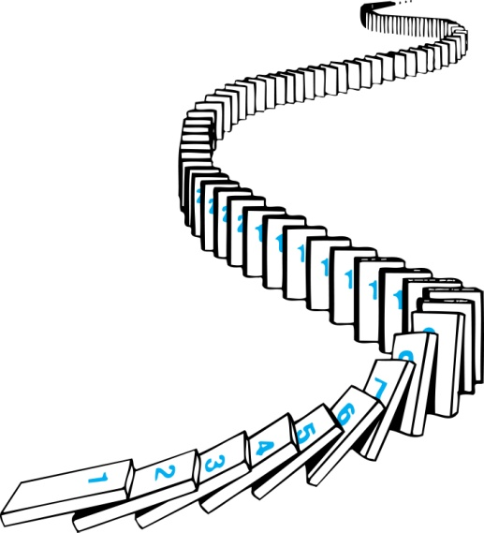
Remembering How Mathematical Induction Works
Consider an infinite sequence of dominoes, labeled 1,2,3, …, where each domino is standing.
We know that the first domino is knocked down, i.e., P(1) is true .
We also know that if whenever the kth domino is knocked over, it knocks over the (k + 1)st domino, i.e, P(k) → P(k + 1) is true for all positive integers k.
Let P(n) be the proposition that the nth domino is knocked over.
Hence, all dominos are knocked over.
P(n) is true for all positive integers n.

Slide 8
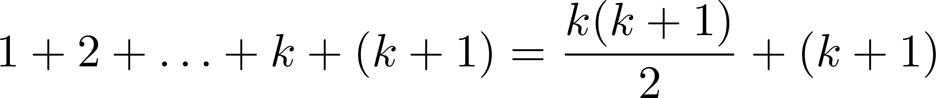
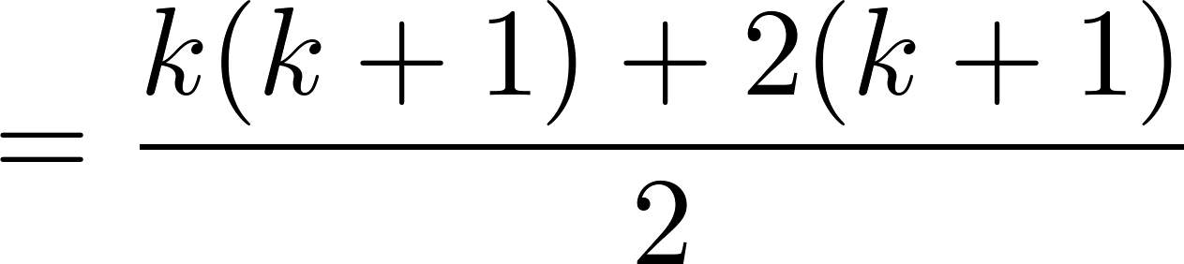
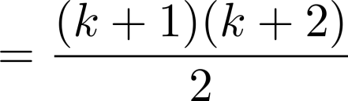
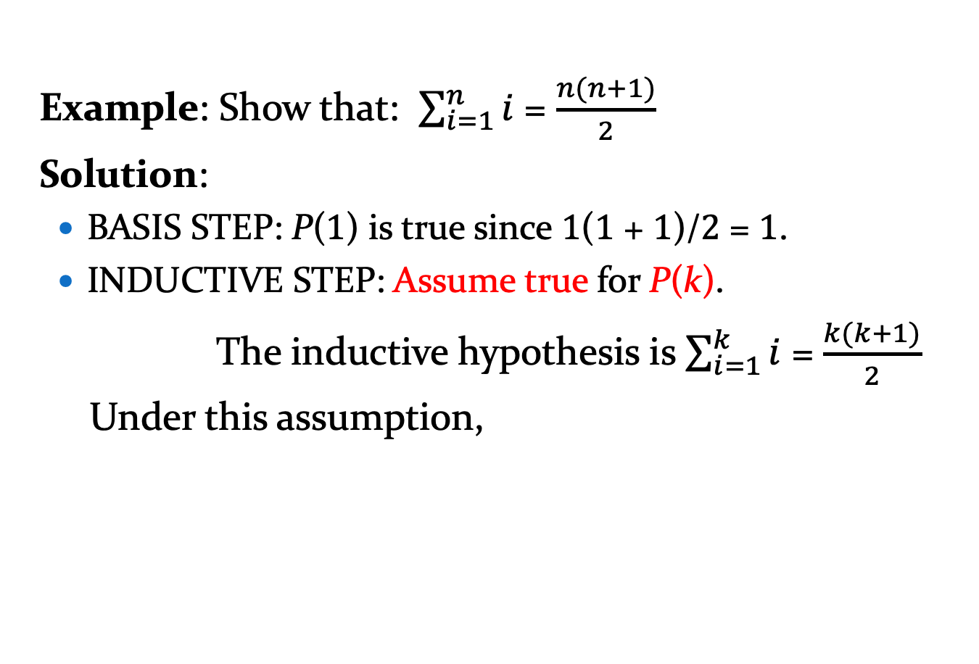
Proving a Summation Formula by Mathematical Induction
Example: Show that: $\sum_{i=1}^{n}{i}$ = $\frac{n(n+1)}{2}$
Solution:
BASIS STEP: P(1) is true since 1(1 + 1)/2 = 1.
INDUCTIVE STEP: Assume true for P(k).
The inductive hypothesis is $\sum_{i=1}^{k}{i}$ = $\frac{k(k+1)}{2}$
Under this assumption,
Note: Once we have this conjecture, mathematical induction can be used to prove it correct.
P(k+1):
Conclusion: …

Slide 9
Conjecturing and Proving Correct a Summation Formula
Example: Conjecture and prove correct a formula for the sum of the first n positive odd integers. Then prove your conjecture.

Slide 10
Conjecturing and Proving Correct a Summation Formula
Example: Conjecture and prove correct a formula for the sum of the first n positive odd integers. Then prove your conjecture.
Solution: We have: 1= 1, 1 + 3 = 4, 1 + 3 + 5 = 9, 1 + 3 + 5 + 7 = 16, 1 + 3 + 5 + 7 + 9 = 25.
We can conjecture that the sum of the first n positive odd integers is n²,
We prove the conjecture is proved correct with mathematical induction.
BASIS STEP: P(1) is true since 1² = 1.
INDUCTIVE STEP: P(k) → P(k + 1) for every positive integer k.
Assume the inductive hypothesis holds and then show that P(k) holds has well.
So, assuming P(k), it follows that:
Hence, we have shown that P(k + 1) follows from P(k). Therefore the sum of the first n positive odd integers is n².
1 + 3 + 5 + ∙∙∙+ (2n − 1) =n² .
Inductive Hypothesis: 1 + 3 + 5 + ∙∙∙+ (2k − 1) =k²
1 + 3 + 5 + ∙∙∙+ (2k − 1) + (2k + 1) =[1 + 3 + 5 + ∙∙∙+ (2k − 1)] + (2k + 1)
= k² + (2k + 1) (by the inductive hypothesis)
= k² + 2k + 1
= (k + 1) ²

Slide 11

Classroom Exercise
Prove that $1^{2}+3^{2}+5^{2}+···+{(2n+1)}^{2}=\frac{(n+ 1)(2n+ 1)(2n+ 3)}{3}$
whenever $n$ is a nonnegative integer.

Slide 12
Classroom Exercise
Prove that
P(n): 1 + 2 + 2² + 2³ + ... + 2^{n} = 2^{n+1} - 1

Slide 13

Classroom Exercise
Prove that
$\sum_{j=0}^{n}{ar^{j}}=a+ar+ar^{2}+ …+ar^{n}=\frac{ar^{n+1}−a}{r−1}$, where $r≠1$

Slide 14
Proving Inequalities
Example: Use mathematical induction to prove that n < 2^{n} for all positive integers n.
Solution: Let P(n) be the proposition that n < 2^{n}.
BASIS STEP: P(1) is true since 1 < 2¹ = 2.
INDUCTIVE STEP: Assume P(k) holds, i.e., k < 2^{k}, for an arbitrary positive integer k.
Must show that P(k + 1) holds. Since by the inductive hypothesis, k < 2^{k}, it follows that:
k + 1 < 2^{k} + 1 ≤ 2^{k} + 2^{k} = 2 ∙ 2^{k} = 2^{k+1}
Therefore n < 2^{n} holds for all positive integers n.

Slide 15
Proving Inequalities
Example: Use mathematical induction to prove that 2^{n} < n!, for every integer n ≥ 4.
Solution: Let P(n) be the proposition that 2^{n} < n!.
BASIS STEP: P(4) is true since 2⁴ = 16 < 4! = 24.
INDUCTIVE STEP: Assume P(k) holds, i.e., 2^{k} < k! for an arbitrary integer k ≥ 4. To show that P(k + 1) holds:
2^{k+1} = 2∙2^{k}
< 2∙ k! (by the inductive hypothesis)
< (k + 1)k!
= (k + 1)!
Therefore, 2^{n} < n! holds, for every integer n ≥ 4.
Note that here the basis step is P(4), since P(0), P(1), P(2), and P(3) are all false.

Slide 16

Classroom Exercise
Prove that $2^{n}>$ $n^{2}$ if $n$is an integer greater than 4.

Slide 17
Proving Divisibility Results
Example: Use mathematical induction to prove that n³ − n is divisible by 3, for every positive integer n.
Solution: Let P(n) be the proposition that n³ − n is divisible by 3.
BASIS STEP: P(1) is true since 1³ − 1 = 0, which is divisible by 3.
INDUCTIVE STEP: Assume P(k) holds, i.e., k³ − k is divisible by 3, for an arbitrary positive integer k. To show that P(k + 1) follows:
(k + 1)³ − (k + 1) = (k³ + 3k² + 3k + 1) − (k + 1)
= (k³ − k) + 3(k² + k)
By the inductive hypothesis, the first term (k³ − k) is divisible by 3 and the second term is divisible by 3 since it is an integer multiplied by 3. So by part (i) of Theorem 1 in Section 4.1 , (k + 1)³ − (k + 1) is divisible by 3.
Therefore, n³ − n is divisible by 3, for every integer positive integer n.

Slide 18
Number of Subsets of a Finite Set
Example: Use mathematical induction to show that if S is a finite set with n elements, where n is a nonnegative integer, then S has 2^{n} subsets.
(Chapter 6 uses combinatorial methods to prove this result.)
Solution: Let P(n) be the proposition that a set with n elements has 2^{n} subsets.
Basis Step: P(0) is true, because the empty set has only itself as a subset and 2⁰ = 1.
Inductive Step: Assume P(k) is true for an arbitrary nonnegative integer k.
continued →

Slide 19
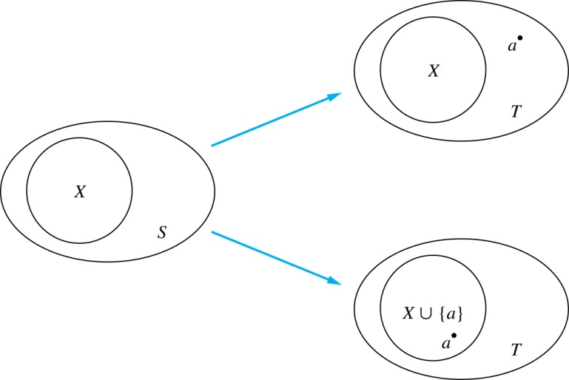
Number of Subsets of a Finite Set
Inductive Hypothesis: For an arbitrary nonnegative integer k, every set with k elements has 2^{k} subsets.
Let T be a set with k + 1 elements. Then T = S ∪ {a}, where a ∈ T and S = T − {a}. Hence |T| = k.
For each subset X of S, there are exactly two subsets of T, i.e., X and X ∪ {a}.
By the inductive hypothesis S has 2^{k} subsets. Since there are two subsets of T for each subset of S, the number of subsets of T is 2 ∙2^{k} = 2^{k+1} .

Slide 20


Tiling Checkerboards
Example: Show that every 2^{n} ×2^{n} checkerboard with one square removed can be tiled using right triominoes.
Solution: Let P(n) be the proposition that every 2^{n} ×2^{n} checkerboard with one square removed can be tiled using right triominoes. Use mathematical induction to prove that P(n) is true for all positive integers n.
BASIS STEP: P(1) is true, because each of the four 2 ×2 checkerboards with one square removed can be tiled using one right triomino.
INDUCTIVE STEP: Assume that P(k) is true for every 2^{k} ×2^{k} checkerboard, for some positive integer k.
A right triomino is an L-shaped tile which covers three squares at a time.
continued →

Slide 21
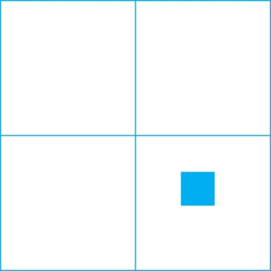

Tiling Checkerboards
Consider a 2^{k+1} ×2^{k+1} checkerboard with one square removed. Split this checkerboard into four checkerboards of size 2^{k} ×2^{k},by dividing it in half in both directions.
Remove a square from one of the four 2^{k} ×2^{k} checkerboards. By the inductive hypothesis, this board can be tiled. Also by the inductive hypothesis, the other three boards can be tiled with the square from the corner of the center of the original board removed. We can then cover the three adjacent squares with a triominoe.
Hence, the entire 2^{k+1} ×2^{k+1} checkerboard with one square removed can be tiled using right triominoes.
Inductive Hypothesis: Every 2^{k} ×2^{k} checkerboard, for some positive integer k, with one square removed can be tiled using right triominoes.

Slide 22
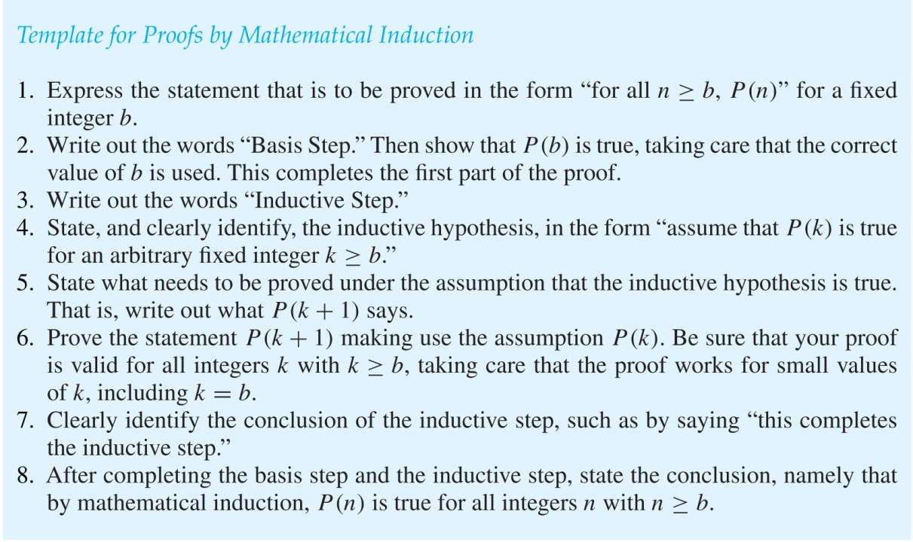
Guidelines: Mathematical Induction Proofs

Slide 23
Recursive Definitions and Structural Induction
Section 5.3

Slide 24
Recursively Defined Functions
Definition: A recursive or inductive definition of a function consists of two steps.
BASIS STEP: Specify the value of the function at zero.
RECURSIVE STEP: Give a rule for finding its value at an integer from its values at smaller integers.
A function f(n) is the same as a sequence a₀, a₁, … , where a_{i}, where f(i) = a_{i}. This was done using recurrence relations in Section 2.4.

Slide 25
Factorial Function
f(n) = 1*2*3*…*n
public static int factorial(int n)
{
if(n <= 1)
return 1;
return n*factorial(n-1);
}
Recursive Expression
f(1) = 1
f(n) = n*f(n-1)

Slide 26
Recursively Defined Functions
Example: Suppose f is defined by:
f(0) = 3,
f(n + 1) = 2f(n) + 3
Find f(1), f(2), f(3), f(4)
Solution:
f(1) = 2f(0) + 3 = 2∙3 + 3 = 9
f(2) = 2f(1)+ 3 = 2∙9 + 3 = 21
f(3) = 2f(2) + 3 = 2∙21 + 3 = 45
f(4) = 2f(3) + 3 = 2∙45 + 3 = 93

Slide 27
Exercise
Give a recursive definition of a^{n}, where a is a nonzero real
number and n is a non-negative integer

Slide 28
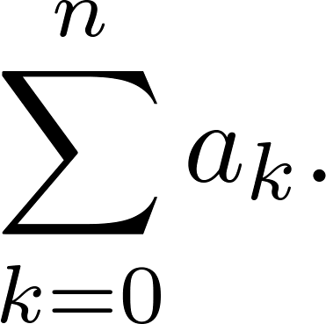
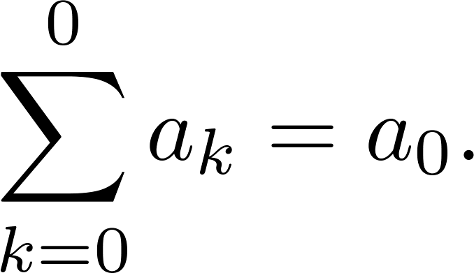
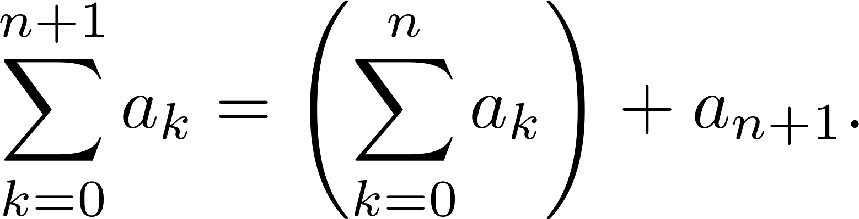
Recursively Defined Functions
Example: Give a recursive definition of:
Solution: The first part of the definition is
The second part is

Slide 29

Classroom Exercise
Give a recursive deﬁnition of the sequence {$a_{n}$}, $n =1,2,3, . .$. if
a) $a_{n}=6n$. b) $a_{n}= 2n+1$.
c) $a_{n}$ $= 10n$. d) $a_{n}$ = $5$.

Slide 30
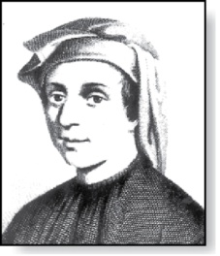
Fibonacci Numbers
Fibonacci
(1170- 1250)
Example : The Fibonacci numbers are defined as follows:
f₀ = 0
f₁ = 1
f_{n} = f_{n−1} + f_{n−2}
Find f₂, f₃ , f₄ , f₅ .
f₂ = f₁ + f₀ = 1 + 0 = 1
f₃ = f₂ + f₁ = 1 + 1 = 2
f₄ = f₃ + f₂ = 2 + 1 = 3
f₅ = f₄ + f₃ = 3 + 2 = 5
In Chapter 8, we will use the Fibonacci numbers to model population growth of rabbits. This was an application described by Fibonacci himself.
Next, we use strong induction to prove a result about the Fibonacci numbers.

Slide 31
Fibonacci Numbers
Example 4: Show that whenever n ≥ 3, f_{n} > α^{n − 2}, where α = (1 + √5)/2.
Solution: Let P(n) be the statement f_{n} > α^{n−2} . Use strong induction to show that P(n) is true whenever n ≥ 3.
BASIS STEP: P(3) holds since α < 2 = f₃
P(4) holds since α² = (3 + √5)/2 < 3 = f₄ .
INDUCTIVE STEP: Assume that P(j) holds, i.e., f_{j} > α^{j−2} for all integers j with
3 ≤ j ≤ k, where k ≥ 4. Show that P(k + 1) holds, i.e., f_{k+1} > α^{k−1} .
Since α² = α + 1 (because α is a solution of x² − x − 1 = 0),
By the inductive hypothesis, because k ≥ 4 we have
Therefore, it follows that
Hence, P(k + 1) is true.
α^{k−1} = α² ∙ α^{k−3} = ( α + 1) ∙α^{k−3} = α ∙α^{k−3}+ 1 ∙α^{k−3} = α^{k−2} + α^{k−3}
Why does this equality hold?
f_{k−1} > α^{k−3}, f_{k} > α^{k−2}.
f_{k+1} = f_{k} + f_{k−1} > α^{k−2} + α^{k−3} = α^{k−1}.
⁻² .

Slide 32
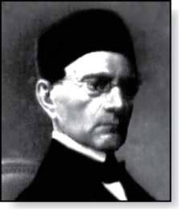
Lamé’s Theorem
Gabriel Lamé
(1795-1870)
Lamé’s Theorem: Let a and b be positive integers with a ≥ b. Then the number of divisions used by the Euclidian algorithm to find gcd(a,b) is less than or equal to five times the number of decimal digits in b.
Euclidean Algorithm
a b
35 15
15 35%15 = 10
10 15%10 = 5
5 10%5 = 0
public static int gcd(int a, int b)
{
if(b == 0)
return a;
else
return gcd(b, a%b)
}
continued →

Slide 33
Lamé’s Theorem
Gabriel Lamé
(1795-1870)
Lamé’s Theorem: Let a and b be positive integers with a ≥ b. Then the number of divisions used by the Euclidian algorithm to find gcd(a,b) is less than or equal to five times the number of decimal digits in b.
Proof: When we use the Euclidian algorithm to find gcd(a,b) with a ≥ b,
n divisions are used to obtain (with a = r₀,b =r₁ ):
Since each quotient q₁, q₂ , …,q_{n-1} is at least 1 and q_{n} ≥ 2:
r₀ = r₁q₁ + r₂ 0 ≤ r₂ < r₁,
r₁ = r₂q₂ + r₃ 0 ≤ r₃ < r₂,
⋮
r_{n-2} = r_{n-1}q_{n-1} + r_{n} 0 ≤ r_{n} < r_{n-1},
r_{n-1} = r_{n}q_{n} + 0
r_{n} ≥ 1 = f₂,
r_{n-1} ≥ 2 r_{n} ≥ 2 f₂ = f₃,
r_{n-2} ≥ r_{n-1} + r_{n} ≥ f₃ + f₂ = f₄,
⋮
r₂ ≥ r₃ + r₄ ≥ f_{n-1} + f_{n-2} = f_{n},
b = r₁ ≥ r₂ + r₃ ≥ f_{n} + f_{n-1} = f_{n+1}.
continued →

Slide 34
Lamé’s Theorem
It follows that if n divisions are used by the Euclidian algorithm to find gcd(a,b) with a ≥ b, then b ≥ f_{n+1}. By Example 4, f_{n+1} > α^{n − 1}, for n > 2, where α = (1 + √5)/2. Therefore, b > α^{n−1}.
Because log₁₀ α ≈ 0.208 > 1/5, log₁₀ b > (n−1) log₁₀ α > (n−1)/5 . Hence,
Suppose that b has k decimal digits. Then b < 10^{k} and log₁₀ b < k. It follows that n − 1 < 5k and since k is an integer, n ≤ 5k.
As a consequence of Lamé’s Theorem, O(log b) divisions are used by the Euclidian algorithm to find gcd(a,b) whenever a > b.
By Lamé’s Theorem, the number of divisions needed to find gcd(a,b) with a > b is less than or equal to 5 (log₁₀ b + 1) since the number of decimal digits in b (which equals ⌊log₁₀ b⌋ + 1) is less than or equal to log₁₀ b + 1.
n−1 < 5 ∙log₁₀ b.
⁻² .
Lamé’s Theorem was the first result in computational complexity

Slide 35
Recursively Defined Sets and Structures
Recursive definitions of sets have two parts:
The basis step specifies an initial collection of elements.
The recursive step gives the rules for forming new elements in the set from those already known to be in the set.
Sometimes the recursive definition has an exclusion rule, which specifies that the set contains nothing other than those elements specified in the basis step and generated by applications of the rules in the recursive step.
We will always assume that the exclusion rule holds, even if it is not explicitly mentioned.
We will later develop a form of induction, called structural induction, to prove results about recursively defined sets.

Slide 36
Recursively Defined Sets and Structures
Example : Subset of Integers S:
BASIS STEP: 3 ∊ S.
RECURSIVE STEP: If x ∊ S and y ∊ S, then x + y is in S.
Initially 3 is in S, then 3 + 3 = 6, then 3 + 6 = 9, etc.
Example: The natural numbers N.
BASIS STEP: 0 ∊ N.
RECURSIVE STEP: If n is in N, then n + 1 is in N.
Initially 0 is in S, then 0 + 1 = 1, then 1 + 1 = 2, etc.

Slide 37
Strings
Definition: The set Σ* of strings over the alphabet Σ:
BASIS STEP: λ ∊ Σ* (λ is the empty string)
RECURSIVE STEP: If w is in Σ* and x is in Σ, then wx ∈ Σ*.
Example: If Σ = {0,1}, the strings in in Σ* are the set of all bit strings, λ,0,1, 00,01,10, 11, etc.
Example: If Σ = {a,b}, show that aab is in Σ*.
Since λ ∊ Σ* and a ∊ Σ, a ∊ Σ*.
Since a ∊ Σ* and a ∊ Σ, aa ∊ Σ*.
Since aa ∊ Σ* and b ∊ Σ, aab ∊ Σ*.

Slide 38
String Concatenation
Definition: Two strings can be combined via the operation of concatenation. Let Σ be a set of symbols and Σ* be the set of strings formed from the symbols in Σ. We can define the concatenation of two strings, denoted by ∙, recursively as follows.
BASIS STEP: If w ∈ Σ*, then w ∙ λ= w.
RECURSIVE STEP: If w₁ ∈ Σ* and w₂ ∈ Σ* and x ∈ Σ, then w₁ ∙ (w₂ x)= (w₁ ∙ w₂)x.
Often w₁ ∙ w₂ is written as w₁ w₂.
If w₁ = abra and w₂ = cadabra, the concatenation w₁ w₂ = abracadabra.

Slide 39
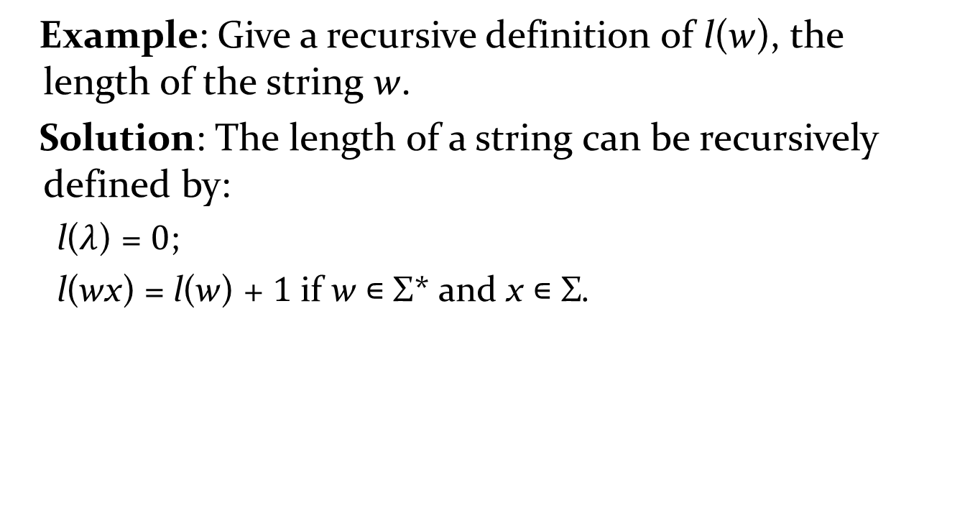
Length of a String
Example: Give a recursive definition of l(w), the length of the string w.
Solution: The length of a string can be recursively defined by:
l($λ$) = 0;
l(wx) = l(w) + 1 if w ∊ Σ* and x ∊ Σ.

Slide 40
Balanced Parentheses
Example: Give a recursive definition of the set of balanced parentheses P.
Solution:
BASIS STEP: () ∊ P
RECURSIVE STEP: If w ∊ P, then () w ∊ P, (w) ∊ P and w () ∊ P.
Show that (() ()) is in P.
Why is ))(() not in P?

Slide 41

Classroom Exercise
Give a recursive deﬁnition of the set of integers that are multiples of $5$.

Slide 42
Rooted Trees
Definition: The set of rooted trees, where a rooted tree consists of a set of vertices containing a distinguished vertex called the root, and edges connecting these vertices, can be defined recursively by these steps:
BASIS STEP: A single vertex r is a rooted tree.
RECURSIVE STEP: Suppose that T₁, T₂, …,T_{n} are disjoint rooted trees with roots r₁, r₂,…,r_{n}, respectively. Then the graph formed by starting with a root r, which is not in any of the rooted trees T₁, T₂, …,T_{n}, and adding an edge from r to each of the vertices r₁, r₂,…,r_{n}, is also a rooted tree.

Slide 43
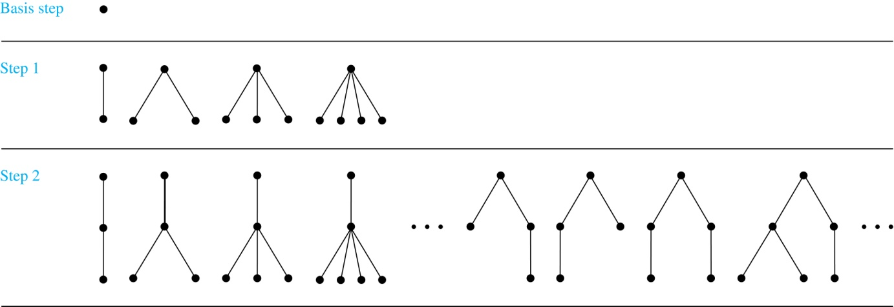
Building Up Rooted Trees
Trees are studied extensively in Chapter 11.
Next we look at a special type of tree, the full binary tree.

Slide 44
Full Binary Trees
Definition: The set of full binary trees can be defined recursively by these steps.
BASIS STEP: There is a full binary tree consisting of only a single vertex r.
RECURSIVE STEP: If T₁ and T₂ are disjoint full binary trees, there is a full binary tree, denoted by T₁∙T₂, consisting of a root r together with edges connecting the root to each of the roots of the left subtree T₁ and the right subtree T₂.

Slide 45
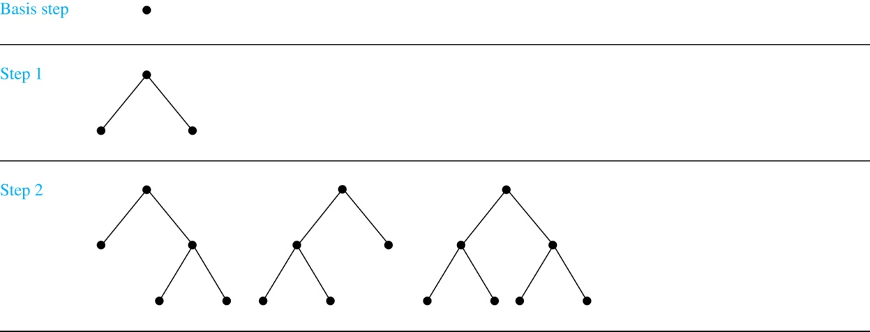
Building Up Full Binary Trees

Slide 46
Induction and Recursively Defined Sets
Example: Show that the set S defined by specifying that 3 ∊ S and that if x ∊ S and y ∊ S, then x + y is in S, is the set of all positive integers that are multiples of 3.
Solution: Let A be the set of all positive integers divisible by 3. To prove that A = S, show that A is a subset of S and S is a subset of A.
A⊂ S: Let P(n) be the statement that 3n belongs to S.
BASIS STEP: 3∙1 = 3 ∊ S, by the first part of recursive definition.
INDUCTIVE STEP: Assume P(k) is true. By the second part of the recursive definition, if 3k ∊ S, then since 3 ∊ S, 3k + 3 = 3(k + 1) ∊ S. Hence, P(k + 1) is true.
S ⊂ A:
BASIS STEP: 3 ∊ S by the first part of recursive definition, and 3 = 3∙1.
INDUCTIVE STEP: The second part of the recursive definition adds x +y to S, if both x and y are in S. If x and y are both in A, then both x and y are divisible by 3. By part (i) of Theorem 1 of Section 4.1, it follows that x + y is divisible by 3.
We used mathematical induction to prove a result about a recursively defined set. Next we study a more direct form induction for proving results about recursively defined sets.

Slide 47
Structural Induction
Definition: To prove a property of the elements of a recursively defined set, we use structural induction.
BASIS STEP: Show that the result holds for all elements specified in the basis step of the recursive definition.
RECURSIVE STEP: Show that if the statement is true for each of the elements used to construct new elements in the recursive step of the definition, the result holds for these new elements.
The validity of structural induction can be shown to follow from the principle of mathematical induction.

Slide 48
Full Binary Trees
Definition: The height h(T) of a full binary tree T is defined recursively as follows:
BASIS STEP: The height of a full binary tree T consisting of only a root r is h(T) = 0.
RECURSIVE STEP: If T₁ and T₂ are full binary trees, then the full binary tree T = T₁∙T₂ has height h(T) = 1 + max(h(T₁),h(T₂)).

Slide 49
Full Binary Trees
The number of vertices n(T) of a full binary tree T satisfies the following recursive formula:
BASIS STEP: The number of vertices of a full binary tree T consisting of only a root r is n(T) = 1.
RECURSIVE STEP: If T₁ and T₂ are full binary trees, then the full binary tree T = T₁∙T₂ has the number of vertices n(T) = 1 + n(T₁) + n(T₂).

Slide 50
Structural Induction and Binary Trees
Theorem: If T is a full binary tree, then n(T) ≤ 2^{h(T)+1} – 1.
Proof: Use structural induction.
BASIS STEP: The result holds for a full binary tree consisting only of a root, n(T) = 1 and h(T) = 0. Hence, n(T) = 1 ≤ 2⁰⁺¹ – 1 = 1.
RECURSIVE STEP: Assume n(T₁) ≤ 2^{h(T1)+1} – 1 and also n(T₂) ≤ 2^{h(T2)+1} – 1 whenever T₁ and T₂ are full binary trees.
n(T) = 1 + n(T₁) + n(T₂) (by recursive formula of n(T))
≤ 1 + (2^{h(T1)+1} – 1) + (2^{h(T2)+1} – 1) (by inductive hypothesis)
≤ 2∙max(2^{h(T1)+1} ,2^{h(T2)+1} ) – 1
= 2∙2^{max(h(T1),h(T2))+1} – 1 (max(2^{x} , 2^{y})= 2^{max(x,y)} )
= 2∙2^{h(t)} – 1 (by recursive definition of h(T))
= 2^{h(t)+1} – 1
⁻² .

Slide 51
Generalized Induction
Generalized induction is used to prove results about sets other than the integers that have the well-ordering property. (explored in more detail in Chapter 9)
For example, consider an ordering on N⨉ N, ordered pairs of nonnegative integers. Specify that (x₁ ,y₁) is less than or equal to (x₂,y₂) if either x₁ < x₂, or x₁ = x₂ and y₁ <y₂ . This is called the lexicographic ordering.
Strings are also commonly ordered by a lexicographic ordering.
The next example uses generalized induction to prove a result about ordered pairs from N⨉ N.

Slide 52
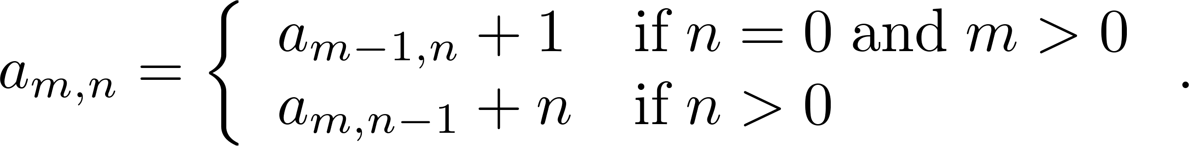
Generalized Induction
Example: Suppose that a_{m,n} is defined for (m,n)∊N ×N by a_{0,0} = 0 and
Show that a_{m,n} = m + n(n + 1)/2 is defined for all (m,n)∊N ×N.
Solution: Use generalized induction.
BASIS STEP: a_{0,0} = 0 = 0 + (0∙1)/2
INDUCTIVE STEP: Assume that a_{m̍,n̍} = m̍+ n̍(n̍ + 1)/2 whenever(m̍,n̍) is less than (m,n) in the lexicographic ordering of N ×N .
If n = 0, by the inductive hypothesis we can conclude
a_{m,n} = a_{m−1,n} + 1 = m − 1+ n(n + 1)/2 + 1 = m + n(n + 1)/2 .
If n > 0, by the inductive hypothesis we can conclude
a_{m,n} = a_{m−1,n} + 1 = m + n(n − 1)/2 +n = m + n(n + 1)/2 .
⁻² .

Slide 53
Recursive Algorithms
Section 5.4

Slide 54
Recursive Algorithms
Definition: An algorithm is called recursive if it solves a problem by reducing it to an instance of the same problem with smaller input.
For the algorithm to terminate, the instance of the problem must eventually be reduced to some initial case for which the solution is known.

Slide 55
Recursive Factorial Algorithm
Example: Give a recursive algorithm for computing n!, where n is a nonnegative integer.
Solution: Use the recursive definition of the factorial function.
procedure factorial(n: nonnegative integer)
if n = 0 then return 1
else return n∙ factorial(n − 1)
{output is n!}

Slide 56
Recursive Exponentiation Algorithm
Example: Give a recursive algorithm for computing a^{n}, where a is a nonzero real number and n is a nonnegative integer.
Solution: Use the recursive definition of a^{n}.
procedure power(a: nonzero real number, n: nonnegative integer)
if n = 0 then return 1
else return a∙ power (a, n − 1)
{output is a^{n}}

Slide 57
Recursive GCD Algorithm
Example: Give a recursive algorithm for computing the greatest common divisor of two nonnegative integers a and b with a < b.

Slide 58
Recursive GCD Algorithm
Solution: Use the reduction
gcd(a,b) = gcd(b mod a, a)
and the condition gcd(0,b) = b when b > 0.
procedure gcd(a,b: nonnegative integers
with a < b)
if a = 0 then return b
else return gcd (b mod a, a)
{output is gcd(a, b)}

Slide 59
Recursive Binary Search Algorithm
Example: Construct a recursive version of a binary search algorithm.

Slide 60
Recursive Binary Search Algorithm
Solution: Assume we have a₁,a₂,…, a_{n}, an increasing sequence of integers. Initially i is 1 and j is n. We are searching for x.
procedure binary search(i, j, x : integers, 1≤ i ≤ j ≤n)
m := ⌊(i + j)/2⌋
if x = a_{m} then
return m
else if (x < a_{m} and i < m) then
return binary search(i,m−1,x)
else if (x > a_{m} and j >m) then
return binary search(m+1,j,x)
else return 0
{output is location of x in a₁, a₂,…,a_{n} if it appears, otherwise 0}

Slide 61
Proving Recursive Algorithms Correct
Both mathematical and str0ng induction are useful techniques to show that recursive algorithms always produce the correct output.
Example: Prove that the algorithm for computing the powers of real numbers is correct.
Solution: Use mathematical induction on the exponent n.
BASIS STEP: a⁰ =1 for every nonzero real number a, and power(a,0) = 1.
INDUCTIVE STEP: The inductive hypothesis is that power(a,k) = a^{k}, for all a ≠0. Assuming the inductive hypothesis, the algorithm correctly computes a^{k+1}, since
power(a,k + 1) = a∙ power (a, k) = a∙ a^{k} = a^{k+1} .
procedure power(a: nonzero real number, n: nonnegative integer)
if n = 0 then return 1
else return a∙ power (a, n − 1)
{output is a^{n}}
⁻² .

Slide 62
Merge Sort
Merge Sort works by iteratively splitting a list (with an even number of elements) into two sublists of equal length until each sublist has one element.
Each sublist is represented by a balanced binary tree.
At each step a pair of sublists is successively merged into a list with the elements in increasing order. The process ends when all the sublists have been merged.
The succession of merged lists is represented by a binary tree.

Slide 63
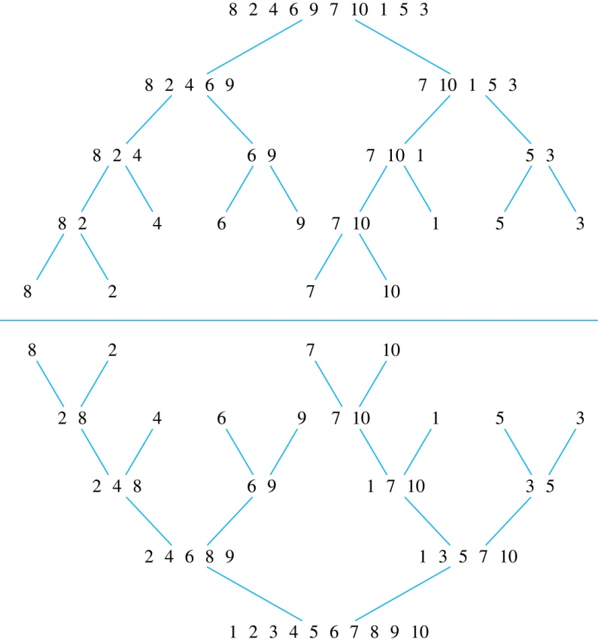
Merge Sort
Example: Use merge sort to put the list
8,2,4,6,9,7,10, 1, 5, 3
into increasing order.
Solution:

Slide 64
Recursive Merge Sort
Example: Construct a recursive merge sort algorithm.
Solution: Begin with the list of n elements L.
procedure mergesort(L = a₁, a₂,…,a_{n} )
if n > 1 then
m := ⌊n/2⌋
L₁ := a₁, a₂,…,a_{m}
L₂ := a_{m+1}, a_{m+2},…,a_{n}
L := merge(mergesort(L₁), mergesort(L₂ ))
{L is now sorted into elements in increasing order}
continued →

Slide 65
Recursive Merge Sort
Subroutine merge, which merges two sorted lists.
Complexity of Merge: Two sorted lists with m elements and n elements can be merged into a sorted list using no more than m + n − 1 comparisons.
procedure merge(L₁, L₂ :sorted lists)
L := empty list
while L₁ and L₂ are both nonempty
remove smaller of first elements of L₁ and L₂ from its list;
put at the right end of L
if this removal makes one list empty
then remove all elements from the other list and append them to L
return L {L is the merged list with the elements in increasing order}

Slide 66
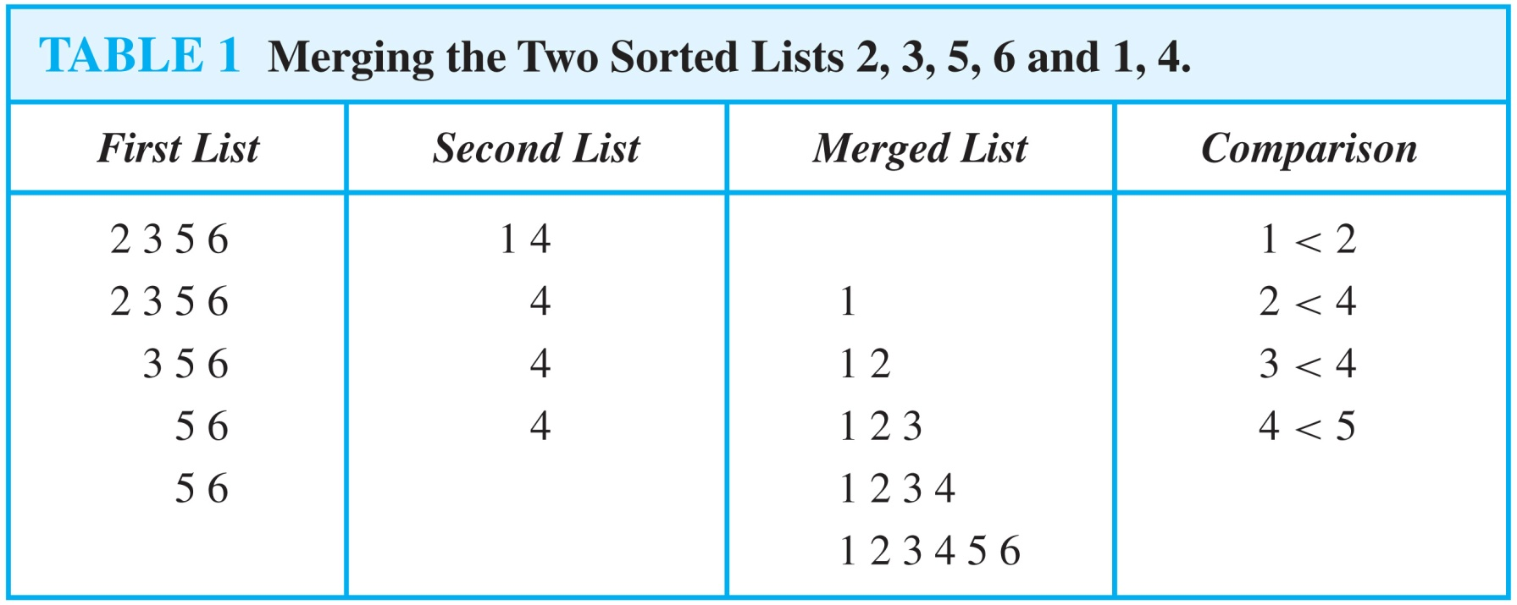
Merging Two Lists
Example: Merge the two lists 2,3,5,6 and 1,4.
Solution:

Slide 67
Complexity of Merge Sort
Complexity of Merge Sort: The number of comparisons needed to merge a list with n elements is O(n log n).
For simplicity, assume that n is a power of 2, say 2^{m}.
At the end of the splitting process, we have a binary tree with m levels, and 2^{m} lists with one element at level m.
The merging process begins at level m with the pairs of 2^{m} lists with one element combined into 2^{m−1} lists of two elements. Each merger takes two one comparison.
The procedure continues , at each level (k = m, m−1, m−1,…,3,2,1) 2^{k} lists with 2^{m−k} elements are merged into 2^{k−1} lists, with 2^{m−k + 1} elements at level k−1.
We know (by the complexity of the merge subroutine) that each merger takes at most 2^{m−k} + 2^{m−k} − 1 = 2^{m−k+ 1} − 1 comparisons.
continued →

Slide 68
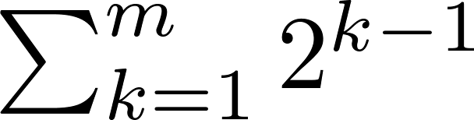
Complexity of Merge Sort
Summing over the number of comparisons at each level, shows that
because m = log n and n = 2^{m}.
(The expression in the formula above is evaluated as 2^{m} − 1 using the formula for the sum of the terms of a geometric progression, from Section 2.4.)
In Chapter 11, we’ll see that the fastest comparison-based sorting algorithms have O(n log n) time complexity. So, merge sort achieves the best possible big-O estimate of time complexity.

