Slide 1
Trees
Chapter 11

Slide 2
Introduction to Trees
Section 11.1

Slide 3
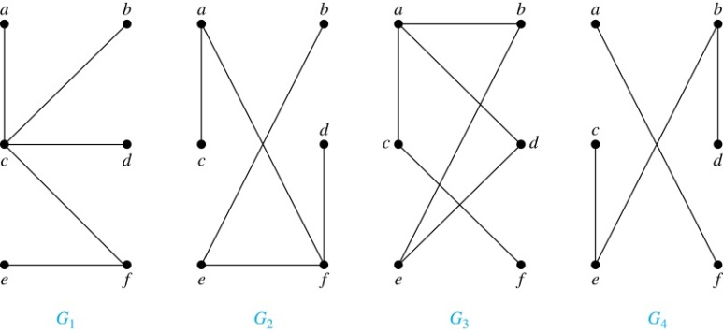
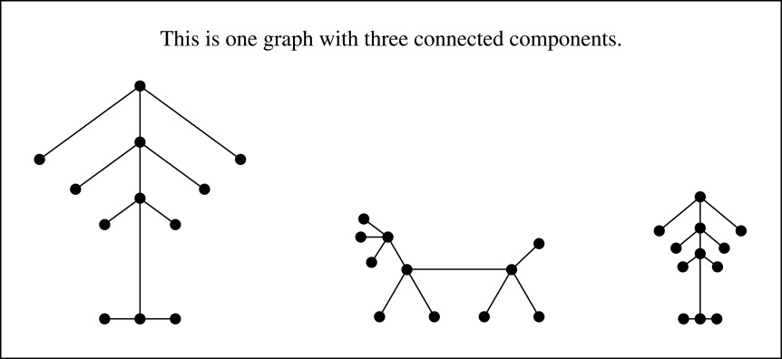
Trees
Definition: A tree is a connected undirected graph with no simple circuits.
Example: Which of these graphs are trees?
Solution: G₁ and G₂ are trees - both are connected and have no simple circuits. Because e, b, a, d, e is a simple circuit, G₃ is not a tree. G₄ is not a tree because it is not connected.
Definition: A forest is a graph that has no simple circuit, but is not connected. Each of the connected components in a forest is a tree.

Slide 4
Trees (continued)
Theorem: An undirected graph is a tree if and only if there is a unique simple path between any two of its vertices.
Proof: Assume that T is a tree. Then T is connected with no simple circuits. Hence, if x and y are distinct vertices of T, there is a simple path between them (by Theorem 1 of Section 10.4). This path must be unique - for if there were a second path, there would be a simple circuit in T (by Exercise 59 of Section 10.4). Hence, there is a unique simple path between any two vertices of a tree.
Now assume that there is a unique simple path between any two vertices of a graph T. Then T is connected because there is a path between any two of its vertices. Furthermore, T can have no simple circuits since if there were a simple circuit, there would be two paths between some two vertices.
Hence, a graph with a unique simple path between any two vertices is a tree.

Slide 5
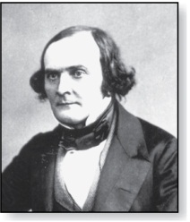
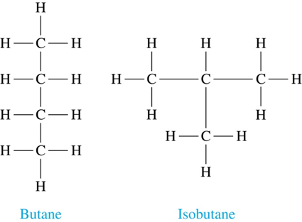
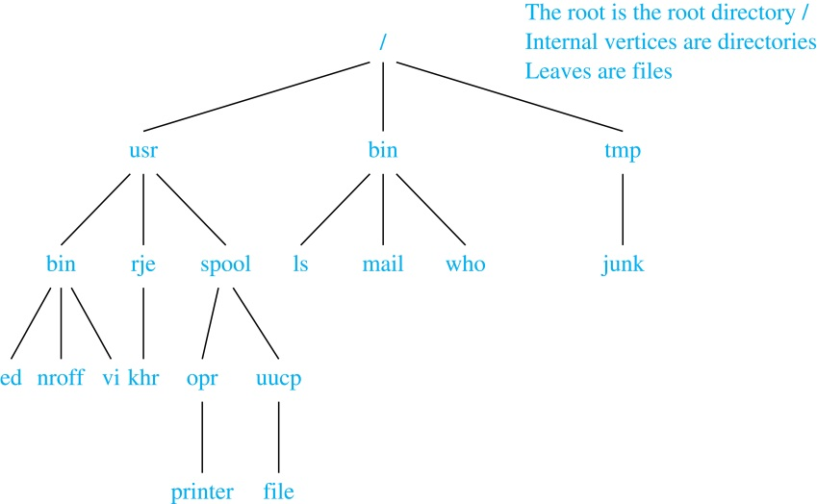
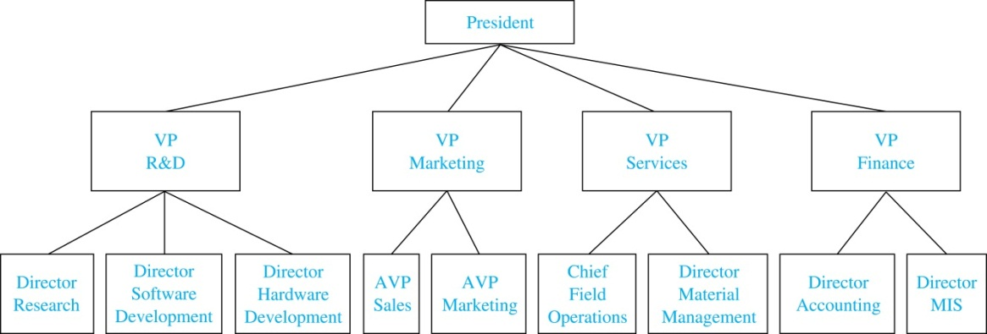
Trees as Models
Arthur Cayley
(1821-1895)
Trees are used as models in computer science, chemistry, geology, botany, psychology, and many other areas.
Trees were introduced by the mathematician Cayley in 1857 in his work counting the number of isomers of saturated hydrocarbons. The two isomers of butane are shown at the right.
The organization of a computer file system into directories, subdirectories, and files is naturally represented as a tree.
Trees are used to represent the structure of organizations.

Slide 6
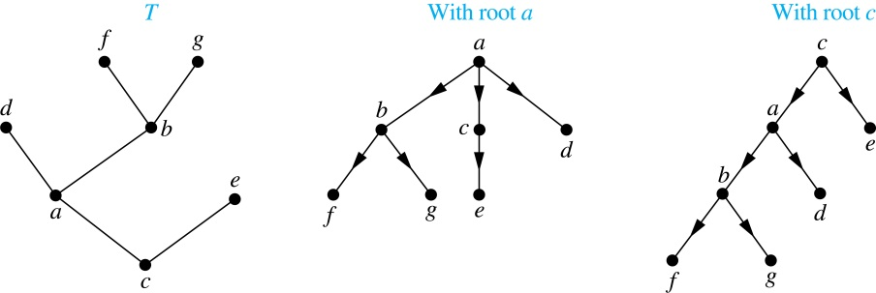
Rooted Trees
Definition: A rooted tree is a tree in which one vertex has been designated as the root and every edge is directed away from the root.
An unrooted tree is converted into different rooted trees when different vertices are chosen as the root.

Slide 7
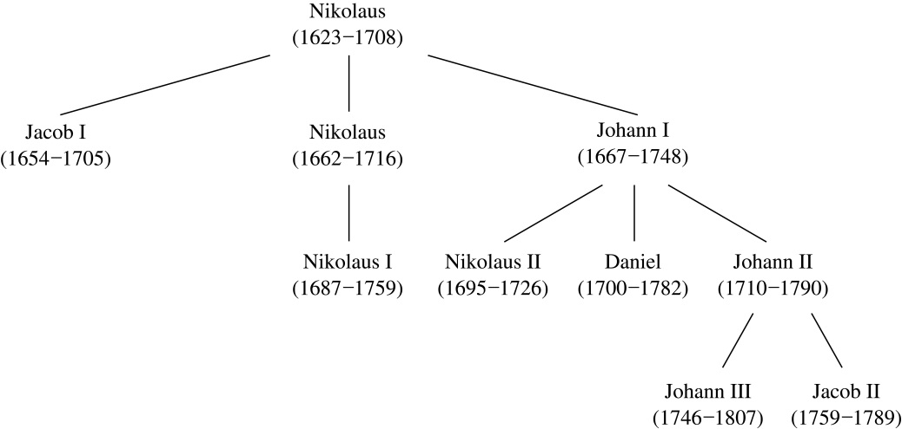
Rooted Tree Terminology
Terminology for rooted trees is a mix from botany and genealogy (such as this family tree of the Bernoulli family of mathematicians).
If v is a vertex of a rooted tree other than the root, the parent of v is the unique vertex u such that there is a directed edge from u to v. When u is a parent of v, v is called a child of u. Vertices with the same parent are called siblings.
The ancestors of a vertex are the vertices in the path from the root to this vertex, excluding the vertex itself and including the root. The descendants of a vertex v are those vertices that have v as an ancestor.
A vertex of a rooted tree with no children is called a leaf. Vertices that have children are called internal vertices.
If a is a vertex in a tree, the subtree with a as its root is the subgraph of the tree consisting of a and its descendants and all edges incident to these descendants.

Slide 8
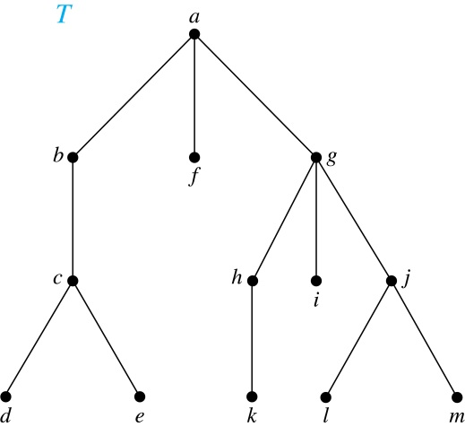
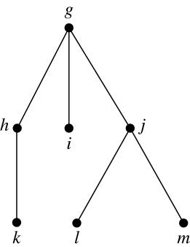
Terminology for Rooted Trees
Example: In the rooted tree T (with root a):
Find the parent of c, the children of g, the siblings of h, the ancestors of e, and the descendants of b.
Find all internal vertices and all leaves.
What is the subtree rooted at G?
Solution:
The parent of c is b. The children of g are h, i, and j. The siblings of h are i and j. The ancestors of e are c, b, and a. The descendants of b are c, d, and e.
The internal vertices are a, b, c, g, h, and j. The leaves are d, e, f, i, k, l, and m.
We display the subtree rooted at g.

Slide 9
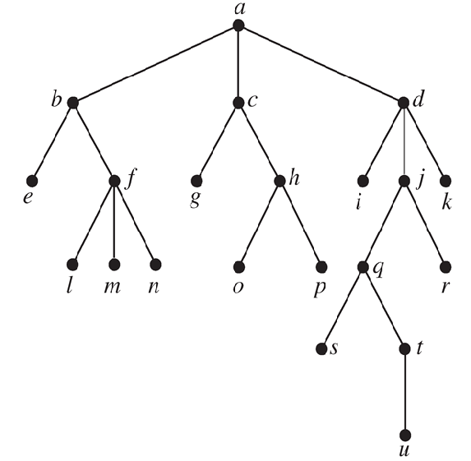
Classroom Exercise
Answer these questions about the rooted tree illustrated.
a) Which vertex is the root?
b) Which vertices are internal?
c) Which vertices are leaves?
d) Which vertices are children of j?
e) Which vertex is the parent of h?
f) Which vertices are siblings of o?
g) Which vertices are ancestors of m?
h) Which vertices are descendants of b?

Slide 10
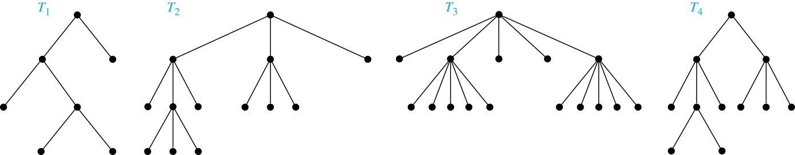
m-ary Rooted Trees
Definition: A rooted tree is called an m-ary tree if every internal vertex has no more than m children. The tree is called a full m-ary tree if every internal vertex has exactly m children. An m-ary tree with m = 2 is called a binary tree.
Example: Are the following rooted trees full m-ary trees for some positive integer m?
Solution: T₁ is a full binary tree because each of its internal vertices has two children. T₂ is a full 3-ary tree because each of its internal vertices has three children. In T₃ each internal vertex has five children, so T₃ is a full 5-ary tree. T₄ is not a full m-ary tree for any m because some of its internal vertices have two children and others have three children.

Slide 11
Classroom Exercise
A chain letter starts with a person sending a letter out to 10 others. Each person is asked to send the letter out to 10 others, and each letter contains a list of the previous six people in the chain. Unless there are fewer than six names in the list, each person sends one dollar to the ﬁrst person in this list, removes the name of this person from the list, moves up each of the other ﬁve names one position, and inserts his or her name at the end of this list. If no person breaks the chain and no one receives more than one letter, how much money will a person in the chain ultimately receive?

Slide 12
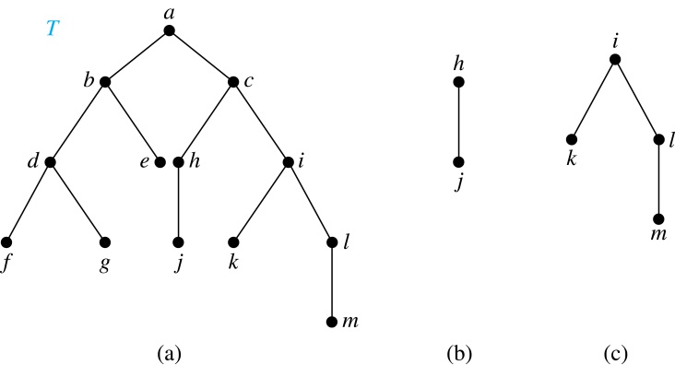
Ordered Rooted Trees
Definition: An ordered rooted tree is a rooted tree where the children of each internal vertex are ordered.
We draw ordered rooted trees so that the children of each internal vertex are shown in order from left to right.
Definition: A binary tree is an ordered rooted where each internal vertex has at most two children. If an internal vertex of a binary tree has two children, the first is called the left child and the second the right child. The tree rooted at the left child of a vertex is called the left subtree of this vertex, and the tree rooted at the right child of a vertex is called the right subtree of this vertex.
Example: Consider the binary tree T.
(i) What are the left and right children of d?
(ii) What are the left and right subtrees of c?
Solution:
(i) The left child of d is f and the right child is g.
(ii) The left and right subtrees of c are displayed in
(b) and (c).

Slide 13
Properties of Trees
Theorem 2: A tree with n vertices has n − 1 edges.
Proof (by mathematical induction):
BASIS STEP: When n = 1, a tree with one vertex has no edges. Hence, the theorem holds when n = 1.
INDUCTIVE STEP: Assume that every tree with k vertices has k − 1 edges.
Suppose that a tree T has k + 1 vertices and that v is a leaf of T. Let w be the parent of v. Removing the vertex v and the edge connecting w to v produces a tree T′ with k vertices. By the inductive hypothesis, T′ has k − 1 edges. Because T has one more edge than T′, we see that T has k edges. This completes the inductive step.

Slide 14
Counting Vertices in Full m-Ary Trees
Theorem 3: A full m-ary tree with i internal vertices has n = mi + 1 vertices.
Proof : Every vertex, except the root, is the child of an internal vertex. Because each of the i internal vertices has m children, there are mi vertices in the tree other than the root. Hence, the tree contains n = mi + 1 vertices.

Slide 15
Counting Vertices in Full m-Ary Trees (continued)
Theorem 4: A full m-ary tree with
(i)
(ii)
(iii)
Proof (of part i): Solving for i in n = mi + 1 (from Theorem 3) gives i = (n − 1)/m. Since each vertex is either a leaf or an internal vertex, n = l + i. By solving for l and using the formula for i, we see that
n vertices has i = (n − 1)/m internal vertices and l = [(m − 1)n + 1]/m leaves,
i internal vertices has n = mi + 1 vertices and l = (m − 1)i + 1 leaves,
proofs of parts (ii) and (iii) are left as exercises
l leaves has n = (ml − 1)/(m − 1) vertices and i = (l − 1)/ (m − 1) internal vertices.
l = n − i = n − (n − 1)/m = [(m − 1)n + 1]/m .

Slide 16
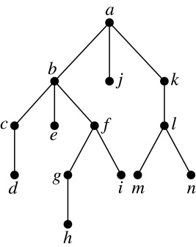
Level of vertices and height of trees
When working with trees, we often want to have rooted trees where the subtrees at each vertex contain paths of approximately the same length.
To make this idea precise we need some definitions:
The level of a vertex v in a rooted tree is the length of the unique path from the root to this vertex.
The height of a rooted tree is the maximum of the levels of the vertices.
Example:
(i) Find the level of each vertex in
the tree to the right.
(ii) What is the height of the tree?
Solution:
(i) The root a is at level 0. Vertices b, j, and k are at level 1.
Vertices c, e, f, and l are at level 2. Vertices d, g, i, m, and n are at level 3.
Vertex h is at level 4.
(ii) The height is 4, since 4 is the largest level of any vertex.

Slide 17
Classroom Exercise
How many edges does a full binary tree with 1000 internal vertices have?

Slide 18
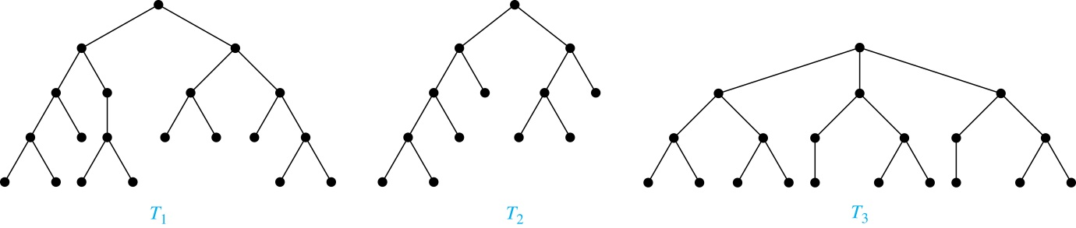
Balanced m-Ary Trees
Definition: A rooted m-ary tree of height h is balanced if all leaves are at levels h or h − 1.
Example: Which of the rooted trees shown below is balanced?
Solution: T₁ and T₃ are balanced, but T₂ is not because it has leaves at levels 2, 3, and 4.

Slide 19
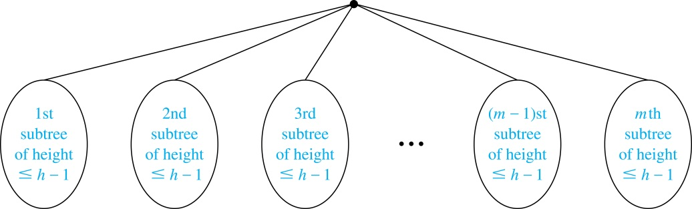
The Bound for the Number of Leaves in an m-Ary Tree
Theorem 5: There are at most m^{h} leaves in an m-ary tree of height h.
Proof (by mathematical induction on height):
BASIS STEP: Consider an m-ary trees of height 1. The tree consists of a root and no more than m children, all leaves. Hence, there are no more than m¹ = m leaves in an m-ary tree of height 1.
INDUCTIVE STEP: Assume the result is true for all m-ary trees of height < h. Let T be an m-ary tree of height h. The leaves of T are the leaves of the subtrees of T we get when we delete the edges from the root to each of the vertices of level 1.
Each of these subtrees has height ≤ h− 1. By the inductive hypothesis, each of these subtrees has at most m^{h− 1} leaves. Since there are at most m such subtees, there are at most m⋅ m^{h− 1} = m^{h} leaves in the tree.
Corollary 1: If an m-ary tree of height h has l leaves, then h ≥ ⌈log_{m} l⌉. If the m-ary tree is full and balanced, then h = ⌈log_{m} l⌉. (see text for the proof)

Slide 20
Tree Traversal
Section 11.3

Slide 21
Tree Traversal
Procedures for systematically visiting every vertex of an ordered tree are called traversals.
The three most commonly used traversals are preorder traversal, inorder traversal, and postorder traversal.

Slide 22
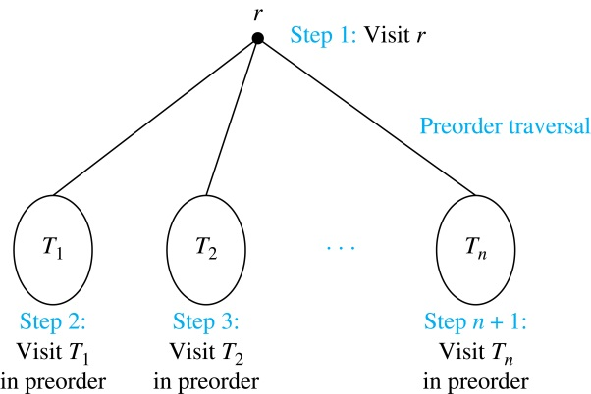
Preorder Traversal
Definition: Let T be an ordered rooted tree with root r. If T consists only of r, then r is the preorder traversal of T. Otherwise, suppose that T₁, T₂, …, T_{n} are the subtrees of r from left to right in T. The preorder traversal begins by visiting r, and continues by traversing T₁ in preorder, then T₂ in preorder, and so on, until T_{n} is traversed in preorder.

Slide 23
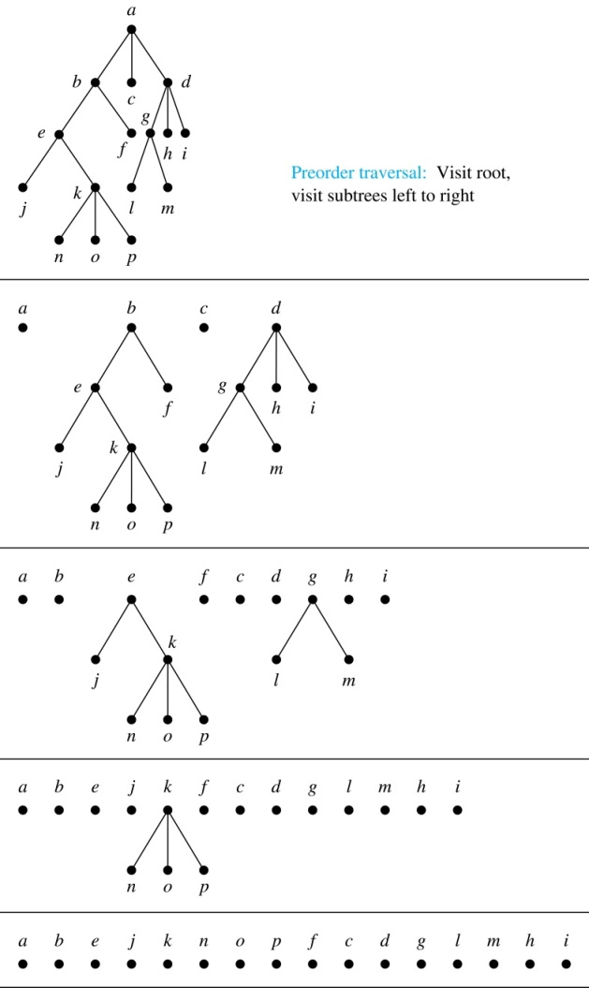
Preorder Traversal (continued)
procedure preorder (T: ordered rooted tree)
r := root of T
list r
for each child c of r from left to right
T(c) := subtree with c as root
preorder(T(c))

Slide 24
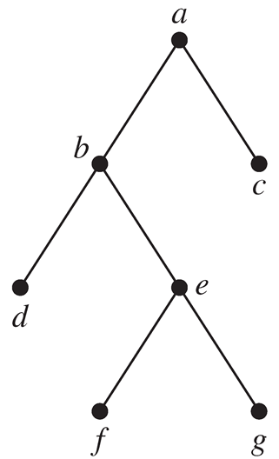
Classroom Exercise
Determine the order in which a preorder traversal visits the vertices of the given ordered rooted tree.

Slide 25
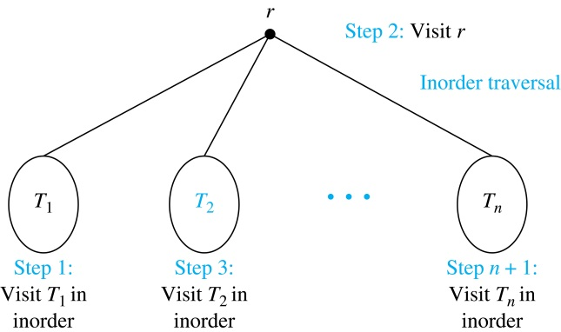
Inorder Traversal
Definition: Let T be an ordered rooted tree with root r. If T consists only of r, then r is the inorder traversal of T. Otherwise, suppose that T₁, T₂, …, T_{n} are the subtrees of r from left to right in T. The inorder traversal begins by traversing T₁ in inorder, then visiting r, and continues by traversing T₂ in inorder, and so on, until T_{n} is traversed in inorder.

Slide 26
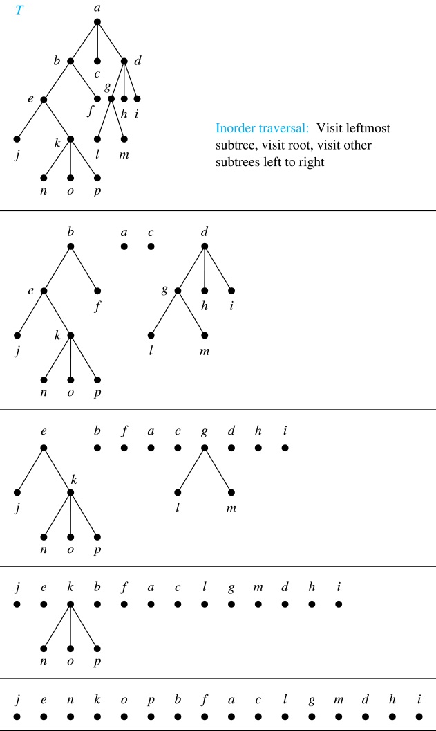
Inorder Traversal (continued)
procedure inorder (T: ordered rooted tree)
r := root of T
if r is a leaf then list r
else
l := first child of r from left to right
T(l) := subtree with l as its root
inorder(T(l))
list(r)
for each child c of r from left to right
T(c) := subtree with c as root
inorder(T(c))

Slide 27
Classroom Exercise
Determine the order in which an inorder traversal visits the vertices of the given ordered rooted tree.

Slide 28
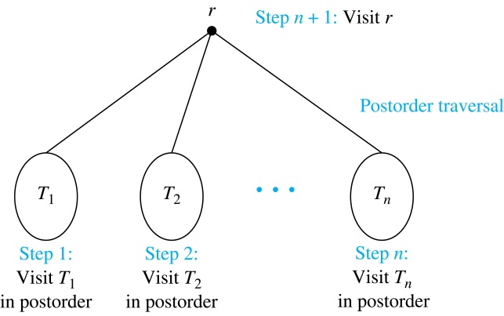
Postorder Traversal
Definition: Let T be an ordered rooted tree with root r. If T consists only of r, then r is the postorder traversal of T. Otherwise, suppose that T₁, T₂, …, T_{n} are the subtrees of r from left to right in T. The postorder traversal begins by traversing T₁ in postorder, then T₂ in postorder, and so on, after T_{n} is traversed in postorder, r is visited.

Slide 29
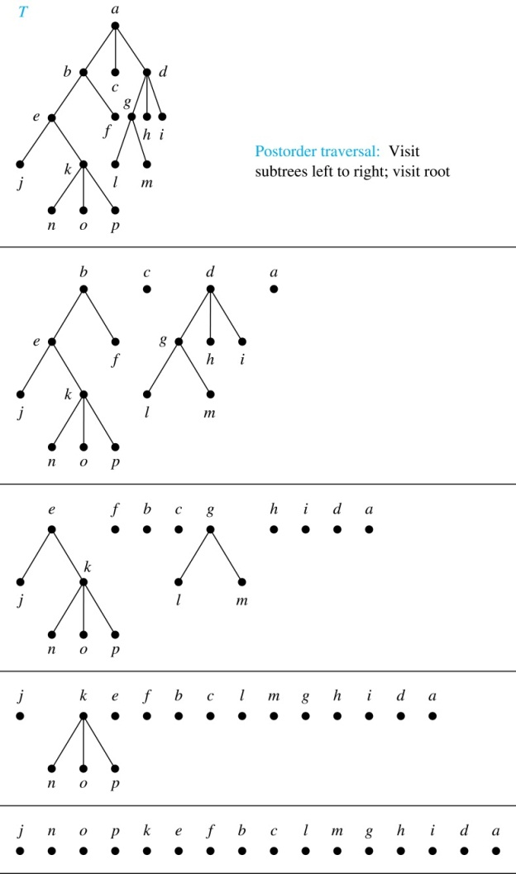
Postorder Traversal (continued)
procedure postordered (T: ordered rooted tree)
r := root of T
for each child c of r from left to right
T(c) := subtree with c as root
postorder(T(c))
list r

Slide 30
Classroom Exercise
Determine the order in which a postorder traversal visits the vertices of the given ordered rooted tree.

Slide 31
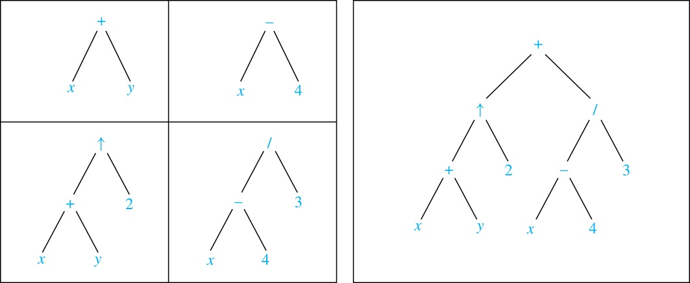
Expression Trees
Complex expressions can be represented using ordered rooted trees.
Consider the expression ((x + y) ↑ 2 ) + ((x − 4)/3).
A binary tree for the expression can be built from the bottom up, as is illustrated here.

Slide 32
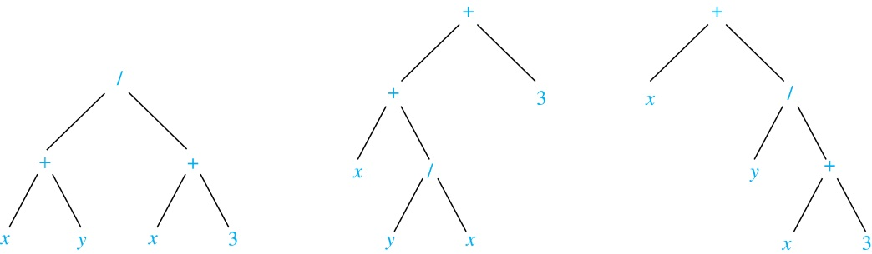
Infix Notation
An inorder traversal of the tree representing an expression produces the original expression when parentheses are included except for unary operations, which now immediately follow their operands.
We illustrate why parentheses are needed with an example that displays three trees all yield the same infix representation.

Slide 33
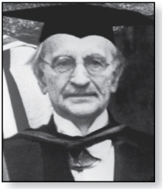
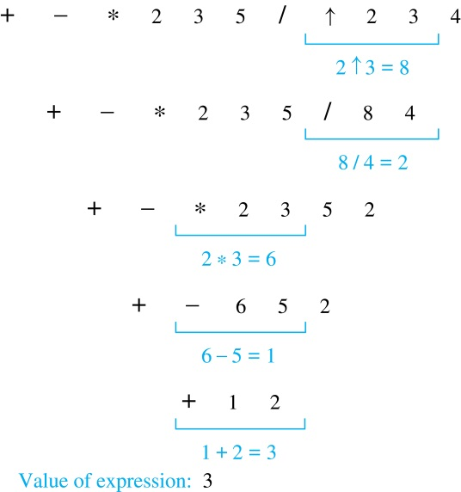
Prefix Notation
Jan Łukasiewicz (1878-1956)
Example: We show the steps used to evaluate a particular prefix expression:
When we traverse the rooted tree representation of an expression in preorder, we obtain the prefix form of the expression. Expressions in prefix form are said to be in Polish notation, named after the Polish logician Jan Łukasiewicz.
Operators precede their operands in the prefix form of an expression. Parentheses are not needed as the representation is unambiguous.
The prefix form of ((x + y) ↑ 2 ) + ((x − 4)/3)
is + ↑ + x y 2 / − x 4 3.
Prefix expressions are evaluated by working from right to left. When we encounter an operator, we perform the corresponding operation with the two operations to the right.

Slide 34
Classroom Exercise
Draw the ordered rooted tree corresponding to each of these arithmetic expressions written in prefix notation. Then write each expression using infix notation.
+∗+−5 3 2 1 4
↑ + 2 3 − 5 1
∗ / 9 3 + ∗ 2 4 − 7 6

Slide 35
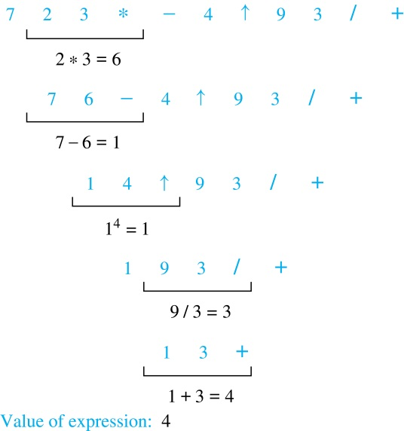
Postfix Notation
Example: We show the steps used to evaluate a particular postfix expression.
We obtain the postfix form of an expression by traversing its binary trees in postorder. Expressions written in postfix form are said to be in reverse Polish notation.
Parentheses are not needed as the postfix form is unambiguous.
x y + 2 ↑ x 4 − 3 / + is the postfix form of ((x + y) ↑ 2 ) + ((x − 4)/3).
A binary operator follows its two operands. So, to evaluate an expression one works from left to right, carrying out an operation represented by an operator on its preceding operands.

Slide 36
Classroom Exercise
What is the value of each of these postfix expressions?
5 2 1−−3 1 4 ++ ∗
9 3 / 5 + 7 2 − ∗
3 2 ∗ 2 ↑ 5 3 − 8 4 / ∗ −

Slide 37
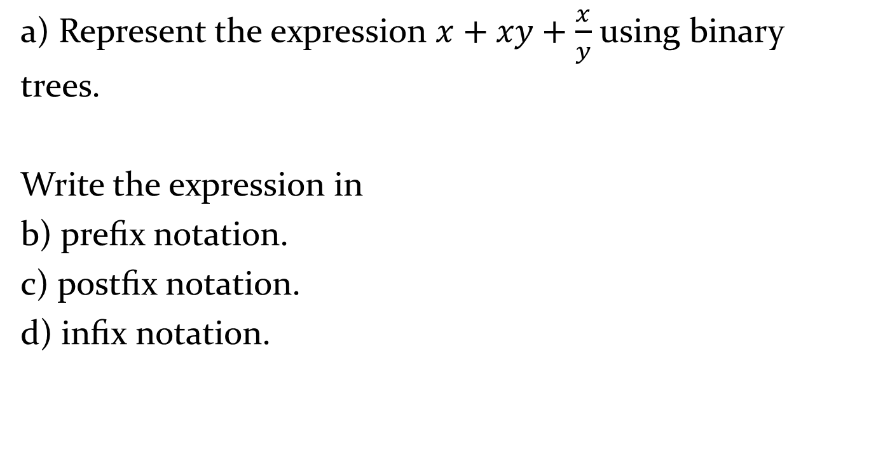
Classroom Exercise
a) Represent the expression $x+xy+\frac{x}{y}$ using binary trees.
Write the expression in
b) preﬁx notation.
c) postﬁx notation.
d) inﬁx notation.

Slide 38
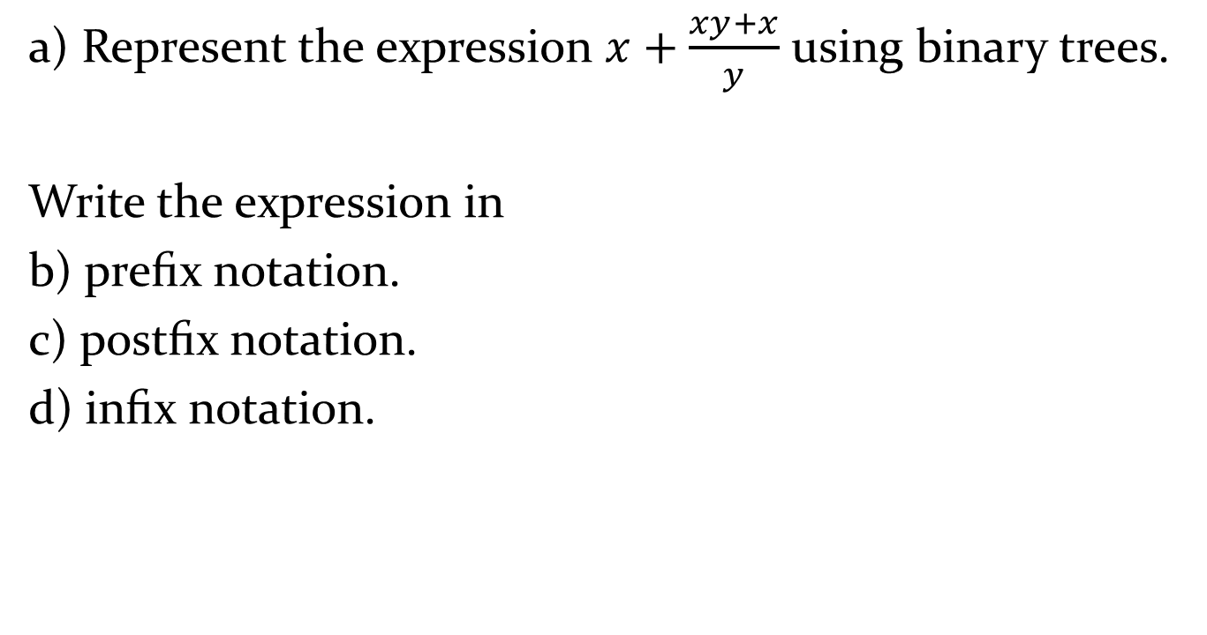
Classroom Exercise
a) Represent the expression $x+\frac{xy+x}{y}$ using binary trees.
Write the expression in
b) preﬁx notation.
c) postﬁx notation.
d) inﬁx notation.

Slide 39
Spanning Trees
Section 11.4

Slide 40
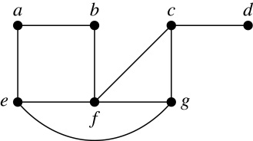
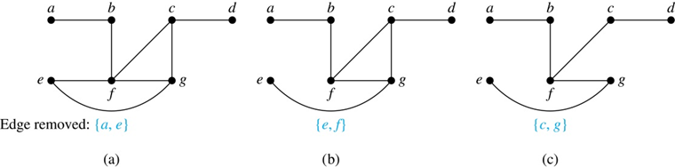
Spanning Trees
Definition: Let G be a simple graph. A spanning tree of G is a subgraph of G that is a tree containing every vertex of G.
Example: Find the spanning tree of this simple graph:
Solution: The graph is connected, but is not a tree because it contains simple circuits. Remove the edge {a, e}. Now one simple circuit is gone, but the remaining subgraph still has a simple circuit. Remove the edge {e, f} and then the edge {c, g} to produce a simple graph with no simple circuits. It is a spanning tree, because it contains every vertex of the original graph.

Slide 41
Spanning Trees (continued)
Theorem: A simple graph is connected if and only if it has a spanning tree.
Proof: Suppose that a simple graph G has a spanning tree T. T contains every vertex of G and there is a path in T between any two of its vertices. Because T is a subgraph of G, there is a path in G between any two of its vertices. Hence, G is connected.
Now suppose that G is connected. If G is not a tree, it contains a simple circuit. Remove an edge from one of the simple circuits. The resulting subgraph is still connected because any vertices connected via a path containing the removed edge are still connected via a path with the remaining part of the simple circuit. Continue in this fashion until there are no more simple circuits. A tree is produced because the graph remains connected as edges are removed. The resulting tree is a spanning tree because it contains every vertex of G.

Slide 42
Depth-First Search
To use depth-first search to build a spanning tree for a connected simple graph first arbitrarily choose a vertex of the graph as the root.
Form a path starting at this vertex by successively adding vertices and edges, where each new edge is incident with the last vertex in the path and a vertex not already in the path. Continue adding vertices and edges to this path as long as possible.
If the path goes through all vertices of the graph, the tree consisting of this path is a spanning tree.
Otherwise, move back to the next to the last vertex in the path, and if possible, form a new path starting at this vertex and passing through vertices not already visited. If this cannot be done, move back another vertex in the path.
Repeat this procedure until all vertices are included in the spanning tree.

Slide 43
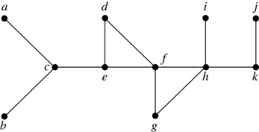
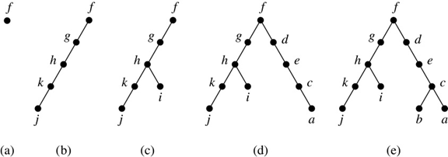
Depth-First Search (continued)
Example: Use depth-first search to find a spanning tree of this graph.
Solution: We start arbitrarily with vertex f. We build a path by successively adding an edge that connects the last vertex added to the path and a vertex not already in the path, as long as this is possible. The result is a path that connects f, g, h, k, and j. Next, we return to k, but find no new vertices to add. So, we return to h and add the path with one edge that connects h and i. We next return to f, and add the path connecting f, d, e, c, and a. Finally, we return to c and add the path connecting c and b. We now stop because all vertices have been added.

Slide 44
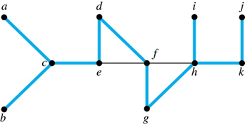
Depth-First Search (continued)
The edges selected by depth-first search of a graph are called tree edges. All other edges of the graph must connect a vertex to an ancestor or descendant of the vertex in the graph. These are called back edges.
In this figure, the tree edges are shown with heavy blue lines. The two thin black edges are back edges.

Slide 45
Depth-First Search Algorithm
We now use pseudo code to specify depth-first search. In this recursive algorithm, after adding an edge connecting a vertex v to the vertex w, we finish exploring w before we return to v to continue exploring from v.
procedure DFS(G: connected graph with vertices v₁, v₂, …, v_{n})
T := tree consisting only of the vertex v₁
visit(v₁)
procedure visit(v: vertex of G)
for each vertex w adjacent to v and not yet in T
add vertex w and edge {v,w} to T
visit(w)

Slide 46
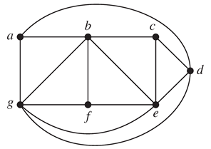
Classroom Exercise
Find a spanning tree for the following graph using depth first search. Start from vertex a and use alphabetical order to resolve conflict.

Slide 47
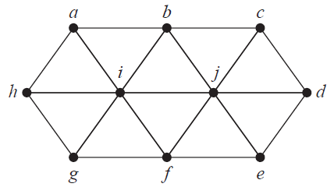
Classroom Exercise
Find a spanning tree for the following graph using depth first search. Start from vertex a and use alphabetical order to resolve conflict.

Slide 48
Breadth-First Search
We can construct a spanning tree using breadth-first search. We first arbitrarily choose a root from the vertices of the graph.
Then we add all of the edges incident to this vertex and the other endpoint of each of these edges. We say that these are the vertices at level 1.
For each vertex added at the previous level, we add each edge incident to this vertex, as long as it does not produce a simple circuit. The new vertices we find are the vertices at the next level.
We continue in this manner until all the vertices have been added and we have a spanning tree.

Slide 49
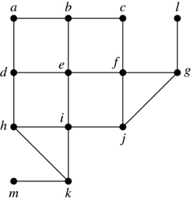
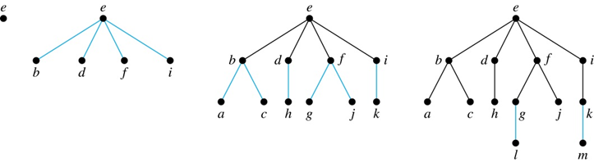
Breadth-First Search (continued)
Example: Use breadth-first search to find a spanning tree for this graph.
Solution: We arbitrarily choose vertex e as the root. We then add the edges from e to b, d, f, and i. These four vertices make up level 1 in the tree. Next, we add the edges from b to a and c, the edges from d to h, the edges from f to j and g, and the edge from i to k. The endpoints of these edges not at level 1 are at level 2. Next, add edges from these vertices to adjacent vertices not already in the graph. So, we add edges from g to l and from k to m. We see that level 3 is made up of the vertices l and m. This is the last level because there are no new vertices to find.

Slide 50
Breadth-First Search Algorithm
We now use pseudocode to describe breadth-first search.
procedure BFS(G: connected graph with vertices v₁, v₂, …, v_{n})
T := tree consisting only of the vertex v₁
L := empty list visit(v₁)
put v₁ in the list L of unprocessed vertices
while L is not empty
remove the first vertex, v, from L
for each neighbor w of v
if w is not in L and not in T then
add w to the end of the list L
add w and edge {v,w} to T

Slide 51
Classroom Exercise
Find a spanning tree for the following graph using the breath first search. Start from vertex a and use alphabetical order to resolve conflict.

Slide 52
Classroom Exercise
Find a spanning tree for the following graph using the breath first search. Start from vertex a and use alphabetical order to resolve conflict.

Slide 53
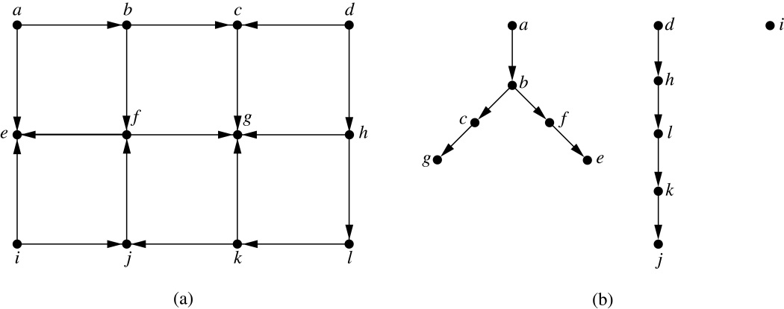
Depth-First Search in Directed Graphs
Both depth-first search and breadth-first search can be easily modified to run on a directed graph. But the result is not necessarily a spanning tree, but rather a spanning forest.
To index websites, search engines such as Google systematically explore the web starting at known sites. The programs that do this exploration are known as Web spiders. They may use both breath-first search or depth-first search to explore the Web graph.
Example: For the graph in (a), if we begin at vertex a, depth-first search adds the path connecting a, b, c, and g. At g, we are blocked, so we return to c. Next, we add the path connecting f to e. Next, we return to a and find that we cannot add a new path. So, we begin another tree with d as its root. We find that this new tree consists of the path connecting the vertices d, h, l, k, and j. Finally, we add a new tree, which only contains i, its root.

Slide 54
Minimum Spanning Trees
Section 11.5

Slide 55
A minimum spanning tree in a connected weighted graph is a spanning tree that thas the smallest possible sum of weights of it edges

Slide 56
Procedure Prim(G)
T:= {a}
For i:= 2 to n
e := a minimum weighted edge incident to T without forming a circuit
Add e to T

Slide 57
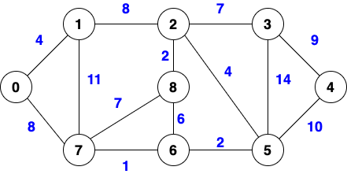

Slide 58
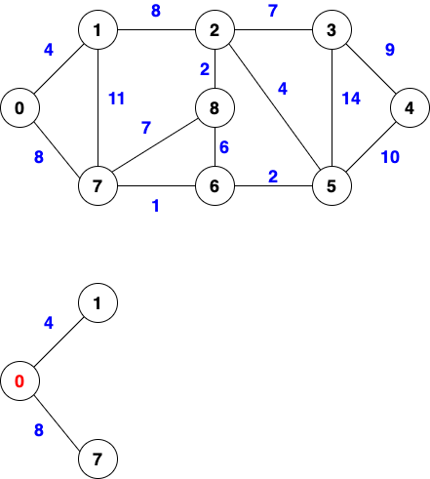

Slide 59
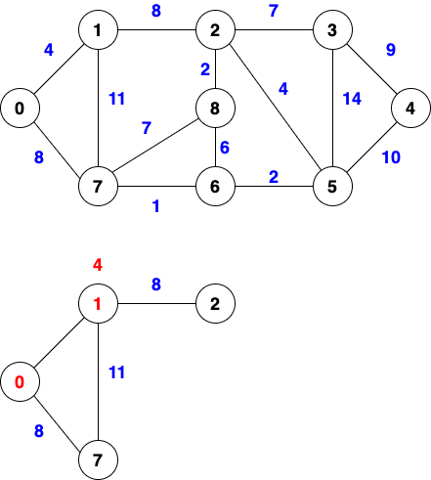

Slide 60
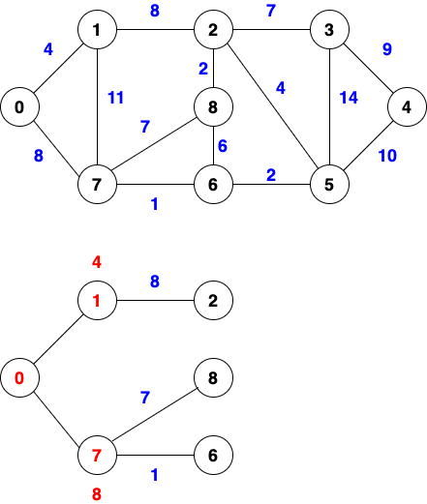

Slide 61
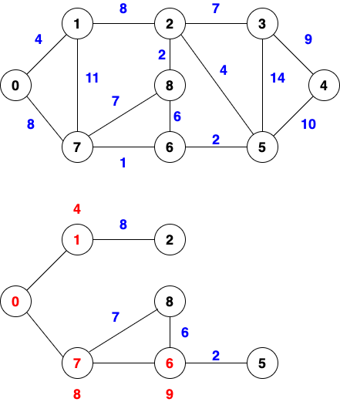

Slide 62
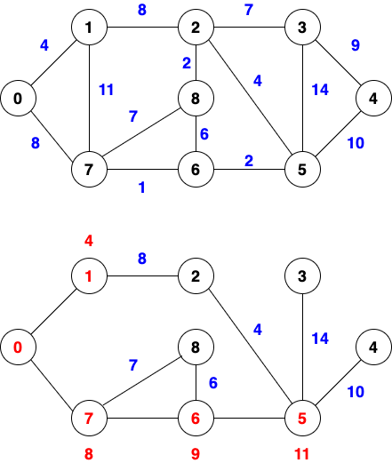

Slide 63
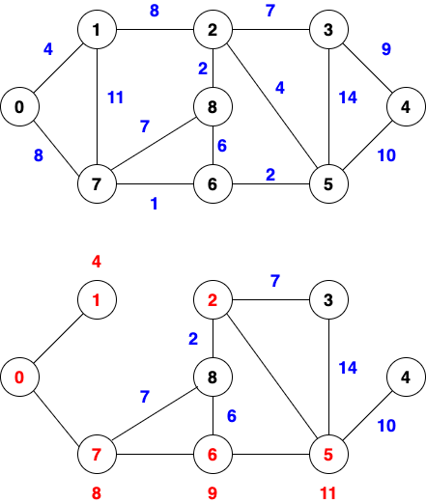

Slide 64
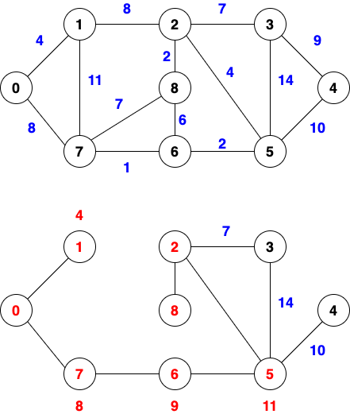

Slide 65
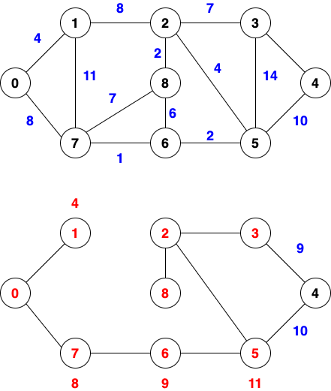

Slide 66
