Slide 1

jGRASP Tutorial
Valdosta State University
Spring 2020
Department of Computer Science

Slide 2
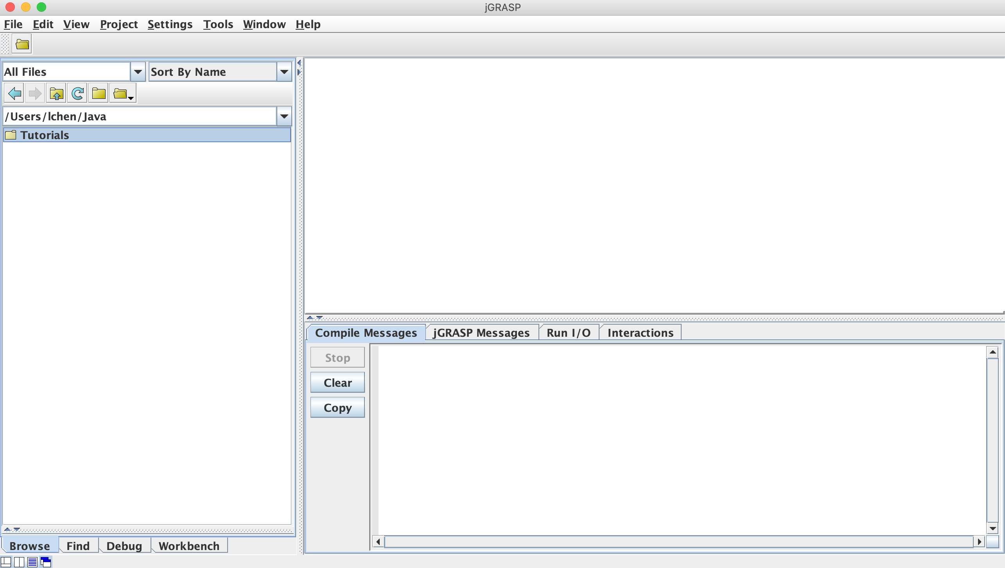
Valdosta State University
jGRASP GUI
Coding Station
Directory Browser
Message Window
Department of Computer Science

Slide 3
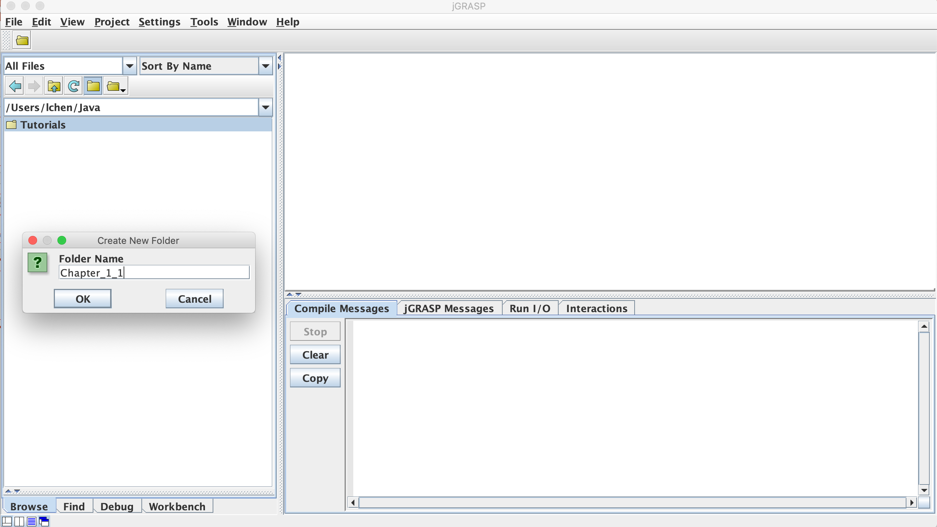
Valdosta State University
Create a folder for a Java Program
Department of Computer Science

Slide 4
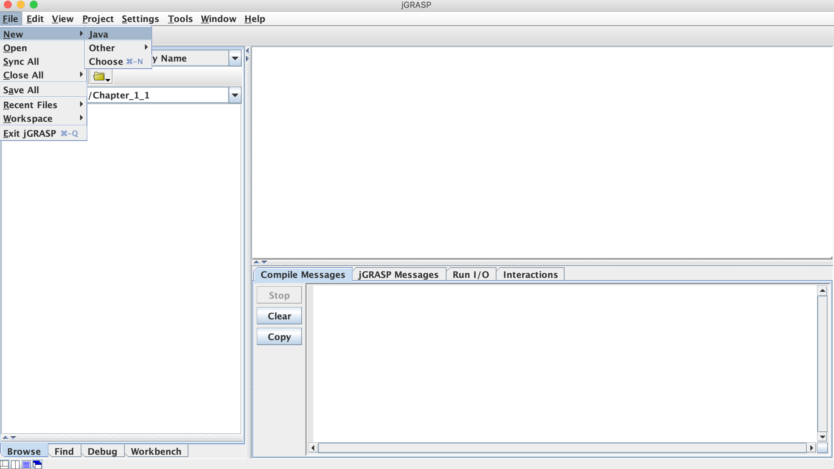
Valdosta State University
Enter the created folder and create a Java file
Department of Computer Science

Slide 5
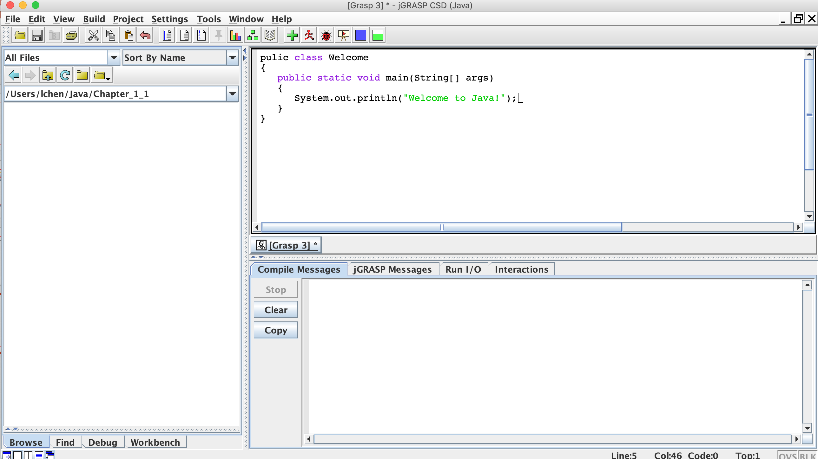
Valdosta State University
Write the code
Department of Computer Science

Slide 6
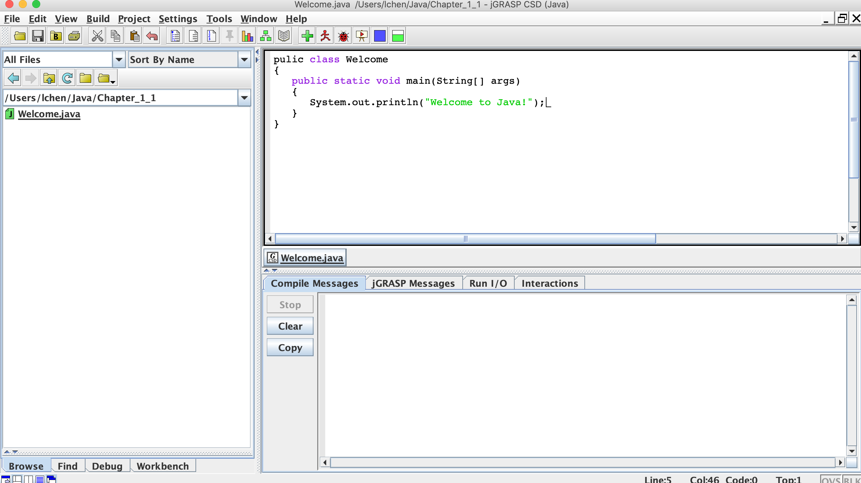
Valdosta State University
Save the code
File name should be same
as the class name
Department of Computer Science

Slide 7
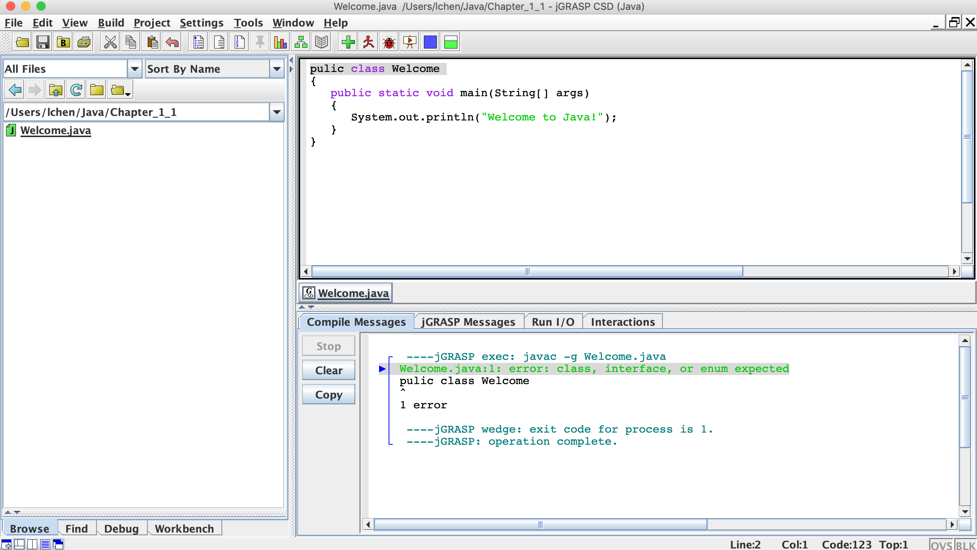
Valdosta State University
Compile the code
Compile Message
Department of Computer Science

Slide 8
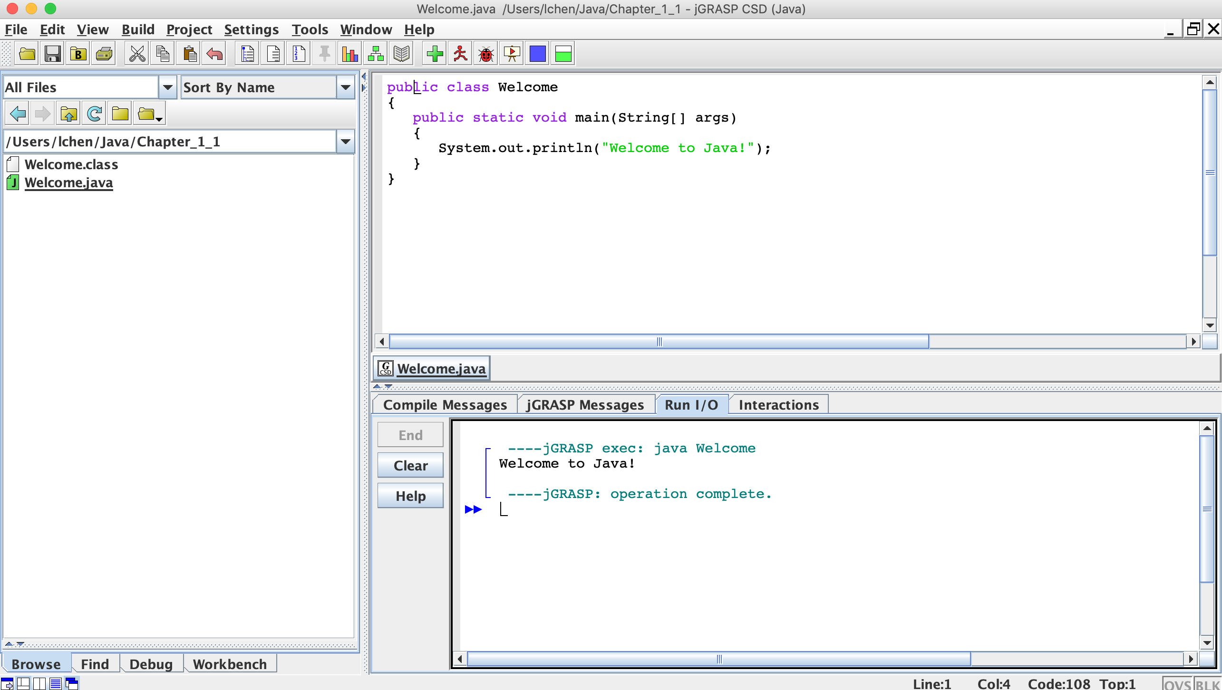
Valdosta State University
Run the code
Outputs
Department of Computer Science

